Slide 1

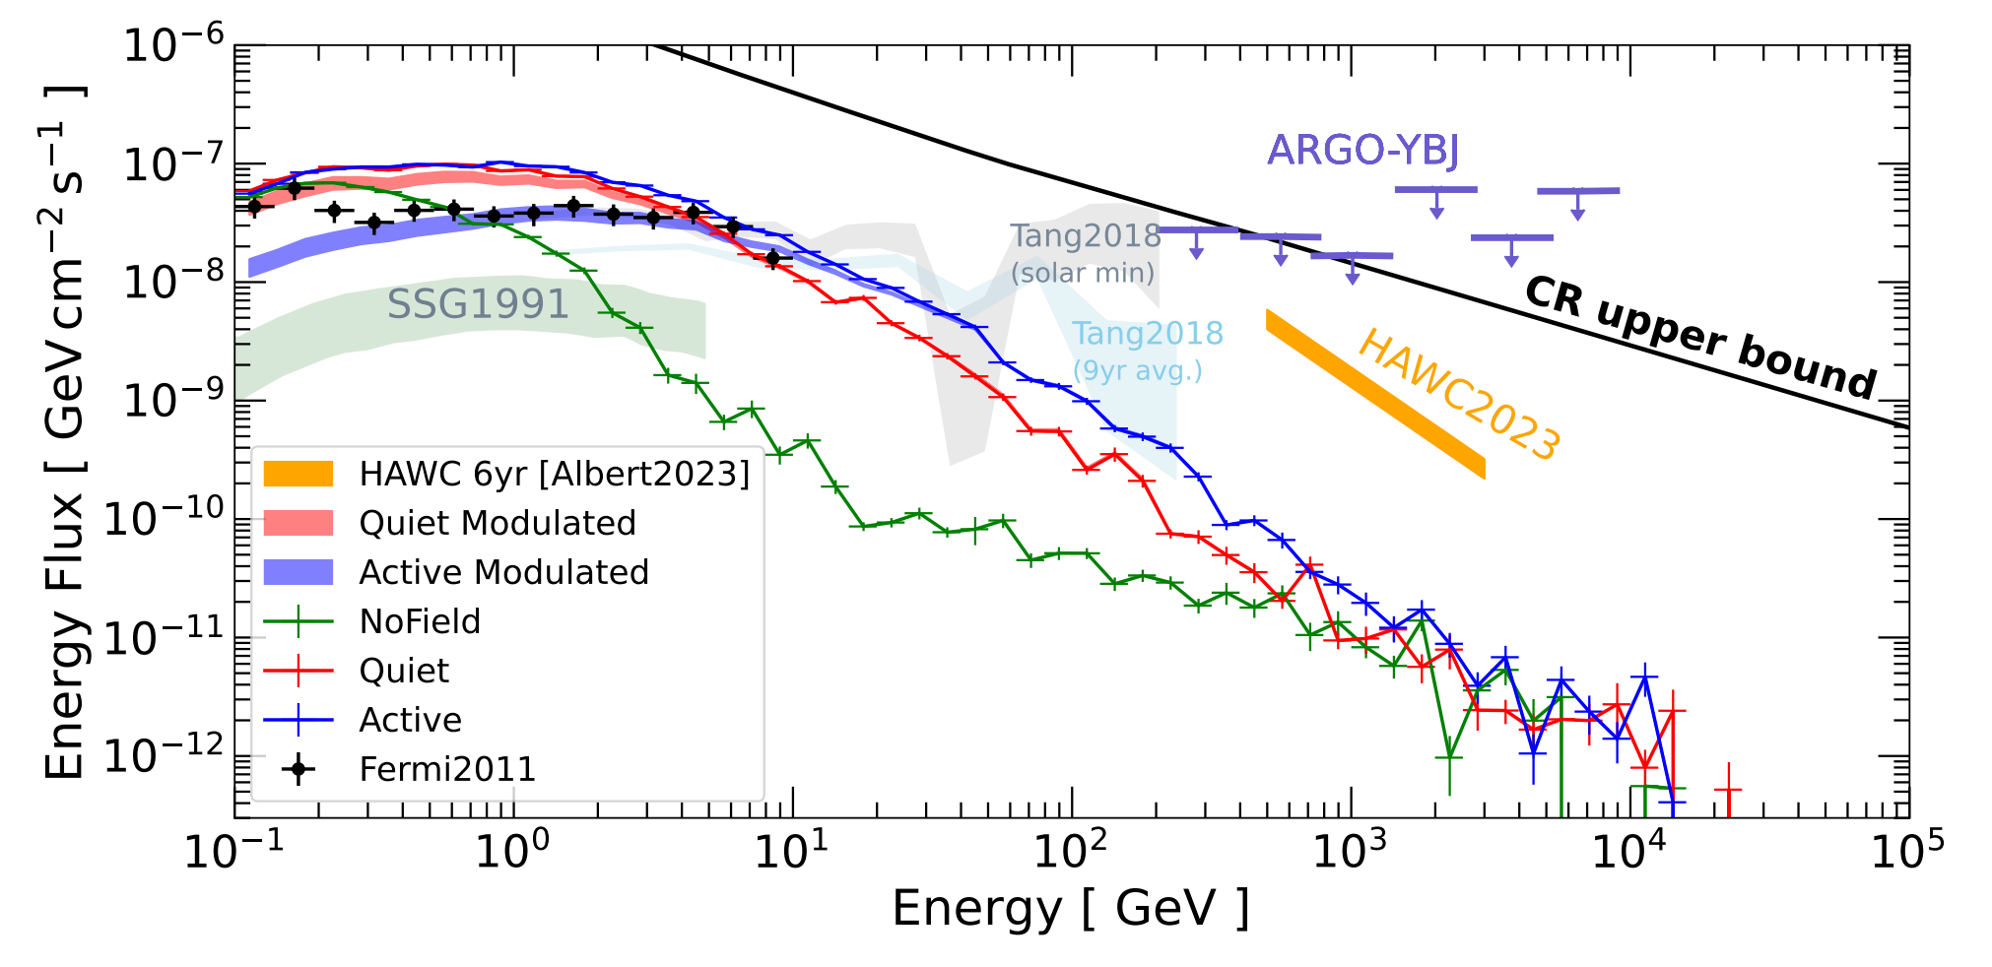
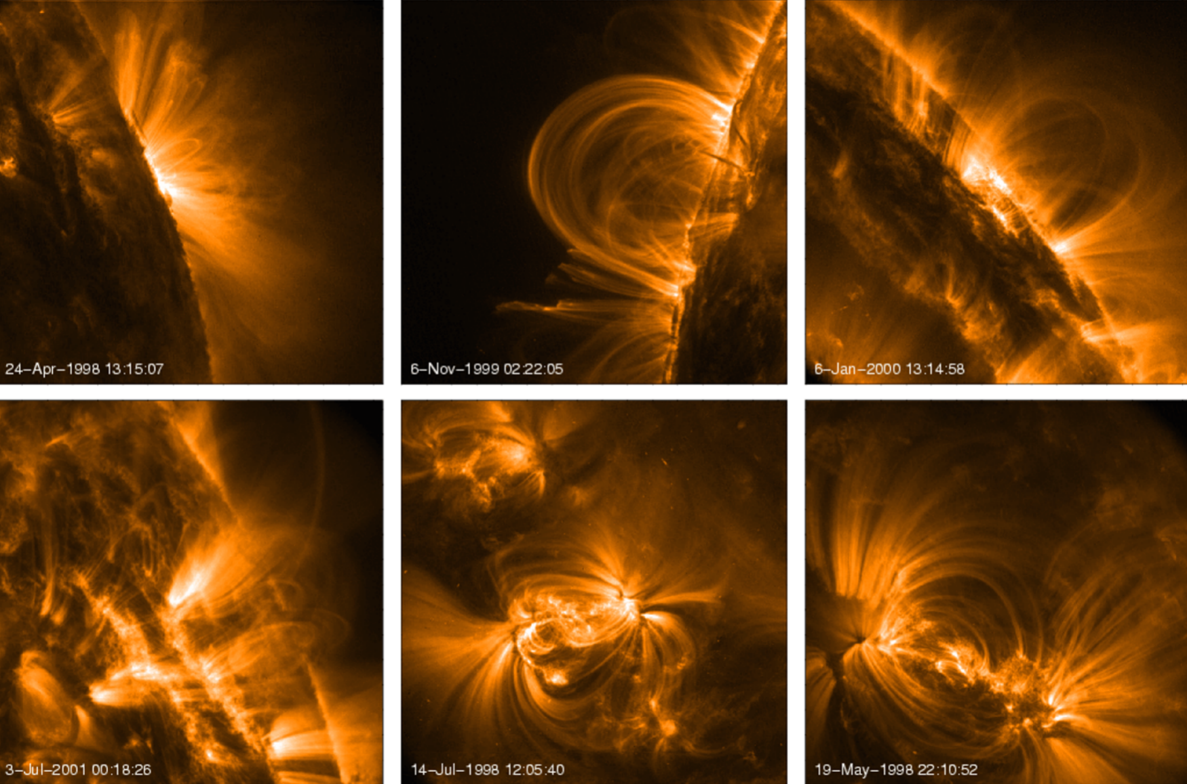
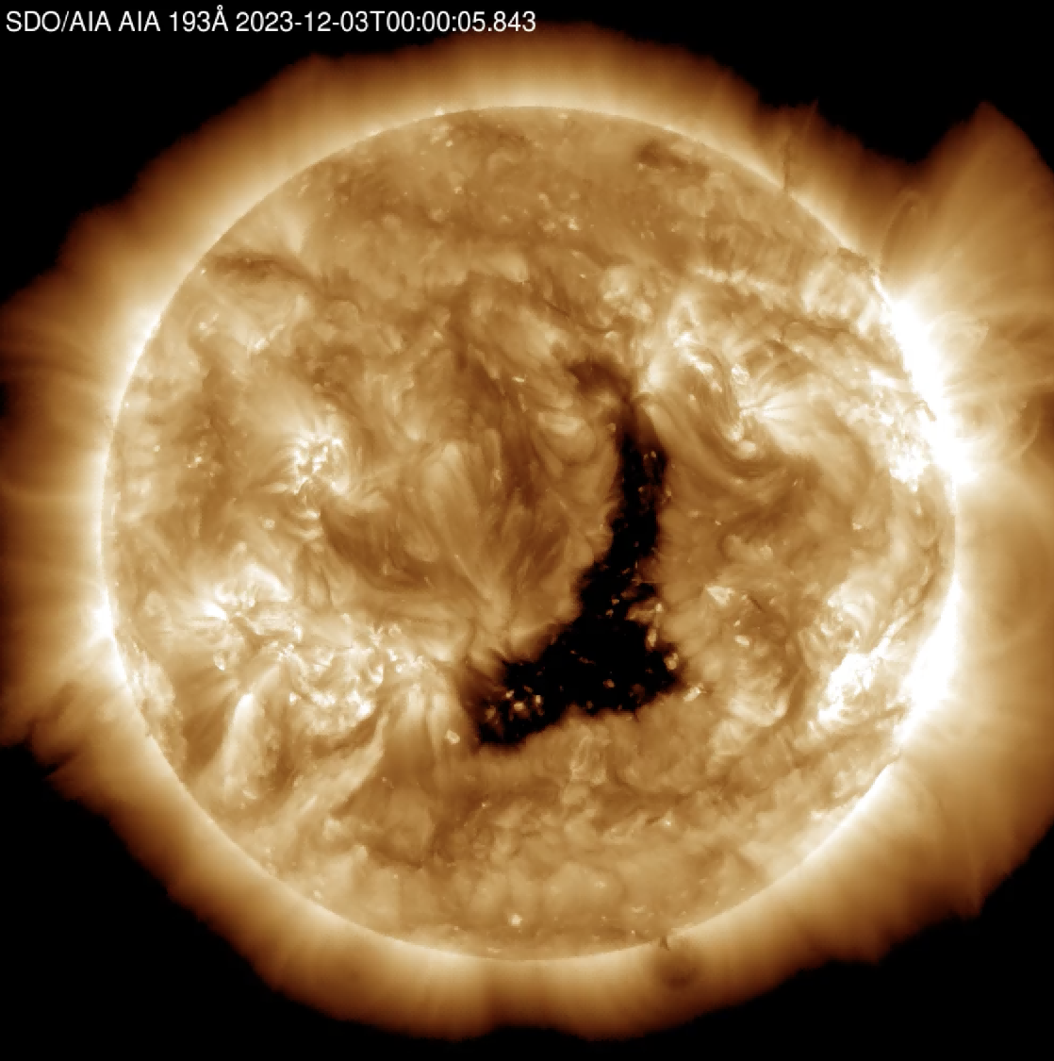
Cosmic-Ray Proton Transport and Solar Gamma-Ray Production in Coronal Flux-Rope Magnetic Structures
Ruopu Han(韩若浦), Zhe Li(李哲), Shanshan Xu(许杉杉)，Songzhan Chen（陈松战）
11
Introduction
Problem:
Discrepancy between theory and observation.
multi-scale magnetic structures and turbulent fields
play a central role in cosmic-ray
transport and gamma-ray production
near the solar surface.

Slide 2
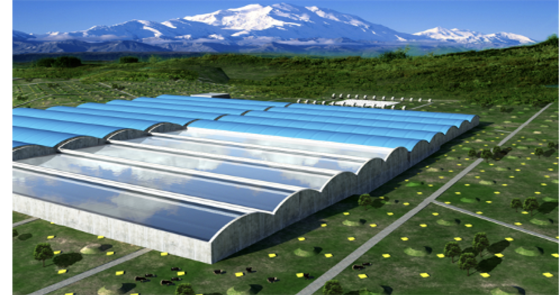
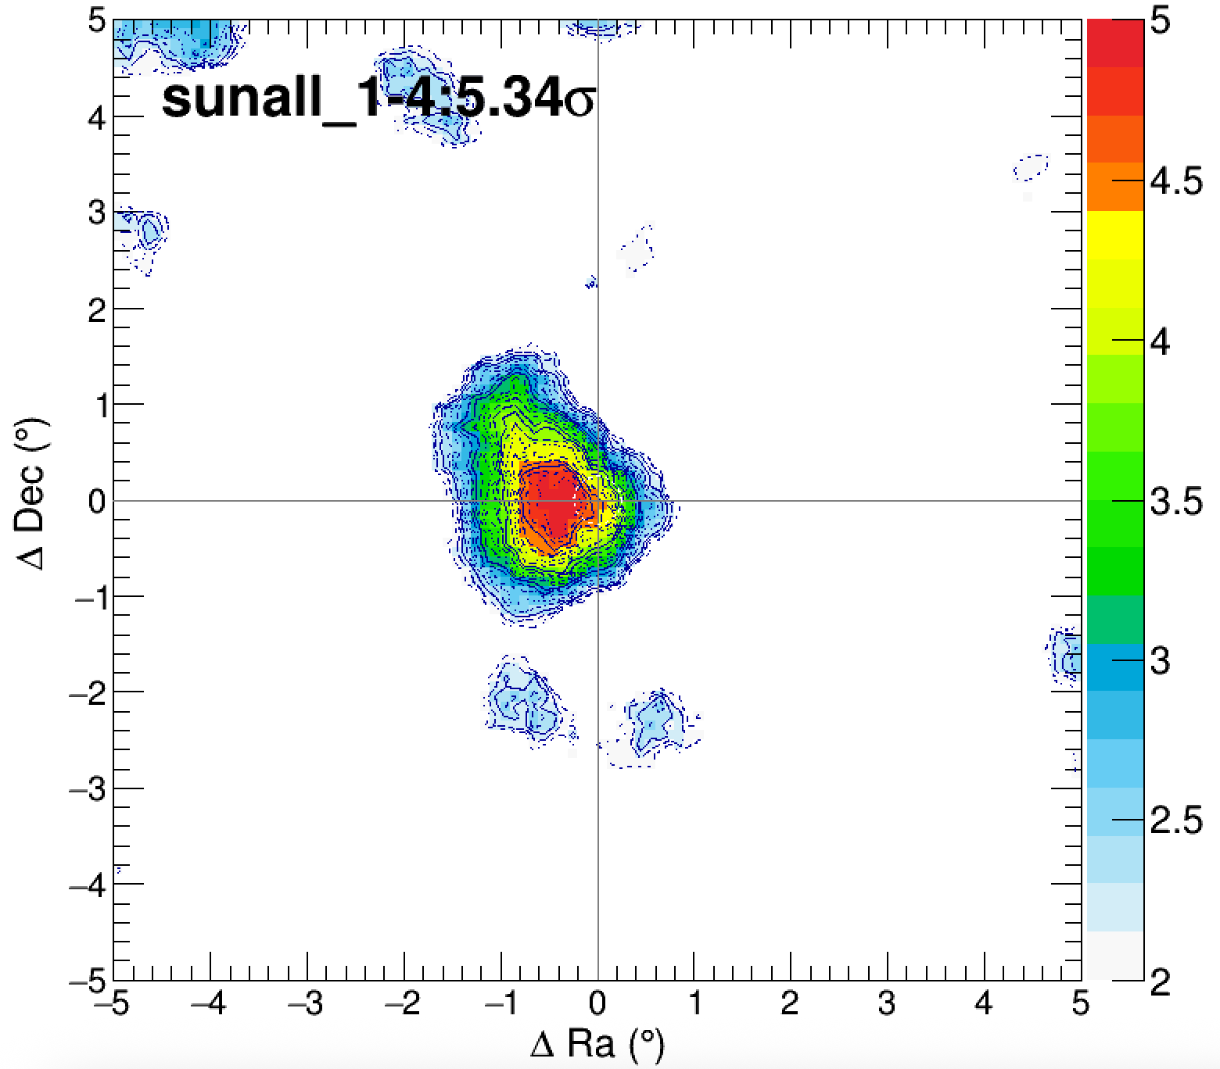
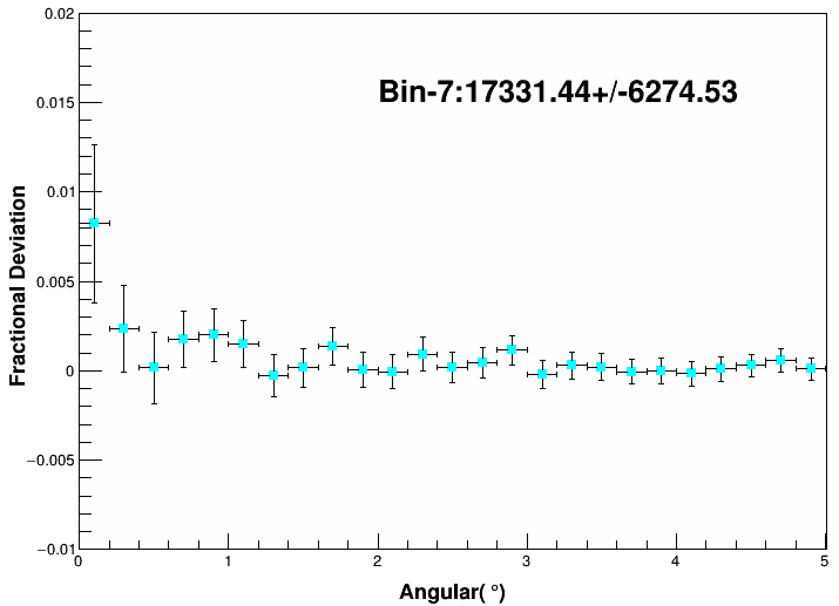
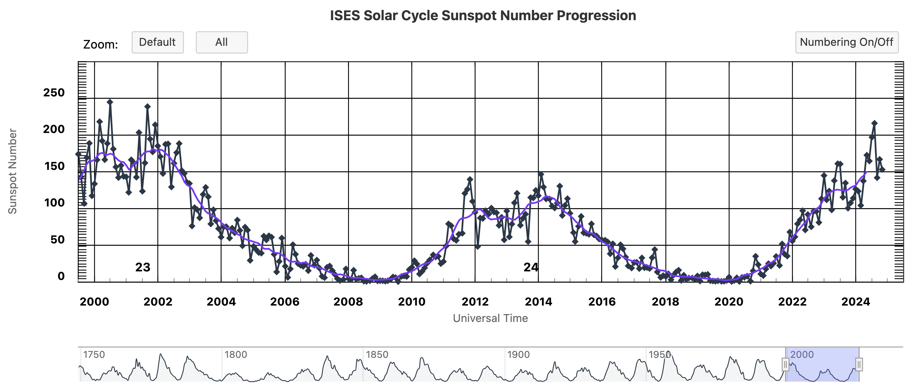
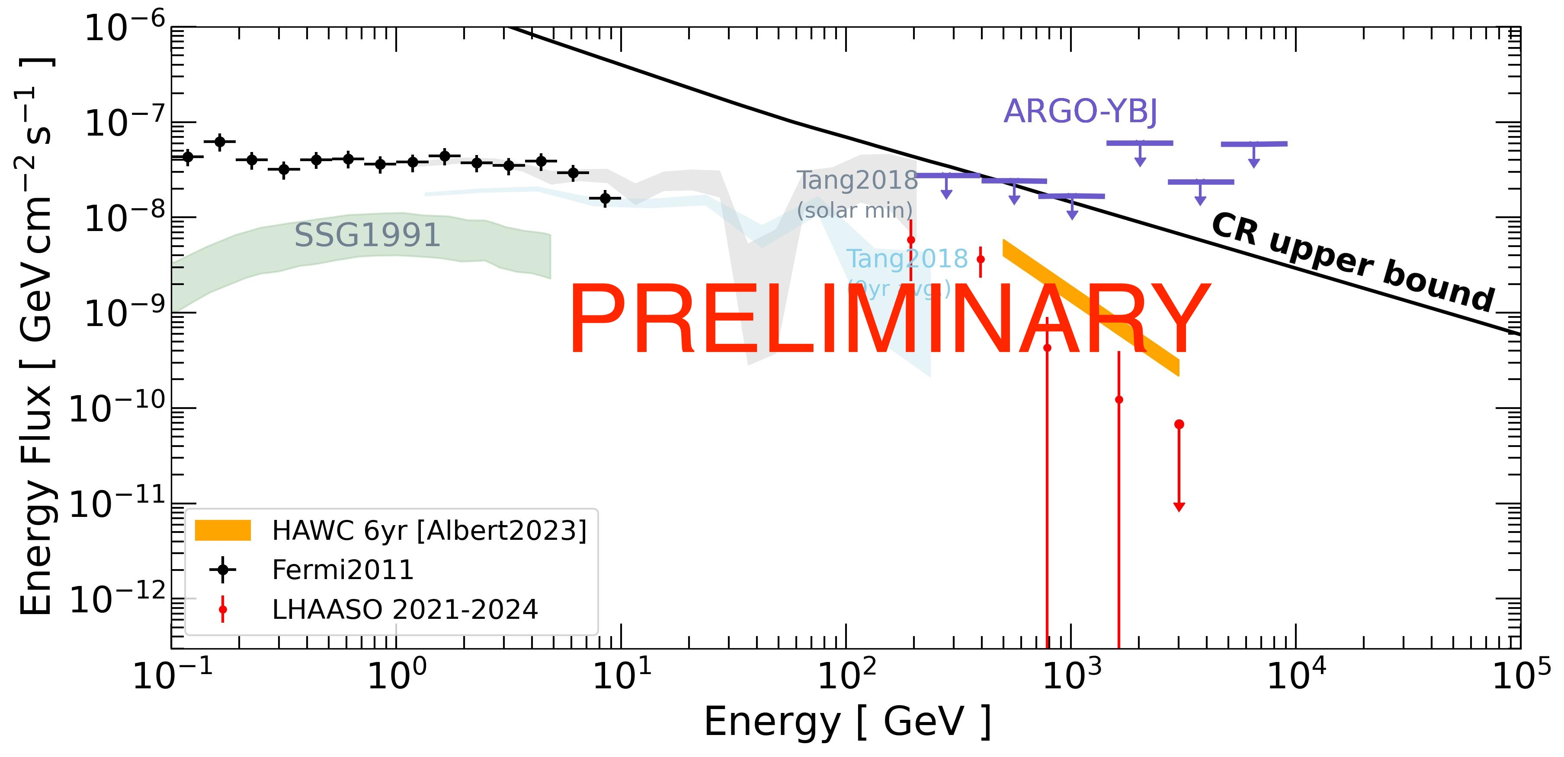
Cosmic-Ray Proton Transport and Solar Gamma-Ray Production in Coronal Flux-Rope Magnetic Structures
Ruopu Han(韩若浦), Zhe Li(李哲), Shanshan Xu(许杉杉)，Songzhan Chen（陈松战）
11
Gamma-ray from the sun
Removed Sun shadow effect
Within this energy range, the overall radial deviation toward the Sun is statistically consistent with zero. A weak positive excess is observed near the solar center; however, given the current statistical uncertainties, this feature alone cannot be interpreted as significant evidence for a solar gamma-ray signal.
Our analysis reveals a marginal detection of TeV gamma-ray excess from the Sun, with a spectrum that appears to connect to the Fermi-LAT band which for the first time fills the flux gap.
WCDA DATA : 2021067-2023365

Slide 3
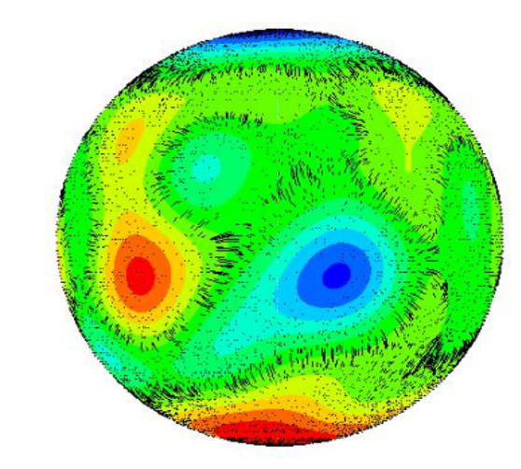
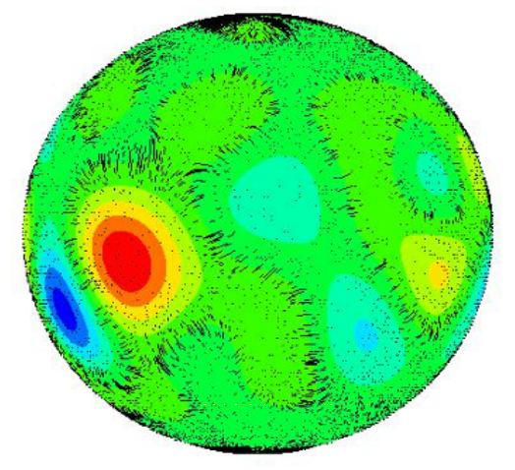
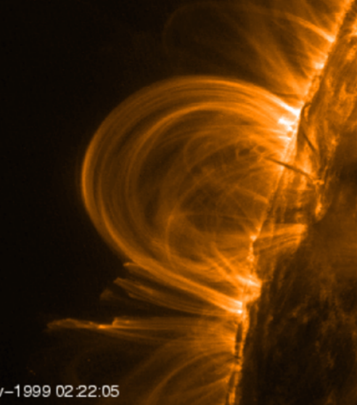
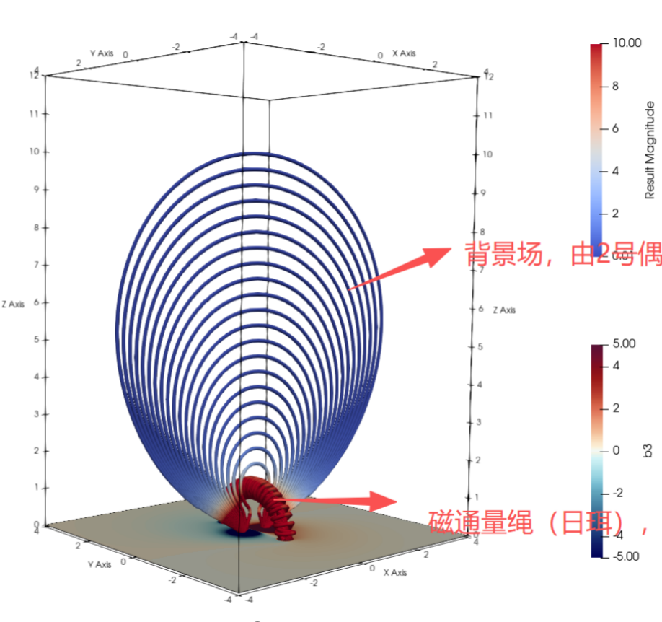
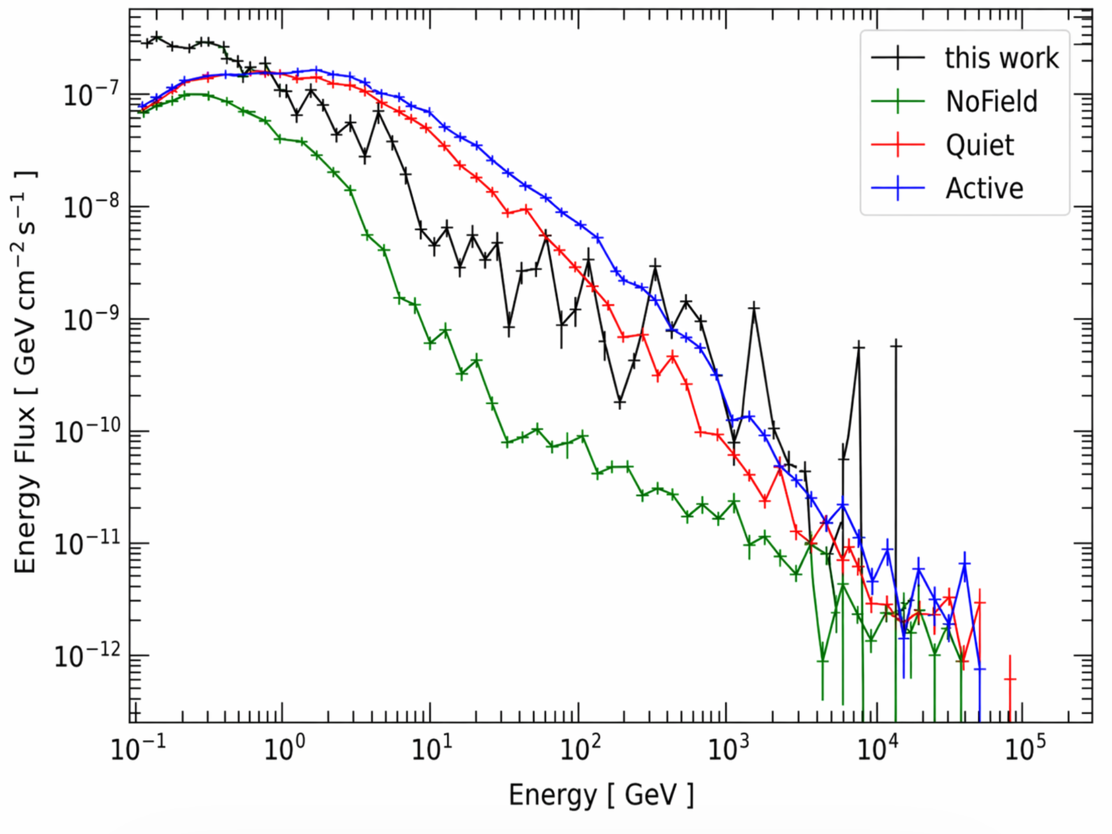
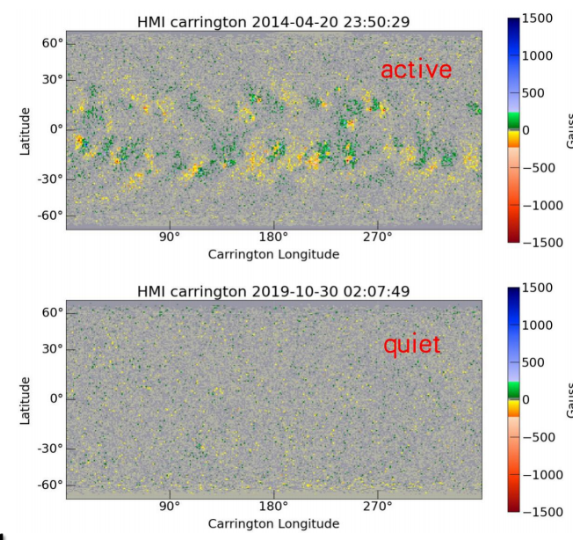
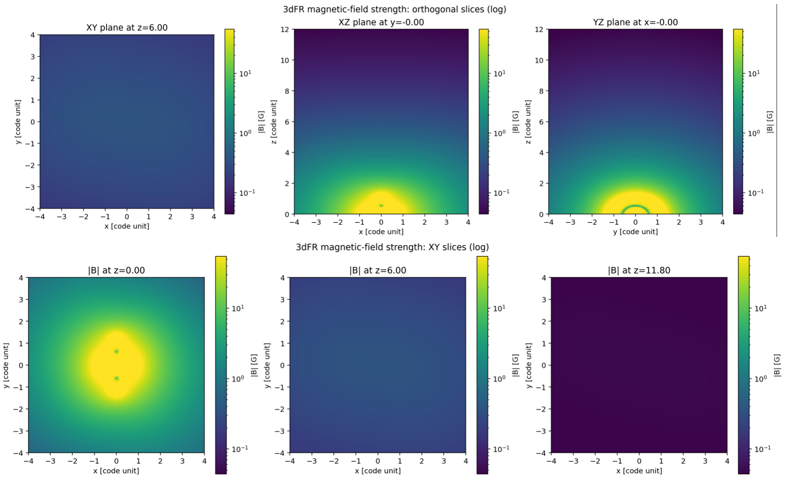
Cosmic-Ray Proton Transport and Solar Gamma-Ray Production in Coronal Flux-Rope Magnetic Structures
Ruopu Han(韩若浦), Zhe Li(李哲), Shanshan Xu(许杉杉)，Songzhan Chen（陈松战）
11
3D Simulation
Magneticflux-rope fields indeed enhance gamma-ray production in the solar atmosphere;
localized strong magnetic structures may be more effective than PFSS models.
Large-scale
Small-scale

