Slide 1
Machine Learning at LHASSO KM2A: Gamma-Ray identification at the Crab Nebula
Chao Yang, Yongfeng Zhu, Manqi Ruan

Slide 2
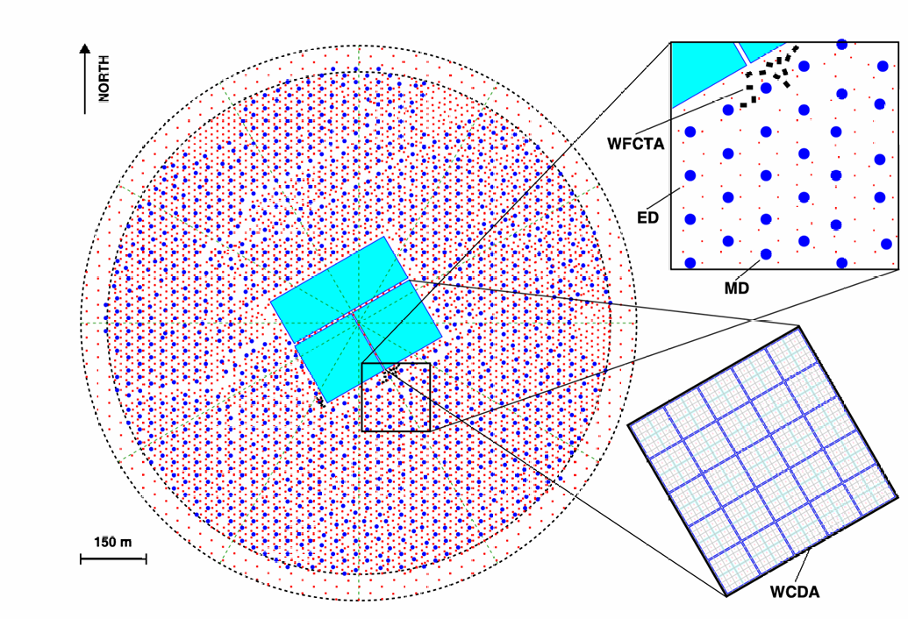
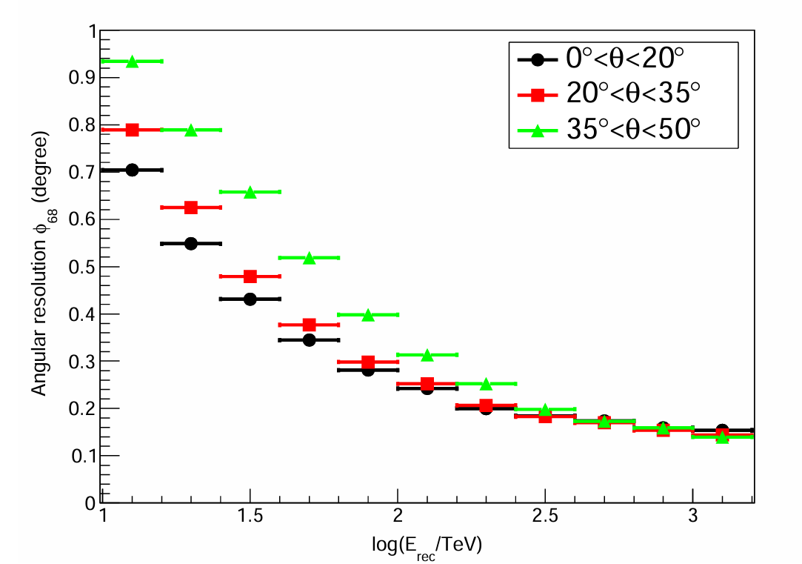
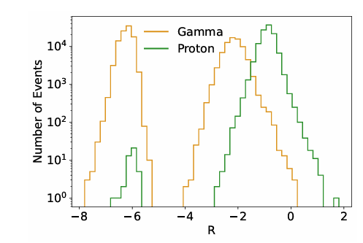


Introduction
Machine learning @ LHASSO
  Identification: gamma, proton, and different species of ions
  Regression: Angular & energy
We focus on the gamma-proton identification @ KM2A, using both simulation and real data
  Crab nebula as standard candle
  Methods: supervised and self-supervised approaches
Angular
$$γ/p$$
LHAASO (2020)
Huang et al., PoS(ICRC2025)1431
5216 EDs+1188 MDs
1

Slide 3
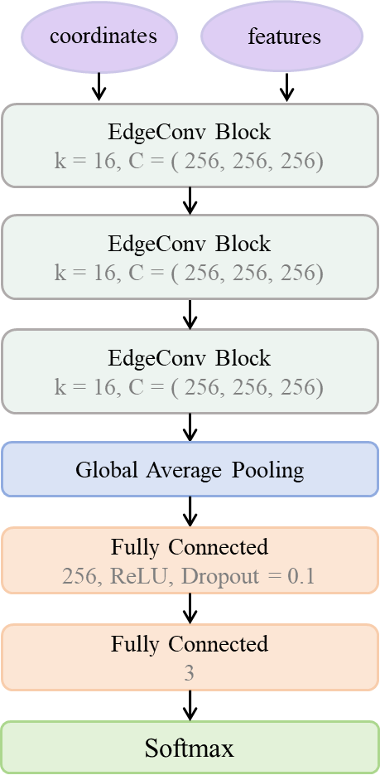
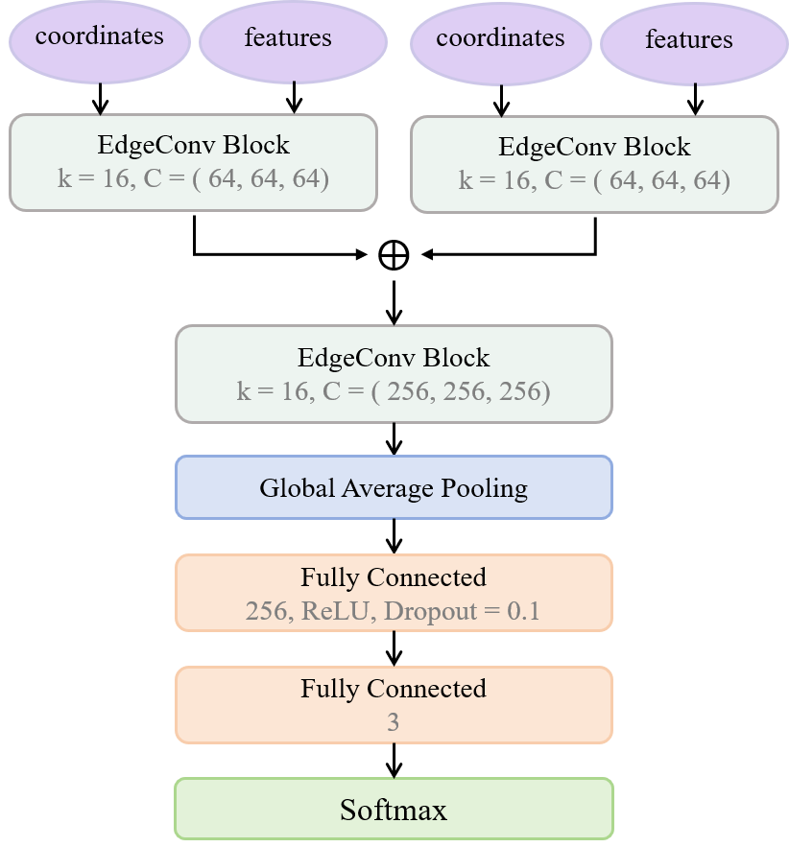
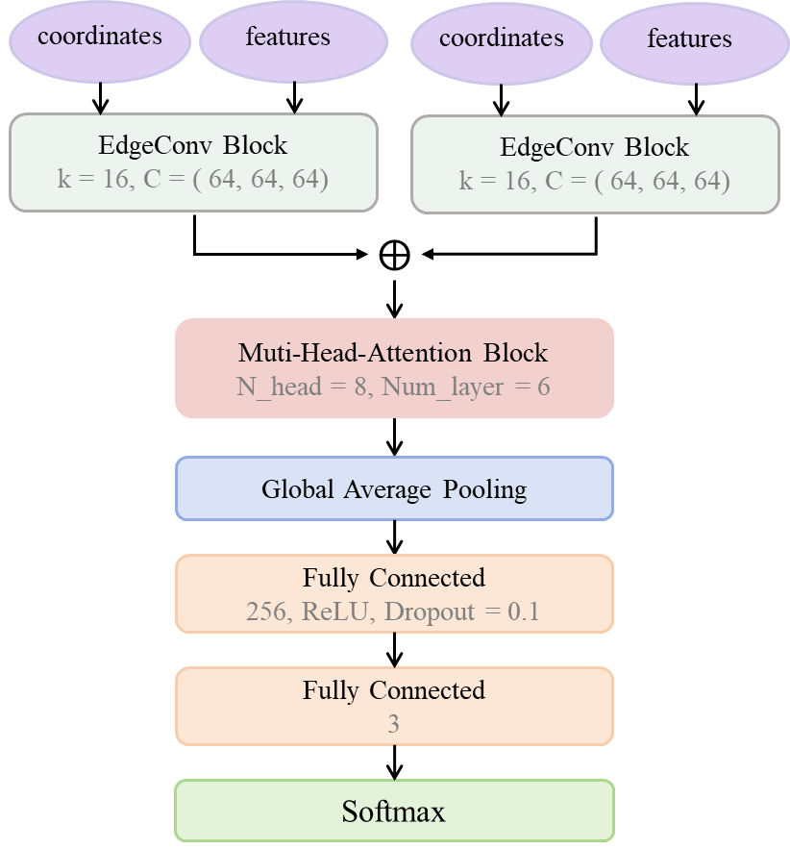
Model design & Optimization
IO: Hits as input, Photon/Proton scores as output
KM2A is composed of 1188 Muon Detector + 5216 of EM detector, correspondingly, the model evolves into a Dual input architecture with ParticleNet or Transformer
2026.3 ~ Dual Stream
GNN-Transformer
2025.10 ~ ParticleNet
2025.12 ~ Dual Stream ParticleNet
2
Notes:
By first extracting neighborhood information separately for different detector structures and then jointly modeling global information, this strategy alleviates the learning burden on the MLP and improves information utilization efficiency compared with mixed-input processing.

Slide 4
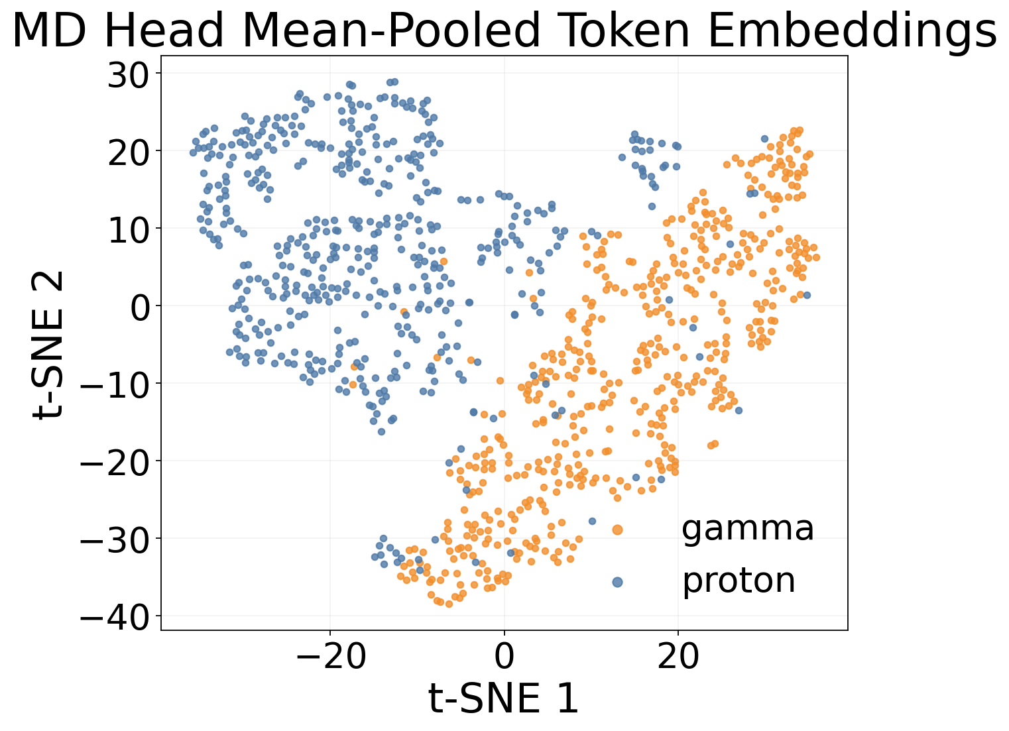
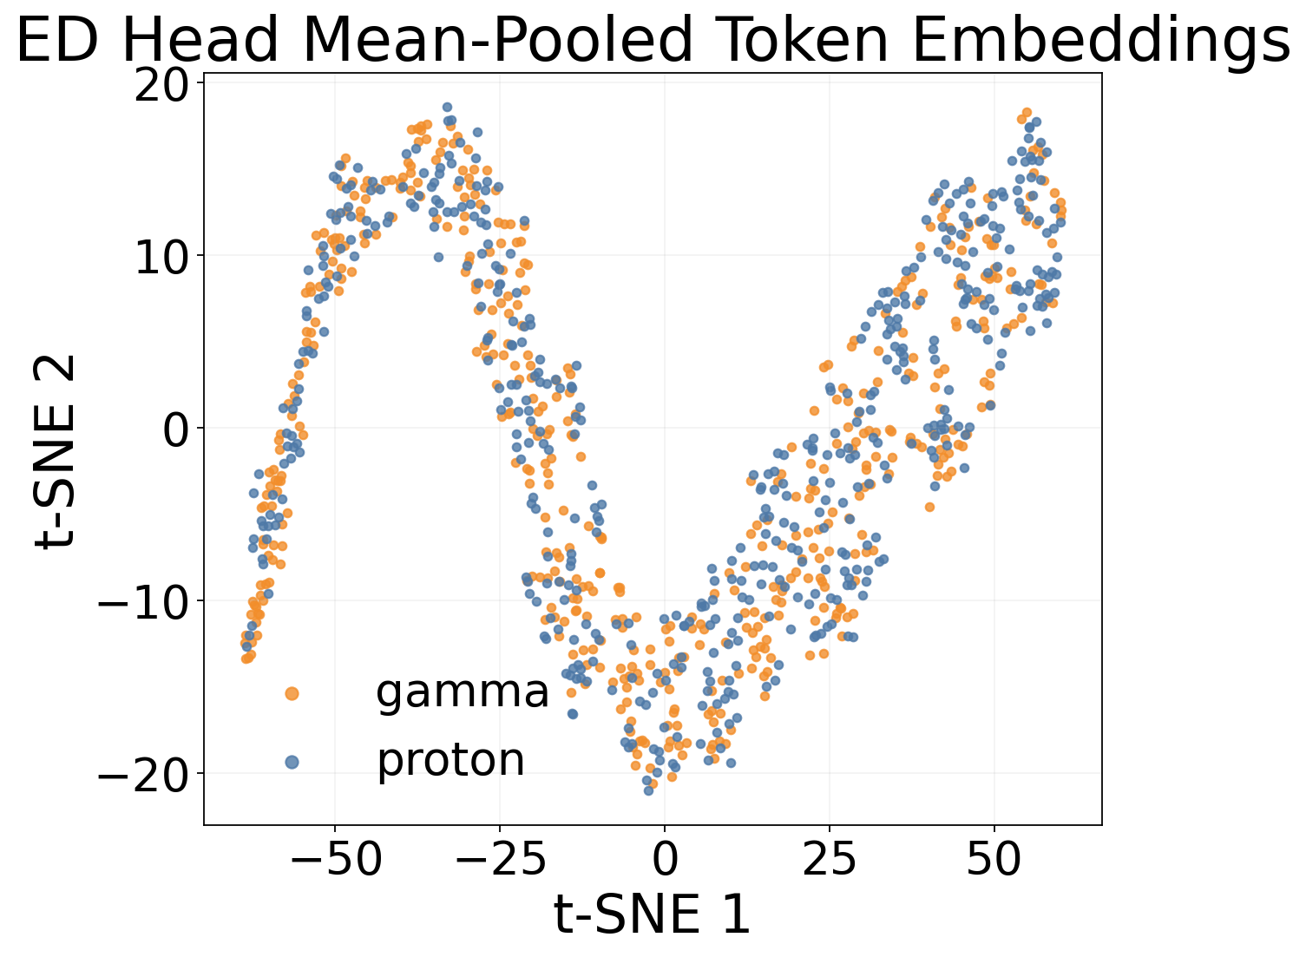
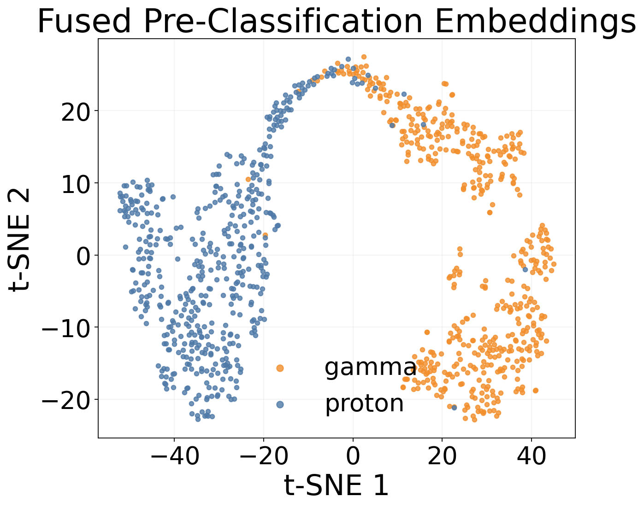
Feature Visualization
ED hits
↓
MD hits
↓
Dimensionality-reduced visualization of high-level features extracted from different model depths.
3

Slide 5
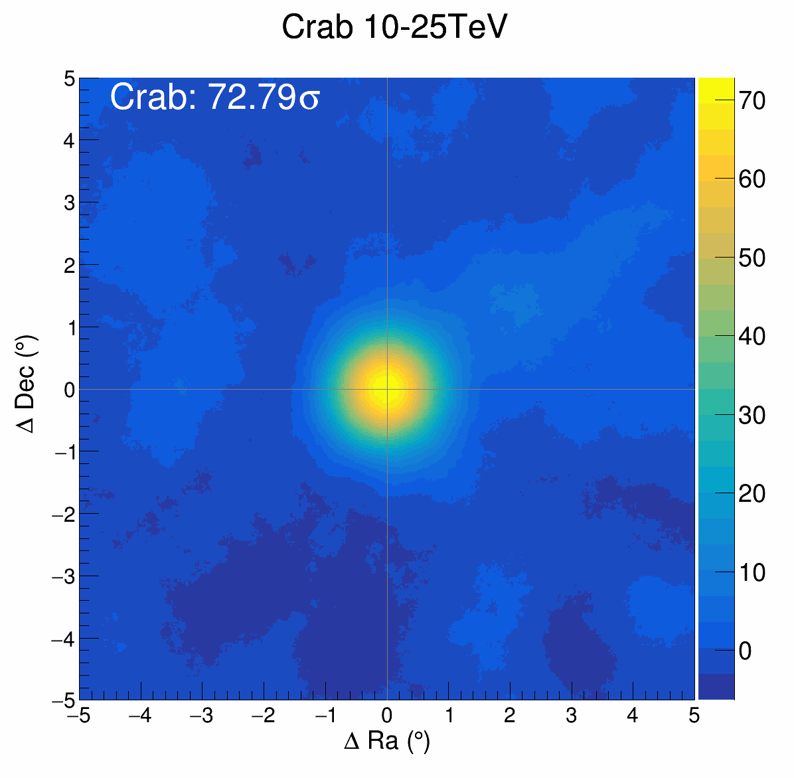
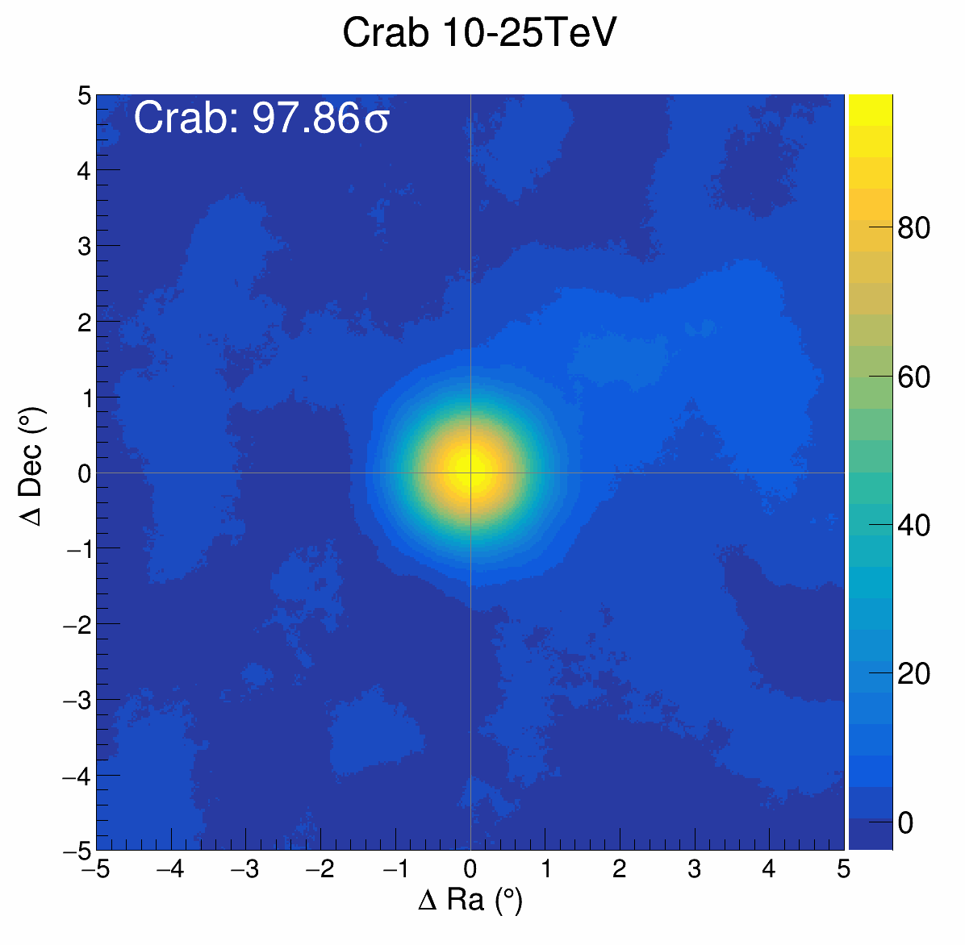
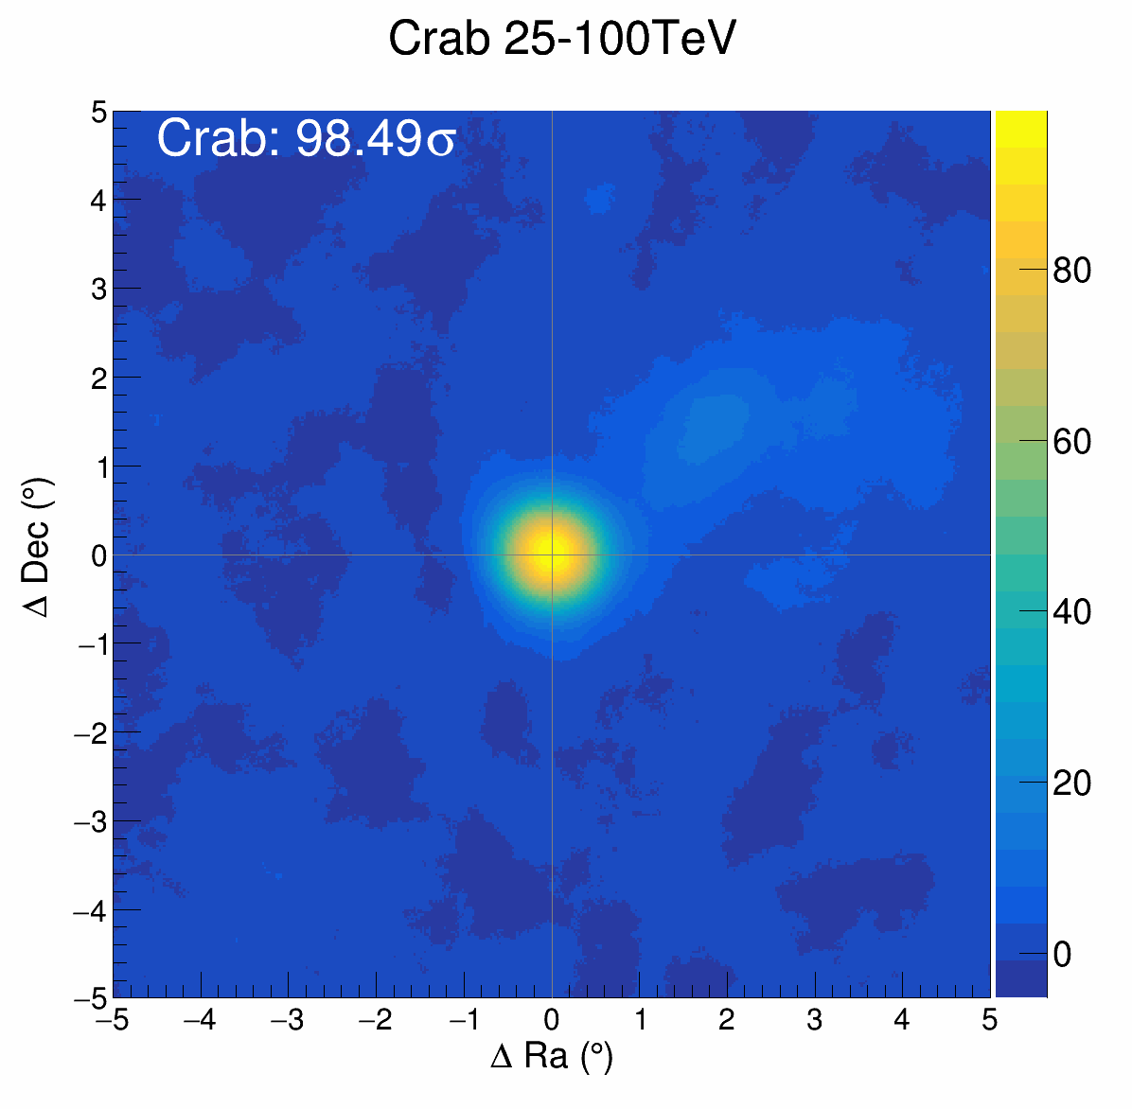
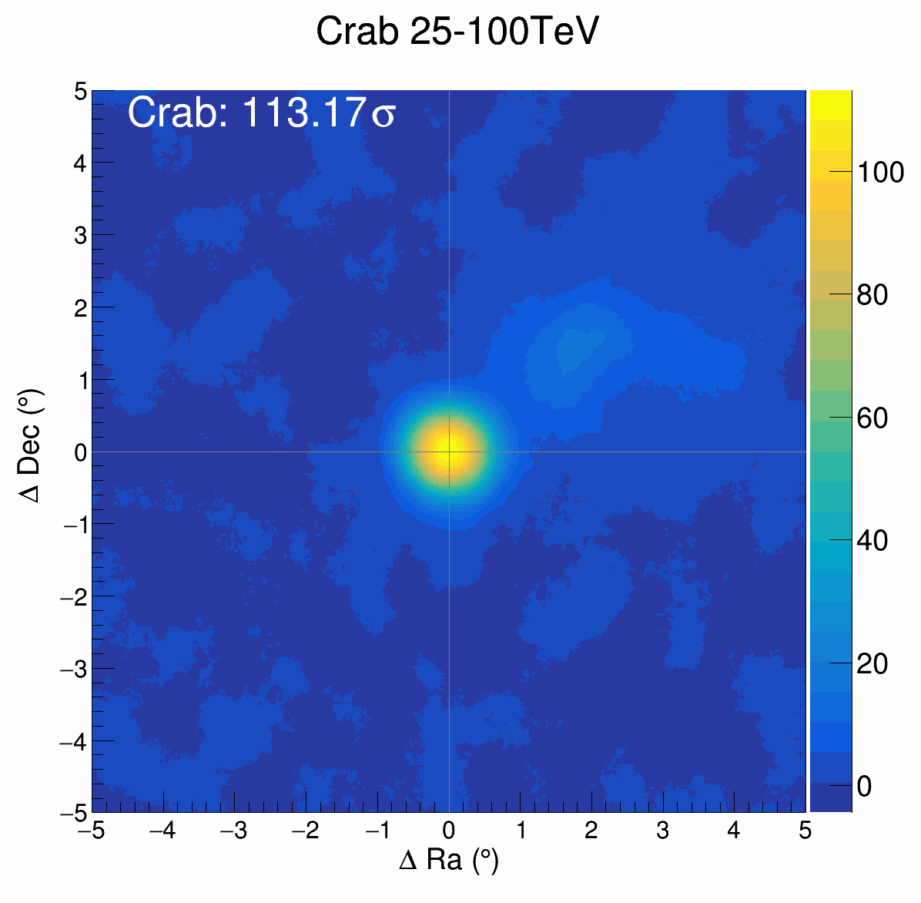
*Zenith angle: 0~50°
Overall Performance
Based on Dual-Stream PN, we performed predictions on the full-year 2024 observational data of the Crab Nebula.
↑34.4%
Supervised Dual-stream PN
 | Nsig | Nb | Significance
ML（10-25） | 12977 | 12703 | 97.86
Baseline（10-25） | 15989 | 40625 | 72.79
ML（25-100） | 3977 | 291 | 113.2
Baseline（25-100） | 3381 | 330 | 98.49
↑14.9%
4
Notes:
By first extracting neighborhood information separately for different detector structures and then jointly modeling global information, this strategy alleviates the learning burden on the MLP and improves information utilization efficiency compared with mixed-input processing.

Slide 6
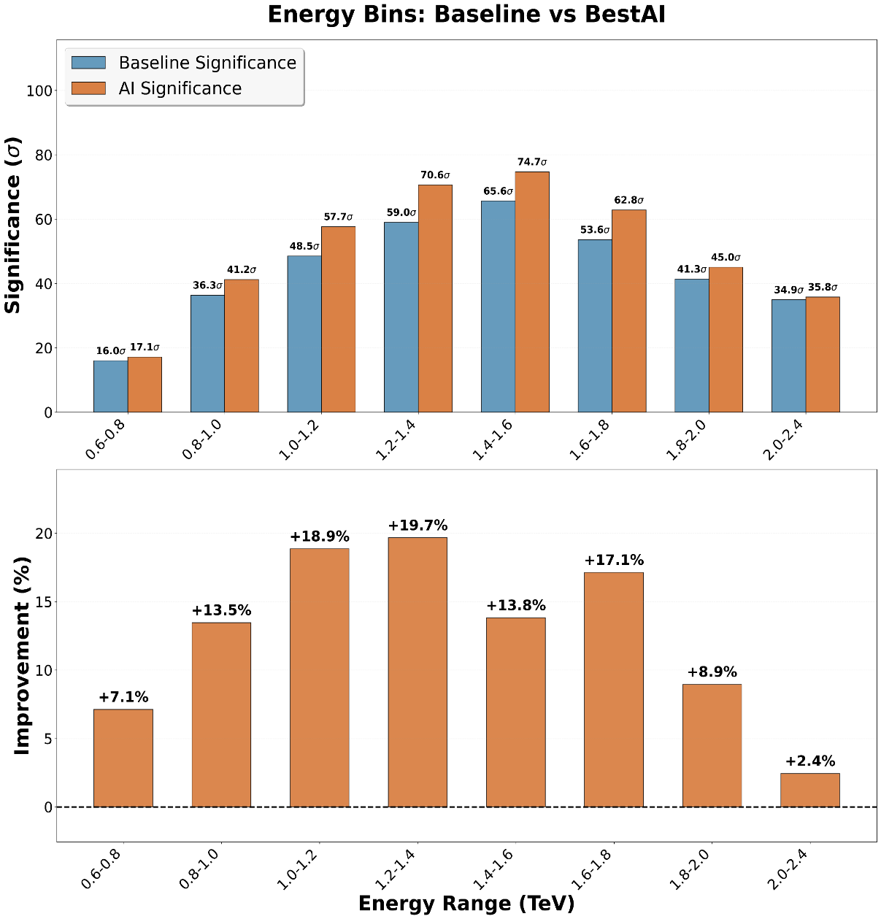
Dependence on Energy & Time
*Zenith angle: 0~50°
Preliminary
Month
5

Slide 7
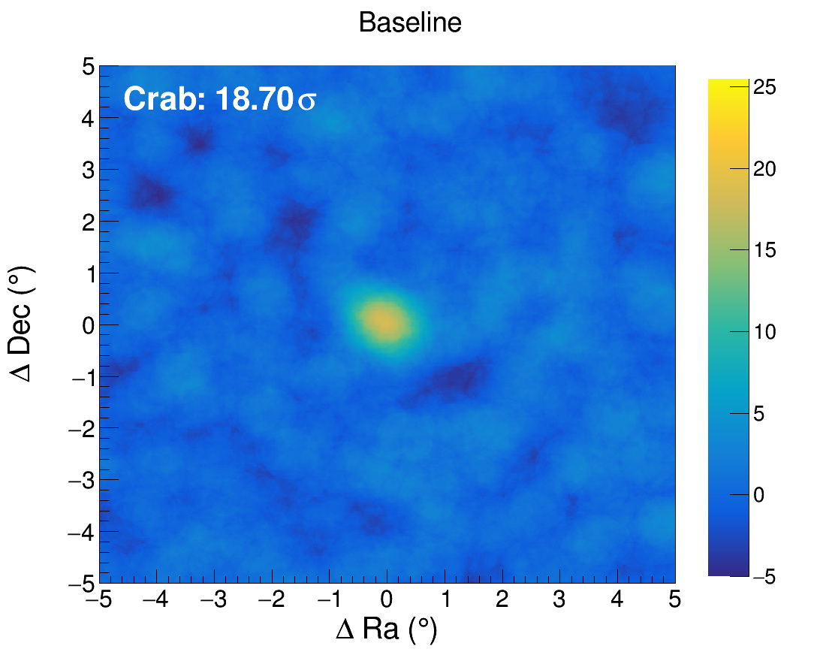
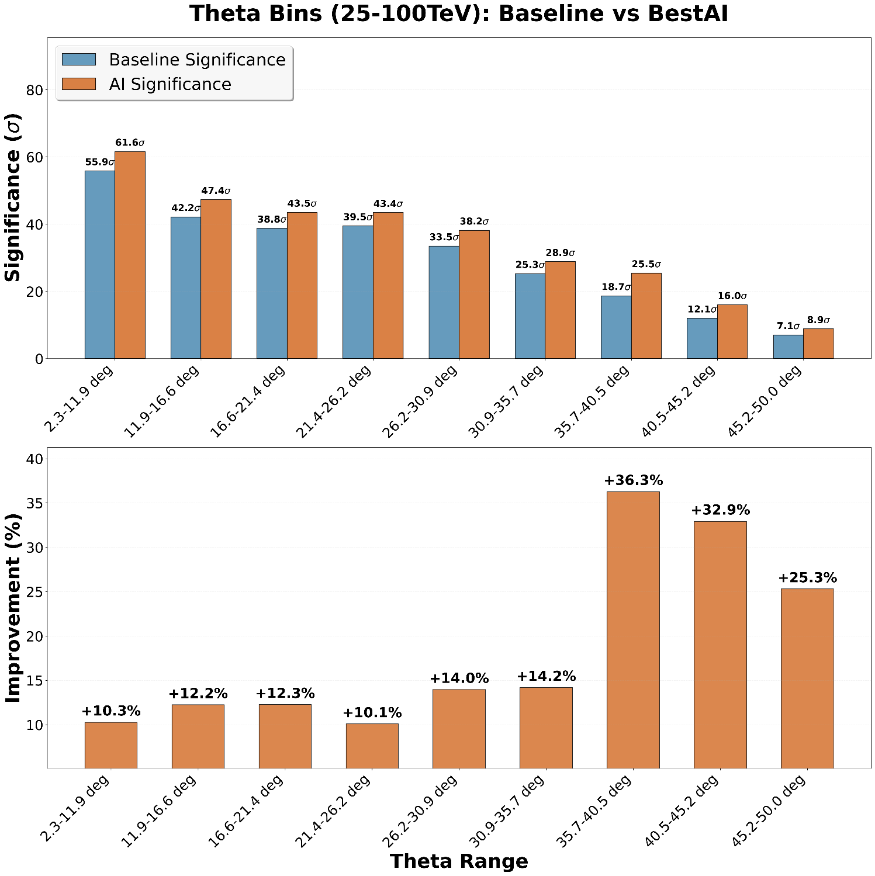
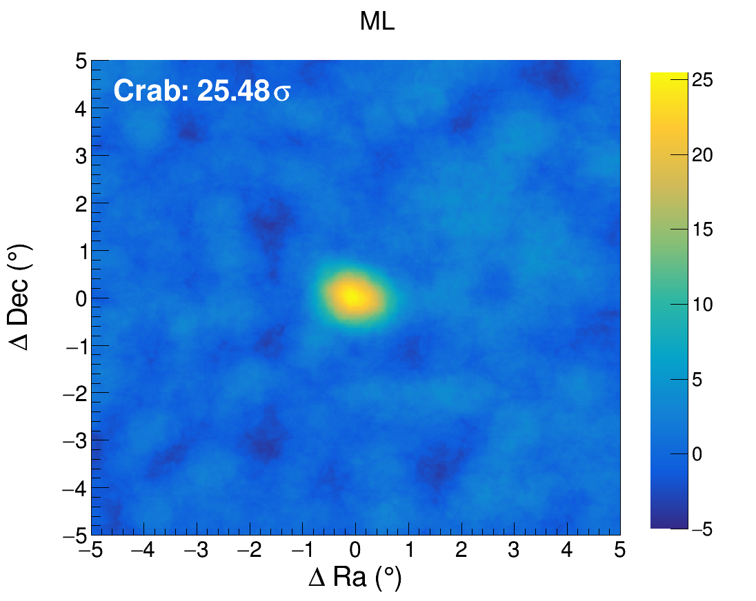
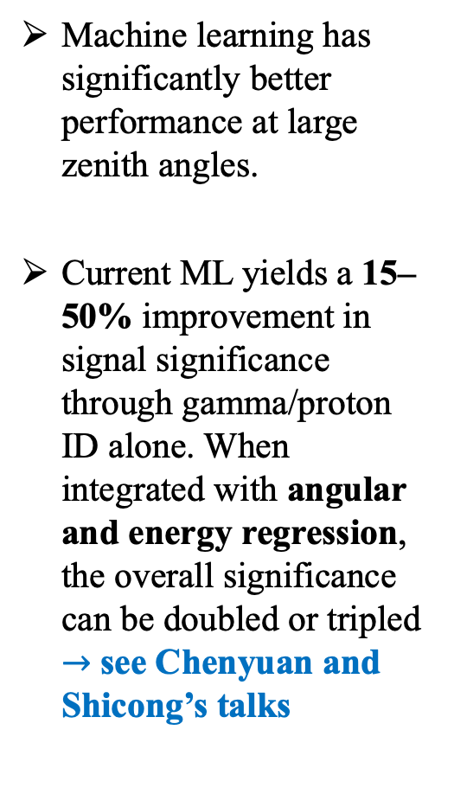
Dependence on Zenith Angle
Machine learning has significantly better performance at large zenith angles.
Current ML yields a 15–50% improvement in signal significance through gamma/proton ID alone. When integrated with angular and energy regression, the overall significance can be doubled or tripled
$→$ see Chenyuan and Shicong’s talks
Preliminary
6

Slide 8
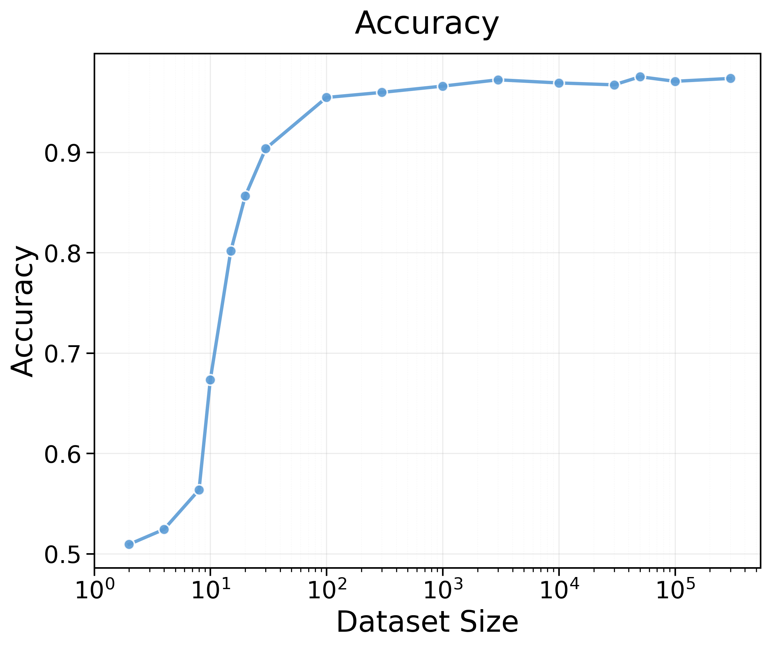
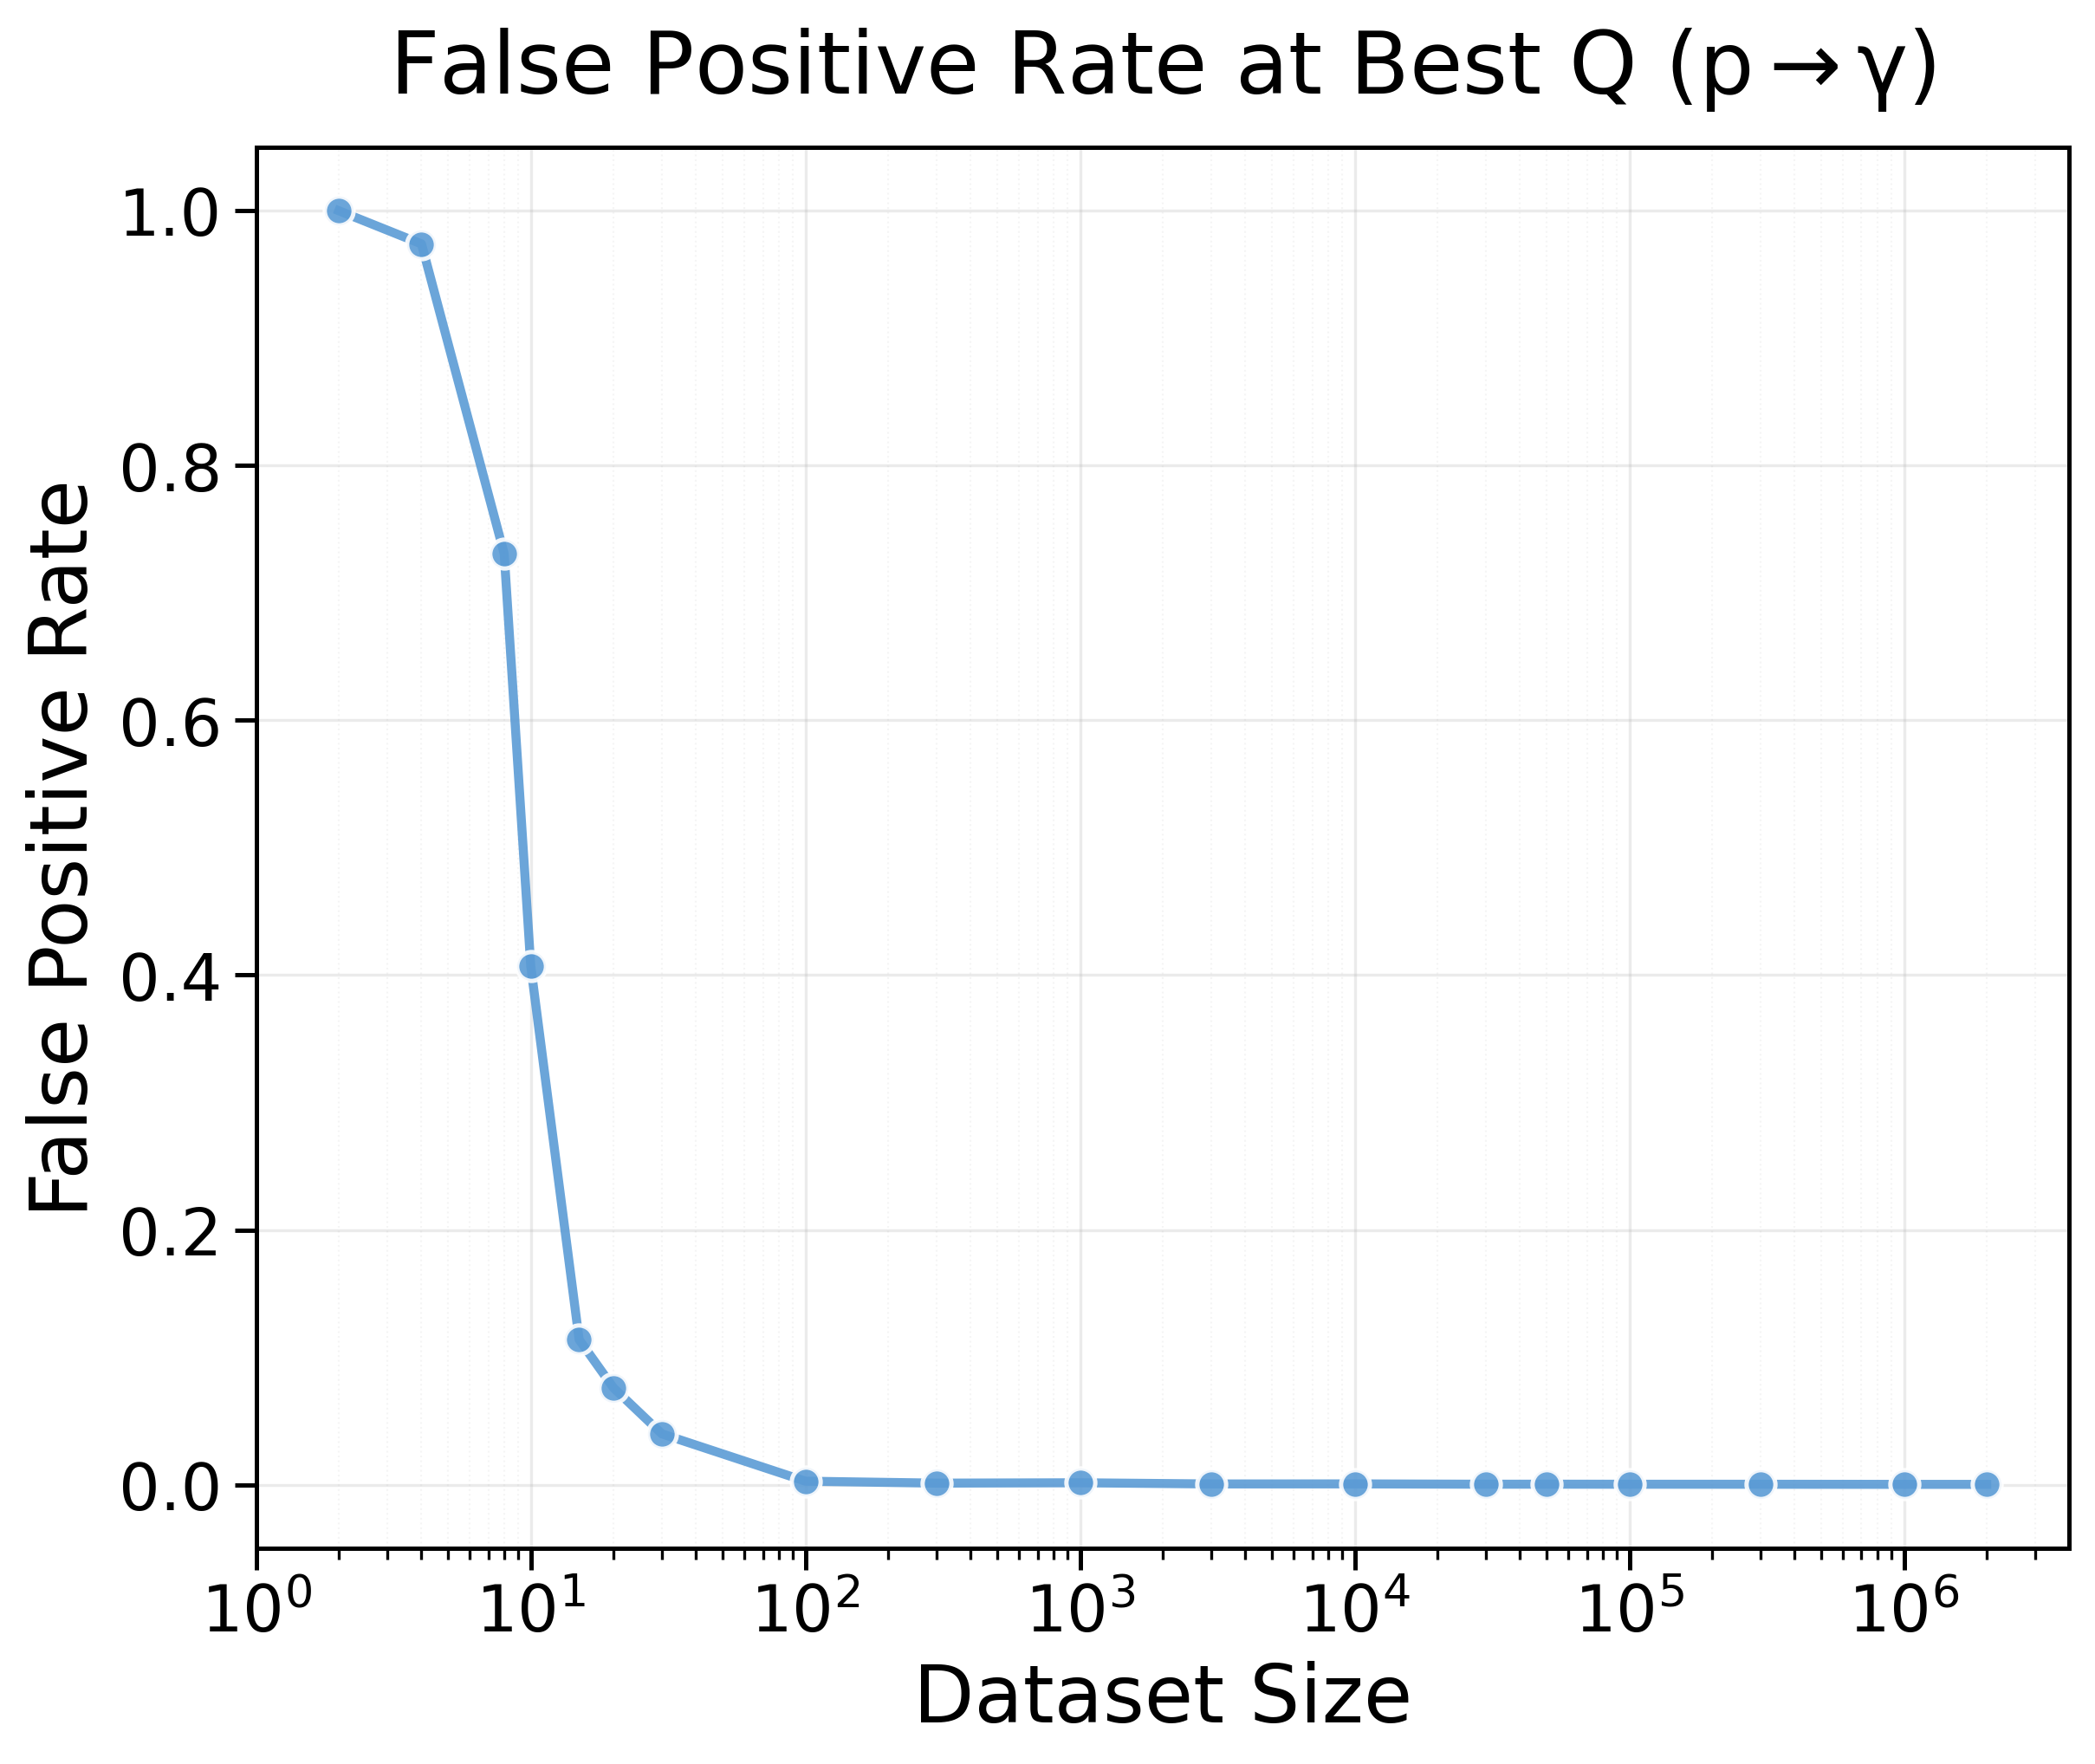
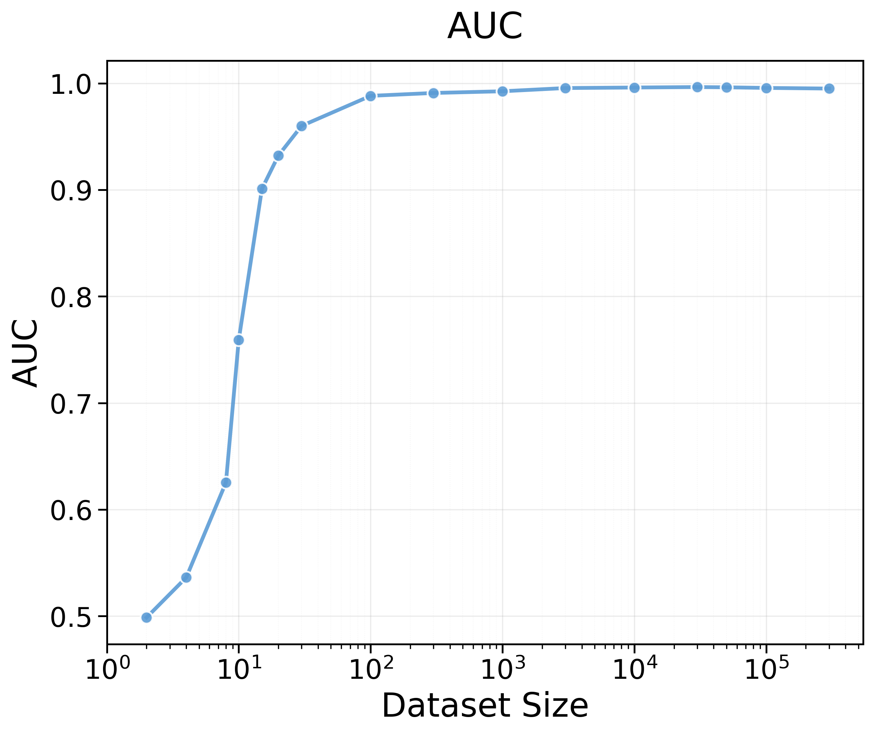
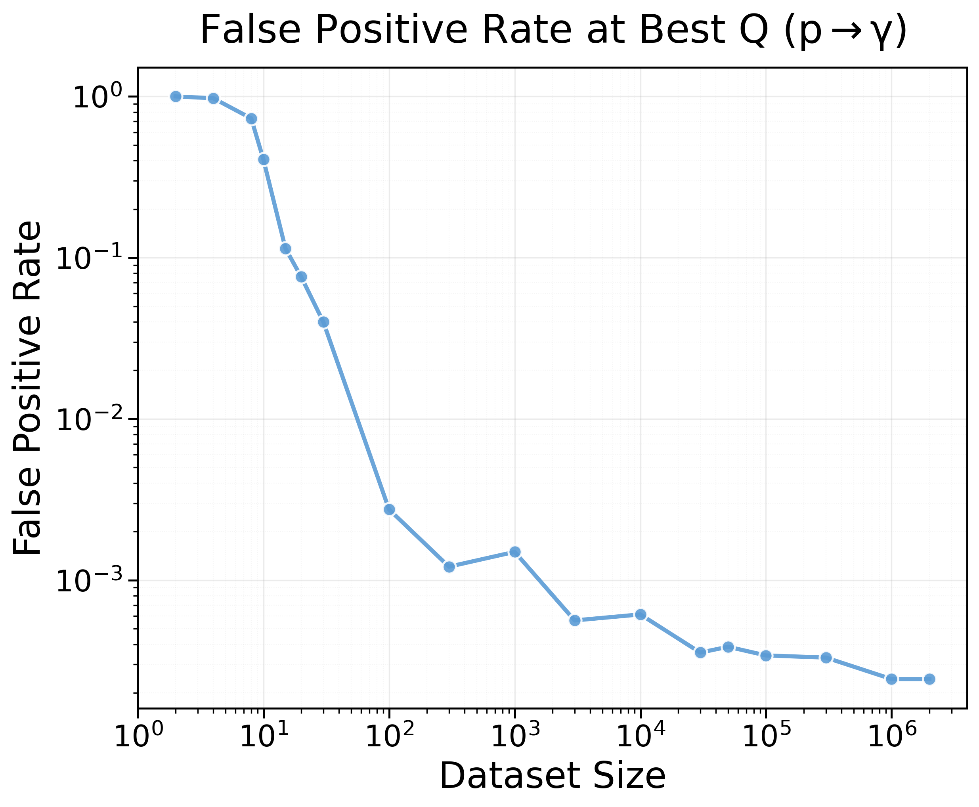
Scaling behavior: diagnosis ML performance
Challenge: While most identification is straightforward, the main difficulty is to identify background events that closely mimic gamma signals.
Need reliable simulation towards those tail events
Or use angular information to get high purity proton sample – and select those with high photon-likelihoods to finetune the model
7

Slide 9
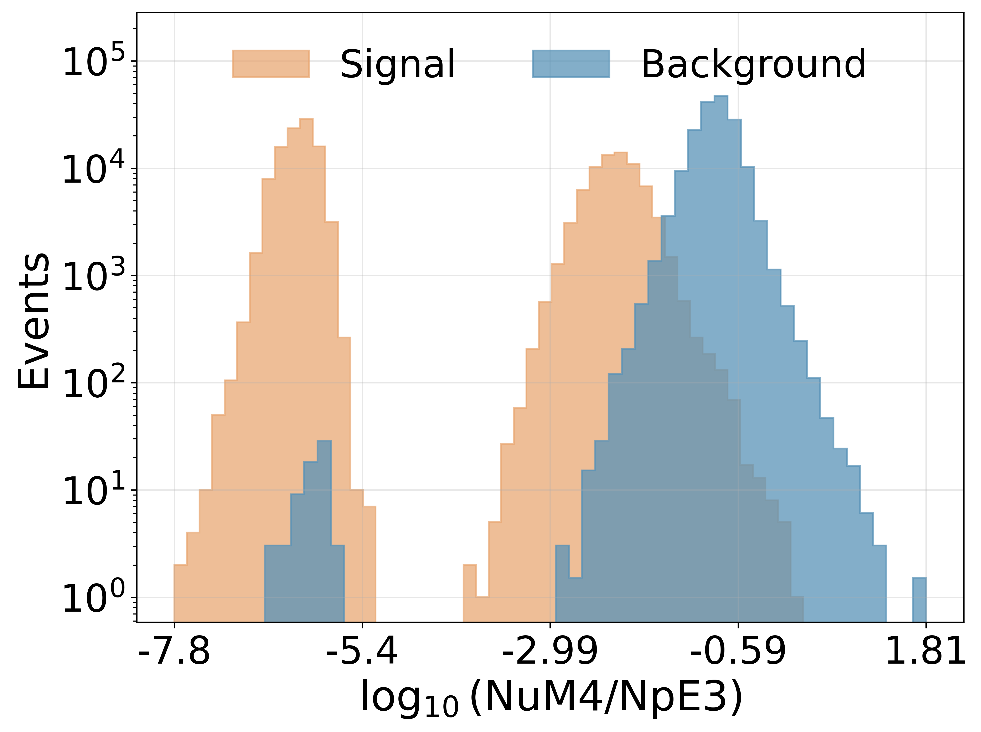
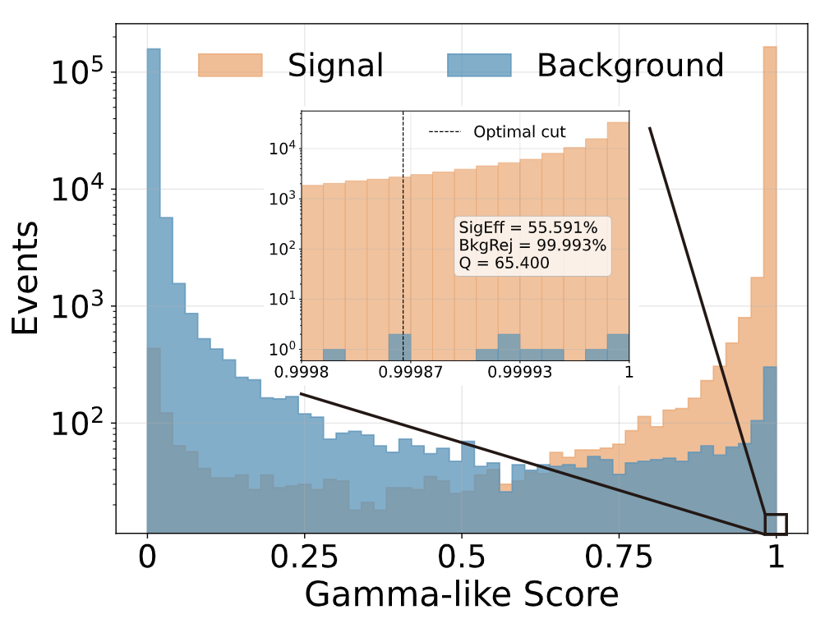
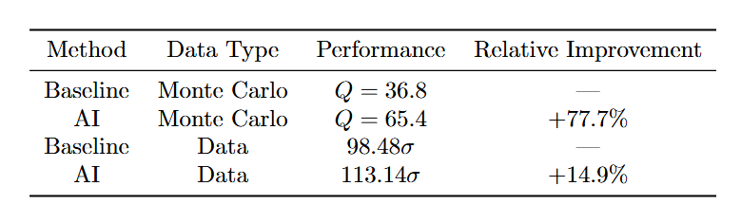
Comparison to MC
*Enegry: 25-100TeV Zenith angle: 0~50°
Q=36.8
Q=65.4
Supervised Dual-stream PN
ML yields notable improvements on real data, but the performance gain on MC is ~5x higher than the actual transfer to real data.
Plausible reason: Data-MC discrepancy.
Need to increase the simulation statistic…
8

Slide 10
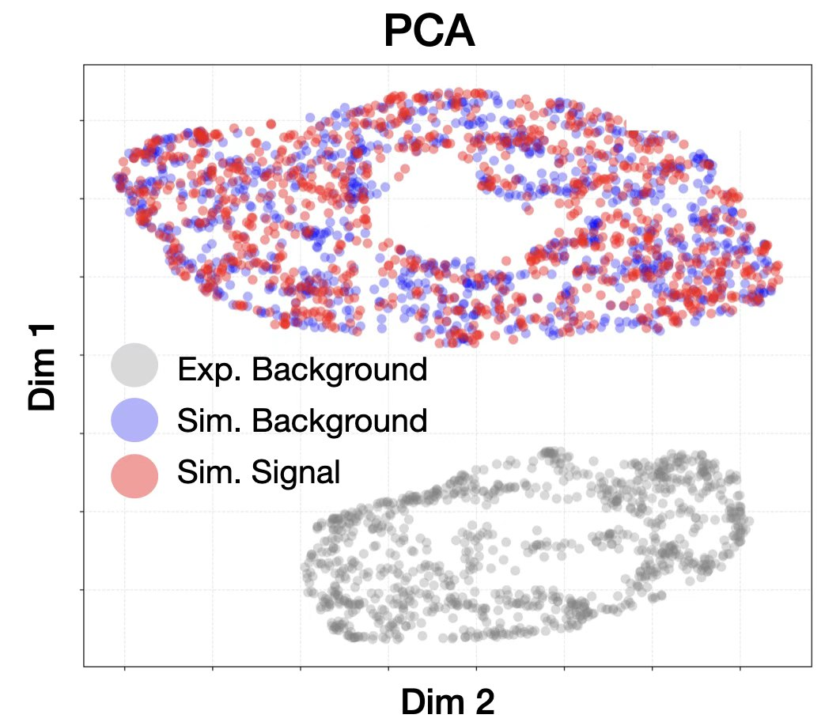
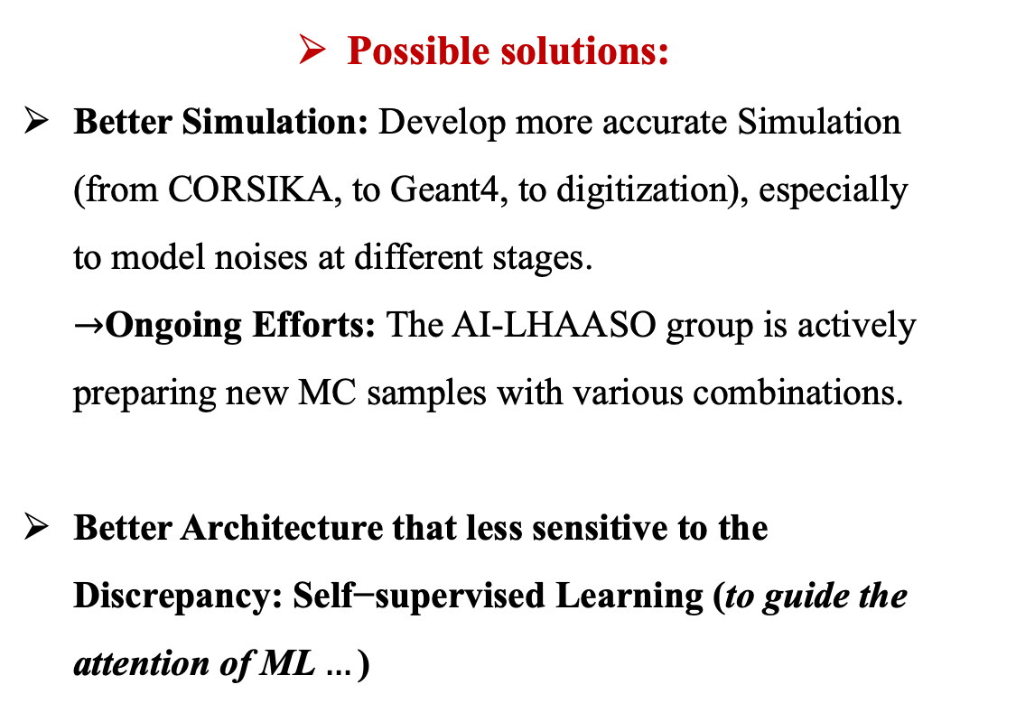
Current Bottleneck：Data-MC Discrepancy
Possible solutions:
Better Simulation: Develop more accurate Simulation (from CORSIKA, to Geant4, to digitization), especially to model noises at different stages.
$→$Ongoing Efforts: The AI-LHAASO group is actively preparing new MC samples with various combinations.
Better Architecture that less sensitive to the Discrepancy: $\text{Se}\text{lf}\text{−}\text{supervised} \text{Learning}\text{ (}\text{to} \text{guide} \text{the} \text{attention} \text{of} \text{ML}…\text{)}$
9

Slide 11
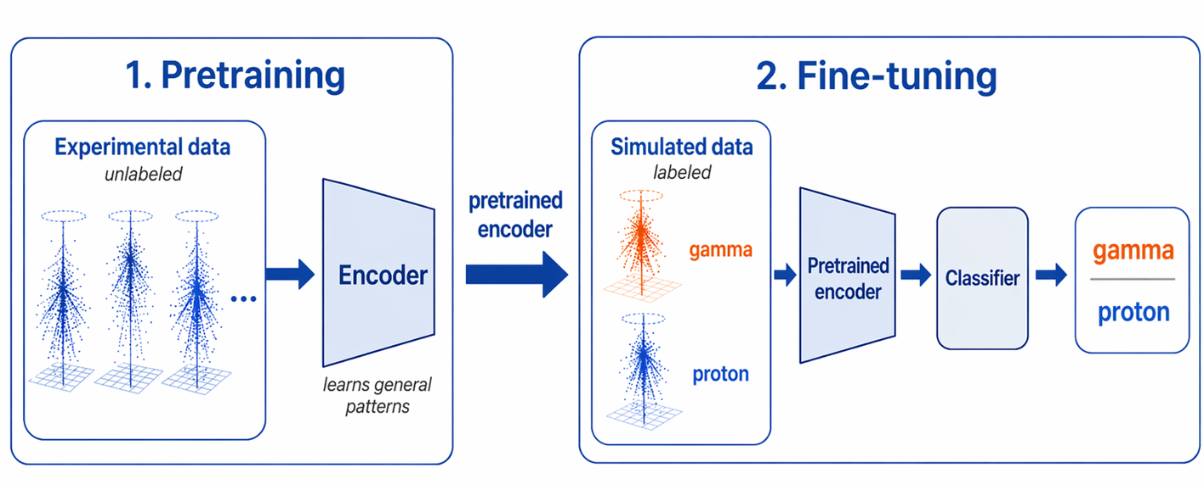
Semi-supervised Learning
*Encoder: Classical ParticleNet
Abundant Experimental Data: We possess an extensive amount of real experimental data.
Representation Learning: Pre-training enables the encoder to effectively capture robust representations from this data.
10

Slide 12
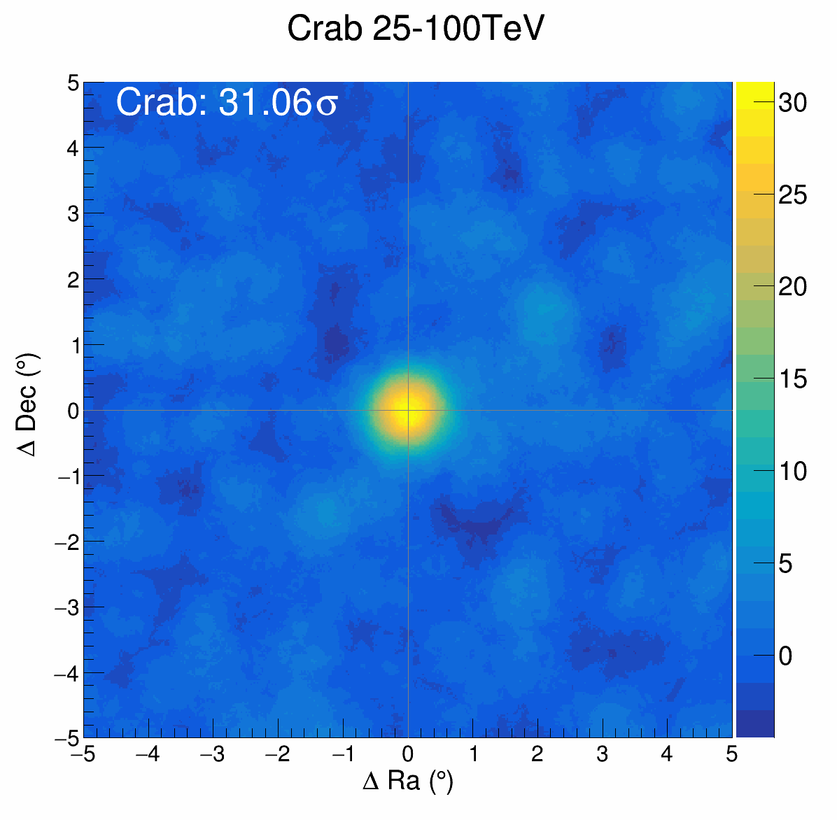
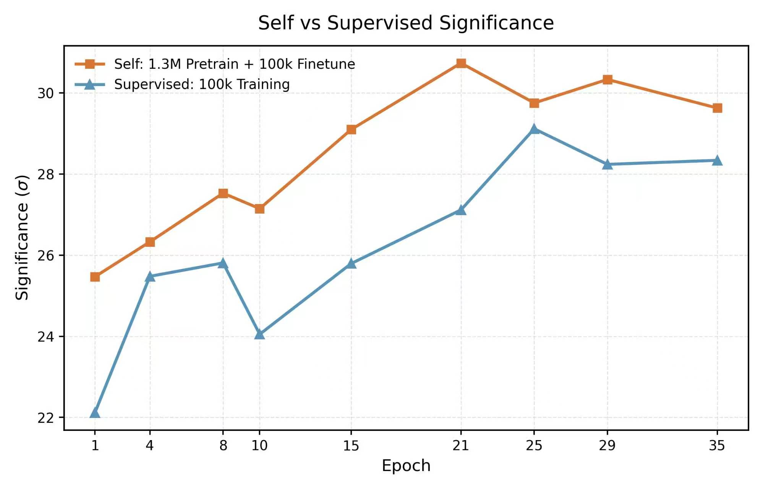
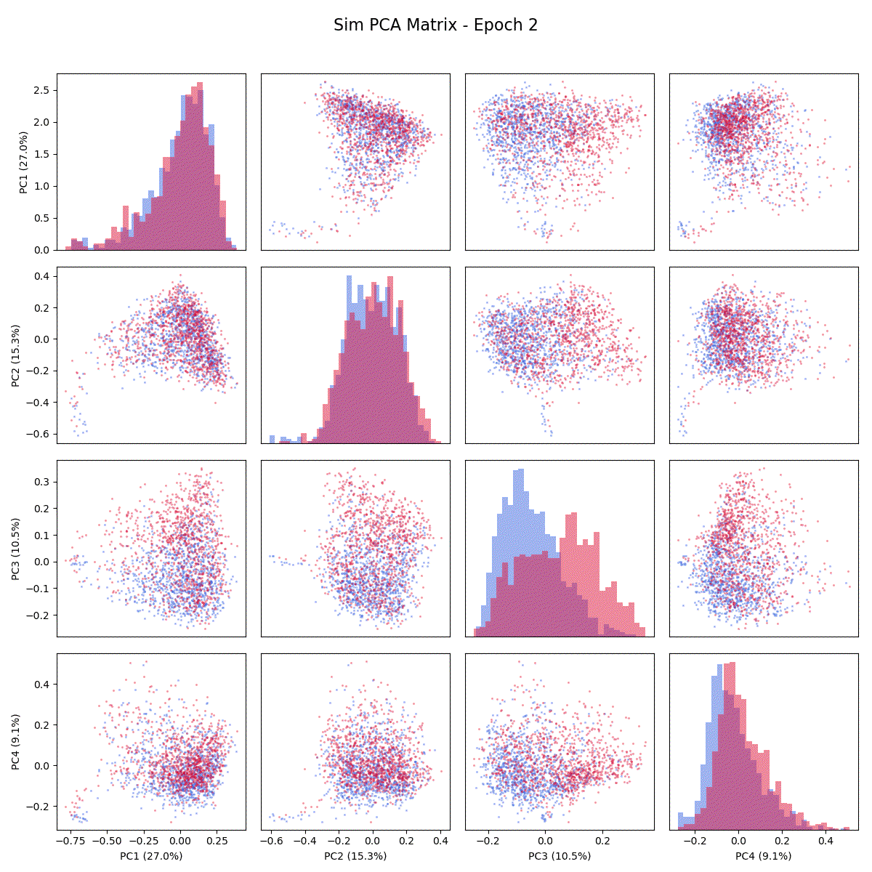
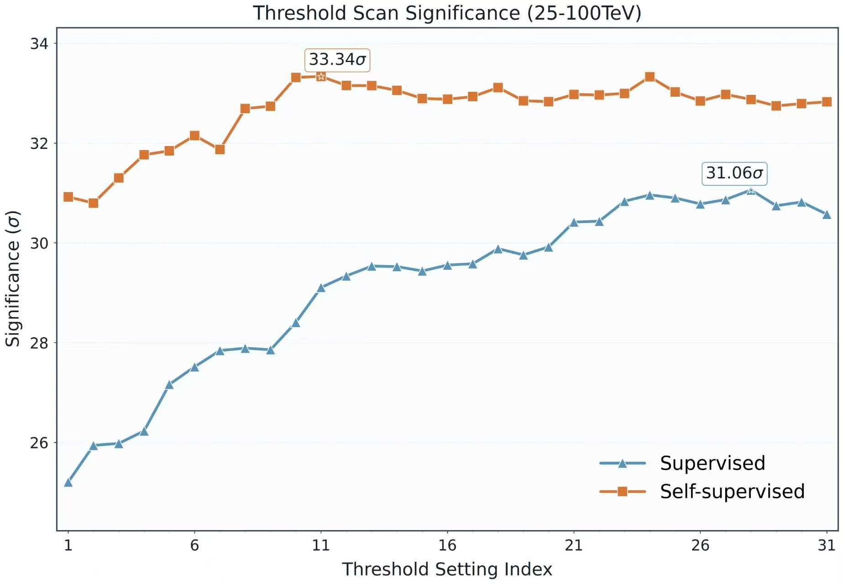
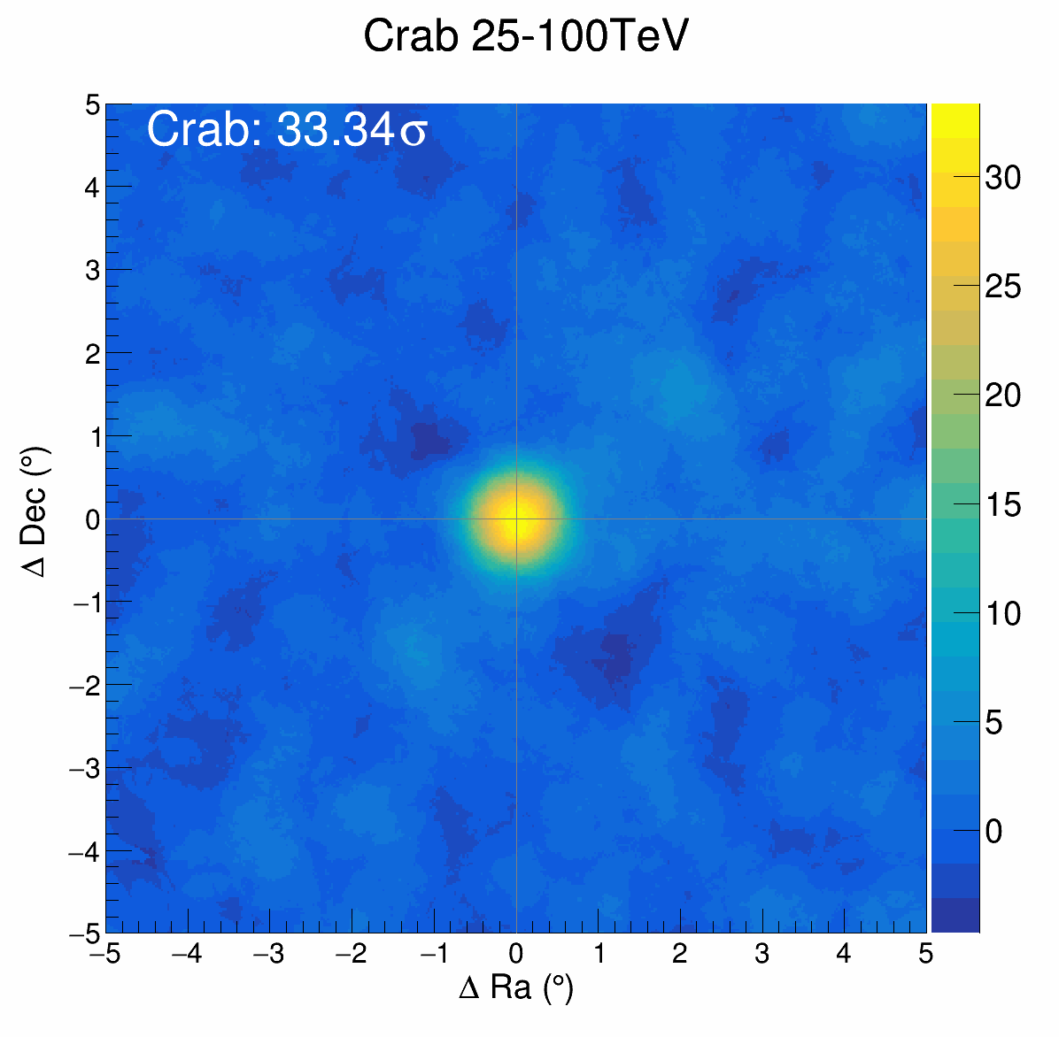
Performance comparison: supervised & self-supervised
Supervised Learning
*Zenith angle: 0~50°
Via pre-training, the encoder effectively learns discriminative features for classification.
Semi-supervised models can outperform their supervised counterparts given the same parameter count and labeled data volume.
Self-supervised Learning
11

Slide 13
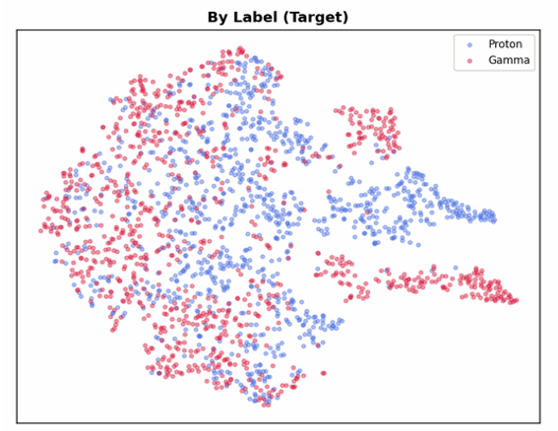
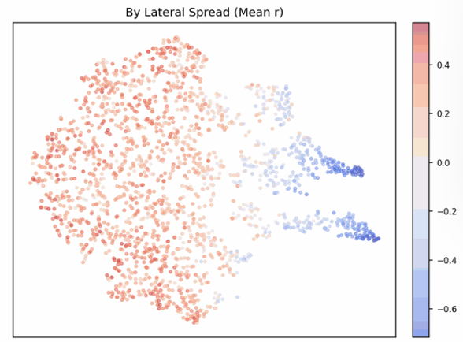
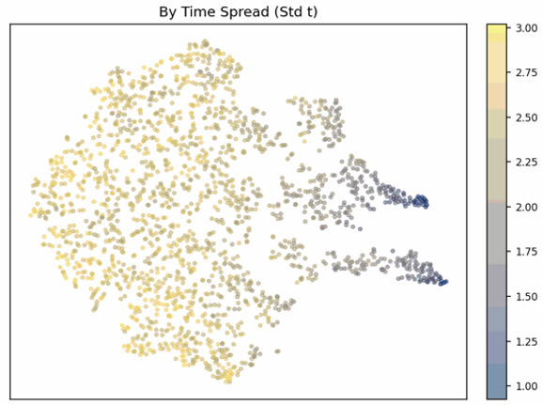
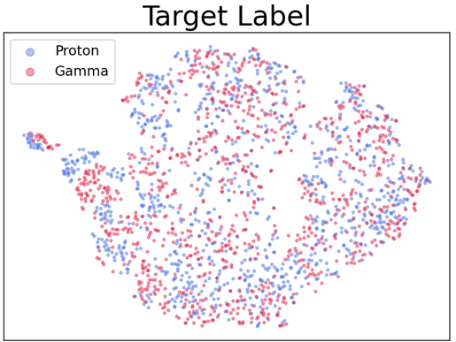
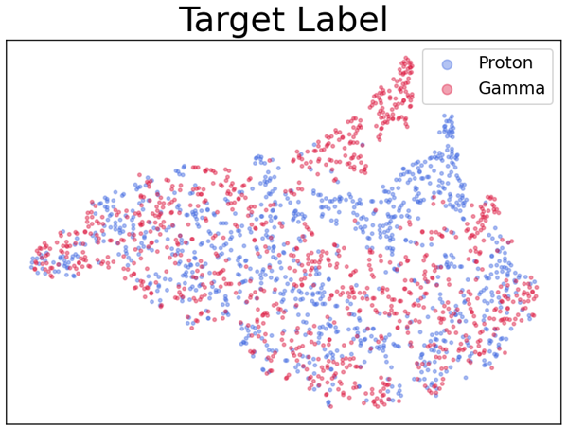
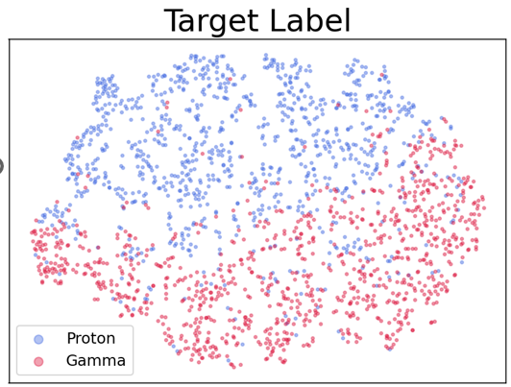





Pretraining - Feature Visualization
$$γ/p$$
$$Shower size:Small←−−→Big$$
$$Time Distribution:$$
$$Dispersed←−−→Compact$$
Dimensionality reduction visualization partially interprets how well the model learns the features.
The encoder's classification performance steadily improves as pre-training progresses.
$$Epoch 4$$
$$Epoch 10$$
12
$$Epoch 43$$

Slide 14
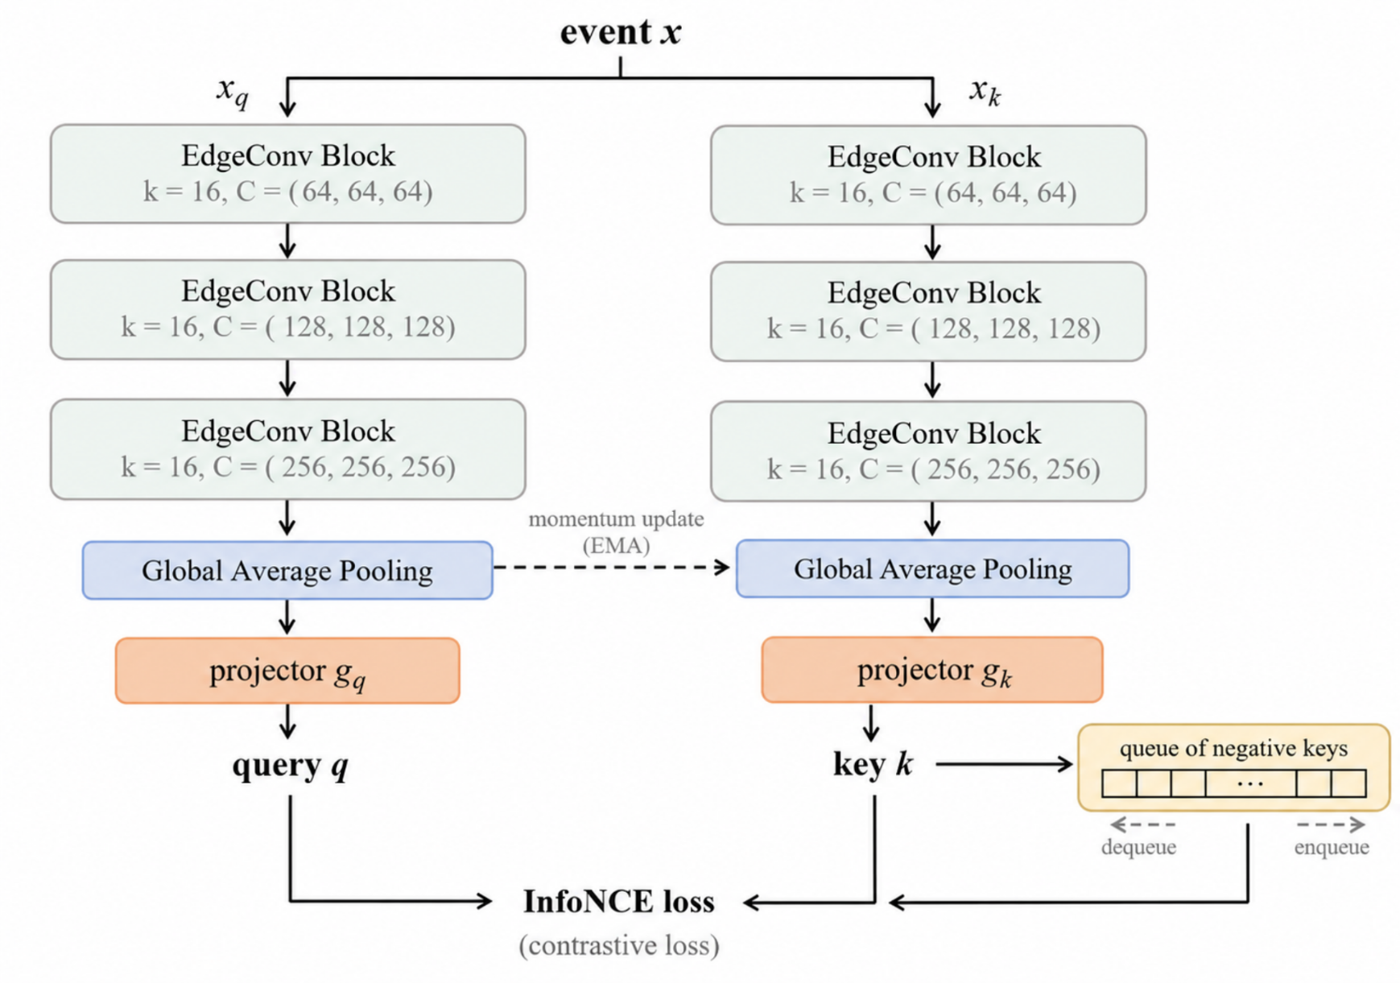
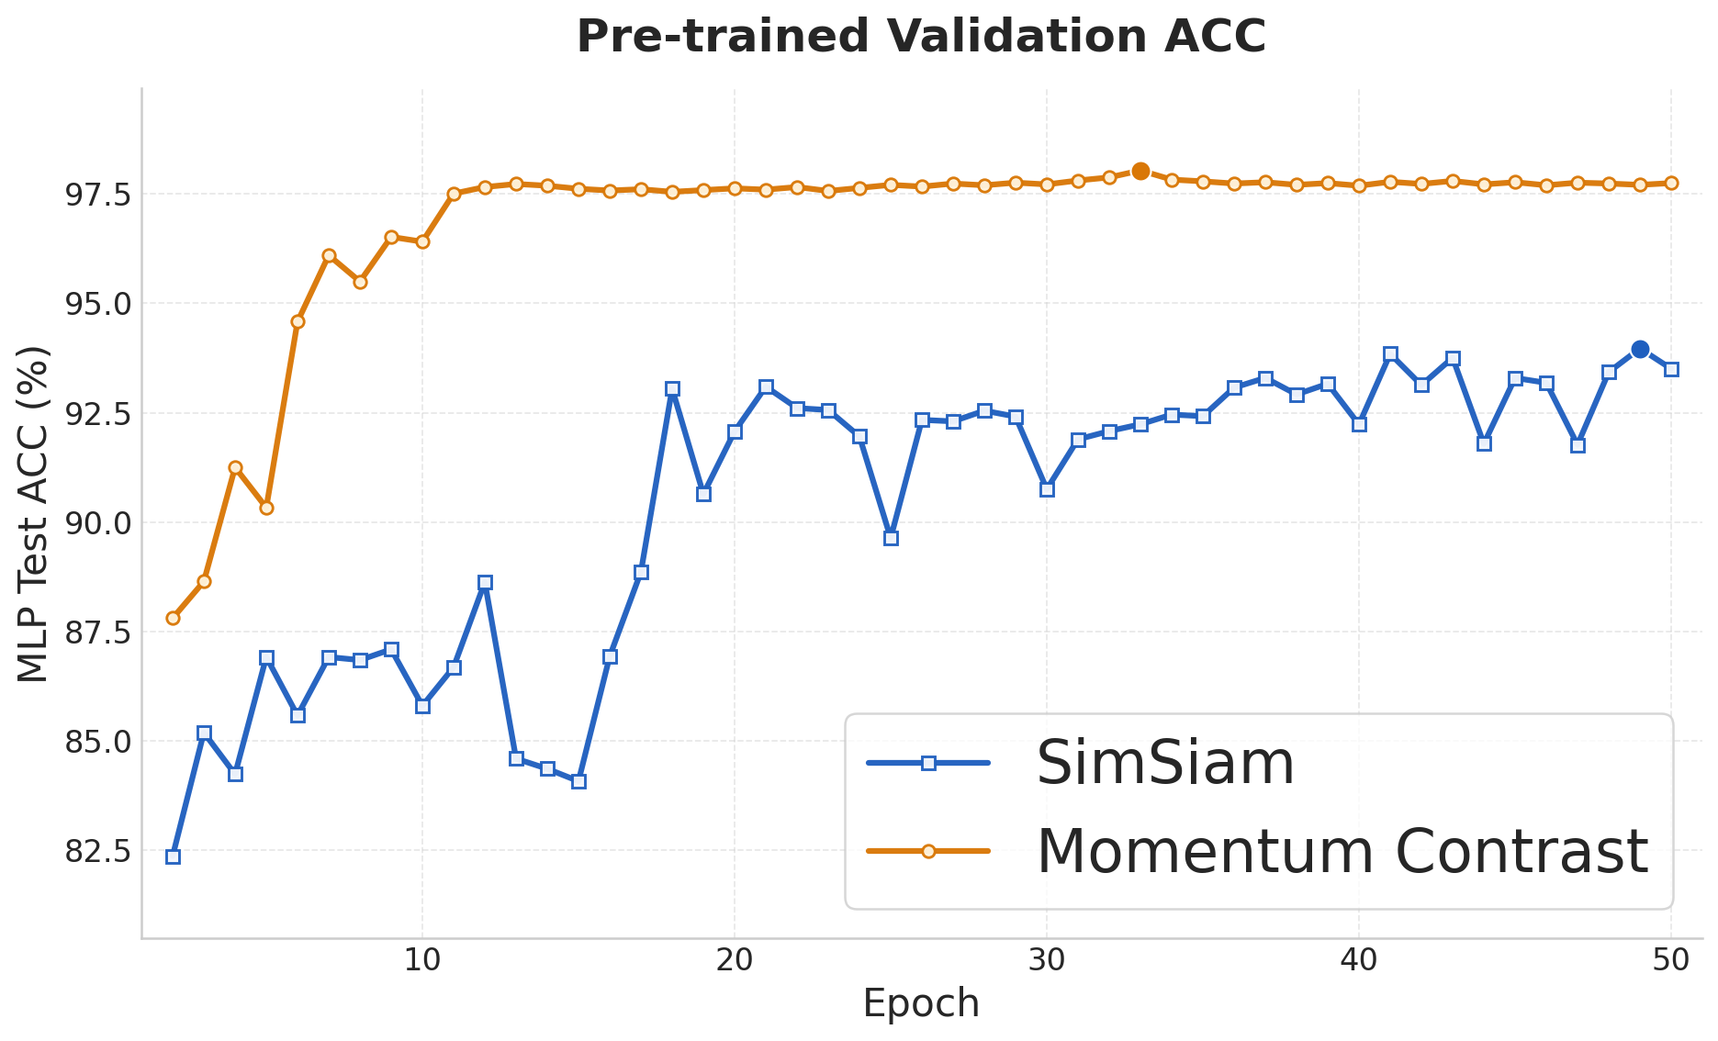
Semi-supervised Learning---Momentum Contrast: Preliminary
Momentum Contrast learning is more stable during training than SimSiam, and it also achieves better pretraining performance.
16

Slide 15
Summary
Machine learning significantly improve the significance of Crab Nebula on real data, with clear differential dependence on energy and zenith angle.
The current bottleneck is the discrepancy between MC and data: to be addressed by better simulation and better machine learning Architecture.
Self-supervised learning shows promising progress, with emerging interpretable patterns in the learned representations.
Future Work
Test new simulation setups, develop different architectures, to improve MC–data consistency. Computing resource and manpower is becoming bottleneck.
Prepare the standard ML toolkit, to cover tasks of angular/energy reconstruction, plus ion identifications, prepare for sky survey.
Continue interpretability studies, to better understand the tools.
13

Slide 16
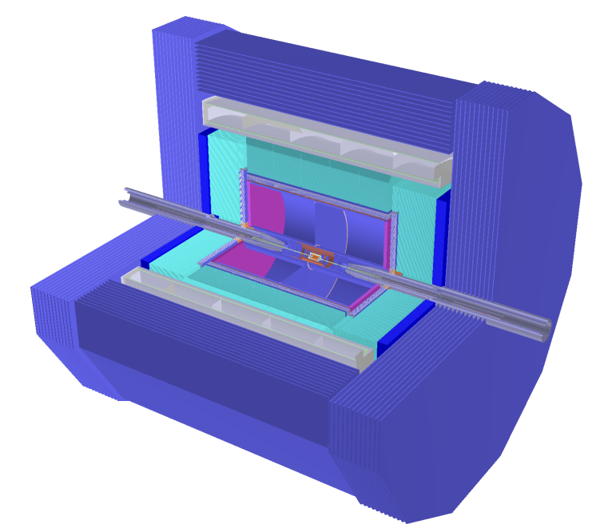
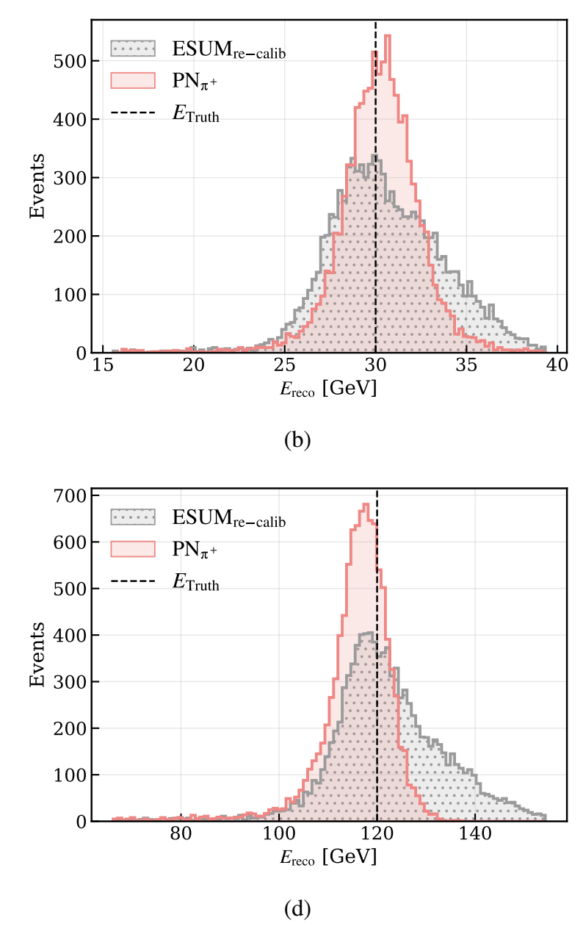
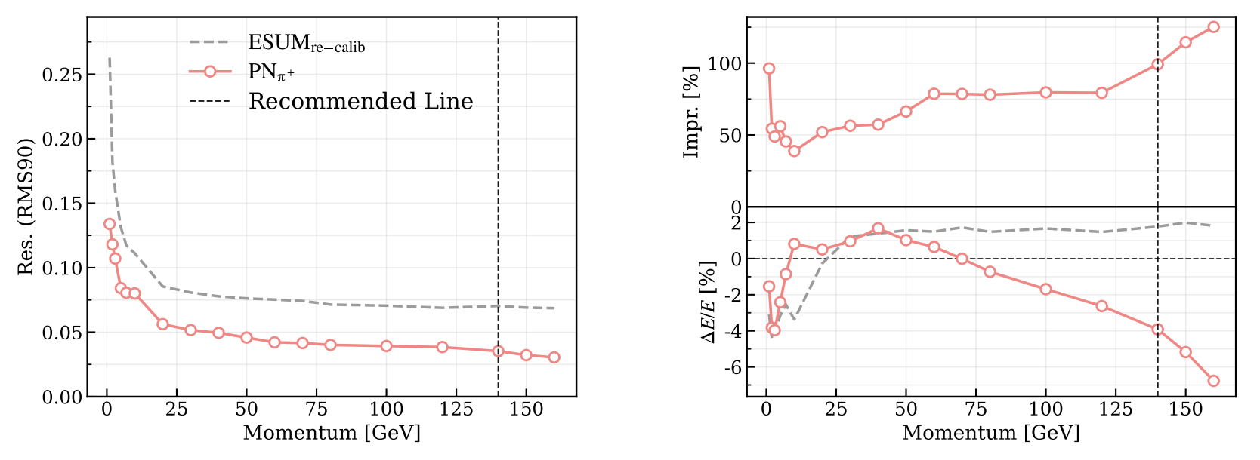
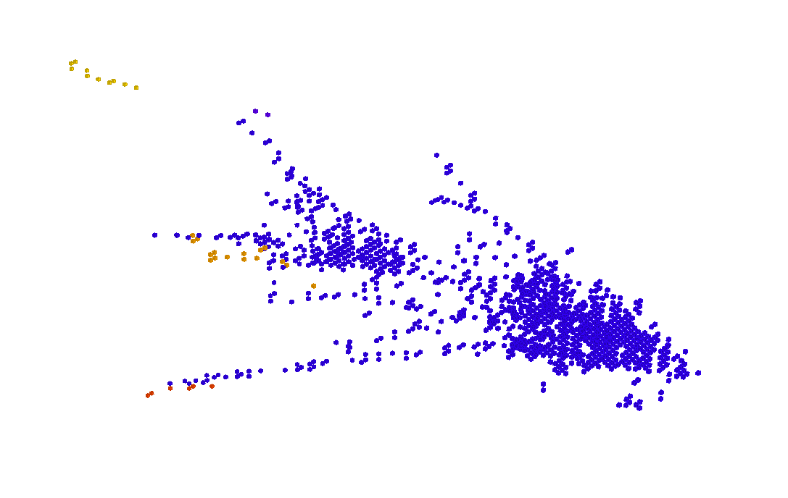
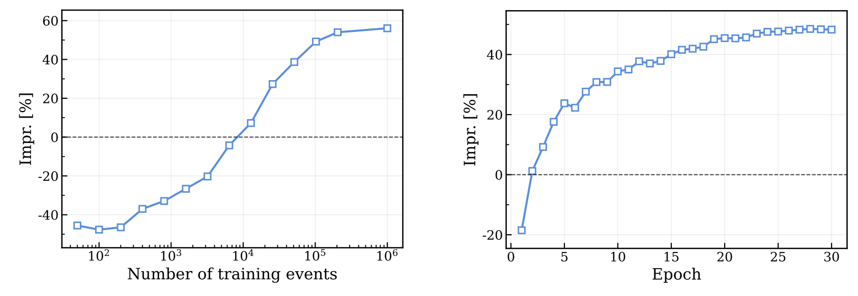
A relevant progress: hadronic energy measurement at CEPC
14

Slide 17
Thank you for your attention!
…and we need more!

Slide 18
Back up

Slide 19
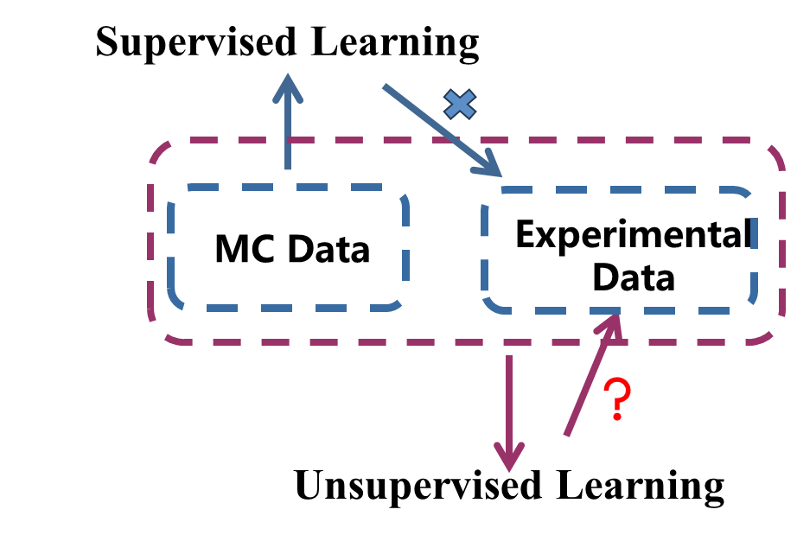
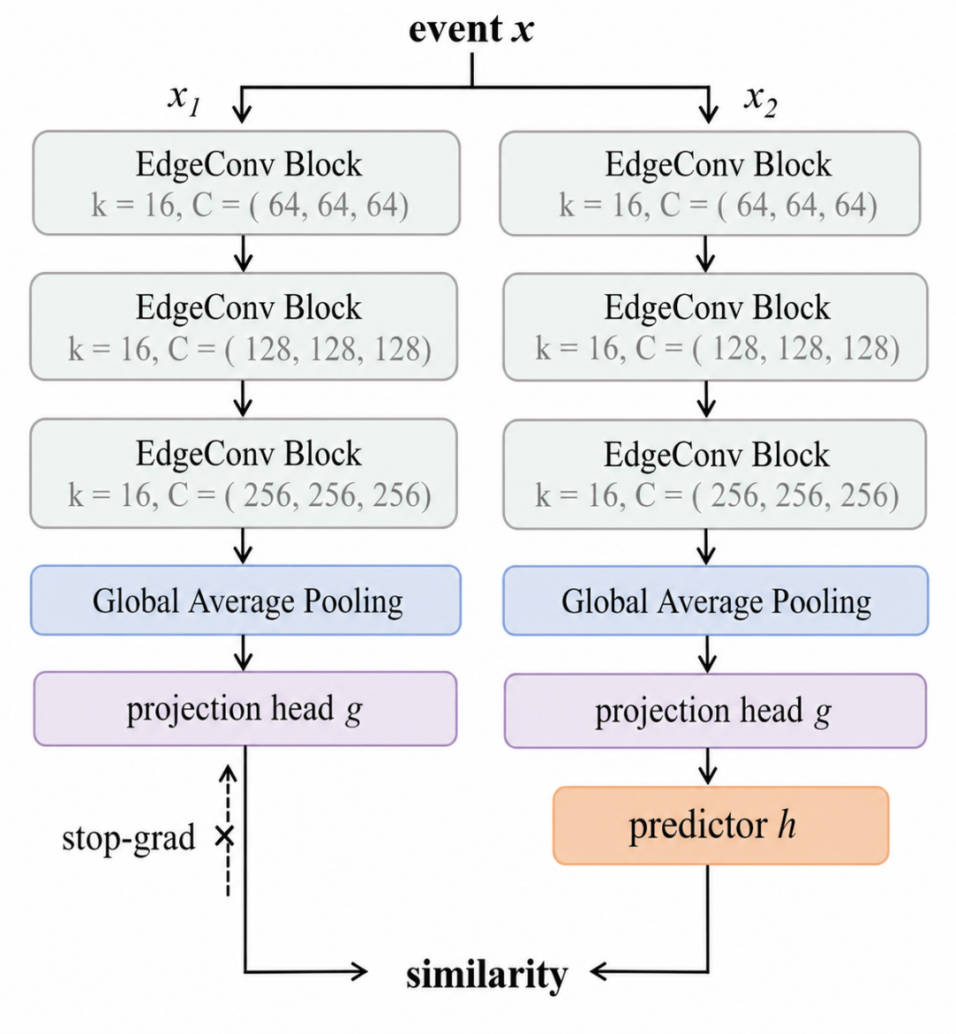
Semi-supervised Learning---Details
`
coordinates
features
EdgeConv Block
k = 16, C = ( 256, 256, 256)
EdgeConv Block
k = 16, C = ( 256, 256, 256)
EdgeConv Block
k = 16, C = ( 256, 256, 256)
Pre-train the encoder on experimental data via the SimSiam contrastive learning framework.
Attach a classification head and fine-tune with simulated (MC) data.
Mitigate performance degradation caused by the MC-Data mismatch
Global Average Pooling
Fully Connected
256, ReLU, Dropout = 0.1
Fully Connected
3
Softmax
Pre-trained with Data
Finetune with MC
15

Slide 20
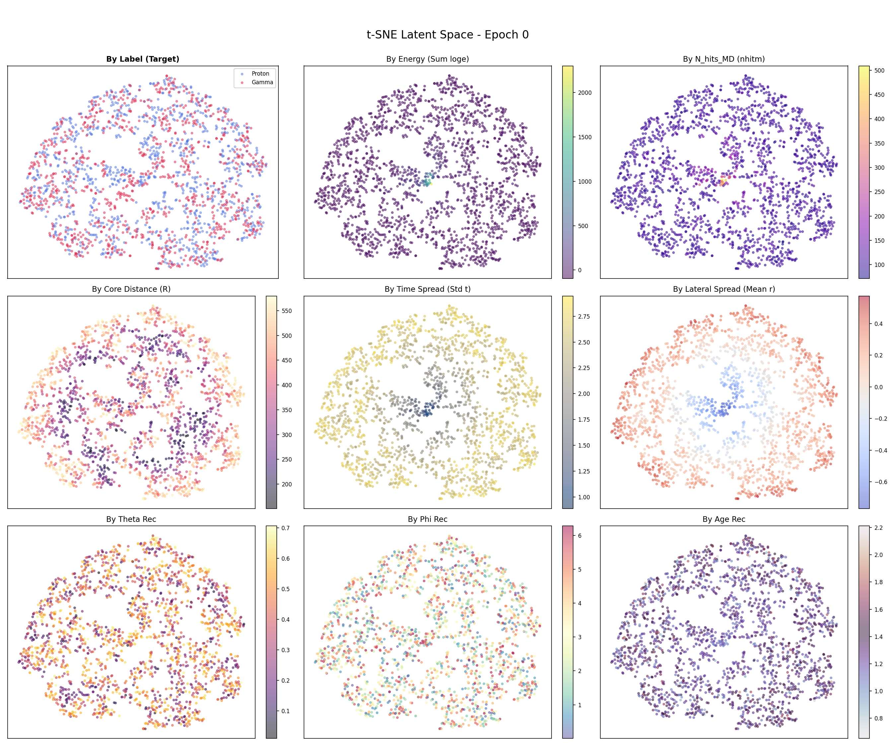
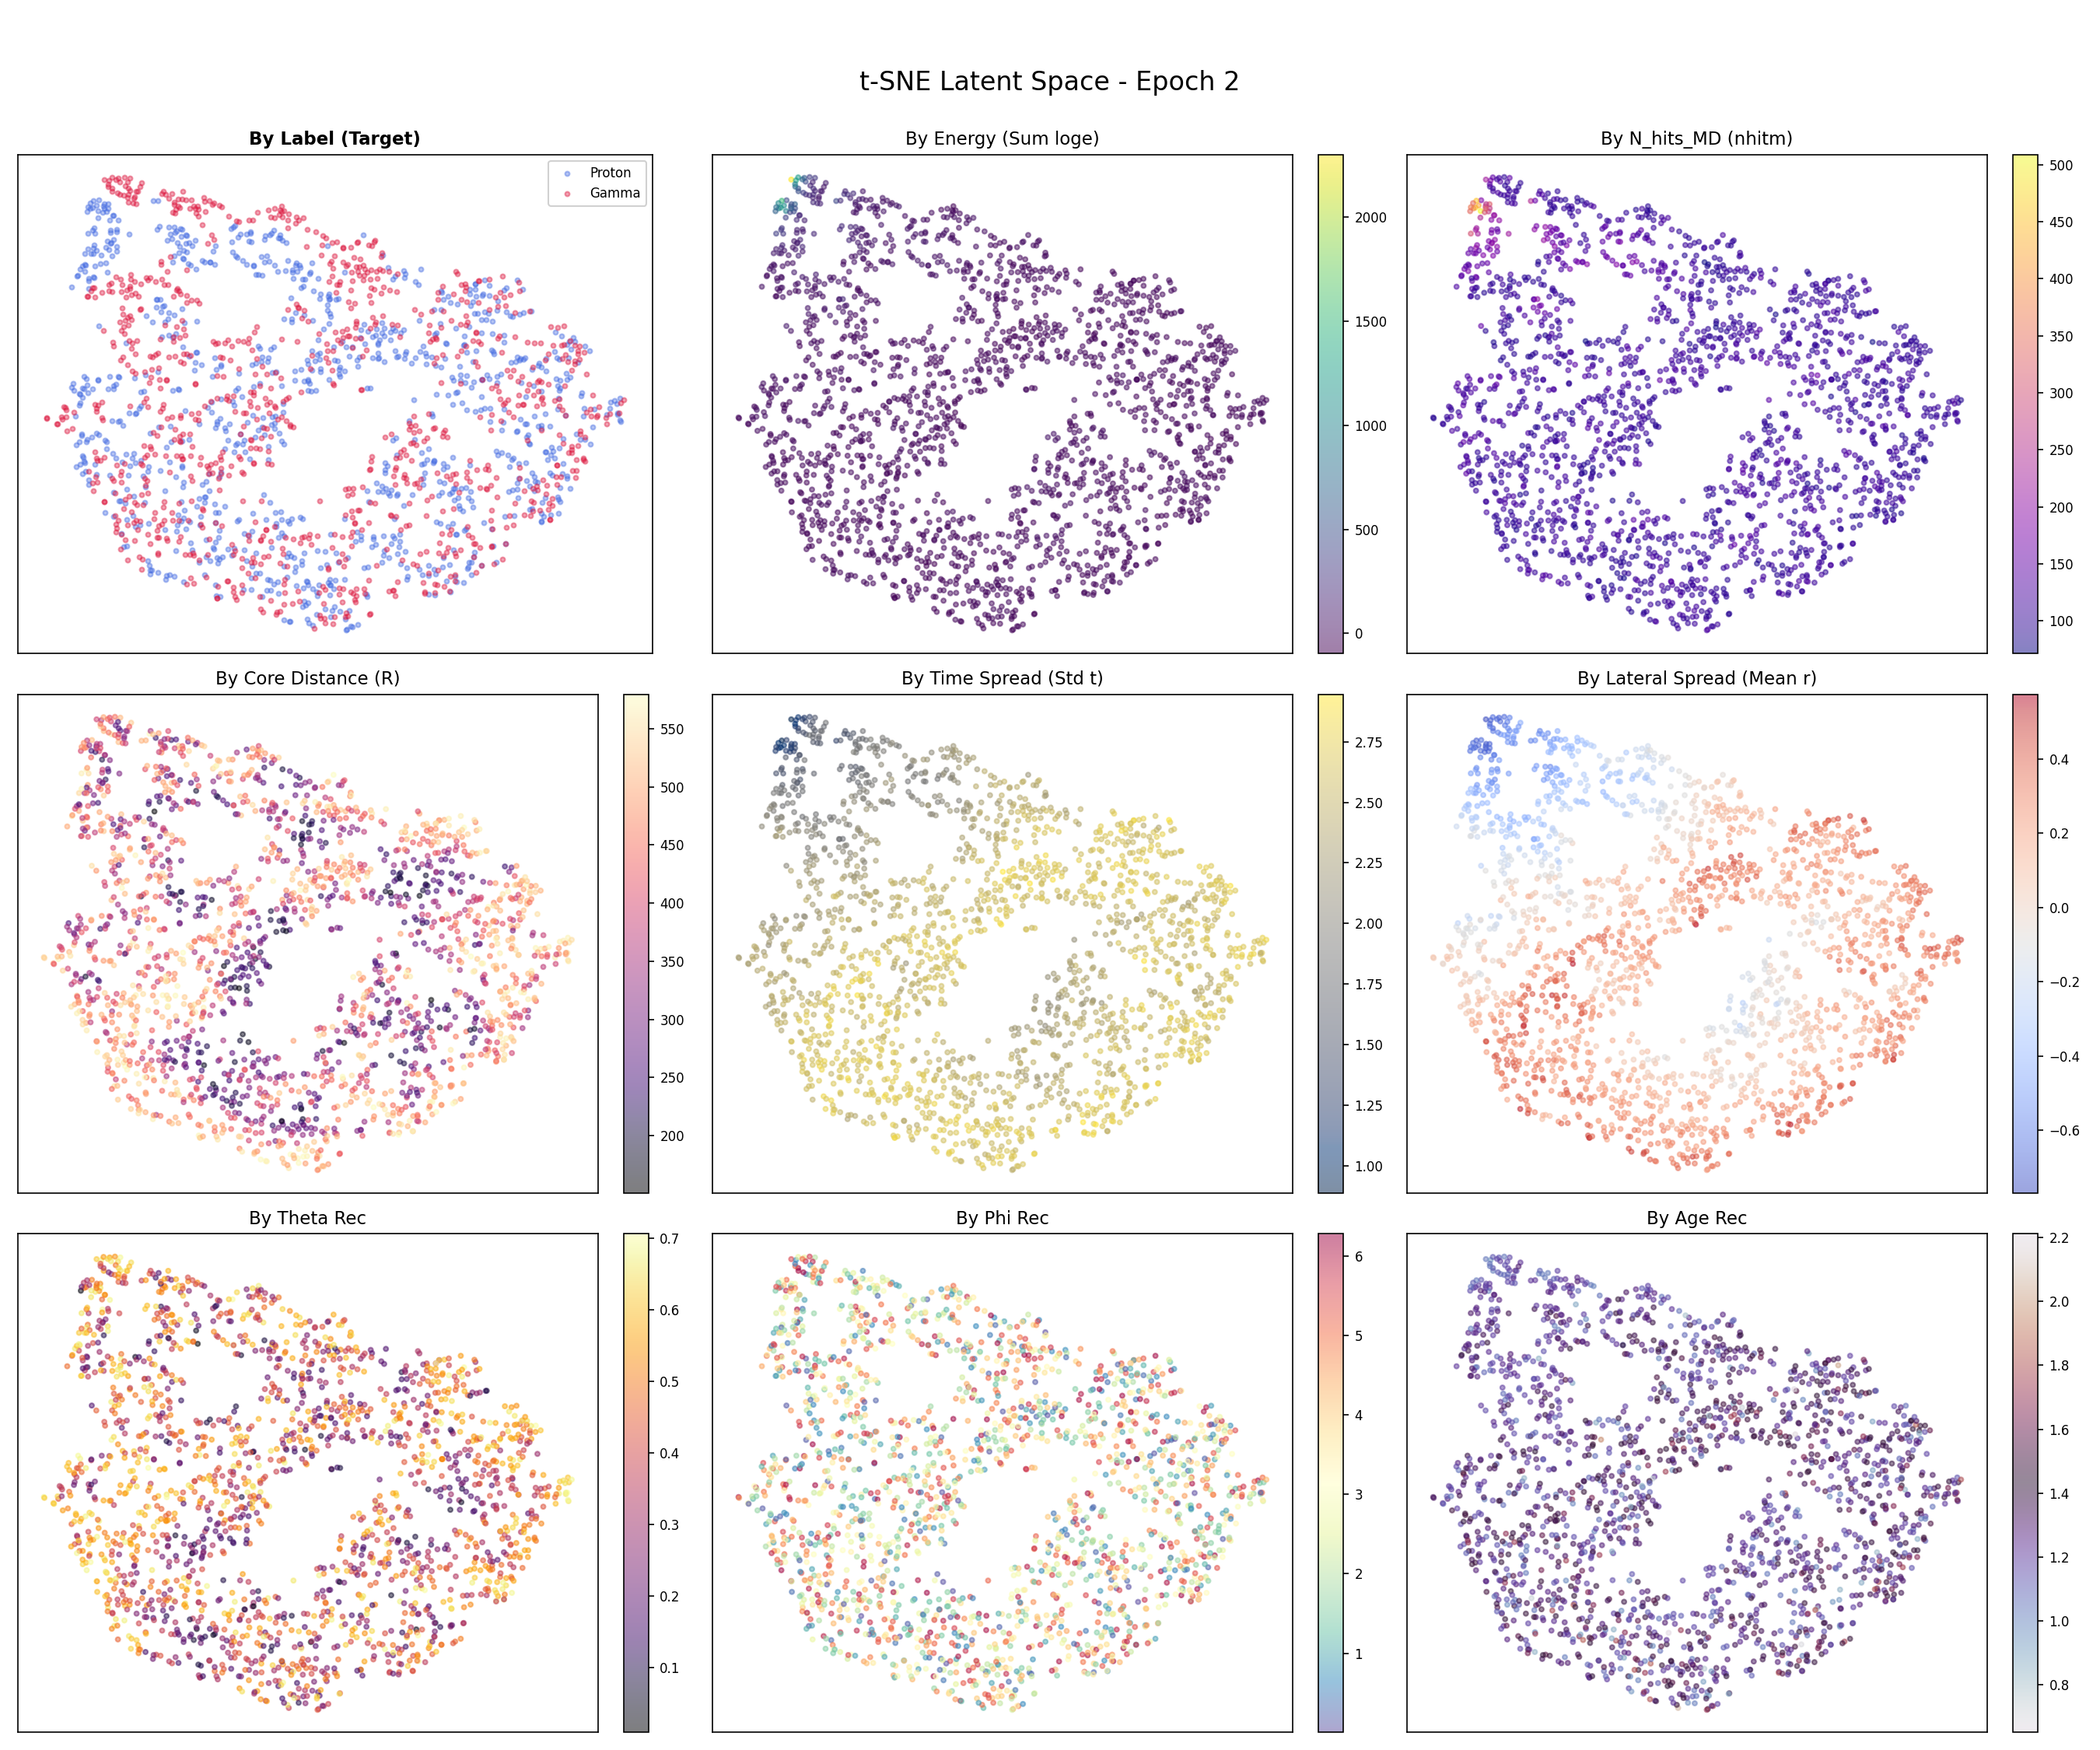
Visualization-Guided Refinement
Early in training, the model tends to learn irrelevant features. (e.g., shower size)
Apply data augmentation to eliminate the variance of these extraneous features, forcing the model to focus on discriminative representations for classification.
17

Slide 21






Photon Tracking with Deep Learning
Geant4
ML
~120x speedup on a single CPU and ~6,800x on GPU inference over Geant4, maintaining an overall error of 2-3%.
18

Slide 22



Photon Tracking with Deep Learning
Verify the feasibility of replacing photon tracing with Deep Learning in upstream/high-level simulations.
Randomly emit 200k high-energy muons from the MD center and analyze the integrated charge distribution on PMTs.
The integrated charge distribution predicted by the two-stage DL model shows good agreement with the G4KM2A ground truth.
19

