Slide 1

Exploration of Multimodal Large Language Models Based on LHAASO-WCDA Data
POS 13
Huang Zijie, IHEP, CAS

Slide 2
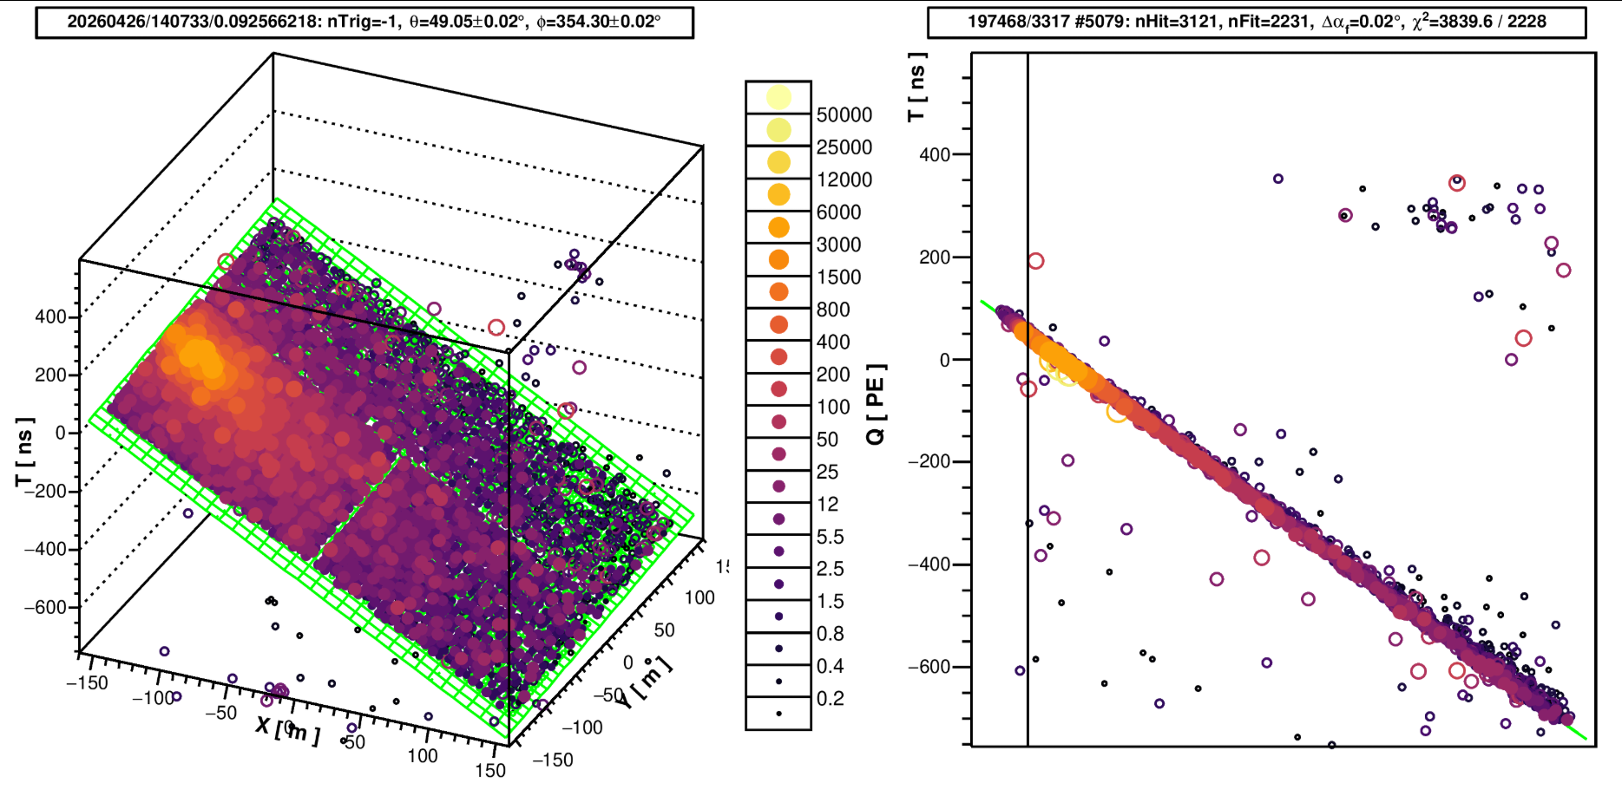
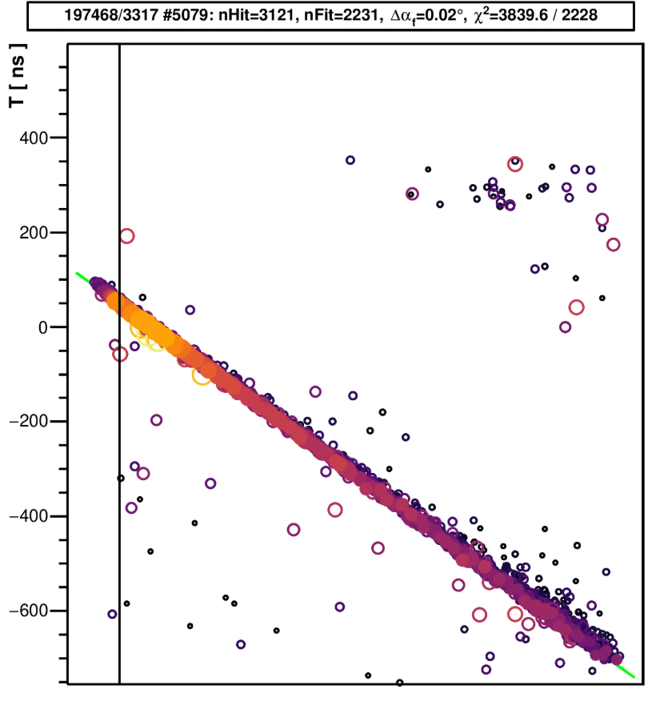
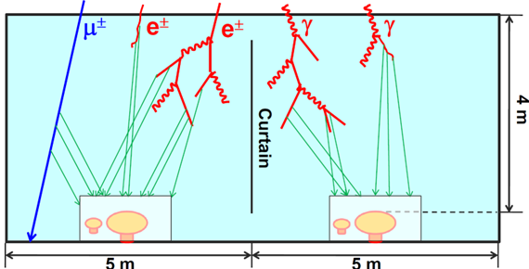
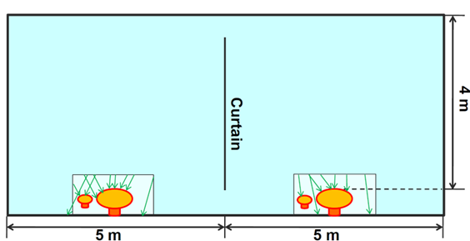
Motivation
COMPLEXITY OF EXPERIMENTAL DATA:
Multi-dimensional Info: Energy, Time, Position(Hit Map);
Multi-task Requirement: Particle ID, Direction/Energy/Core Reconstruction;
Non-linearity: Complex cascade processes detector responses difficult to describe analytically.
MULTIMODAL LLMS

Slide 3
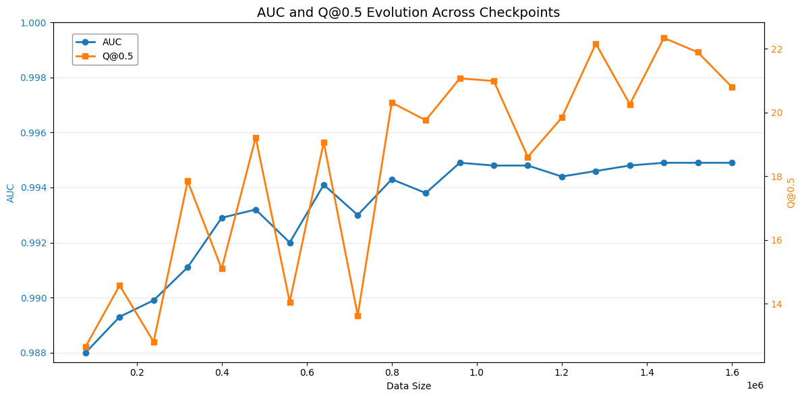
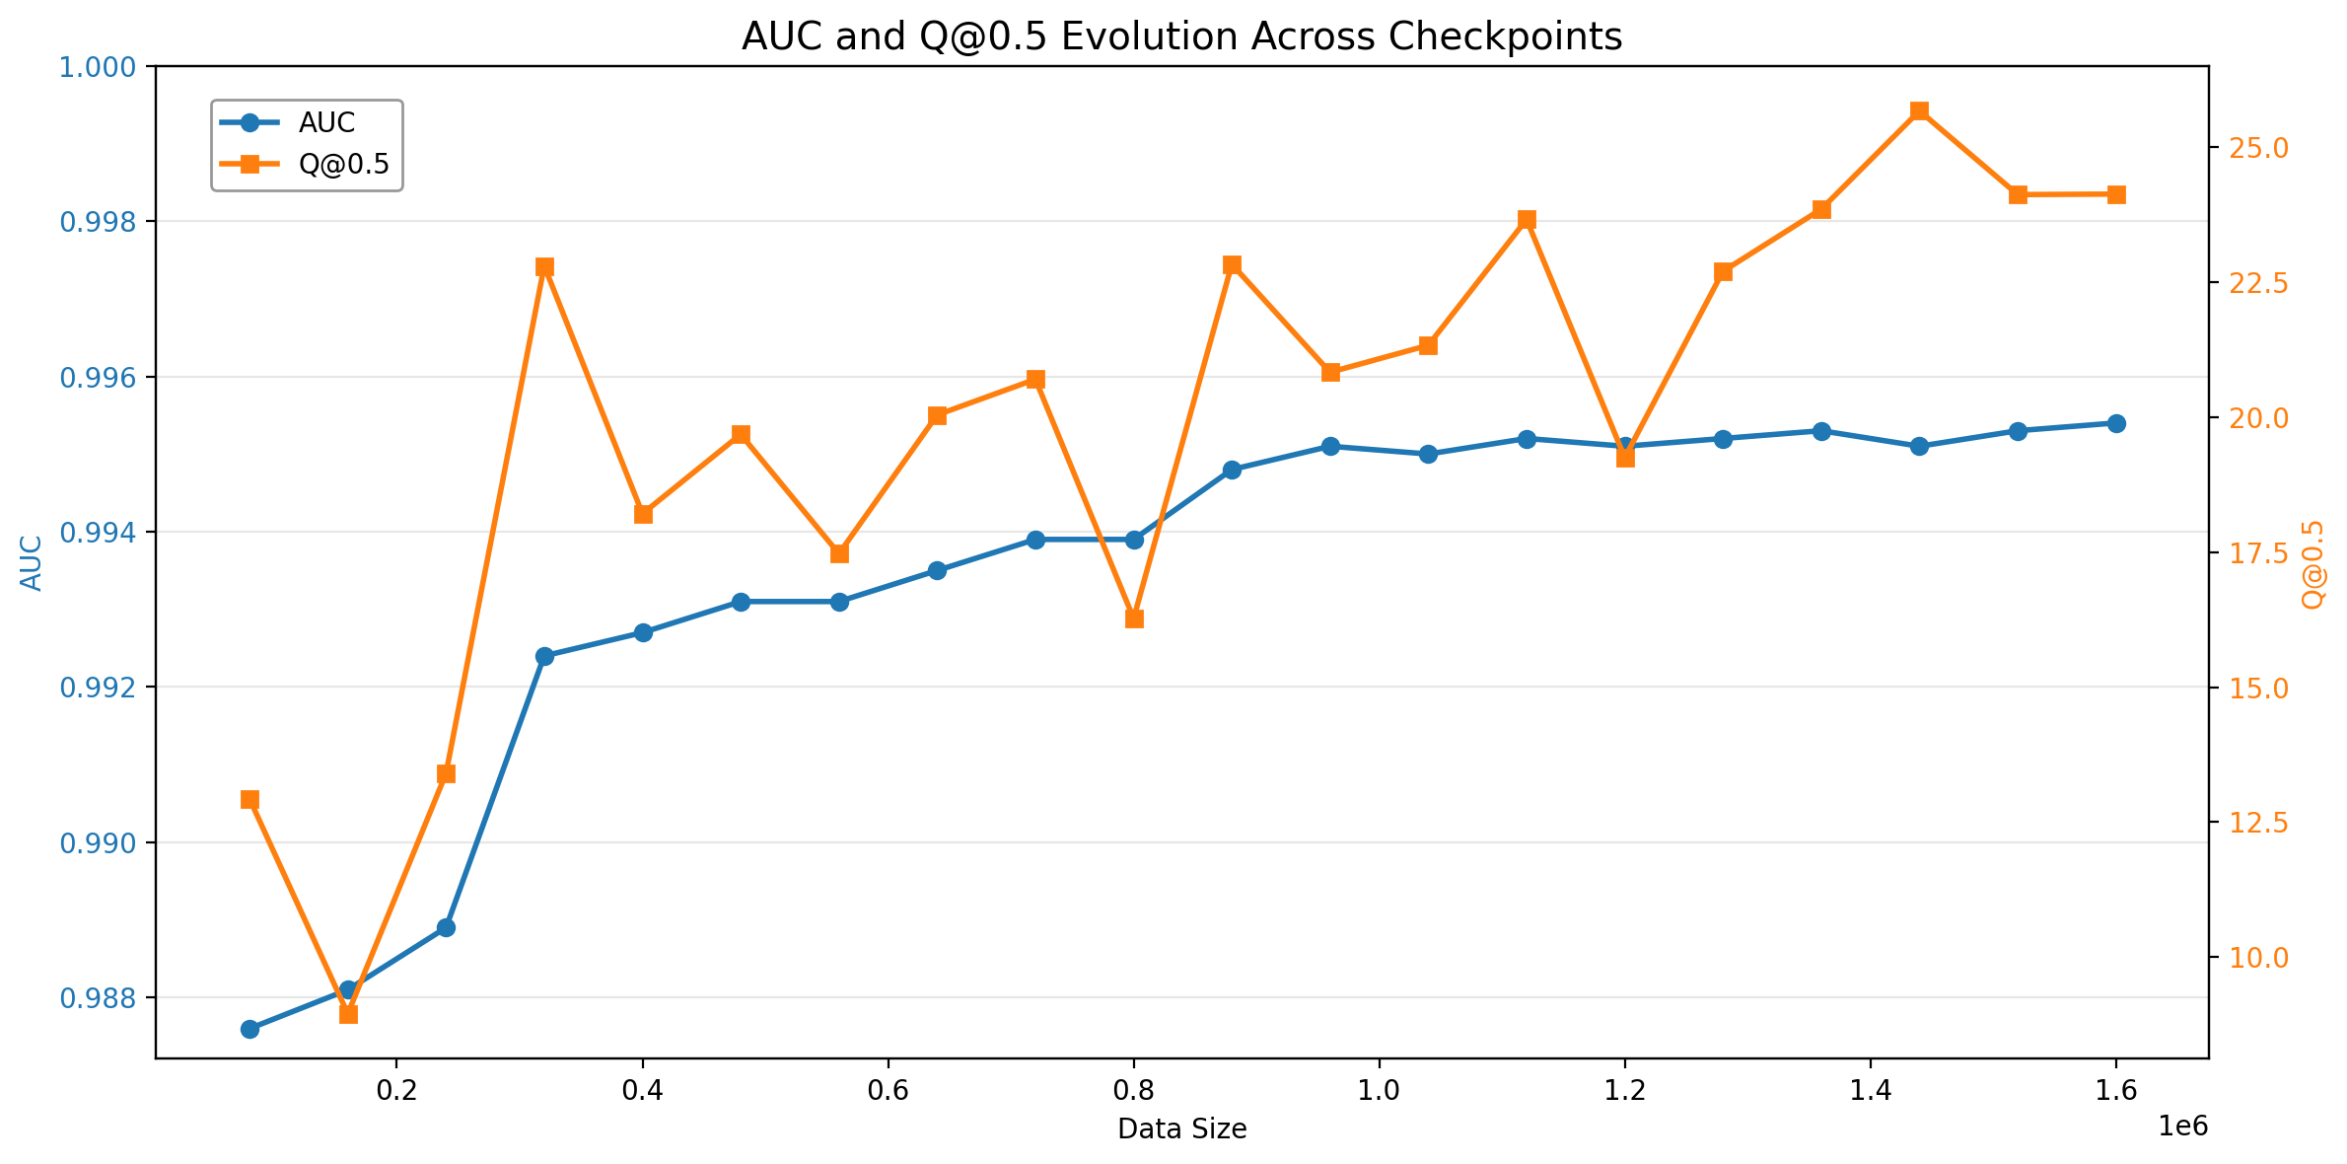
First Step: Data Augmentation Strategy
--Curriculum Learning‌
Representative Hit Selection (100/Event):
  Max_vq_hit (10): Indicates sub-core existence, crucial for high-energy cosmic rays
  Min_r_hit (90): Shows shower distribution near core for ID & reconstruction
Hard-case Mining (Pincness-based):
  Easy: No Pincness cut
  Mid: Pincness 0.7-1.7 mixed with Easy (1:1)
  Hard: Gamma(Pincness>1.1) + CR(Pincness<1.2) mixed with Easy (1:1)

Slide 4
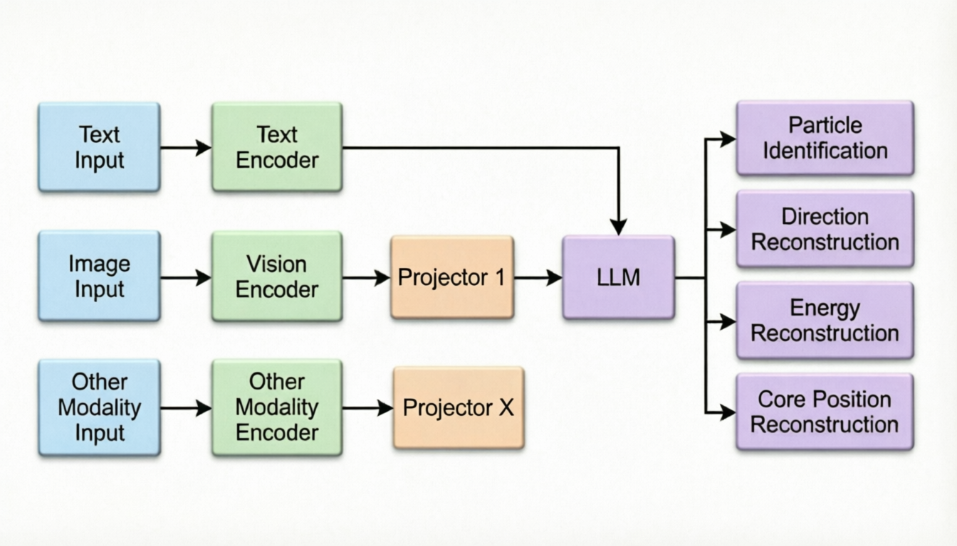
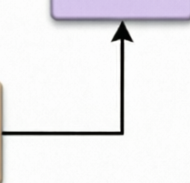
Second Step: LLAVA Architecture Design
Vision-Language Model mappingvisual features to LLM embedding space via Projector.
Input Layer: Text Encoder, Image Encoder, Metadata Encoder
Fusion Layer: Projector, Multi-modal Alignment, LLM Space Mapping
Output Layer: Particle ID, Direction Reconstruction, Energy/Core Reconstruction

Slide 5
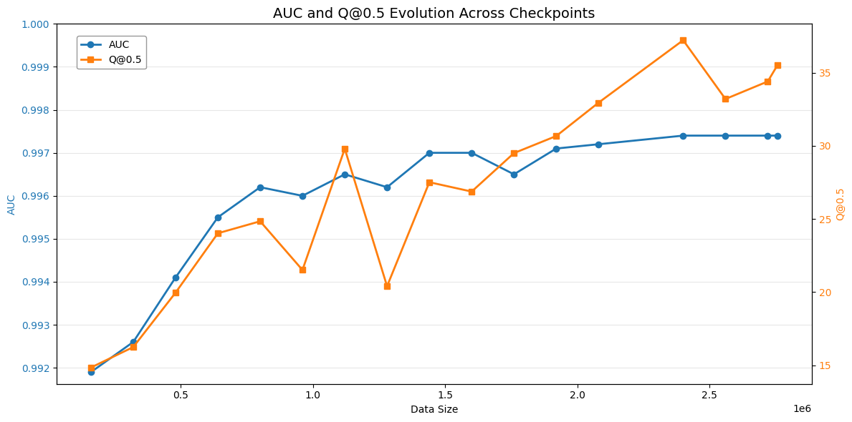
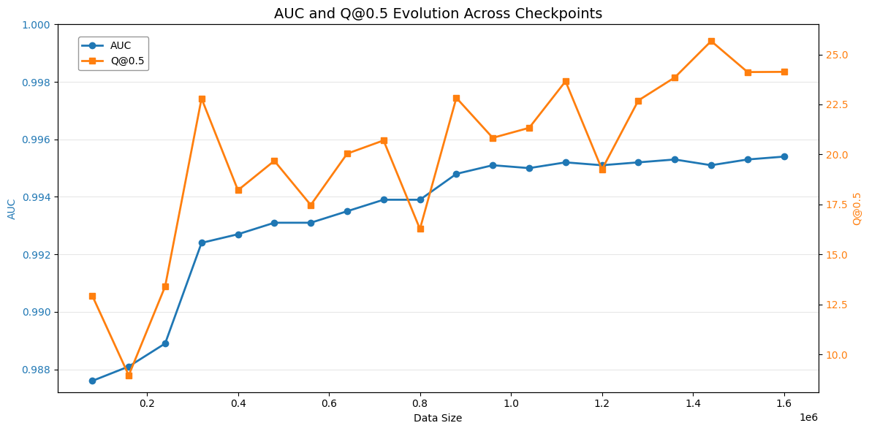
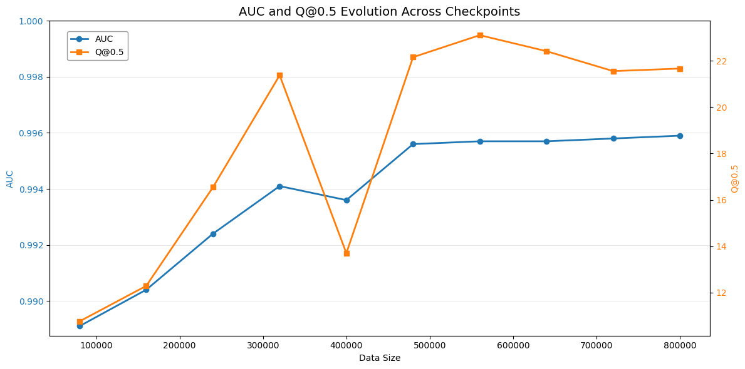
LLM vs. VLM

Slide 6
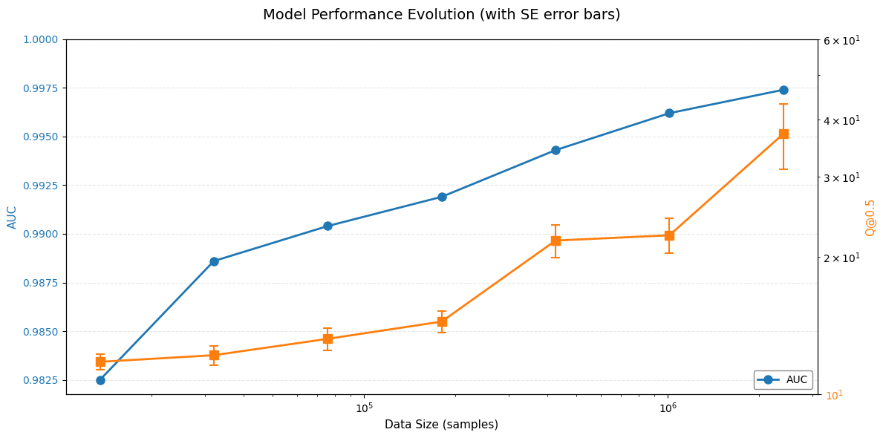
VLM Results – Scaling laws?
P r e l i m i n a r y

Slide 7
Summary
Developed data processing strategies: Structured text, multi-task optimization, data augmentation
Explored LLaVA architecture: Input-Fusion-Output design with Projector alignment
Validated VLM superiority over text-only LLM
Future work
Modality Alignment Optimization: Align fine-tuned LLM with Vision Model and other modalities
Multi-turn Dialogue Mechanism: Fine-grained construction of reconstruction-particle type association
Loss Function Optimization: Differentiable task-specific loss functions bypassing argmax
Large Vision Models: It's also a potential method for achieving our goal of multi-model latent space alignment.

