Slide 1

Research Progress on the Correlation between Cosmic Rays and Earthquake Precursors
Haolong Dong¹，Fengrong Zhu¹ ，Maoyuan Liu² ，Xinrui Gao² ， Yusen Wang²
The Key Laboratory of Cosmic Rays (Xizang University), Ministry of Education, Lhasa 850000, People’s Republic of China

Slide 2
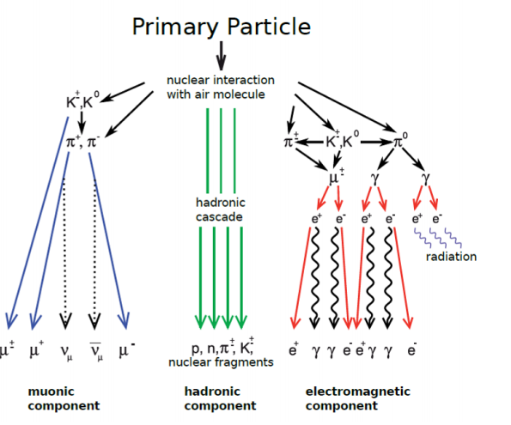
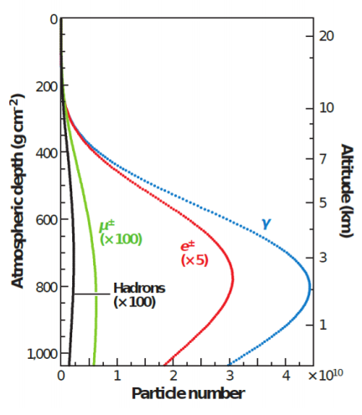
Background and Motivation
Fig. 1. Overview of an Extensive Air Shower (EAS). (Left) Schematic representation of the cascade processes producing muonic, hadronic, and electromagnetic components. (Right) Longitudinal development profile of these secondary particles as a function of atmospheric depth.

Slide 3
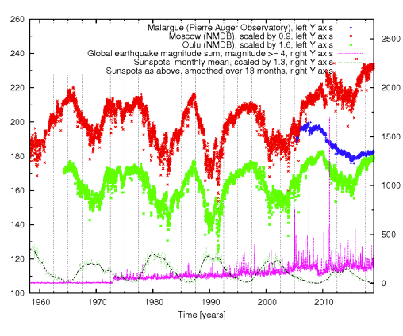
Review of Correlation Studies
Fig. 2: Piotr Homola's team demonstrates that variations in cosmic ray intensity serve as a precursor to global seismic activity (M ≥ 4.0) with a delay of approximately 15 days. Utilizing data from the Pierre Auger Observatory, Moscow and Oulu neutron monitors, and USGS records, the study reveals a local maximum correlation exceeding 6σ, fully satisfying the scientific standard for correlation.
Homola P, Marchenko V, Napolitano A, et al. Observation of large scale precursor correlations between cosmic rays and earthquakes[J]. Submitted Manuscript, 2021.

Slide 4
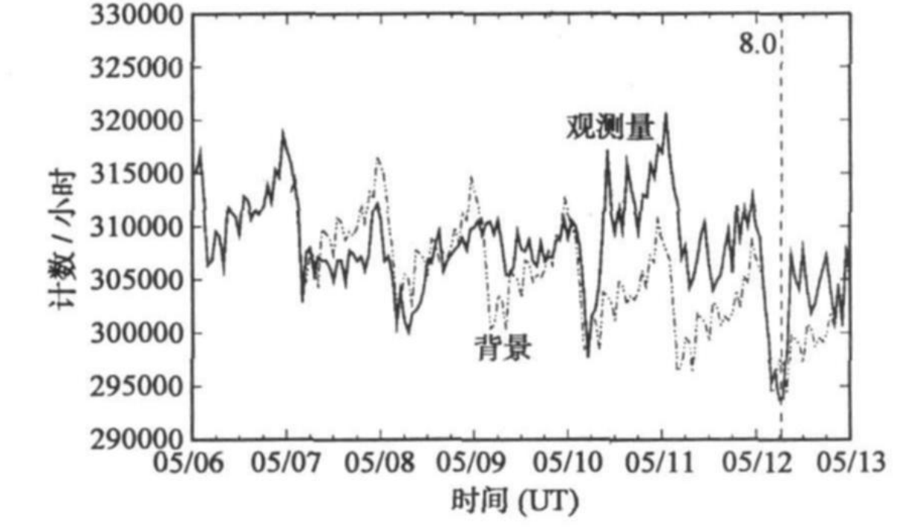
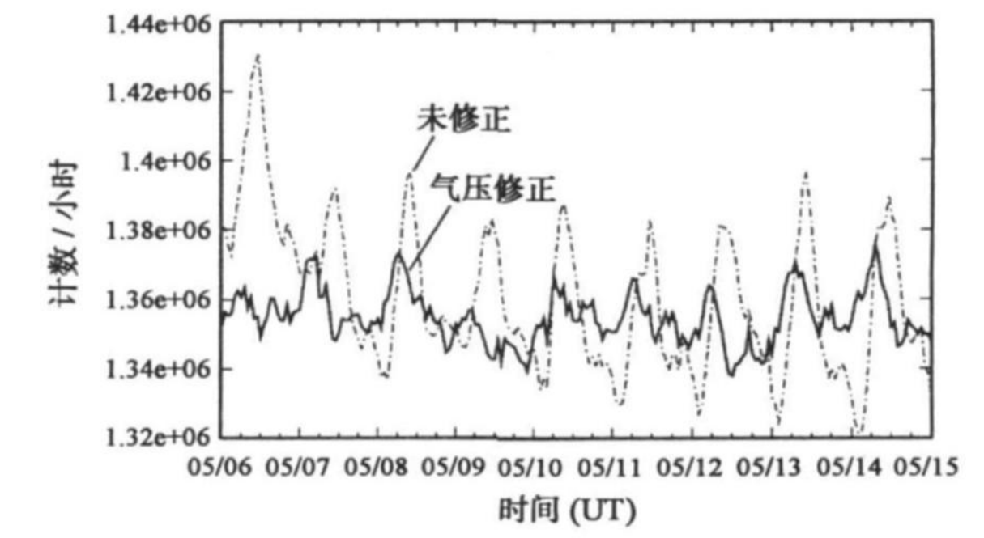
Review of Correlation Studies
Fig. 3. Specifically, data from the muon monitor revealed that the muon count rate fluctuated by approximately ±15% around May 9, 2008. During the same period, the neutron count rate exhibited a distinct peak suppression phenomenon.
张吉龙，丁鉴海，申旭辉，等。汶川地震前羊八井中子 -μ 子望远镜计数率异常 [J]. 电波科学学报，2010, 25 (2): 227-233.

Slide 5
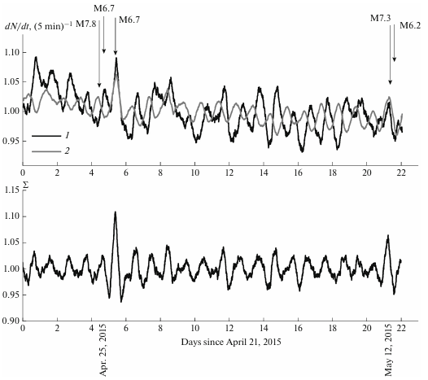
Review of Correlation Studies
Fig. 4. PRISMA-YBJ array in Tibet recorded significant pre-seismic count rate anomalies. As illustrated, the precursor peak reached a significance of 6.5 σ.
Stenkin Yu V, Alekseenko V V, Cai Z, et al. Response of the PRISMA-YBJ Detectors to Earthquakes[J]. Bulletin of the Russian Academy of Sciences: Physics, 2019, 83(5): 607-610.

Slide 6
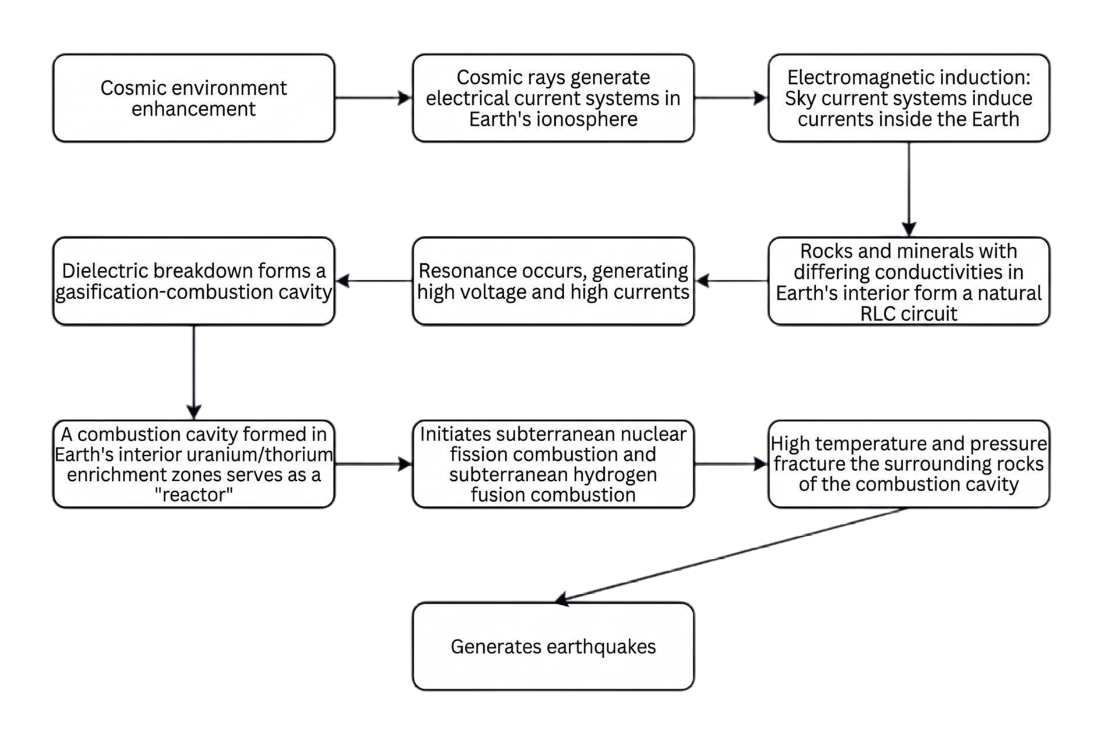
Underground Nuclear Burning Hypothesis
虞震东。大地震成因的 “电离层 + 地下核燃烧” 假说 [J]. 自然杂志，2004, 26 (4): 215-218.

