Slide 1



Updated LHAASO and Fermi-LAT analysis of a Complex Galactic Plane Region
Linjie Liu (YNAO)
with Xian Hou (YNAO), Pierrick Martin (IRAP), Shaoqiang Xi (IHEP), Chuyuan Yang (YNAO)
The First LHAASO Collaboration Conference 2026
Suzhou, China
Apr 27, 2026
Notes:
the complex 52◦ < l < 55◦ region, which encompasses the three ultra-high energy sources 1LHAASO J1928+1746u,1LHAASO J1928+1813u, and 1LHAASO J1929+1846u.

Slide 2
Outline
Introduction
Data set and analysis method
Fermi-LAT results
LHAASO results
Discussion (G54.1+0.3)
Summary

Slide 3
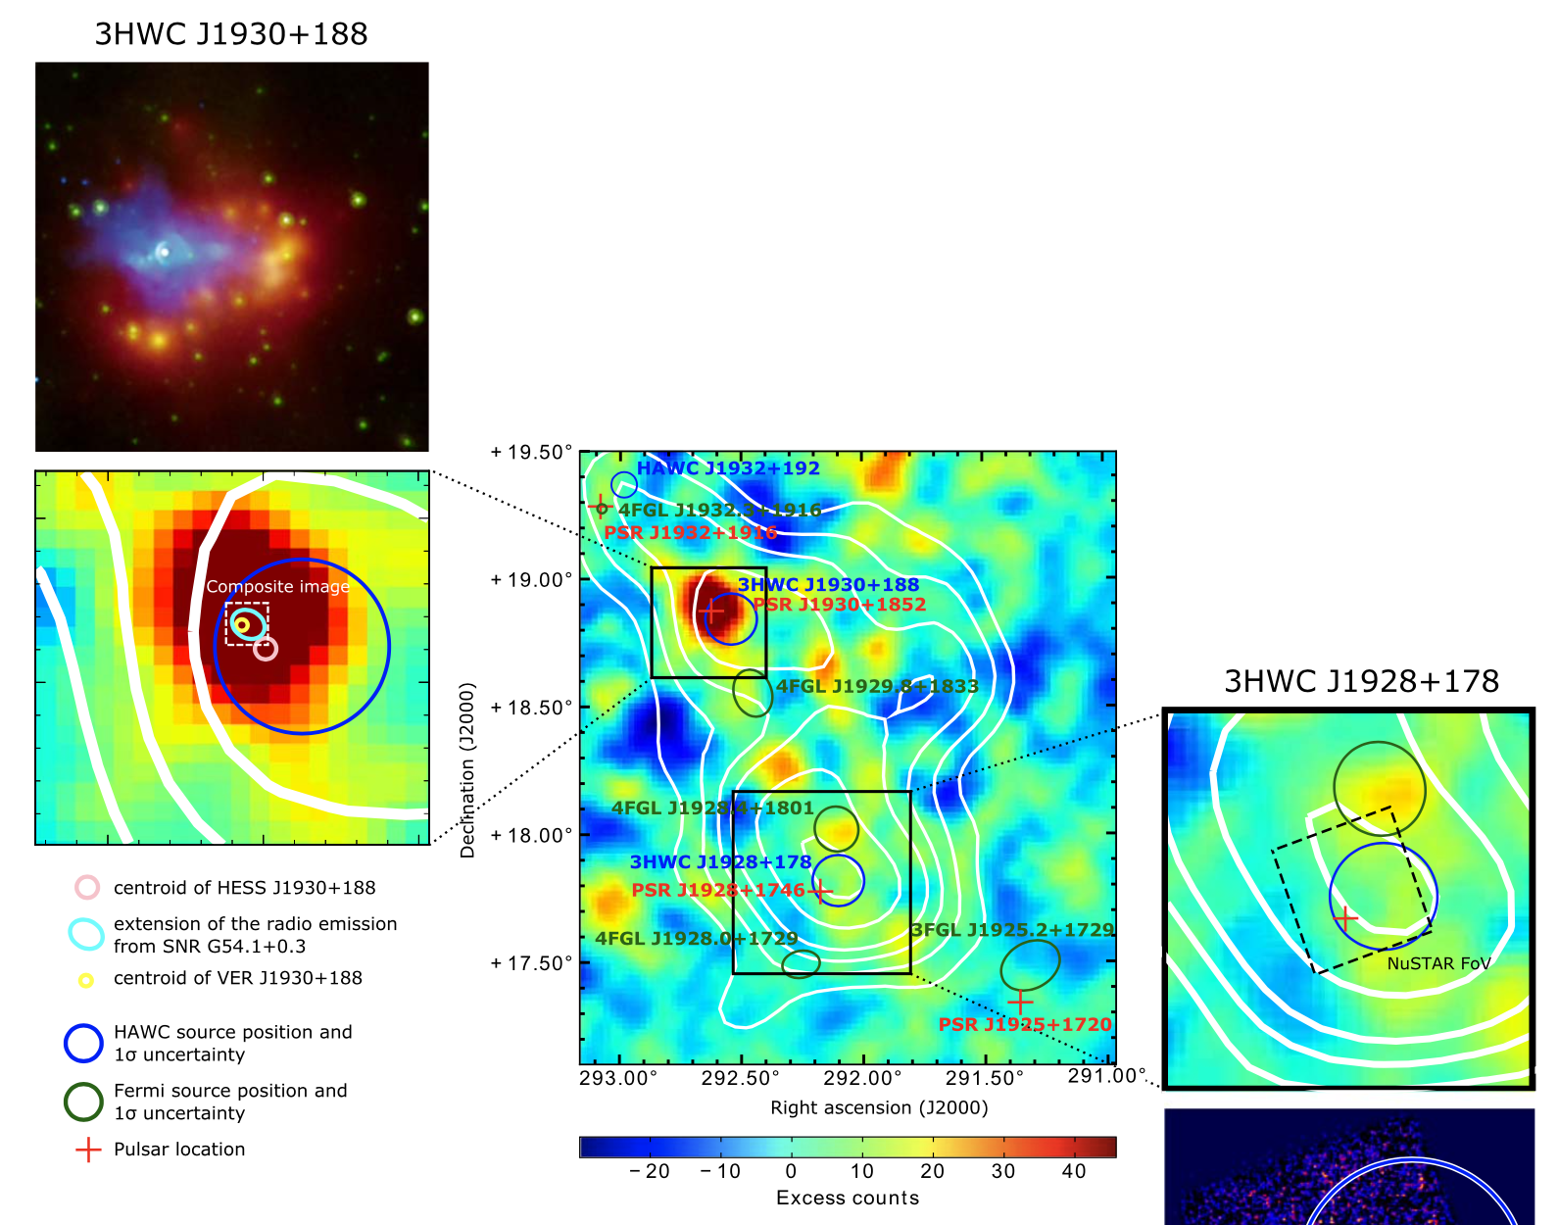
Introduction
From Albert et al. 2023, building up from 3HWC
3HWC J1930+188
X-ray/radio SNR/PWN G54.1+0.3
No clear SNR shell at the paper publish time
PSR J1930+1852
2-3 kyr, 1.2x10³⁷ erg/s, ~5-6 kpc Crab cousin
PWN interpretation very likely
1LHAASO J1929+1846u
1LHAASO J1928+1813u
×
×
Complex region
Pulsars
SNRs/PWNs
TeV sources
UHE LHAASO sources
(Cao et al. 2024)
×
1LHAASO J1928+1746u
Notes:
J1928 source
Extended component
Unseen by IACTs
...until adapted HESS analysis
(Abdalla et al. 2021)
PSR J1928+1746
82 kyr, 1.6x10³⁶ erg/s, 4.3 kpc
Origin ?

Slide 4
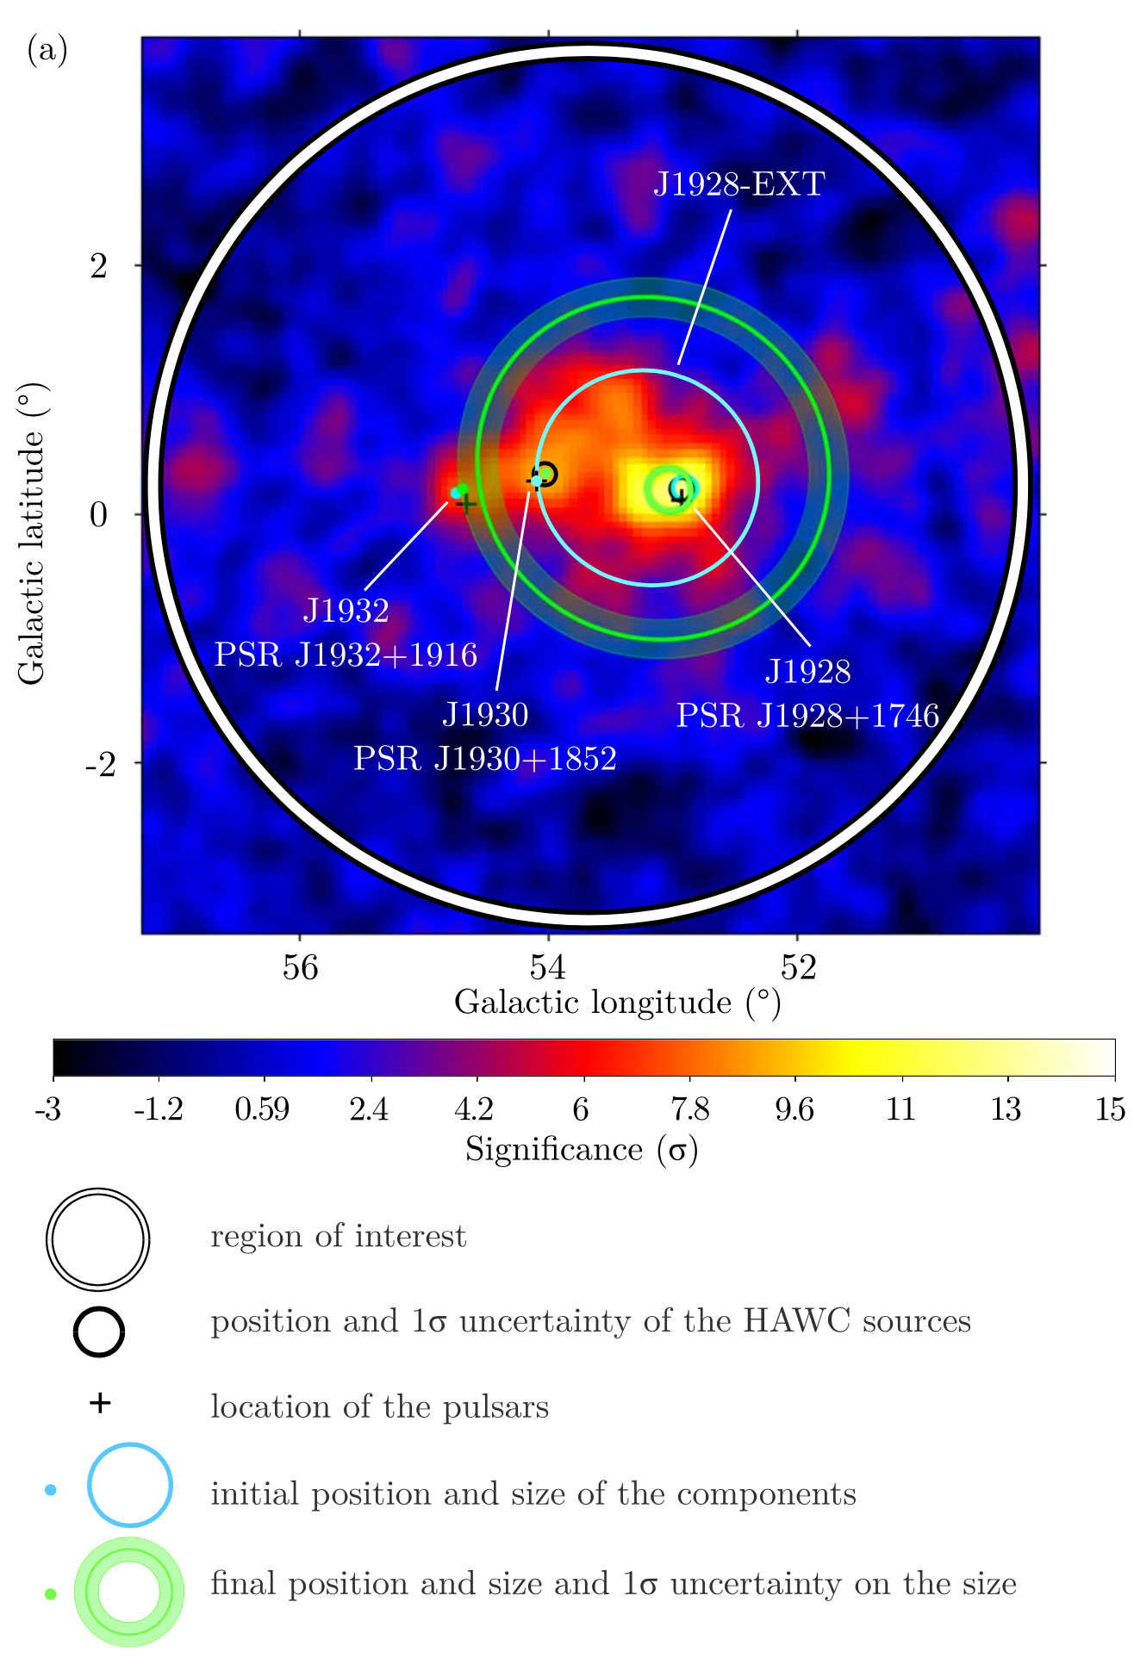
Introduction
The HAWC analysis resulted in:
Two point-like sources: J1930, J1932
Two extended sources: J1928, J1928-EXT
Newly detected point source: J1932 (coincident with gamma PSR J1932+1916)
Refined two-comp morphology for J1928
Our goal:
• Joint Fermi-LAT and LHAASO analysis of the gamma-ray emission in this complex region
HAWC analysis (Albert et al. 2023)
Notes:
Interpretation:
PWN interpretation very likely for J1930
PWN interpretation viable for J1932
Origin of J1928 unclear but PWN or TeV halo around PSR J1928+1746 viable
Origin of J1928-EXT unclear
Large-scale Galactic diffuse emission absent in the model
Mismodeling of J1928
May be the same object as J1928

Slide 5
Data set and analysis method
Fermi-LAT (GeV):
Pass 8 (P8R3) data, 17.3 yr, SOURCE
Energy range: 0.1~500 GeV
Summed binned likelihood analysis (Fermitools / Fermipy)
LHAASO (TeV):
Pass 4 data (up to July 31, 2024)
KM2A: 1570 days, WCDA: 1137 days
Energy range: >1 TeV
Spatial : WCDA and KM2A treated separately
Spectral : WCDA + KM2A
Notes:
We use Pass 8 data with the P8R3 Instrument Response Functions.
Time range: till 2024-7-31
KM2A: 1570 days, including ½ and ¾ arrays
WCDA: 1137 days, full array
Energy range: [17, 0, 3.4] → >1 TeV
Spatial: mask: [1.1,1.3] → KM2A 10-25 TeV
Spectral: no mask

Slide 6
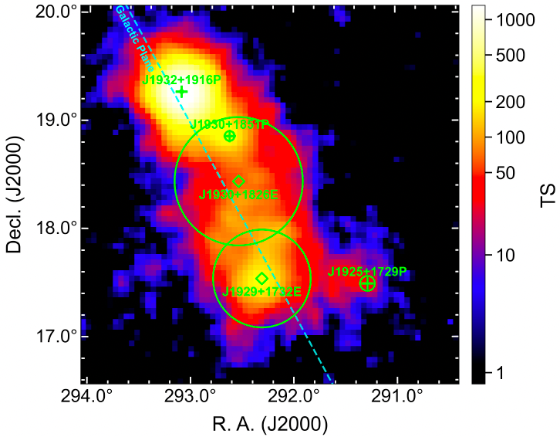
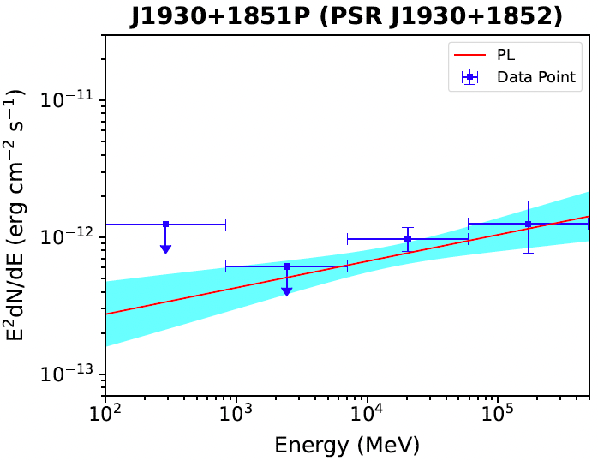
Fermi-LAT results
1-500 GeV spatial analysis
0.1-500 GeV spectral analysis
Target:
Upper limits if TS<4
Spatial: 3 point-like + 2 extended sources
SED
significant improvement over 4FGL-DR4 (ΔAIC ~ 78)
J1930+1851P (coincident with G54.1+0.3)

Slide 7
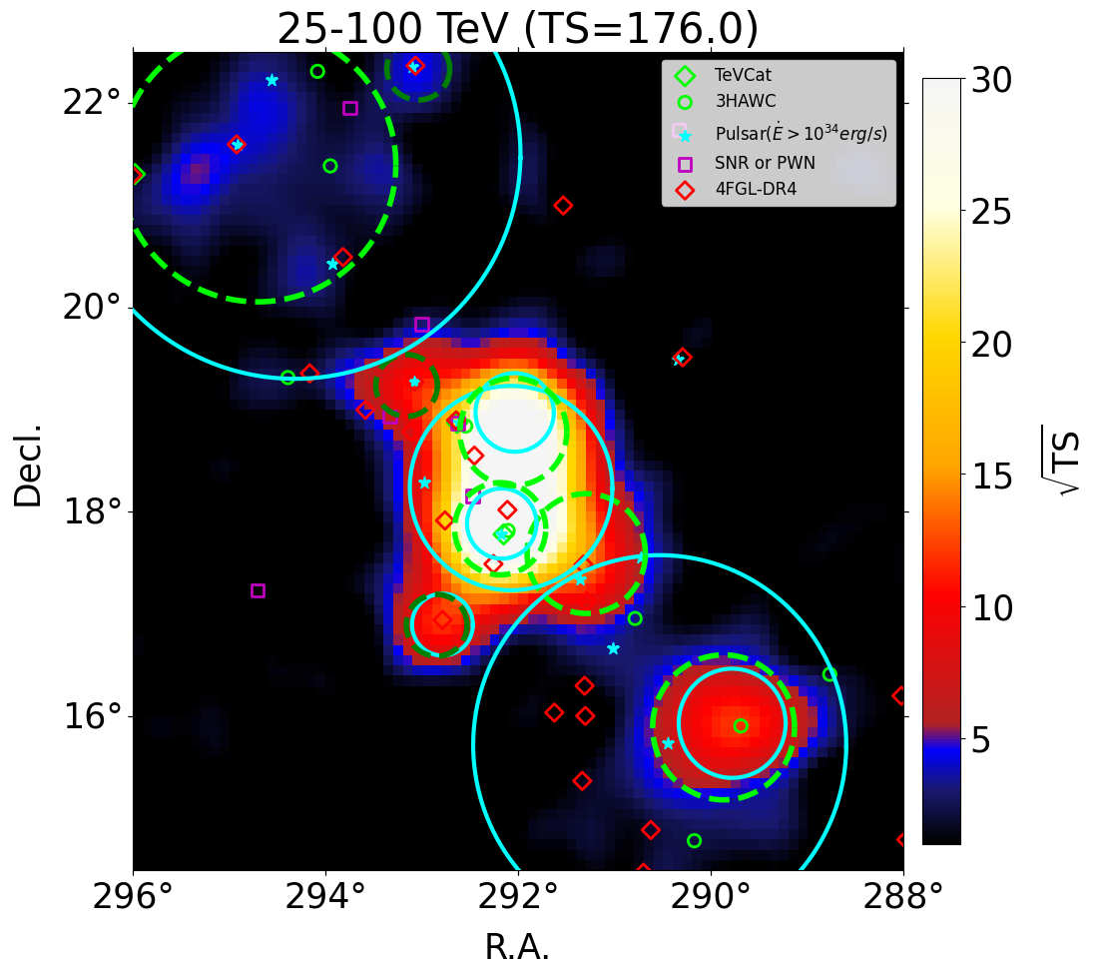
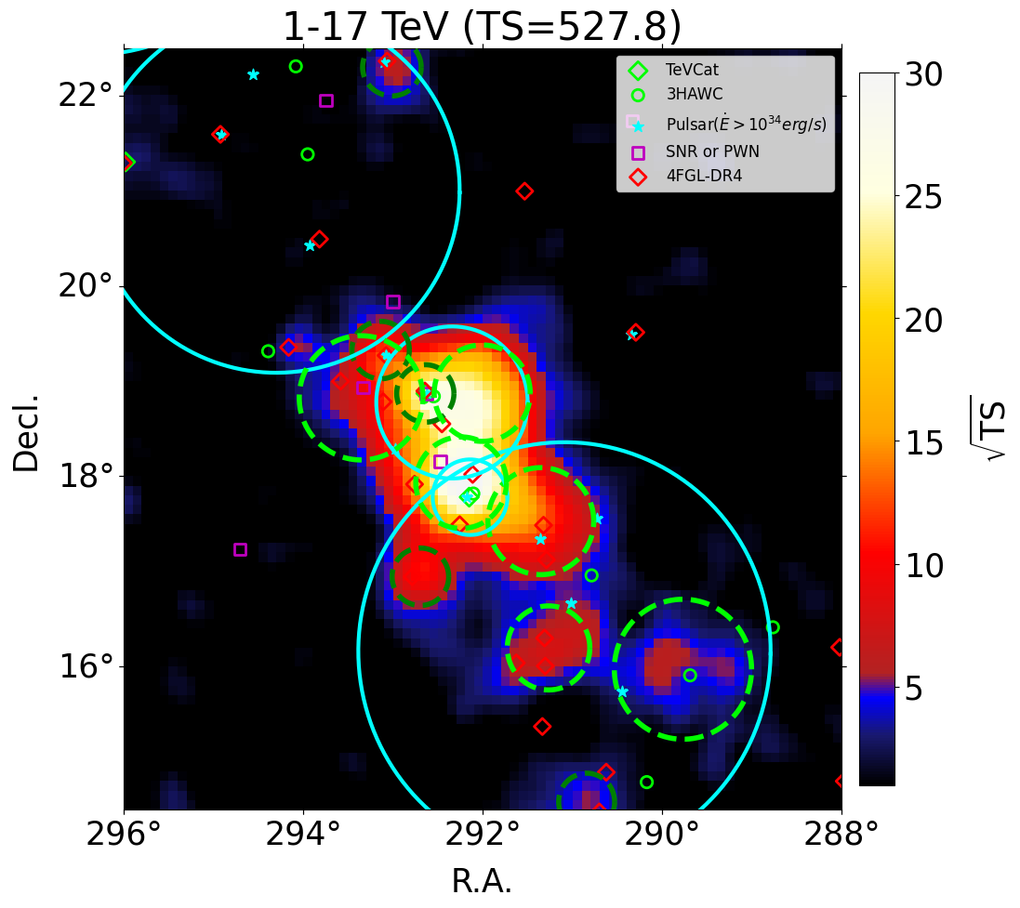
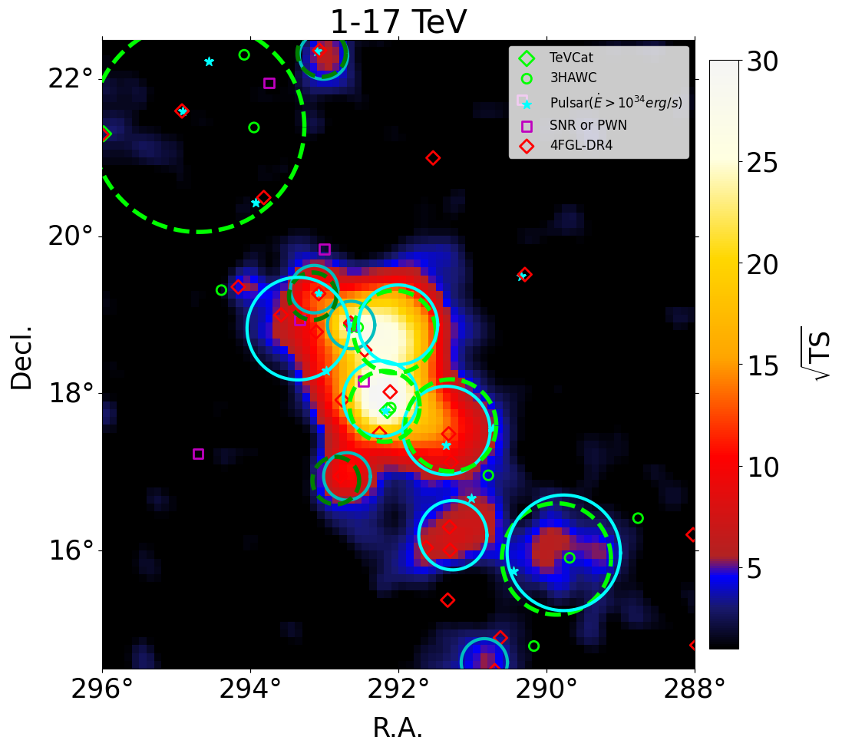
LHAASO results
Morphology
Starting from 1st catalog
Source detection threshold : TS>16
Spectral model: PL
Blue solid: the 2nd model
Green dashed: the 1st model
Dark green dashed: point srcs in 1st model
WCDA: hou vs. catalog
KM2A: hou vs. catalog
KM2A vs. WCDA (hou)
Notes:
TS threshold: 6 for curvature, 9 for extension

Slide 8
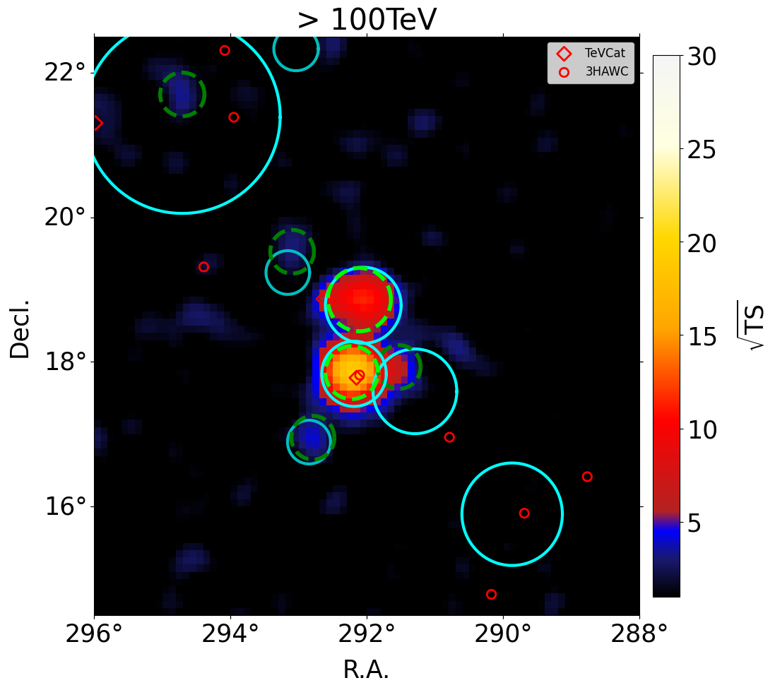
LHAASO results
Morphology
KM2A: 100 TeV vs. 25-100TeV
Blue solid: the 2nd model
Green dashed: the 1st model
Dark green dashed: point src in 1st model
Notes:
KM2A >100 TeV:
Starting from the best-fit model of 25-100 TeV
Source detection threshold : TS>4
Spectral model: PL
KM2A>100 TeV: 没有独立解源
At above 100 TeV, we have started from the best-fit of 25-100 TeV and redo the optimization. This time, we used a looser threshold of TS for source detection. You can see the strongest emission is still from the central region.

Slide 9
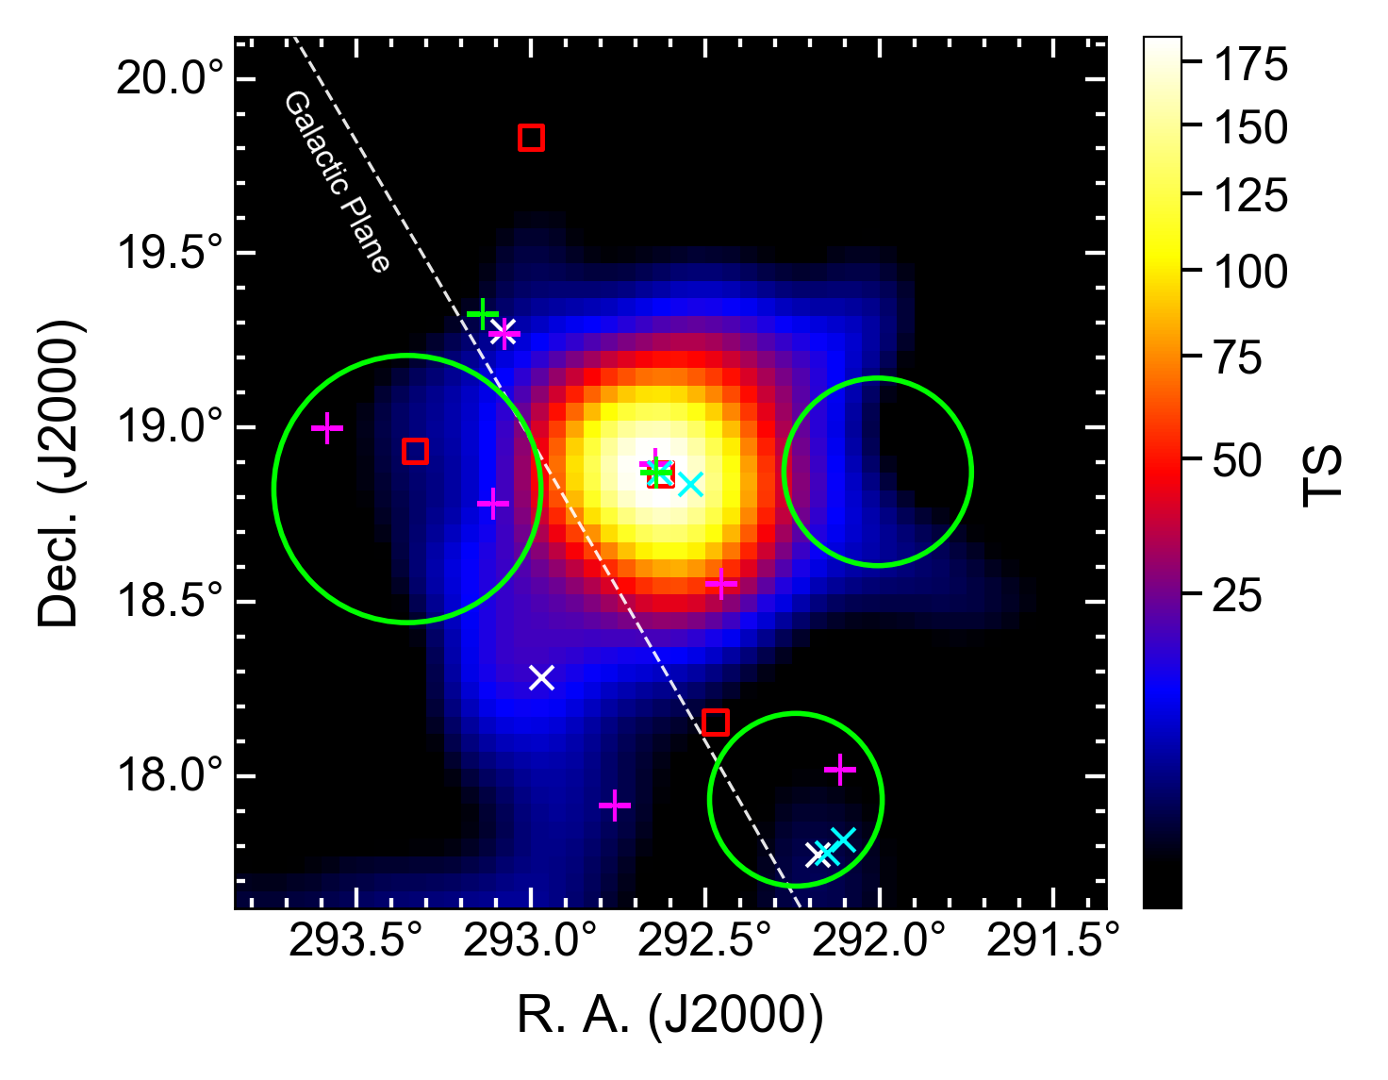
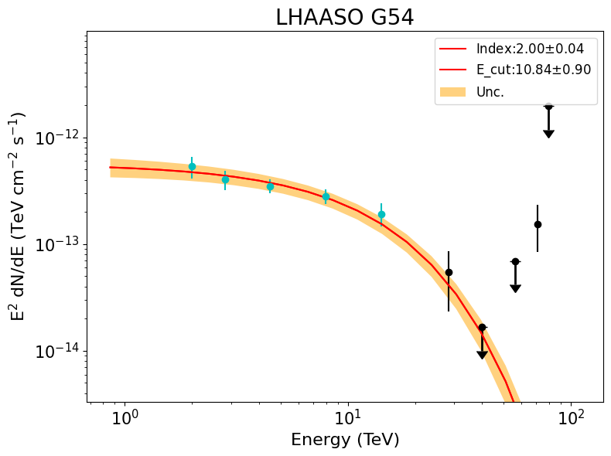
LHAASO results
Target: PWN/SNR G54.1+0.3
25-100 TeV
Scale: sqrt
> 1 TeV
1-17 TeV
1-17 TeV
>100 TeV
1-17 TeV
Overlapped with: PSR, SNR, TeVCat, Fermi-LAT 4FGL, other LHAASO srcs

Slide 10
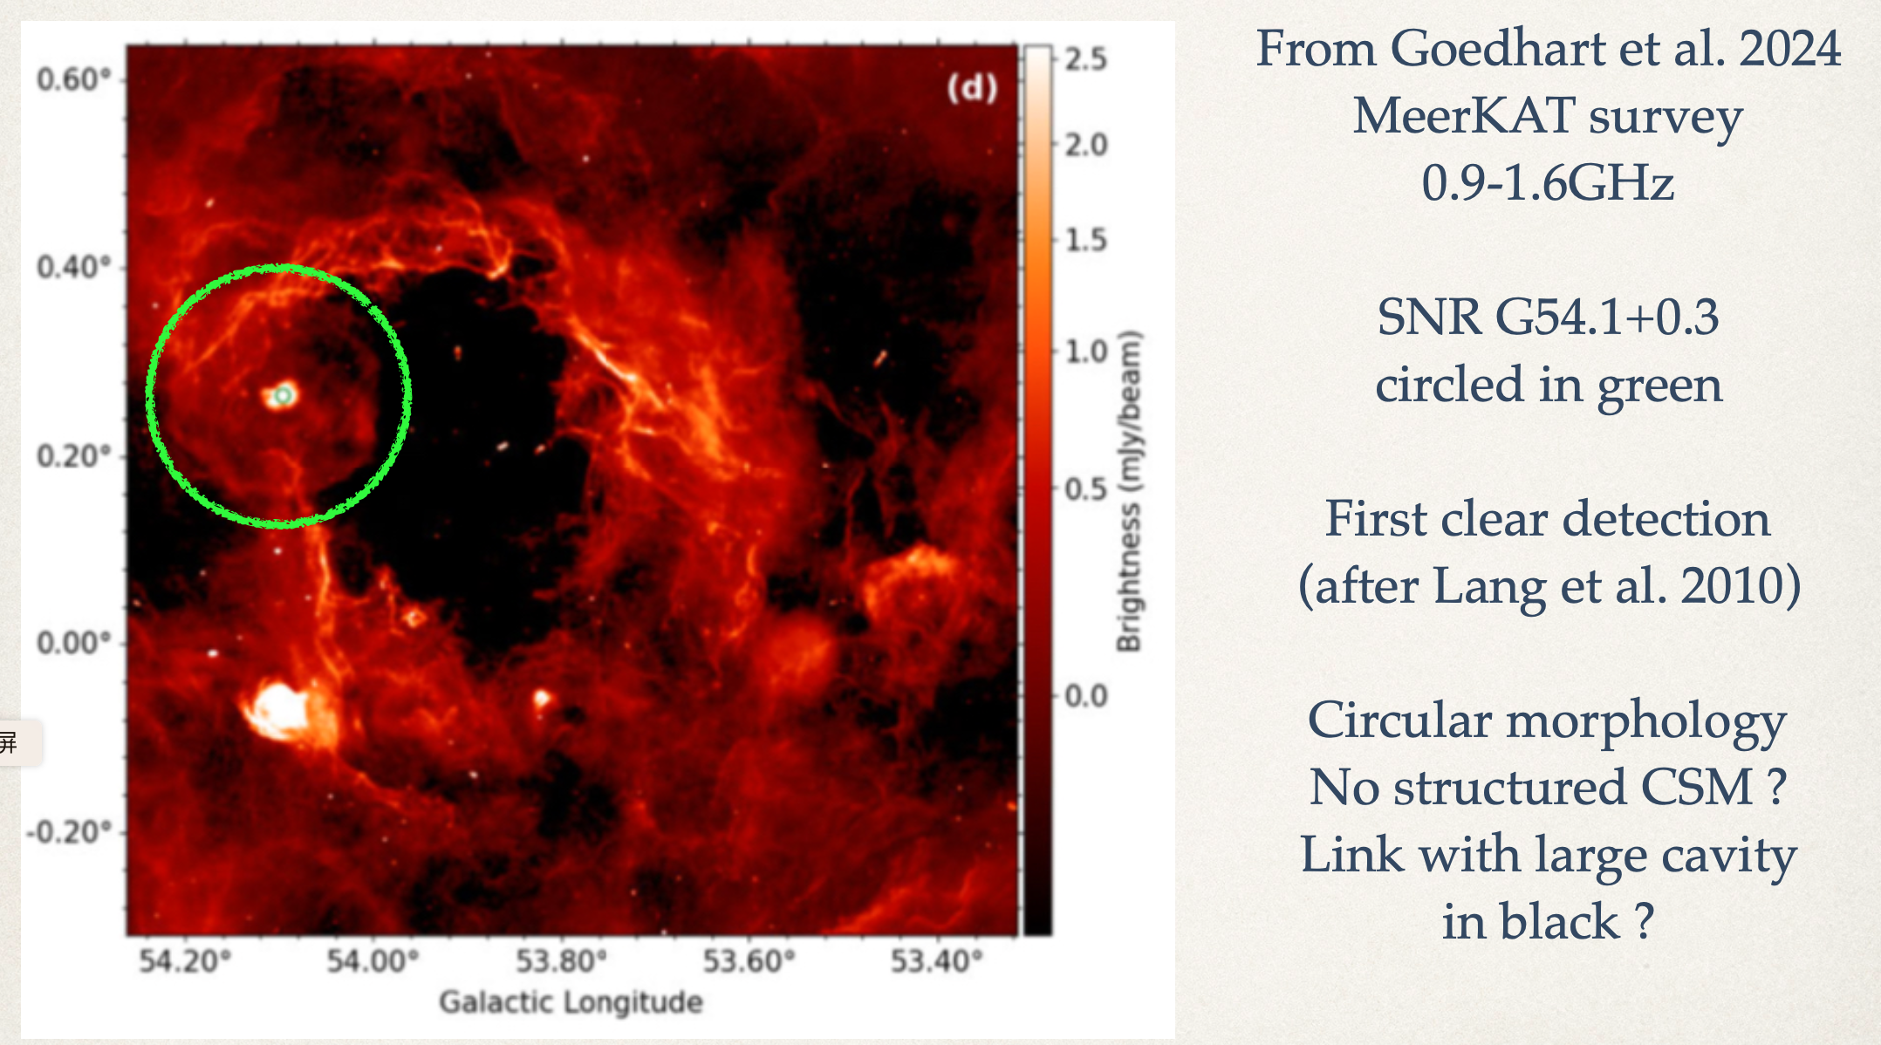
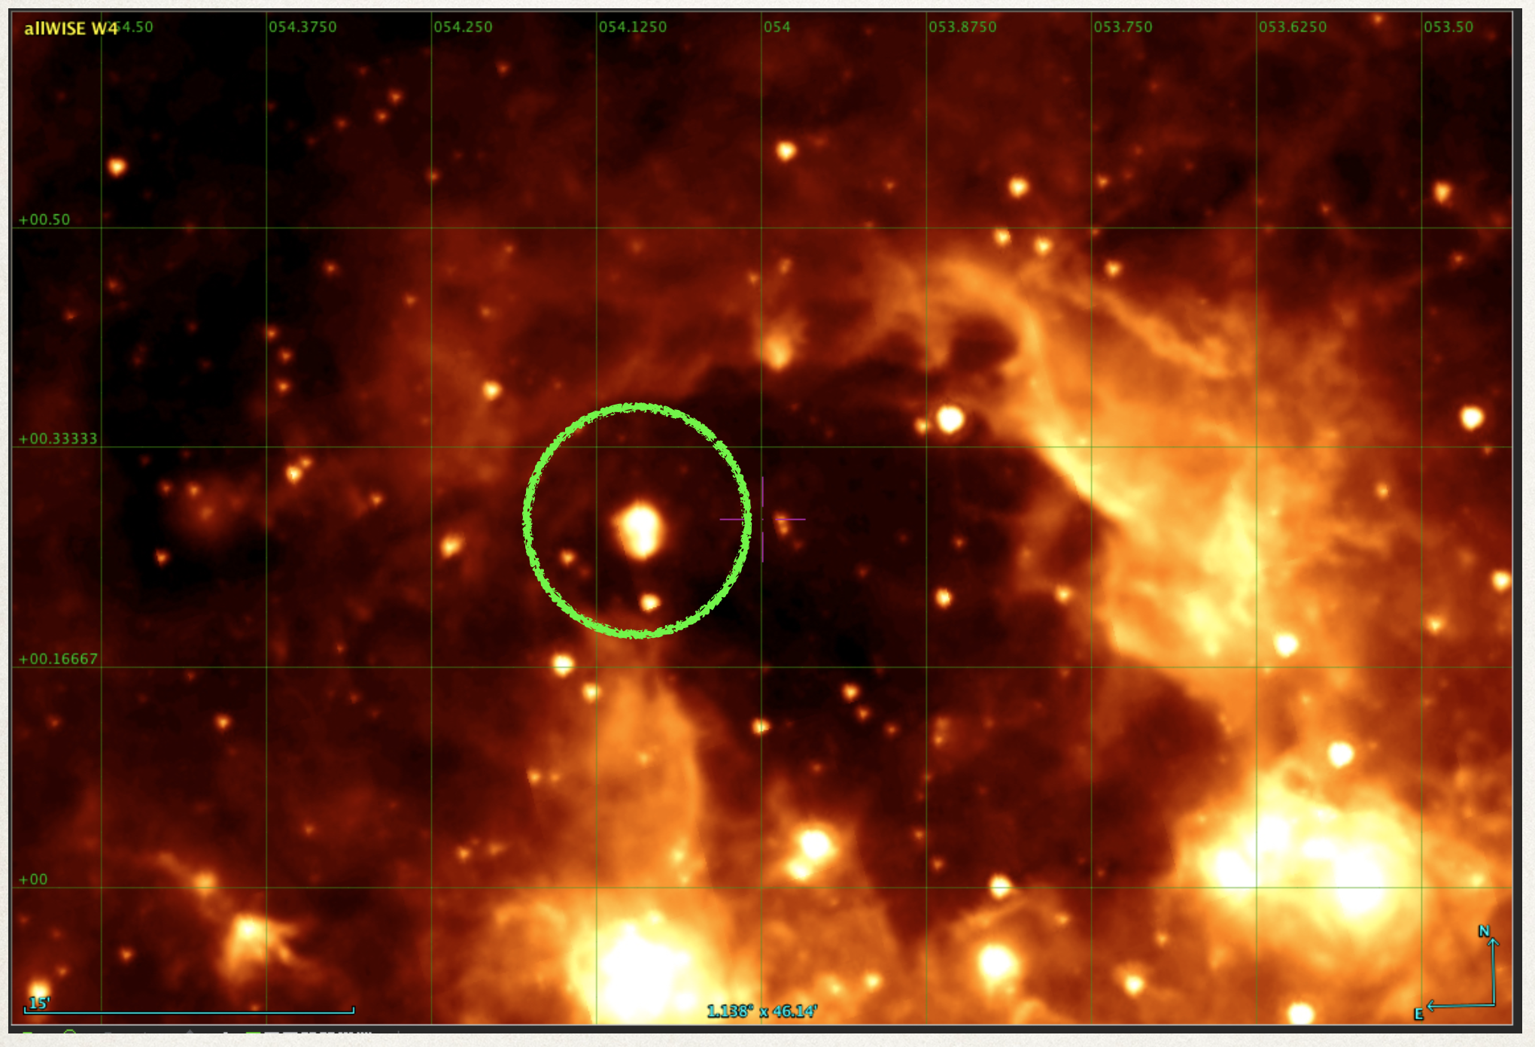
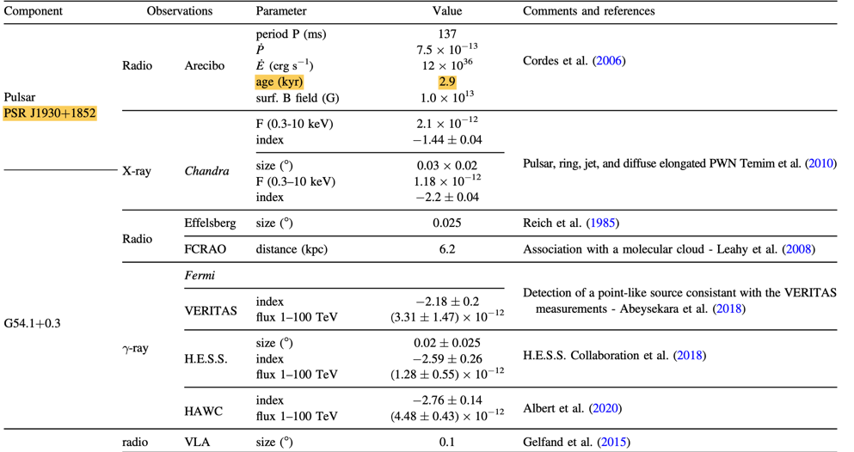
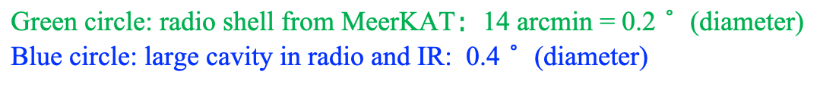
G54.1+0.3: Crab-like PWN/SNR system
Associated with young radio PSR J1930+1852 (τ_{c} = 2900 yr，Edot=1.2e³⁷ erg/s)
New kinematic distance based on Reid 2019 model and using MWISP (CO) data : d=4.9 kpc
Radio from MeerKAT
IR from WISE 22 Microns
No infrared emission from SNR (apart from central PWN)
Green circle: radio shell from MeerKAT：14 arcmin = 0.2$°$ (diameter)
Blue circle: large cavity in radio and IR: 0.4$°$ (diameter)
Albert et al. 2023
Notes:
In Leahy 2008, ¹³CO data resulted in d=6.2 kpc corresponding to V=53 km/s
Their rotation model is different to Reid 2019
Associated with radio PSR J1930+1852 (young)

Slide 11
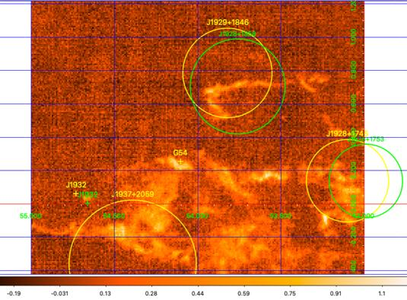
MWISP (CO) data
¹²CO
Extract ¹²CO data within 0.03$°$ around G54 WCDA position
GLAT (deg)
K=53.5 km/s
d=4.9 kpc
GAL (deg)
G54 and J1929 are in a complex CO region
BUT: NO gas clouds whose morphology nicely delineates the boundaries of the remnant as seen in radio

Slide 12
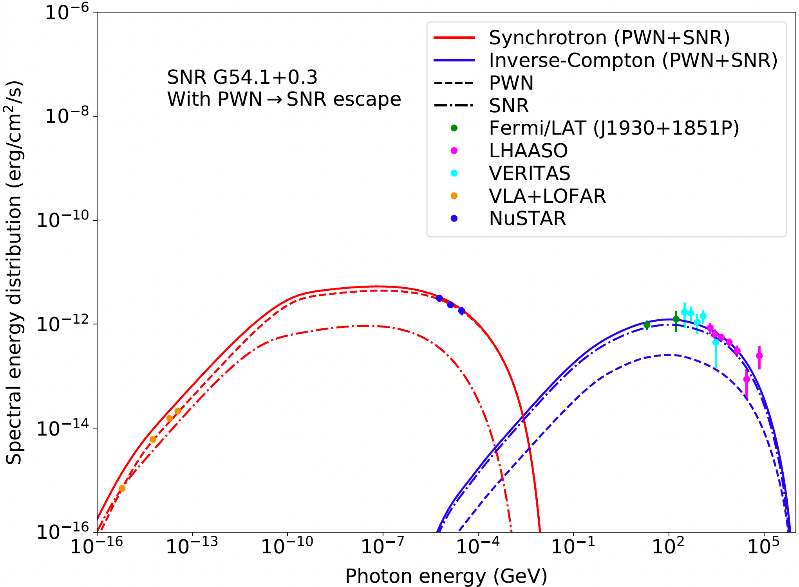
SED modeling: G54.1+0.3
  1D multi-zone model framework from Martin et al. 2024, 2025
Pulsar power converted at 95% into ultrarelativistic pairs and 5% into magnetic turbulence
Fermi-LAT SED points updated compared to last report
G54 origin: particles accelerated in the PWN, and then escaped to and trapped in the SNR
Notes:
At 2000yr, R_{PWN}=2pc and R_{SNR}=7.9pc
...to be compared with 1.5pc and 8pc @ 4.9kpc
→ PWN slightly too large
Main parameters
System age 2000 yr and pulsar spin-down time scale 900 yr (pulsar characteristic age τc = 2900 yr)
Canonical SNR with 10⁵¹ erg and 8M☉ and nism=0.1 H/cm³ (fixed)
Pulsar power converted at 95% into ultrarelativistic pairs and 5% into magnetic turbulence
Pair injection spectrum with indices 1.6/2.7, break at 400 GeV, cutoff at 400 TeV
Strong Alfvenic turbulence in PWN with largest scale at 2% of PWN radius
No need for ISRF enhancement from Popescu et al. 2017 average Galactic model

Slide 13
Summary
We perform a joint analysis of Fermi-LAT and LHAASO data in this complex region
G54.1+0.3 appears point-like across GeV to >100 TeV energies and is embedded in a complex molecular cloud environment
The broadband SED indicates that the gamma-ray emission from G54.1+0.3 is driven by particles accelerated in the PWN, which likely escape into and trapped in the SNR.
Paper status: full draft available for review in around 2 months

Slide 14
Thanks!

Slide 15
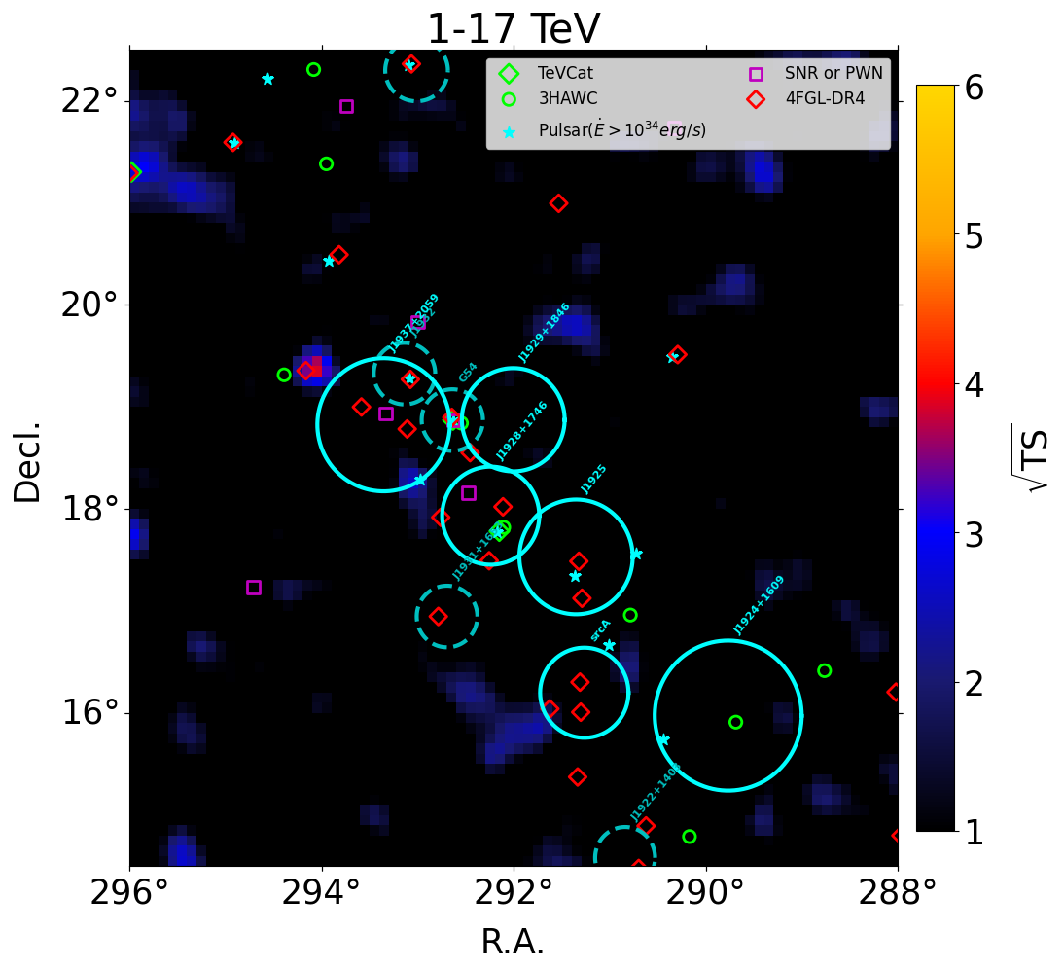
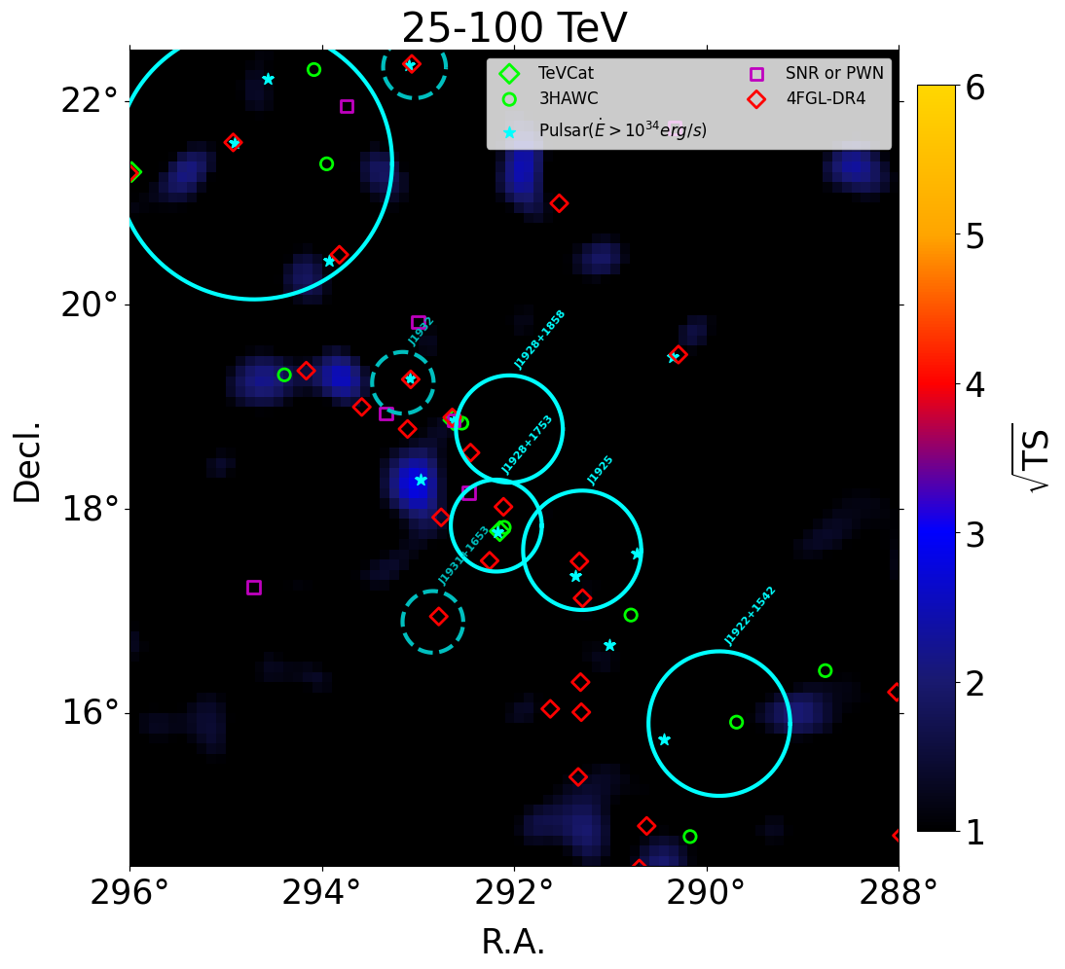
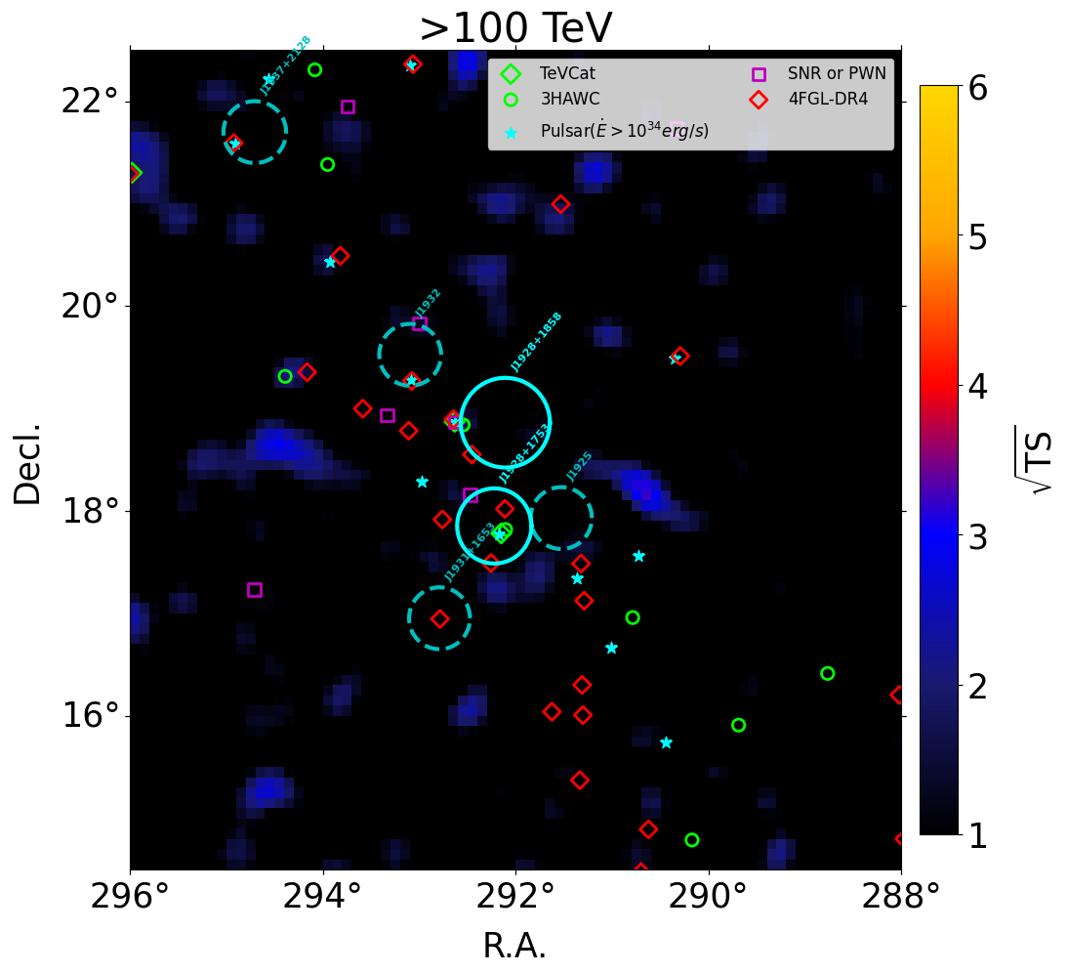
LHAASO results
Morphology: residual TS maps
No significant residuals
1-17 TeV
25-100 TeV
>100 TeV
TS threshold: 6 for curvature, 9 for extension

Slide 16
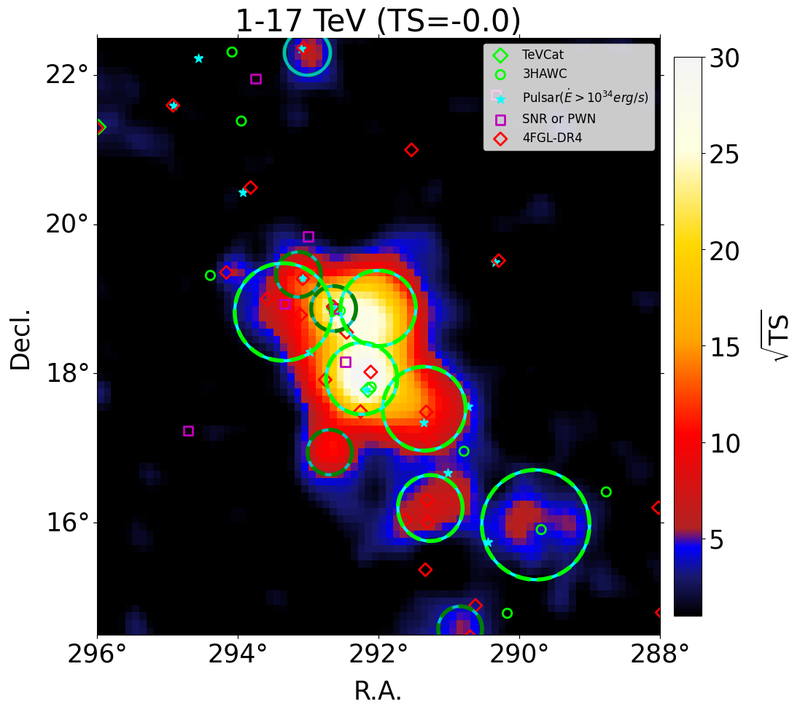
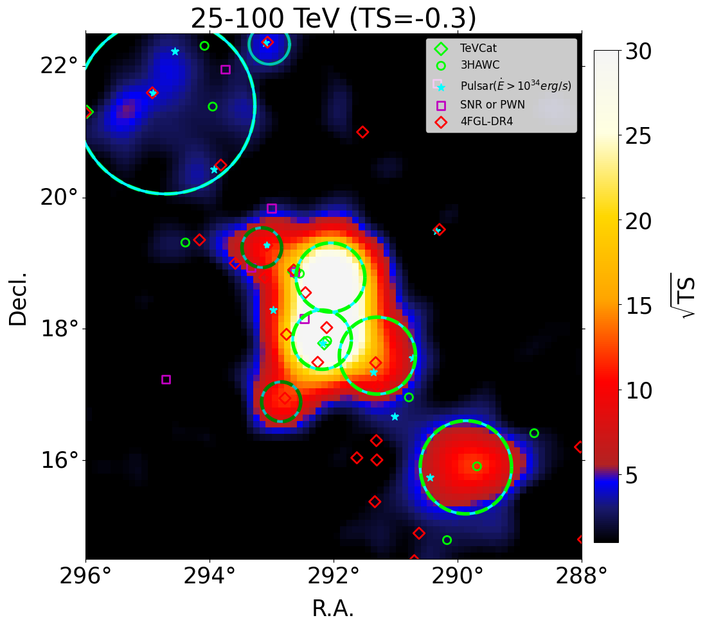
LHAASO results
Morphology
Blue solid: the 2nd model
Green dashed: the 1st model
Dark green dashed: point srcs in 1st model
Cross checked by Xi Shaoqiang → Good!
WCDA: hou vs. xi
KM2A: hou vs. xi
TS threshold: 6 for curvature, 9 for extension

Slide 17
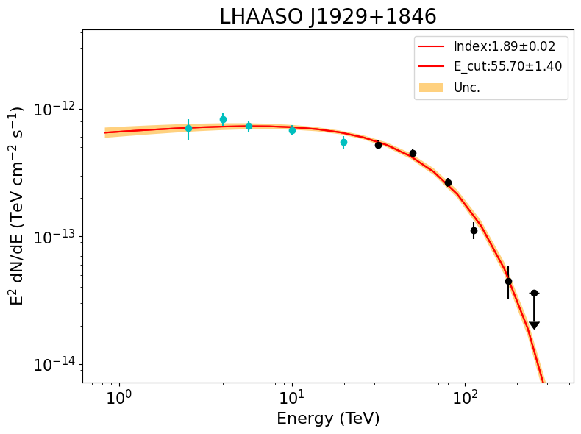
LHAASO results
Broad Band Spectra: > 1 TeV (energy-dependent spatial model)
Combine the WCDA and KM2A best-fit models, for same extended sources detected with both WCDA and KM2A, use 2-component Gaussian model: WCDA model if E < 25 TeV, KM2A model if E > 25 TeV
Test curvature and change to PLEC if TS_curv > 6
Fit
TS threshold: 6 for curvature, 9 for extension

Slide 18
SED modeling: G54
Main modeling goals
  Fit the broadband radio-to-gamma SED for SNR/PWN G54.1+0.3
  Reproduce PWN radius ~1.5pc @ 4.9kpc
  Reproduce SNR radius ~8pc @ 4.9kpc
  Note: both are <6 arcmin so unresolved by LAT or LHAASO
Main modeling assumptions
  1D multi-zone model framework from Martin et al. 2024, 2025
  Distance to object = 4.9 kpc
  Allowing particle escape from PWN to SNR (but not from SNR to ISM)
  Main fit parameters:
    Pulsar spin-down history (spin-down time scale)
    Particle injection spectrum (broken power-law spectrum)
    Pulsar power injection (particle and magnetic turbulence injection efficiencies)
(Lang et al. 2010 Goedhart et al. 2010)

