Slide 1
Search for very high energy gamma-ray emission from non-repeating fast radio bursts with LHAASO-WCDA
Yao Ge, Qiang Yuan, Rui Zhang
Purple Mountain Observatory, Chinese Academy of Sciences
Notes:
Good afternoon, everyone! My name is . Today, I’m going to present a paper about LHAASO-KM2A Measurement of Diffuse Gamma-Ray Emission. Scientists have been studying cosmic rays for over a hundred years and have developed theoretical models to account for their origin and propagation. But are these theoretical models correct? This has to be verified with observational data, which is the main focus of this paper.

Slide 2
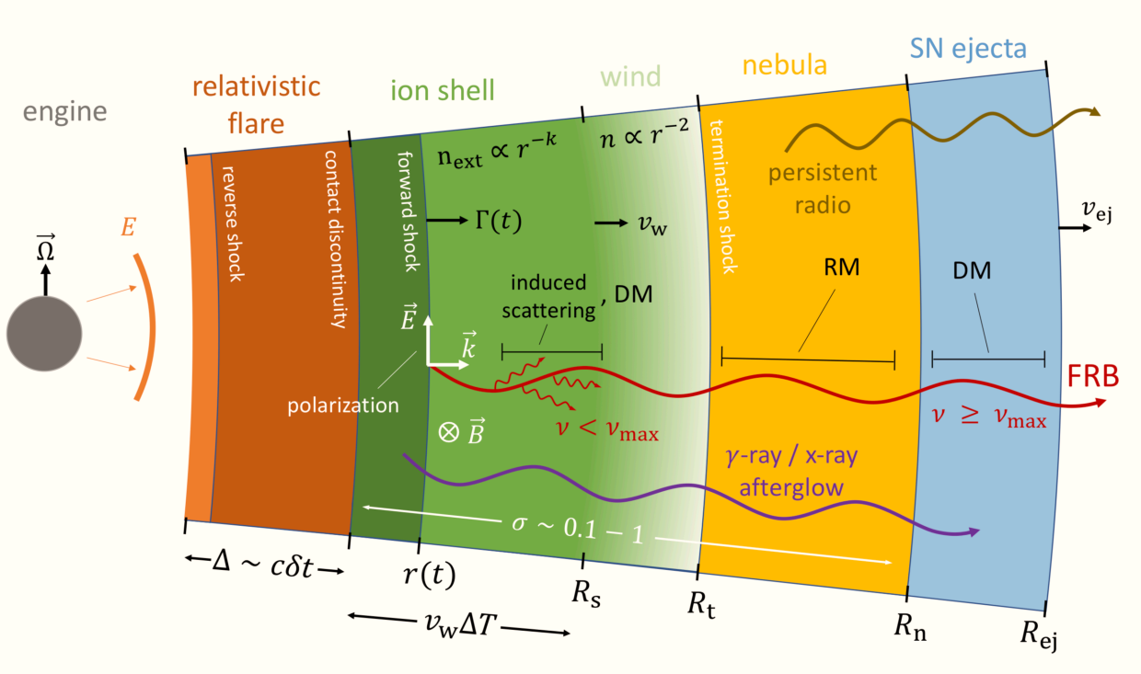
Introduction
Research Object: 25 low-redshift non-repeating FRBs that appeared within the FOV of WCDA from 2021.3.5 to 2024.7.31.
Objective:
  Investigate gamma-ray signal from non-repeating FRBs
  Estimate their significance
  Calculate their flux upper limits within a certain period after the burst.
Cartoon picture of the GRB-like FRB radiation model
Bing Zhang, 2020
Notes:
LHAASO is located at Haizi Mountain in Sichuan Province, China. It combines multiple detection methods for data collection, which makes it the newest, largest and most sensitive cosmic ray detector in the world. Its advantage lies in its ability to accurately measure gamma ray with extremely high energy.

Slide 3
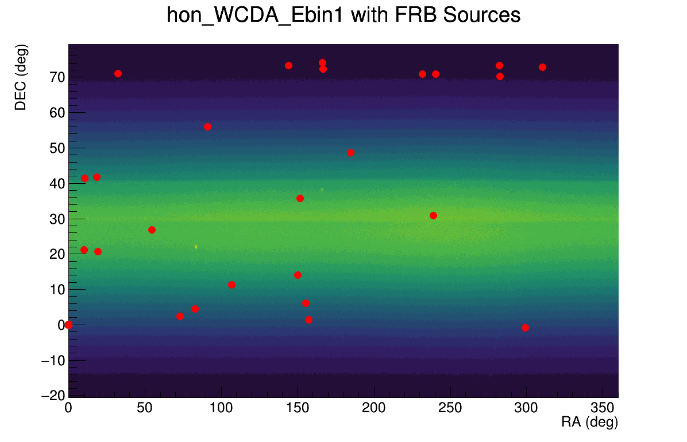
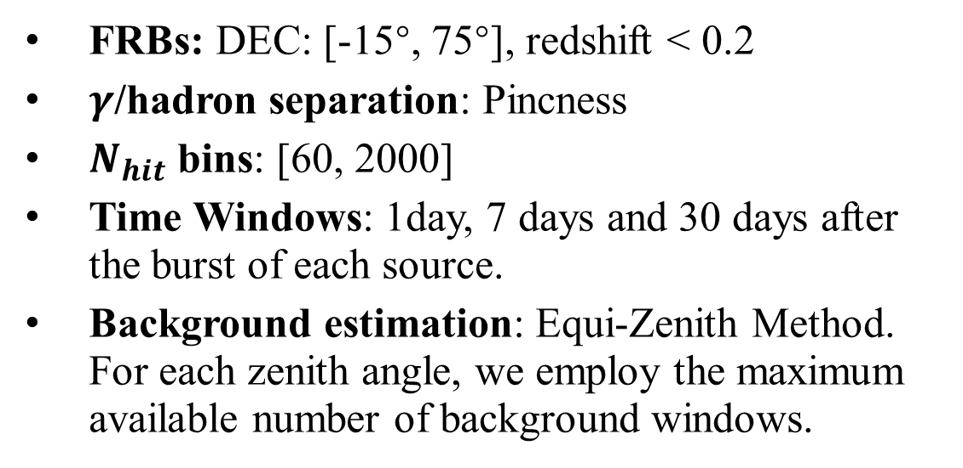
Analysis
FRBs: DEC: [-15°, 75°], redshift < 0.2
$γ$/hadron separation: Pincness
$N_{hit}$ bins: [60, 2000]
Time Windows: 1day, 7 days and 30 days after the burst of each source.
Background estimation: Equi-Zenith Method. For each zenith angle, we employ the maximum available number of background windows.
Fig 1. Distribution of the 25 FRBs in this work within the WCDA field of view.

Slide 4
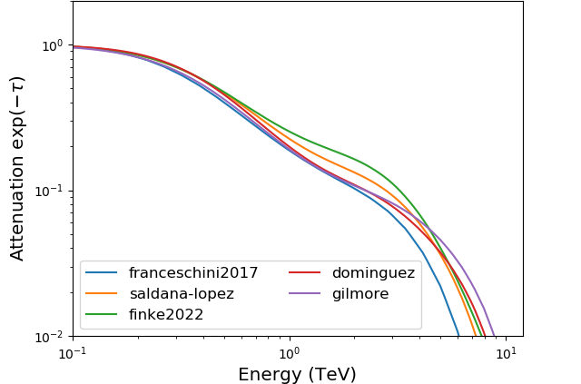
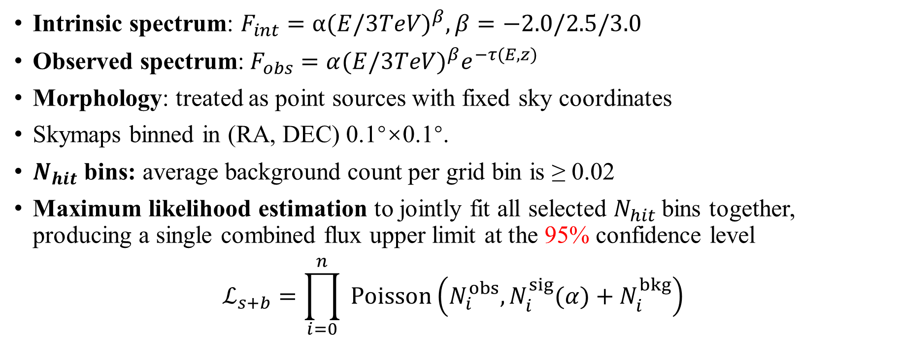
Analysis
Intrinsic spectrum: $F_{int}=α{(E/3TeV)}^{β}, β=−2.0/2.5/3.0$
Observed spectrum:$F_{obs}=α{(E/3TeV)}^{β}e^{−τ(E,z)}$
Morphology: treated as point sources with fixed sky coordinates
Skymaps binned in (RA, DEC) 0.1°×0.1°.
$N_{hit}$ bins: average background count per grid bin is ≥ 0.02
Maximum likelihood estimation to jointly fit all selected $N_{hit}$bins together, producing a single combined flux upper limit at the 95% confidence level
$$ℒ_{s+b}=\prod_{i=0}^{n}{ }Poisson\left(N_{i}^{obs},N_{i}^{sig}(α)+N_{i}^{bkg}\right)$$

Slide 5
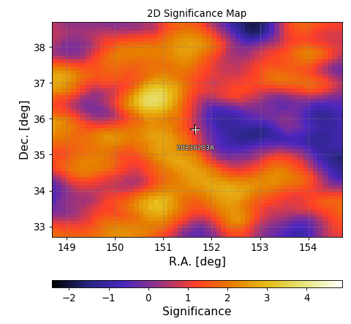
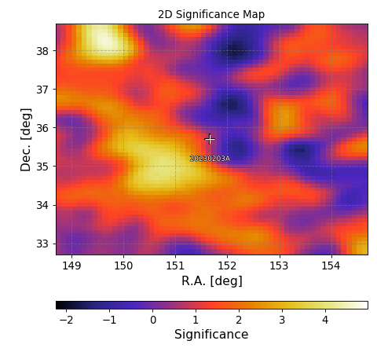
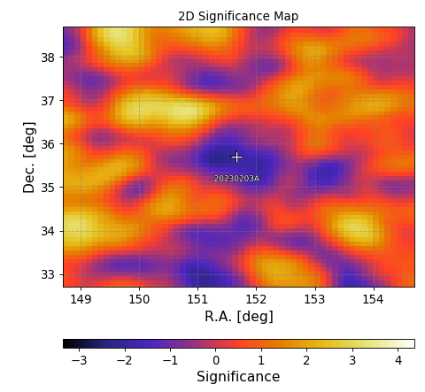
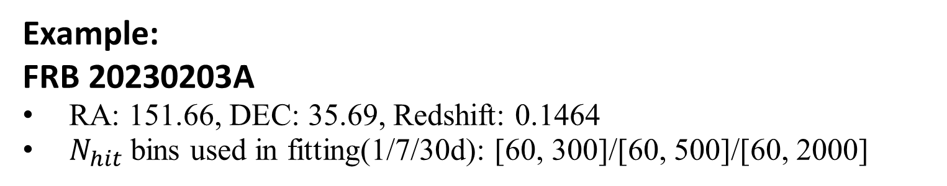
 | 1day | 7days | 30days
Discovery Time/h | 3.18 | 22.22 | 95.21
Example:
FRB 20230203A
RA: 151.66, DEC: 35.69, Redshift: 0.1464
$N_{hit}$ bins used in fitting(1/7/30d): [60, 300]/[60, 500]/[60, 2000]
1 day
7 days
30 days

Slide 6
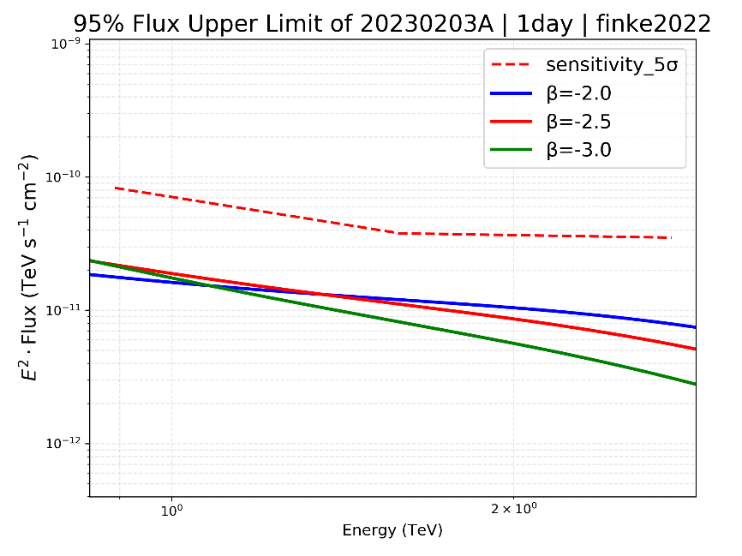
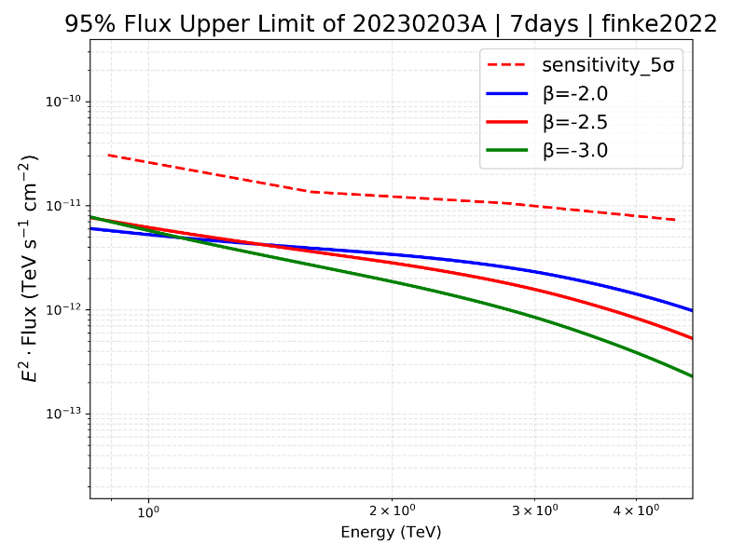
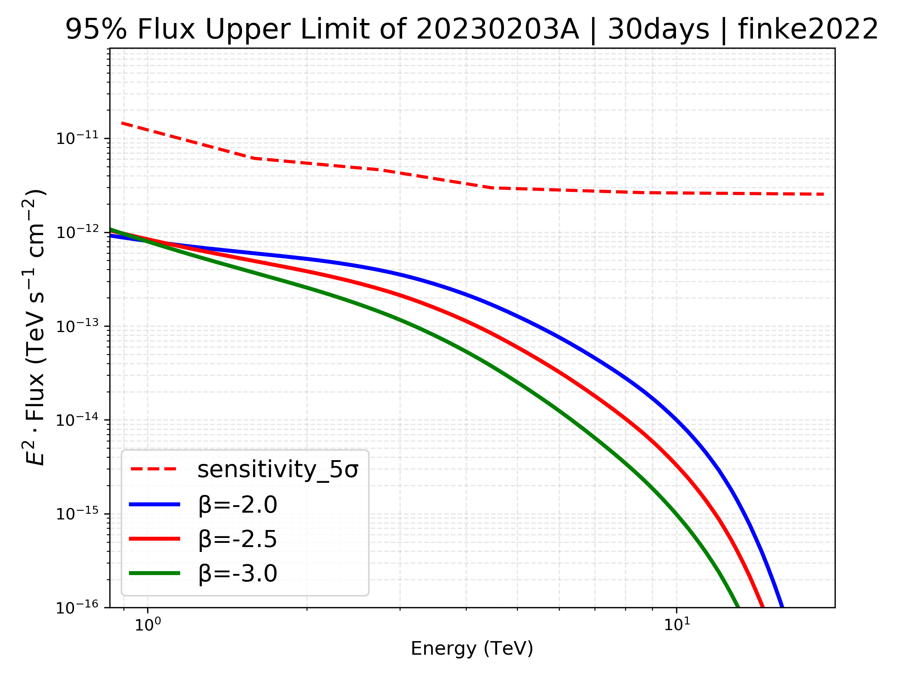
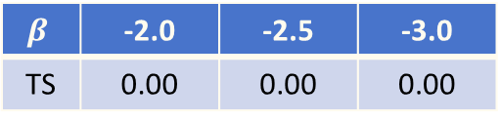
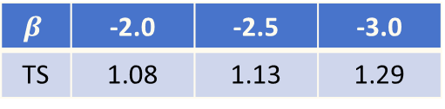
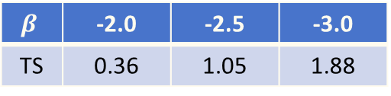
95% Flux Upper Limits of FRB 20230203A for Different Spectral Indices at 1/7/30 Days After the Burst
$$β$$ | -2.0 | -2.5 | -3.0
TS | 0.36 | 1.05 | 1.88
$$β$$ | -2.0 | -2.5 | -3.0
TS | 1.08 | 1.13 | 1.29
$$β$$ | -2.0 | -2.5 | -3.0
TS | 0.00 | 0.00 | 0.00

Slide 7
Conclusion
In this work, a search for gamma-ray emission from 25 low-redshift non-repeating FRBs was conducted using LHAASO-WCDA, yielding no statistically significant signal from any source.
Combined 95% C.L. flux upper limits were derived for these FRBs across multiple time windows, spectral indices, and EBL models.
Notes:
In the future, we can focus our efforts on expanding the analysis to other Galaxy regions, improving measurement methods and equipment, and modifying the theoretical models. These topics may help us gain a better understanding of the universe and its fundamental laws.

