Slide 1
Report on SNRs
Siming Liu on behalf of the SNR group
Southwest Jiaotong University

Slide 2
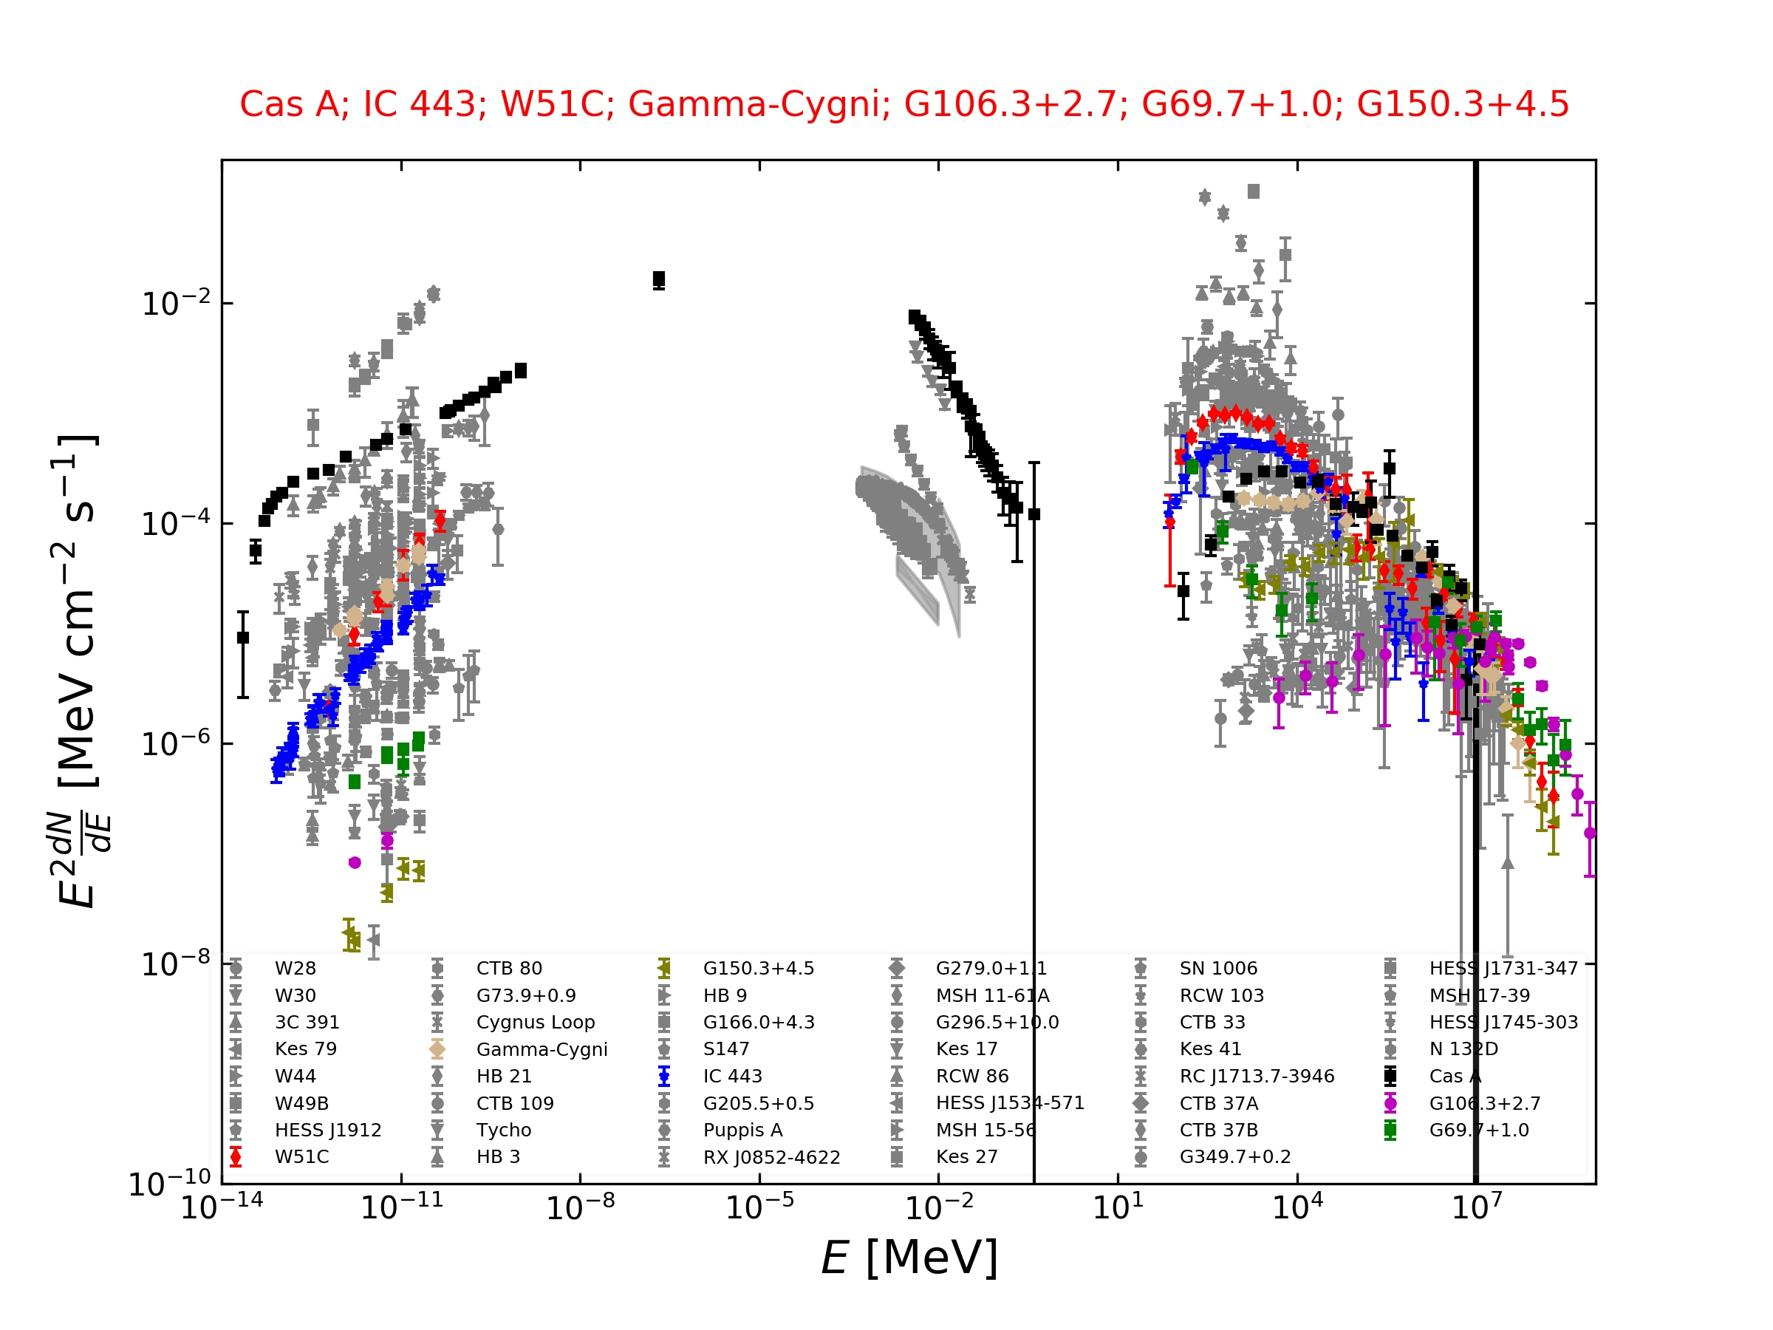
10 SNRs Detected by LHAASO
W44, Kes78, J0534+3535
Songzhan Chen
Hanrong Wu
Yunzhi Shen
Xiurong Li
Preliminary
10TeV
The higher energy spectra are softer
(but harder than an exponential cutoff)

Slide 3
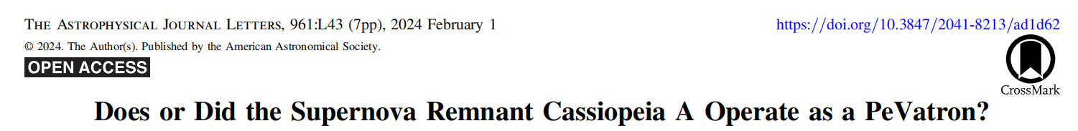
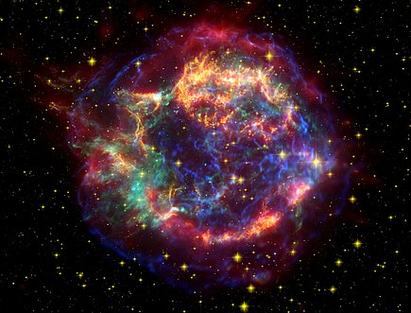
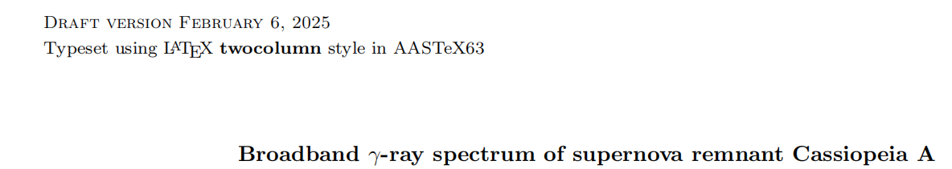
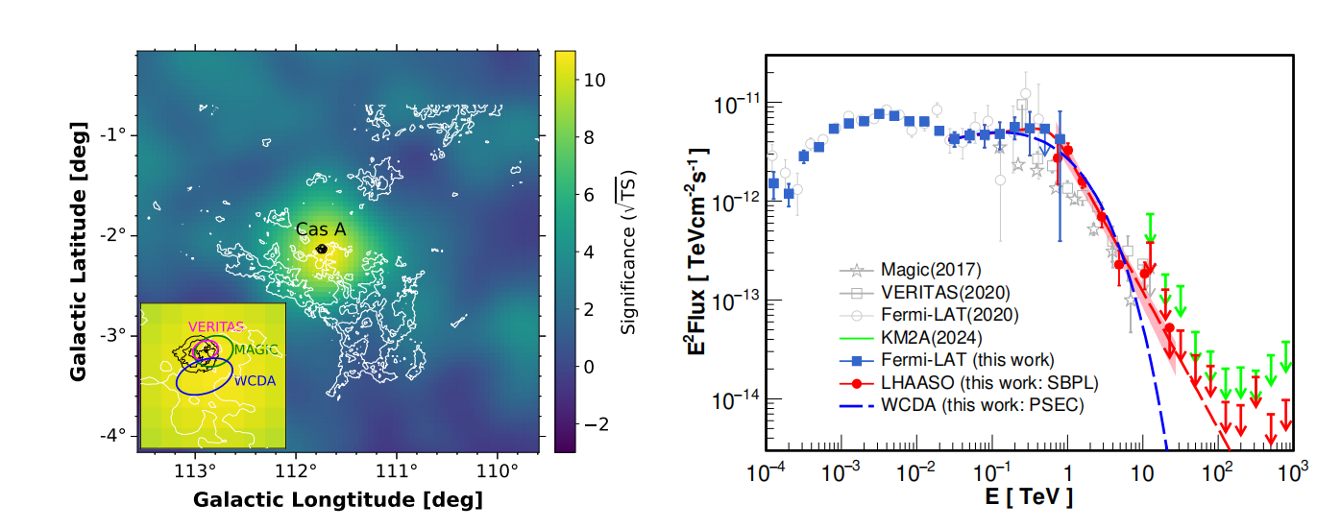
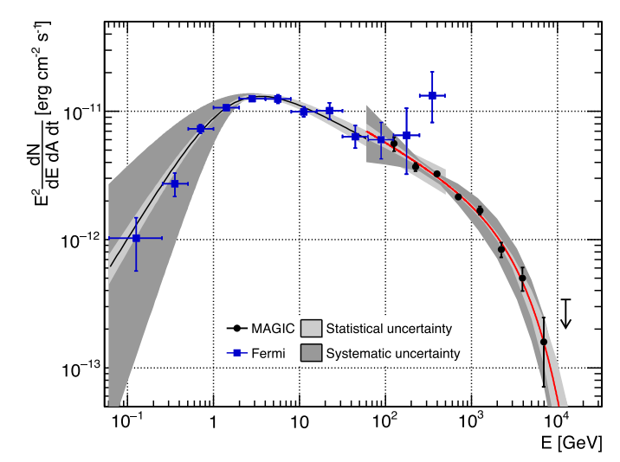
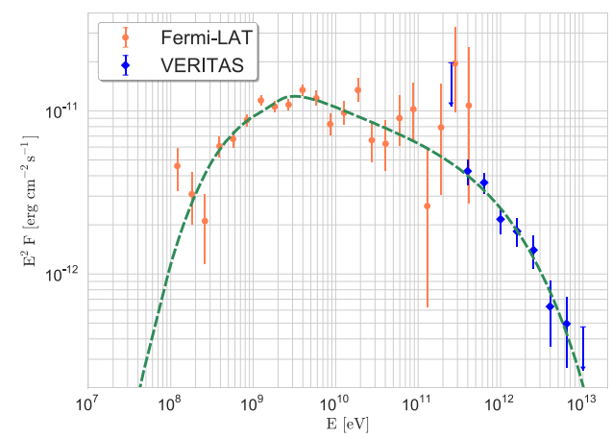
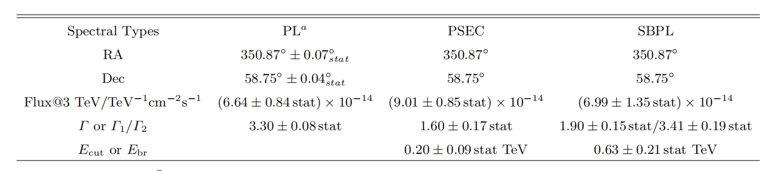
ms34
ms59
350 years old, 3.4 kpc away with a radius of 2.5 pc ~ 2.5’

Slide 4
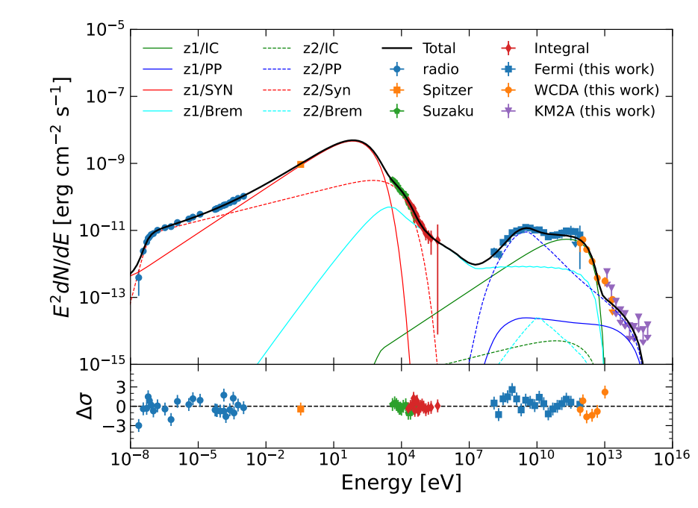
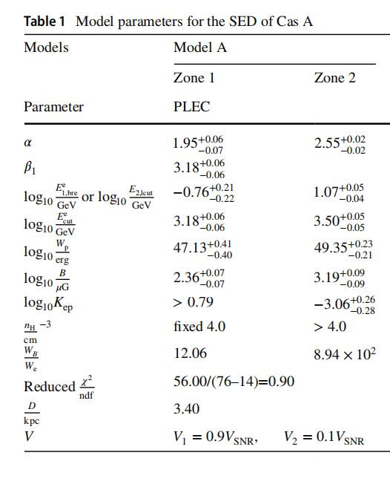
Observations near 10 TeV are warranted
Reverse/inward Shock
Forward Shock

Slide 5
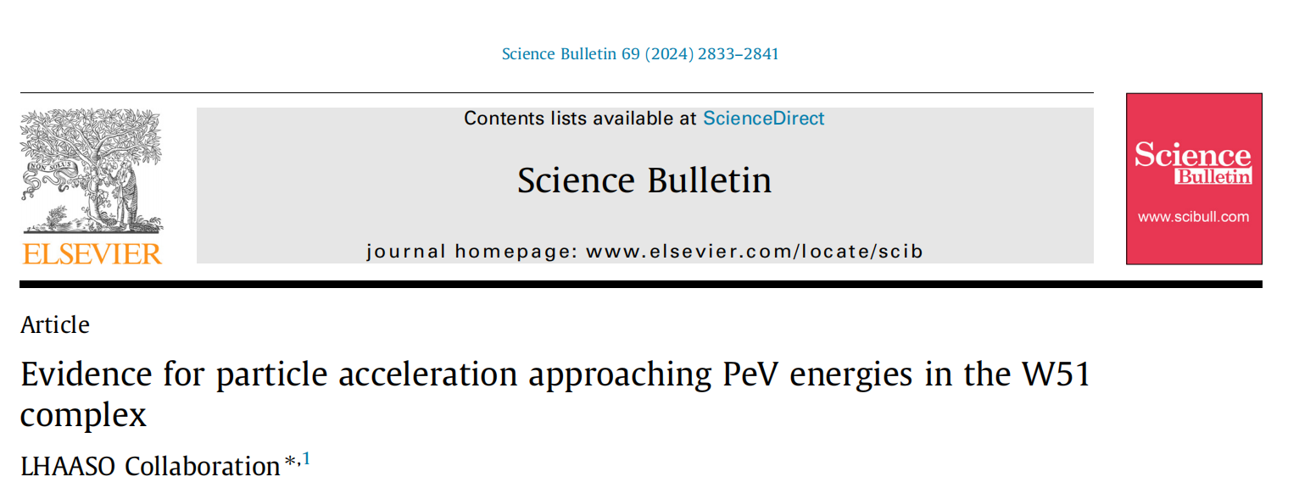
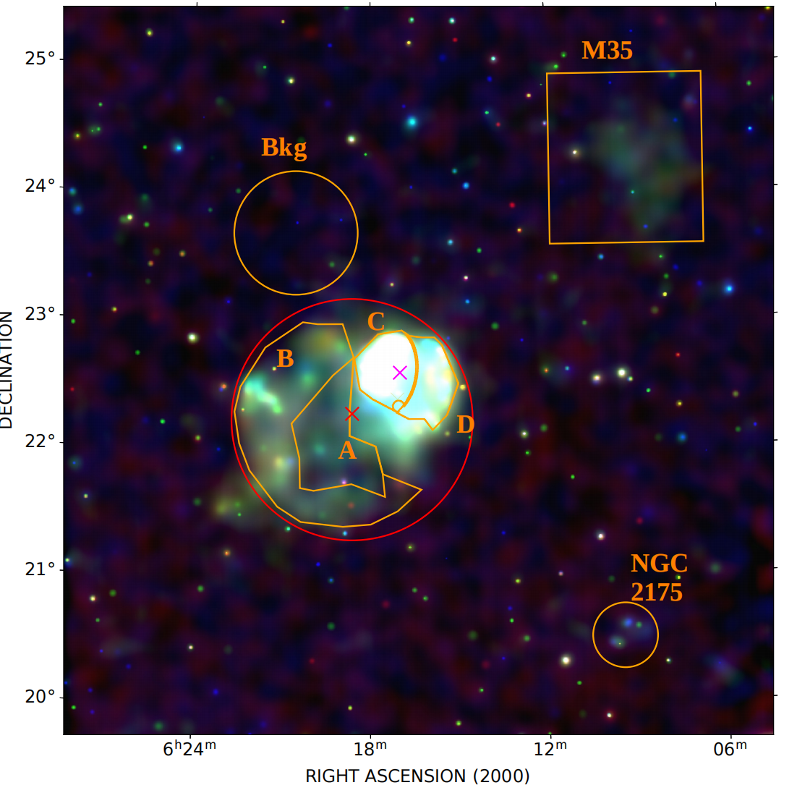
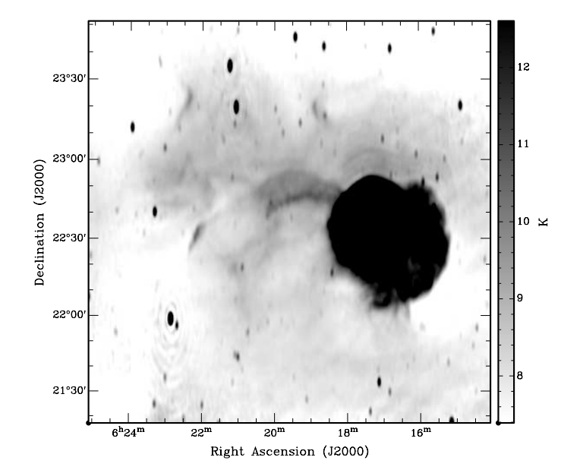
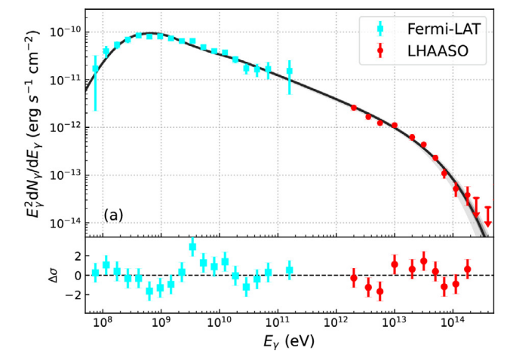
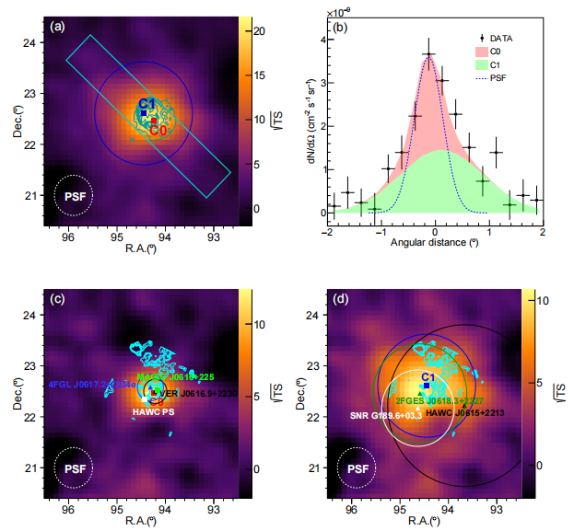
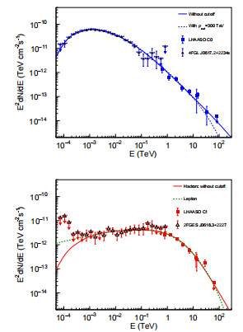
radio
X-ray
IC433/G189.1+3.0
ms45
G189.6+3.3
Evidence of cosmic-ray acceleration up to sub-PeV energies in the supernova remnant IC 443 Accepted by PRL eprint arXiv:2510.26112
ms68

Slide 6
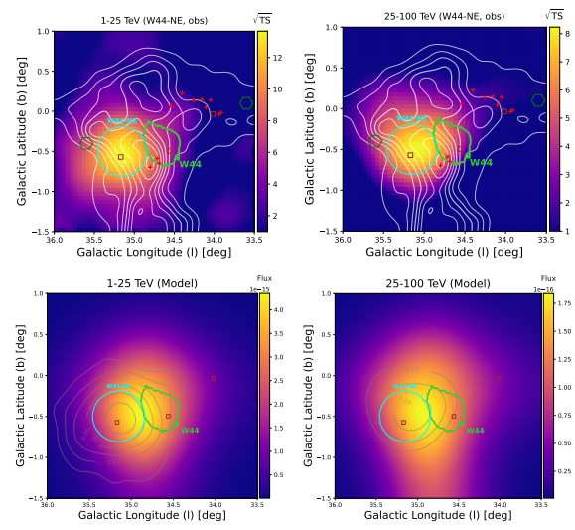
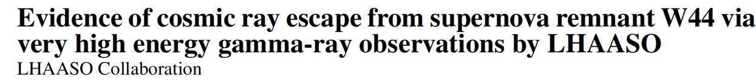
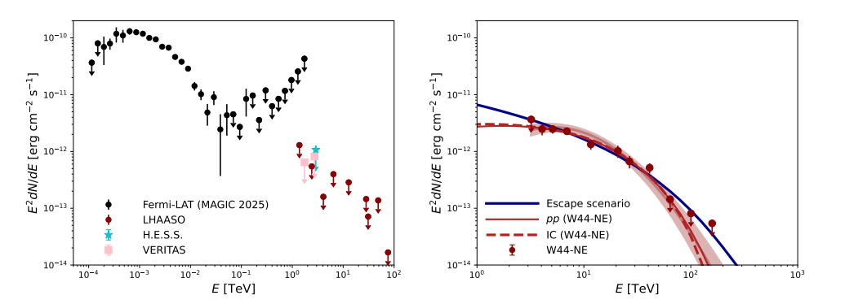
W44 submitted to ?
ms72

Slide 7
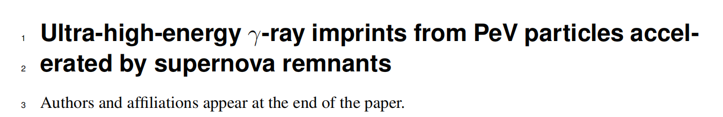
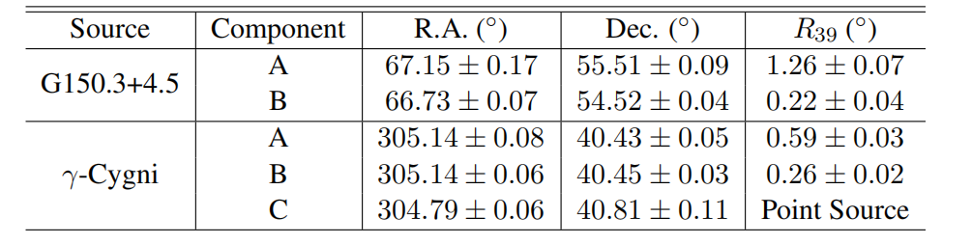
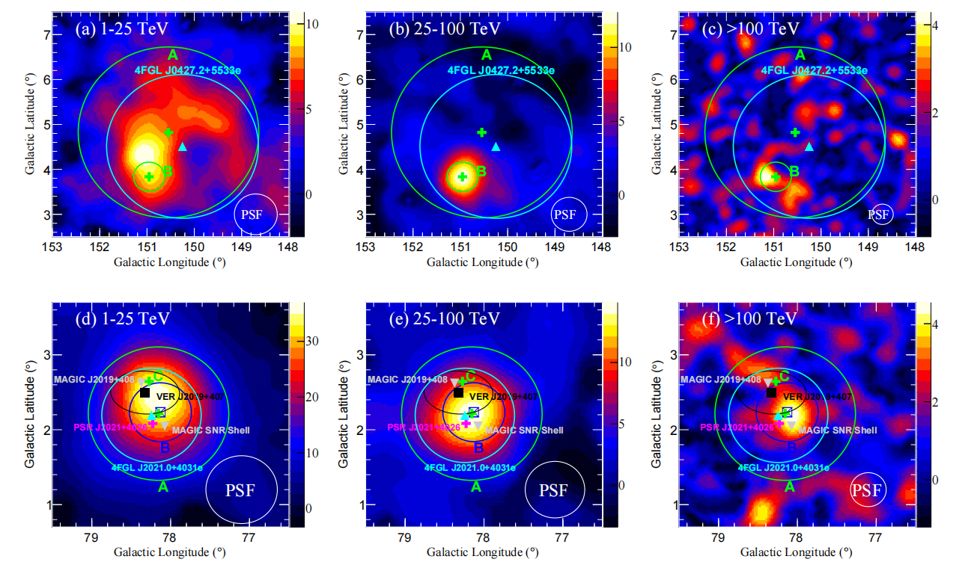
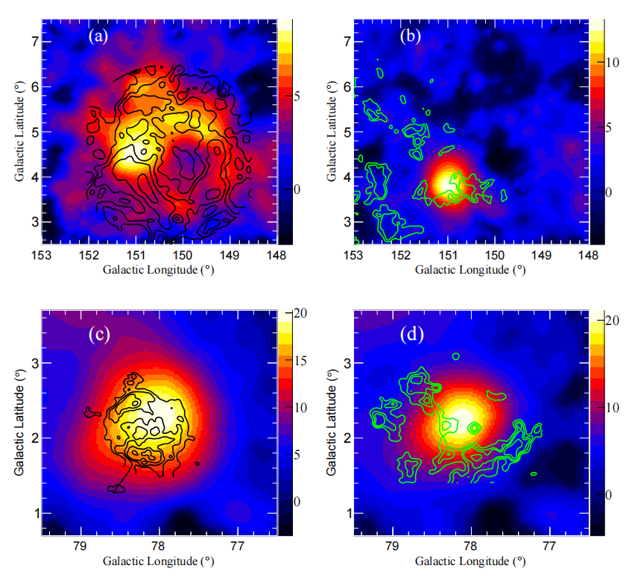

Slide 8
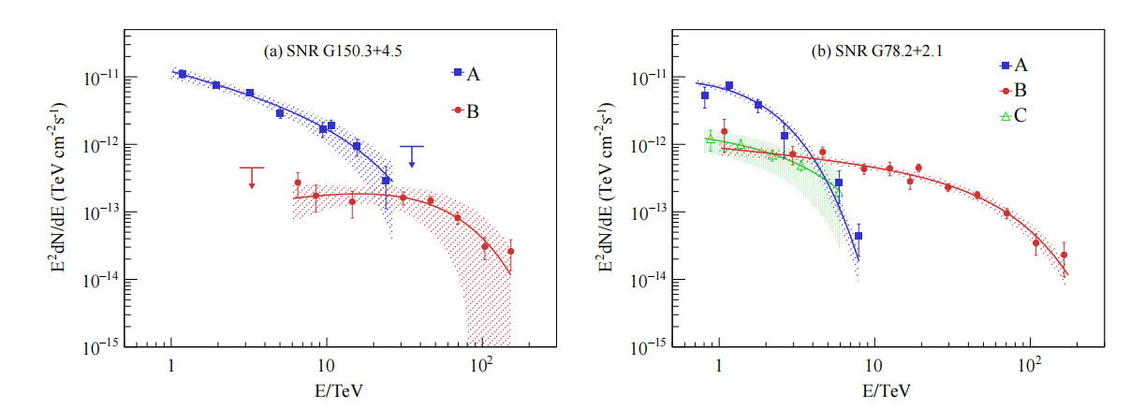
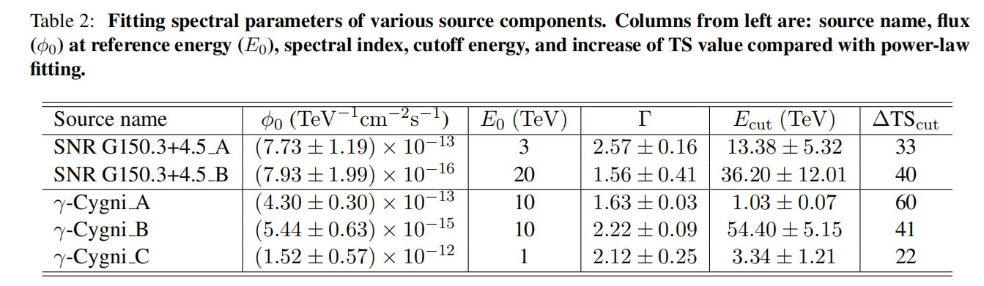
Sumitted to Nature Communication
ms74

Slide 9
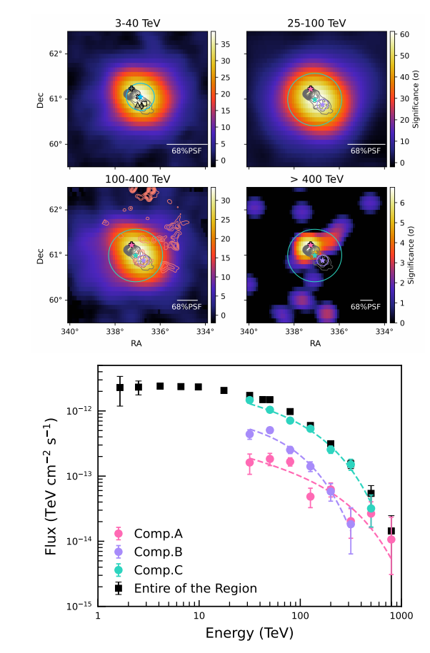
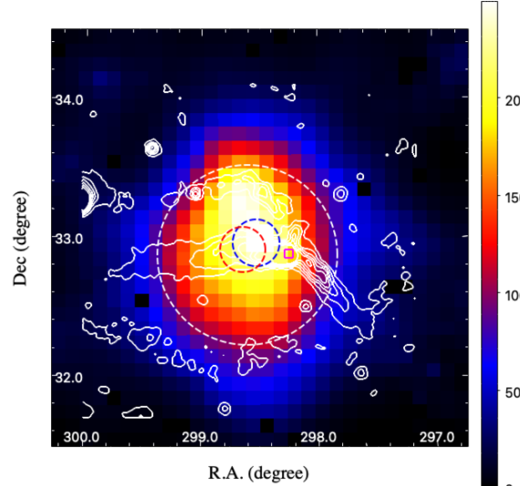
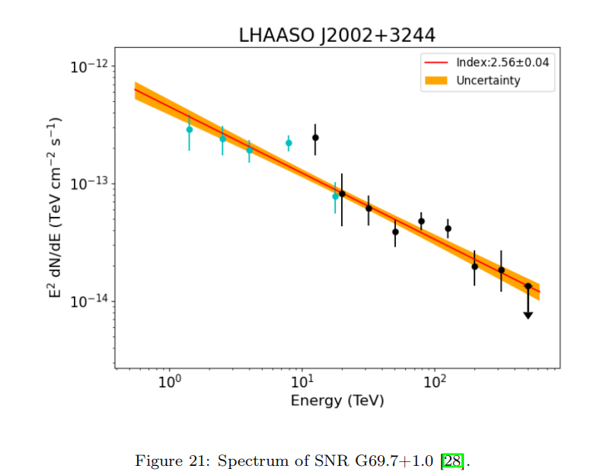
G106 Wu sha
CTB80 Bing Liu
G69.7+1.0 Xi and Chen

Slide 10
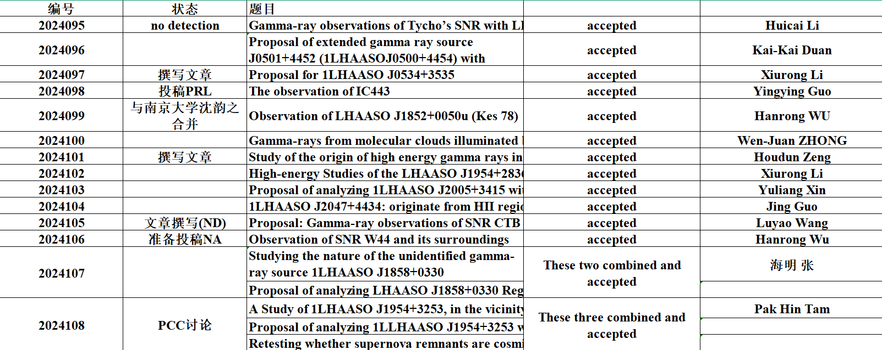
Summary on proposals

Slide 11
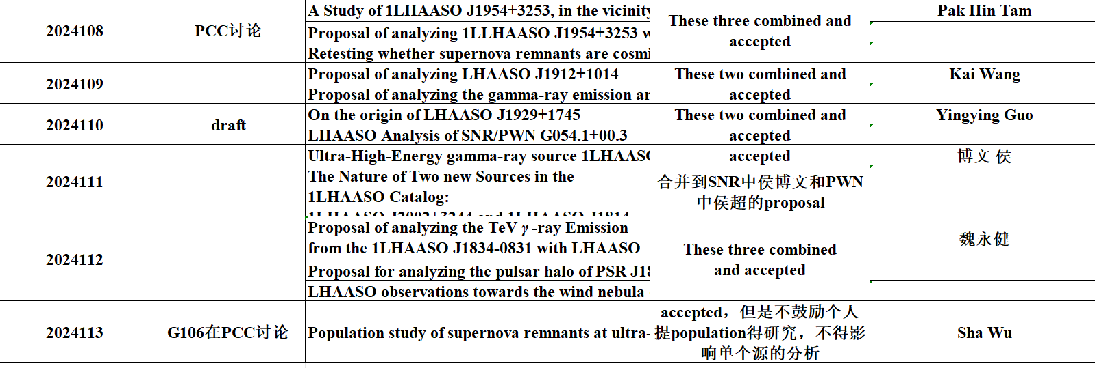
Summary on Proposals

Slide 12
Conclusions
Cassiopeia A might be detected with LHAASO-KM2A in the near future, constraining particle acceleration in the free expansion phase 2 papers
For SNRs in the Sedov phase, the acceleration particle distribution follows a broken power-law with a high-energy cutoff at hundreds of TeV (W51C, IC443, G150, gamma cygni) and molecular clouds illuminated by CRs escaping from SNRs have been seen in G150 and gamma-cygni (W44) 2 papers published 2 submitted
G106, CTB80, G69.7+1.0/J2002+3244u very interesting 3 papers in preparation
J0534+3535(XR Li), J1929 (YY Guo), J2005+3415 (YL Xin), J1839-0545(XB Chen), G57.2+0.8 (HD Zeng) in preparations
CTB109(LY Wang) Tycho (HC Li) no detection.
Other sources proposed before should be released

Slide 13
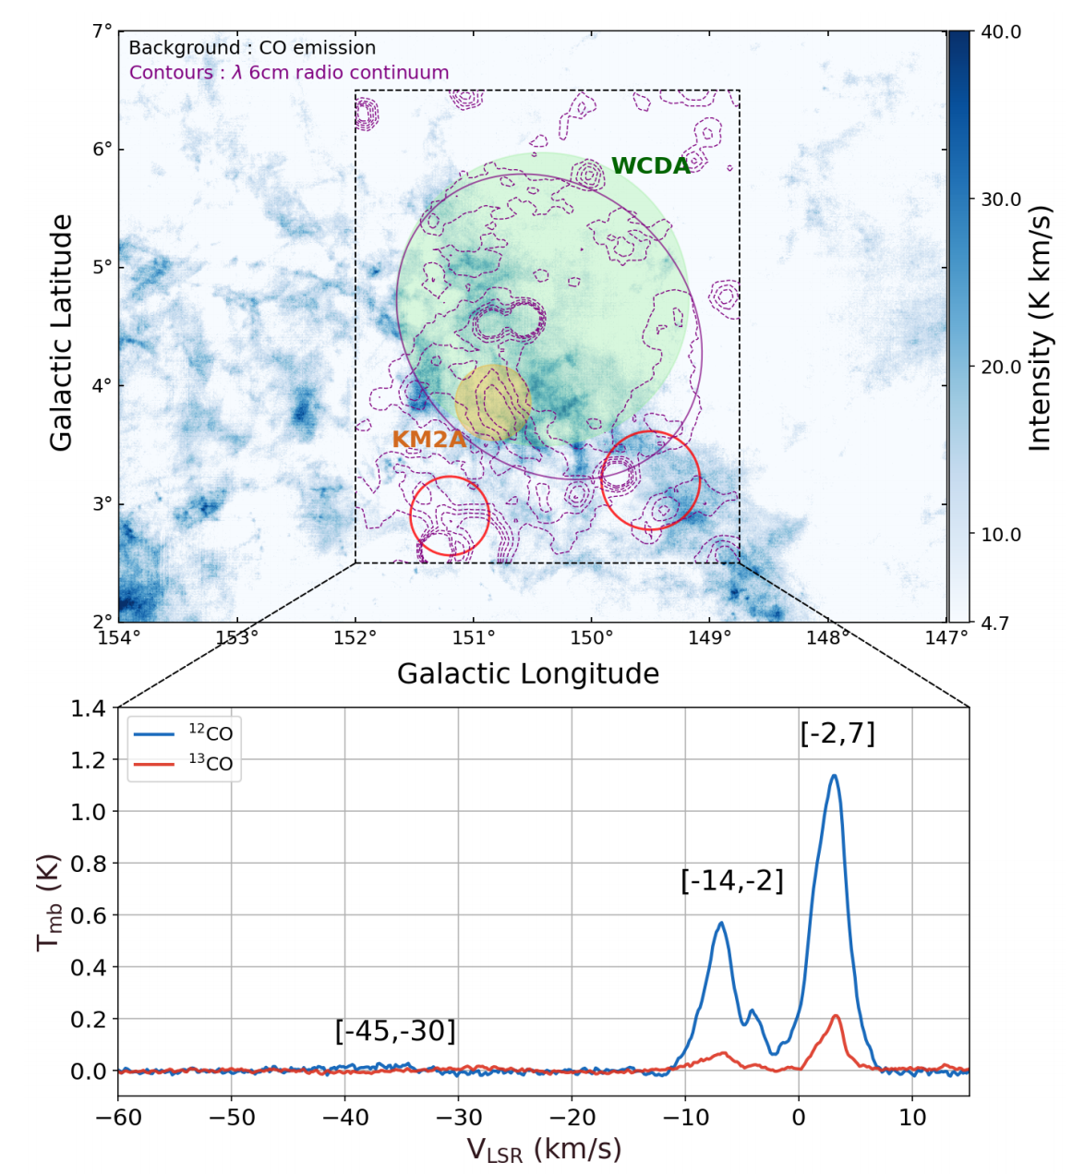
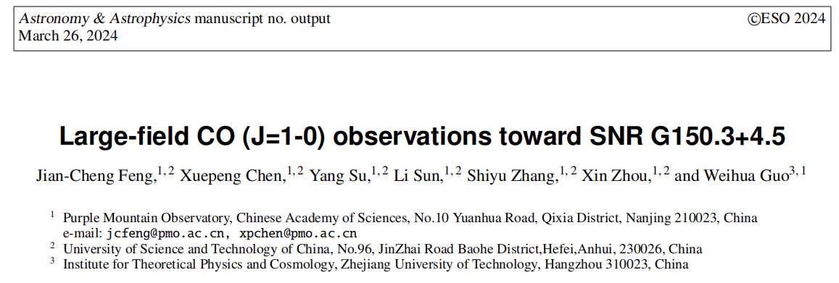
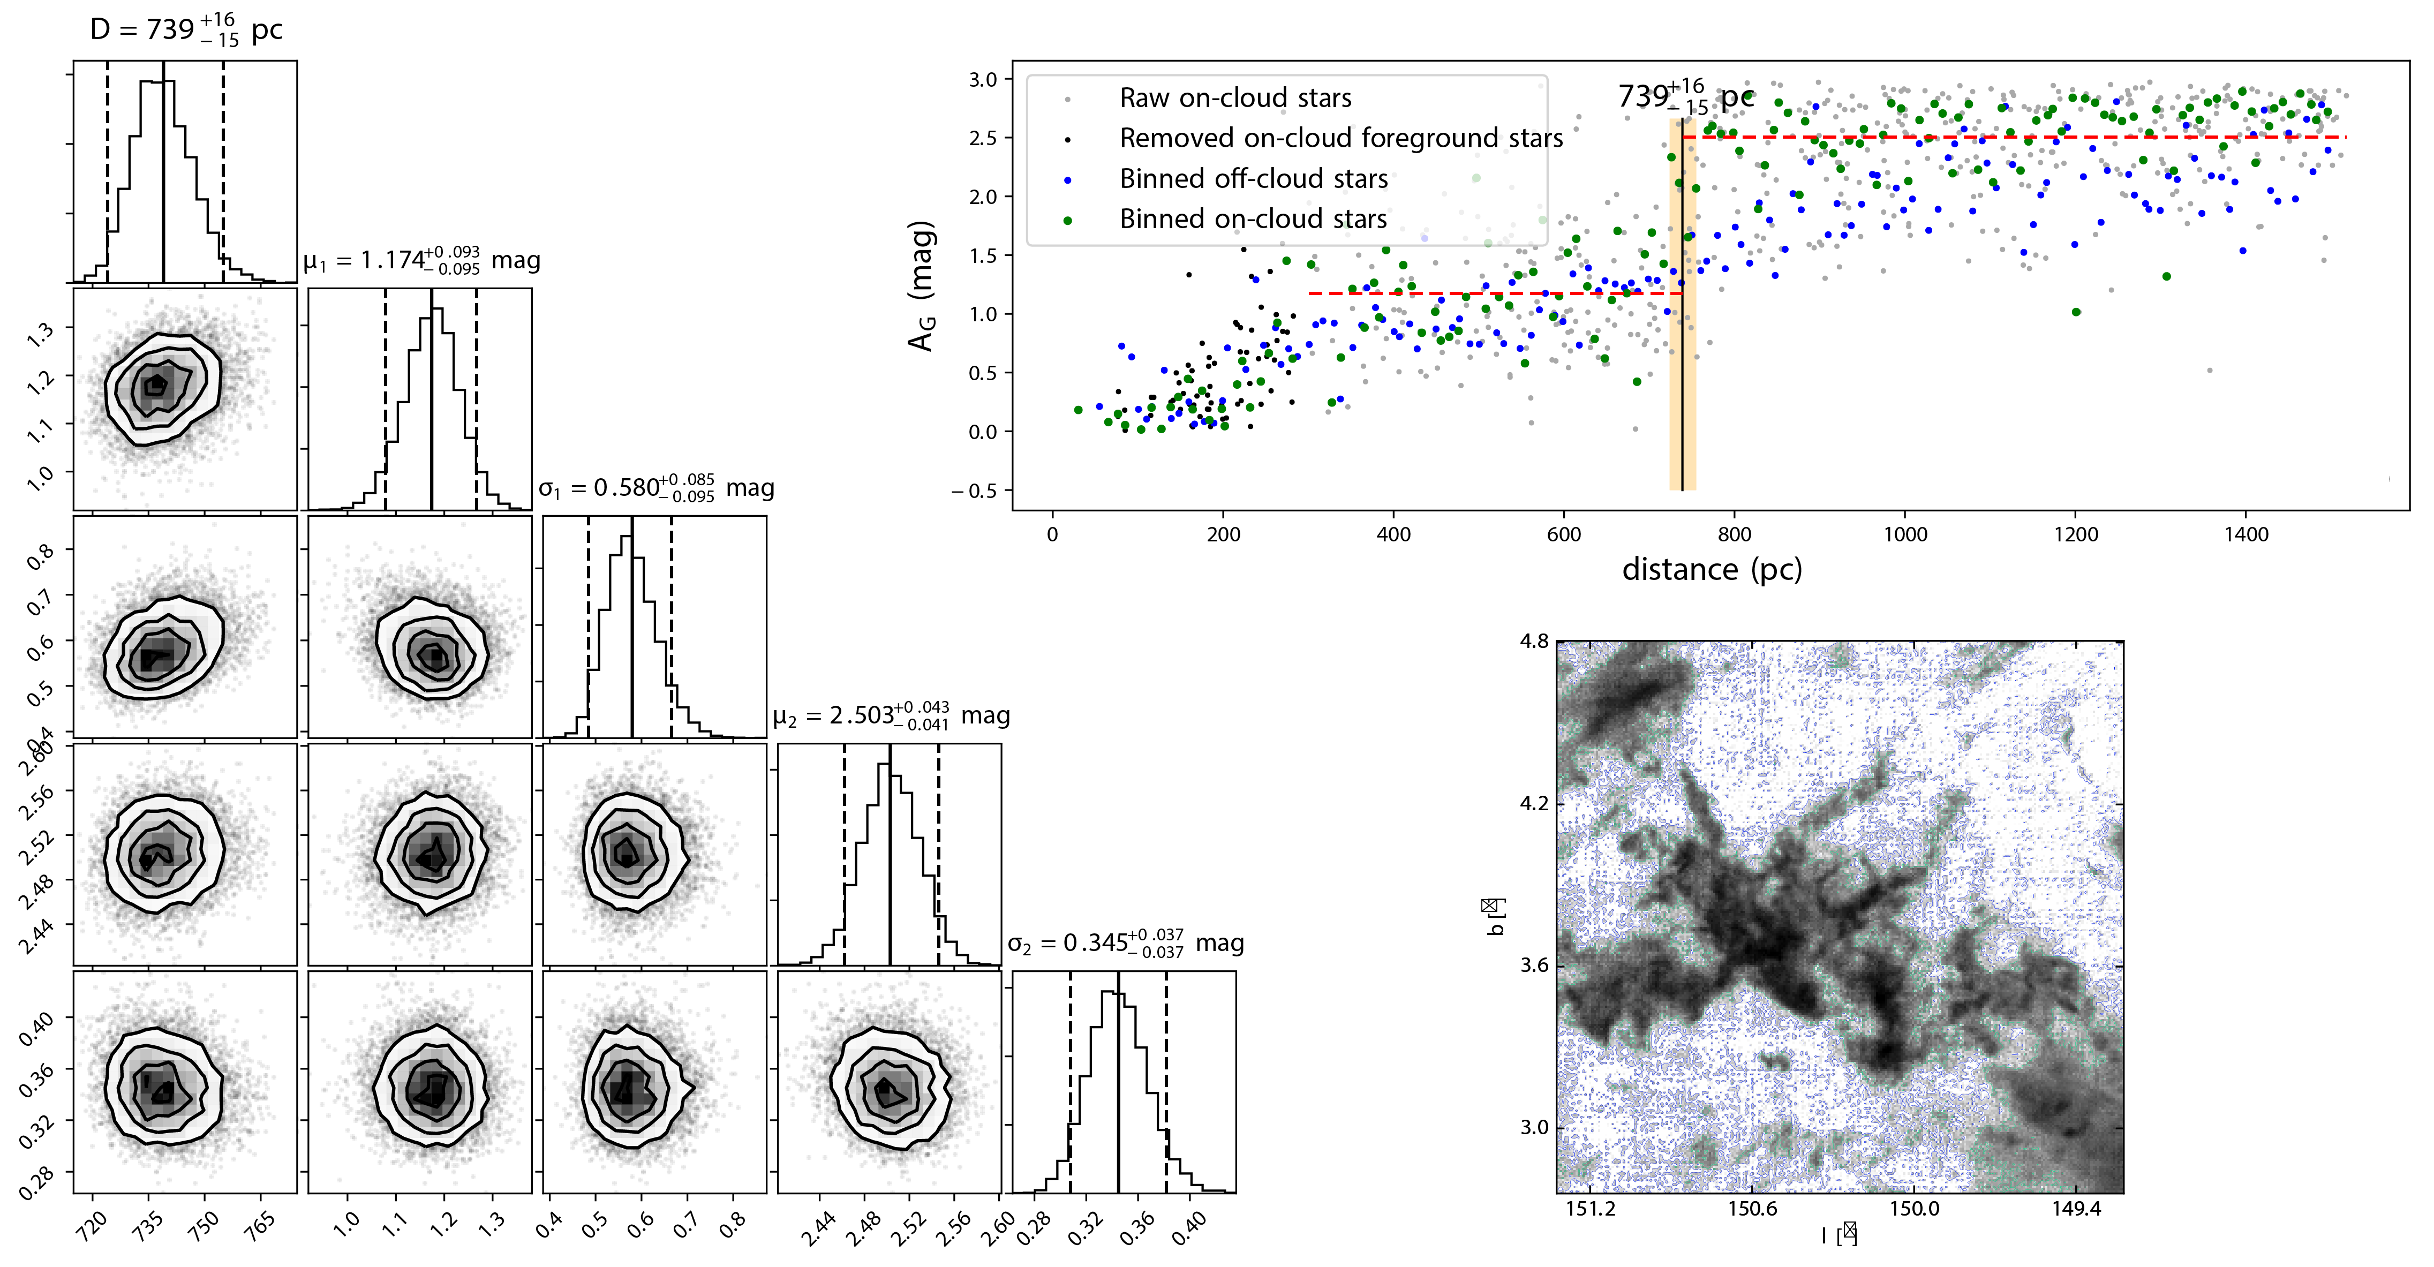
Distance: 740pc Size: 40pc*33 pc Age: 38kyr

Slide 14
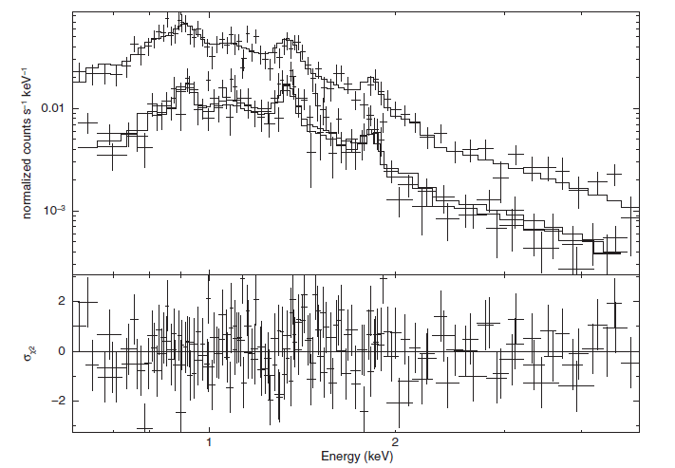
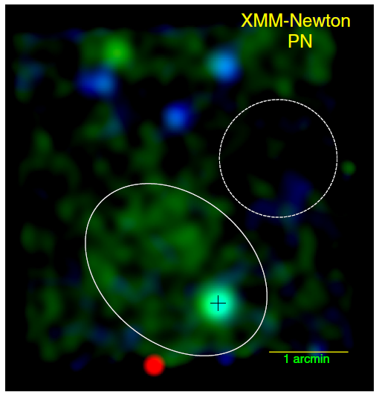
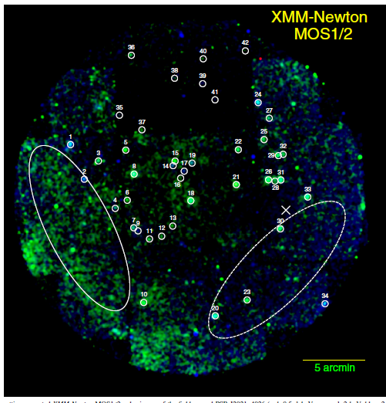
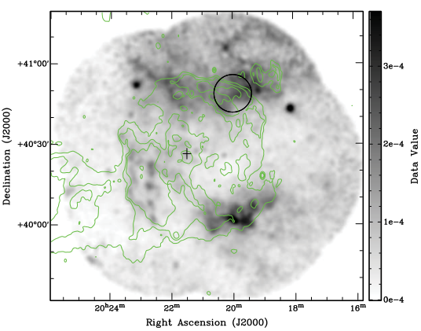
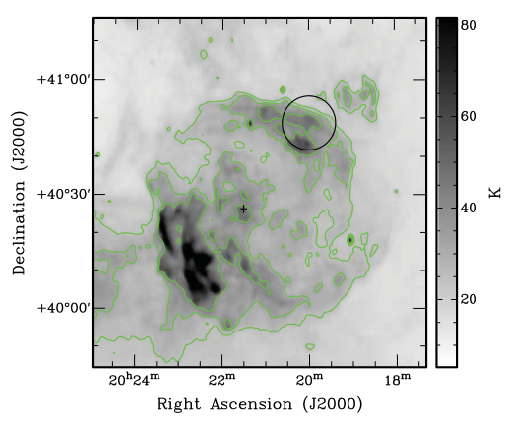
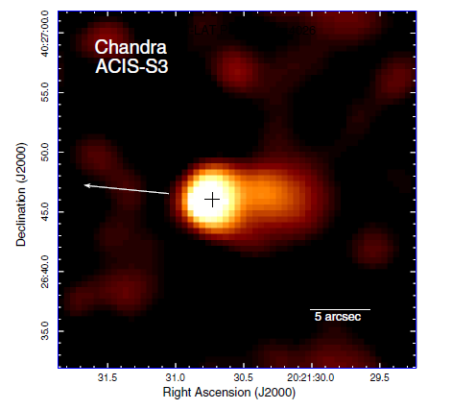
Radio/X-ray obs ϒ Cygni SNR
Distance=1.7kpc
Age =7kyr
PSR J2021+4026
Distance=2.15kpc
τ =77kyr(First variable ϒ-ray pulsar)
Period P=265ms
Edot=10³⁵ erg s ⁻¹
0.2-0.3cm⁻³
15µG
ROSAT PSPC 0.5–2.0keV X-ray image
The 1420-MHz image
MNRAS 436, 968–977 (2013)， Hui et al. ApJ, 799, 76, (2015)

Slide 15
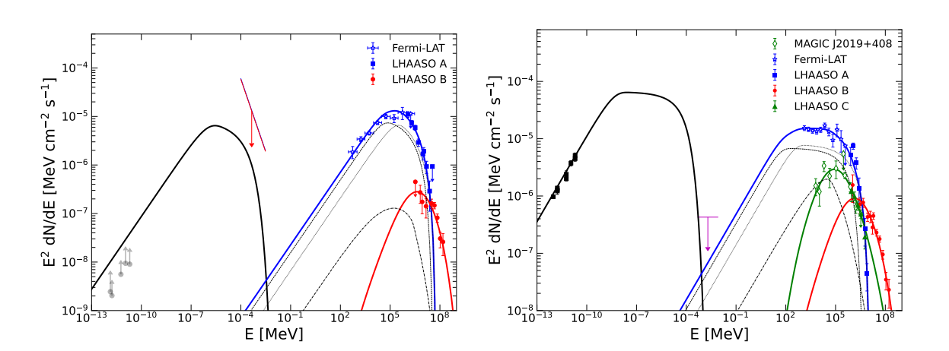
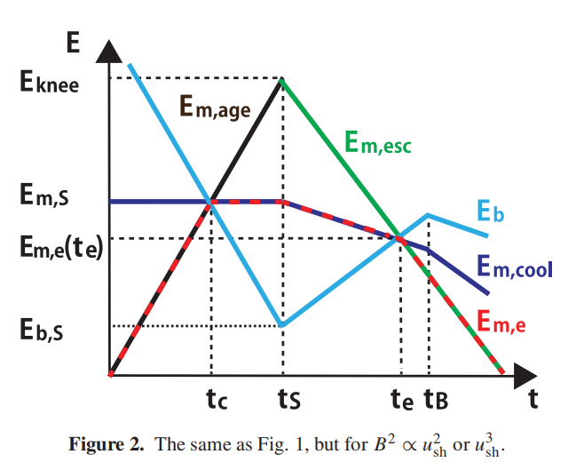
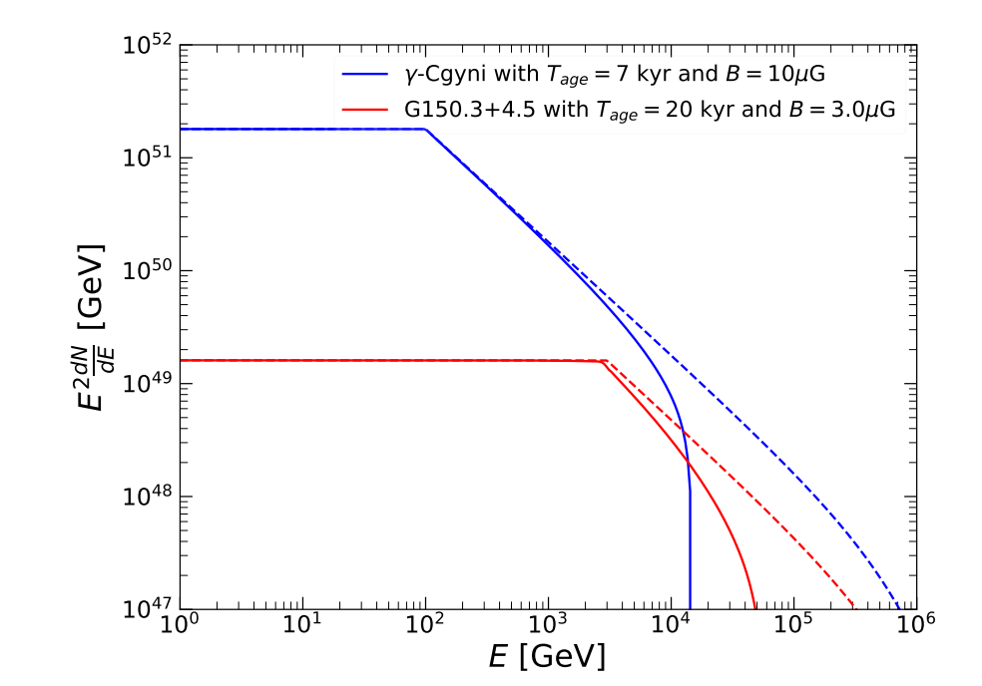
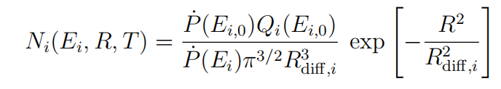
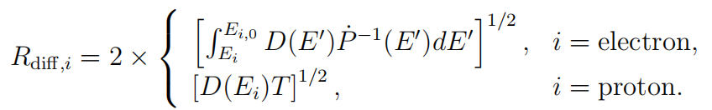

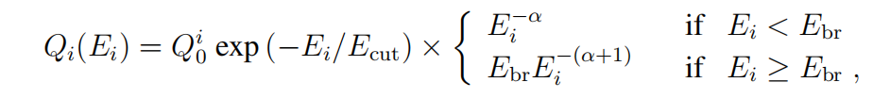
31pc, 6.5e3MꙨ
15pc, 7e4MꙨ
9.3pc, 3.5e3MꙨ
0.1TeV
3TeV
800TeV

Slide 16
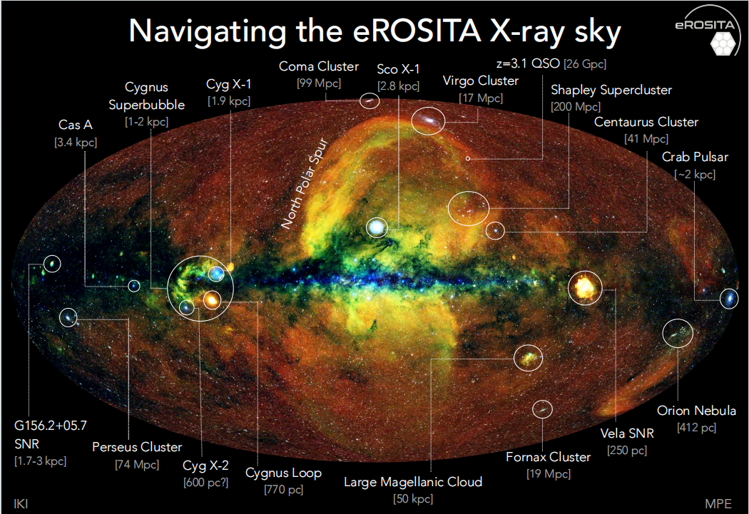
IC443

Slide 17
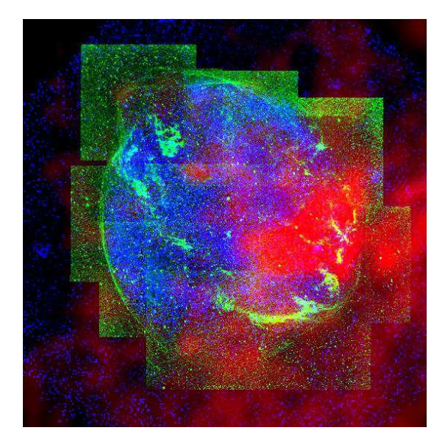
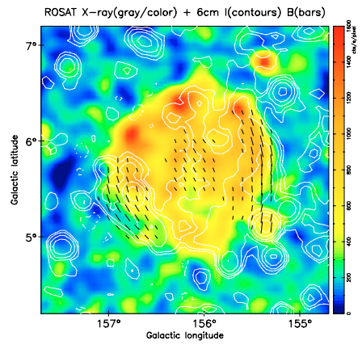
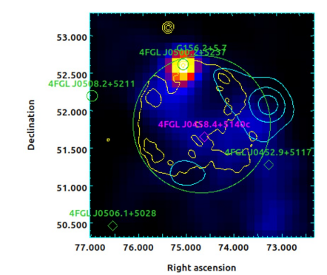
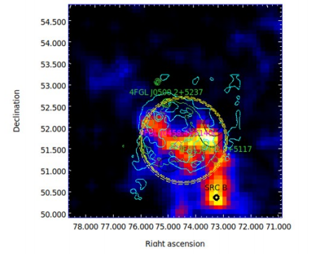




G156.2+5.7

Slide 18



Slide 19


Slide 20





G150: Radio by Urumqi (6 cm) and LHAASO
White: Radio Contour
White: Radio Contour
Black Radio Contours
WCDA KM2A
Urumqi 6 cm observations of the SNR G150.3+4.5.
A&A 643, A28 (2020)
The WCDA source from 2 to 20TeV is spatially associated with the whole radio observation.
The small source at higher energy is concentrated on the brightest part A.

Slide 21



ΔTS(Ecut)= 23 for large
ΔTS(Ecut)= 22 for small

Slide 22




Slide 23


WCDA
KM2A

Slide 24

A Uniformed Interpretation
T: Age
U: shock speed
R: Radius ~ UT
D: Diffusion coefficient ~E^{δ}
Acceleration time： ~D/U²
Escape time: ~R²/D
D/U² ≤R²/D then D ≤UR ~T(free expansion)
~T^{-1/5} (Sedov)
Ohira et al. MNRAS, 2012, 427, 91

Slide 25
Publication Plan
Evidence for sub-PeV cosmic ray acceleration by supernova remnants
Consistent with general views of particle acceleration by shocks of SNRs
Nature

Slide 27


A Uniformed Interpretation
T: Age
U: shock speed
R: Radius ~ UT
D: Diffusion coefficient ~E^{δ}
Acceleration time： ~D/U²
Escape time: ~R²/D
D/U² ≤R²/D then D ≤UR ~T(free expansion)
~T^{-1/5} (Sedov)

Slide 28

SEDs
 | PLEcut(SNR) +PLEcut(dense) (npar=15) | PLEcut(SNR) +PLEcut(dense) (npar=14) | PLEcut(SNR) +PLEcut(dense) (npar=14)
TS(dense_region) | 93 | 71 | -
TS(snr_WCDA) | 138 |  | 115
ΔTS(Ecut)= 23 for large
ΔTS(Ecut)= 22 for small
Highlight: exhibiting a cutoff $\sim 4.7 σ$

Slide 29



Energy-dependent morphology
(Subtract point-source contribution)
From Yuan Li et al. Submitted to AA
Best extension sigma:1.52 degree disk;
Index in north part harder than south part;
White Radio Contours
1GeV above
10GeV above
100GeV above

Slide 30



SED (Yuan Li et al. 2024)
Extend to lower energy(100MeV), no pulsation detected, maybe we can interpret it as hadronic scenario

Slide 31


Multi-wavelength: --------Radio
Radio flux from the entire SNR (Xuyang Gao)
Extra-galactic source
Search for pulsars by FAST with 0.5 hour(Jianli Zhang)
No pulse signals!

Slide 32



LHAASO Catalog
Data: WCDA:2021-2022/09/30 KM2A: 2019-2022/09/30
Analysis: separately analyzed two arrays
?
Extension: 1.18 ± 0.12
Extension: 0.3 ± 0.06 ΔTS(ext)= 18.1
SED: Power law assumption

Slide 33
Background: the results of ICRC2023
Data: WCDA:2021-2022/09/30 KM2A: 2019-2022/09/30 Update to 2023/07
Analysis: separately analyzed two arrays Combined analysis
?
Extension: 1.18 ± 0.12
Extension: 0.3 ± 0.06 ΔTS(ext)= 18.1
SED: Power law assumption

Slide 34






Morphologies
  Jiont fit with WCDA data( 20210305-20230731 MK&Feb) and Full KM2A data (2021-202307)
  Two gaussian templates + Planck dust template
WCDA (nhit>200 2-20TeV ) KM2A: 25-100TeV >100TeV
Extension: 1.3 +-0.18 degree for “SNR_WCDA(large source)”
0.18 +-0.07 degree for “dense region(small source)” by KM2A
Notes:
First, let's take a look at the current observations' significance, which shows significant observations from 2 TeV to 100 TeV.
The joint 3D liklihood is applyied using two arrais.
The model includes two ga
We find two source, ….
The extion
We used a joint fit of the two arrays, employing two Gaussian sources and a template for dust fitting, and found that the extension of the larger source is 1.3 degrees, and the extension of the smaller source is 0.18 degrees. Then, we updated the spectra of the two sources. The blue square markers represent the spectrum points of the larger source, and the red circular markers represent the spectrum points of the smaller source. In this work, we applied power-law spectra with exponential cutoffs. We found that the gamma-ray spectra of both sources have cutoffs, and the significance of the cutoffs is close to 5 sigma.

Slide 35


The association of the high energy component and CO data
ROI(according to radio.)
KM2A
Erec>40TeV
Notes:
/home/lhaaso/yyguo/WCDA_allsky/snrG150_com_AT4/draw_snr150 $ root draw_SNR150_GT40.c
I
f we ovverlap the co contour onto the LHAASO obcervation, we got the two map. The co concentrate on the southern bright part of WCDA ,and spacially conincident with KM2A obeservation.

Slide 36

Significance of high energy cutoff of protons
Proton distribution： E^alpha*exp{-E/100TeV}
alpha=-1
Ecut= 154+-32TeV
delta_TS(Ecut)=23
Notes:
/home/lhaaso/yyguo/WCDA_allsky/snrG150_com_AT2 $ root draw_SED_fromRoot_ColMeeting_pp.c

Slide 37


Constraints on proton distribution

Slide 38


2: High Energy Observations
VERITAS >320GeV
Ra=305°.02, Dec= 40° .76;
Extension=0.23°
MAGIC >250GeV
Ra=304°.89, Dec= 40° .85;
Extension=0°.16
Aliu, E.,et al. 2013, ApJ, 770, 93
MAGIC, 2023, AA arXiv:2010.15854

Slide 39

SED拟合：强子模型
虚线：单幂律（a=2.1）
+指数截断(Ec=10 TeV)
实线：双幂律(a2=a+1,Eb=4TeV)
+指数截断(Ec=10 PeV)

Slide 40


Slide 41




Slide 42

SED拟合：轻子模型----两区模型

Slide 43


2: LHAASO Results
>3TeV
  gaussian：sigma = 0.374 +/- 0.040
  disk：radius = 0.592 +/- 0.056

Slide 44

10GeV-1TeV TSmap
-- total region

Slide 45

10GeV-1TeV TSmap
-- VERITAS region
10GeV-1TeV TSmap
-- SNR shell region

Slide 46


Joint Analyses（delta_TS=24)
Significance of WCDA （left 1-20TeV）and KM2A（right >25TeV)

Slide 47

High energy component:
SED and significance of high energy cutoff
delta_TS(Ecut_KMA2Asource)=26
PLEcut: Power-law with an exponential cutoff

Slide 48


Correlation with CO maps
WCDA KM2A

Slide 49


Correlation with Radio map
WCDA KM2A

Slide 50


Significance of the two components
Significance of low energy component
Significance of high energy component

Slide 51


A Uniformed Interpretation
Broken power-law with high energy cutoffs:
Low energy component: IC dominated one zone emission model with a super exponential cutoff determined by energy loss
High energy component: molecular clouds illuminated by escaping protons
G150
Gamma cygni

Slide 52


G150 and Gamma Cygni

Slide 53


SOME BACKUPS

Slide 54

WCDA 分成两个Gaus是什么样子的

Slide 55



Effects of the diffuse background
对大源的extension 和流强影响最大，和统计误差相当～1error_stat
黑色：用KM2A 测量的弥散伽马流强

Slide 56






The association of γ radiation and CO data
ROI(according to radio.)
KM2A
Erec>40TeV
WCDA
Nhit>200
2-20TeV
Notes:
To compare the gamma signals and co mass distribution, we draw singal profile along declination. In the right pannal, The red points denotes … the profile above 40TeV is consistant with co Mass distribution.The chi2 is comparable to ndf. However, at low energy, this northenn flux is significantly higher than co distribution.

Slide 57


The multi-wavelength observation--Fermi
2-20TeV
Fermi Gaussian Sigma
Fermi Gaussian Sigma(Left)/R68(Right)
The position measured by WCDA is consistent with the results from Fermi at the 1σ level.

Slide 58

Multi-wavelength: Gaia data
Credit: Yang Su
The distance is precisely determined to ${739}_{−15}^{+16}$ pc

Slide 59


Multi-wavelength: CO data by MWISP
Credit: Yang Su
The velocity distributions in different regions.
The broadening of spectral lines implies that the molecular cloud is likely interacting with SNRG150.3+4.5.

Slide 60

LHAASO: More high-energy γ rays
Radio: Brightest part
CO: dense region

Slide 61

The association of γ radiation and CO data
ROI(according to radio.)
WCDA Nhit>200
2-20TeV
KM2A
Erec>40TeV

Slide 62
The association of γ radiation and CO data
WCDA
Nhit>200
2-20TeV
ROI(according to radio.)
KM2A
Erec>40TeV

Slide 63

Constraints on proton distribution
Proton distribution： E^alpha*exp{-(E/100TeV)**Super}
super=1
super=10

Slide 64
A brief summary of multiwave observation
LHHASO observed two sources:
The differences of these parameters may imply different origins.
Name | Location(J2000) | Extension(deg) | Ecut(TeV) | Association
SNR_WCDA | RA:66.98+-0.40， DEC:55.52+-0.21 | 1.30+-0.18 | 13.7+-5.5 | SNR G150.3+4.5
Dense region | RA: 66.63+-0.12, DEC:54.52+-0.06 | 0.18+-0.07 | 29.2+-13.3 | CO cloud
The distance(740pc) of the SNR and the mass(total snr: 1e4Msun) of the molecular cloud has been precisely determined

Slide 65

Discussion on their origins
SNR is interacting with molecular cloud.
SNR_WCDA: dominated by leptonic process
Low energy cutoff come from energy loss of electrons: about 10 TeV with Tage=20 kyr and B=9 muG (J2000)eg)
Dense region: dominated by hadronic process
High energy cutoff come from the maximum proton energy of SNRs acceleration: 550 TeV
X-ray upper limit may not be reliable

Slide 66
Discussion on their origins
SNR is interacting with molecular cloud.
SNR_WCDA: dominated by leptonic process
Low energy cutoff come from energy loss of electrons: about 10 TeV with Tage=20 kyr and B=9 muG (J2000)eg)
Dense region: dominated by hadronic process
High energy cutoff come from the maximum proton energy of SNRs acceleration: 550 TeV
X-ray upper limit may not be reliable
Thanks!

Slide 68

Back up X-ray upper limit

Slide 69



Slide 70


Back up

Slide 71



Slide 72


弥散对测量的影响
弥散=0 roi（gb：0-8）内平均弥散~PRL out_region 自由拟合roi 内的弥散(PL能谱）

Slide 73
弥散对能谱点误差的影响

Slide 74


弥散对误差的影响
x[0]=2.551, y[0]=5.6248e-12, ex[0]=0, ey[0]=1.2407e-12
x[1]=4.058, y[1]=3.9397e-12, ex[1]=0, ey[1]=1.2103e-12
x[2]=6.386, y[2]=2.9794e-12, ex[2]=0, ey[2]=8.616e-13
x[3]=10.723, y[3]=2.0733e-12, ex[3]=0, ey[3]=7.783e-13
x[4]=19.052, y[4]=1.272e-12, ex[4]=0, ey[4]=0
x[5]=24.406, y[5]=7.971e-13, ex[5]=0, ey[5]=0
x[0]=12.196, y[0]=3.211e-13, ex[0]=0, ey[0]=0
x[1]=17.256, y[1]=1.24457e-13, ex[1]=0, ey[1]=1.04203e-13
x[2]=29.055, y[2]=1.15694e-13, ex[2]=0, ey[2]=8.13095e-14
x[3]=32.104, y[3]=1.40107e-13, ex[3]=0, ey[3]=7.80308e-14
x[4]=47.541, y[4]=1.42714e-13, ex[4]=0, ey[4]=4.81389e-14
x[5]=69.741, y[5]=9.09819e-14, ex[5]=0, ey[5]=3.47397e-14
x[6]=102.281, y[6]=3.43239e-14, ex[6]=0, ey[6]=2.52476e-14

Slide 75

Galactic pictures

Slide 76

J2000 all components

Slide 77

Morphologies
  Jiont fit with WCDA data( 20210305-20230731 MK) and Full KM2A data (2021-202307)
  Two gaussian templates + Planck dust template
WCDA (nhit100-800: 2-10TeV ) KM2A: 25-100TeV >100TeV
Extension: 1.3 degree for “SNR_WCDA(large source)”
0.18 degree for “dense region” by KM2A

Slide 78
Multi-wavelength: Gaia data
The distance is precisely determined to ${739}_{−15}^{+16}$ pc

Slide 79



Multi-wavelength: CO data by MWISP
740pc
300pc
[-40,-25]
[-14,-1]
[-1,10]

Slide 80

Updata on the analysis of SNR G150.3+4.5 ---- CO data with MWISP

Slide 81

Updata on the analysis of SNR G150.3+4.5 ---- CO data with MWISP
The distance of the SNR and the mass of the molecular cloud has been determined
d=740pc
size：40 X 35 pc （3◦x 2.6◦）
Z_scale: 50 pc
Assumed M～10^4 Msun, r~20pc, μ=2.33：
n0～5 cm-3
Base on
t_age ～ 1.1*^4 yrs
Vs ～366 km/s

Slide 82



Slide 83


backup

Slide 84





Slide 85


Backgroud: the results of ICRC2023
Black: WCDA; Purple: KM2A;
red dashed: radio Blue and green: Fermi
has a pulsar-like spectrum.
Consider morphology, Two possible explanations:
Scenario one: SNR plus PWNs
Scenario two: SNR plus MCs

Slide 86


Scenario two: SNR plus MCs
Scenario one: SNR plus PWNs

Slide 87

Fermi

