Slide 1


A Multi-wavelength Study of the
UHE γ-ray Source LHAASO J1839−0553
Speaker: Xiao-Bin Chen
Collaborators: Felix Aharonian, Shao-Qiang Xi, Yi-Heng Chi,
Xiang-Yu Wang, Ruo-Yu Liu
The First LHAASO Collaboration Conference in 2026
Notes:
Today I will present a multi-wavelength study of the ultra-high-energy gamma-ray source 1LHAASO J1839−0545u, focusing on the latest results from LHAASO.

Slide 2

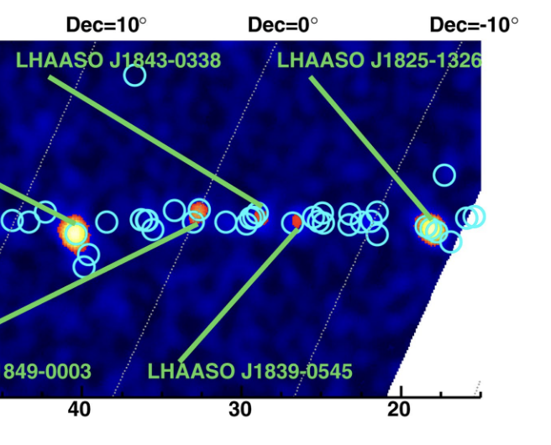
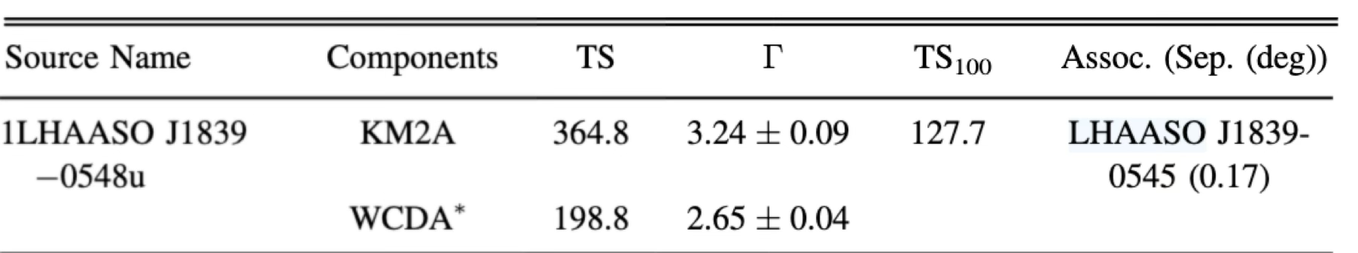
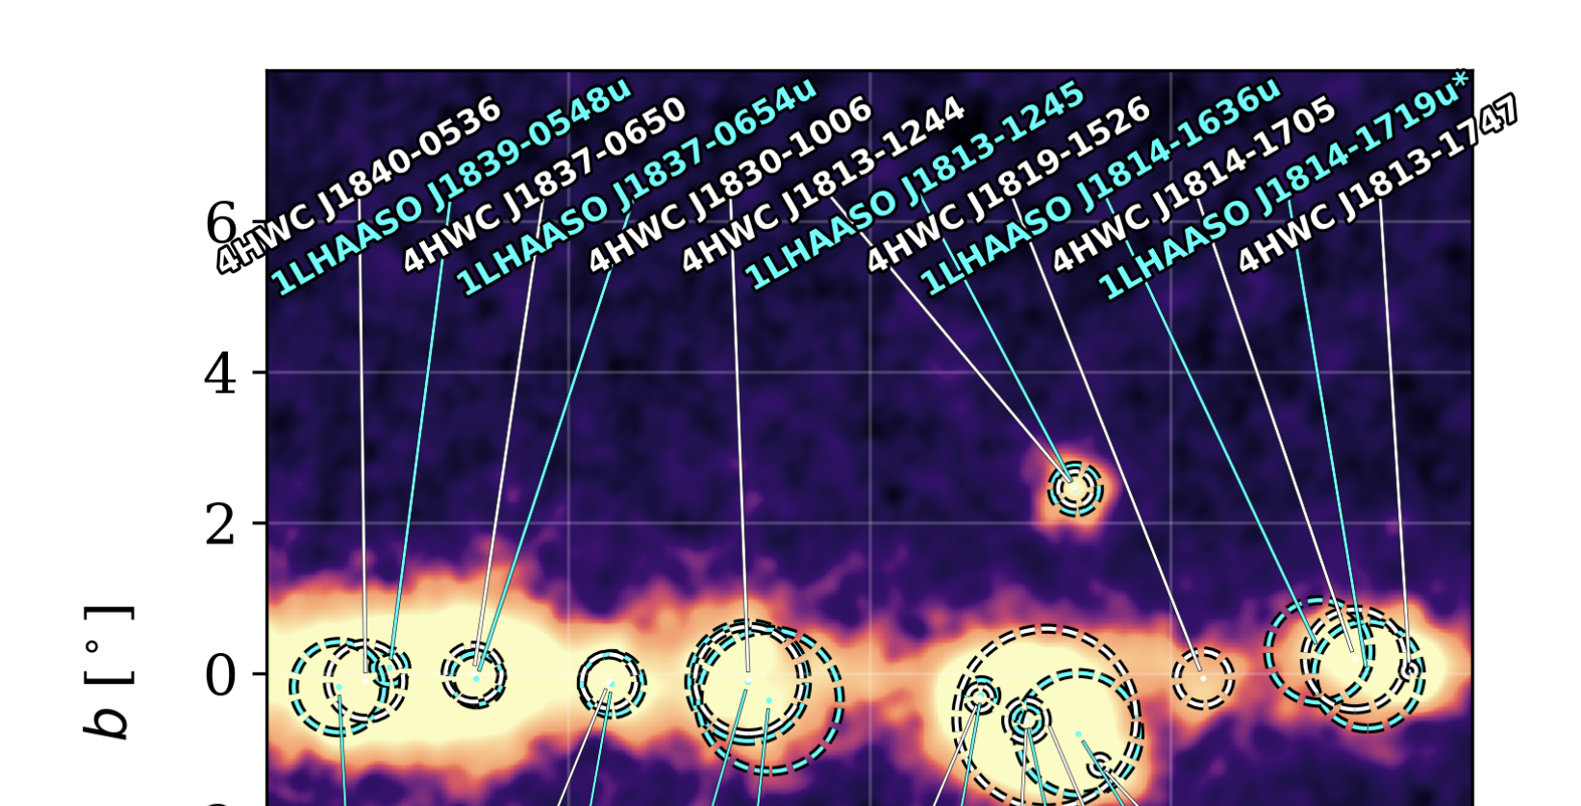

01
Introction: 1LHAASO J1839−0545u
LHAASO sky map at energies above 100 TeV
Ultrahigh-energy photons up to 1.4 petaelectronvolts from 12 γ-ray Galactic sources (Cao et al. 2021 paper)
KM2A: 308.33 days
Significance above 100 TeV : 7.7σ
Emax (PeV) : 0.21 ± 0.05
Flux at 100 TeV (CU) : 0.70(0.18)
The First LHAASO Catalog of Gamma-Ray Sources
Extended UHE
J1839-0548u
WCDA: 508 days && KM2A: 933 days
The Fourth HAWC Catalog (HAWC in 2026)
Extended UHE
HWC J1840-0536
Notes:
This source was first highlighted by the LHAAS, Ultrahigh-energy photons up to PeV from twelve γ-ray Galactic sources。
It shows significant emission above 100 TeV, indicating very efficient particle acceleration in this region.
Then， In the first LHAASO catalog, this source was updated using both WCDA and KM2A data.
Also， It has been independently detected by HAWC.

Slide 3
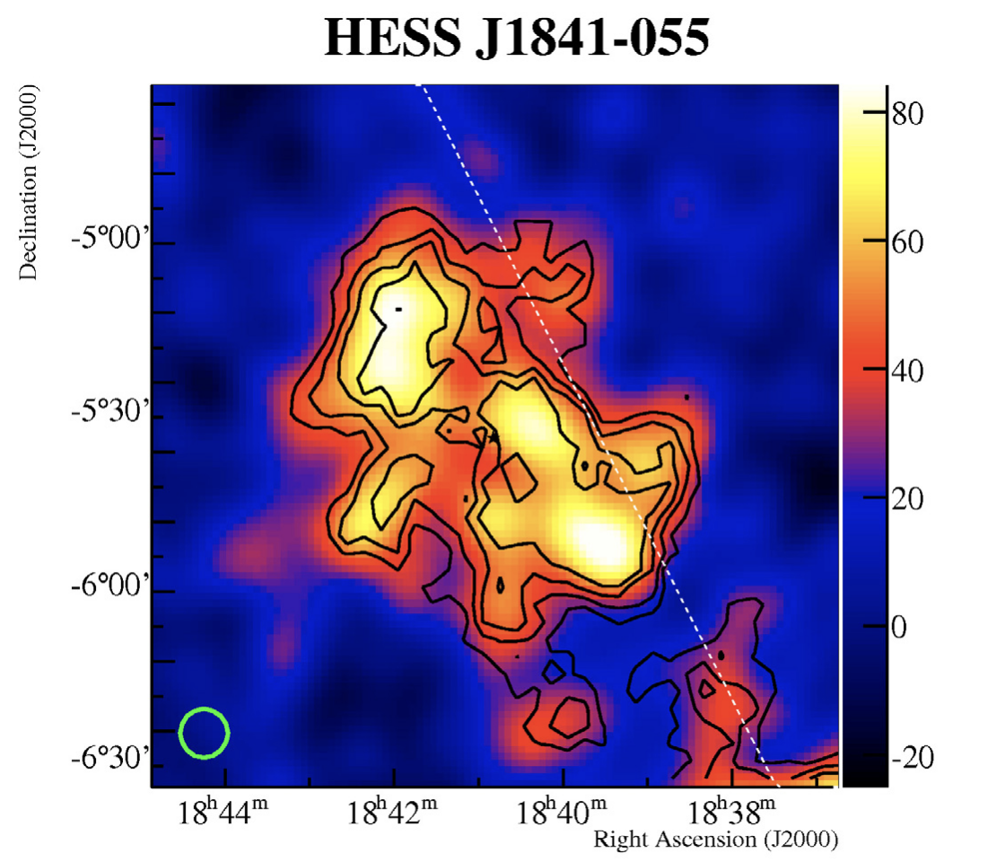
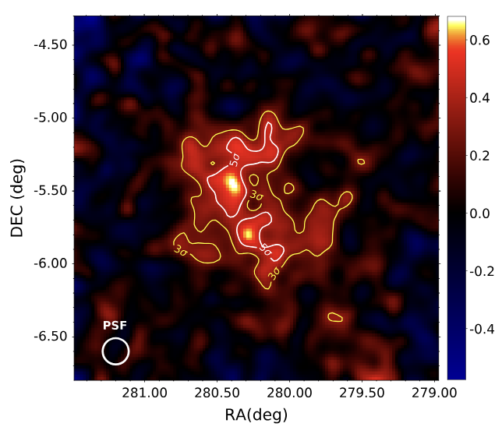
01
Introction: Resolving HESS J1841-055 with LHAASO
First discovered by H.E.S.S. in 2007
MAGIC in 2020
LHAASO Results:
HESS J1841-055 is resolved into:
• LHAASO J1839-0553
• LHAASO J1841-0527
→ Two independent extended sources
→ Different spectral properties
Elongated 2-D Gaussian model fit (H.E.S.S. in 2007)
2 Gaussian components fit (H.E.S.S. in 2018)
multisource model (MAGIC in 2020)
→ Complex morphology
→ Possibly two or three peaks
Notes:
This region was first discovered by H.E.S.S.
It shows a very complex and extended morphology, possibly with multiple peaks,
but the structure could not be clearly resolved.
Later, MAGIC also suggested a multi-source scenario,
but the interpretation was still unclear.
With LHAASO, we can now clearly resolve this region.
In particular, the HESS source is separated into two independent extended sources:

Slide 4
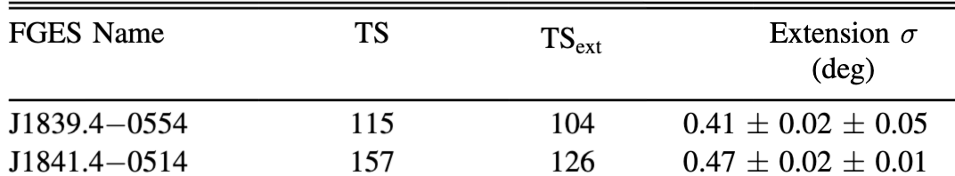
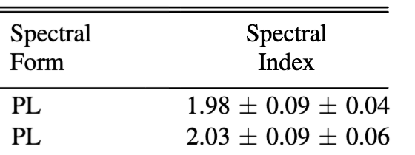
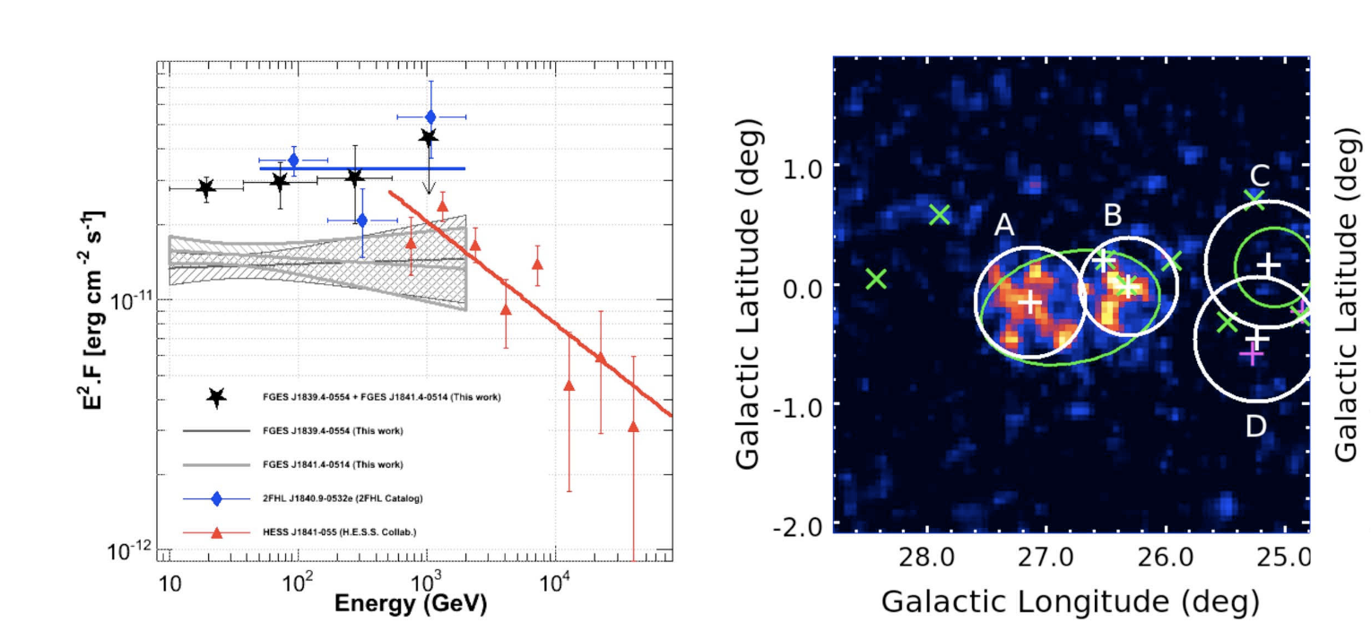
01
Introction: Fermi-LAT (>10GeV)
Fermi Galactic Extended Source (FGES) catalog
HESS J1841-055 is resolved into:
• FGES J1839.4−0554
• FGES J1841.4−0514
→ Two extended sources
→ Consistent with LHAASO decomposition
Ackermann et al. (2017 Fermi-LAT)
It is detected as two separate disks.
Notes:
Next, We look at the Fermi-LAT results above 10 GeV.
In the Fermi Extended Source catalog, this region is also resolved into two extended sources,
This is very important, because it independently confirms that the region is not a single source, but consists of multiple components.
The morphology and extension are also consistent with what we see in the LHAASO data.
Therefore, both Fermi and LHAASO consistently indicate that HESS J1841-055 should be interpreted as multiple extended sources rather than a single complex structure.

Slide 5
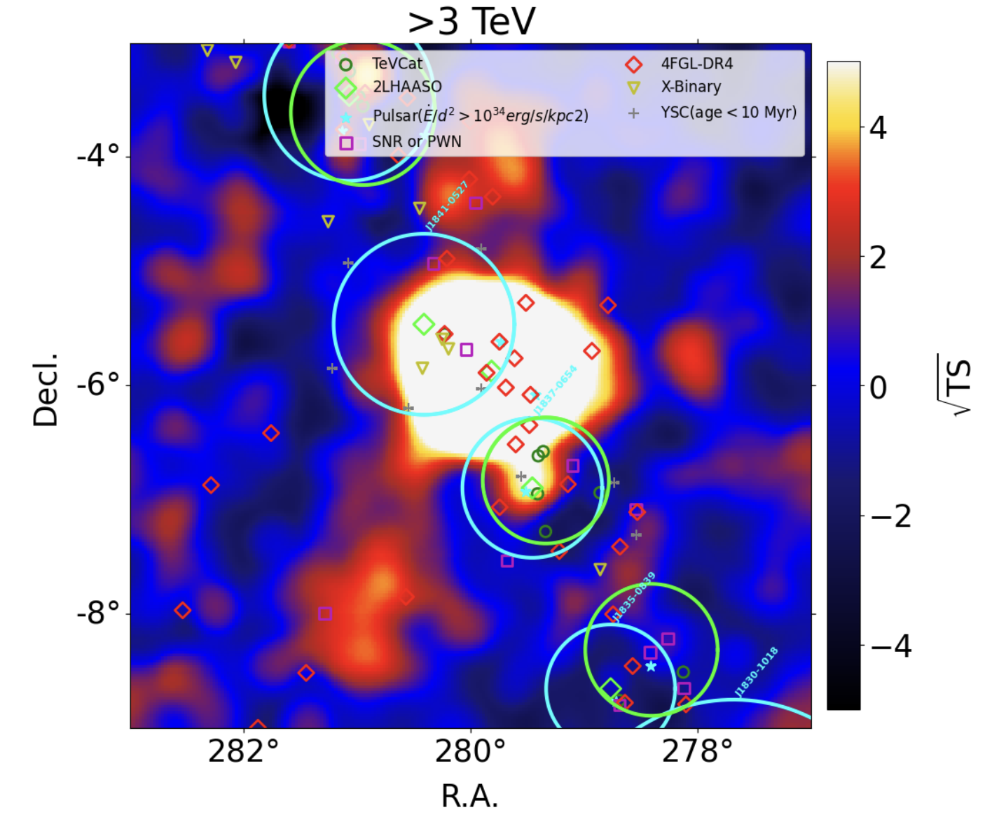
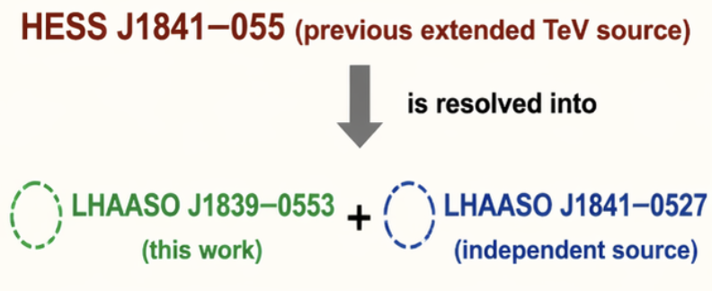
02
LHAASO Analysis: Resolving the Source Region
Source-subtracted TS map
All neighboring sources removed
Residual emission from J1839−0553
Update for LHAASO:
The life time of the WCDA data is 1484.36 days!
The life time of the KM2A data is 1944.3 days!
The zenith angle cuting of this data is 50 degree!
6 independent LHAASO sources within ROI
J1839-0533
J1839-0533
Notes:
Using the latest LHAASO data up to 2025, we analyze this region.
We defined a ROI of 6 by 6 degrees, covering the entire complex area.
Within this region, we identify six LHAASO sources.
Importantly, the previously extended TeV source HESS J1841−055 is now resolved into two new sources: LHAASO J1839−0553 and LHAASO J1841−0527.
In this work, we focus on LHAASO J1839−055.

Slide 6
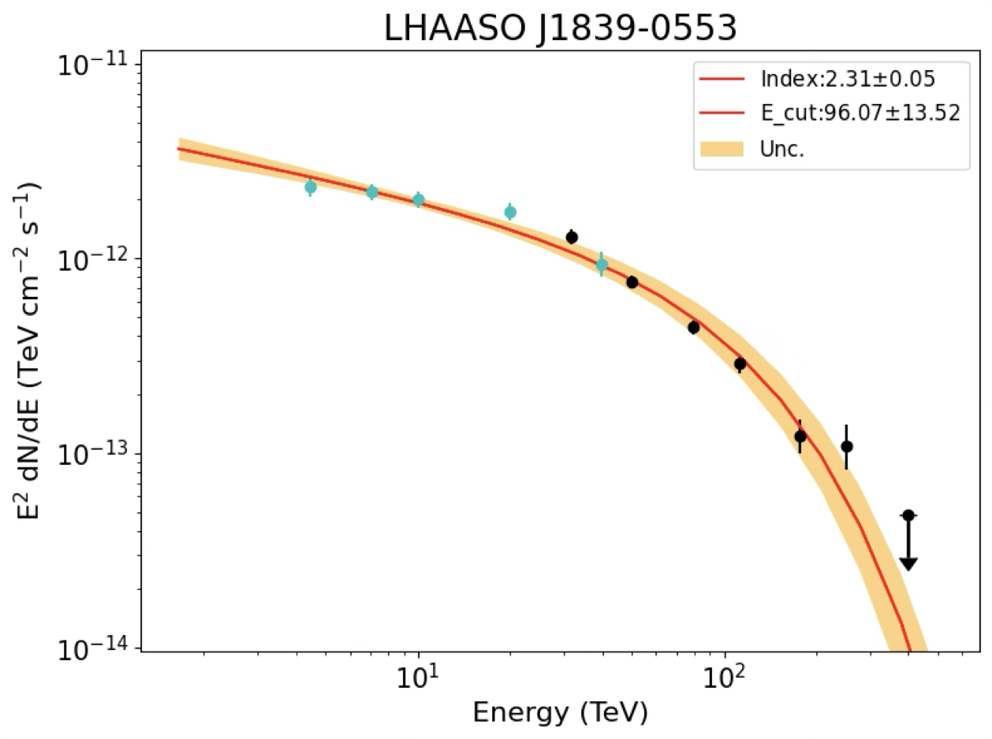
02
LHAASO result: Morphological and Spectral Fitting Results
SED: fix PLC
Morpholog: fix gaussian
new data to 2025/07/31
model | negative_loglike | Δ AIC
point source | -17712.623 | --
gaussian | -17826.593 | -225.9
disk | -17827.802 | -228.3
halo | -17822.201 | -217.1
two gaussian | -17826.593 | -219.9
Ellipse gaussian | -17828.825 | -226.4
sed | negative_loglike | Δ AIC
PL | -17759.752 | --
PLC | -17826.593 | -131.6
LP | -17830.424 | -139.3
BPL | -17826.654 | -129.8
Significant spectral curvature：
the maximum acceleration or
the confinement capability
Disk model provides the best-fit morphology!
Notes:
Here we present the morphological and spectral fitting results.
On the left, we compare different spatial models.
The source is clearly extended, with the disk model preferred.
On the right, we test different spectral models while fixing the Gaussian morphology.
A simple power-law model is bad, while curved models such as the power-law with exponential cutoff is better.
In particular, the data show a clear spectral curvature, as illustrated in the SED plot below.
The clear spectral curvature may reflect the maximum acceleration or confinement of particles.

Slide 7
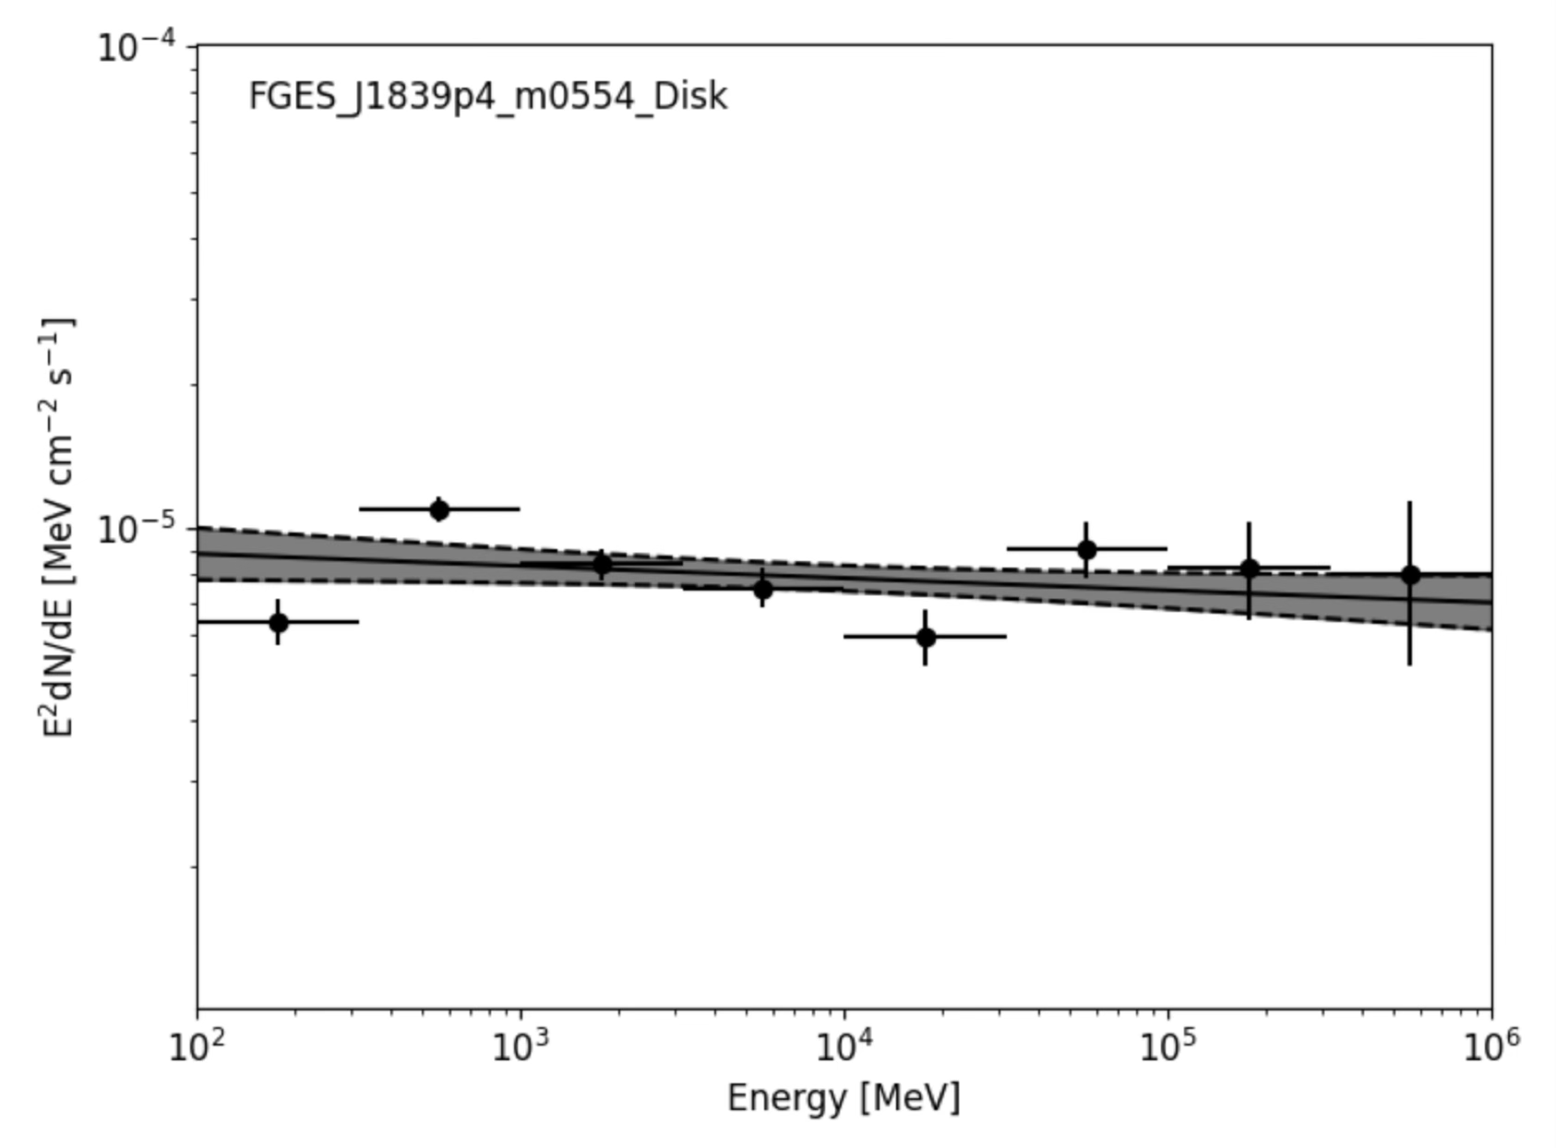
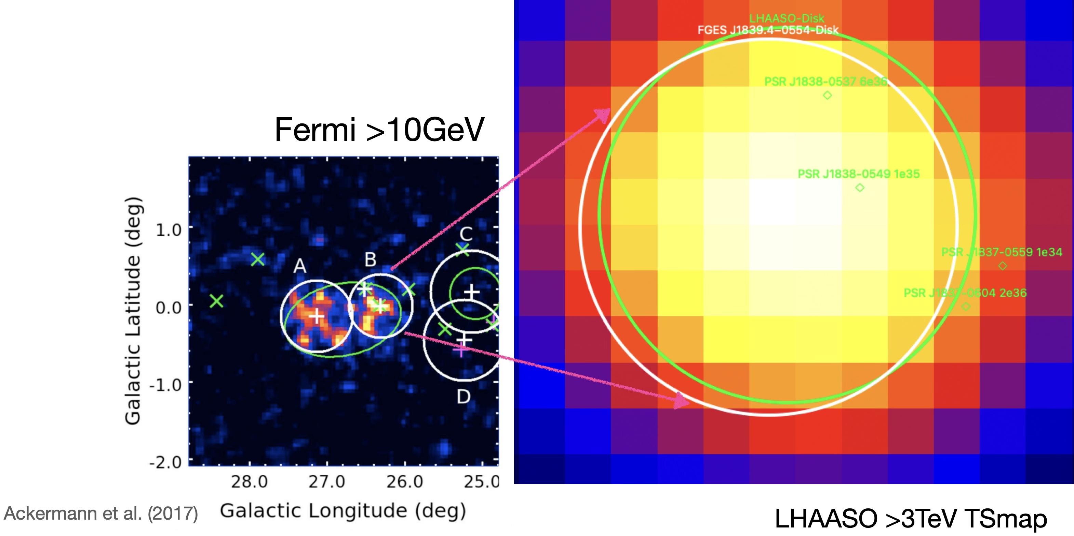
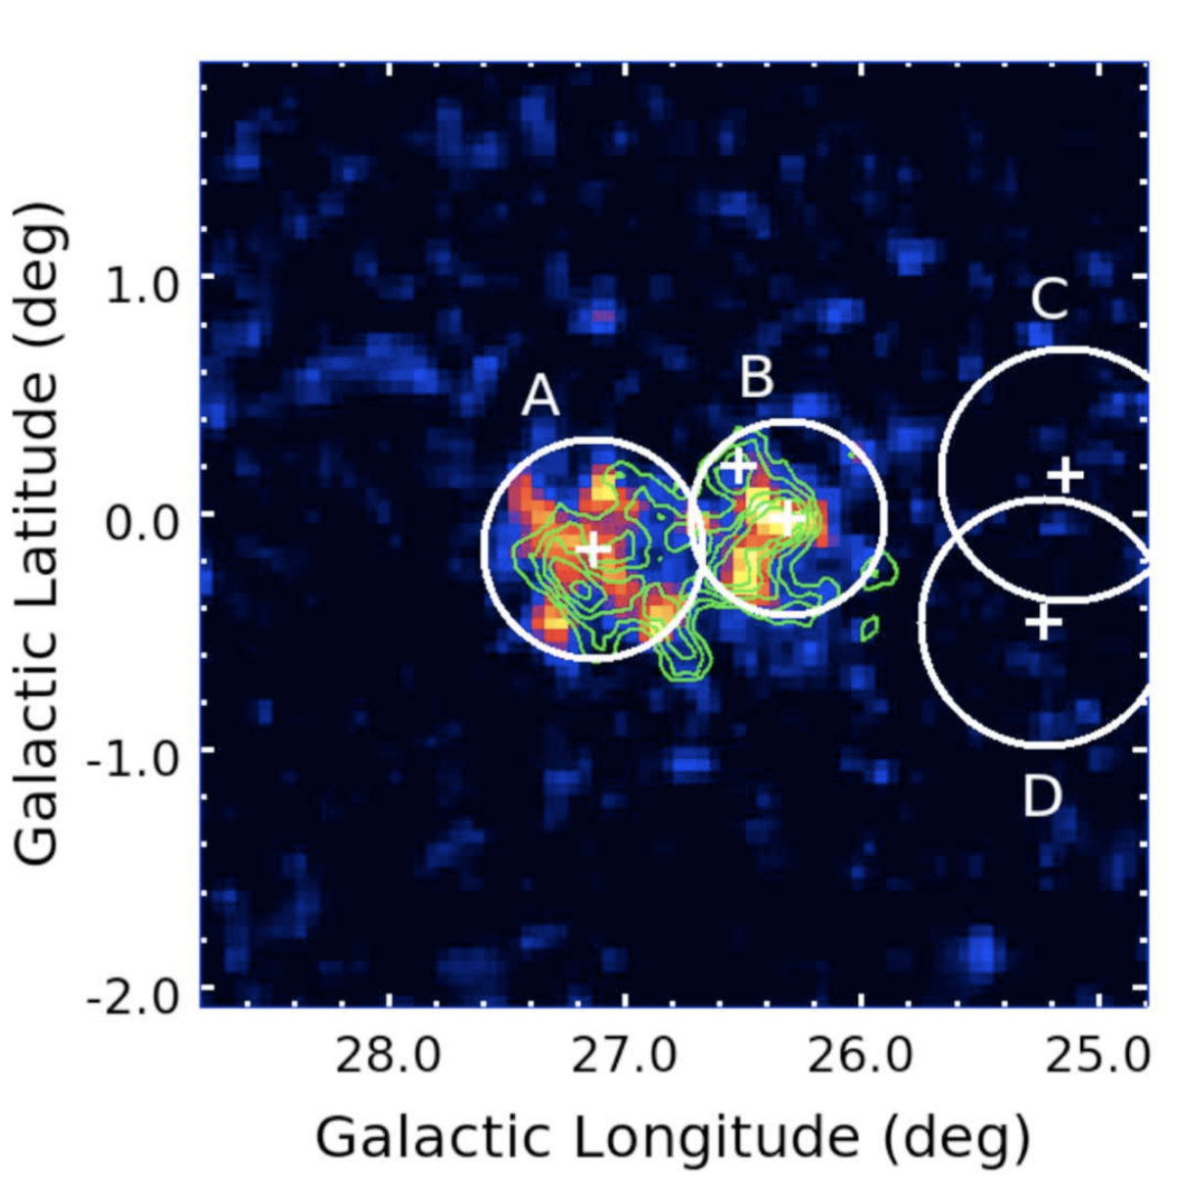
02
Multi-wavelength: update for Fermi-LAT
SED
We also reanalyzed the latest Fermi-LAT data
from 100MeV to 1TeV
multi-wavelength consistency
green contours:
HESS J1841-055
Fermi > 10GeV TSmap
Notes:
Here we combine the Fermi and LHAASO results to study the source across a broad energy range.
We also reanalyzed the latest Fermi-LAT data from 100MeV to 1TeV.
The morphology is already consistent with the two-component structure.
It suggests that the emission across this wide energy range originates from the same physical source.
This May indicate a common emission mechanism from GeV to TeV energies.

Slide 8
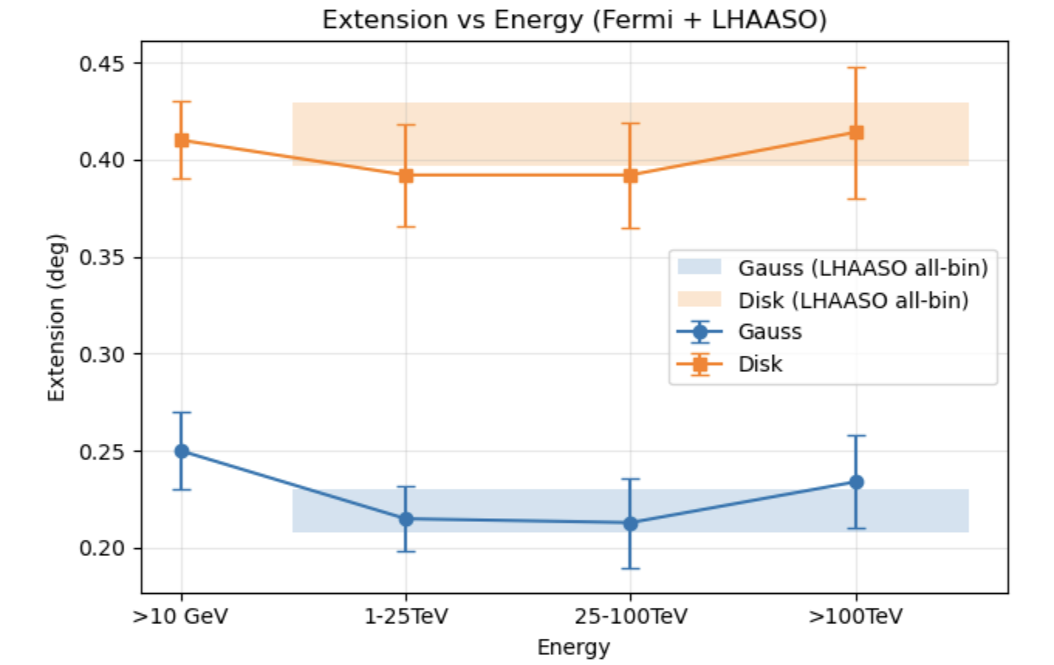
02
LHAASO and Fermi-LAT
 |  | Fermi-LAT (>10GeV) | WCDA | 25-100TeV | >100TeV | LHAASO all bin
gauss | ext (r₃₉) | 0.25 ± 0.02 | 0.215 ± 0.017 | 0.213 ± 0.023 | 0.234 ± 0.024 | 0.219 ± 0.011
disk | ext | 0.41 ± 0.02 | 0.392 ± 0.026 | 0.392 ± 0.027 | 0.414 ± 0.034 | 0.413 ± 0.016
No morphology evolution from 10 GeV to >100 TeV
→ Same physical region
→ No strong energy-dependent transport
→ Gas distribution may dominate the morphology
Notes:
To study this further, we also look at the LHAASO data in different energy bins.
The table summarizes the best-fit extensions using both Gaussian and disk models.
We find that the extension is almost constant from 10 GeV to above 100 TeV.
as the figure, showing the extension as a function of energy.
Within uncertainties, the extension remains remarkably constant across the all energy range.
This suggests the same origin and no strong energy-dependent morphology.

Slide 9
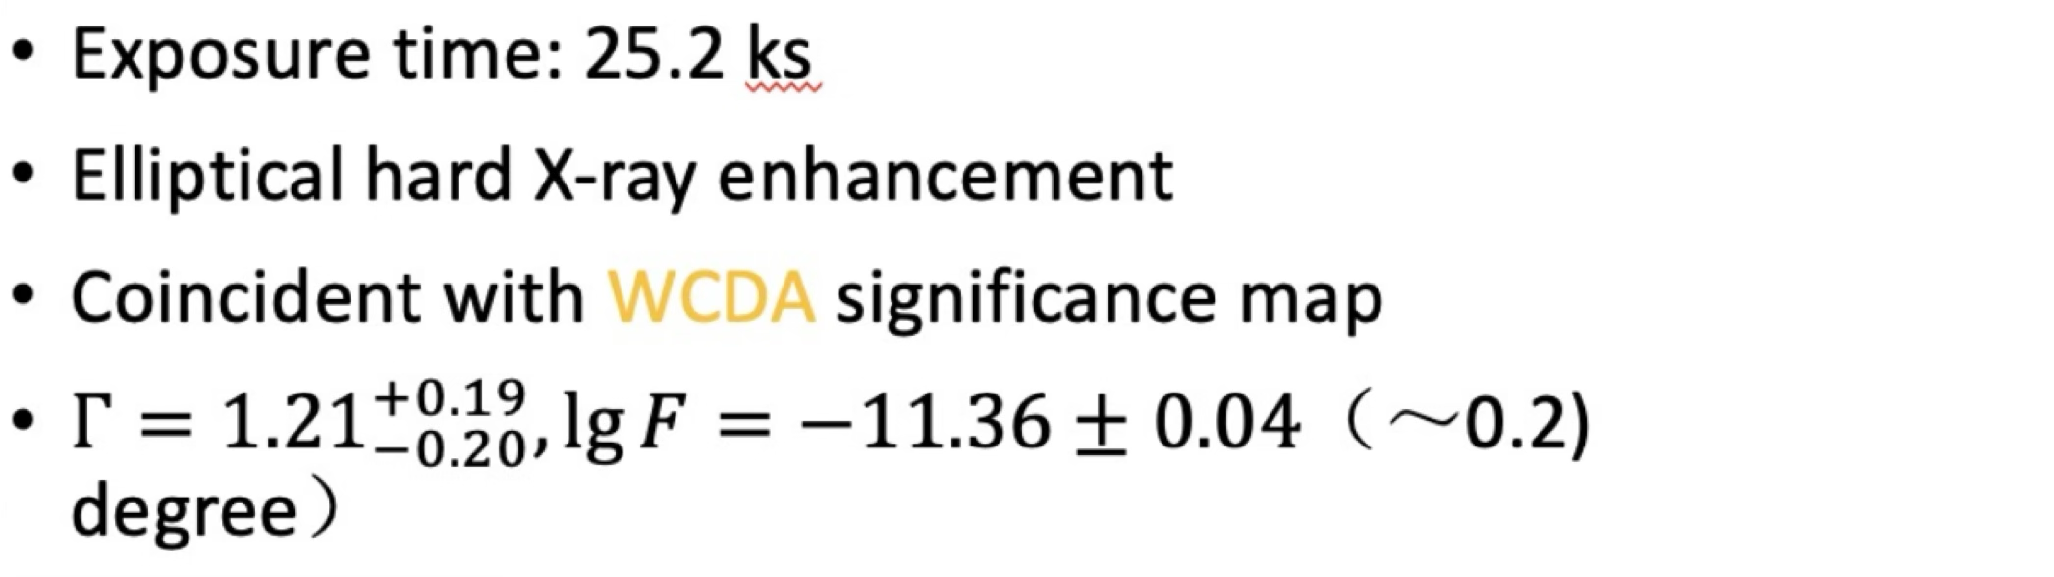
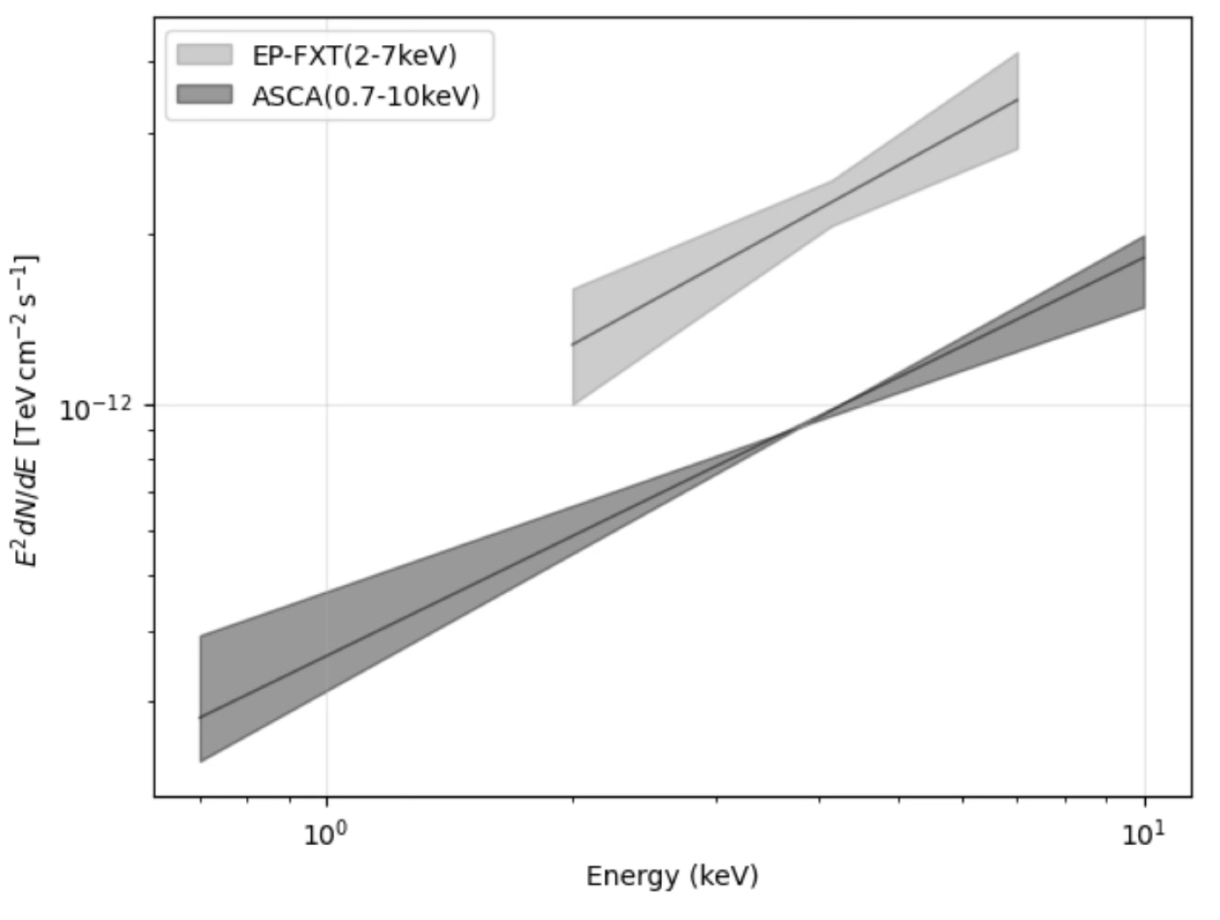
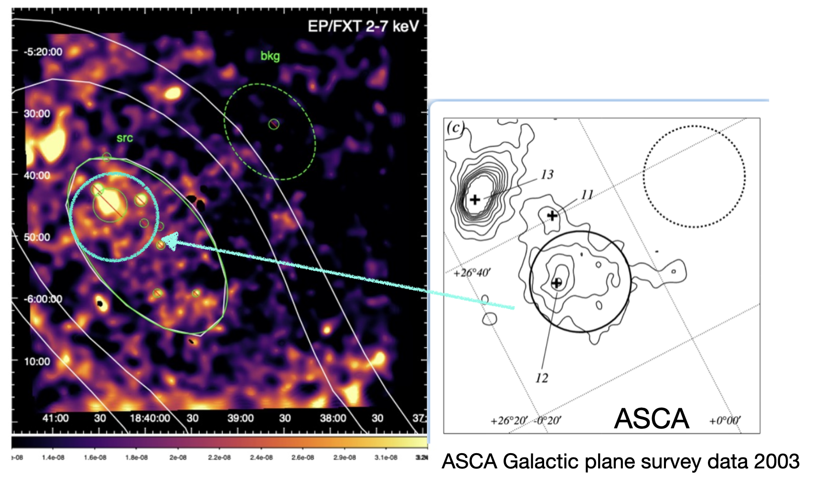
02
Multi-wavelength： update for X-ray
EP observation
Hard X-ray Spectrum
G026.6-00.1
(uncertain SNR)
significantly harder than typical SNR values (Γ ~ 2–3)
Notes:
Here we present the X-ray results from our dedicated EP-FXT observation.
Before, this region was already observed by ASCA in 2003,
where an extended hard X-ray source, G26.6−0.1, was a candidate supernova remnant.
With our new EP-FXT data, we confirm the presence of extended hard X-ray emission in this region.
With our new data, we clearly confirm extended hard X-ray emission in this region.
The morphology is elliptical, and matches the LHAASO region.
Spectrally, the photon index is about 1.2, which is much harder than typical SNRs.
This unusually hard spectrum is difficult to explain with standard synchrotron emission.

Slide 10
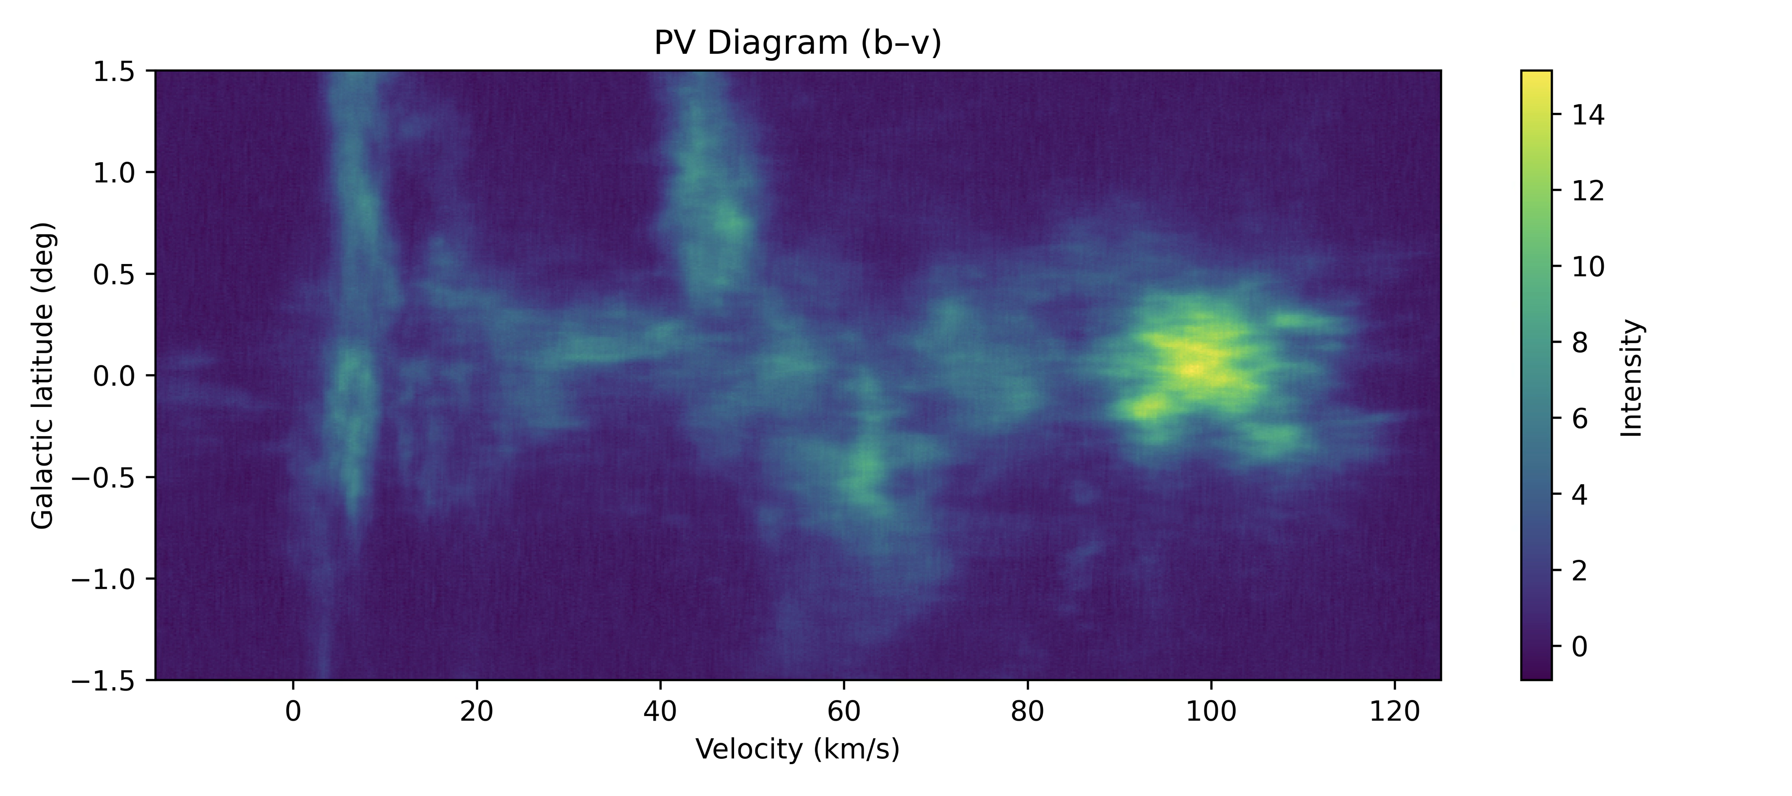

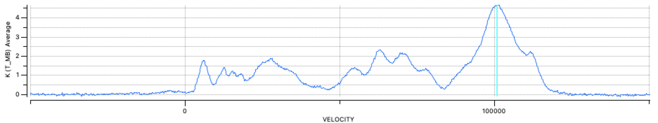
03
MWISP ¹²CO PV Analysis: Gas Enhancement
Latitude–velocity diagrams of the 12CO emission
Milky Way Imaging Scroll Painting Survey
Dense molecular gas at ∼100 km s⁻¹
clear CO enhancement near the TeV/X-ray region
indicates a high target gas density
supports particle–gas interaction scenario
prominent ¹²CO enhancement
Notes:
Next, we investigate the molecular gas environment using the Milky Way Imaging Scroll Painting Survey 12CO data.
Here I show the PV diagram of the CO emission in this region.
We can clearly see a prominent enhancement around a velocity of about 100 km/s.
where a strong peak appears at the velocity.
Such an enhancement indicates the presence of dense molecular gas, which provides a significant target density in this region.
Importantly, this dense gas is spatially coincident with the TeV and X-ray emission region.
This suggests that high-energy particles are interacting with the dense gas.
Therefore, the presence of dense molecular material naturally supports scenarios such as hadronic γ-ray production via proton–proton interactions.

Slide 11
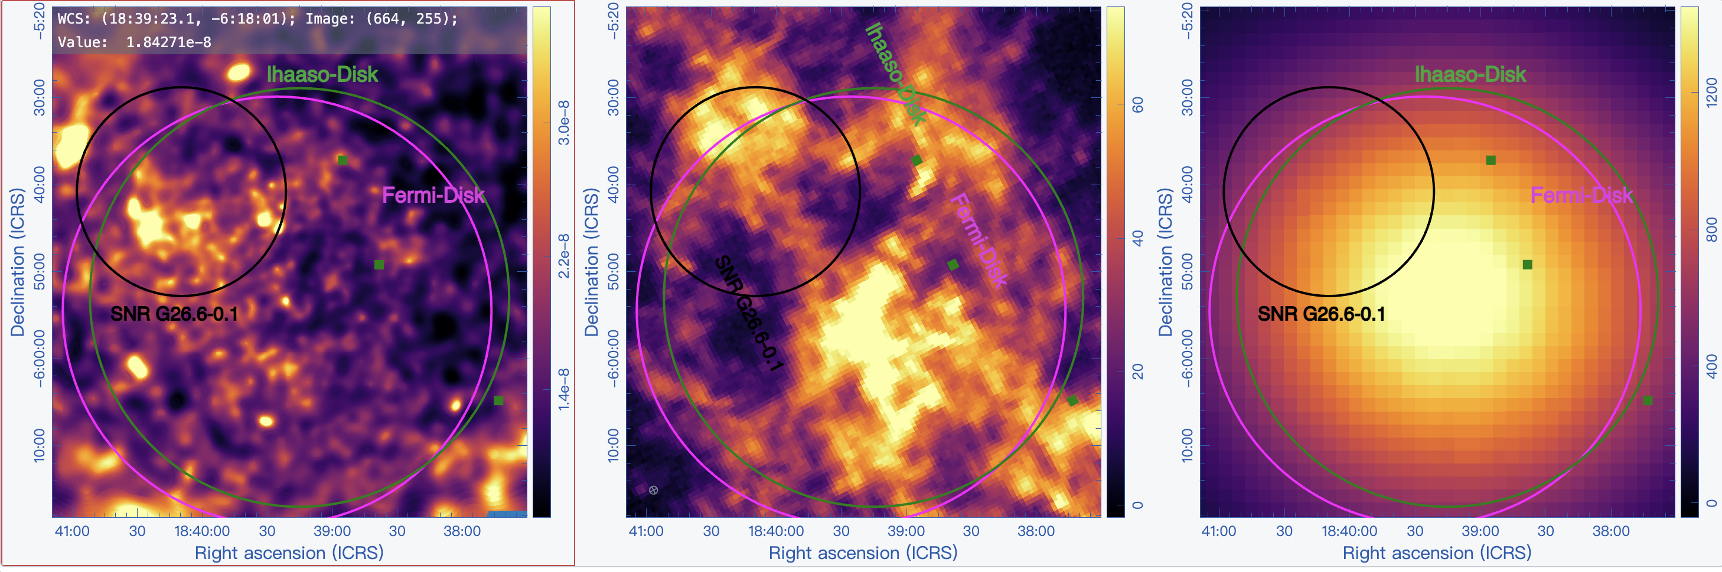
03
Multi-wavelength：update for ¹²CO gas map
EP/FXT 2-7keV
¹²CO int[95-105]km/s => d: ~5kpc
LHAASO TS map
Notes:
After identifying a strong CO enhancement,
we further compare the integrated CO map with the X-ray image and the lhaaso ts map.
The dense molecular gas is spatially coincident with the X-ray / γ-ray source region,
supporting the presence of target material.

Slide 12
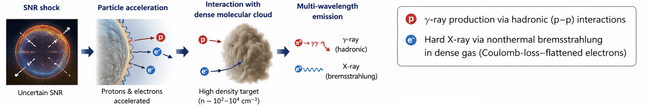
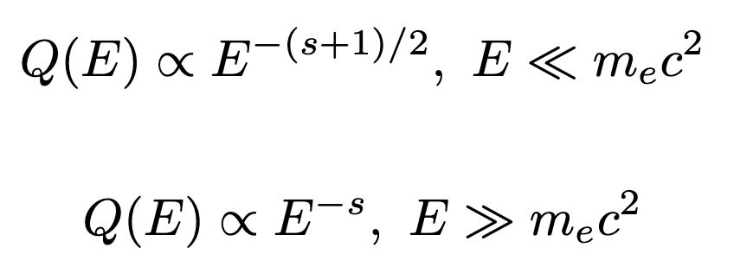
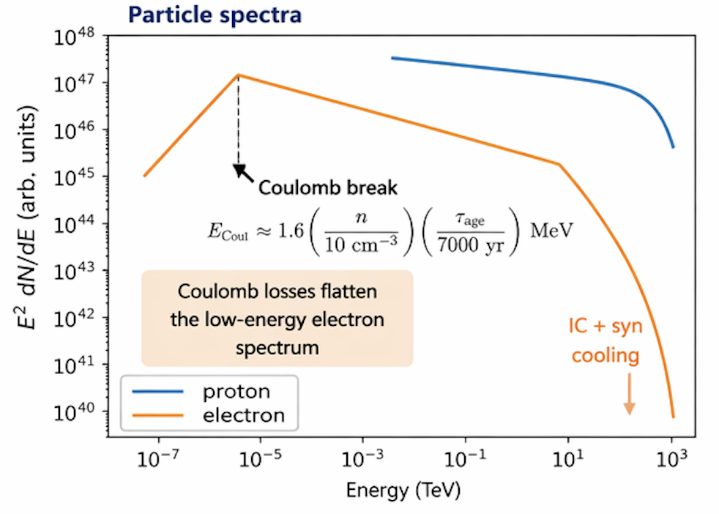
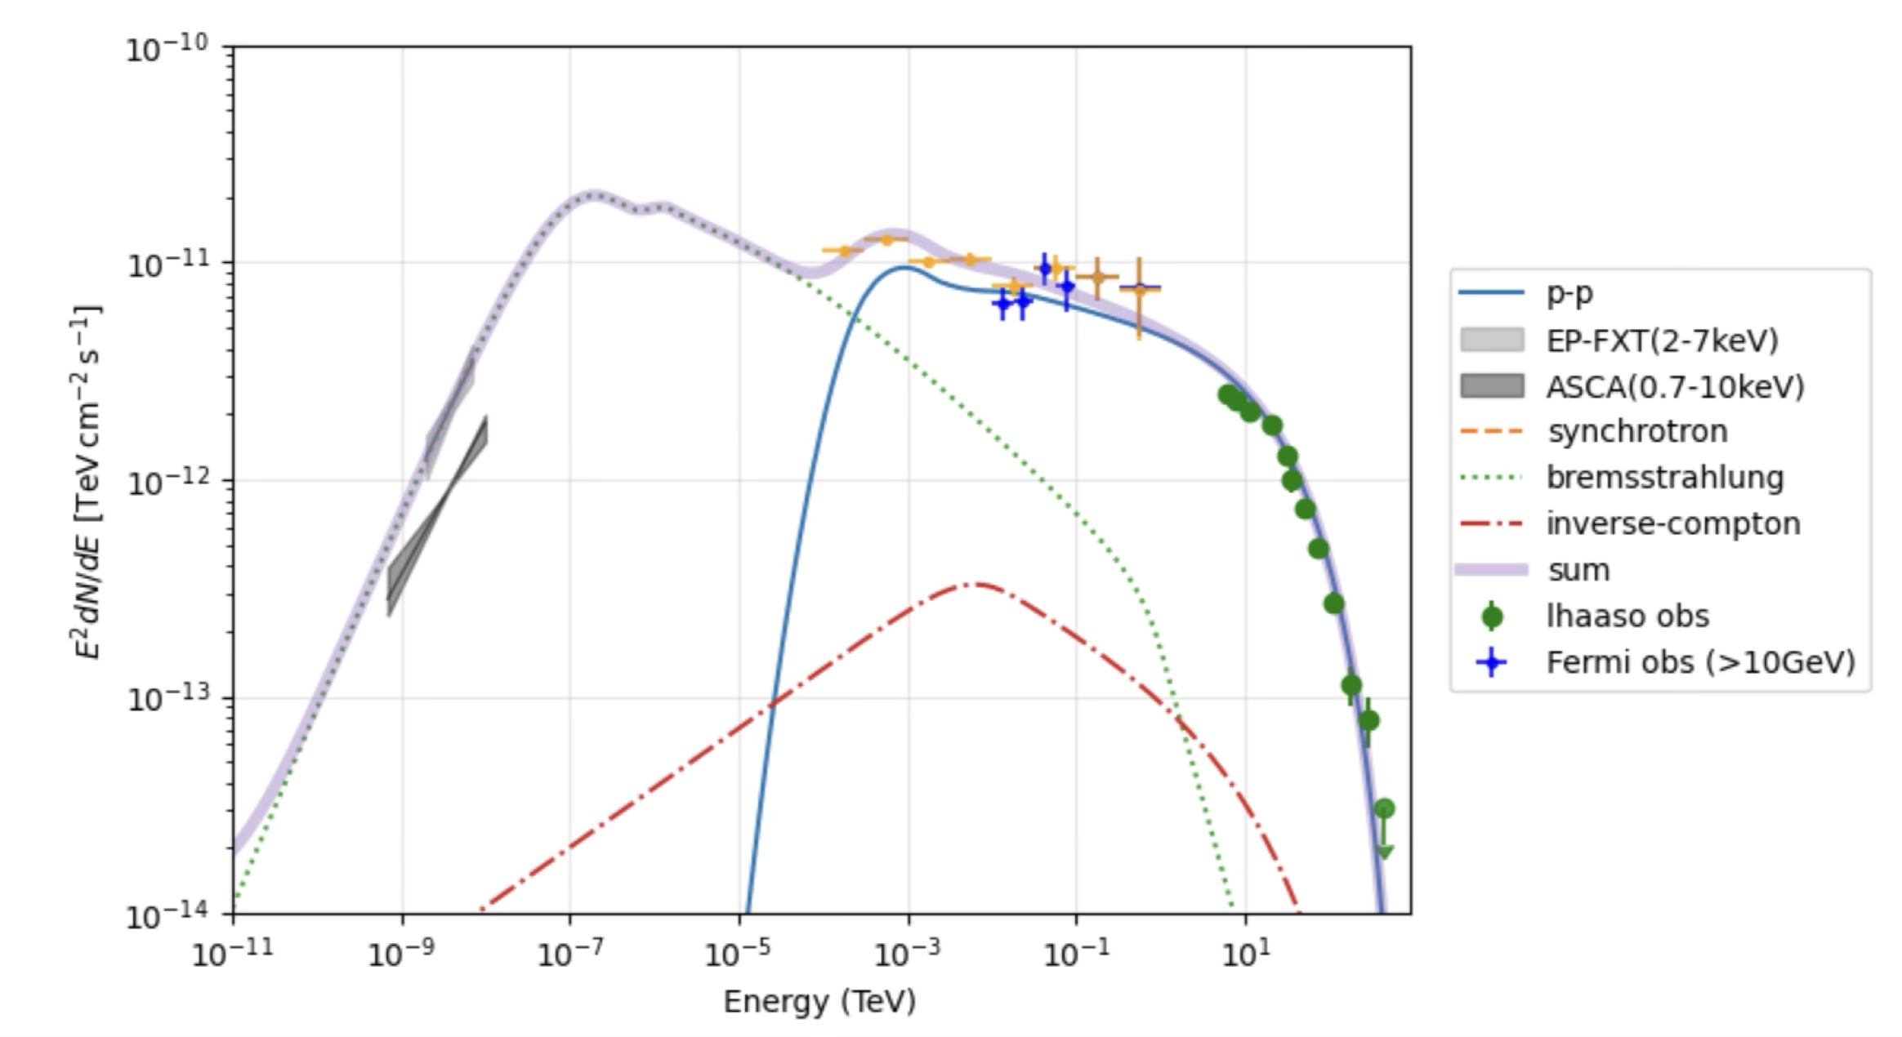
04
Modelling： Proton-Electron Scenario
uncertain SNR
Bremsstrahlung dominated X-ray
Notes:
So here we combine all the observations and propose a simple physical picture.
The high-energy particles are accelerated by a candidate supernova remnant in this region,
and then interact with the surrounding molecular cloud.
In this scenario, the γ-ray emission is naturally explained by hadronic proton–proton interactions,
while the hard X-ray emission is dominated by nonthermal electron bremsstrahlung.
This bremsstrahlung arises from electrons whose spectrum is flattened by Coulomb losses in the dense environment.
As shown in the particle spectrum and SED modeling,
this framework provides a consistent explanation of the broadband emission,
from X-rays up to ultra-high-energy γ-rays above 100 TeV.

Slide 13
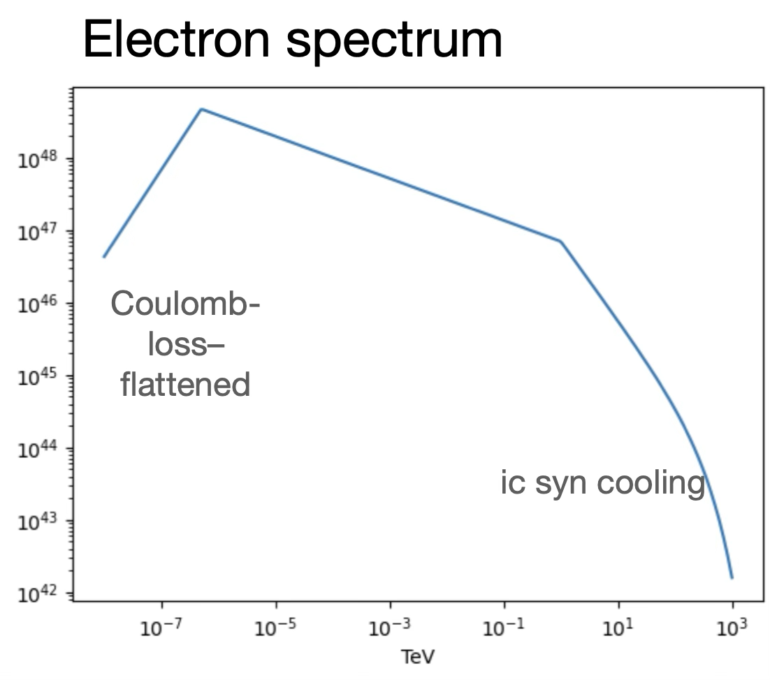
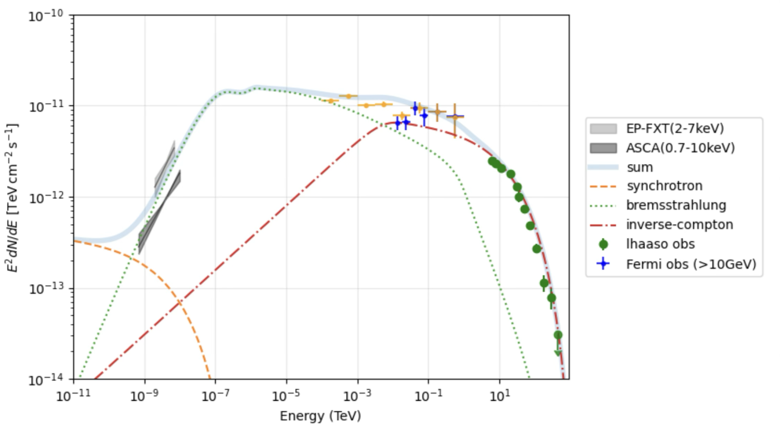
04
Modelling： Electron-only Scenario
Bremsstrahlung dominated X-ray
IC dominated gamma-ray
Need a small magnetic field （B~1uG）
to suppress synchrotron radiation
Notes:
Here I also test a Electron-only Scenario as an alternative explanation.
In this case, the hard X-ray emission is produced mainly by nonthermal Electron bremsstrahlung,
while the GeV–TeV gamma-ray emission is dominated by inverse Compton scattering from the same electron population.
As shown in the SED, this model can in principle reproduce the broadband data.
However, this scenario requires a small magnetic field, about 1 uG, in order to suppress the synchrotron emission.
So, we conclude that the electron-only scenario cannot be ruled out,
but it is less favored than the hadronic scenario.

Slide 14
05
Conclusions
LHAASO J1839-0553 is clearly extended, with the disk model preferred over a point source.
The broadband spectrum is clearly curved, implying a limit on particle acceleration or confinement.
The extension remains nearly constant from 10 GeV to >100 TeV, indicating no significant energy-dependent morphology.
Dense molecular gas is found at v ~ 100 km/s, spatially coincident with the X-ray/gamma-ray emission region.
A unified SNR–molecular cloud interaction scenario is favored, while a pure leptonic model is less favored.

Slide 15
01

Slide 16
02
Multi-wavelength ： update for X-ray

Slide 17
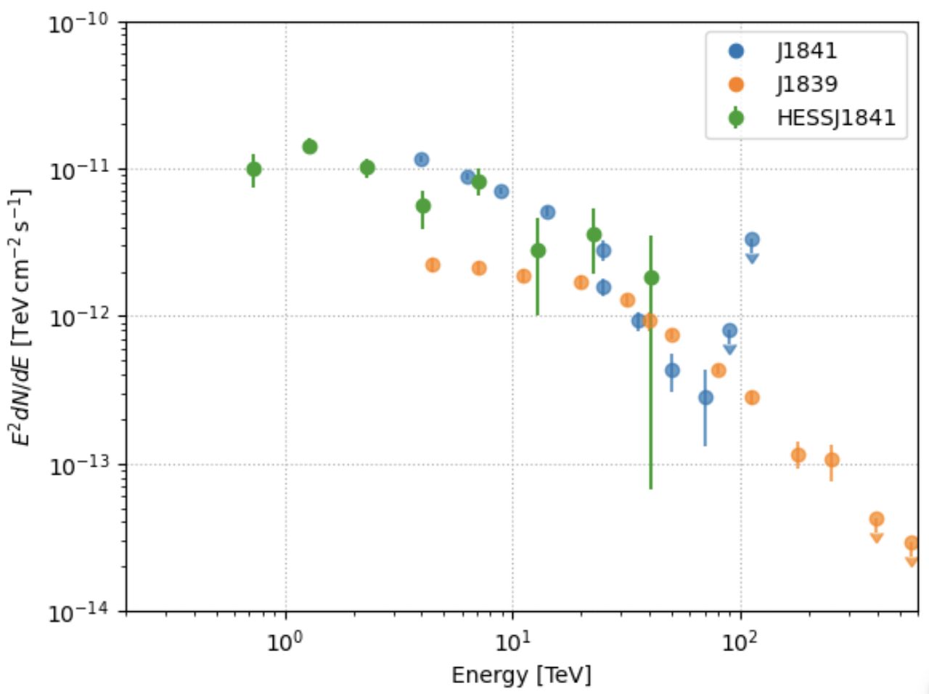
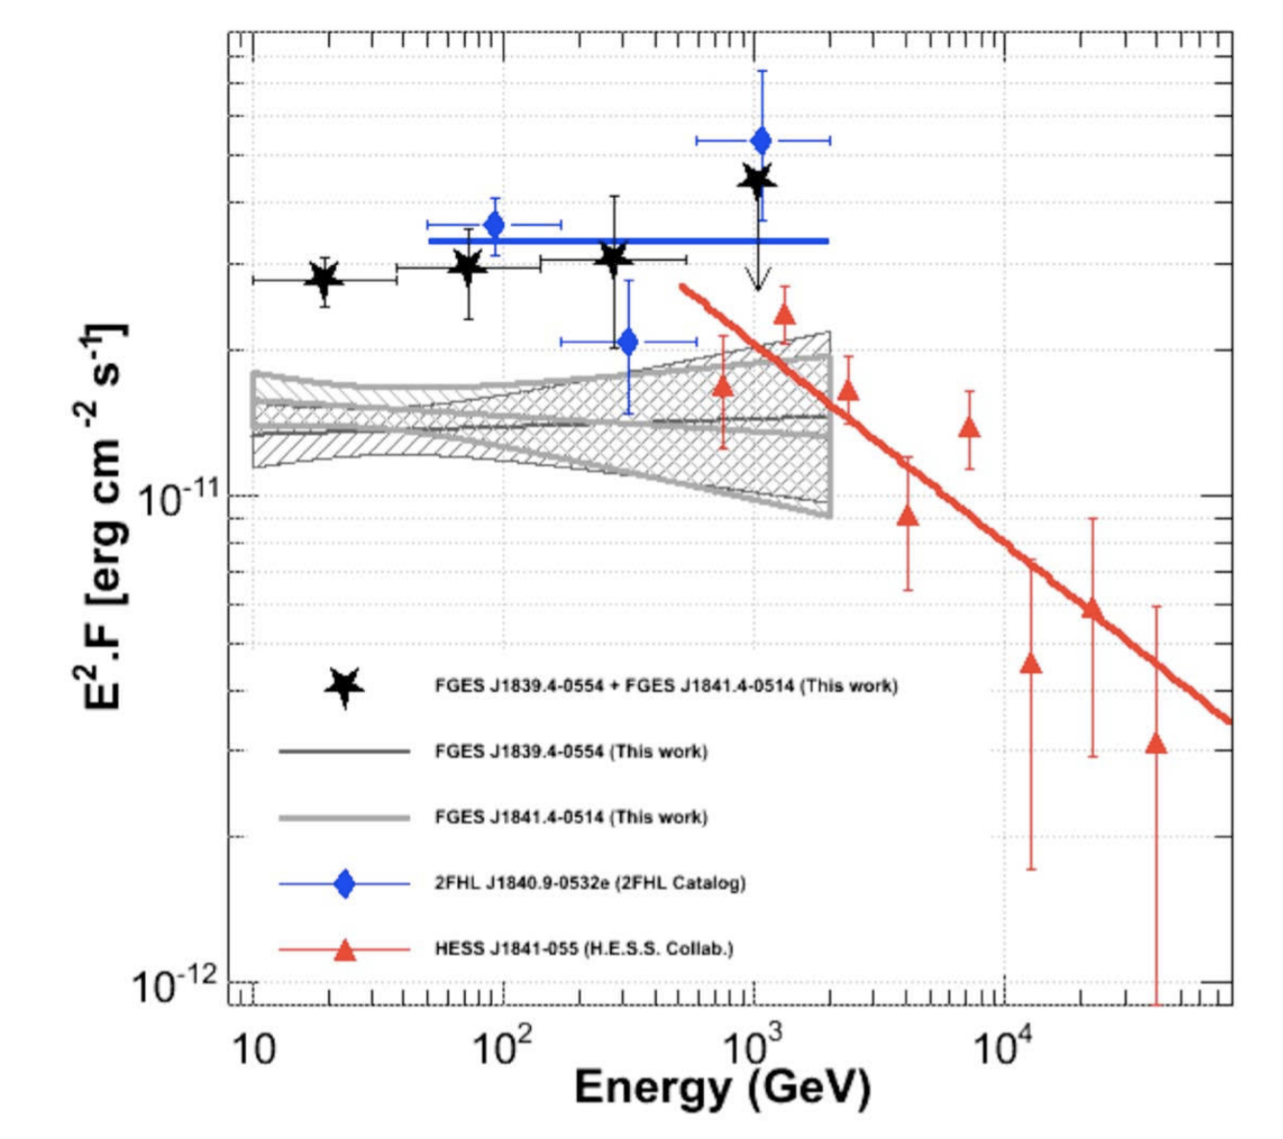
01
HESS J1841 region
Fermi >10GeV
green contours:
HESS J1841-055
B
A

Slide 18
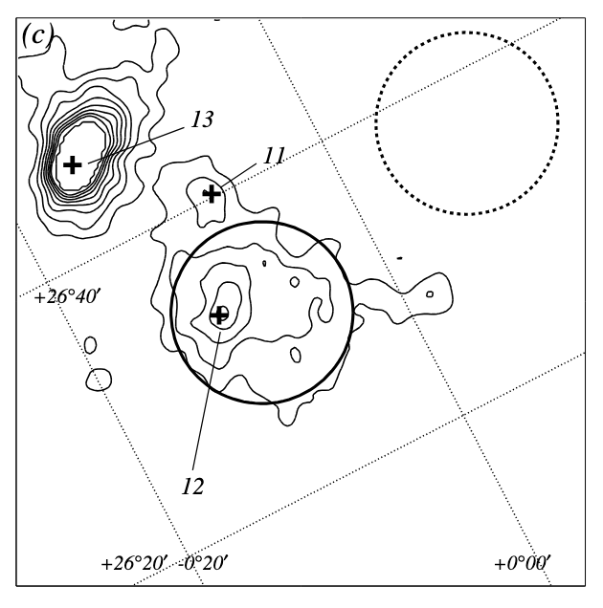
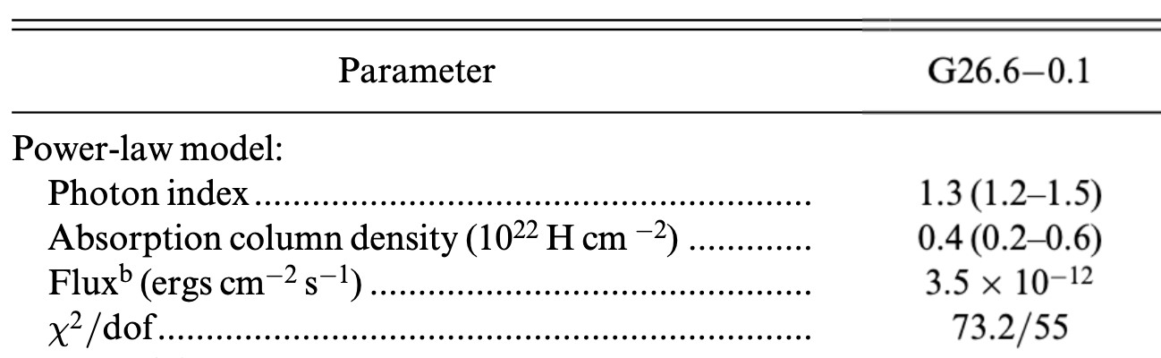
01
Introction
ASCA Galactic plane survey data 2003
G026.6-00.1 (uncertain SNR)
G026.6-00.1
(uncertain SNR)
Multiwavelength observations have not yet identified the origin of its high-energy emission.
1LHAASO J1839−0553 is a promising target for studying particle acceleration in complex Galactic environments.

Slide 19
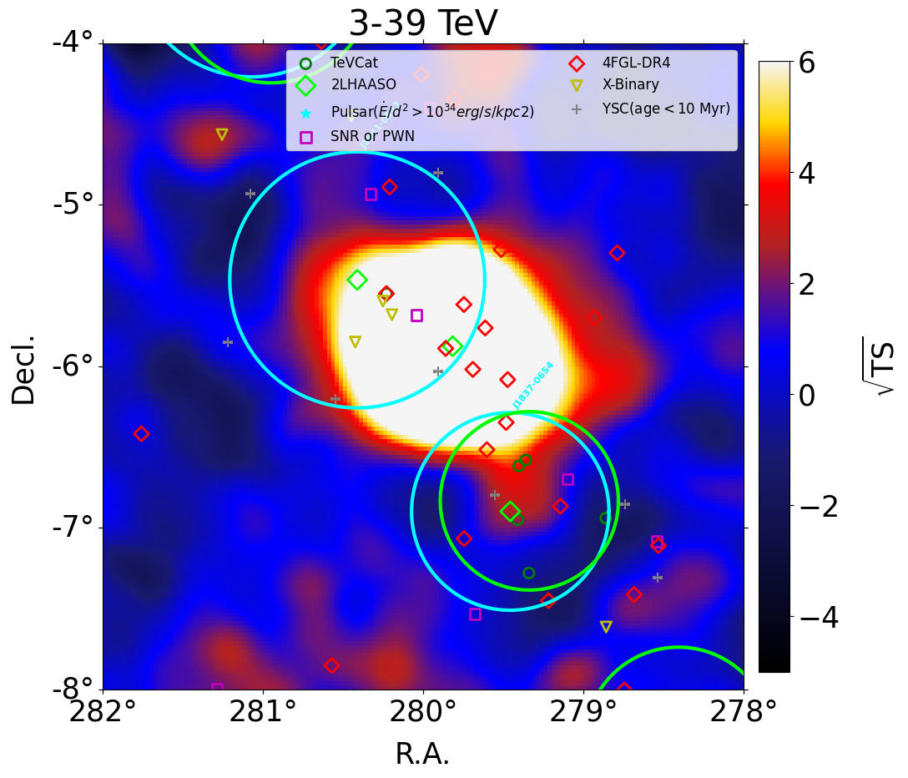
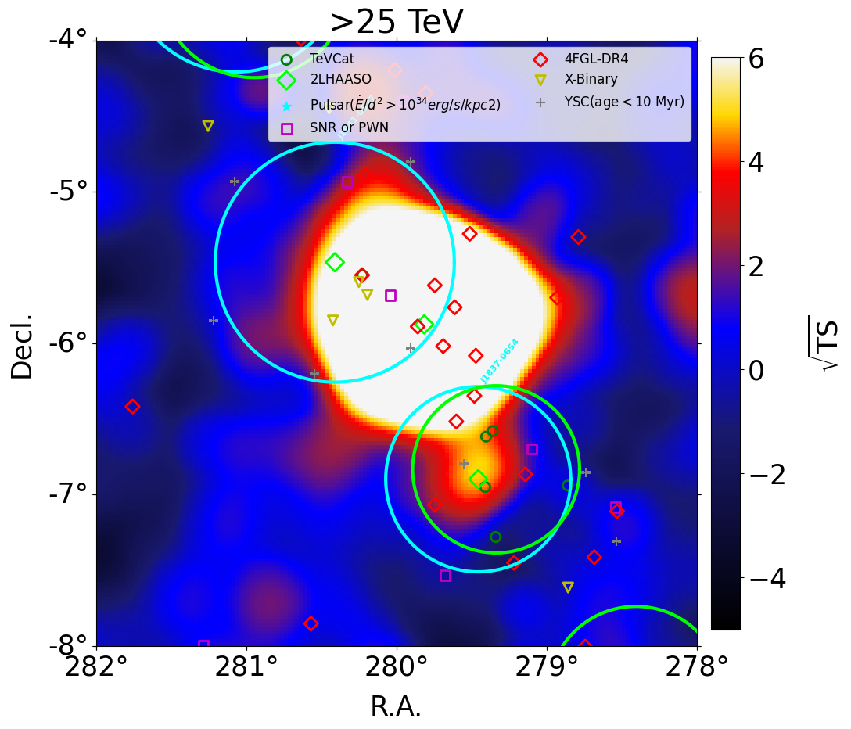
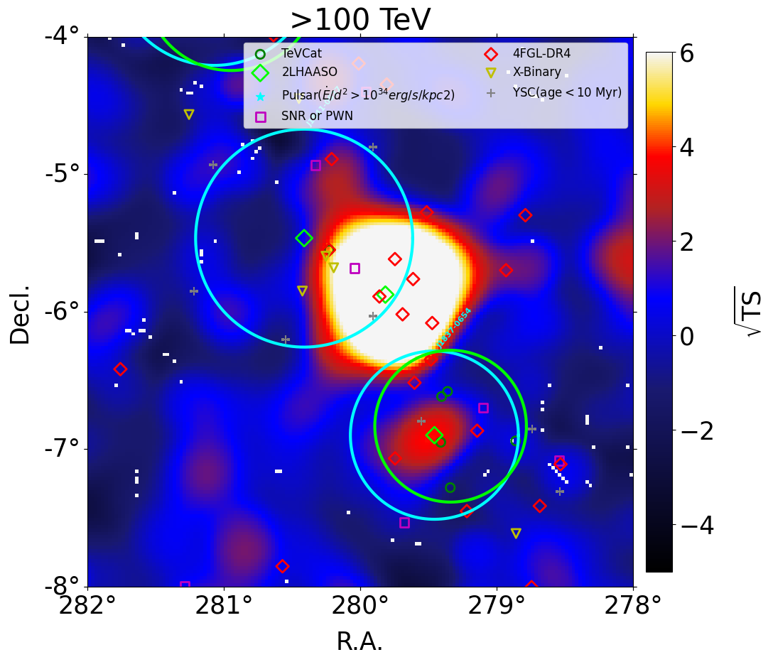
01

Slide 20
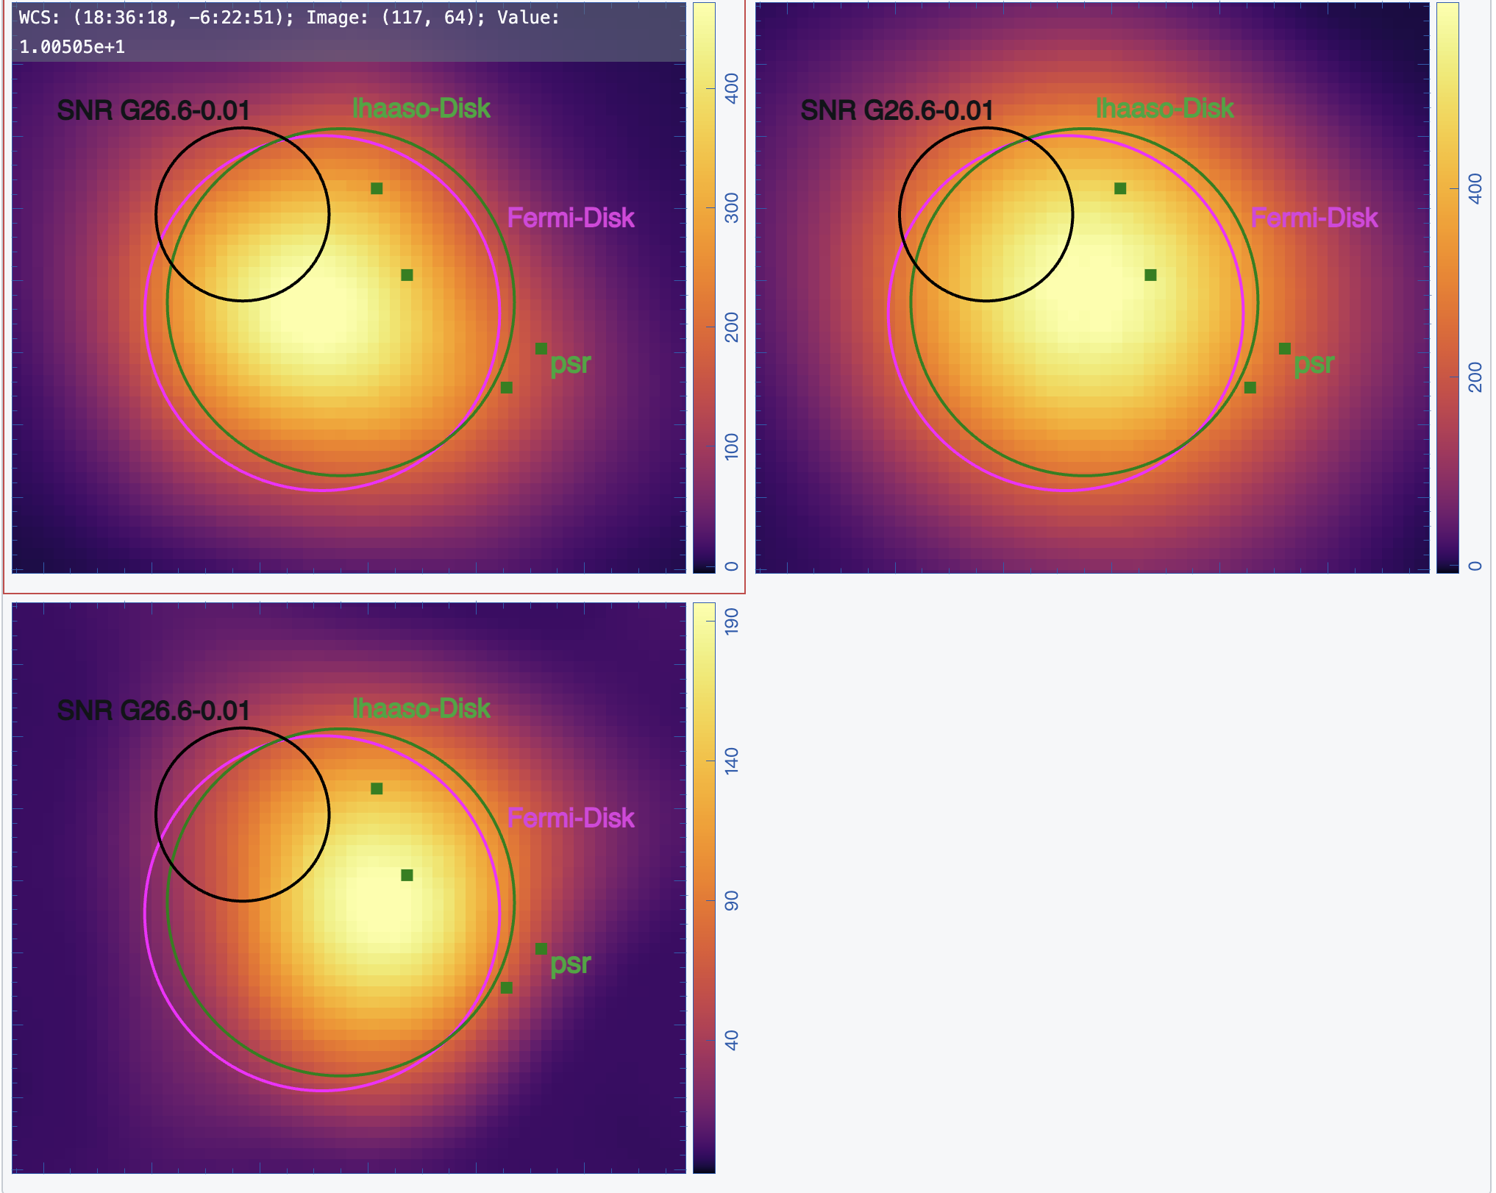
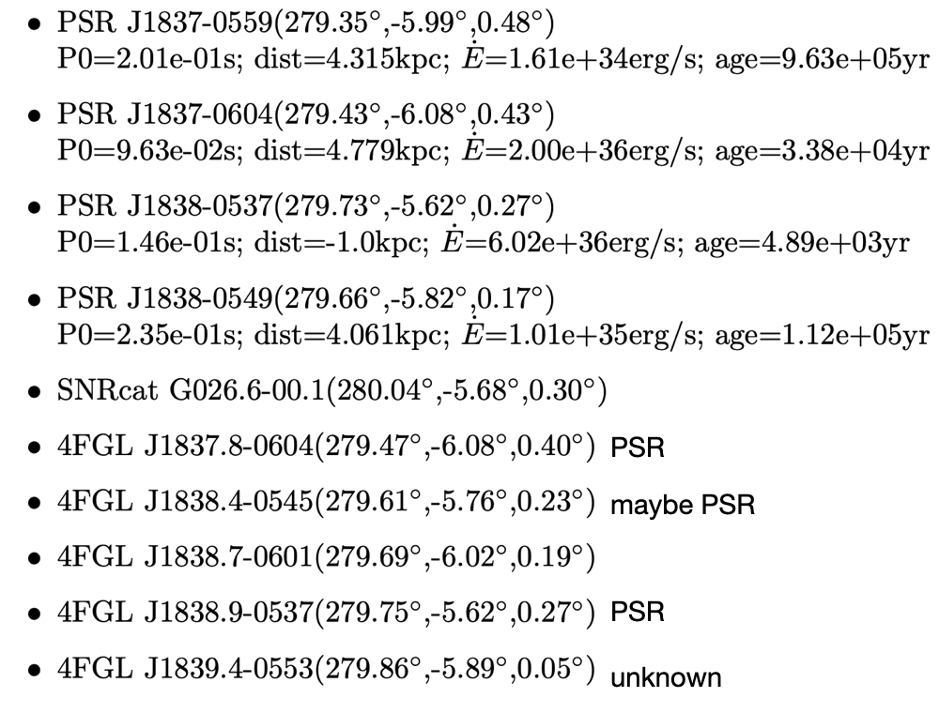
01
LHAASO result
In this region:
WCDA
KM2A: 25-100TeV
FGES J1839.4−0554 (>10GeV)
KM2A: >100TeV

Slide 21
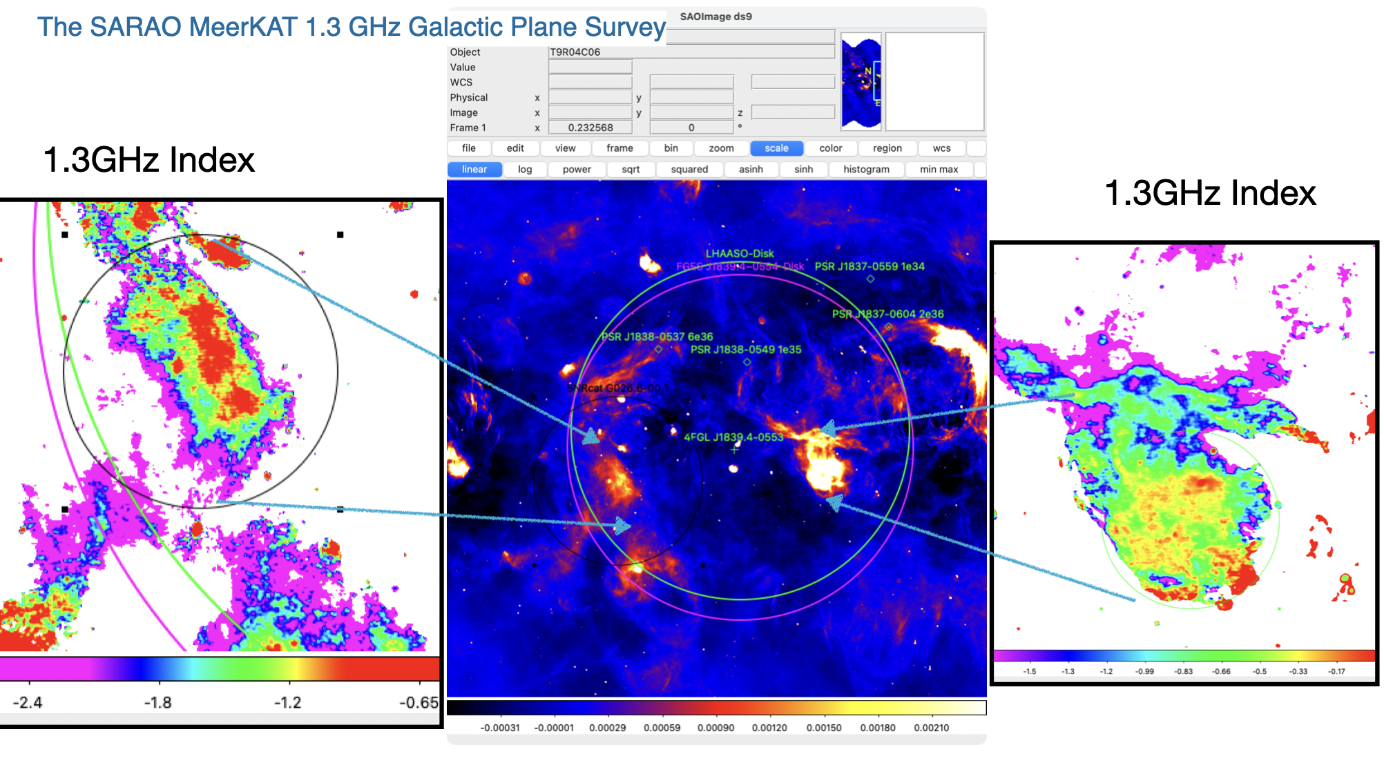
01

Slide 22
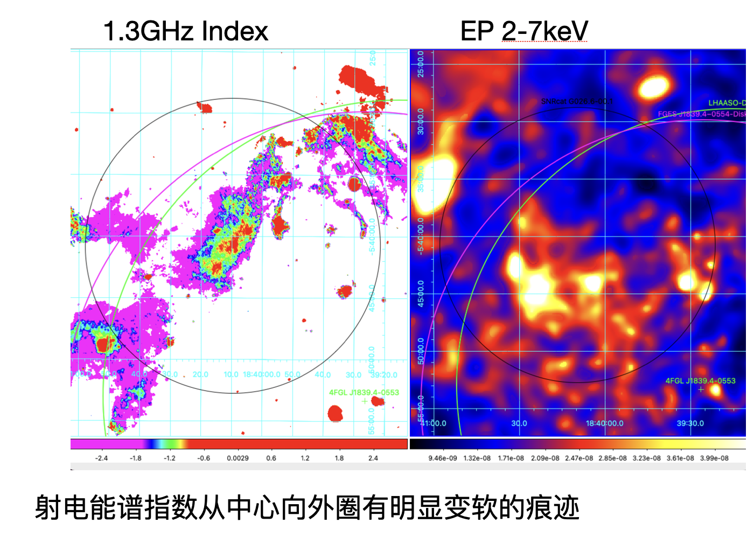
01

Slide 23
01

Slide 24
01

