Slide 1



WCDA Observations of HESS J1943+213
A non-classical EHBL on Galactical panel
Introduction of HESS J1943+213
Establishment of extra-Galactical origin
LHAASO-WCDA observation
Further Plan
Co-authors: Guangman Xiang, Min Zha, Shuwang Cui and Dixuan Xiao

Slide 2
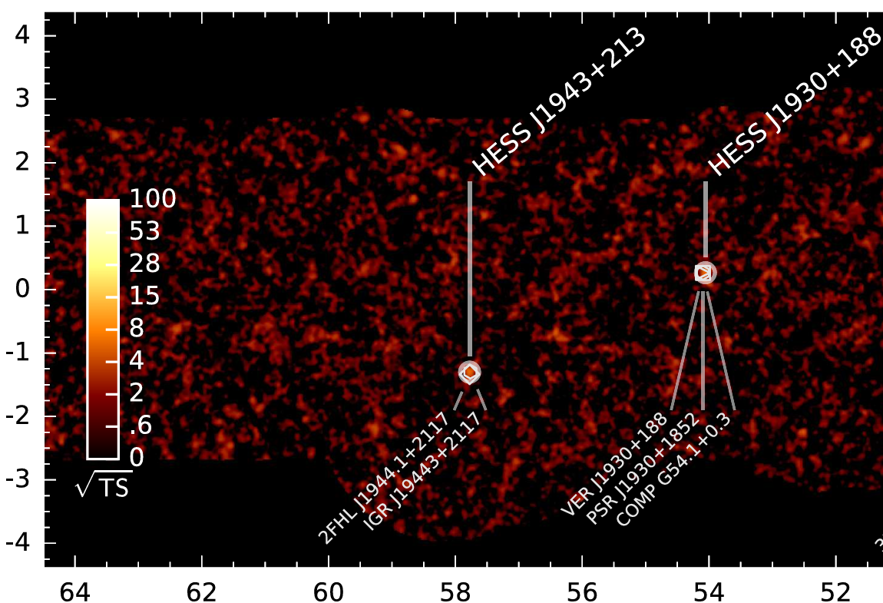
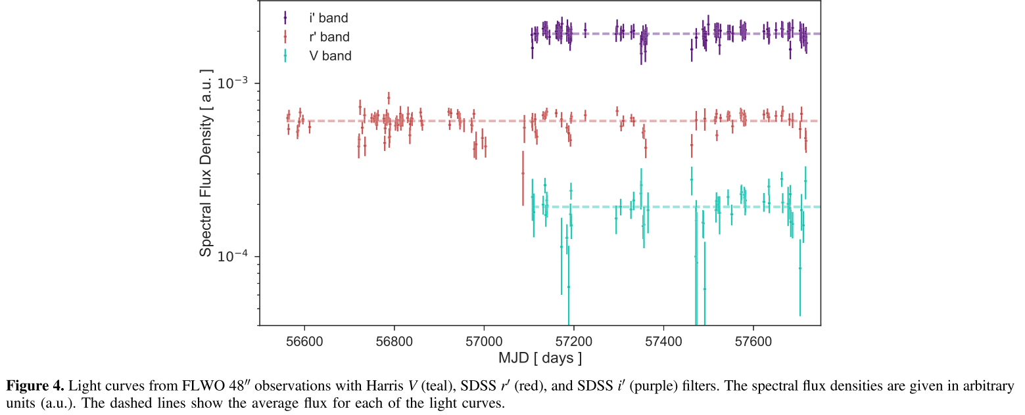
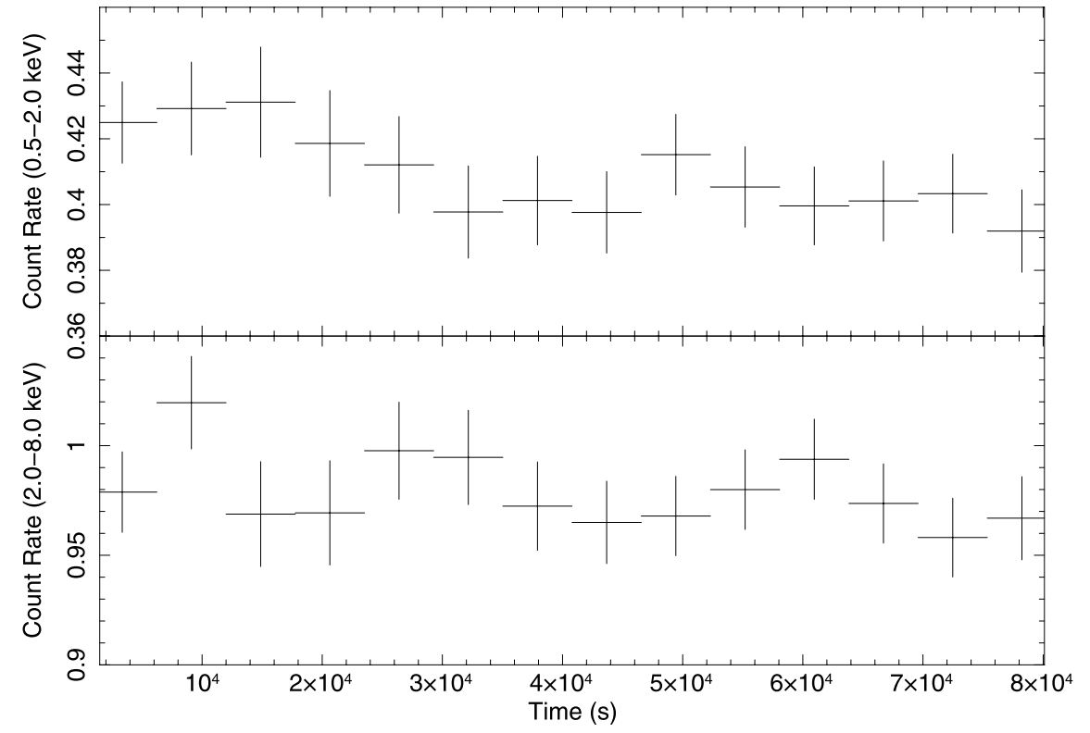
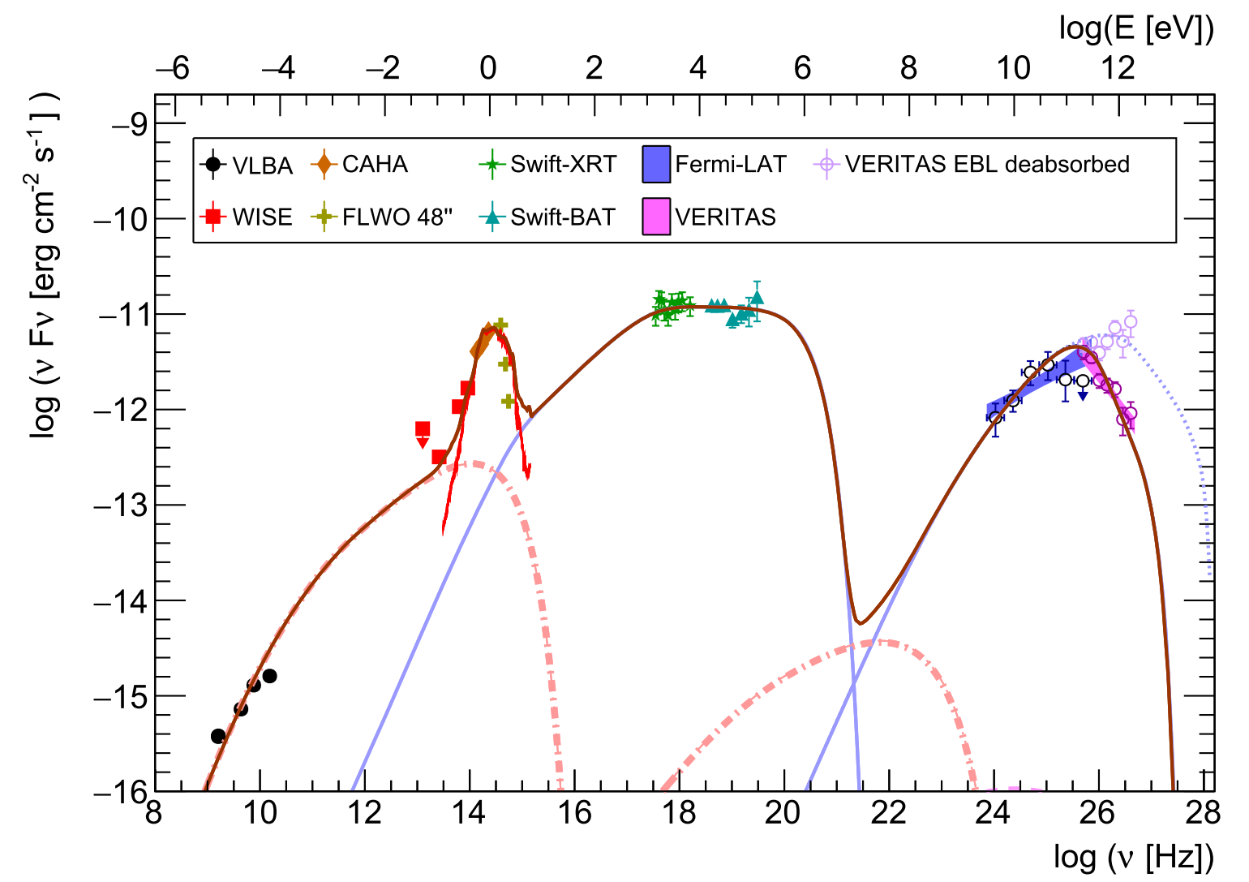
HESS J1943+213
H.E.S.S. Galactic Plane Survey
G. LAT. [degree]
Optical
X-ray
The Astrophysical Journal, 862:41 (15pp), 2018 July 20
The Astrophysical Journal, 787:155 (10pp), 2014 June 1
G. LON. [degree]
Low Galactic latitude (b = −1.29°)
Lack variability
Hard X-ray spectrum, ${Peak}_{syn}$ > 10 keV
Soft VHE gamma-ray spectrum

Slide 3
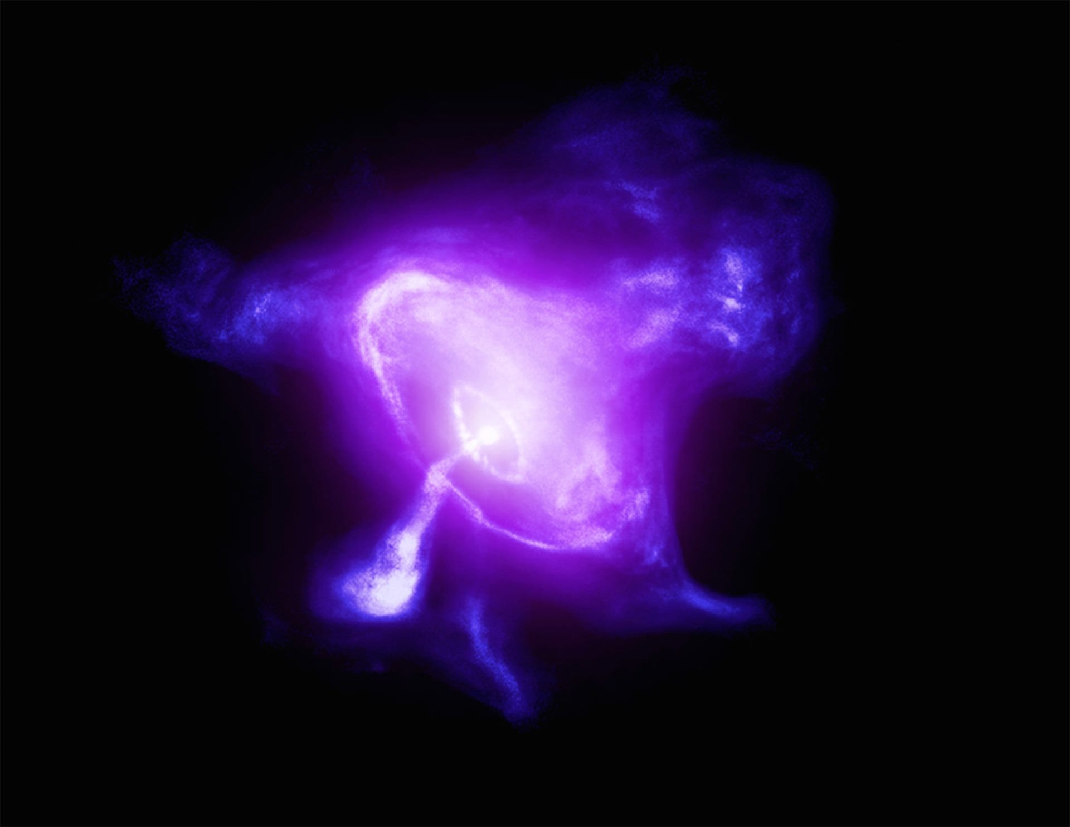
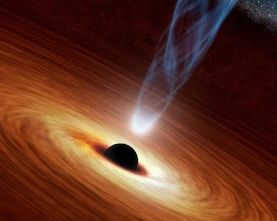
PWN? Or Blazar?
Crab Nebula image From IXPE / NASA / Chandra / CXC / SAO / K. Arcand / L. Frattare
PWN scenario ?
Blazar scenario ?

Slide 4
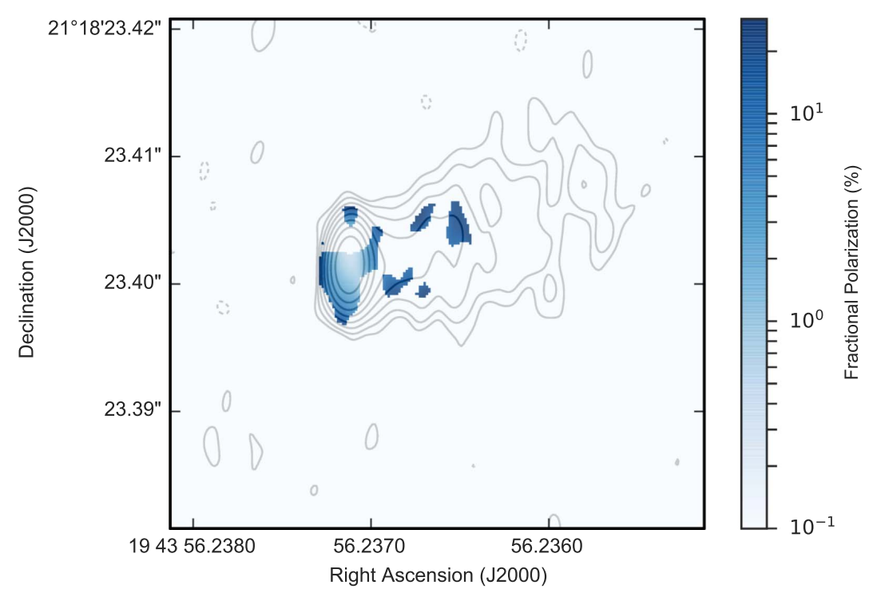
PWN? Or Blazar?
VLBA imaging revealed a compact core and jet
Crab Nebula image From IXPE / NASA / Chandra / CXC / SAO / K. Arcand / L. Frattare
Support Extra-Galactic origin !
The Astrophysical Journal, 862:41 (15pp), 2018 July 20
Tanaka et al. (2014) | -> IR consistent with elliptical galaxy
Straal et al. (2016) | -> No pulsar detection
Archer et al. (2018) | -> proper motion <8 km/s rules out Galactic origin
….
And many other evidences…

Slide 5
PWN? Or Blazar?
Crab Nebula image From IXPE / NASA / Chandra / CXC / SAO / K. Arcand / L. Frattare
Knockout
PWN scenario ?
Blazar scenario ?
HESS J1943+213, an extreme high-frequency-peaked BL Lac object (EHBL)
But lack variability!

Slide 6
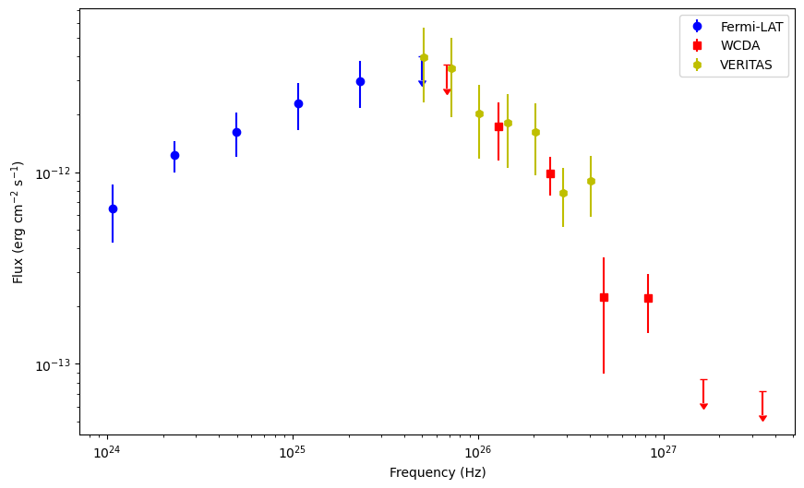
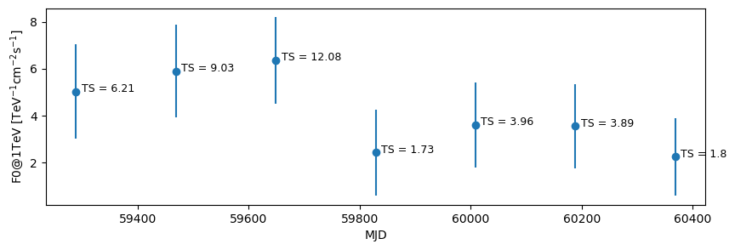
WCDA Observation & Further Plan
Preliminary
Crab Nebula image From IXPE / NASA / Chandra / CXC / SAO / K. Arcand / L. Frattare
No significant variability
Preliminary
Further Plan
  Using AI promoted data achieved higher sensitivity
  And refine current results
SED is consistent with Fermi-LAT and VERITAS

Slide 7
