Slide 1


Detection of High-Energy Particle Radiation During Lightning Leader Processes Based on LHAASO
Speaker: Wang Hanyu ^{a,b}
Co-author: Xu Baining ^{a,b}, Liu Cheng ^{b}, Sheng Xiangdong ^{b} ,Yuan Shanfeng ^{c} , Zhang Xiaopeng ^{b},
Cui Shuwang ^{d} , Qie Xiushu ^{c} , Chai gongchuan ^{d} , Wang Zhengqi ^{c} ,Li Mengyao ^{d} , Su Jing ^{a,b}
a) School of Physics and Technology, University of Jinan
b) Institute of High Energy Physics, CAS
c) Institute of Atmospheric Physics, CAS
d) Hebei Normal University

Slide 2
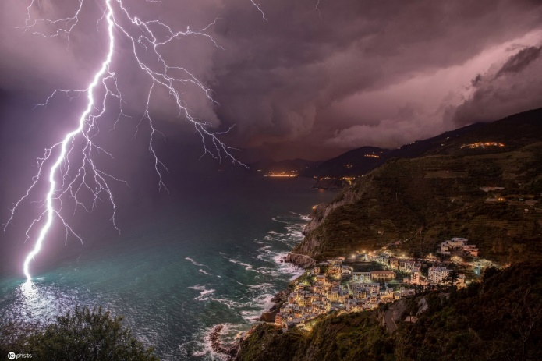
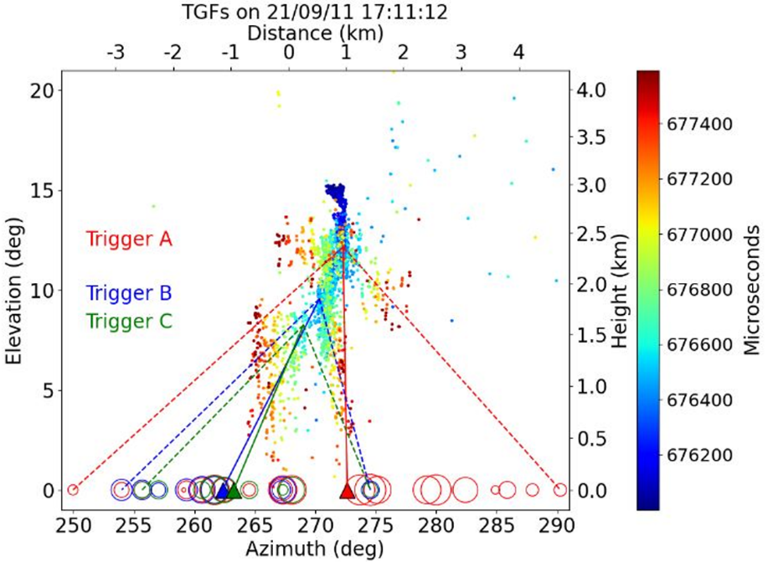
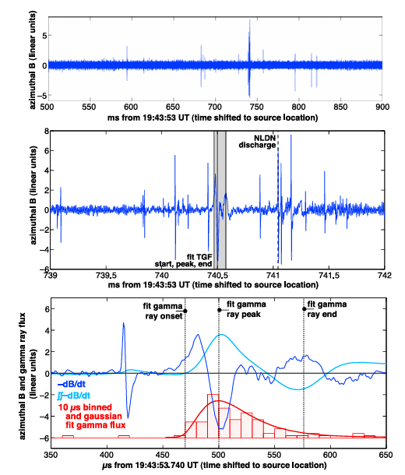
Motivation​
Lightning: a sudden electric discharge in thunderstorms
Generate high-energy particle radiation
Fermi Satellite: ~1000 TGF / year
Telescope Array: first detection of downward TGF
Cummer (2011)
Abbasi (2023)
Fermi
Fermi-GBM：TGF‐LIGHTNING TIMING
TGF studies at TA.

Slide 3

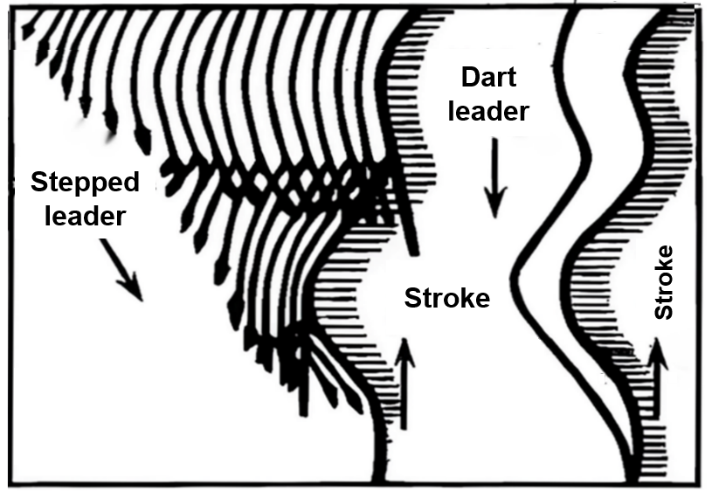
Motivation
70μs
20ms
40ms
2ms
Two stages:​ Leader process and return stroke process
For Leader process
  Stepped leader:​
    initial air breakdown
    developing in steps with branches
  Dart leader:​
    Propagates along the pre-existing channel
    faster and with fewer branches
In which process is high-energy radiation produced?
  Satellites:​ Insufficient temporal resolution
  Ground-based:​ Large detector spacing
Elevation
Stroke
Time(ms)
Direct experimental evidence remains lacking!

Slide 4
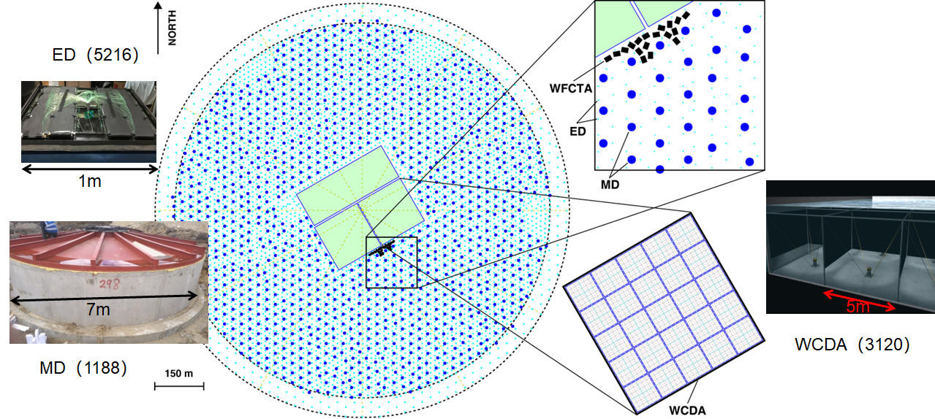
LHAASO
实际应用
第三方面
实际应用
第四方面
Large number of detectors ~ns time resolution

Slide 5
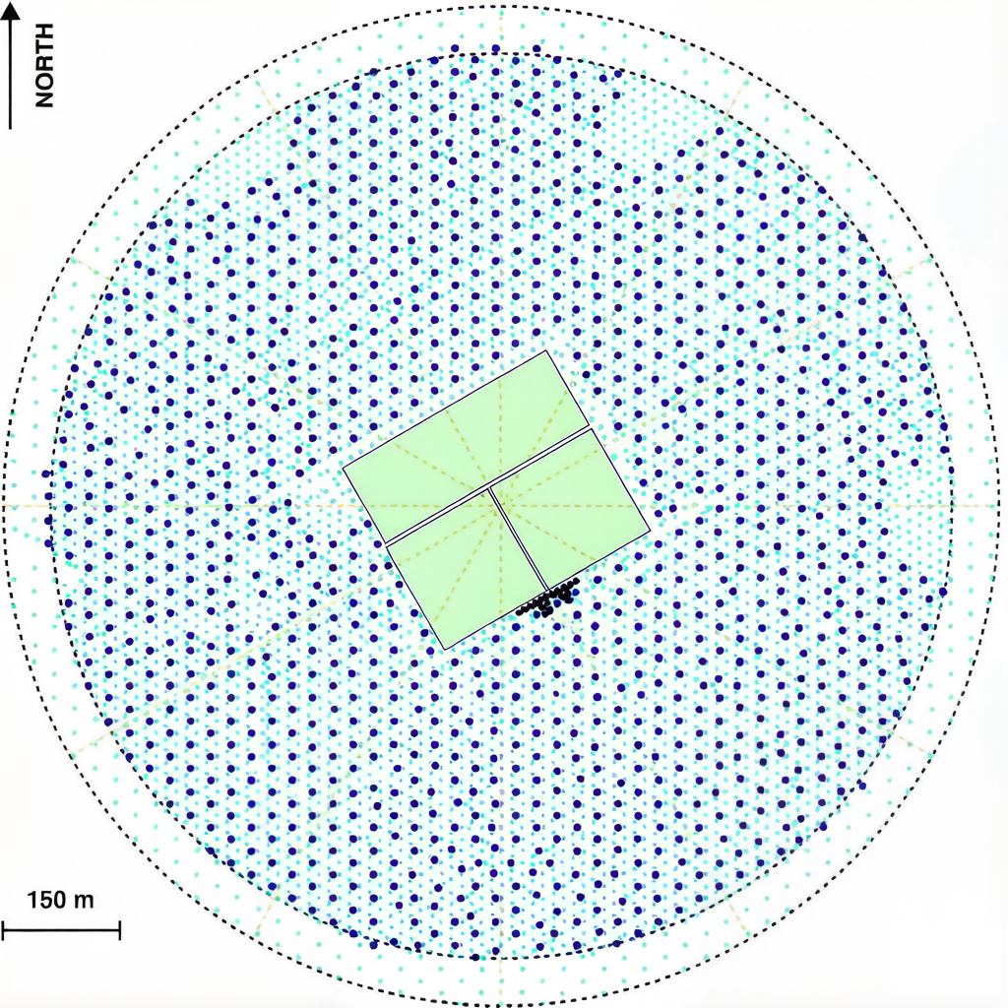
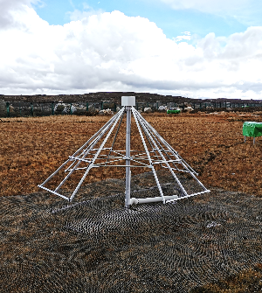
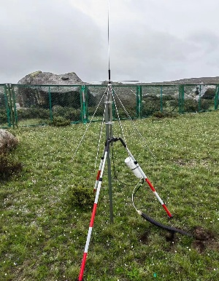
INTF @ LHAASO
VHF lightning interferometer (INTF) – high-resolution mapping of lightning channels
  Localization precision:​ 0.1°
  Detection frequency: 35-70 MHz;
  Sampling rate: 250 MHz
  Time offset with LHAASO: < 1us
×
×
×
×
×
×
×
×
×
×
×
×
×

Slide 6
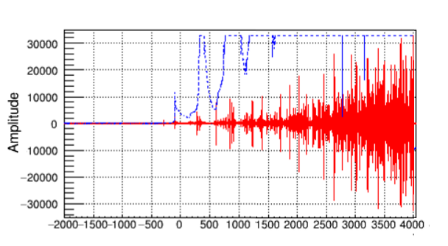
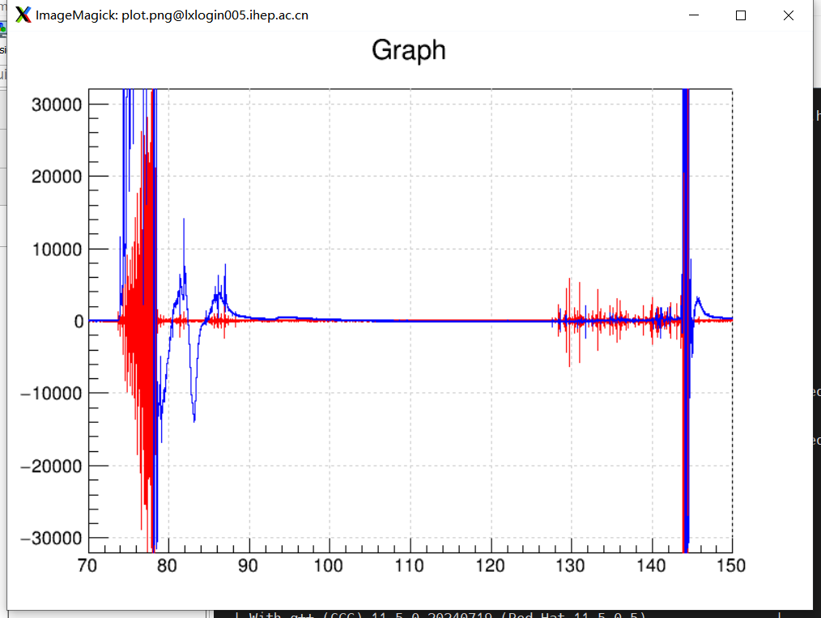
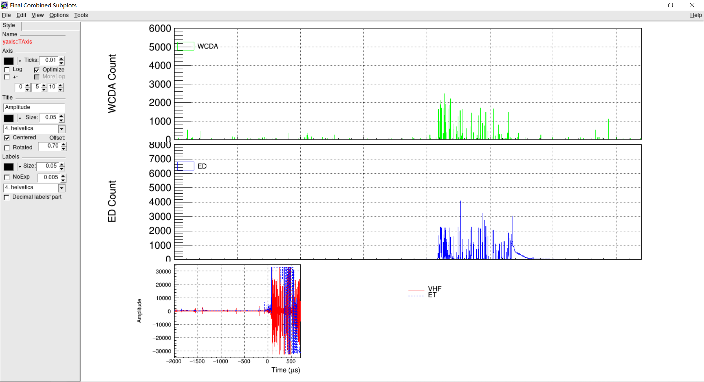

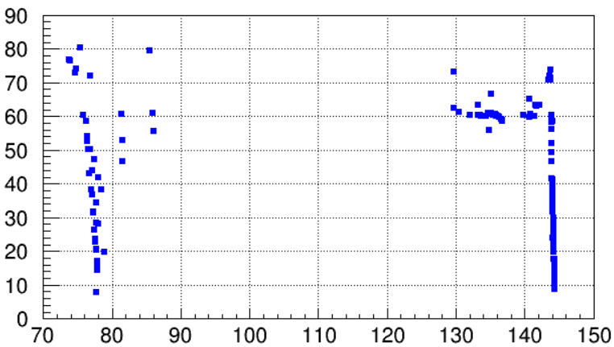
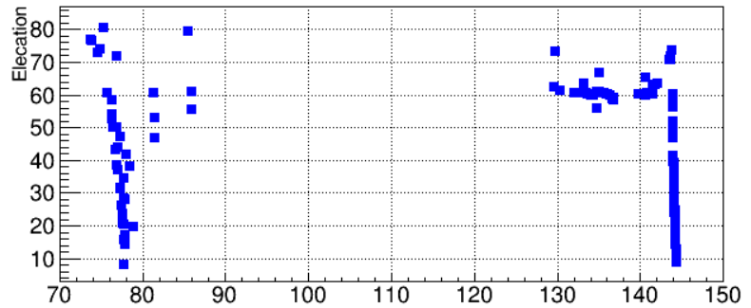
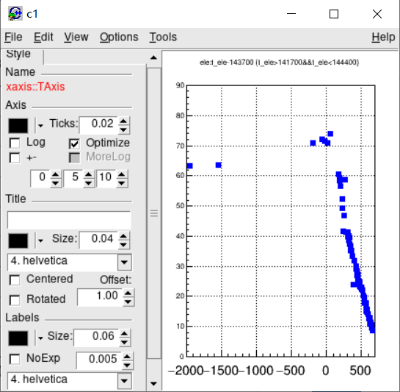
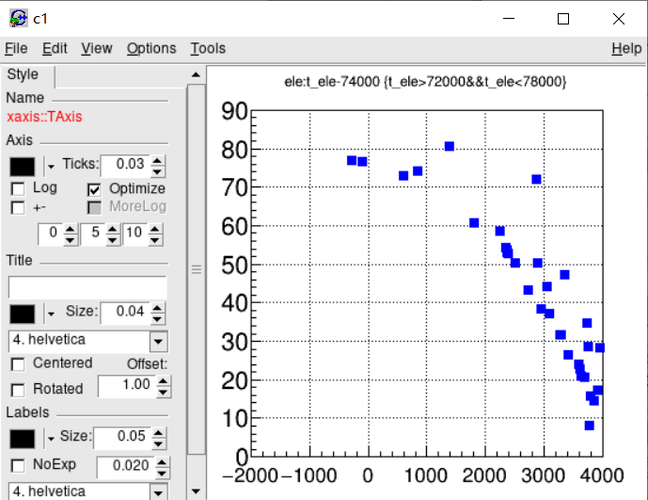

Two Downward Leader in a Lightning on 20240901
①
Electric field
②
①
Leader1 4ms
②
Leader2 0.7ms
65.7ms
Elevation
Lightning localization
■ Elevation
Time(ms)
Occurring at 2024-09-01 17:01:00
The interval between the two leaders was 65.7 ms.
Leader 1 ：
  time: 17:01:00.0740
  lasting 4 ms.
leader 2：
  time: 17:01:00.1437
  lasting 0.7 ms.

Slide 7
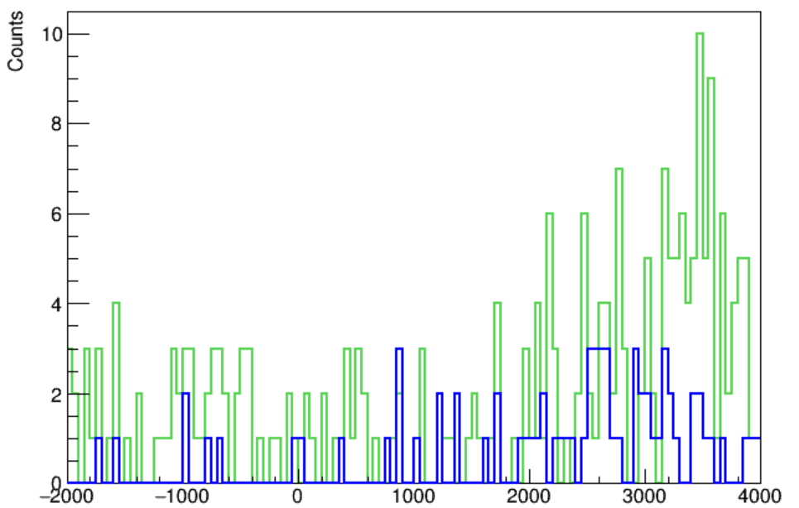
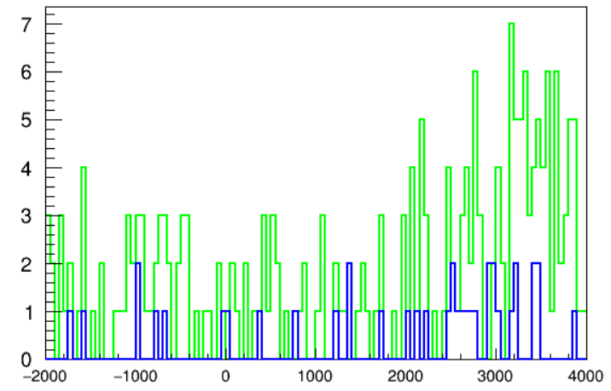
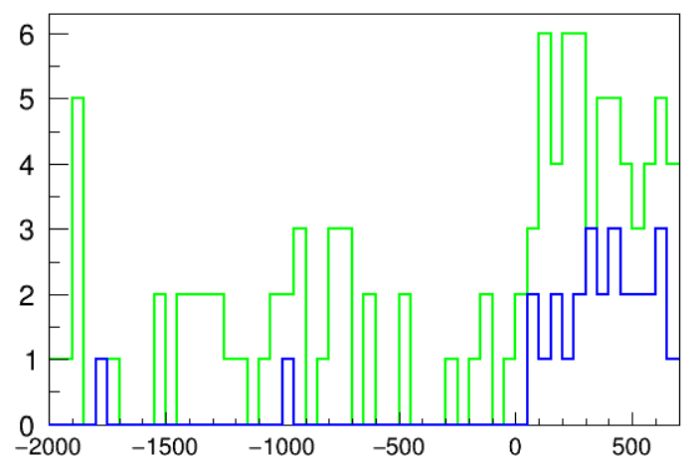
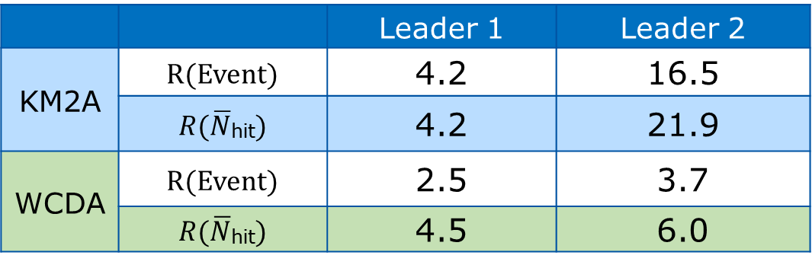
Increased event count on LHAASO
KM2A: increased by up to 16 times.
WCDA: increased by up to 3 times.
Event Property: Average number of triggered detectors per event was 4 times higher​ than during quiet periods.
 |  | Leader 1 | Leader 2
KM2A | R(Event) | 4.2 | 16.5
 | $R(\overline{N}$_{hit}) | 4.2 | 21.9
WCDA | R(Event) | 2.5 | 3.7
 | $R(\overline{N}$_{hit}) | 4.5 | 6.0
实际应用
第三方面
High number of events, dominated by large ones
Leader 1
— KM2A
— WCDA
Leader 2
— KM2A
— WCDA
实际应用
第四方面
Notes:
50us/bin

Slide 8
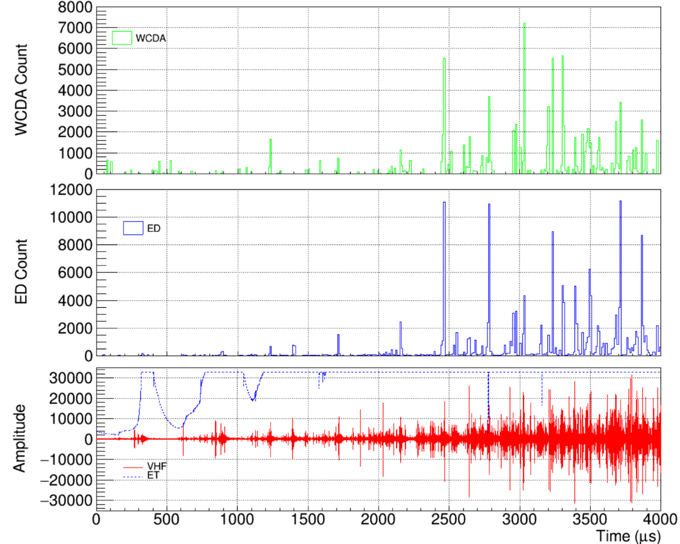
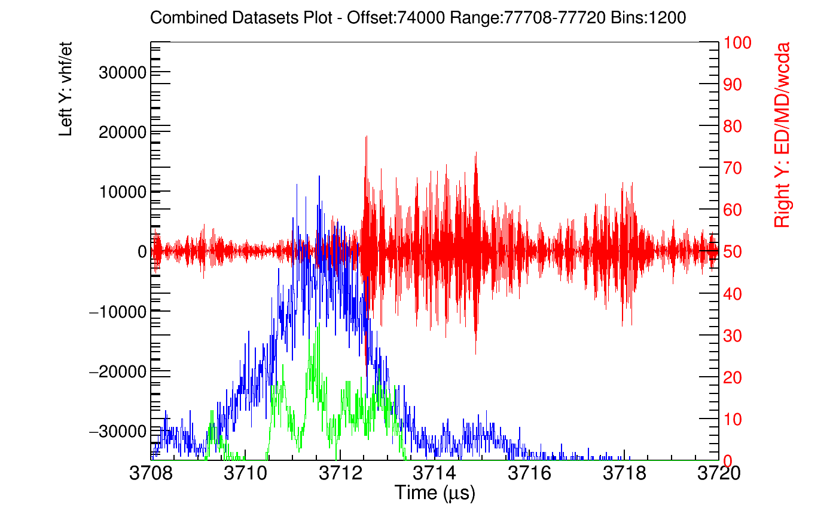

Leader 1
— VHF
— ED
— WCDA
实际应用
第三方面
Clustering phenomena repeatedly occurred.
  ——several events detected within a short period in WCDA.
Temporal Variation in the Number of Fired Detectors
The trigger rate in both WCDA and ED increased over time.
These clustered events also show correspondence with the VHF
Notes:
10μs/bin
10ns/bin

Slide 9
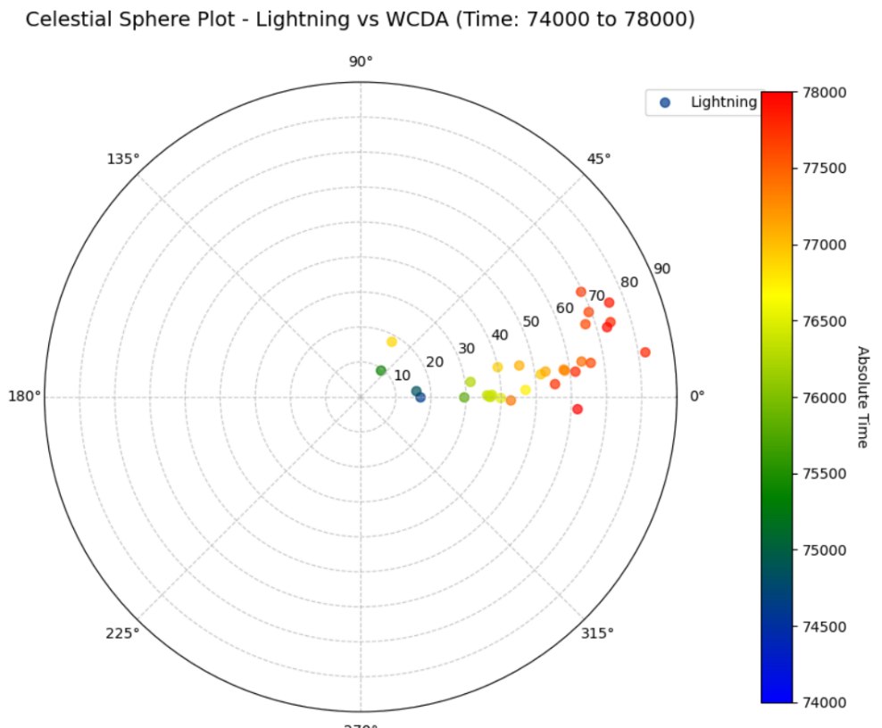
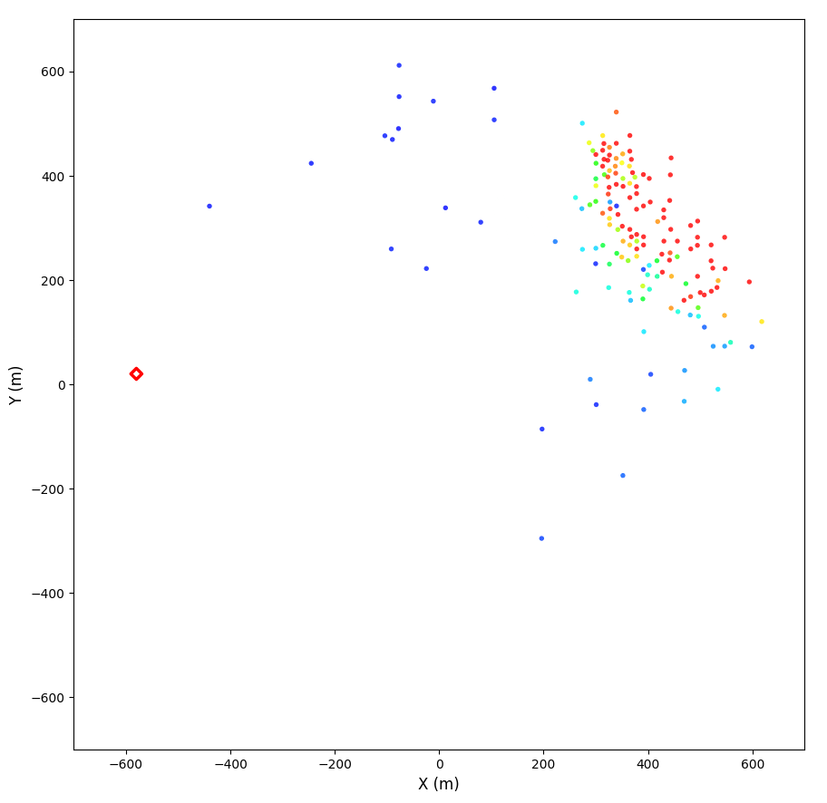
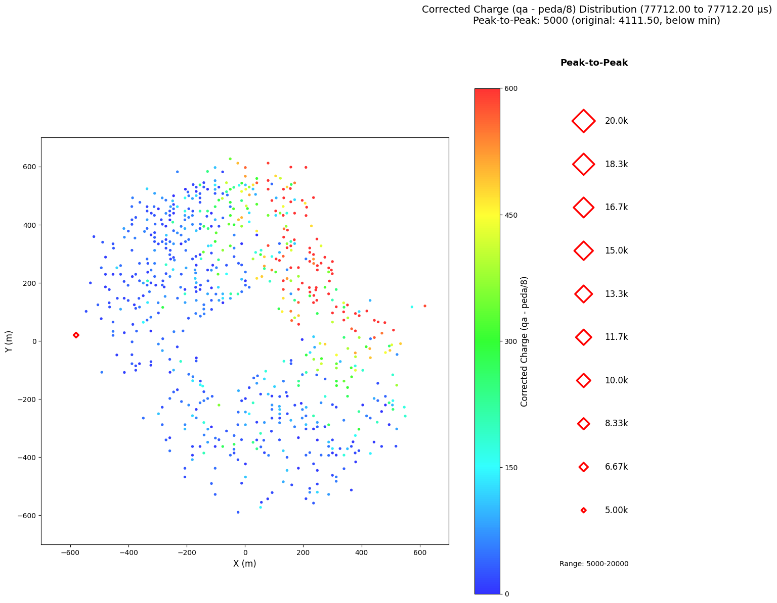
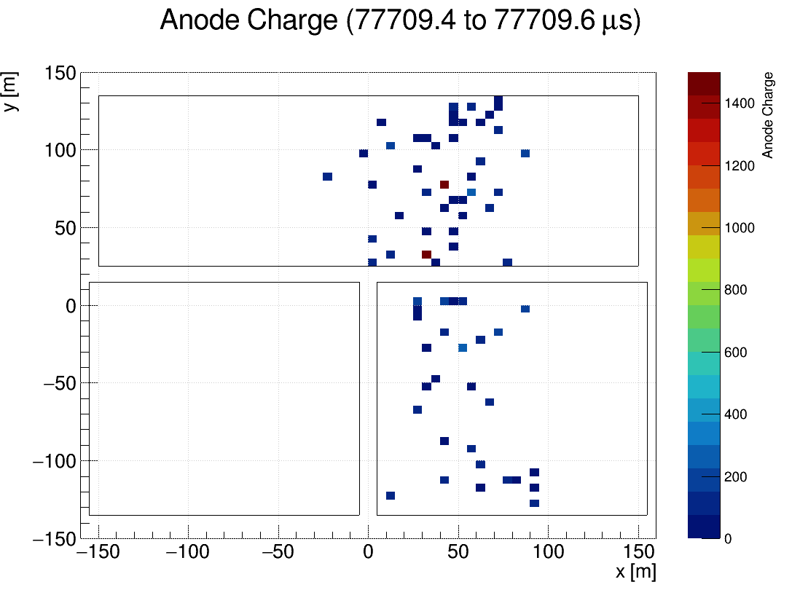
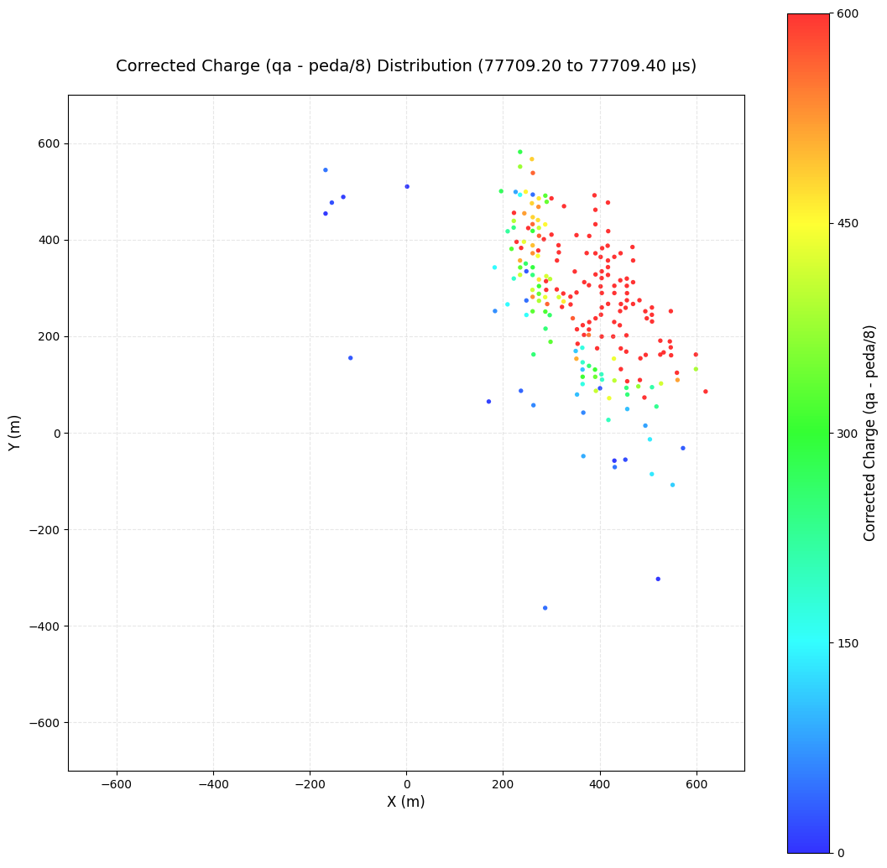

Leader 1
Amplitude WCDAQa EDQ
WCDA&ED charge distribution &VHF
Zenith-angle sky map
Time: Sweeps across array in 5 μs
Charge: Low overall, enhanced near lightning
Reason:​
  Multiple branches​ → stepped leader
  Develop relatively slowly (~1e5 m/s).
200 ns per frame
Total duration: 5 µs

Slide 10
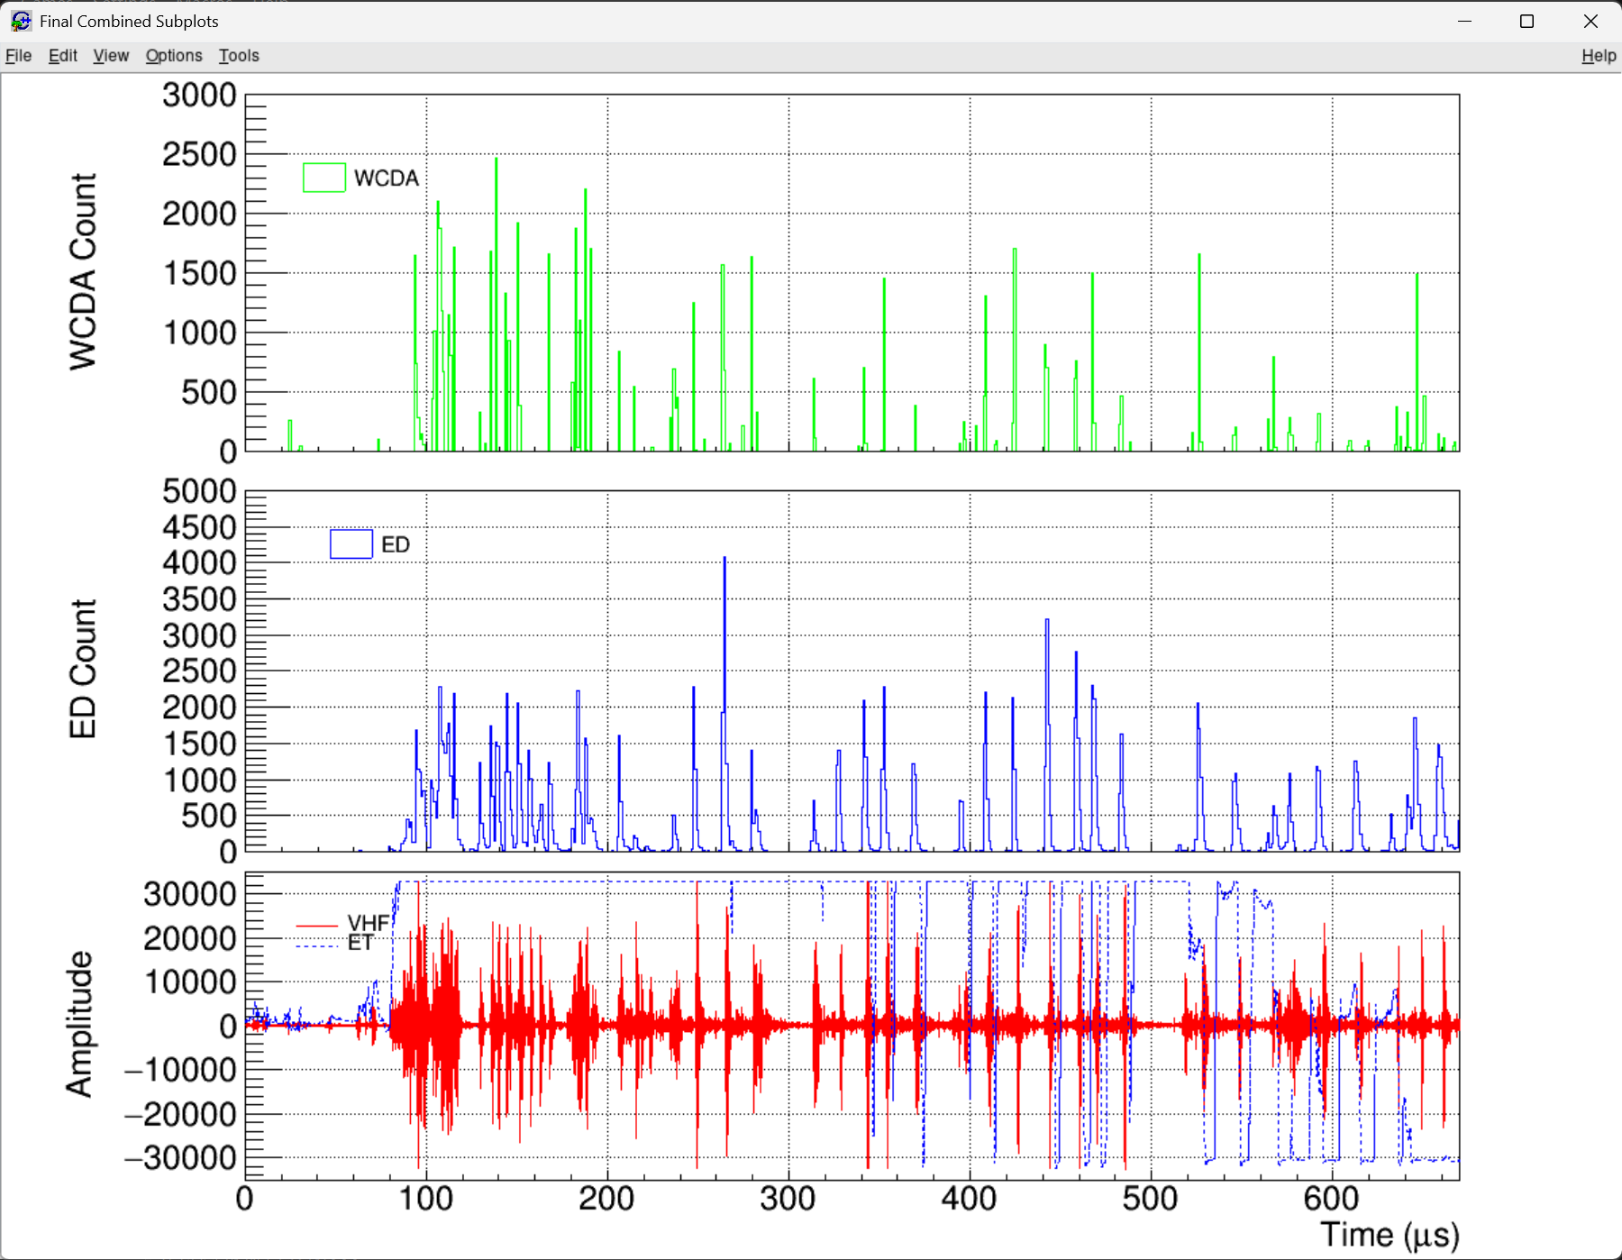
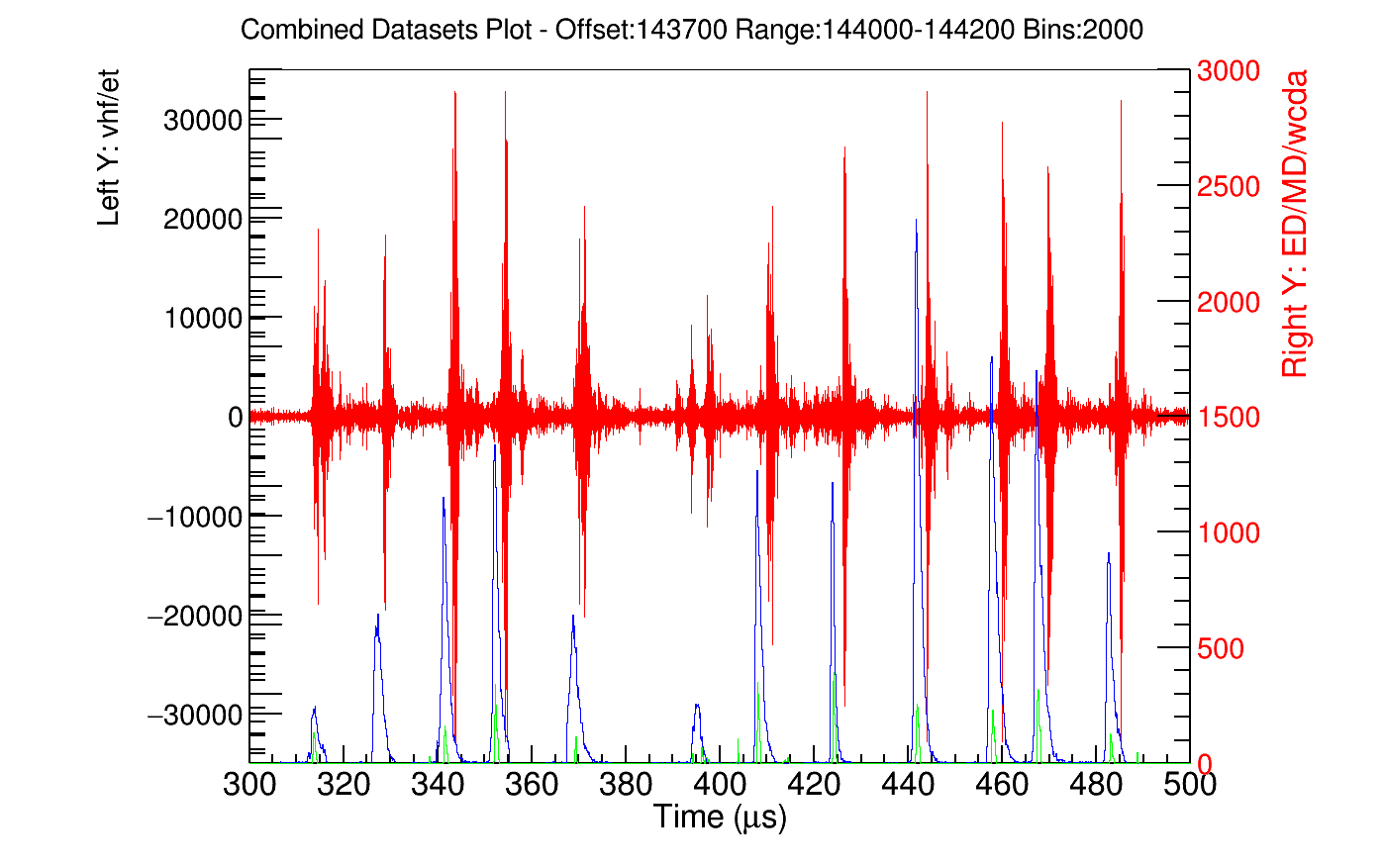
Leader 2
实际应用
第三方面
— VHF
— ED
— WCDA
实际应用
第四方面
Temporal Variation in the Number of Fired Detectors
WCDA and ED triggers :​ Concentrated first, then decreased.
Events were relatively dispersed, with no obvious clustering.
Detector response showed a nearly one-to-one correspondence with lightning VHF pulses.

Slide 11
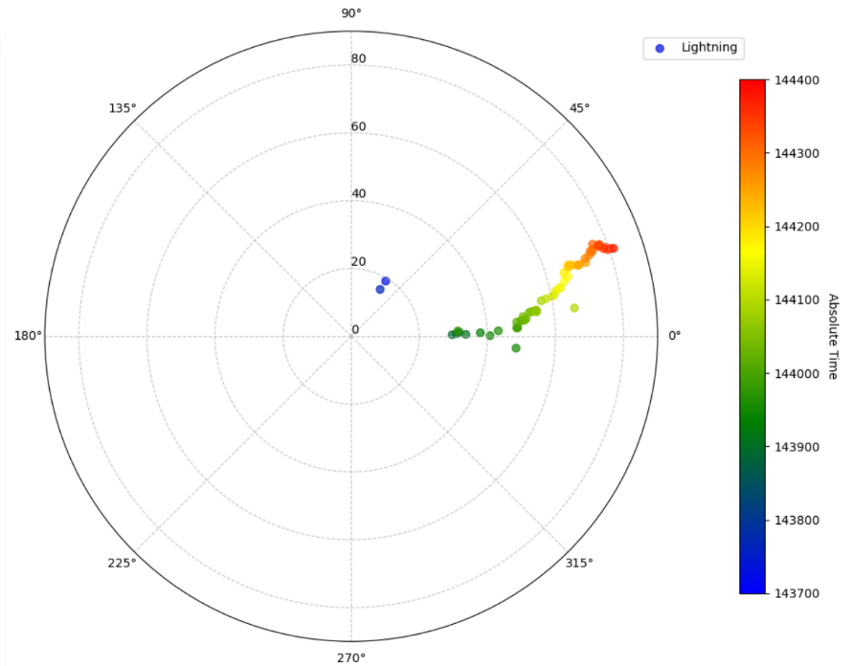
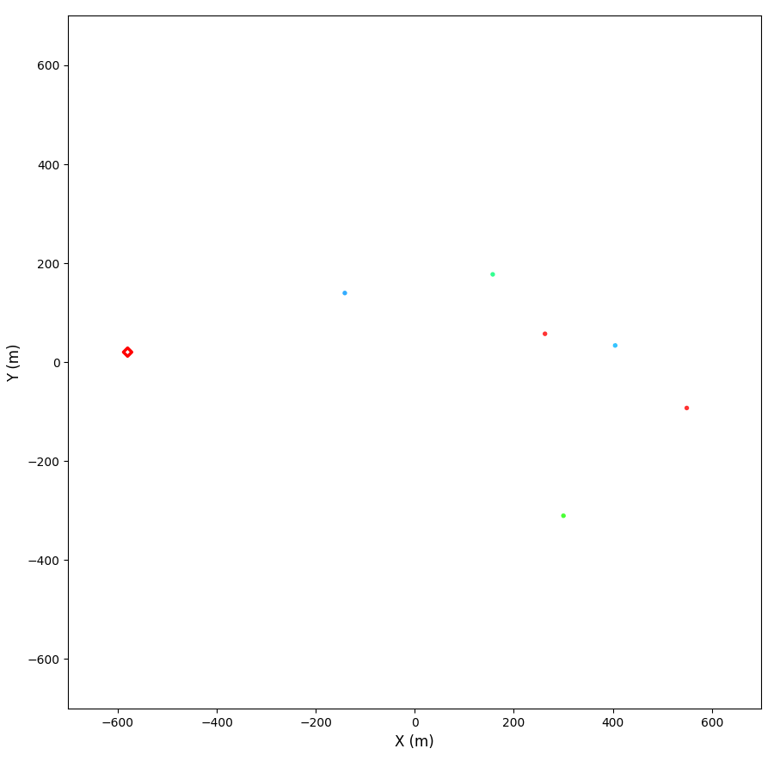

Leader 2
WCDA&ED charge distribution
Amplitude WCDAQa EDQ
实际应用
第三方面
Zenith-angle sky map
Time: Sweeps across array in 3 μs
  Large time intervals between events.
Reason:​
  Dart leader develops without branching
  Develop relatively faster (~1e6 m/s).
200 ns per frame
Total duration: 3 µs

Slide 12
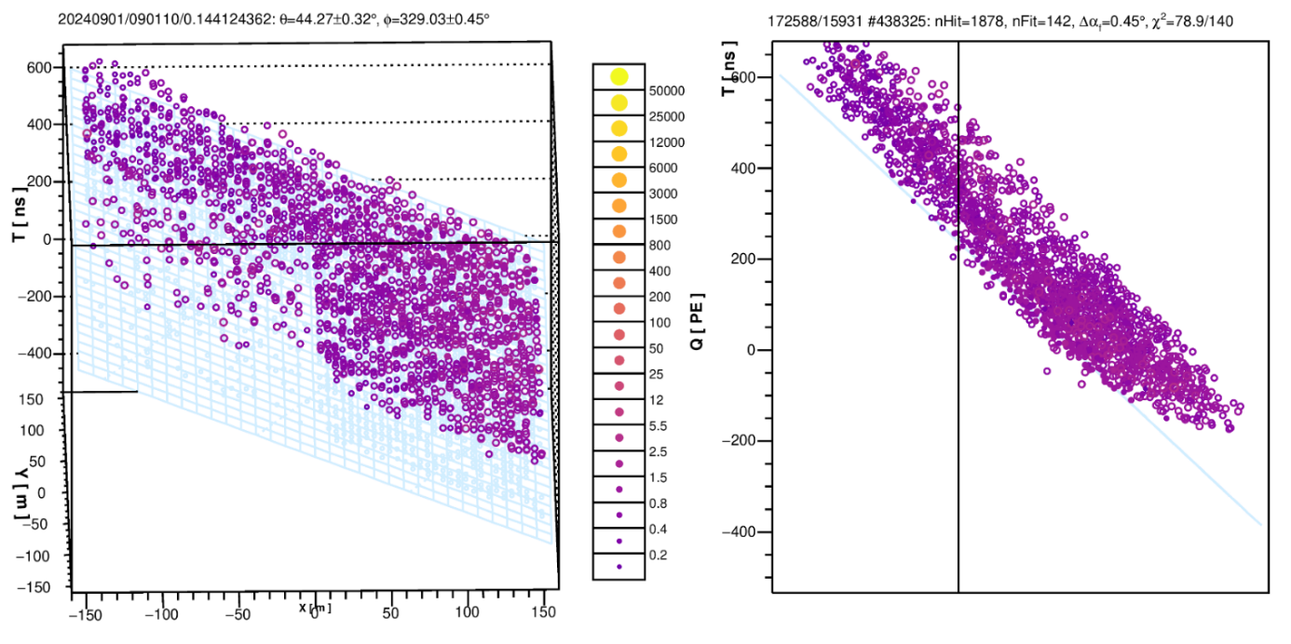
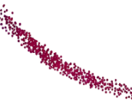
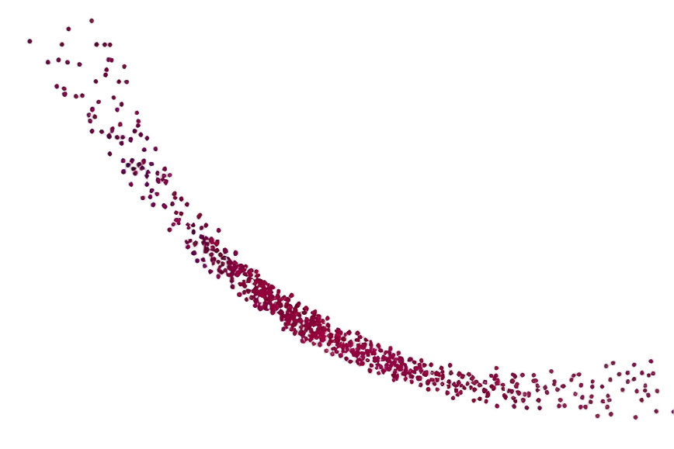
Reconstruction Results
Lightning leader is a near-ground process (1-3 km),
Assume the particles originate from a point source and propagate through the air as a spherical wave to the ground (LHAASO array) for reconstruction.
实际应用
第三方面
Reconstruction Results (EAS)
实际应用
第四方面
Broader time profile and longer duration than typical Extensive Air Shower (EAS)
Time distribution exhibited a distinct arc-like structure.
Schematic diagram of the spherical wave hypothesis.

Slide 13
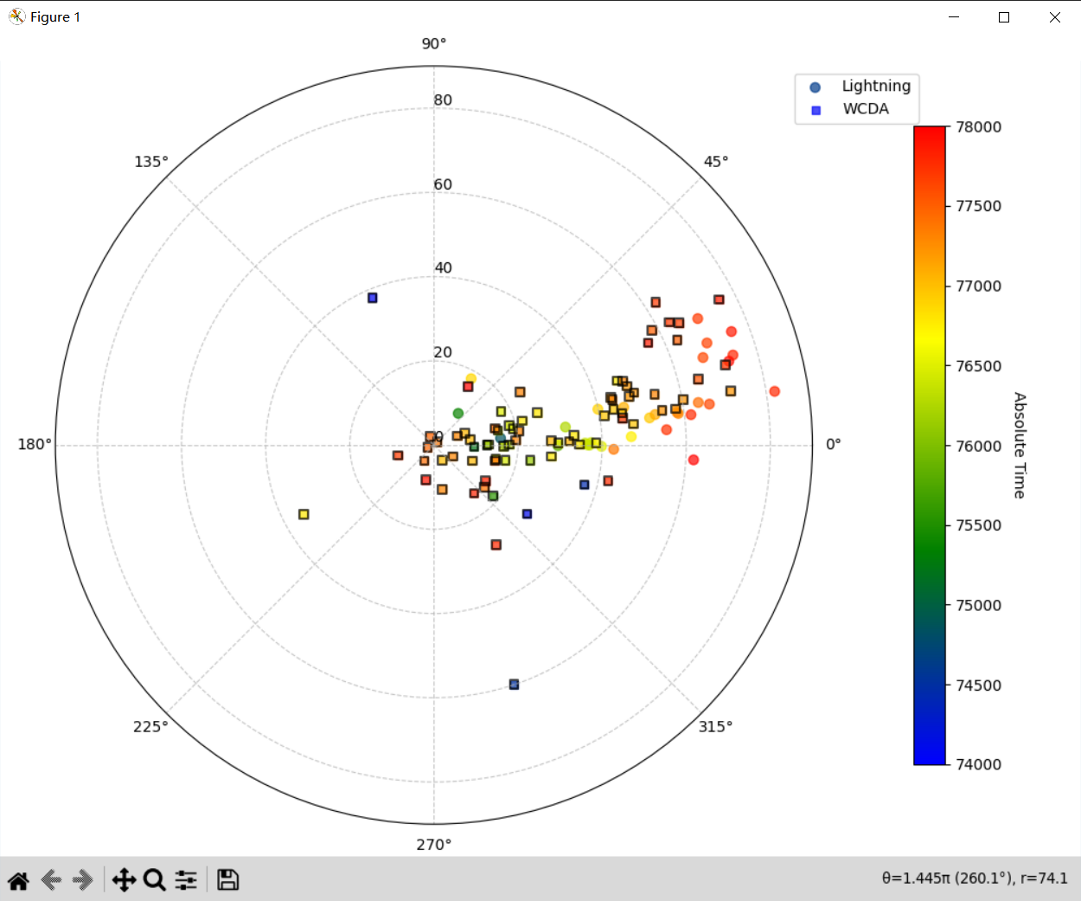
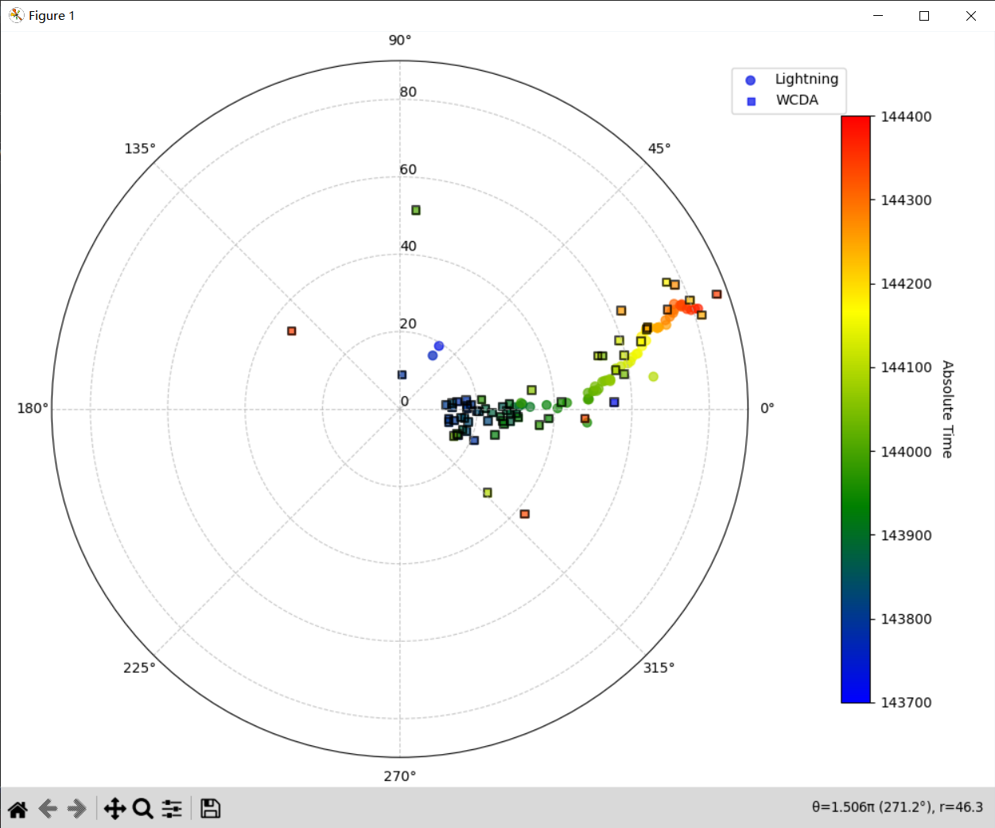
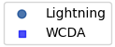
Reconstruction Results
Leader 1
Leader 2
WCDA reconstruction & lightning localization
The reconstruction results are consistent with the lightning localization data.

Slide 14
Summary
LHAASO detected high-energy radiation from downward lightning leaders.
  During the first leader, the high-energy particle radiation showed event clustering.
  During the second leader, the high-energy particles were more dispersed.
  The origin of these high-energy particles coincides with the lightning location.

Slide 15
THANKS

Slide 16
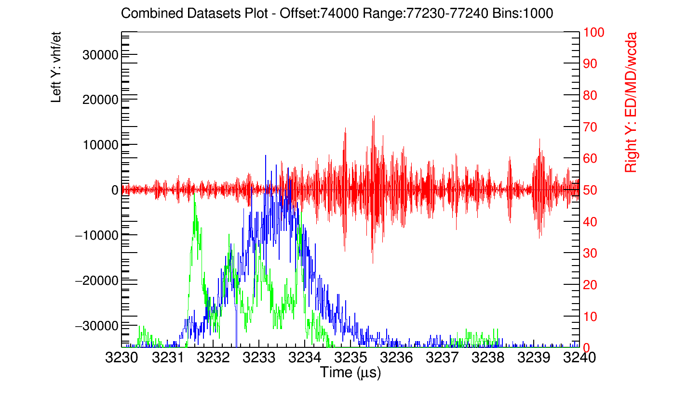
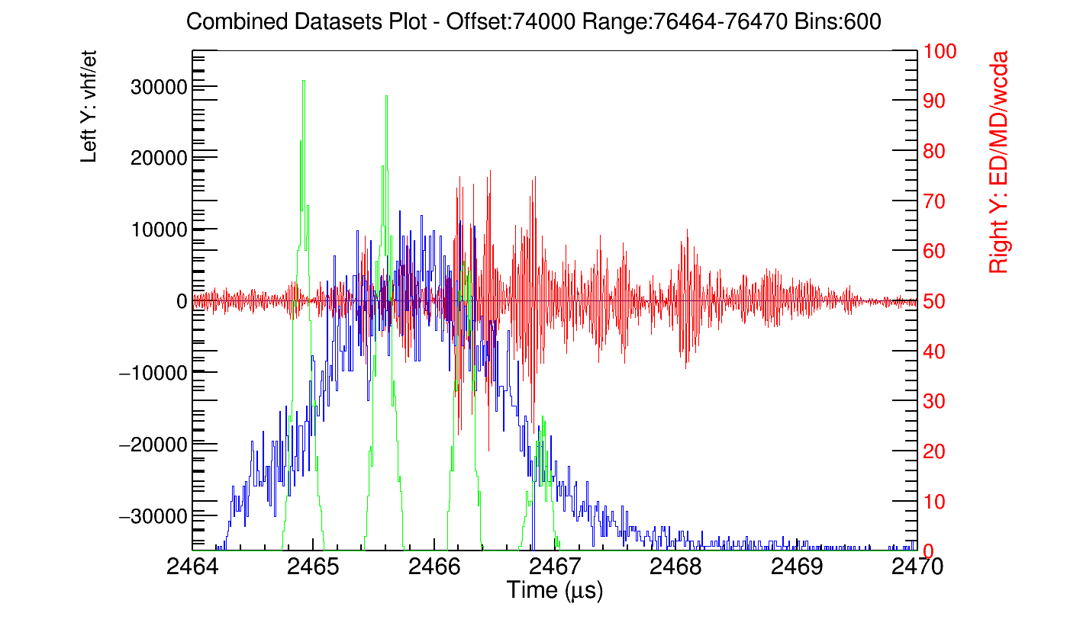
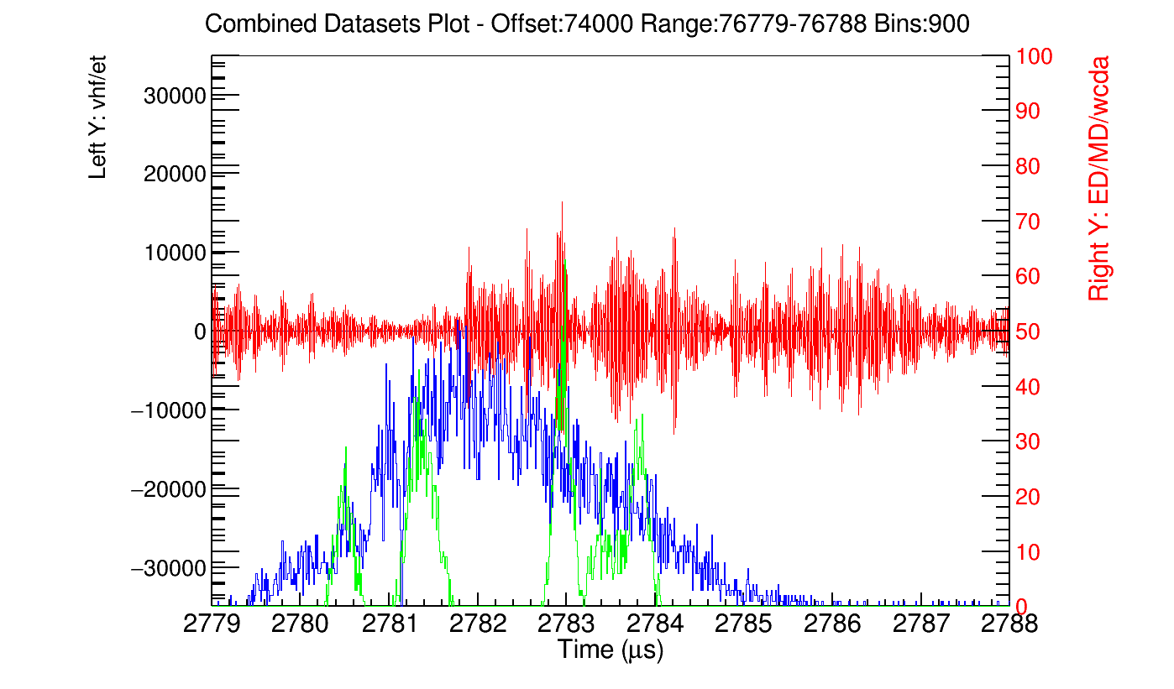
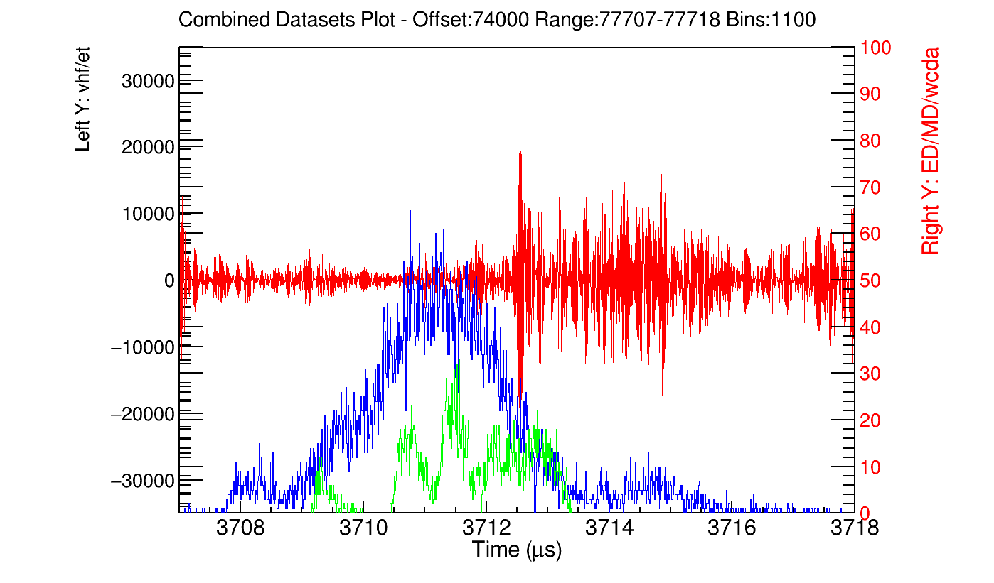
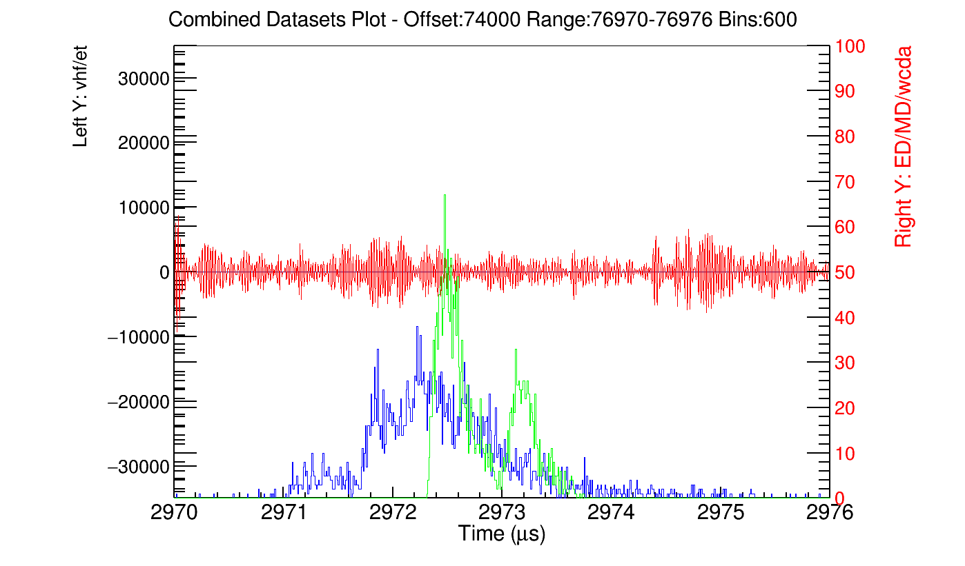
第一次先导期间
— 高频电场
— ED着火数
— WCDA着火数

Slide 17
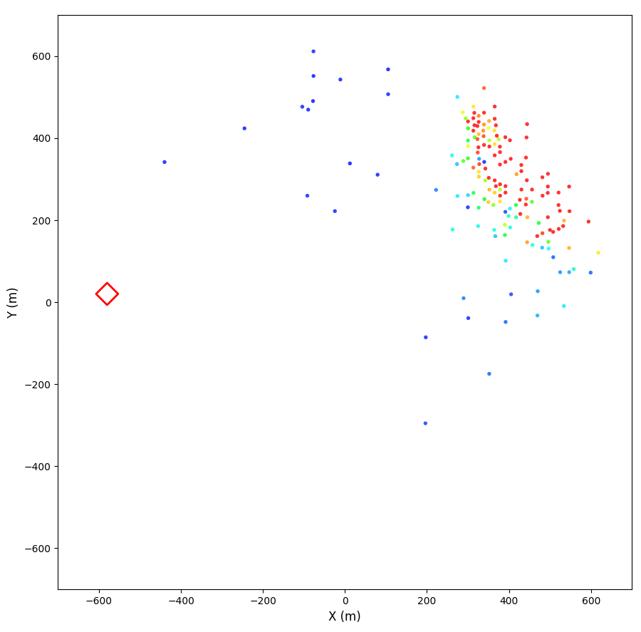
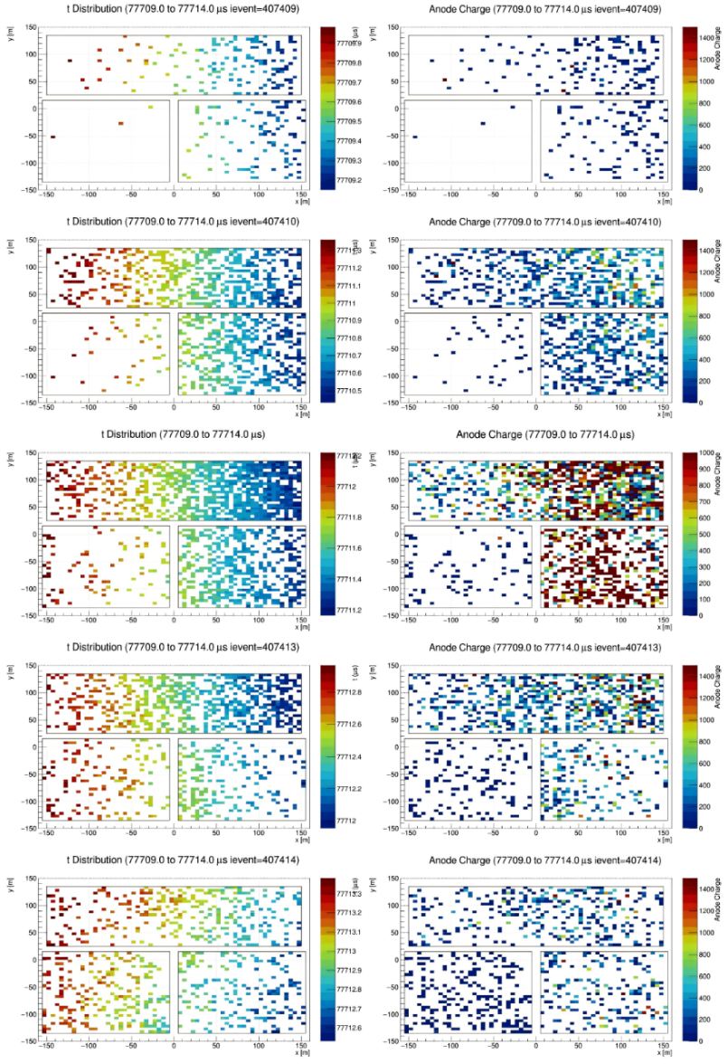
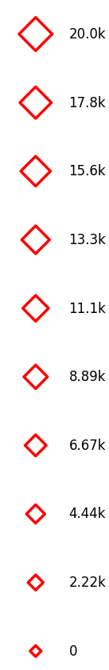
第一次先导期间
WCDA五个事件单独t与 Qa分布
Amplitude WCDAQa EDQ
T Qa
实际应用
第三方面
Peak to peak
WCDAQa EDQ
200 ns per frame
Total duration: 5 µs
实际应用
第四方面

Slide 18
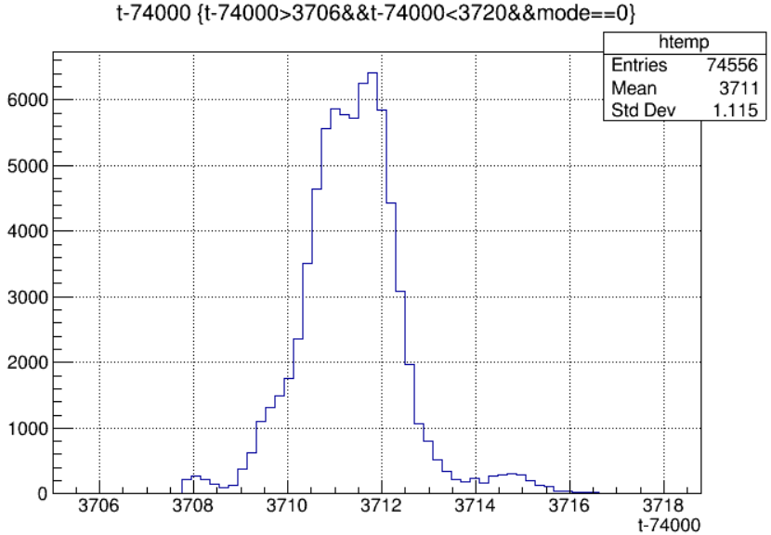
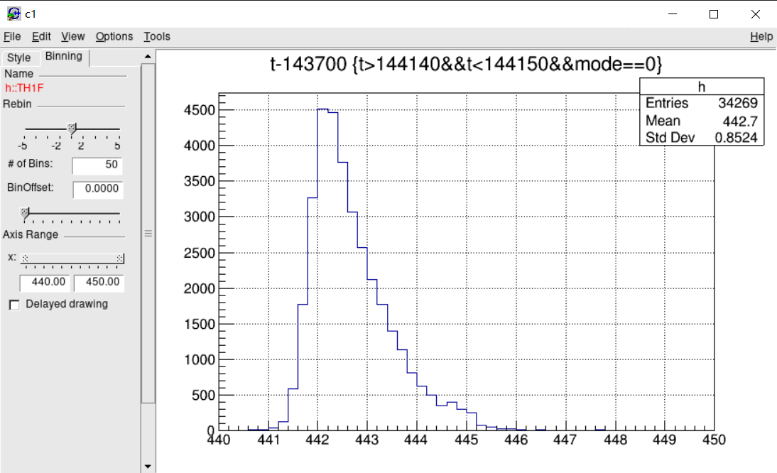
半高宽：先导1：约2.1μs
先导2：约1.2μs

Slide 19
