Slide 1
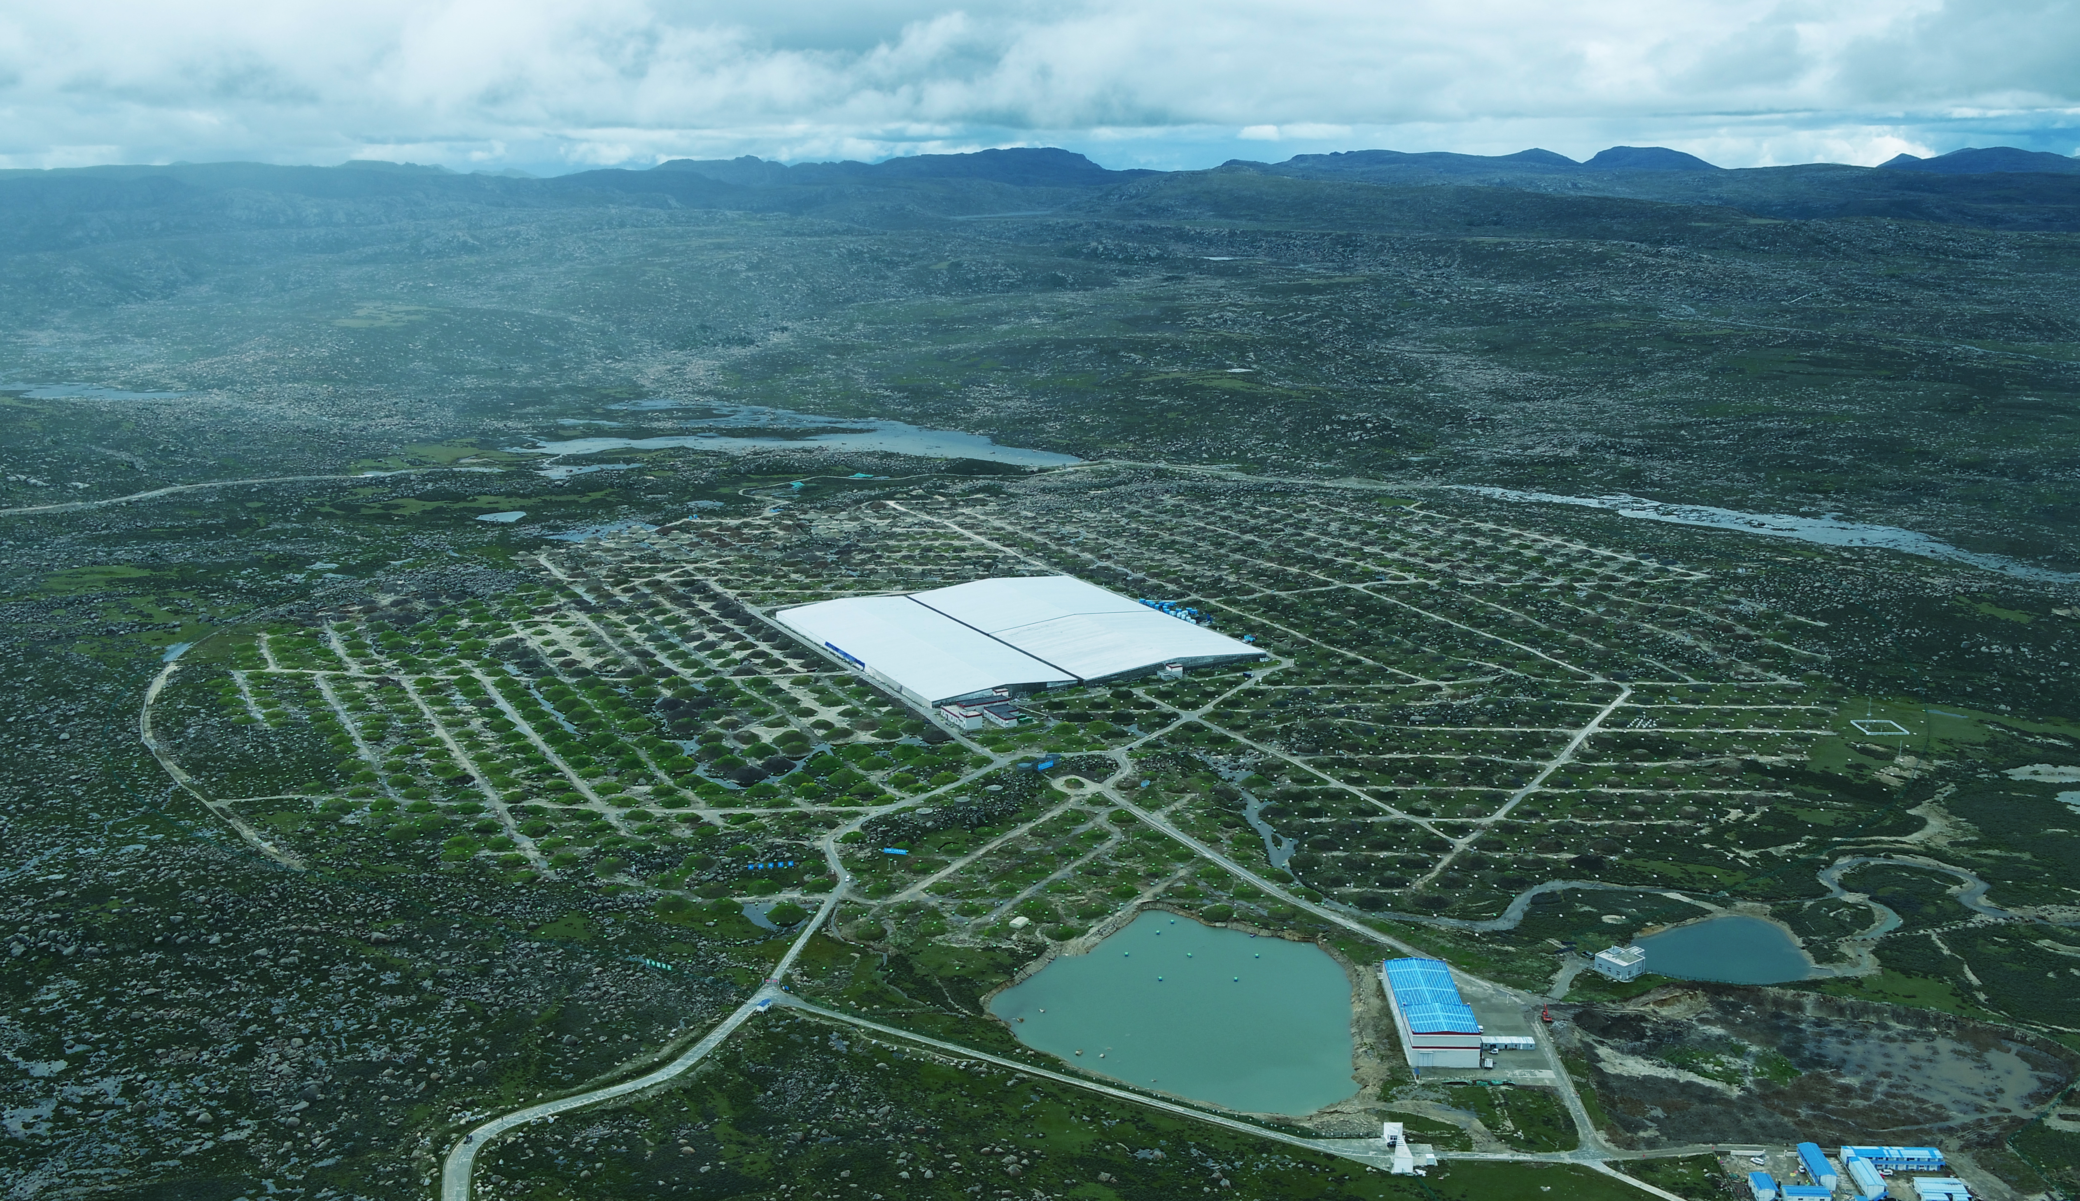
First Detection of a VHE Gamma-ray Flare from RX J0648.7+1516 with LHAASO-WCDA
Jiayi Wang, Guangman Xiang, Min Zha and Bing Zhang for the LHAASO Collaboration
Institute of High Energy Physics, CAS
NO.40

Slide 2
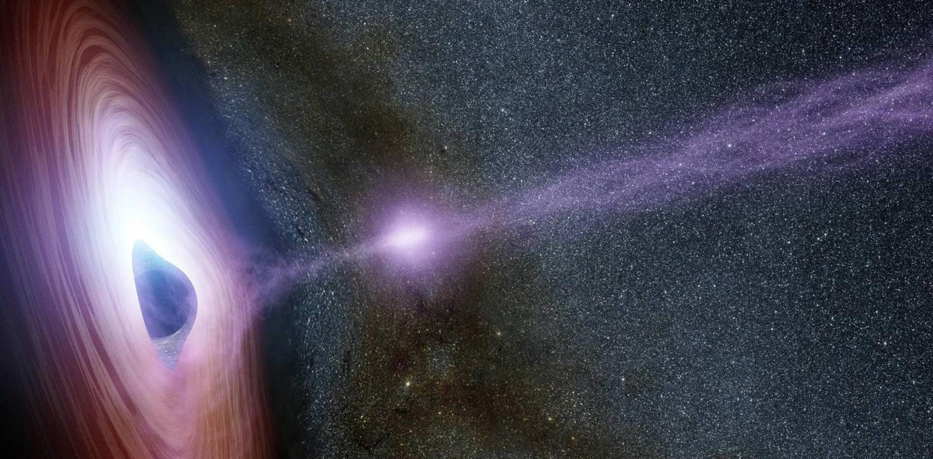
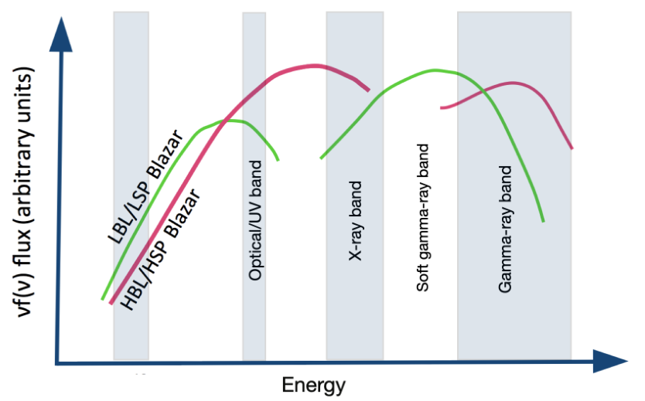
Introduction of RX J0648.7+1516
Source Type: HBL(high-frequency-peaked BL Lac )
Position:
  R.A.: 102.19°, Dec.: 15.27°
  Gal Long: 198.99°, Gal Lat: 6.32°
Red shift:
  z = 0.179
Characteristics of HBLs：
  Strong non-thermal emission;
  Rapid variability;
  Featureless optical spectra;
  High polarization;
  Significant gamma-ray production;

Slide 3
Multi-Wavelength Observational History
Radio:​ Associated with a compact, flat-spectrum source, characteristic of blazar jets .
Optical/UV:
  Early optical spectroscopy failed to identify the source .
  After the VERITAS VHE detection, follow-up spectra were obtained with the Shane 3-m Telescope at Lick Observatory .
  Contemporaneous optical/UV data were provided by the MDM observatory and Swift-UVOT .
X-ray:
  The original discovery band (ROSAT)
  Contemporaneous X-ray observations were conducted with Swift-XRT during the VERITAS campaign .
Gamma-ray (GeV): Detected as 1FGL J0648.8+1516 by Fermi-LAT
Gamma-ray (TeV/VHE):
  First detection of VHE emission (>200 GeV) by VERITAS
  No significant variability during the VERITAS observation

Slide 4
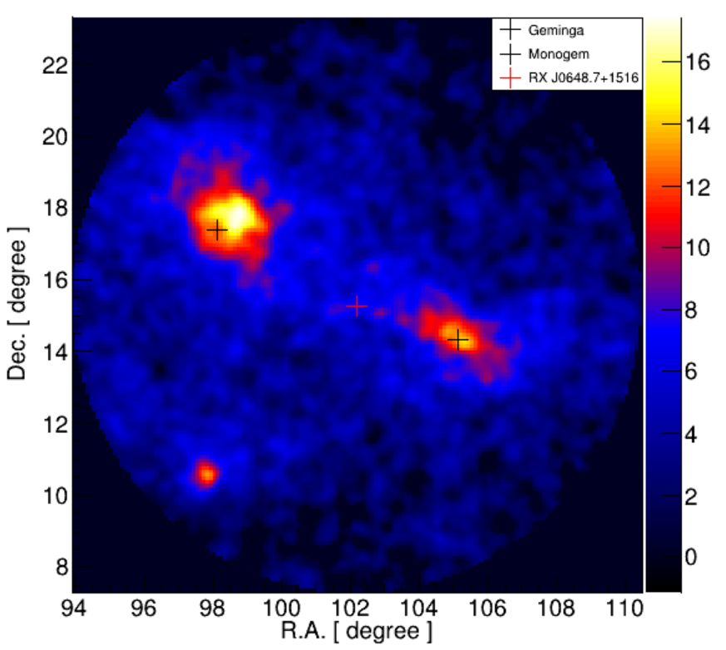
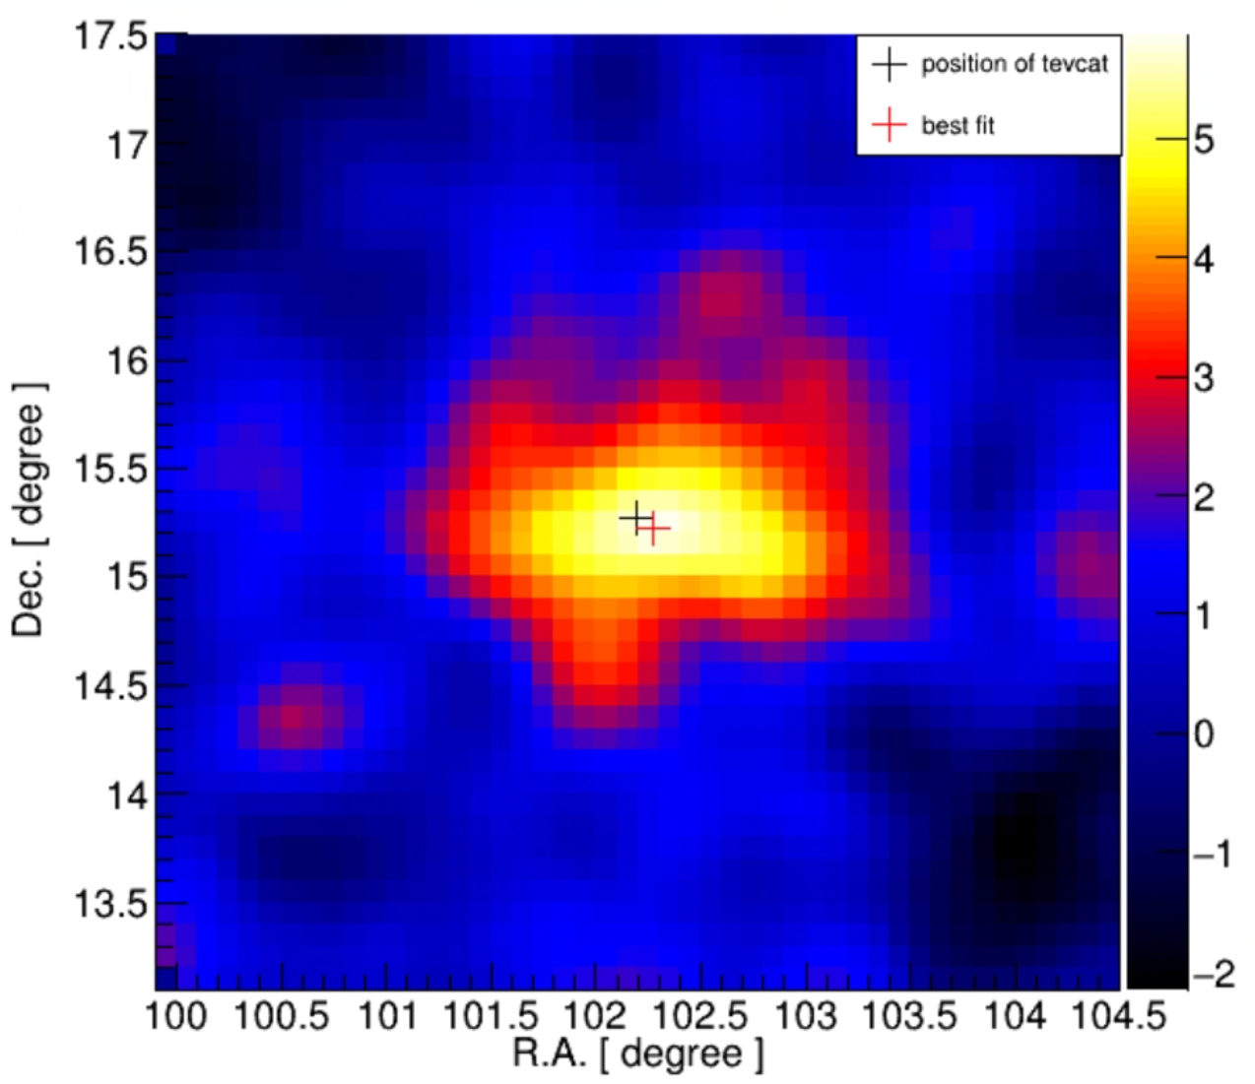


Data and Analysis
The source lies in a complex region between the bright pulsar wind nebulae Geminga and Monogem. Their bright, diffuse emission acts as a structured background.
  2 methods used to correct these effects
Software: 3D maximum likelihood package.
Data set: 2021-03-05 to 2025-07-31
Nhit bins: [30, 60, 100, 200, 300, 500, 800, 2000]
ROI: 6° X 6° around the target source
Long-term observation
  Significance above 5σ
  Position Shift: 0.09º
$$\sqrt{TS}$$
$$\sqrt{TS}$$
Long term sky map

Slide 5
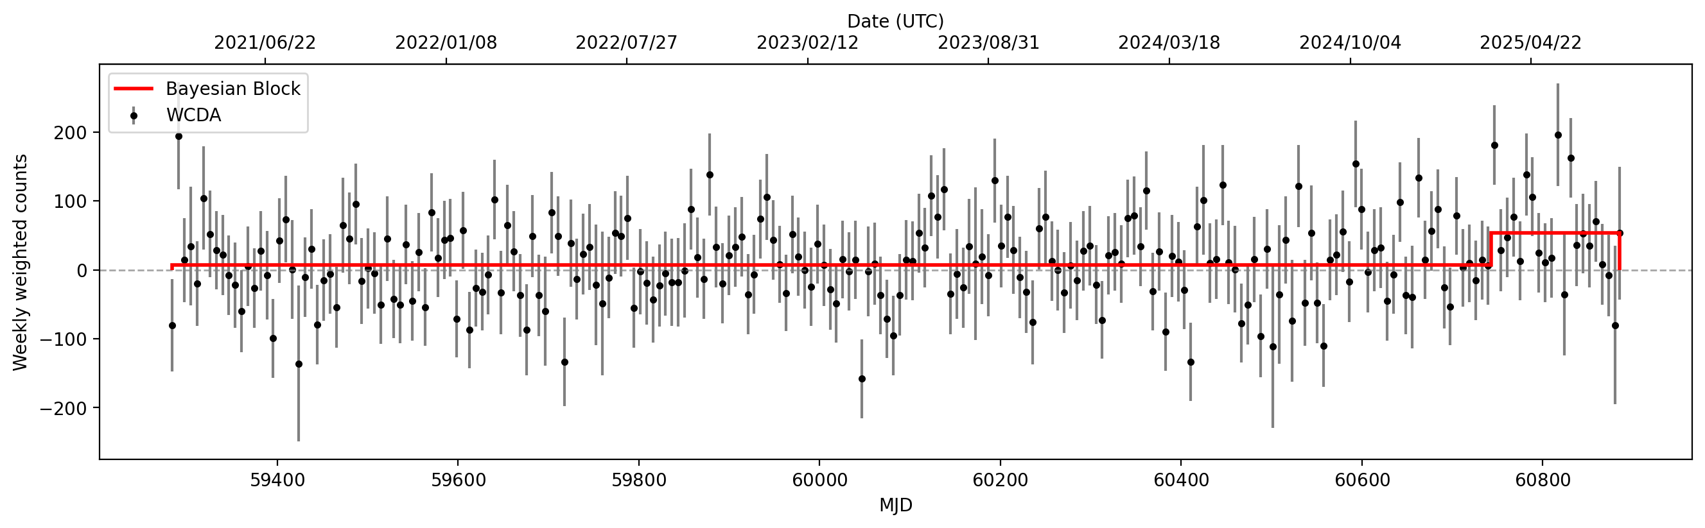
Weekly light curve
flaring
Bayesian blocks to identify the flare
  1 flare identified (First discover a flare in VHE band)
  145days (2025-03-09 to 2025-07-31)
  The most direct evidence of a blazar

Slide 6
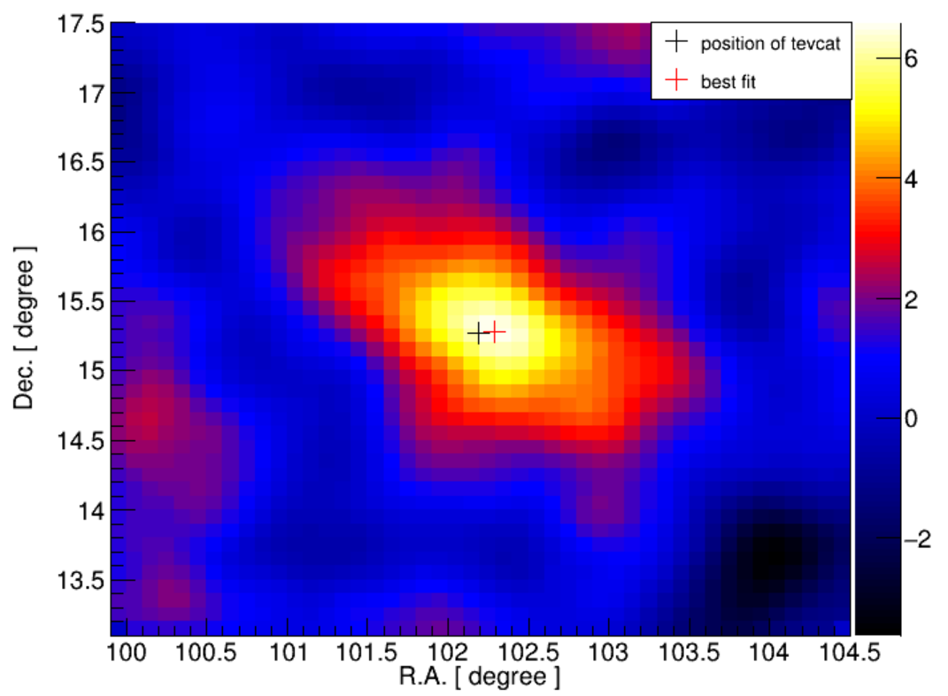
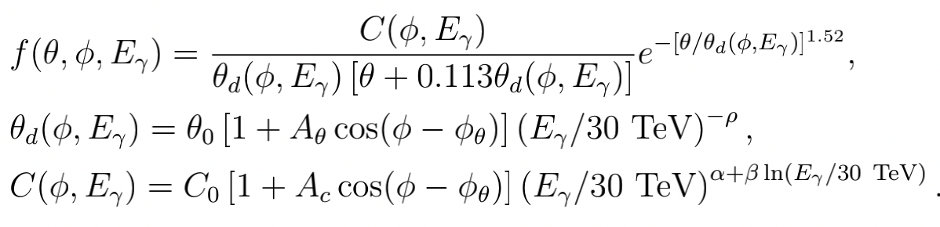
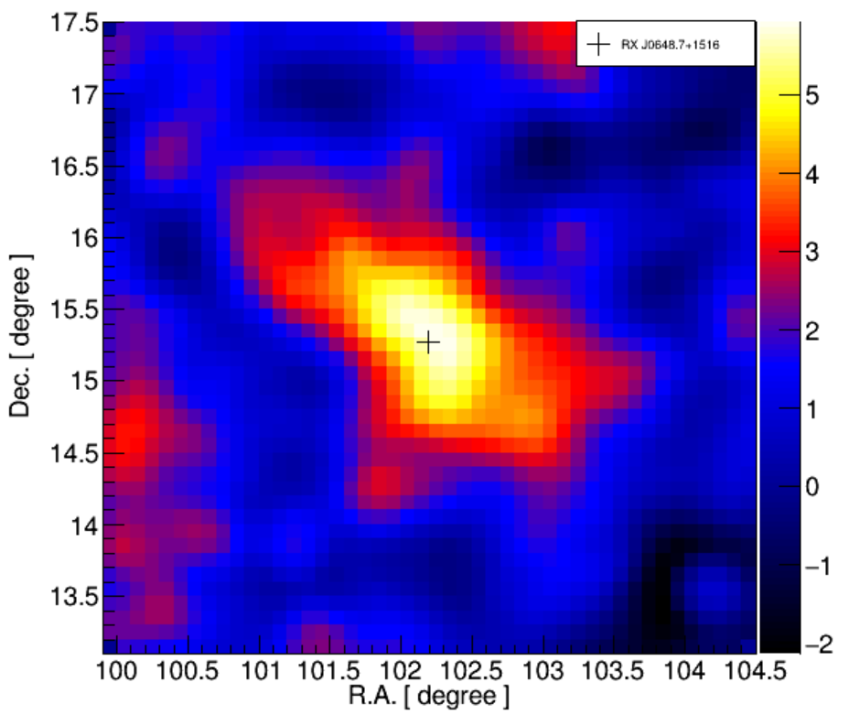


Flaring state
Method1 6.6σ
Method1
$$\sqrt{TS}$$
Add the expected excess of the below model of Geminga and Monogem to the background
Method2
Method2 5.8σ
$$\sqrt{TS}$$
Scale and add the ground state Ns to the background of the high state based on the observation time

Slide 7
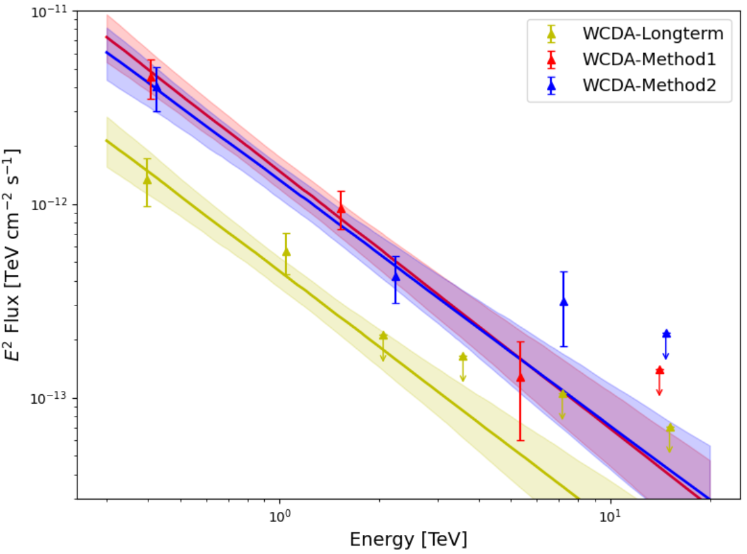
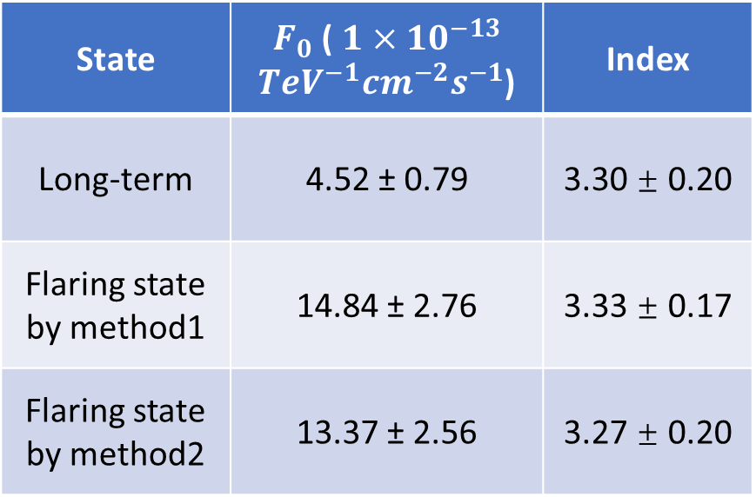
SED
State | $F_{0}$ ( $1×{10}^{−13}$ ${TeV}^{−1}{cm}^{−2}s^{−1}$) | Index
Long-term | 4.52 ± 0.79 | 3.30 ± 0.20
Flaring state by method1 | 14.84 ± 2.76 | 3.33 ± 0.17
Flaring state by method2 | 13.37 ± 2.56 | 3.27 ± 0.20
The observed differential energy spectrum is well described by a power-law function. The best-fit parameters are displayed in the table.
Flux level is around 5.2% of the Crab Nebula flux, while high state is 2-3 times higher than long-term flux.

Slide 8
Summary and outlook
First VHE gamma-ray flare from the HBL RX J0648.7+1516 using LHAASO-WCDA, providing the strongest evidence to date for its blazar classification
Future plans:
  Continued WCDA monitoring: the flaring is ongoing
  SED Modelling: detailed modelling of broad band SED during the flaring and quiescent states
  Refined analysis utilizing AI-version data: AI will significantly enhance the analytical performance of WCDA
Thanks for your attention!

