Slide 1
Measurement of the Proton-Air Inelastic Cross Section at 1 PeV with the LHAASO
KM2A and WFCTA Hybrid Observations
Mingyang Ni*, Qiang Yuan, Yi Zhang,
Zhen Cao, Zhiyong You, Lingling Ma, Shoushan Zhang,
Shaoqiang Xi, Felix Aharonian
Purple Mountain Observatory, CAS
Institute of High Energy, CAS
The First LHAASO Collaboration Conference in 2026, Suzhou-Jiangsu

Slide 2
Outline
Motivation: p–air cross section at PeV
LHAASO Hybrid Measurement
Simulation & Events Selection
Xmax-based Analysis Method
Results & Uncertainties discussion

Slide 3
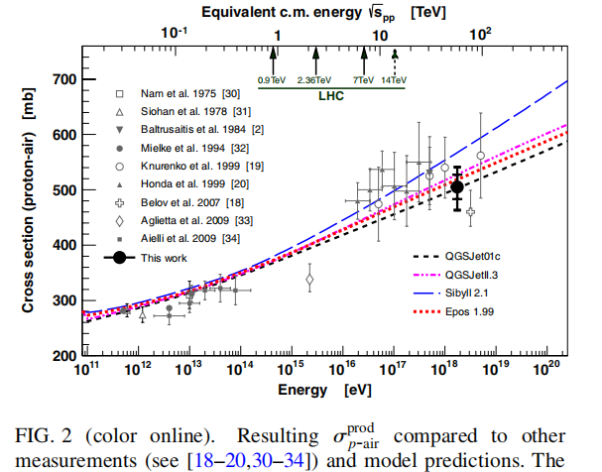
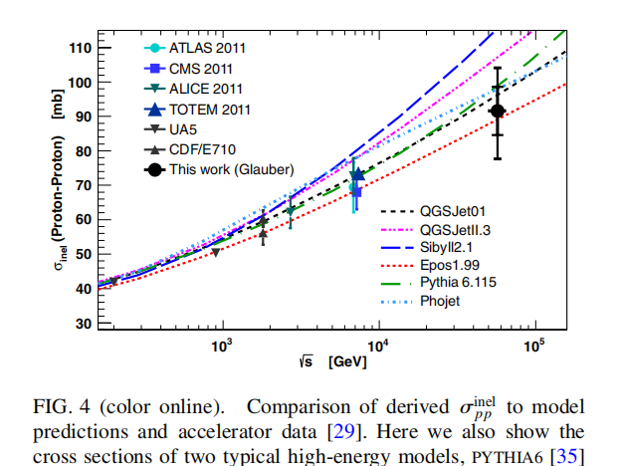
Motivation
1、Cosmic ray experimental data around the PeV range are still very limited.
2、Related to Proton-Proton cross section results from accelerator data. [Glauber model]
DOI: 10.1103/PhysRevLett.109.062002

Slide 4
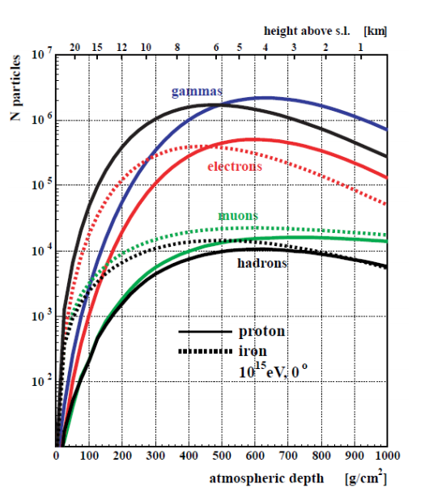
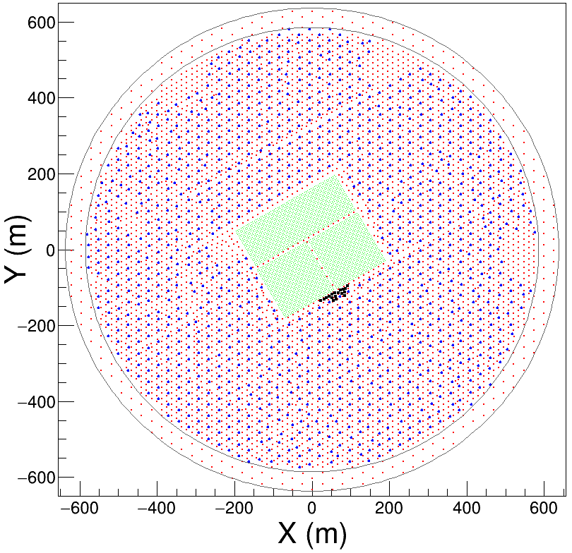
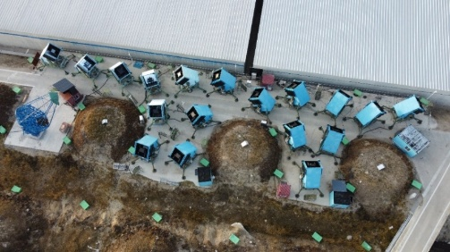
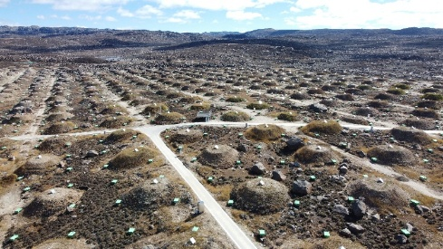
LHAASO as a New Window
LHAASO is located at a high altitude with vertical atmospheric depth of ~600 g/cm², which is close to the shower maximum (Xmax) of air showers induced by PeV proton.
KM2A–WFCTA hybrid measurement
KM2A: provides mass component selection, with good angular & energy resolution
WFCTA: enables the measurement of Xmax
WFCTA
KM2A
DOI 10.1088/0034-4885/66/7/202

Slide 5
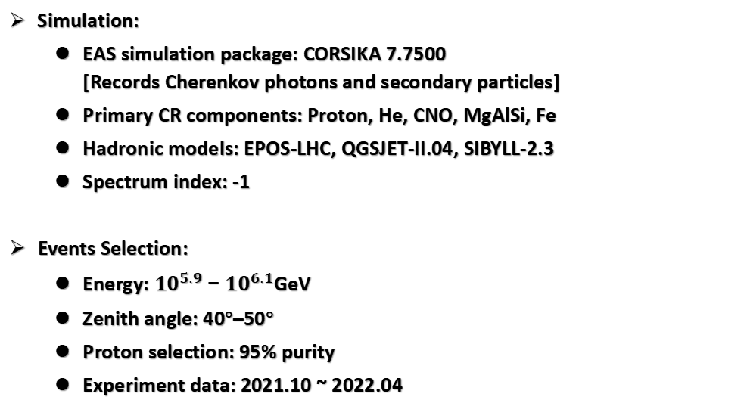
Simulation & Events selection
Simulation:
  EAS simulation package: CORSIKA 7.7500
  [Records Cherenkov photons and secondary particles]
  Primary CR components: Proton, He, CNO, MgAlSi, Fe
  Hadronic models: EPOS-LHC, QGSJET-II.04, SIBYLL-2.3
  Spectrum index: -1
Events Selection:
  Energy: ${10}^{5.9}−{10}^{6.1}$GeV
  Zenith angle: 40°–50°
  Proton selection: 95% purity
  Experiment data: 2021.10 ~ 2022.04

Slide 6
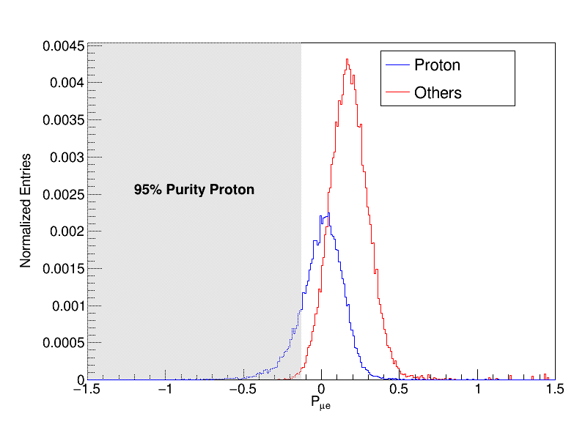
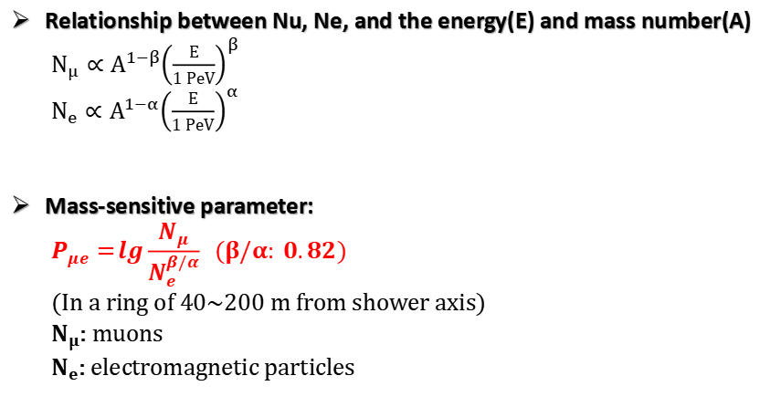
Proton selection
Relationship between Nu, Ne, and the energy(E) and mass number(A)
  $N_{μ}∝A^{1−β}{\left(\frac{E}{1 PeV}\right)}^{β}$
  $N_{e}∝A^{1−α}{\left(\frac{E}{1 PeV}\right)}^{α}$
Mass-sensitive parameter:
  $$P_{μe}=\lg{\frac{N_{μ}}{N_{e}^{β/α}}} (β/α: 0.82)$$
  (In a ring of 40~200 m from shower axis)
  $N_{μ}$: muons
  $N_{e}$: electromagnetic particles
Notes:
Purity Eff = 0.164825

Slide 7
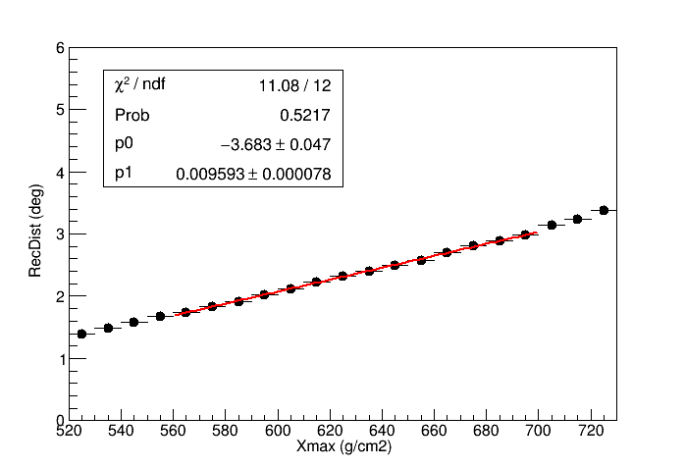
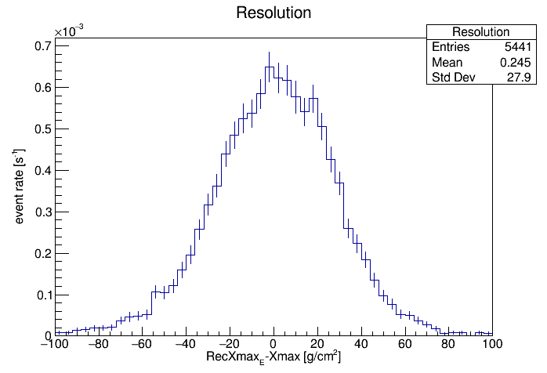
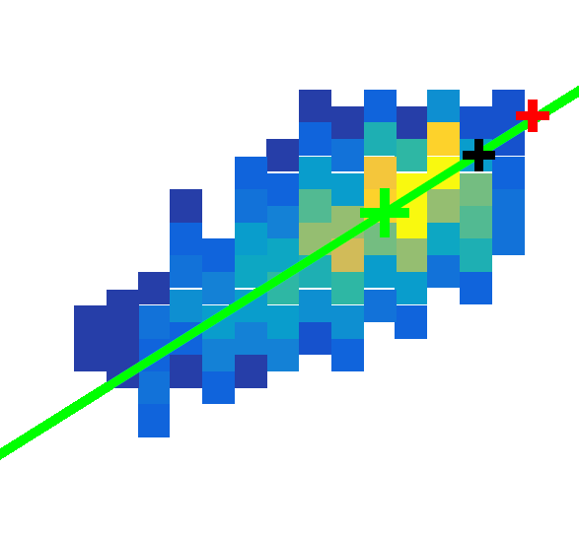
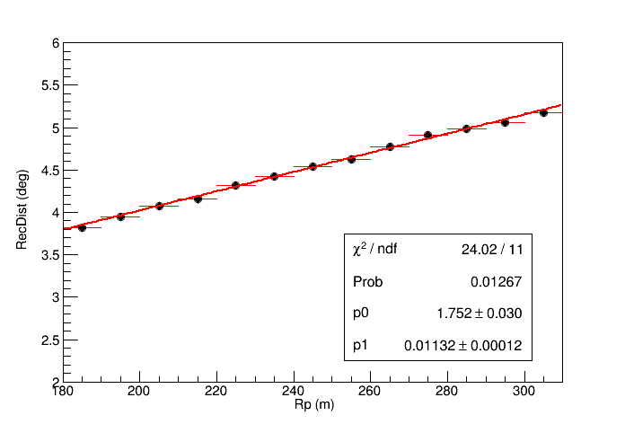


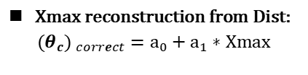

$X_{max}$ Reconstruction
$Dist:θ_{c}$
$$θ_{c}$$
Source
Centroid
${(θ_{c}) }_{correct}=θ_{c} − p1∗Rp$
  Xmax reconstruction from Dist:
  $${(θ_{c}) }_{correct}=a_{0}+a_{1}∗Xmax$$
  Xmax Bias: ~0 g/cm²
  RMS(RecXmax-Xmax) : ~27.9 g/cm²
Notes:
RMS

Slide 8
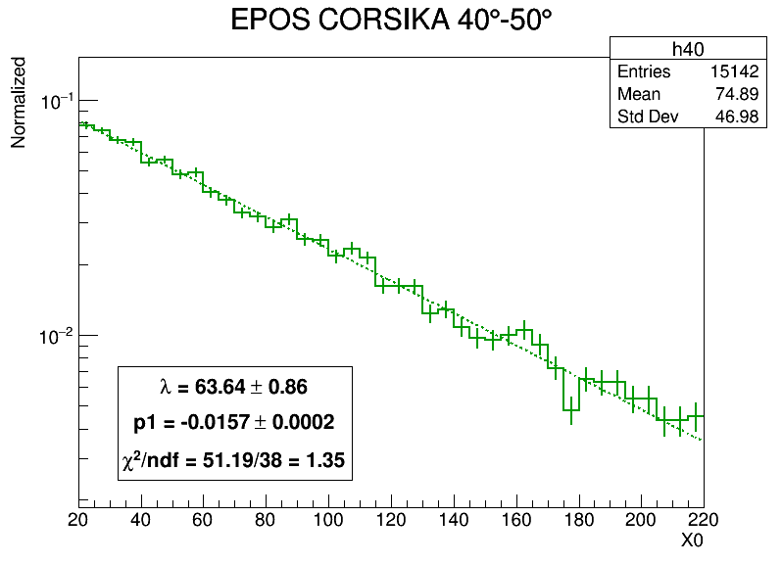
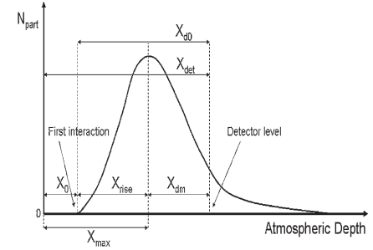
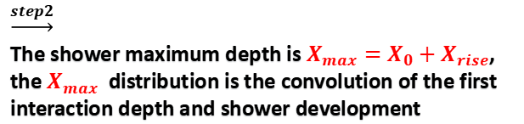
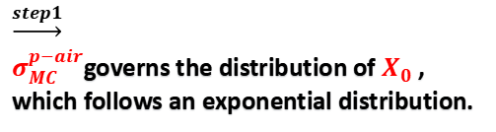
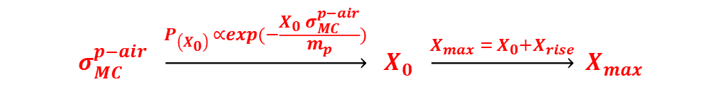
Method-Theory
$$σ_{MC}^{p−air} \underset{→}{P_{\left(X_{0}\right) }∝exp(−\frac{X_{0} σ_{MC}^{p−air}}{m_{p}})} {X_{0} \underset{→}{{X_{max}= X}_{0}+X_{rise}} X}_{max }$$
$\underset{→}{step1}$
$σ_{MC}^{p−air}$governs the distribution of $X_{0}$ , which follows an exponential distribution.
$\underset{→}{step2}$
The shower maximum depth is $X_{max}=X_{0}+X_{rise}$, the $X_{max}$​ distribution is the convolution of the first interaction depth and shower development

Slide 9
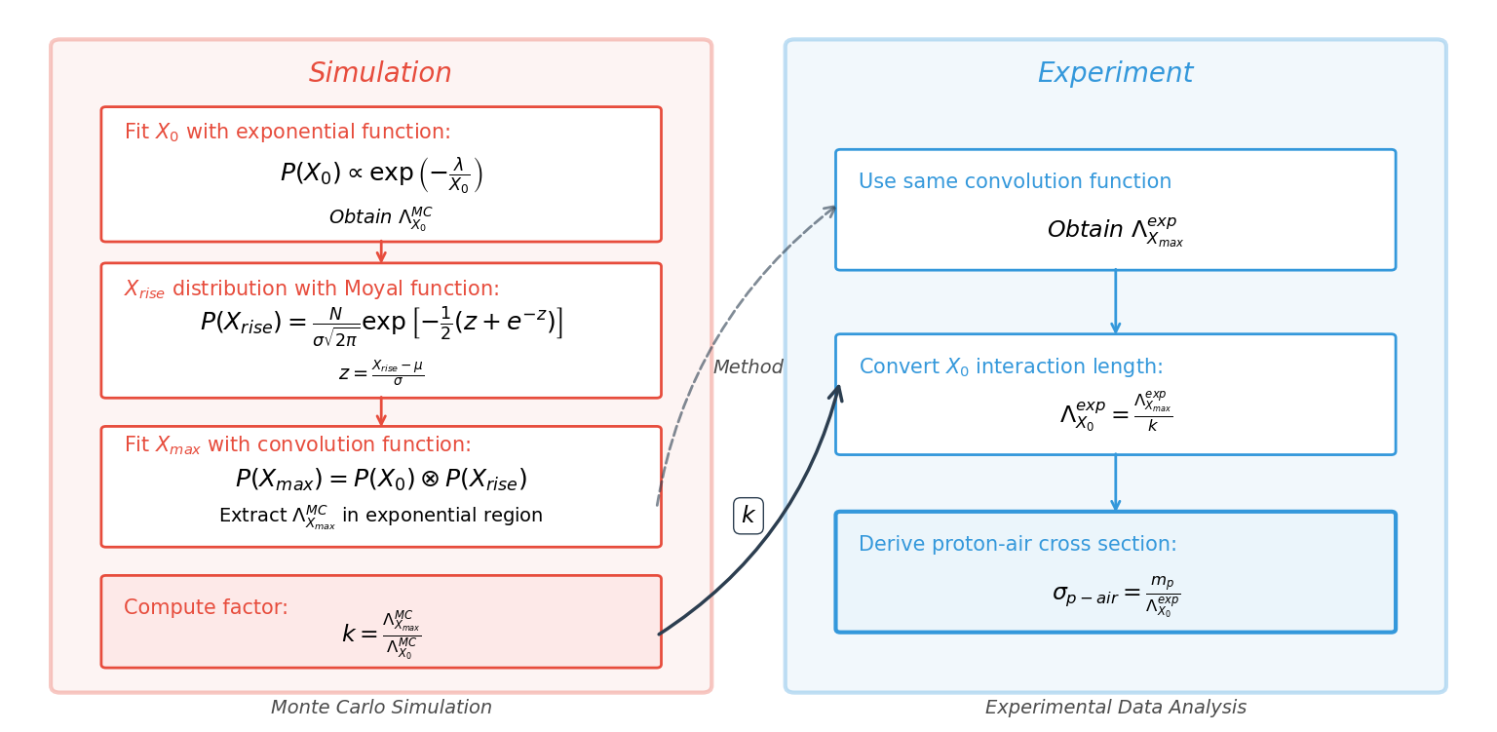
Method-Analysis

Slide 10
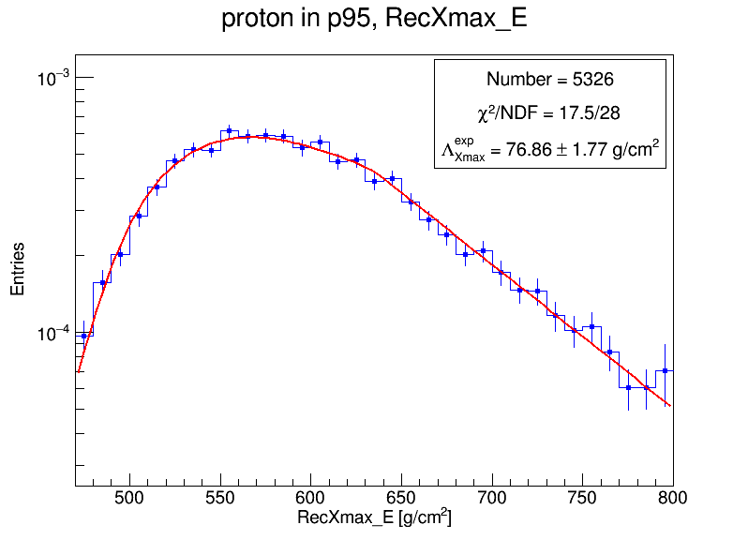
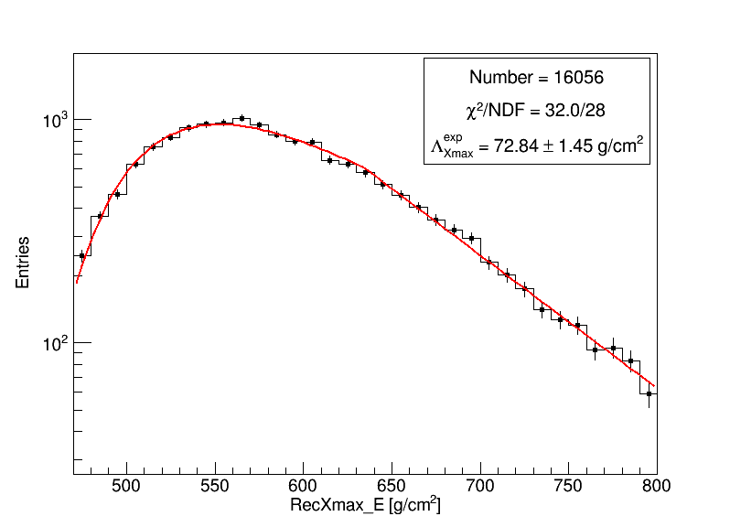

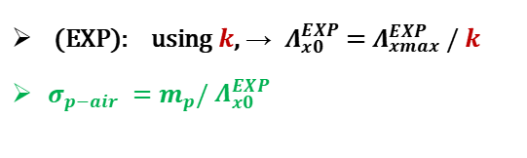
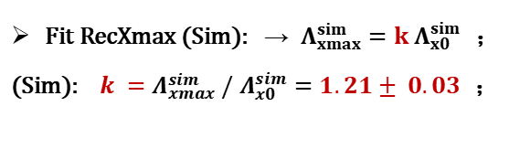
Analysis-Fitting
$$\text{P} \text{(}X_{max}\text{)=}\text{P} \text{(}X_{0}\text{​)⊗}\text{P} \text{(}X_{rise}\text{​)}$$
Fit RecXmax (Sim): → $Λ_{xmax}^{sim}=k Λ_{x0}^{sim}$ ；
(Sim): $k =Λ_{xmax}^{sim} / Λ_{x0}^{sim}=1.21± 0.03$ ；
(EXP): using $k$, → $Λ_{x0}^{EXP}$ = $Λ_{xmax}^{EXP} / k$
$σ_{p−air} =m_{p}/ Λ_{x0}^{EXP}$

Slide 11
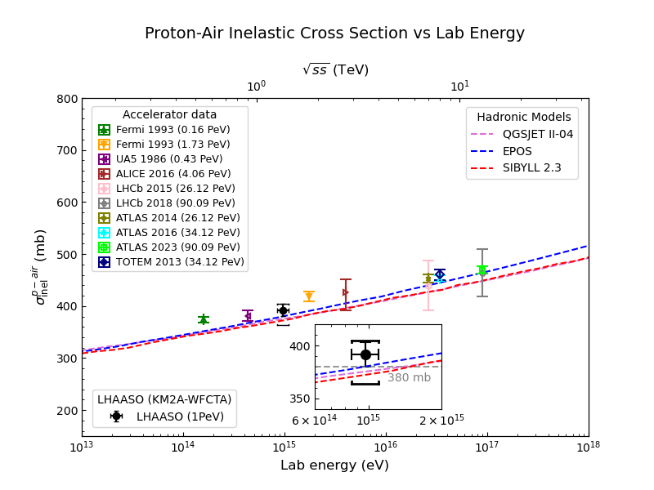

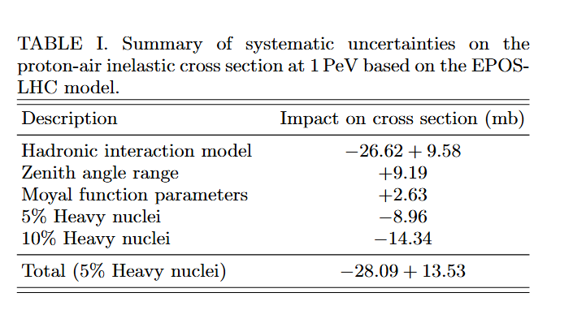
Result
Black dot: represents our result obtained with the KM2A–WFCTA hybrid data; error bars show statistical uncertainties, while the open brackets indicate total systematic uncertainties.
Compare our result with the p-air cross section derived by pp measurements from accelerator data using the Glauber model.

Slide 12
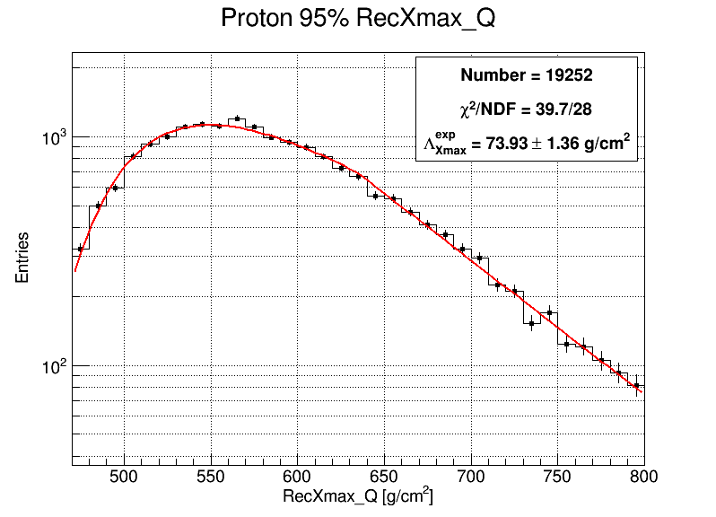
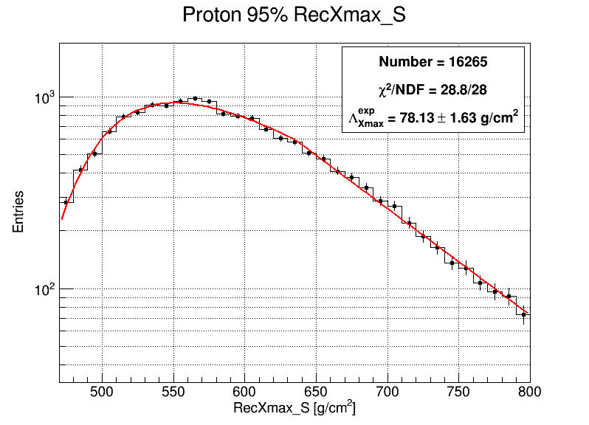
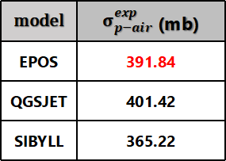
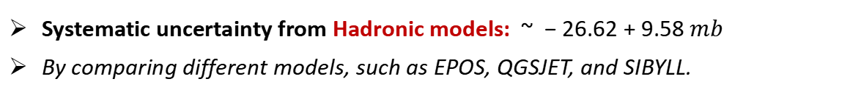
Uncertainty Discussion
Systematic uncertainty from Hadronic models: $\sim −26.62+9.58 mb$
By comparing different models, such as EPOS, QGSJET, and SIBYLL.
model | $σ_{p−air}^{exp}$ (mb)
EPOS | 391.84
QGSJET | 401.42
SIBYLL | 365.22

Slide 13
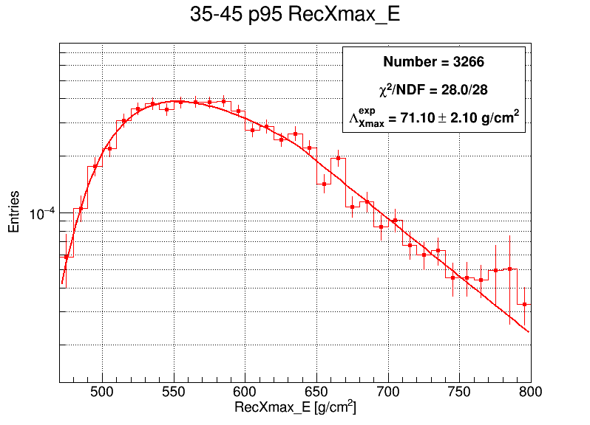
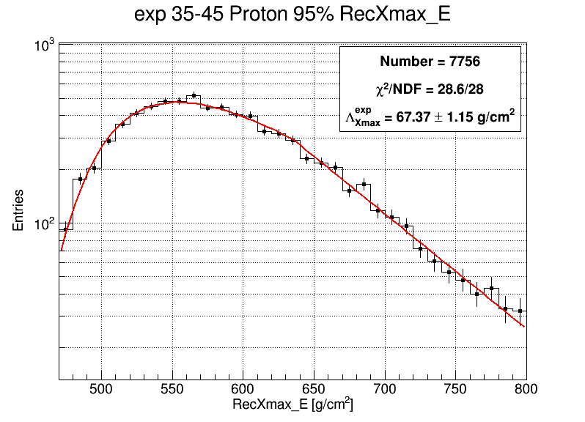
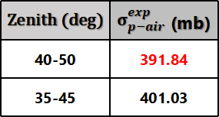
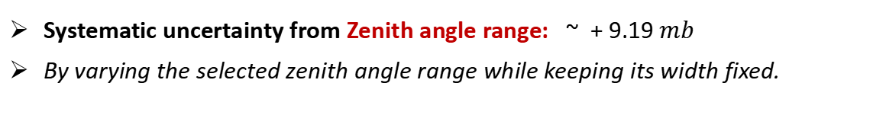
Uncertainty Discussion
Systematic uncertainty from Zenith angle range: $\sim +9.19 mb$
By varying the selected zenith angle range while keeping its width fixed.
Zenith (deg) | $σ_{p−air}^{exp}$ (mb)
40-50 | 391.84
35-45 | 401.03

Slide 14
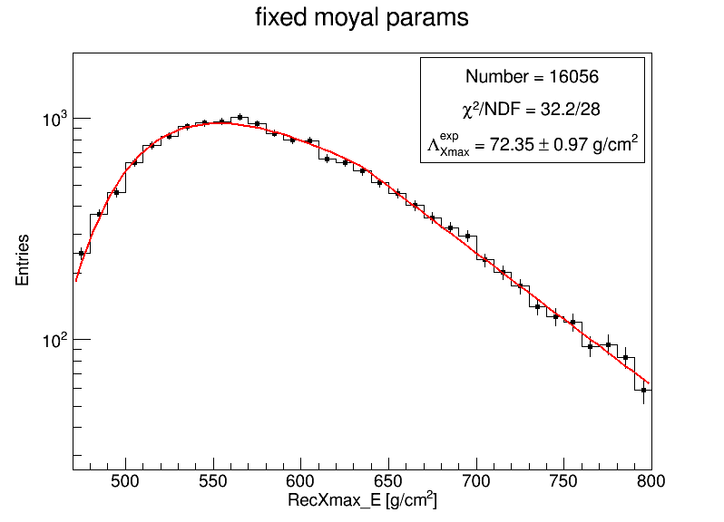
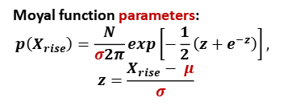
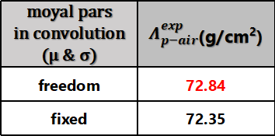

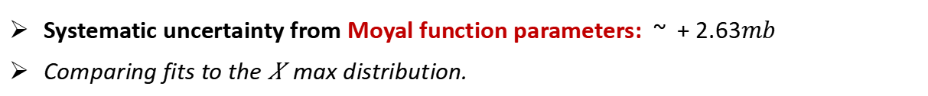
Uncertainty Discussion
Systematic uncertainty from Moyal function parameters: $\sim +2.63mb$
Comparing fits to the 𝑋max distribution.
Moyal function parameters:
$$p\left(X_{rise}\right)=\frac{N}{σ2π}​exp\left[−\frac{1}{2}​\left(z+e^{−z}\right)\right],$$
$$z=\frac{X_{rise}− μ}{σ}$$
moyal pars in convolution (μ & σ) | $Λ_{p−air}^{exp}$(g/cm²)
freedom | 72.84
fixed | 72.35
Impact on $σ_{p−air}^{exp}$ | +2.63 (mb)
$$\text{P} \text{(}X_{max}\text{)=}\text{P} \text{(}X_{0}\text{​)⊗}\text{P} \text{(}X_{rise}\text{​)}$$

Slide 15
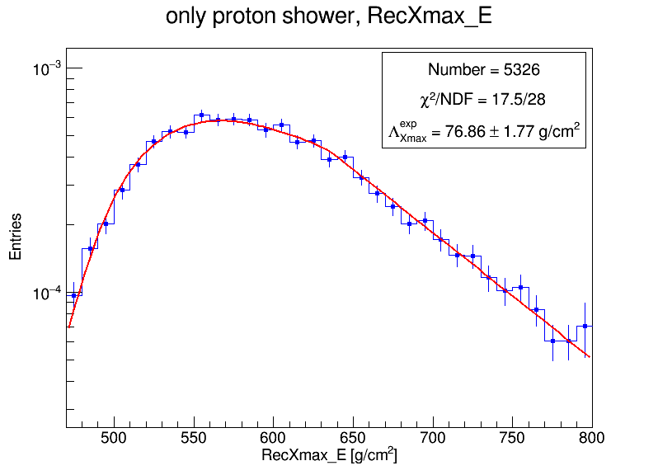

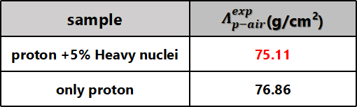
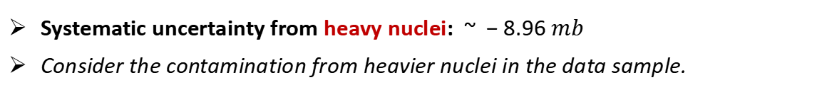
Uncertainty Discussion
Systematic uncertainty from heavy nuclei: $\sim −8.96 mb$
Consider the contamination from heavier nuclei in the data sample.
sample | $Λ_{p−air}^{exp}$(g/cm²)
proton +5% Heavy nuclei | 75.11
only proton | 76.86
Impact on $σ_{p−air}^{exp}$ | -8.96 (mb)

Slide 16
Summary
Measurement summary: This work using KM2A–WFCTA hybrid data, we measured the proton–air inelastic cross section an energy of 1 PeV.
𝝈_{𝒑−𝒂𝒊𝒓} = 391.84 ± 11.8 (stat.) ​+ 13.53 -28.09 (syst.)​ mb.
This measurement fills the gap in cosmic-ray observations at this energy,
And is in a good agreement with accelerator data.
Publication plan:
The first draft and related notes are ready and are being revised..
Plans to submit to Physical Review L/D.

Slide 17
2026.04.26
Thank you for being here!

Slide 18
Backup
Notes:
筛选成质子成分可能的影响：1

Slide 19
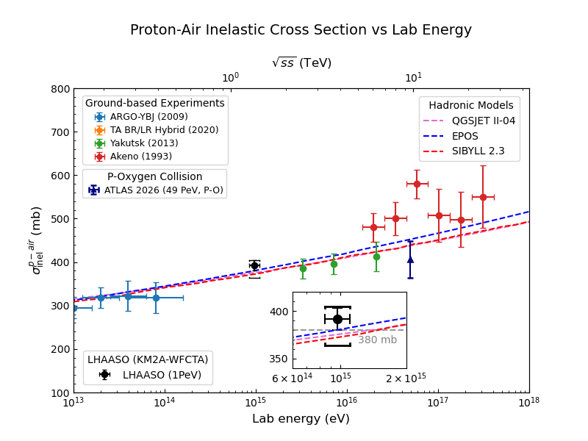
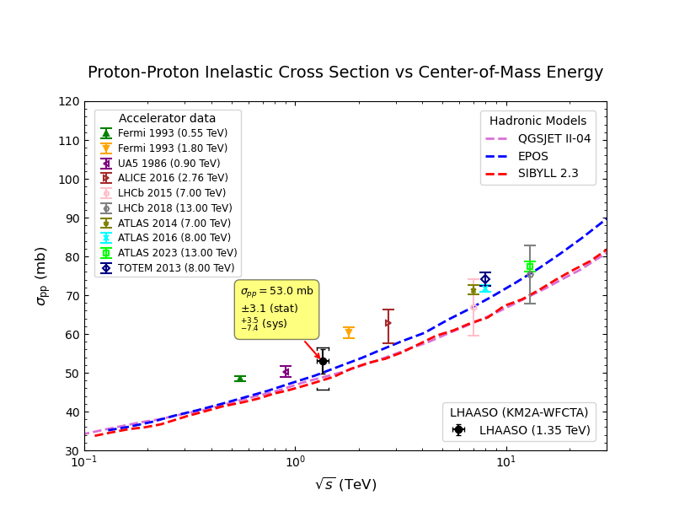

p-air(Ground) & pp(Accelerator)

Slide 20
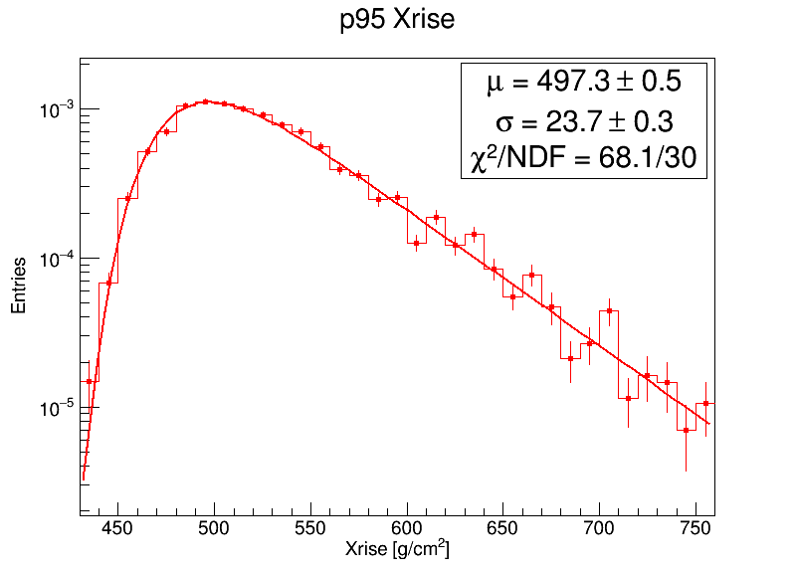
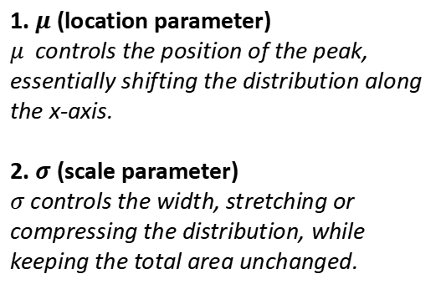
Moyal function & Xrise fitting
Moyal function: $p\left(ΔX_{rise}\right)=\frac{N}{σ2π}​exp\left[−\frac{1}{2}​\left(z+e^{−z}\right)\right], z=\frac{ΔX_{rise} − μ}{σ}$
1. $μ$ (location parameter)
$μ$ controls the position of the peak, essentially shifting the distribution along the x-axis.
2. $σ$ (scale parameter)
$σ$ controls the width, stretching or compressing the distribution, while keeping the total area unchanged.

Slide 21
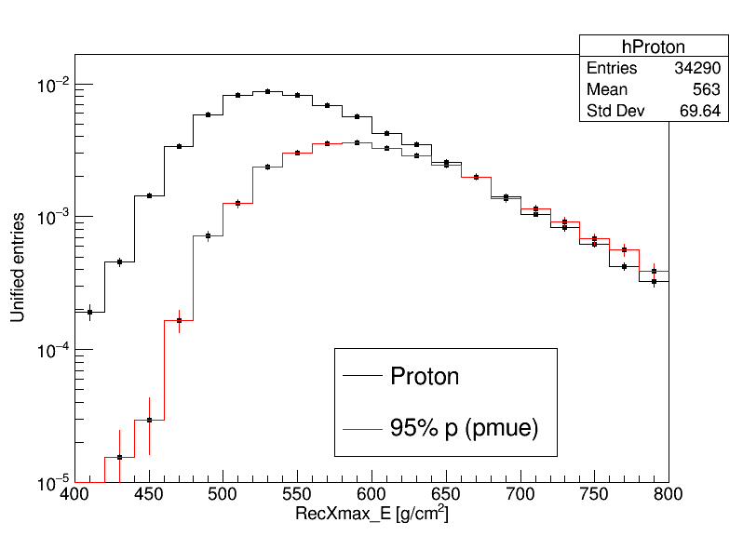
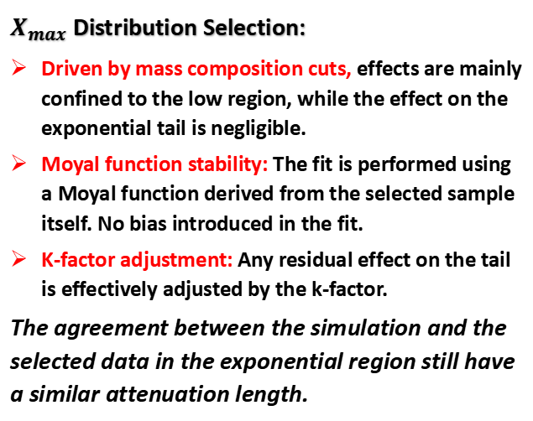
Impact of Data Selection
$X_{max}$ Distribution Selection:
Driven by mass composition cuts, effects are mainly confined to the low region, while the effect on the exponential tail is negligible.
Moyal function stability: The fit is performed using a Moyal function derived from the selected sample itself. No bias introduced in the fit.
K-factor adjustment: Any residual effect on the tail is effectively adjusted by the k-factor.
The agreement between the simulation and the selected data in the exponential region still have a similar attenuation length.

Slide 22
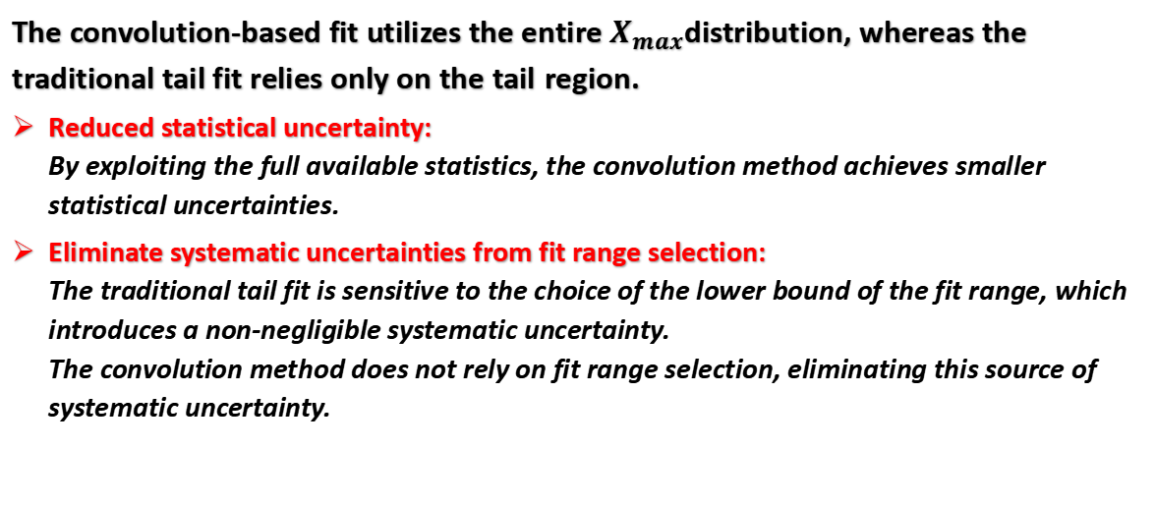
Advantages of the convolution
The convolution-based fit utilizes the entire $X_{max}$distribution, whereas the traditional tail fit relies only on the tail region.
Reduced statistical uncertainty:
By exploiting the full available statistics, the convolution method achieves smaller statistical uncertainties.
Eliminate systematic uncertainties from fit range selection:
The traditional tail fit is sensitive to the choice of the lower bound of the fit range, which introduces a non-negligible systematic uncertainty.
The convolution method does not rely on fit range selection, eliminating this source of systematic uncertainty.
Notes:
筛选成质子成分可能的影响：1

Slide 23
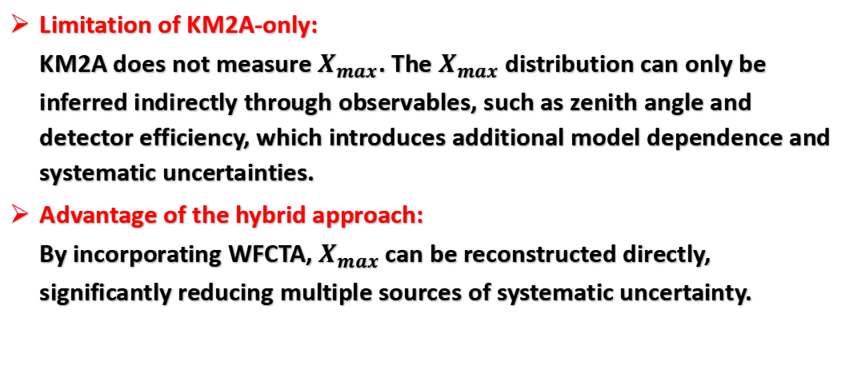
Advantages of the hybrid data
Limitation of KM2A-only:
KM2A does not measure $X_{max}$. The $X_{max}$ distribution can only be inferred indirectly through observables, such as zenith angle and detector efficiency, which introduces additional model dependence and systematic uncertainties.
Advantage of the hybrid approach:
By incorporating WFCTA, $X_{max}$ can be reconstructed directly, significantly reducing multiple sources of systematic uncertainty.
Notes:
筛选成质子成分可能的影响：1

Slide 24
Cosmic Ray Spectrum Model
We have considered different energy spectra.
We tested several spectral assumptions, and since this measurement is performed in a narrow energy range with a ~95% proton purity, the impact is very small and is well below our dominant systematic uncertainties.
Notes:
筛选成质子成分可能的影响：1

Slide 25
Void truncation-induced bias
The altitude of our experiment corresponds to an atmospheric depth of about 600 g/cm².
Because of our site altitude and the selected zenith angle range in 40°–50°, showers with Xmax > 800 g/cm² do not reach their maximum within the observable atmosphere.
In that case, Xmax cannot be reliably determined and reconstructed by Dist.
Notes:
筛选成质子成分可能的影响：1

Slide 26
Hadronic Interaction Models
For p-p predictions, the main difference among these three models is the cross section.
However, this work measures the p-air inelastic cross section, and the differences among models for p-air are not only in the cross section, they also differ in how they treat the air nucleus, like the nuclear density distribution.
Notes:
筛选成质子成分可能的影响：1

Slide 27
Backup
Notes:
筛选成质子成分可能的影响：1

