Slide 1
Investigating nature of the micro quasar MAXI J1820+070 with updated LHAASO observations
Shicong Hu^{a,b}, Bing Theodore Zhang^{a,b}, Dimitry Khangulyan^{a,b}
ª Institute of High Energy Physics, Chinese Academy of Sciences, 100049, Beijing, China
^{b}TIANFU Cosmic Ray Research Center, Chengdu, Sichuan, People’s Republic of China

Slide 2
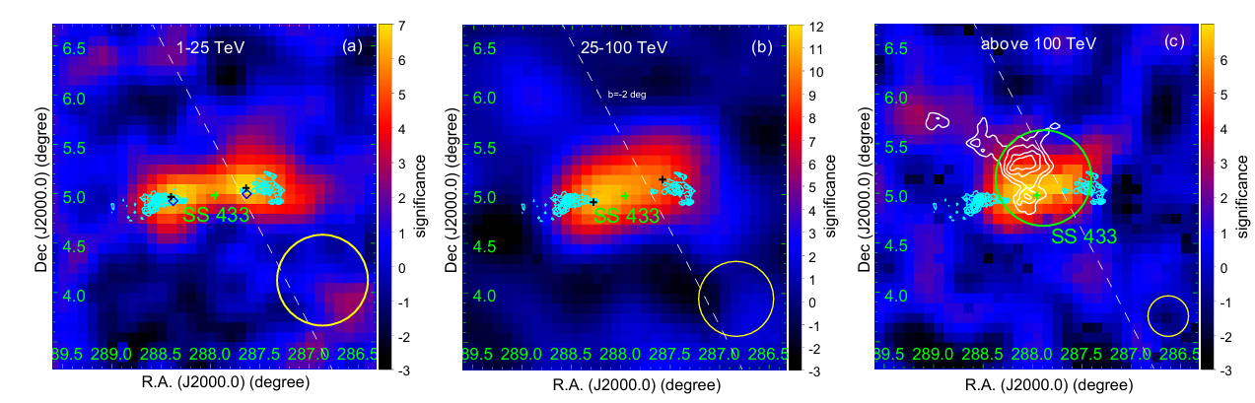
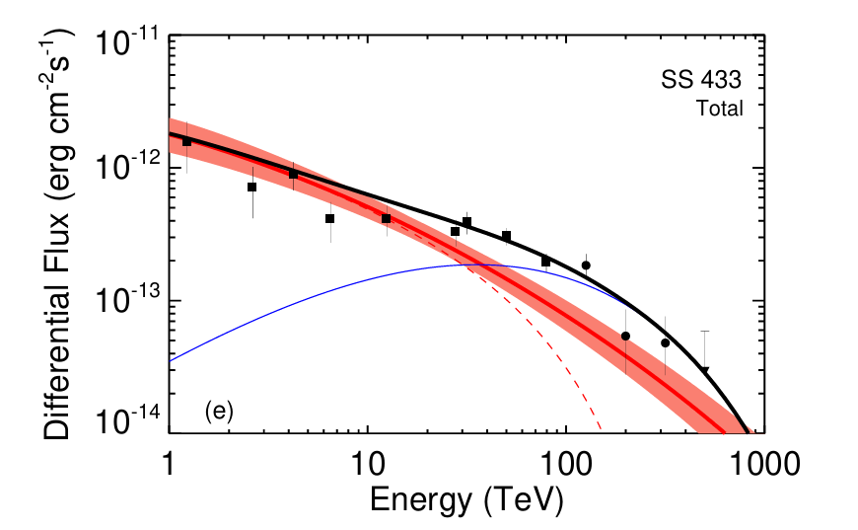
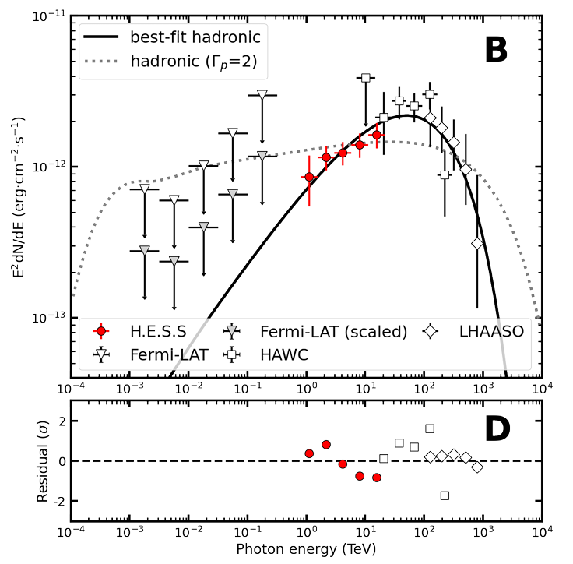
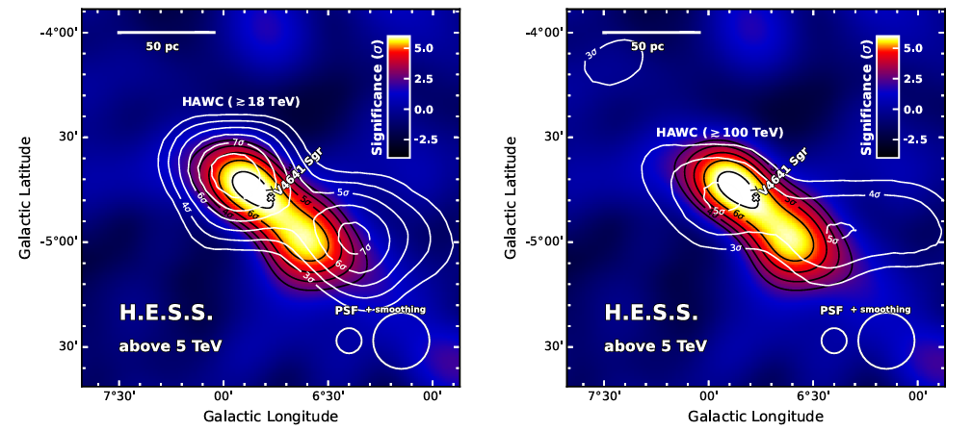
Micro quasar as PeVatron
LHAASO, NSR, 2025
SS 433
LHAASO
H.E.S.S., A&A, 2025
V4641 sgr
H.E.S.S.
HAWC
LHAASO

Slide 3
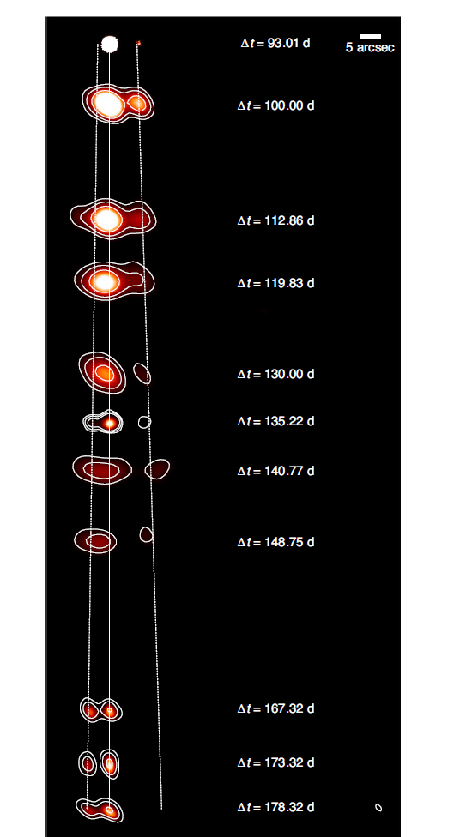
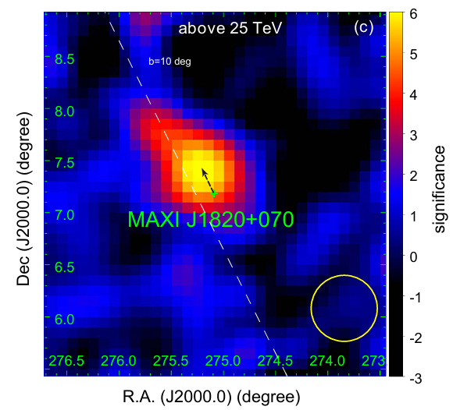
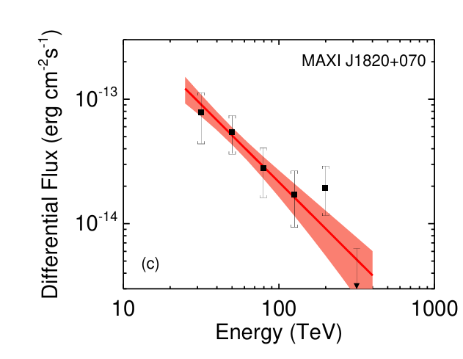
Black hole LMXB MAXI J1820+070
Item | Information
Discovery | MAXI @ 03/06/2018
Orbital period | 16.45 hours (Torres, 2019)
Mass | 9.2±1.3 M☉ (Atri, 2020)
Companion star | K3-5, 0.4-0.5 M☉ (Mikołajewska, 2022)
Incline angle | 62°-63° (Atri, 2020)
Jet speed | 0.88-0.89 c (Atri, 2020)
LHAASO, NSR, 2025
Bright JS, et al, NA, 2020

Slide 4
Updated LHAASO observations
Data updated
 | Published | Updated
WCDA | — | 2025/07
KM2A | 2024/12 | 2025/07
Method
Fitting: 3D likelihood
Diffuse background: not included given that b of MAXI J1820+070 is 10°
No other TeV sources in the vicinity of J1820

Slide 5
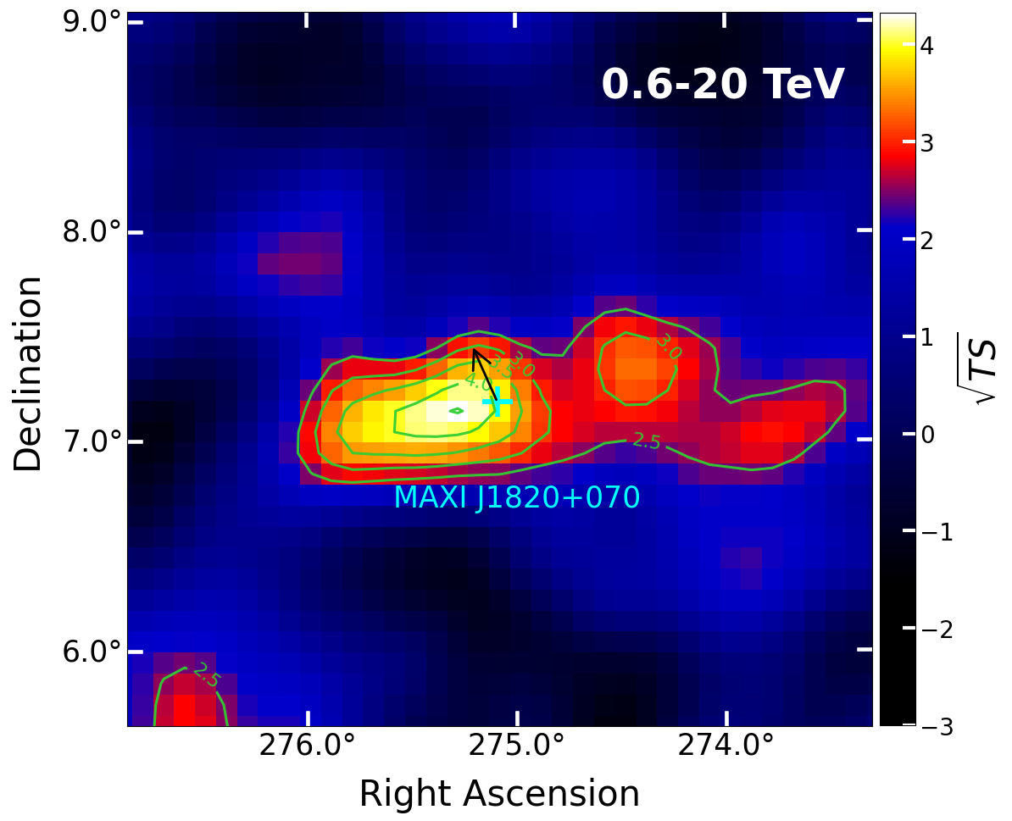
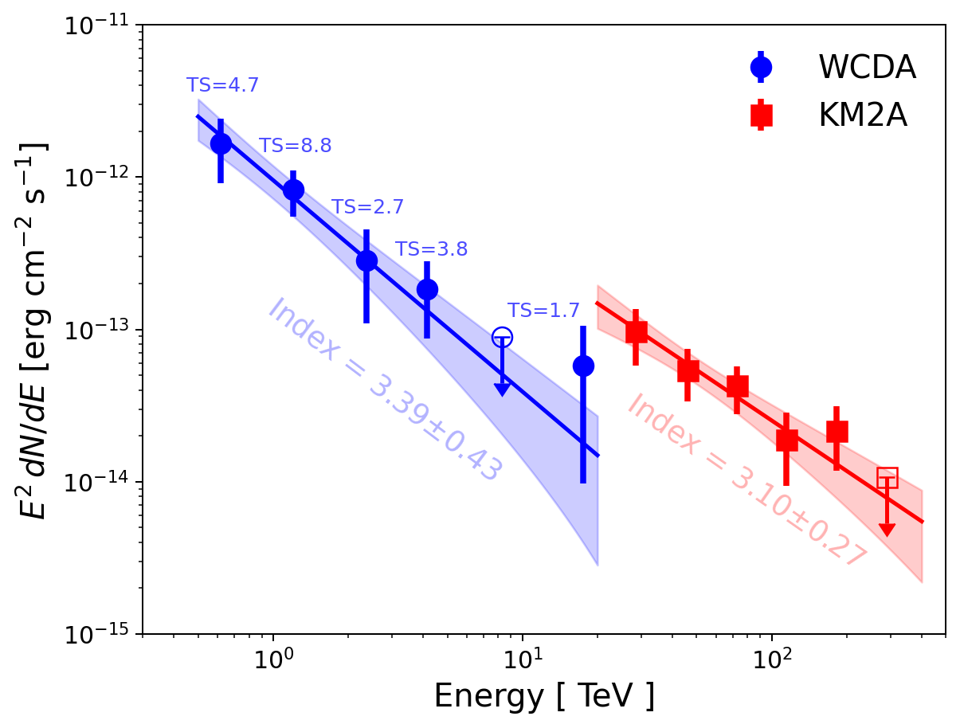
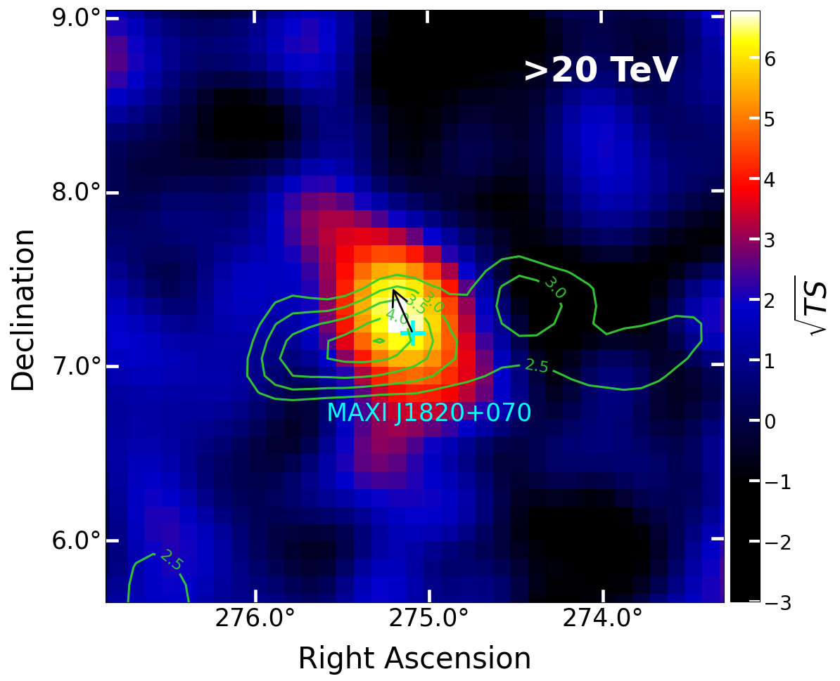
Updated LHAASO observations
Independent analysis
 | WCDA | KM2A
Significance | 4.3 σ | 6.8 σ
RA | 275.33±0.12 | 275.22±0.05
DEC | 7.15±0.08 | 7.29±0.06
Extension | Point-like | Point-like
Positional discrepancy of about 0.2 degrees between the WCDA and KM2A source.
black arrow:
The propagation direction of the receding ejecta
The discrepancy of SED and position below and above ~20 TeV may suggest a multi-component origin of gamma-ray emission above ~0.5TeV.
The flux measured by KM2A is higher than the extrapolation of the WCDA spectrum.

Slide 6
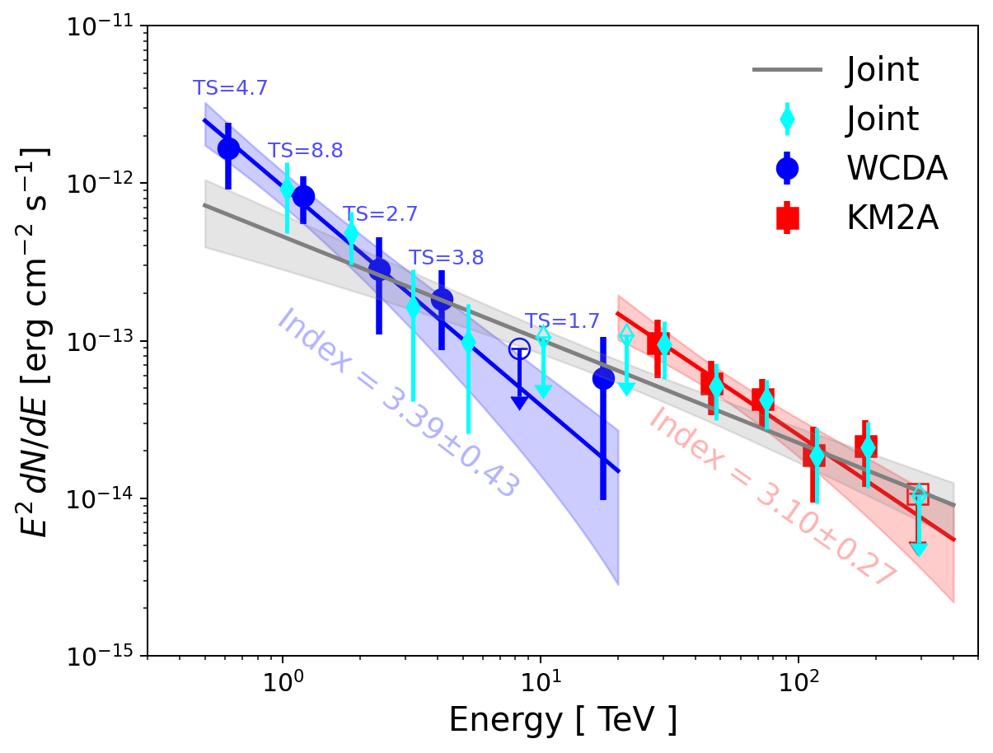
Updated LHAASO observations
Joint analysis
 | 1 component | 2 components
TS | 52.4 | 65.5 (+13.1)
RA | 275.24±0.04 | 275.39±0.22 | 275.23±0.05
DEC | 7.29±0.06 | 7.11±0.09 | 7.34±0.06
Extension | Point-like | Point-like | Point-like
black arrow:
The propagation direction of the receding ejecta
We expect that AI-enhanced analyses will improve the detection significance in the WCDA energy range and may help clarify this scenario.

