Slide 1
Search for Gamma-Ray Signatures of Dark Matter Annihilation in the Galactic Center with KM2A
Xiaojun Bi, Songzhan Chen, Houbing Jiang, Yunfeng Liang, Shaoqiang Xi
1. IHEP
2. Zhengzhou University
3. Guangxi University

Slide 2
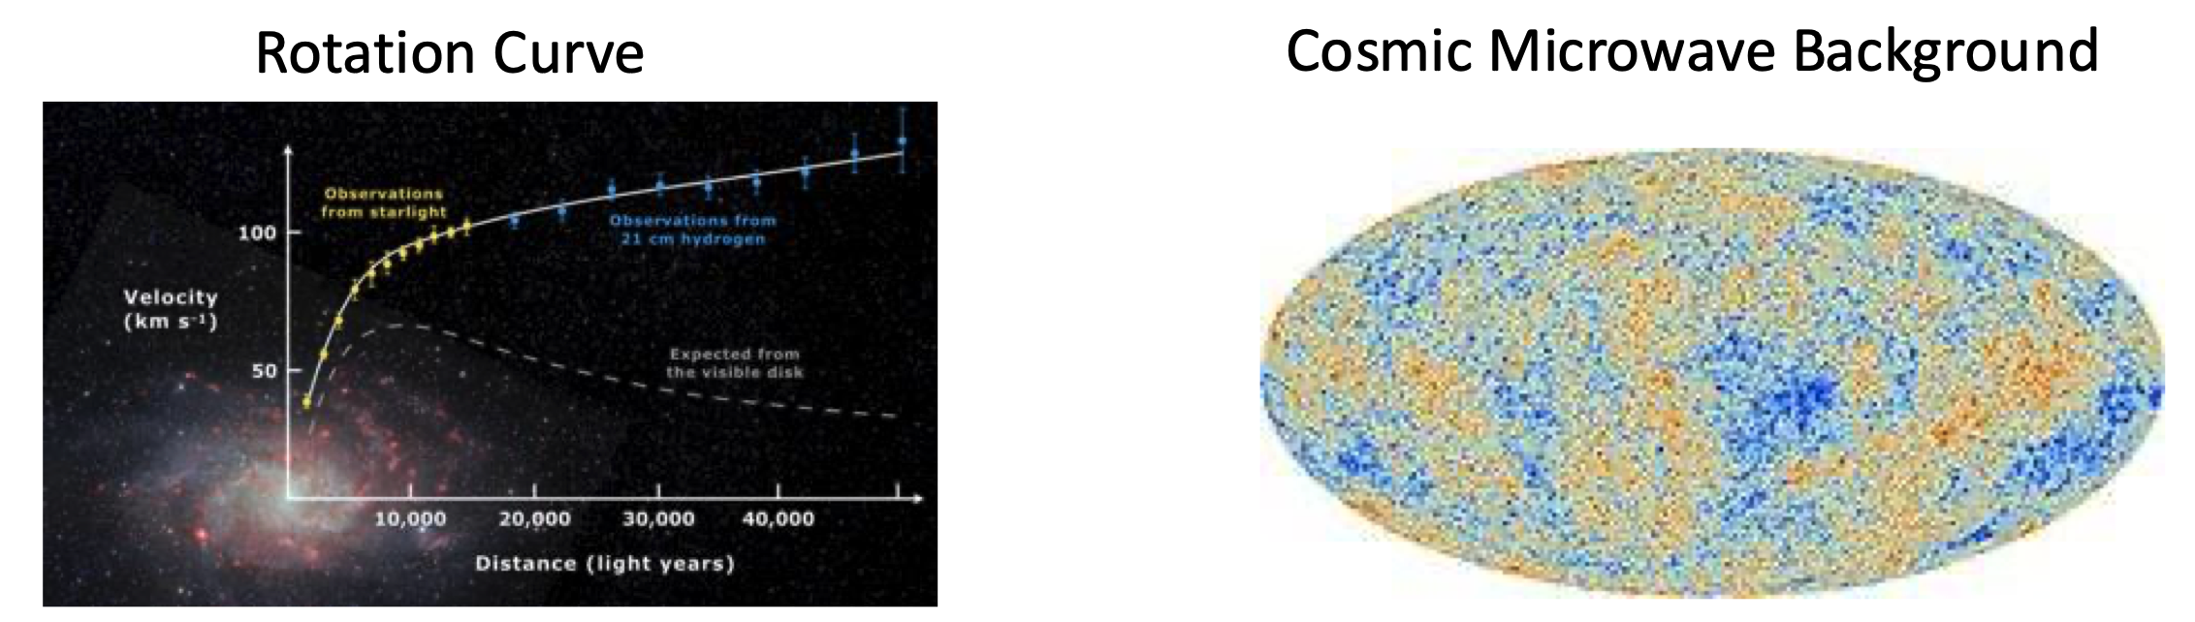
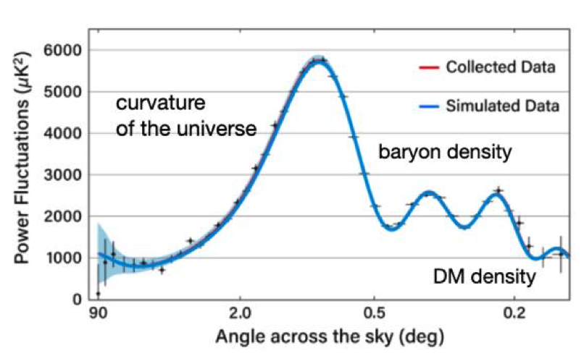
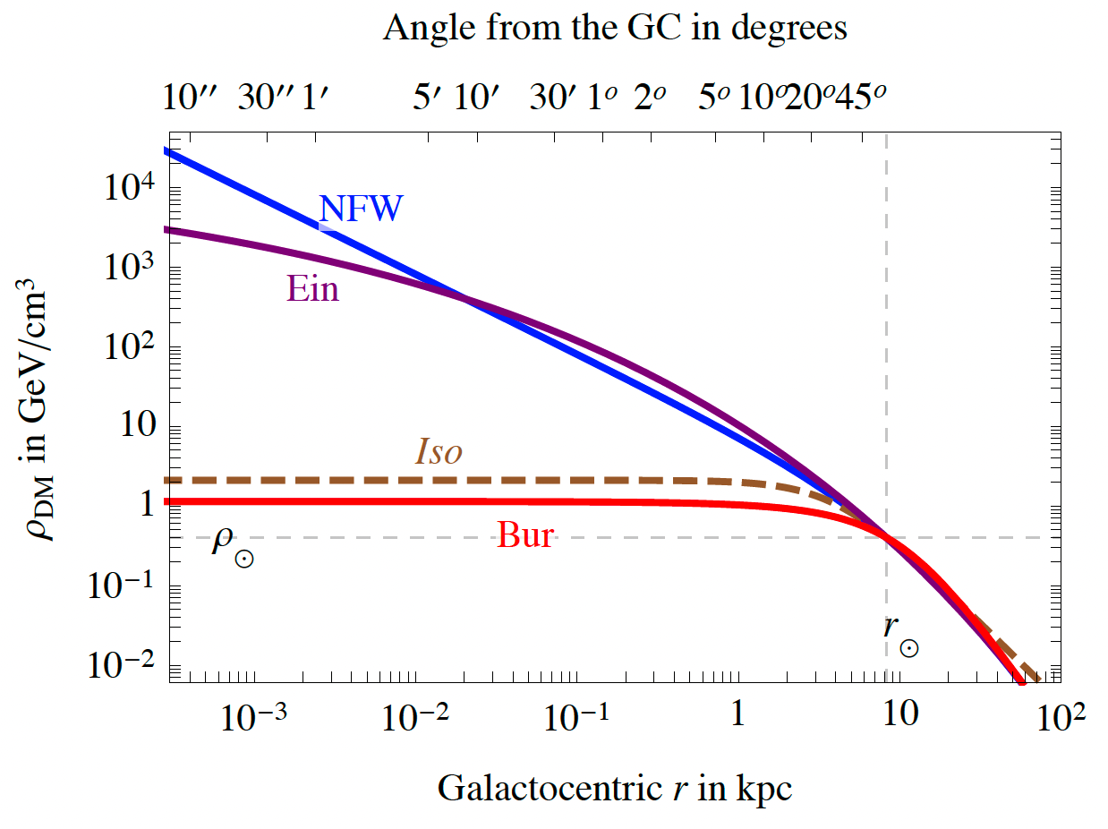
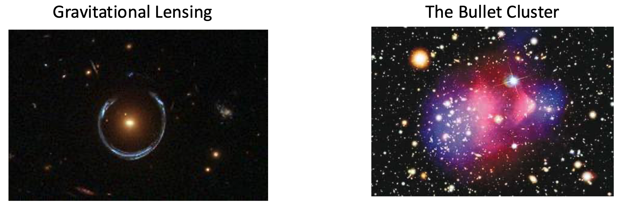
Dark matter
Dark matter is one of the most mysterious components in modern physics and cosmology
The region around the Galactic Center (GC) is one of the richest and most promising targets for the indirect detection of dark matter

Slide 3
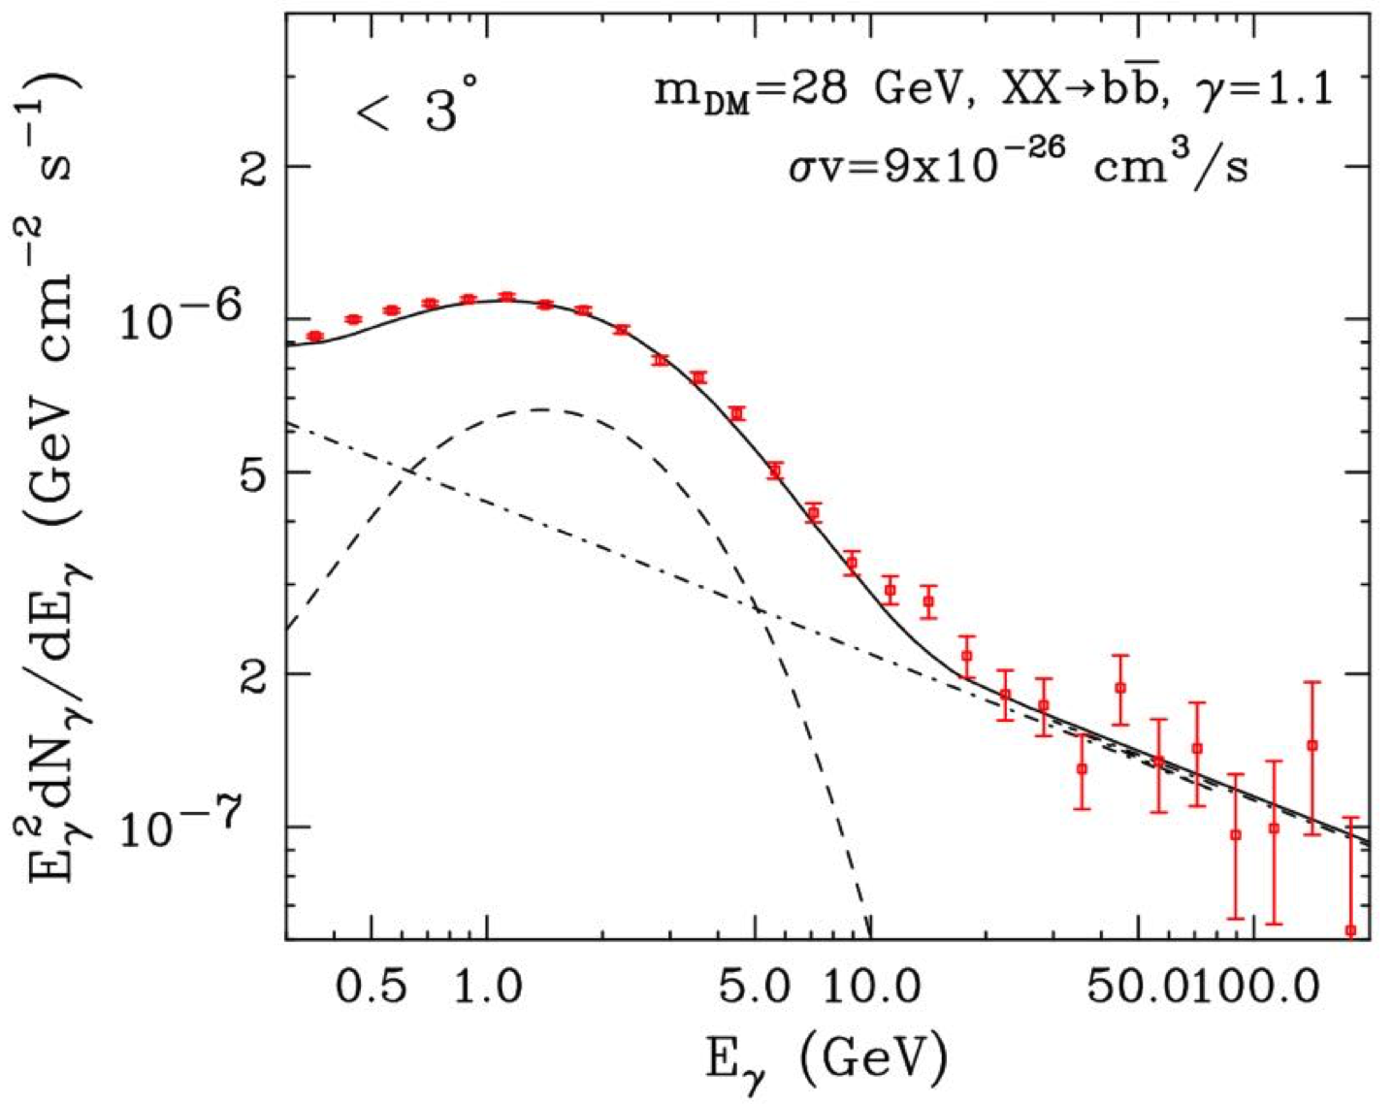
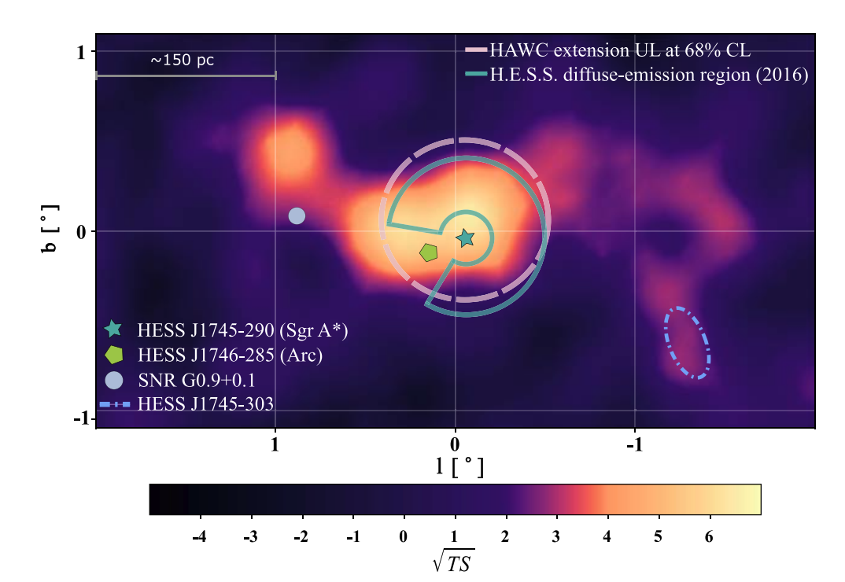
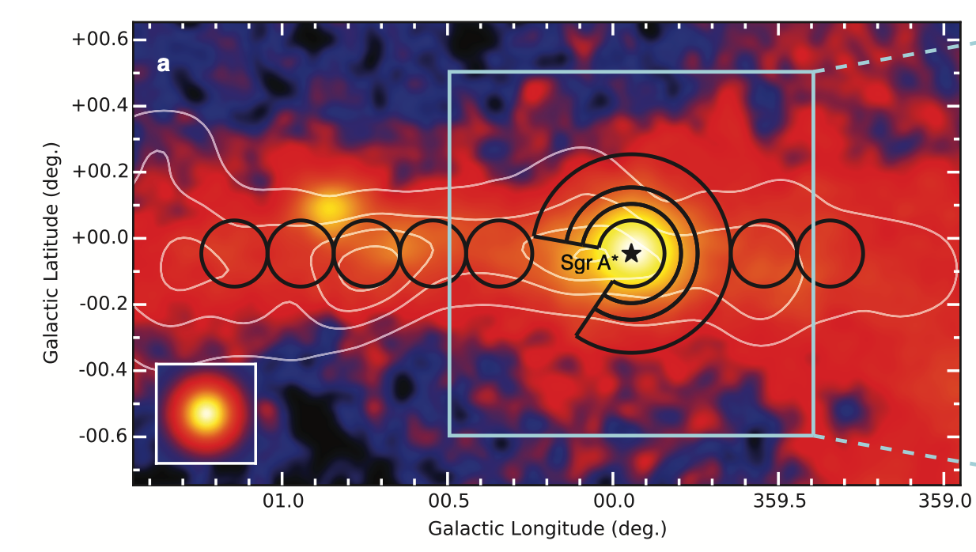
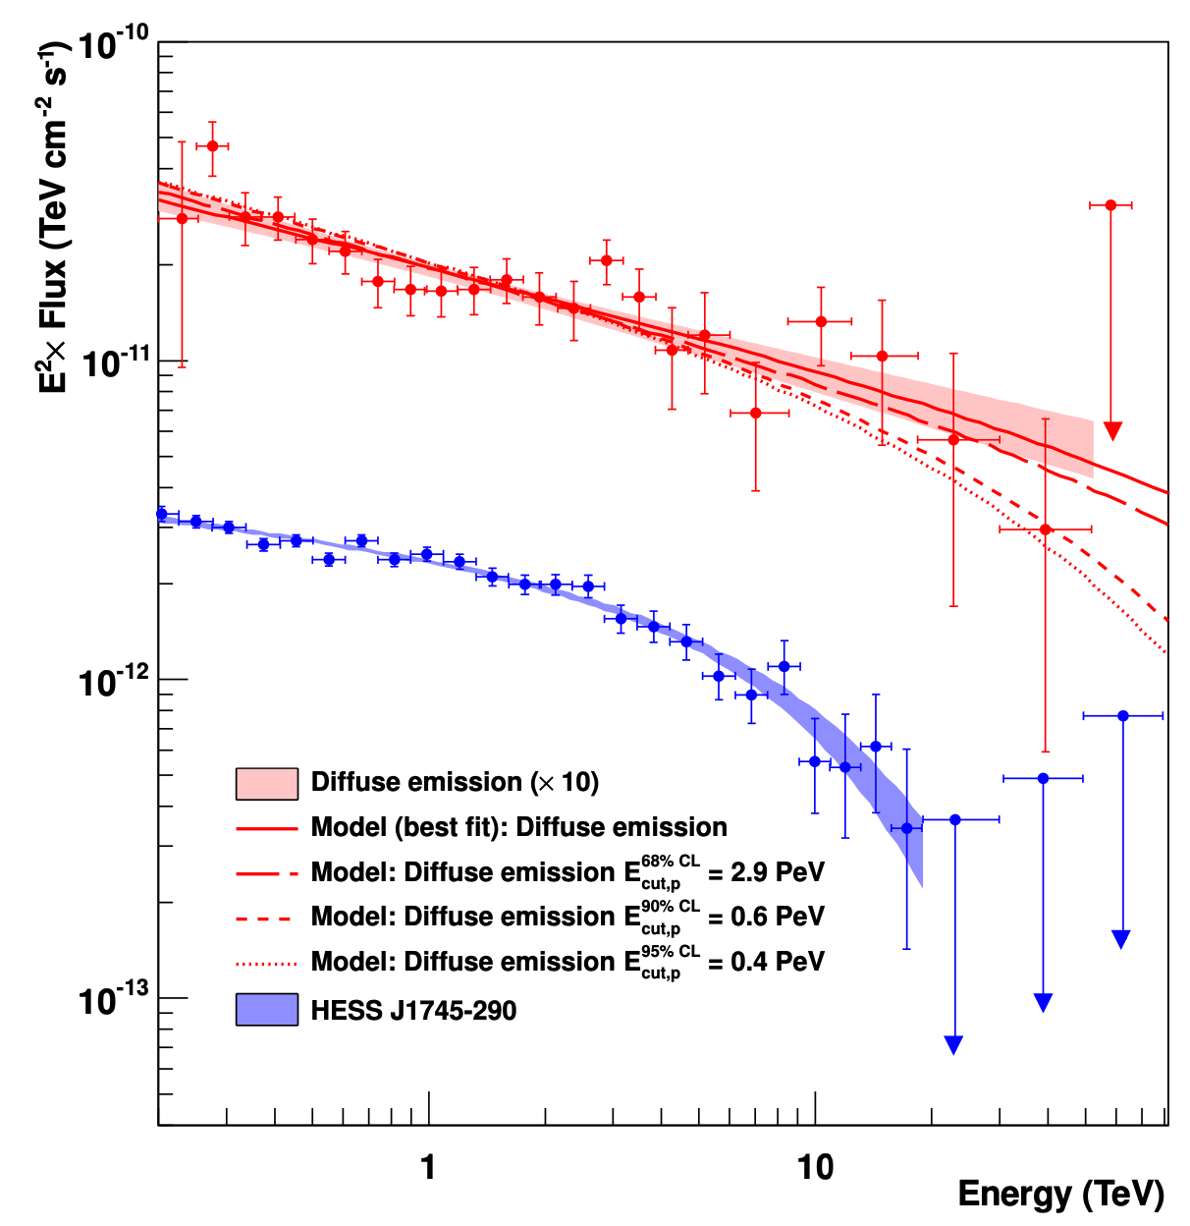
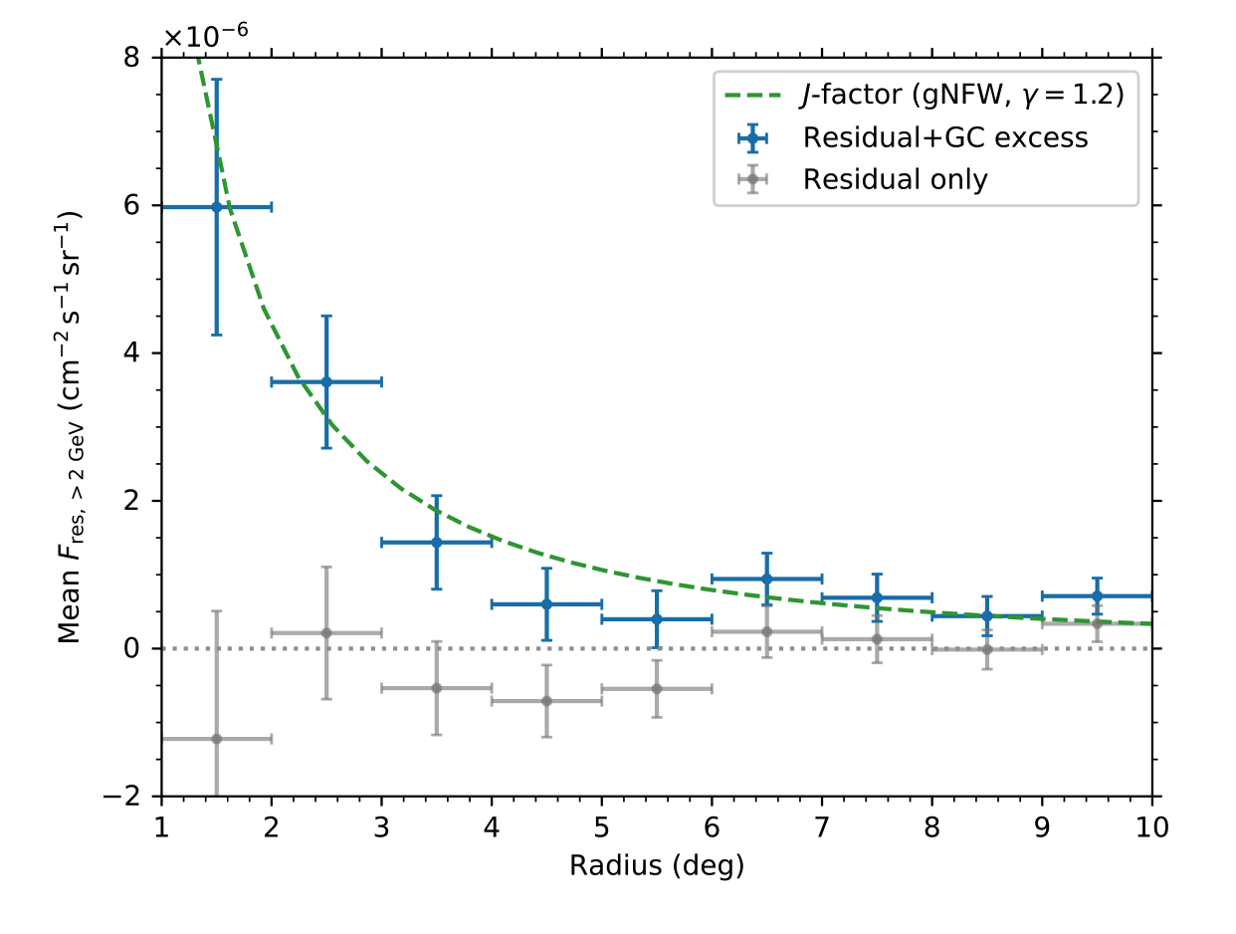
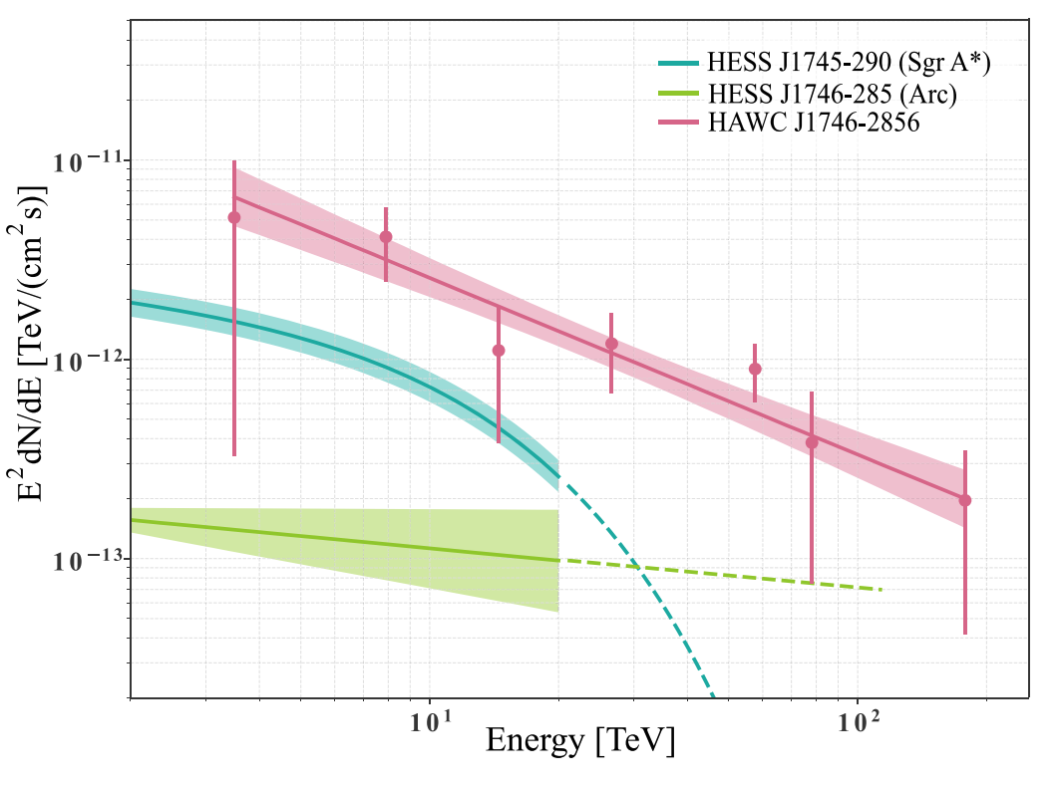
The Galactic Center in the Gamma-Ray Sky
GC GeV excess
VHE gamma-rays around GC
HESS
HAWC
Fermi-LAT
DAMPE

Slide 4
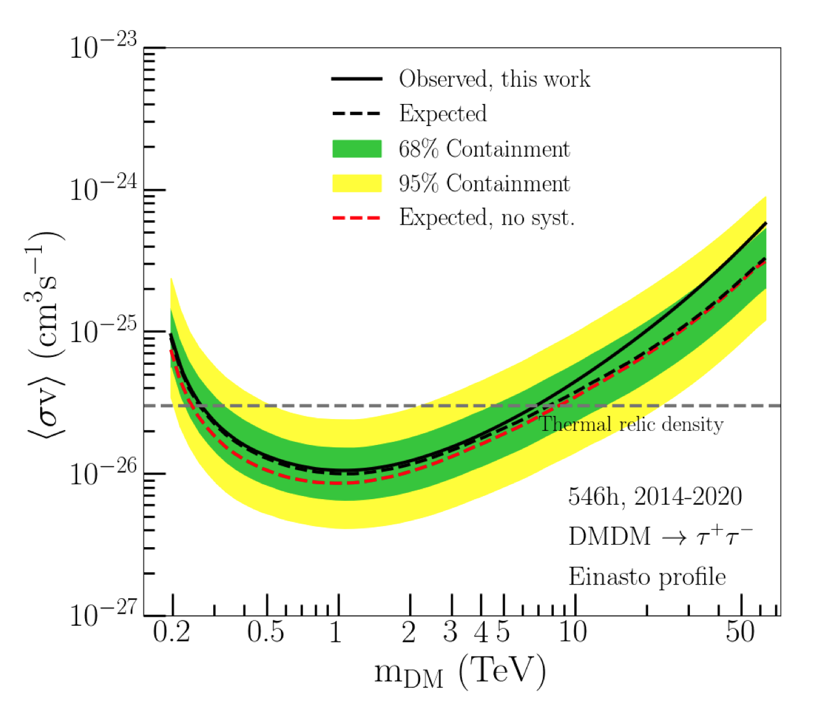
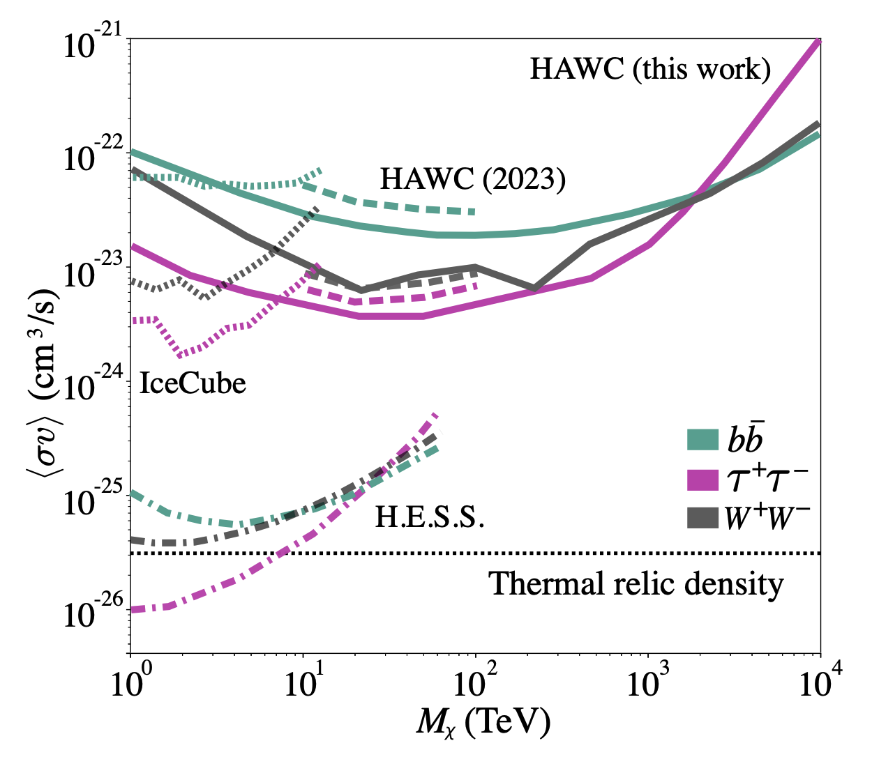
Indirect dark matter search around the GC
The Galactic Center region provides stringent constraints on the dark matter annihilation cross section
H.E.S.S
HAWC
Phys.Rev.Lett. 129 (2022), 111101
2509.06210

Slide 5
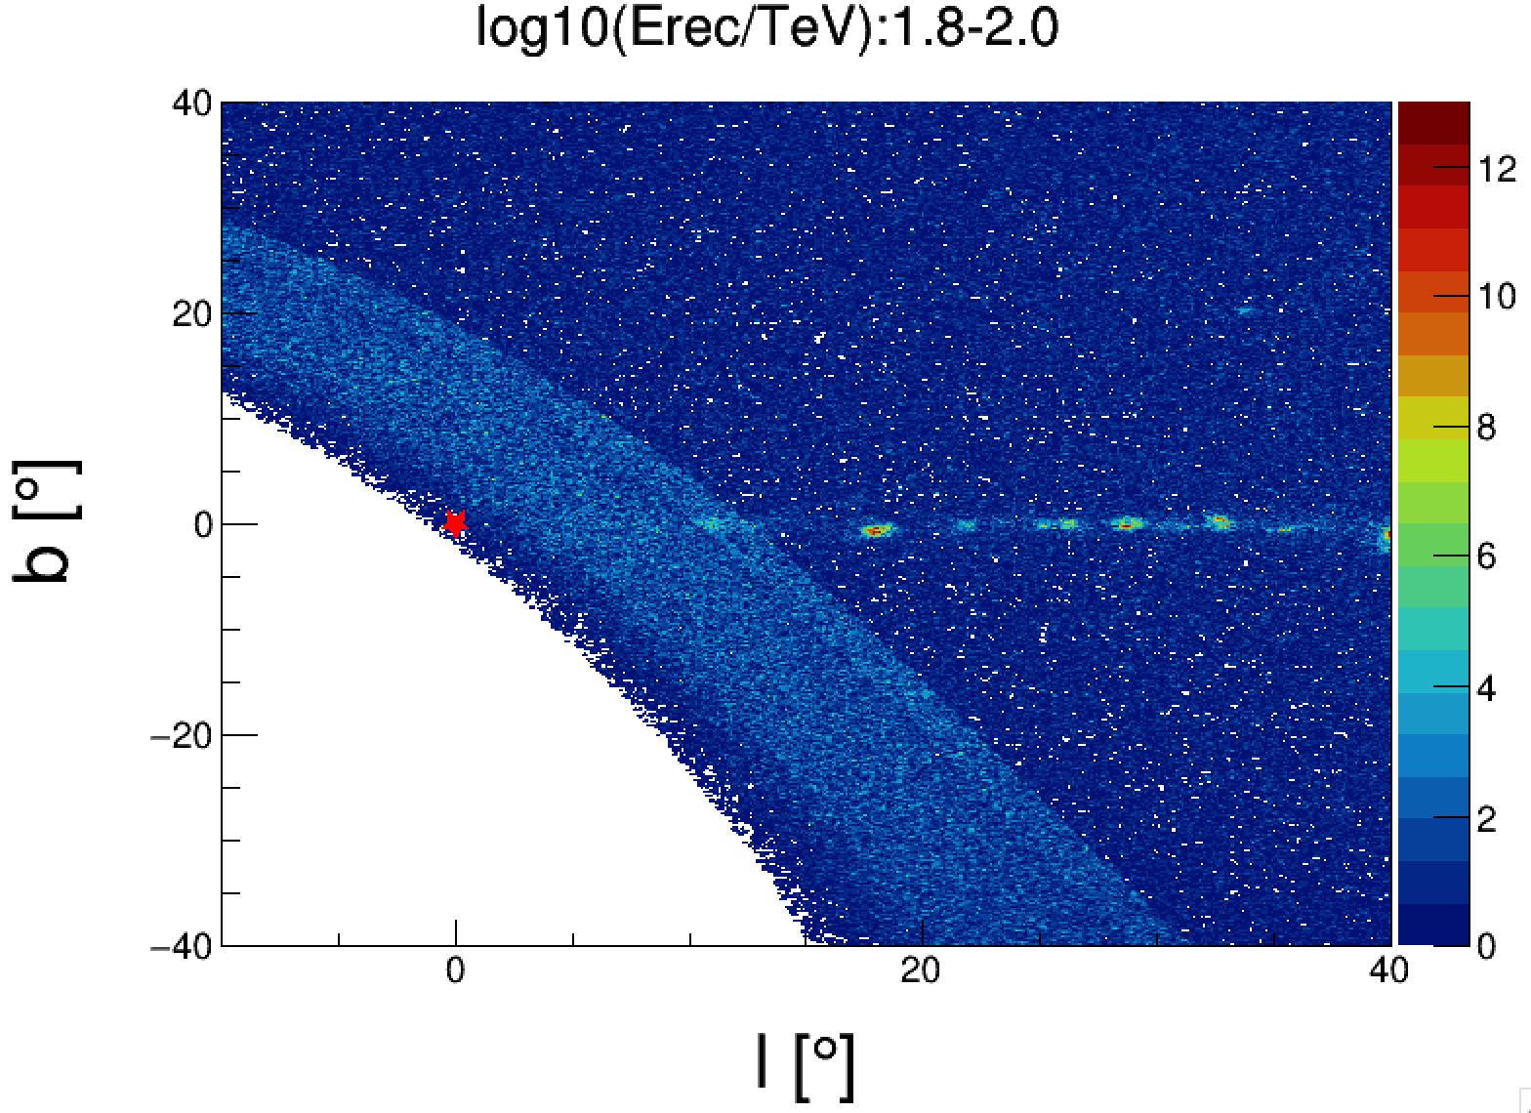
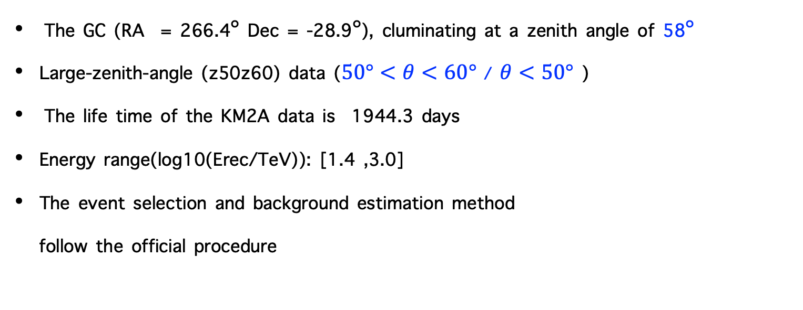
GC and KM2A data set
The GC (RA = 266.4$°$ Dec = -28.9$°$), cluminating at a zenith angle of 58$°$
Large-zenith-angle (z50z60) data ($50°<θ<60°$ / $θ<50°$ )
The life time of the KM2A data is 1944.3 days
Energy range(log10(Erec/TeV)): [1.4 ,3.0]
The event selection and background estimation method
follow the official procedure

Slide 6
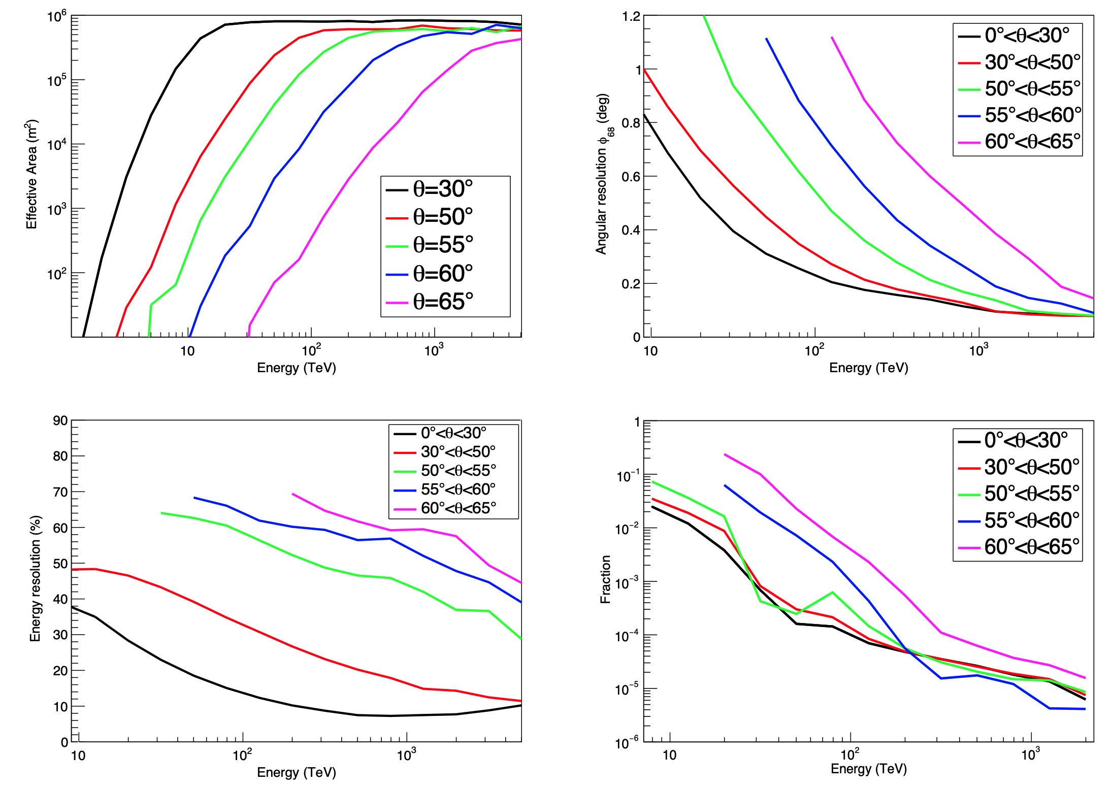
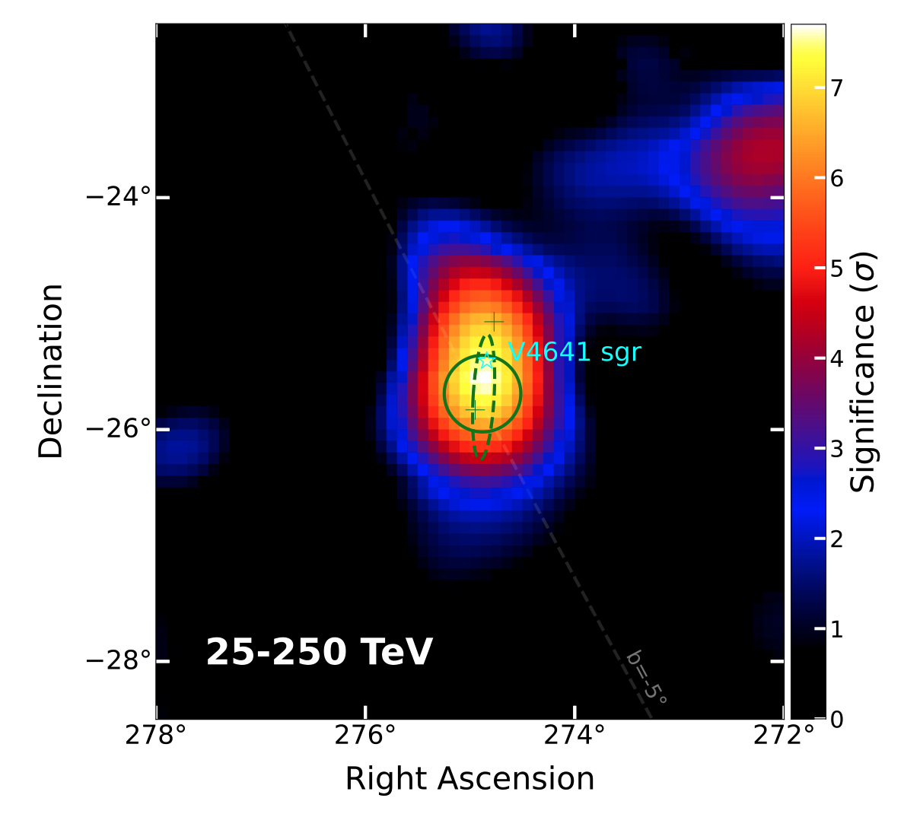

The performances of KM2A for large-zenith-angle
V4641 Sgr, cluminating at a zenith angle of 55$°$
Natl. Sci. Rev. 12, nwaf496

Slide 7
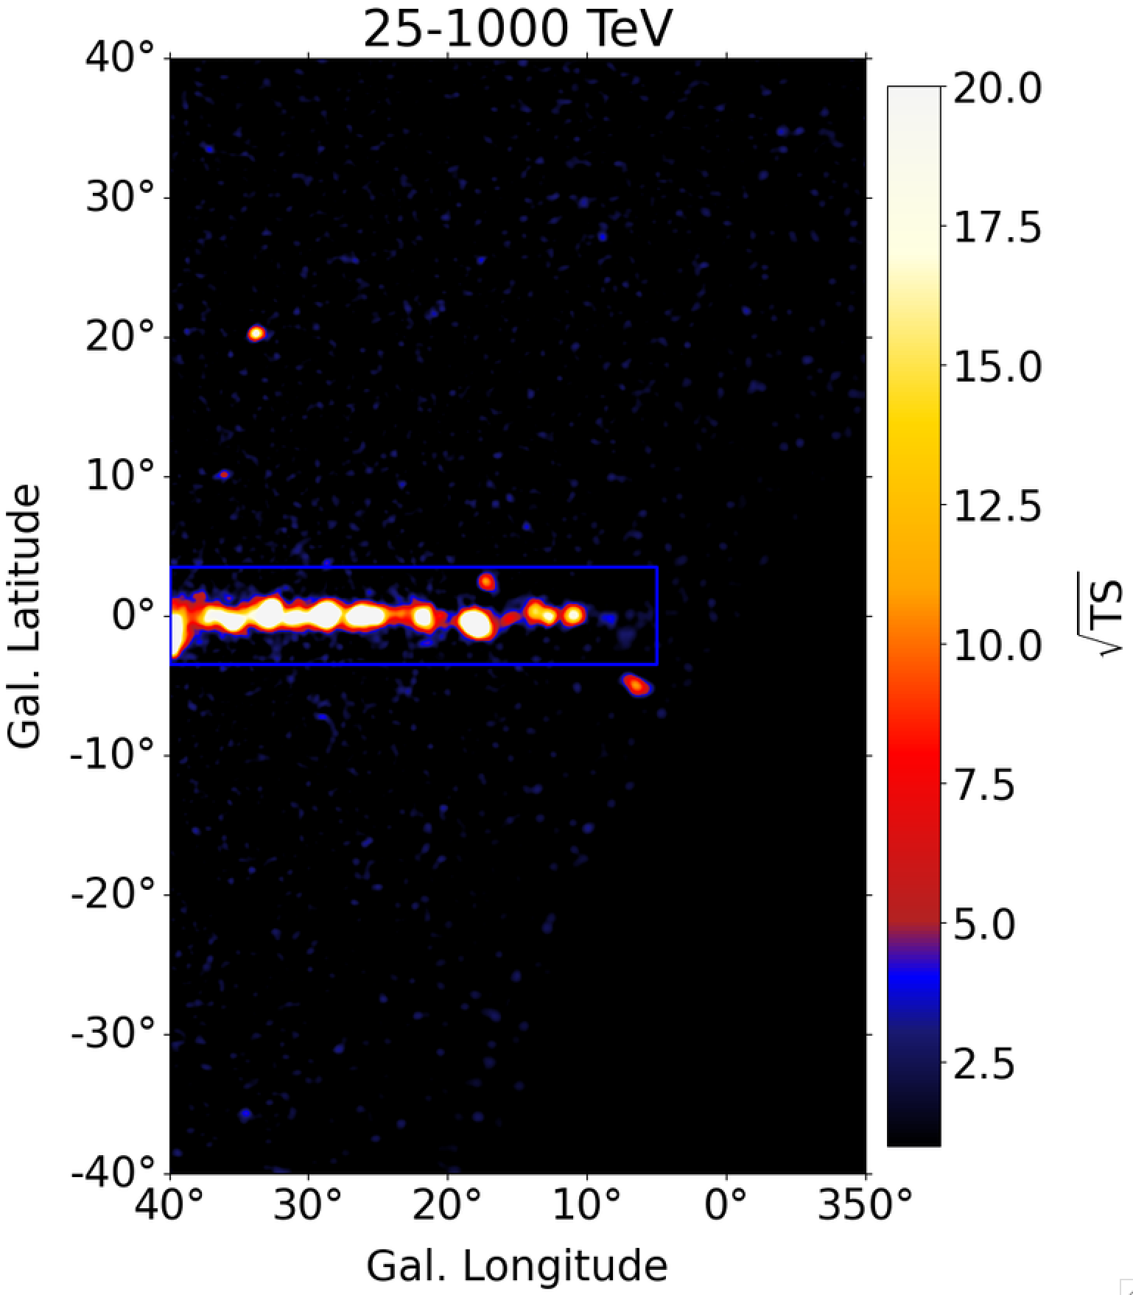
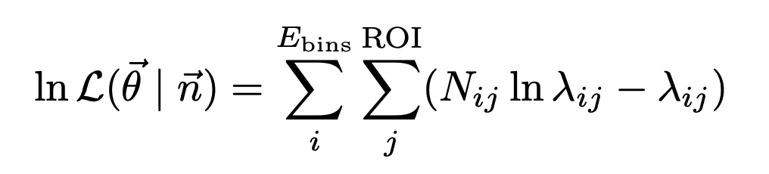
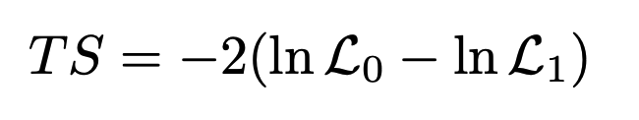
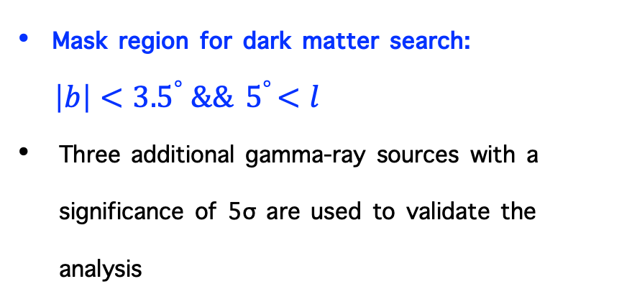
Significance map around GC from KM2A
Method: Likelihood analysis
Mask region for dark matter search:
$\left|b\right|<{3.5}^{°} \&\&{ 5}^{°}<l$
Three additional gamma-ray sources with a significance of 5σ are used to validate the analysis

Slide 8
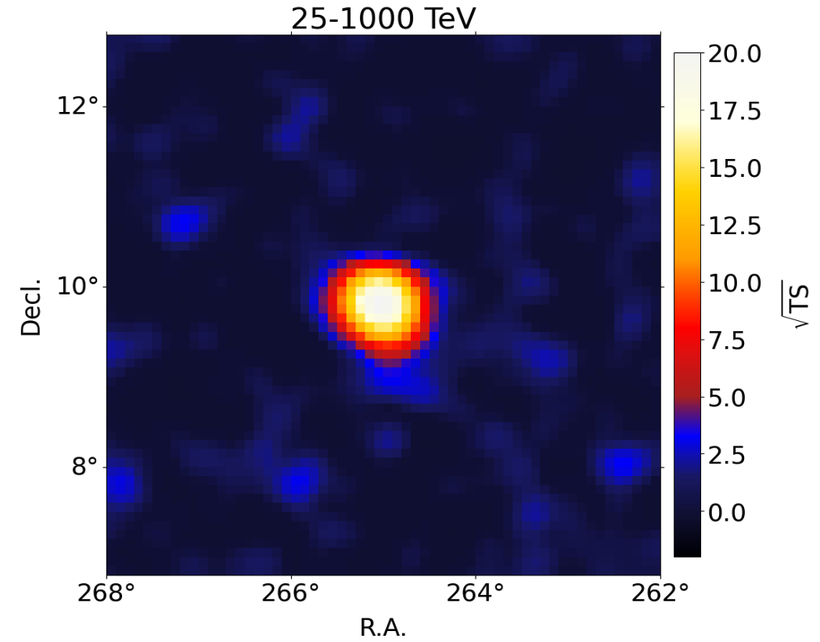
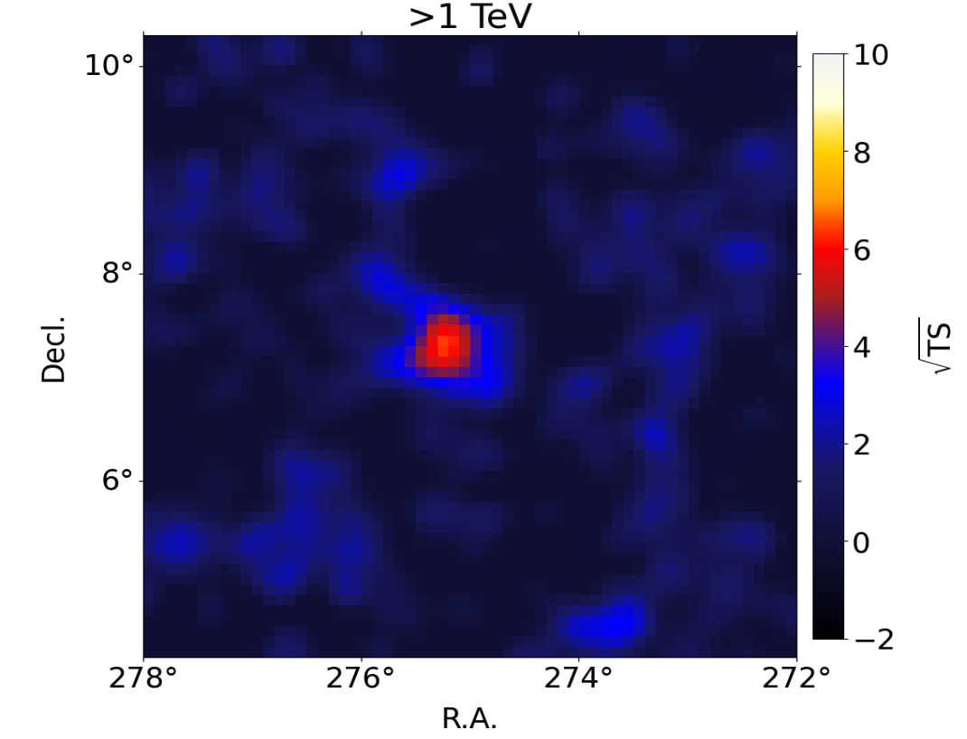
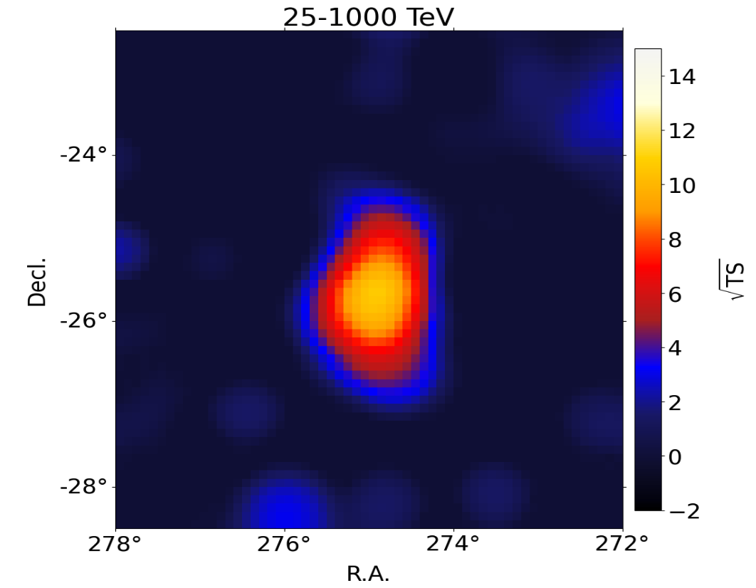
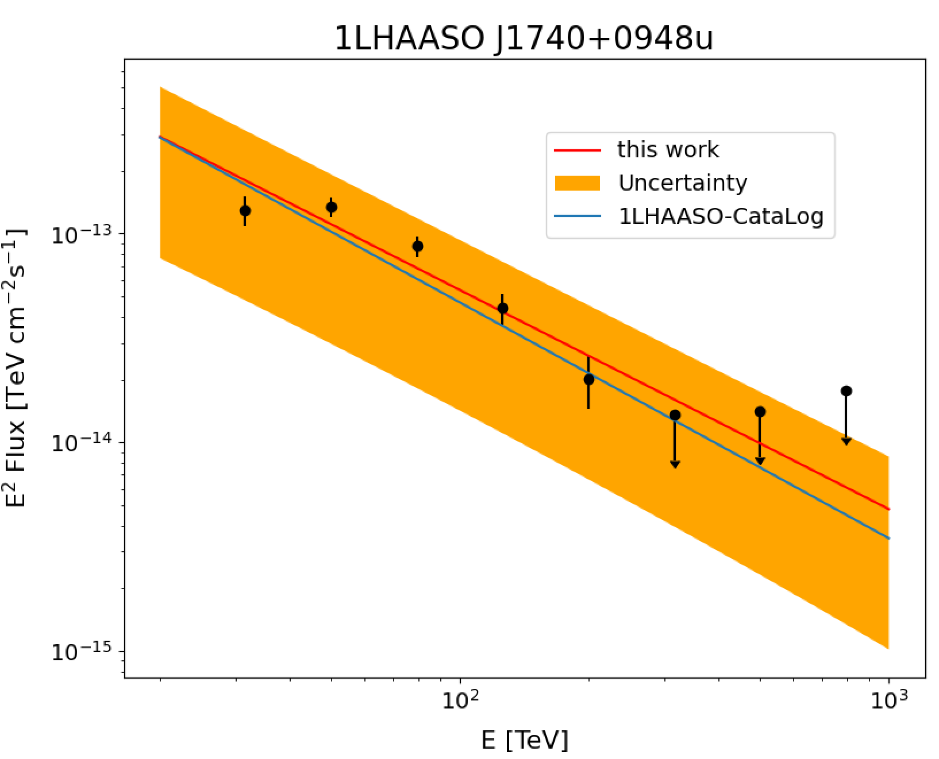
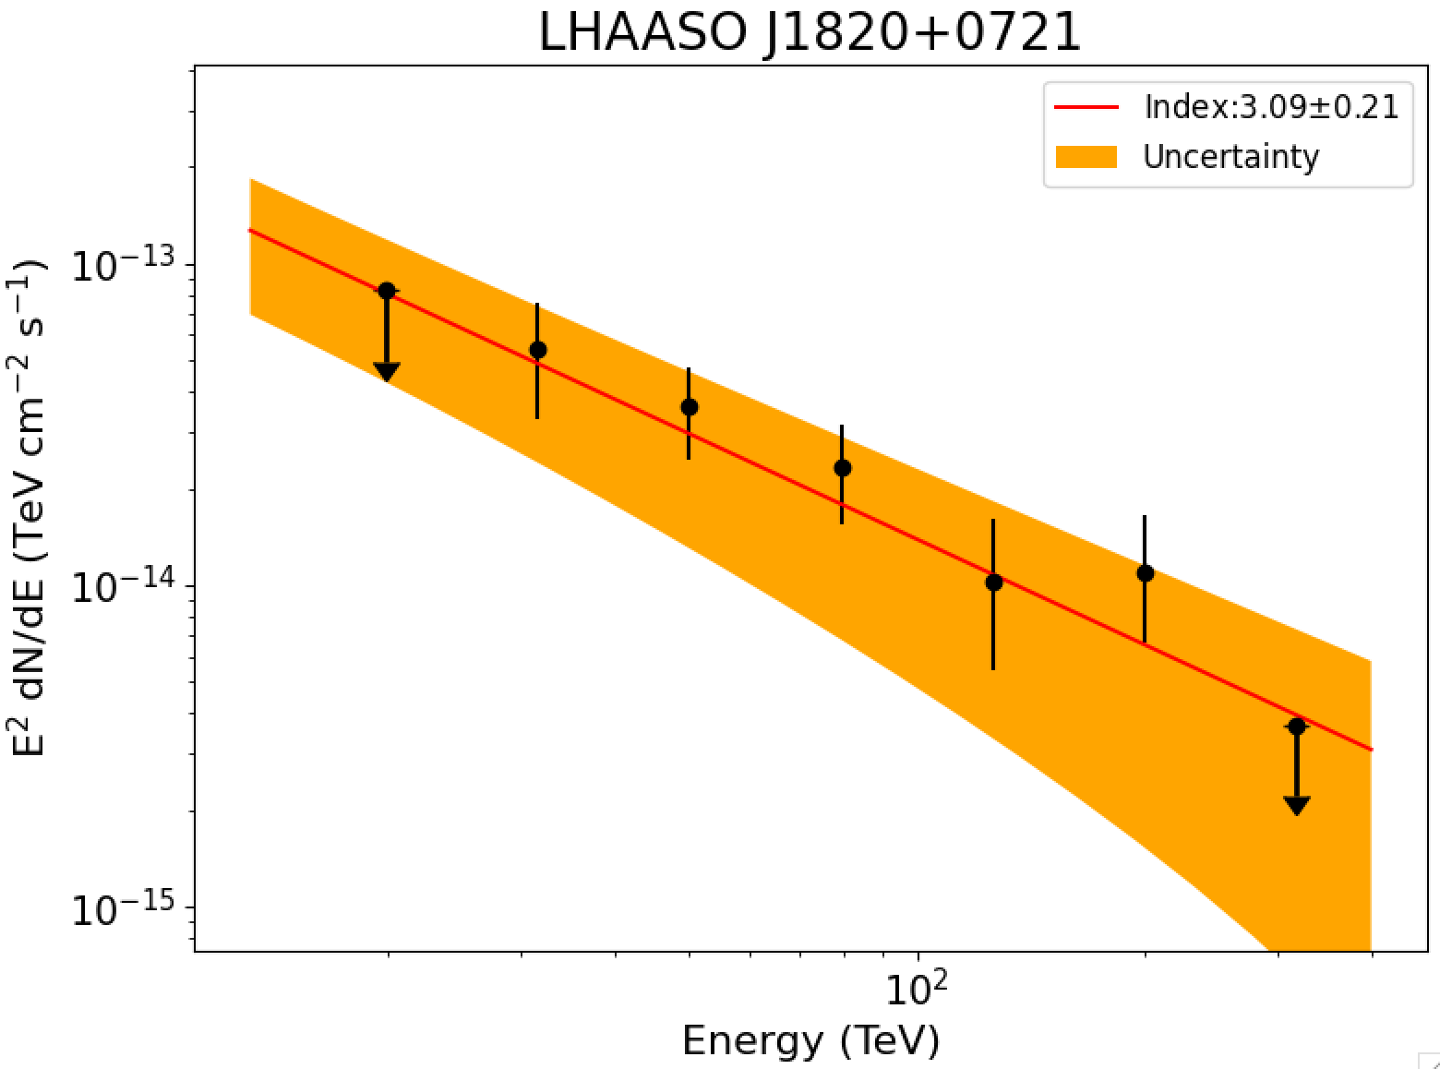
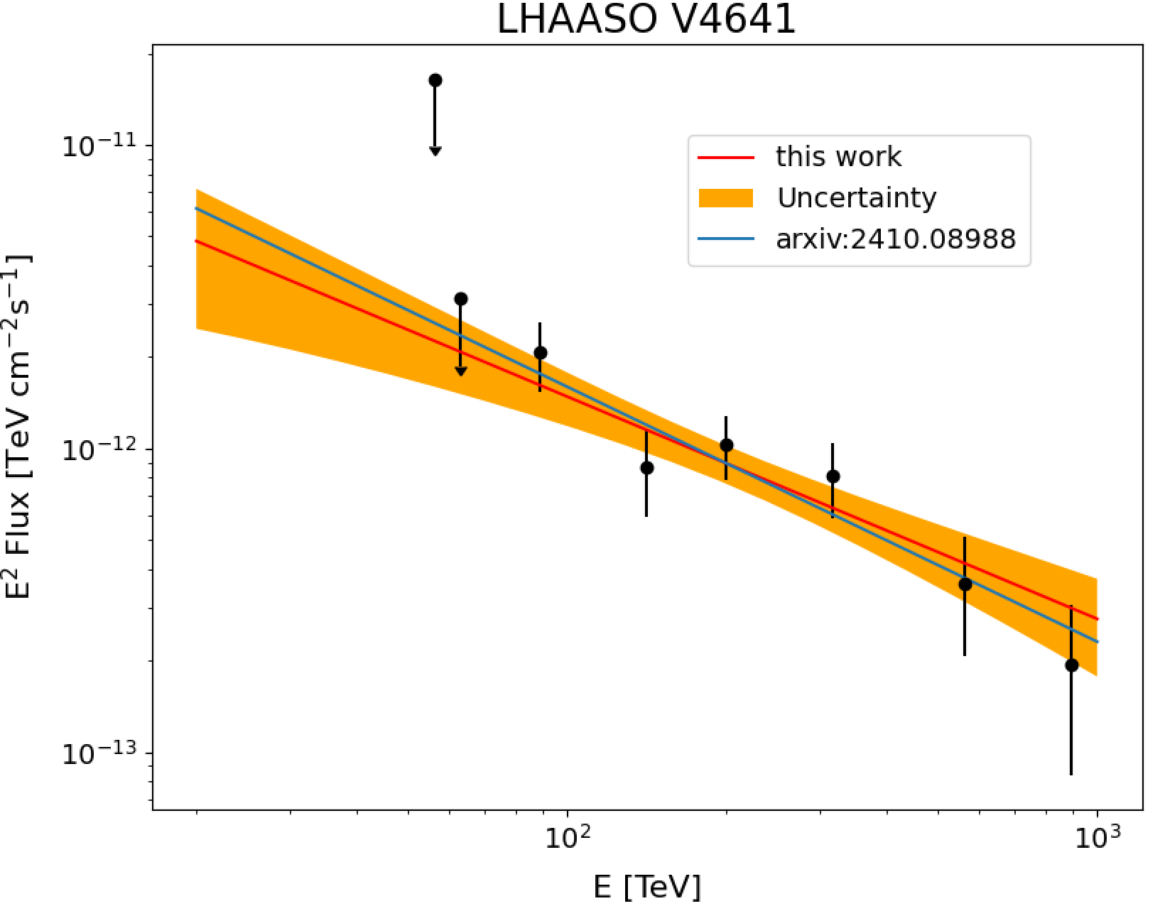
Three residual gamma sources

Slide 9
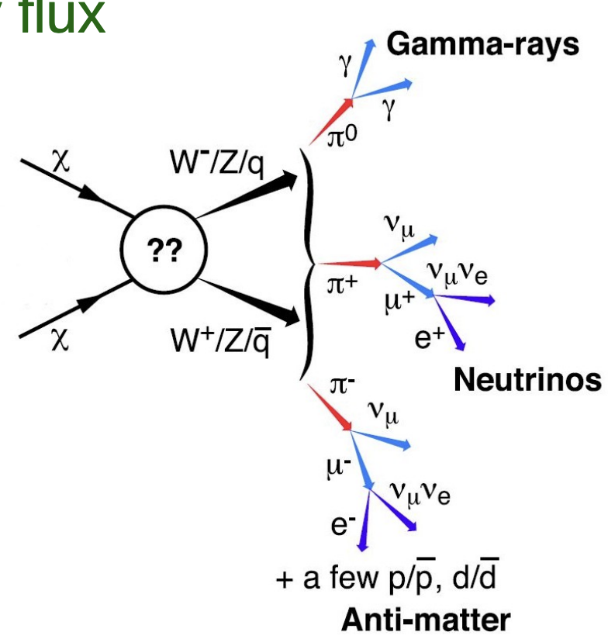
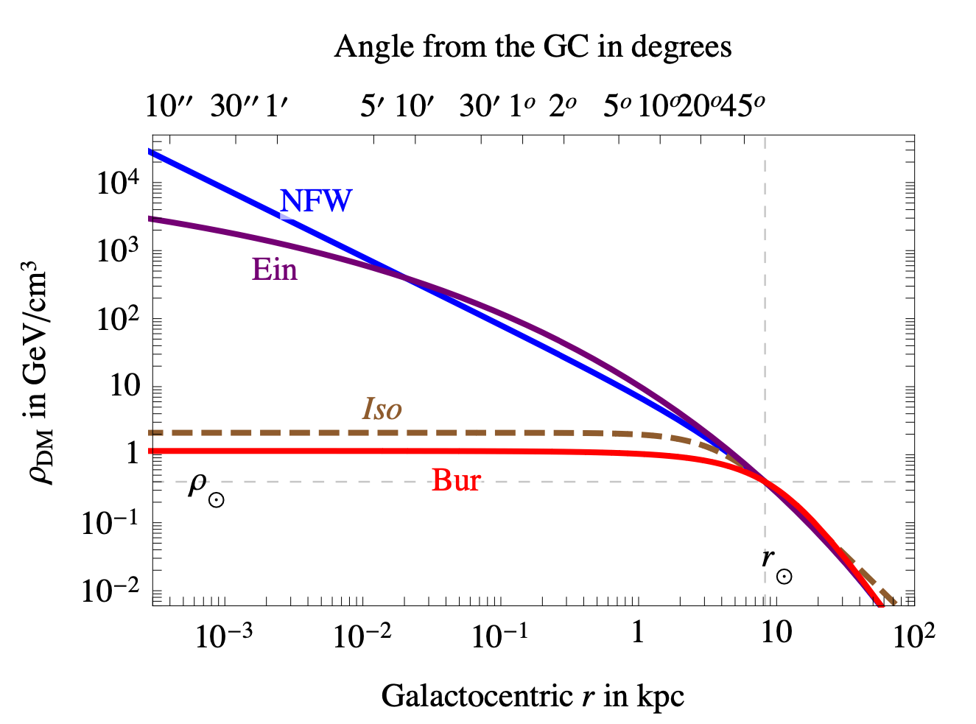
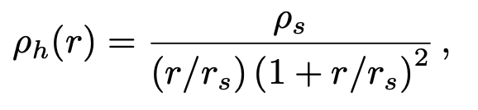

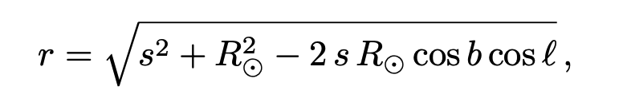

DM annihilation modelling: Prompt gamma-ray intensity
cross-section
Spectrum
J factor
JCAP10(2015)014
The NFW profile is adopted as the nominal model

Slide 10
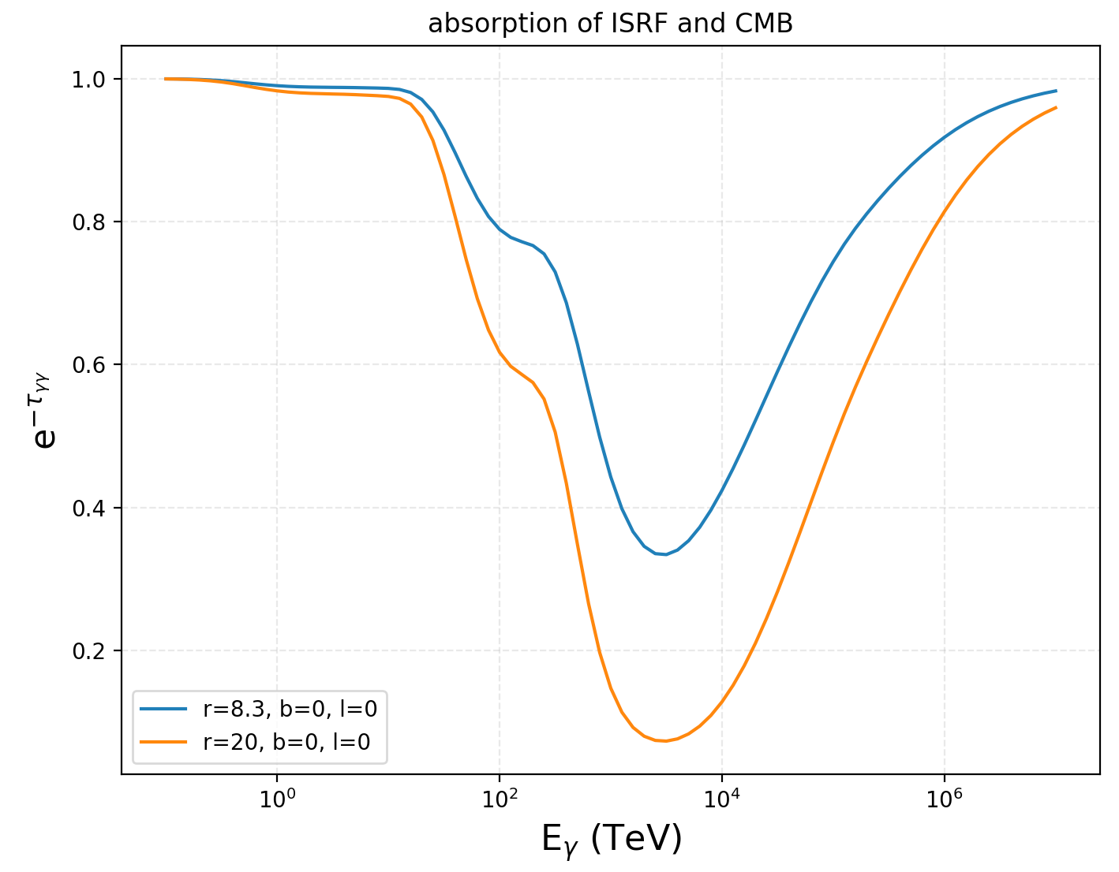
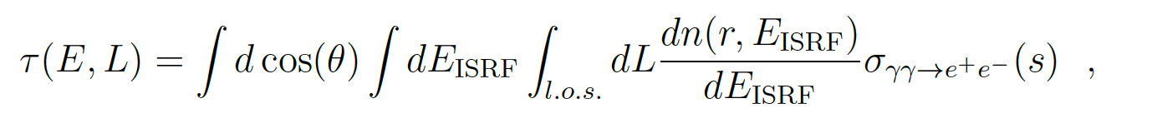
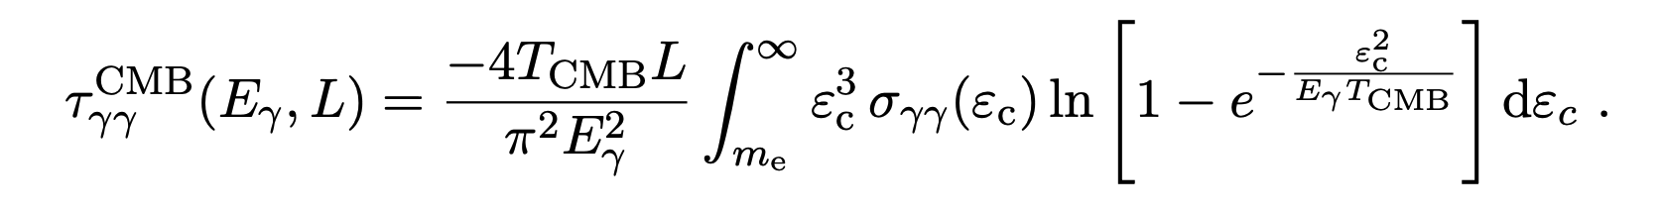
gamma-ray absorption
Interstellar Radiation Field
Astron.Astrophys. 449 (2006) 641
From GALPROB
CMB

Slide 11
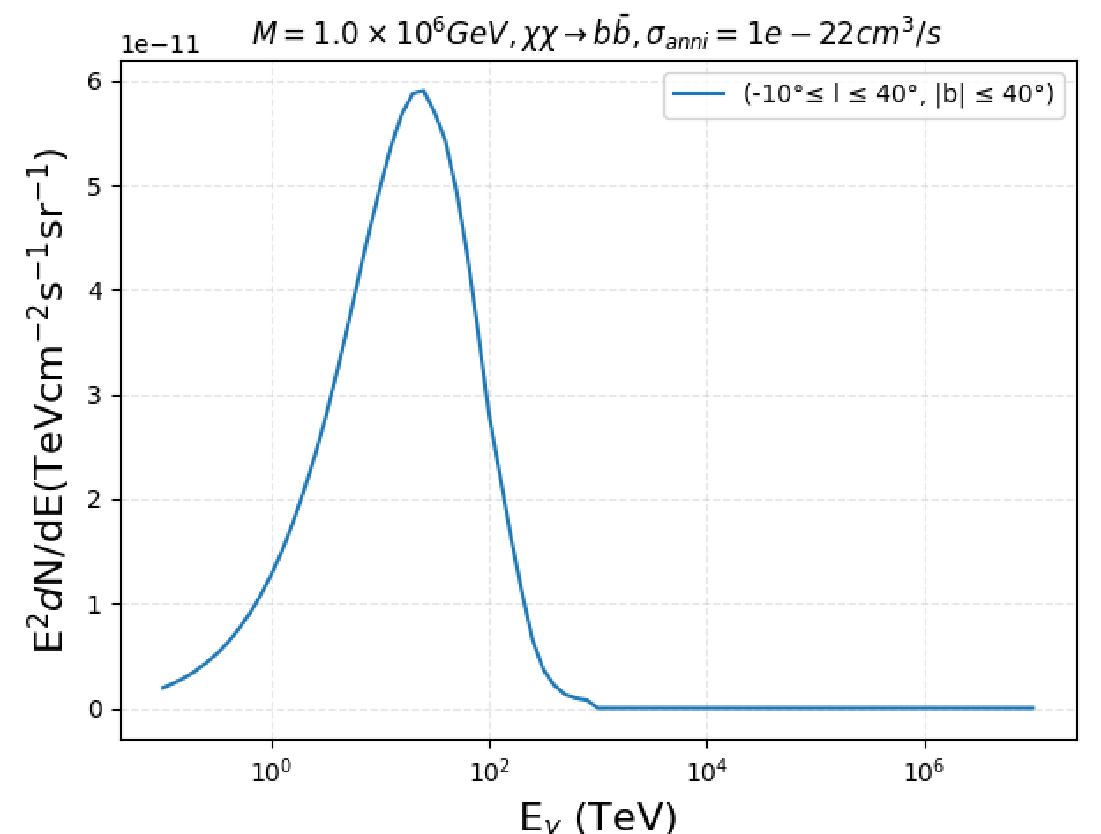
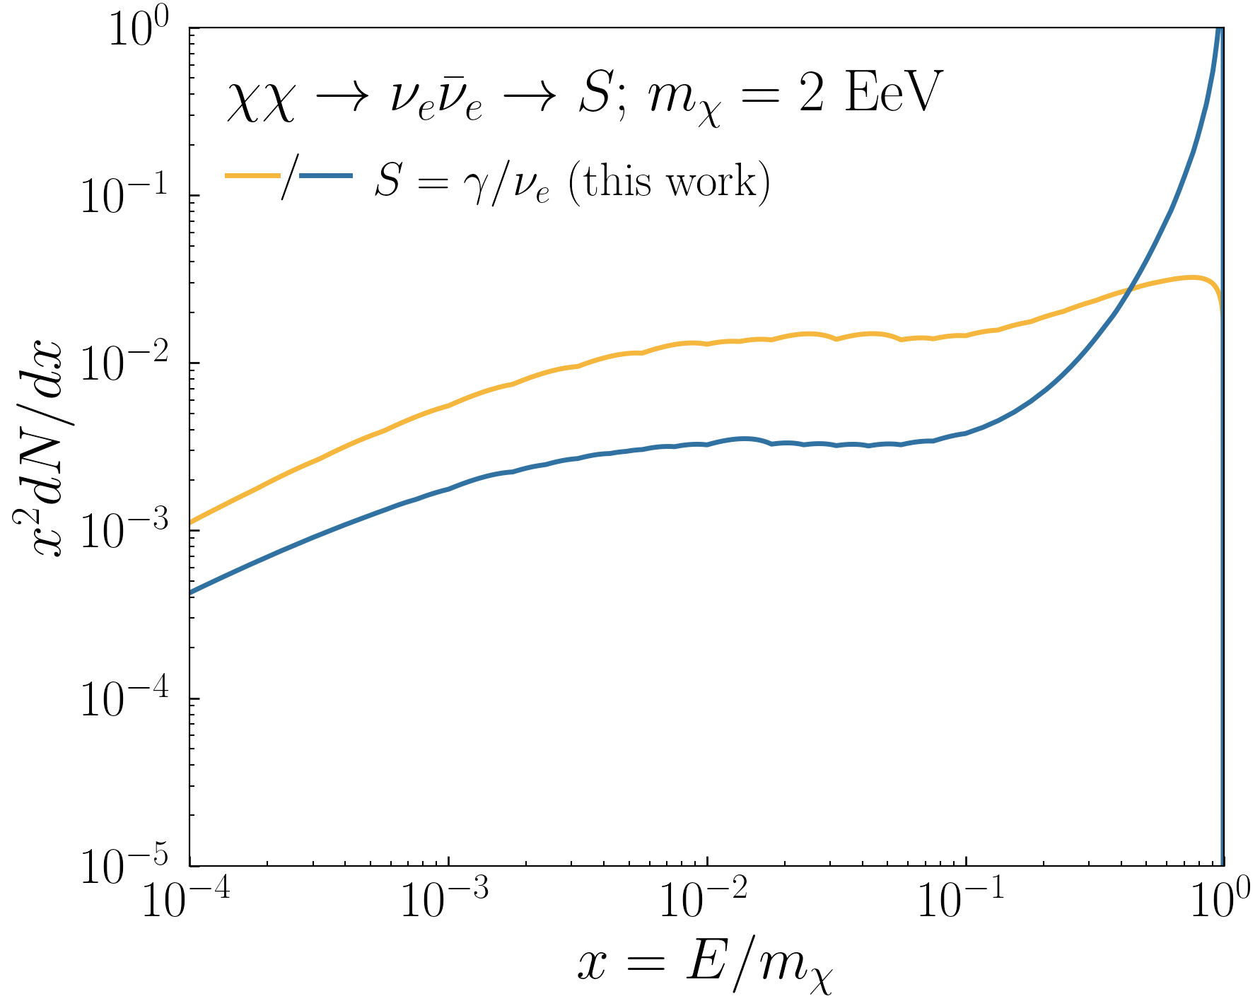
Energy spectrum of DM annihilation
HDMSpectra
JHEP06(2021)121

Slide 12
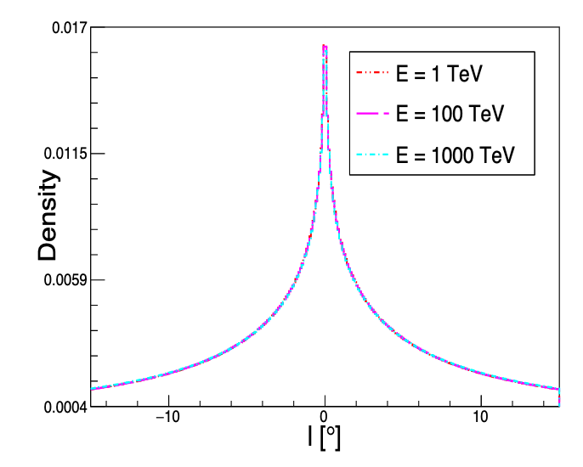
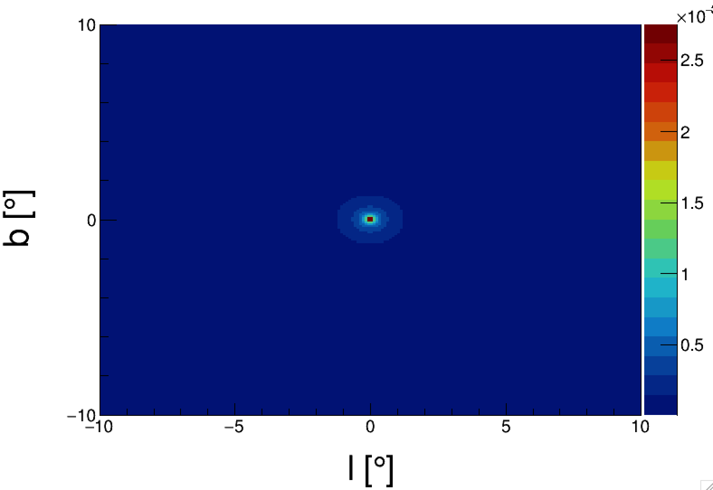
Spatial distribution
NFW
Energy-independent !!!

Slide 13
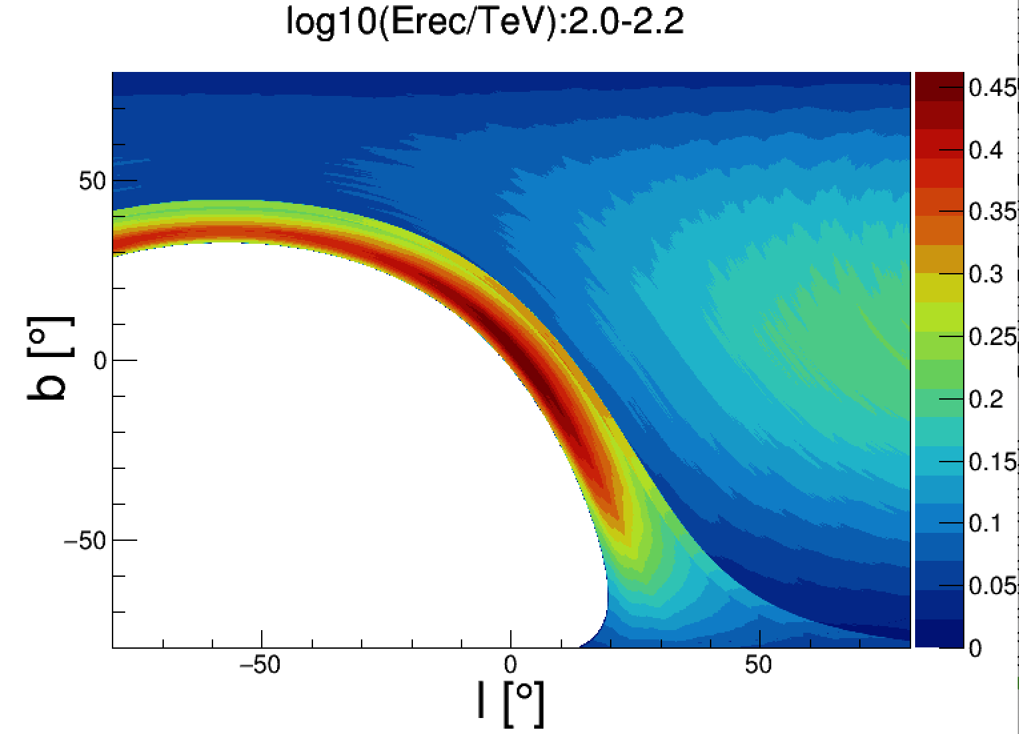
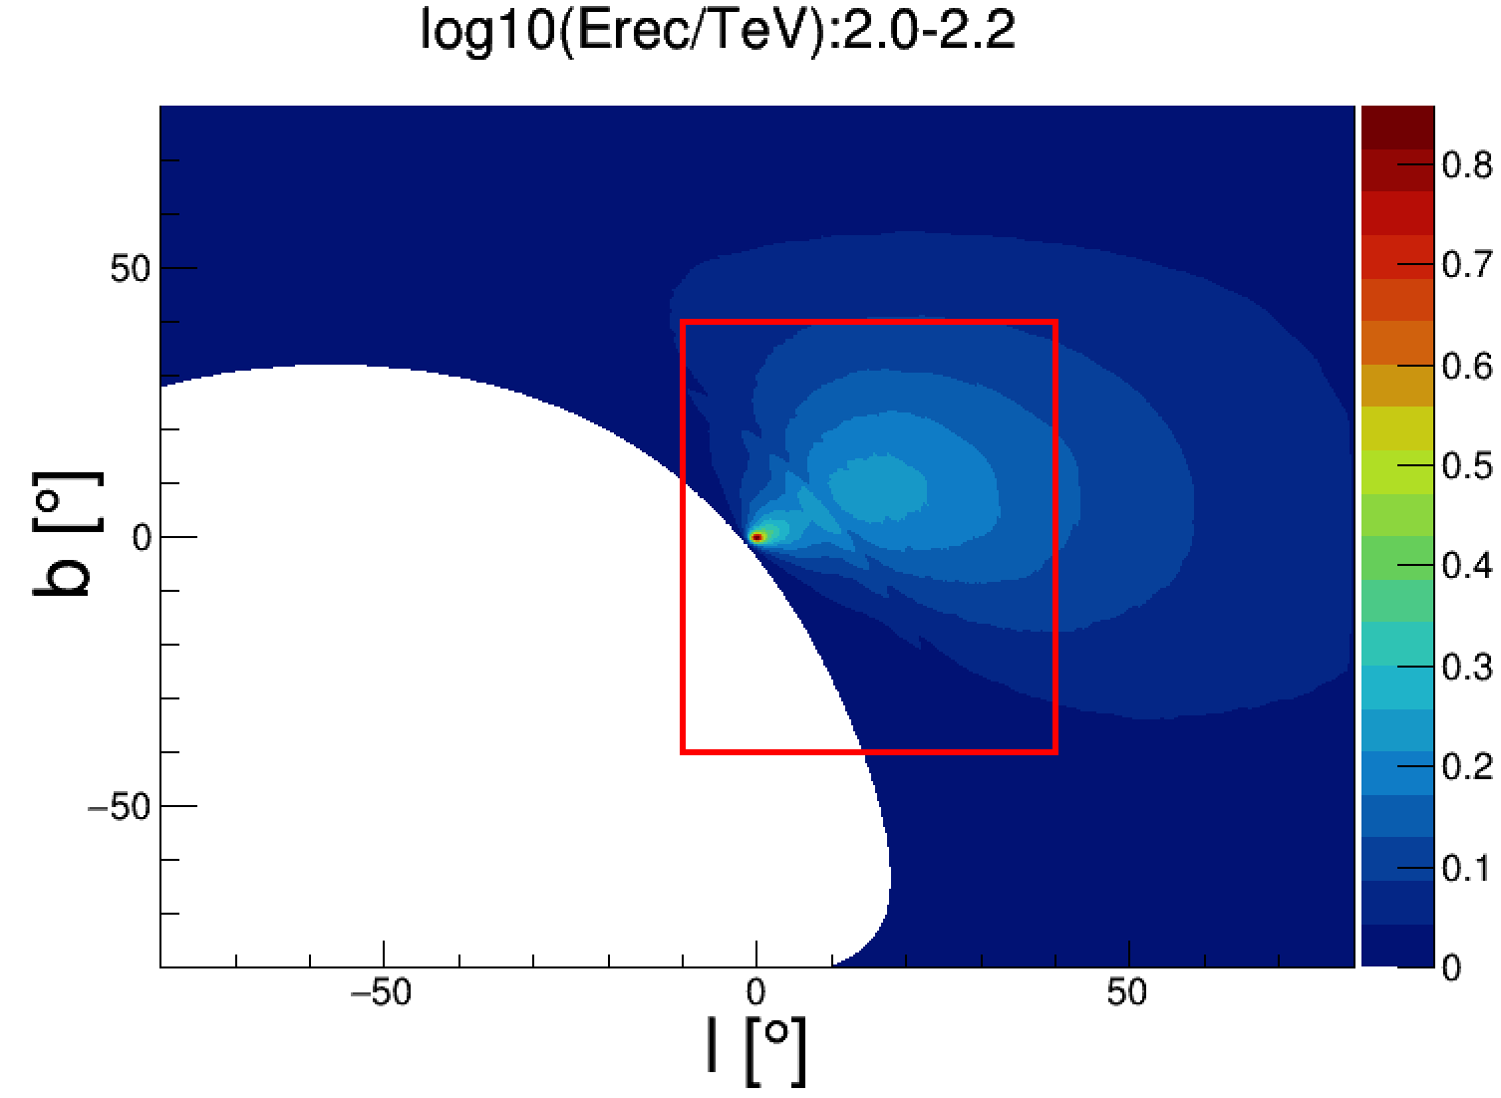
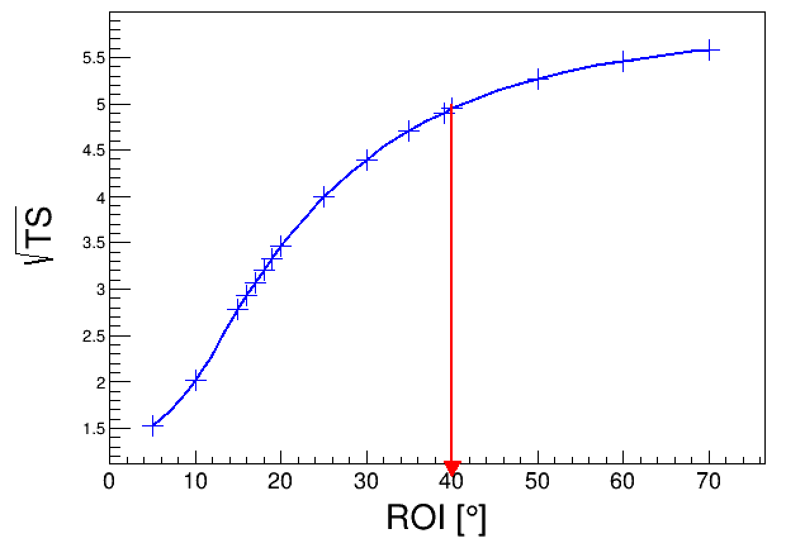
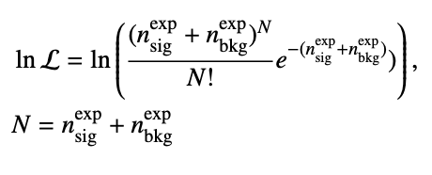
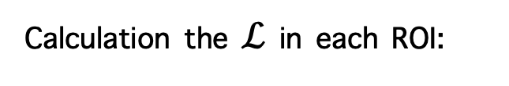

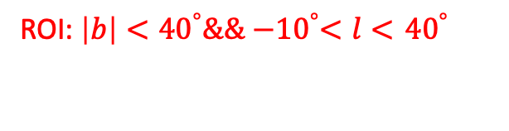
Optimization of ROI
Cosmic-ray BKG
Expected DM signal map with $M_{χ}={10}^{6}$ GeV
Calculation the $ℒ$ in each ROI:
ROI: $\left|b\right|<{40}^{°}\&\& {−10}^{°}<l<$ ${40}^{°}$

Slide 14
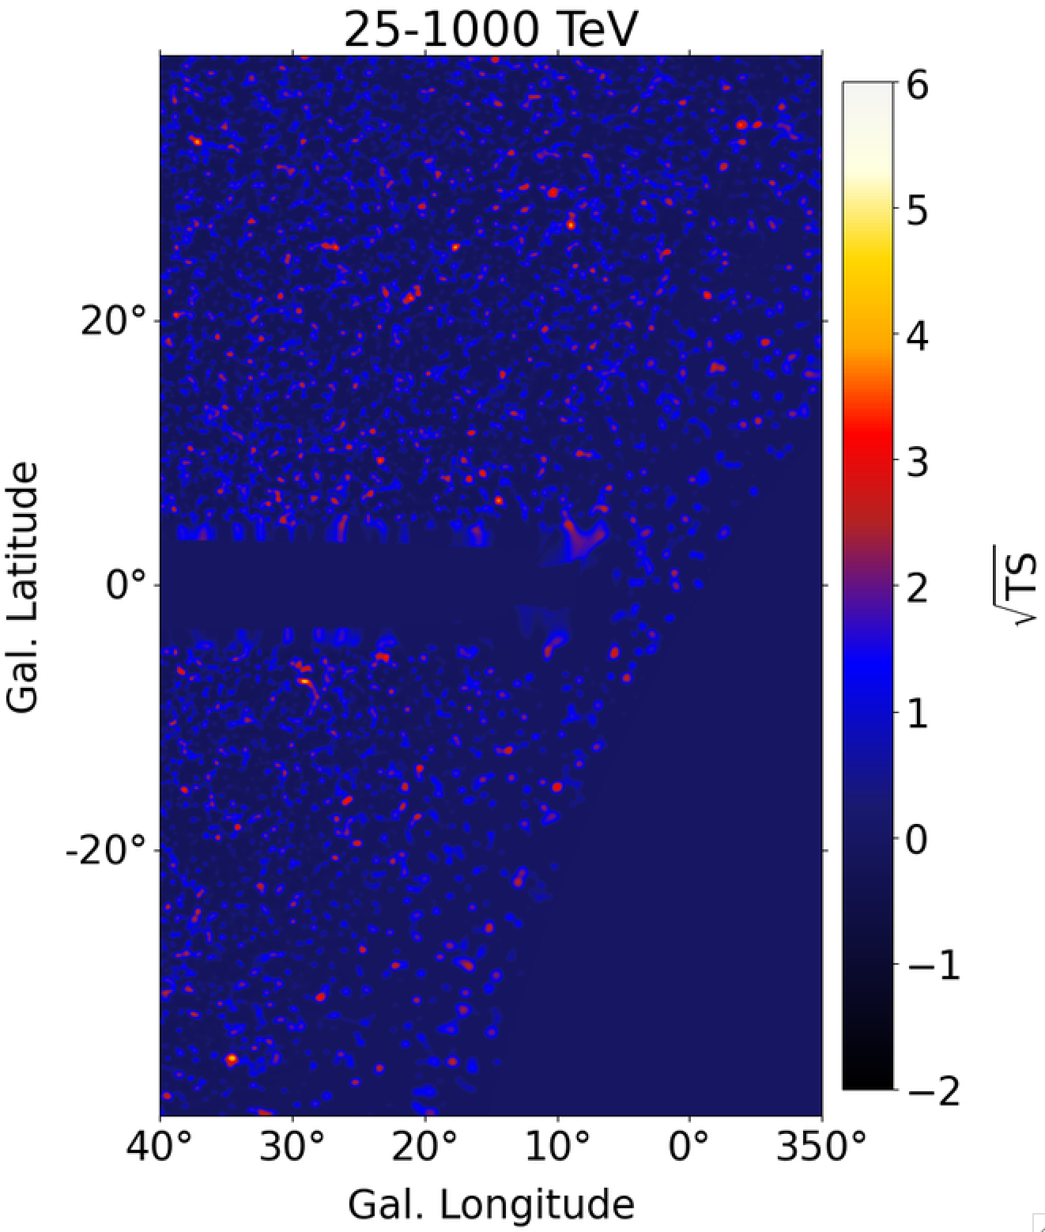
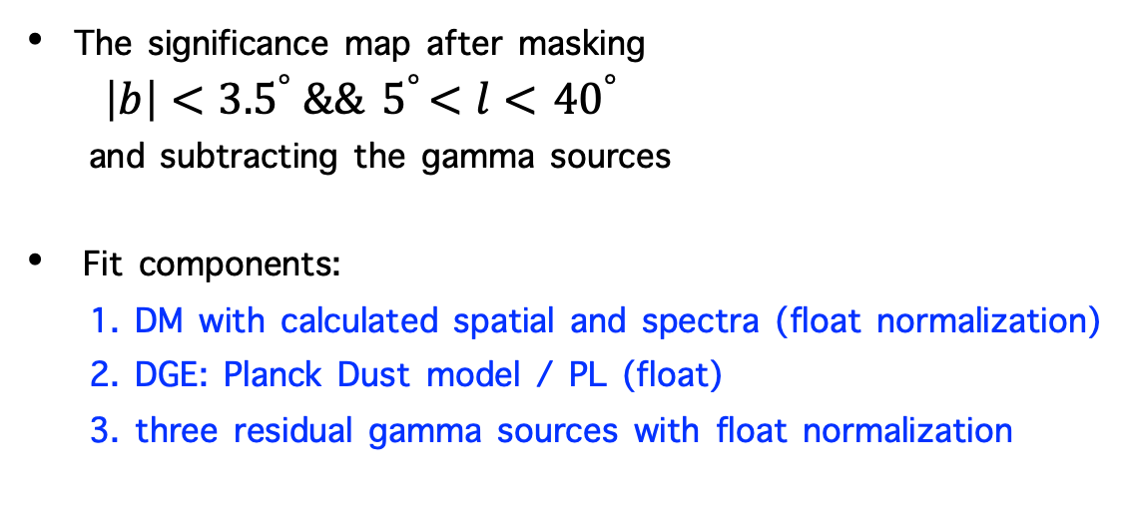

Search for DM signal with KM2A data
The significance map after masking
$\left|b\right|<{3.5}^{°} \&\&{ 5}^{°}<l<$ ${40}^{°}$
and subtracting the gamma sources
Fit components:
1. DM with calculated spatial and spectra (float normalization)
2. DGE: Planck Dust model / PL (float)
3. three residual gamma sources with float normalization
No evidence of DM signal withs significance less than 1$σ$

Slide 15
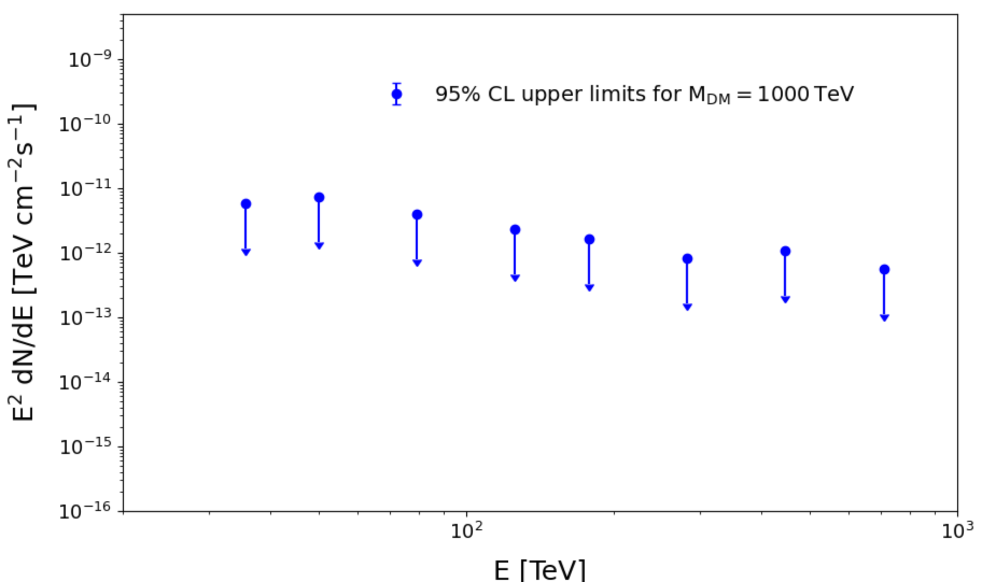
Search for DM signal with KM2A data
Search for the DM annihilation signal in the mass range 10 TeV – 1 EeV
No evidence signal is found (1$σ$)
$$χχ→b\overline{b}$$
Notes:
e

Slide 16
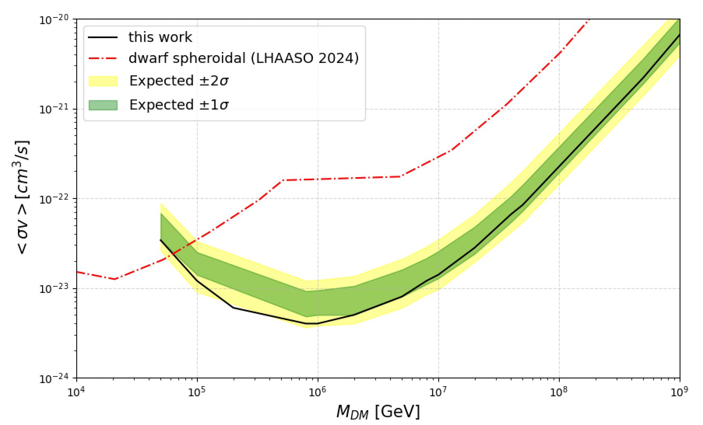
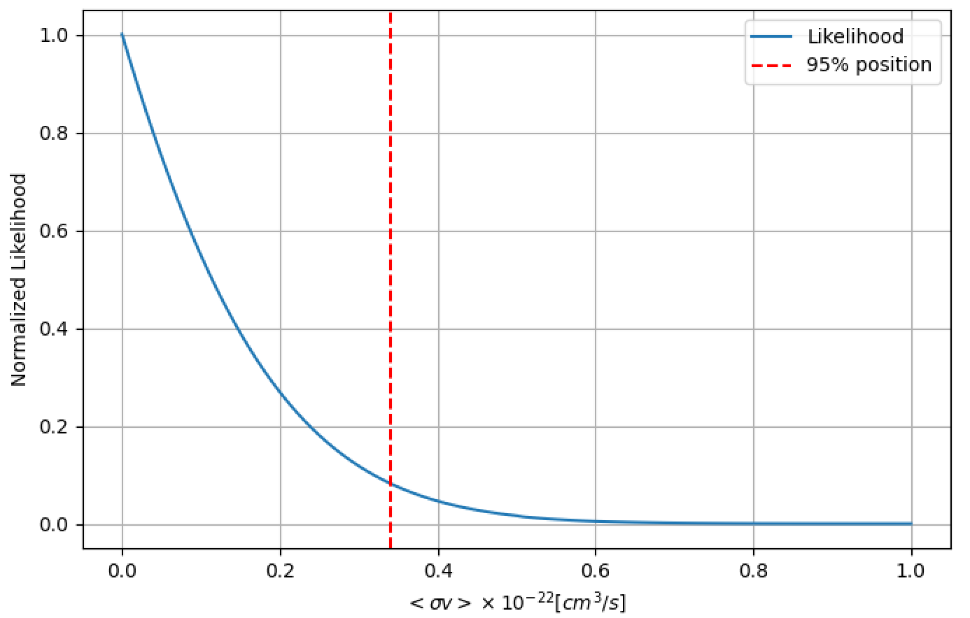

Upper limits on the DM annihilation cross-section
Profile likelihood to determine the 95% CL upper limits under different DM mass assumption
The expected bands are determined with 1000 mock data under the background-only hypothesis
$$χχ→b\overline{b}$$
$$M_{χ}=5×{10}^{4} GeV$$

Slide 17
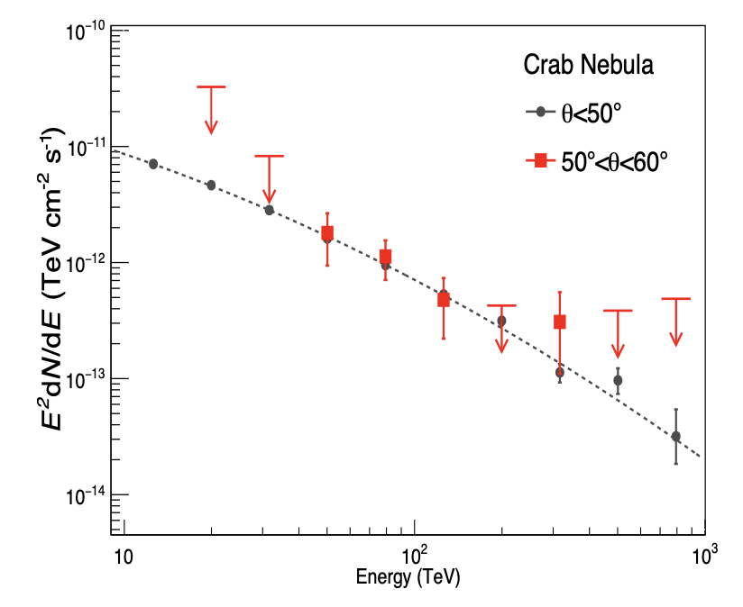
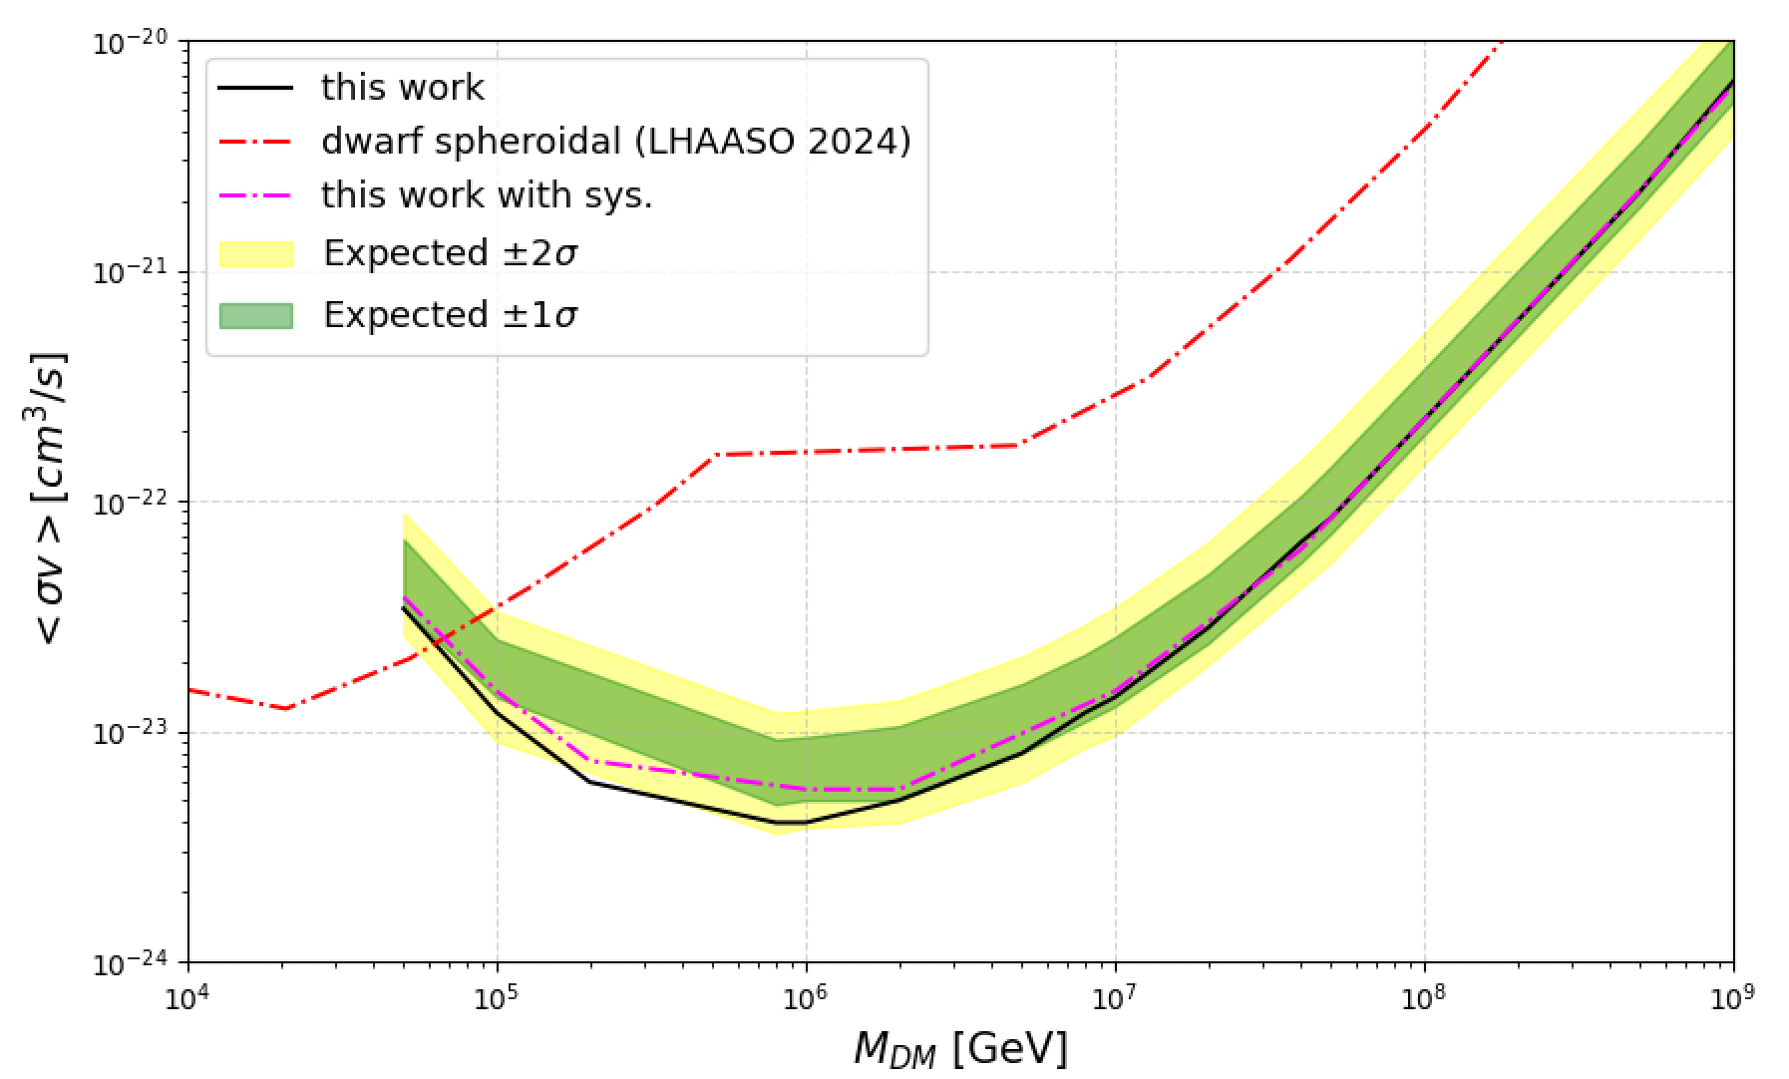
Systematic Uncertainty
The atmospheric model used in the Monte Carlo simulations due to seasonal and daily changes: 7%
The DGE: artificially adjust the normalization of DGE by $N_{0}−2σ$;
$$χχ→b\overline{b}$$

Slide 18
Summary
The large-zenith-angle KM2A data cover the GC and can therefore be used to search for dark matter annihilation signals
We perform an indirect dark matter search over the mass range 10 TeV–1 EeV. The most stringent constraints are obtained around the PeV scale, improving upon previous LHAASO dSph work by one order of magnitude.
Next:
Discuss different DM density profile models
Further systematic uncertainties
$$χχ→b\overline{b}$$

Slide 19
Back Up

Slide 20


Crab observation of large-zenith-Angle data

