Slide 1

Modeling of Cosmic Ray Escape into Molecular Clouds surrounding middle age Supernova Remnants
Siyu Chen，B. Theodore Zhang，Siming Liu

Slide 2

How do accelerated particles become CRs?
FS
Accelerated at the shock
$$u_{sh}$$
Lose energy adiabatically inside the remnant
RS
Escape from the remnant
contact discontinuity
Propagation inside the Galaxy
Observation
Notes:
Supernova remnants are still one of the important places where cosmic rays get accelerated.
The escape part is a important link between what happens at the acceleration site and what we observe, but our understanding of this process is still poor.
we use A theoretical model，it gives a picture under spherical symmetry, particles get accelerated at the shock, then they suffer adiabatic losses inside the remnant, and finally escape.

Slide 3


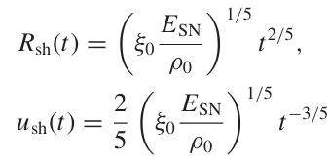



The spectrum at the shock
FS
$$f_{0}（t，p）=\frac{3 ζ_{CR} u_{sh}^{2}(t) ρ_{0}}{4 π c {(m_{p}c)}^{4} ⋀(p_{max,0}(t))}{(\frac{p}{m_{p}c})}^{−α}⊝[p_{max,0}(t)−p]$$
$$u_{sh}$$
acceleration
efficiency
normalization factor when $P_{CR}=ζ_{CR}u_{sh}^{2}(t) ρ_{0}$
RS
acceleration spectrum
( $α$~4 from DSA)
S. Celli et al. 2019
contact discontinuity
shock's acceleration of particles gradually weakens
Notes:
Since Supernova remnants in the Sedov phase make an important contribution to cosmic rays,and during this phase, the particle spectrum inside the remnant is a broken power-law shape ，this model only focuses on this stage.
We derive the spectrum at the shock from the acceleration efficiency.
Since the shock's acceleration of particles gradually weakens after the Sedov phase, we can also figure out the escape time and the escape radius for particles of different energies

Slide 4

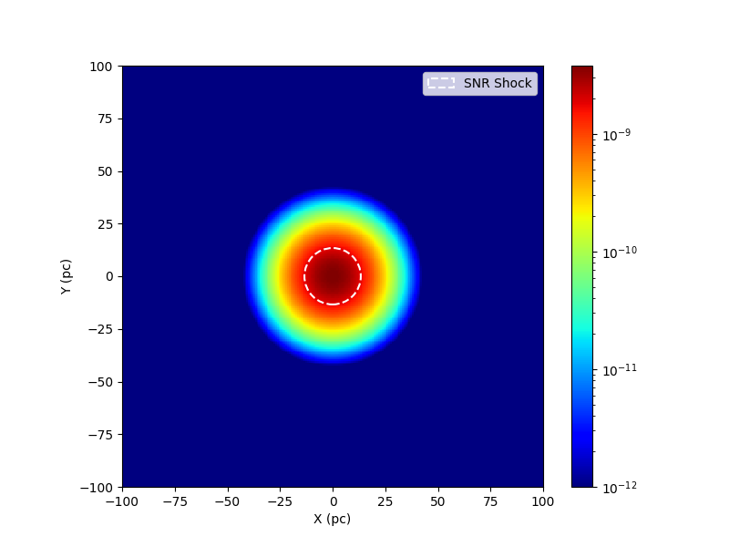
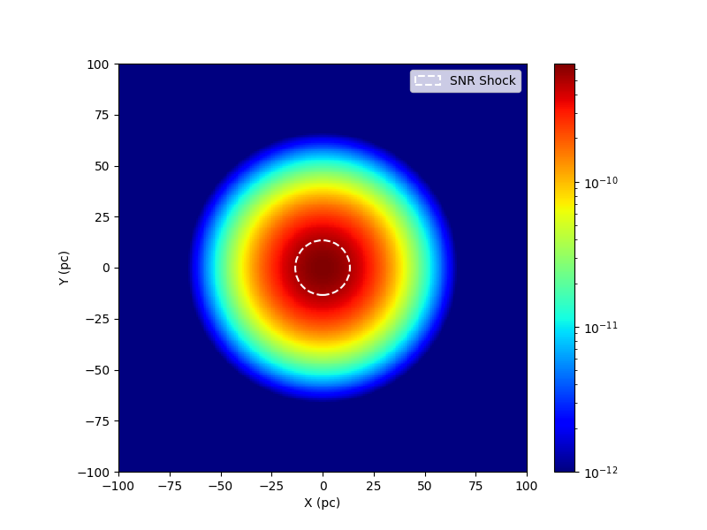
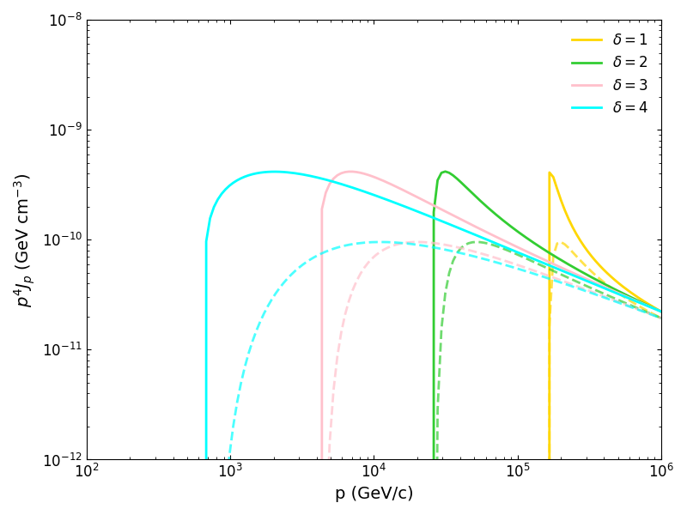
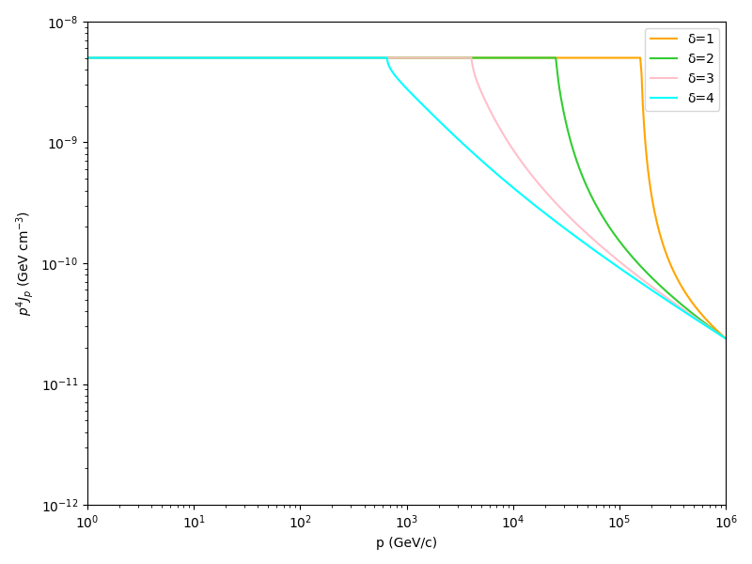
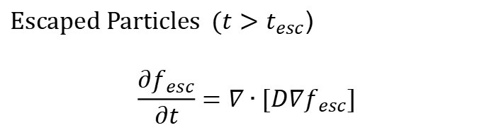
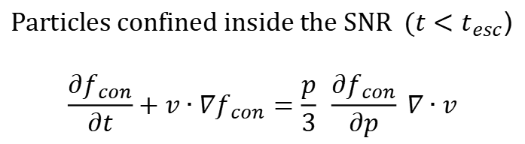
$$\frac{∂f}{∂t}+v∙∇f=\frac{p}{3} \frac{∂f}{∂p} ∇∙v+∇∙[D∇f]$$
shell radiation
radiation from escaped CRs
Particles confined inside the SNR ($t<t_{esc}$)
$$\frac{∂f_{con}}{∂t}+v∙∇f_{con}=\frac{p}{3} \frac{∂f_{con}}{∂p} ∇∙v$$
Escaped Particles ($t>t_{esc}$)
$$\frac{∂f_{esc}}{∂t}=∇∙[D∇f_{esc}]$$
10TeV
50TeV
Spatial distribution of particles at different energies at the same time. The white dashed line marks the shock front.
At a fixed time, the distribution of particles inside the remnant for different delta.
At a fixed time, the distribution of particles outside the remnant for different delta and distances.
Notes:
So, depending on the escape time, we can get the distribution of confined particles inside the remnant and escaping particles outside, at any given time.
these two figures on the bottom left show the Spatial distribution of particles at different energies at the same time. The white dashed line marks the shock front. It's pretty clear particles with higher energy escape farther out.
The middle figure shows the particle distribution inside the remnant at a given time for different delta. At low energies, it's dominated by the confined particles, while at high energies, the escaping component takes over. The combination of the two produces a broken power-law spectrum.
The last figure shows how the spectrum of escaping particles varies with distance and delta.

Slide 5
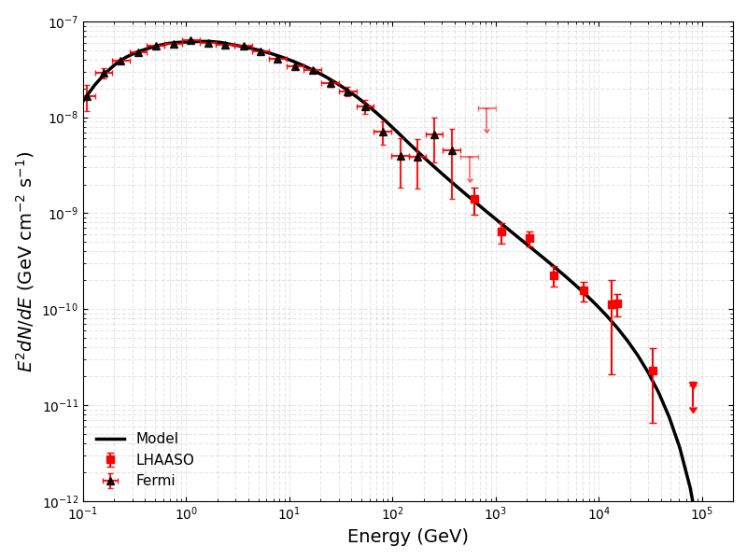
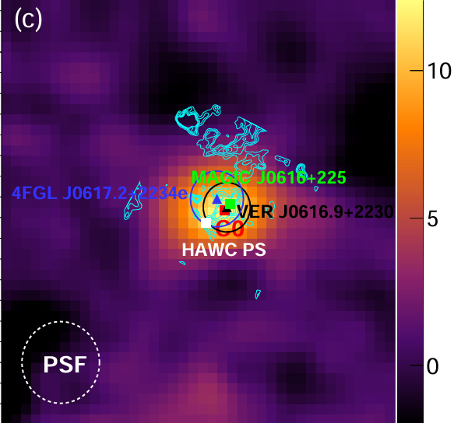
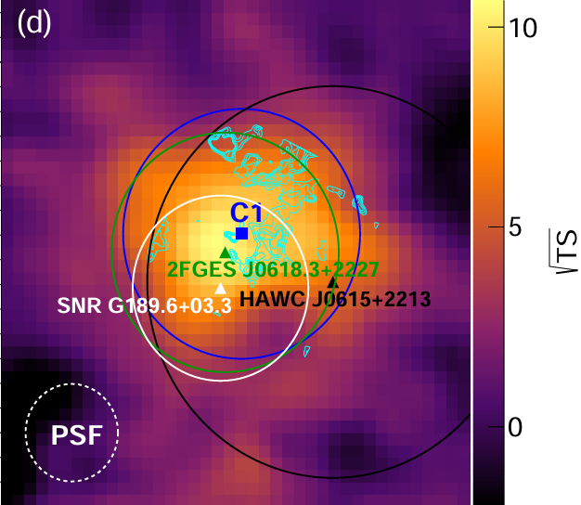
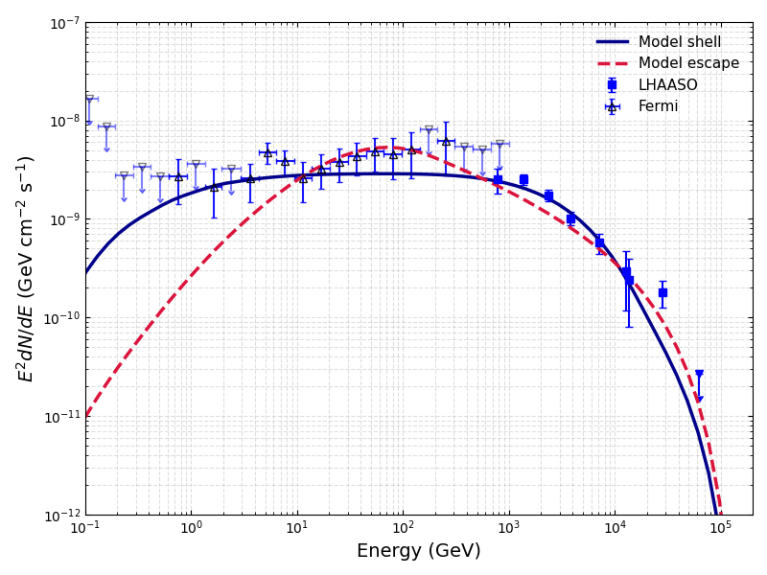
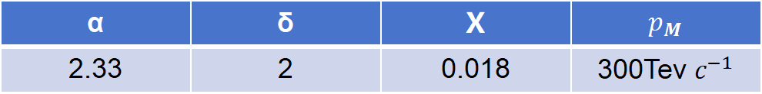
GeV-TeV gamma-ray emission from IC 443
α | δ | Χ | $$p_{M}$$
2.33 | 2 | 0.018 | 300Tev $c^{−1}$
C0:shell radiation
Cao et. al., 2026
C1:escape or another SNR?
IC 443 is a middle-aged SNR with an estimated age ranging from 3 to 30 thousand years, at a distance of approximately 1.5 kpc.
C1 is from escaped CRs ? but it’s insufficent(red dashed line),or another supernova remanants? (blue line)
Notes:
Next, we apply the model to fit data from some supernova remnants.
For IC 443, the LHAASO observations show two components, called C0 and C1.
For the C0 component, we assume the emission comes from the shell.
For C1, we assumed it comes from cosmic rays escaped from C0. We fit it with escape model, but it‘s insufficient. However, when we used a shell model instead, the result is more reasonable.

Slide 6
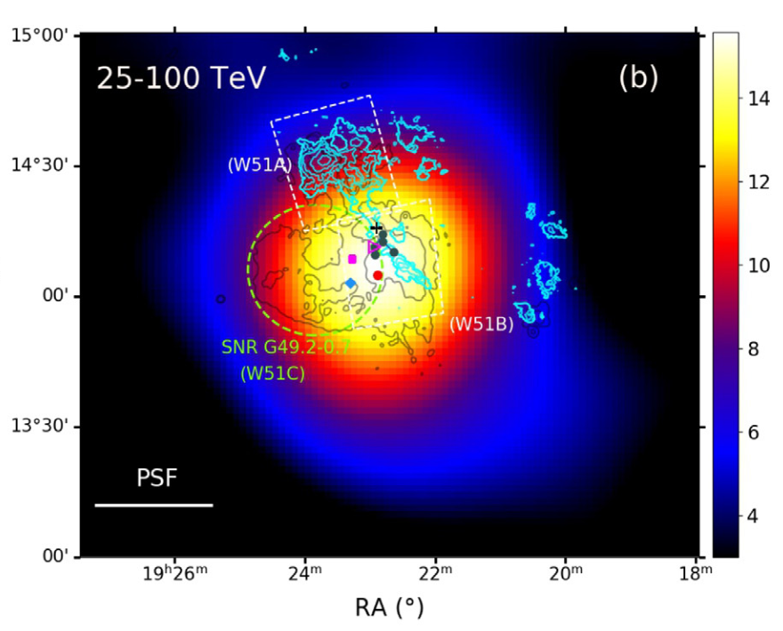
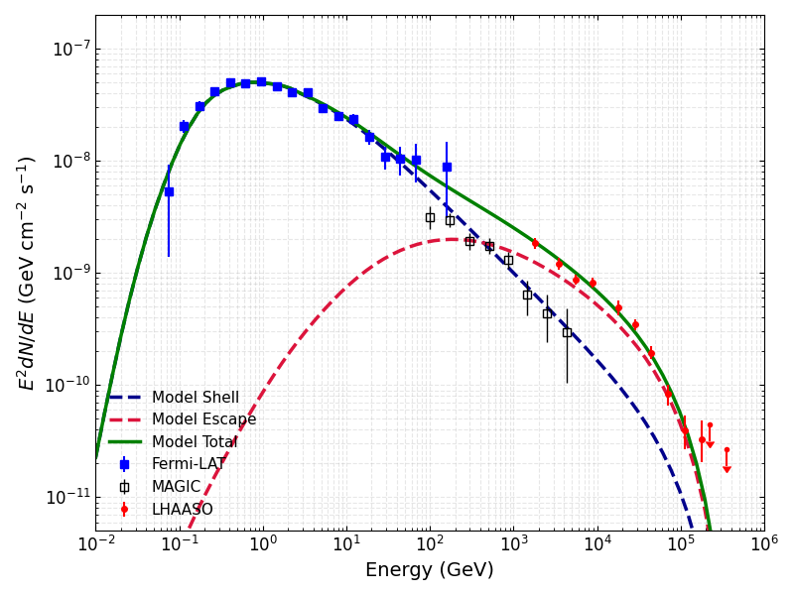
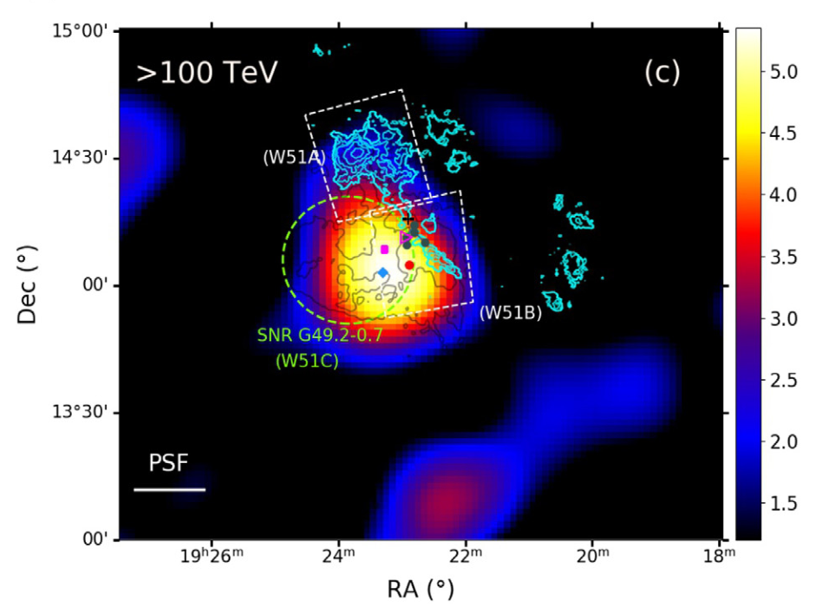
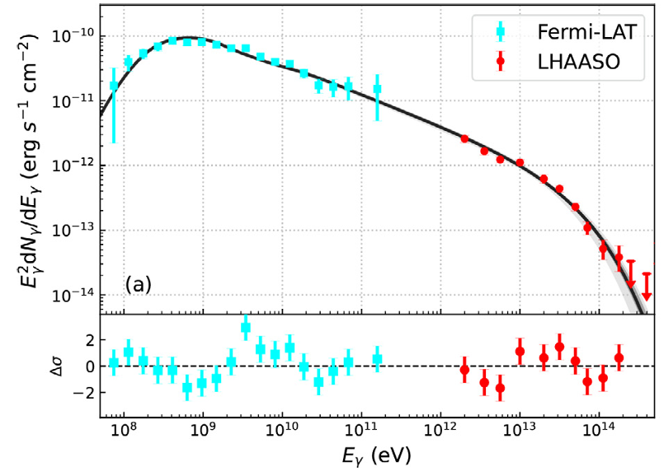
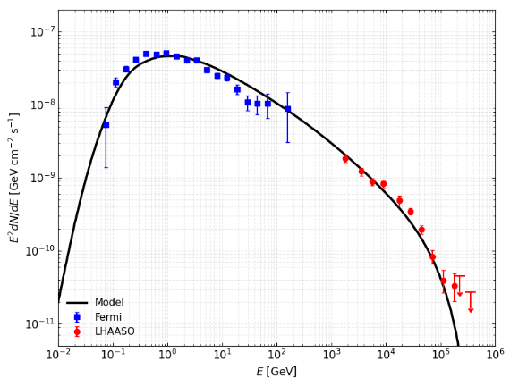
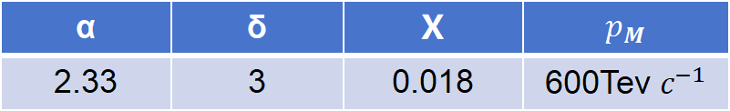
GeV-TeV gamma-ray emission from W51C
α | δ | Χ | $$p_{M}$$
2.33 | 3 | 0.018 | 600Tev $c^{−1}$
shell radiation(Fermi,MAGIC)
escaping CRs radiation(LHAASO)
shell radiation？
MAGIC coll. 2012
Fermi-LAT coll. 2009
W51C is a middle-aged SNR with an estimated age 18 thousand years, at a distance of approximately 5.5 kpc.
LHAASO coll. 2024
Notes:
For W51C, we propose the Fermi and MAGIC data come from the shell emission, while the LHAASO component corresponds to the contribution from cosmic rays escaped.

Slide 7
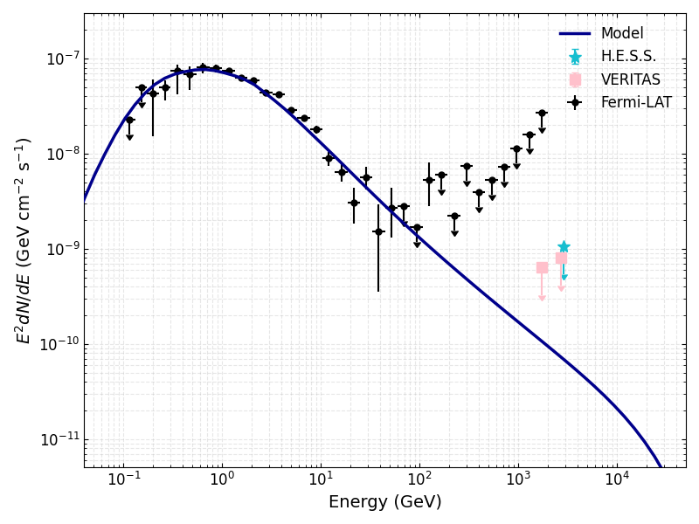
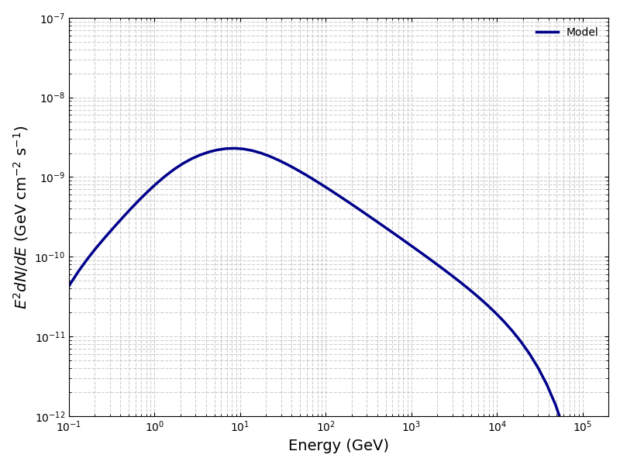
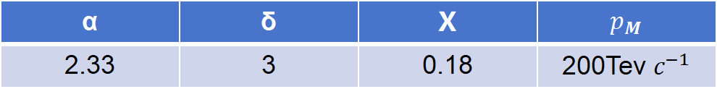
GeV-TeV gamma-ray emission from W44
α | δ | Χ | $$p_{M}$$
2.33 | 3 | 0.18 | 200Tev $c^{−1}$
The escaped cosmic-ray emission at twice the shock radius
shell radiation
W44 is a middle-aged SNR with an estimated age 20 thousand years, at a distance of approximately 2.2 kpc.
Fermi Colla. 2010; Peron et. al. 2020; Abe et. al. 2025; LHAASO Colla. 2026
Notes:
For W44, we fit the observed data with a shell model, and we also derived the gamma-ray spectrum produced by escaped cosmic rays at twice the shock radius.

Slide 8
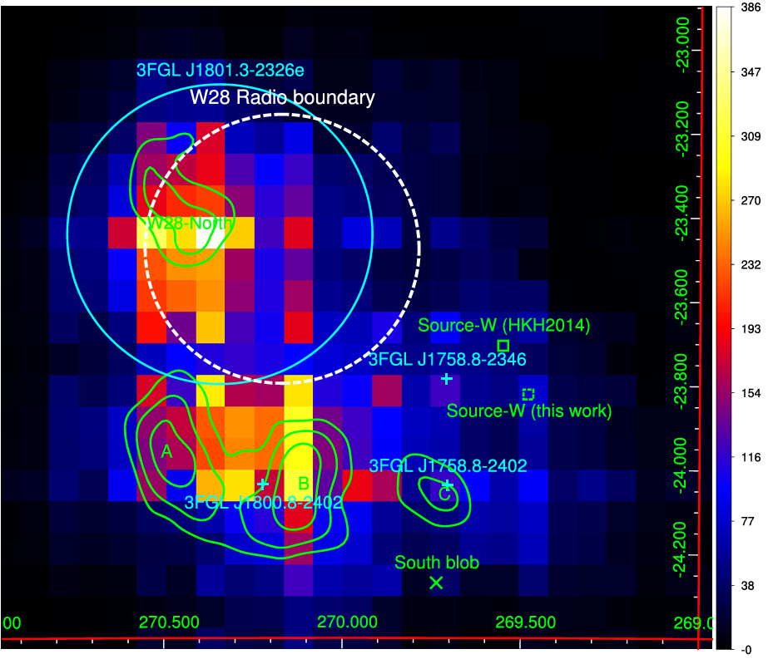
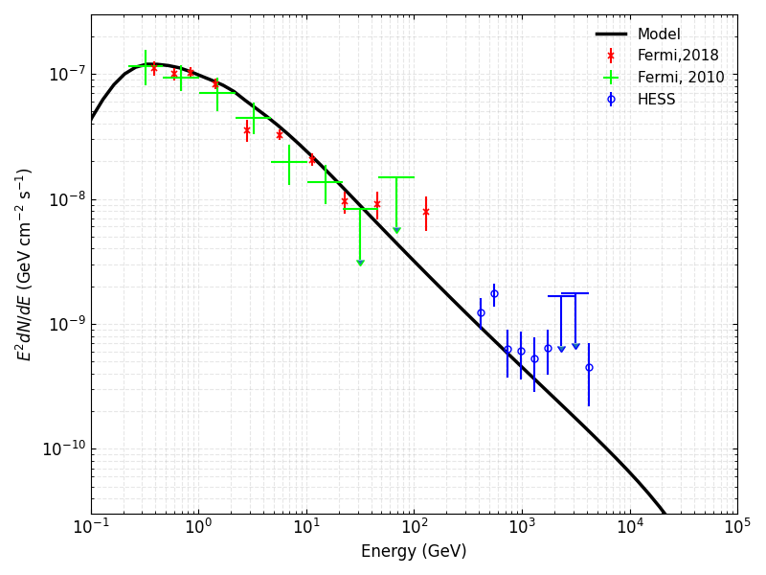
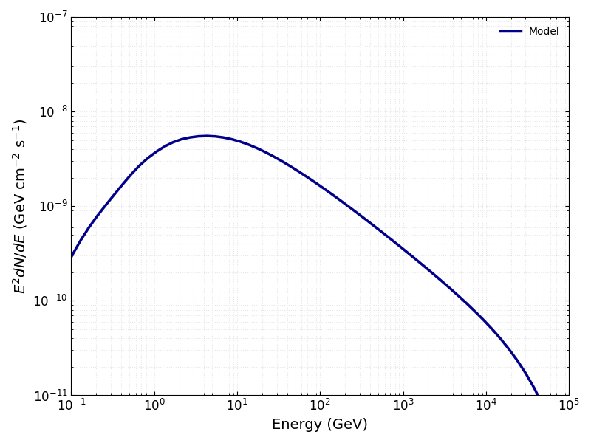
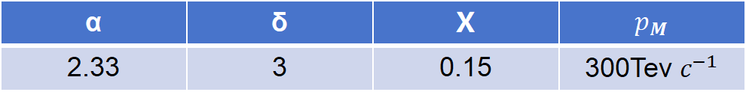
GeV-TeV gamma-ray emission from W28
α | δ | Χ | $$p_{M}$$
2.33 | 3 | 0.15 | 300Tev $c^{−1}$
The escaped cosmic-ray emission at twice the shock radius
shell radiation
W28 is a middle-aged SNR with an estimated age 30 thousand years, at a distance of approximately 2 kpc.
HESS Collab. 2008; Nava & Cabici 2013
Yudong Cui, et al 2018
Yudong Cui, et al 2018
Notes:
We also used the same method for W28—fitting the observations with a shell model and then deriving the gamma-ray spectrum from escaped cosmic rays.

Slide 9
Summary
We revisit the spectra of four famous supernova remnants using realistic physical model with continuous escape of CRs and time-dependent acceleration capability and constrain the relevant parameters.
IC 443: The emission from C1 may originate either from escaped CRs or from another supernova remnant.
W51C: The broadband gamma-ray emission includes contributions from CRs confined within the shell as well as escaped CRs (LHAASO data?).
W44: The evidence for the pion-zero bump is particularly significant. The observed emission can be explained by contributions from CRs inside the shell.
W28: The VHE emission might comes from CRs inside the shell.

