Slide 1

Observation for TeV candidate of HMXB XTE J1858+034
Presenter: Xinpeng Cui
School: Guizhou Normal University
Collaborator:Shaoqiang Xi Xiaoli Huang
Notes:
The title of my report is *Observation for TeV candidate of HMXB XTE J1858+034*. My name is Xinpeng Cui , from Guizhou Normal University, and my collaborators are Xi Shaoqiang and Huang Xiaoli.

Slide 2
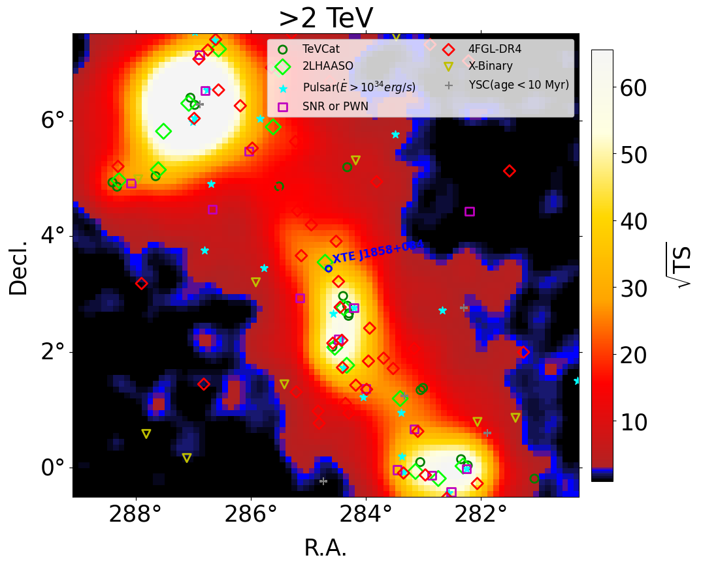
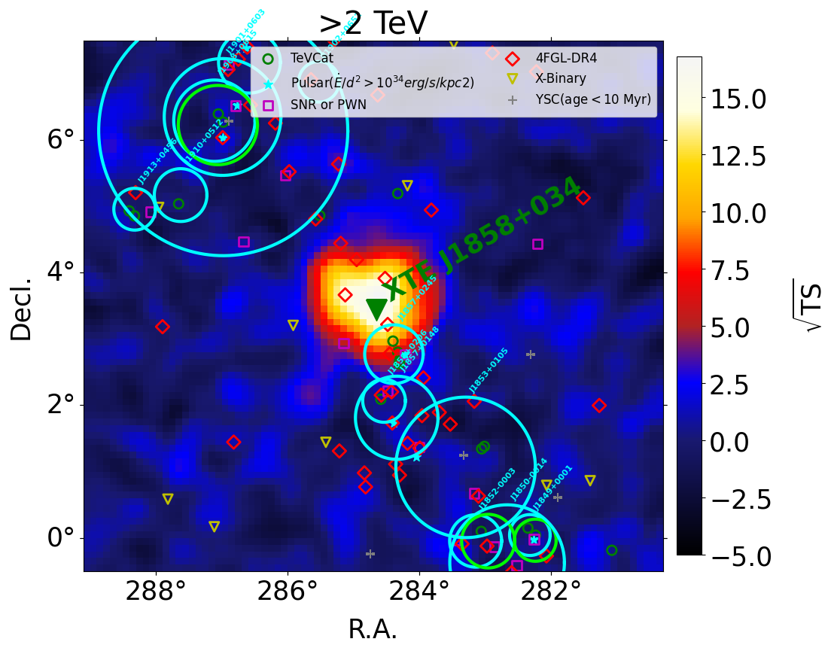
LHAASO Data Analysis
XTE J1858+034 is located at the center of the TeV source LHAASO J1858+0330. The source LHAASO J1858+0330 exhibits an extended structure of 0.52°.
Figure 1:The left panel shows the TS map within an 8.8° mutiplied by 8° region centered on LHAASO J1858+0330(R.A. = 284.71° , Decl. = 3.55°), while the right panel displays the TS map after excluding all other sources except this one.
Notes:
XTE J1858+034 is located at the center of the TeV source LHAASO J1858+0330. The source LHAASO J1858+0330 exhibits an extended structure of 0.52°. If LHAASO is physically associated with this binary system, such extension may imply the presence of an 80-parsec-scale bubble or halo structure related to this high-mass X-ray binary (HMXB).
First, a region of interest (ROI) was specifically defined for XTE J1858+034, which is a rectangular region centered at LHAASO J1858+0330, with coordinates of right ascension R.A. = 284.71° and declination Decl. = 3.55°. Signal maps and background maps across all energy bands within this ROI were selected for subsequent analysis.
Second, for LHAASO J1858+0330, all other sources in the field were excluded, and a significance map was produced to visualize the morphological characteristics of the source ,and the results are shown in Figure 1.

Slide 3
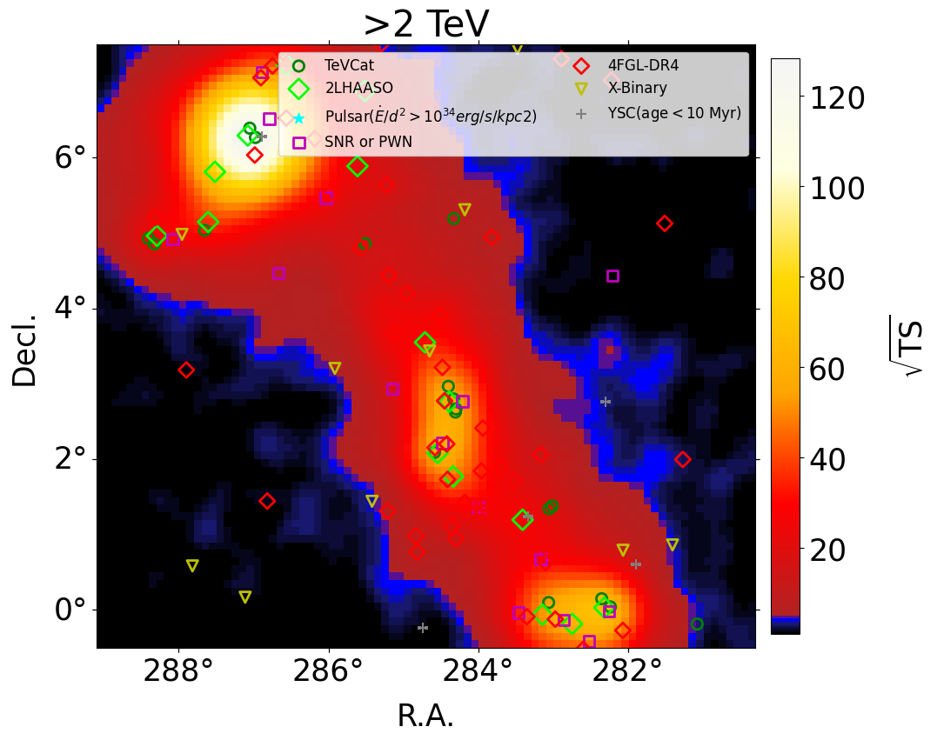
LHAASO Data Analysis
Table 1: Morphological Fit Results for J1858+0330
Energy | Spatial Model | TS | R.A. deg | Decl. deg | Major Axis deg | Minor Axis deg | Position Angle | AIC
＞ 2TeV | Point | 264.4 | 284.5815 | 3.6055 |  |  |  | 0
 | Gaussian | 574.0 | 284.6902 | 3.5778 | 0.5199±0.024 |  |  | -299.084
 | Elliptical gaussian | 577.3 | 284.6905 | 3.5794 | 0.5336±0.033 | 0.4972±0.031 | 0 | -295.722
 | Disk | 531.9 | 284.7250 | 3.5682 | 0.6551±0.016 |  |  | -260.106
Note that TS differences cannot be used to quantitatively determine the best-fit model when models are non-nested.
The Akaike information criterion (AIC; Akaike, 1974) was employed for model comparison.
The AIC values are subtracted from that of the point model for a clear comparison.
A comparison shows that the Gaussian model yields the smallest AIC value and is therefore adopted.
Energy | Spatial Model | TS | R.A. deg | Decl. deg | Major Axis deg | Minor Axis deg | Position Angle deg | AIC
＞ 2TeV | Gaussian | 574 | 284.7 | 3.58 | 0.52±0.02 |  |  | -14.69
 | Elliptical gaussian | 577.3 | 284.7 | 3.58 | 0.53±0.03 | 0.50±0.03 | 0 | −10.69
2-25TeV （WCDA） | Gaussian | 231.5 | 284.7 | 3.51 | 0.53±0.04 |  |  | -13.28
25-100TeV | Gaussian | 276.4 | 284.6 | 3.58 | 0.49±0.03 |  |  | -12.76
Energy | Spatial Model | TS | R.A. deg | Decl. deg | Major Axis deg | Minor Axis deg | Position Angle deg | AIC
＞ 2TeV | Gaussian | 574 | 284.7 | 3.58 | 0.52±0.02 |  |  | -14.69
 | Elliptical gaussian | 577.3 | 284.7 | 3.58 | 0.53±0.03 | 0.50±0.03 | 0 | −10.69
2-25TeV （WCDA） | Gaussian | 231.5 | 284.7 | 3.51 | 0.53±0.04 |  |  | -13.28
25-100TeV | Gaussian | 276.4 | 284.6 | 3.58 | 0.49±0.03 |  |  | -12.76
Notes:
We used empirical geometric models, including the point-source model, Gaussian model, disk model, and elliptical Gaussian model. In the three-dimensional maximum-likelihood analysis, a simple power-law model was used to fit the spectrum of the J1858+0330 region above 2 TeV.,and the fitting results are summarized in Table 1.Note that TS differences cannot be used to quantitatively determine the best-fit model when models are non-nested. The Akaike information criterion (AIC; Akaike, 1974) was employed for model comparison.
The AIC values are subtracted from that of the point model for a clear comparison.
A comparison shows that the Gaussian model yields the smallest AIC value and is therefore adopted.

Slide 4
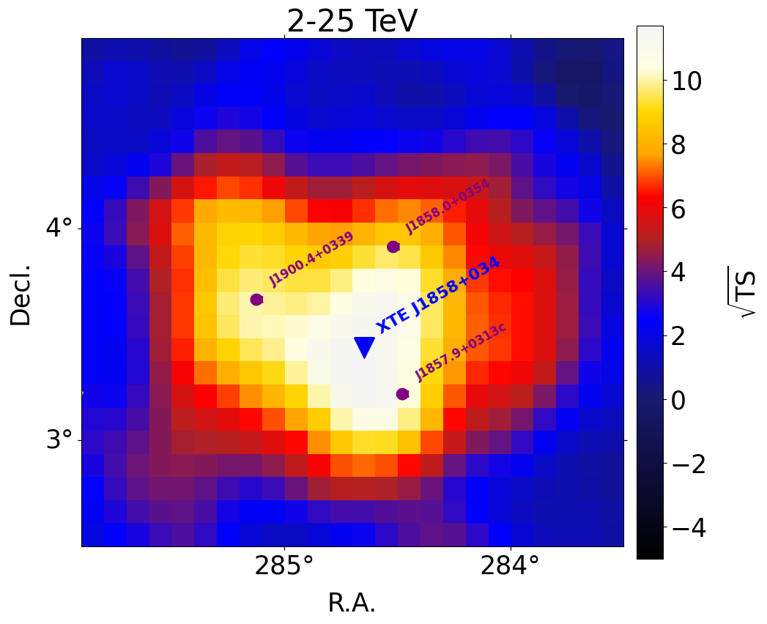
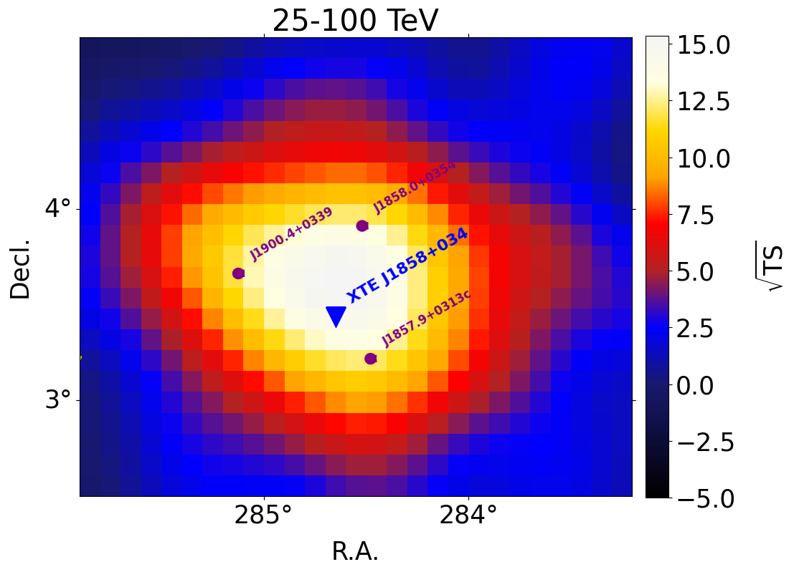
LHAASO Data Analysis
Figure 2:The left panel displays the TS map for WCDA (2 TeV < E < 25 TeV), while the right panel presents the TS map for KM2A (25 TeV < E < 100 TeV).
Notes:
We have plotted the TS maps for WCDA and KM2A separately, with KM2A divided into two energy bands: 25 TeV＜E＜100 （Greater than 25 and less than 100）TeV and E＞100 TeV. The TS value in the E＞100 TeV band is less than 5, while the results for WCDA and the 25 TeV＜E＜100 TeV band are shown in Figure 2.

Slide 5
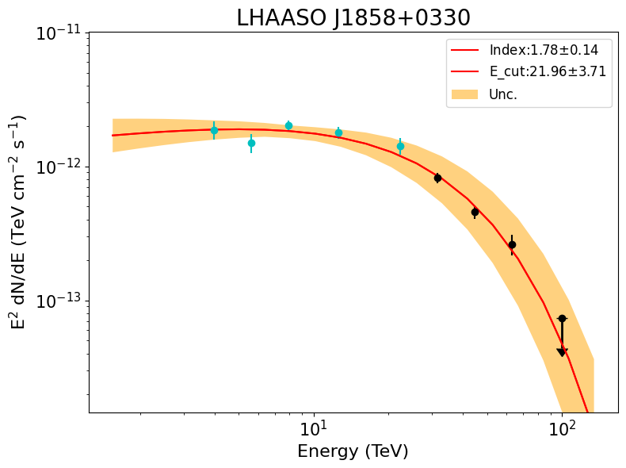
LHAASO Data Analysis
Figure 3: Energy spectrum of J1858+0330 observed by LHAASO.
Notes:
Finally, the energy spectrum of LHAASO J1858+0330 is obtained and shown in Figure 3.The red line and the orange butterfly represent the best-fit PLC model and its uncertainties,respectively.

Slide 6
Thank You！

