Slide 1


Gamma-ray Emission from the M17 Region with LHAASO
Huan Yang, Bing Liu, Xiaoyuan Huang
Purple Mountain Observatory, CAS
Apr. 27th 2026
The First LHAASO Collaboration Conference in 2026

Slide 2
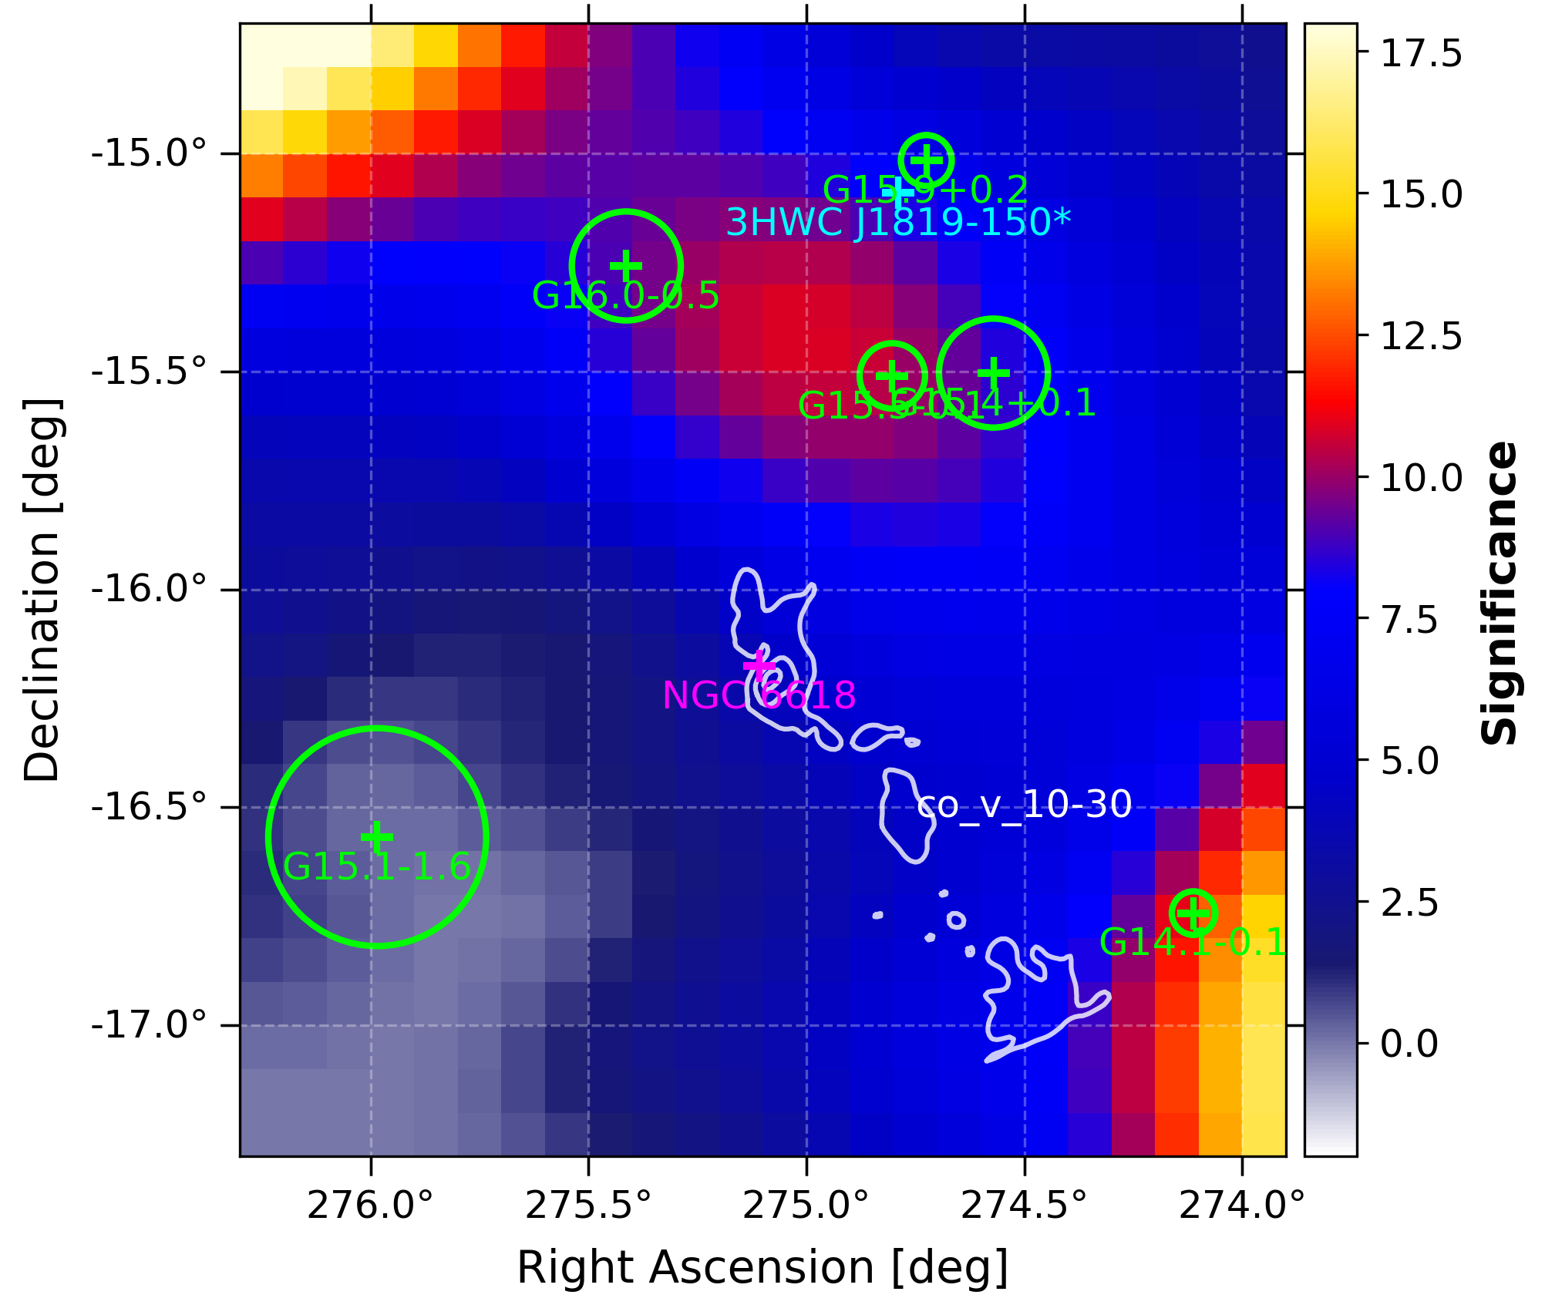
Introduction
M17 (Omega Nebula): massive star-formin region ~2 kpc
Powered by young star cluster NGC 6618, with massive OB stars and an HII region
Hosts a giant molecular cloud (~10⁵ M⊙) with dense molecular gas
Contains numerous SNR(eg.G015.4+00.1), and HAWC detected a source，3HWC J1819‑150.
Significance Map of LHAASO

Slide 3
Data Selection
ROI
KM2A
WCDA
R.A. = [271.2°, 279.2°]
Dec. = [-20.0°, -11.8°]
1943 days, including ½ and ¾ arrays and full arrays
Energy> 25TeV
1484 days
Nhit >100

Slide 4
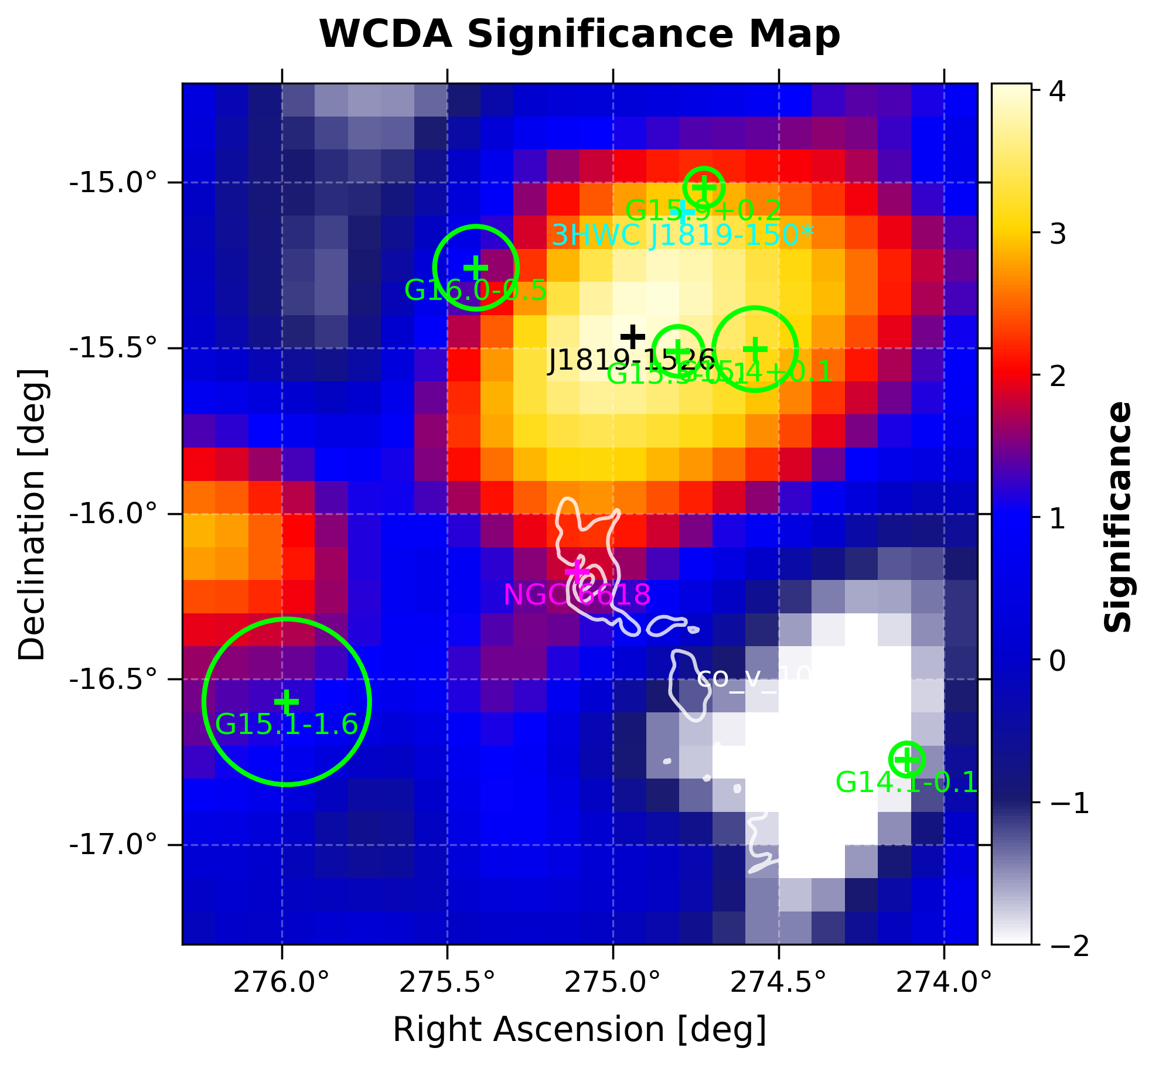
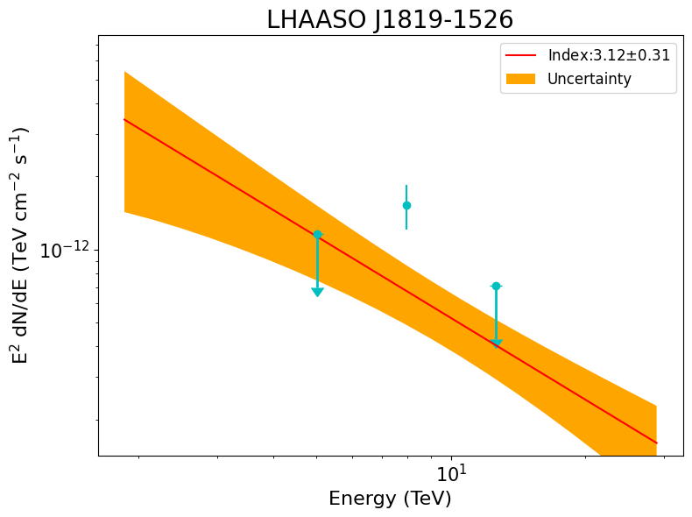
WCDA
Position : R.A. 274.94±0.15° DEC.-15.47±0.11° Ts_{ext} : 7
Index : 3.12±0.31 TS : 19

Slide 5
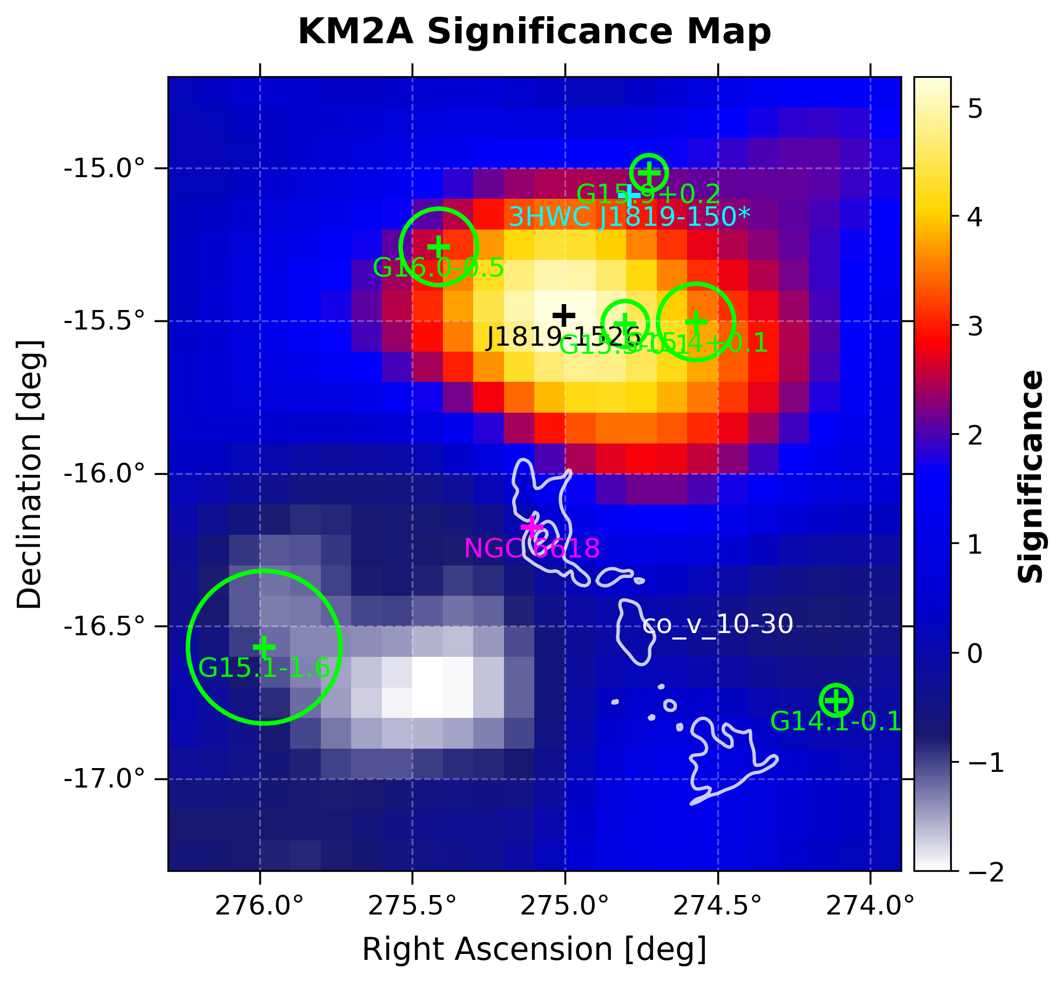
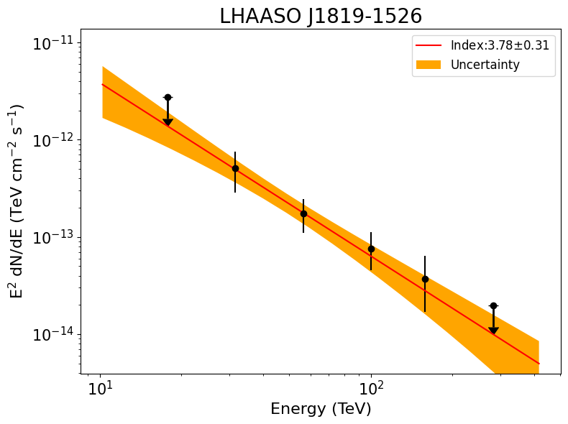
KM2A
Position : R.A. 275.00±0.07° DEC.-15.48±0.7° Ts_{ext} : 0
Index : 3.78±0.31 TS : 30

Slide 6
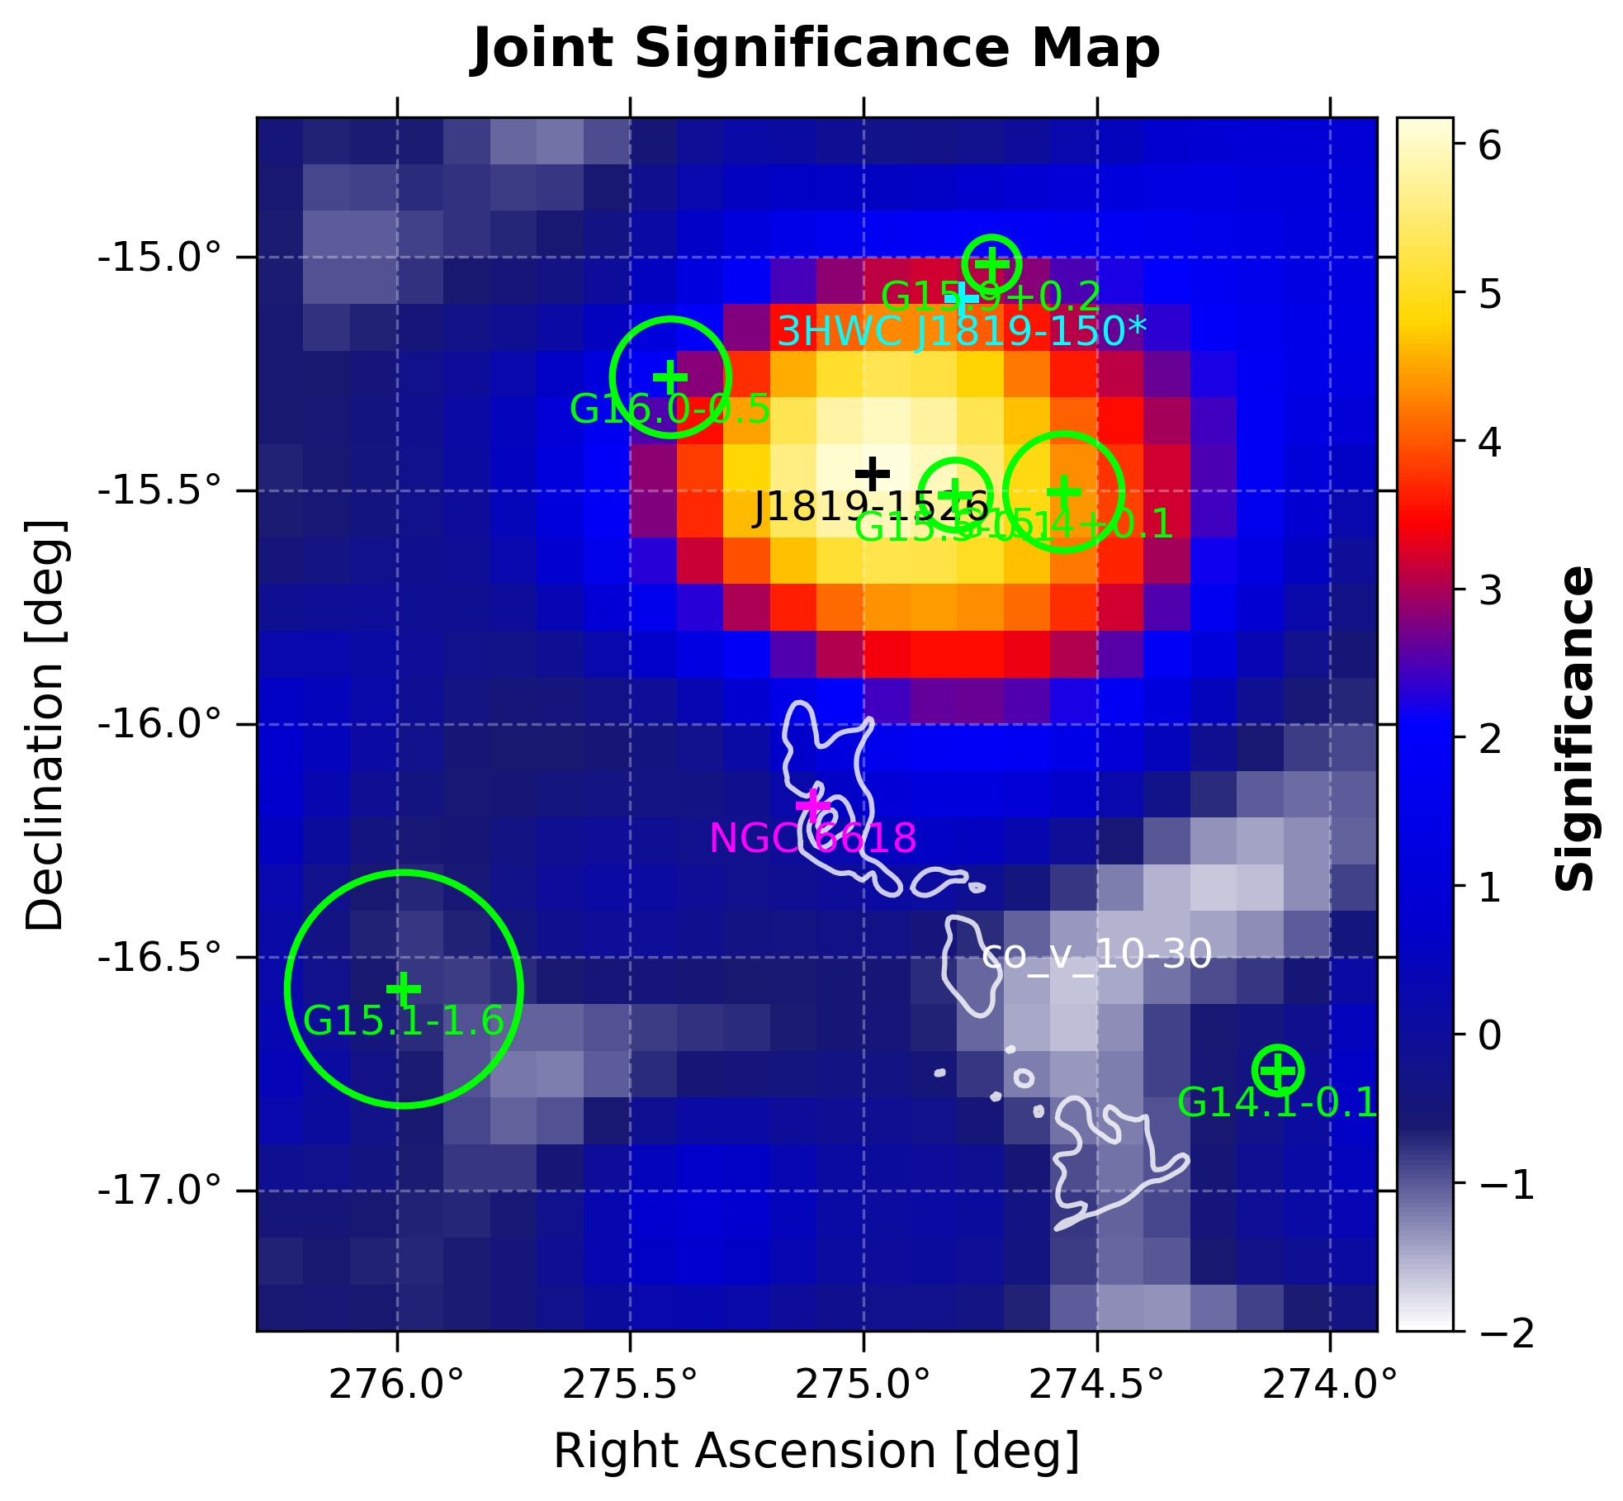
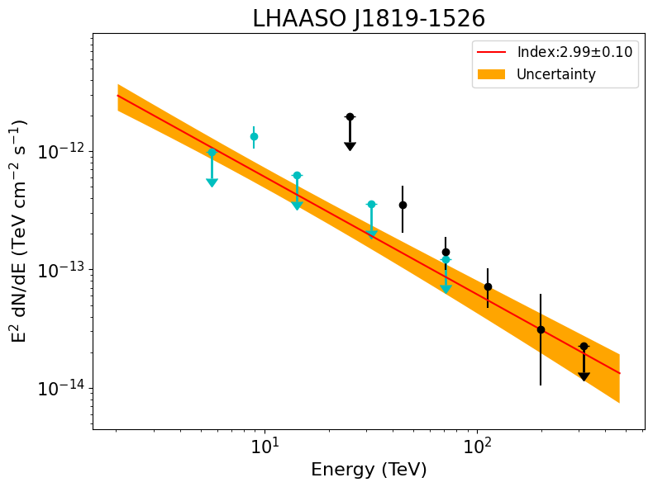
Joint
Position : R.A. 274.98±0.06° DEC.-15.46±0.6° Ts_{ext} : 6
Index : 2.99±0.10 TS : 48

Slide 7
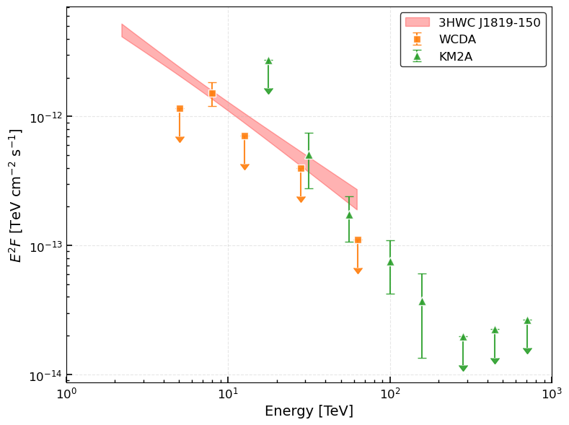
Outlook
Explore the association of J1819 with M17 or other candidate counterparts (e.g., SNR)
Identify the high-energy emission origin: leptonic
vs. hadronic
Constrain the total CR energy content and
acceleration efficiency under different physical assumptions

Slide 8
Thank You

