Slide 1
Gamma-ray constraints on heavy dark matter from the full LHAASO field of view
Speaker: Weizhen Zhang
Cooperators: Wenyu Cao, Kenny Ng, Zhe Li, Xiaohao You
CUHK and IHEP

Slide 2
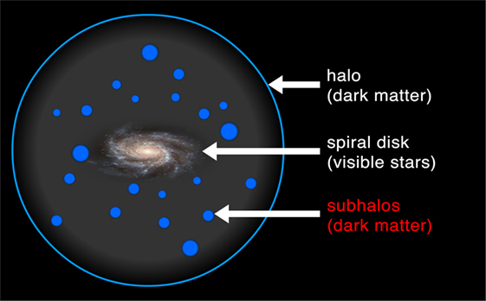
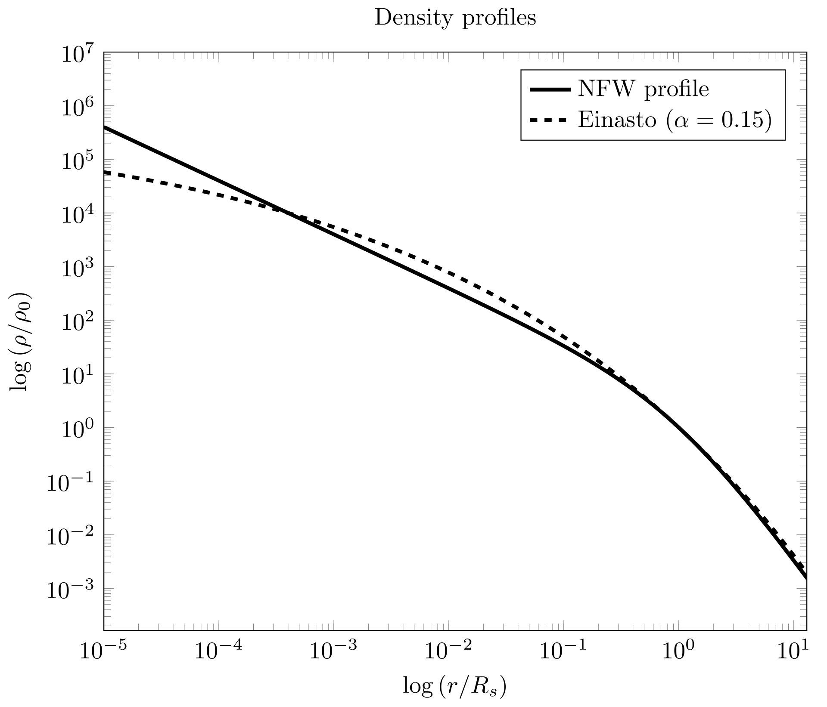
DM detection
Dark matter is everywhere in the universe. Our galaxy is inside a DM halo.
Indirect detection:
Dark matter decay or annihilation
-> product -> possible signal
NFW profile
Image source: https://kids.frontiersin.org/
https://es.wikipedia.org/wiki/Perfil_de_Navarro–Frenk–White

Slide 3
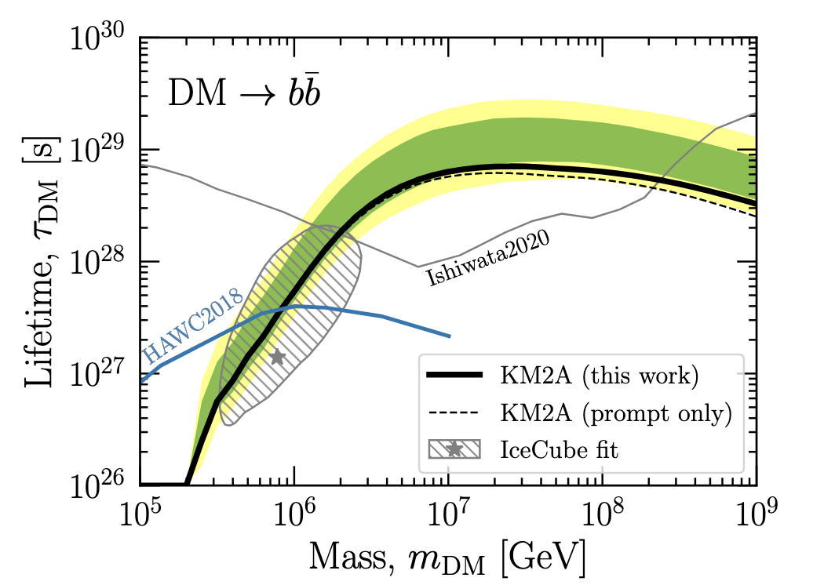
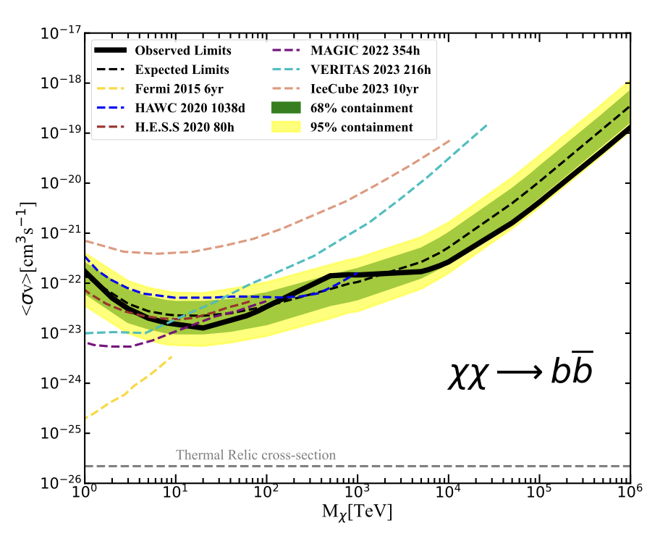
Previous work
LHAASO, PRL,2024
LHAASO, PRL,2022

Slide 4
Motivation
This work used 1/2 and 3/4 KM2A data, with energy > 100 TeV.
No KM2A lower energy range because of background model limit
No DM annihilation case
Now we have full-array KM2A data, and WCDA data
Other targets to search for dark matter

Slide 5
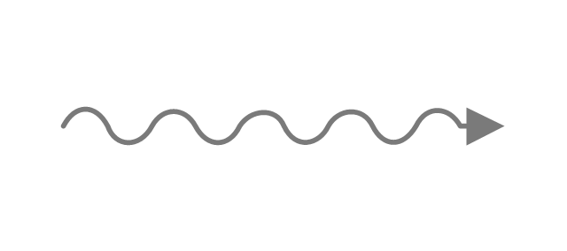
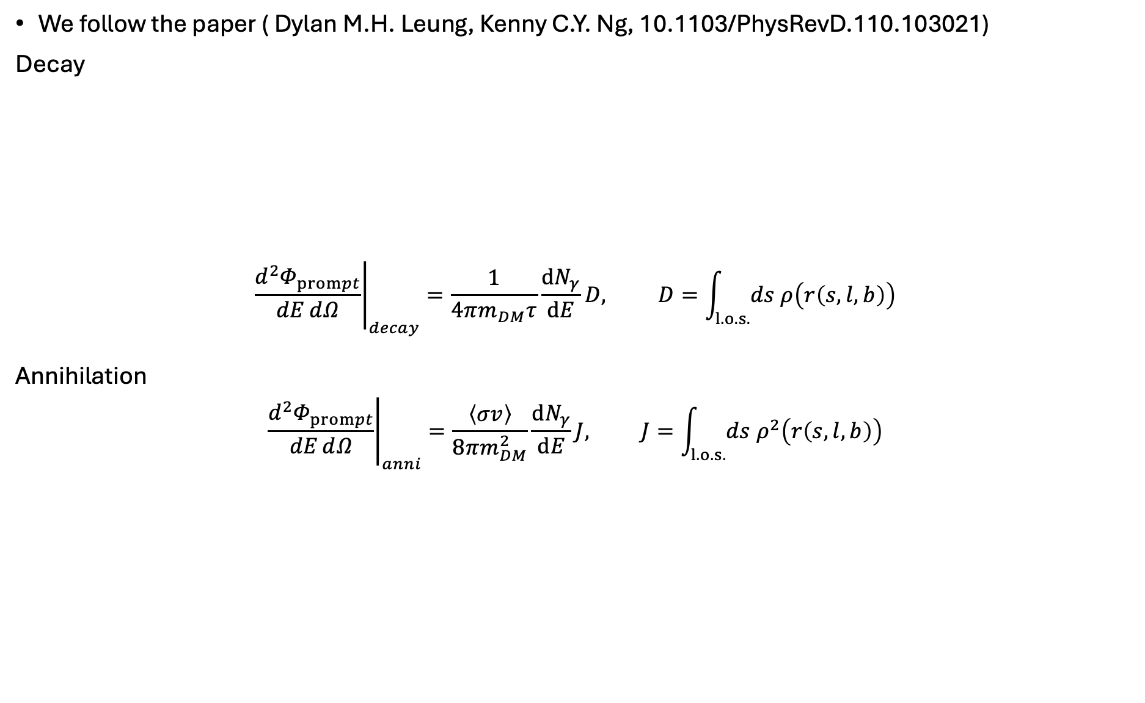


DM Flux Theory
We follow the paper ( Dylan M.H. Leung, Kenny C.Y. Ng, 10.1103/PhysRevD.110.103021)
Decay
$${\left.\frac{ⅆ^{2}Φ_{prompt}}{dEⅆΩ}\right|}_{decay}=\frac{1}{4πm_{DM}τ}\frac{ⅆN_{γ}}{ⅆE}D, D=\int_{l.o.s.}{ds ρ\left(r\left(s,l,b\right)\right)}$$
Annihilation
$${\left.\frac{ⅆ^{2}Φ_{prompt}}{dEⅆΩ}\right|}_{anni}=\frac{\left\langle σv\right\rangle }{8πm_{DM}^{2}}\frac{ⅆN_{γ}}{ⅆE}J, J=\int_{l.o.s.}{ds ρ^{2}\left(r\left(s,l,b\right)\right)}$$
Series of reaction
Inverse Compton Scattering
Gamma-ray (secondary)
Decay
$$e^{\text{±}}$$
Dylan’s paper follow
Channel particle
with background
photon
DM
Gamma-ray(prompt)
$$e^{\text{±}}$$
Gamma-ray (secondary)
Channel particle

Slide 6
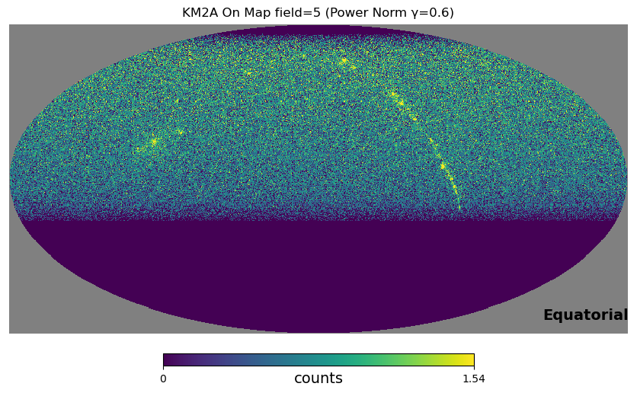
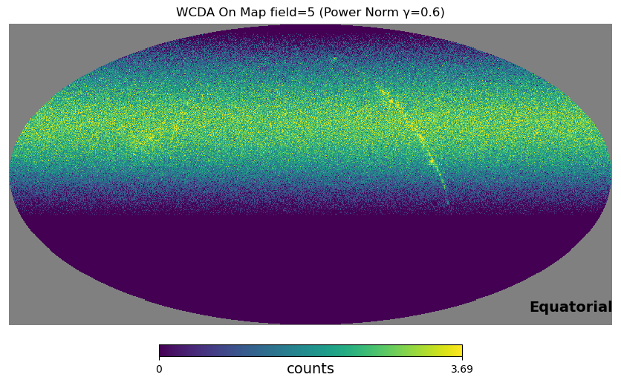
Full sky gamma ray Data
WCDA :
20210331-20250731
1484.363 Effective days
7 Nhit bins
KM2A full array:
20210720-20250731
1438.810 Effective days
> 10TeV , 11 Energy bins
Official released sky map data with standard gamma/hadron cut
KM2A
WCDA
Log scale
Wcda

Slide 7
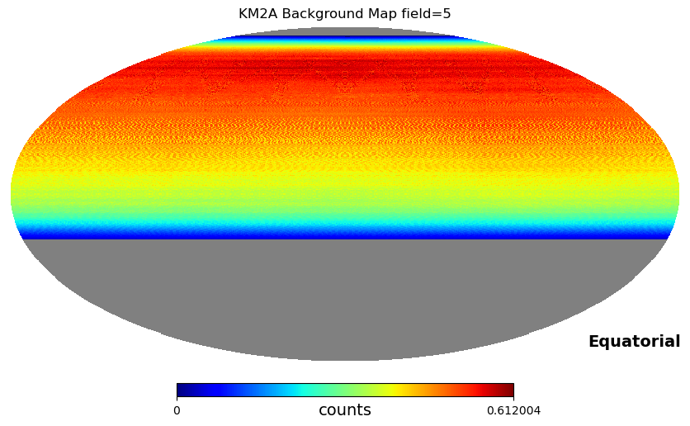
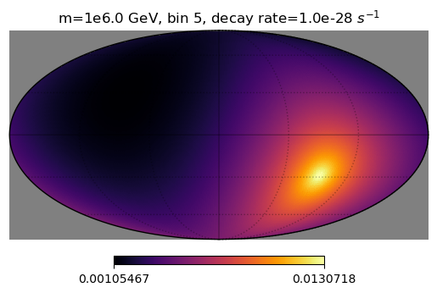
Background / DM counts
Official background map:
  direct integration method
Theoretical DM counts per energy bin per pixel per effective day:
  the dark matter energy spectrum for each pixel is convolved with the detector response of the DEC to yield the expected counts.

Slide 8
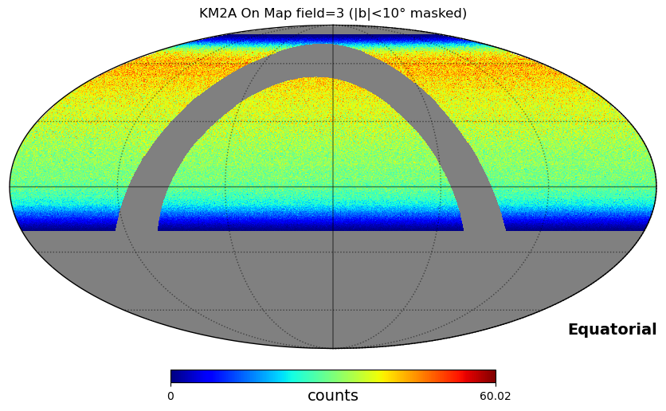
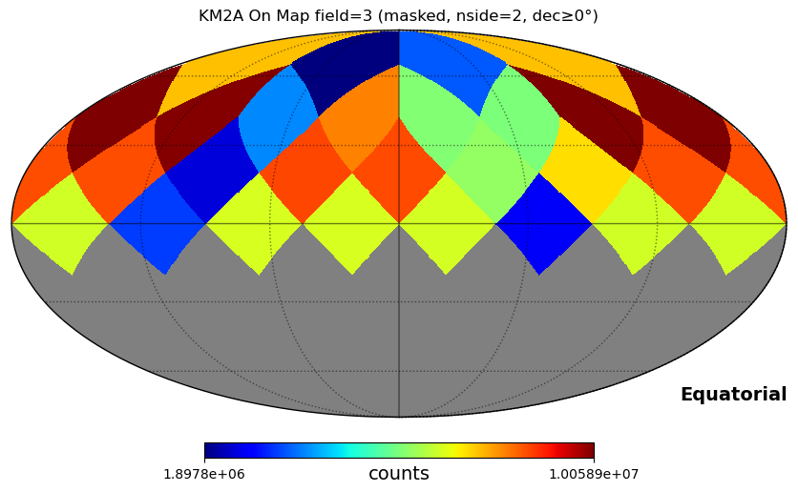
Mask
We mask galactic plane, |b|<10 degree
Then from 30000 pixels down to 28 ROIs
Skip one ROI, because of large extended sources Geminga, Monogem.

Slide 9
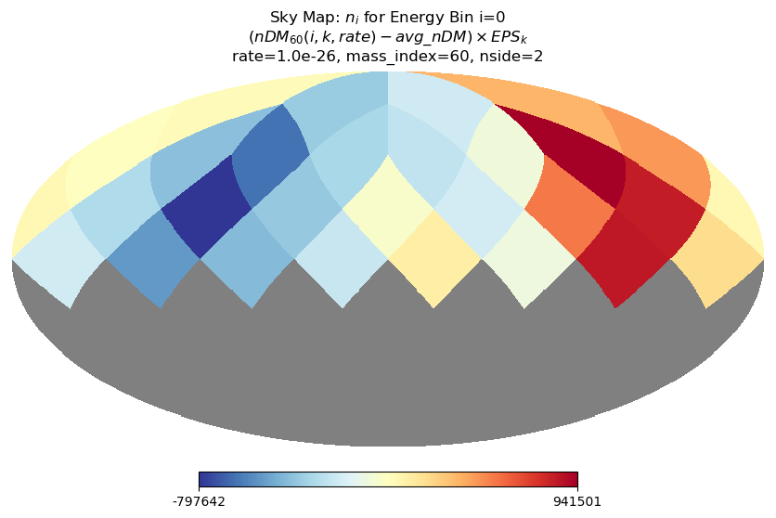
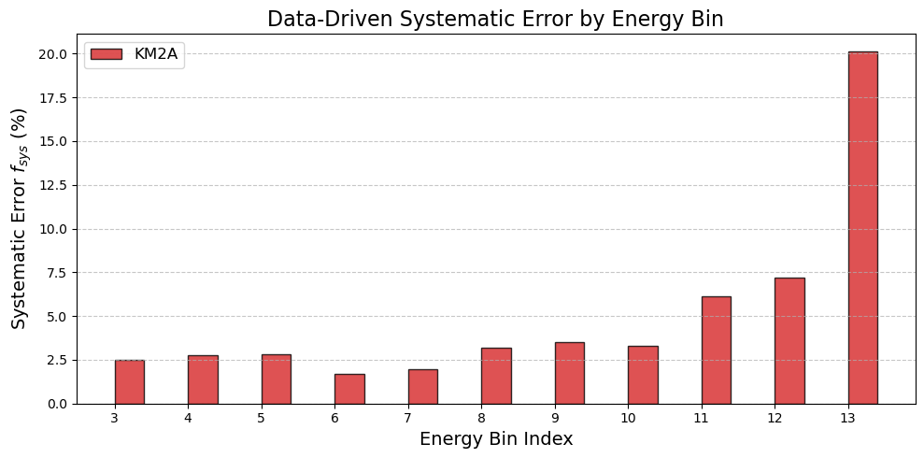
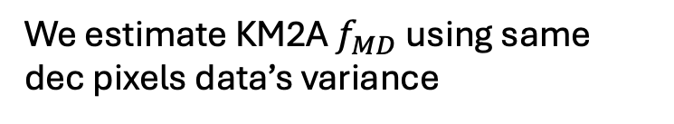
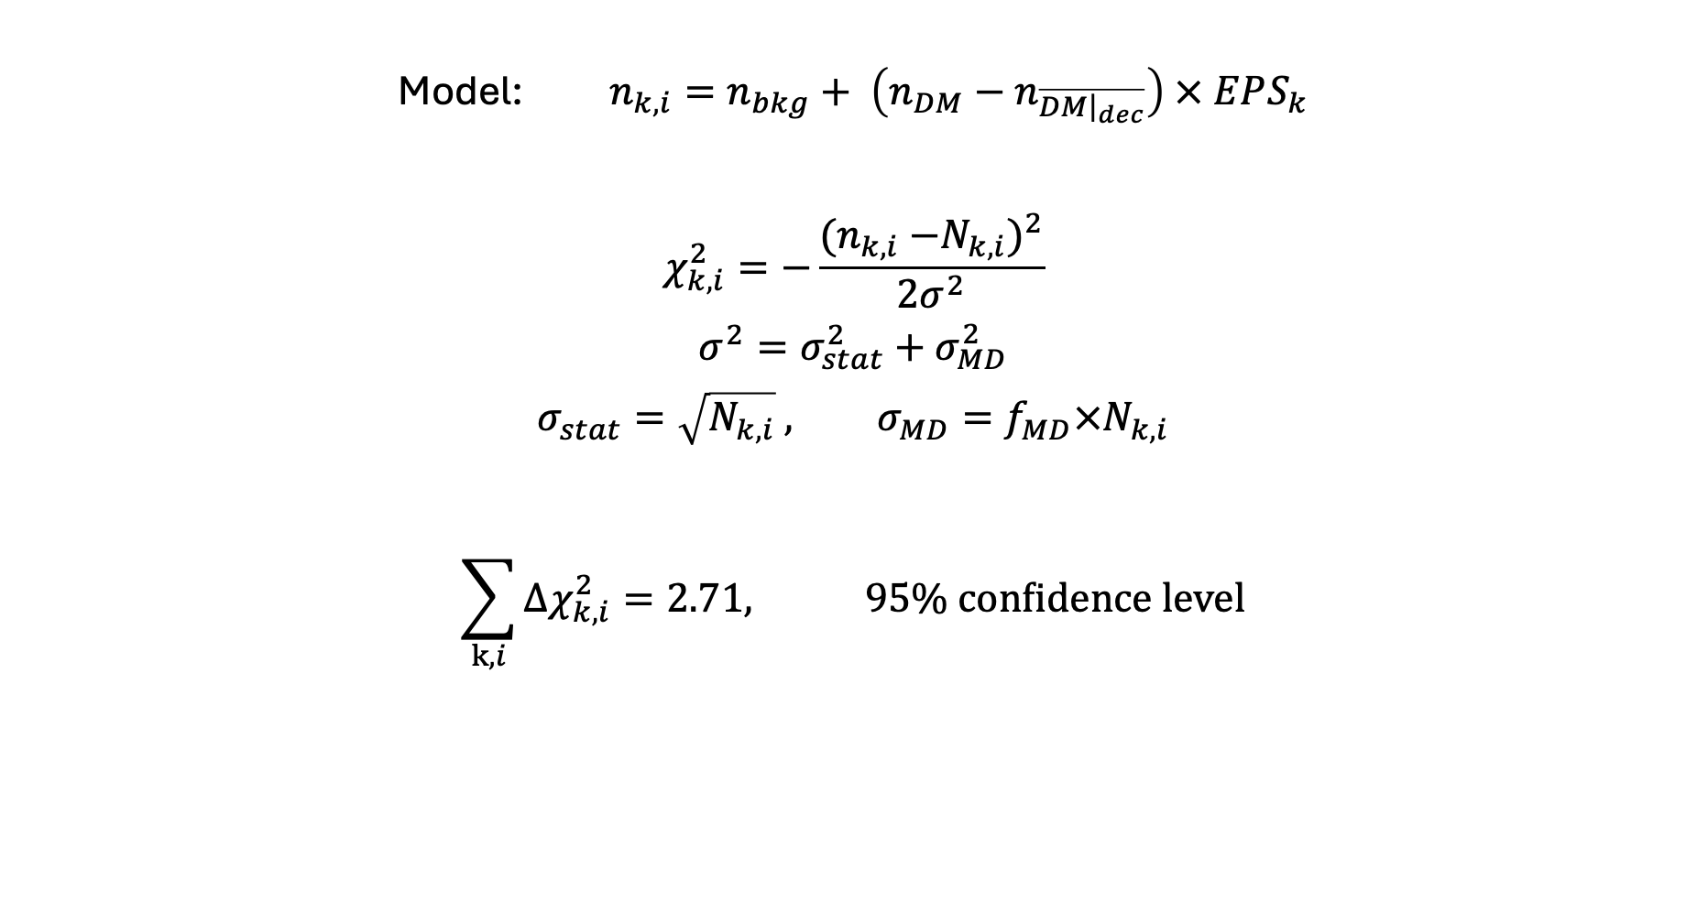

Chi square analysis
Direct integrated background contains a part of DM
Model: $n_{k,i}=n_{bkg}+ \left(n_{DM}−n_{\overline{DM{\left.​\right|}_{dec}}}\right) × EPS_{k}$
$$χ_{k,i}^{2}=−\frac{{{(n}_{k,i} −N_{k,i})}^{2}}{2σ^{2}}$$
$$σ^{2}=σ_{stat}^{2}+σ_{MD}^{2}$$
$$σ_{stat}=\sqrt{N_{k,i}} , σ_{MD}=f_{MD}×N_{k,i}$$
$$\sum_{k,i}{Δχ_{k,i}^{2}}=2.71, 95\% confidence level$$
i - energy bin
k - ROI
We estimate KM2A $f_{MD}$using same dec pixels data’s variance
Model variance
WCDA: We set $f_{MD}$= 5%

Slide 10
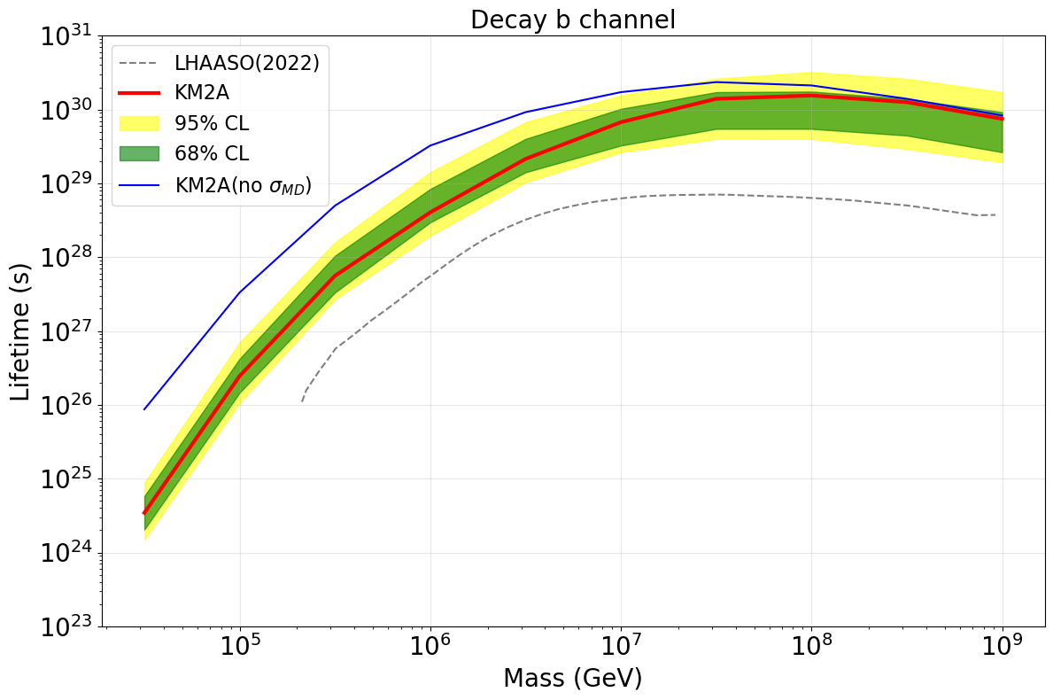
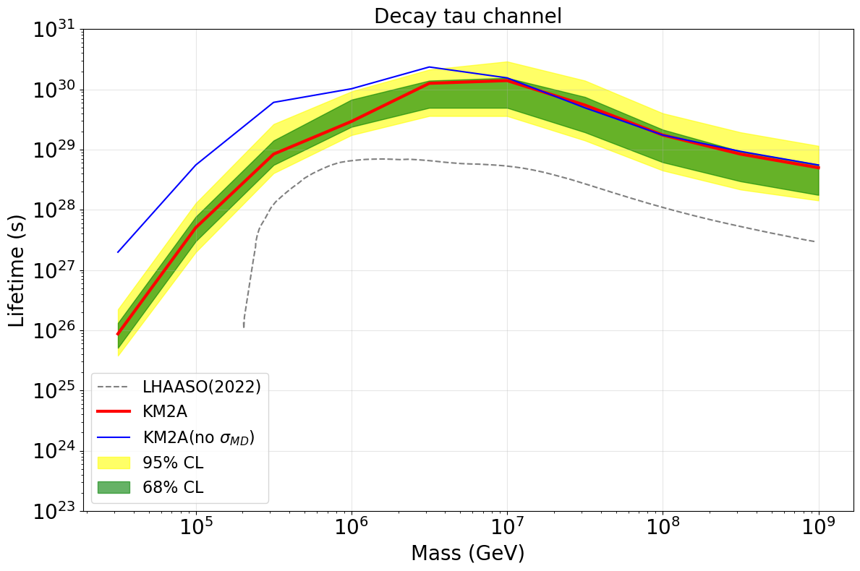
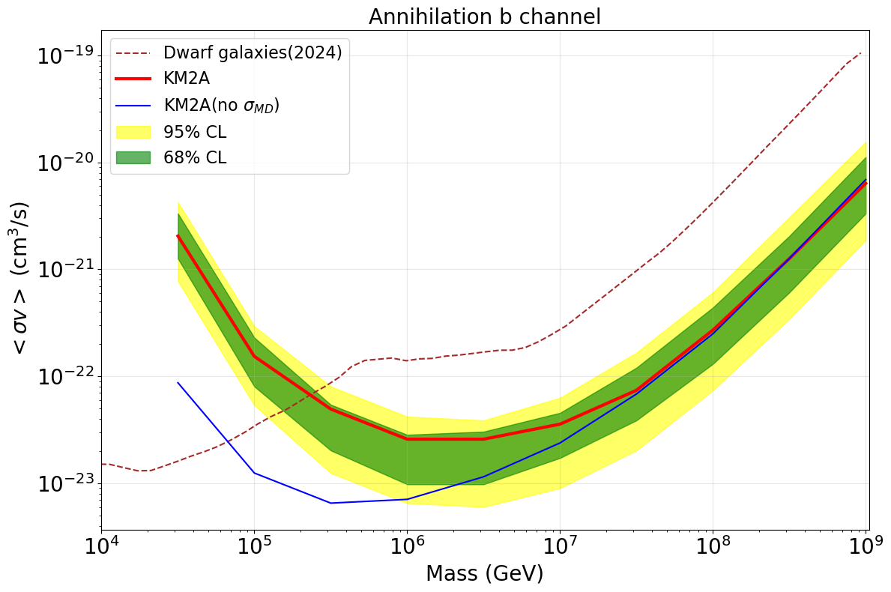
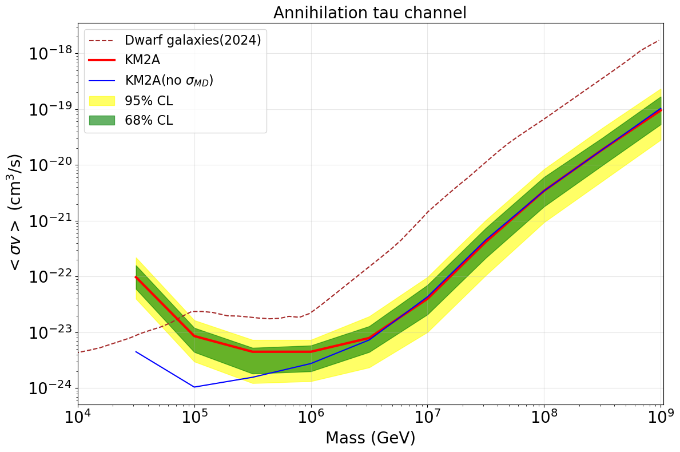
Results (KM2A)
Our results are roughly one order of magnitude better than previous results.
We have both with model variance and without model variance.

Slide 11
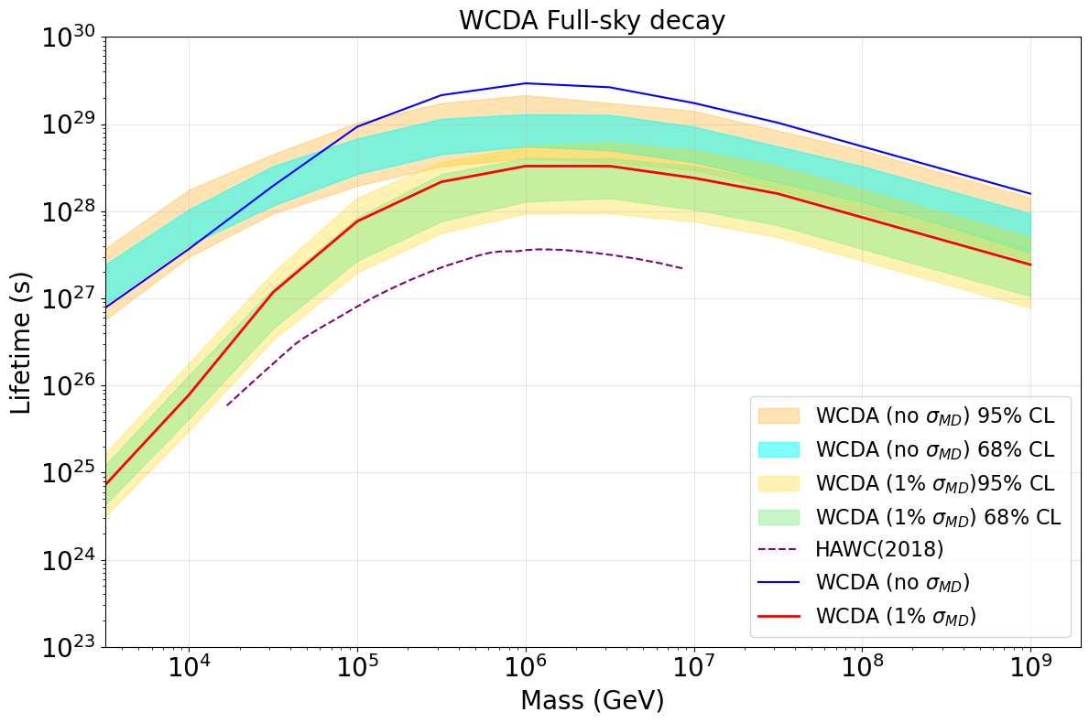
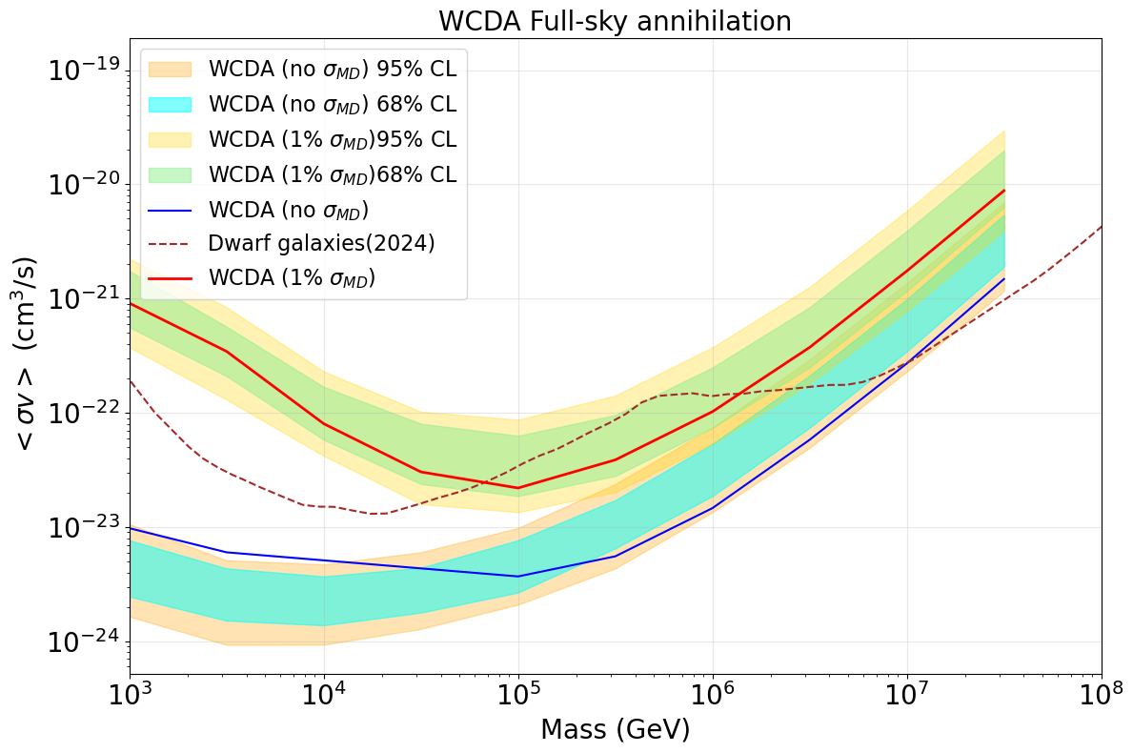
Results (WCDA)
b channel
b channel
When no model variance , the results are slightly outside Monte-carlo band.
-> Model variance are needed.
Model variance affect a lot at WCDA case.

Slide 12
Conclusion
THANK YOU!
We use a better background model than the one from 2022 to analyse low-energy KM2A data (>10 TeV).
We added model variance to the analysis to make our results more solid.
We obtained decay and annihilation constraints using KM2A and WCDA data; our KM2A results are currently the strongest by one order of magnitude.
If model variance is not included, the WCDA result is more than one order of magnitude better.
We will test our results using a signal injection test in the future.

Slide 13
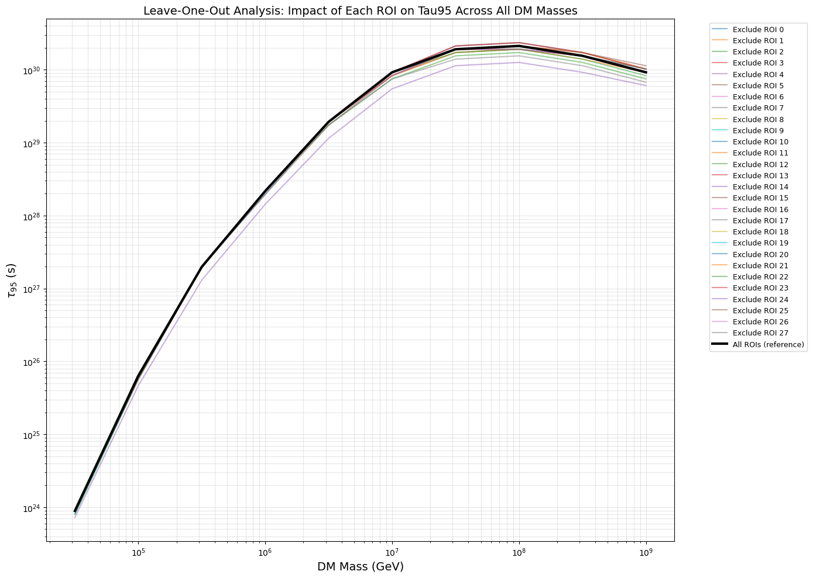
APPENDIX
Better direct integration background
Chi-square -> likelihood analysis

