Slide 1
Searching for TeV Quasi-Periodic Oscillations in
Markarian 421 and Markarian 501 with
LHAASO-WCDA
G.M.Xiang, J.N.Zhou, M.Zha, L.Chen, D.X.Xiao
The First LHAASO Collaboration Conference in 2026
2026.04.27@suzhou

Slide 2
Introduction
AGN variability & QPOs
AGN emission: white + red noise dominated
QPO detection → non-stochastic probe of central engine
Possible physical origins:
SMBH binaries → orbital modulation / jet precession
Jet effects → precession or helical motion (Doppler boosting)
Disk instabilities → inner accretion flow variability

Slide 3
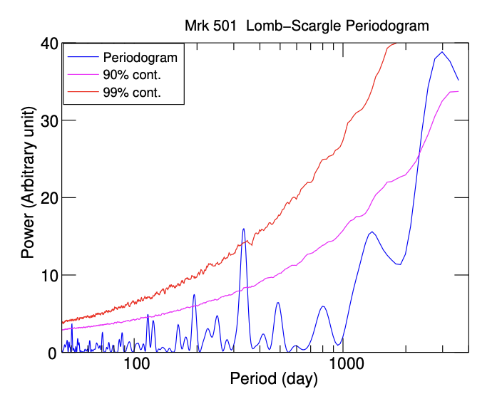
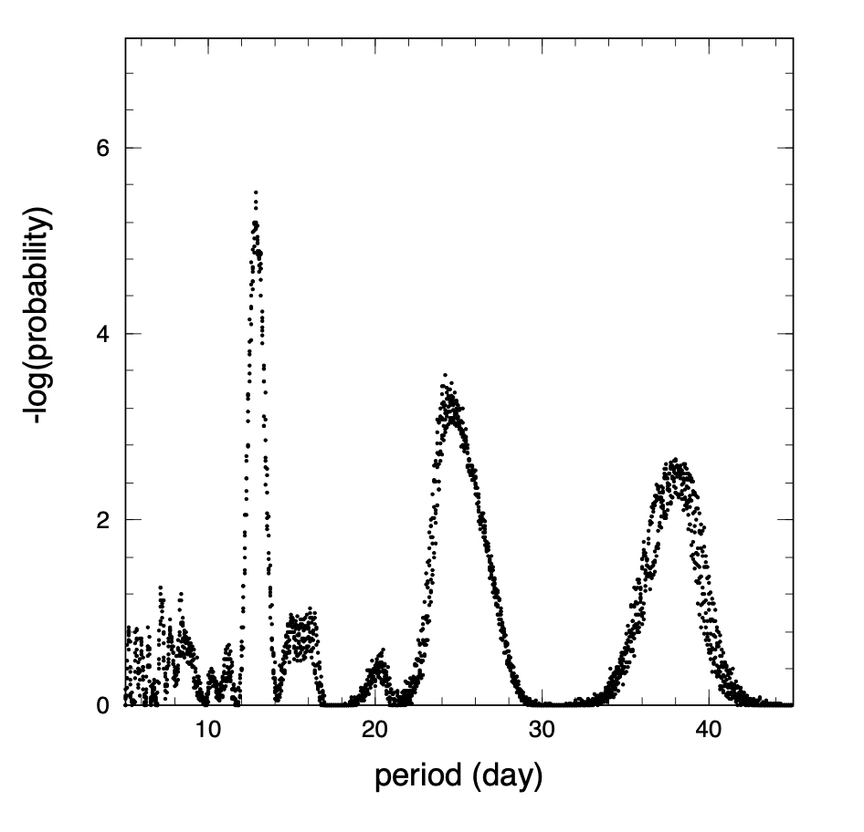
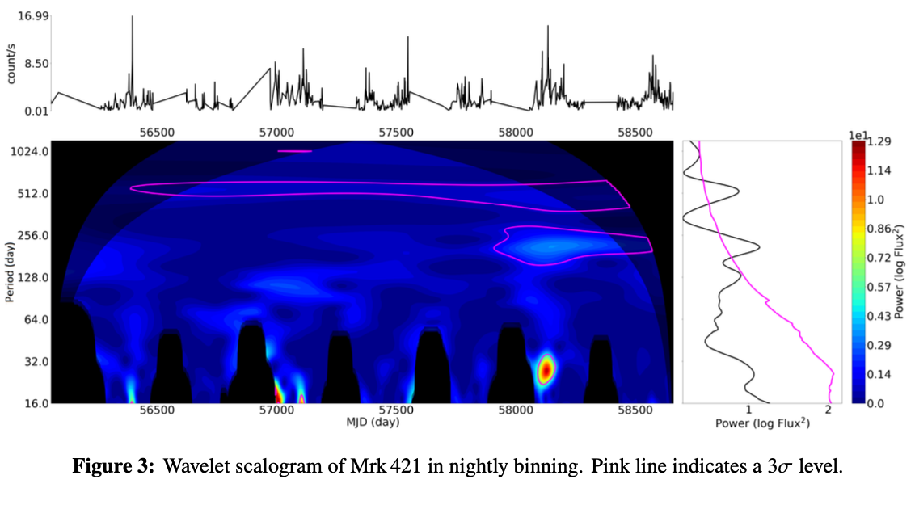
Observation
G Bhatta,2018
GeV: no significant signals
TeV: a period of ∼12.7 days from Mrk 501
FACT reported 3 sigma QPO from Mrk 421
LHAASO enables continuous monitoring, making systematic searches for TeV QPOs possible.
TA.1998
FACT.ICRC2021

Slide 4
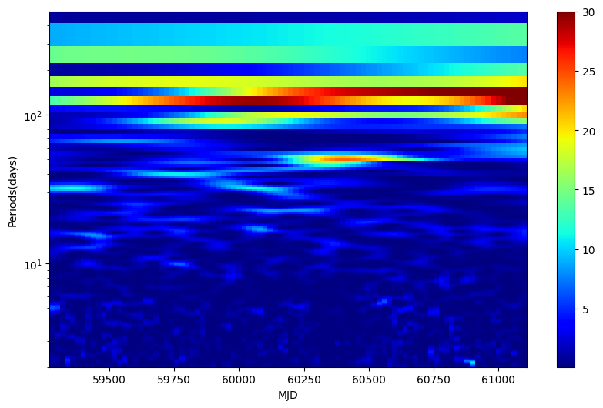
Weighted Wavelet Z-transform

Slide 5
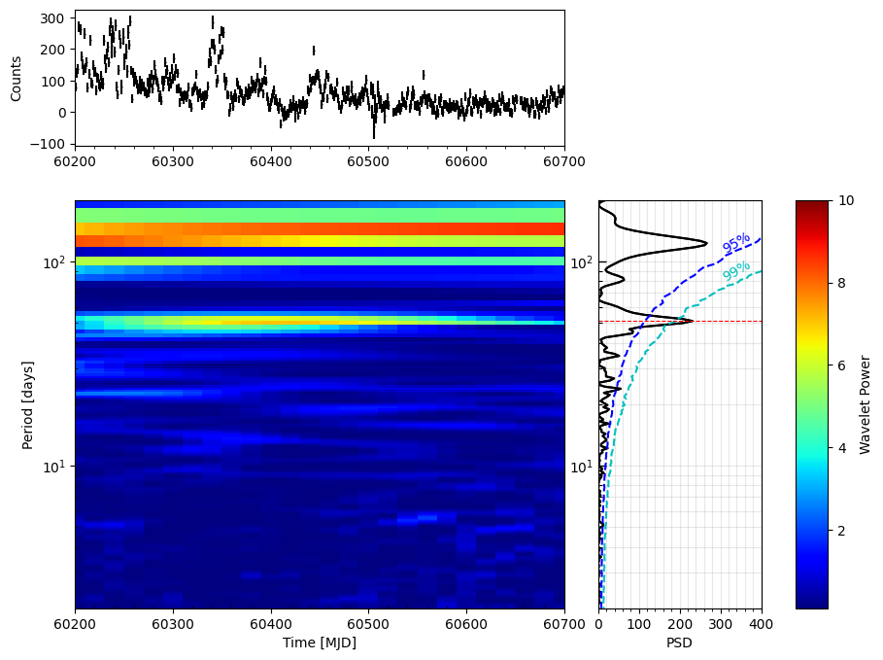
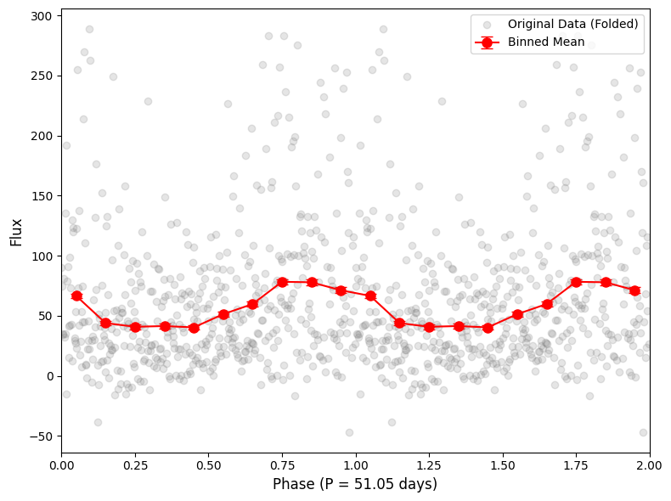
MJD 60200-60700
Period=51.05 days

Slide 6
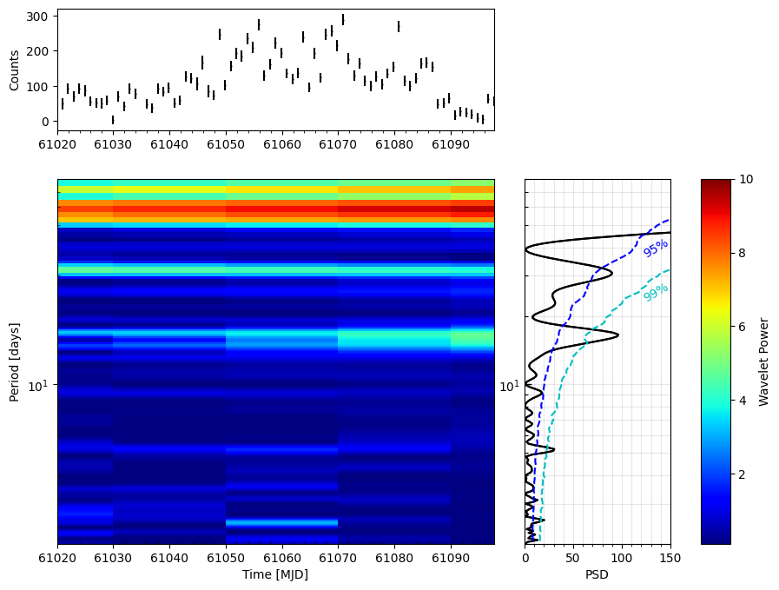
MJD 60120-61098
Period=2.54, 5.2 , 16.6 days

Slide 7
Future Plan
Preliminary analysis suggests a 51 days QPO in the light curve of Mrk 421.
Time-series analysis: Independent methods (LSP, WWZ, Gaussian Process) are employed to robustly characterize variability and account for red-noise effects.
Multi-wavelength counterparts: Contemporaneous data (Swift-BAT/MAXI, Fermi-LAT) are analyzed to search for correlated signals.
AI-driven enhancement: improve sensitivity by a factor of 2-3, enhancing detectability of faint QPO signals in Mrk 421 and Mrk 501.

