Slide 1
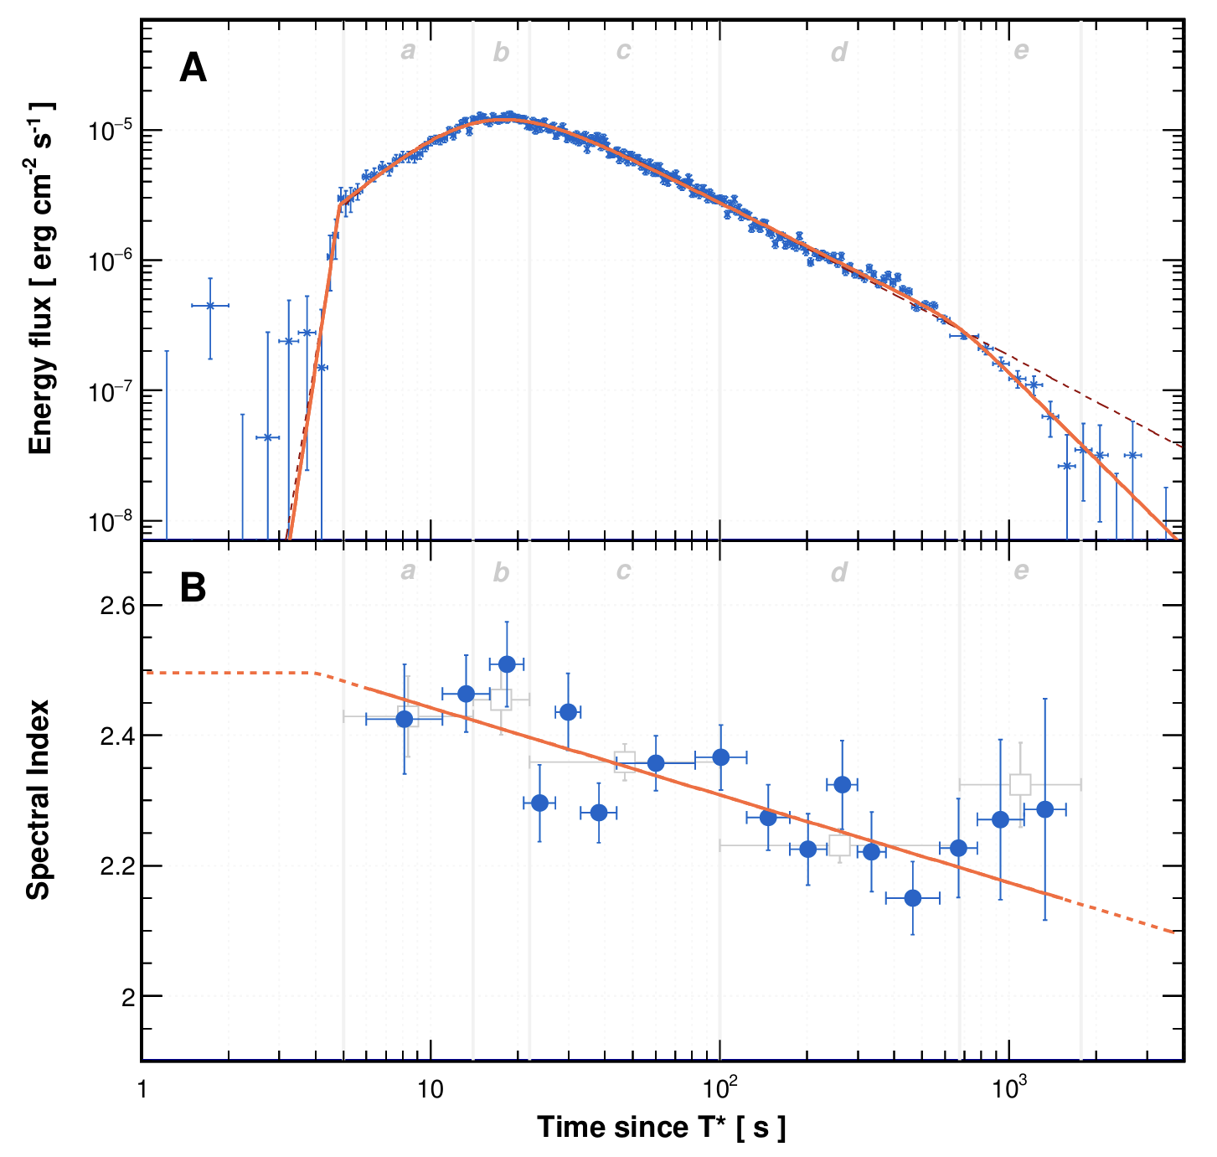

LHAASO-detected GRB 221009a (I)
LHAASO-detected
very early time GRB >10 TeV
Very narrow jet (jet break)
Half opening angle < 1 degree

Slide 2
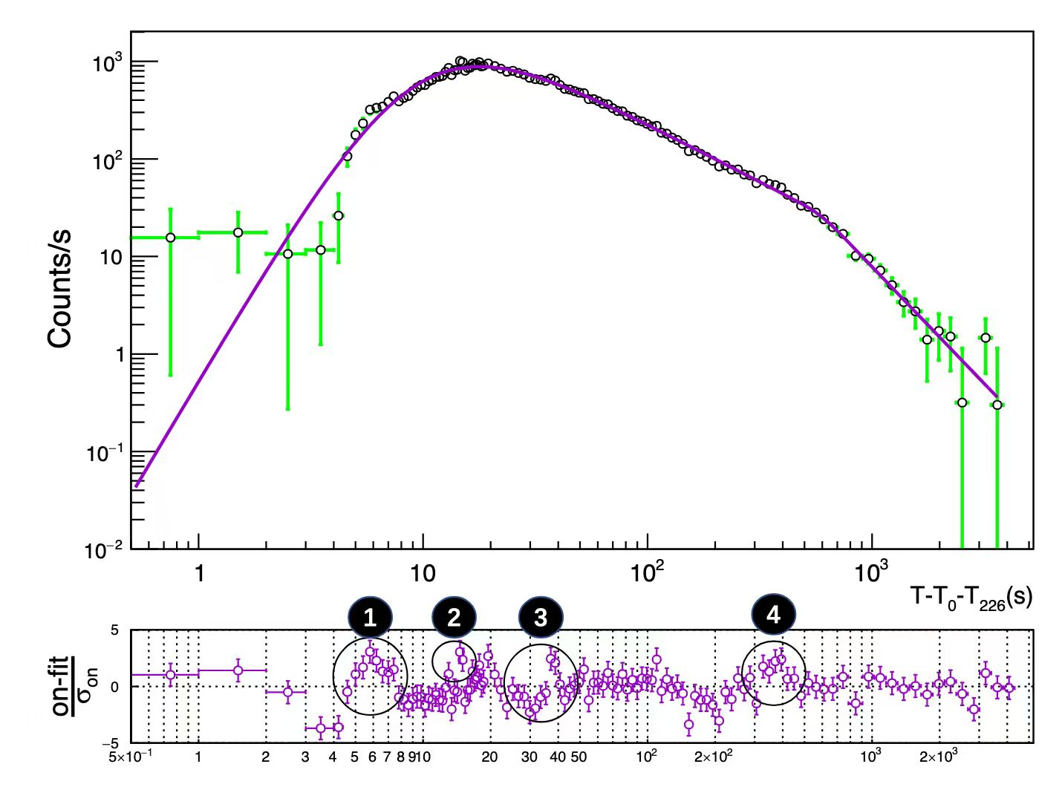
LHAASO-detected GRB 221009a (II)
Other components for the excess?
Hao Zhou & Jieshuang Wang is still working

Slide 3
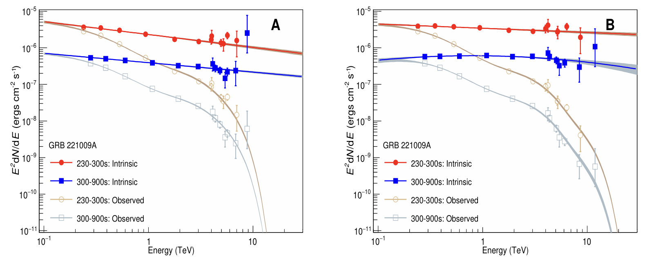
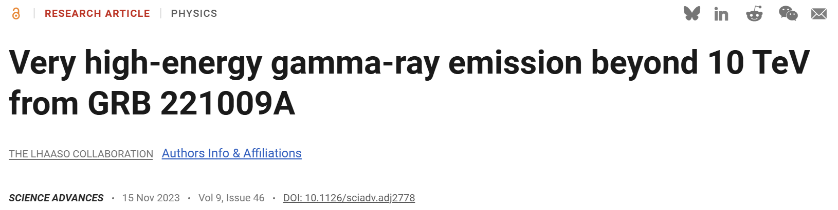
LHAASO-detected GRB 221009a (III)
LHAASO-constrained EBL model

Slide 4
LHAASO-detected GRBs: More?
GRB 220226A follow-up?
Shicong Hu, Yong Huang, Min Zha et al.
Stacked data for searching: Yuanchuan Zou
AI-helped to search?

Slide 5
Understanding GRB physics by LHAASO: multiwavelength
Multi-wavelength:
prompt emission: short/long, hard/soft GRB(XRF)
Afterglow: GeV detection by Fermi-LAT linked to LHAASO
early X-ray emission linked to prompt emission?
X-ray & optical detection for GRB environment
optical spectrum: redshift (GRB 221009A @z=0.151)

Slide 6

Understanding GRB physics by LHAASO: multimessanger
Neutrino: linked to IceCube (Hunt future)
High-frequency gravitational wave
New physics?

Slide 7
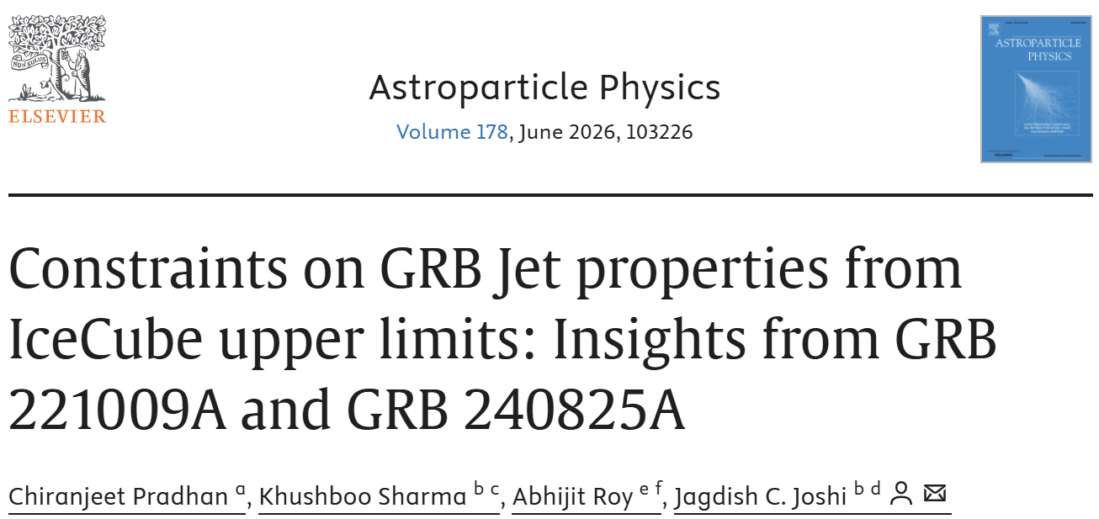
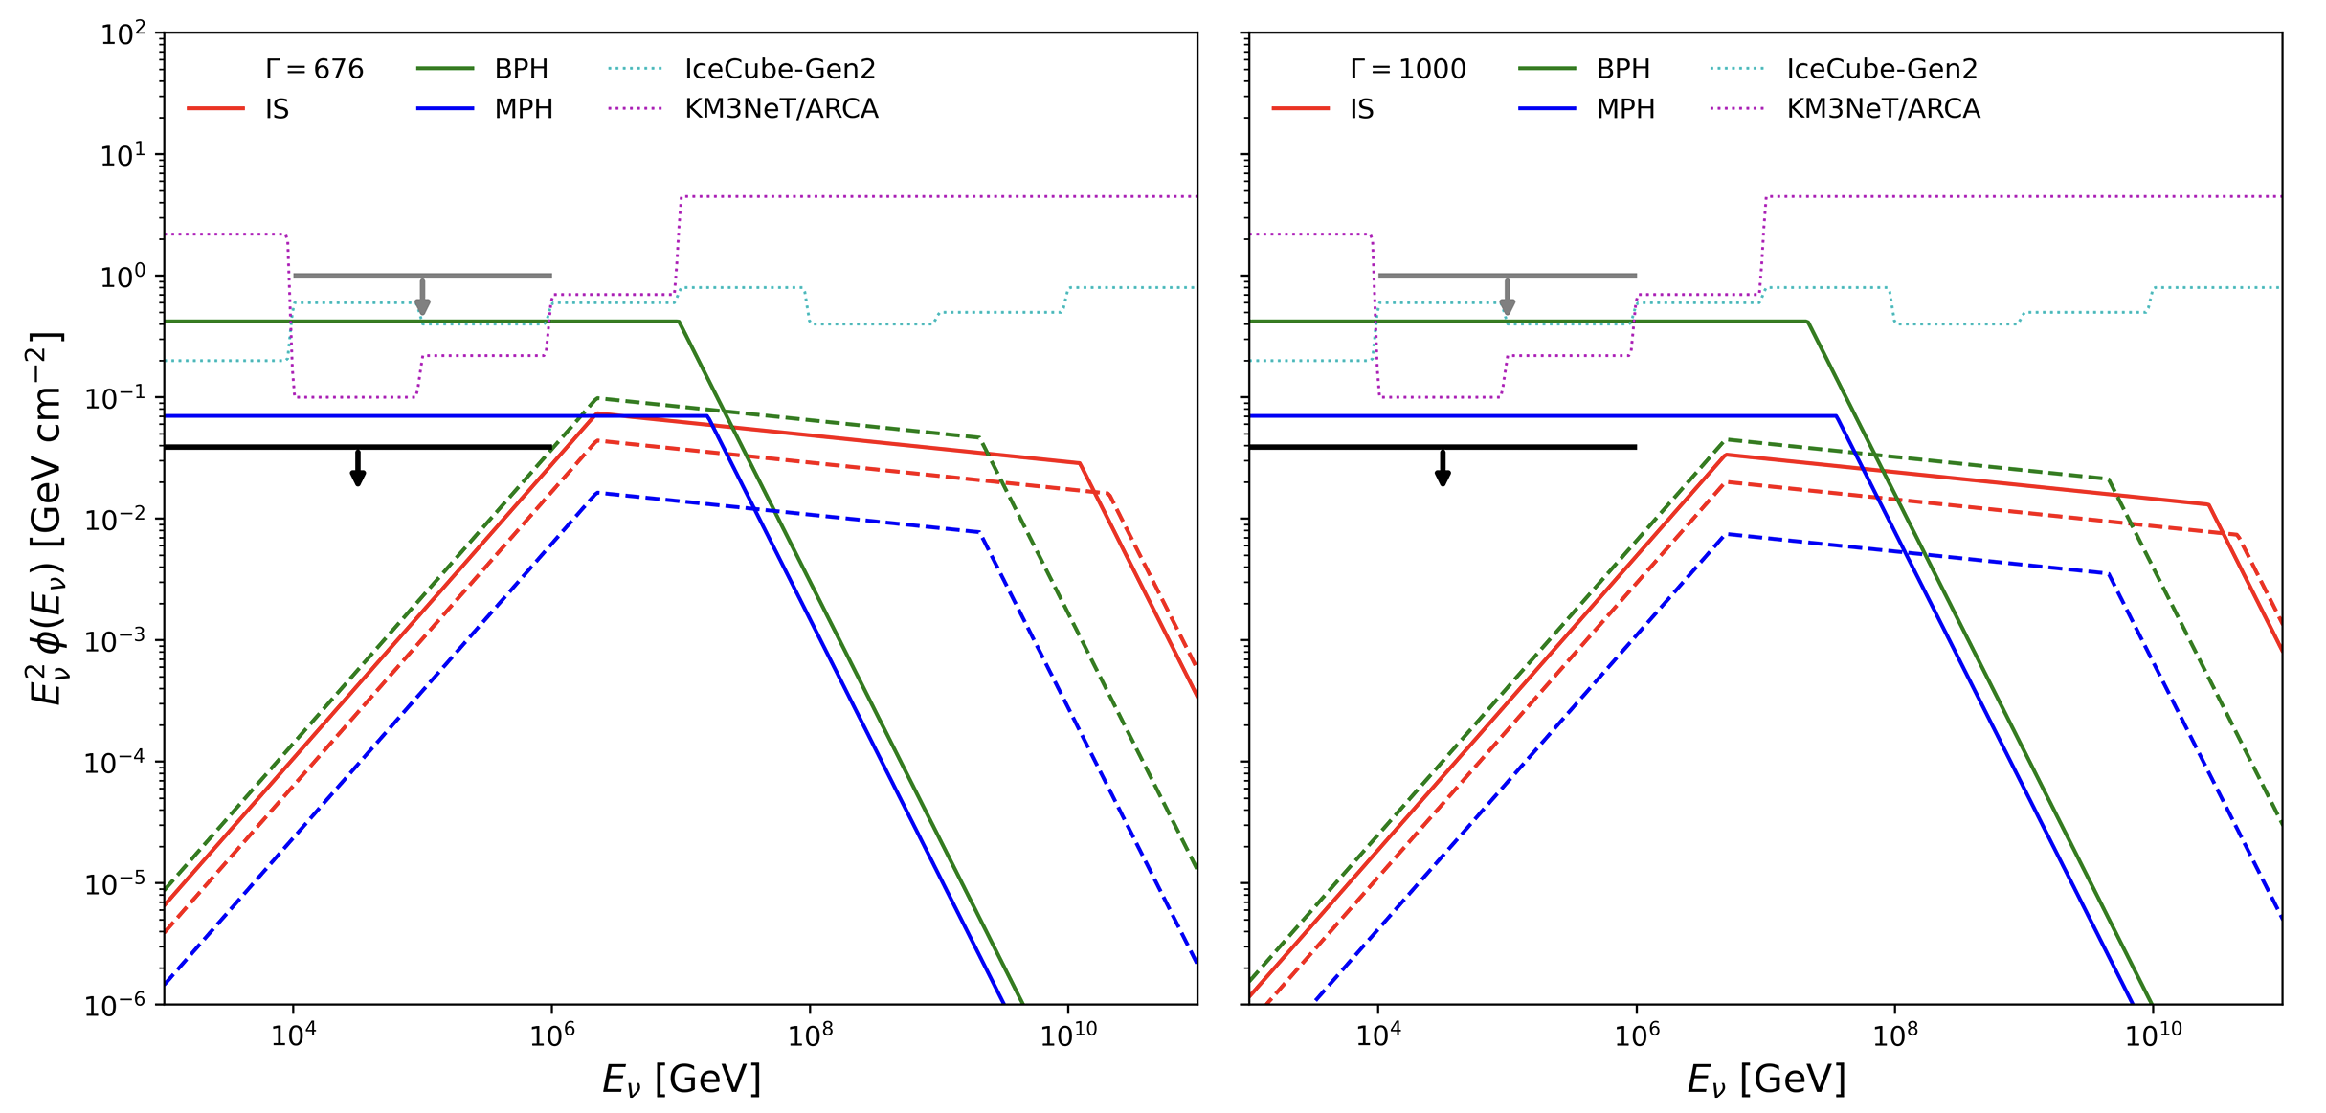
Understanding GRB physics by LHAASO: multimessanger
Neutrino: linked to IceCube (Hunt future)?

Slide 8
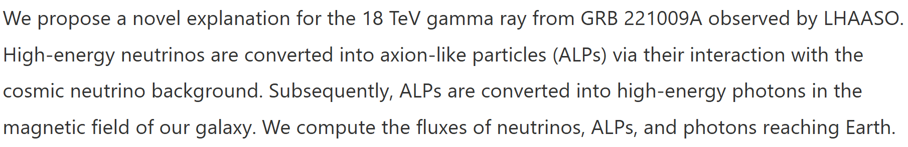
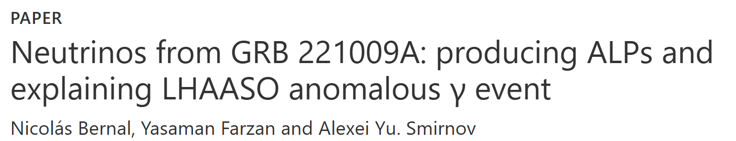
Understanding GRB physics by LHAASO: multimessanger
Neutrino: linked to IceCube (Hunt future)?

Slide 9
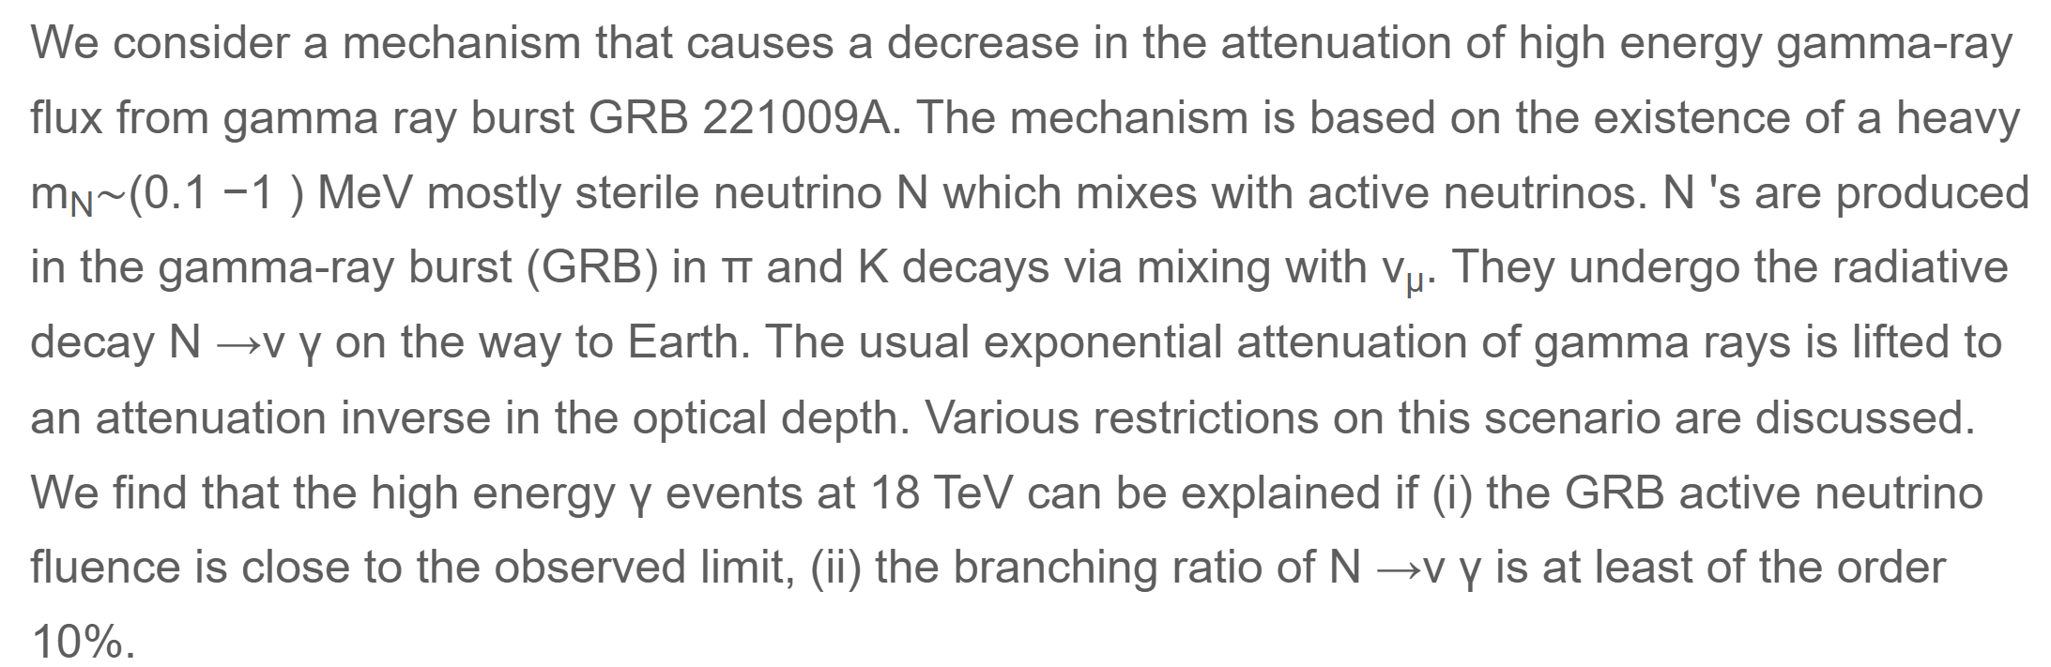

Understanding GRB physics by LHAASO: multimessanger
Neutrino: linked to IceCube (Hunt future)?

Slide 10
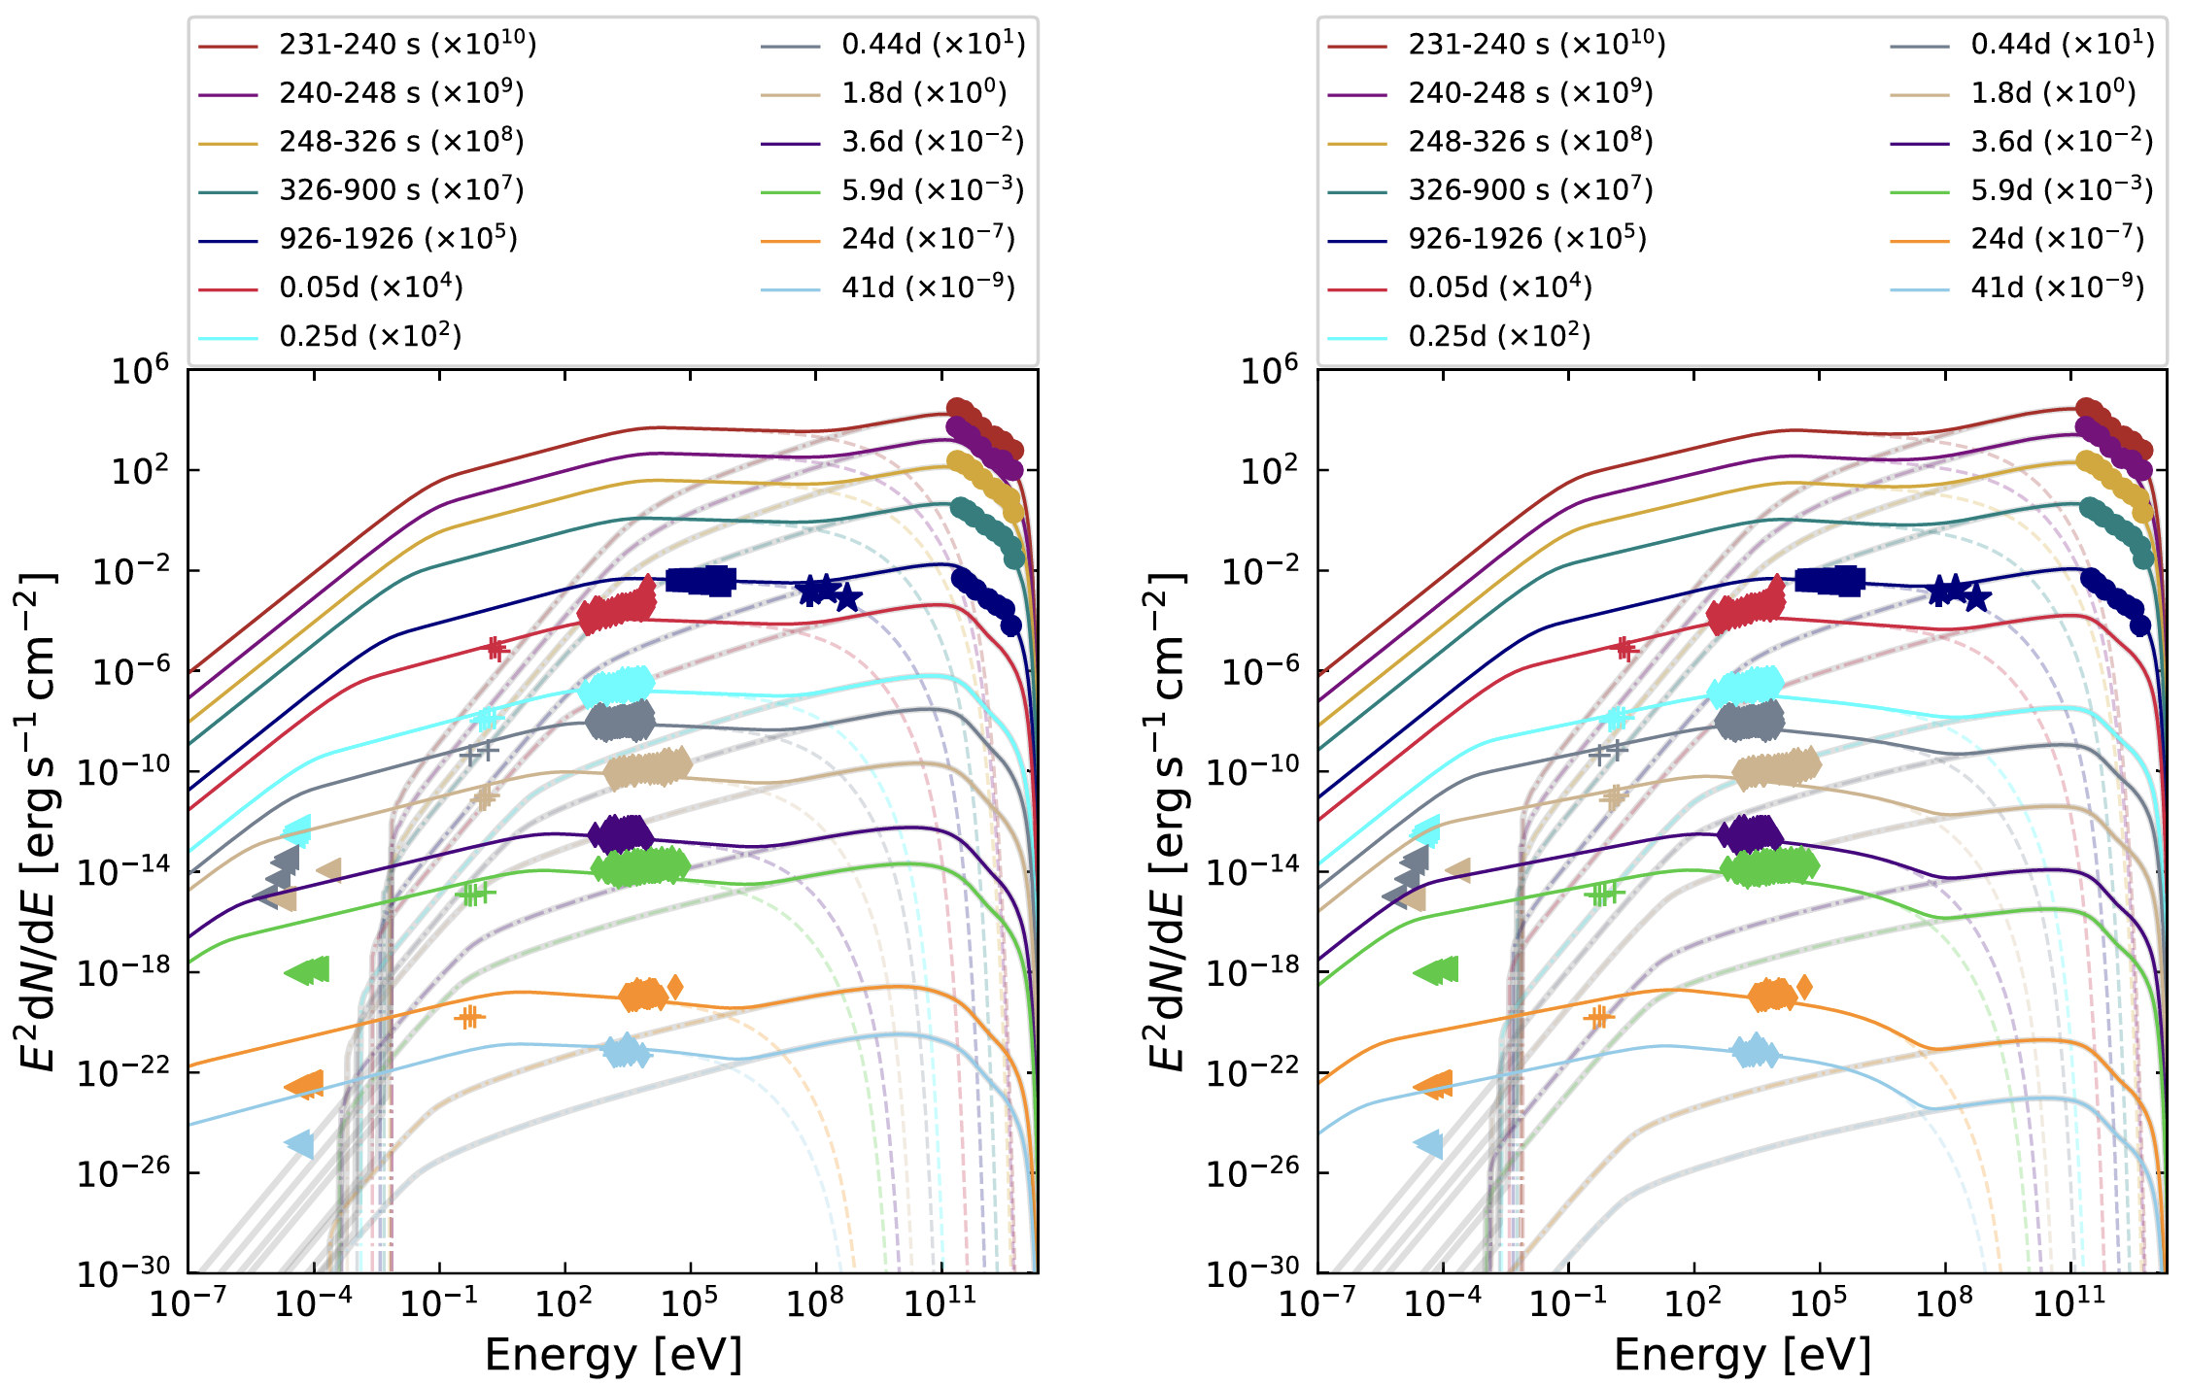
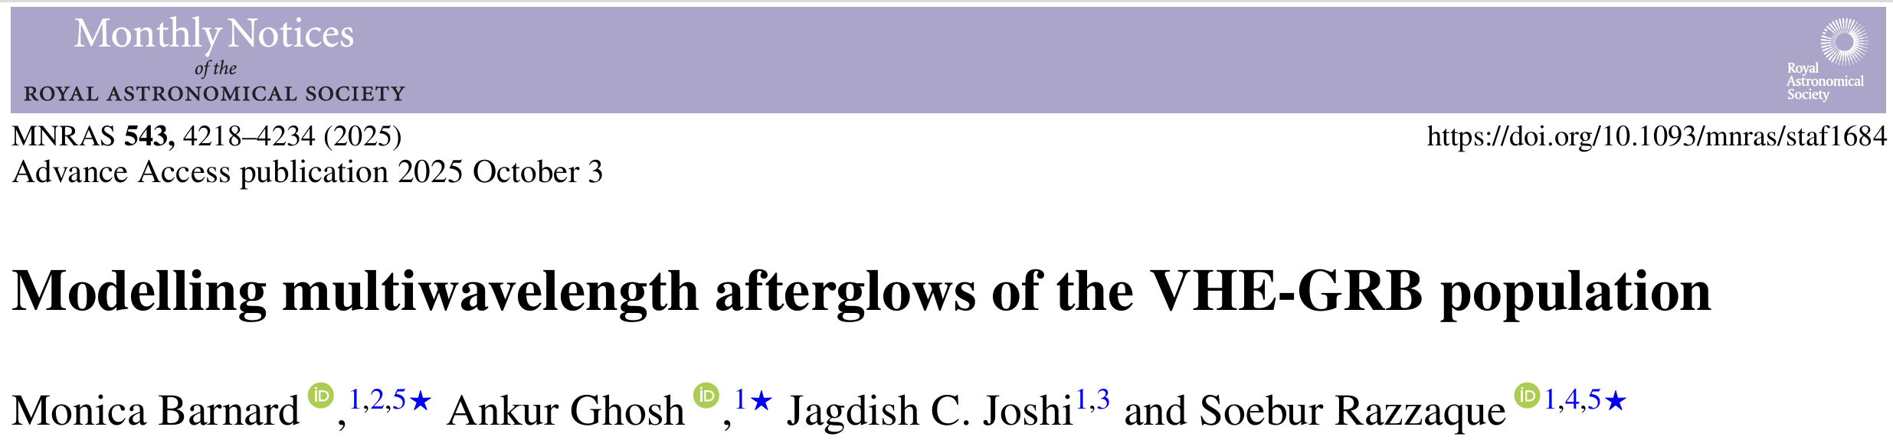
Understanding GRB physics by LHAASO: multiexplanation
Leptonic explanation: multiwavelength constraint

Slide 11
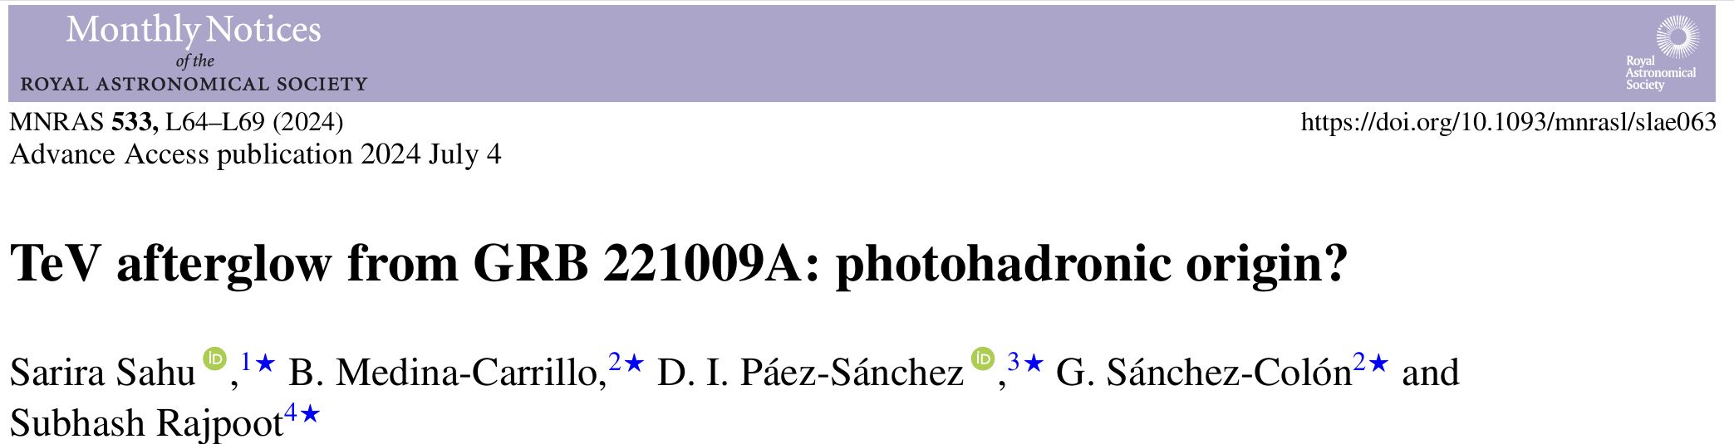
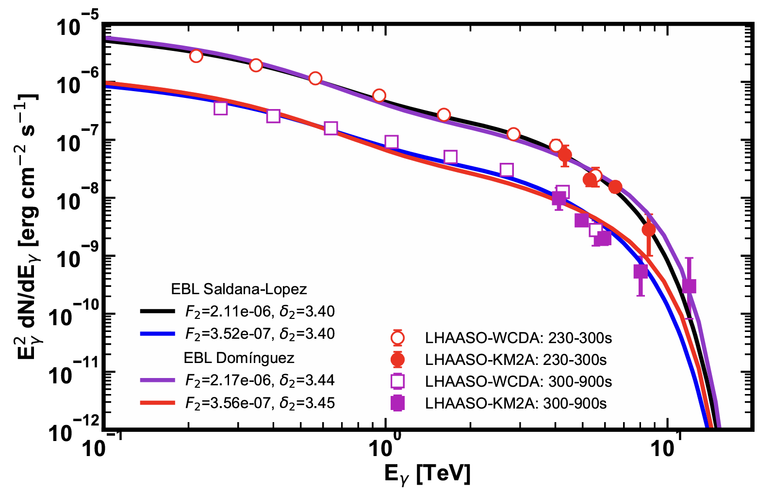
Understanding GRB physics by LHAASO: multiexplanation
Leptonic explanation vs hadronic explanation?
hadronic explanation: high-energy linked to neutrino emission

Slide 12
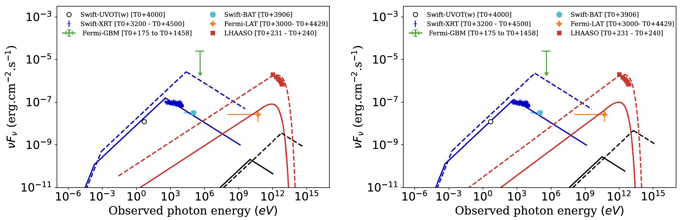

Understanding GRB physics by LHAASO: multiexplanation
Leptonic (X-ray, opt) & hadronic (proton-synchrotron TeV)

Slide 13
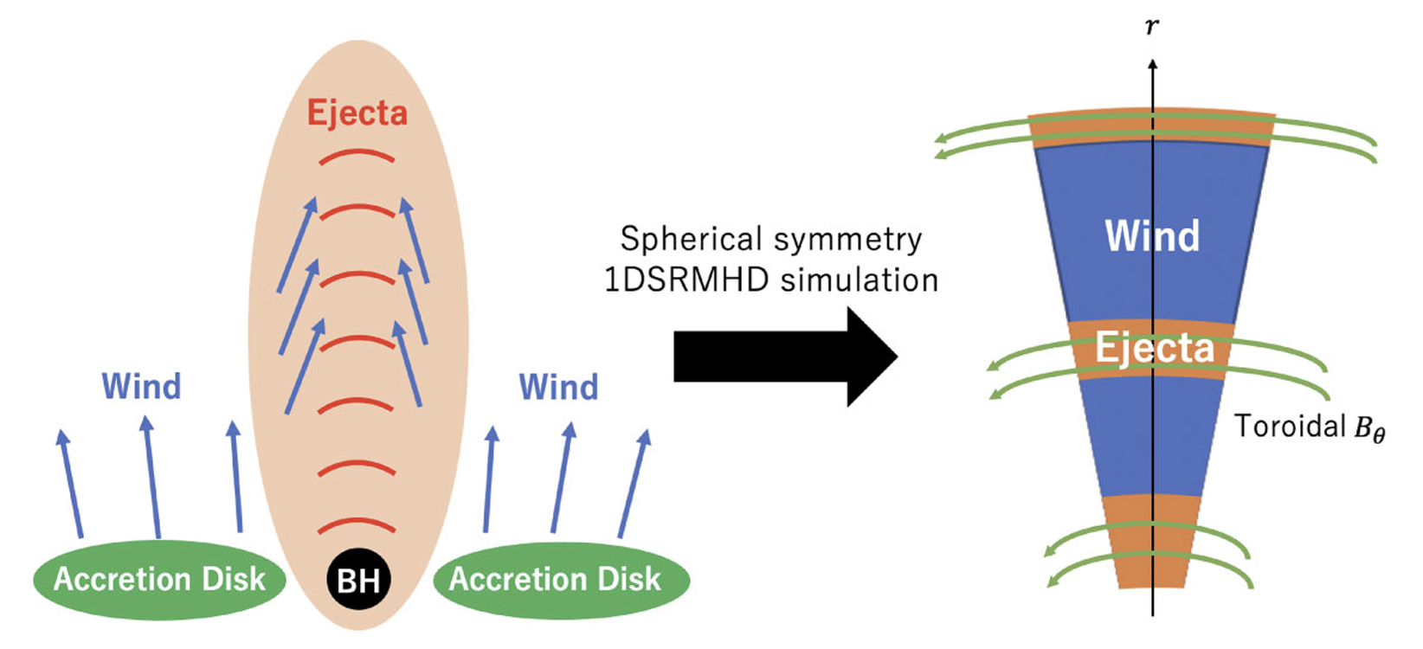
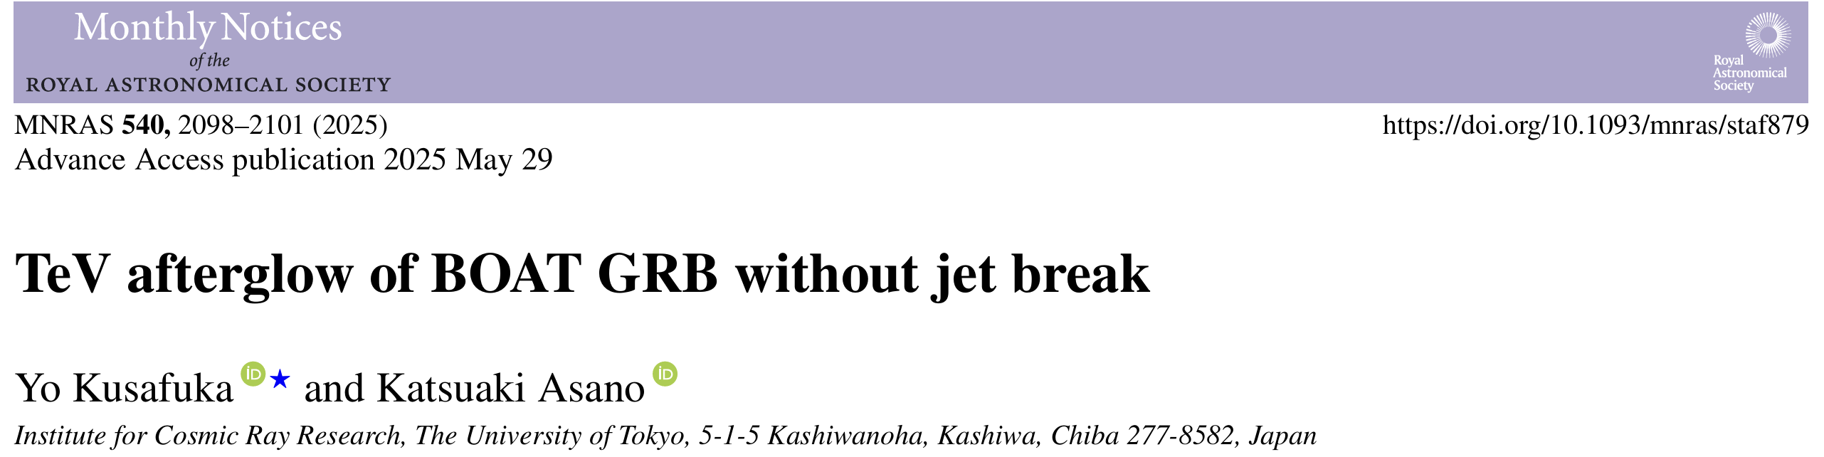
Understanding GRB physics by LHAASO: multiexplanation
Traditional leptonic explanation vs magnetization
Magnetic-dominated process:
magnetic reconnection
MHD instabilities
and small-scale kinetic properties
How to fit the data
and how to applied to LHAASO observation

Slide 14
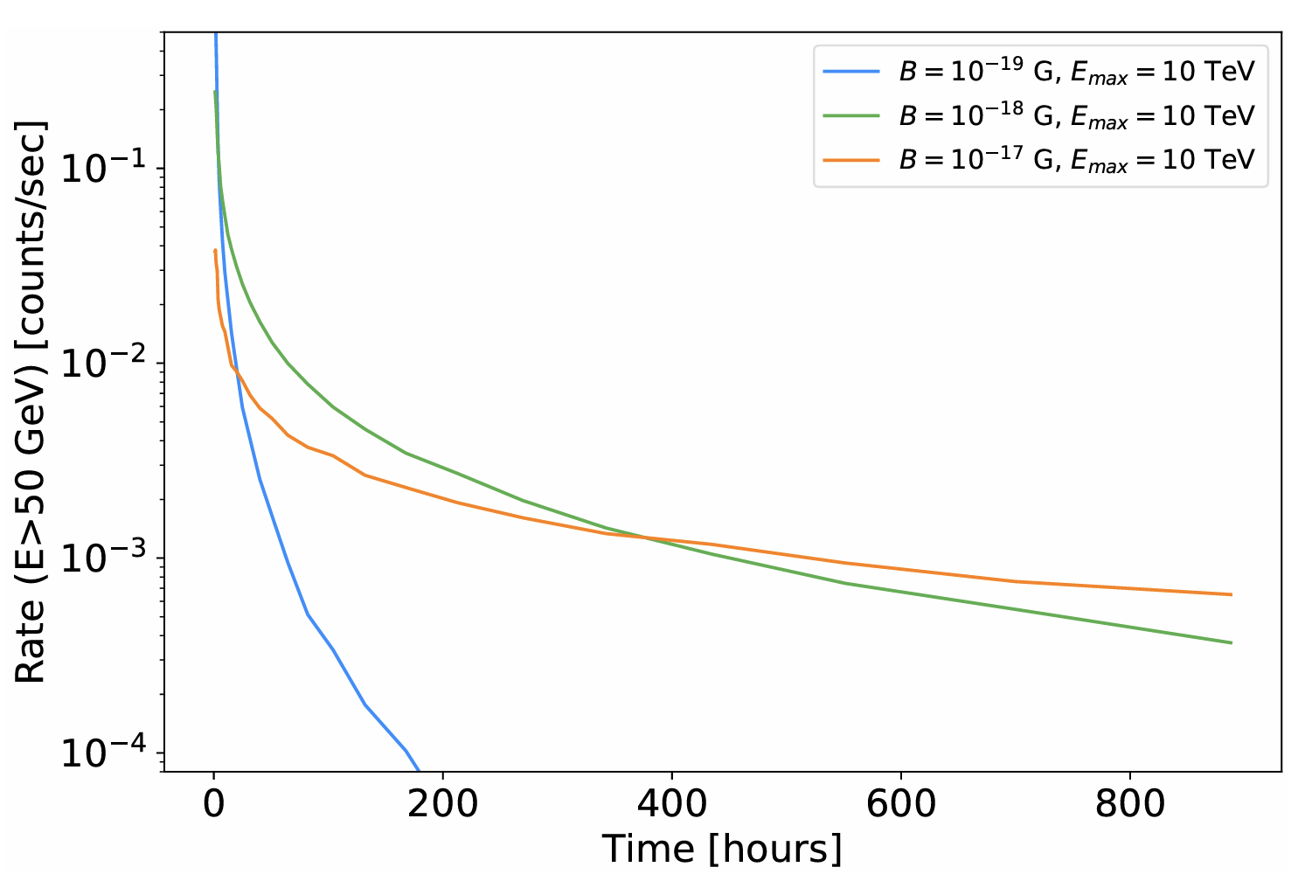

Understanding GRB physics by LHAASO: multiexplanation
Intergalactic magnetic field is important
initial gamma rays interact
with EBL
plasmas are deflected
by IGMF
time decayed lightcurve

Slide 15
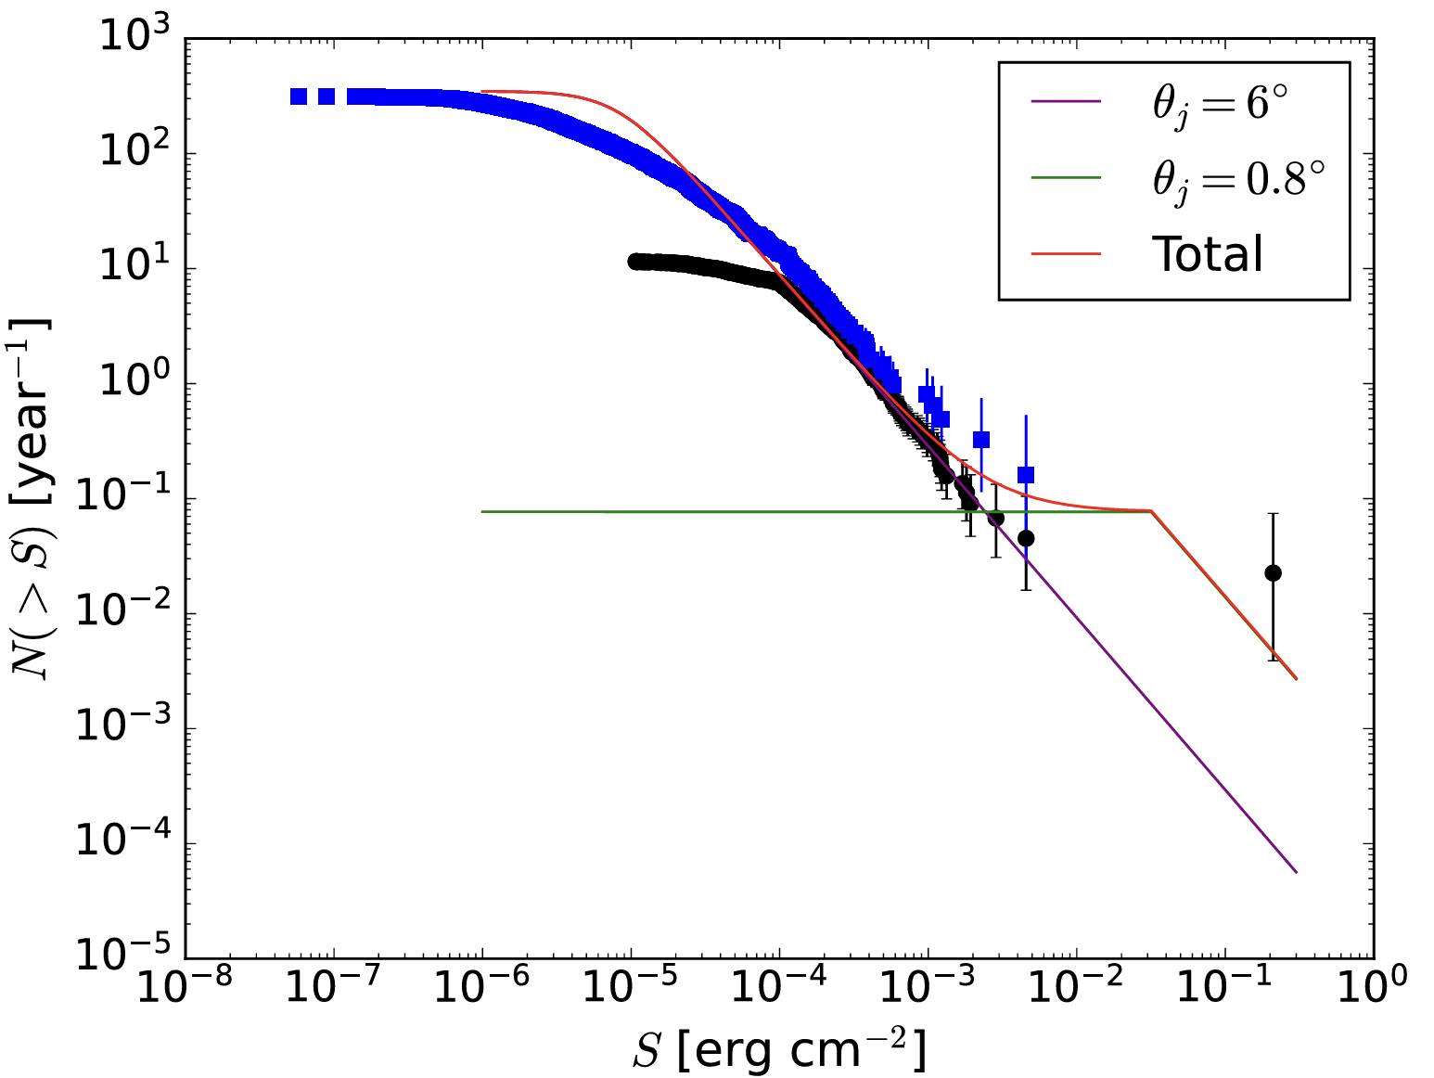
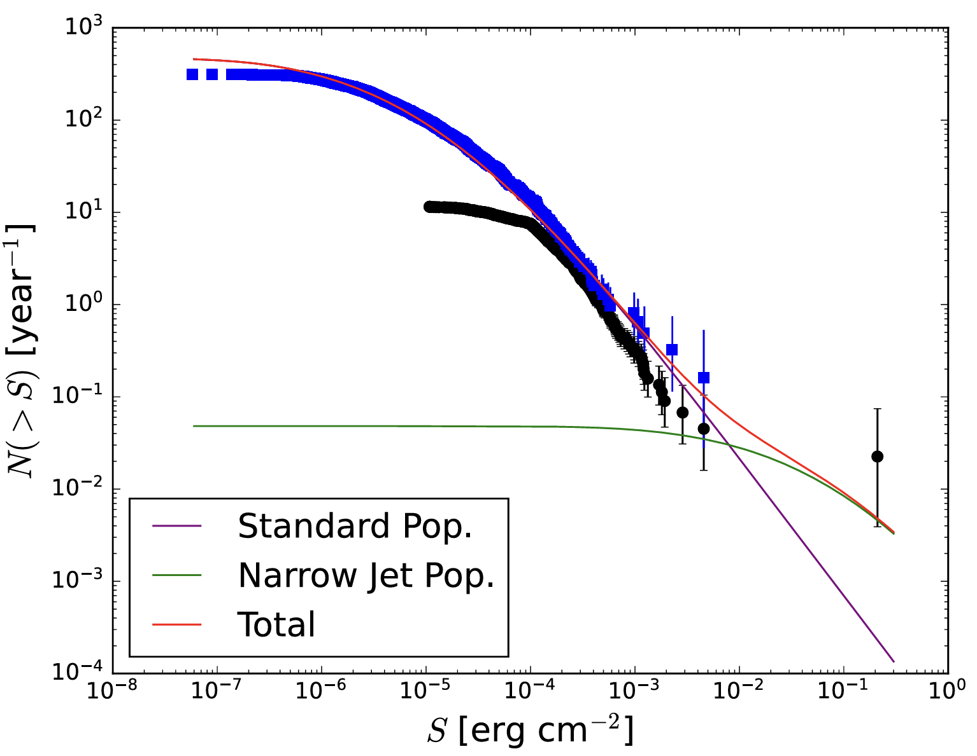

Understanding GRB physics by LHAASO: detection rate
Formation rate in the universe

Slide 16
Understanding GRB physics by LHAASO: multiexplanation
High-energy physics & particle physics
Observation and experiment: a lot of phenomena
Physical understanding: unify all phenomena and have a unified model to
explain all phenomena

Slide 17
Understanding GRB physics by LHAASO: multiexplanation
High-energy physics & particle physics
Observation and experiment: a lot of phenomena
Physical understanding: unify all phenomena and have a unified model to
explain all phenomena
astronomy and high-energy astrophysics
Observation: a lot of phenomena
Physical understanding: why diversities but not unified scenario

Slide 18
Understanding GRB physics by LHAASO: multiexplanation
GRBs are violet transients in the universe
Typical example of high-energy, multiwavelength, multi-messanger
Hot topic in the frontiers of astronomy and high-energy physics
What LHAASO can do next? many issues …
Advantage of LHAASO collaboration: astronomers + high-energy physicists
Open our minds to accept anything possible: something NEW
But self-consistent in the framework

