Slide 1
Report of the Publication Committee
lhaaso-eb@ihep.ac.cn
Siming Liu (SMSWJTU), Dmitri Semikoz(DSAPC)
Hongbo Hu (HB), Zhiguo Yao (ZG), Songzhan Chen(SZ), Shoushan Zhang(SS), Xiaojun Bi(XJ), Dmitriy Khangulyan(DKIHEP),
Qiang Yuan(QY), Yi Zhang (YZPMO), David Ruffolo (DRMahidol)
Zhen Cao, Felix Aharonian, Bing Zhang

Slide 2


Slide 3
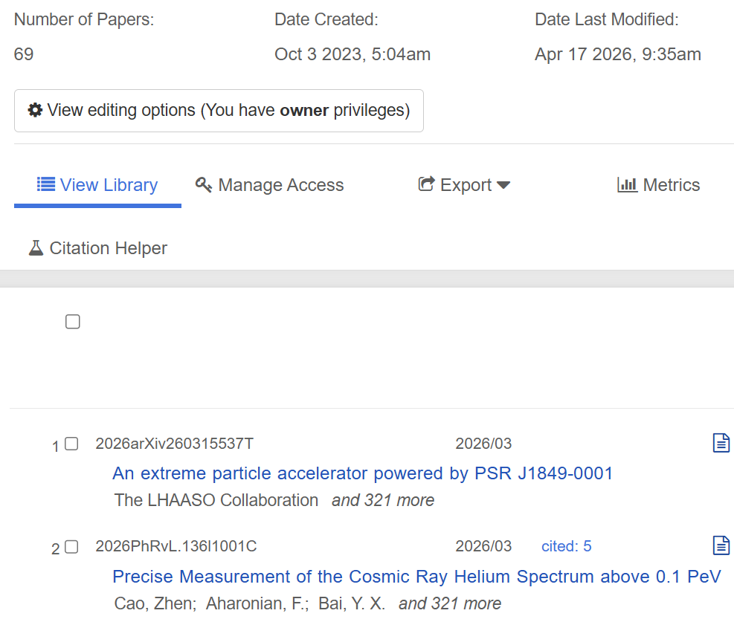
ADS Library https://ui.adsabs.harvard.edu/user/libraries/MX-IK-lmT0iMB5rIy7XeFQ

Slide 4
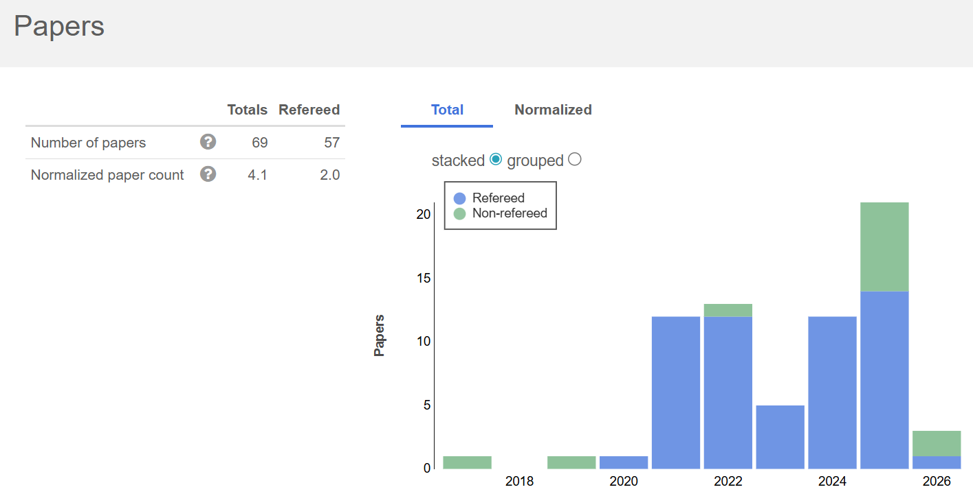
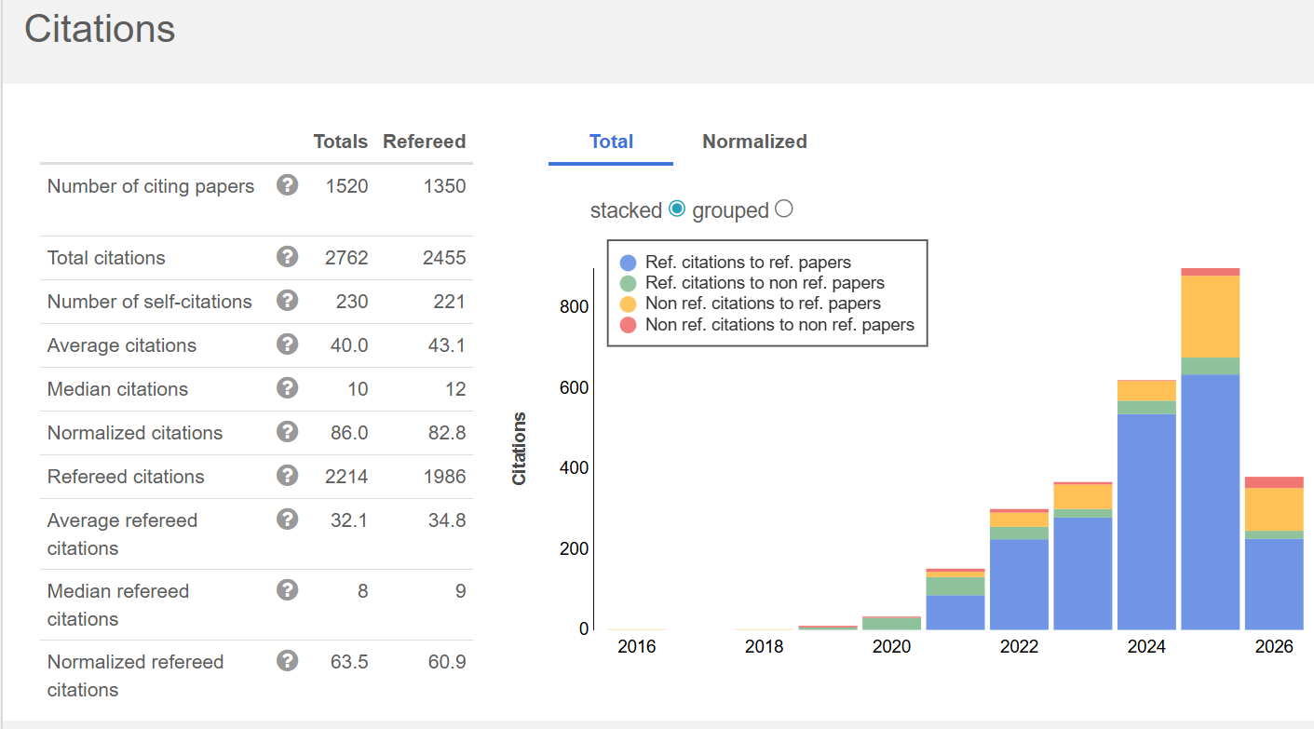
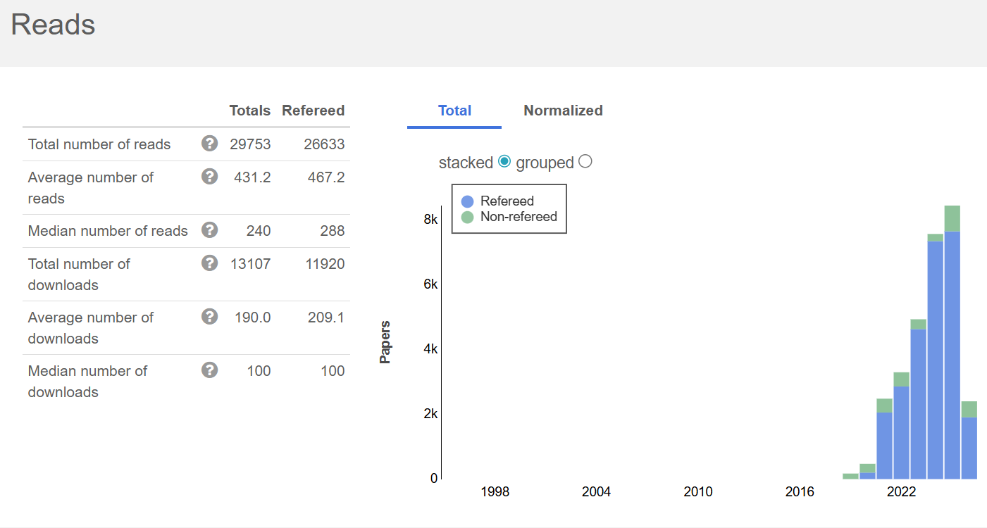
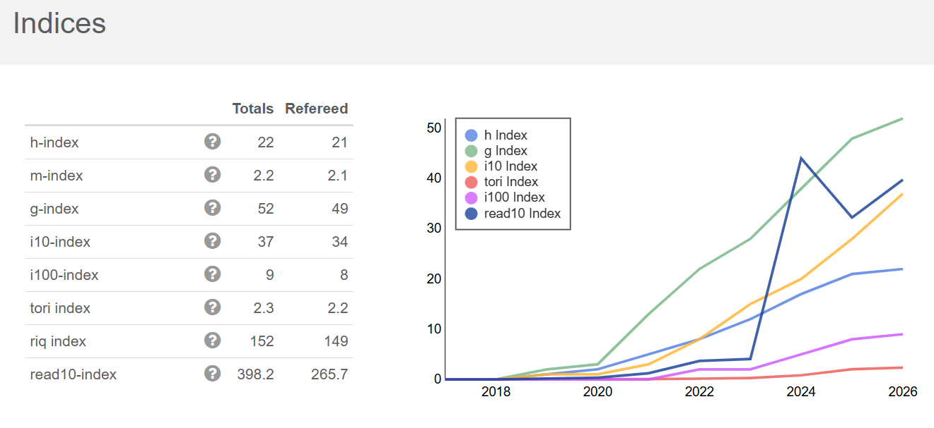

Slide 5
LHAASO Manuscripts
MS0(DD):Geometrical reconstruction of fluorescence events observed by the LHAASO experiment Chinese Physics C Vol. 45, No. 4 (2021) 045101 DOI: 10.1088/1674-1137/abdeaa Published April 2021
MS1(DD): Construction and on-site performance of the LHAASO WFCTA camera Eur. Phys. J. C (2021) 81:657 https://doi.org/10.1140/epjc/s10052-021-09414-z Received: 22 December 2020 / Accepted: 3 July 2021 / Published online: 27 July 2021
MS2(YZ): Observation of the Crab Nebula with LHAASO-KM2A− a performance study Chinese Physics C Vol. 45, No. 2 (2021) 025002 DOI: 10.1088/1674-1137/abd01b Received 13 October 2020; Accepted 30 November 2020; Published online 14 January 2021
MS3: Ultrahigh-energy photons up to 1.4 petaelectronvolts from 12 γ-ray Galactic sources Nature, Volume 594, Issue 7861, p.33-36 DOI:10.1038/s41586-021-03498-z Received 21 October 2020; Accepted 26 March 2021; Published online 17 May 2021
MS4(YC): Chapter 2 Galactic Gamma-ray Sources Chinese Physics C Vol. 46, No. 3 (2022) 030002 DOI: 10.1088/1674-1137/ac3fa8 Received 2 December 2021; Accepted 2 December 2021; Published online 13 January 2022
MS5(YZ):Performance of LHAASO-WCDA and observation of the Crab Nebula as a standard candle Chinese Physics C Vol. 45, No. 8 (2021) 085002 DOI: 10.1088/1674-1137/ac041b Received 8 January 2021; Accepted 24 May 2021; Published online 28 June 2021
MS6: Peta–electron volt gamma-ray emission from the Crab Nebula Science, vol. 373, pp.425-430 DOI: 10.1126/science.abg5137 Received 12 January 2021; Accepted 23 June 2021; Published online 8 July 2021
MS7(HB): Extended Very-High-Energy Gamma-Ray Emission Surrounding PSR J0622 + 3749 Observed by LHAASO-KM2A PHYSICAL REVIEW LETTERS 126, 241103 (2021) DOI: 10.1103/PhysRevLett.126.241103 Received 19 January 2021; revised 23 March 2021; accepted 10 May 2021; published 16 June 2021
MS8: Performance test of the electromagnetic particle detectors for the LHAASO experiment Nuclear Inst. and Methods in Physics Research, A 1001 (2021) 165193 https://doi.org/10.1016/j.nima.2021.165193 Received 3 December 2020; Received in revised form 25 February 2021; Accepted 26 February 2021; Available online 23 March 2021
MS9(HB): Line-of-shower trigger method to lower energy threshold for GRB detection using LHAASO-WCDA Radiation Detection Technology and Methods (2021) 5:531–541 https://doi.org/10.1007/s41605-021-00281-6 Received: 18 March 2021 / Revised: 23 August 2021 / Accepted: 24 August 2021 / Published online: 24 November 2021
MS10(ZG): Design and Testing of the Front-End Electronics of WCDA in LHAASO IEEE TRANSACTIONS ON NUCLEAR SCIENCE, VOL. 68, NO. 8, AUGUST 2021 https://doi.org/10.1109/TNS.2021.3092739 March 17, 2021; revised May 22, 2021; accepted June 13, 2021

Slide 6
LHAASO Manuscripts
MS11(HH): Calibration of the air shower energy scale of the water and air Cherenkov techniques in the LHAASO experiment PHYSICAL REVIEW D 104, 062007 (2021) DOI: 10.1103/PhysRevD.104.062007 Received: 2 June 2021 / Accepted: 11 August 2021 / Published: 15 September 2021
MS12(ZG): A dynamic range extension system for LHAASO WCDA-1 Radiation Detection Technology and Methods (2021) 5:520–530 https://doi.org/10.1007/s41605-021-00275-4 Received 20 April 2021; Revised: 9 June 2021; Accepted 30 June 2021; Published online 4 September 2021
MS13(DD): Measurement of cosmic ray mean mass around the knee region by muon content in air showers with LHAASO-KM2A Internal review done in May 2021 >>>MS36
MS14(SM): Discovery of the Ultrahigh-energy Gamma-Ray Source LHAASO J2108+5157 The Astrophysical Journal Letters, 919:L22 (9pp), 2021 October 1 https://doi.org/10.3847/2041-8213/ac2579 Received 2021 June 15; revised 2021 August 27; accepted 2021 September 9; published 2021 September 30
MS15(SM): Discovery of a New Gamma-Ray Source, LHAASO J0341+5258, with Emission up to 200TeV The Astrophysical Journal Letters, 917:L4 (7pp), 2021 August 10 https://doi.org/10.3847/2041-8213/ac0fd5 Received 2021 May 31; revised 2021 June 27; accepted 2021 June 30; published 2021 August 11
MS16(HB): Exploring Lorentz Invariance Violation from Ultrahigh-Energy γ Rays Observed by LHAASO PHYSICAL REVIEW LETTERS 128, 051102 (2022) DOI: 10.1103/PhysRevLett.128.051102 (Received 23 June 2021; revised 6 December 2021; accepted 24 December 2021; published 3 February 2022
MS17(DD): Absolute calibration of LHAASO WFCTA camera based on LED Nuclear Inst. and Methods in Physics Research, A 1021 (2022) 165824 https://doi.org/10.1016/j.nima.2021.165824 Received 5 July 2021; Received in revised form 11 September 2021; Accepted 13 September 2021 Available online 22 September 2021
MS18(HY): Chapter 7 Solar and Heliospheric Physics and Interdisciplinary Research with LHAASO Chinese Physics C Vol. 46, No. 3 (2022) 030002 DOI: 10.1088/1674-1137/ac3fae Received 2 December 2021; Accepted 2 December 2021; Published online 13 January 2022
MS19(XY): Chapter 3 Extra-galactic Gamma-ray Sources Chinese Physics C Vol. 46, No. 3 (2022) 030002 DOI: 10.1088/1674-1137/ac3fa9 Received 2 December 2021; Accepted 2 December 2021; Published online 13 January 2022
MS20(XJ): Chapter 5 Dark Matter and New Physics beyond the Standard Model with LHAASO Chinese Physics C Vol. 46, No. 3 (2022) 030002 DOI: 10.1088/1674-1137/ac3fab Received 2 December 2021; Accepted 2 December 2021; Published online 13 January 2022

Slide 7
LHAASO Manuscripts
MS21(LZ): Chapter 6 Multimessenger Physics Chinese Physics C Vol. 46, No. 3 (2022) 030002 DOI: 10.1088/1674-1137/ac3fac Received 2 December 2021; Accepted 2 December 2021; Published online 13 January 2022
MS22(SM): Chapter 4 Cosmic Ray Physics Chinese Physics C Vol. 46, No. 3 (2022) 030002 DOI: 10.1088/1674-1137/ac3faa Received 2 December 2021; Accepted 2 December 2021; Published online 13 January 2022
MS23(HB): Constraints on heavy decaying dark matter with 570days LHAASO observation PRL, 129, 261103 (2022) DOI: 10.1103/PhysRevLett.129.261103 Received 29 March 2022; revised 19 August 2022; accepted 27 October 2022; published 21 December 2022
MS24(DD): Reconstruction of Cherenkov Image by Multiple Telescopes of LHAASO-WFCTA RDTM 6:544-557 https://doi.org/10.1007/s41605-022-00342-4 Received: 18 April 2022 / Revised: 14 June 2022 / Accepted: 5 July 2022 / Published online: 5 September 2022
MS25(HH): Self-calibration of LHAASO-KM2A electromagnetic particle detectors using single particles within extensive air showers PRD 106, 122004 (2022) DOI: 10.1103/PhysRevD.106.122004 Received 15 April 2022; accepted 21 November 2022; Published 22 December 2022
MS26(DR): Flux Variations of Cosmic Ray Air Showers Detected by LHAASO-KM2A During a Thunderstorm on 10 June 2021 CPC, 47, 015001 (2023) DOI: 10.1088/1674-1137/ac9371 Received 11 July 2022; Accepted 21 September 2022; Published online 22 September 2022
MS27(SS): A method to measure muon content of Extensive Air Showers with LHAASO KM2A-WCDA synergy The Nuclear Instruments and Methods in Physics Research Section A, 1059, 168958, https://doi.org/10.1016/j.nima.2023.168958, Published Feb. 2024
MS28(SZ): A Teraelectronvolt afterglow from a narrow jet in the extremely bright GRB Science, Volume 380, Issue 6652, pp. 1390-1396 (2023), DOI: 10.1126/science.adg9328 Published June 2023
MS29 (SL): An Ultrahigh-energy $\gamma$-ray Bubble Powered by a Super PeVatron Science Bulletin, Volume 69, Issue 4, p. 449-457 DOI: 10.1016/j.scib.2023.12.040 Published Feb 2024
MS30 (SZ): Measurement of ultra-high-energy diffuse gamma-ray emission of the Galactic plane from 10 TeV to 1 PeV with LHAASO-KM2A PRL, 131, 151001, DOI:10.1103/PhysRevLett.131.151001 Published October 2023

Slide 8
LHAASO Manuscripts
MS31(ZY): The First LHAASO Catalog of Gamma-Ray Sources ApJS, Volume 271, Issue 1, id.25, 26 pp DOI: 10.3847/1538-4365/acfd29
Published March 2024
MS32(ZY): Very high energy gamma-ray emission out of 10 TeV from GRB 221009A, Science Advances, vol. 9, issue 46, id. eadj2778 DOI:
  10.1126/sciadv.adj2778 Published Nov. 2023
MS33(DR): Pointing calibration of LHAASO-WFCTA telescopes using bright stars Nuclear Inst. and Methods in Physics Research, A, Volume 1056, article id. 168662, DOI: 10.1016/j.nima.2023.168662 Published Nov 2023
MS34(SL): Does or did the supernova remnant Cassiopeia A operate as a PeVatron? The Astrophysical Journal Letters, Volume 961, Issue 2, id.L43, 7 pp, DOI: 10.3847/2041-8213/ad1d62 , Published February 2024
MS35(ZY): Optimization of the performance of KM2A full array with Crab Nebula Chinese Physics C, Volume 48, Issue 6, id.065001, 10 pp DOI: 10.1088/1674-1137/ad2e82 Published June 2024
MS36(SS): Measurements of all-particle energy spectrum and mean logarithmic mass of cosmic rays from 0.3 to 30 PeV with LHAASO-KM2A PRL 132. 13, 132.131002 DOI: 10.1103/PhysRevLett.132.131002 Published March 2024
MS37(HB): Constraints on Ultra Heavy Dark Matter Properties from Dwarf Spheroidal Galaxies with LHAASO Observations
Physical Review Letters, Volume 133, Issue 6, article id.061001 DOI: 10.1103/PhysRevLett.133.061001 Published August 2024
MS38(HH): LHAASO-KM2A detector simulation using Geant4 Radiation Detection Technology and Methods, Volume 8, Issue 3, pp. 1437-1447 DOI: 10.1007/s41605-024-00467-8 Published September 2024
MS39(ZY): Searching for neutrino emission from the Cygnus Bubble submitted as a group paper
MS40(HB): Stringent Tests of Lorentz Invariance Violation from LHAASO Observations of GRB 221009A Physical Review Letters, Volume 133, Issue 7, article id.071501 DOI: 10.1103/PhysRevLett.133.071501 Published August 2024

Slide 9
LHAASO Manuscripts
MS41(SL): An enigmatic PeVatron in an area around HII region G35.6−0.5 ApJ 979, 1 70, DOI: 10.3847/1538-4357/ad991d arxiv:2412.00379, Published in Jan 2025
MS42(SL): Monitoring the Daily Interplanetary Magnetic Field Measurement Using the Cosmic-ray Sun Shadow Observed by LHAASO-KM2A innovation 5(6): 100695 DOI: 10.1016/j.xinn.2024.100695 Published in Septempber 2024
MS43(ZG): LHAASO detection of very-high-energy γ-ray emission surrounding PSR J0248+6021 Science China Physics, Mechanics & Astronomy, Volume 68, Issue 7, id.279504 DOI: 10.48550/arXiv.2410.04425 Published in July 2025
MS44(HB): Observation of the γ-ray Emission from W43 with LHAASO Science China Physics, Mechanics & Astronomy, Volume 68, Issue 7, id.279502 DOI: 10.48550/arXiv.2408.09905 Published in July 2025
MS45(SL): Evidence for Proton Acceleration Approaching PeV Energies in the W51 Complex Science Bulletin, Volume 69, Issue 18, pp. 2833-2841 doi:10.1016/j.scib.2024.07.017 Published in September 2024
MS46(DR): Discovery of VHE Gamma-Ray Emissions from the low luminosity AGN NGC 4278 by LHAASO ApJL 971, 2, L45 DOI:
10.3847/2041-8213/ad5e6d Published in Aug 2024
MS47(HH): Data quality control system and long-term performance monitor of the LHAASO-KM2A Astroparticle Physics, Volume 164, id.103029 DOI: 10.1016/j.astropartphys.2024.103029 Published in January 2025
MS48(SL): Deep view of Composite SNR CTA1 with LHAASO in γ-rays up to 300 TeV Science China Physics, Mechanics & Astronomy, Volume 68, Issue 7, id.279503 DOI: 10.48550/arXiv.2409.09499 Published in July 2025
MS49(ZY): Detection of two TeV gamma-ray outbursts from NGC 1275 by LHAASO, MNRAS, DOI: 10.1093/mnras/stae2512 Published in November 2024
MS50(DR): Ultrahigh-energy gamma emission associated with the tail of a bow-shock pulsar wind nebula Innovation 6(4): 100802 DOI：10.1016/j.xinn.2025.100802 Published in Feb 2025

Slide 10
LHAASO Manuscripts
MS51(HH): Measurement of attenuation length of the muon content in extensive air shower from 0.3-30 PeV at LHAASO PRD 110, 10, 103017 DOI: 10.1103/PhysRevD.110.103017 Published in Nov 2024
MS52(SZ): Study of ultra-high-energy gamma-ray source 1LHAASO J0056+6346u and its possible origins Science China Physics, Mechanics & Astronomy, Volume 68, Issue 7, id.279505 DOI: 10.1007/s11433-024-2661-8 Published in Jul 2025
MS53(DR): Detection of very high-energy gamma-ray emission from the radio galaxy M87 with LHAASO ApJL 975, 2, L44 DOI: 10.3847/2041-8213/ad8921 Published in Nov 2024
MS54(ZY): Ultrahigh-Energy Gamma-ray Emission Associated with Black Hole-Jet Systems National Science Review, Vol. 12, No. 12, id. nwaf496 DOI: 10.1093/nsr/nwaf496 arXiv:2410.08988 Published in Dec 2025
MS55(ZG): A Giant Peanut-shaped Ultra-High-Energy Gamma-Ray Emitter Off the Galactic Plane Submitted to Science bulletin DOI:10.48550/arXiv.2510.06786
MS56(SZ): Measurement of Very-high-energy Diffuse Gamma-ray Emissions from the Galactic Plane with LHAASO-WCDA PRL, Volume 134, Issue 8, id.081002, 9 pp DOI: 10.1103/PhysRevLett.134.081002 February 2025
MS57(SS): Constraining the Cosmic-Ray Energy Based on Observations of Nearby Galaxy Clusters by LHAASO The Astrophysical Journal Letters, Volume 982, Issue 1, id.L19, 11 pp DOI: 10.3847/2041-8213/adb97d March 2025
MS58(HB): Cosmic-ray Electron Spectrum over 25TeV from the LHAASO experiment Physical Review D, Volume 112, Issue 2, id.022007, 11 pp.DOI: 10.1103/wy2f-b9p3 July 2025
MS59(ZY): Broadband γ-ray spectrum of supernova remnant Cassiopeia A The Astrophysical Journal Letters, Volume 982, Issue 1, id.L33, 8 pp. DOI: 10.3847/2041-8213/adb97c March 2025
MS60(ZG): Precise measurements of the cosmic ray proton energy spectrum in the ‘‘knee” region Science Bulletin 70(2025)4173-4180; doi:10.1016/j.scib.2025.10.048, arXiv:2505.14447, Nov 2025

Slide 11
LHAASO Manuscripts
MS61(SL): An extreme particle accelerator powered by PSR J1849-0001 Accepted by NA DOI: 10.48550/arXiv.2603.15537 March 2026
MS62(HB): All-sky search for individual Primordial Black Hole burst with LHAASO Physical Review Letters, Volume 135, Issue 18, id.181005, 8 pp. DOI: 10.1103/nkby-9cs3 October 2025
MS63(ZY): LHAASO Detection of Ultra-High-Energy Gamma-Ray Emission toward the Giant Molecular Clouds submitted to NA arXiv:2511.05015 DOI: 10.1103/gc7n-ypqw December 2025
MS64(SS): Cygnus X-3: A variable petaelectronvolt gamma-ray source Submitted to NSR DOI: 10.48550/arXiv.2512.16638
MS65 (ZY): Energy calibration of the LHAASO-KM2A by using the cosmic ray Moon shadow Physical Review D, Volume 112, Issue 12, id.123051, 12 pp, December 2025
MS66(SL): First detection of ultra-high energy emission from gamma-ray binary LS I +61◦ 303 Accepted by PRL eprint arXiv:2510.23345
MS67(ZG): Precise Measurement of Cosmic Ray Light and Helium Spectra above 0.1 Peta-electron-Volt Phys. Rev. Lett. 136, 121001 – Published 26 March, 2026 DOI: https://doi.org/10.1103/d838-49gt http://arxiv.org/abs/2511.05013
MS68(DR): Evidence of cosmic-ray acceleration up to sub-PeV energies in the supernova remnant IC 443 Accepted by PRL eprint arXiv:2510.26112
MS69(HB): Transient Large-Scale Anisotropy in TeV-Range Cosmic Rays due to an Interplanetary Coronal Mass Ejection Submitted to PRL
MS70(HB): Observation of Medium-Scale Anisotropy in Very-High-Energy Cosmic Rays using LHAASO-KM2A Submitted to PRL

Slide 12
LHAASO Manuscripts
MS71(SS): Investigating Pulsar Wind Nebula DA 495: Insights from LHAASO and Multi-Wavelength Observations Submitted to ApJL https://arxiv.org/abs/2601.11071
MS72(SL): LHAASO detection of very high energy emission from the vicinity of supernova remnant W44 to be submitted to ？
MS73(HH): LHAASO observation of Mrk 421 during 2021 March - 2024 March: a comprehensive VHE catalog of multi-timescale outbursts and its time average behavior submitted to ApJS.
MS74(SZ): Ultra-high-energy γ-ray imprints from PeV particles accelerated by supernova remnants to be sumitted to Science?
MS75(YQ): Anisotropic Particle Transport from a Pulsar Wind Nebula Revealed by Einstein Probe and LHAASO to be submitted to NSR
MS1(XJ}: LHAASO-WCDA observed a ∼6 days TeV-delayed ffaring event in blazar 1ES 1959+650
MS2(HB): Observations of Large-Scale Cosmic Ray Anisotropy at Energies up to PeV with LHAASO
MS3(SZ): Discovery of an Enigmatic UHE Gamma Ray Source: LHAASO J1857+0751
MS4(DK): Unraveling the Complexity of Cosmic Ray Transport through Pulsar Gamma-Ray Halo Morphology
MS5(DS): Observation of the gamma-ray emission from the G25.0+0.0 region with LHAASO
MS6(ZY): Broadband Gamma-Ray Emission Reveals Extreme Particle Acceleration in Microquasar GRS 1915+105
MS7(ZG): Calibration of Energy Scale by using Cosmic Ray Moon shadow for LHAASO-WCDA
MS8(DR): The Extended Ultrahigh-energy Gamma-Ray Emission in the Vicinity of PSR J2238+5903
MS9(SS)：LHAASO J1852+0050u: GeV-100TeV Gamma-ray emission Powered by Star-forming Region? to be submitted to Science China
G106, CTB80, G156

Slide 13
Published(Accepted) in Top Journals:
Nature 1,
Science 2 (Crab, GRB),
Science Advance 1 (GRB},
NA 2 (halo, MC),
NSR 3 (micro-quasar,Cyg X3, J1740)
Science Bulletin 4 (W51C, bubble, proton, mPSR),
PRL 14 (1halo, 2DG, 1CR, 2DM, 2LIV, 1BH, 1SNR, 1Bi, 1He，2iso),
Innovation 2（sun, halo）,
SCPMA 4 (2halo, 2clusters),
ApJL 8 (2U, 2SNR, 3G, 1halo)
Total 41 (7)
Submitted: NSR 2, Nature A 1, Science bulletin 1, PRL 2，ApJL 1.
Thank you！

Slide 14
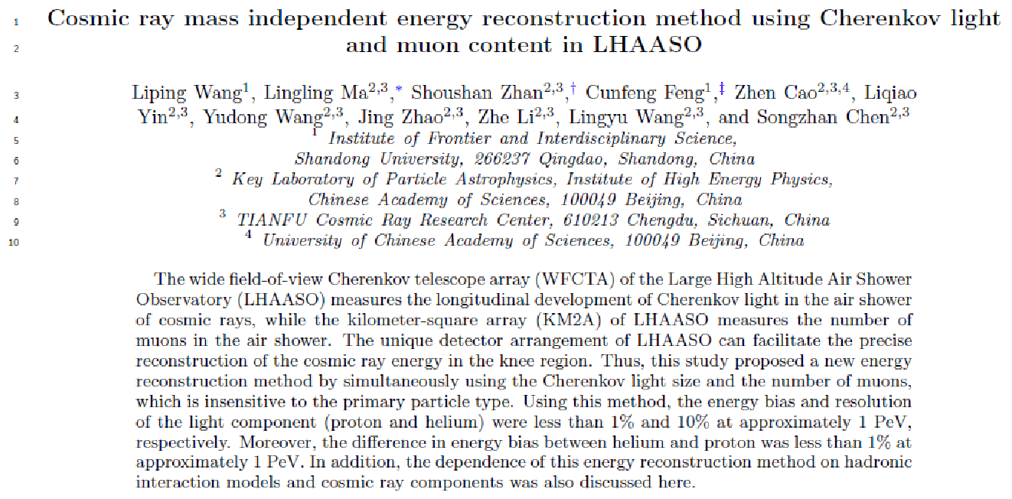

Slide 15
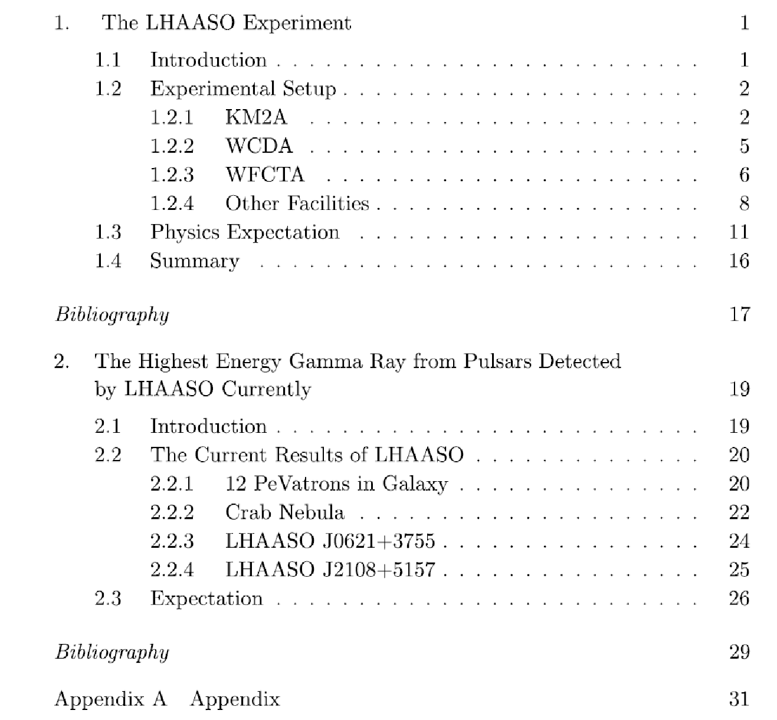

Slide 16
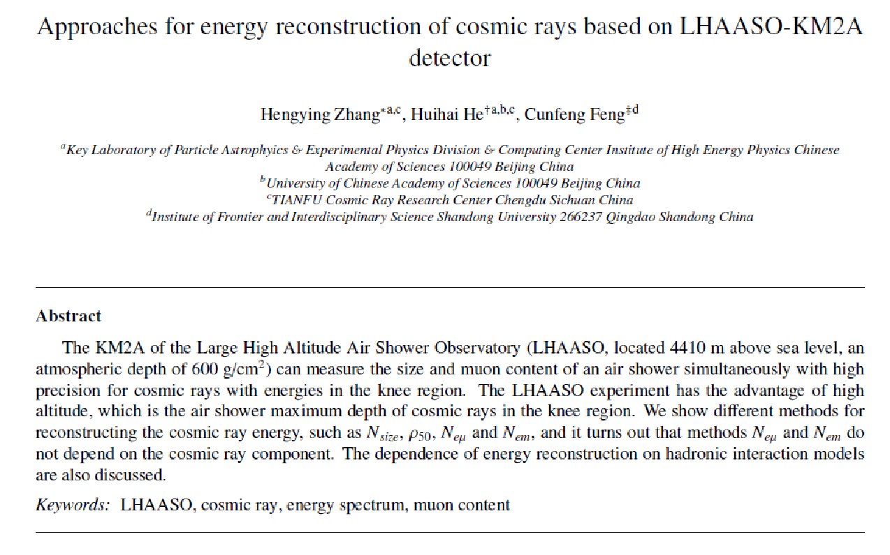

Slide 17
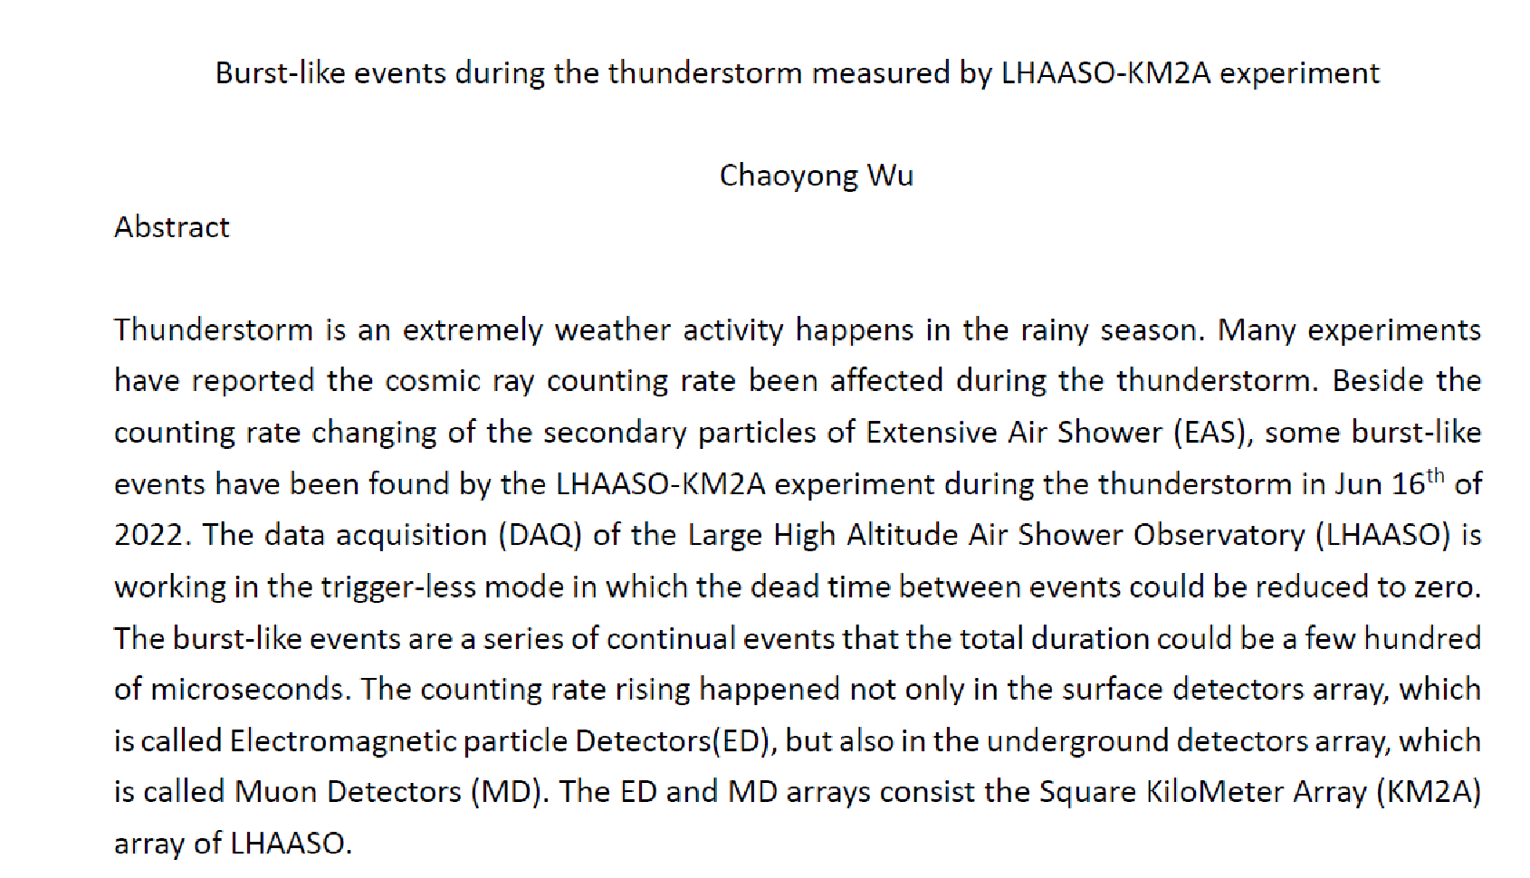

Slide 18
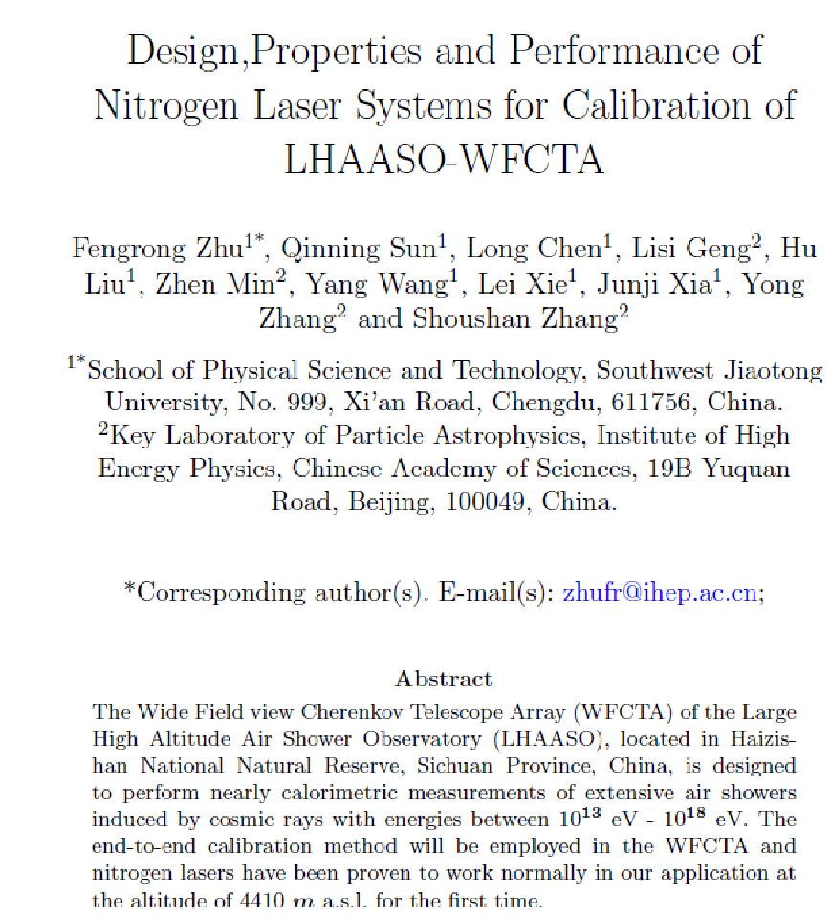

Slide 19
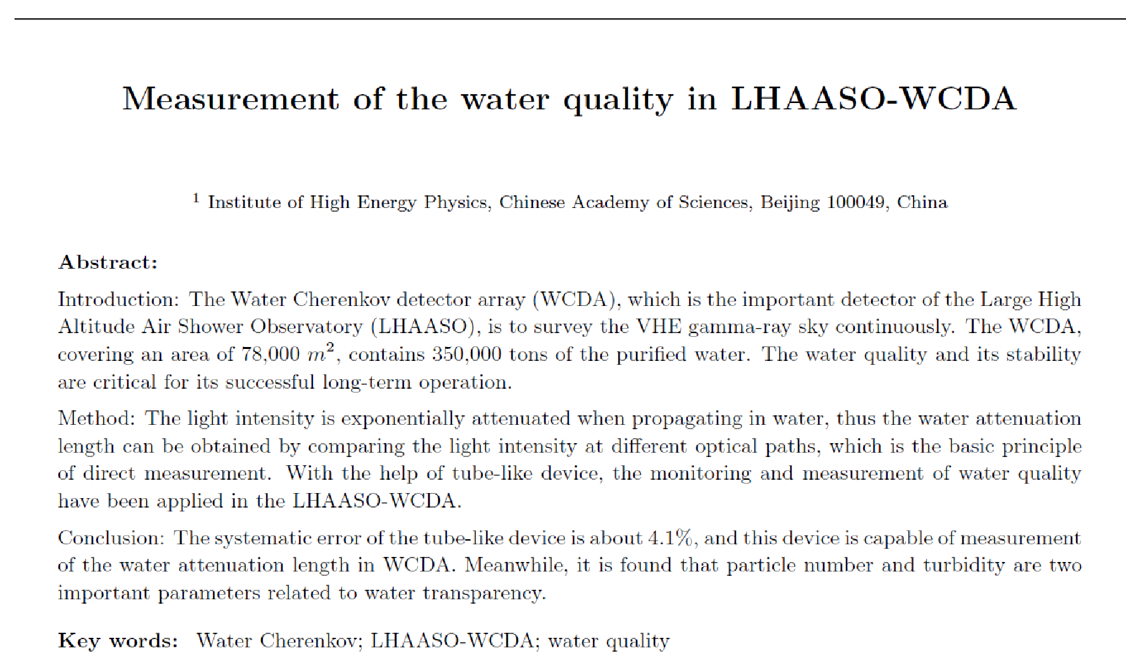

Slide 20
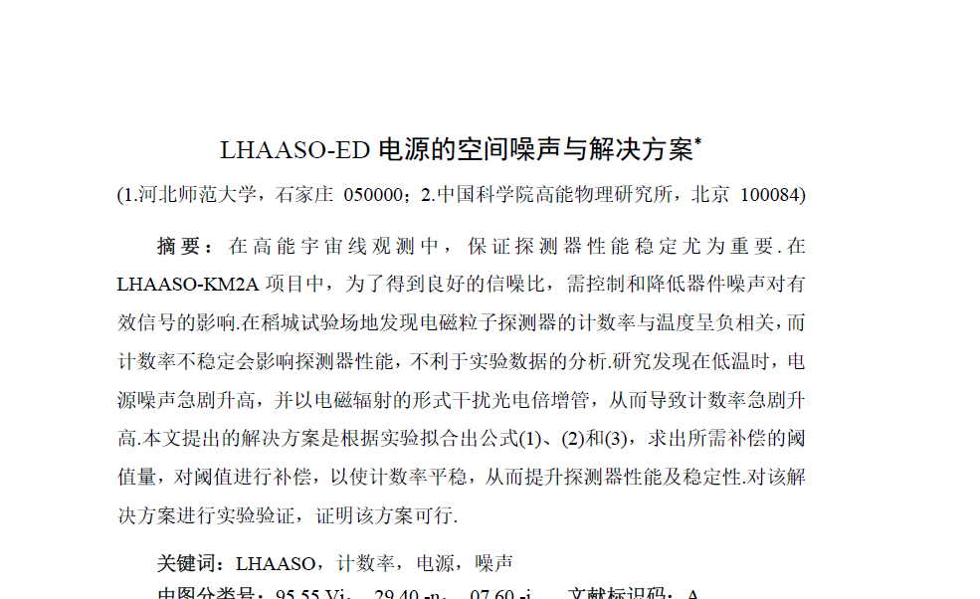

Slide 21
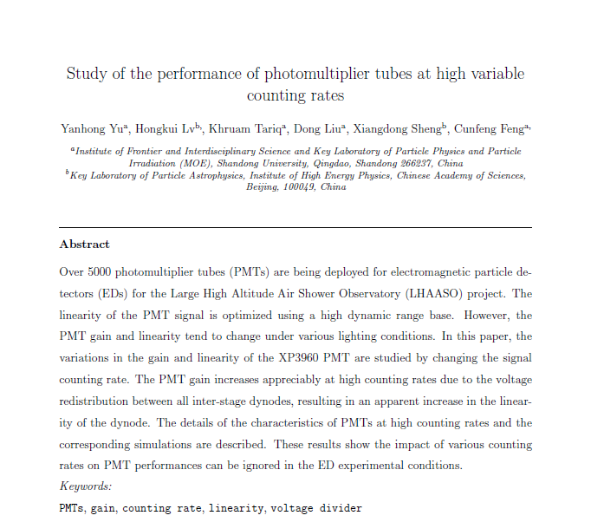

Slide 22
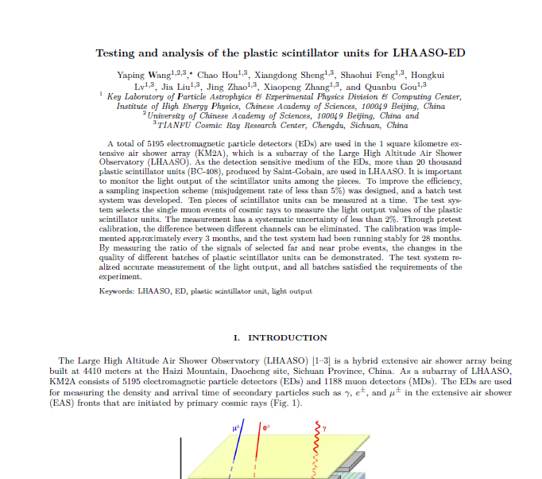

Slide 23
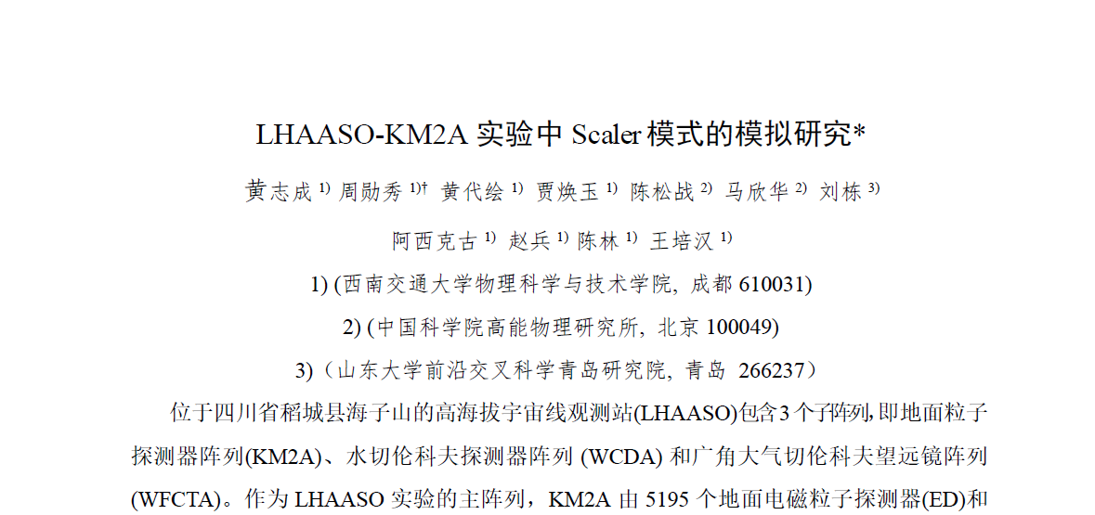

Slide 24
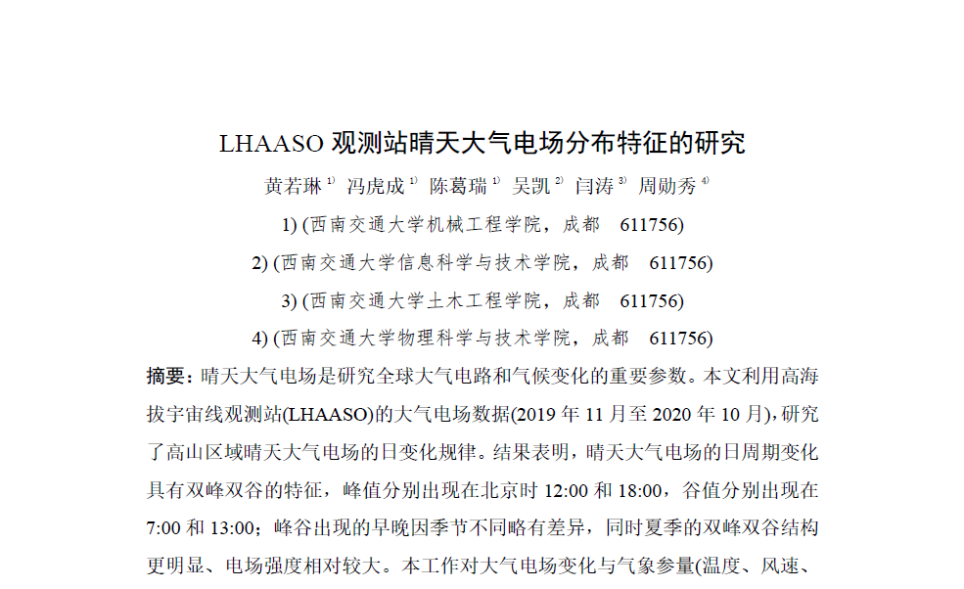

Slide 25
成像激光雷达标定系统中三维升降转台的性能研究*
李新¹，陈龙¹，耿利斯²，刘虎¹，孙秦宁¹，王阳¹，夏君集¹，祝凤荣¹，张勇²
(1.西南交通大学物理科学与技术学院，四川 成都 611756；2.中国科学院高能物理研究所，北京 100049)
摘 要：三维升降转台是高海拔宇宙线观测站(LHAASO)广角切伦科夫望远镜阵列(WFCFA)成像激光雷达标定系统的核心组成部分，主要由慢控子系统、机械子系统和标准零点子系统构成，用于精确控制激光束的出射方向。本文采用高精度数字图像处理技术对三维升降转台的性能进行研究，结果表明其旋转和升降定位精度分别为0.005°和0.056 mm、重复精度分别为0.003°和0.075 mm，满足成像激光雷达标定系统的实验要求。三维升降转台的自动控制巡航功能，有效减少了人工干预，提高了系统远程使用的可靠性和效率。标准零点的校准功能可以有效地监测三维升降转台的定位精度并且在失准的情况下，能够实现远程校准，以确保三维升降转台长期高精度稳定运行。
关键词：三维升降转台； PLC； 数字图像处理技术； 标准零点； 自动控制巡航
中图分类号： 文献标识码： 文章编号：

Slide 26
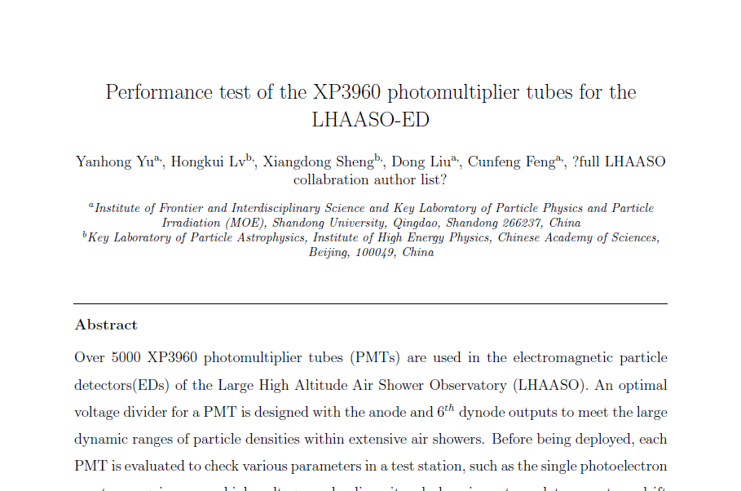

Slide 27
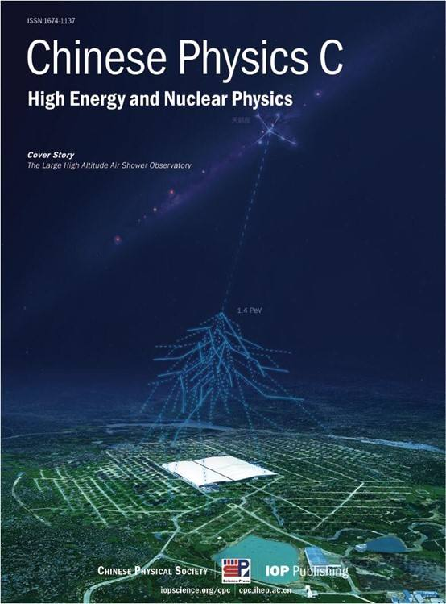
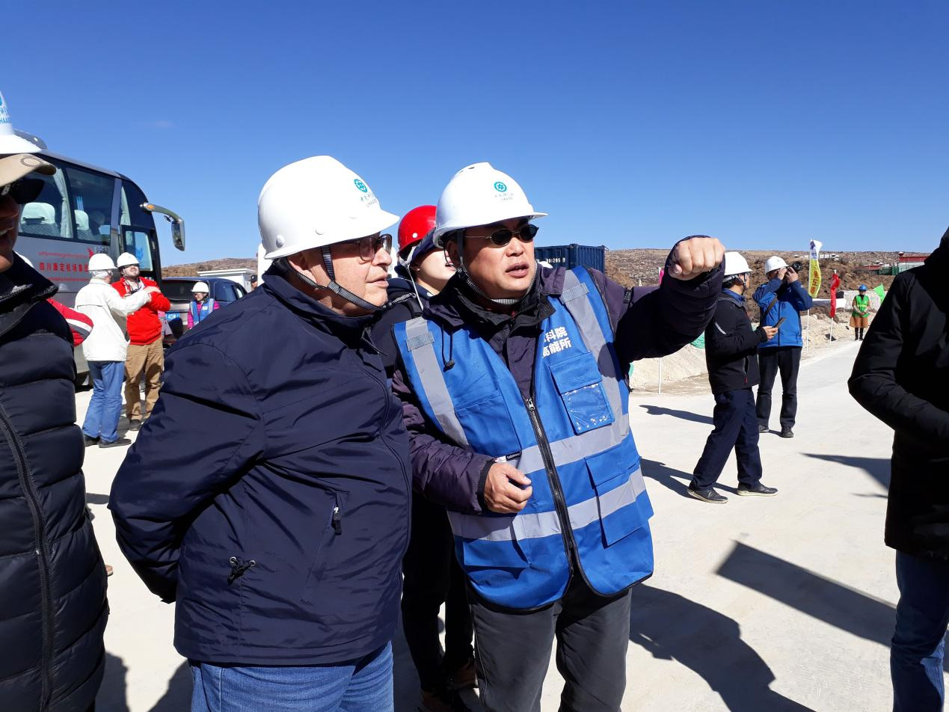
The LHAASO Science Book (CPC V46 No.3 March 2022)
Chapter 1 LHAASO Instruments and Detector Technology (Xin-Hua MA)
Chapter 2 Galactic Gamma-ray Sources (Yang Chen and Xiao Zhang)
Chapter 3 Extra-galactic Gamma-ray Sources (Xiang-Yu Wang)
Chapter 4 Cosmic Ray Physics (Si-Ming Liu)
Chapter 5 Dark Matter and New Physis beyond the Standard Model with LHAASO (Xiao-Jun Bi)
Chapter 6 Multimessenger Physics (Zhuo Li)
Chapter 7 Solar and Heliospheric Physics and Interdisciplinary Research with LHAASO (Huan-Yu Jia)
Benedetto
D’Ettorre
Piazzoli
Passed away on
Feb 7 2022

Slide 28
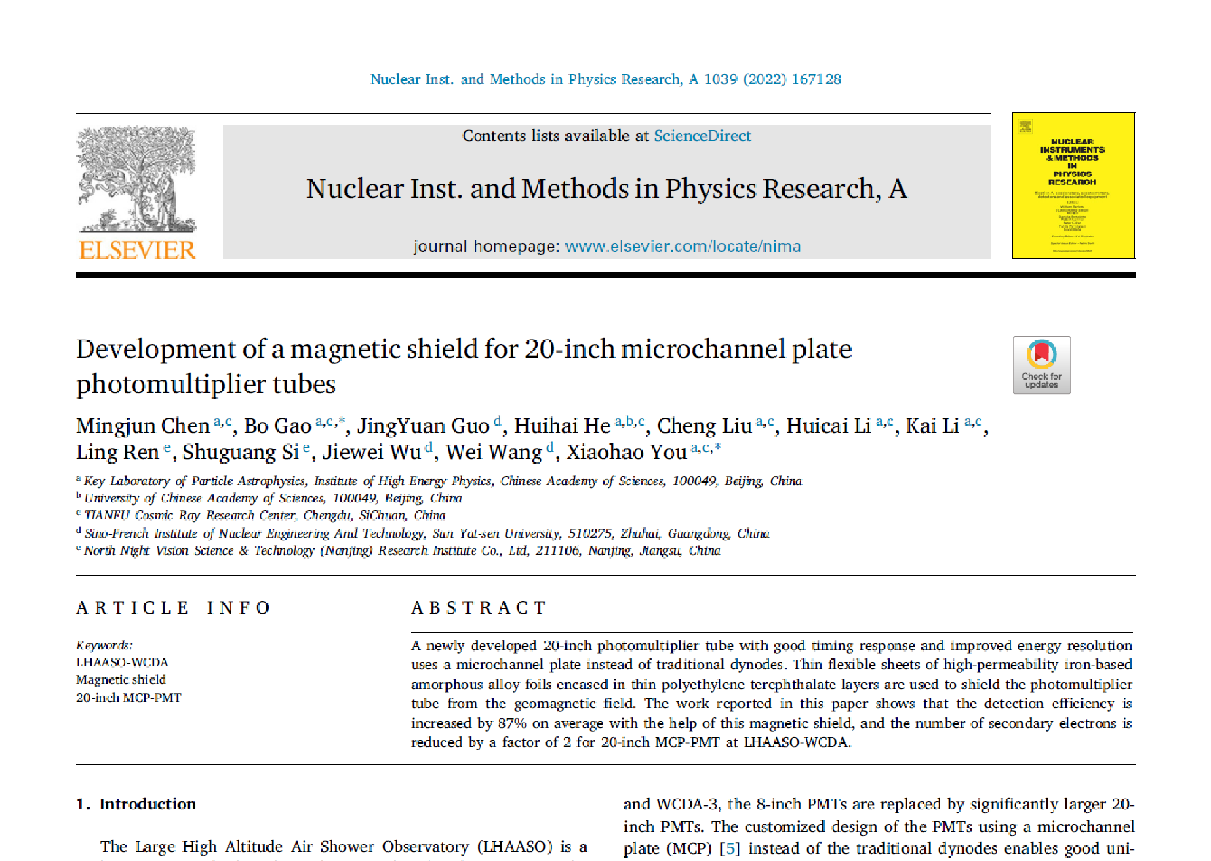

Slide 29
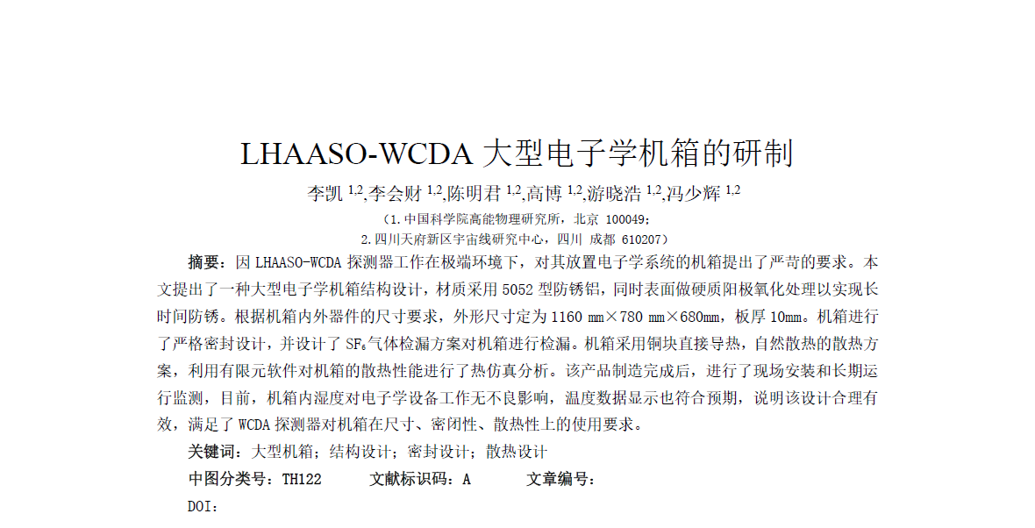

Slide 30
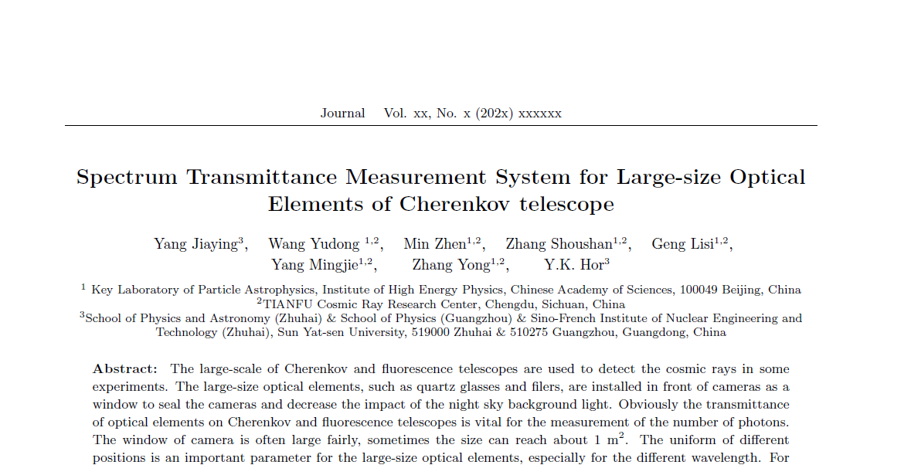

Slide 31
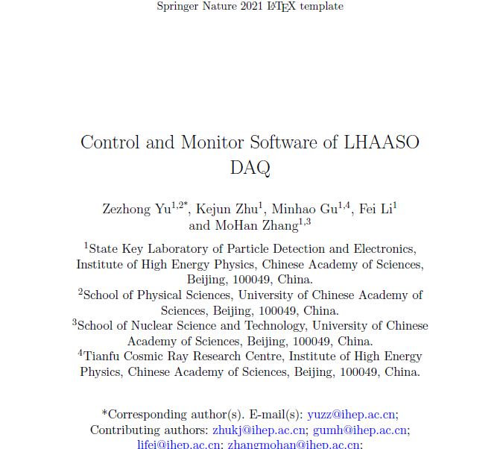

Slide 32
