Slide 1

Radiation hard SiPM development for CEPC calorimeter
Zhijun Liang
IHEP,CAS
Notes:
重点报告内容：（1）未来5年拟开展的研究工作，包括主要研究方向、关键科学问题与研究内容；（2）研究方案，包括骨干成员之间的分工及合作方式、学科交叉融合研究计划、年度工作计划与目标等；（3）五年预期目标和可能取得的重大突破等。

Slide 2
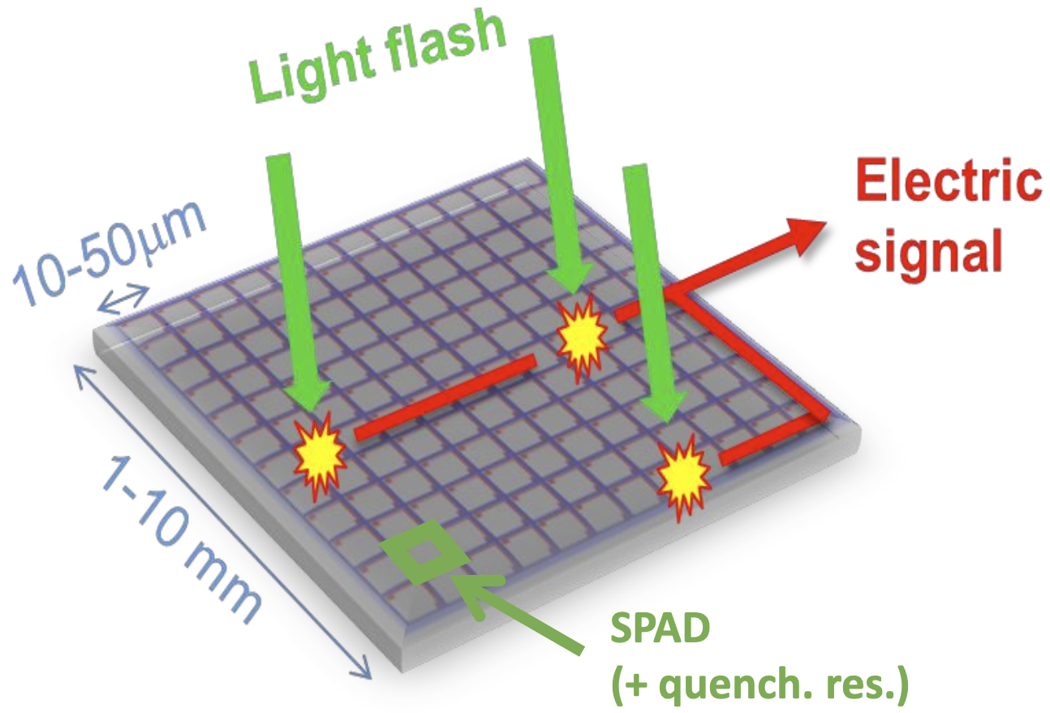
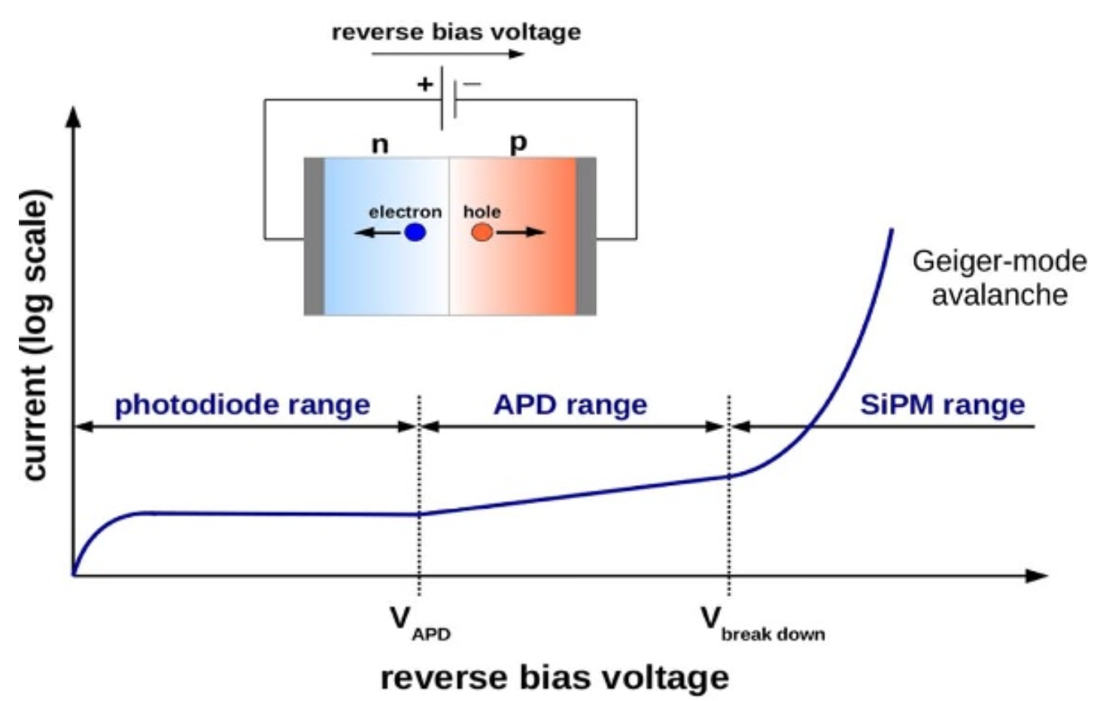
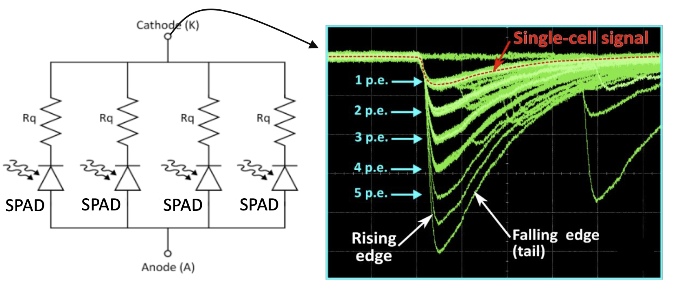
SiPM introduction
SiPM--silicon photomultiplier: advantage:
High resolution
Single photon counting
The goal is to develop Radiation hard SiPM

Slide 3
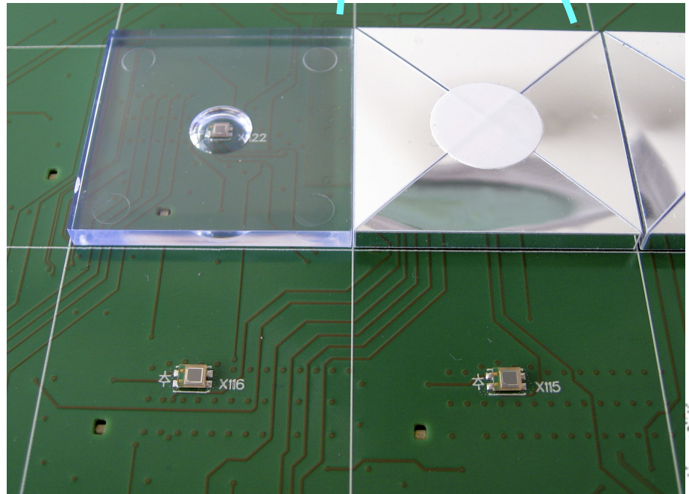
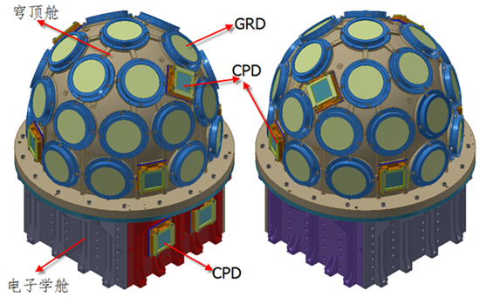
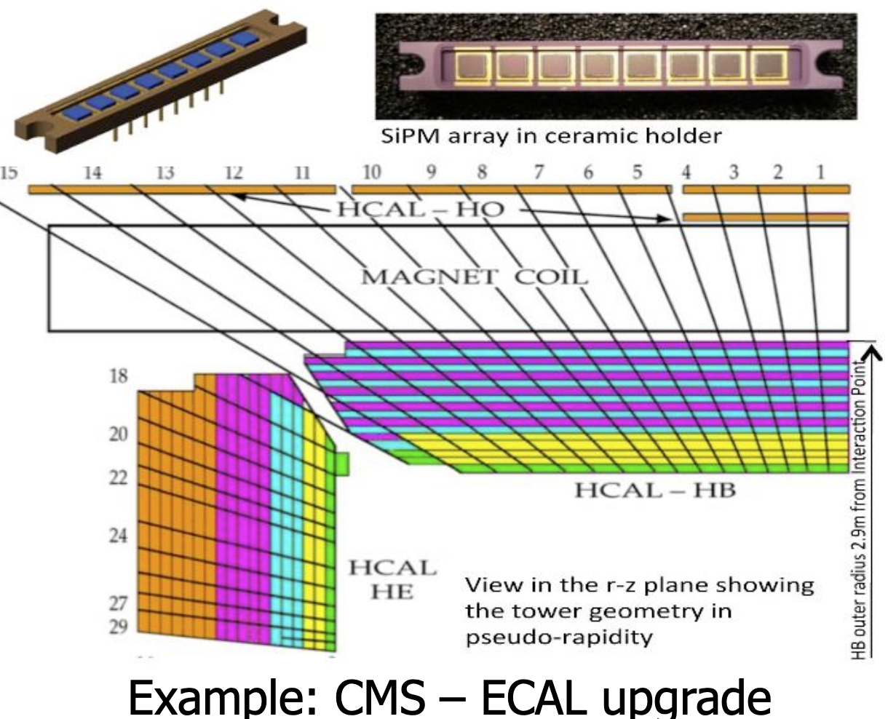
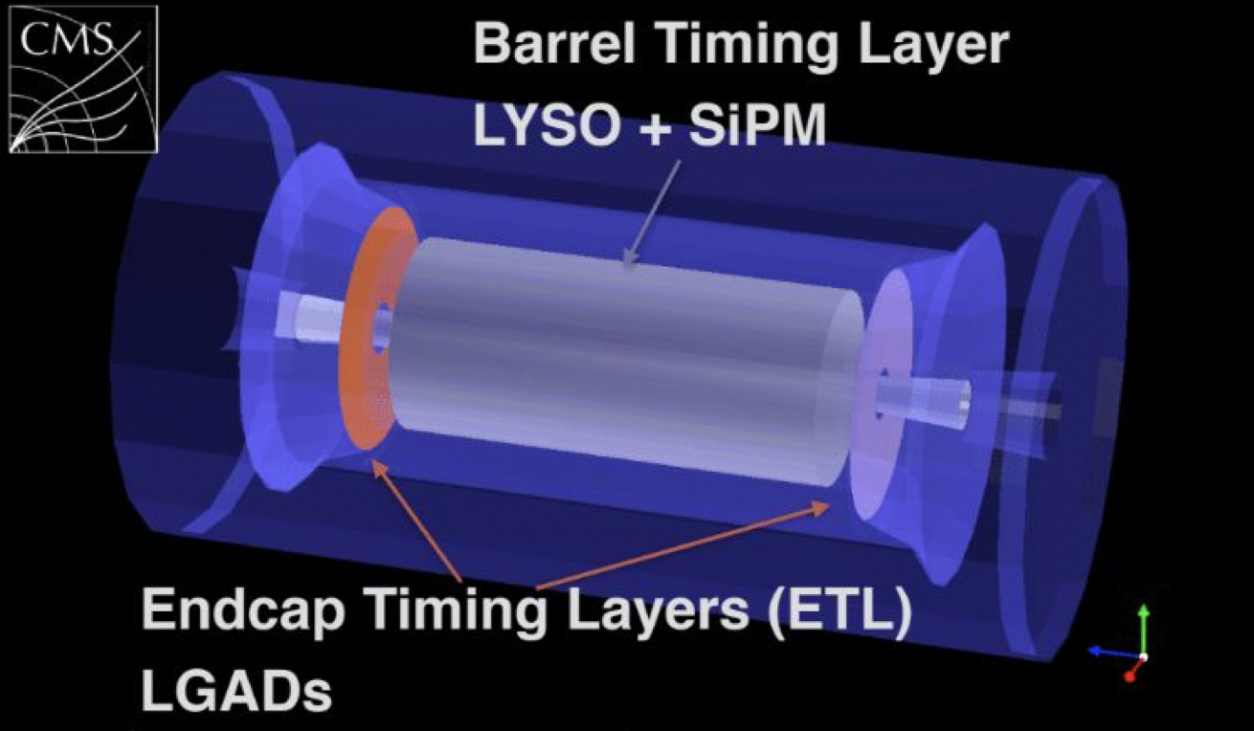
Radiation SiPM application
Astrophysics: Space station scientific experiment (Herd …)
Collider physics: calorimeter application
CMS timing layer, calorimeter
CEPC calorimeter and time of flight detector
GECAM
CEPC PFA
calorimeter
prototype
CMS MIP timing detector
CMS Calorimeter

Slide 4
CEPC ECAL and HCAL: SiPM requirement
ECAL : Small pixel size (6um*6um), large dynamic range
HCAL: High PDE Sipm (PDE>60-70%)
Cherenkov: high PDE for UV light
 | SiPM for ECAL | SiPM for HCAL/muon | SiPM for Cherenkov
Wavelength | 350 – 600 nm | 350 – 600 nm | 100 nm – 600 nm
Size | 3 mm× 3mm | 3 mm× 3mm | 3 mm× 3mm (position sensitive) Or 1mm× 3mm (conventional)
Pixel size | 6 μm × 6 μm | 50 μm × 50 μm Or 20μm × 20 μm | 50 μm × 50 μm ?
PDE | >= 30% (at 420-480nm) | >= 60% (at ~400nm) | 50% at 420nm Sensitive for 200-300nm?
Number of SiPM | ~1 Million | ~5 Million | ~0.2 Million

Slide 5
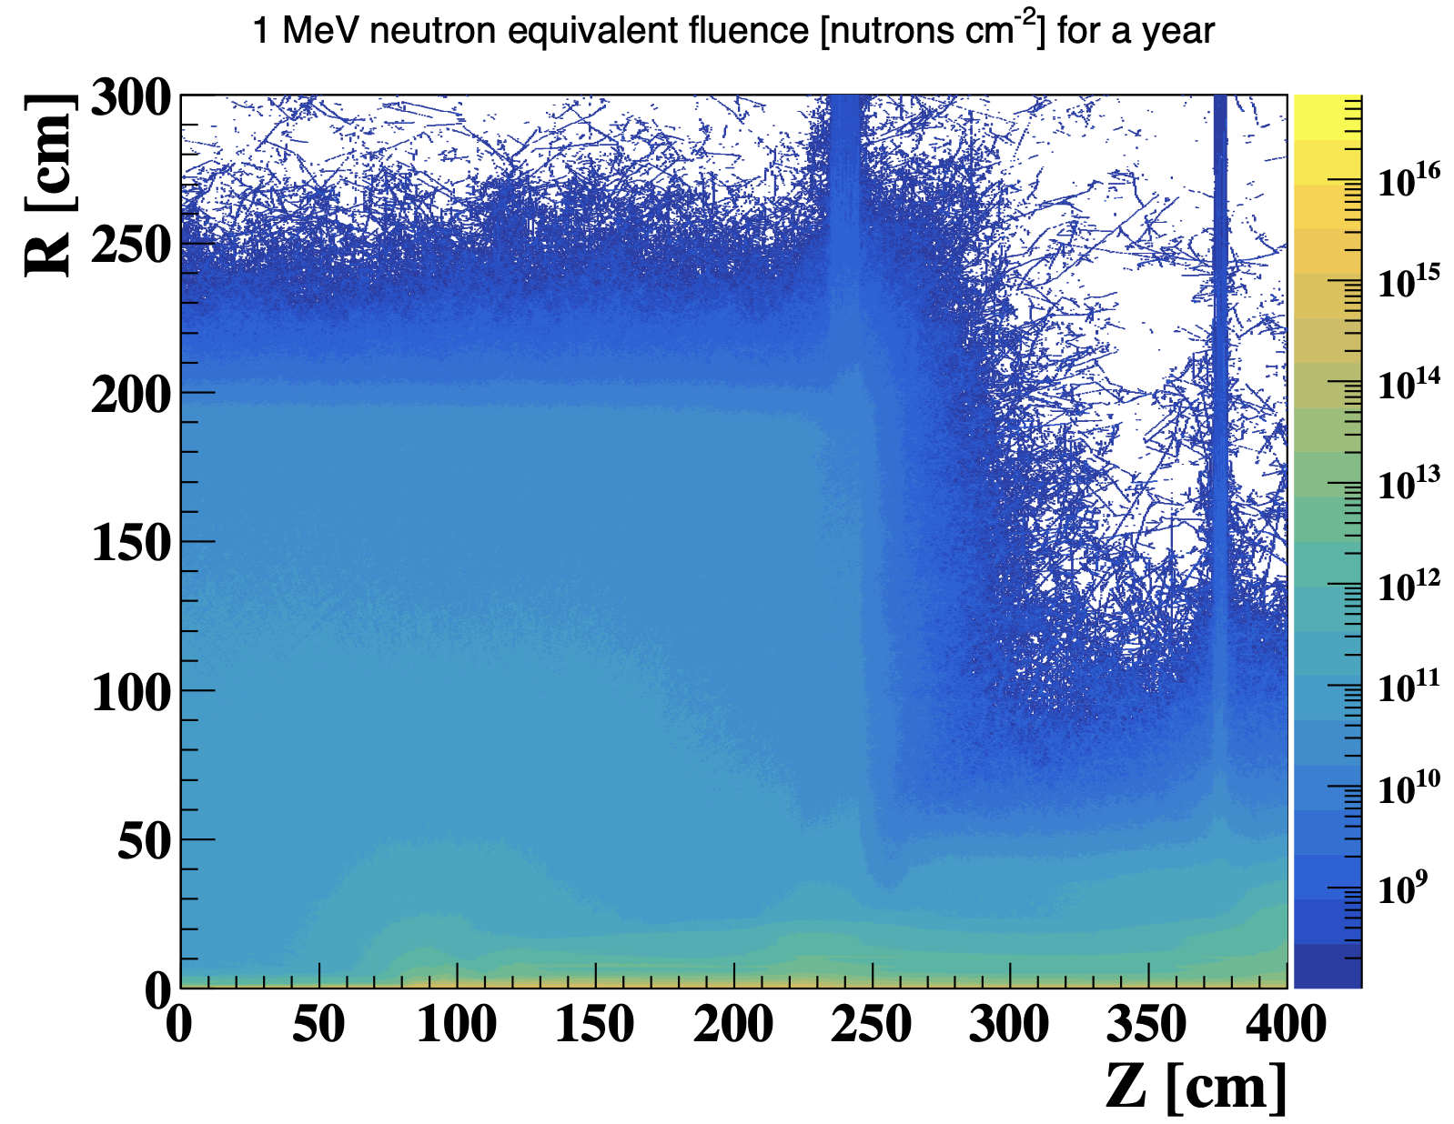
SiPM radiation hardness challenge
After 10 year operation of CEPC, fluence is above 10¹³ n_{eq}/cm²
SiPM typically work below 1krad or 10⁹ n_{eq}/cm² fluence
Performance drop after 1krad or 10⁹ n_{eq}/cm²
In great need to develop radiation hard SiPM
 | Long term Satellite or Space station application | CEPC requirement
TID does | 100 krad | >100 krad
Fluence | ~10¹⁰ n_{eq}/cm² | ~10¹⁰ n_{eq}/cm² (Barrel) ~10¹³ n_{eq}/cm² (Endcap)
Fluence in ZH run（240GeV）

Slide 6
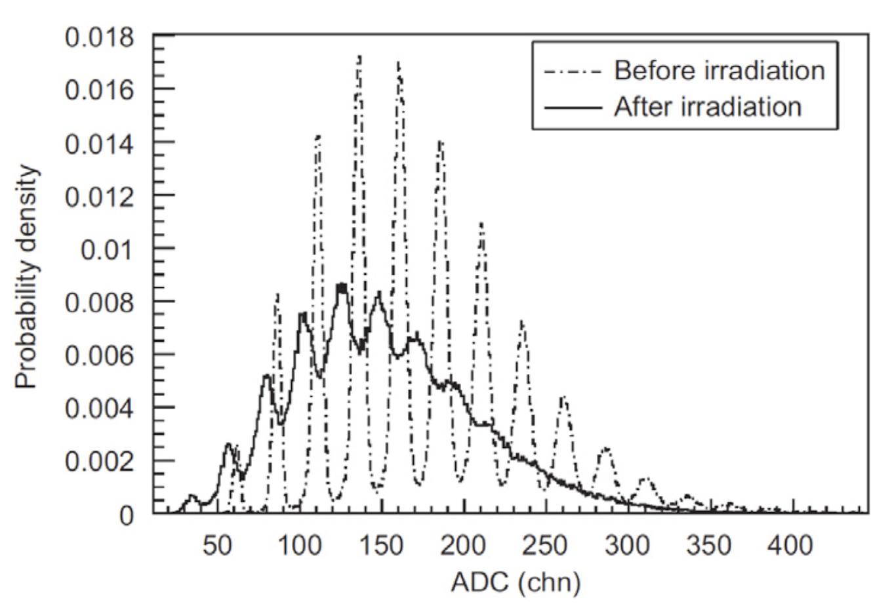
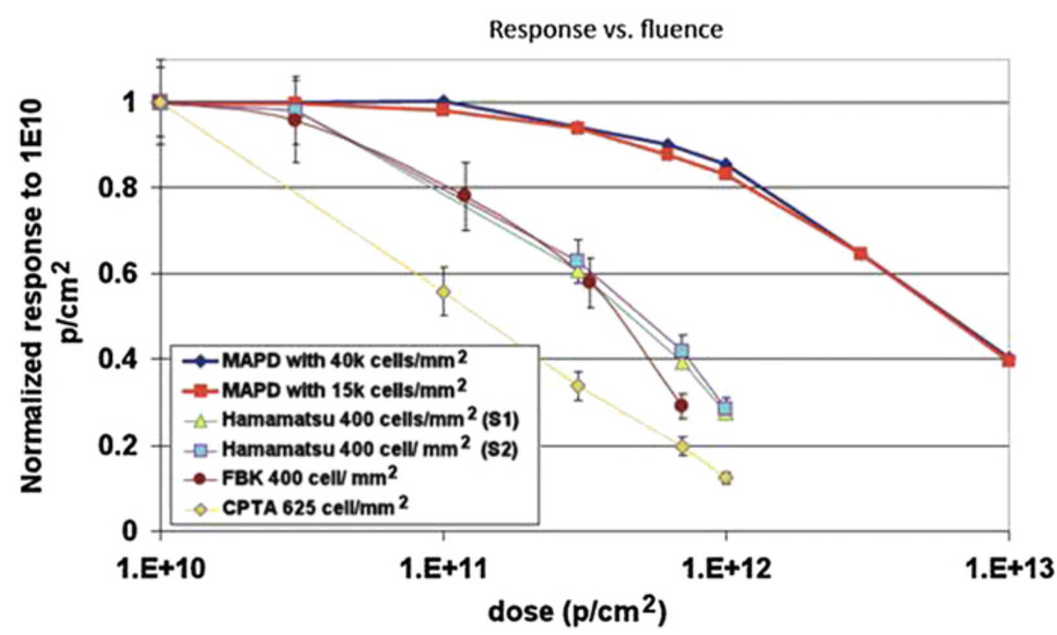
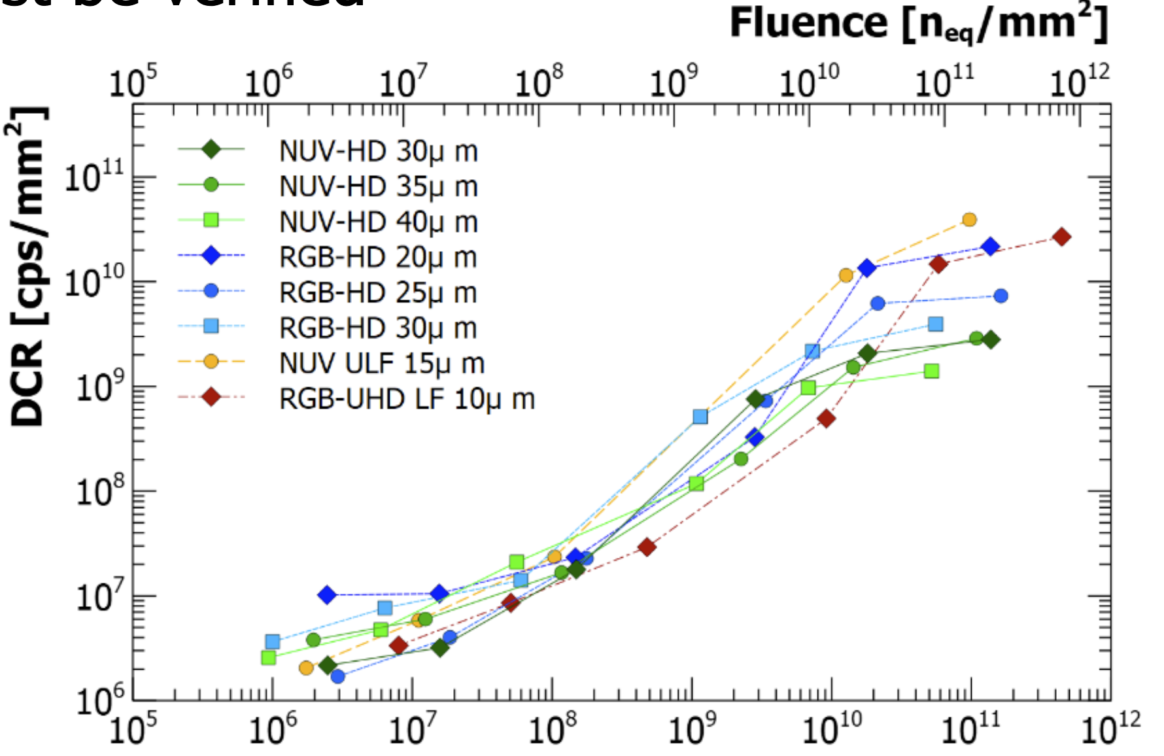
SiPM Radiation hardness
Energy resolution
before/after irradiation
After 10¹⁰ n_{eq}/cm² or 10Krad dose
Signal gain decrease
Energy resolution decrease
Dark count increase
SiPM gain VS Dose
SiPM dark count VS Fluence

Slide 7
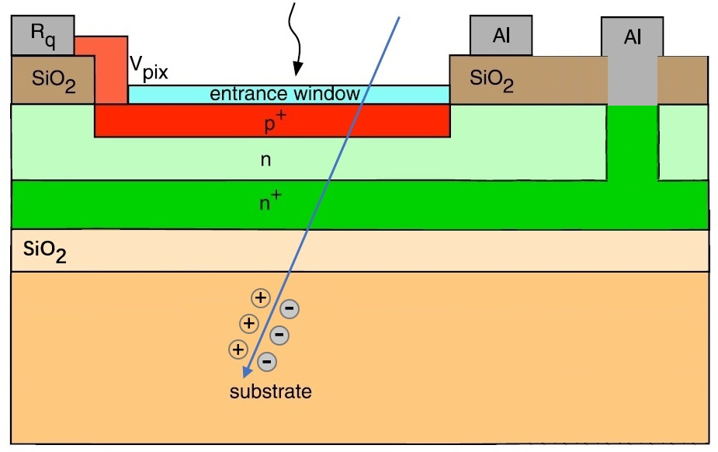
SiPM dark count after irradiation
Bulk damage after irradiation → dark count increased
Potential Solution:
Design a special wafer to isolate the dark current from bulk damage
Isolate the bulk damage from the device
Special wafer

Slide 8
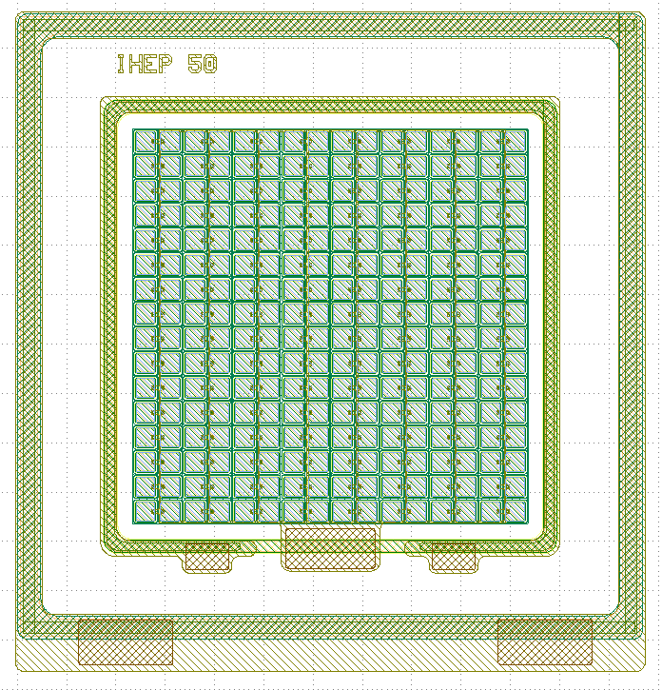
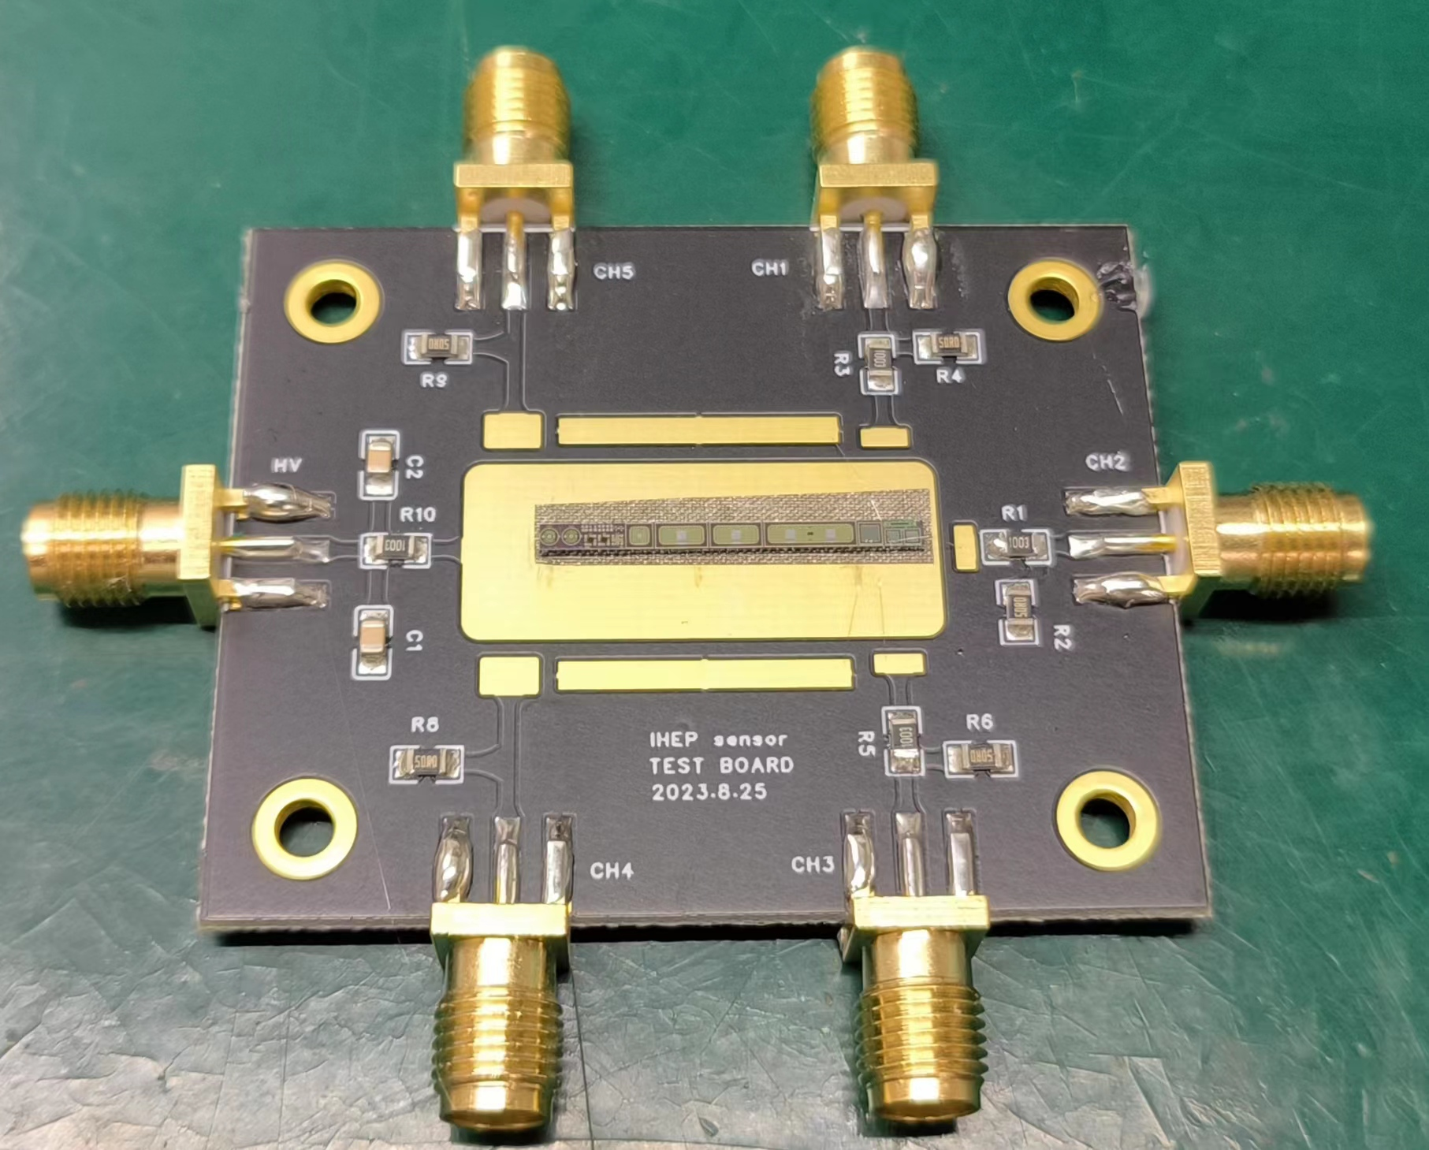
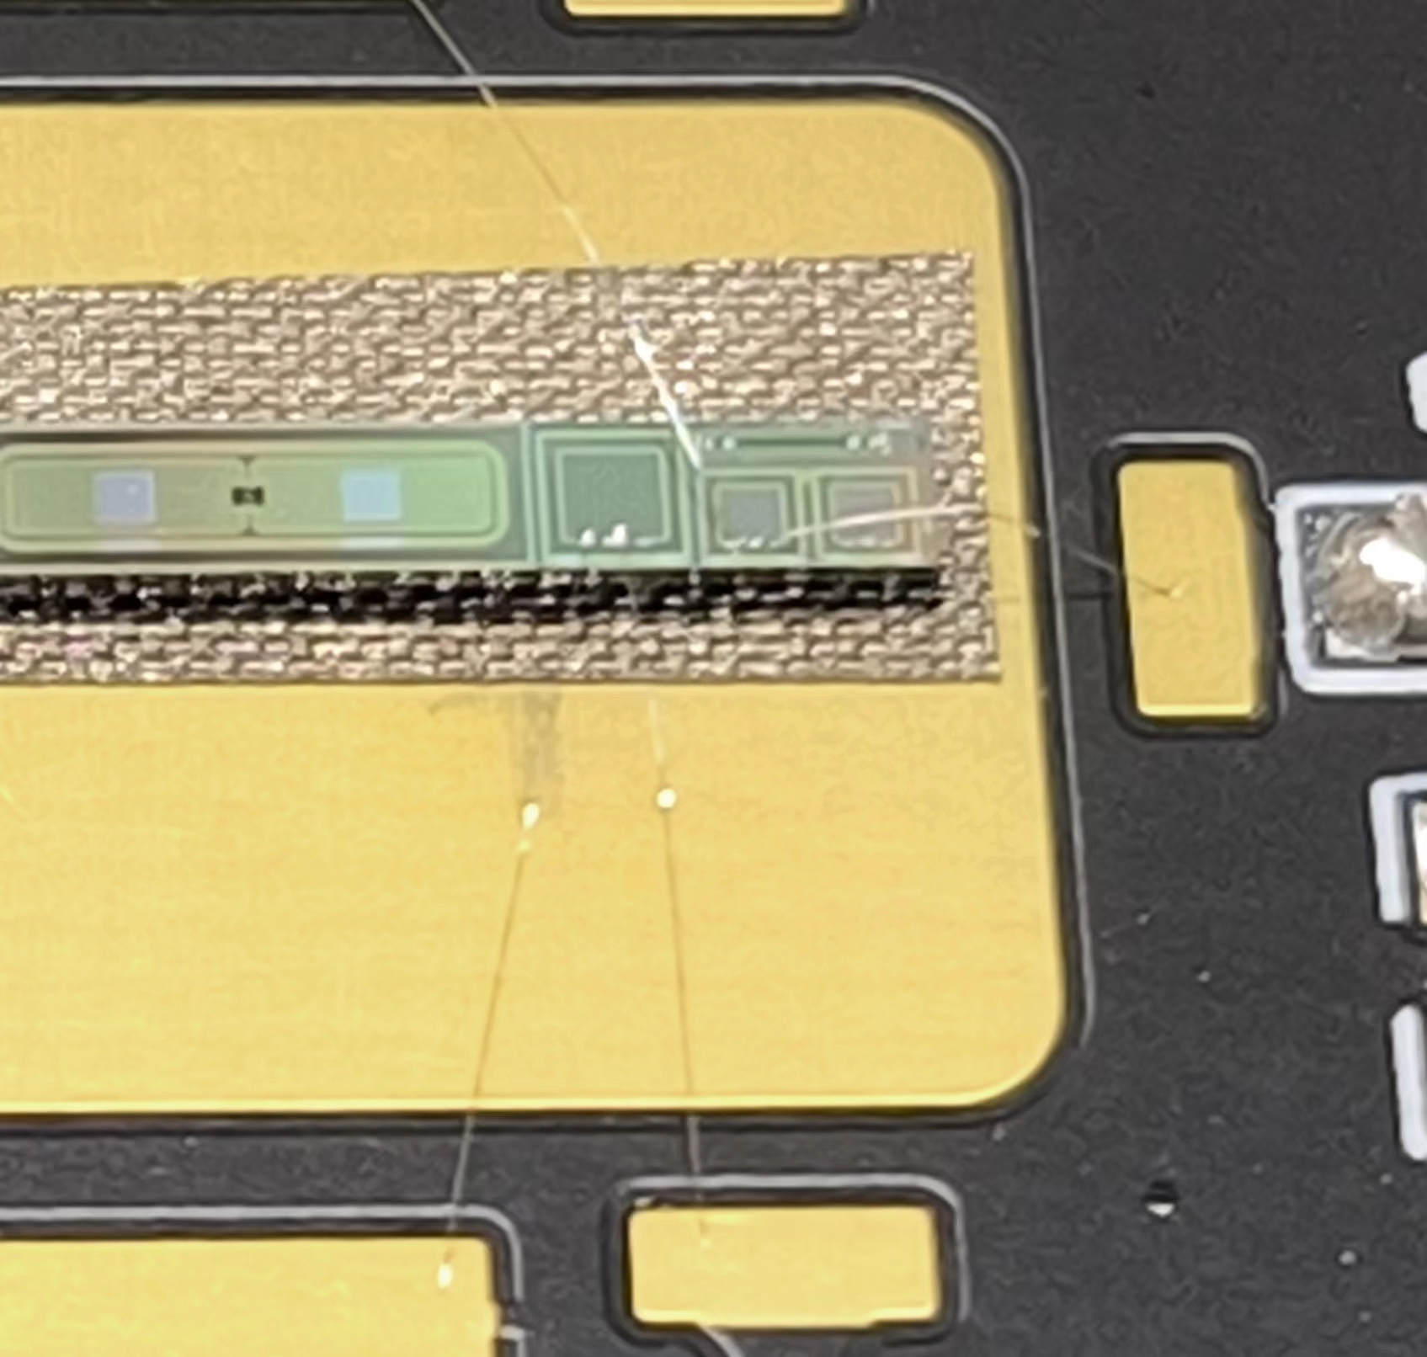
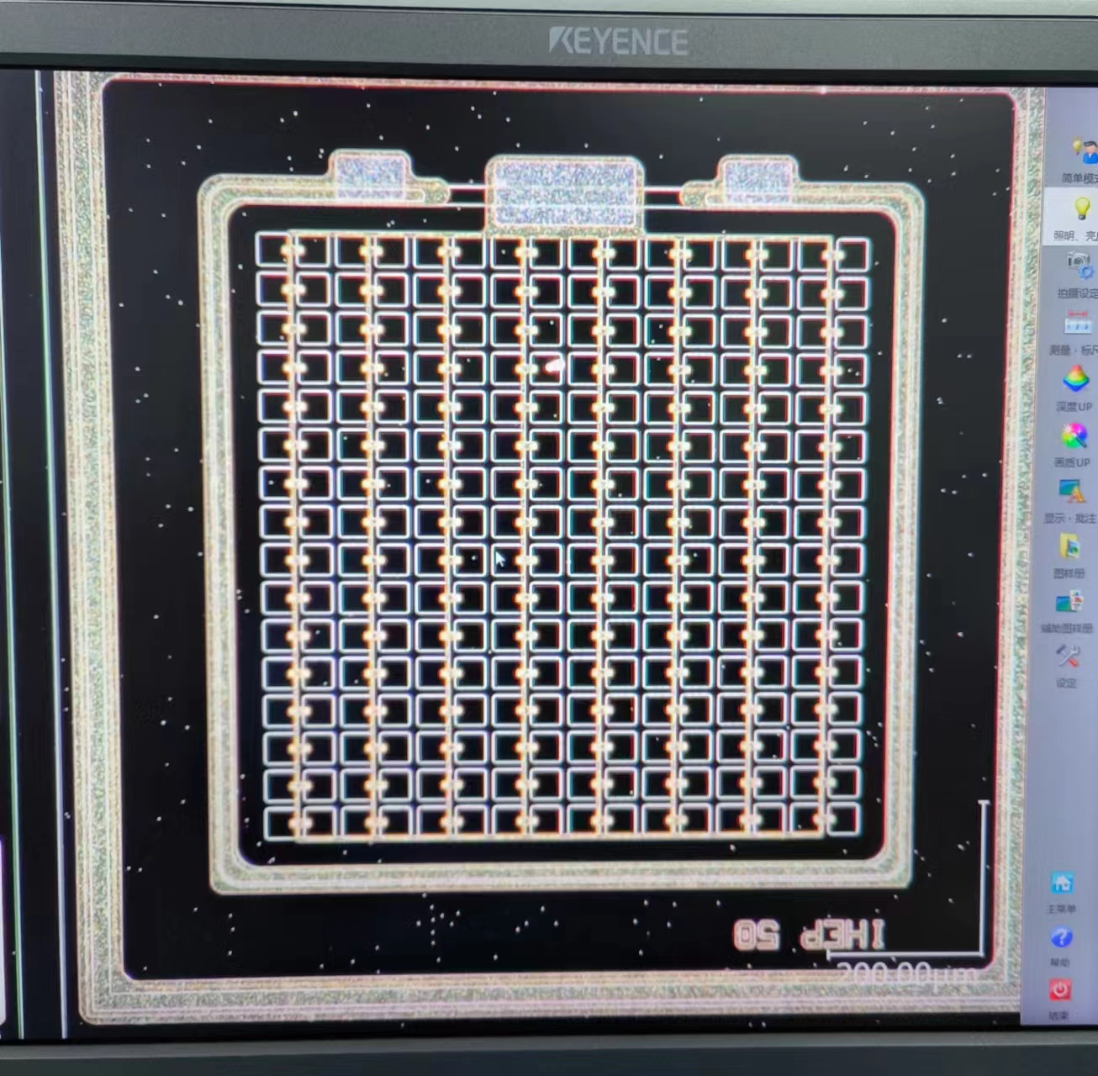
SiPM sample from 1st trial MPW run
We prototyped a small SiPM design
Small SiPM
Pixel size： 50μm
16 x 16 pixels

Slide 9
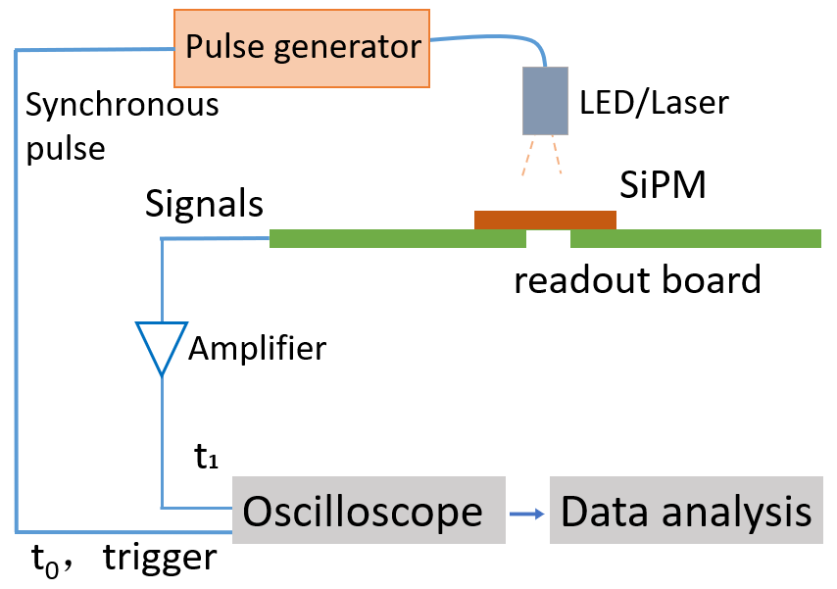
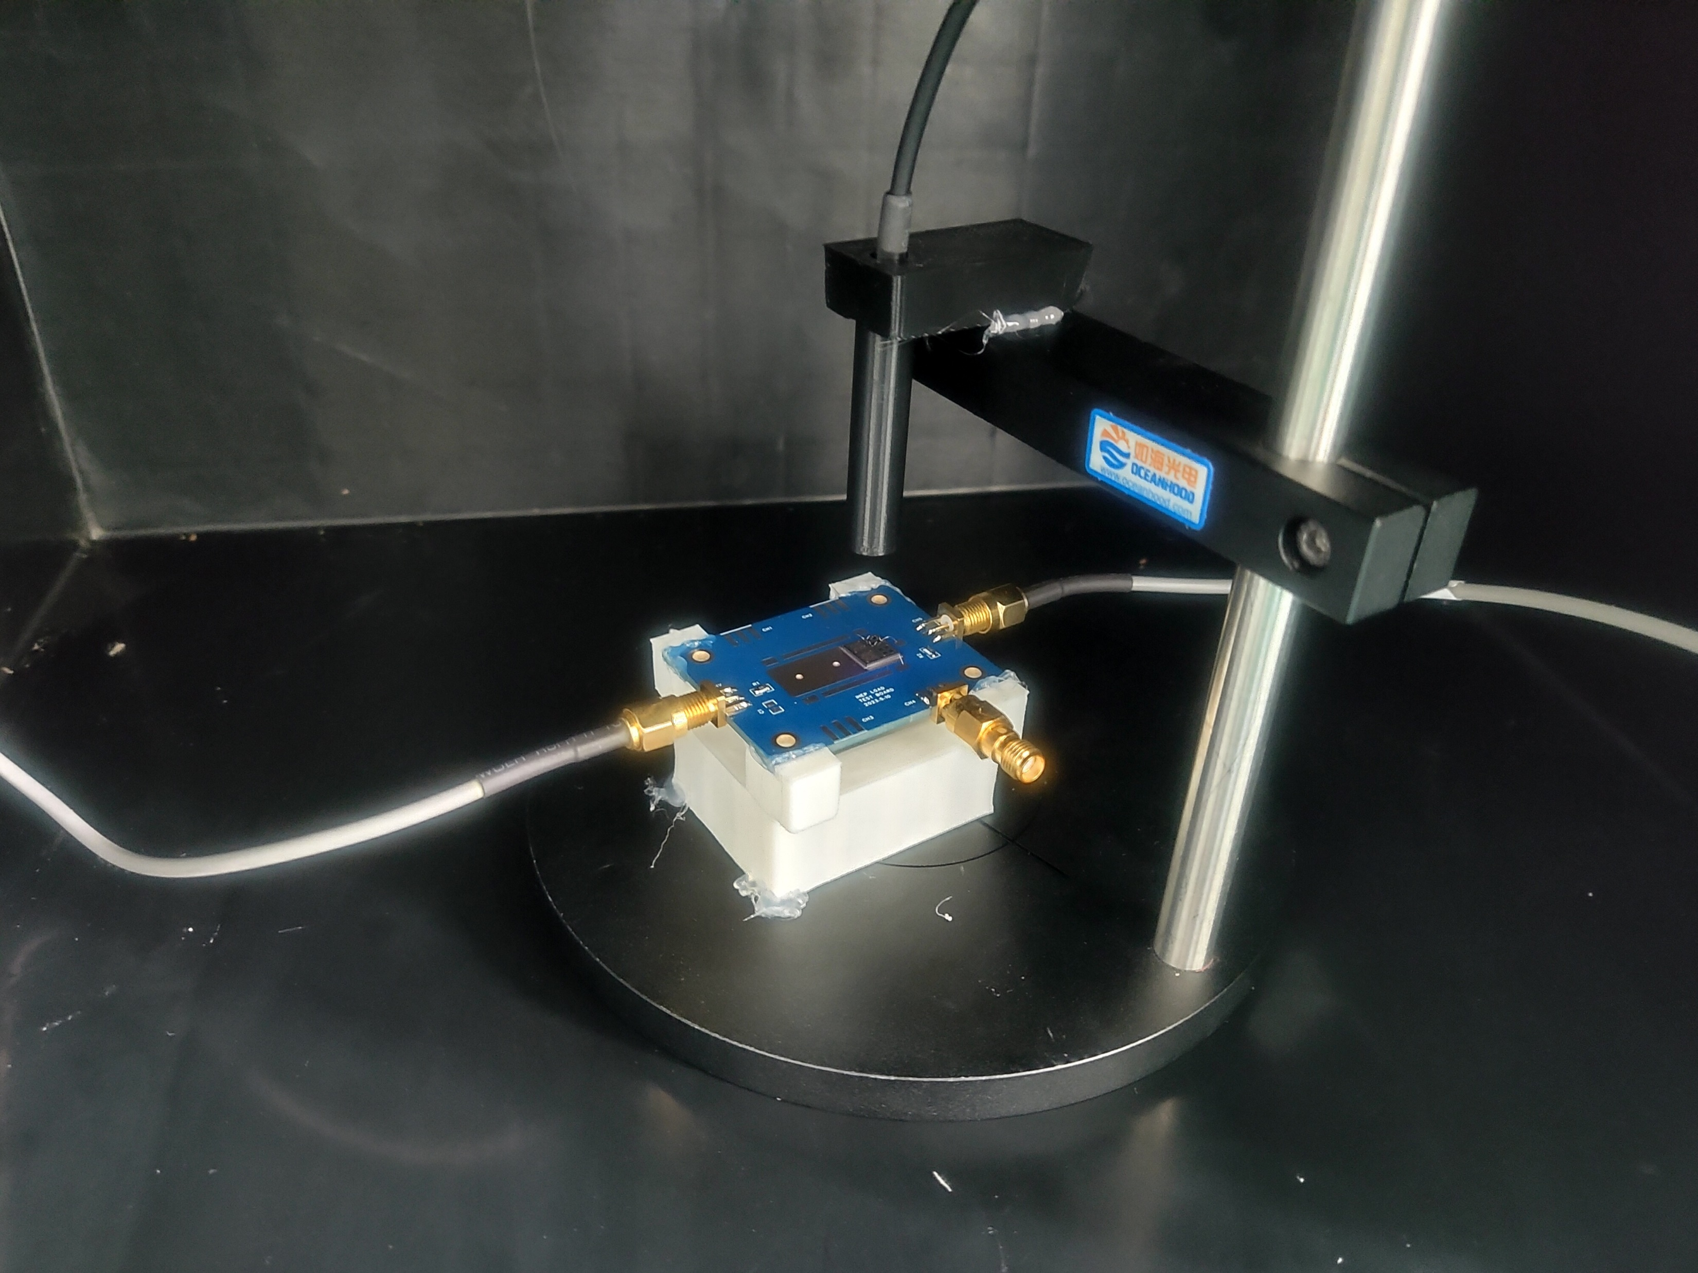
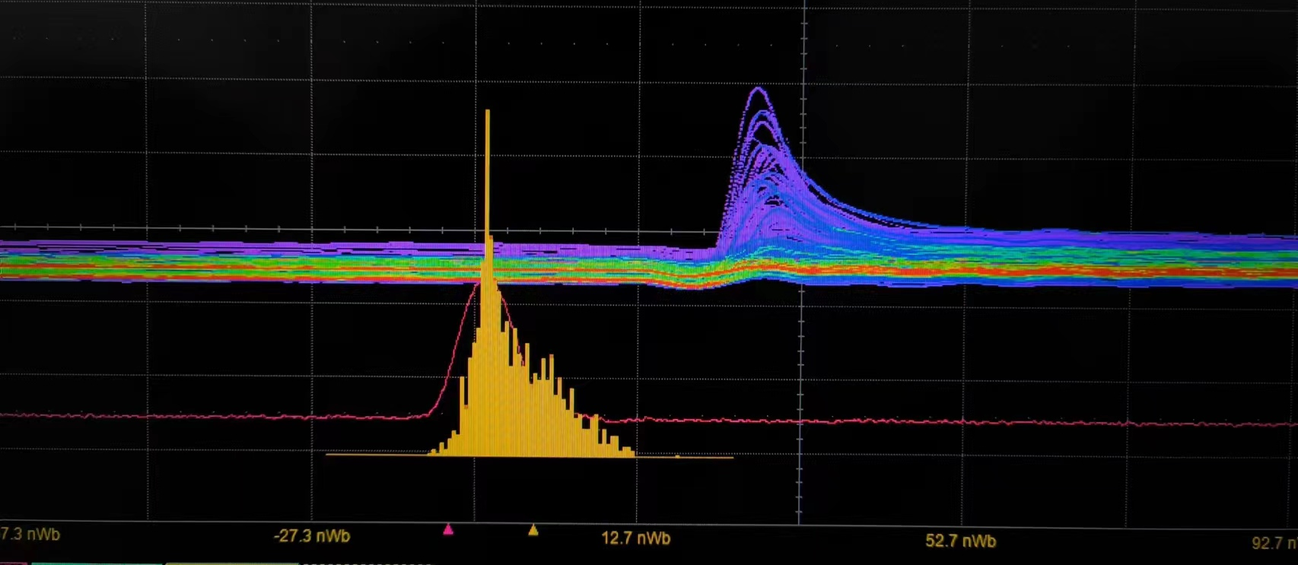
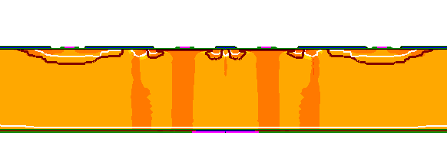
SiPM sample from 1st trial MPW run
SiPM test system
Typical SiPM signal
Found a bug in design
SiPM读出板
SiPM Leakage current is a bit high in 1st trial run
Pstop and GR design has some issue
Optimized the design for engineering runs
SiPM layout and process has been validated

Slide 10
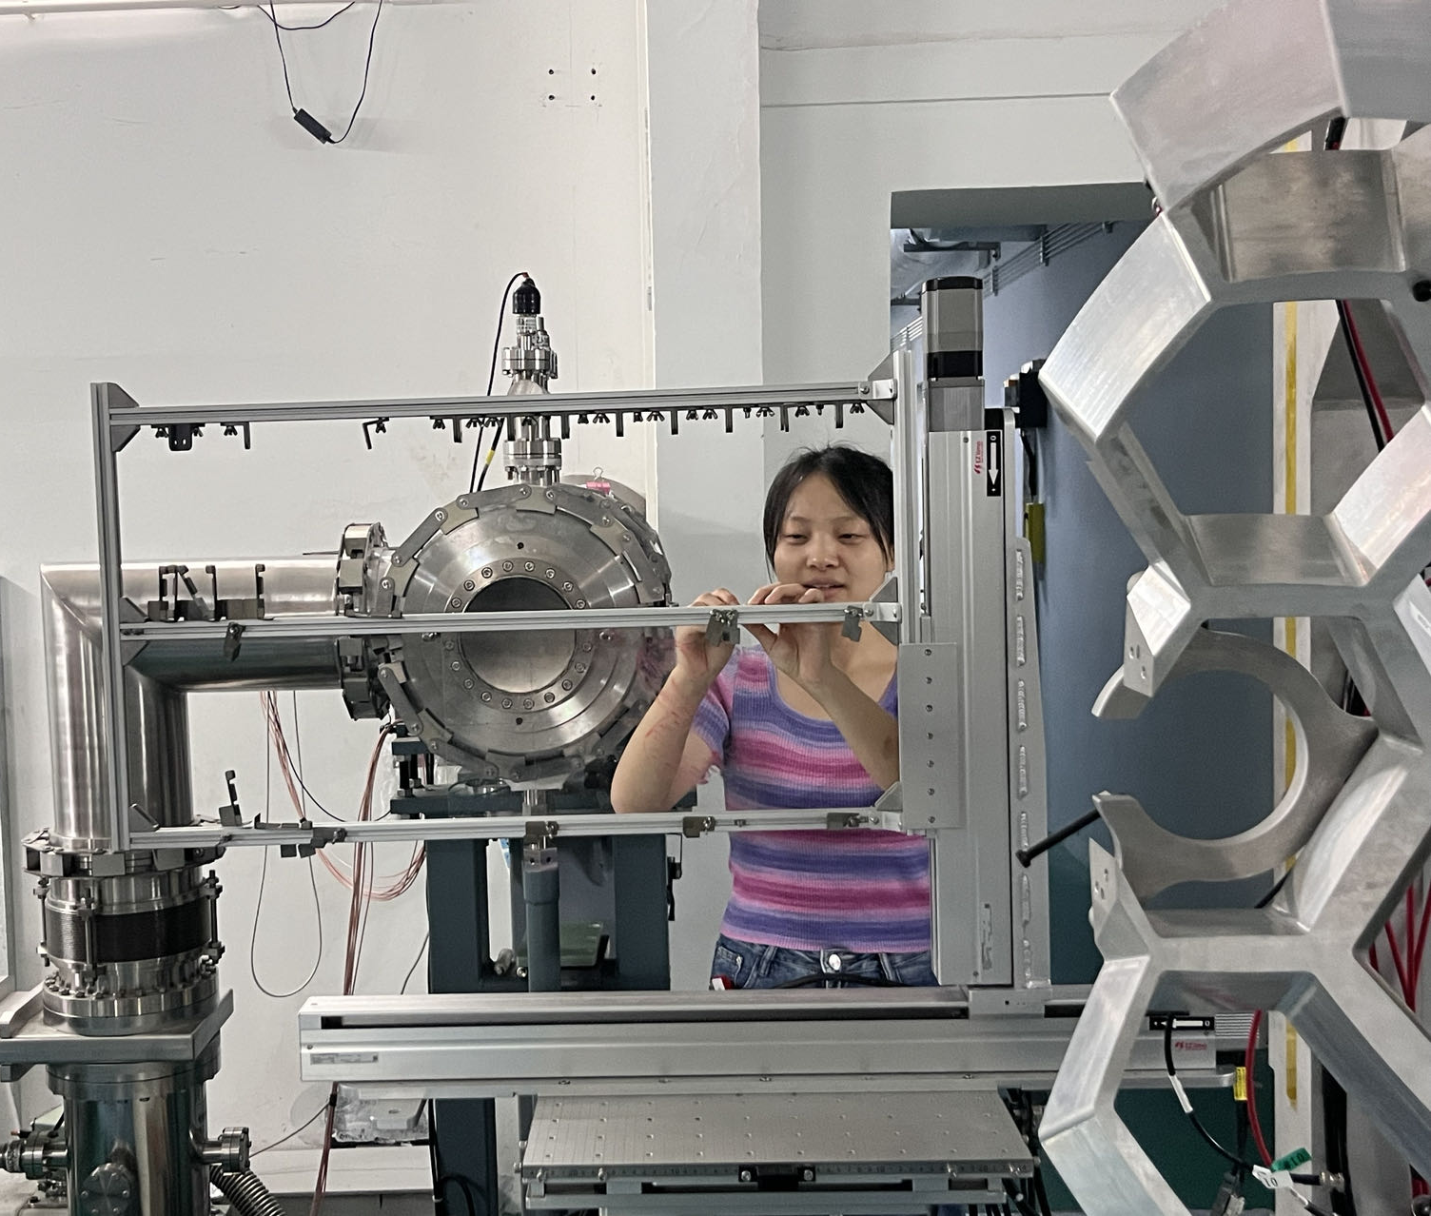
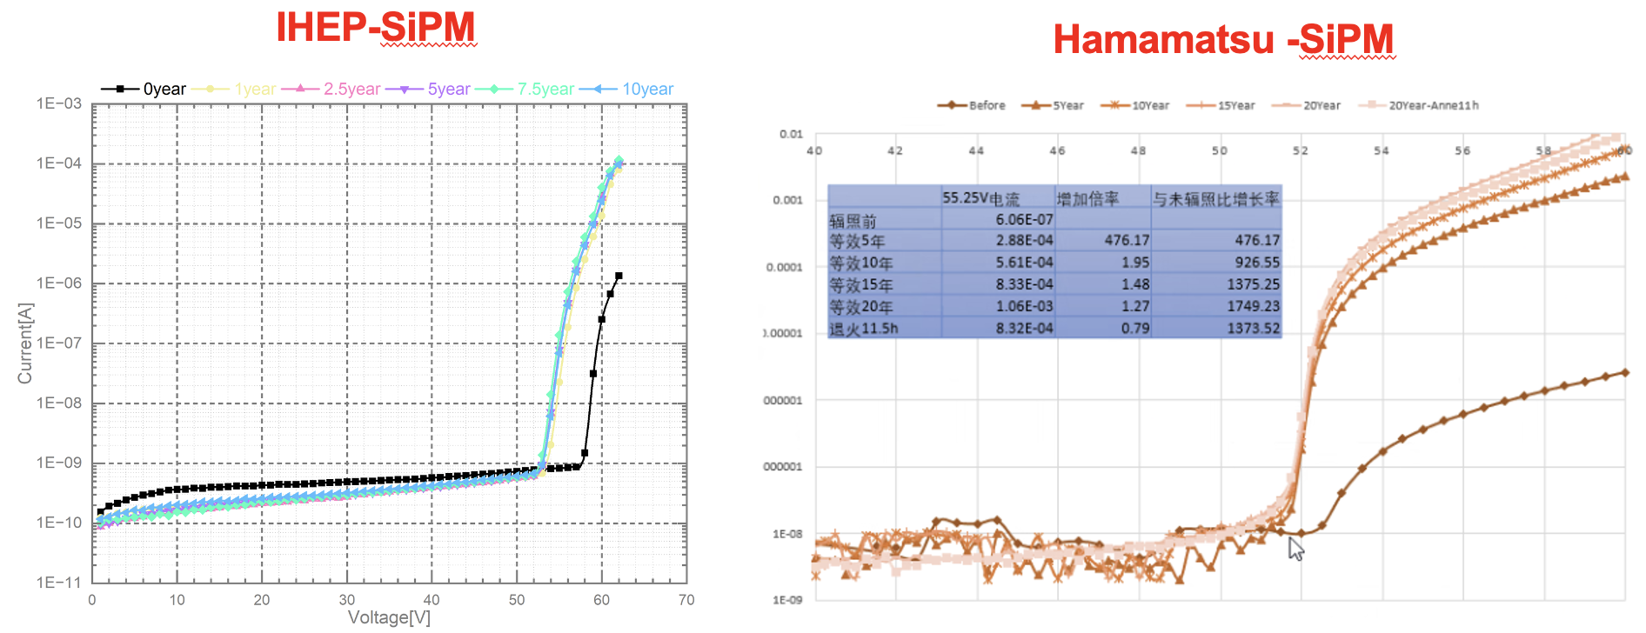
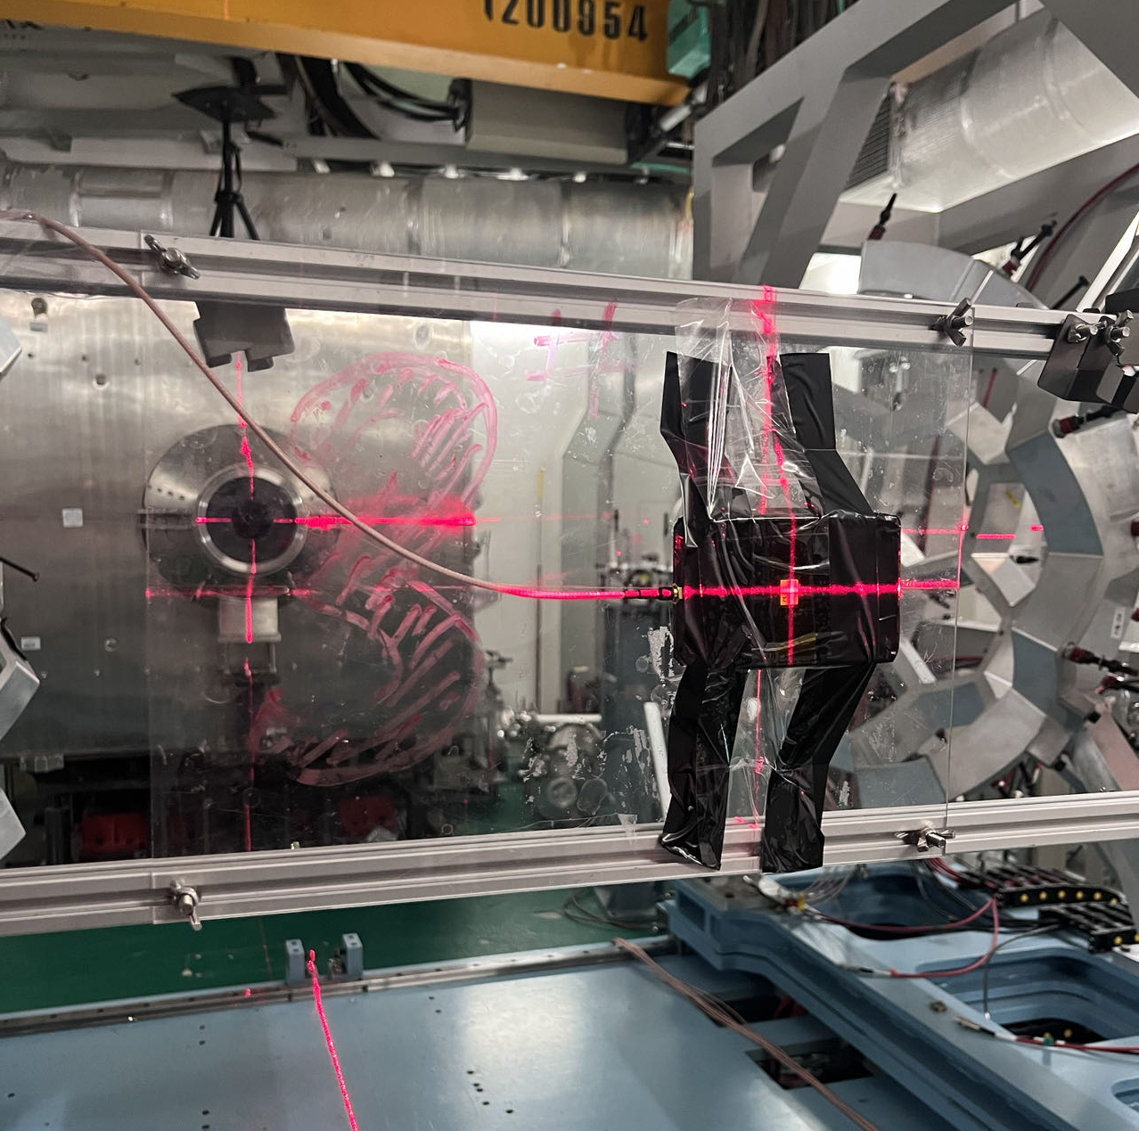
Leakage current of Sipm after irradiation
First trial of this special wafer idea in LGAD development
Indication that IHEP Sipm has potential to be irradiation hard
After 2E10 n_{eq}/cm2, IHEP SiPM leakage current increased by ~10
After 2E10 n_{eq}/cm2, HKP sipm increase by 2-3 order of magnitude
by Tianyuan Zhang.
Tested together with HERD team in CSNS.
1E10 n_{eq}/cm2 is the fluence received by HERD in 10 years operation

Slide 11
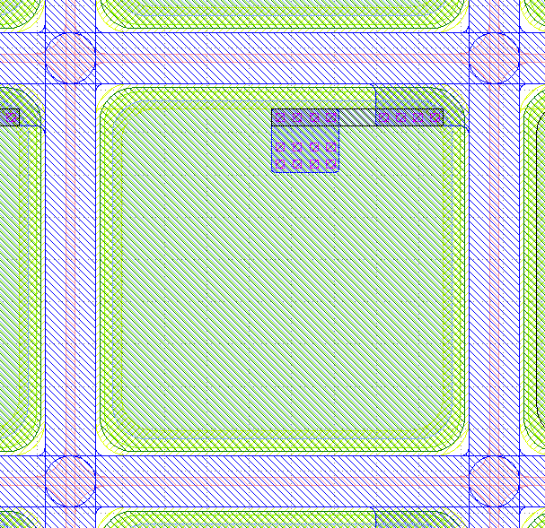
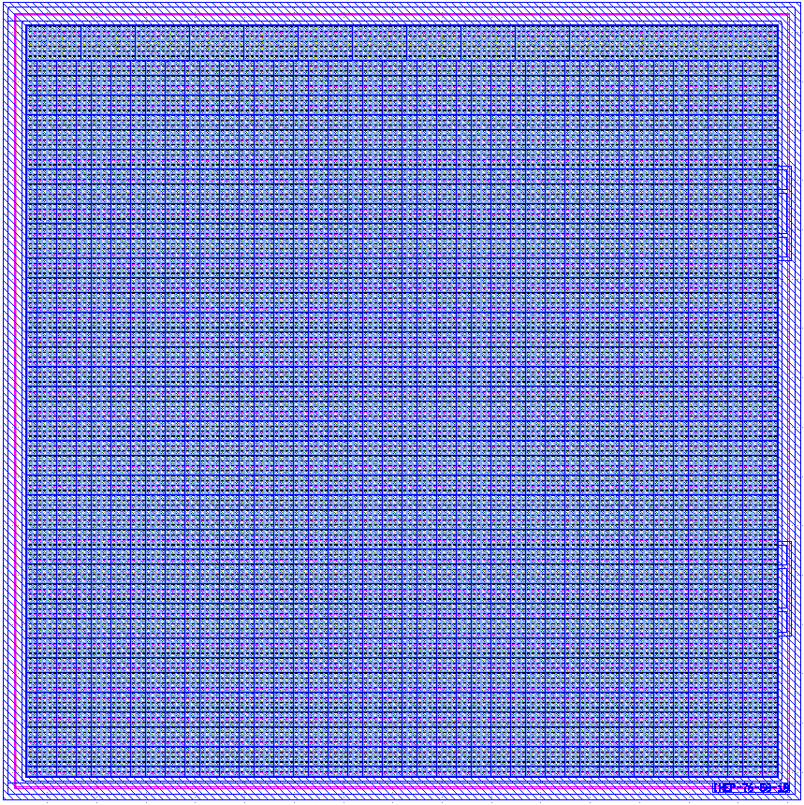
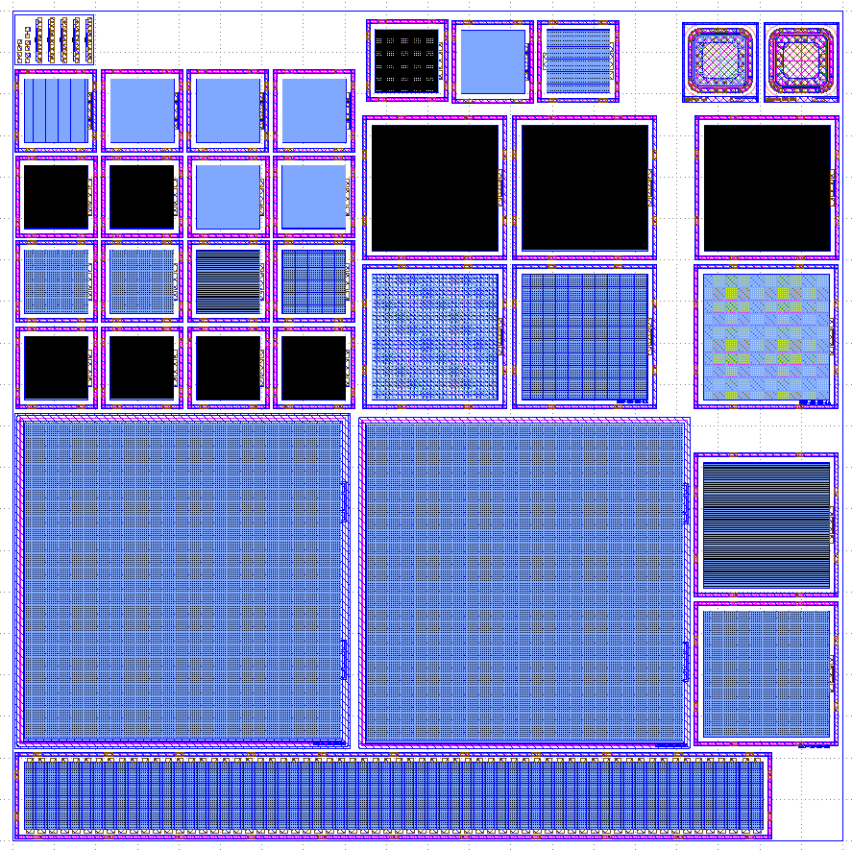
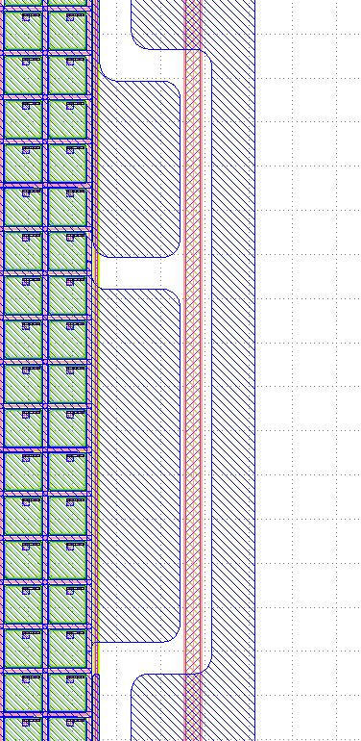
Dedicated SiPM engineering run
Dedicated radiation hard SiPM run will be submitted next month
Various SiPM size: 1*1mm, 3*3mm, 5*5mm
Various Pixel size: 10um ,20um, 50um
SiPM designed for LACT
Pixel size 50um
Quenching resistance 200KΩ
anode
GR
IHEP SiPM layout
cathode
SiPM for LACT：
7.6 mm X 7.6 mm
152 x 152 pixels
Pixel size： 50um
Fill factor 64%
Designer: MengZhao Li, Mei Zhao

Slide 12
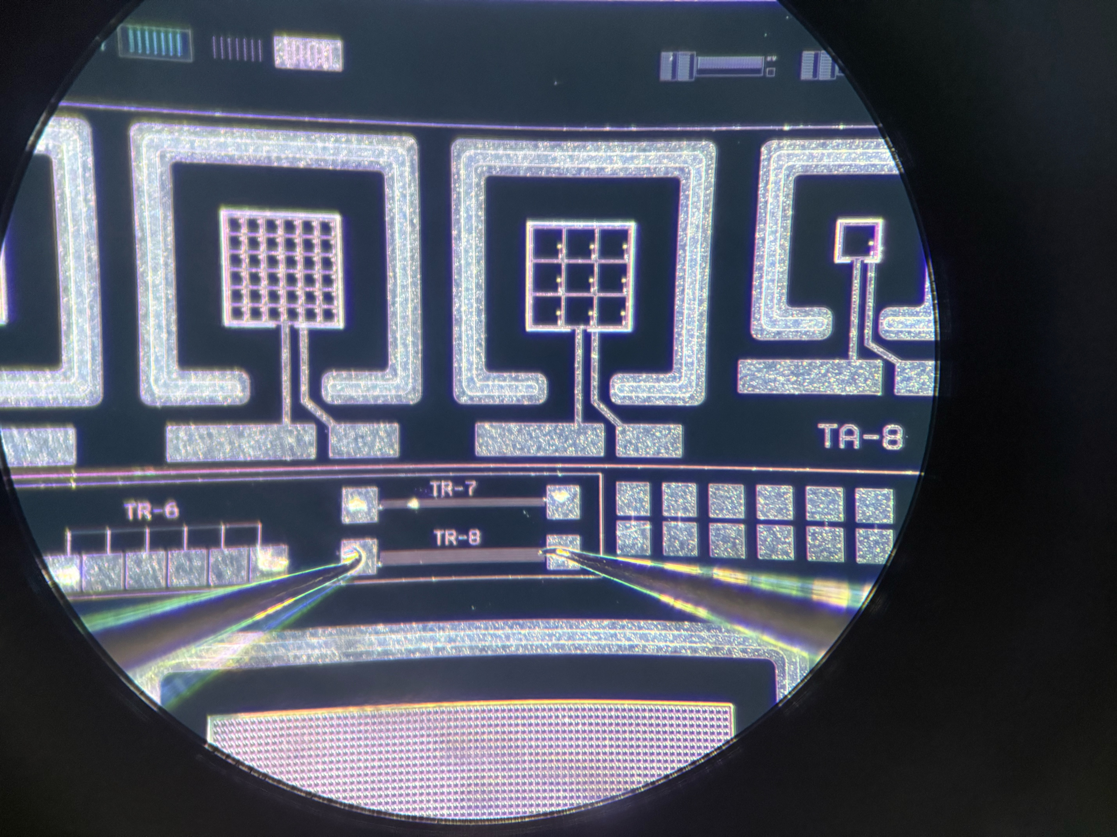
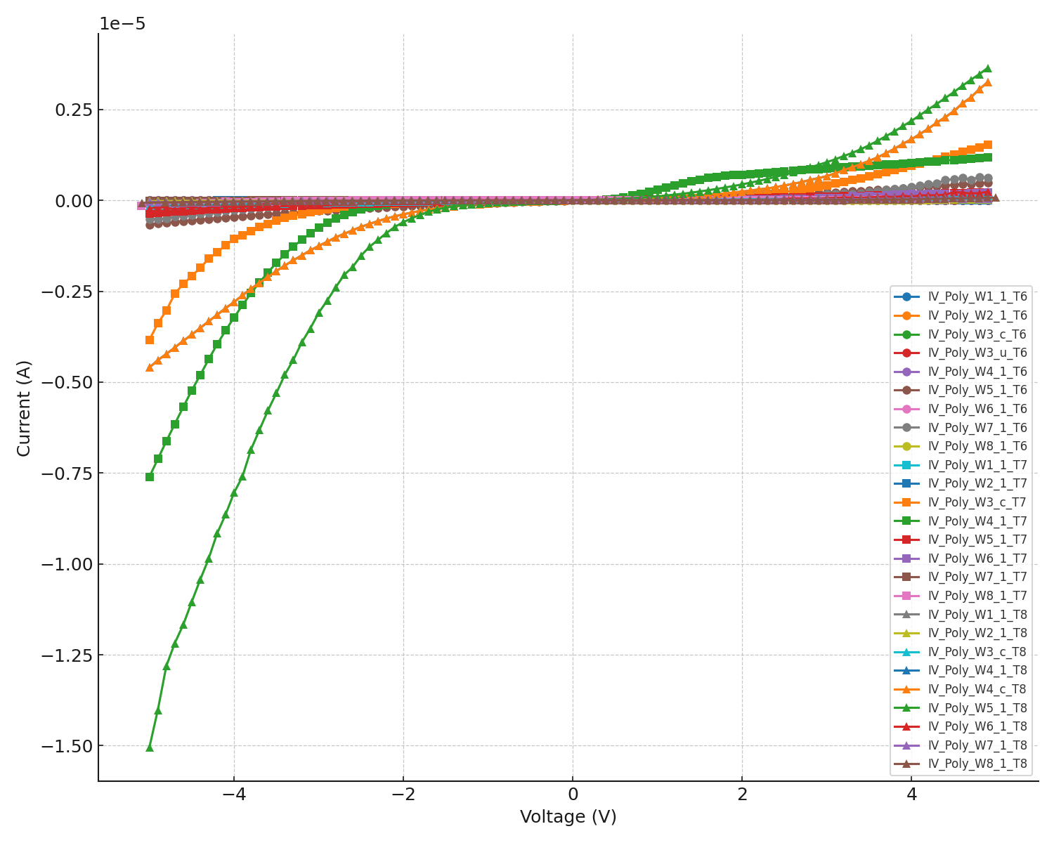
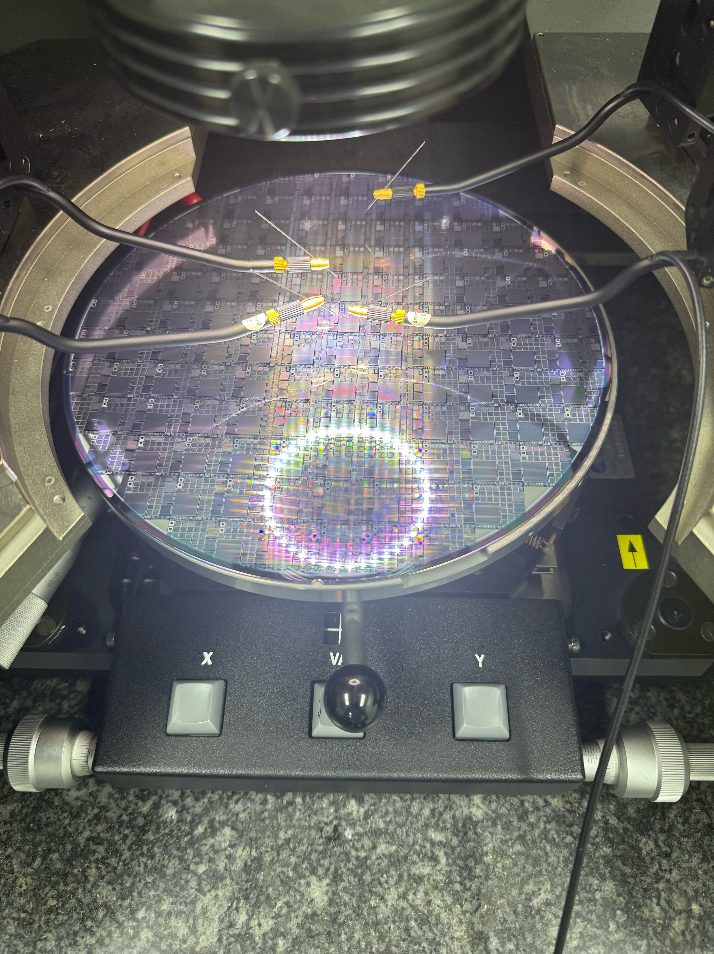
Dedicated SiPM engineering run
First trial run wafers received at the end of 2025.
Validate the doping for poly-silicon quenching resistors
Validate the mask design
Validating quenching resistors: I-V curve
Engineering run wafers
By Weiyi Sun

Slide 13
Time line for radiation hard SiPM
2026 :SiPM irradiation hard design engineering run
1st full engineering run ready in June:
Two type of radiation hard Sipm
Normal wafers and Special wafers with bulk damage isolation.
2027: 2nd engineering run (More dedicated optimization for CEPC )
Integration with ECAL/HCAL/ Cherenkov prototype

Slide 14
Summary
Development for radiation hard SiPM
Aim for CEPC and Astrophysics application
Key technology has been validated in ATLAS HGTD detector
Radiation hard LGAD sensor developed by IHEP team
Status of Radiation SiPM R & D project
1st MPW small prototype was fabricated and tested.
Showed good potential to be radiation hard in the tests
Full engineering run designed
Received trial run wafers at the end of 2025.
Expect to get full wafers by middle of 2026.
Plan to integrate into ECAL and HCAL prototyping in the coming years.

Slide 15
Some thought about the Cost
One 8 inch cost in production : 16k RMB
Number of 3*3mm SiPM in one wafer (assuming 90% yield): ~3000
Raw Cost of SiPM: ~5 RMB
Assuming packaging of SiPM will double the price
Final cost per Sipm ~10 RMB

