Slide 1
Techniques of multi-loop Feynman integral computation and their applications
吴子昊
华南师范大学

Slide 2
Contents of this talk
Background
Why multi-loop Feynman integrals
Review of Methods
Introduction to NeatIBP package
The algorithm
Examples and applications
The spanning cuts consistency problem and one of its answer (new)
Summary

Slide 3
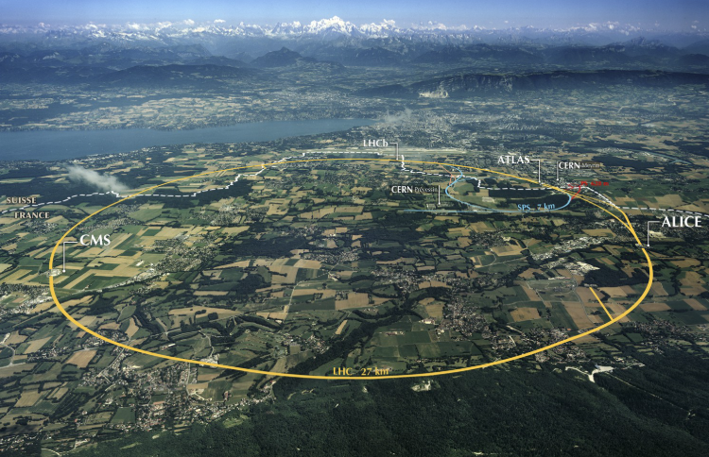



Advances in HEP
High precision Higgs physics,
New physics beyond standard model,
…
High-precision experimental measurements
High-precision theoretical predictions
Phase space integration,
IR subtraction,
…
…
(picture from the internet)
Computing fixed-order amplitudes for scattering processes remains a key obstacle to producing precise predictions for the LHC and HL-LHC. – Les Houches Wish List 2023
LHC
……
High-order Amplitudes
In the future…
HL-LHC
CEPC
perturbation
QFT
FCC
……

Slide 4
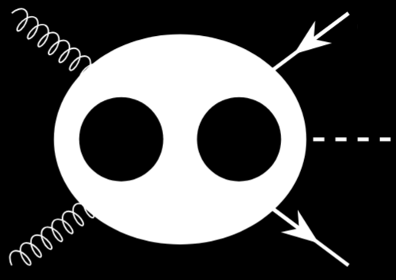
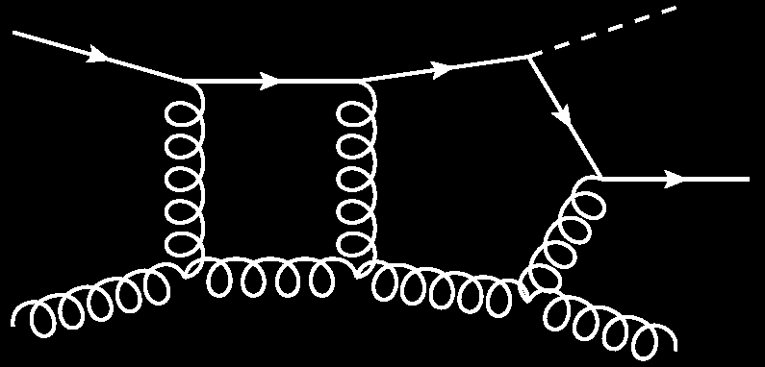
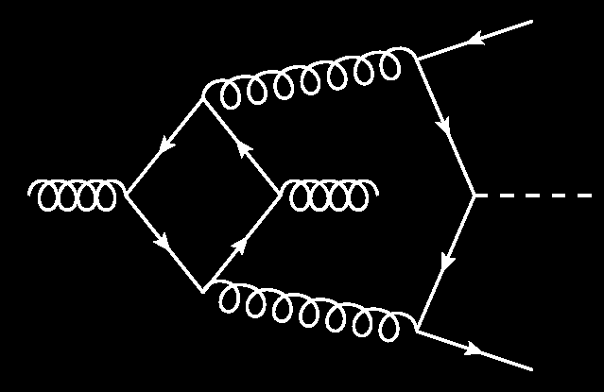
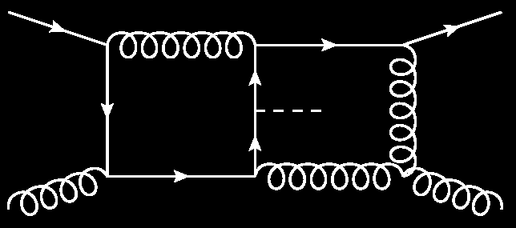

Amplitudes from multi-loop Feynman integrals
Amplitudes (in high order expansion)
Σ
…
Multi-loop Feynman diagrams
Σ
Multi-loop Feynman integrals
Multi-loop Feynman integrals are key objects to evaluate high-order amplitudes.

Slide 5
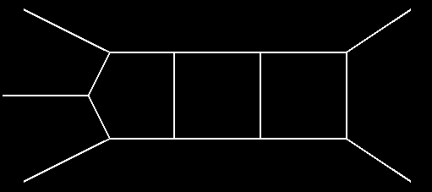
Frontier of Feynman integral computations
 | One-loop | Two-loop | Three-loop | ≥ Four-loop
Four-point | Known | Most known, with some hard problems unknown | Partially known | Frontier
Five-point | Known | Partially known | Frontier | Unknown
≥ Six-point | Known | Frontier | Unknown | Unknown
Feynman integral computations is one of the bottlenecks for plenty of computations in precision frontier.
Its breakthrough relies highly on the development of techniques

Slide 6
Review of Methods

Slide 7
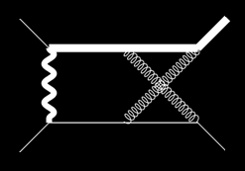

Workflow of analytic computation of Feynman integrals
Feynman diagrams
Feynman rules
Feynman integrals
Tensor reduction
Scalar integrals
Integration-by-parts (IBP) reduction
Evaluation methods:
(canonical) differential equations, method of region…
AMFlow, pySecDec, Fiesta,…
Analytic functions / Numerical results
Master Integrals
A linear independent basis of the scalar integrals

Slide 8




Integration by parts (IBP) reduction
Feynman integral family
IBP relations
IBP reduction
Master integrals
Gaussian
Elimination
Linear system of IBP relations
Coefficients

Slide 9
Integration by parts reduction
Problem : High computation cost for reduction
3
4
Target integrals with degree-5 numerators
Quantity: 2483
# of IBP (FIRE6): 11207942
2
Example
5
1
Gaussian elimination of a HUGE matrix with Analytic elements
…
…
s12 + s23
…
…
…
We cannot finish the reduction analytically in a tolerable time
…
…
…
10^7 × 10^7

Slide 10
Our goal:
Compute of high-order amplitudes that are needed for high energy physics
How:
1. Developments of new methods and computation tools to solve the bottlenecks in multi-loop Feynman integrals
2. Applying the new methods and computation tools to advance the computations

Slide 11
Introduction to NeatIBP

Slide 12
Traditional IBP algorithm
Linear system of IBP relations (large)
Linear solver
Traditional IBP generators
IBP reduction results
Computational expensive
NeatIBP:
Linear solver
IBP generators from syzygy
Linear system of IBP relations (small)
IBP reduction results
Computational less expensive

Slide 13
The work flow and program package NeatIBP
Syzygy equations
Nicer IBP generators
Seeding
Smaller IBP system
Minimal-needed IBP system
Reduced IBP
Refining
system
IBP reduction

Slide 14
The work flow and program package NeatIBP
Syzygy equations
NeatIBP
Seeding
Based on:
Mathematica
Singular
Nicer IBP generators
https://github.com/yzhphy/NeatIBP
Smaller IBP system
Minimal-needed IBP system
Refining
system

Slide 15
NeatIBP inputs & outputs
IBP relations
kinematics
NeatIBP
./run.sh
target integrals
master integrals
configurations
relative integrals

Slide 16

Performance of NeatIBP
Target integrals:
Max numerator degree: 5
Max denominator power: 1
Quantity: 2483
# of IBP (FIRE6): 11207942
# of IBP (NeatIBP): 14120
Time used: 27m at
2L5P Example
3
4
2
5
1
CPU threads: 20
RAM: 128GB

Slide 17
NeatIBP 1.1 new feature: kira interface
NeatIBP
Small-size IBP system
IBP solver?
IBP reduction results
IBP reduction inputs
KIRA
as a popular integral reduction software, is a very nice IBP solver for NeatIBP output.
Comput.Phys.Commun. 230 (2018) 99-112, Comput.Phys.Commun. 266 (2021) 108024, etc.
Kira allows user to feed in linear systems of IBP relations (called user defined system) and then reduce them .
The Kira+NeatIBP interface is included in NeatIBP 1.1

Slide 18
NeatIBP 1.1 new feature: kira interface
NeatIBP
IBPs generated by NeatIBP
Input files of KIRA format (.yaml)
Inputs for NeatIBP
Converter
Converter
Optional
Kira
KIRA user defined system ( solvable using KIRA)
Reduced IBP system
In NeatIBP 1.1, to use Kira to reduce the IBP generated by NeatIBP, add the following commands into NeatIBP “config.txt”
PerformIBPReduction=True;
IBPReductionMethod=“Kira”;
KiraCommand=“/some/path/kira”
FermatPath=“/some/path/fer64”

Slide 19
I/O of NeatIBP with Kira interface
kinematics
NeatIBP
./run.sh
Kira
target integrals
IBP Table (reduced)
(no need to prepare Kira input files manually)
configurations

Slide 20
NeatIBP Applications

Slide 21
Applications of NeatIBP
A three-loop five-point planar diagram
Yuanche Liu, Antonela Matijašić, Julian Miczajka, Yingxuan Xu, Yongqun Xu, Yang Zhang, Phys.Rev.D 112 (2025) 1, 016021
“On a laptop, NeatIBP finds about 85000 IBP identities in full kinematics dependence within several hours. These relations are sufficient to derive the differential equation. As a comparison, standard IBP tools would generate three orders of magnitude more IBP relations, which make the reduction computation impossible.”
Traditional (Laporta) IBPs | NeatIBP
~ 1 0000 0000 IBPs | ~ 85000 IBPs
IBP reduction impossible | IBP reduction doable

Slide 22
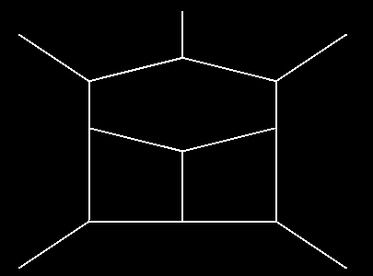
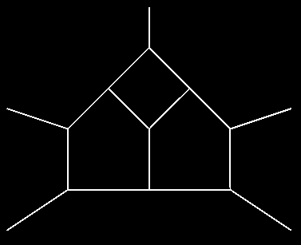
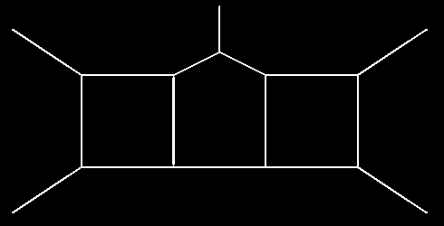
Applications of NeatIBP
More three-loop five-point planar diagrams
Dmitry Chicherin, Yu Wu, Zihao Wu, Yongqun Xu, Shun-Qing Zhang, Yang Zhang, 2512.17330
With the spanning cuts method developed in the latest version of NeatIBP (1.1), there are break throughs on the above diagrams.

Slide 23
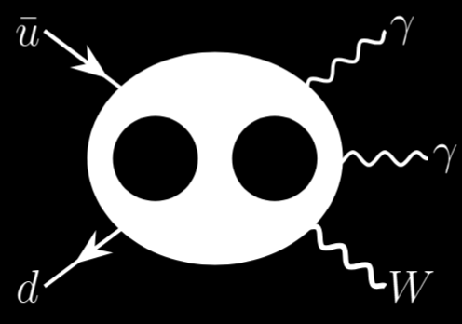
Applications of NeatIBP
𝑊𝛾𝛾 production at LHC
Cross section measurements
ATLAS
CMS
Phys. Rev. Lett. 115 (2015) 031802
Phys. Lett. B 848 (2024) 138400
JHEP 10 (2017) 072
JHEP 10 (2021) 174
Latest amplitude progress: NNLO correction in QCD
Simon Badger, Heribertus Bayu Hartanto, ZW, Yang Zhang and Simone Zoia, JHEP 03 (2025) 066

Slide 24
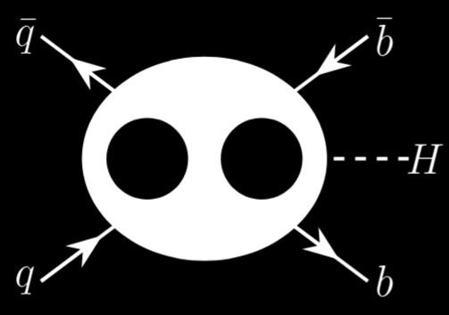
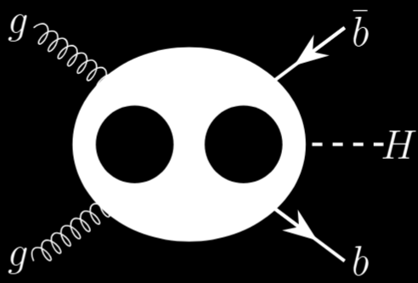

Applications of NeatIBP
$b\overline{b}H$ production at LHC
Cross section measurements
CMS
Phys. Lett. B 860 (2025) 139173
Latest amplitude progress: two-loop five-point amplitudes in 5FS
Simon Badger, Heribertus Bayu Hartanto, Rene Poncelet, ZW, Yang Zhang and Simone Zoia, JHEP 12 (2025) 221

Slide 25
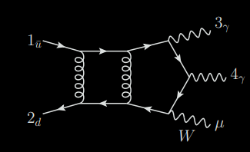
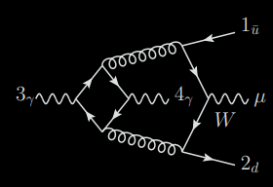
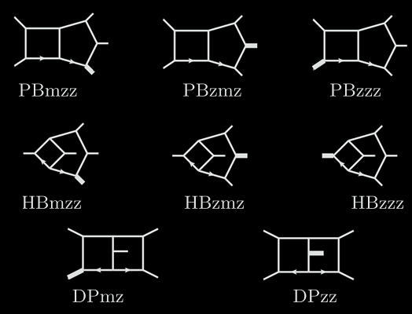
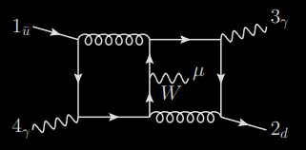
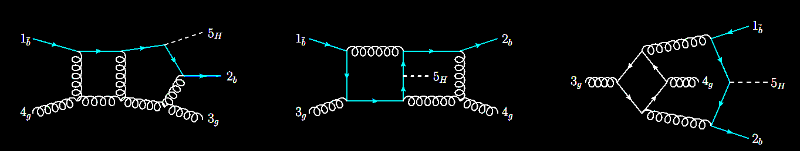
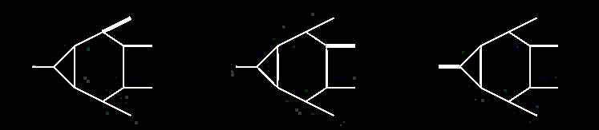
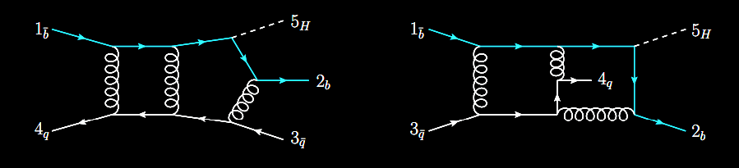
Scalar integral families
Wγγ
…
Tensor
reduction
$$b\overline{b}H$$
…

Slide 26
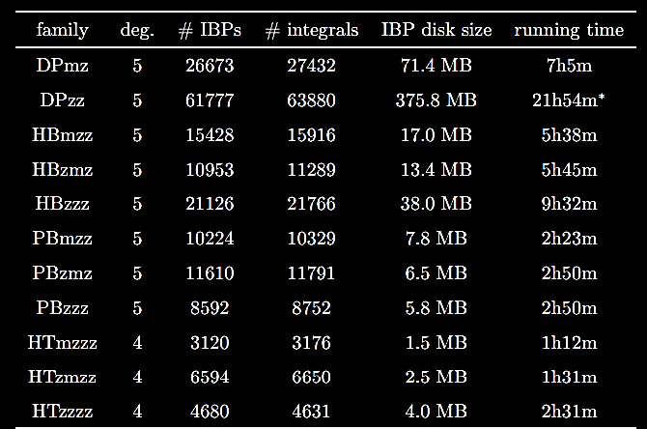
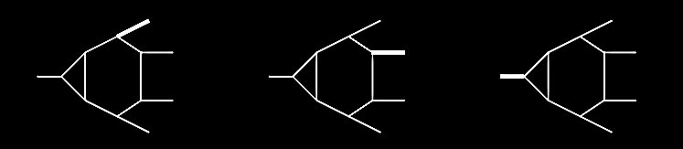
Workflow and performance of the tools
IBP systems from NeatIBP

Slide 27
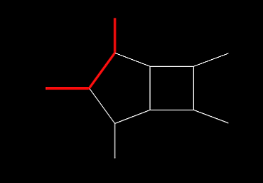
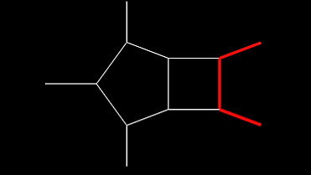
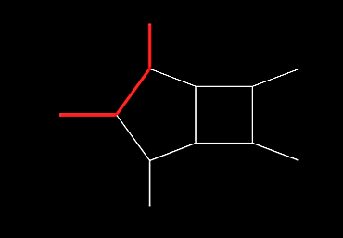
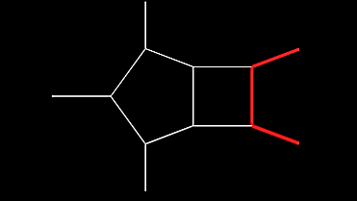
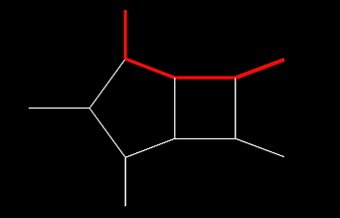
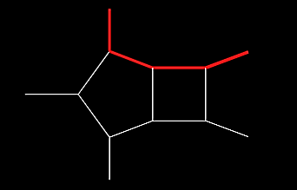
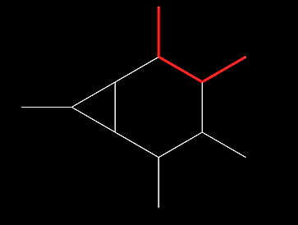
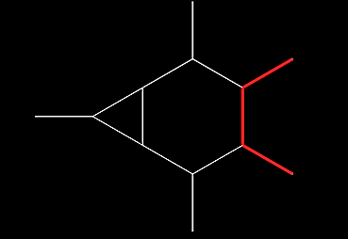
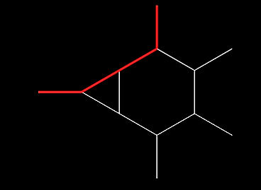
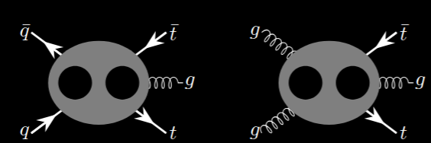

Applications of NeatIBP
Two-loop five-point diagrams with massive propagators
Applications:
$t \overline{t} j$ production
JHEP 07 (2024) 073
SciPost Phys. 19 (2025) 6, 165
JHEP 03 (2025) 070
2511.11424
2411.10856

Slide 28
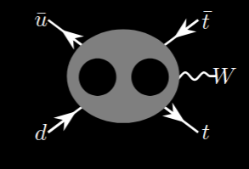

Applications of NeatIBP
Two-loop five-point diagrams with massive propagators
Applications:
$t \overline{t} W$ production
JHEP 07 (2025) 001

Slide 29
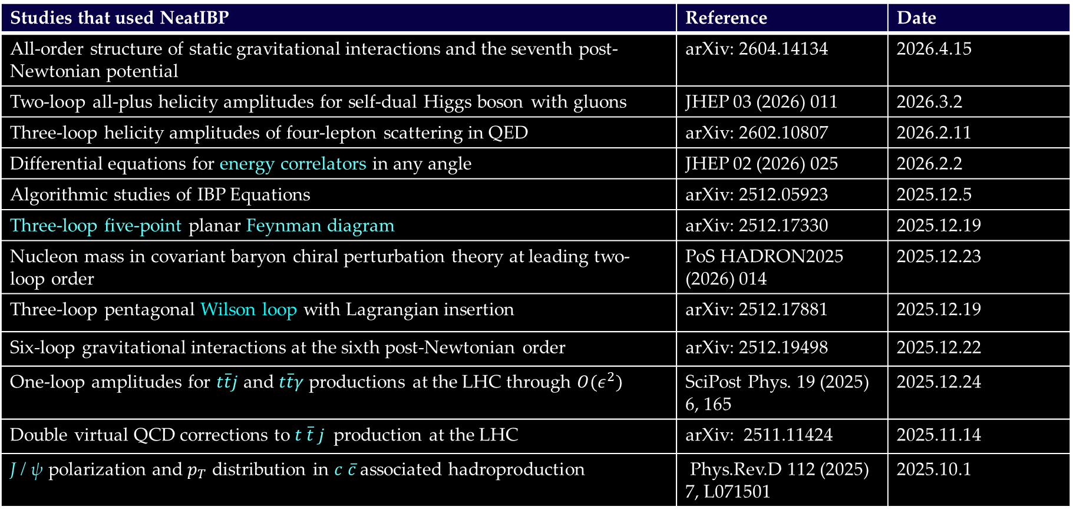
Applications of NeatIBP (1/2)
Studies that used NeatIBP | Reference | Date
All-order structure of static gravitational interactions and the seventh post-Newtonian potential | arXiv: 2604.14134 | 2026.4.15
Two-loop all-plus helicity amplitudes for self-dual Higgs boson with gluons | JHEP 03 (2026) 011 | 2026.3.2
Three-loop helicity amplitudes of four-lepton scattering in QED | arXiv: 2602.10807 | 2026.2.11
Differential equations for energy correlators in any angle | JHEP 02 (2026) 025 | 2026.2.2
Algorithmic studies of IBP Equations | arXiv: 2512.05923 | 2025.12.5
Three-loop five-point planar Feynman diagram | arXiv: 2512.17330 | 2025.12.19
Nucleon mass in covariant baryon chiral perturbation theory at leading two-loop order | PoS HADRON2025 (2026) 014 | 2025.12.23
Three-loop pentagonal Wilson loop with Lagrangian insertion | arXiv: 2512.17881 | 2025.12.19
Six-loop gravitational interactions at the sixth post-Newtonian order | arXiv: 2512.19498 | 2025.12.22
One-loop amplitudes for $t\overline{t}j$ and $t\overline{t}γ$ productions at the LHC through $O(ε^{2})$ | SciPost Phys. 19 (2025) 6, 165 | 2025.12.24
Double virtual QCD corrections to $t \overline{t} j$ production at the LHC | arXiv: 2511.11424 | 2025.11.14
J / ψ polarization and $p_{T}$ distribution in $c \overline{c}$ associated hadroproduction | Phys.Rev.D 112 (2025) 7, L071501 | 2025.10.1

Slide 30
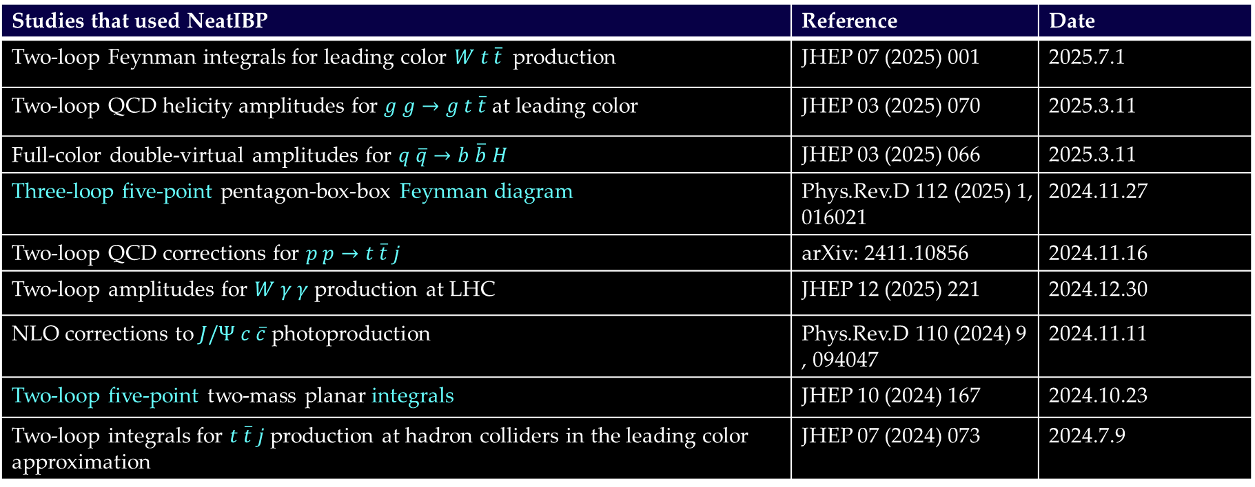
Applications of NeatIBP (2/2)
Studies that used NeatIBP | Reference | Date
Two-loop Feynman integrals for leading color $W t \overline{t}$ production | JHEP 07 (2025) 001 | 2025.7.1
Two-loop QCD helicity amplitudes for $g g→g t \overline{t}$ at leading color | JHEP 03 (2025) 070 | 2025.3.11
Full-color double-virtual amplitudes for $q \overline{q}→b \overline{b} H$ | JHEP 03 (2025) 066 | 2025.3.11
Three-loop five-point pentagon-box-box Feynman diagram | Phys.Rev.D 112 (2025) 1, 016021 | 2024.11.27
Two-loop QCD corrections for $p p→t \overline{t} j$ | arXiv: 2411.10856 | 2024.11.16
Two-loop amplitudes for $W γ γ$ production at LHC | JHEP 12 (2025) 221 | 2024.12.30
NLO corrections to $J/Ψ$ $c \overline{c}$ photoproduction | Phys.Rev.D 110 (2024) 9, 094047 | 2024.11.11
Two-loop five-point two-mass planar integrals | JHEP 10 (2024) 167 | 2024.10.23
Two-loop integrals for $t \overline{t} j$ production at hadron colliders in the leading color approximation | JHEP 07 (2024) 073 | 2024.7.9

Slide 31
Advanced feature of NeatIBP: the spanning cuts method

Slide 32

NeatIBP 1.1 new feature: the spanning cuts method
Generalized unitarity cuts in Baikov representation

Slide 33


NeatIBP 1.1 new feature: the spanning cuts method
Generalized unitarity cuts in Baikov representation
Cuts change the integrals but preserve IBP relations (conjecture)
Cuts increases the number of zero sectors in a family

Slide 34
NeatIBP 1.1 new feature: the spanning cuts method
{1,3} - cut
{2,4} - cut
A spanning cuts is defined so that for all nonzero sector in a family, , such that
SpanningCutsMode=True;
Step 1: Run NeatIBP on each cut
Current version of NeatIBP avoids cutting multiple propagators. Thus, for integrals such that , means
Benefit：
1. Split a difficult problem into simpler pieces
2. Parallelizable
Step 2: Reduce the IBP system on each cut
Kira
Step 3: Merge the reduced IBP system of all cuts

Slide 35




Merging the spanning cut systems
{1,3} - cut
{2,4} - cut
merge
Currently, NeatIBP uses a “direct” merging strategy:
Consistency condition
NeatIBP checks consistency conditions before merging the spanning cut systems. This step cannot be omitted because the condition is NOT always guaranteed according to our observation.

Slide 36
The Kira+NeatIBP interface (spanning cuts mode)
IBPs generated by NeatIBP on each cut
KIRA user defined systems on each cut
Reduced IBP system on each cut
NeatIBP
Inputs for NeatIBP
Converter
Kira
Consistency check
Merged reduced IBP system
Passed
Not passed
Merge spanning cuts
Terminate

Slide 37
A baby example of Kira+NeatIBP performance (with spanning cuts)
Two-loop five-point, with numerator degree 3
CPU threads: 20
RAM: 128GB
Running NeatIBP + Kira in spanning cuts mode:
1. NeatIBP: Generates equations on 10 spanning cuts, using 5m
2. Number of equations: vary from 130 ~ 624, on different cuts
3. Kira running time: 10m (including converting, checking consistency, reducing and merging, in parallel mode)
Running NeatIBP + Kira in normal mode:
1. NeatIBP: Generates 1358 equations spanning cuts, using 16m
2. Kira reduction time used: 27m

Slide 38
The spanning cuts consistency problem
Three-loop five-point planar diagrams
Dmitry Chicherin, Yu Wu, Zihao Wu, Yongqun Xu, Shun-Qing Zhang, Yang Zhang, 2512.17330
Rely on spanning cuts method, the consistency conditions holds

Slide 39
The importance of the spanning cuts method + its consistency problem = The problem must be solved
An answer to the consistency problem

Slide 40
Previous studies
Observation: Magic relation spoils the spanning cuts method
Xin Guan, Xiao Liu, Yan-Qing Ma, Wen-Hao Wu, Comput.Phys.Commun. 310 (2025) 109538
(Magic relation leads to high dimensional critical variety)
Giulio Crisanti, Hjalte Frellesvig, Andrzej Pokraka, Sid Smith, 2605.29789
Magic relations:
IBP relation generated in
a sector
Contains integrals only in its subsectors

Slide 41
Previous studies
Observation: Magic relation spoils the spanning cuts method
Xin Guan, Xiao Liu, Yan-Qing Ma, Wen-Hao Wu, Comput.Phys.Commun. 310 (2025) 109538
(Magic relation leads to high dimensional critical variety)
Giulio Crisanti, Hjalte Frellesvig, Andrzej Pokraka, Sid Smith, 2605.29789
Question: why?
?
Cuts change the integrals but preserve IBP relations (conjecture)
Magic relations may be broken under cuts
}
Magic relations are IBP relations

Slide 42
Previous studies
Observation: Magic relation spoils the spanning cuts method
Xin Guan, Xiao Liu, Yan-Qing Ma, Wen-Hao Wu, Comput.Phys.Commun. 310 (2025) 109538
(Magic relation leads to high dimensional critical variety)
Giulio Crisanti, Hjalte Frellesvig, Andrzej Pokraka, Sid Smith, 2605.29789
Question: why?
Not always true!
ZW, Yingxuan Xu, 2606.02485
×
Cuts change the integrals but preserve IBP relations (conjecture)
Magic relations may be broken under cuts
}
Magic relations are IBP relations

Slide 43
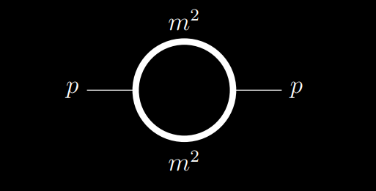


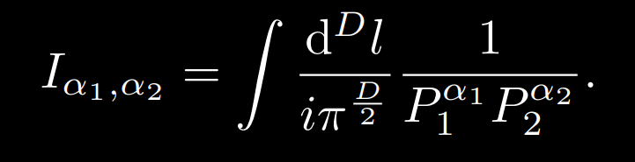
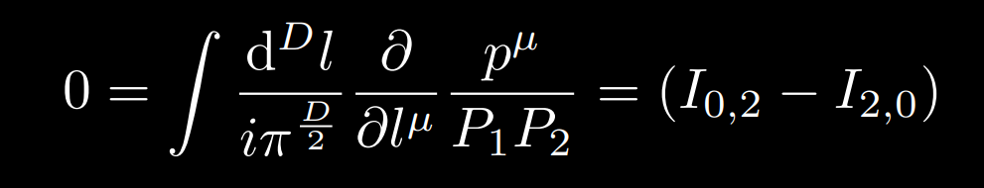
A first look into the diagrams with inconsistency
ZW, Yingxuan Xu, 2606.02485
Key point:
Generalized unitarity cuts some times breaks the IBP relations, if hidden terms (see later) are erased
An example:
One of the IBP relations:

Slide 44
A first look into the diagrams with inconsistency
ZW, Yingxuan Xu, 2606.02485
Key point:
Generalized unitarity cuts some times breaks the IBP relations, if hidden terms (see later) are erased
An example:
One of the IBP relations:
Vanishes under {1}-cut
=0 under {1}-cut?

Slide 45
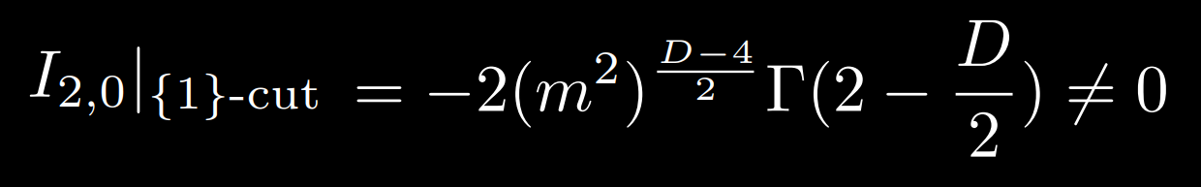

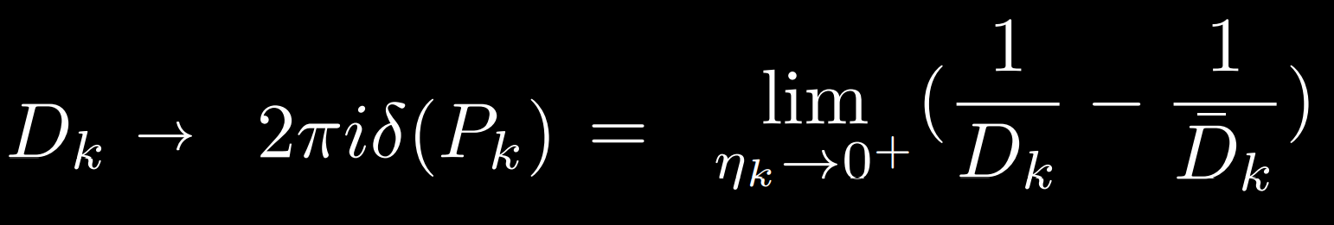
Vanishes under {1}-cut
=0 under {1}-cut? No!
The underlying reason: the hidden terms proportional to Feynman prescription parameters in the IBP relations were naively erased
The propagators with Feynman prescription parameters
{k}-cut:

Slide 46
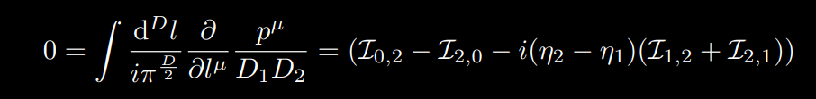



The IBP with Feynman prescription parameters
Finite
Taking
to apply {1}-cut
Hidden terms, vanishes
Divergent
where
Hidden terms, finite
explains

Slide 47





The first answer to the question
Oh no, the spanning cuts seems to break this IBP relation …
×
but
Don’t worry, this IBP relation still holds under the cut if you keep the hidden terms.
= 0
-
√
Hidden terms

Slide 48


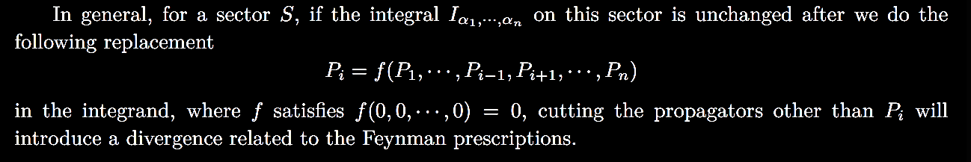
Why singularity?
Divergent
The external-massless bubble diagram is equivalent to a vacuum diagram
Hidden relation
p = 0
Hidden relations
Hidden relations

Slide 49
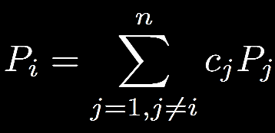
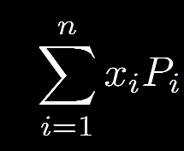
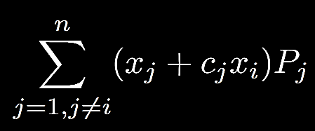
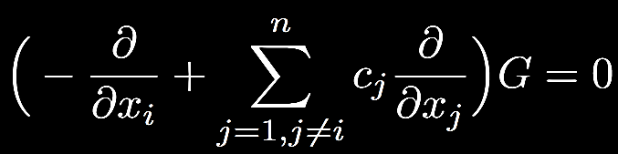
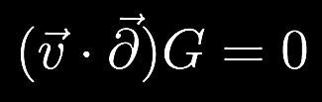

Searching for linear hidden relations
Feynman parameterization / Lee-Pomeransky representation
Algorithm: Find the annihilating differential operator for LP polynomial:
It leads to hidden relation:

Slide 50
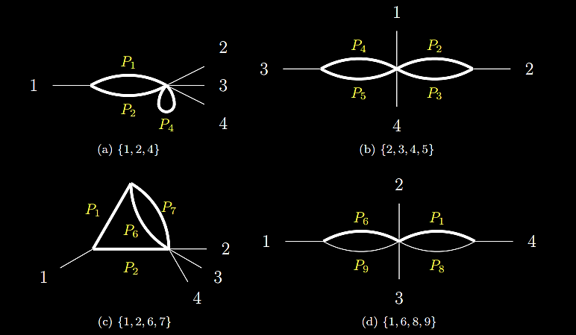
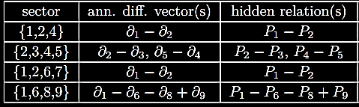
Some examples of linear hidden relations
Top sector: massive double box
A typical feature: one external massless momentum with massive propagators

Slide 51
The problematic feature
One external massless momentum with massive propagators
Safter: without internal massive propagators
Less safe: with internal massive propagators
(because the vacuum diagram vanishes)

Slide 52
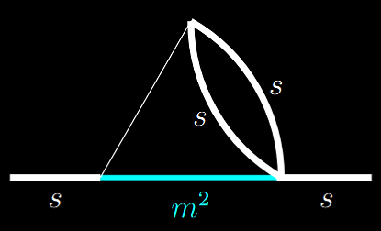
The problematic feature
One external massless momentum with massive propagators
Diagram with such sub-structure, with consistency problem
No linear hidden relations found in this diagram

Slide 53
The underlying relation between hidden relations and magic relation and critical varieties…
Giulio Crisanti, Hjalte Frellesvig, Andrzej Pokraka, Sid Smith, 2605.29789
The existence of linear hidden relation
indicates a higher dimensional (linear)critical variety
Existence of magic relations
High-dimensional critical varieties
(observation)
?
Linear hidden relations
Hidden relations
Broken IBP relations under cuts
ZW, Yingxuan Xu, 2606.02485

Slide 54
Summary
We aim at the computation of multi-loop Feynman integrals.
For this purpose, we need to perform IBP reduction. This is a challenging work due to high reduction cost.
We introduced NeatIBP and its applications, aiming at breaking through the bottleneck problems concerning heavy IBP computation.
We introduced a study to the spanning cuts consistency problem.

