Slide 1

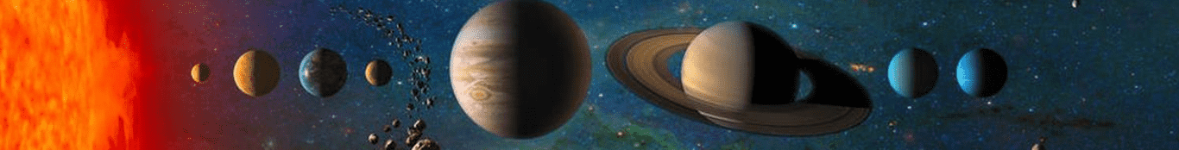
暗物质直接探测和无中微子双贝塔衰变
林箐
中国科学技术大学
第十五届全国粒子物理学术会议@ 广州
2026.07.18

Slide 2
CONTENTS
01
物理动机
02
暗物质探测现状
03
无中微子双贝塔衰变探测现状
04
未来趋势
**Disclaimer: Apology for omittance!**
** Most materials are borrowed from public talks, especially from Prof J. Liu, Prof. Q. Yue’s, Prof. K. Han, Prof. Andrea Giuliani, and many talks from previous conferences and seminars.**

Slide 3


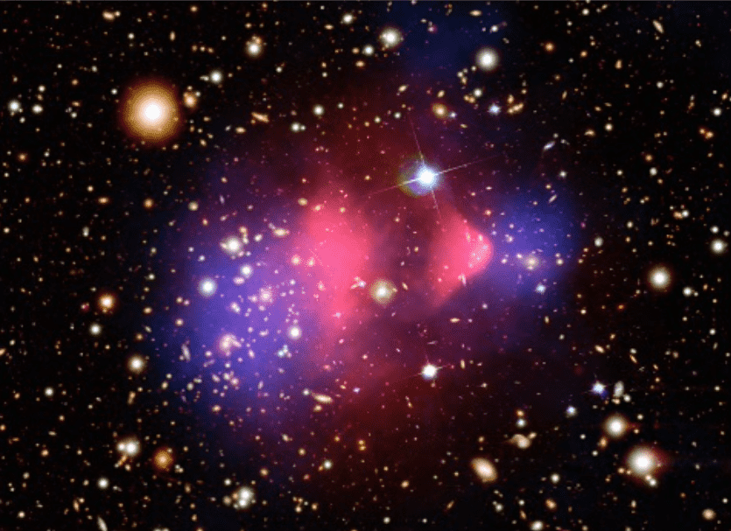
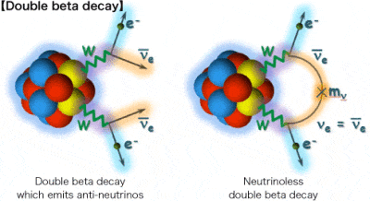
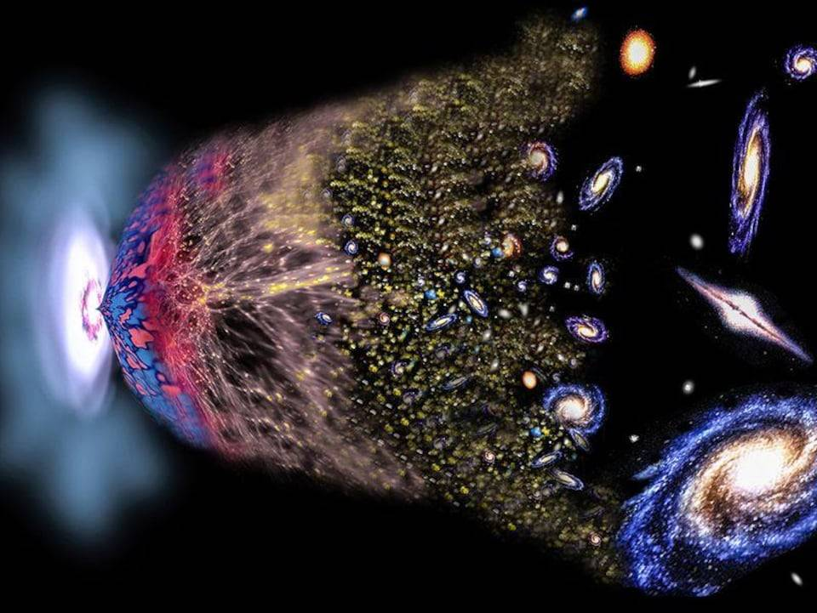

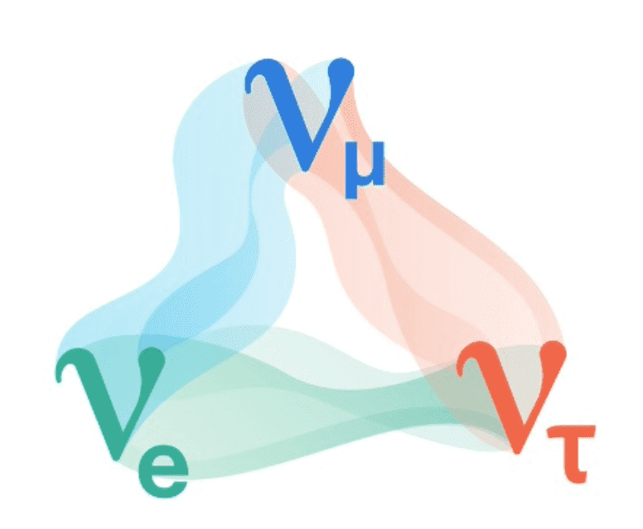
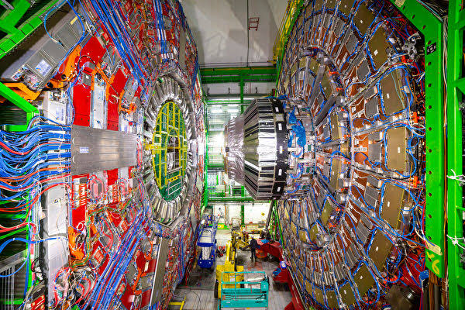
新物理搜寻
Image credit: SHiP，DUNE， ESA，LEGEND
稀有过程新物理方向：
Standard Model window
1
g
u
c
t
Energy Frontier
γ
d
s
b
Planck scale
H
W
Z
log₁₀( Interaction strength )
Precision Frontier
ν_{e}
ν_{μ}
暗物质探测
无中微子双贝塔
ν_{τ}
Coupling Frontier
Space for New Physics
log₁₀( Energy)
中微子物理
对撞机物理
(7/15贾怡教授大会报告)
(7/17肖朦教授大会报告)
1

Slide 4
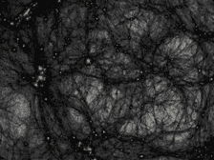
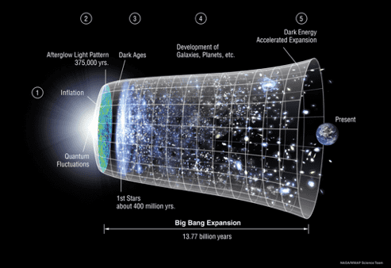
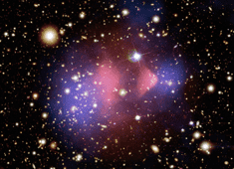
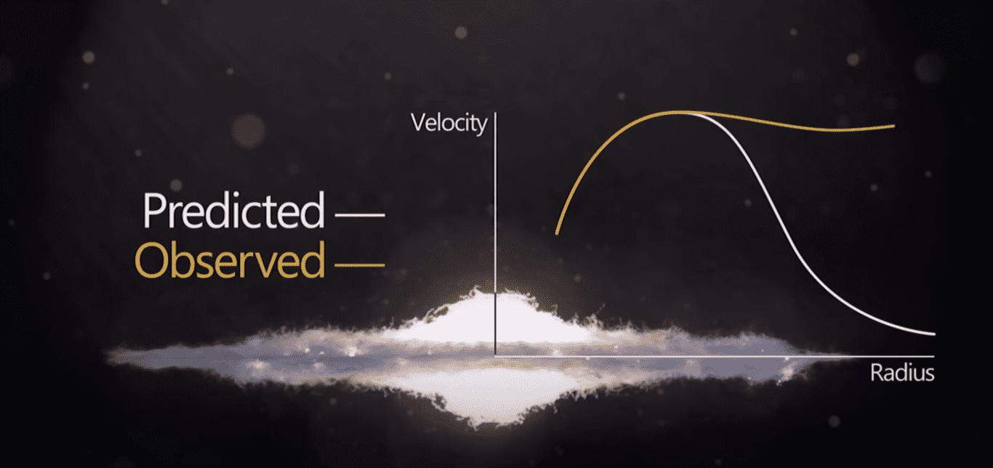
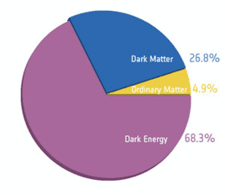
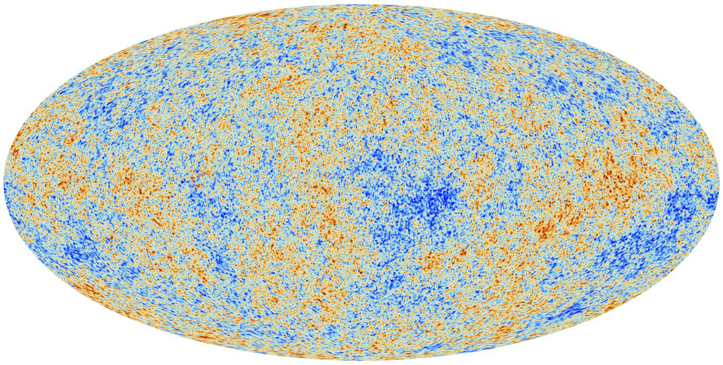
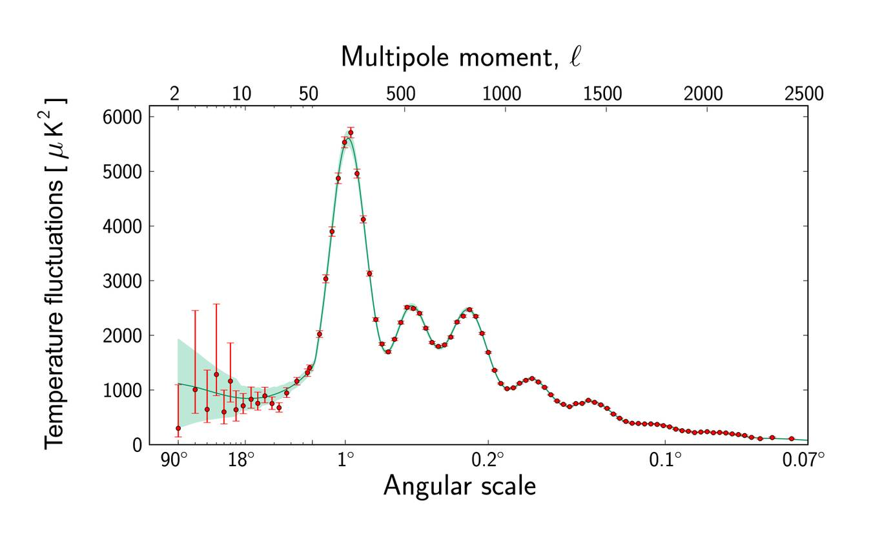
暗物质及其引力证据
大尺度结构
～10⁷光年
Courtesy of NASA
Credit: https://youtu.be/sI23cwbbNqs
小尺度结构
原初宇宙
星系团碰撞（～10⁶光年）
星系旋转曲线（～10⁴-10⁵光年）
引力证据显示：暗物质是宇宙中物质的主要存在方式，远比我们日常所见重子物质来得多！
～10¹⁰光年
Courtesy of PLANCK
3

Slide 5
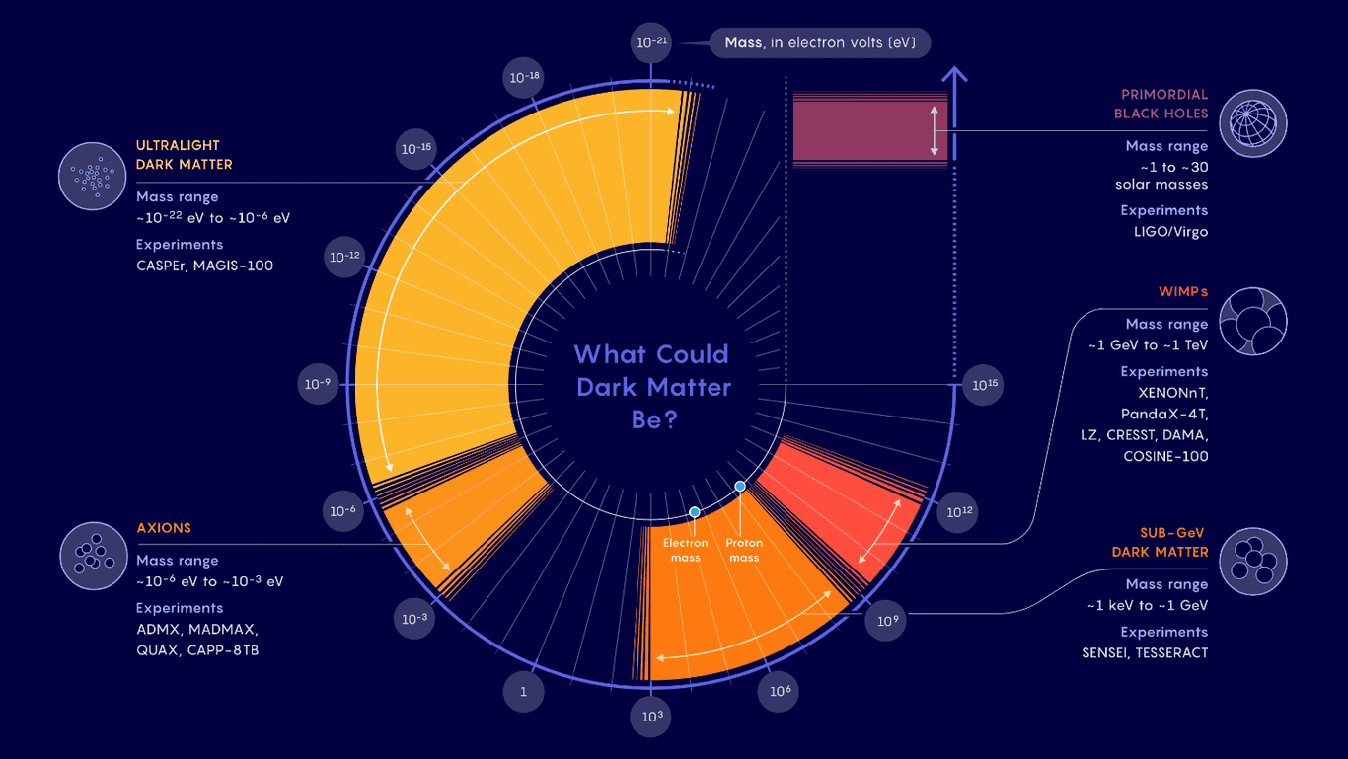
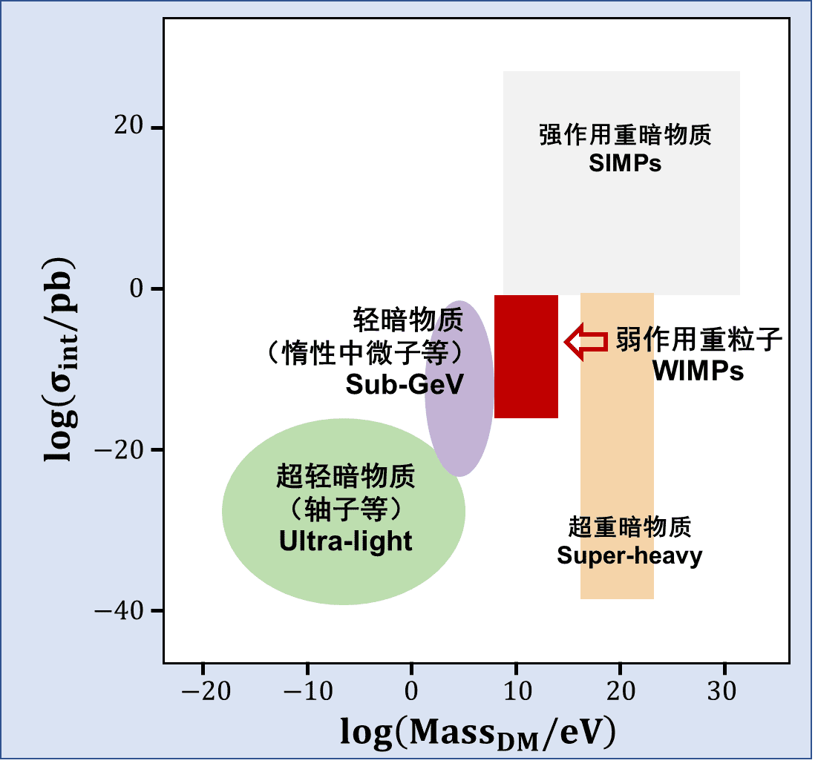
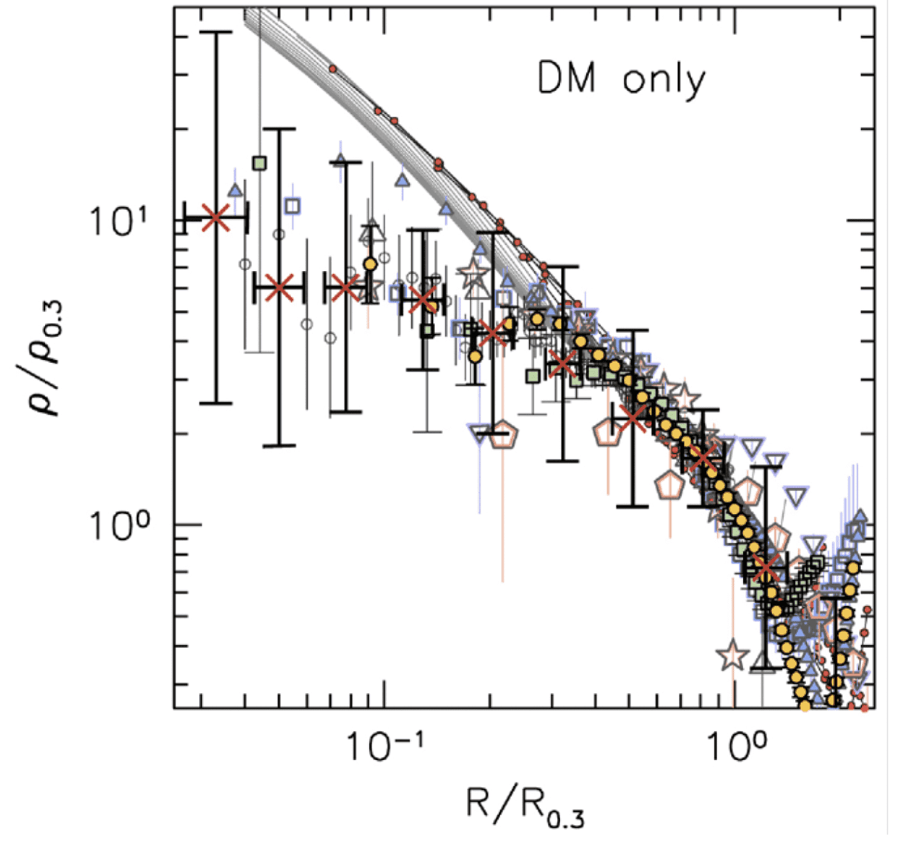
暗物质候选者
Samuel Velasco/Quanta Magazine
暗物质粒子质量与反应截面参数空间跨度都可达30-40个量级！
Core-cusp Problem
4
From Prof. Yifu Cai

Slide 6
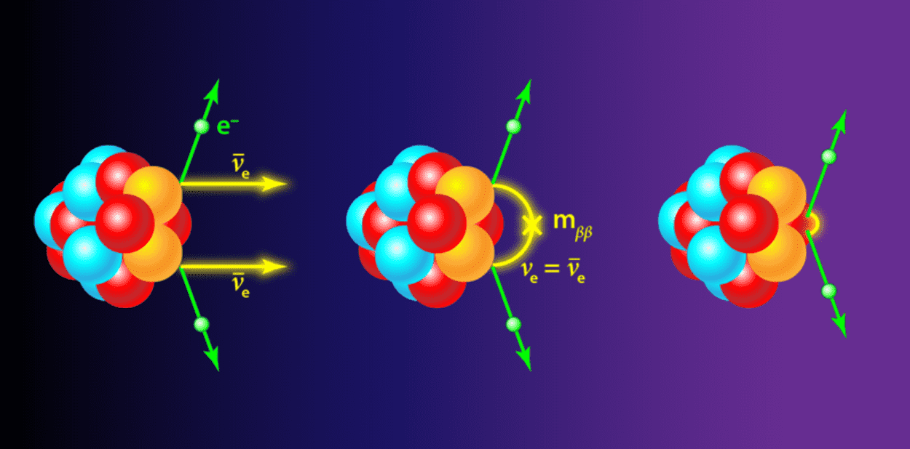
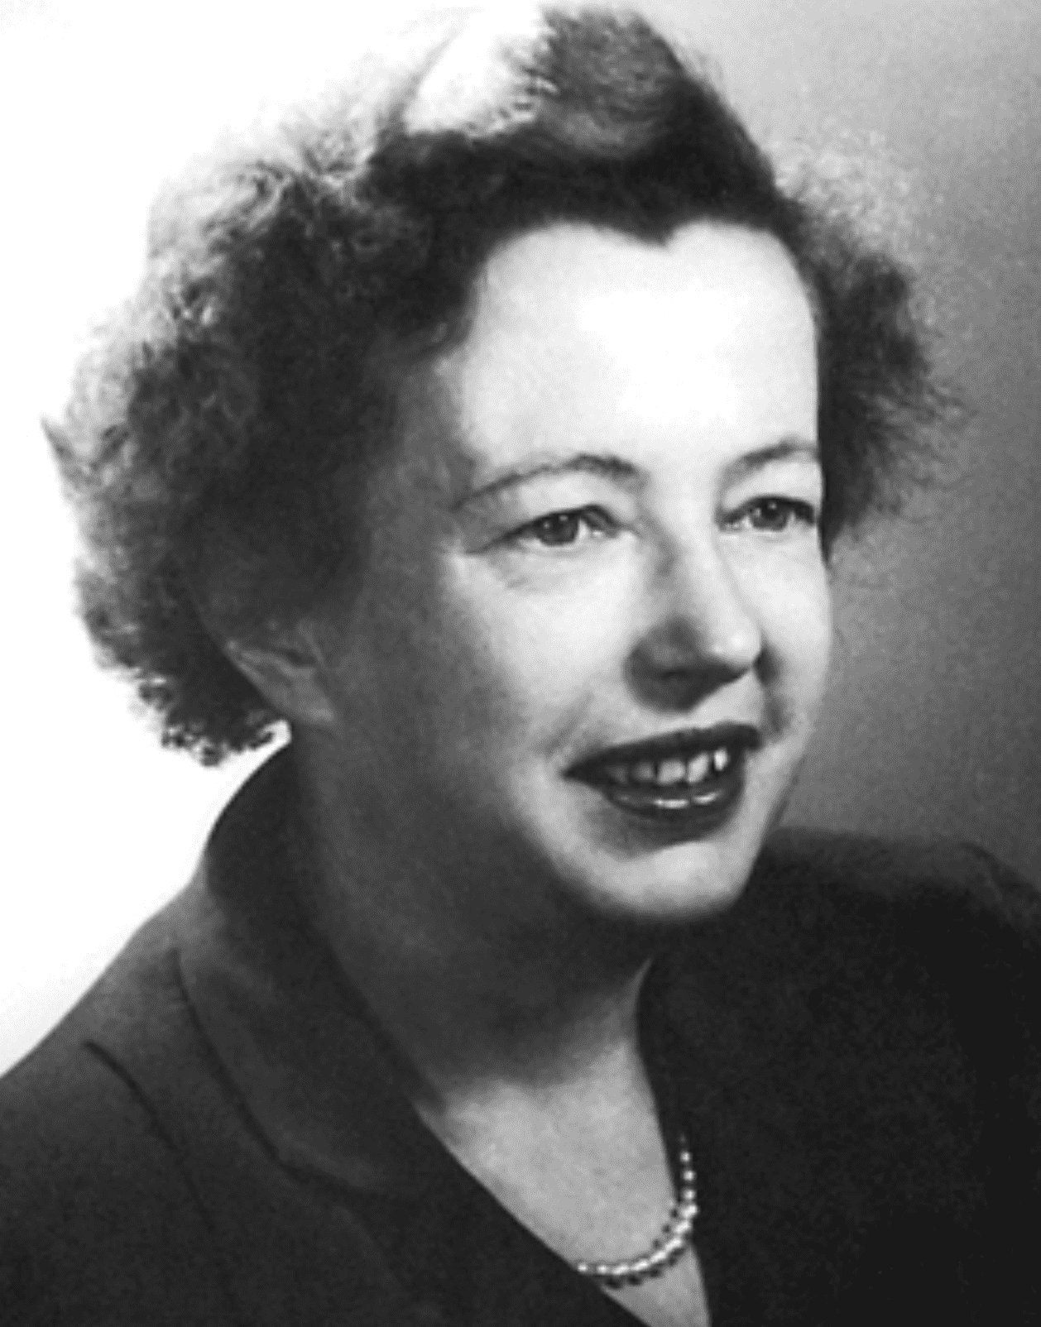
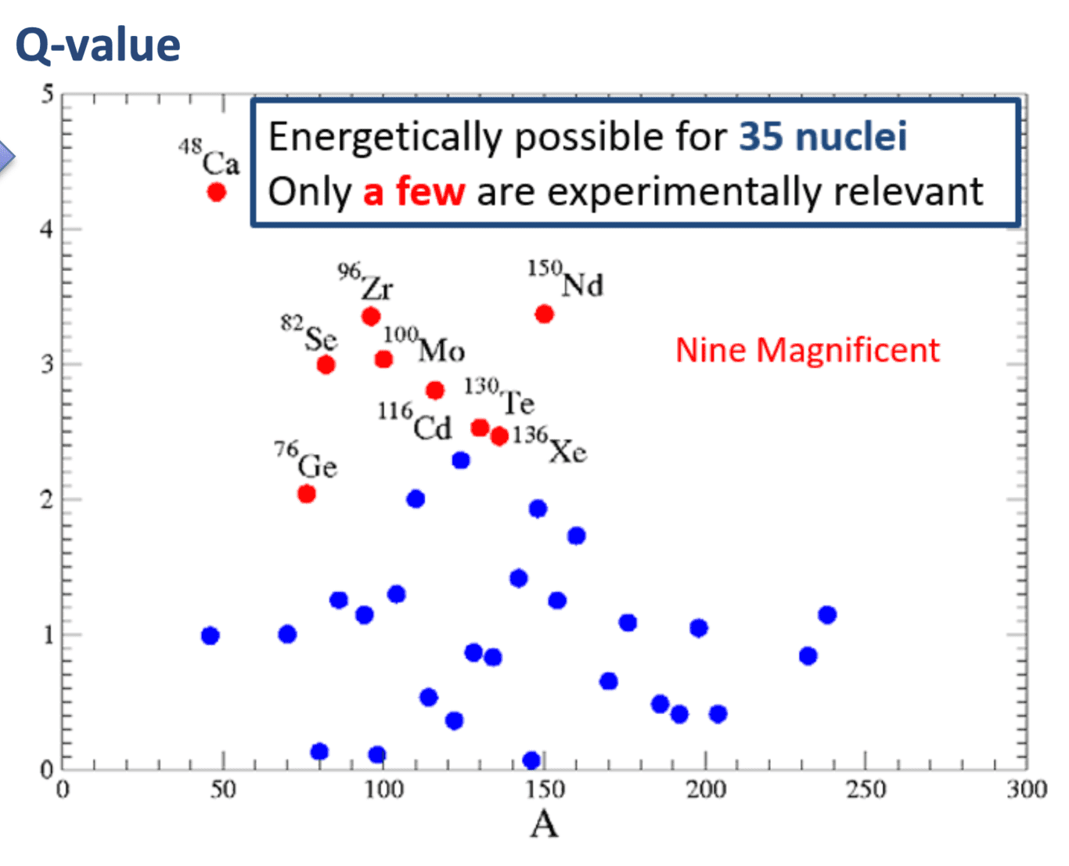
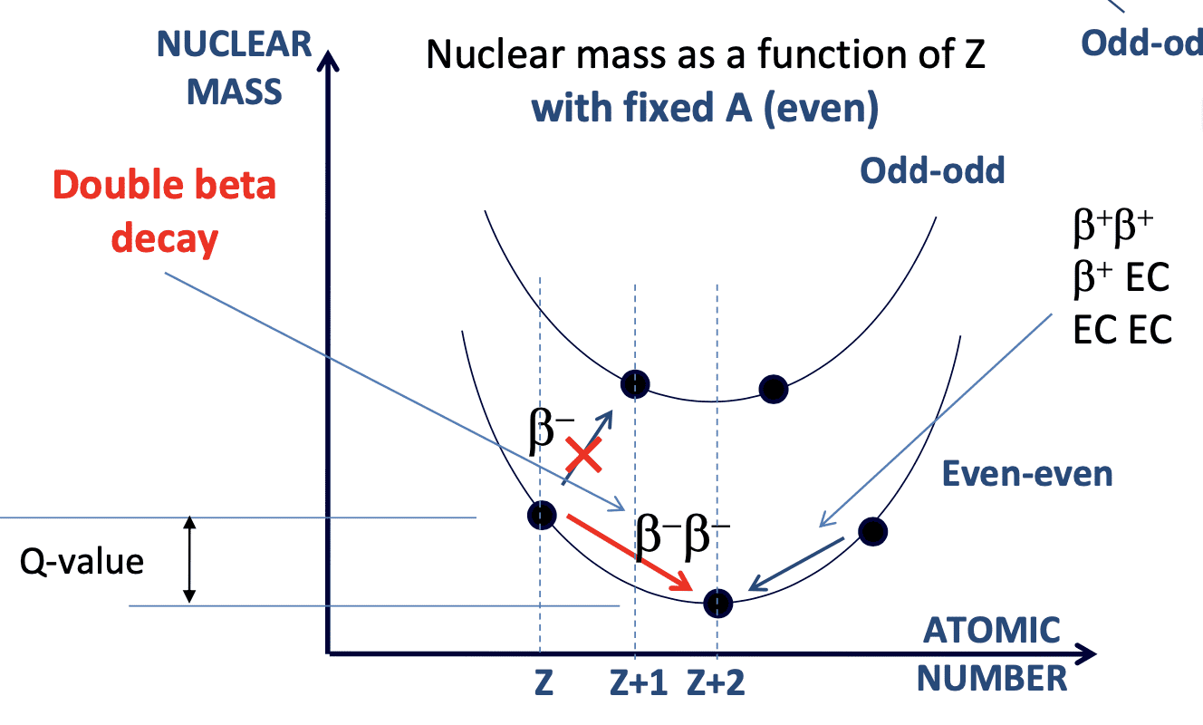
双贝塔衰变
稀有衰变道: (A, Z) -> (A, Z+2) + 2e⁻ + 2𝑣_{e}
Maria Mayer
1935年
Weiszaecker核结合能：
奇偶项
双贝塔衰变，半衰期～10¹⁷年
6

Slide 7
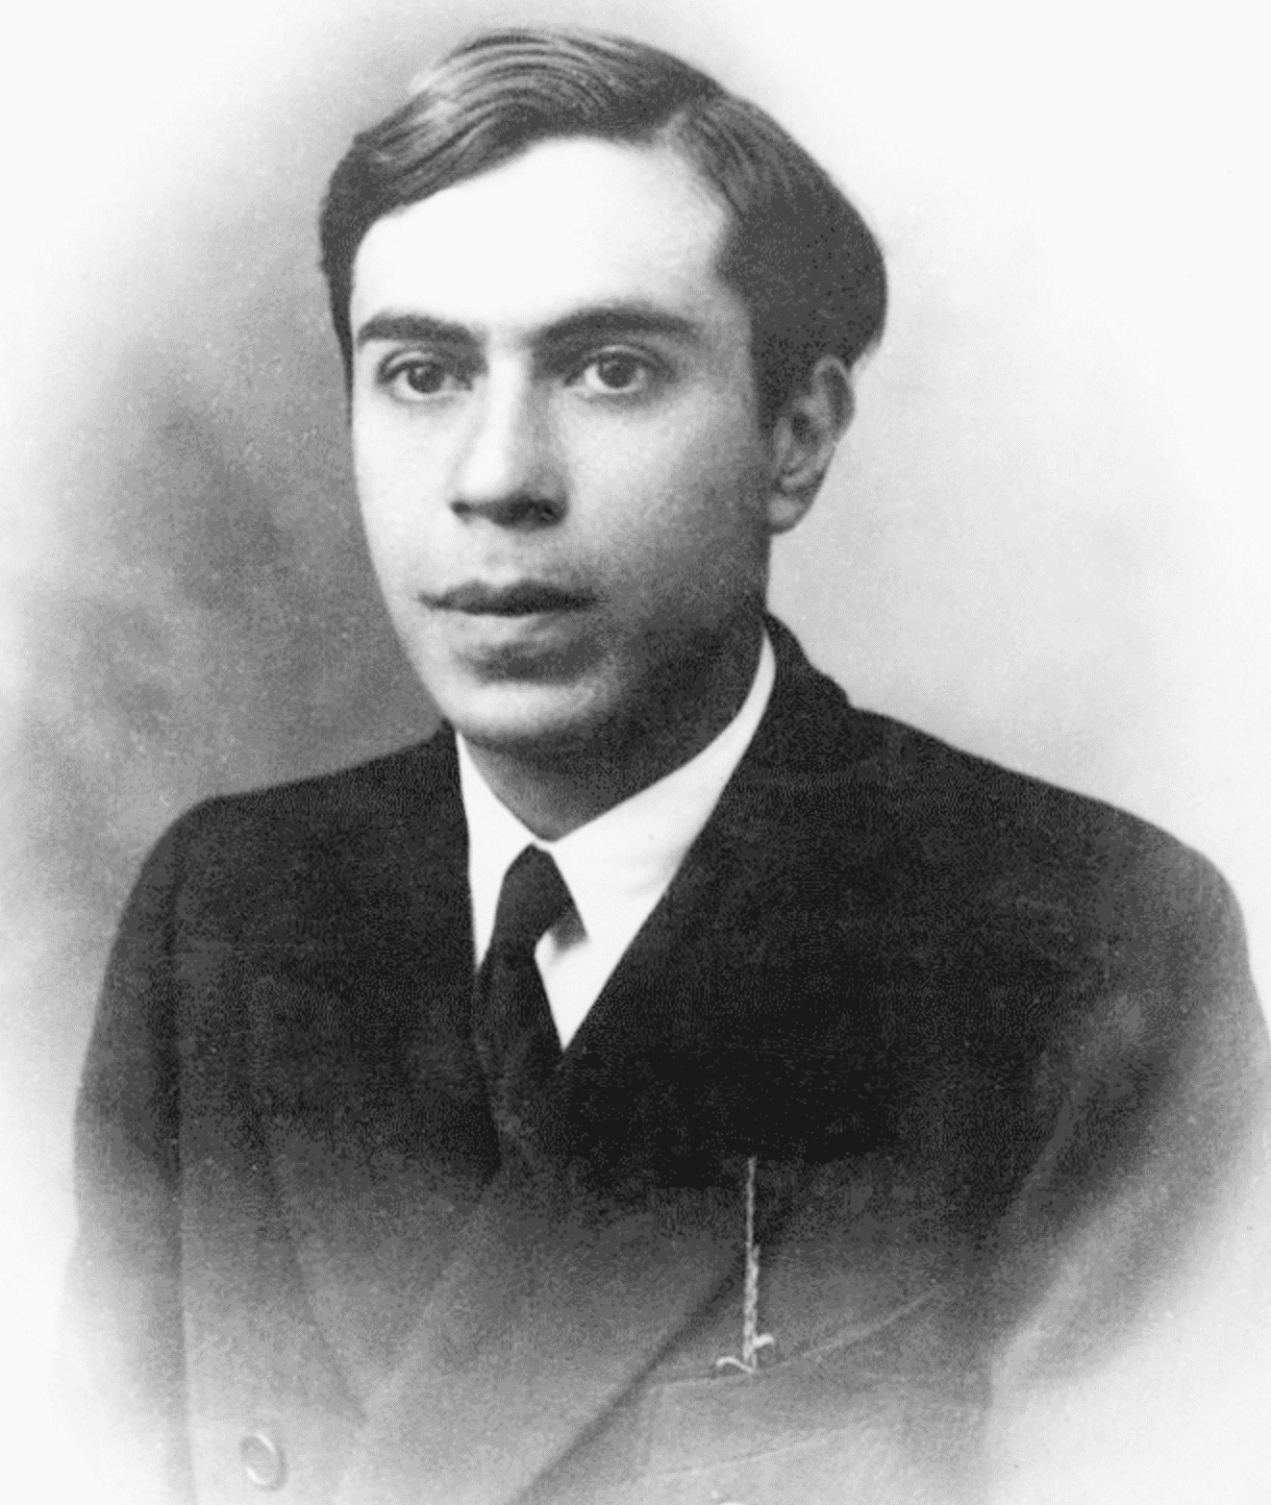
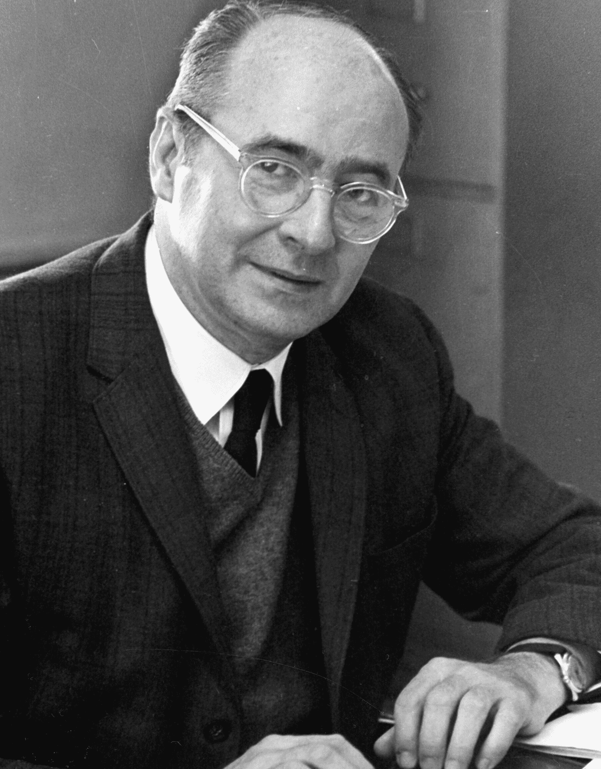
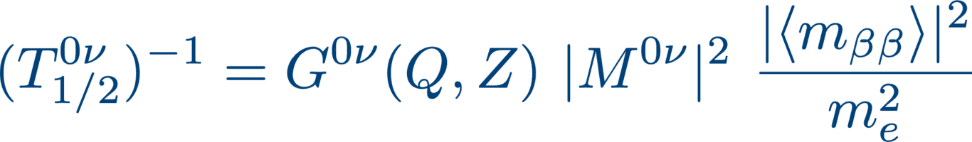

无中微子双贝塔衰变
E. Majorana
1937年
²⁰⁹Bi (𝛼)
ν≡$\overline{ν}$
(A, Z) -> (A, Z+2) + 2e⁻ + 2𝑣_{e}
~10¹⁸-10²⁴ y
有效Majorana质量
W. Furry
1939年
参数空间因子
核矩阵元
～1evt/y/ton
无中微子
双贝塔衰变
包含中微子物理参数，alpha为Majorana相位
7

Slide 8
无中微子双贝塔衰变测量意义总结
轻子数或轻子数-重子数破缺过程（萨哈诺夫条件一）；
通过轻子创世解释正反物质不对称；
中微子质量顺序的测量；
See-saw模型解释中微子质量微小原因；
8

Slide 9
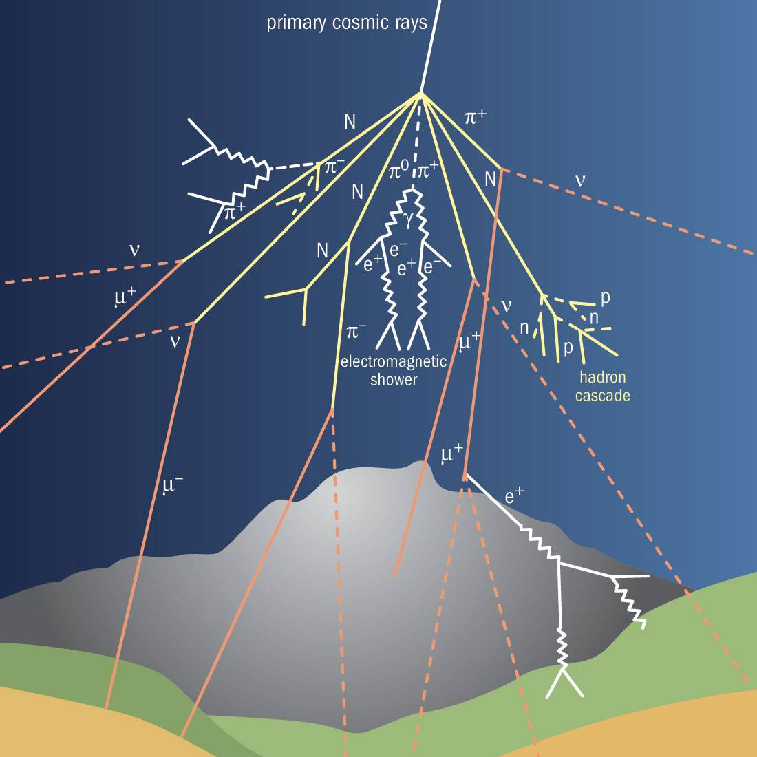
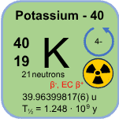

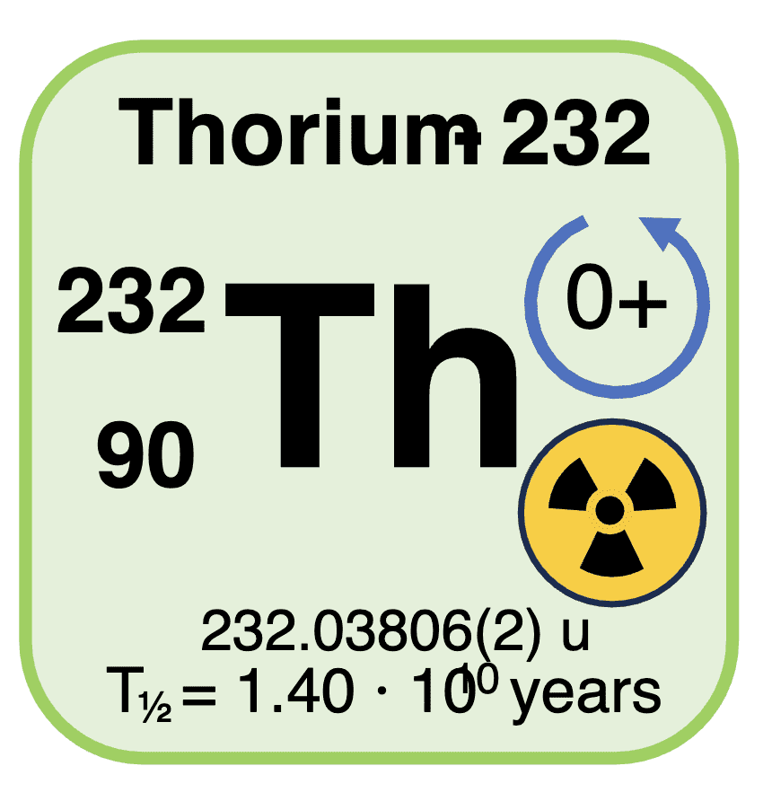
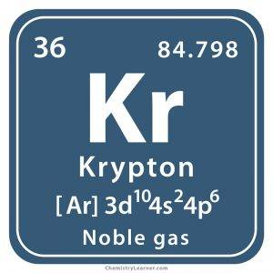
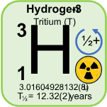
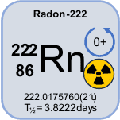
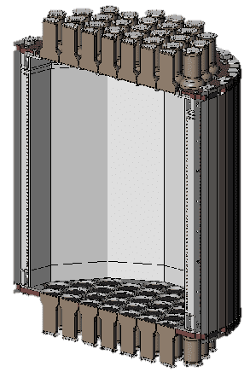
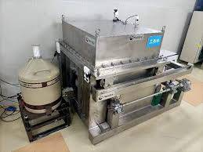
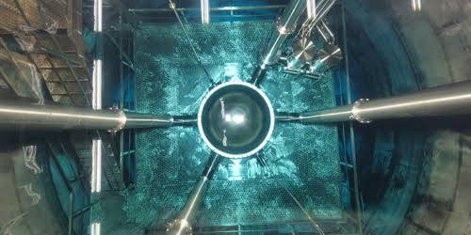
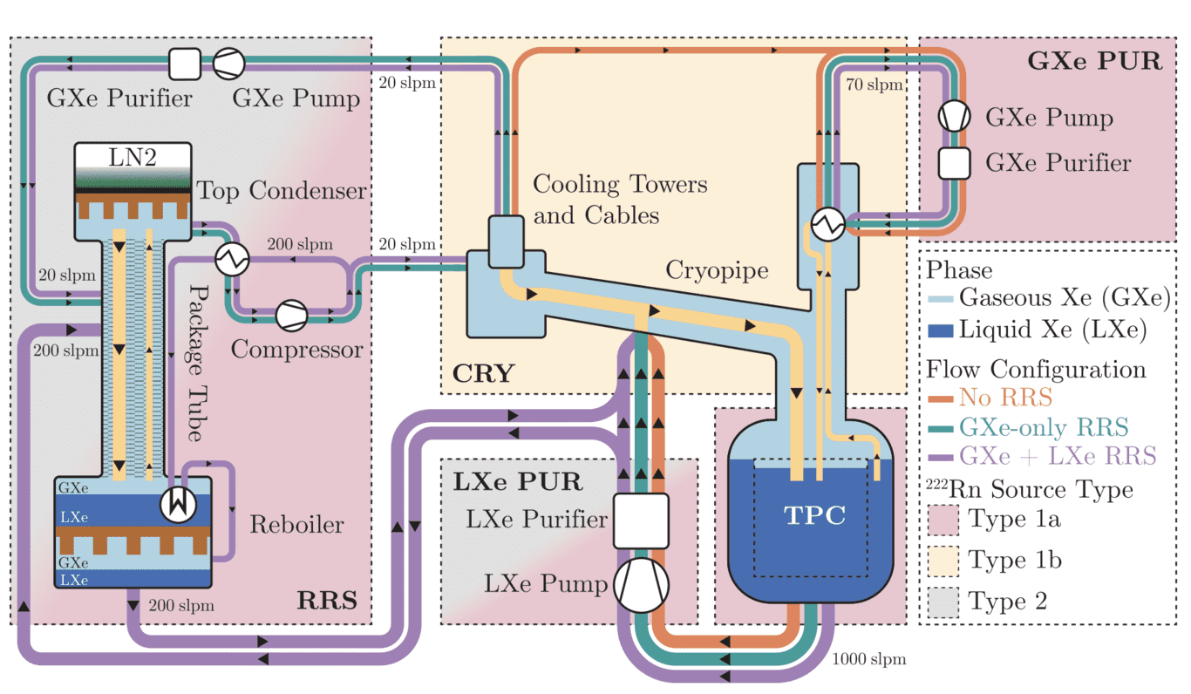
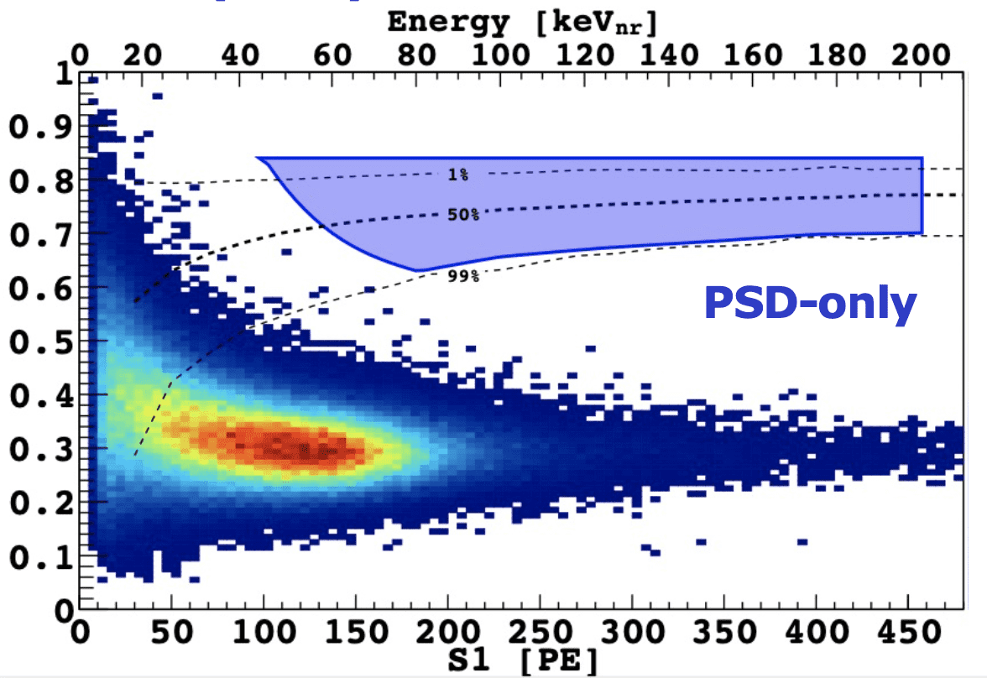
共通挑战：本底控制
宇宙线本底
Image credit: XENON, DarkSide, PandaX
自然放射性本底
外部
内部
探测器材料筛选
物理屏蔽
实时提纯（气体，液体探测器)
Annu. Rev. Nucl. Part. Sci. 67, 231 (2017)
Qian Yue报告（7/14）
粒子鉴别能力
9

Slide 10
CONTENTS
01
物理动机
02
暗物质探测现状
03
无中微子双贝塔衰变探测现状
04
未来趋势
**Disclaimer: Apology for omittance!**
** Most materials are borrowed from public talks, especially from Prof J. Liu, Prof. Q. Yue’s, Prof. K. Han, Prof. Andrea Giuliani, and many talks from previous conferences and seminars.**

Slide 11
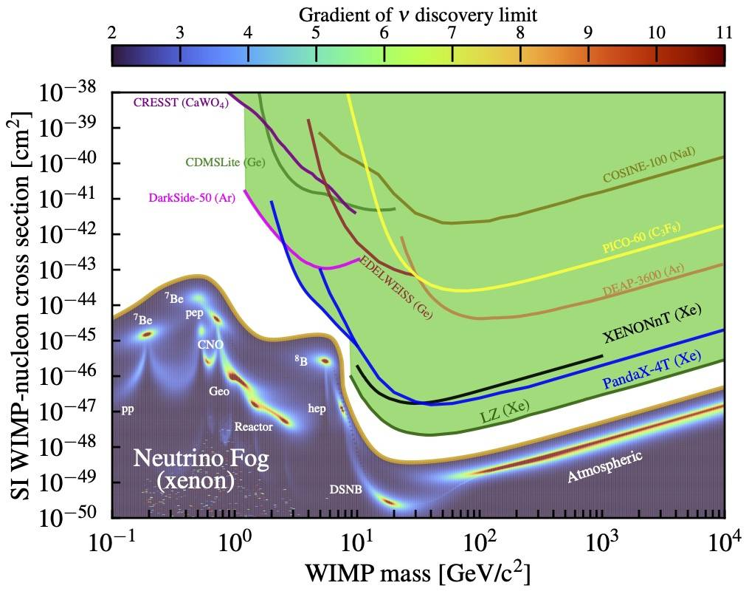
暗物质直接探测现状全景
新型技术
低阈值
大曝光
低本底
11
4

Slide 12
暗物质直接探测现状全景
低温量热器;
半导体;
闪烁体;
气体探测器;
气泡室;
新型技术：
Skipper CCD;
Migdal effect;
WIMP-electron scattering;
Solar and CR boosted DM;
Quantum sensors;
惰性液体探测器
12
5

Slide 13
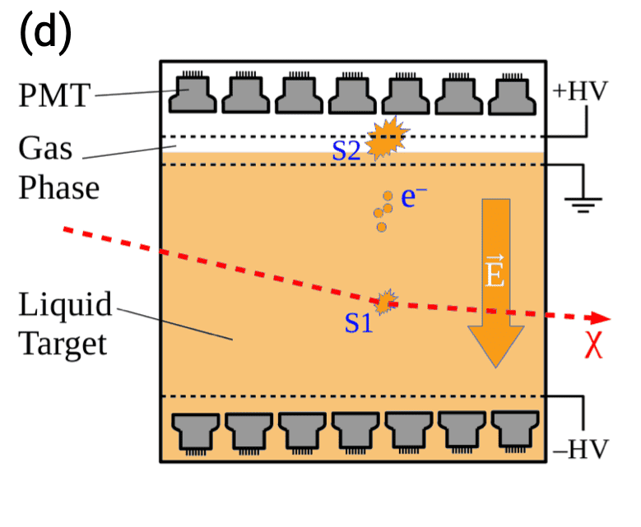
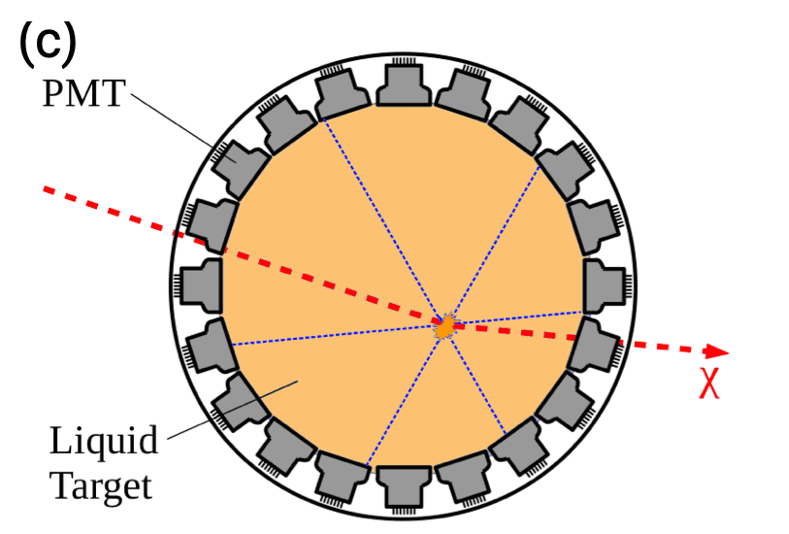
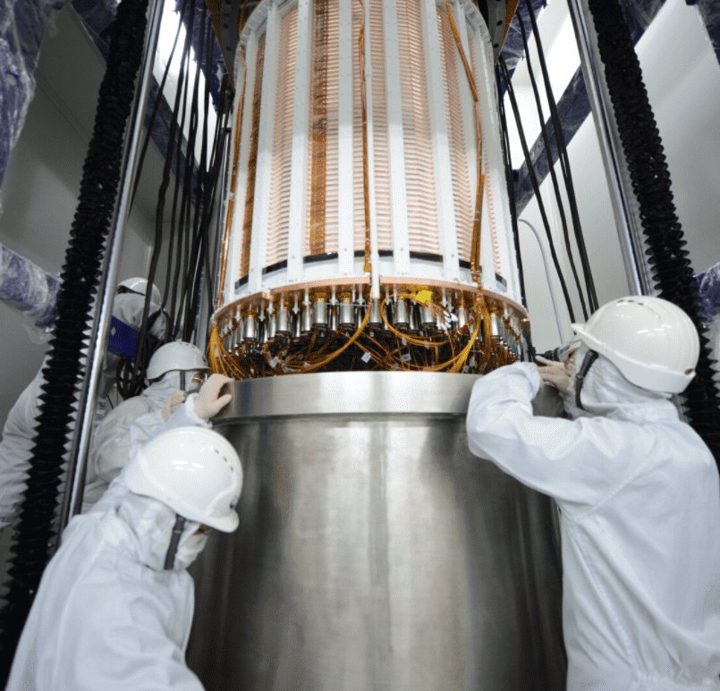
惰性液体探测器
Scalability | Good | Good
Density | 3 kg/L | 1.4 kg/L
A | 133 | 40
Long-lived bkg | Xe136 Negligible | Ar39 (1 Bq/kg in ^{nat}Ar, T_{half}=269yr)
Bkg rej. | S2/S1, 3D pos. | S2/S1, Pulse shape, 3D pos.
Scintillation light | 178 nm | 128 nm (need WLS)
Cost | ¥15000/kg | ¥20/kg for ^{nat}Ar
DEAP-3600
DarkSide-50
(DarkSide-20k
ARGO)
PandaX-4T
XENONnT
LZ
(XLZD
PandaX-xT)
High sensitivity to >10GeV DM due to its good scalability and bkg discrimination;
Liquid xenon dual-phase TPC currently has the world-leading sensitivity to >10GeV DM.
XMASS
13
7

Slide 14
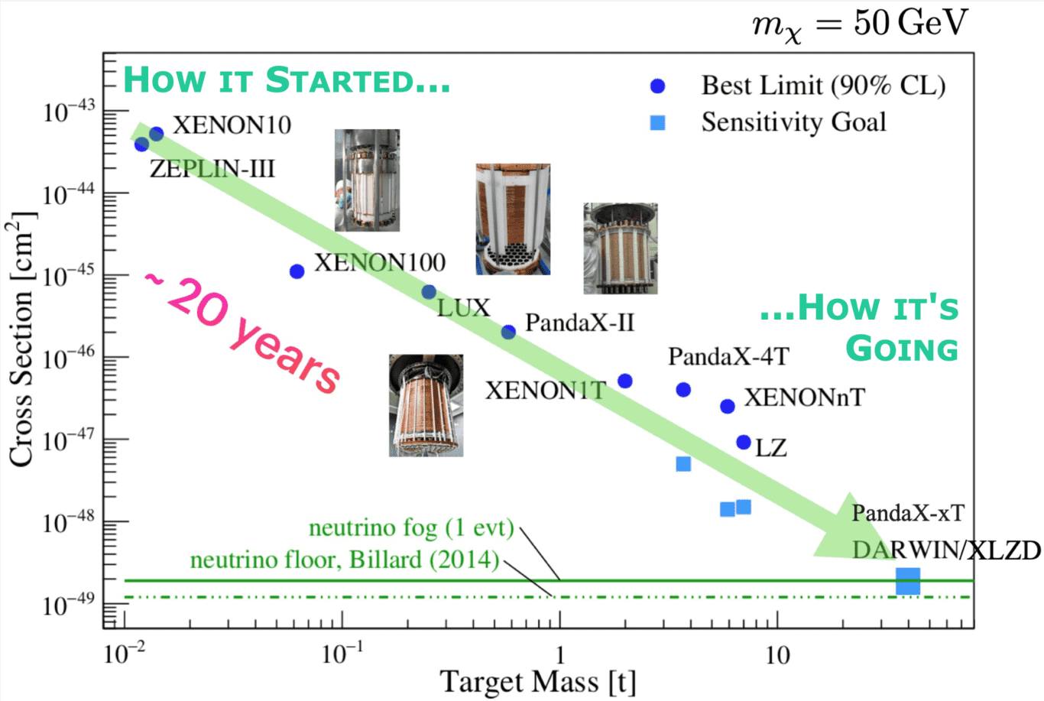
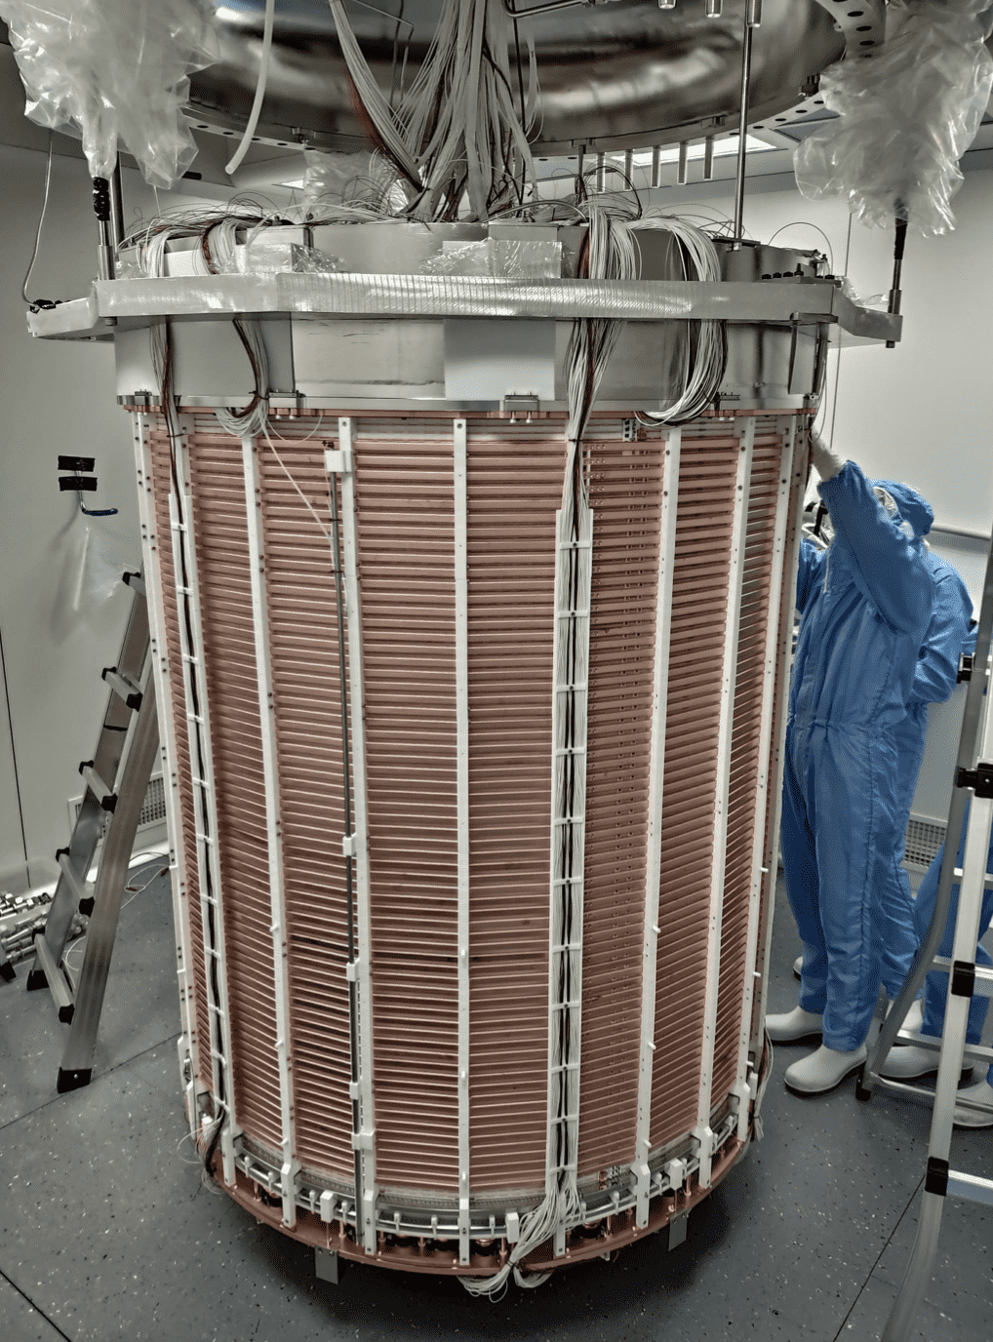
惰性液体探测器灵敏度演化
Courtesy to P. Ullio
& M.E. Monzani
14
8

Slide 15
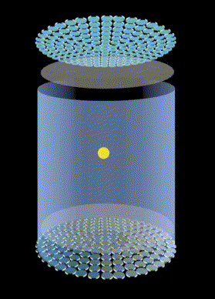
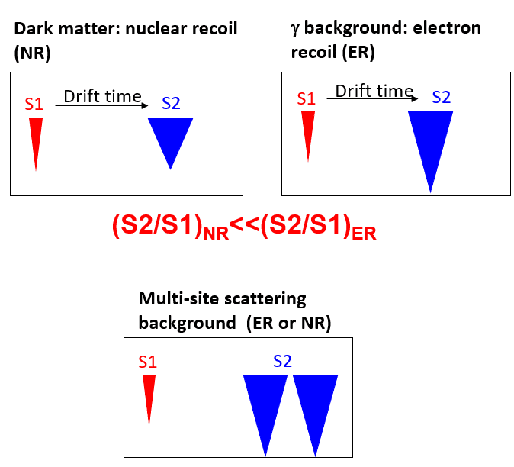

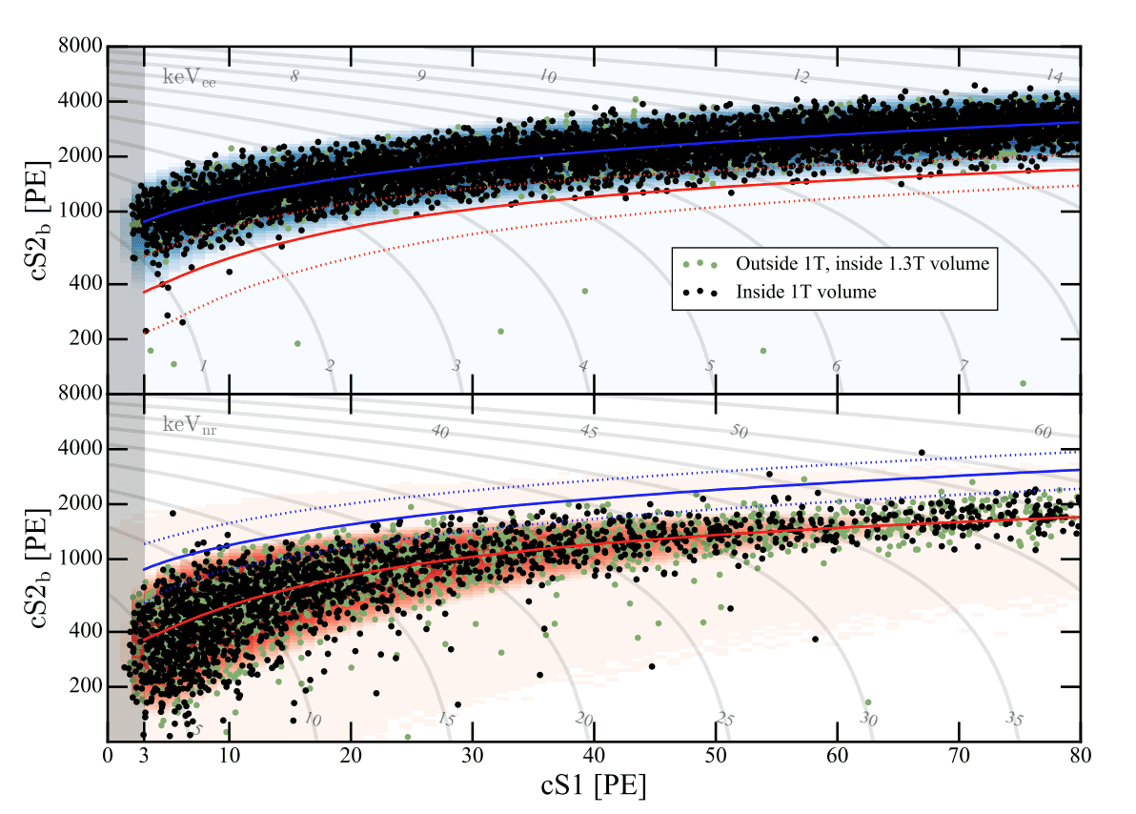
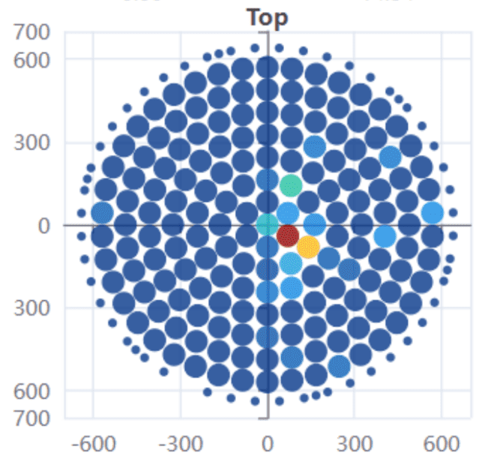
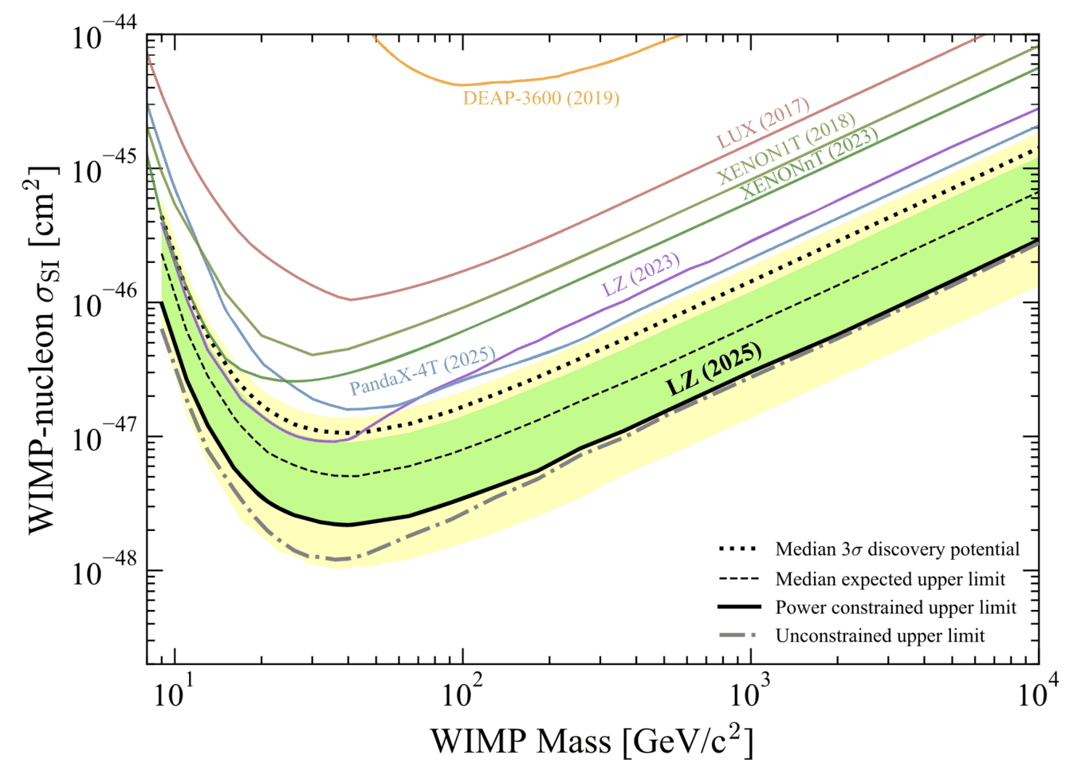
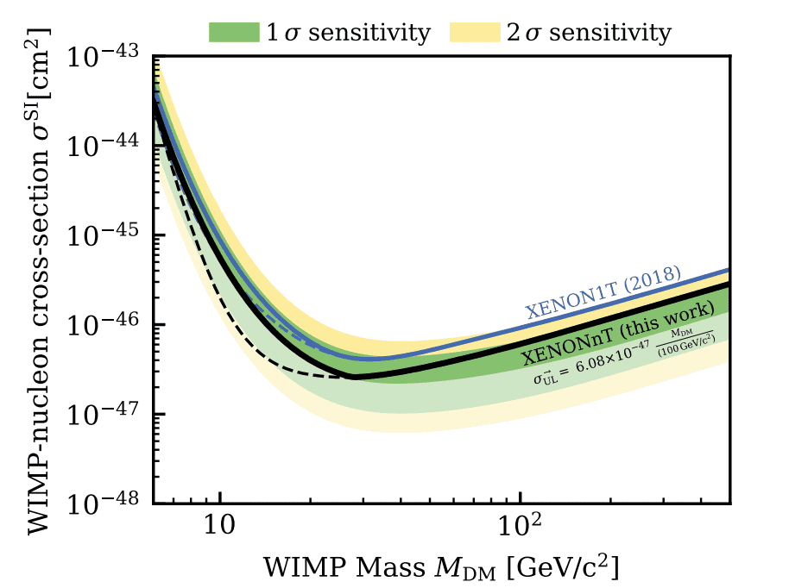
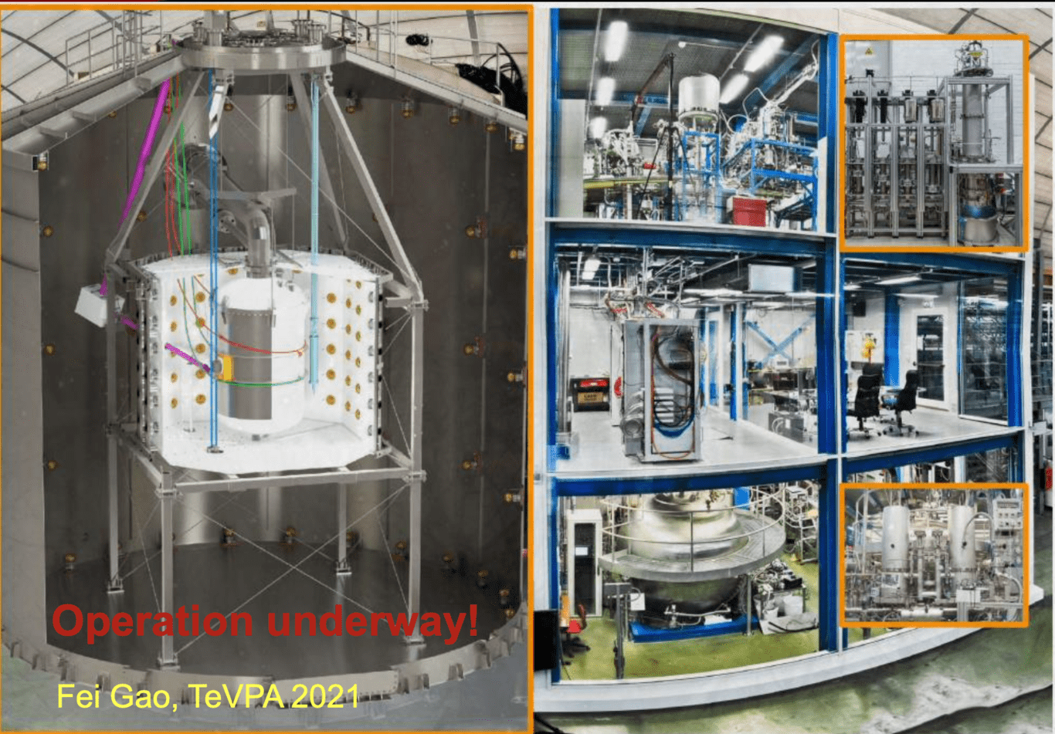
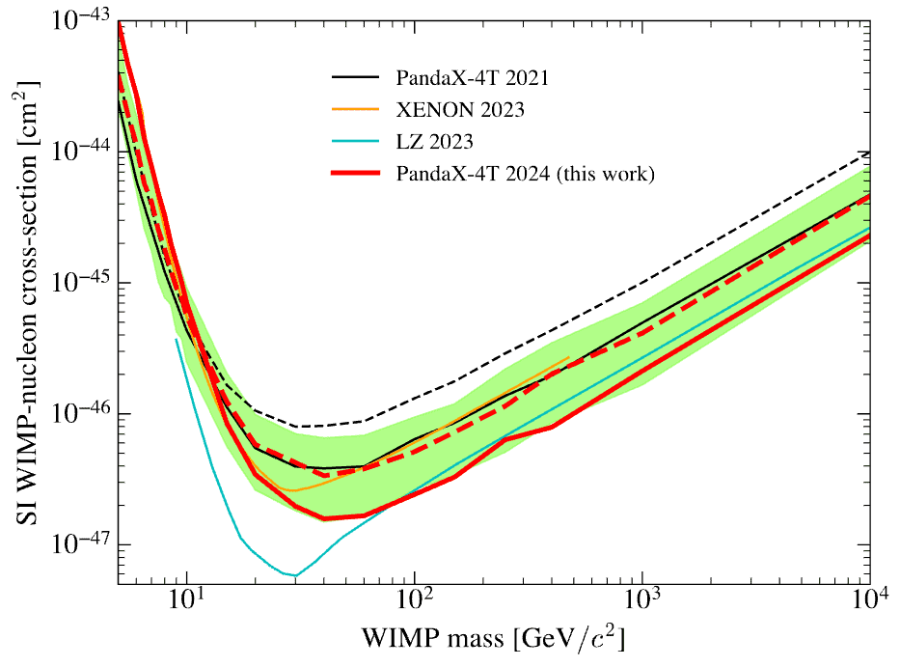
二相型液氙时间投影室
Three multi-tonne detectors operating.
Sanford, LZ, 7ton
LNGS, XENONnT, 6.5ton
CJPL, PandaX-4T, 3.7ton
Chang Cai报告（7/16）
Xiangyi Cui 报告（7/16）
LZ
XENONnT
PandaX-4T
PRL135, 011802 (2025)
PRL131, 041003 (2023)
PRL134, 011805 (2025)
15
9

Slide 16
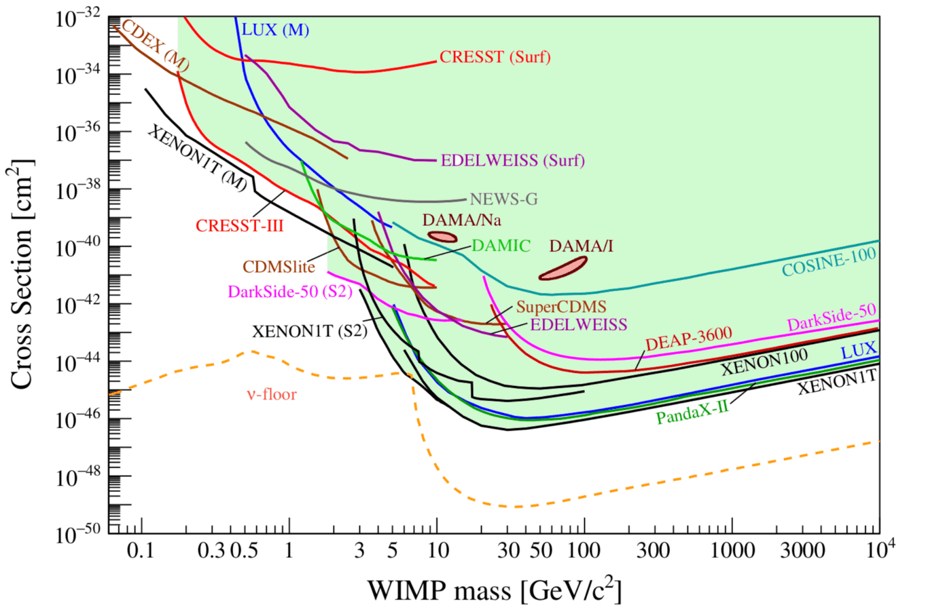
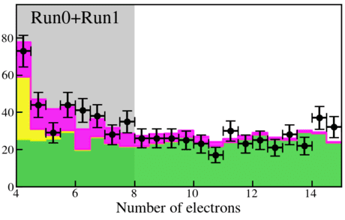












触碰中微子地板
PandaX-4T (1.05 t-yr;2.64𝛔)
Minzhen Zhang报告（7/15）
Best-fit B8
= 75+-28
From APPEC report (2019)
Q. Lin, IDM2024
PRL 133, 191001 (2024)
XENONnT (3.51 t-yr->6.6 t-yr; 2.7𝛔-> 3.3𝛔)
Solar
Kexin Liu报告（7/15）
PRL 133, 191002 (2024)
SN
Atomspheric
arXiv: 2604.06002 (2026)
LZ (5.7 t-yr;4.5𝛔)
要求：低阈值低本底
arXiv: 2512.08065 (2025)
16
10

Slide 17






极低温量热器
SuperCDMS @ SNOLAB
M. Mancuso, Journal of Low Temperature Physics 199, 547 (2022)
CRESST @ LNGS
PHYSICAL REVIEW LETTERS 121, 051301 (2018)
Phys. Rev. D 102, 091101 (2020)
PHYS. REV. D 99, 062001 (2019)
Super-high resolution, 3% to single e-h pair;
High sensitivity to GeV WIMP.
Current status: Detector under construction, commissioning in Oct.
Great background rejection power.
Status: Upgrade detector and readout
17
16

Slide 18





SuperCDMS @ SNOLab
本底将由太阳中微子本底主导
Nov. 2024
18

Slide 19



低能异常“超出”
不同实验显示不同“超出”率
“超出”事例率随时间衰减
与探测器操作历史关联
https://github.com/fewagner/excess
Courtesy to C. Strandhagen, IDM2024
19
17

Slide 20






尝试理解异常“超出”
支撑应力
辐射损伤
晶体缺陷模拟仿真
Courtesy to C. Strandhagen, IDM2024 & Rupak Mahapatra, Magnificent CEvNS
20
18

Slide 21




异常“超出”仍然存在。。。
BULLKID-DM
CRESST-III
Silicon wafers with KIDS readout
Paolo Gorla, TAUP2025
CRESST多种尝试未见明显“超出”减弱；
异常“超出”可能由于多重效应叠加产生；
Matteo Folcarelli, TAUP2025
21
25

Slide 22
CONTENTS
01
物理动机
02
暗物质探测现状
03
无中微子双贝塔衰变探测现状
04
未来趋势
**Disclaimer: Apology for omittance!**
** Most materials are borrowed from public talks, especially from Prof J. Liu, Prof. Q. Yue’s, Prof. K. Han, Prof. Andrea Giuliani, and many talks from previous conferences and seminars.**

Slide 23




无中微子双贝塔衰变探测灵敏度
靶丰度
探测效率
靶质量
测量时长
$$∝η∙ε∙\sqrt{\frac{M∙t}{b∙δE}}$$
Sensitivity
Phonon
Image credit: NEXT
本底水平
能量分辨
SuperCDMS
CUORE
CRESST
AMoRE
CUPID
CDEX
MIMAC
LEGEND
NνDEX
PandaX
DARWIN
XENON/LZ
DarkSide
EXO/nEXO
NEXT
SuperNEMO
ANAIS/COSINE
KamLAND-Zen
SNO+
JUNO-0νββ
Electron
Photon
22

Slide 24






低温量热器
优势：超高能量分辨
CUPID
光热同时读出，本底分辨；
2-3MeV能量分辨：5-10keV；
时间响应～ms量级；
千克量级单模块，吨量级阵列；
Temperature
Sensor
Germanium
Light detector
CUORE
Scintillation
Lights
Module
prototype
AMoRE
Thermal
coupling
Temperature
Sensor
Cooling
Power
Absorber
SuperCDMS
Energy deposition
EPJ C 2023 Jul 28;83(7):675
23
Image credit: CUORE，CUPID

Slide 25
















CUPID-CJPL
SICCAS/NBU/SINAP
USTC
Fudan
锦屏钼-100低温晶体量热双贝塔衰变实验(CUPID-CJPL)
基于¹⁰⁰Mo同位素靶材 (Q_{ββ}~3034 keV，超越天然放射性本底集中区）
高能量分辨率：Γ<0.25% (FWHM@Q_{ββ})
光-热两相信号读出本底甄别（>99.9% α本底压低@Q_{ββ}）
24

Slide 26







CUPID-CJPL时间表
晶体测试
CJPL A2
6-12块天然/富集晶体 (2026-2028)
样机实验
10公斤富集晶体
(2028-2030)
200/1000公斤实验
>200公斤富集晶体(2030+)
立足锦屏国家重大科技基础设施和国内晶体研发优势，发展新一代钼基无中微子双贝塔衰变大型实验，取得国际领先成果
25

Slide 27




闪烁体探测器
优势：超大曝光质量
JUNO-0νββ
KamLAND-ZEN (and SNO+)
千吨液体闪烁体
内部气球充满含～800 kg ¹³⁶Xe的液闪
国际领先的无中微子双贝塔衰变实验
JUNO-0νββ
20 kton LS 可掺约100吨量级Te/Xe
10²⁸年量级的半衰期灵敏度
高能量分辨率$<$3% @ 1 MeV
KamLAND-ZEN
26

Slide 28





气体探测器
优势：topology分辨伽马
NEXT
AXEL/NEXT/ NνDEX /PandaX-III高气压气体探测器
利用双贝塔衰变的径迹特征提取信号，压低本底
多种探测器读出技术
当前目标建成百公斤级探测器
MicroMegas
NνDEX PandaX-III
27

Slide 29




半导体探测器
Litao Yang, Rui Xu 报告（7/16）
PRD 106, 032012 (2022)
国内首次0nbb搜寻
优势：高能量分辨率
高能量分辨率 ~1‰ @ 2MeV;
CDEX/LEGEND：下一代旗舰级吨级无中微子双贝塔搜寻锗探测器阵列；
GERDA - Italy
+
MAJORANA - USA
= LEGEND
From CDEX
28

Slide 30






惰性液体探测器：富集靶
EXO-200
nEXO
M. Videl, Lake Louise Winter (2025)
PRD 99, 095038 (2019)
C. Hall, DUSEL town meeting (2007)
PRL 123, 161802 (2019)
SiPM for light readout, Si plate for charge readout;
Reaching ~10meV of m_{𝛃𝛃};
$$T_{1/2}<3.5×{10}^{25}yr;m_{ββ}\sim \left[78,239\right]meV$$
29

Slide 31





惰性液体探测器：自然靶
惰性液体探测器具有ER/NR鉴别，有效自屏蔽等优点；
领域内多年研发，已经可以使惰性液体探测器覆盖100eV-10MeV能区；
虽然靶元素丰度在8%~10%水平，因其较大曝光量结果已经渐渐进入到世界领先行列。
PandaX-4T Xe136 0nbb, Science Bulletin 70, 1779 (2025)
XENON1T Xe136 0nbb, PRC 106, 024328 (2022)
PandaX-4T Xe134 0nbb, PRL 132, 152402 (2024)
Image credit: PandaX, XENON
30

Slide 32

未来实验灵敏度
CDEX-300
PandaX-xT
Courtesy: Andrea Giuliani
31

Slide 33
CONTENTS
01
物理动机
02
暗物质探测现状
03
无中微子双贝塔衰变探测现状
04
未来趋势
**Disclaimer: Apology for omittance!**
** Most materials are borrowed from public talks, especially from Prof J. Liu, Prof. Q. Yue’s, Prof. K. Han, Prof. Andrea Giuliani, and many talks from previous conferences and seminars.**

Slide 34




未来趋势
暗物质与双贝塔衰变的融合交叉：
  共同的探测器技术
  100eV-10MeV能区覆盖
  一致的大体量诉求
  类似的低本底挑战
CDEX
Litao Yang, Rui Xu 报告（7/16）
PandaX
Xiangyi Cui 报告（7/16）
32

Slide 35




未来趋势
KamLAND2-ZEN
暗物质与双贝塔衰变的融合交叉：
  共同的探测器技术
  100eV-10MeV能区覆盖
  一致的大体量诉求
  类似的低本底挑战
探测器向吨及几十几百吨量级挺进；
CUPID
SNO+
LEGEND
nEXO
33

Slide 36


未来趋势
暗物质与双贝塔衰变的融合交叉：
  共同的探测器技术
  100eV-10MeV能区覆盖
  一致的大体量诉求
  类似的低本底挑战
探测器向吨及几十几百吨量级挺进；
新型技术百花齐放；
超流液氦
SENSEI：Skip CCD技术
Phys. Rev. D 100, 092007 (2019)
R. Essig/Stony Brook University; APS/Carin Cain
34
https://news.fnal.gov/2020/06/sensei-gets-quiet/

Slide 37


未来趋势
PandaX-4T pp中微子最新结果
暗物质与双贝塔衰变的融合交叉：
  共同的探测器技术
  100eV-10MeV能区覆盖
  一致的大体量诉求
  类似的低本底挑战
探测器向吨及几十几百吨量级挺进；
新型技术百花齐放；
参与中微子天文：
  太阳中微子
  超新星中微子
Preliminary
K. Han, NEUTRINO2026
PandaX-xT预期中微子物理结果
Sci. China Phys. Mech. Astron. 68, 221011 (2025)
太阳⁸B中微子相干散射通道
太阳pp中微子电子散射通道
SNO 2013
SSM (HZ)
SSM (LZ)
PandaX-xT
200 t-y
35

Slide 38
总结
暗物质探测以及无中微子双贝塔衰变是新物理搜寻的重要核心方向，是深地极低本底实验的两颗明珠；
暗物质探测未来两大探测器方向：惰性液体探测器for重质量暗物质，及低温量热器等for GeV暗物质；
无中微子双贝塔实验多种探测技术并行铺开；
未来探测器将向吨至几十几百吨量级挺进，提倡一机多用。
Thanks for listening!
36

Slide 39
backup

Slide 40






Future LXeTPC
2nd-generation LXe-TPCs continue taking data!
XLZD (XENON-LZ-DARWIN); > 60t
Courtesy to L. Baudis, IDM2024
Courtesy to M. E. Monzani, IDM2024
Confidence intervals for 200 tonne-yr (1-, 2-, 3-σ)
PandaX-xT; ~43 tonne
LZ
arXiv: 2402.03596
11

Slide 41


LAr-TPC work force
From G. Giovanetti
From M. E. Monzani, IDM2024
Higher intrinsic bkg with natural Ar, but with PSD discrimination!
12

Slide 42






DarkSide-20k
From M.E. Montani, IDM2024
From Roberto Santorelli - La Thuile 2022
Under construction,;
50-tonne total mass;
20t fiducial mass for 10-year exposure;
SiPM 4pi coverage;
UAr mined from Urania;
Further distillated at Aria facility;
Courtesy to J. Monroe, IDM2024
13

Slide 43



DAMA/LIBRA (Scintillator)
Full exposure 13.7𝛔
NaI crystal coupled with PMT at both ends.
Crystal array embedded in copper cage, then shielded by PE and lead.
No PID, bkg high;
Annual Modulation Signal
Nuclear Physics and Atomic Energy.
Credit：Fabio Cappella
Credit： James Josephides
19

Slide 44

Annual modulation validation working force
20

Slide 45





Joint analysis between COSINE and ANAIS
3-yr results
6-yr results
Energy | Amplitude [dru] | DAMA exclusion
1-6 keV | -0.0002+-0.0026 | 3.7𝛔
2-6 keV | 0.0021+-0.0028 | 2.6𝛔
Energy | Amplitude [dru] | DAMA exclusion
1-6 keV | 0.0005+-0.0019 | 4.7𝛔
2-6 keV | 0.0027+-0.0021 | 3.5𝛔
arXiv: 2503.19559
21

Slide 46





Detection Techniques
Coutesy of APPEC report
Bubble Chamber
Heat
Bolometer
Bolometer
Scintillator
Gaseous TPC
Light
Point-contact Ge
Charge
Single-phase Noble Liquid
Dual-phase Noble Liquid
6

Slide 47




Directional Detector: Gaseous TPC
SE. Vahsen et al., arXiv:2008.12587
Low-pressure gaseous TPC;
Highly pixelized charge readout for high track resolution;
Directionality can help go beyond neutrino floor to some extent.
Solar
SN
Atomspheric
PHYSICAL REVIEW D 92, 063518 (2015)
Ultimate background: neutrinos
14

Slide 48


CDEX @ CJPL
From Q. Yue
PRL120, 241301 (2018)
LN2 temperature; HPGe collects pure ionization signal;
Point-contact detector (small cap. ~pF; low electronic noise);
Background level ~2 counts/kg/keV/day (2-4keV);
CDEX-10, threshold ~160eV;
From Litao Yang, IDM2024
16

Slide 49





S2-only in Noble Liquid Detectors
XENONnT, PRL 134, 111802 (2025)
Greatly lower the threshold for Noble Liquid TPCs;
Combine with large exposures, can reach leading sensitivities for ~100 MeV LDM (WIMP-e scattering);
PandaX-4T, PRL 130, 261001 (2023)
arXiv: 2507.11930 (2025)
24

Slide 50




ANAIS-112
112.5-kg mass
Phys. Rev. D 103, 102005 (2021)
3-year exposure
ANAIS-112’s 3-year results support the absence of annual modulation;
The results are incompatible with DAMA/LIBRA at 3.3 (2.6) 𝛔 for energy window of 1-6 (2-6) keV.
11

Slide 51




COSINUS Experiment @ LNGS
Courtesy to F. Reindl, IDM2024
Start data taking in 2025;
Cryogenic NaI detector with light and phonon readout;
Event-by-event discrimination;
Counting & Modulation searches;
22

Slide 52

Low energy regimes
Courtesy to D. Baxter, IDM2024
23

Slide 53


S2-only in Noble Liquid Detectors
XENON1T, PRL 123, 251801 (2019)
Greatly lower the threshold for Noble Liquid TPCs;
Combine with large exposures, can reach leading sensitivities for ~100 MeV LDM (WIMP-e scattering);
PandaX-4T, PRL 130, 261001 (2023)
24

Slide 54


CCD detectors
https://news.fnal.gov/2020/06/sensei-gets-quiet/
0.01 g Si Skipper CCD;
Reduce noise through non-destructively measure charge multiple times;
Single electron sensitivity with resolution to 6.7%.
26

Slide 55


Superfluid Helium Detector
Phys. Rev. D 100, 092007 (2019)
Gamma coherent
neutrino
gamma
neutron
Very low W value for roton and phonon;
Quasiparticle propagate ballistically, including directionality;
Background dominated by gamma and neutrino coherent scattering;
27

Slide 56




Bubble Chamber: PICO
Single Scatter
Multi-Scatter
PandaX-II
XENON1T
https://www.picoexperiment.com/pico-60/
Largest bubble chamber with superheated C₃F₈;
No bkg from gamma, e and muons;
Discrimination against neutron through single and multiple scatter images;
PandaX-II
XENON1T
LUX
8

Slide 57









DM-e scattering and Migdal effect
DM-electron scattering
Migdal Effect
Essig, Mardon, Volansky, PRD 85, 076007 (2012)
M. Ibe et al., Journal of High Energy Physics 2018.3 (2018)
XENON collaboration, PRL 123, 241803 (2019)
PandaX collaboration, arXiv: 2212.10067 (2022)
XENON1T
CDEX
Capable of Probing light dark matter due to high momentum transfer
17

Slide 58





Diurnal Modulation
From J. Liu
PHYSICAL REVIEW LETTERS 126, 091804 (2021)
PHYSICAL REVIEW LETTERS 128, 171801 (2022)
𝛘
From XiangYi Cui
𝛘
𝛘
Expected diurnal modulation due to traveling length’s day-night difference for transpassing boosted DM.
18

Slide 59



Quantum sensors
Magnetometer
Optimechanical
Ion Trap
Nature Phys. 17, 1402–1407 (2021).
arXiv: 2306.09726
PRX QUANTUM 3, 010330 (2022)
21

