Slide 1



Parton distribution function on Lattice QCD
Peng Sun
Institute of Modern Physics,
Chinese Academy of Sciences
Lattice Parton
collaboration
Chinese Lattice
collaboration
2026/07/14

Slide 2
Outline
Large-Momentum Effective Theory
Results from Lattice Parton collaboration (LPC)
summary

Slide 3
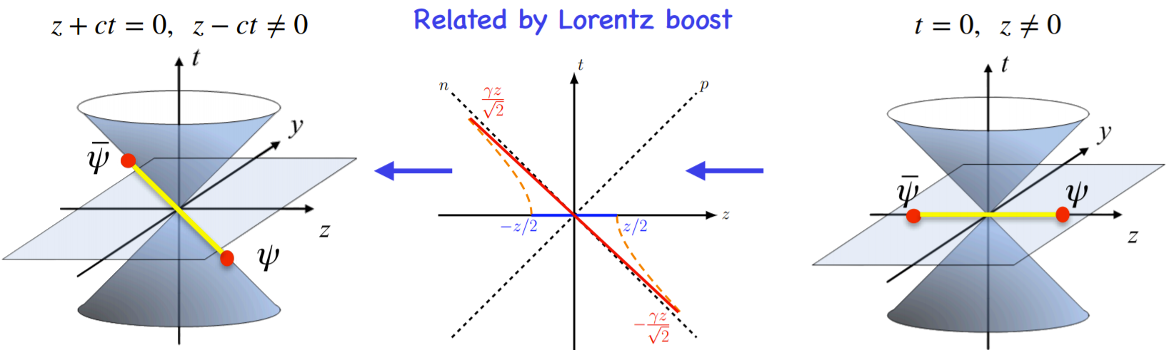
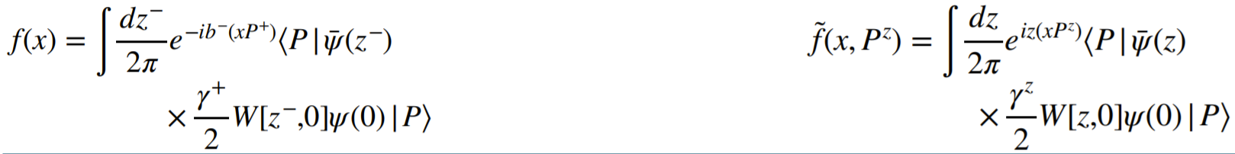
Large-Momentum Effective Theory (LaMET)
X. D. Ji, Phys.Rev.Lett 110 (2013) 262002
X. Ji, Y.-S. Liu, Y. Liu, J.-H. Zhang and Y Zhao , Rev. Mod. Phys. 93, 35005 (2021).
Light-cone PDF : Cannot be
calculated on the lattice
Quasi-PDF : Directly
calculable on the lattice

Slide 4
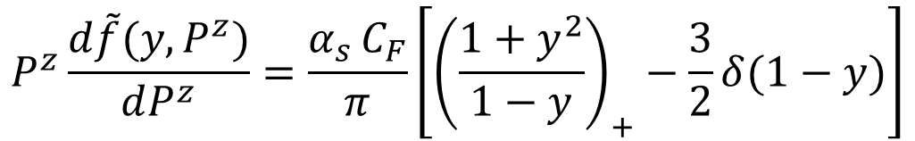
Matching between Qausi-PDF and LC-PDF
Factorization formula rigorously proven in the momentum space in MS scheme
*The qausi-PDF and LC-PDF share the same IR physics in x,y=[0, 1]
Then we can build the matching relationship:
Y.-Q. Ma and J. Qiu, Phys.Rev. D 98 (2018)
X. Ji, Y.-S. Liu, Y. Liu, J.-H. Zhang and Y. Zhao, Rev. Mod. Phys. 93, 35005 (2021)

Slide 5
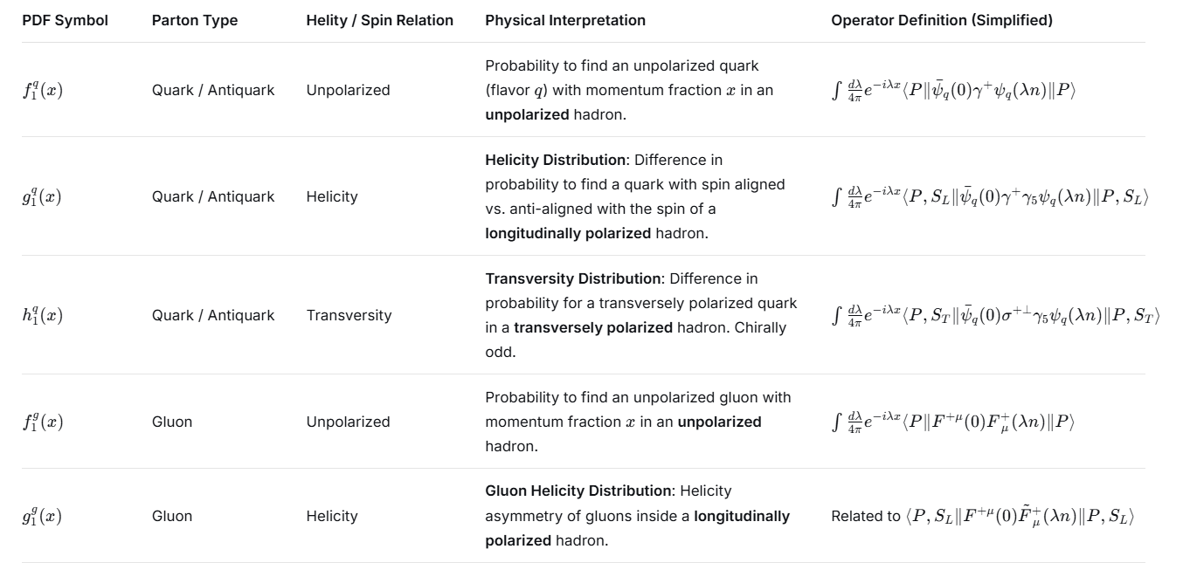
Leading twist light-cone PDF

Slide 6
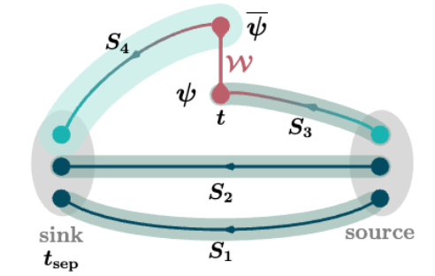
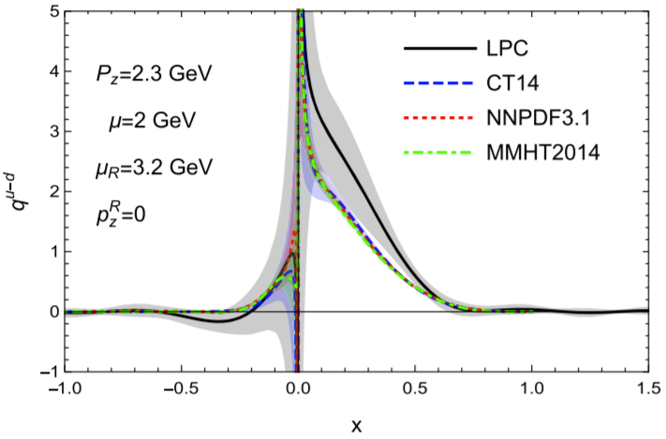
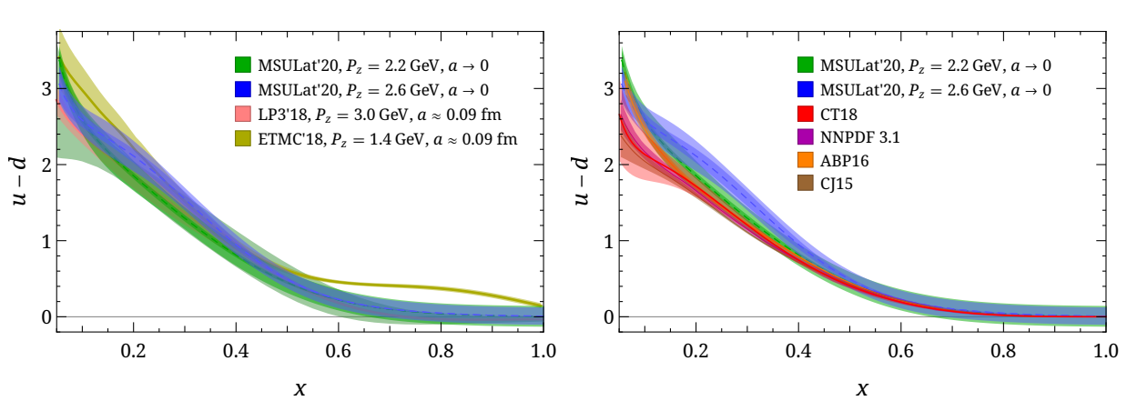
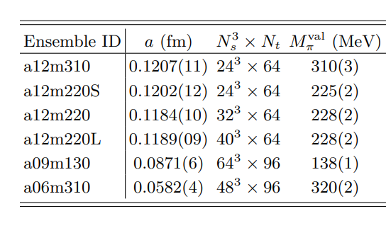
Unpolarized PDF on Lattice
Using CLS 32x96 2+1 flavor clover fermion ensemble H102 Lattice spacing a=0.086 fm, Mπ= 356MeV
Y. Liu, et.al., LPC, PRD101(2020)034020
HW. Lin arXiv:2011.14971 (2020)

Slide 7
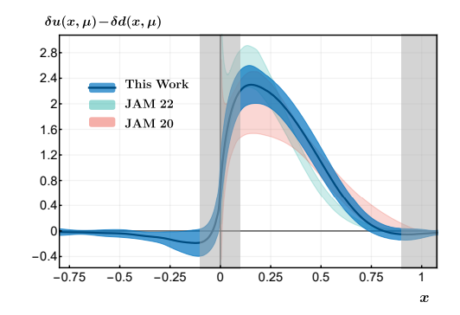
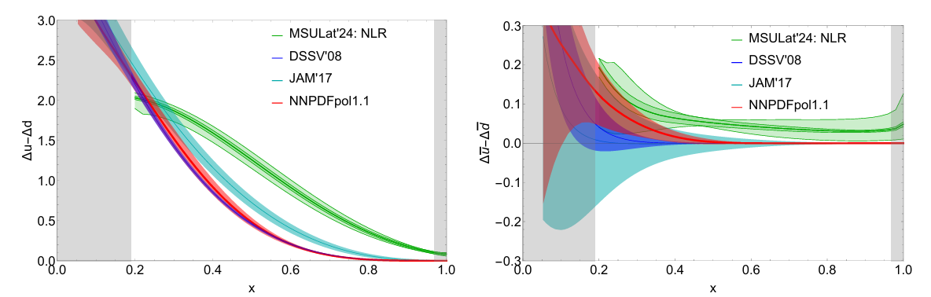
Transversity and Helicity PDF on Lattice
F Yao et al LPC Phys. Rev. Lett. 131, 261901
J Holligan, HW Lin Phys.Lett.B 854 (2024) 138731

Slide 8
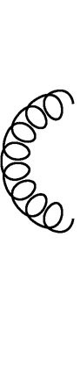
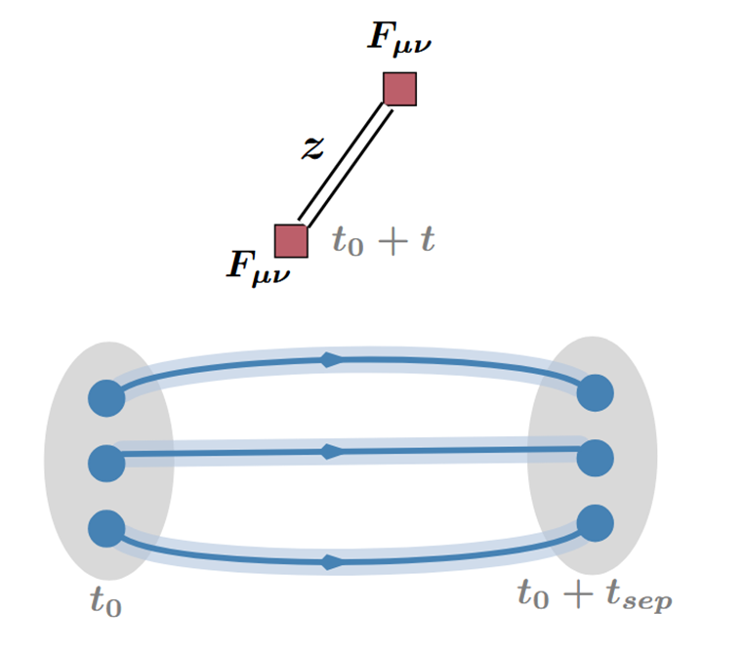
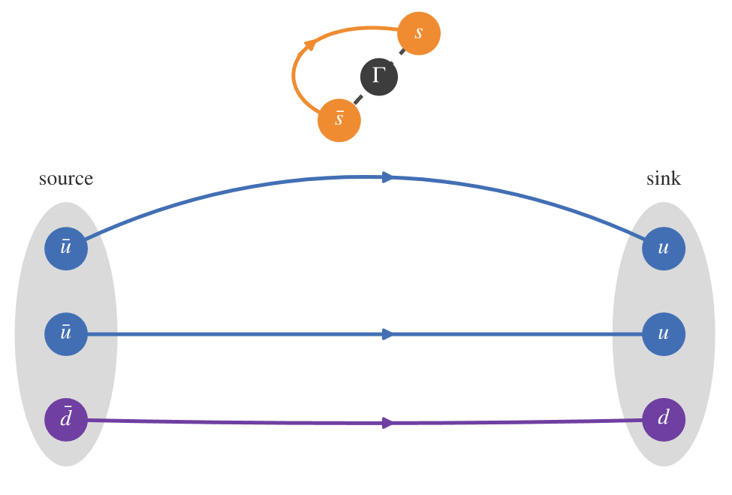
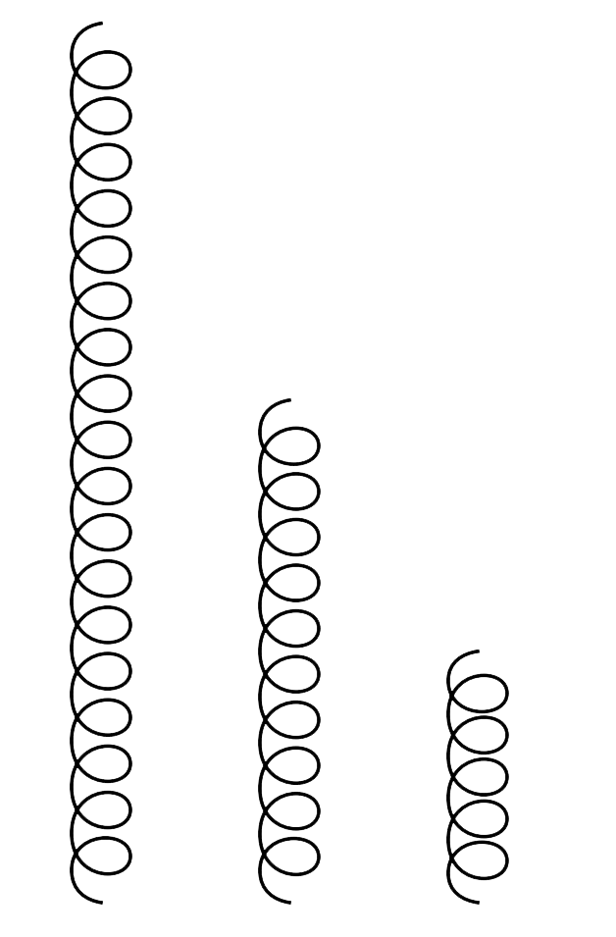
Gluon and sea quark PDF on Lattice
Lattice QCD calculation :

Slide 9
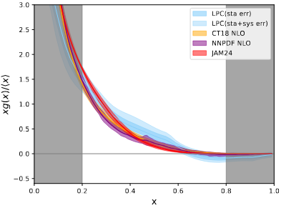
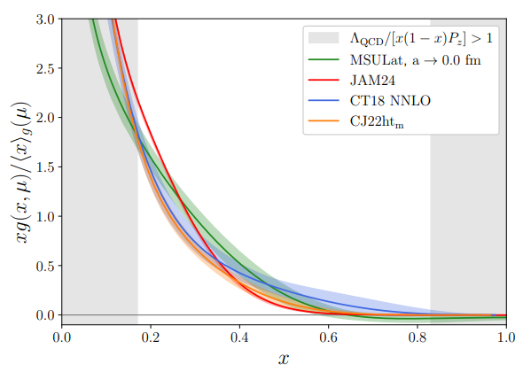
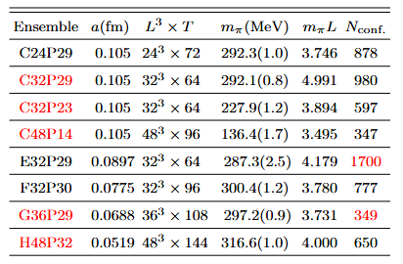
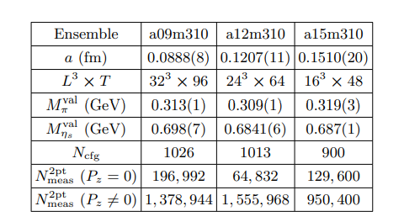
Unpolarized Gluon PDF on Lattice
arXiv:2510.26425
arXiv:2510.17758

Slide 10
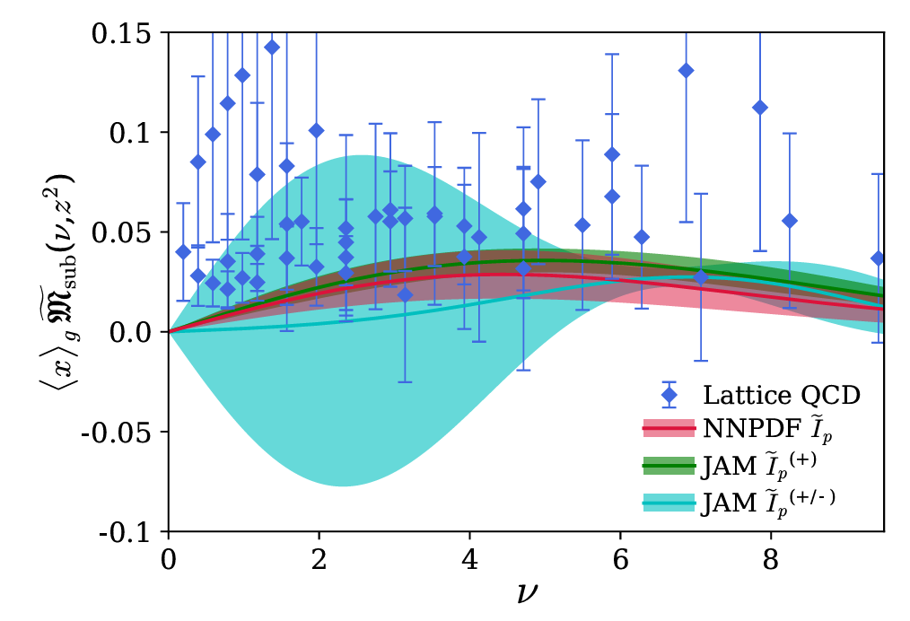
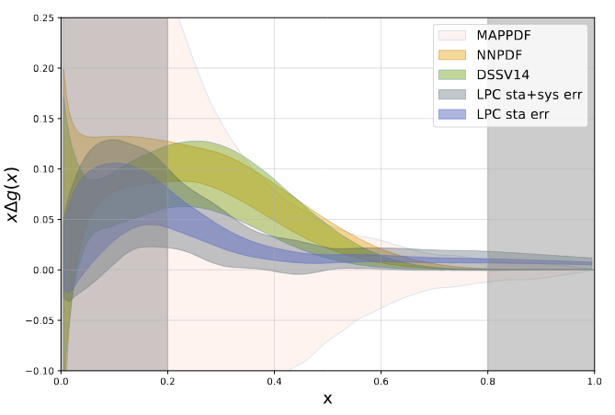

Helicity Gluon PDF on Lattice
HadStruc Collaboration
Phys.Rev.D 106 (2022) 9, 094511
LPC Collaboration

Slide 11
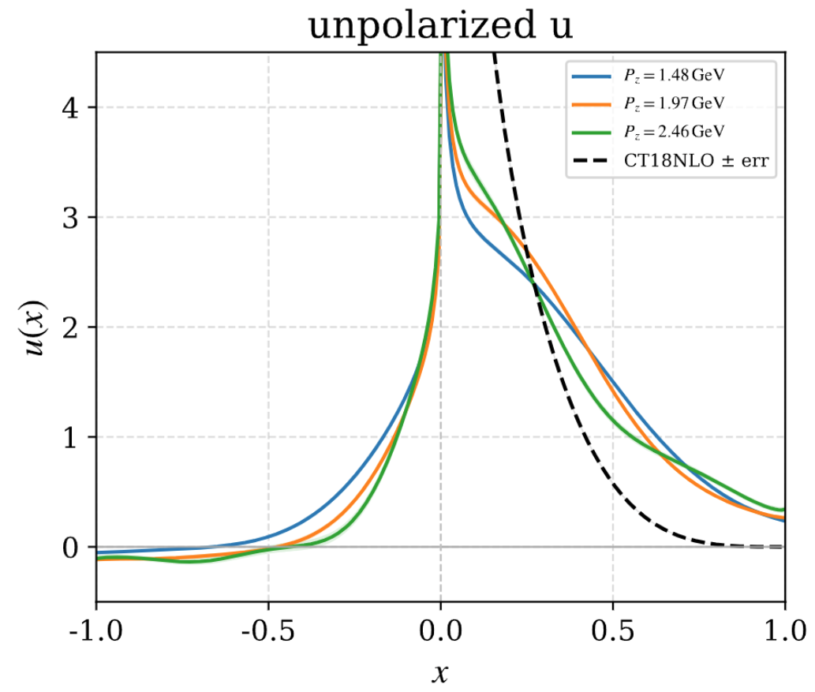
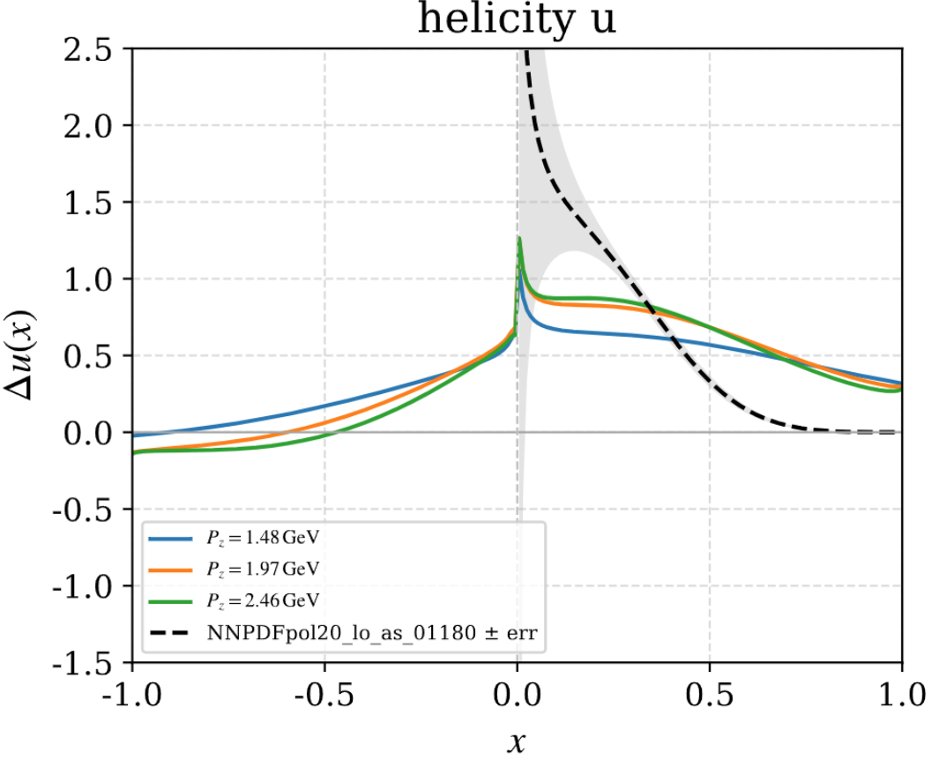
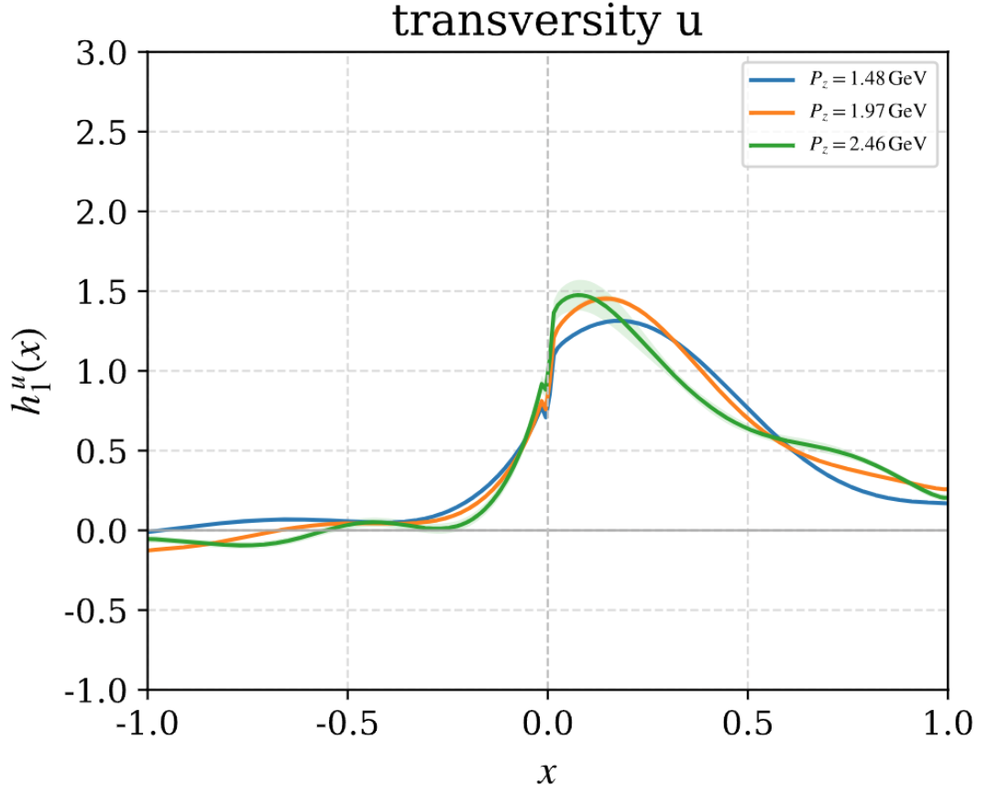
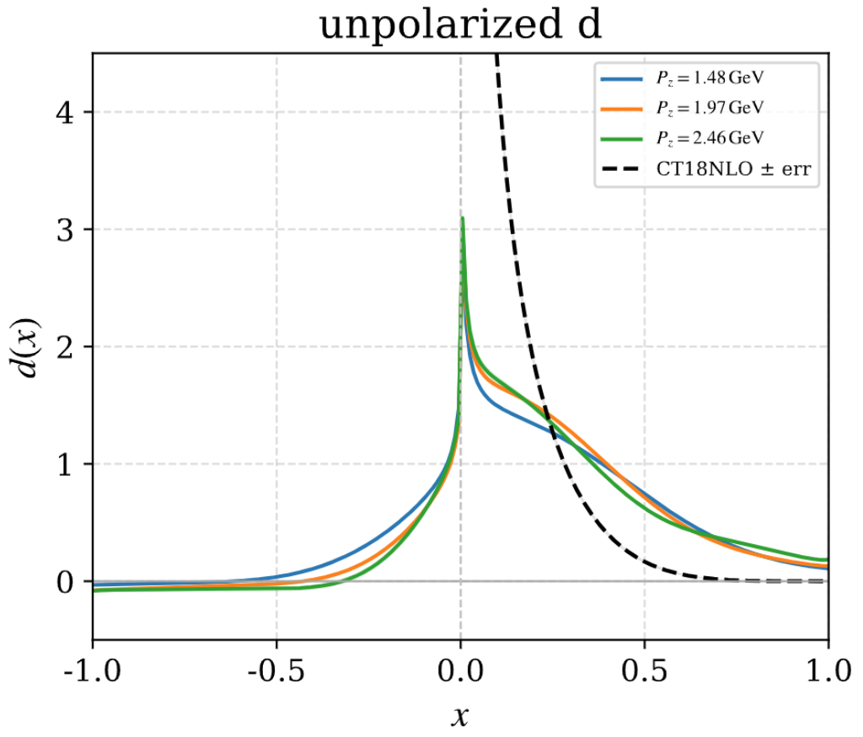
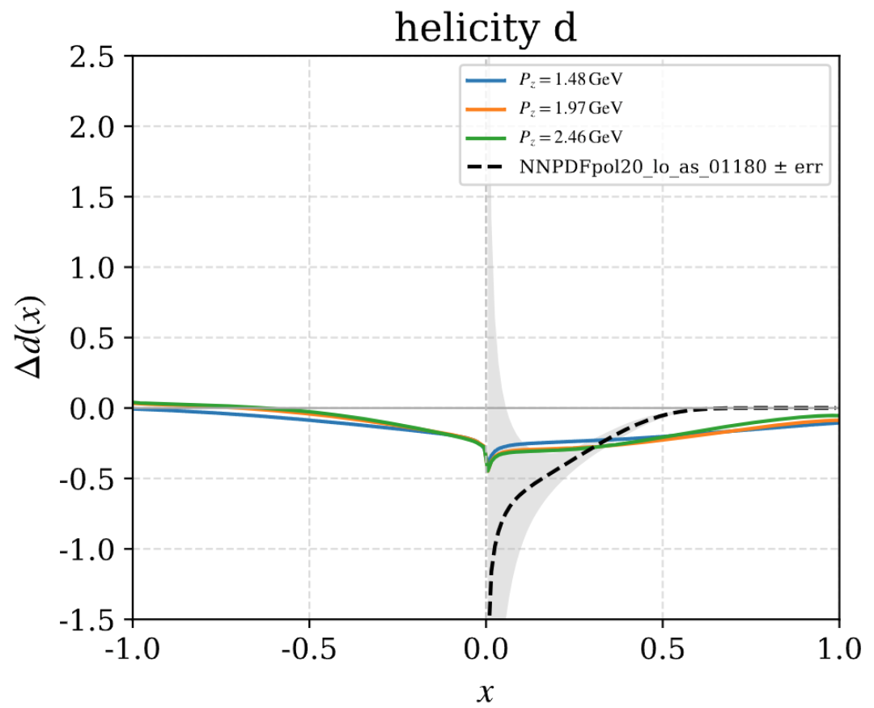
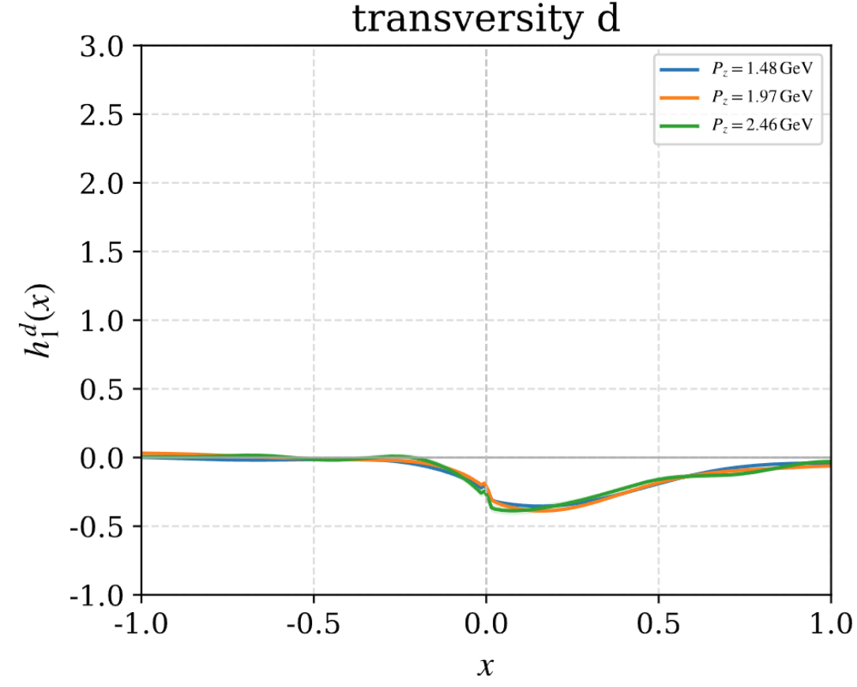
u and d quark PDF on Lattice

Slide 12
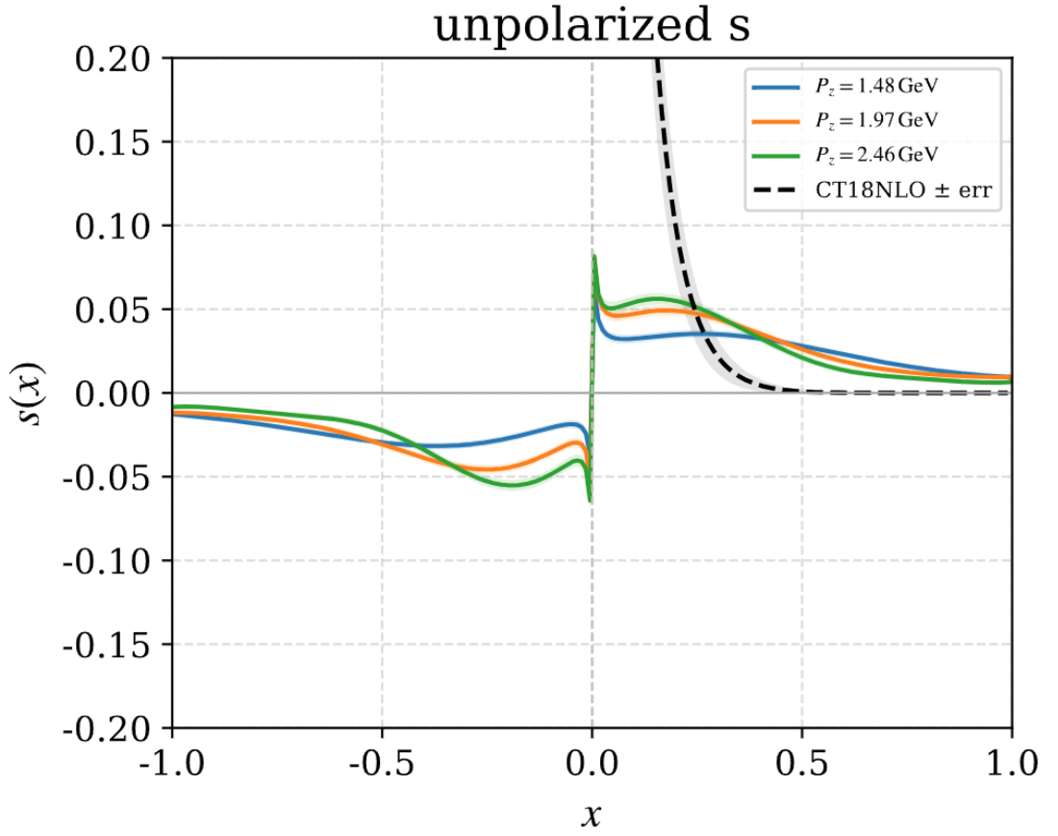
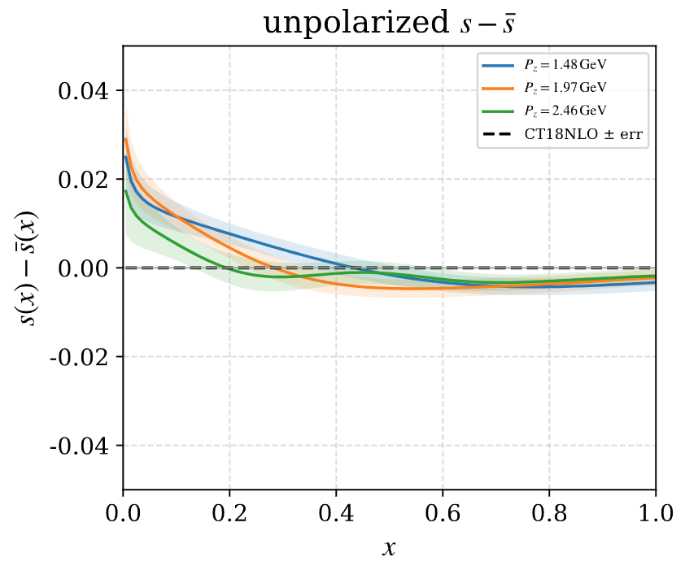
s quark PDF on Lattice

Slide 13
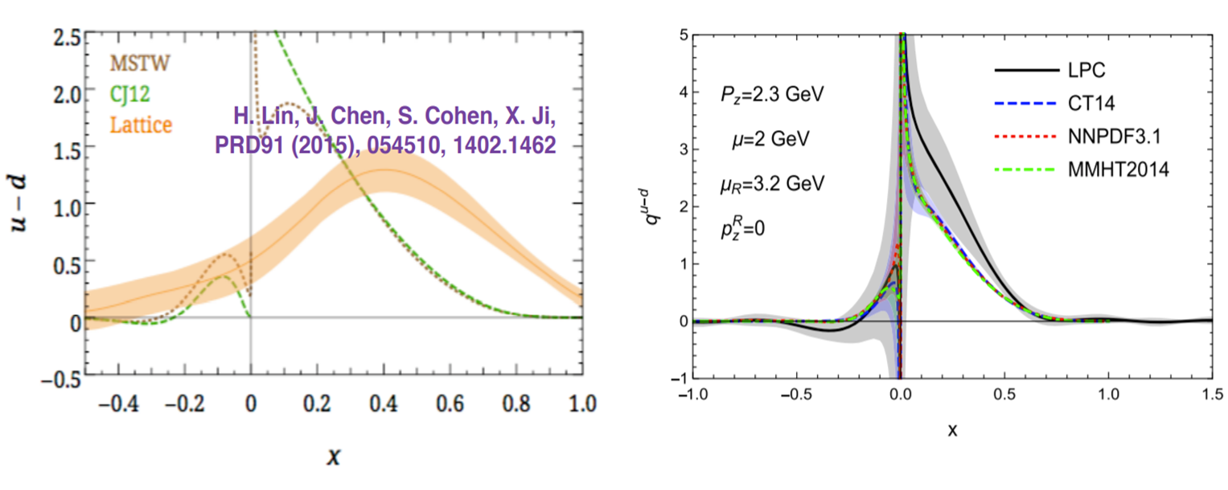
Summary
We have completed many works on the lattice calculation of PDFs.
• Improved operator definition;
• Improved renormalization;
• higher loop matching;
• Better systematic and statistical error control
LPC 2020
However, a lot of much more difficult works need to do, like sea quark PDF, TMD, GPD and so on.

