Slide 1
Belle II实验的进展
王小龙
复旦大学
中国物理学会高能物理分会，第12届学术年会
广州，2026年7月17日

Slide 2
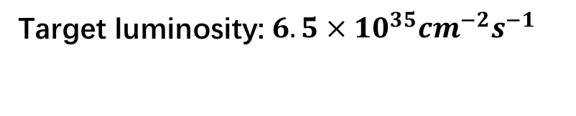
SuperKEKB accelerator
Target luminosity: $6.5×{10}^{35}cm^{−2}s^{−1}$

Slide 3
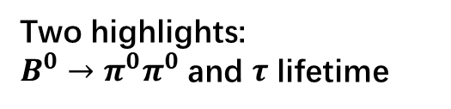
Belle II Physics
关于Belle II物理的分会报告：
曹璐：“Recent highlights from the Belle II experiment,” 7/15
李春花：“tau physics at Belle II,” 7/16
李龙科：“Recent Charm Results at Belle II,” 7/17
Two highlights:
$B^{0}→π^{0}π^{0}$ and $τ$ lifetime

Slide 4
CERN may help to fix many troubles in SuperKEKB. I guess.

Slide 5
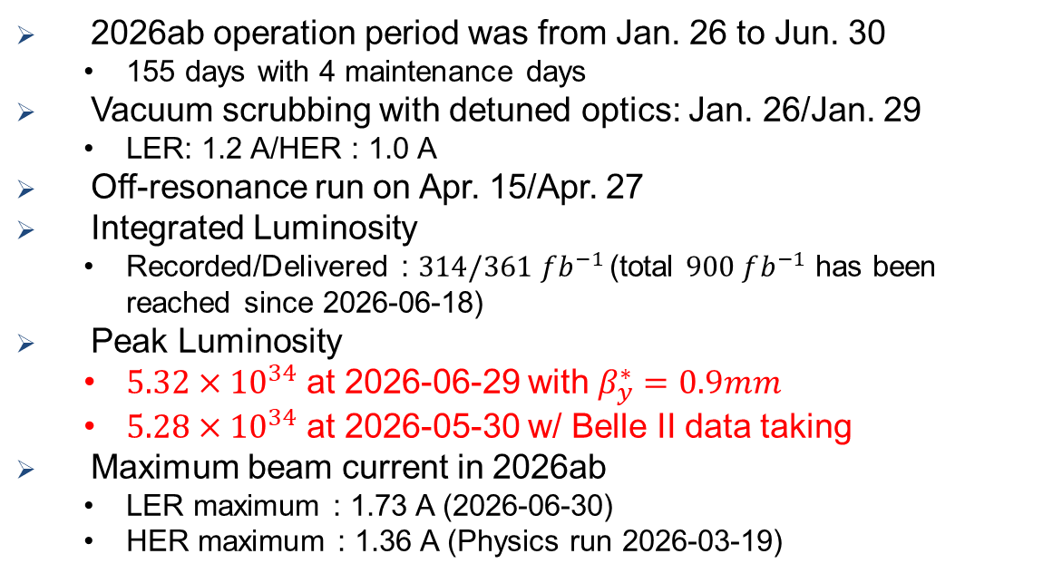
2026ab operation history
􀋙 2026ab operation period was from Jan. 26 to Jun. 30
  155 days with 4 maintenance days
􀋙 Vacuum scrubbing with detuned optics: Jan. 26/Jan. 29
  LER: 1.2 A/HER : 1.0 A
􀋙 Off-resonance run on Apr. 15/Apr. 27
􀋙 Integrated Luminosity
  Recorded/Delivered : $314/361 fb^{−1}$ (total $900 fb^{−1}$ has been reached since 2026-06-18)
􀋙 Peak Luminosity
  $5.32×{10}^{34}$ at 2026-06-29 with $β_{y}^{∗}=0.9mm$
  $5.28×{10}^{34}$ at 2026-05-30 w/ Belle II data taking
􀋙 Maximum beam current in 2026ab
  LER maximum : 1.73 A (2026-06-30)
  HER maximum : 1.36 A (Physics run 2026-03-19)
Stable operation with $L>5×{10}^{34}cm^{−2}s^{−1}$
High current operation with 2-bunch injection in the HER started on Apr. 1.

Slide 6

Integrated luminosity
$314 fb^{−1}$ data were taken in 2026ab run.
Belle II has a larger $Υ(4S)$ data sample than Belle.

Slide 7
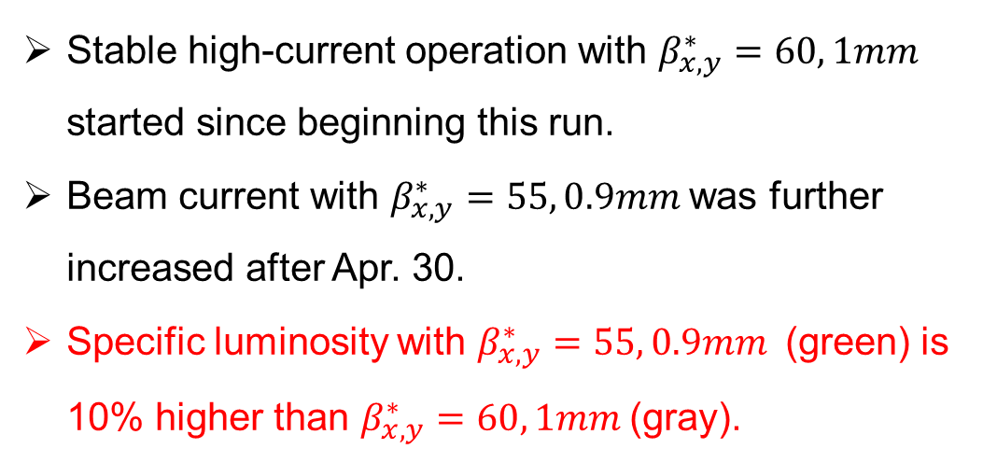
Increase peak luminosity
Peak luminosity (w/ Belle II): $5.28×{10}^{34}cm^{−2}s^{−1}$
Stable high-current operation with $β_{x,y}^{∗}=60, 1mm$ started since beginning this run.
Beam current with $β_{x,y}^{∗}=55, 0.9mm$ was further increased after Apr. 30.
Specific luminosity with $β_{x,y}^{∗}=55, 0.9mm$ (green) is 10% higher than $β_{x,y}^{∗}=60, 1mm$ (gray).
10%

Slide 8
Beam abort statistics
SBL frequency of the HER increases with beam current.
SBLs of the LER often involves QCS quenches.
Reducing the SBL frequency in both rings is essential, and SBL Task Force is currently investigating possible countermeasures.

Slide 9
Paper Submission Status

Slide 10
Workshop and B2GM for Belle II Upgrade

Slide 11
New detector for two-photon physics
Fudan, IHEP, SDU, Nankai, NJNU…

Slide 12
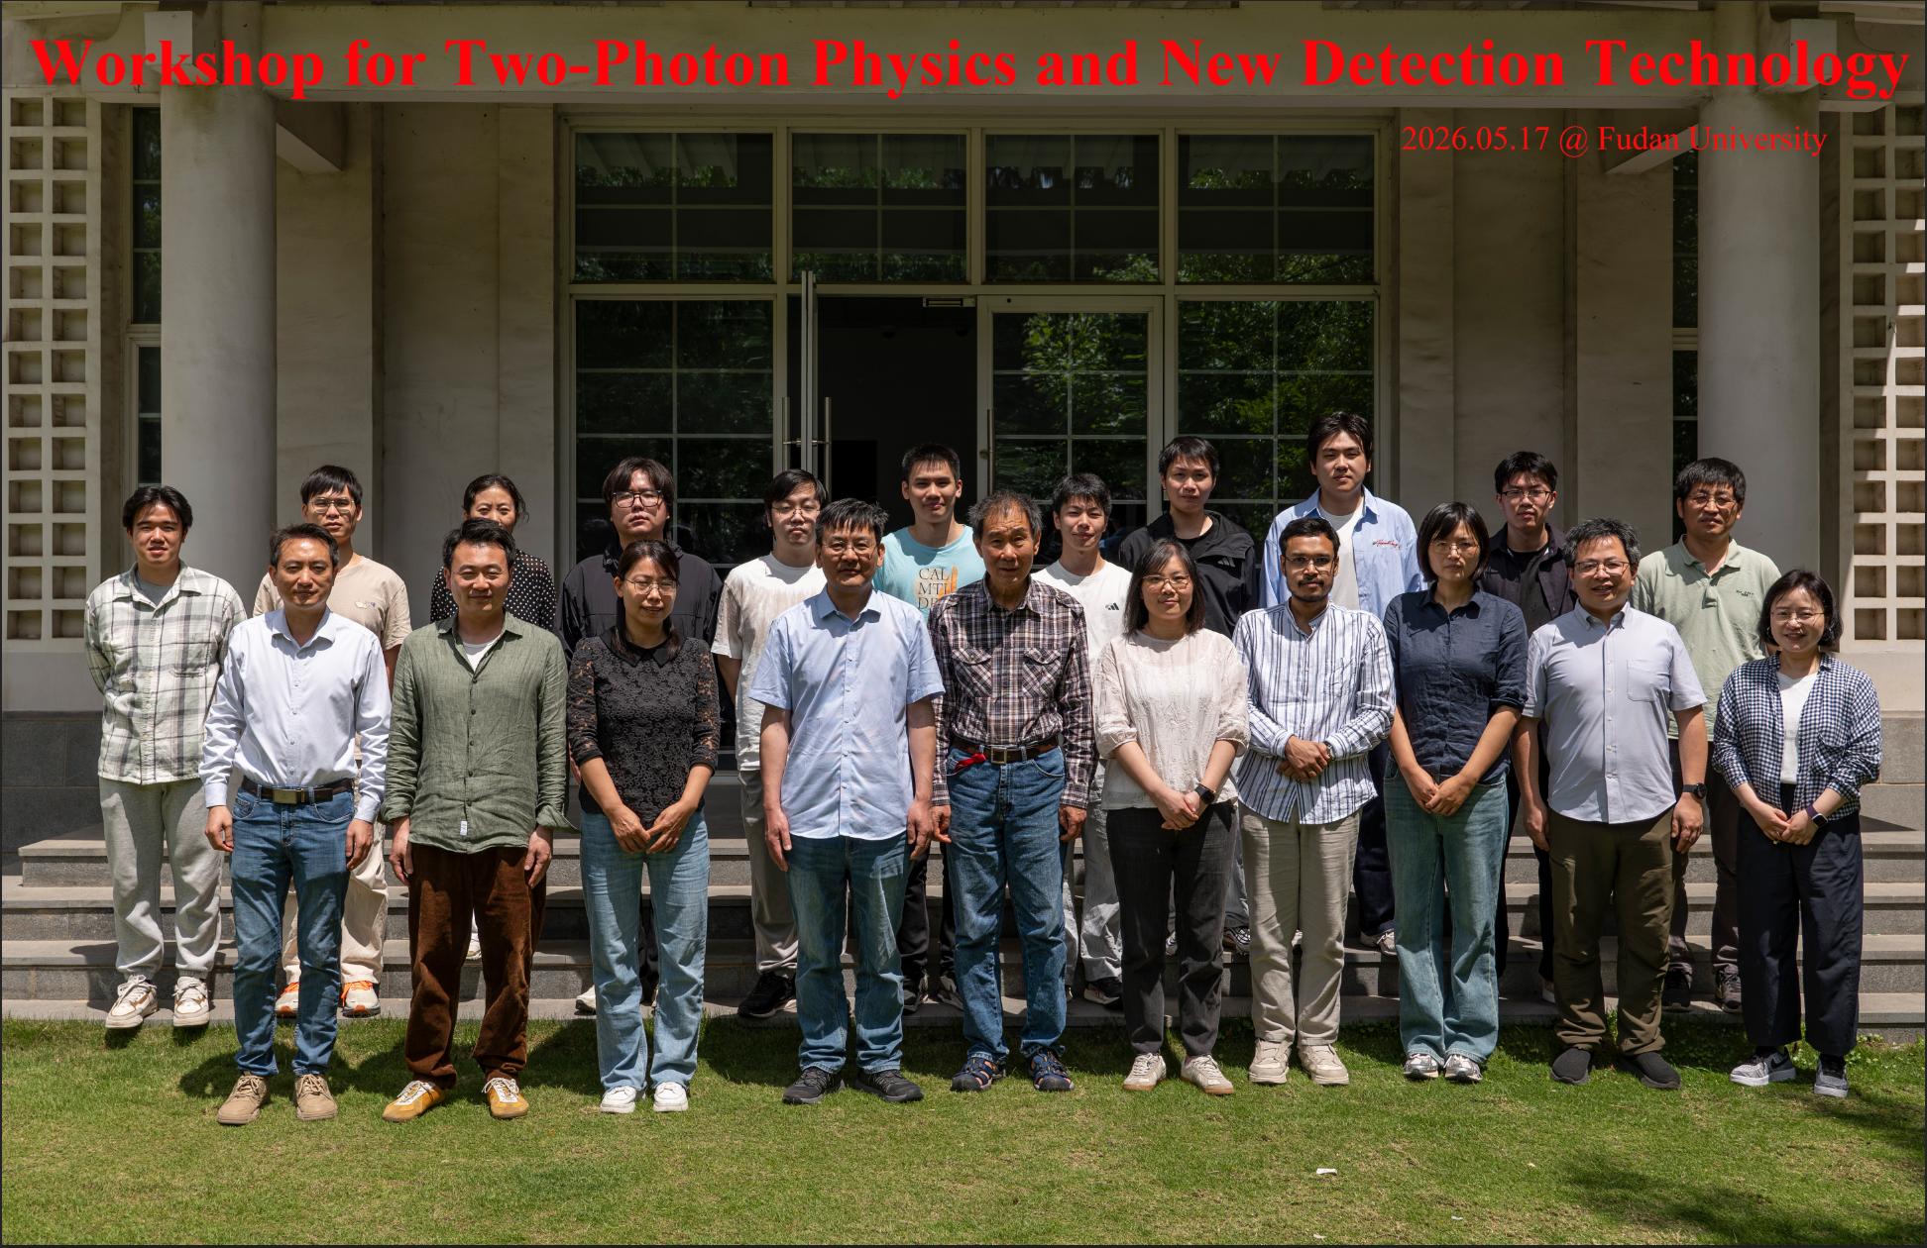
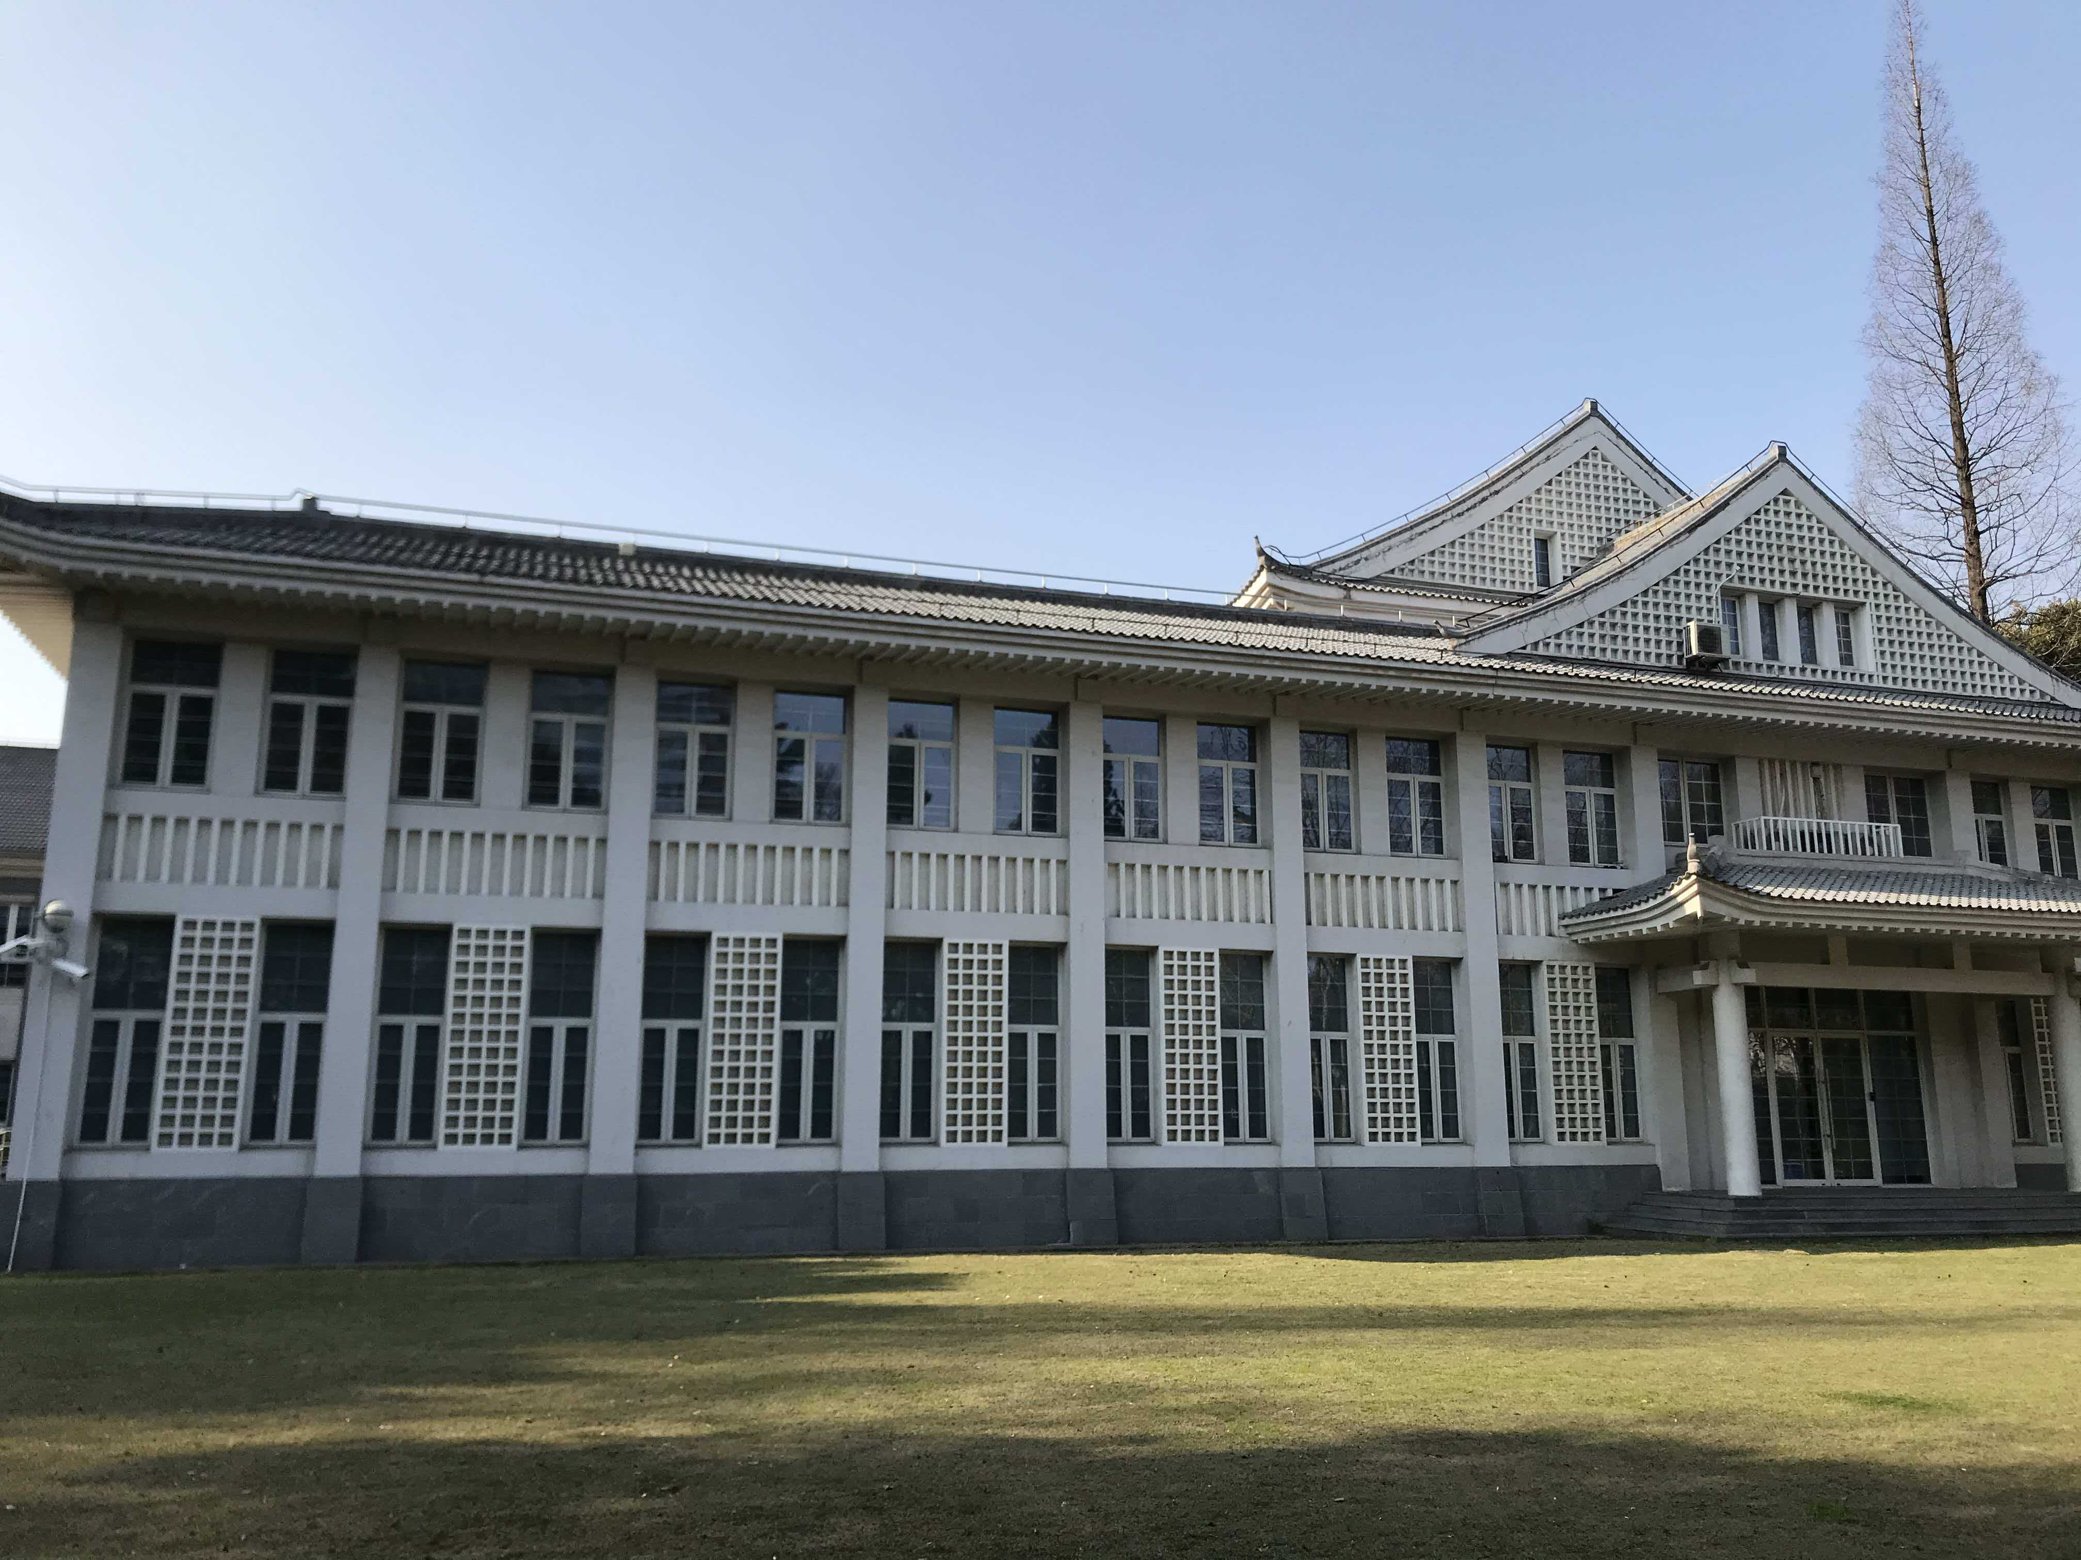
Workshop@Fudan
https://indico.ihep.ac.cn/event/29263/
我们走在前面！

Slide 13

$e^{+}e^{−}$ in $γγ$ collision

Slide 14
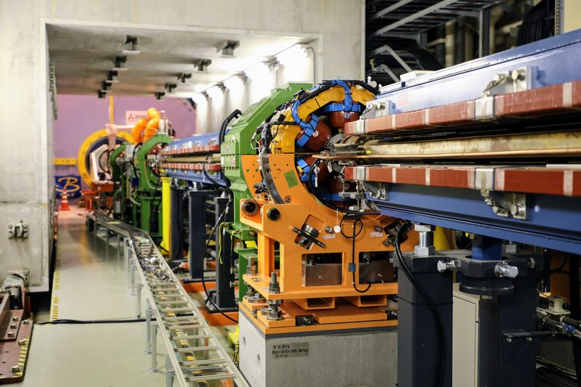
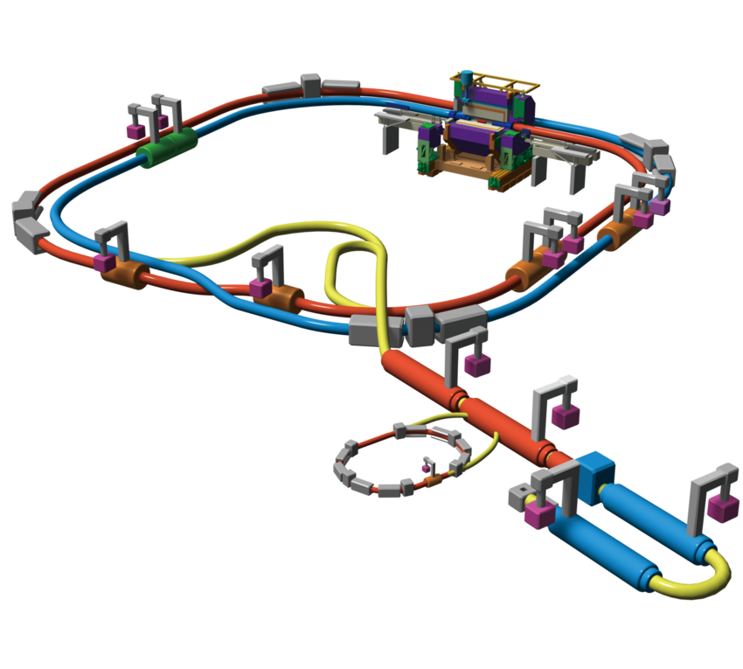


Detector(s) for tagging $e^{+}e^{−}$
Bending magnet
$γ_{ISR}$ or SR
Can we build a new detector for two-photon physics? More than tagging.

Slide 15
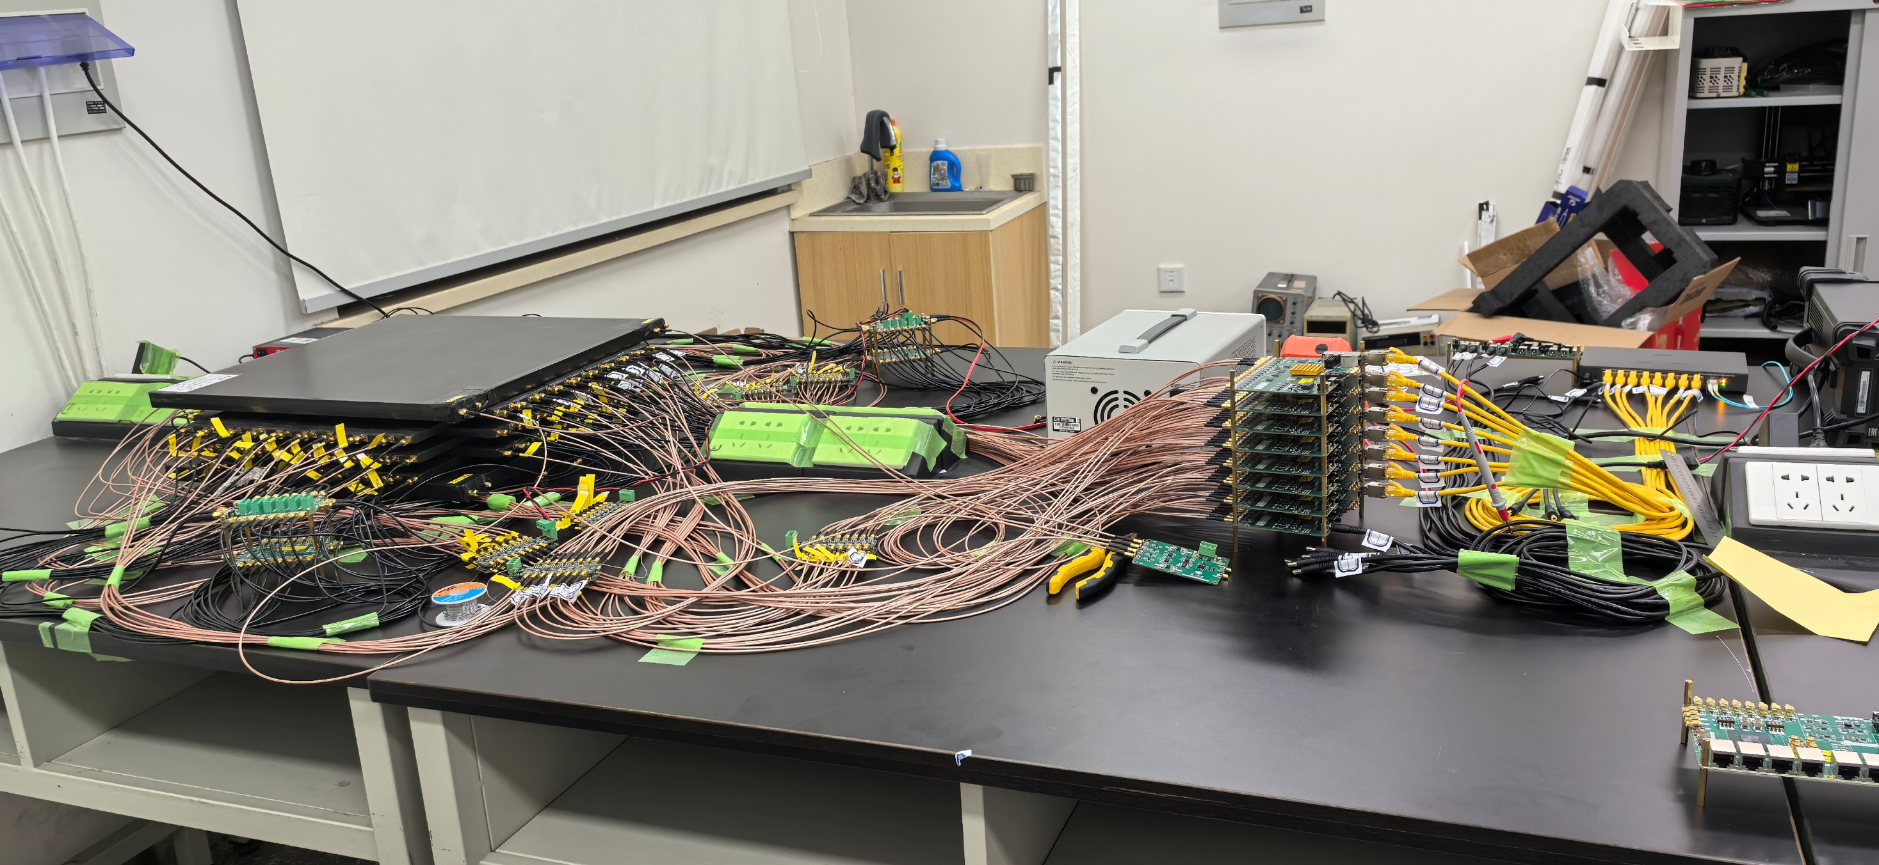
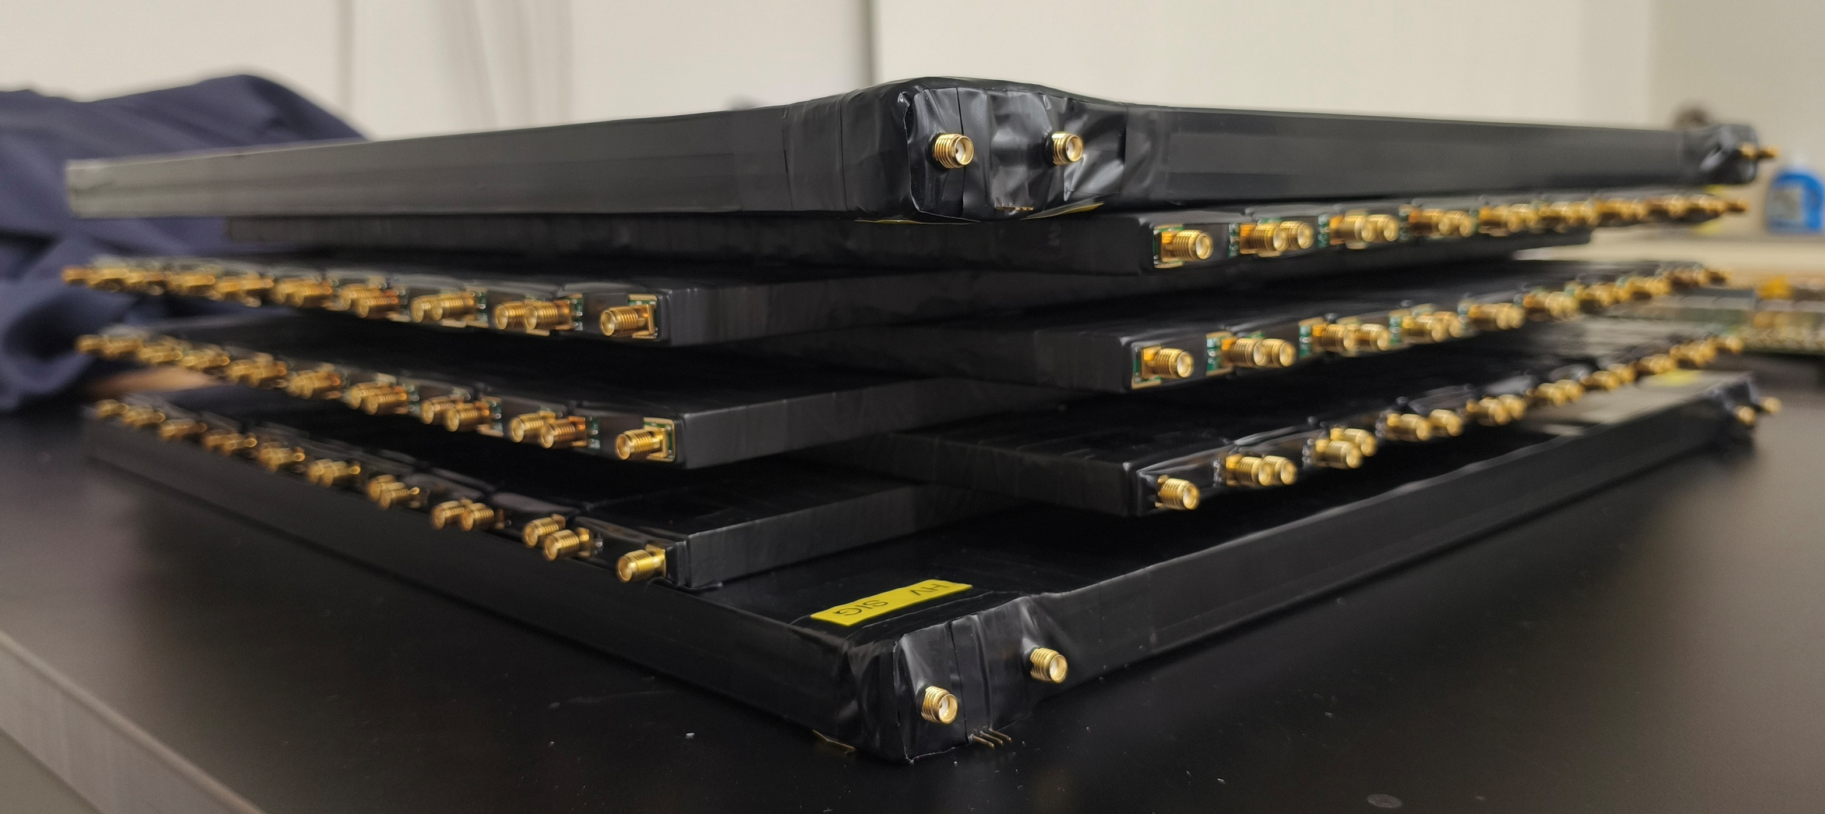
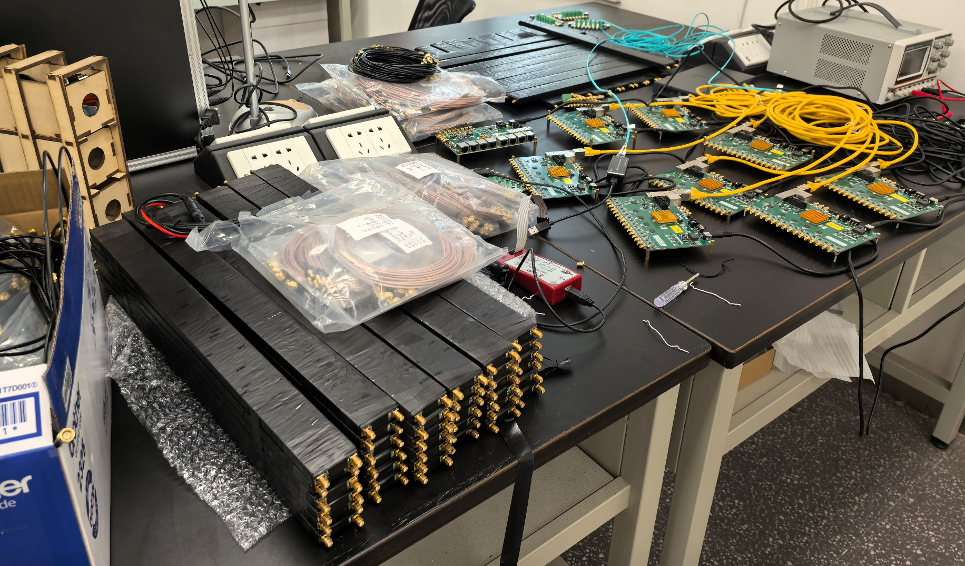
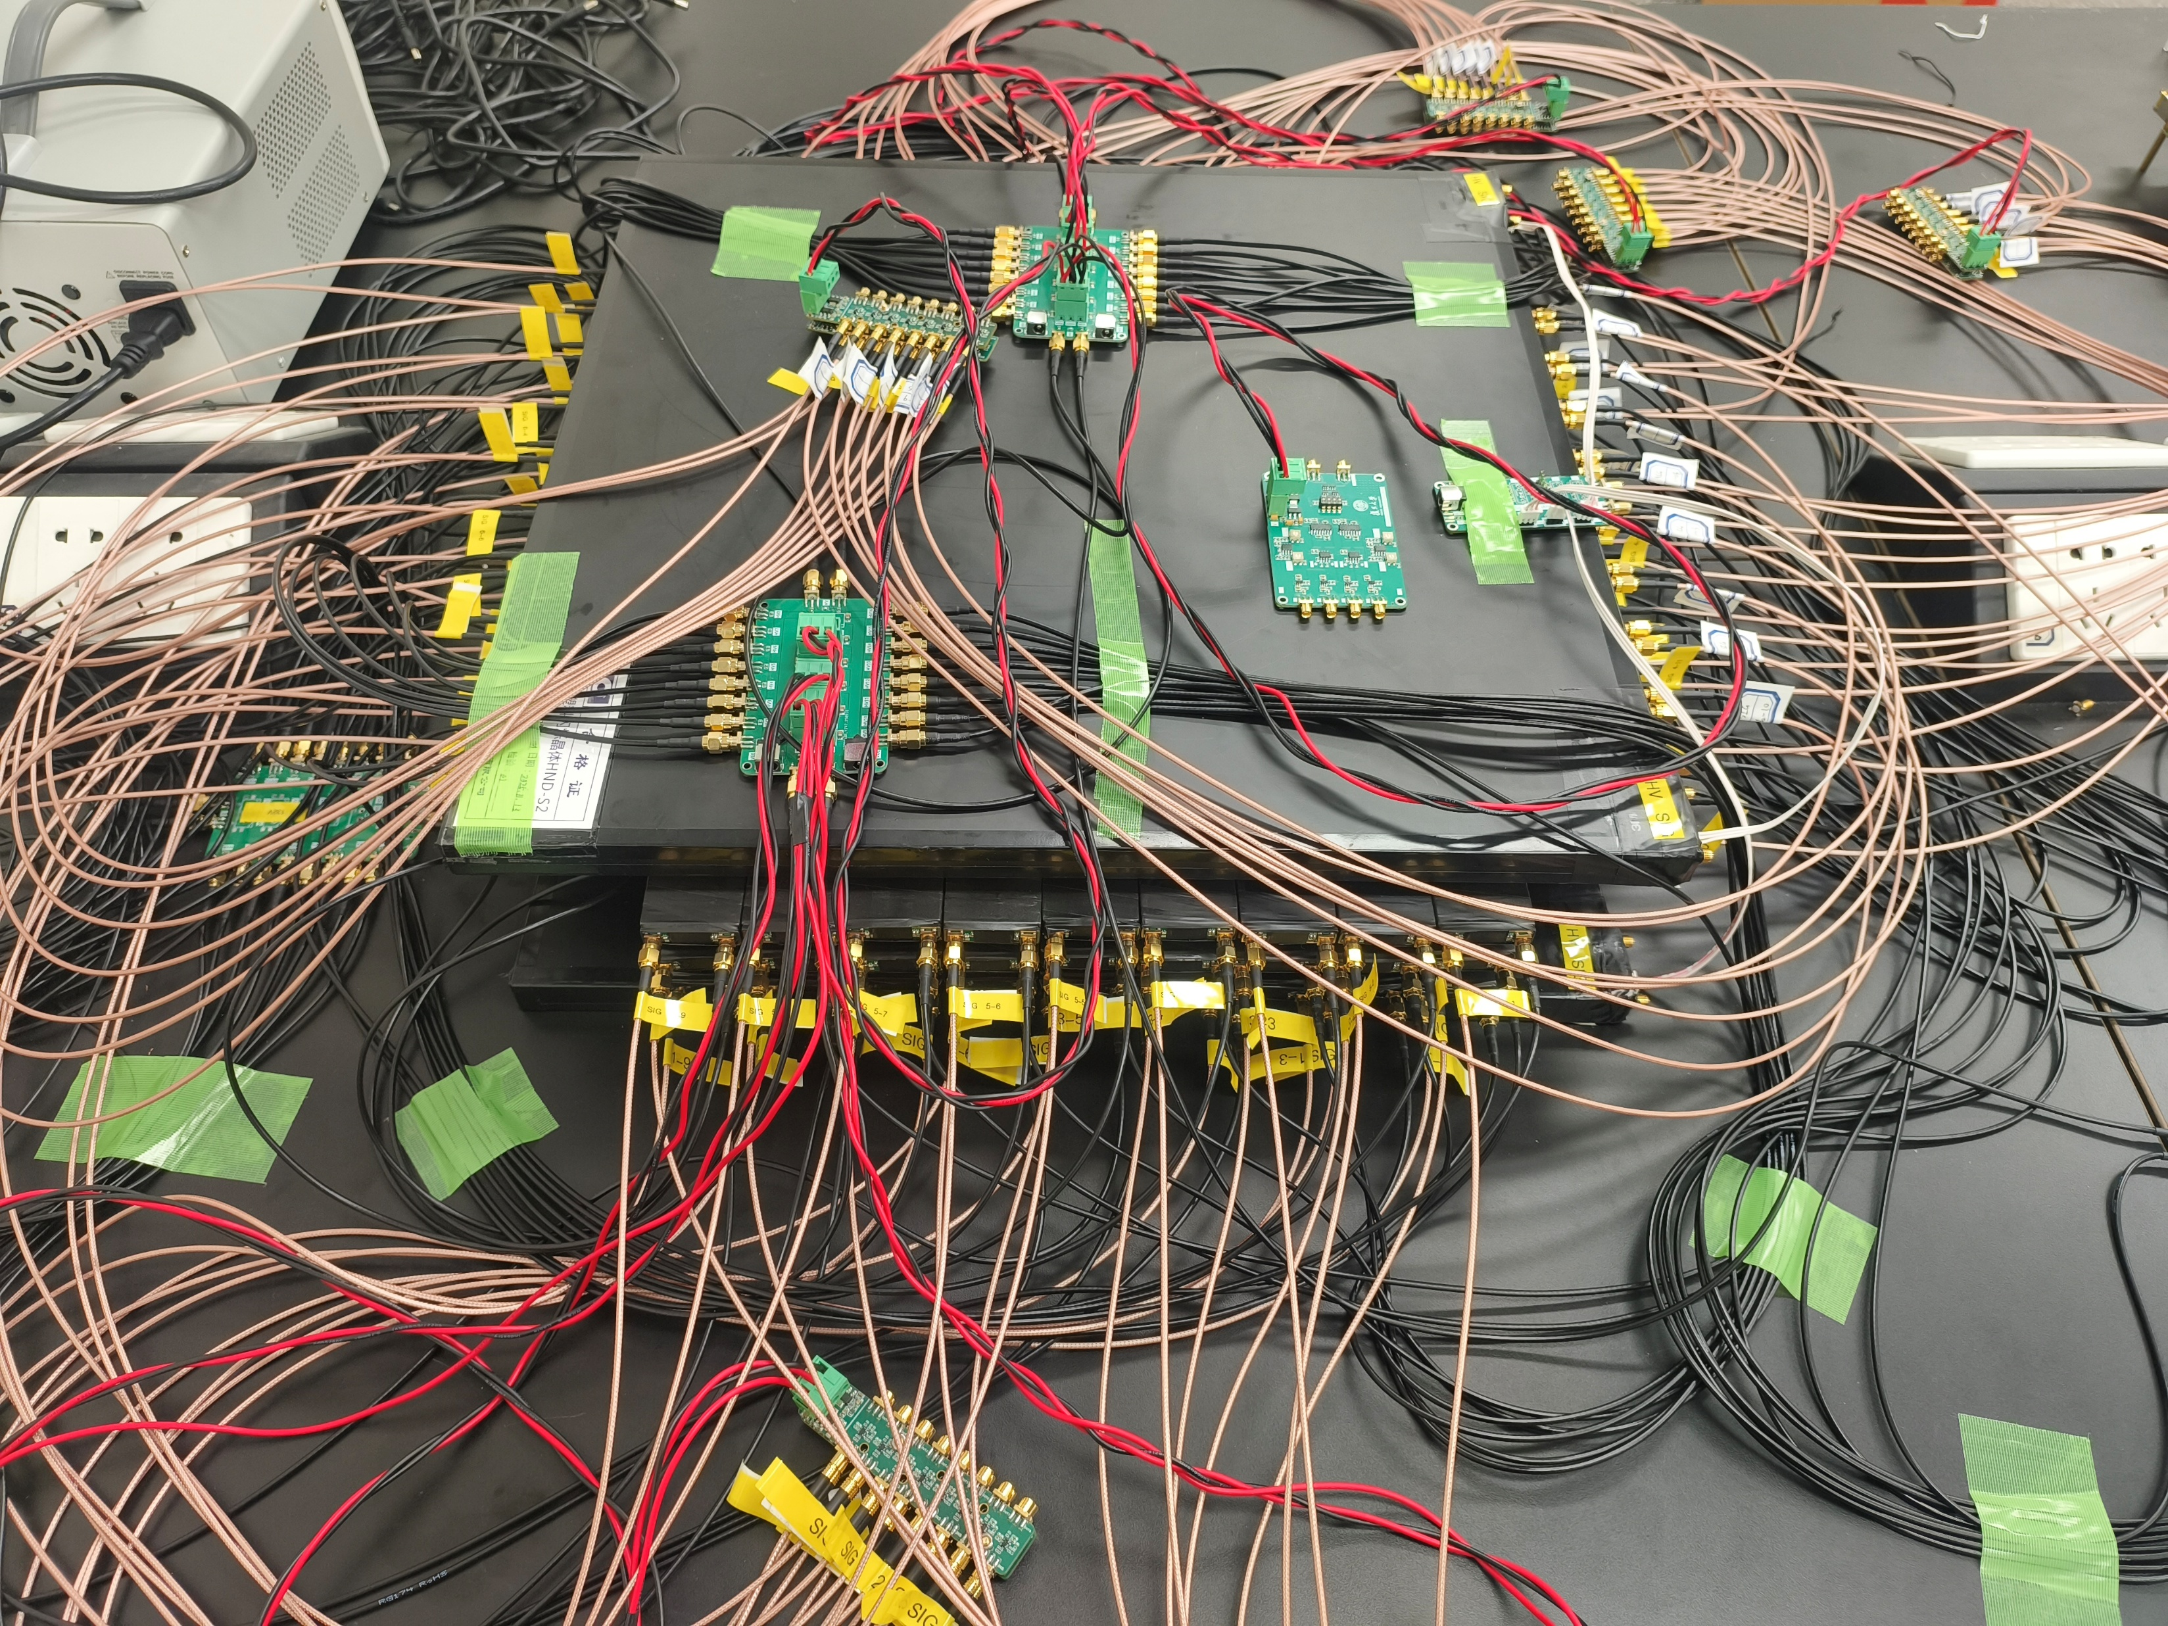

Prototype for KLM upgrade
Preamplifier with time resolution of about 20 ps. NST34,169(2023)
Scintillator strips: $1cm×4cm×50cm$, time resolution of ~70ps.
DAQ system: 250MSPS, 120 channels.
X.Y. Wang et al., Development of a high resolution Time-of-Flight with SiPM-readout Scintillator in Belle II for measurement of Neutral Hadron momentum, NIMA 1084, 171194(2026).

Slide 16
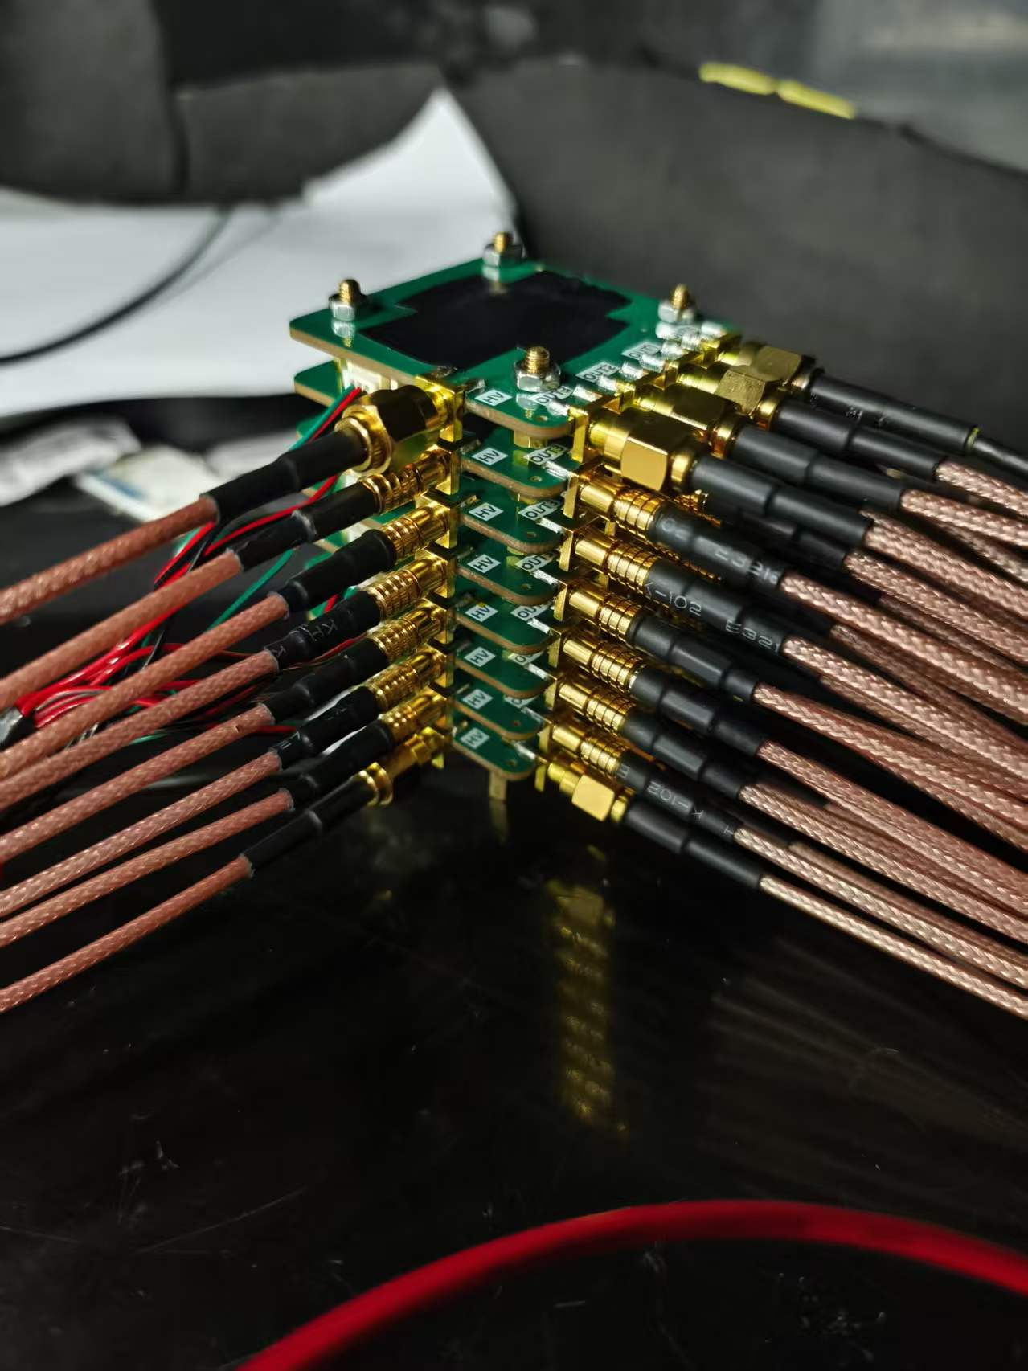
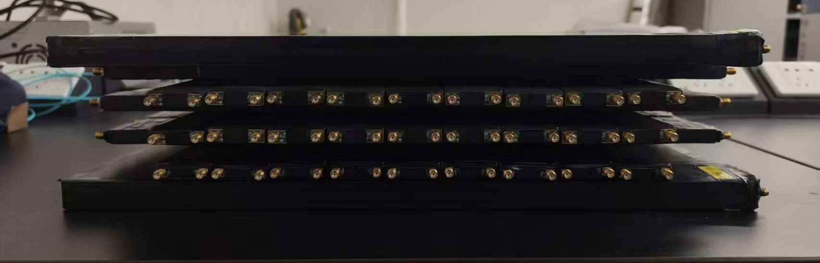



Idea of the two-photon tagger
Beam pipe in dipole magnet
$e^{−}$ beam
$e^{−}$ from $γγ$ colision
escape point
We have developed two prototypes for the tagger:
The first utilizes 8-layers position-sensitive silicon photomultipliers (PSS) for charged particle tracking.
The second employs scintillator strips with a time resolution of approximately 70 ps, using the technology developed for Belle II KLM upgrade. NIMA 1084, 171194(2026)
Both of them can give the track information and scintillators can provide precise timing information to suppress beam backgrounds.
Infor. for $E(e^{−})$
8-layer PSS.
Scintillator detector.

Slide 17
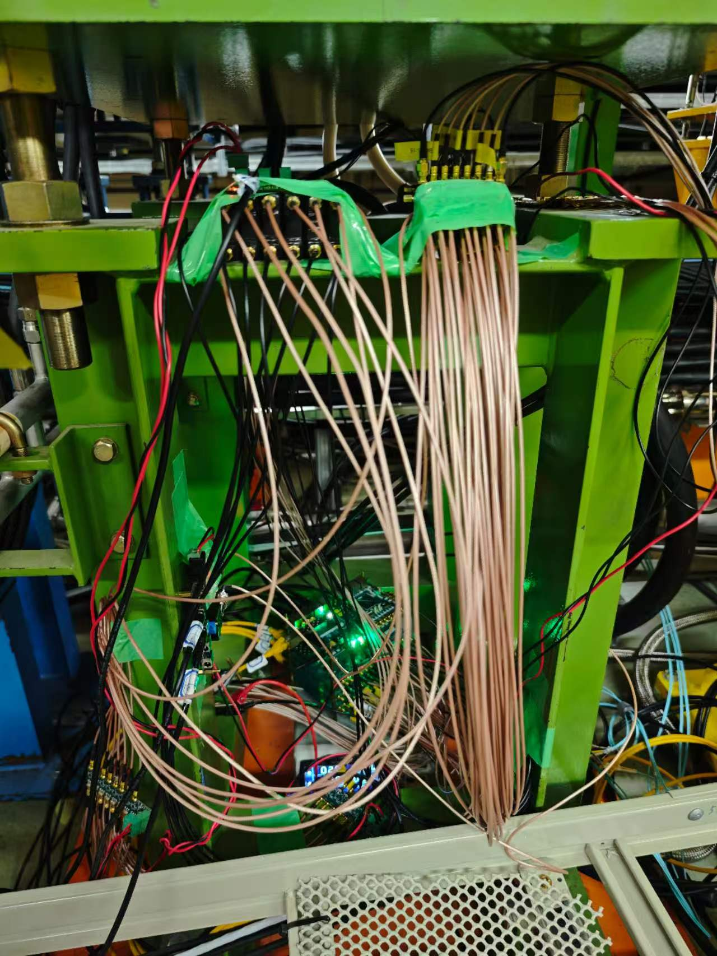
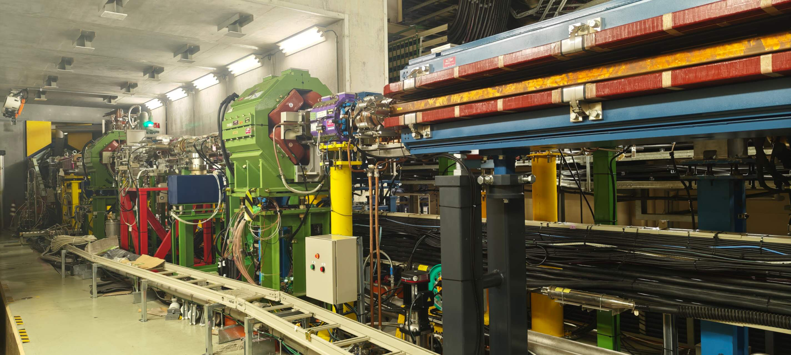




Prototypes under LER
quadrupole magnet
Belle II
dipole magnet
Prototype
Prototypes under quadrupole magnet of the positron beam pipe.
Installation finished on June 17.
Data taking for two weeks.
$$e^{+}$$
IP
$$e^{−}$$
$$e^{−}$$
$$e^{+}$$
Prototype

Slide 18
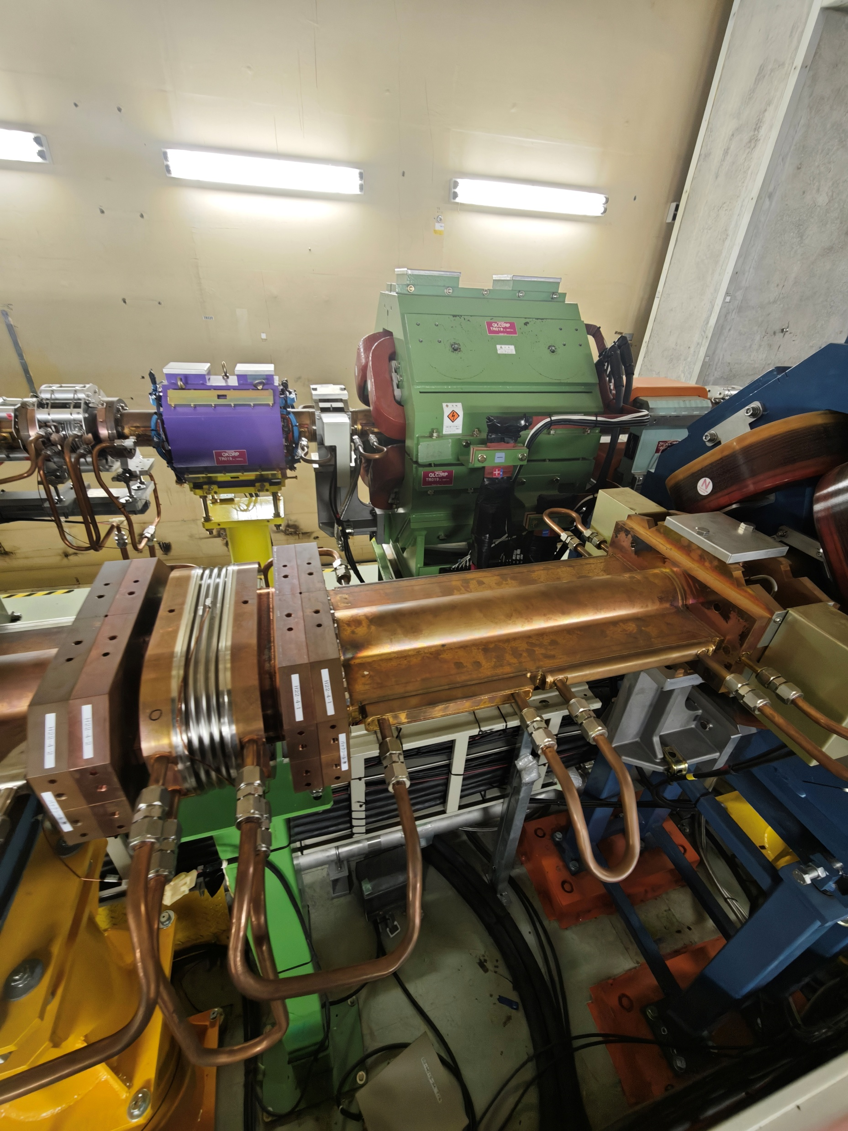
HER nearby
LER beam
HER beam
Distance between LER and HER is about 1m.

Slide 19
Scintillator prototype

Slide 20
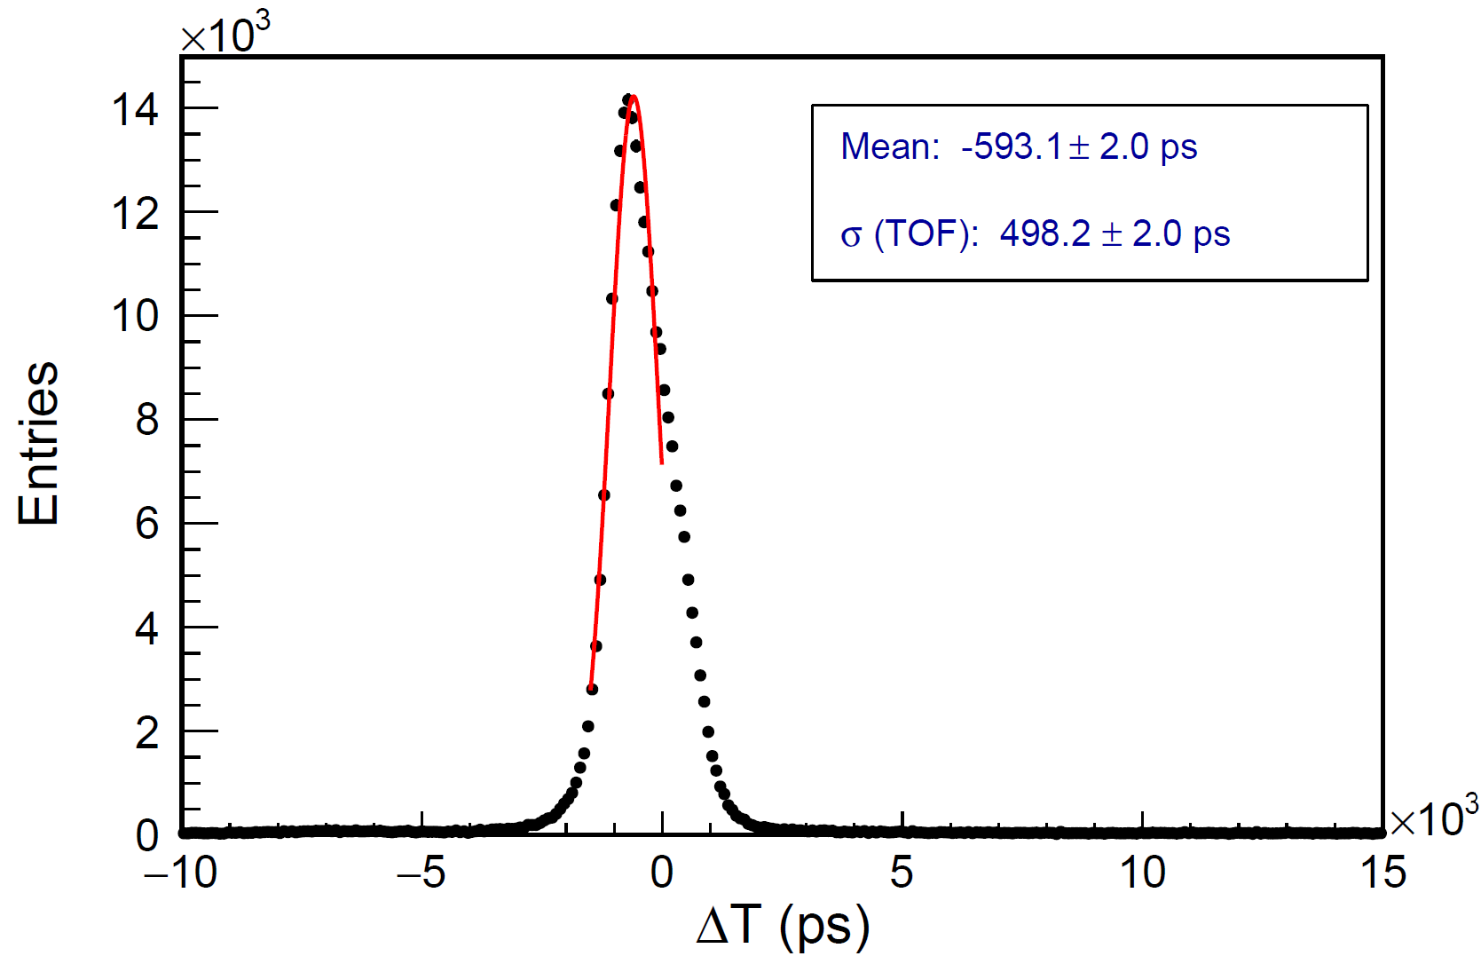
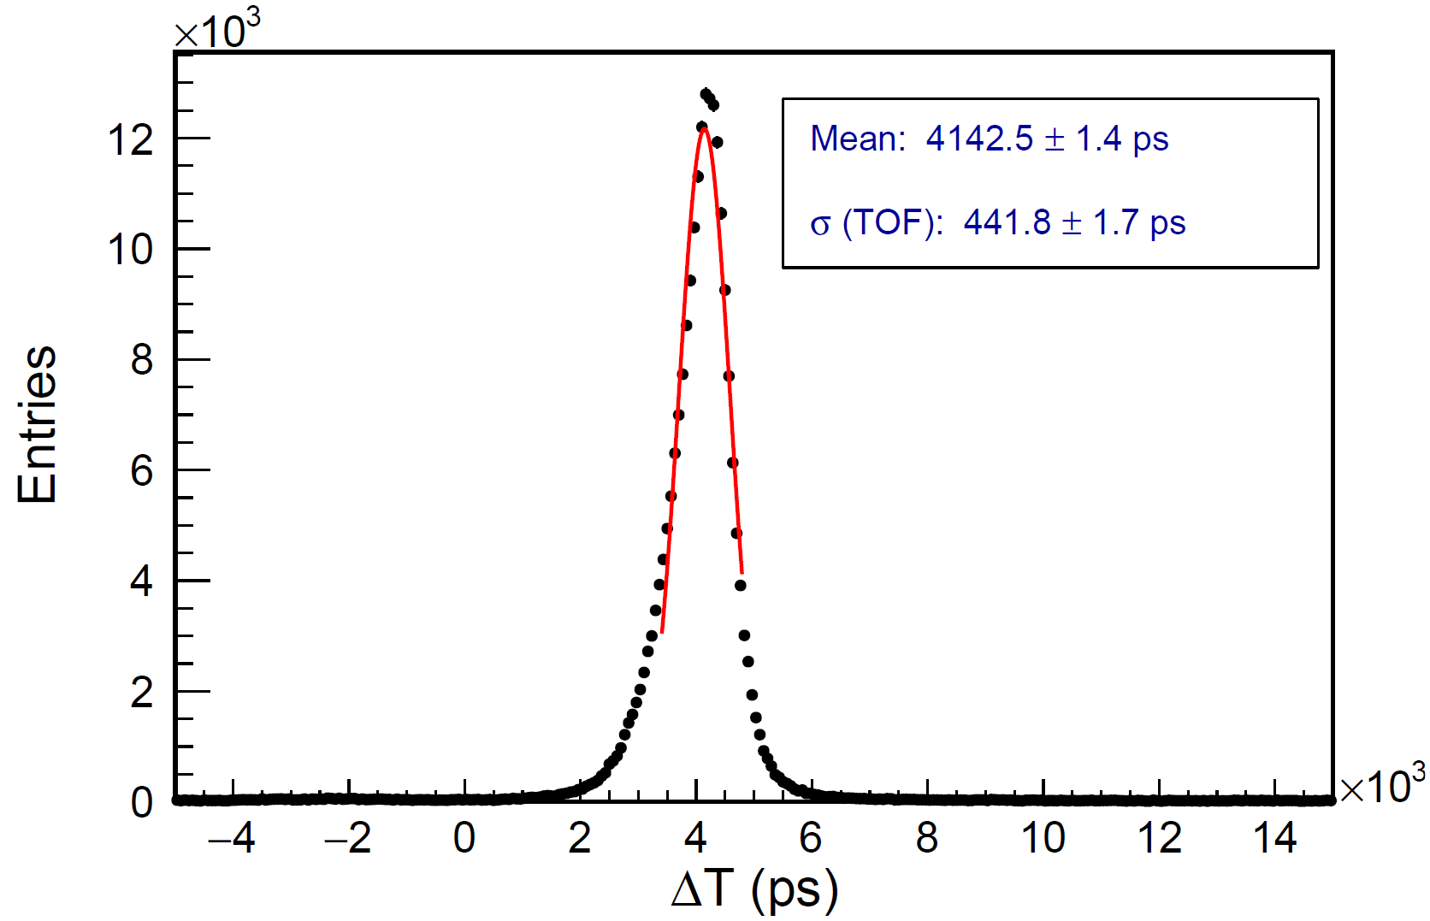
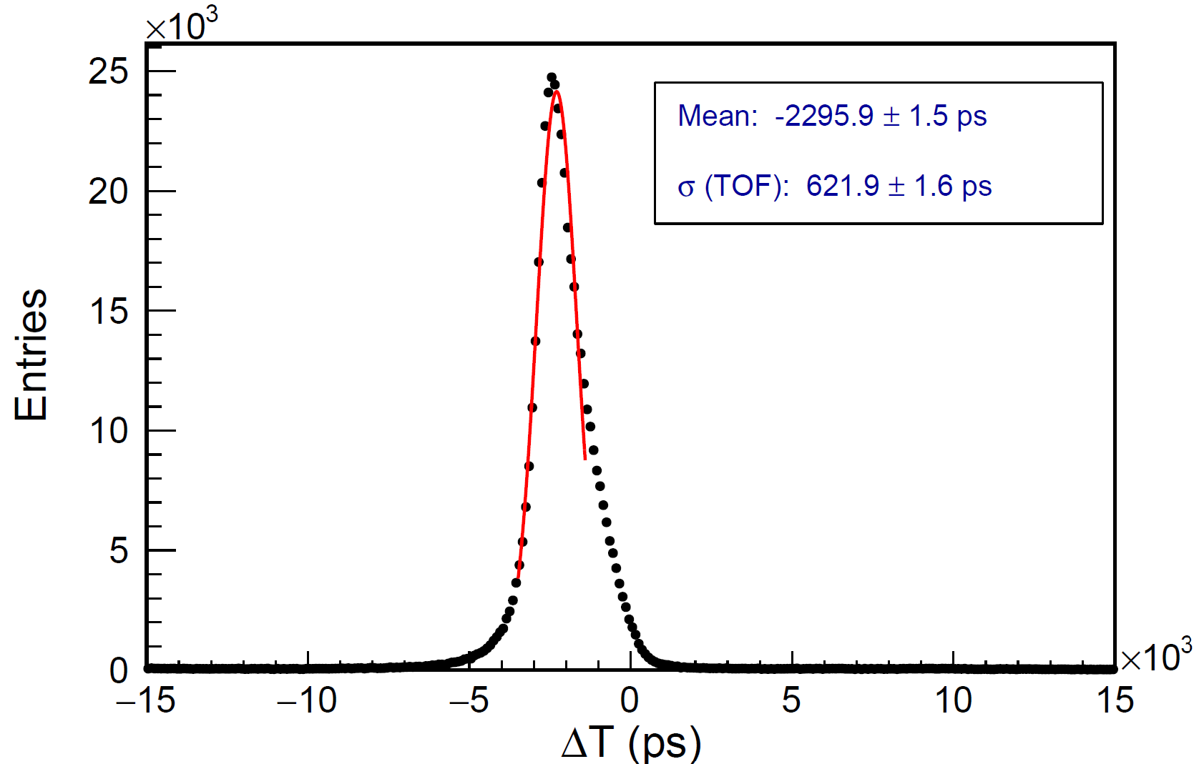
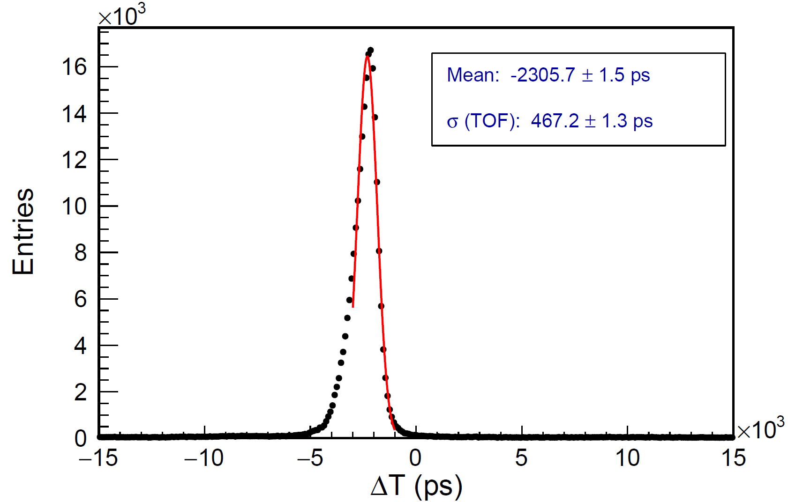
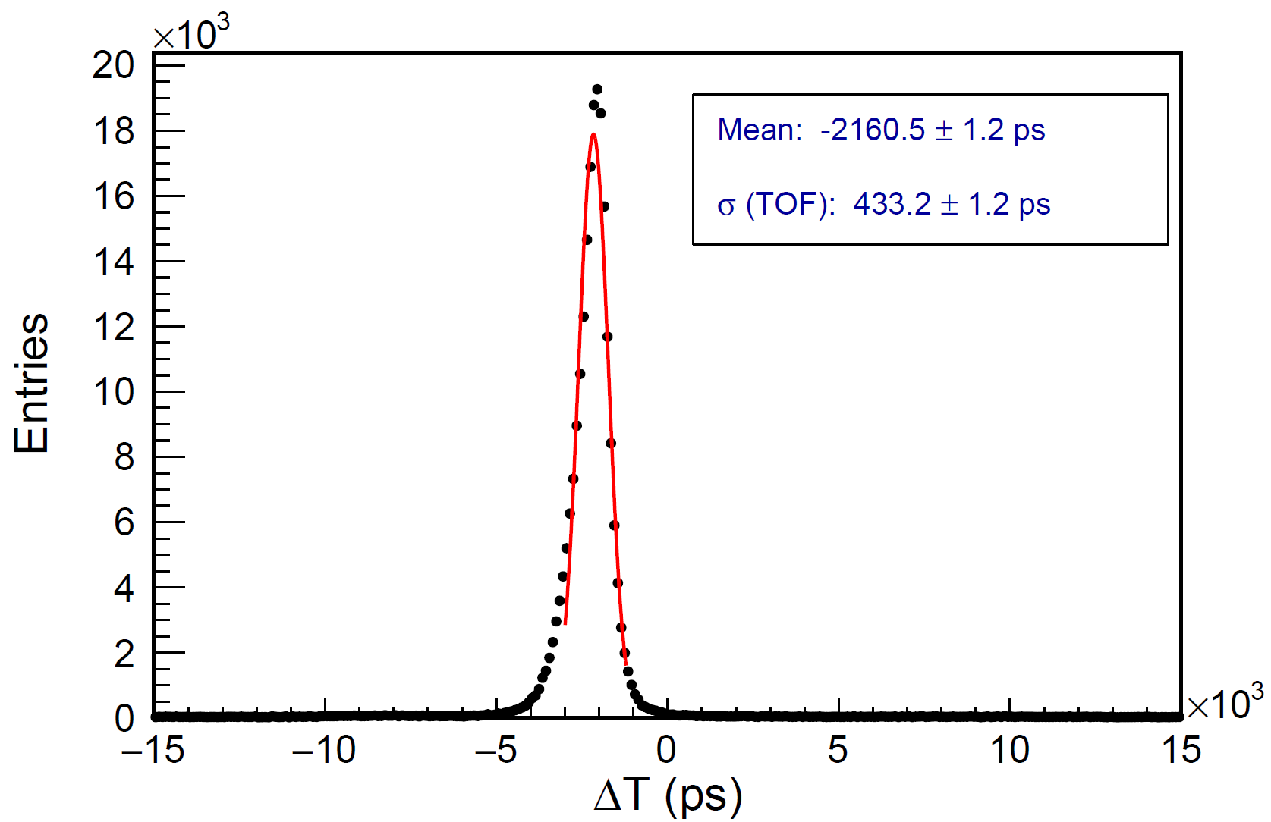
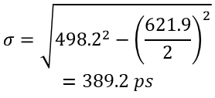
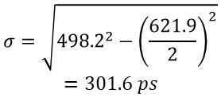
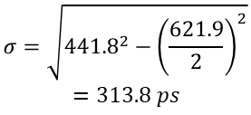

Time resolution
S1
S2
S1-TRG
S2-TRG
S3
S4
$$σ=\sqrt{{498.2}^{2}−{\left(\frac{621.9}{2}\right)}^{2}}$$
$$=389.2 ps$$
$$σ=\sqrt{{441.8}^{2}−{\left(\frac{621.9}{2}\right)}^{2}}$$
$$=313.8 ps$$
TRG
SCNT
S3-TRG
S4-TRG
TRG
$$σ=\sqrt{{46732}^{2}−{\left(\frac{621.9}{2}\right)}^{2}}$$
$$=348.7 ps$$
$$σ=\sqrt{{498.2}^{2}−{\left(\frac{621.9}{2}\right)}^{2}}$$
$$=301.6 ps$$

Slide 21
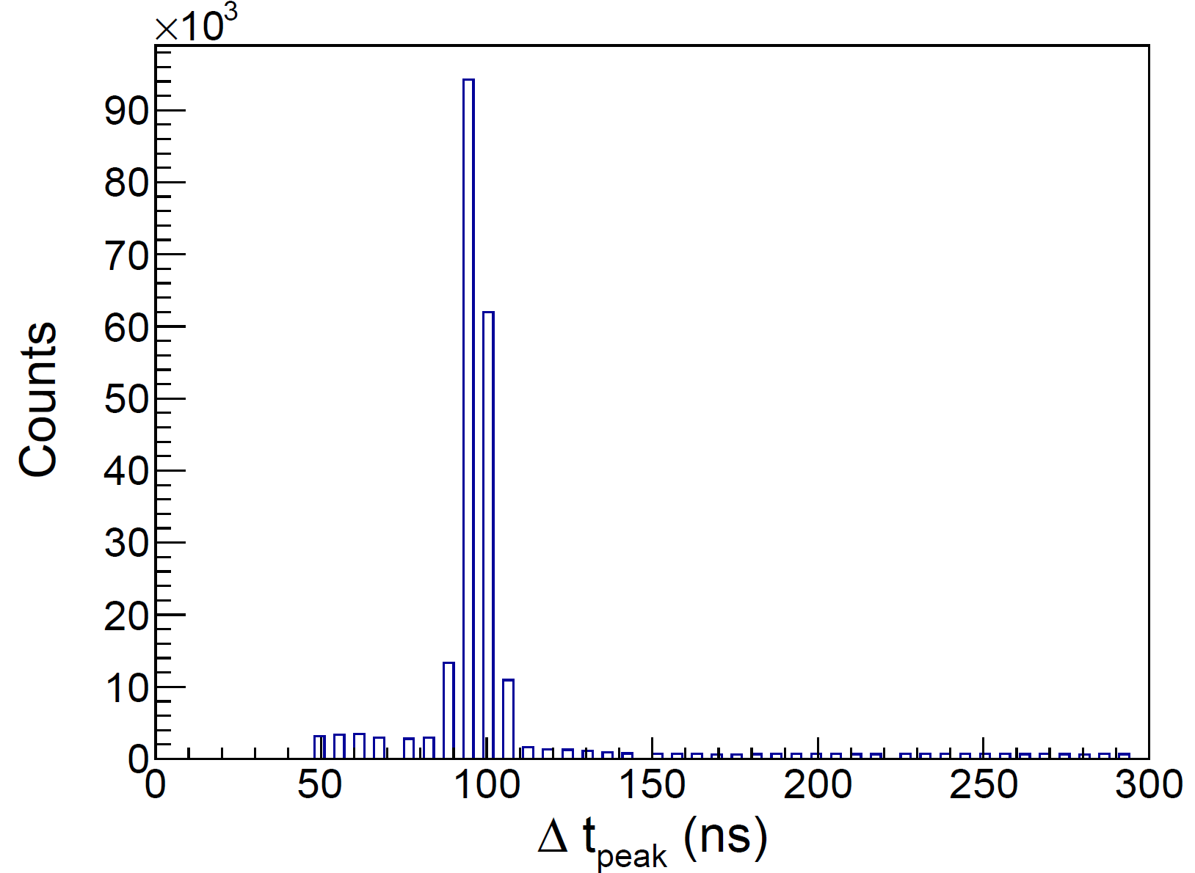
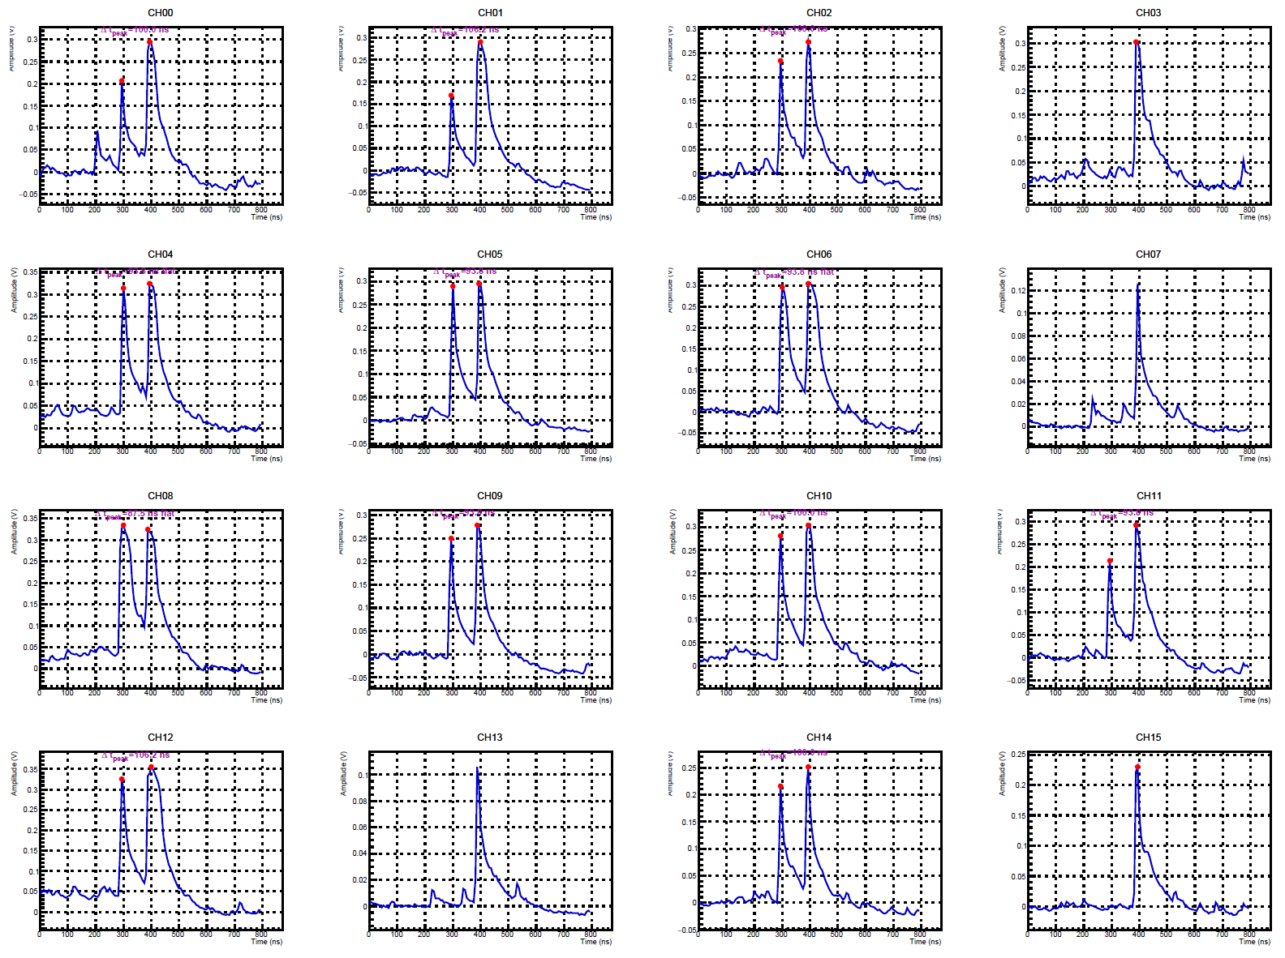
Waveforms of scintillator signals
A clue: SuperKEKB inject new particles into two bunches separated by 49 RF buckets (96.3 ns).
The two-peak signals have been verified with more data and PSS detector.

Slide 22
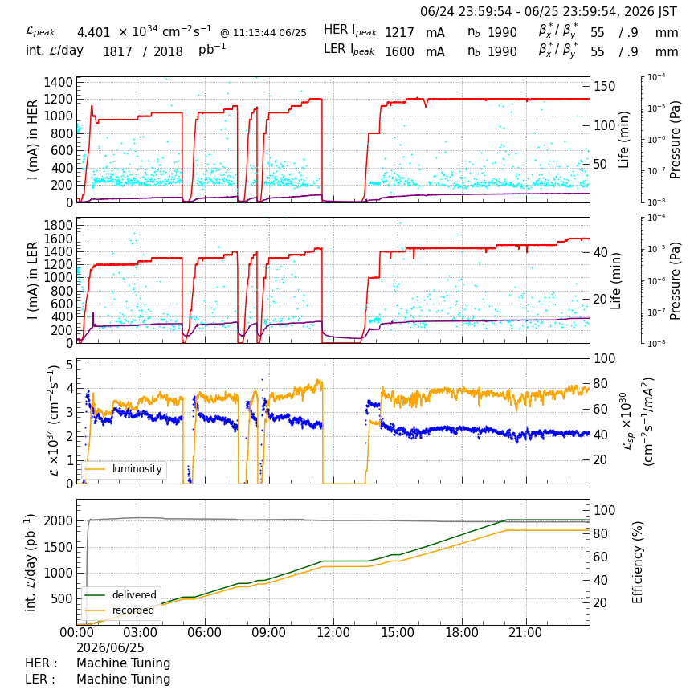
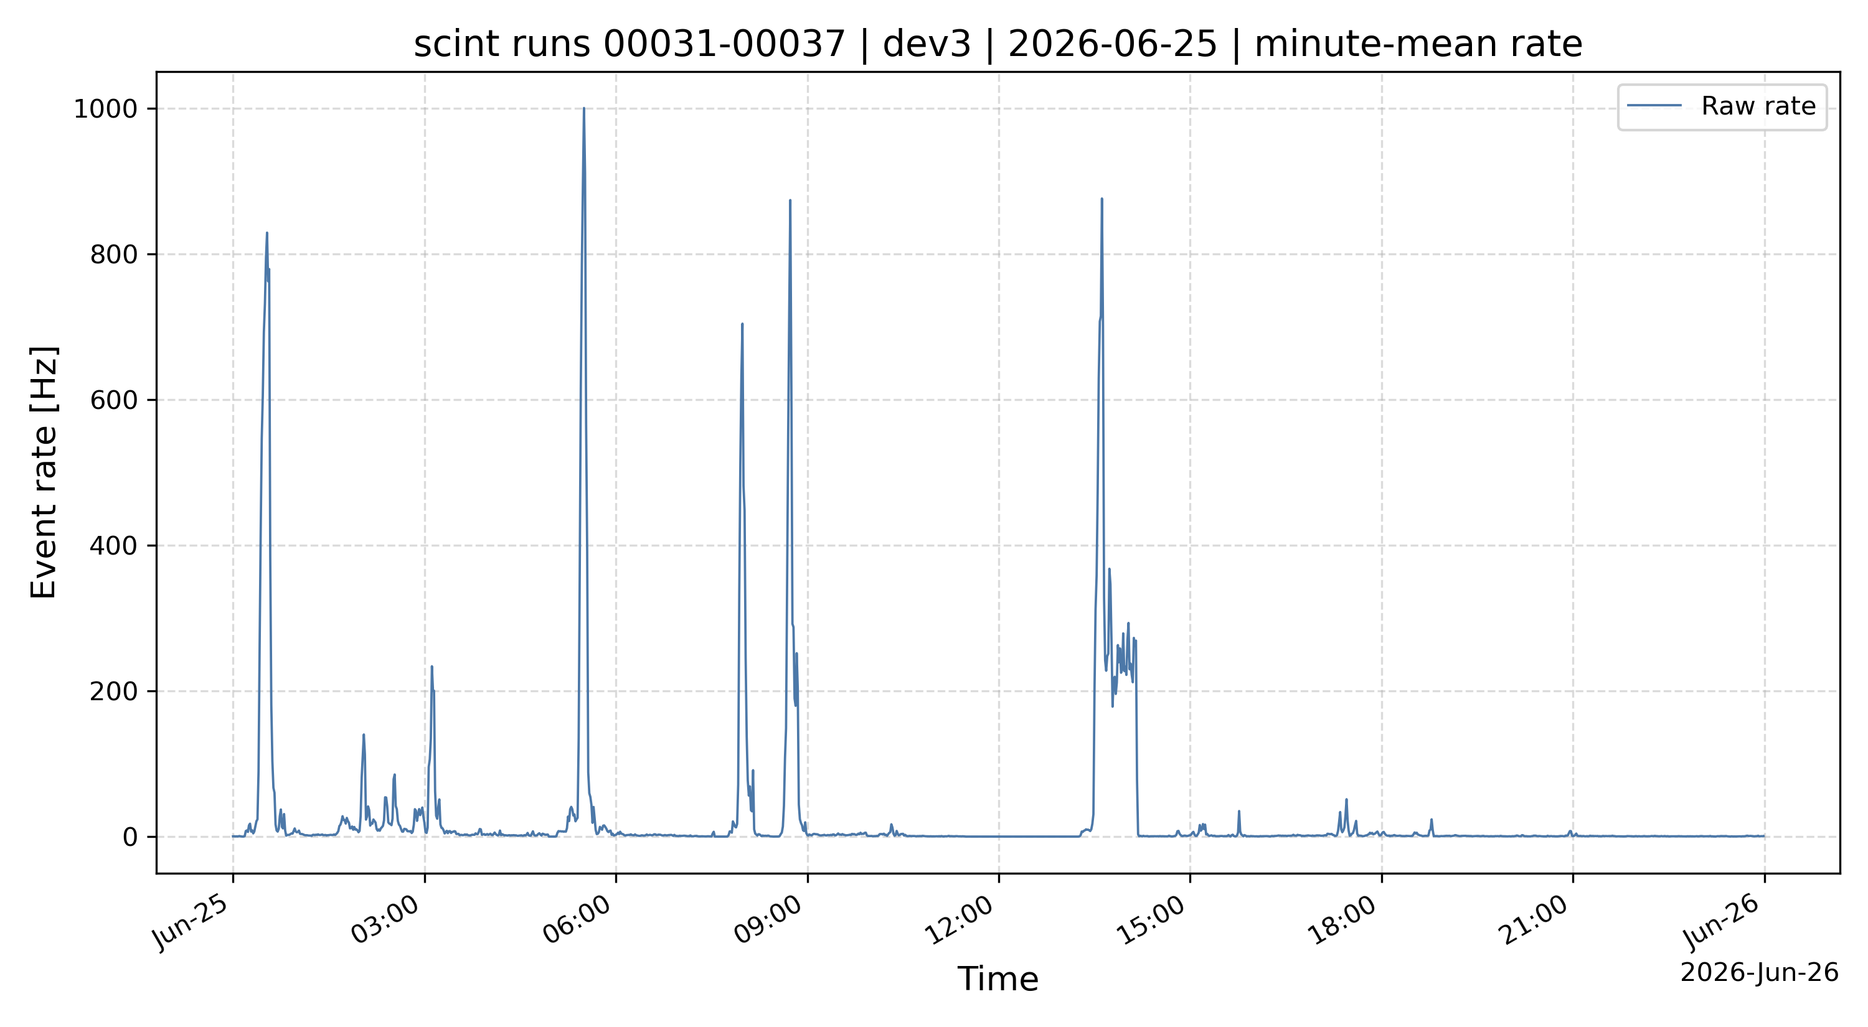
Event rate of scintillators
Event rate on 25th June
What we learn from scintillator detectors:
Trigger using two strips, the event rate is very low during stable data taking.
Background level increases significantly during the beam injection!

Slide 23
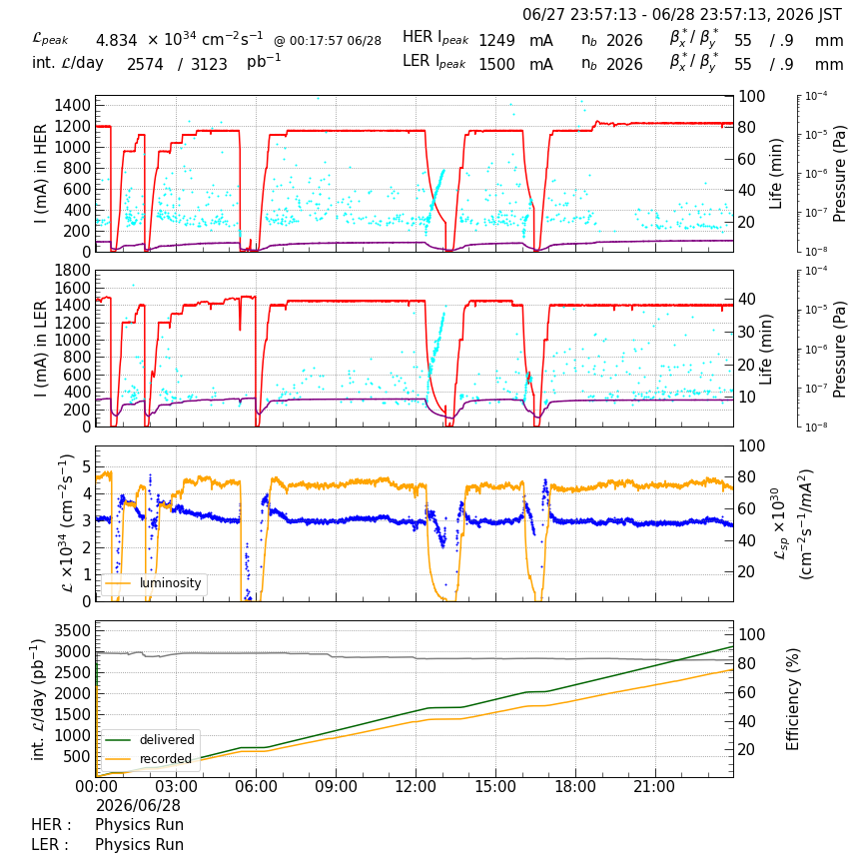
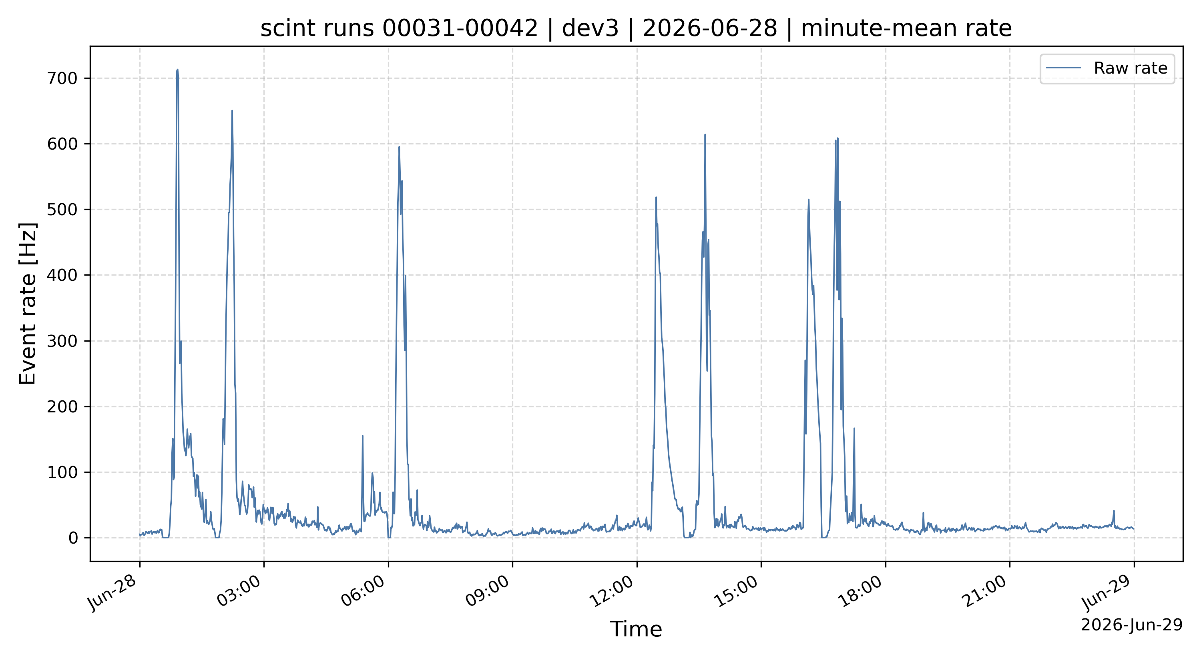
From 6/28 00:00 – 6/29 00:00

Slide 24
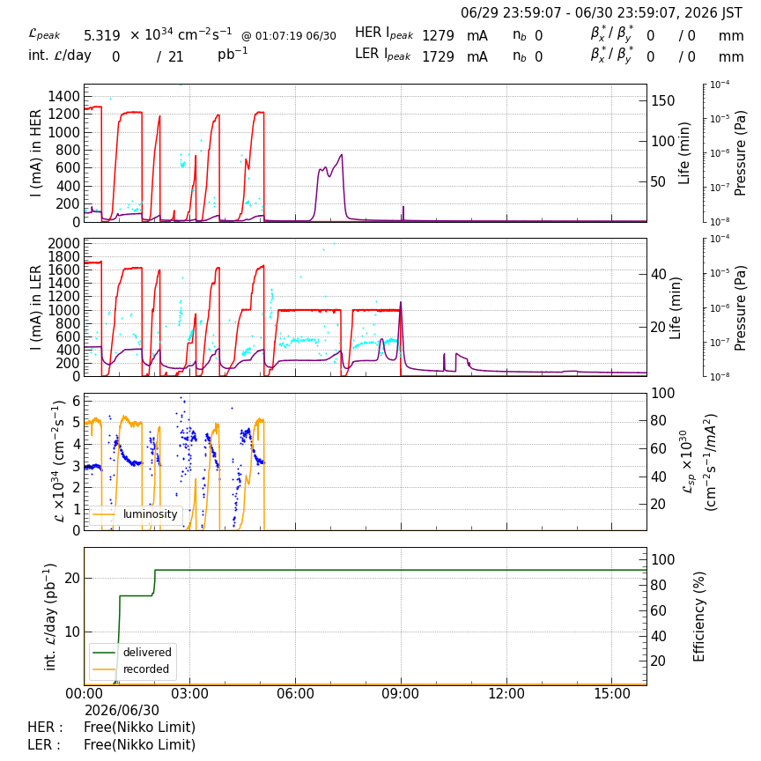
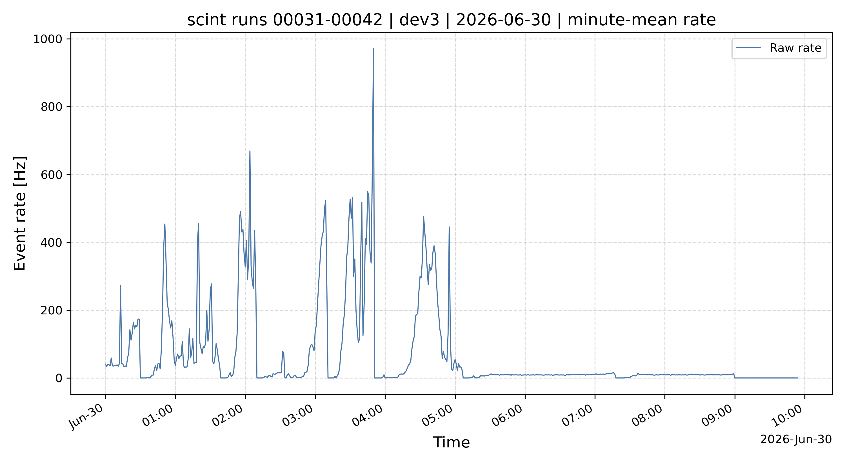
From 6/30 00:00 – 6/30 10:00
Last day of 2026ab run, for machine study.

Slide 25
New tracking prototype

Slide 26
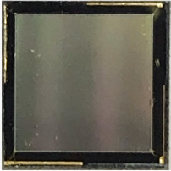
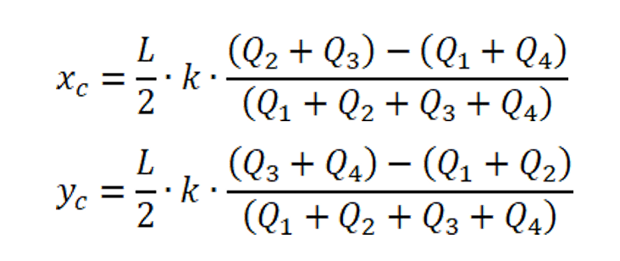
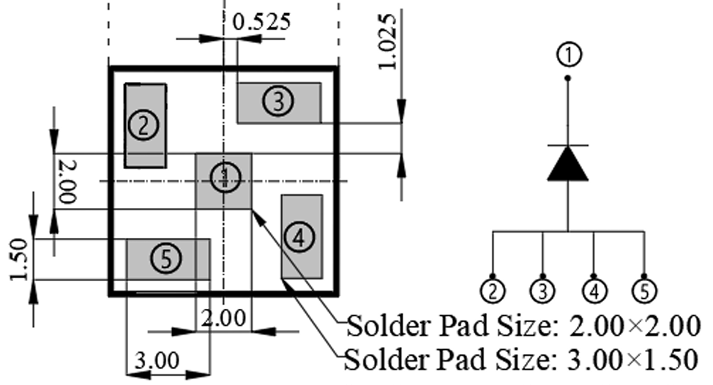
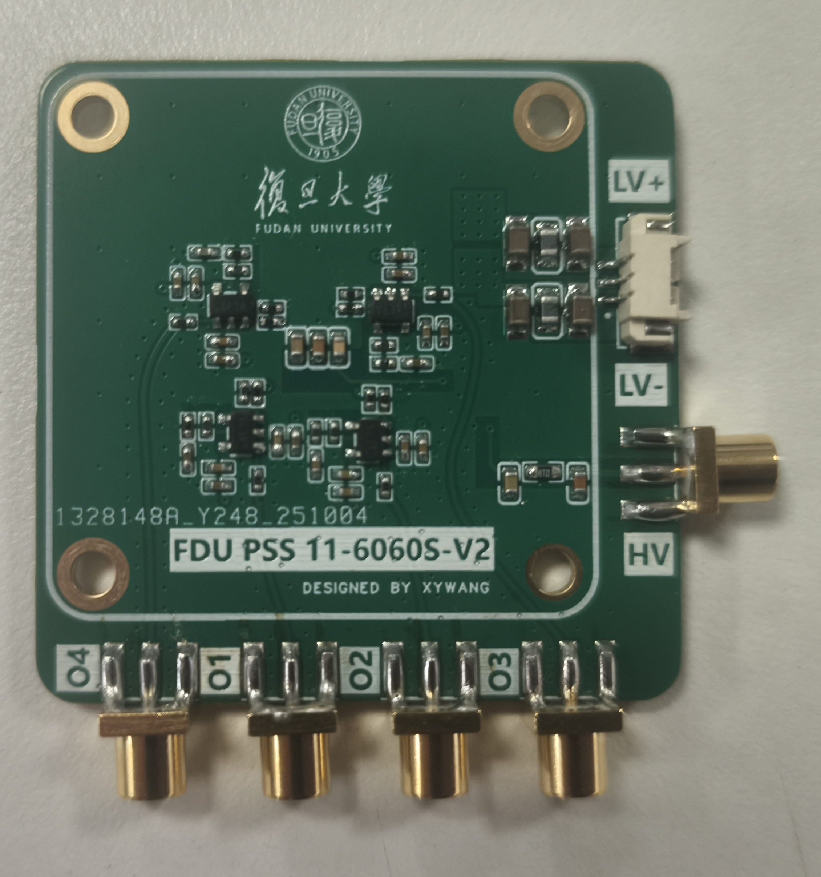
Basic tests on PSS-11-6060 SiPM
The position resolution of a standalone SiPM is limited by its size.
To achieve higher position resolution, we utilize PSS.
ZJGD PSS 11-6060
Pitch: 20um
Active Area: 6.24×6.24 mm²
DCR: 150 kHz/mm²
Position Algorithm
Readout board for PSS
Gain：+20 V/V
Bandwidth(-3dB)：400 MHz
Baseline noise(RMS): 300uV
Input impedance: 50Ω
The charge is distributed via the four pads

Slide 27
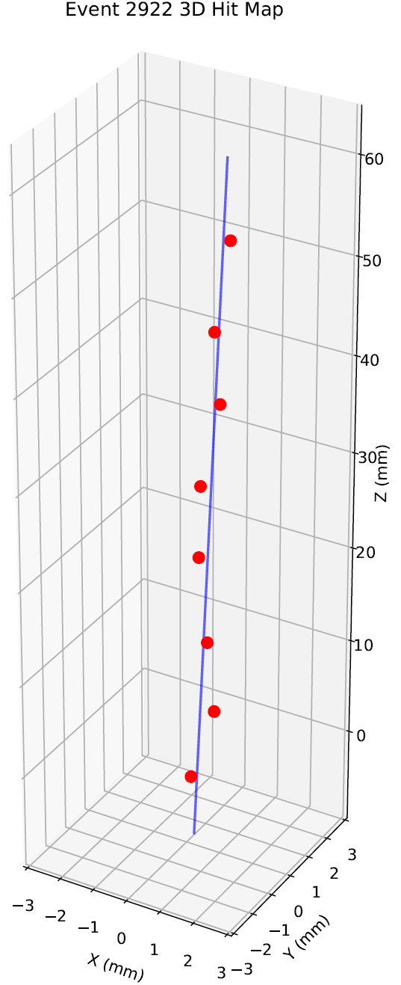
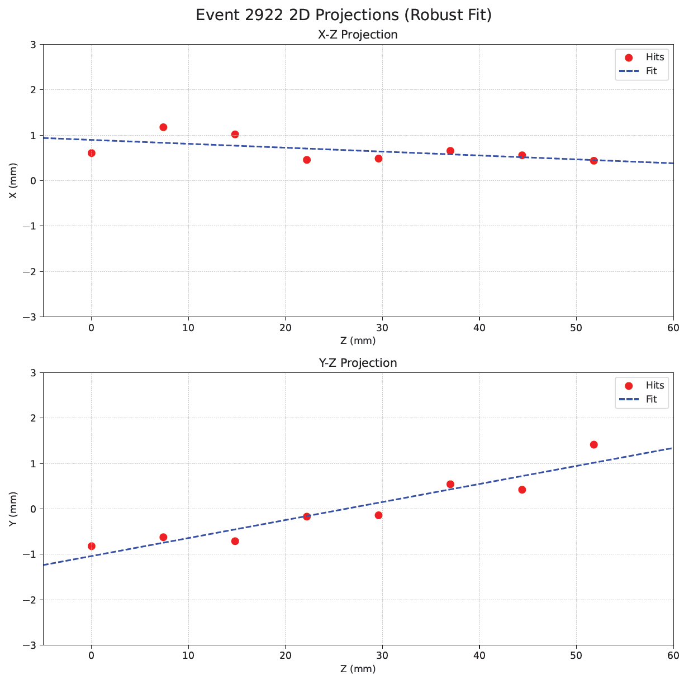
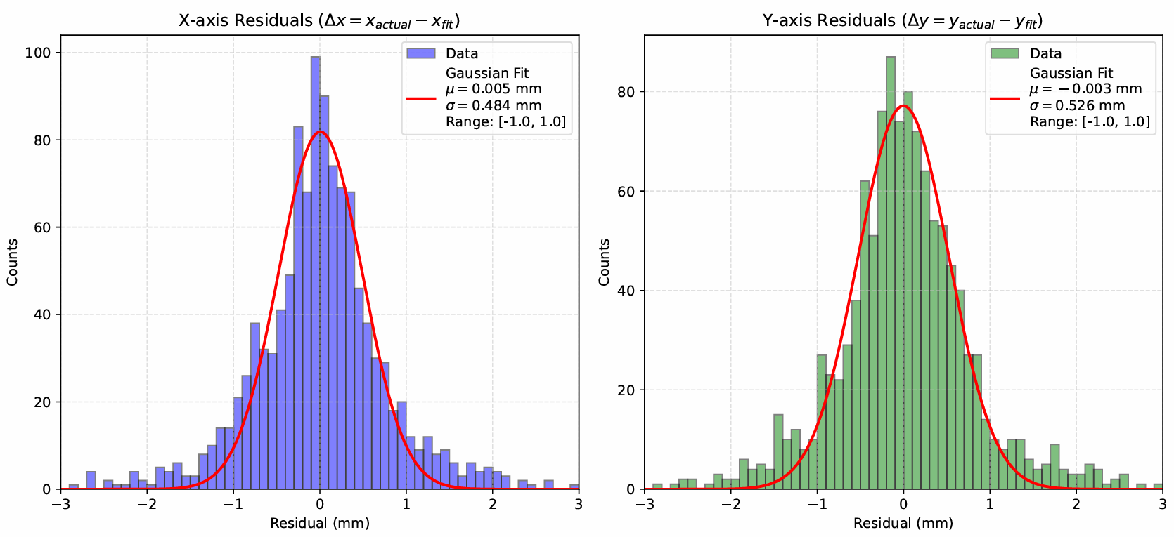
Charged track from 8-layer PSS
Event rate is very low!
All the events with amplitude larger than 10 p.e. are kept.
The distributions of X-Residuals and Y-Residuals are fitted with a Gaussian function.
The resolution is about 0.50 mm, which is similar to the one of cosmic ray test (~0.47 mm).

Slide 28
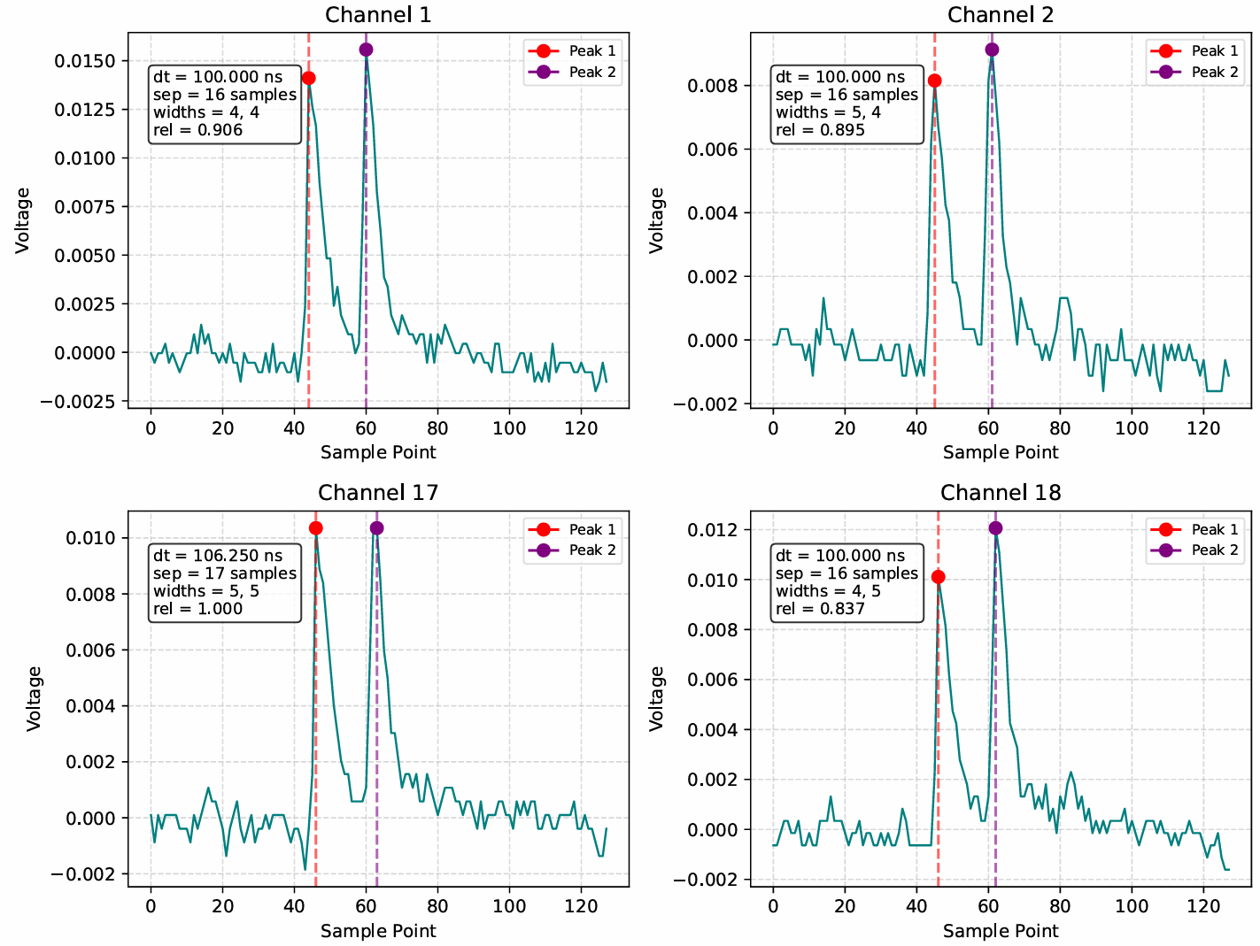
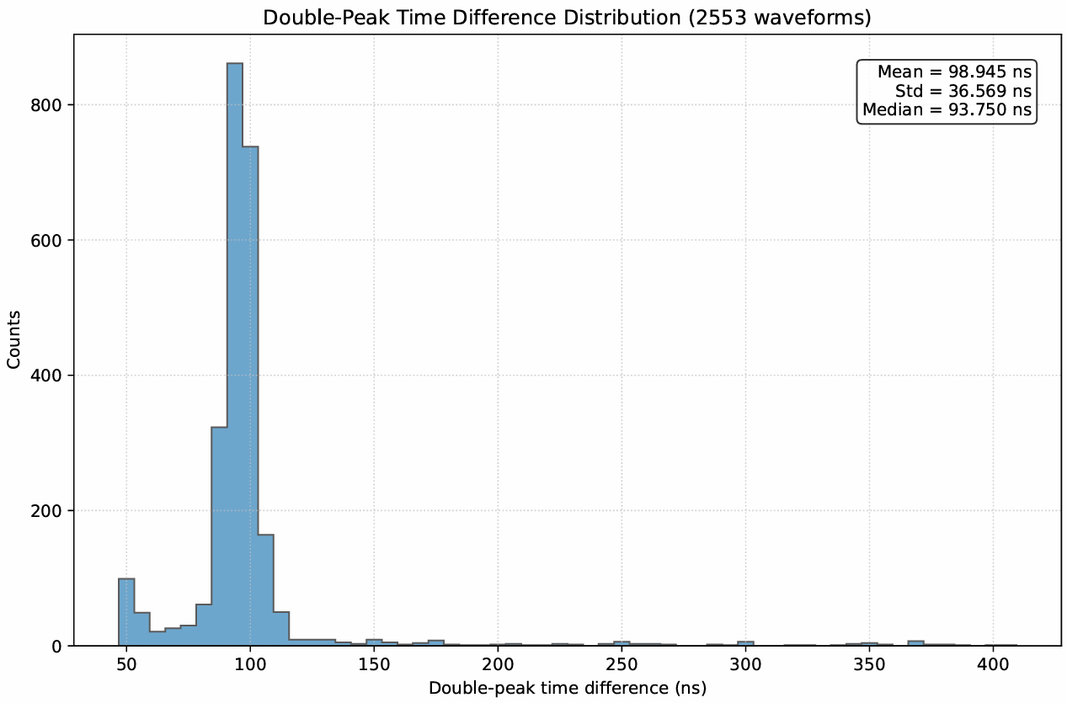
Double-peak waveforms in PSS
There are also many waveforms of PSS exhibit double-peak structure like the scintillators.
The time differences of the two peaks are closed to 100 ns for most waveforms.

Slide 29
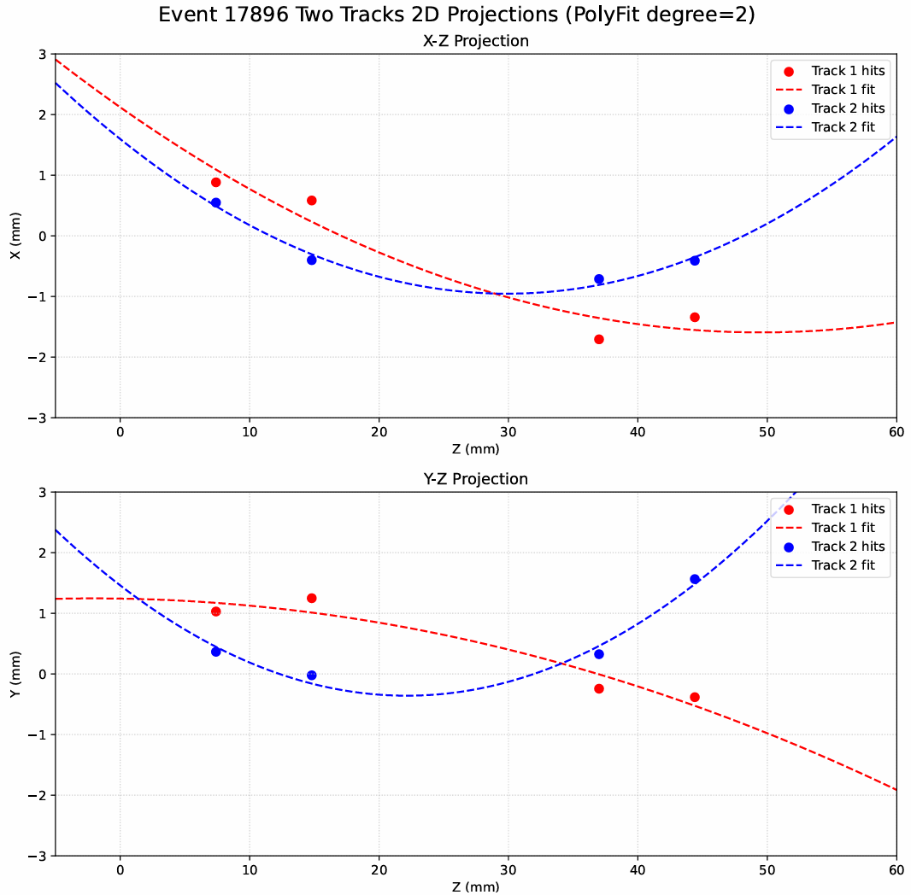
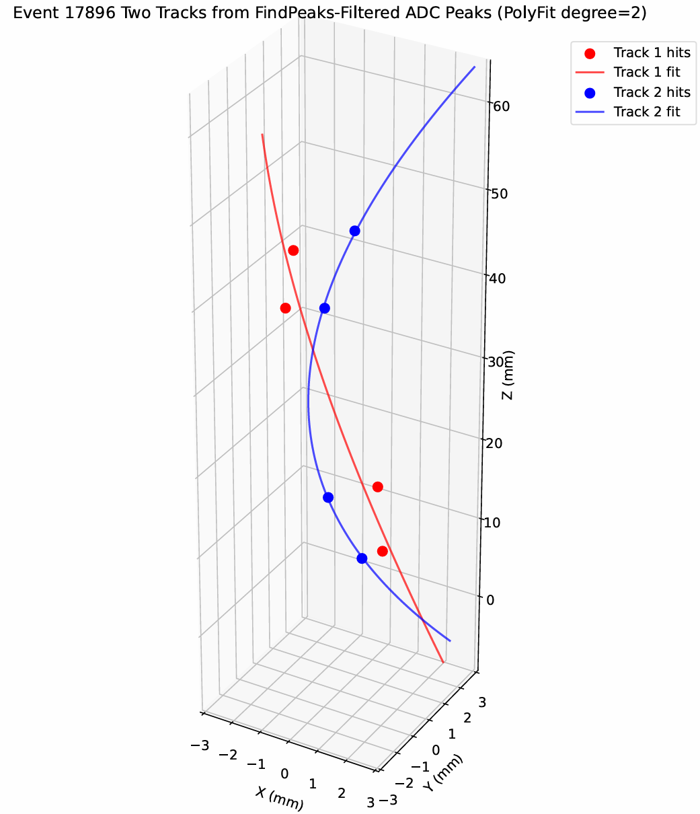
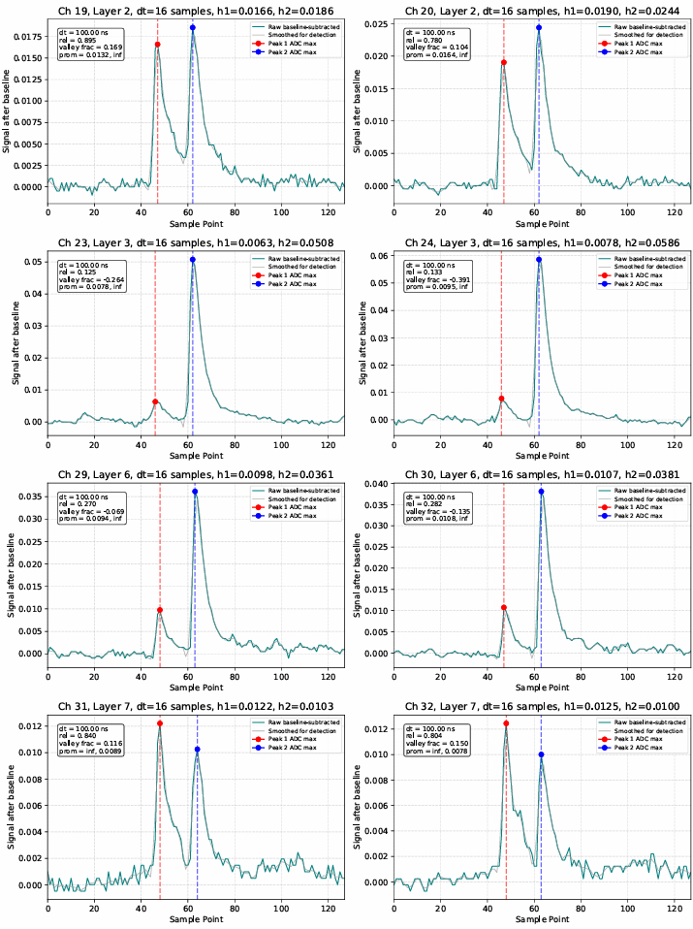
Two-peak signals from PSS
Here we use two 2nd polynomial functions to fit the two tracks from two peaks.

Slide 30
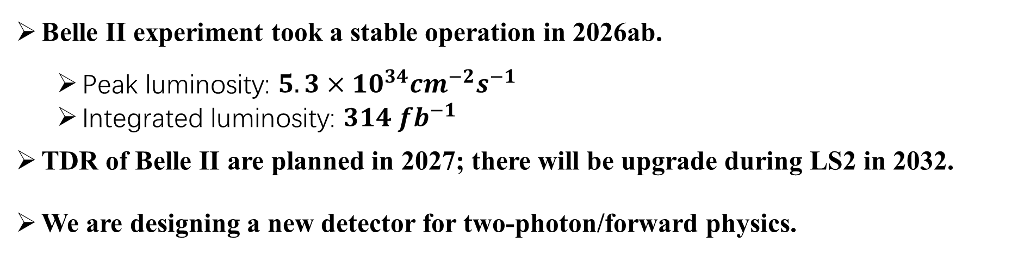
Summary
Belle II experiment took a stable operation in 2026ab.
  Peak luminosity: $5.3×10^{34}cm^{−2}s^{−1}$
  Integrated luminosity: $314 fb^{−1}$
TDR of Belle II are planned in 2027; there will be upgrade during LS2 in 2032.
We are designing a new detector for two-photon/forward physics.
Thank you for your attention!

Slide 31
Highlights of Belle II operation
Achieve for long period ~90% data taking efficiency.
Port feature extraction off detector in iTOP.
Had to lower CDC HV in inner layers due to high beam backgrounds.
L1 high-rate test was carried out to better understand the current throughput limitations

