Slide 1
Nonlinear response of flow harmonics in Gubser flow
with participant-reaction planes mismatch
Xiang Ren (任 翔)
中国科学技术大学
第十二届高能全国物理会议
2026.6.14-19 广州
  Based on Xiang Ren, Jin-Yu Hu, Hao-Jie Xu, Shi Pu, PRD (2026)

Slide 2
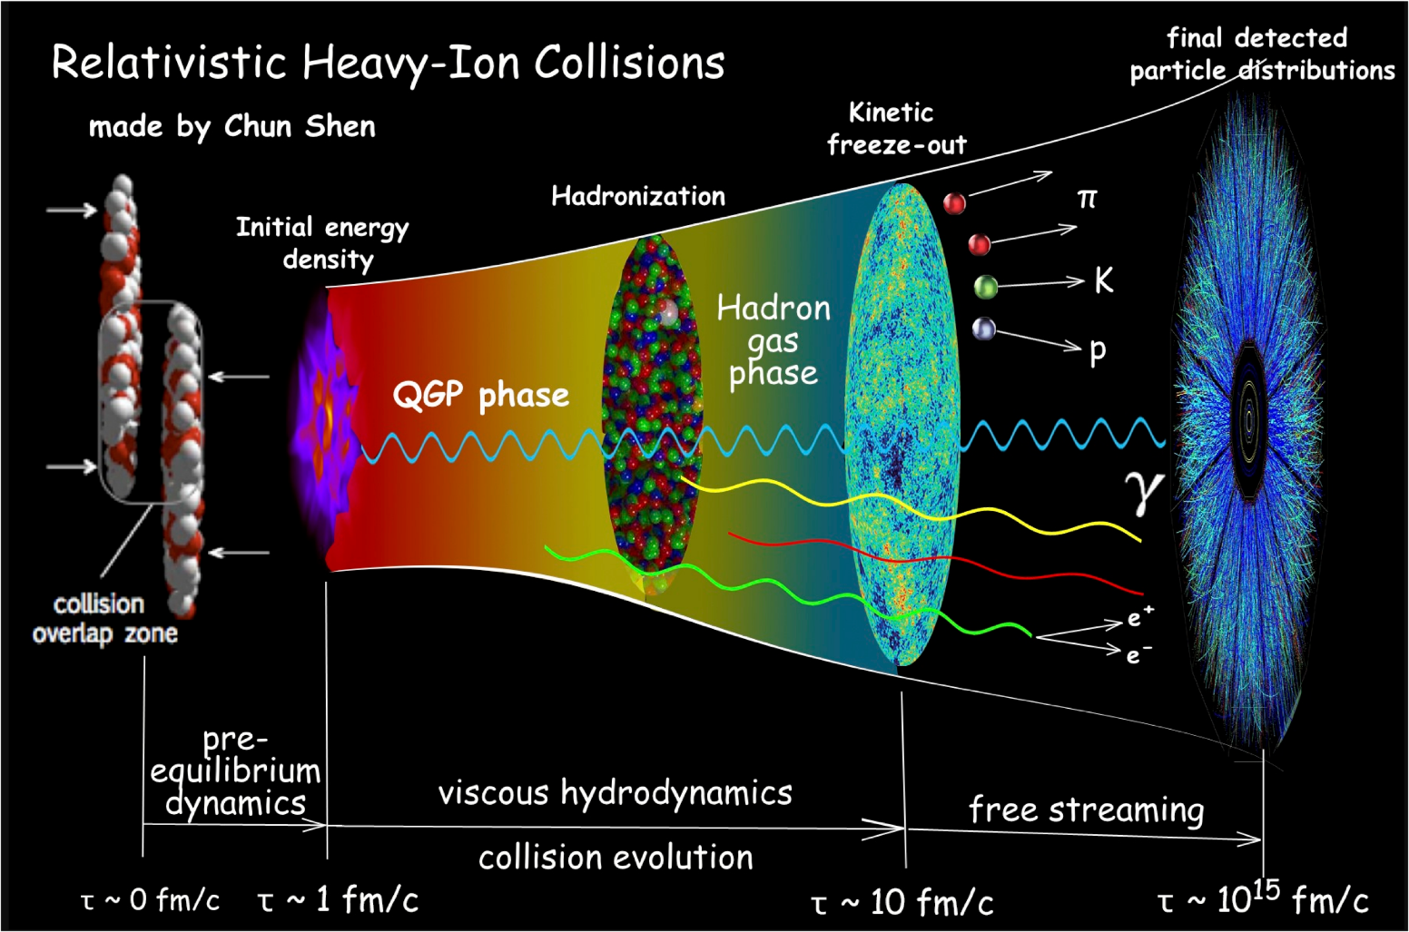
Relativistic Heavy-Ion Collisions and hydrodynamics
Relativistic hydrodynamics
A powerful tool to describe the evolution of quark-gluon plasma.
The “Standard Model” in relativistic heavy ion collisions.

Slide 3
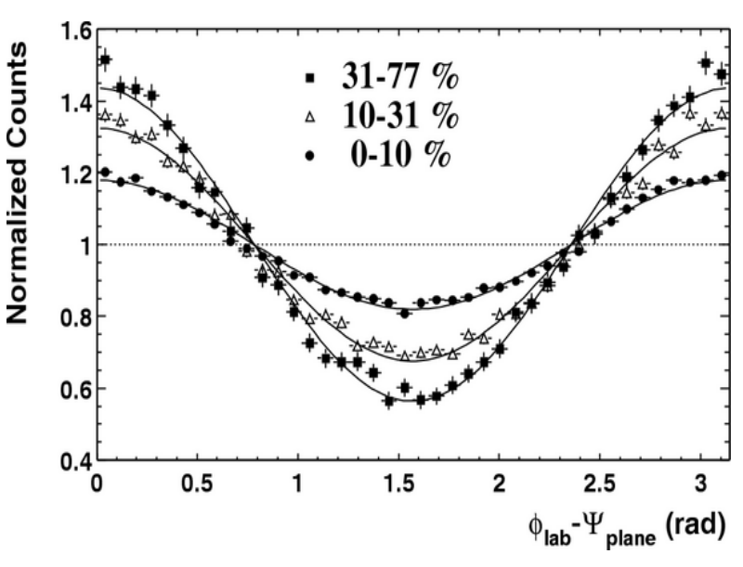

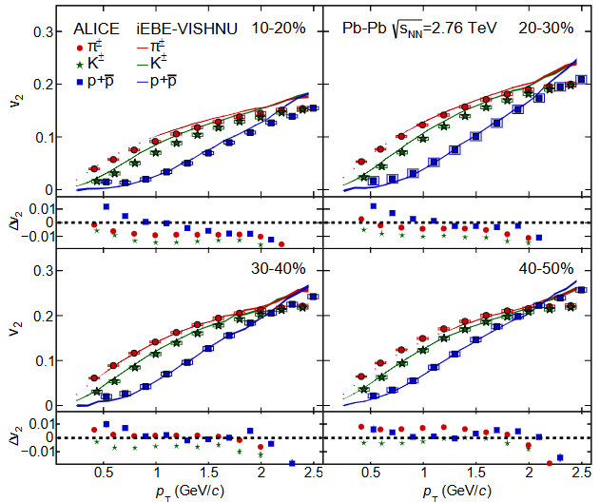
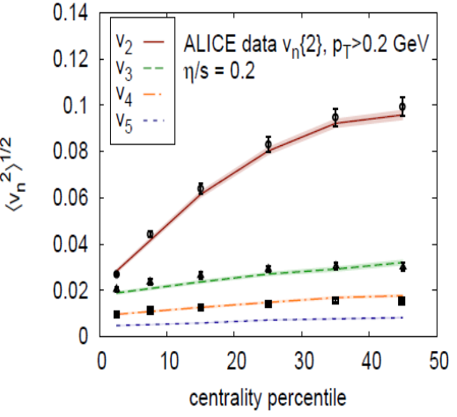
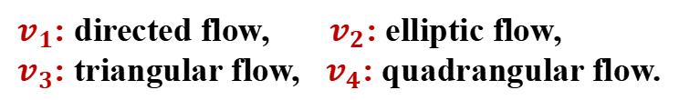
Anisotropic flow
Azimuthal distributions
Flow harmonics coefficients
$v_{1}$: directed flow, $v_{2}$: elliptic flow,
$v_{3}$: triangular flow, $v_{4}$: quadrangular flow.
Hydrodynamics can describe the anisotropic flows
STAR, PRL90 032301 (2003)
-Hydro + IP-Glasma Gale, et. Al, PRL2013
-iEBE-VISHNU + AMPT Xu, Li, H. S, PRC 2016
Alice, JHEP 1609 164 (2016)

Slide 4
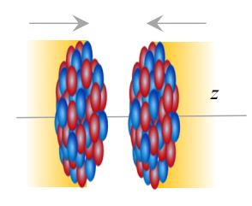
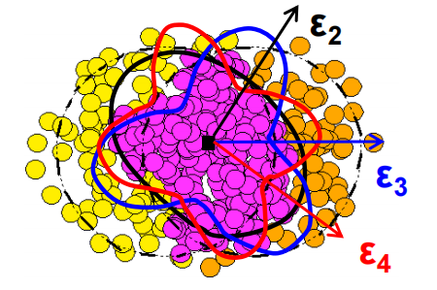
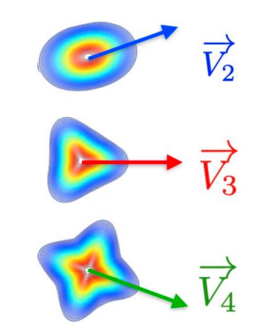

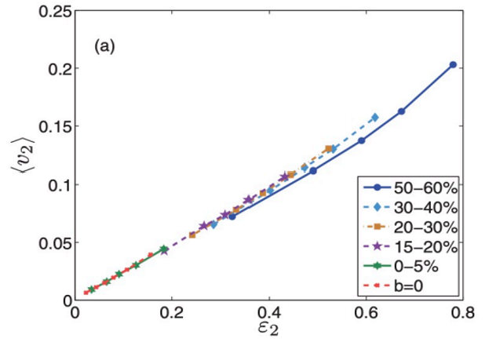
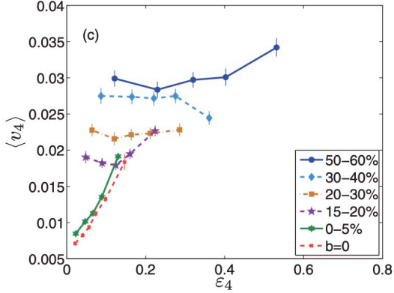
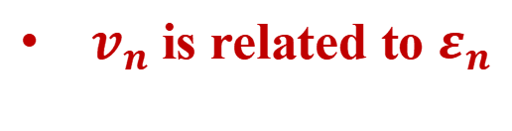

Nonlinear response of the flows
$v_{n}$is related to $ε_{n}$
nuclear collision
Initial state
Final state
Anisotropic pressure gradients
Structure and fluctuation of nuclear
Anisotropy of energy density in coordinate space. ( )
Final-state momentum-space anisotropy.( )
Nonlinear response for $v_{4}$
Z. Qiu and U. Heinz, PRC84, 024911(2011)

Slide 5
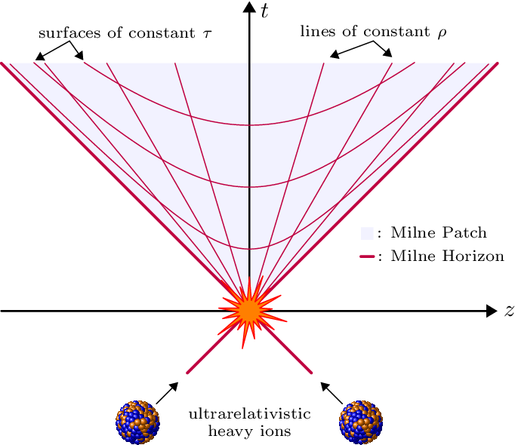

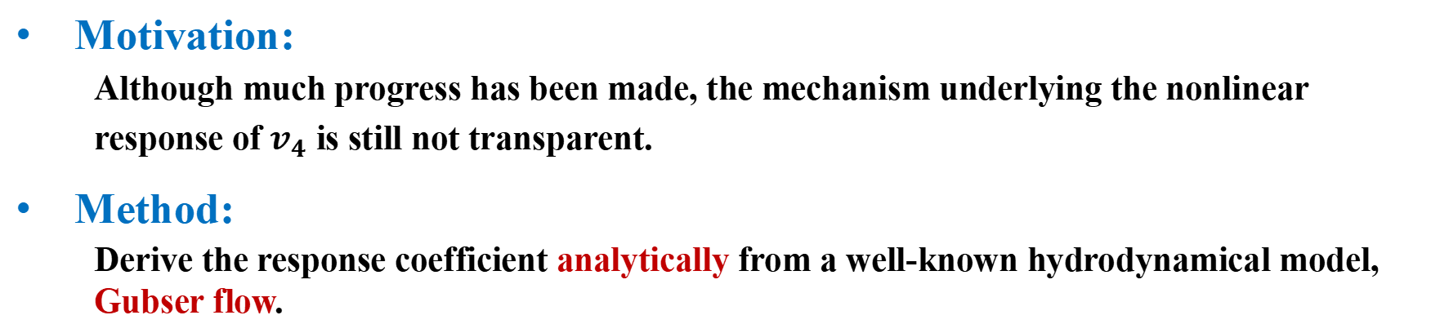
Motivation and Method of this work
Motivation:
  Although much progress has been made, the mechanism underlying the nonlinear response of $v_{4}$ is still not transparent.
Method:
  Derive the response coefficient analytically from a well-known hydrodynamical model, Gubser flow.
Bjorken flow
Gubser flow
Gubser flow: a 1+1 dimensional analytic solution for relativistic hydrodynamics with transverse flows
Symmetry:
Minkowski spacetime (analytically difficult)
Weyl transformation
de-Sitter space-time
Gubser, PRD (2010);
Gubser, Yarom, NPB (2011)

Slide 6
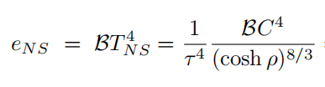

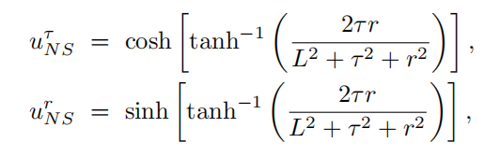

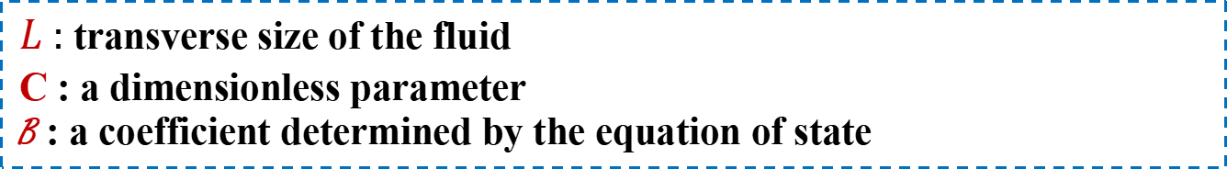
A review to Gubser flow
Gubser flow
A 1+1 dimensional analytic solution for relativistic hydrodynamics with transverse flows.
$$ds^{2}= −dτ^{2}+dr^{2}+r^{2}dφ^{2}+τ^{2}dy^{2}$$
Gubser, PRD (2010);
Gubser, Yarom, NPB (2011)
$τ$ : proper time r : radial coordinate
$φ$ : azimuthal angle y : spacetime rapidity
Navier-Stokes solution
Solution for energy density
$L$ : transverse size of the fluid
C : a dimensionless parameter
B : a coefficient determined by the equation of state
Solution for velocity
But, no azimuthal angle $φ$ dependence!

Slide 7

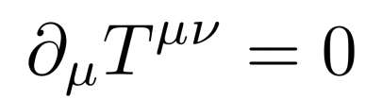
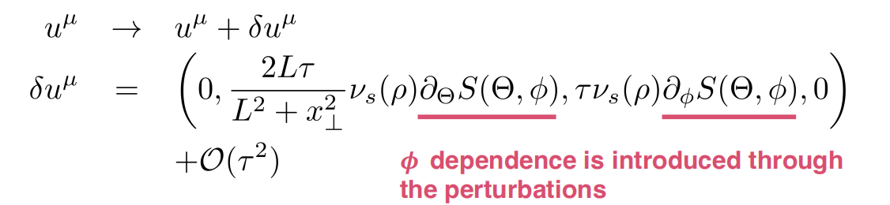
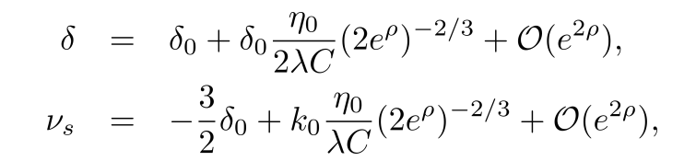
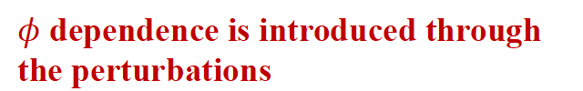
Perturbation solutions on Gubser flow
Perturbation on temperature
Perturbed velocity
Insert the perturbed temperature into the conservation equation, we could derive the perturbed velocity.
$φ$ dependence is introduced through the perturbations
where
Hatta, Noronha, Torrieri, B.W.Xiao, PRD (2014)
Hatta, Monnai, B.W.Xiao, PRD(2015)

Slide 8

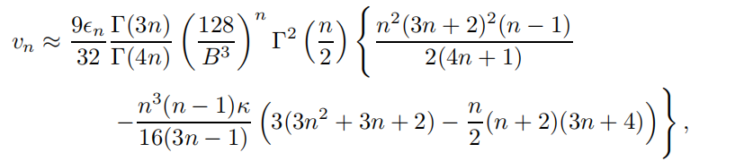
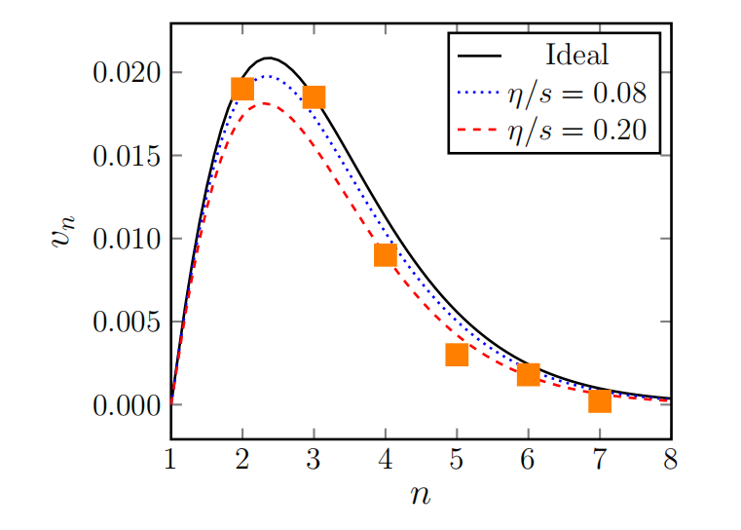
Recalling previous work
Flunctuation in previous work
Linear response between $ε_{n}$ and $v_{n}$
ideal
viscous
Hatta, Noronha, Torrieri, B.W.Xiao, PRD (2014)
Hatta, Noronha, Torrieri, B.W.Xiao, PRD (2014)
Hatta, Monnai, B.W.Xiao, PRD(2015)

Slide 9

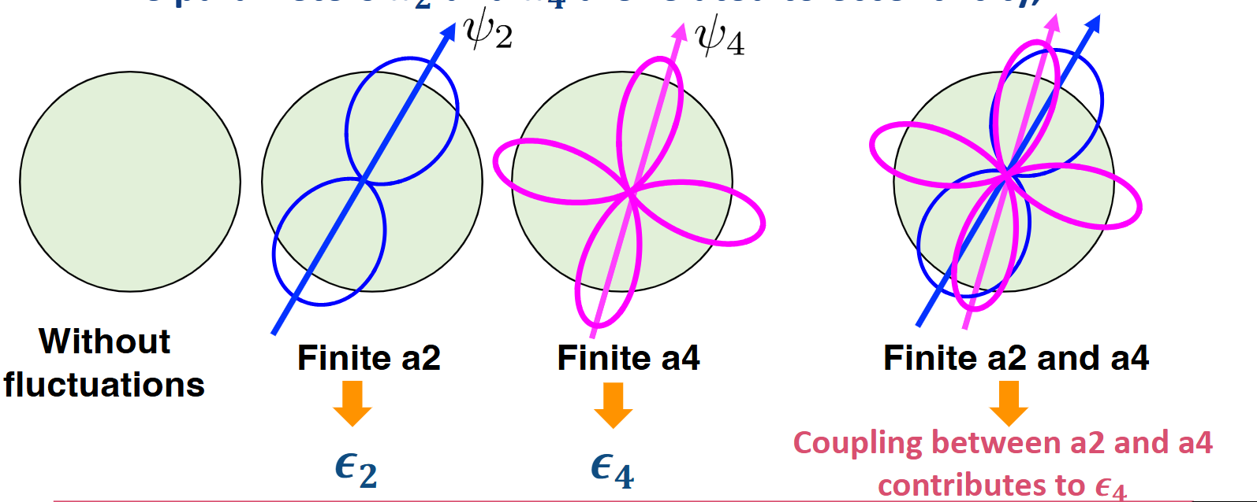
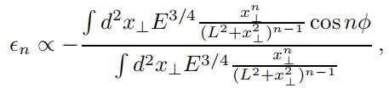


Setup in current work
Flunctuation in our work
Relation between $a_{n}$and eccentricity $ε_{n}$
Coupling between $a_{2}$ and $a_{4}$ contributes to $ε_{4}$
Hatta, Noronha, Torrieri, B.W.Xiao, PRD (2014)
Power counting

Slide 10


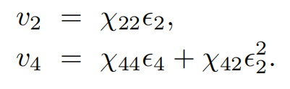
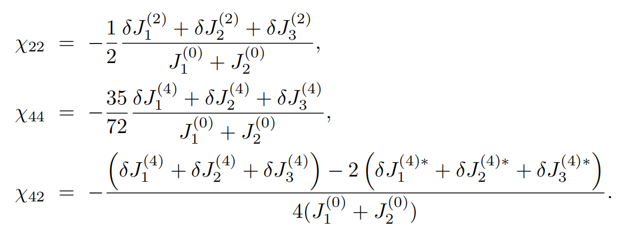
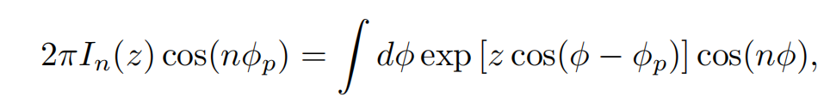
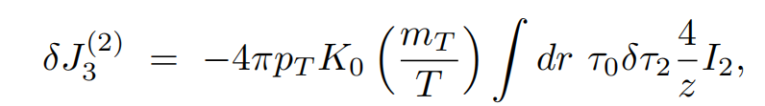
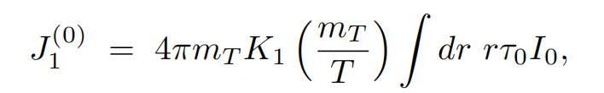
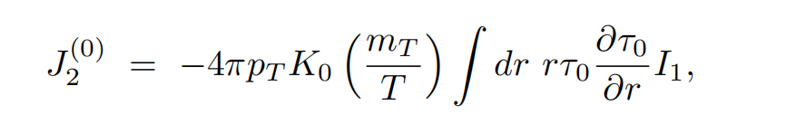
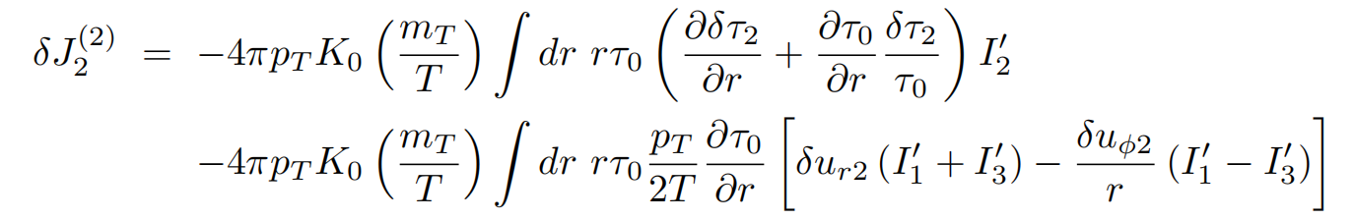
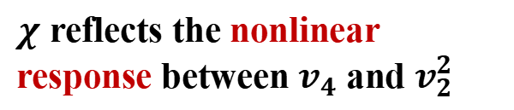
Cooper-Frye formula and $v_{2}$ ,$v_{4}$
Cooper-Frye formula with a given freeze-out temperature
Isothermal surface
Analytical expressions for $v_{2},v_{4}$
$χ$ reflects the nonlinear response between $v_{4}$ and $v_{2}^{2}$

Slide 11
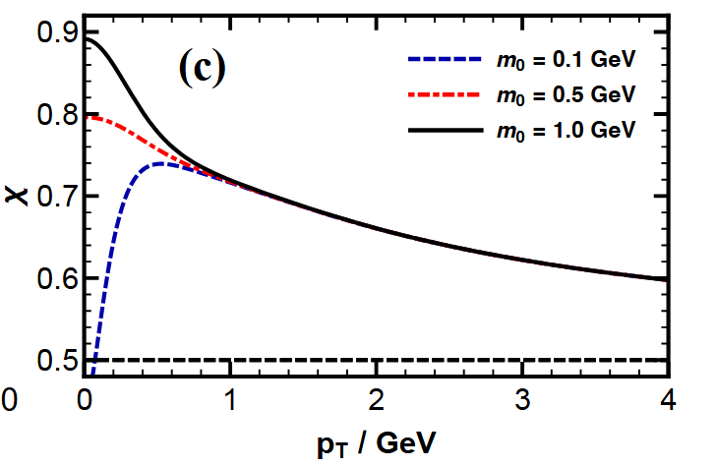
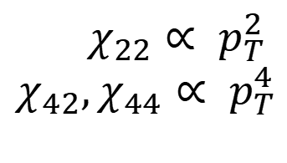
Coefficients $χ$ in small $p_{T}$ limit
Simplified analytical expressions for $χ_{ij}$ in small $p_{T}$limit
$χ_{22}∝ p_{T}^{2}$
$$χ_{42},χ_{44}∝ p_{T}^{4}$$
Mass dependence

Slide 12

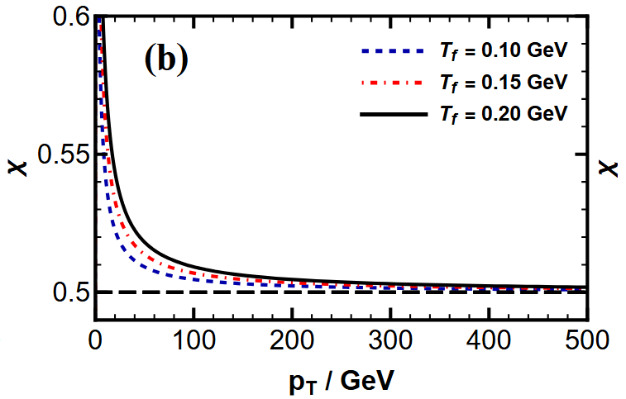
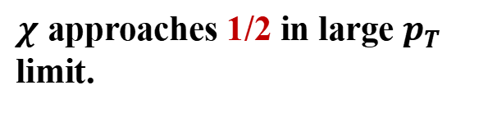
Coefficients $χ$ in large $p_{T}$ limit
Simplified expressions for $χ$ in large $p_{T}$limit
Consistent with hydrodynamics simulations.
N. Borghini ,J.-Y. Ollitrault,
Phys. Lett. B 642, 227 (2006),
D. Teaney and L. Yan, Phys. Rev. C 86, 044908 (2012)
C. Lang and N. Borghini, Eur. Phys. J. C 74, 2955 (2014)
C. Gombeaud and J.-Y. Ollitrault, Phys. Rev. C 81, 014901 (2010)
Temperature Dependence
Weak freeze-out temperature dependence.
$χ$ approaches 1/2 in large $p_{T}$ limit.

Slide 13
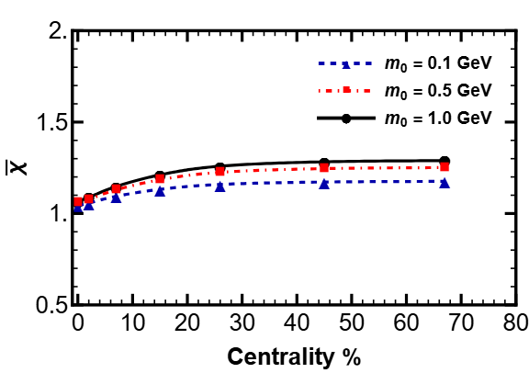
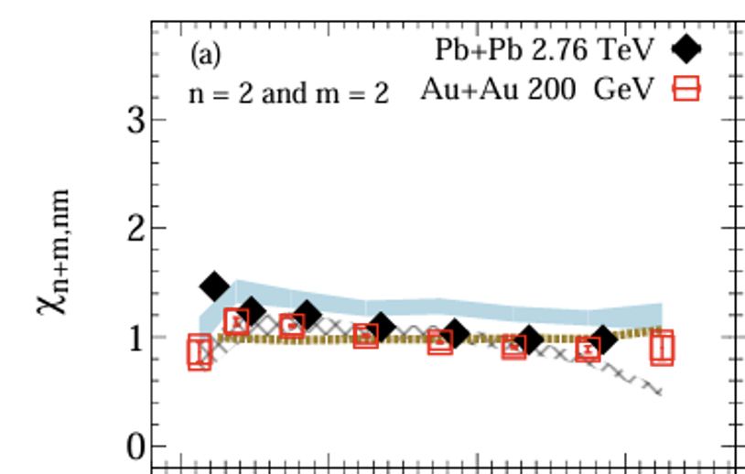

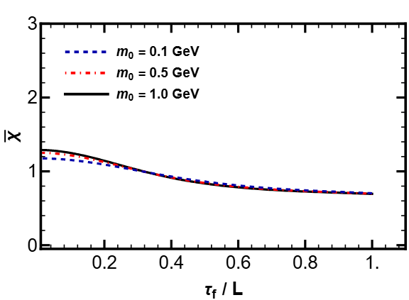
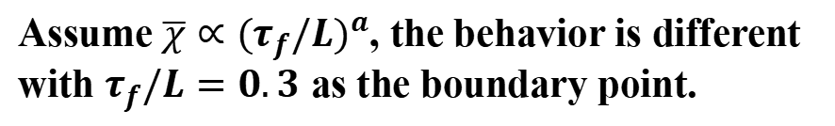
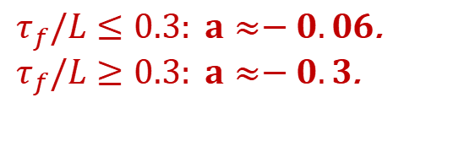
Centrality dependence
Centrality denpendence
Hatta, Noronha, Torrieri, B.W.Xiao, PRD (2014)
Hatta, Monnai, B.W.Xiao, PRD(2015)
R. S. Bhalerao, J.P. Blaizot, N. Borghini,
J.Y. Ollitrault, Phys. Lett. B(2005)
Parameters are fixed by using 200 GeV Au+Au collisions.
Agrees with STAR data
Scaling behavior
Hatta, STAR, J.Adam, Phys. Lett. B (2020)
Assume $\overline{χ}∝{(τ_{f}/L)}^{a}$, the behavior is different with $τ_{f}/L=0.3$ as the boundary point.
$τ_{f}/L≤0.3: a≈−0.06$.
$τ_{f}/L≥0.3: a≈−0.3$.

Slide 14





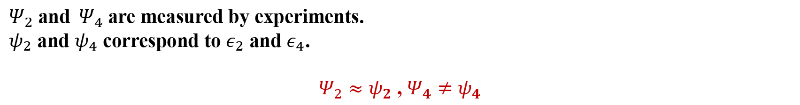
Role of reaction and participant planes
Experimental measurements
Reaction plane
$Ψ_{2}$ and $Ψ_{4}$ are measured by experiments.
$ψ_{2}$ and $ψ_{4}$ correspond to $ε_{2}$ and $ε_{4}$.
$Ψ_{2}≈ψ_{2}$ , $Ψ_{4}≠ψ_{4}$
Experimental assumption: the linear part and nonlinear part are uncorrelated.
$$4ψ_{4}$$
$$v_{4}\{Ψ_{4}\}$$
Linear part
Nonlinear part
$$v_{4L}$$
L.Yan, J.Y.Ollitrault, PLB(2015)
F.G.Gardim, J.N.Hostler, M.Luzum, Grassi, PRC(2015)
J.Y.Jia, J.Phys.G(2014)
$$v_{4}\{Ψ_{2}\}$$
$$4ψ_{2}/4Ψ_{2}$$

Slide 15
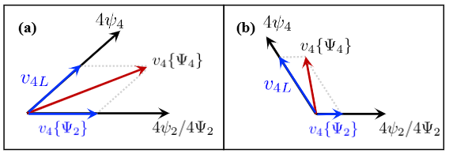


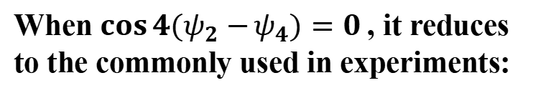
Effect of mismatch between reaction and participant planes
Our results in Gubser flow
$ψ_{2}$ and $ψ_{4}$ are introduced by perturbation, the linear part and nonlinear part are correlated while $\cos{4(ψ_{2}−}ψ_{4})≠0$.
Rigorous result:
When $\cos{4(ψ_{2}−}ψ_{4})=0$, it reduces to the commonly used in experiments:
When $\cos{4(ψ_{2}−}ψ_{4})≠0$, taking Taylor expansion:
$v_{4L}≫v_{4}\{Ψ_{2}\}$:
$v_{4L}≪v_{4}\{Ψ_{2}\}$:

Slide 16











Summary
Analytical results of $v_{2}$, $v_{4}$ in Gubser flow
Centrality dependence
Agrees with STAR data
Small $p_{T}$ limit
Large $p_{T}$ limit
Participant - reaction planes mismatch
Experimental assumption
Our results in Gubser flow
$$4ψ_{4}$$
$$v_{4}\{Ψ_{4}\}$$
$$v_{4L}$$
$$v_{4}\{Ψ_{2}\}$$
$$4ψ_{2}/4Ψ_{2}$$

Slide 17
Thank you!

