Slide 1

Weyl anomaly induced transport in hydrodynamics
Shi-Zheng Yang
Zhejiang Ocean University
SZY, J. H. Gao, Z. T. Liang, G. Prokhorov, S. Pu, O. Teryaev, V. Zakharov, arXiv:2604.23849

Slide 2
Content
  Introduction
  Chiral anomaly induced current (first order)
  Weyl anomaly induced current (second order)
  Weyl anomaly induced current in an accelerated frame
  Summary

Slide 3
Content
  Introduction
  Chiral anomaly induced current (first order)
  Weyl anomaly induced current (second order)
  Weyl anomaly induced current in an accelerated frame
  Summary

Slide 4
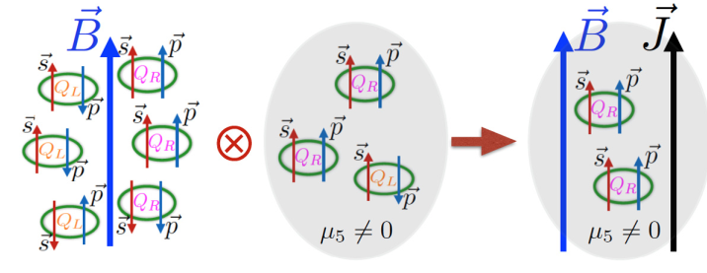
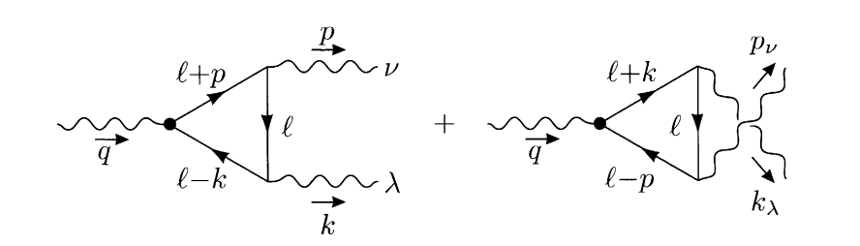
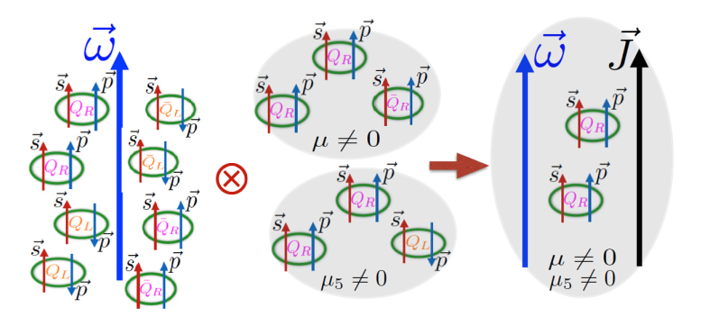
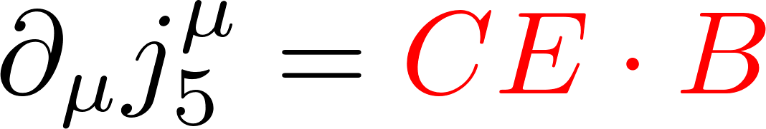
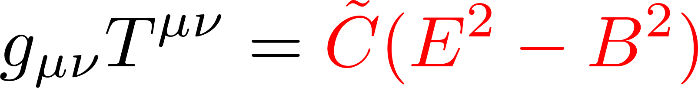
Quantum anomaly
In quantum field theory, the axial‑vector current is no longer conserved for massless particles due to loop diagrams, which is called the chiral anomaly.
The Weyl anomaly reflects the quantum breaking of classical conformal invariance
Chiral magnetic effect
Chiral vortical effect

Slide 5
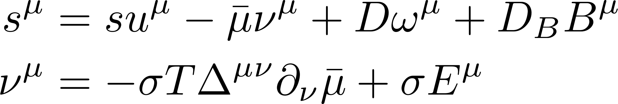
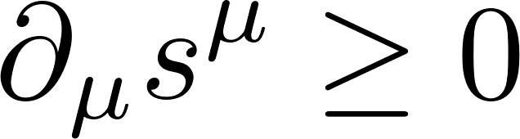
Principle of entropy increase
Hydrodynamic equations with chiral anomaly:
Principle of entropy increase:
The anomalous transport coefficients can be determined by chiral anomaly:
D. T. Son, P. Surowka, Phys. Rev. Lett. 103, 191601 (2009)

Slide 6
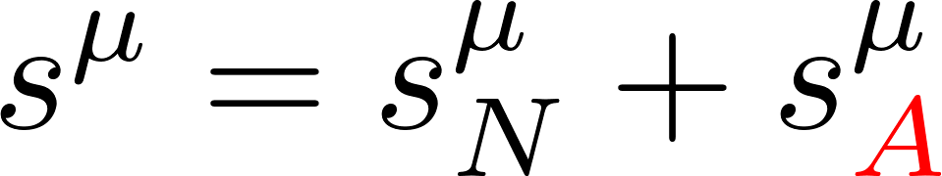
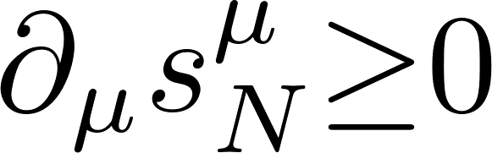
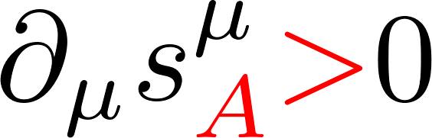
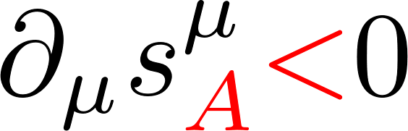
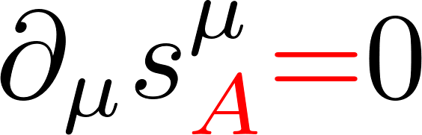
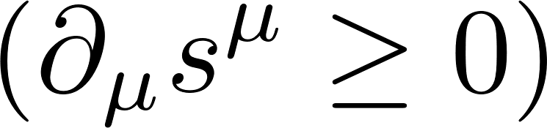
Anomalous transport is non-dissipative
Entropy current includes normal and anomalous terms:
Entropy production from normal terms is positive semi-definite:
Entropy production from anomalous terms is indefinite: or or
Principle of entropy increase requires:
Anomalous transport is non-dissipative and can exist in global equilibrium!
Can we determine these coefficients without invoking the principle of entropy increase?
D. T. Son, P. Surowka, Phys. Rev. Lett. 103, 191601 (2009)

Slide 7
Content
  Introduction
  Chiral anomaly induced current (first order)
  Weyl anomaly induced current (second order)
  Weyl anomaly induced current in an accelerated frame
  Summary

Slide 8
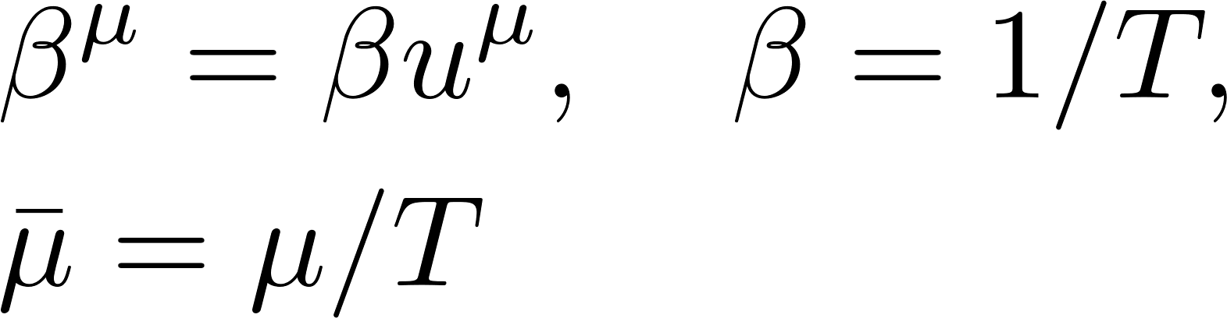
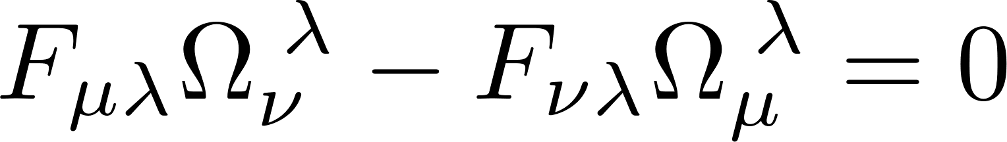

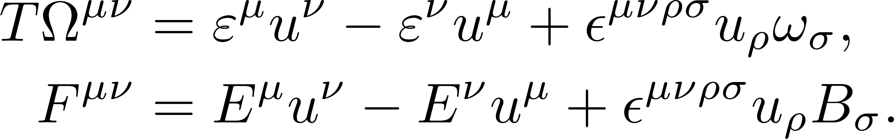
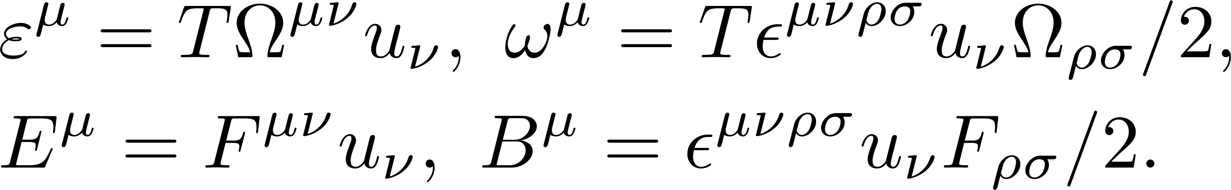
Hydrodynamic at global equilibrium
At global equilibrium, the system satisfies the Killing conditions
The tensor can be decomposed
constant thermal vorticity
integrability condition

Slide 9
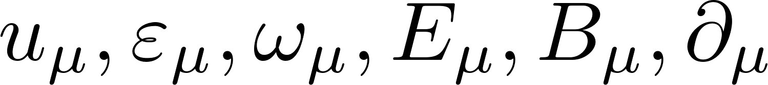
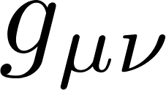
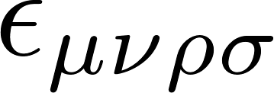
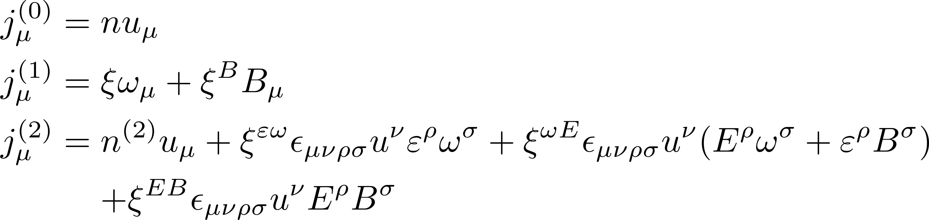
The zeroth to second order currents
To construct the currents, we have
The zeroth- to second-order currents
vector
tensor
Levi-Civita tensor
2rd number density:

Slide 10
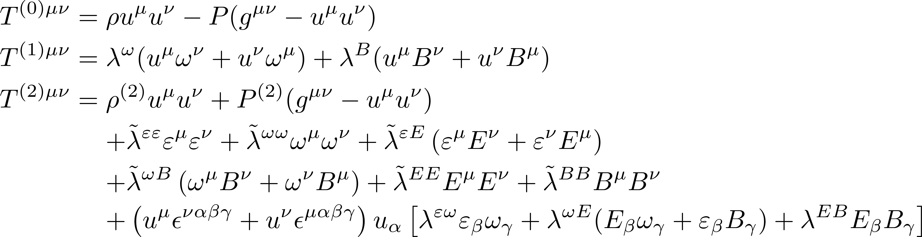
The zeroth to second order energy momentum tensor
The zeroth- to second-order energy momentum tensor
The conservation law:
2rd energy density:
2rd pressure:
Notes:
neglect other possible second-order contributions

Slide 11
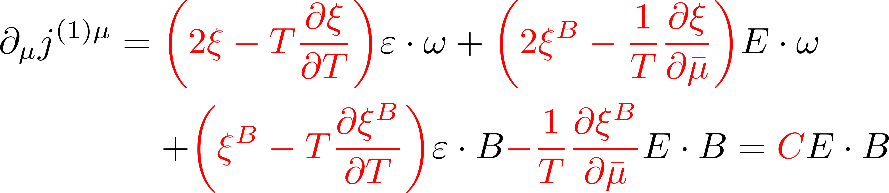
Chiral anomaly induced transport coefficients
First order conservation laws:
The chiral anomaly gives:
The energy momentum conservation gives:
First order results:

Slide 12
Content
  Introduction
  Chiral anomaly induced current (first order)
  Weyl anomaly induced current (second order)
  Weyl anomaly induced current in an accelerated frame
  Summary

Slide 13

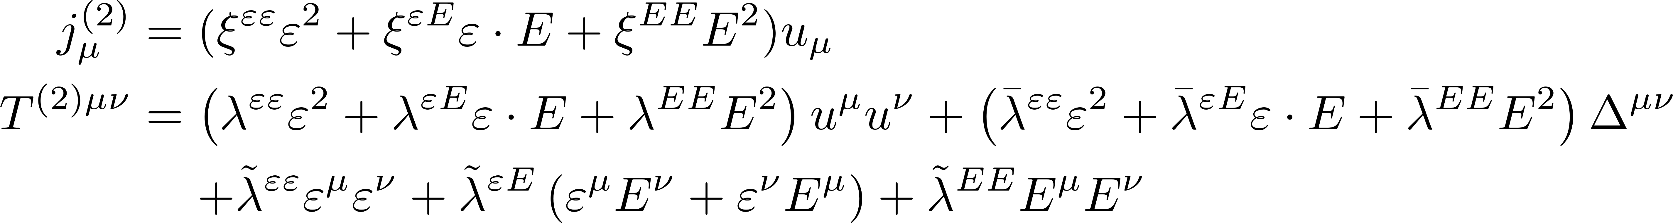
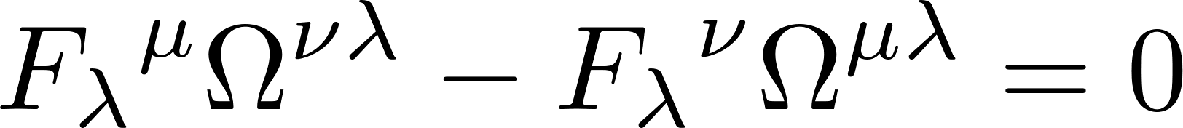
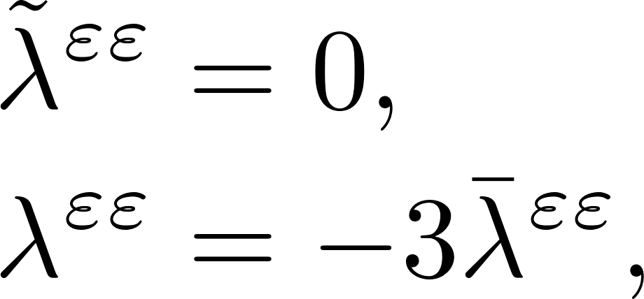
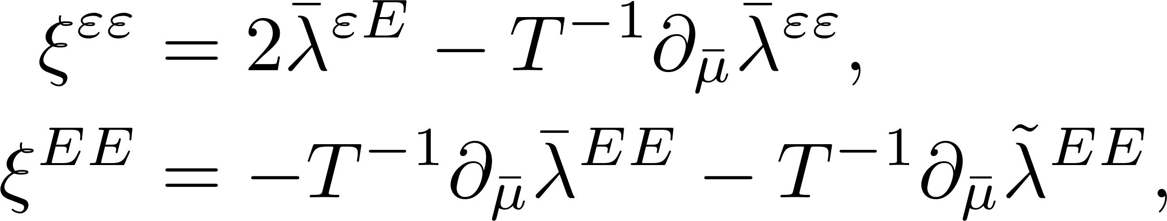
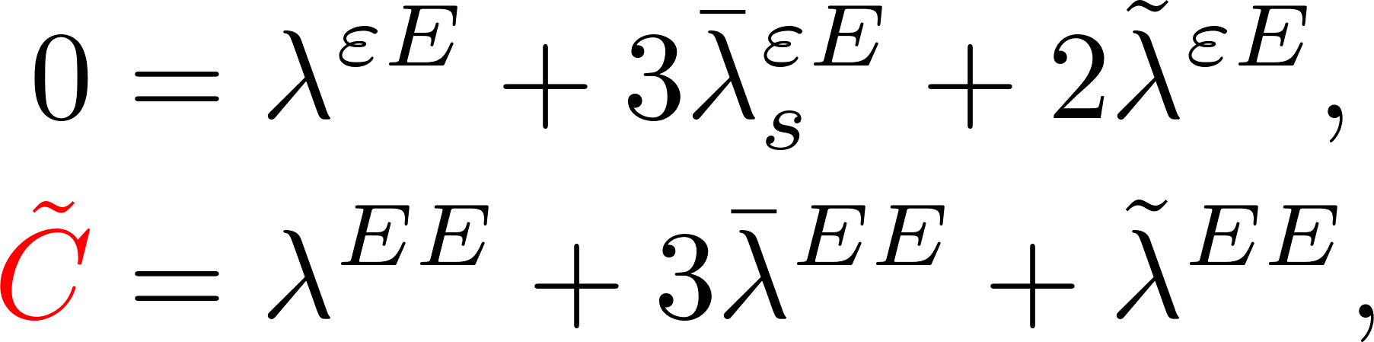
Second order under constant EM field
The second order current and energy momentum with :
Second order conservation laws:
=0 in global equilibrium
Constrain:
Dimensional analysis

Slide 14
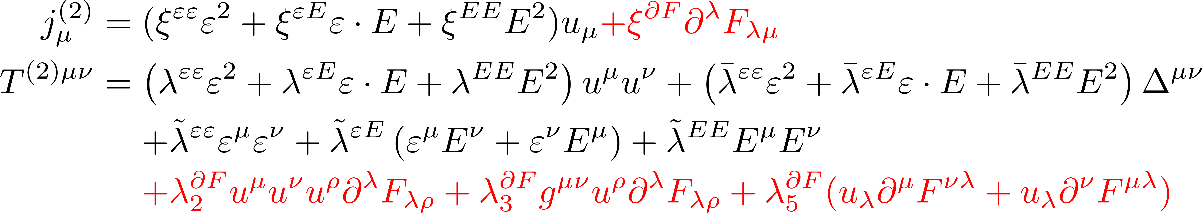
Second order under varying EM field
The second order current and energy momentum under varying EM field:
Compared to a constant electromagnetic field, a space-time dependent one imposes stronger constraints on global equilibrium.
SZY, J. H. Gao and S. Pu, Phys. Rev. D 111, 036013 (2025)

Slide 15
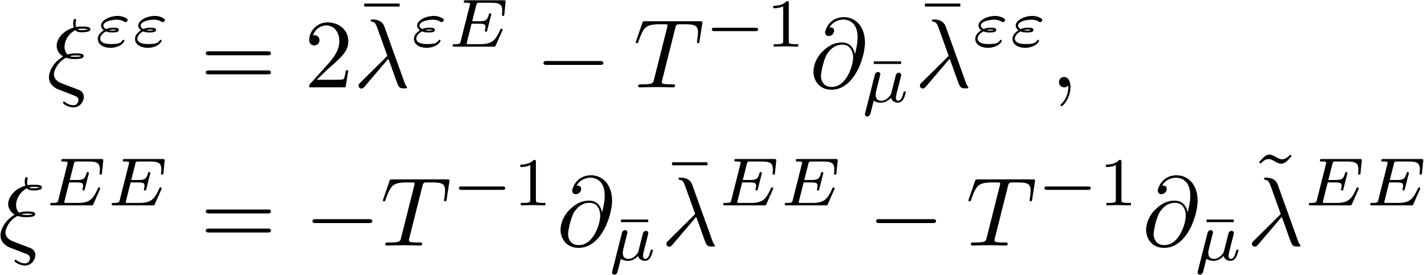
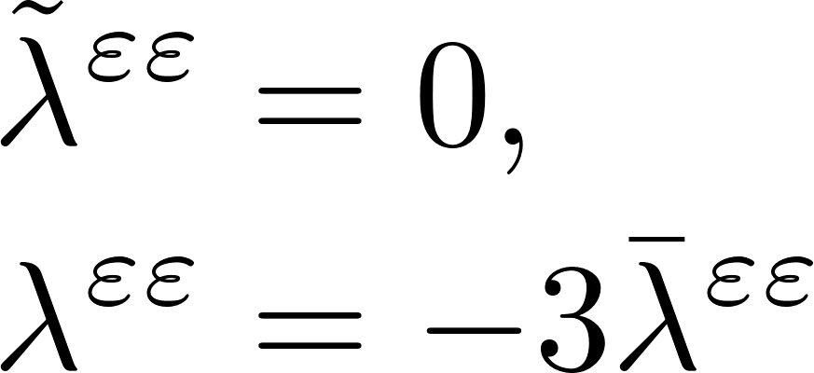
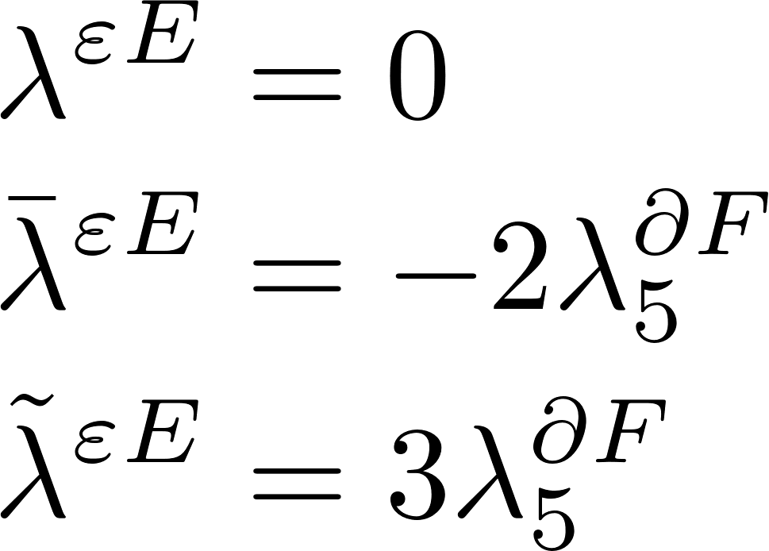
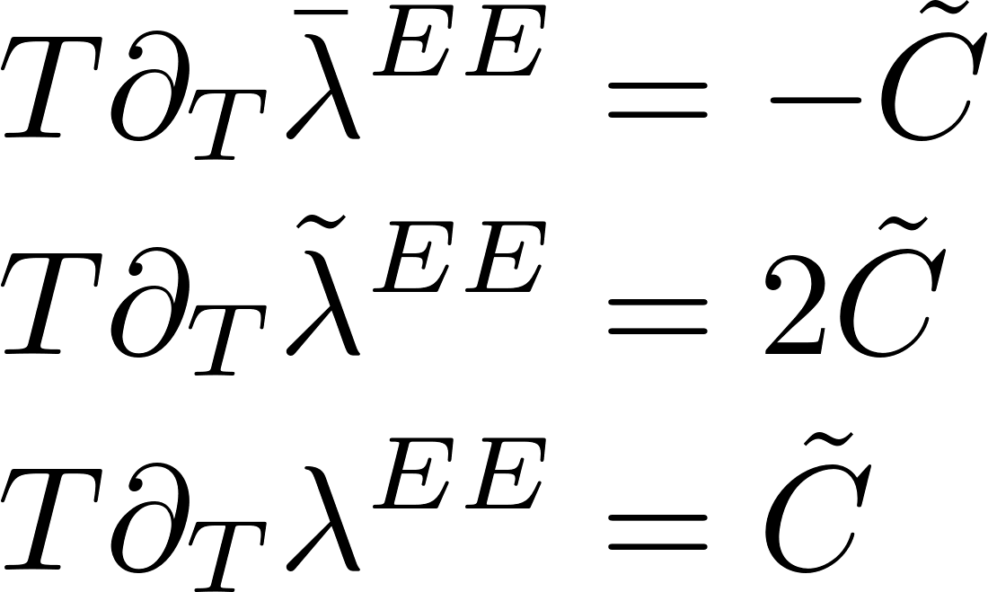
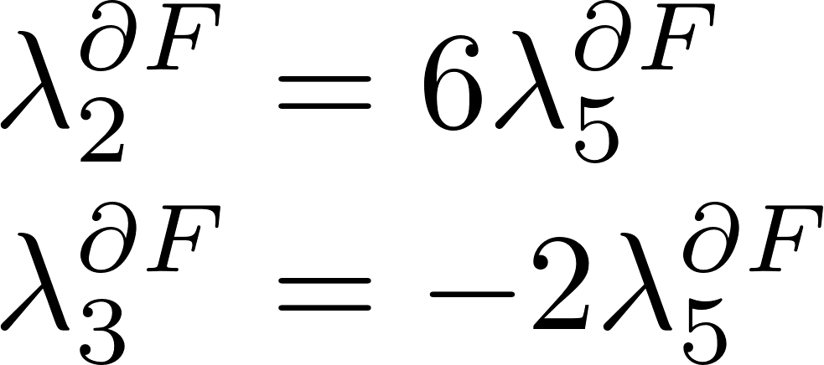
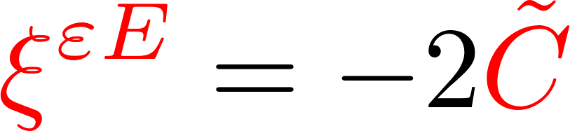
Weyl anomaly induced transport coefficient
Second order conservation laws:
Hydrodynamics transport coefficients
For other recent discussions on the scale anomaly and acceleration, see
Dimensional analysis
Constraint:
Weyl anomaly term
Z. H. Zhang, X. H. Lv and X. G. Huang, arXiv: 2603.17794
S. Z. Zhong, X. G. Deng, X. G. Huang and Y. G. Ma, arXiv:2604.00302

Slide 16
Content
  Introduction
  Chiral anomaly induced current (first order)
  Weyl anomaly induced current (second order)
  Weyl anomaly induced current in an accelerated frame
  Summary

Slide 17
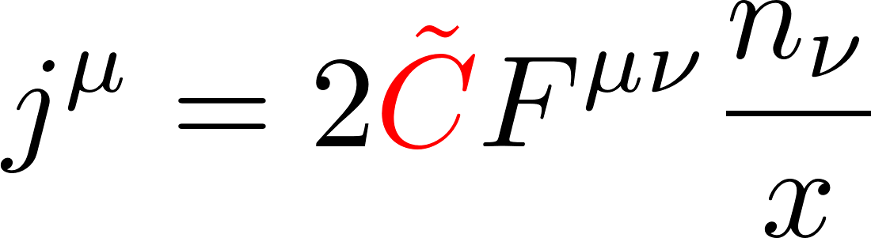
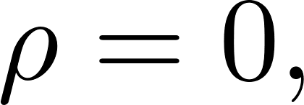
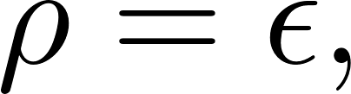
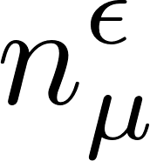
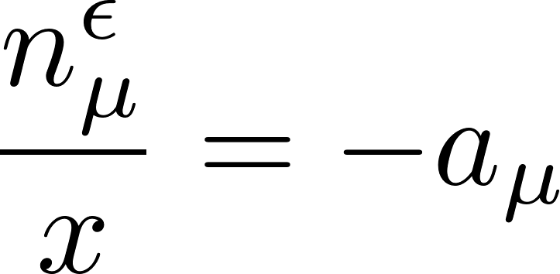


Weyl anomaly induced transport in an accelerated frame
Weyl anomaly induced current from boundary quantum field theory (BQFT):
Treat Rindler horizon in an accelerated frame as a boundary:
Rindler coordinates:
Horizon: Stretched horizon: The inward unit normal vector:
$$x$$
$$n_{μ}$$
0
C. S. Chu, R. X. Miao, Phys.Rev. Lett. 121,251602 (2018)

Slide 18
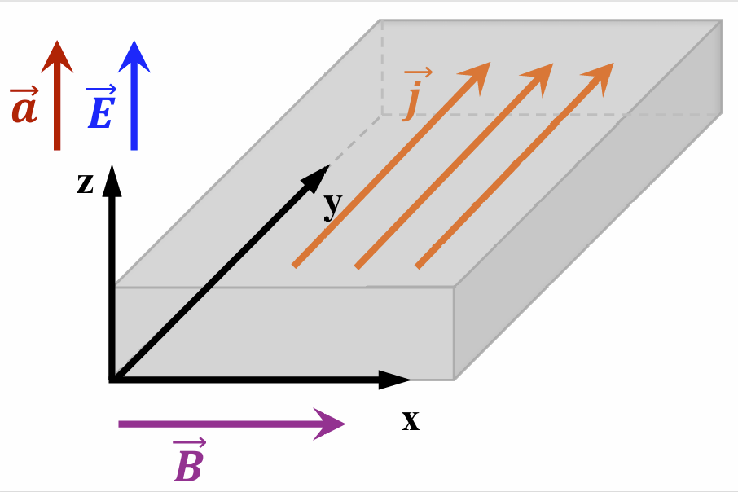
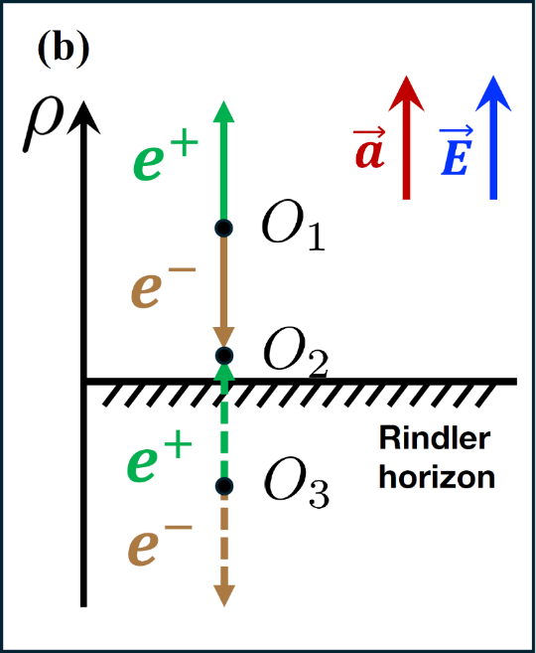
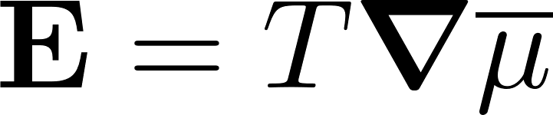
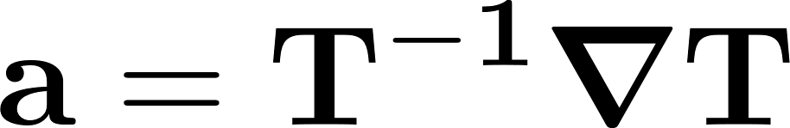
Weyl anomaly induced transport in an accelerated frame
In the local rest frame of the fluid
At Global equilibrium:
Nernst-like current:

Slide 19
Content
  Introduction
  Chiral anomaly induced current (first order)
  Weyl anomaly induced current (second order)
  Weyl anomaly induced current in an accelerated frame
  Summary

Slide 20
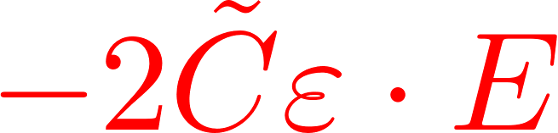
Summary and outlook
We have identified a Weyl-anomaly induced current from second-order relativistic hydrodynamics at global equilibrium.
Our results independently reproduce the same result from BQFT as a nontrivial boundary-induced effect.
What about massive fermions, strong electromagnetic fields, or gravitational fields ?
Phenomenological and numerical study on Weyl anomaly‑induced transport?

