Slide 1

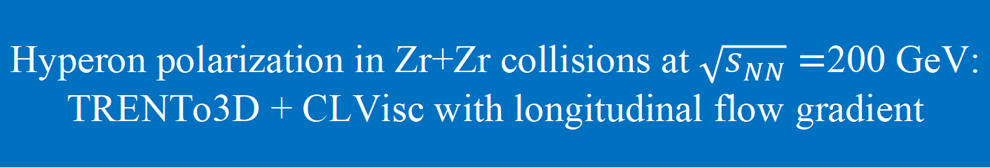
Hyperon polarization in Zr+Zr collisions at $\sqrt{s_{NN}}=$200 GeV:
TRENTo3D + CLVisc with longitudinal flow gradient
Ze-Fang Jiang
江泽方
arXiv: 2606.09093；Phys. Rev. C 112 (2025) 4, 044906
中国物理学会高能物理分会第十二届全国会员代表大会暨学术年会
中国 广州 2026年7月16日

Slide 2
Outline
Introduction
Theory Framework: TRENTo3D + CLVisc
Hyperon Polarization results: P_{y}(η, p_{T}, cen.), P_{y,c0}(cen.), P_{y,c2}(cen.), P_{z}(ϕ).
Summary
中国物理学会高能物理分会第十二届全国会员代表大会暨学术年会
中国 广州 2026年7月16日

Slide 3
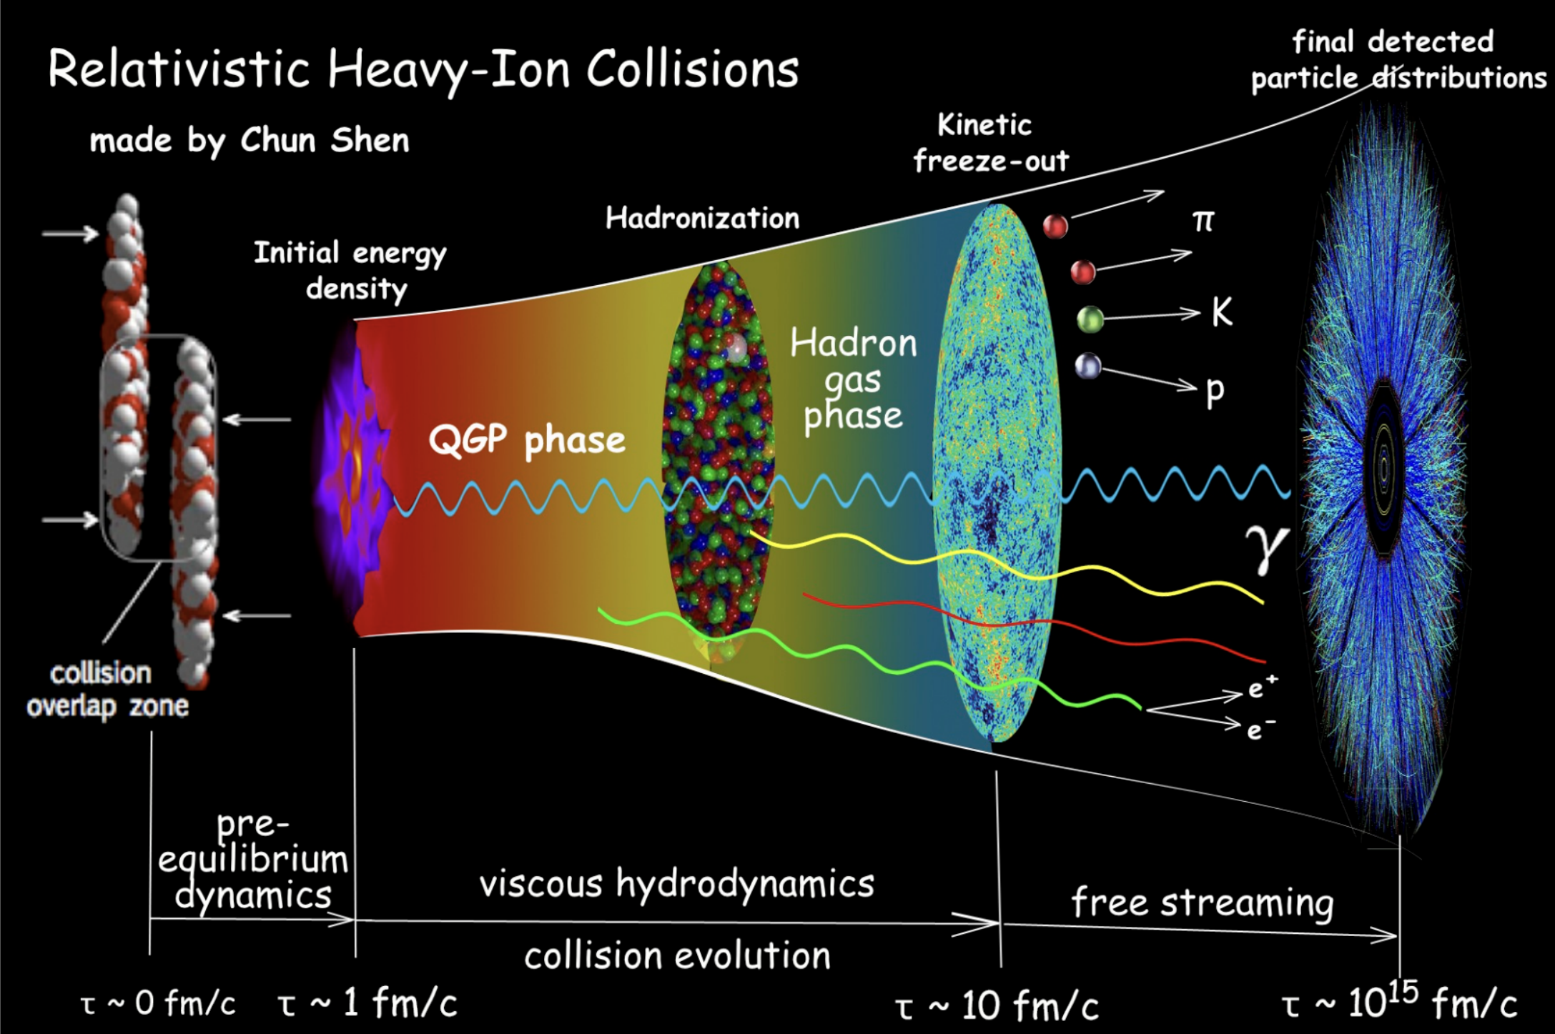
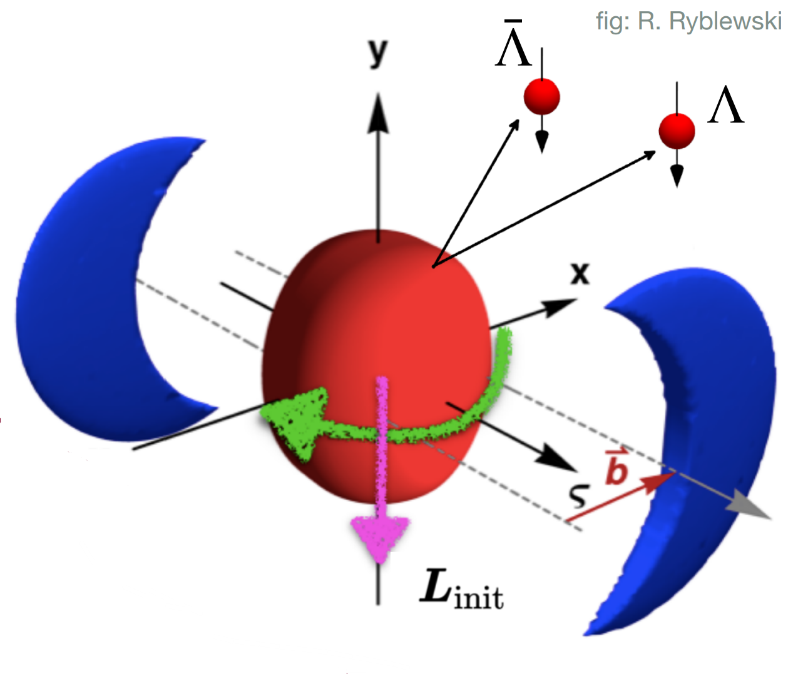
Introduction: Heavy Ion collisions & QGP
HIC, QGP and Spin-Orbital Coupling
EB field
B
Nearly perfect fluid with low η/s.
Non-central collisions: huge orbital angular momentum.
The most vortical fluid ever observed.
Liang, Wang, PRL. 94, 102301 (2005)
Liang, Wang, PLB 629, 20 (2005)
Becattini, Chandra, Zanna, and Grossi, Annals Phys. (2013)
Becattini and Karpenko, PRL 120, 01230

Slide 4
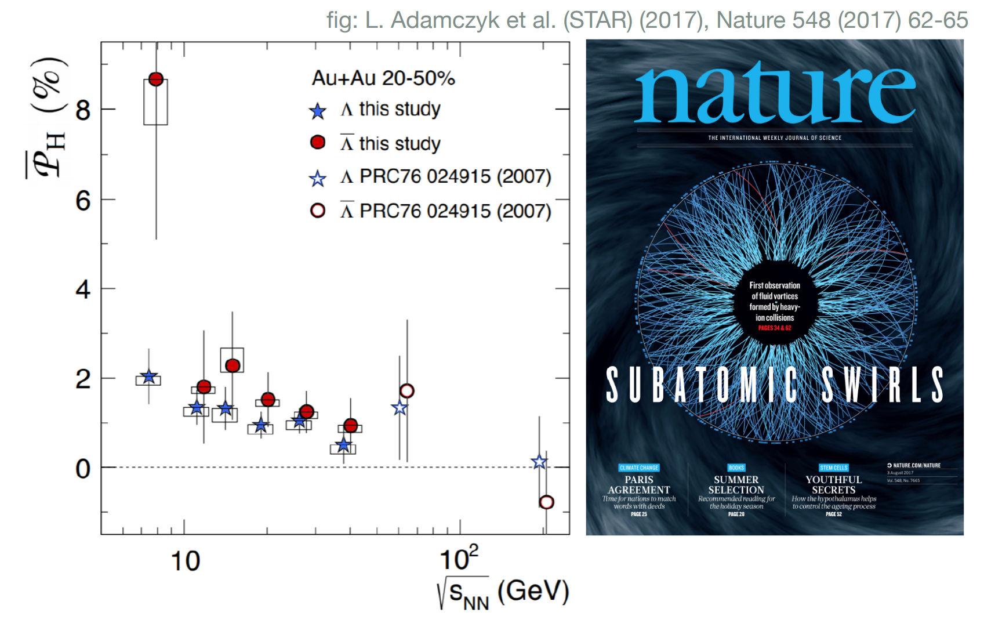
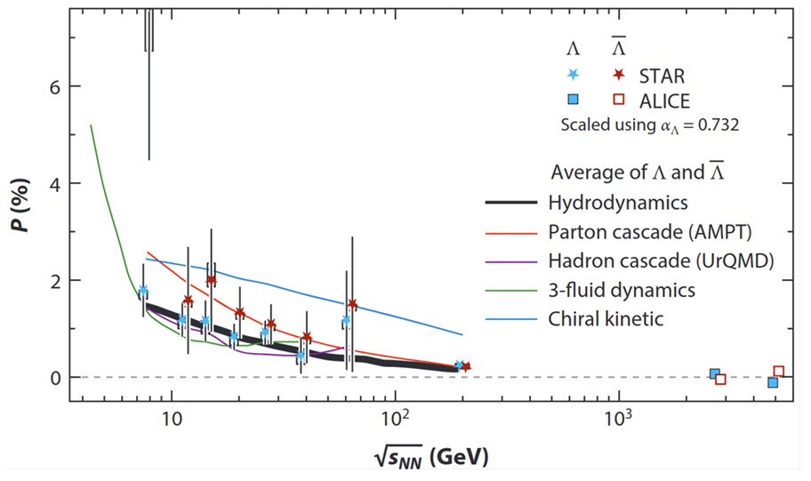
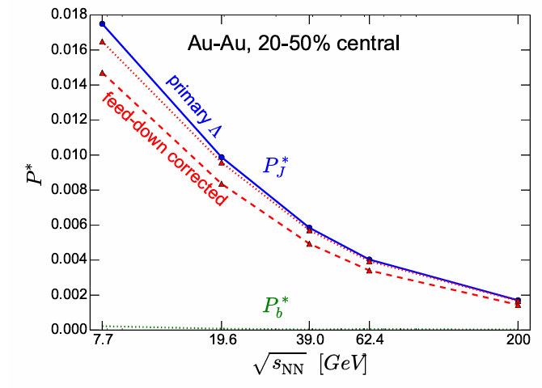
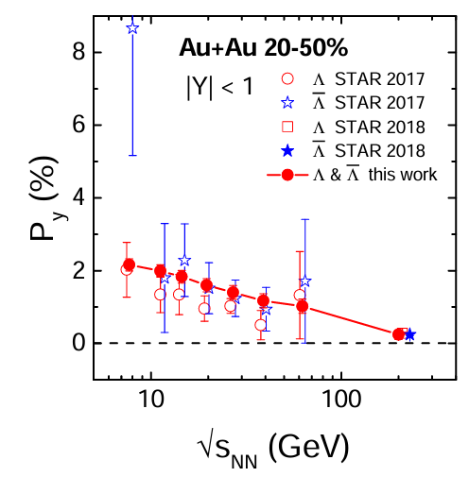
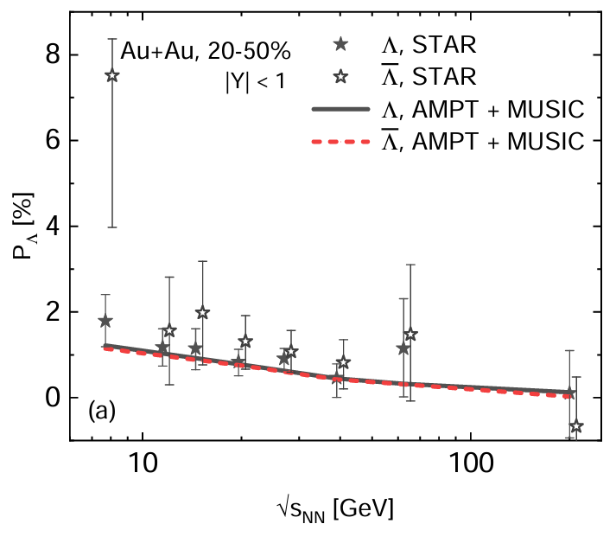
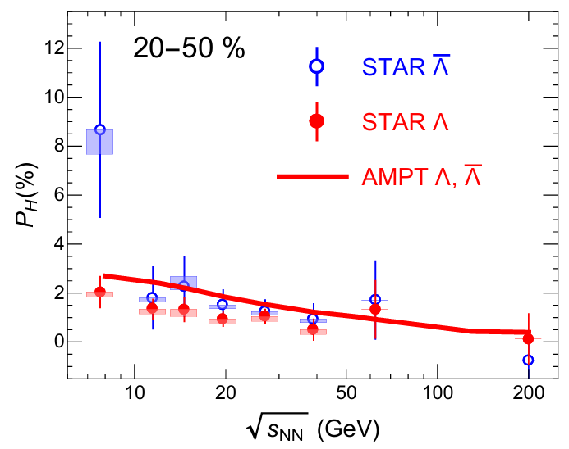
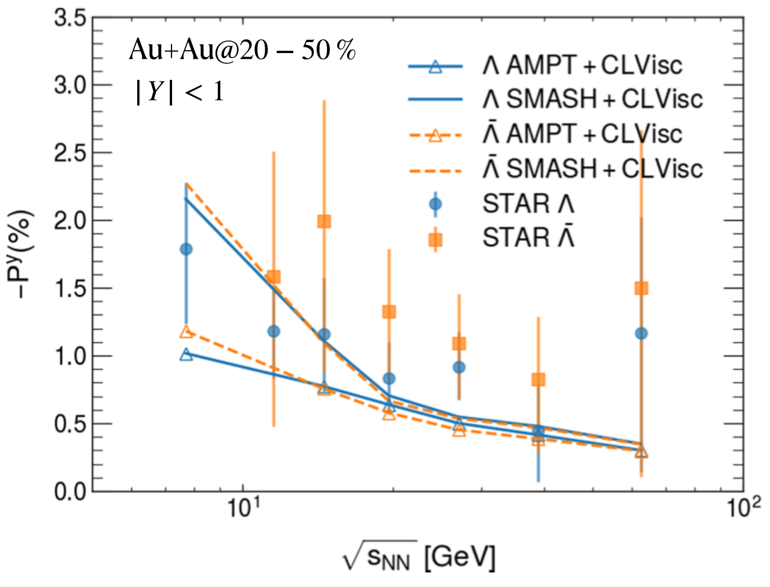
Spin Polarization: A New Frontier
Advance studies for global polarization
Karpenko, Becattini, EPJC(2017)
AMPT
Wei, Deng, Huang, PRC(2019)
Fu, Xu, Huang, Song, PRC(2021)
Shi, Li, Liao, PLB(2019)
Wu, YI, Qin, Pu, PRC(2022)

Slide 5
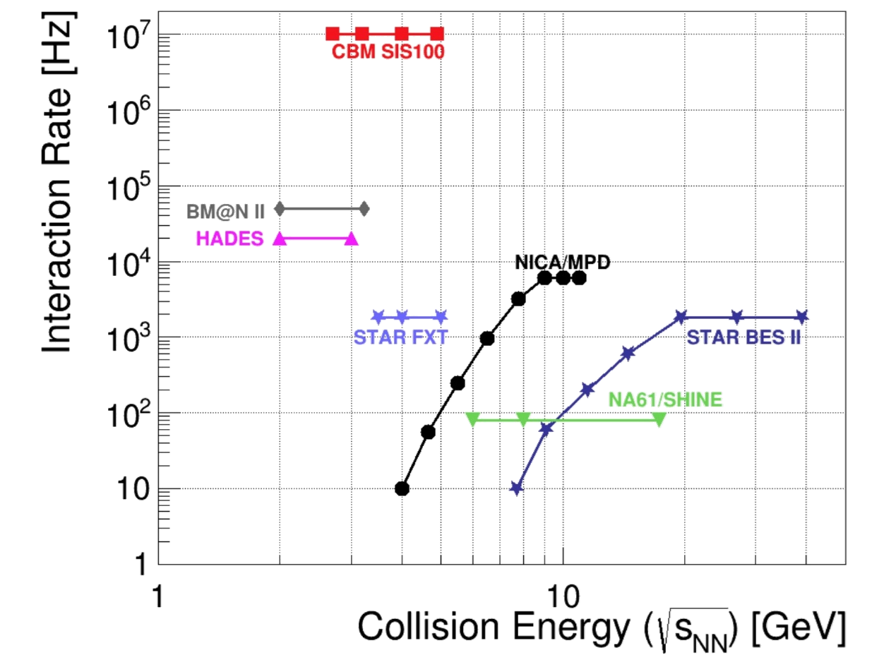
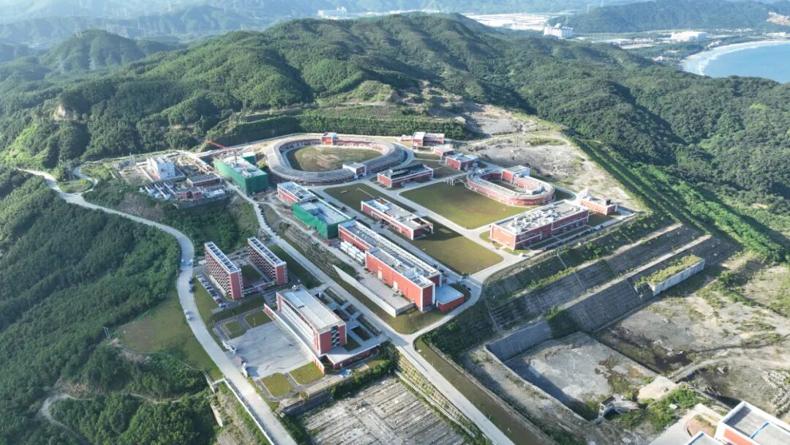
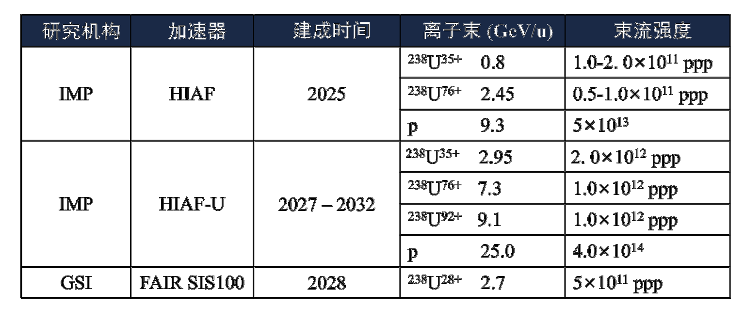
Spin Polarization: A New Frontier
Experimental Facilities
强流重离子加速器装置 HIAF, 中国 惠州
These new facilities open a new window into the physics of global polarization at high baryon density in the few GeV energy regime.
Yi-Liang Yin’s talk, July 18, 15:10

Slide 6
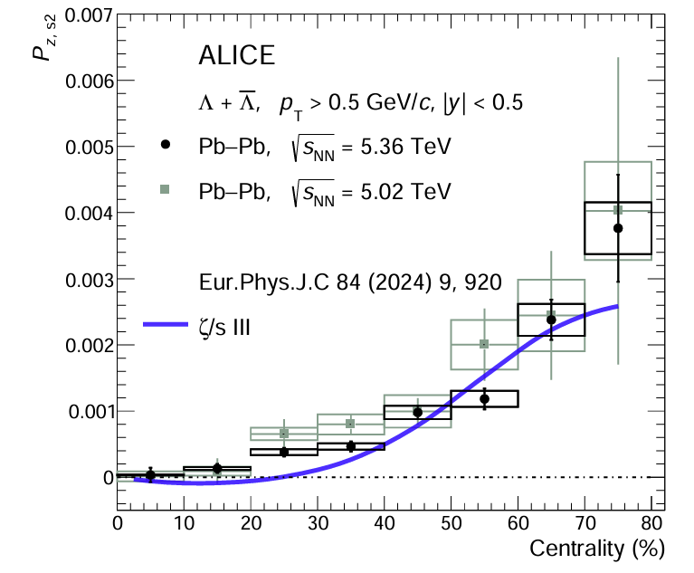
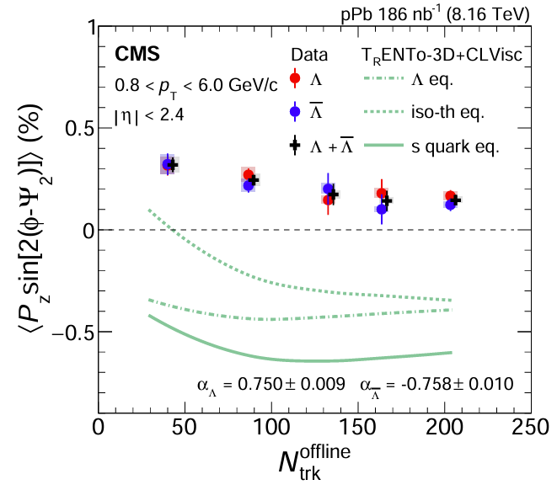
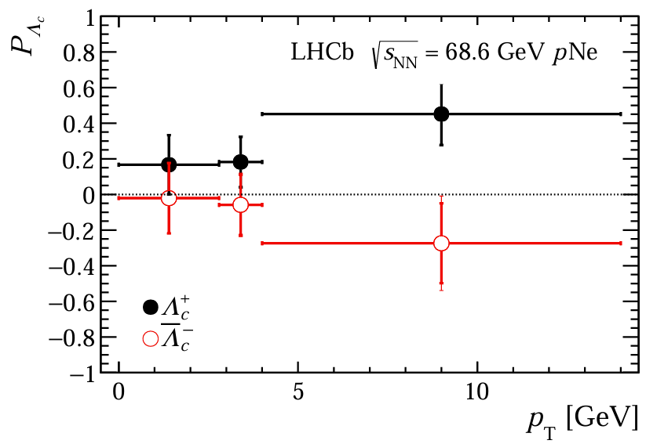



Introduction: Spin Polarization: A New Frontier
Experimental Facilities
ALICE 5.02 TeV/5.36 TeV PbPb
CMS 8.16 TeV pPb
CMS 68.6 GeV pNe
Challenges in Hyperon Polarization Theory:
“Sign puzzle” of P_{z}：opposite P_{z} sign（bulk vis., iso-thermal, EoS, et.al?）.
QGP 3D initial condition poorly constrained---longitudinal flow profile, fireball tilt largely unknown.
Isobaric Ru/Zr collisions: can polarization probe nuclear structure?

Slide 7
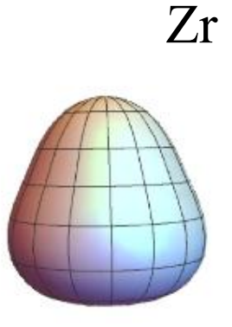
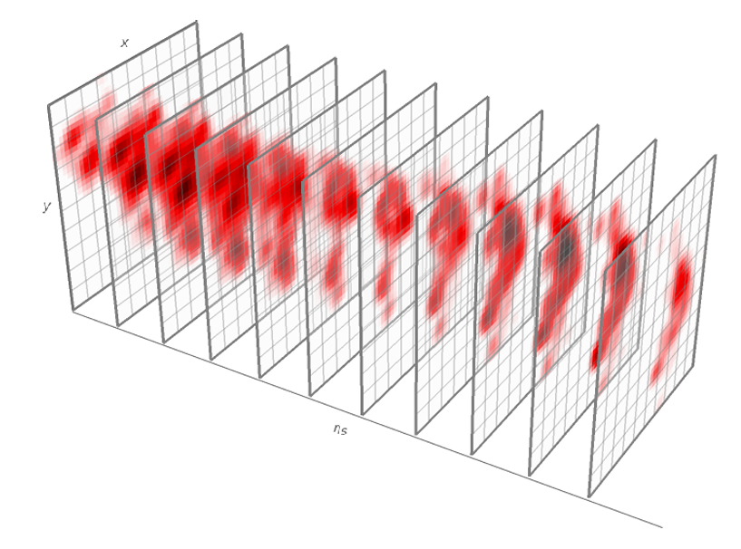
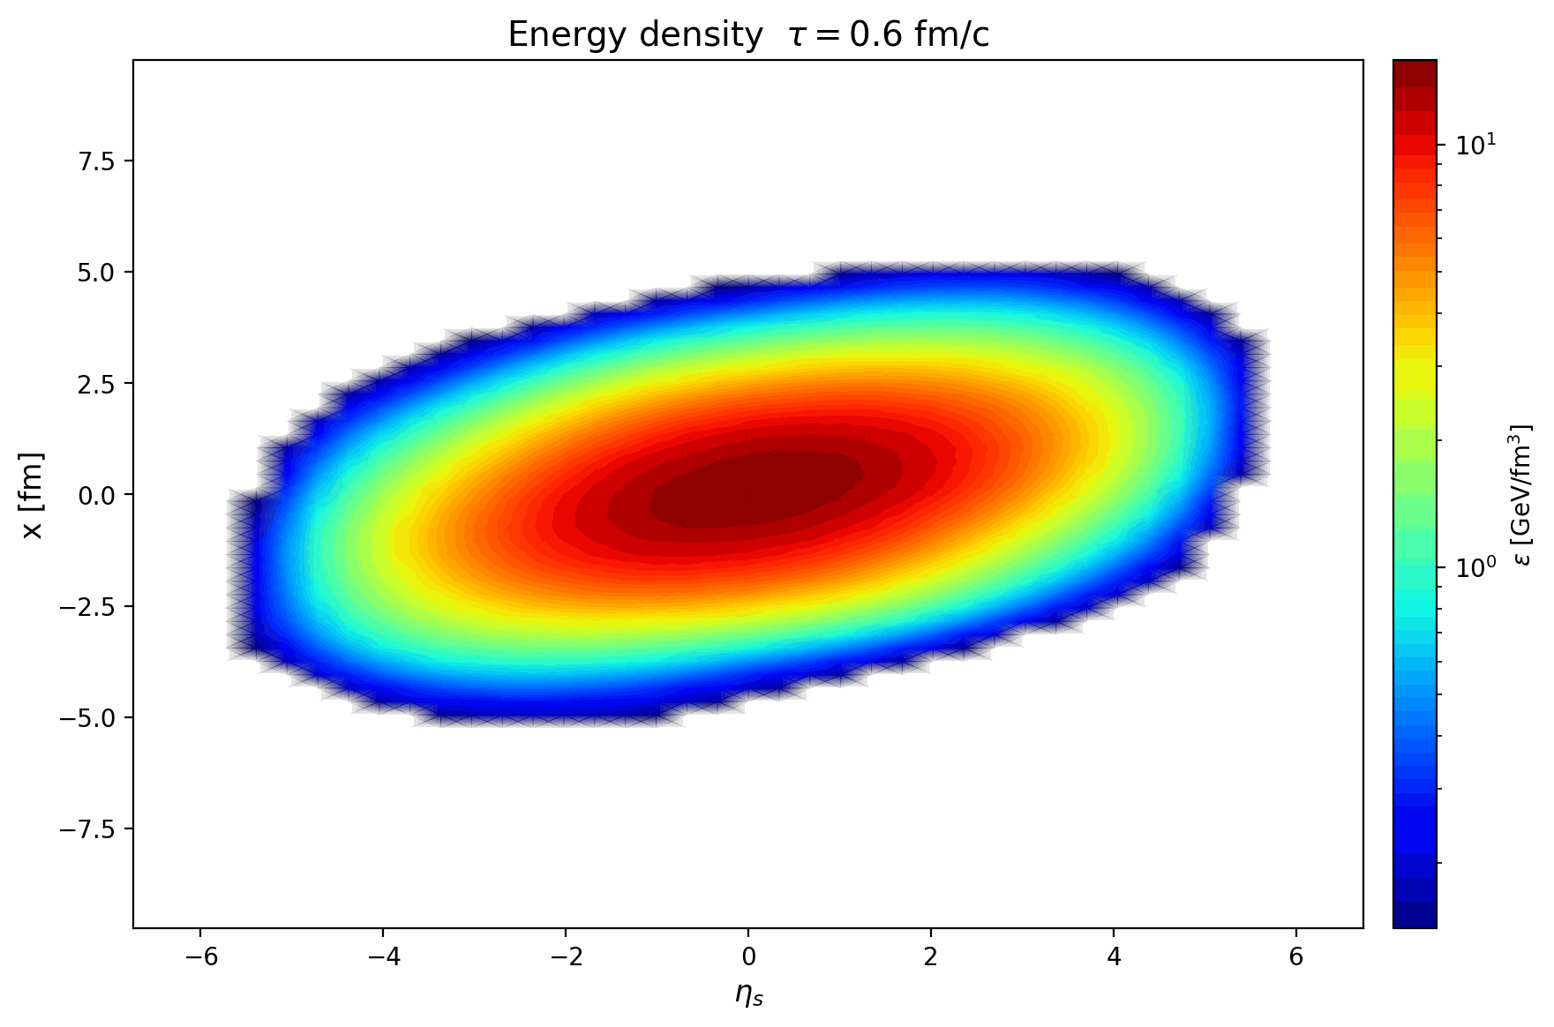
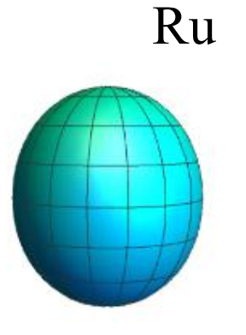
Introduction: Spin Polarization: A New Frontier
Experimental Facilities
TRENTo-3D
CLVisc (3+1D hydro)
This Work:
Framework: TRENTo3D + CLVisc (3+1D hydro) + isothermal polarization
Flow: initial longitudinal flow -- beyond Bjorken flow
Systematic scans: f_{v}, k_{T}, 5 nuclear structure configs., 3 bulk viscosity.
Observables: P_{y}(η, p_{T}, cen.), P_{y,c0}(cen.), P_{y,c2}(cen.), P_{z}(ϕ).
Derek Soeder, Weiyao Ke, J. F. Paquet, and Steffen A. Bass. arXiv: 2306.08665.
Yi, Wu, Zhu, Pu, and Qin, Phys. Rev. C, 111(4):044901, 2025.
Becattini, Buzzegoli, Phys. Rev. Lett.,127(27):272302, 2021.

Slide 8
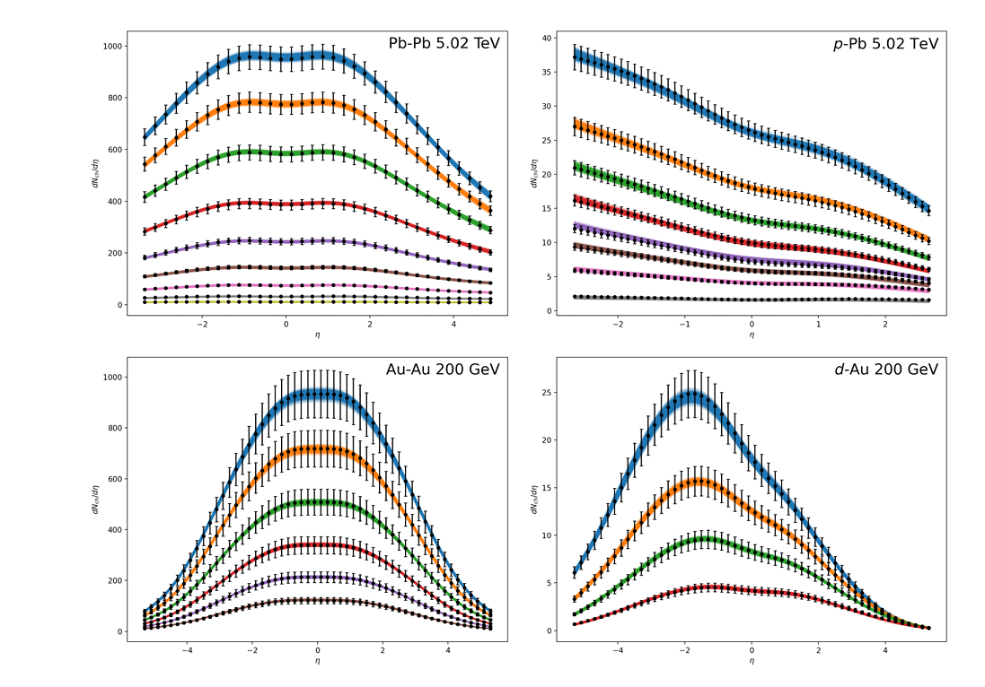
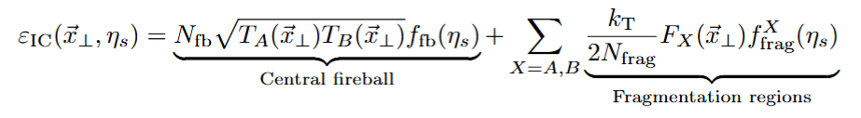
Theory Framework: TENTo-3D initial condition
TRENTo 3D initial Condition
(1+1)D Hydro + Bayesian calibration
Derek Soeder, Weiyao Ke, J. F. Paquet, and Steffen A. Bass. arXiv: 2306.08665.
TRENTo-3D is a fast, parametric model of the 3D initial-state geometry.
Longitudinally extending the initial deposition to form a central fireball near midrapidity and two fragmentation regions at forward and backward rapidities.
⁹⁶Zr: deformed Woods-Saxon, β₂=0.06, β₃=0.20.

Slide 9
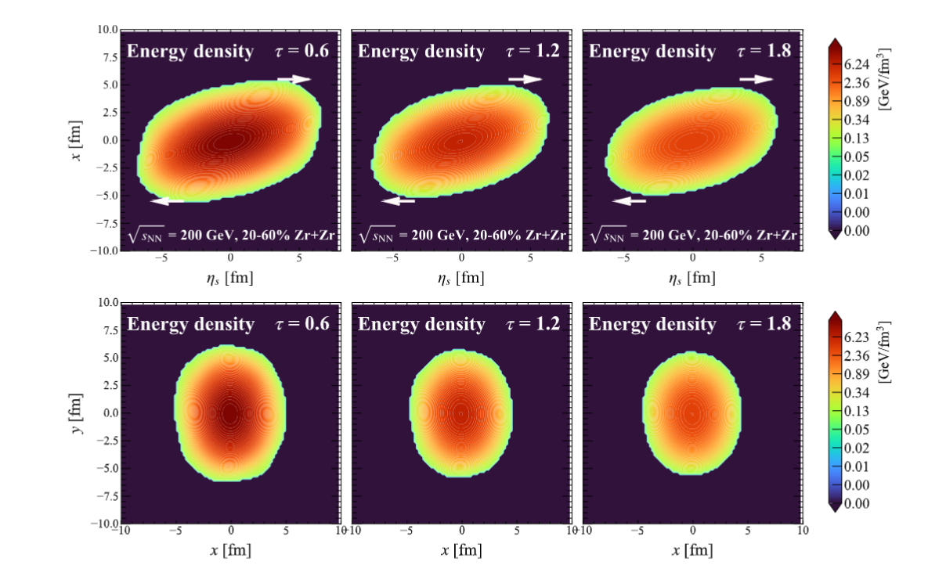


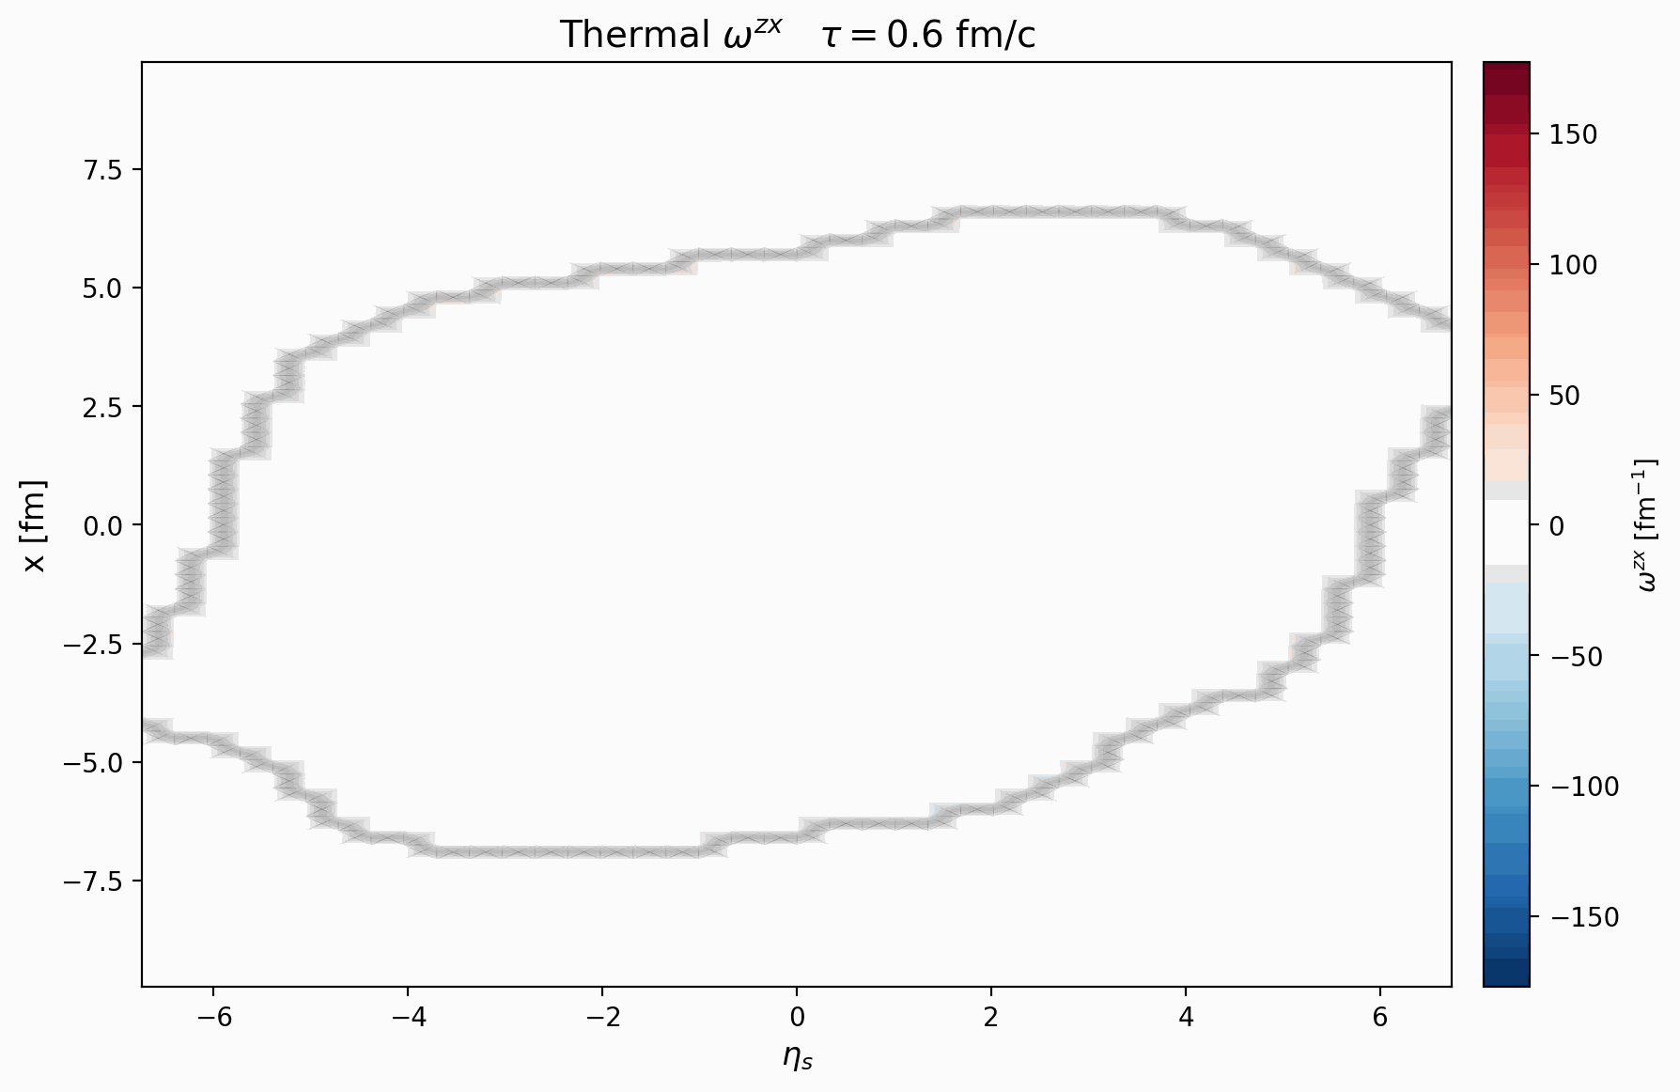

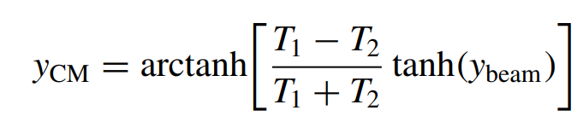
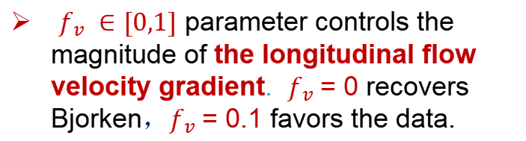
Theory Framework: Longitudinal Flow Extension+CLVisc
Longitudinal Flow Extension
At the initial proper time $τ_{0}$, the initial energy-momentum tensor components are:
200 GeV Zr+Zr 20-60% evolution
Ryu, Jupic, Shen, Phys. Rev. C 104 (2021) 5, 054908
$f_{v} ∈[0,1]$ parameter controls the magnitude of the longitudinal flow velocity gradient. $f_{v}$= 0 recovers Bjorken，$f_{v}$= 0.1 favors the data.
Hydrodynamic evolution: (3+1)-D CLVisc.
Long-Gang Pang, Qun Wang, Xin-Nian Wang, PRC(2012).
Wu, Qin, Pang, Wang, Phys. Rev. C 105 (2022) 3, 034909

Slide 10
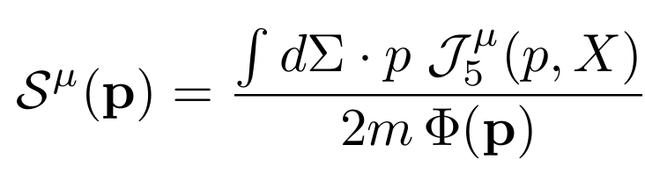
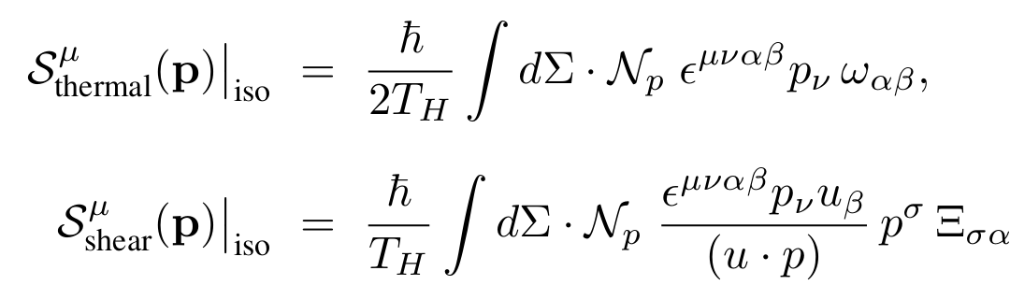
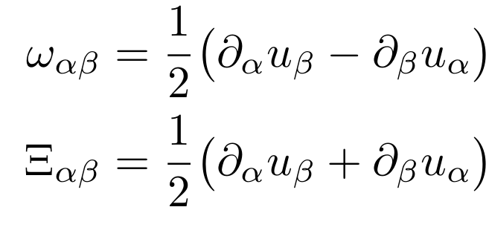
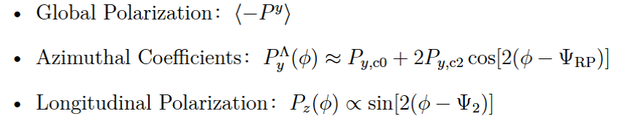
Theory Framework: Iso-thermal Polarization
The polarization pseudo vector for spin-$\frac{1}{2}$ particles
axial charge
current density
fermions number
Iso-thermal equilibrium limit, kinematic vorticity and shear tensors:
$∇$T terms vanish on iso-thermal freeze-out.
Polarization observables:
Related to: Xin-Li Sheng’s talk, 2509.14301
Yi, Pu, and Yang, Phys. Rev. C, 104(6):064901, 2021.
Becattini, Buzzegoli, Phys. Lett. B, 820:136519, 2021.
Yi, Wu, Zhu, Pu, and Qin, Phys. Rev. C, 111(4):044901, 2025.
Becattini, Buzzegoli, Phys. Rev. Lett.,127(27):272302, 2021.

Slide 11
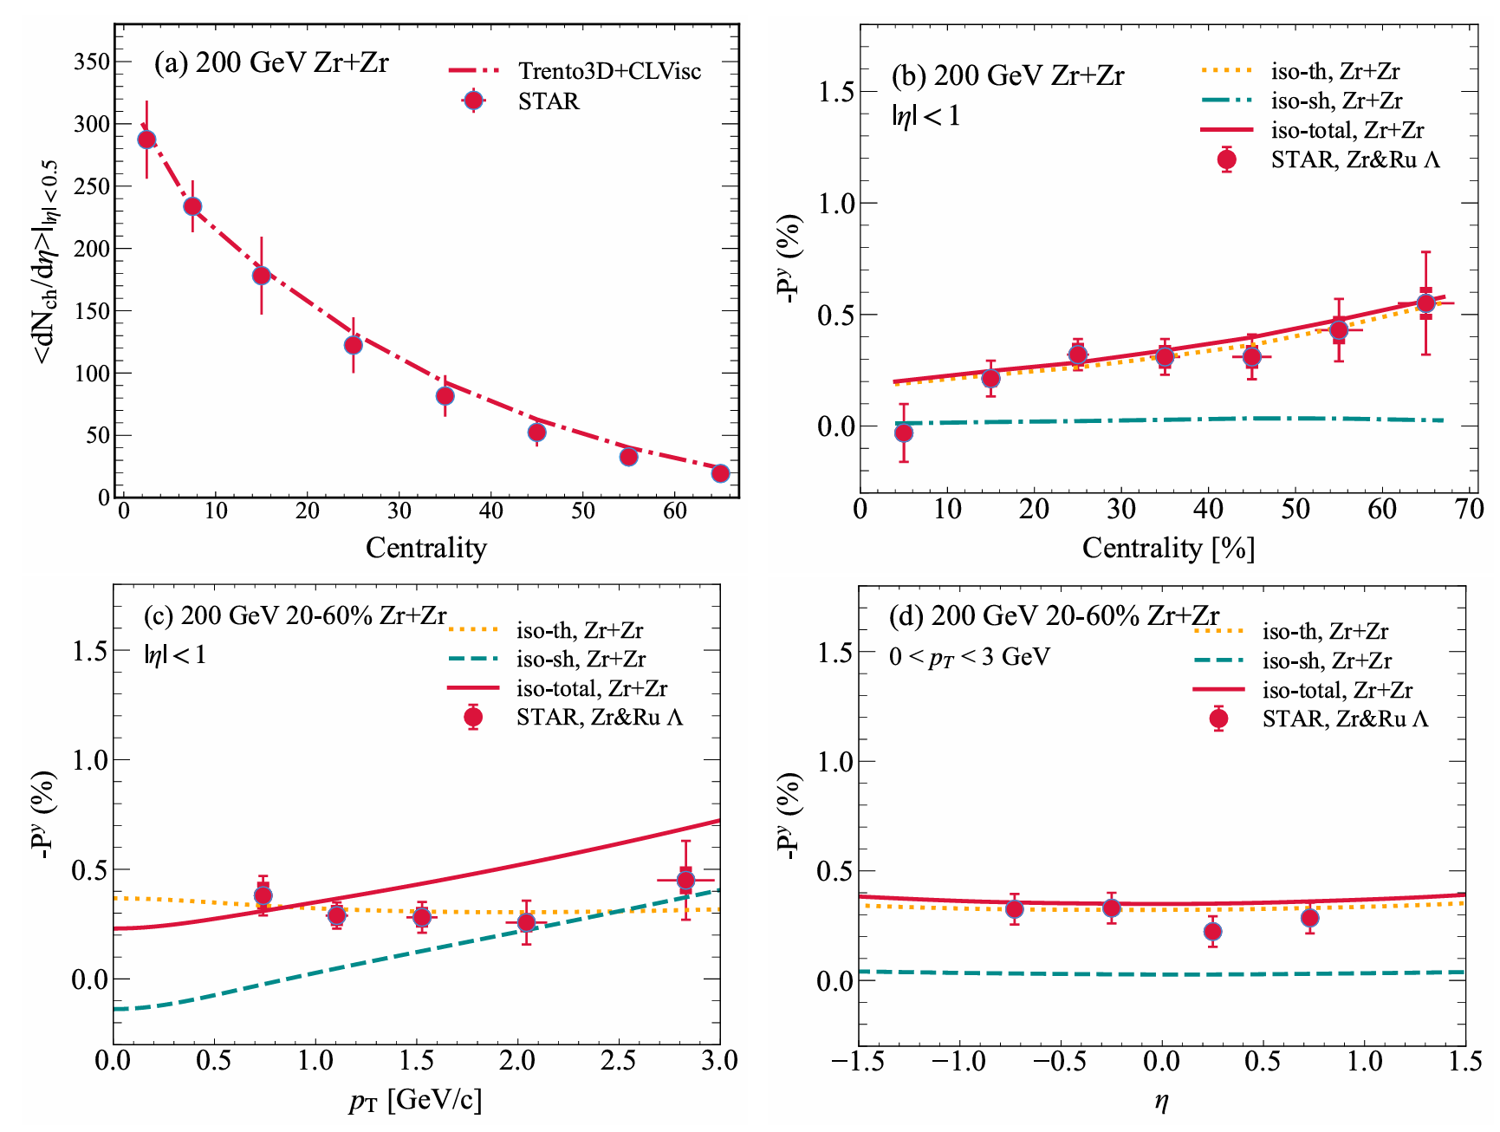

Results: 1. Baseline observables
Baseline observables in Zr+Zr collisions
√
√
√
STAR, Phys. Rev. C, 105(1):014901, 2022.
STAR, Phys. Lett. B, 870:139891, 2025.
Our Trento3D coupled with CLVisc reproduces the STAR Zr+Zr data.

Slide 12
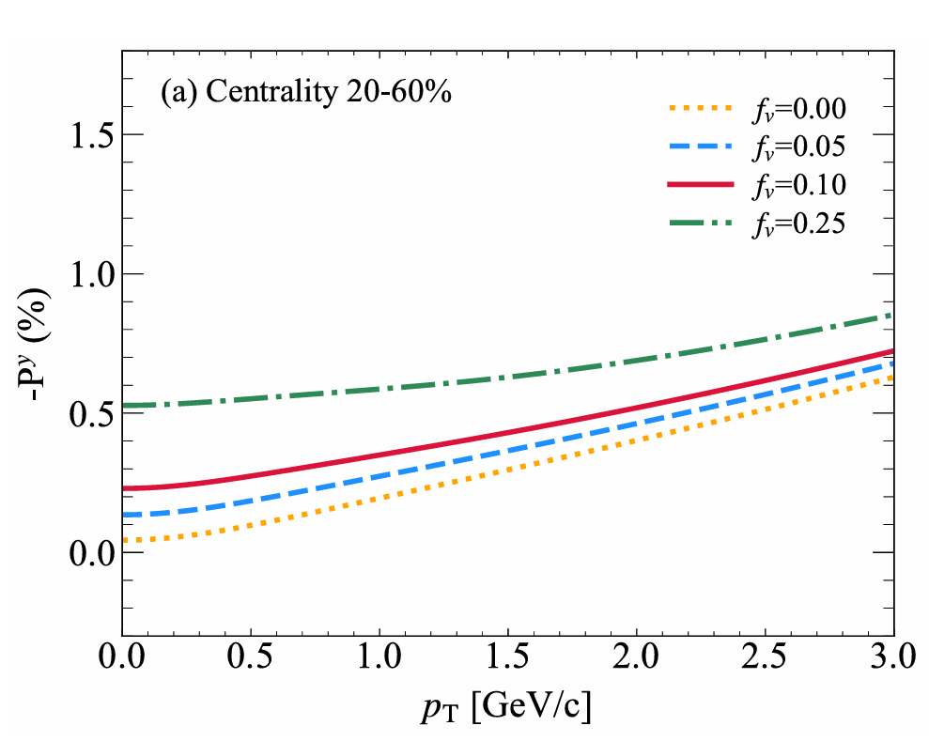
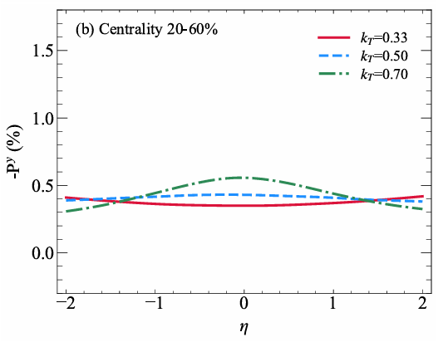
Results: 2. Sensitivity to f_{v} and k_{T}
f_{v} : Longitudinal flow
Gradient
k_{T} ：transverse momentum
scale
Iso-total
Iso-total
f_{v} controls overall magnitude (vorticity), enhanced low p_{T} magnitude.
k_{T} controls the space-time rapidity extent of the fireball, enhances shear polarization.

Slide 13
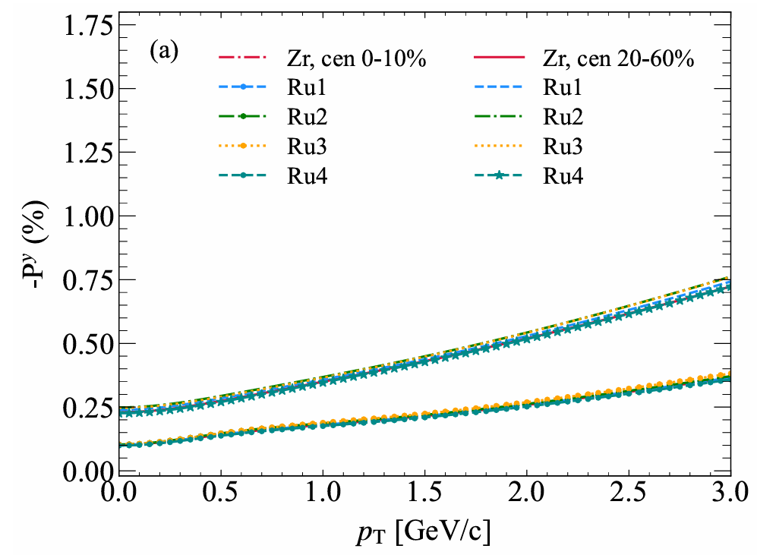
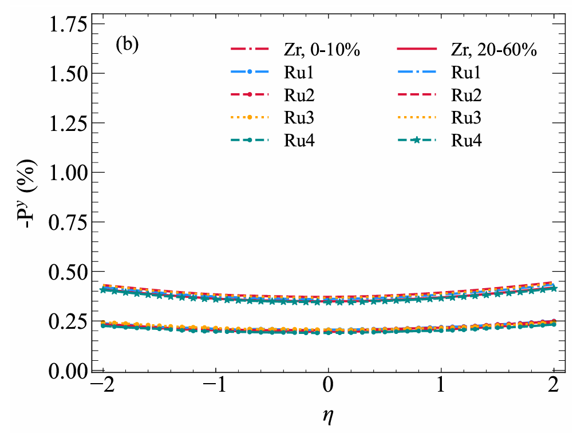
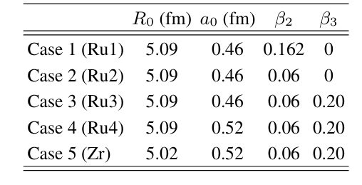
Results: 3. Nuclear Structure
Nuclear Structure: Negligible Impact
5 Nuclear structure
Jia, Giacalone, Zhang, PRL(2023)
Global polarization is insensitive to fine geometrical differences at the nuclear surface.
Anisotropic flow ratios are better suited for constraining nuclear structure.

Slide 14
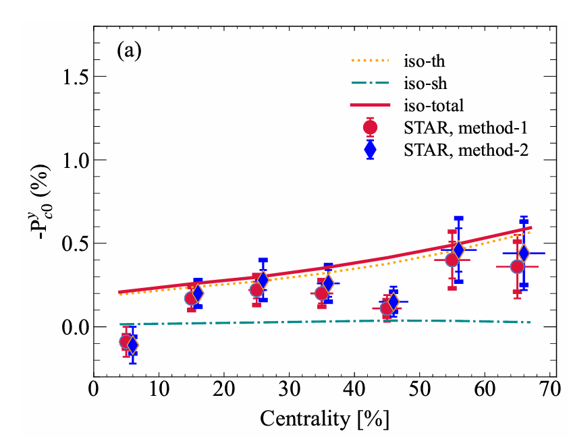
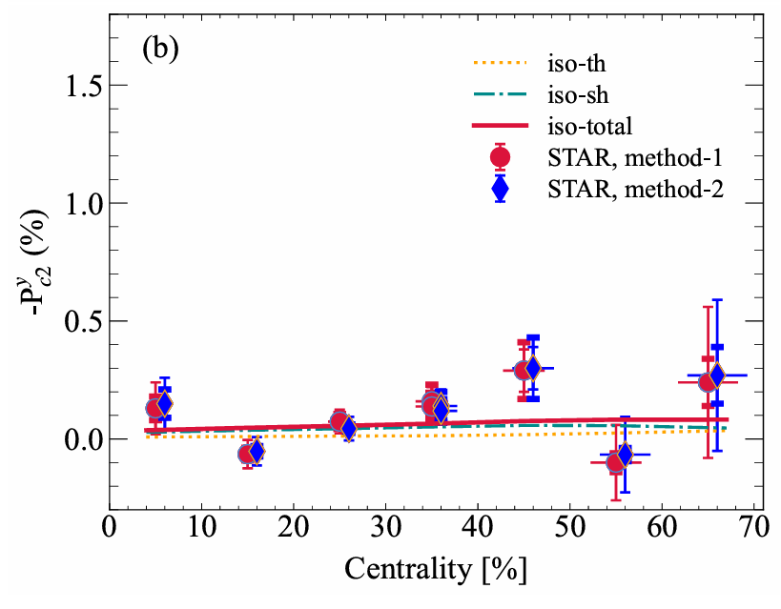
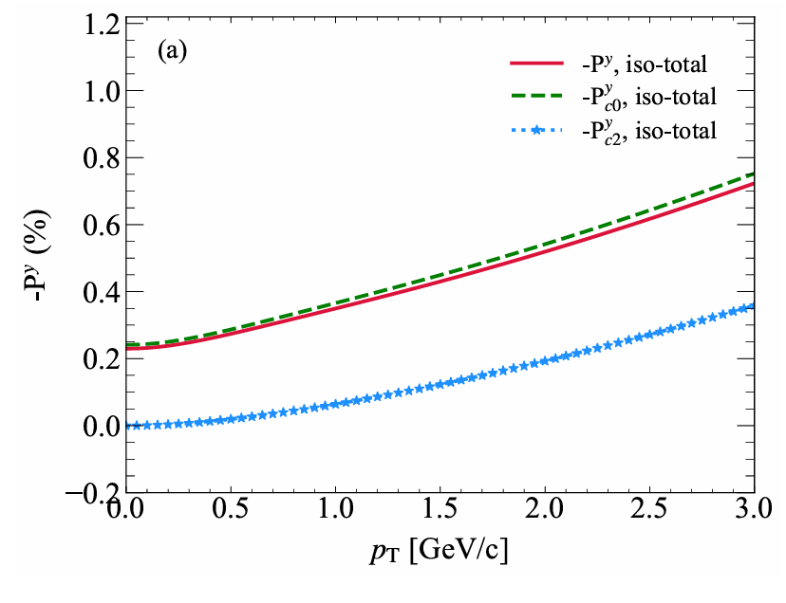
Results: 4. Azimuthal Coefficients
STAR Phys.Lett. B 844, 138101 (2023)
Azimuthal Coefficients: Clean Separation of Mechanisms
-P_{y,c0} ：vorticity dominated, probe global rotation.
-P_{y,c2} ：shear driven, probe anisotropic shear tensor.
-P_{y,c0/c2} vs. p_{T}: distinguish between thermal and shear?
Our results have a good description of polarization Azimuthal Coefficients in Zr+Zr collisions.

Slide 15
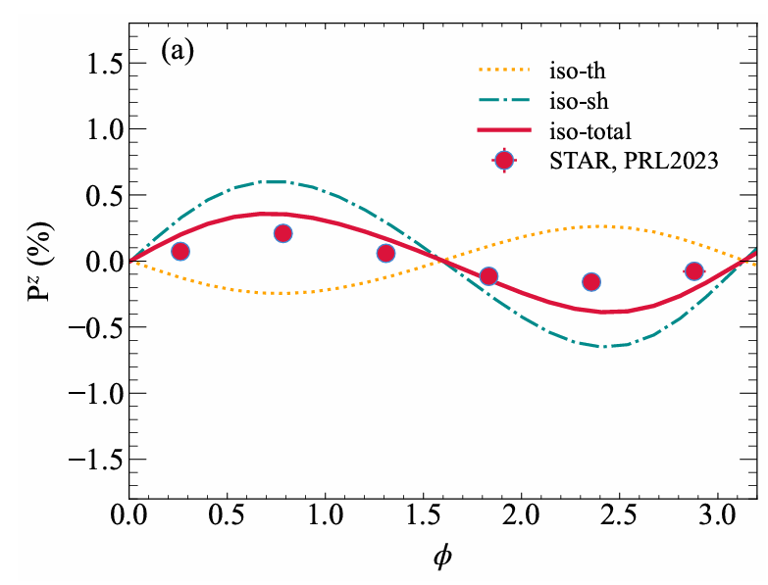
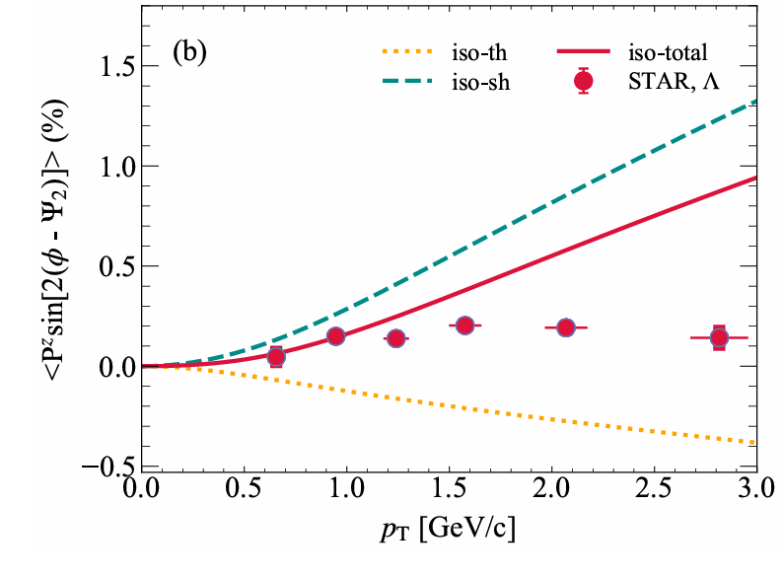
Results: 5. Longitudinal Polarization P_{z}
Longitudinal Polarization P_{z}
√
X
iso-thermal scenario captures azimuthal phase, agrees with STAR data
Model overpredicts <P_{z} sin[2(ϕ-ψ₂)]> for p_{T} larger than 1.5 GeV.
Our results also have a good description of longitudinal polarization.

Slide 16
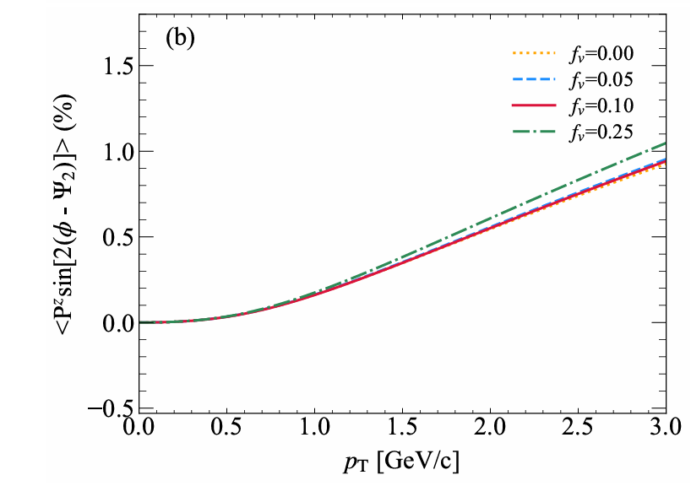
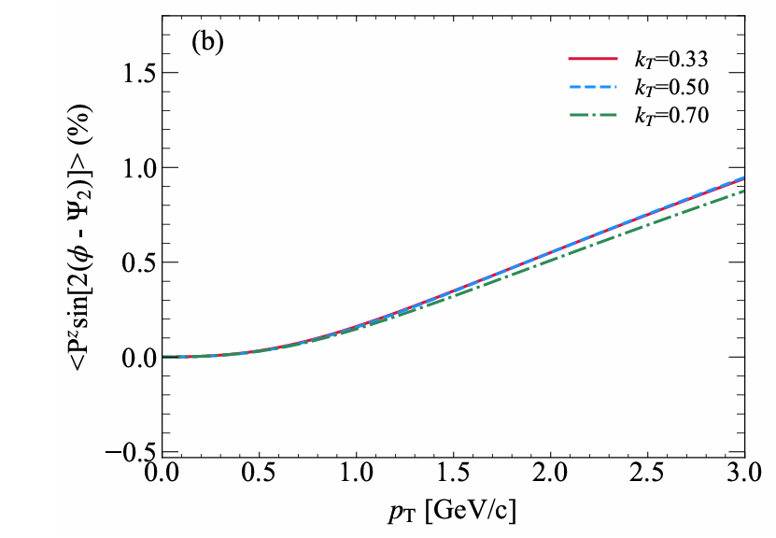
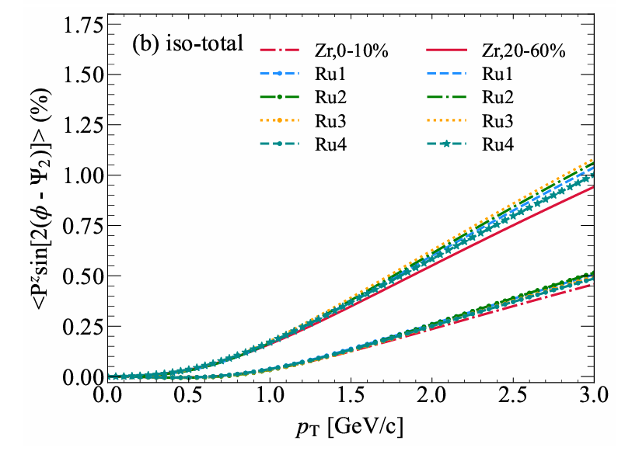
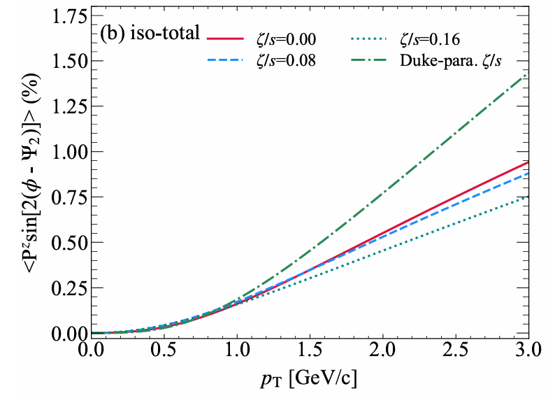
Results: 6. What Affects P_{z}? Summary of Scan
f_{v}, k_{T}, nuclear structure, bulk viscosity
f_{v}
k_{T}
nuclear structure
bulk viscosity
None of these resolve the high-p_{T} overprediction -- new mechanisms needed.

Slide 17
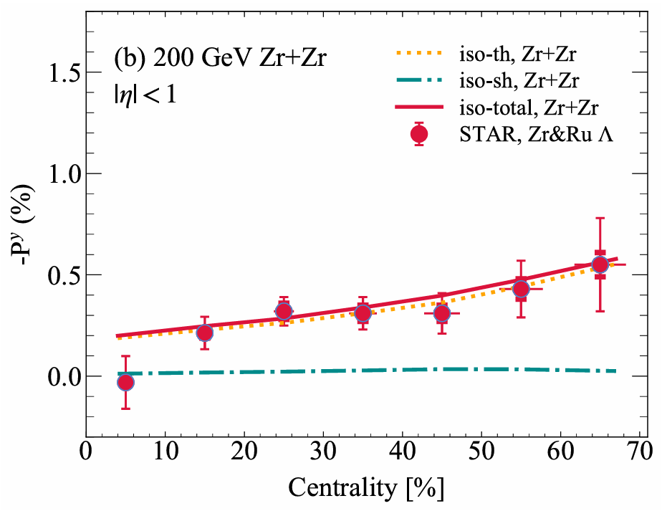
Summary and outlook
First comprehensive study of global polarization in Zr+Zr within a single self-consistent framework --- TENTo-3D + CLVisc + isothermal polarization.
Reproduces the experimental data well : P_{y}(η, p_{T}, cen.), P_{y,c0}(cen.), P_{y,c2}(cen.), P_{z}(ϕ). P_{y,c0}(vorticity-dominated) and P_{y,c2} (shear-driven).
Nuclear structure has negligible impact on global polarization.
Open Issues
P_{z} sin[2(ϕ-ψ₂)] overpredicted at high p_{T} — needs new mechanisms. Global polarization at AuAu 7.7 GeV / PbPb 5.36 TeV collisions.

Slide 18
Thanks for your attention!
Summary and outlook
中国物理学会高能物理分会第十二届全国会员代表大会暨学术年会
中国 广州 2026年7月16日

Slide 19
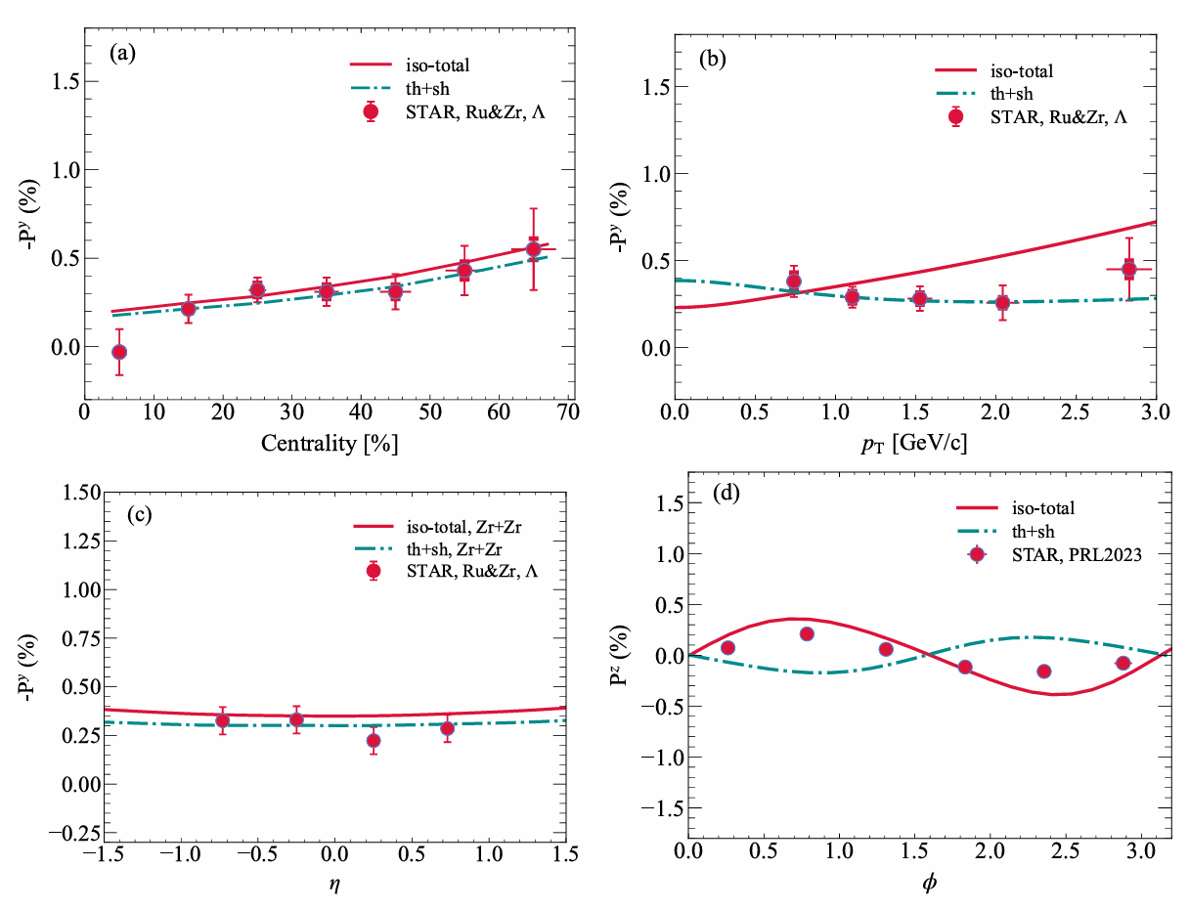
Results: 7. Isothermal vs. Standard Thermal
Yi, Wu, Zhu, Pu, and Qin, Phys. Rev. C, 111(4):044901, 2025.
Isothermal vs. Standard Thermal: A Nuanced Picture
Isothermal: correct P_{z} phase.
Thermal: slightly better P_{y}(p_{T}), wrong P_{z} sign!
Neither scenario simultaneously describes all observables.
A more complete polarization framework is needed?

Slide 20
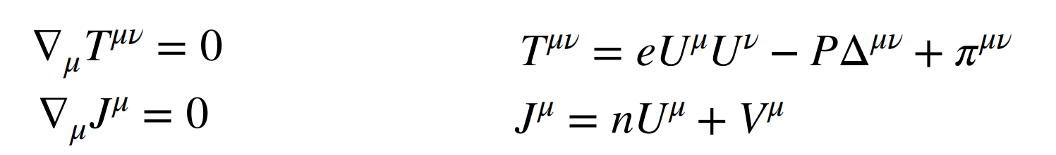
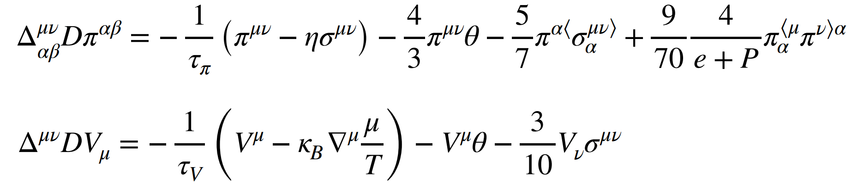
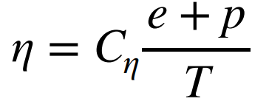
Hydrodynamic evolution: (3+1)-D CLVisc
Wu, Qin, Pang, Wang, Phys. Rev. C 105 (2022) 3, 034909
Energy-momentum conservation and net baryon current conservation:
Equation of motion of dissipative current:
The shear viscosity:
Equation of state: Hot QCD-2014

