Slide 1



ACTS-based 4D Tracking and a design of timing pixel chip
Hongzhang Xie, Yanqi Wang on behalf of all the contributors
in Guang Zhou on July, 2026
Notes:
Hello, everyone. Today I am very glad to give the presentation presenting the progress of ACTS-based 4D Tracking and a design of timing pixel chip.

Slide 2

Introduction
Chance of future 4D tracking for ATLAS ITk
Pictures from: ATL-PHYS-PUB-2023-023: Investigating the impact of 4D Tracking in ATLAS Beyond Run 4
Motivation – LHC upgraded to HL-LHC
  Luminosity up to $7.5×{10}^{34} cm^{−2}s^{−1}$ , pile-ups up to 200
Longitudinal view of a simulated $t\overline{t}$ event with <μ>= 200 in ATLAS ITk
No time information
Add time information
Zoom in space
Separation by time
Notes:
First, it’s the reason why we study 4D tracking. LHC will be upgraded to HL-LHC after RUN 3.
The luminosity will reach up to 7.5 times nominal /na-mi-nl/ value, which means 200 pile-ups. Higher luminosity can provide more dataset, but, as well as more challenges.
The four plots show the longitudinal /long-gi-tu-din-nal/ view of a simulated $t\overline{t}$ (tee tee bar, top–antitop pair) event with 200 pile-ups in ATLAS Inner Tracker.
The first plot is tracking without time information. Lines are the tracks and dots are the vertexes.
The second plot is an illustration /i-ler-stration/ of adding time information to the track, with different colors representing different time. If we add a time cut of 30 ps, the hard-scatter vertex will be able to be separated from other vertexes by time information.
i.e. time information has the ability to improve the performance of tracking, a step forward, the performance of physics measurement
首先，这就是我们研究4D追踪的原因。大型强子对撞机将在第三次运行后升级为HL-LHC。亮度将达到标称值的7.5倍，相当于多达200个堆积。更高的亮度可以提供更多的数据集，但也带来了更多的挑战。四个图显示了模拟的纵向视图𝑡𝑡ATLAS Inner Tracker上有200个堆积物的活动。第一个图是没有时间信息的跟踪。线是轨迹，点是顶点。第二个图是向轨道添加时间信息的示意图，不同的颜色表示不同的时间。如果我们添加30ps的时间切割，(硬)散射顶点将能够通过时间信息与其他顶点分开。 也就是说，时间信息有能力提高跟踪性能，向前迈进一步，提高物理测量性能

Slide 3
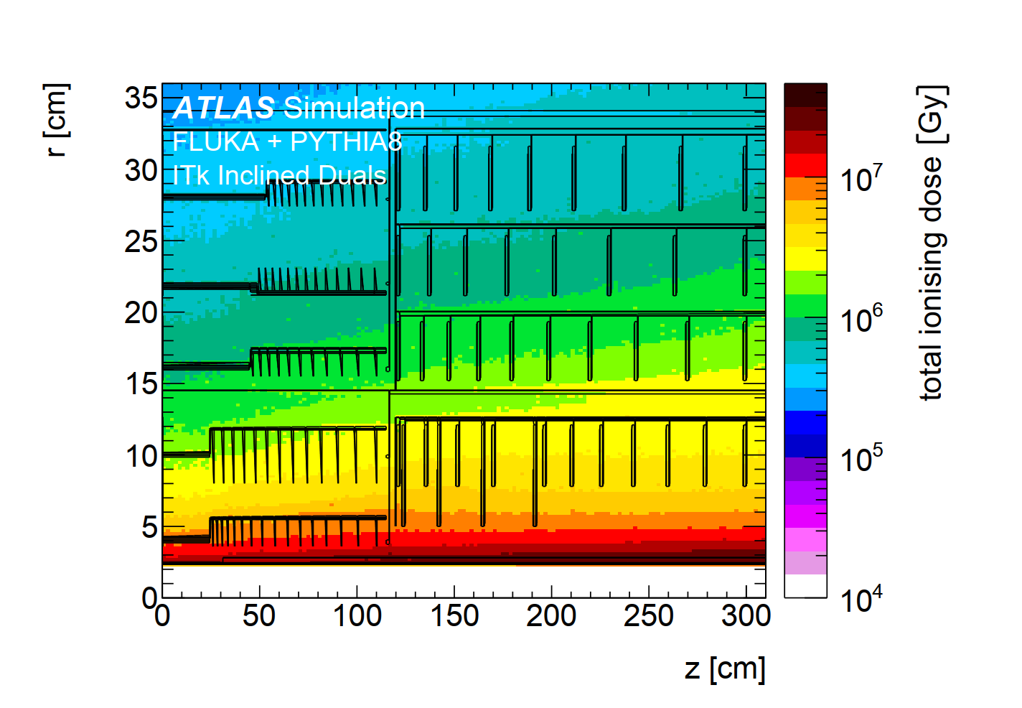
Introduction
Chance of future 4D tracking for ATLAS ITk
The two innermost layers of the ATLAS ITk Pixel﻿ is designed for a maximum luminosity of 2000 fb⁻¹.
Chance to implement 4D tracking for ATLAS in the middle of HL-LHC operation:
  Efforts in hardware and software
  Need to understand the physics potential
  This talk reports the progress of low-level 4D tracking and a design of timing pixel chip
﻿The total ionizing dose distributions for the ITk Pixel Detector.
<5 MGy in 4000 fb⁻¹ for unreplaceable part
up to 10 MGy for 2000 fb⁻¹ for Layer 0
ATLAS-TDR-030 Inner Tracker Pixel Detector
Notes:
… 2000 $fb^{−1}$ (2000 inverse femto-barns), which needs to be replaced during the operation of LHC.
The right plot shows the simulation of the total ionizing /io-nizing/ dose /dou-s/ distributions for the ITk Pixel Detector.
So, it’s an opportunity to implement 4D tracking during the pixel replacement.
It needs efforts from both hardware and software, to understand the physics potential (潜力) of using time information.
This talk will report the progress of low-level 4D tracking and a design of timing pixel chip
ATLAS ITk Pixel的两个最内层﻿ 设计最大光度为2000𝑓𝑏^（-1）(2000倒飞靶恩)，在LHC运行期间需要更换。右图显示了ITk像素探测器的总电离剂量分布的模拟。 因此，在像素替换期间实现4D跟踪是一个机会。 （可能）实现4D跟踪需要硬件和软件的共同努力，以了解使用时间信息的物理潜力。本次演讲将报告低级4D跟踪的进展和像素数字芯片的设计

Slide 4
4D tracking with ACTS

Slide 5
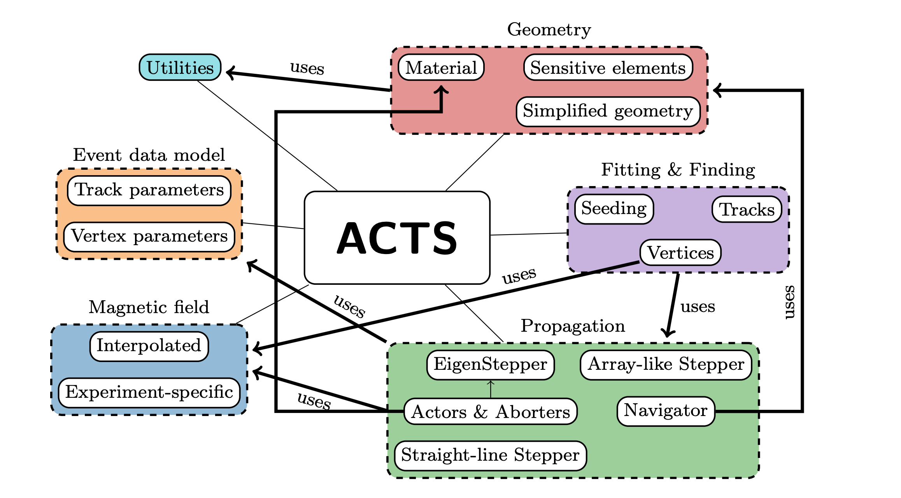
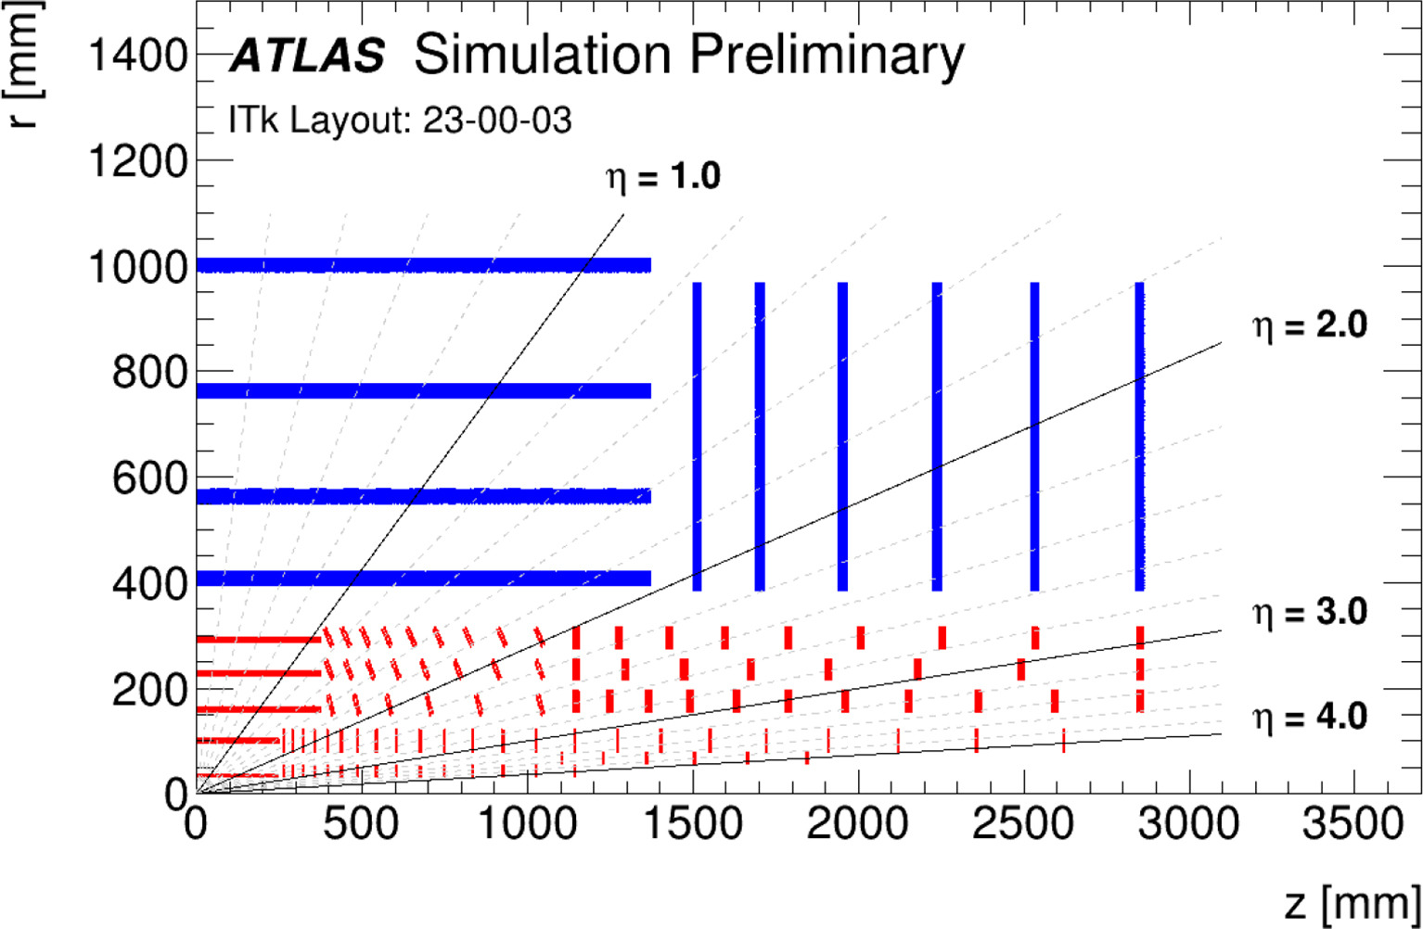
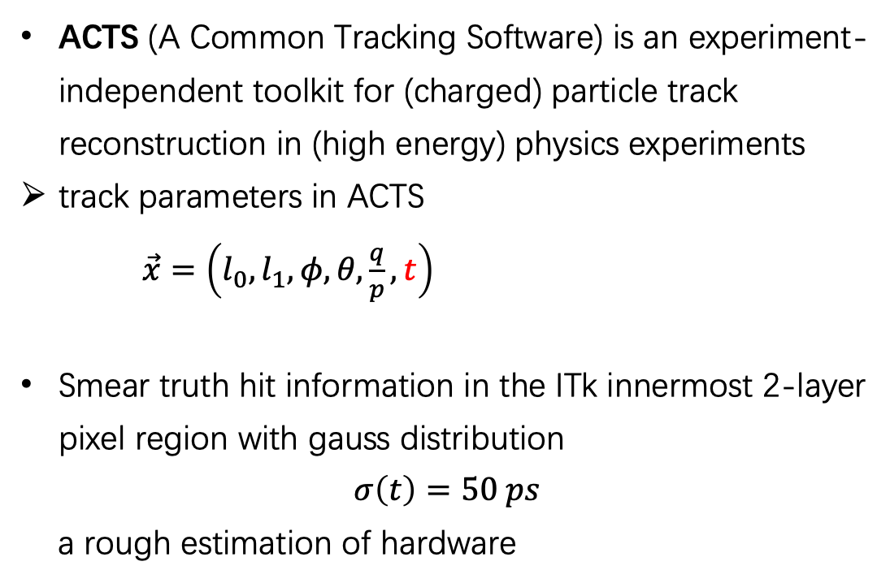
Introduction to Software
ACTS GitHub: https://github.com/acts-project/acts
ACTS docs : https://acts.readthedocs.io/en/latest/index.html
ACTS (A Common Tracking Software) is an experiment-independent toolkit for (charged) particle track reconstruction in (high energy) physics experiments
track parameters in ACTS
$\vec{x}=\left(l_{0},l_{1},φ,θ,\frac{q}{p},t\right)$
Smear truth hit information in the ITk innermost 2-layer pixel region with gauss distribution
$$σ\left(t\right)=50 ps$$
a rough estimation of hardware
Notes:
… , which will also be used in ATLAS Run 4 ITk reconstruction.
ACTS has 6 parameters for its tracking, which includes time information. And this would benefit the studies on 4D tracking.
The results we show later will use the ITk geometry, and
smear /s-mi-r/ truth hit information in the ITk innermost 2-layer pixel region with gauss /gao-s/ distribution
using 50 ps time resolution, to provide time measurements.
ACTS是一个独立于实验的工具包，用于（高能）物理实验中的（带电）粒子轨道重建，也将用于ATLAS Run 4 ITk重建。ACTS有6个跟踪参数，其中包括时间信息。这将有利于4D跟踪的研究。我们稍后展示的结果将使用ITk几何结构，并使用50ps时间分辨率在ITk最内层2层像素区域中的高斯分布涂抹真值命中信息，以提供时间测量。这个数字是硬件的粗略估计。

Slide 6
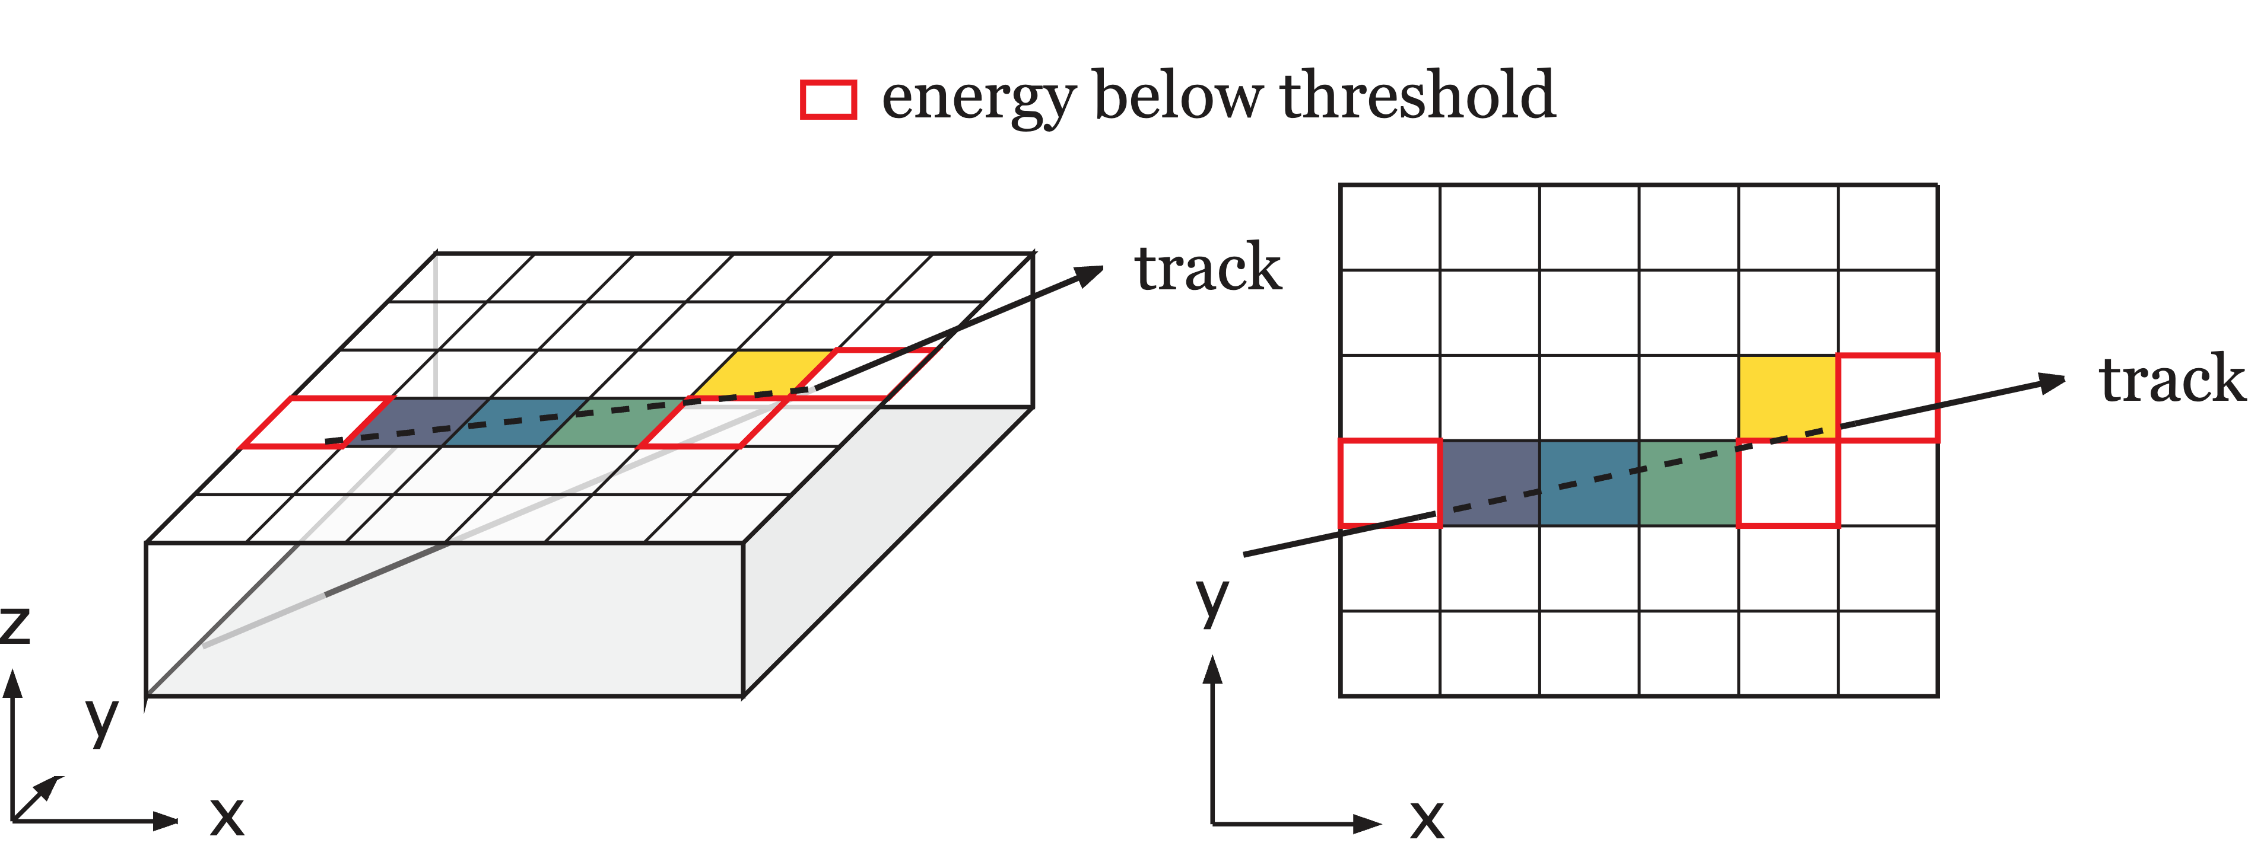
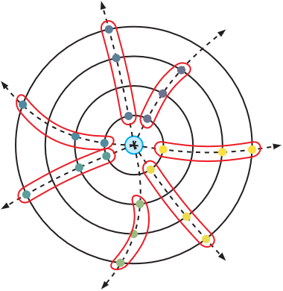
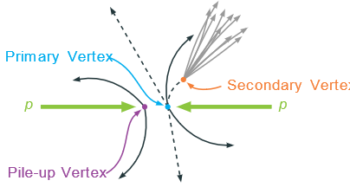
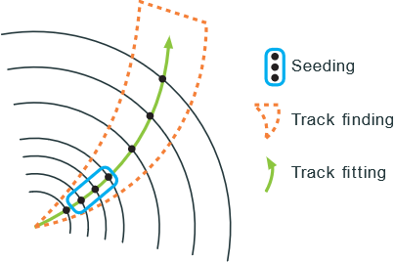
Full chain workflow in ACTS
with time algorithm
propagate time information, not used in algorithms
Fatras / Geant4
simulation
digitization & clustering
time information
use smeared hit information
seeding
track finding& fitting (CKF)
vertexing
Notes:
This is the full chain tracking workflow in ACTS.
First is Fatras/Geant4 /fa-tri-s, gi-en-t four/ simulation, simulating a particle going through the detector.
Followed is digitization, simulating the detector electronic response.
And clustering, organizing several cells and producing spacepoints.
Seeding will combine the spacepoints to form initial tracks.
Then is track finding and fitting, which extends the initial tracks.
Finally it’s vertexing, to find where an interaction or a decay /di-kei/ occurred.
这是ACTS中的全工作流。首先是Fatras/Geant4 /fa-tri-s, gi-en-t four/ 模拟，模拟粒子通过探测器。接下来是数字化，模拟探测器的电子响应。clustering，组织几个cells并产生spacepoints。seeding将把spacepoints组合起来形成初始track。然后是track的查找和拟合，它扩展了初始track。最后，它是重建，找到相互作用或衰变发生的地方。

Slide 7
Full chain workflow in ACTS
with time algorithm
propagate time information, not used in algorithms
Fatras / Geant4
studying in Athena
simulation
digitization & clustering
time information
use smeared hit information
vertexing
studied in ACTS
seeding
track finding& fitting (CKF)
Notes:
ACTS tracking algorithms /a欧-go-ri-thr-ms/ could prograte /prou-grate/ time information from true information of simulation to track and vertex.
From the start of the tracking workflow, now we are doing some studies of digitization and clustering in Athena /er-thi-na/ framework.
There are already some studies on 4D vertexing in ACTS with ODD geometry, which shows that timing could improve the performance of vertexing.
This presentation will show the algorithms /an-l-ge-ri-thr-ms/ and performance of 4D seeding and the 4D tracking.
ACTS跟踪算法可以将时间信息从真实模拟信息编程到轨迹和顶点。 从跟踪工作流程开始，现在我们正在Athena /er-thi-na/ 框架（与CERN小组合作）中对数字化和clustering进行一些研究。已经有一些关于ODD几何ACTS中4D翻转的研究表明，定时可以提高翻转的性能。本演示文稿将展示4D播种的算法和性能，以及4D跟踪的性能。

Slide 8
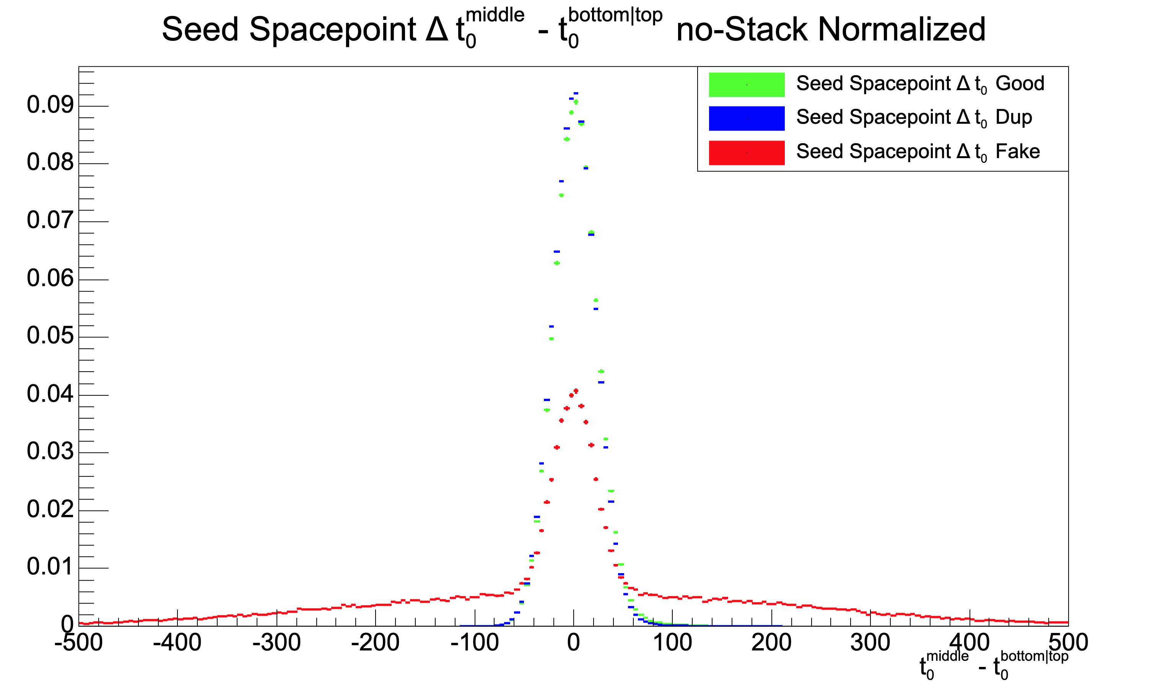
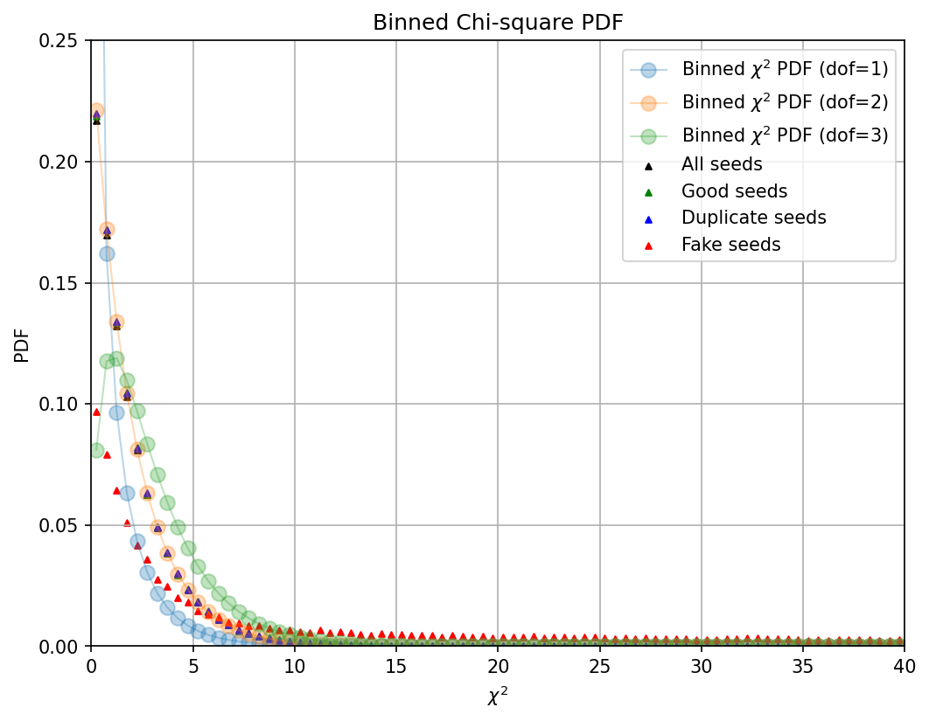

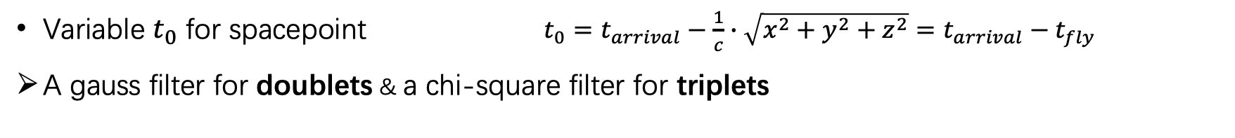

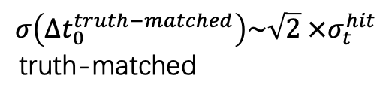
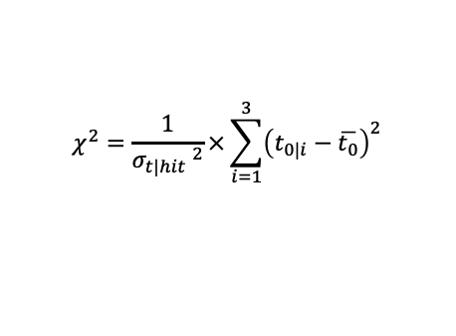

4D seeding algorithm
Variable $t_{0}$ for spacepoint $t_{0}=t_{arrival}−\frac{1}{c}∙\sqrt{x^{2}+y^{2}+z^{2}}=t_{arrival}−t_{fly}$
A gauss filter for doublets & a chi-square filter for triplets
$$χ^{2}=\frac{1}{{σ_{t|hit} }^{2}}×\sum_{i=1}^{3}{{\left(t_{0|i}−\overline{t_{0}}\right)}^{2}}$$
$$\left|Δt_{0}\right|=\left|t_{0}^{middle}−t_{0}^{top|bottom}\right|$$
Chi-square distribution with dof =2 for truth-matched
$$σ\left(Δt_{0}^{truth−matched}\right)\sim \sqrt{2} {×σ}_{t}^{hit}$$
truth-matched
Doublet - Normalized distribution of $Δt_{0}$
Triplet - Normalized distribution of $χ^{2}$
Notes:
In the 4D seeding algorithms /a欧-go-ri-thr-ms/ , an additional variable $t_{0}$ (tee naught) is introduced for spacepoint, which is defined as the time of arrival substracted by the time of flight. It describes the original time of the particle track.
Since a traditional seeding algorithm would combine three spacepoints into one seed.
A gauss filter for seed doublets and a chi-square /kai-square/ filter for seed triplets are introduced to filter truth-matched seeds with time information.
From left figure, we could see that, the doublets from truth-matched seeds follows gaussian /ga-sion/ distribution with a resolution, which is square root 2 times as the time resolution. While doublets from fake seeds have a flatter component in the pile-up time distribution.
In the right figure, with the kai-square discriminator, truth–matched triplets follow the distribution of kai-square with 2 degrees of freedom. While fake triplets have more components in the tail.
With those discriminators, truth-matched seeds could be separated from fake seeds, in time dimension /dai-men-sion/.
在4D seeding 算法中，一个额外的变量𝑡0 引入，定义为到达时间减去飞行时间。它描述了粒子/轨迹的原始时刻。因为传统的seeding算法会将三个空间点组合成一个seed。引入了用于seed doublets的高斯滤波器和用于seed triplets的卡方滤波器，以过滤具有时间信息的truth-matched的seed。从左图中，我们可以看到，来自truth-matched的seed的doublets遵循高斯分布，其分辨率为时间测量分辨率的根号2倍。而来自fake seed的doublets在堆积时间分布上有更平坦的尾巴。在右图中，使用卡方过滤，truth-matched的seed triplets遵循卡方分布，具有2个自由度。而fake seed triplets的尾巴上有更多的成分。有了这些过滤，在时间维度上，truth-matched的seed可以与假 seed分开

Slide 9
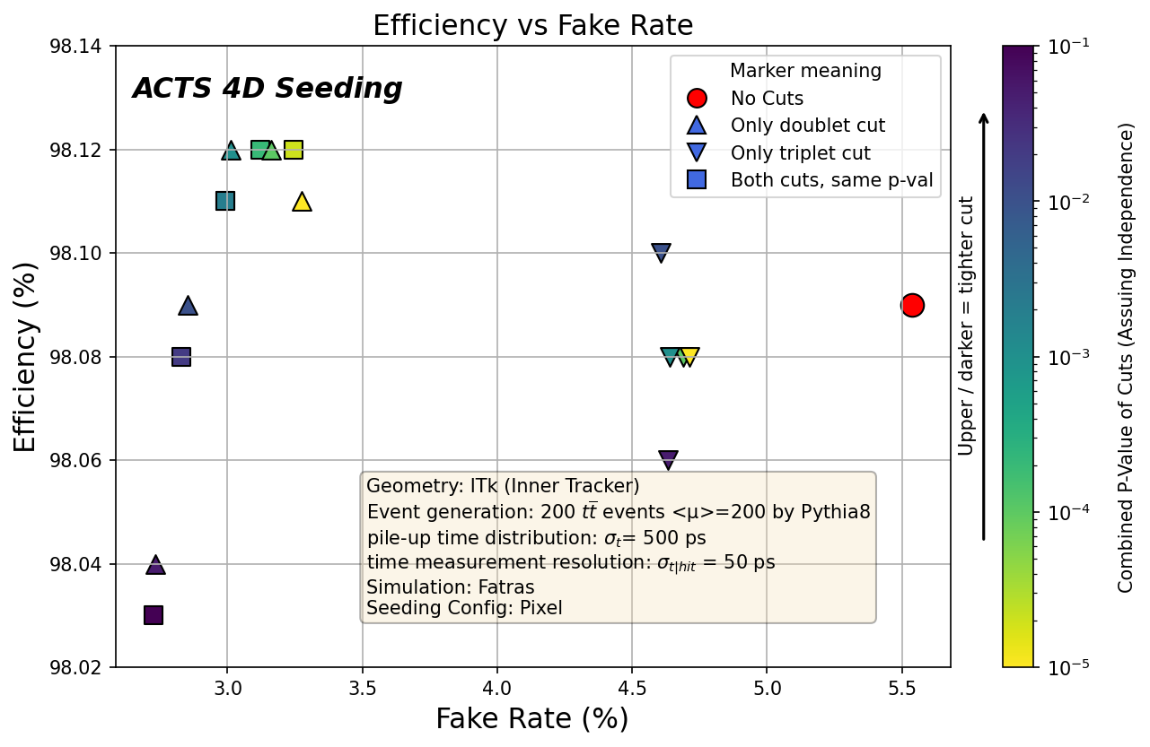
4D seeding performance
Only apply triplet cut
No time cut
（base line）
higher efficiency and lower fake rate with time cut
Using pixel (5 layers) spacepoint seeding
Adding time for innermost 2 layers
p-value: corresponds to the probability of excluding a truth-matched seed by cut
Notes:
Here we see the final 4D seeding performance.
Remember that we are using 5 pixel layers to do seeding, and adding time information of the innermost 2 pixel layers.
In the left figure, the color shows the p-value corresponding to the probability of excluding a truth-matched seed by time-cut.
With different configurations of time-cut, compared with no time-cut one (the red dot) ,
we could achieve better seeding purity (x-axis) and seeding efficiency (y-axis) at the same time.
这里我们看到最终的4D seeding 性能。我们使用5层像素层进行tracking，并在最内层的2层像素层中添加了时间测量。
在左图中，不同颜色表示与通过时间信息过滤掉truth-matched的种子相对应的概率。
与无时间信息过滤的配置（红点）相比，在不同阶段采用时间信息过滤，我们能够同时获得更好的seeding纯度（x轴）和seeding效率（y轴）。

Slide 10
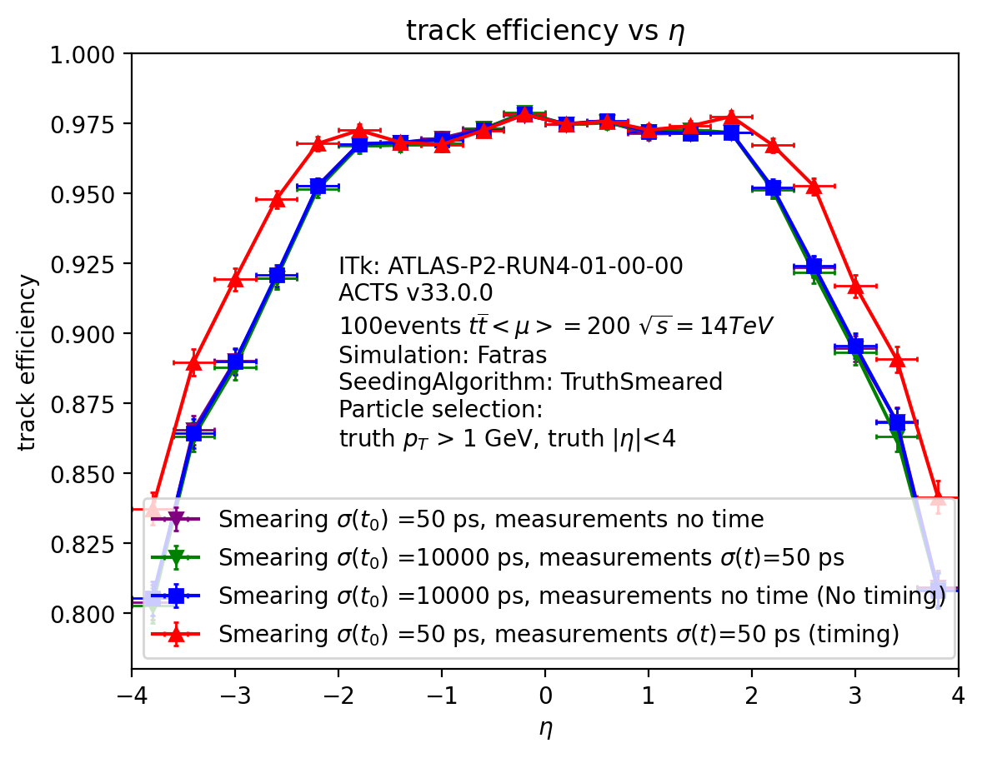


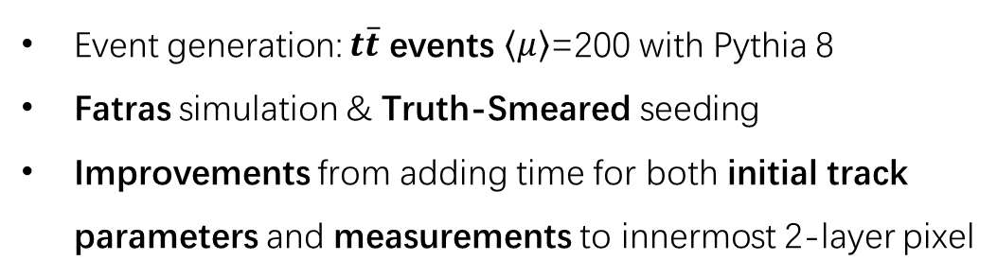
4D tracking performance
Combinatorial Kalman Filter
$\vec{x}=\left(l_{0},l_{1},φ,θ,\frac{q}{p},t\right)$
  $${\vec{x}}_{k}={\vec{x}}_{k}^{k−1}+K_{k}({\vec{m}}_{k}−H_{k}{\vec{x}}_{k}^{k−1})$$
Event generation: $t\overline{t}$ events $\left\langle μ\right\rangle$=200 with Pythia 8
Fatras simulation & Truth-Smeared seeding
Improvements from adding time for both initial track parameters and measurements to innermost 2-layer pixel
RED (4D tracking): CKF initial track parameters and measurements have time information
BLUE (3D tracking): no time information for CKF initial track parameters and measurements
Tracking efficiency
93.72% (no timing) to 94.87%↑ (50 ps timing)
93.71% (only “measured” time for initial track parameters)
93.63%↓ (only time for measurements)
Notes:
Following the seeding, it’s track finding and fitting.
ACTS track finding and fitting uses /com-bai-nr--tuo-rail/ Combina-torial Kalman Filter, and involves time in its track parameter.
So it could process time information automatically within Kalman formation.
The simulated events are t-t-bar events with 200 pile-ups.
Here we used fatras simulation, and didn’t use any 4D seeding algorithms /an-l-ge-ri-thr-ms/ (even without any seeding algoes),
Instead, we use truth-smeared particle information to form initial track parameters.
And finally, we could see improvement on tracking efficiency if we add time in both initial track parameters and measurements.
seeding完成之后，接下来是tracking寻找和tracking拟合。ACTS的tracking寻找和tracking拟合使用组合Kalman过滤，并将时间信息纳入tracking参数中，因此它可以在Kalman框架内自动处理时间信息。
模拟的事例是带有200个堆积事例的ttbar事例。
这里我们使用了快速仿真，并且没有使用任何4D tracking寻迹算法（甚至没有使用任何径迹寻迹算法），而是使用经过真值抹匀的粒子信息来形成初始tracking参数。
最终，如果在初始tracking参数和测量值中都加入时间信息，我们可以看到tracking寻找效率有所提升。

Slide 11
A design of Timing Pixel chip

Slide 12
Overview
Modules for the Readout ASIC:
  Pixel: Amplifier, Discriminator, Time-to-digital converter, 200 μm×200 μm
  Cores Array: 1 core includes 8×8 pixels, same as ITKPix. 8 pixels are in one region.
  Periphery: End of Column, Chip Bottom.
Core Array
Periphery
Pixel circuit
Overview
Notes:
This is the overview of the structure of the readout chip. The chip has core array and periphery circuit.
In the core array, every core has 8 x 8 pixels. 8 pixels are in one region.
Every pixel could achieve amplification, discrimination, and time measurement.
In the periphery (/pəˈrɪfəri/)(per-ri-fer-ri), it needs to do the data readout and concentration. It consists of some EOCs and a Bottom.

Slide 13

Pixel: Analog Front-end
Two-stage Amplifier:
  Charge sensitive amplifier: folded cascode + Voltage Amp.
Two-stage Discriminator：
  Differential driver: positive feedback
  Common source driver: saving power
3D sensor@3fC
Amplifier
Precisions of Amp. + Discr.
（130nm）
Discriminator
Notes:
First, it is the Analog Front-end in the pixel. It includes a two-stage amplifier and a discriminator.
We use two-stage structure to amplify the weak signal from the sensor.
The first is a CSA with a folded cascode. It uses MOS reset feedback. And the second one is a voltage amplifier.
The discriminator is also a two-stage one. And the figure on the right shows the precision simulation of the front-end in different input charges.

Slide 14
Pixel: Time to Digital Converter
Delay line + Loop counter:
  Edge detector
  SR latch
  ToA & ToT measurement ( bin size ~ (90~120) ps )
Designs for Time to Digital Converter
ToA measurement:
  Line’s cycle + Line’s phase
ToT measurement
  Only line’s cycle
Designs for Time to Digital Converter
Notes:
The next part is the TDC. We used the delay line combining a loop counter.
It can reduce the area greatly.
The hit would enter the loop and TDC would latch the state when the clk arrives.
ToA and ToT measurement would shared the same loop.

Slide 15
Core
Shared memory structure:
  Reduce the storage space due to the sparse hits
Factors:
  All pixels shared are need to be independent.
  The cluster size effect is universal in the detector.
Eliminating the cluster effect:
  Using a specific map to share the pixels
Storage space
The cluster size
Shared map
Notes:
To hold the TDC data and the hit rate, we use a shared memory structure. The hits are usually sparse, that give us an idea. Some pixels could share the storage space to avoid being the idle.
We did a simulation to verify the idea, as the figure shows on the right.
As the shared pixels increase, the storage space could be used more fully, the storage units per pixel decline.
This structure need a condition, the hit data of these pixels needs to be independent. So we need to eliminate (/ɪˈlɪmɪneɪt/) the cluster effect.
We use a specific shared map, as the figure in the middle shows, the same color pixels are shared, to Eliminating the cluster effect.

Slide 16
Core
Core degin:
  8 × 8 pixels, core is same as others and they are connected as a chain
  Receiving and buffering data from TDC
  completed the trigger matching
Shared memory structure:
  8 pixels shared in one region
  One core consists of 8 regions
Readout:
  Priority readout
  Core column readout to the End of column
Core Column
Core design
Core array
Notes:
In the digital core, its function is receiving and buffering data from TDC, and completed the trigger matching.
We design a shared memory structure to reduce the area. Each core consists of 8 regions. All pixels in the same region shared a same memory.
In the core column, the region data would be readout in priority to the End of column.

Slide 17
Region
Functions:
  Storing the time stamp (BCID) and TDC data, doing the trigger matching.
Two priority arbiters for Leading Edges and Trailing Edges:
  Manage the address of memory.
Every cell in shared memory needs a FSM to process trigger matching.
Processing the trigger matching
Managing the pixel order
Shared memory structure (eg. 1 region)
Notes:
Based on the shared memory structure, we design the region circuits.
In the region, we design the priority (/praɪˈɒrəti/) arbiters (/ˈɑːbɪtə(r)/) , data selectors, memory address manager to control the storage of the shared memory.
In the memory, each cell stores one hit per pixel and it needs a state machine to process the trigger matches.

Slide 18
Simulation
The simulation results (in 130 nm)
  Holding the corresponding data rate (~75 kHz/pixel)
  Lower power, Lower density.
  Shared memory could reduce power and area obviously.
The area comparison for the layout
Lost rate lower than the red line (1%)
The performance of shared memory (eg.8-pixel)
The power comparison for the layout
Notes:
According to the design of the core and region mentioned above, we simulate the power and area to verify our shared memory scheme.
We completed the core layout.
On the left, it shows that, the circuits can handle the hit rate. 8 pixels are shared, and when we hold the most of hit data, we need 15 units in the memory. And the figure shows the frequency of each unit being used when it works.
And the figure on the right shows that, our circuit really consumes a lower power compared to a rd53b-like structure

Slide 19
Periphery
Modules for the Periphery:
  End of Column: packaging and encoding and compressing the data.
  Bottom: concentrating the chip data and control the trigger.
Core Array
Periphery
EOC design
Data flow
Overview
Notes:
This is the overview of the structure of the chip data flow
In the periphery (per-ri-fer-ri), it needs to do the data readout and concentration. It consists of several EOCs and one chip bottom.
In the end of column, we add encoding and packaging module to compress the hit data.

Slide 20
End of Column
End of Column:
controlling the readout of core column, and packaging the hit data
Shared memory:
Disrupt the order of reading data from the core.
Breaking up the concentration of clusters. Making data more dispersed which is not conducive to data compression
eta
:
Packaging area:
8 pixels
Remap data to make it more concentrated
phi
Remap module:
Reorganizing the hit as the packaging area.
The packaging area use the cluster effect to concentrate the data.
EOC design
Notes:
Packaging by the physical position and the cluster size can reduce the data bits.
But the shared memory disrupt the order of reading data.
So, we use a remap module to reorganize the hit as the packaging area.
The orange box in the figure show how we reorganize the hits.

Slide 21
End of Column
Hoffman coding to compress
Packaging data: coarse address + hit map + hit data
Encoder:
Based on the frequency distribution of hit-map in simulation data, use Huffman encoding to compress the hit-map
Encoding schemes:
Comparing several compression schemes to get the best
Compression efficiency:
packaging + Huffman → ~73% (27% reduced)
Encoding of hit map |  | Entropy
Bitmask |  | 8
Binary-tree |  | 7.79
Independent address |  | 11.20
Multi-stages Hoffman | 4-6-14 | 7.17
 | 3-6-14 | 7.84
 | 6-14 | 6.34
coarse address
hit map
hit data
EOC design
A data packet
Encoding schemes
Notes:
After the packaging, we get the data packets.
The hit map part could be compressed further.
We compared some encoding schemes, and finally, we use the Huffman encoding.
Based on the frequency distribution of hit-map of the hit data, we encode it by Multiply stages.

Slide 22
Bottom
Functions for the Bottom:
  Trigger table: manage the trigger and generate the trigger ID to control the readout.
  Data concentration: concentrating the chip data.
Trigger Table logic
Notes:
Finally, it’s the bottom circuits. Bottom need to manage the trigger and generate the trigger ID to control the data readout from the pixel array (core array).
And it also need to concentrating the chip data.

Slide 23
Summary
Thanks!
4D tracking
  ACTS simulation & tracking workflow is powerful for 4D tracking study
  Investigating and implementing 4D seeding & track finding/fitting algorithms with ACTS
  – possibilities of improvement
  Studying 4D tracking workflow in ATLAS Software Framework
  Outlook: physics case using the 4D tracking + 4D vertexing + 4D flavor tagging
Timing Pixel design
  the overview of the chip design scheme: Pixel, Core array, Periphery.
  Pixel: Amplifier, Discriminator (precision sim. < 80ps), Time-to-digital converter
  Core array: the shared memory structure, Eliminating the cluster effect
  Periphery:
    End of column: remap, package, encode the hit data to compress data bits
    Chip Bottom: concentrating the chip data

Slide 24
Back-ups

Slide 25
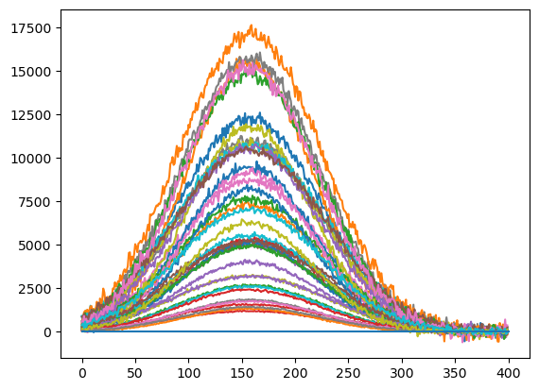
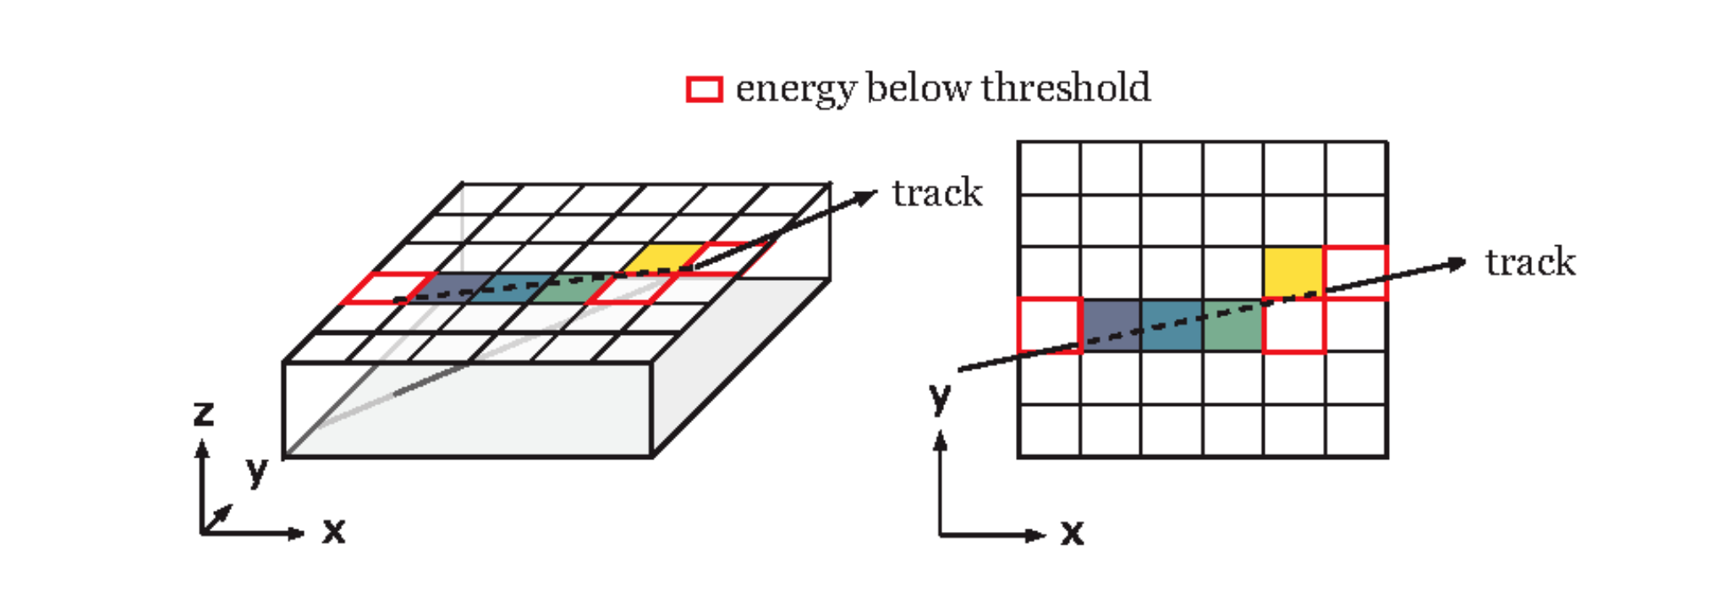
Timing pixel digitization in Athena
Digitization
  simulate detector response from hit simulation information
  HIT (Geant4 simulation) -> RDO (Raw data output)
  (position, charge…) -> (identifier/position of cells, ToT, ToA)
Graphs from ACTS docs
fast time digitization
smeared time
(add random gaussian distribution)
digitized time
stored in RDO
Geant4 hit time
simulate pulse and calculate ToA
based on parameterized pulse waveform
more realistic digitization
(the same method with HGTD)
example
1.732 ns
1.851 ns
00011010…

Slide 26
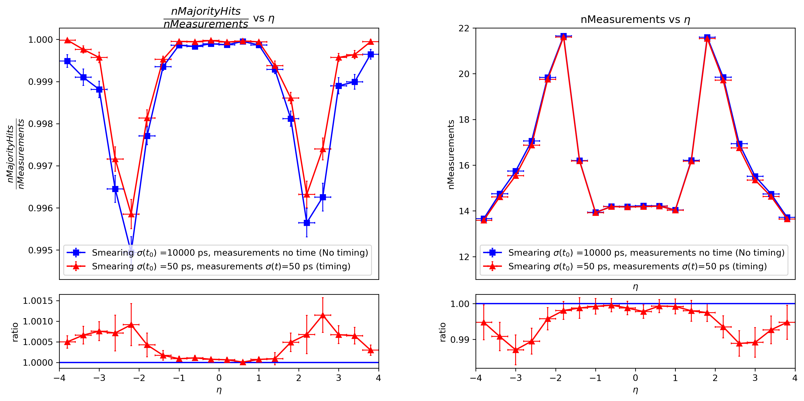
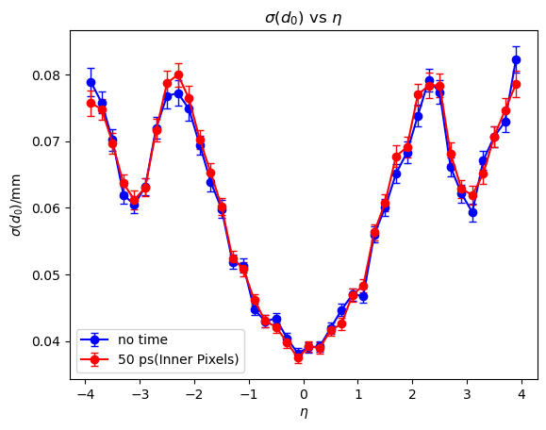
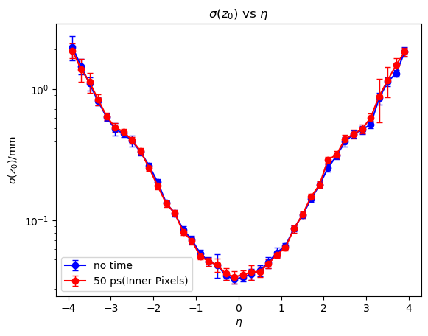
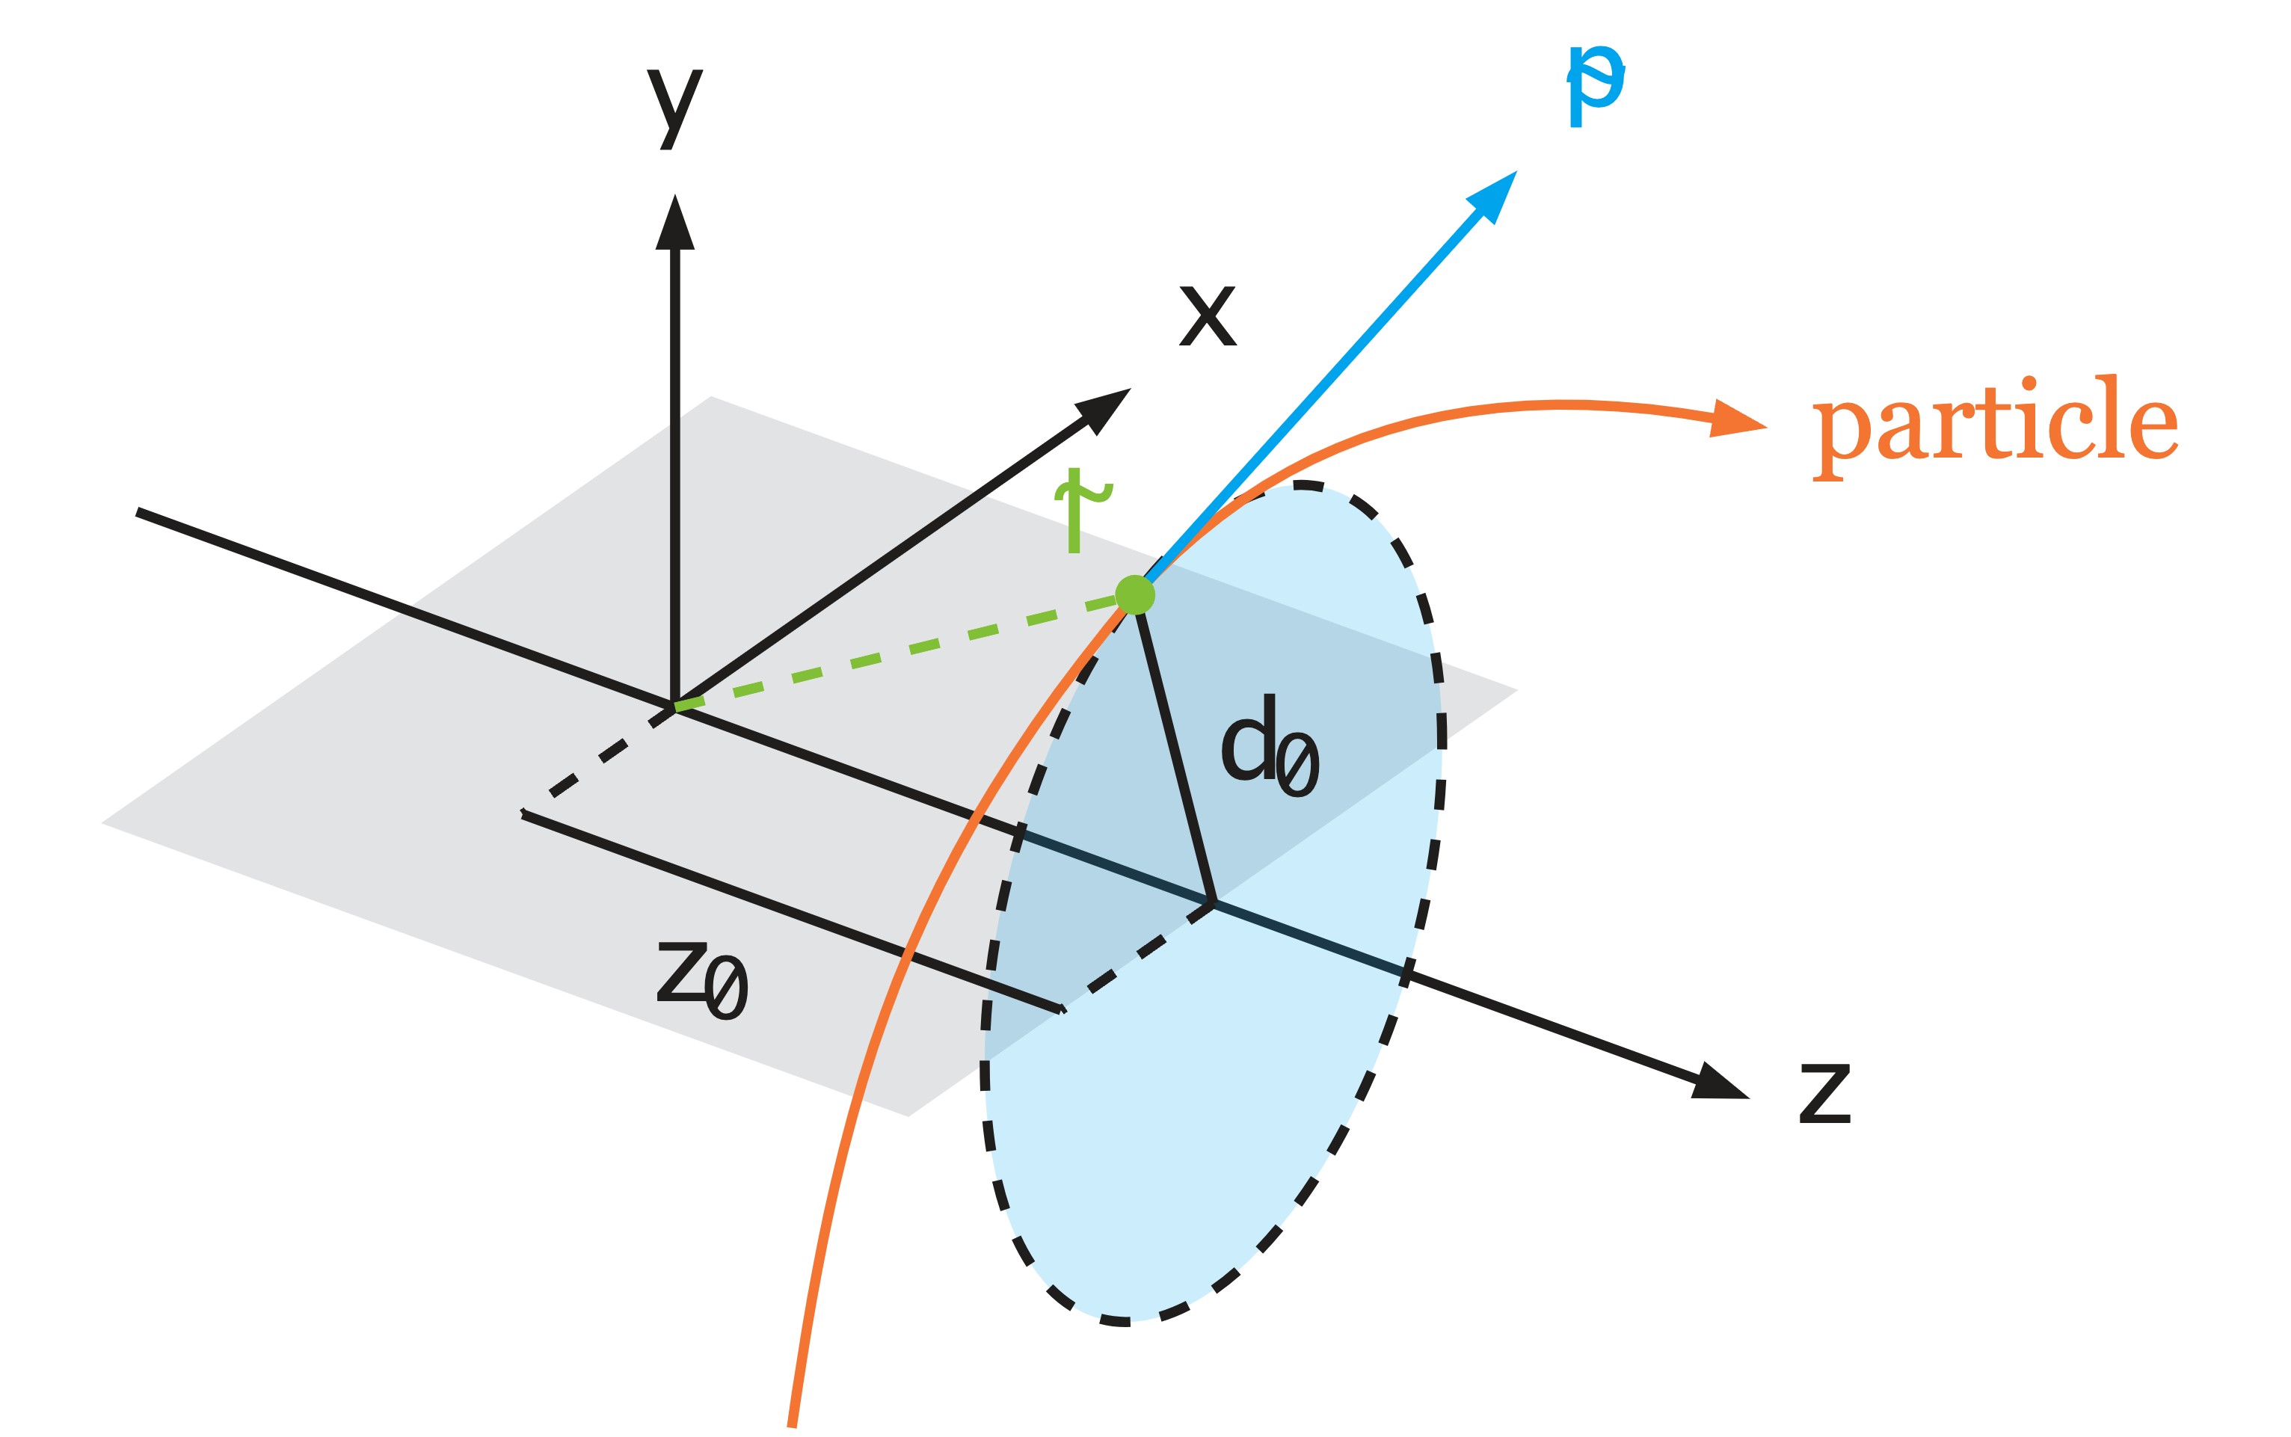
Purity and track-only impact parameter resolution
$$\begin{aligned}\frac{nMajorityHits}{nMeasurements}= \frac{\# hits that belongs to the particle with the highest fraction of hits on the track}{\# total measuremts on a track}\end{aligned}$$
No significant change on the resolution of impact parameters $d_{0}/z_{0}$

Slide 27
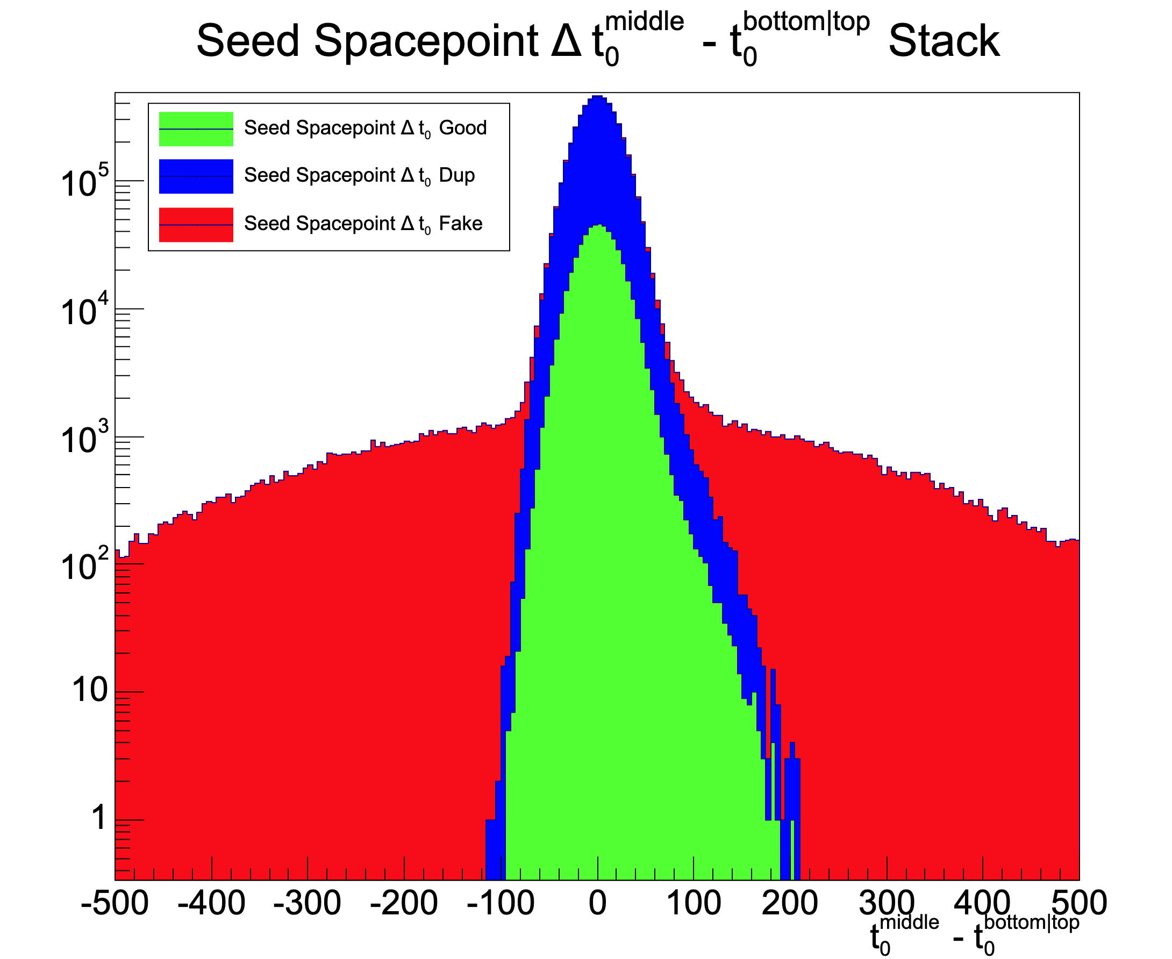

Slide 28
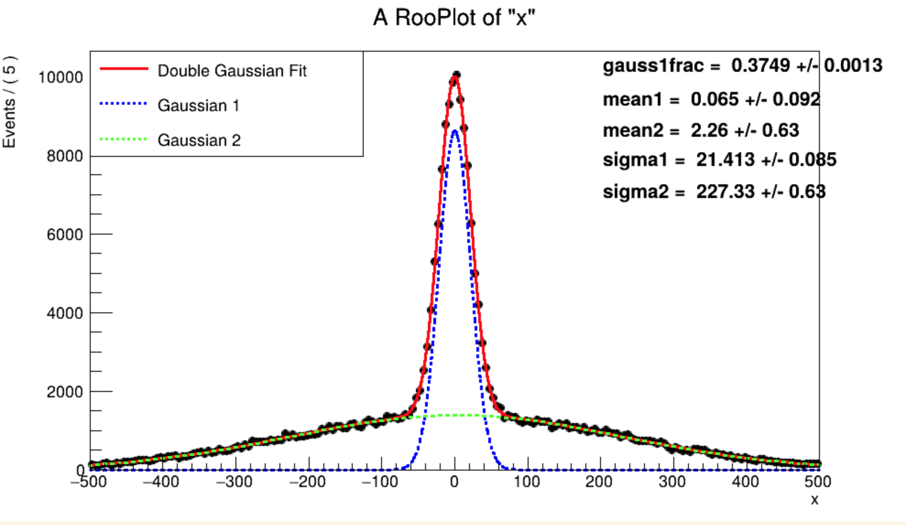

Slide 29
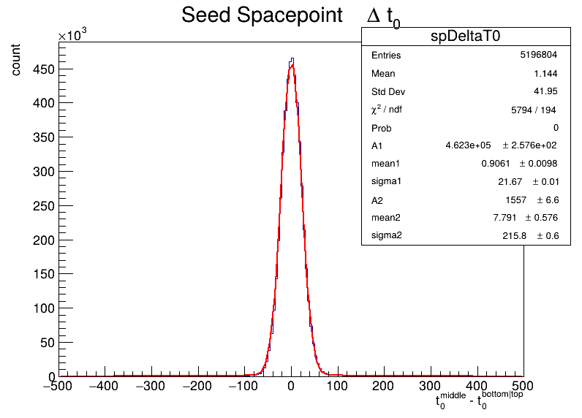
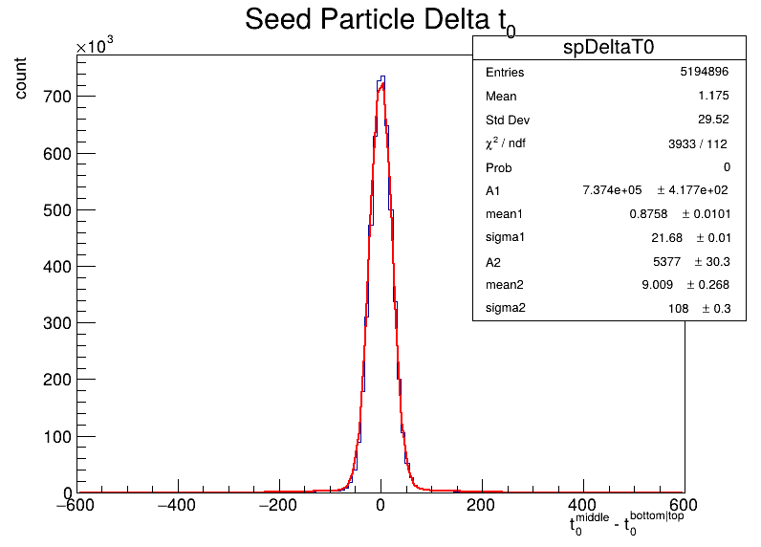
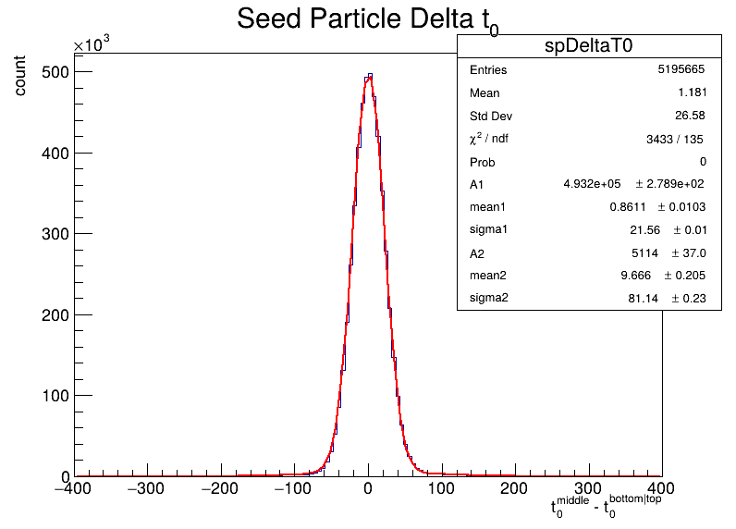
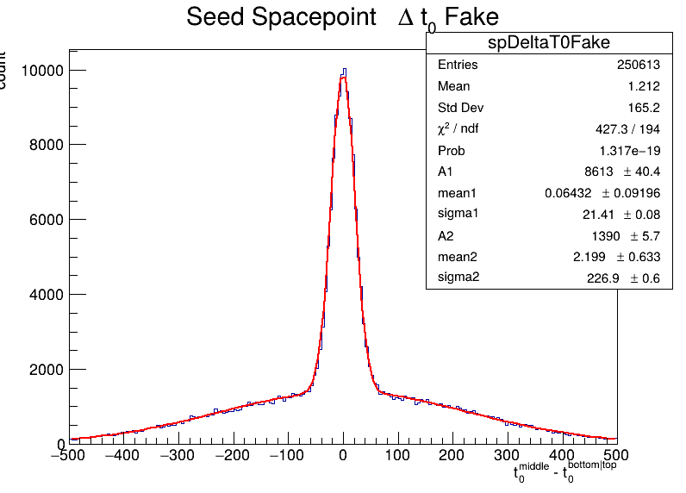
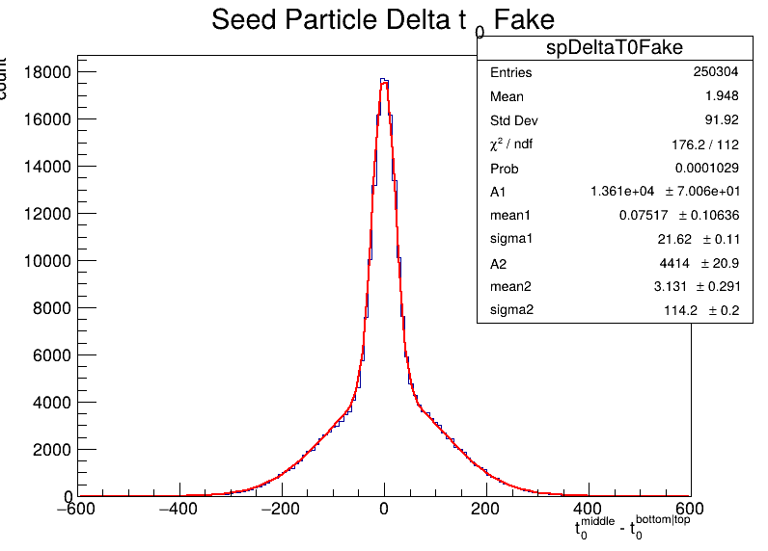
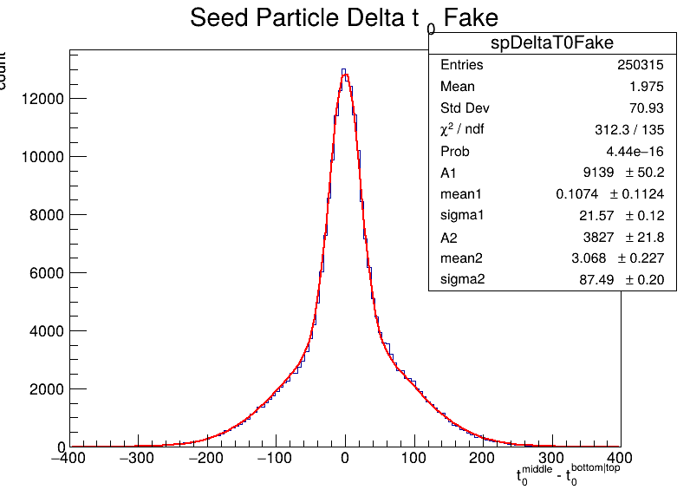
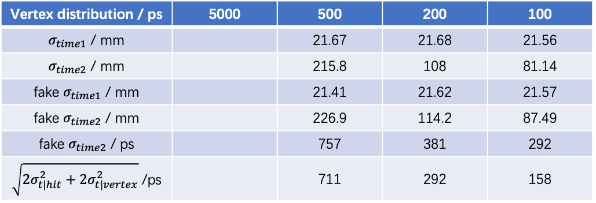
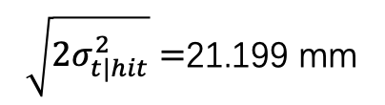
Vertex distribution / ps | 5000 | 500 | 200 | 100
$σ_{time1}$ / mm |  | 21.67 | 21.68 | 21.56
$σ_{time2}$ / mm |  | 215.8 | 108 | 81.14
fake $σ_{time1}$ / mm |  | 21.41 | 21.62 | 21.57
fake $σ_{time2}$ / mm |  | 226.9 | 114.2 | 87.49
fake $σ_{time2}$ / ps |  | 757 | 381 | 292
$\sqrt{2σ_{t|hit}^{2}+2σ_{t|vertex}^{2}}$ /ps |  | 711 | 292 | 158
$\sqrt{2σ_{t|hit}^{2}}=$21.199 mm

Slide 30
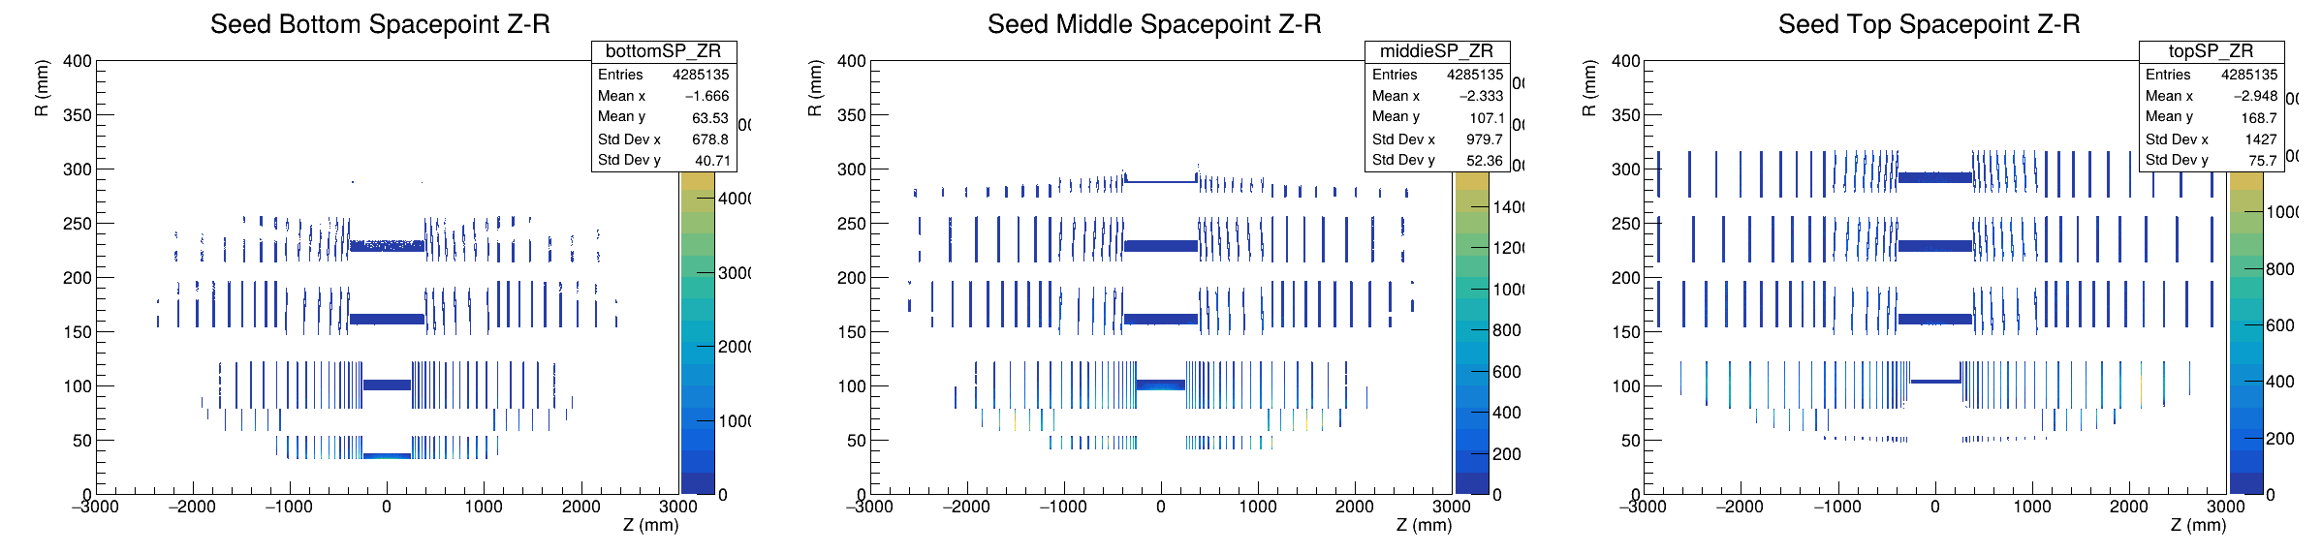
ITk spacepoint distribution

Slide 31
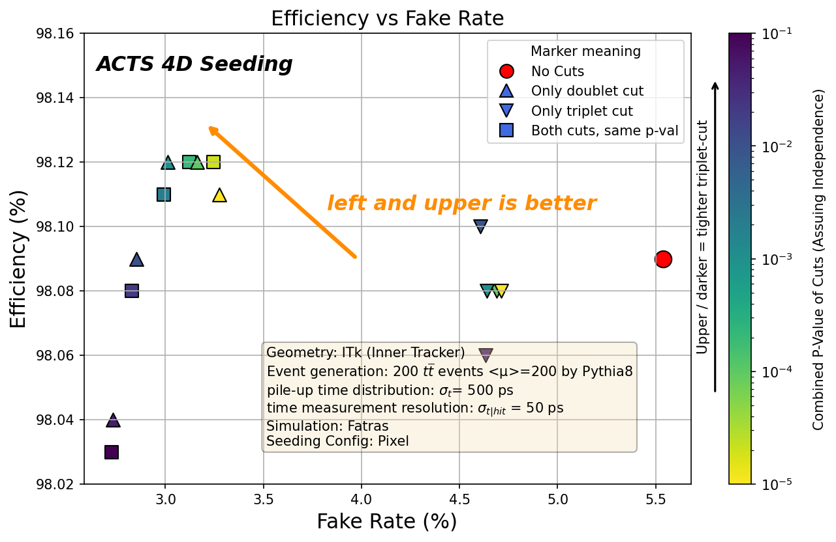
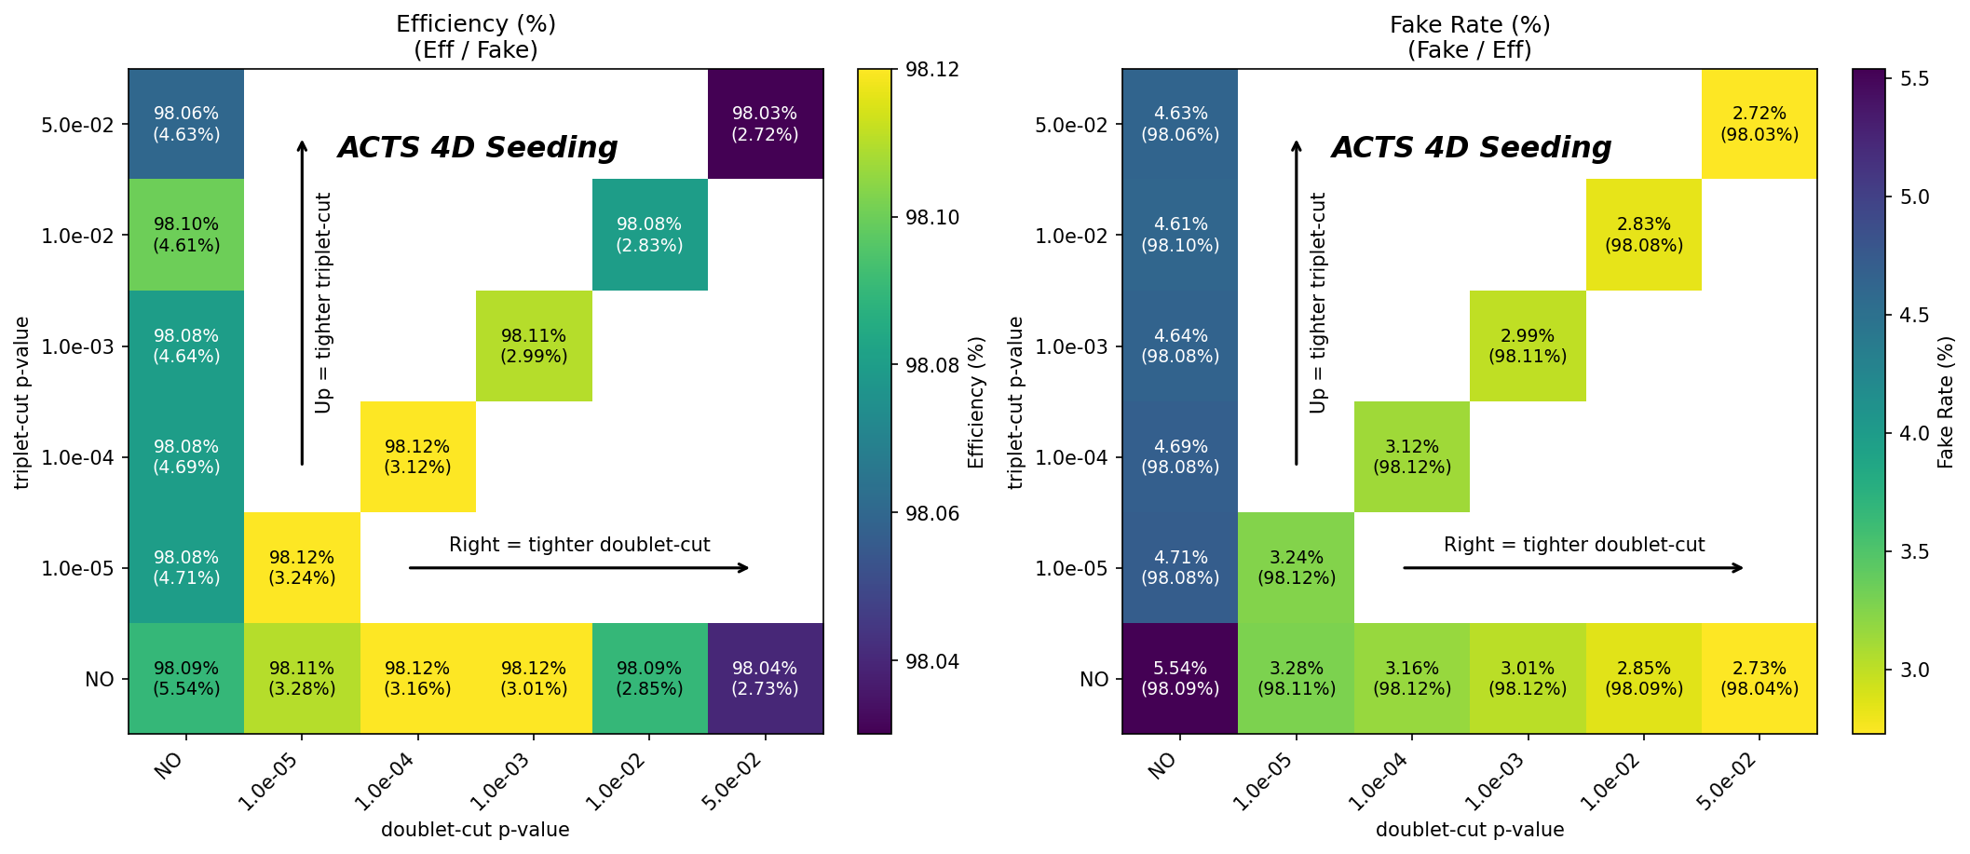
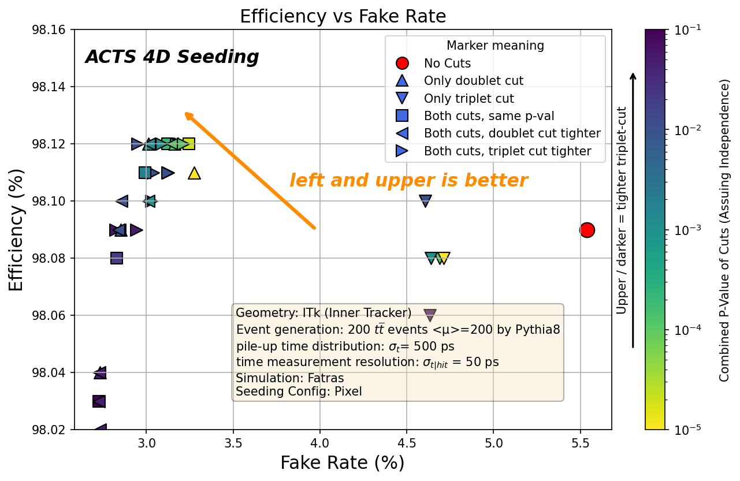
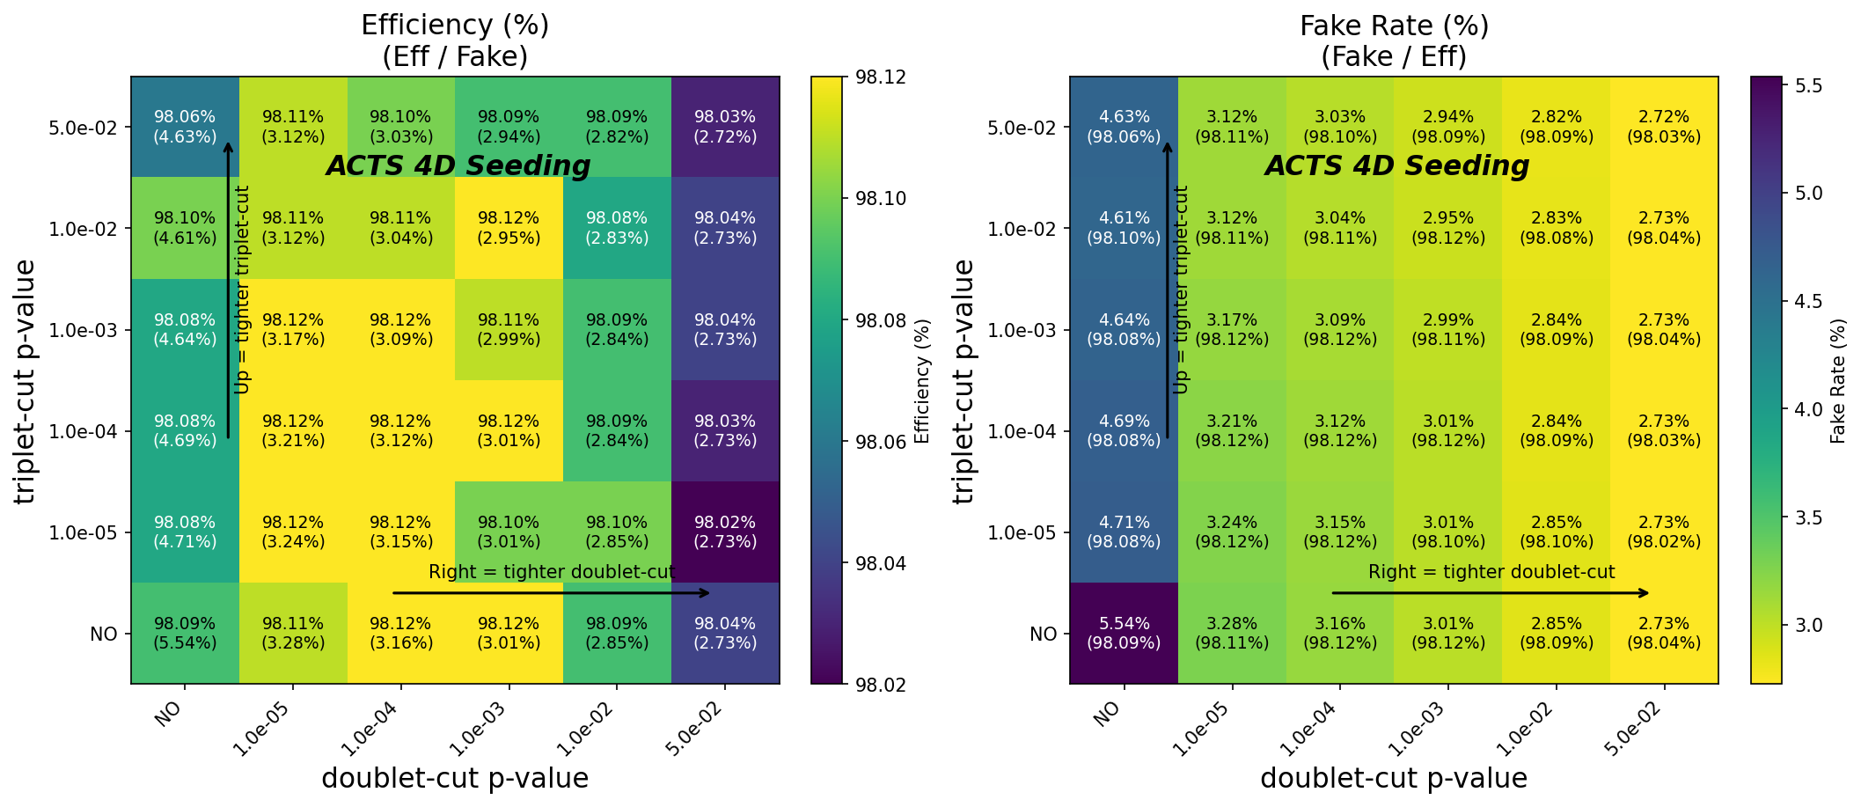
4D seeding performance with ITk

Slide 32
Huffman coding
Sort | Hit-map (bitmask) | Frequency | “6-14” mode bits
1 | 10101010 | 6.966% | 6
2 | 01010101 | 6.418% | 6
3 | 01000000 | 6.183% | 6
4 | 00000010 | 5.784% | 6
5 | 00000011 | 5.175% | 6
6 | 11000000 | 4.533% | 6
7 | 00000001 | 3.960% | 6
… | … | …
64 | 11101010 | 0.173% | 6+8
65 | 11110100 | 0.173% | 6+8
66 | 00110101 | 0.150% | 6+8
… | … | …
Encoding of hit map |  | Entropy
Bitmask |  | 8
Binary-tree |  | 7.79
Independent address |  | 11.20
Multi-stages Hoffman | 4-6-14 | 7.17
 | 3-6-14 | 7.84
 | 6-14 | 6.34
Encoding schemes
Huffman Encoding schemes (eg. 6-14 mode):
For the first 63 high-frequency hit-maps: use 6 bits to encode.
Since 6 bits correspond to 64 combinations, the last combination will be used as the header for other 193 hit-maps.
For the other 193 hit-maps: 6 bits header + the original bitmask hit-map (8 bits)
Bitmask: 1 bit for 1 pixel,
1 for hit and 0 for not

