Slide 1
Compact Periscopic Light Guide
A Novel Design to Improve Light Collection and
Response Uniformity of High-Granularity Calorimeters
Mingzheng Yang, Xilei Sun, Lei Cao, Dejing Du, Yong Liu,
Tao Liu, Qiuping Shen, Min Ouyang, & Jingbo Ye
July 15th, 2026
Notes:
Hello everyone, thank you all for being here for my talk. My presentation today is about the use of a compact periscopic light guide design to improve light collection and response uniformity of high-granularity of calorimeters.

Slide 2
Background
Problem: High-granularity calorimeter designs are favoring SiPMs for compactness. Yet, the size mismatch between large scintillator tiles and small SiPMs leads to poor Light Collection Efficiency (LCE) and response uniformity. Worse for scintillator with short photon absorption length such as glass scintillator.
Objective: Improve LCE and uniformity without significantly increasing construction cost or introducing unacceptable dead zones.
Proposal: Utilizing a Periscopic Light Guide (PLG) design to make use of the Total Internal Reflection (TIR) of photons to guide them towards SiPM with minimal footprint.
Notes:
First, some background information.
This research is trying to solve a universal problem in high-granularity calorimeter designs. Nowadays, calorimeter designs are favoring SiPMs for compactness.
However, the size mismatch between large scintillator tiles and small SiPMs often leads to poor Light Collection Efficiency (LCE) and uniformity. This is even worse for scintillators with short photon absorption length, such as the glass scintillator.
We propose to use a compact periscopic light guide to improve the LCE and uniformity of the calorimeter without significantly increasing the construction cost or introducing unacceptable dead zones.

Slide 3
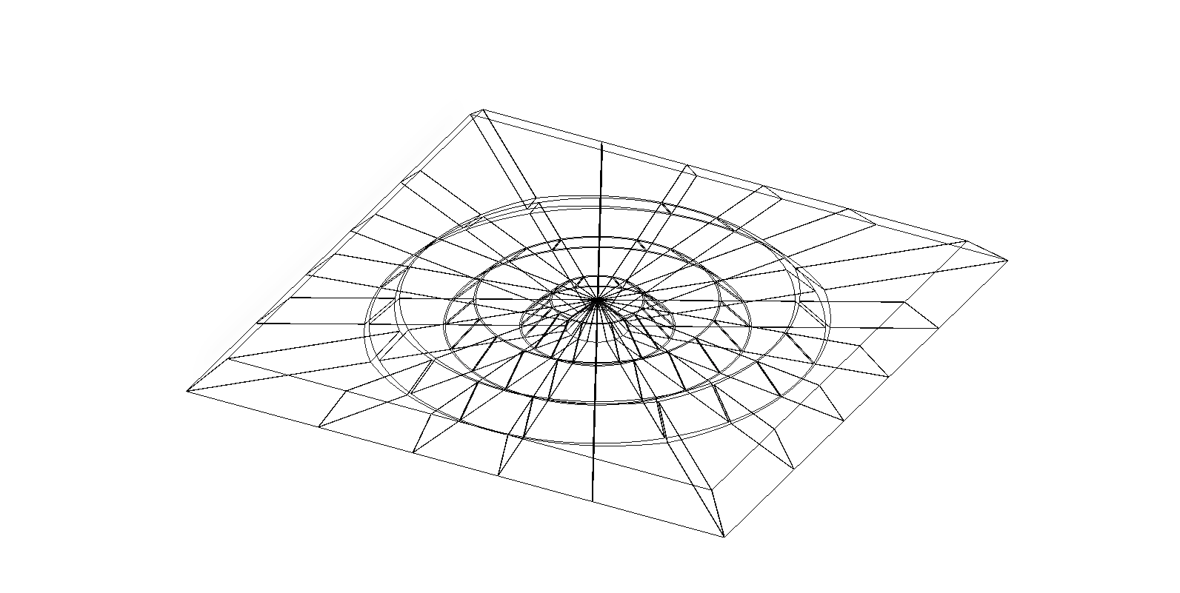
Overview of the PLG Design
Air Gap
SiPM
Top PLG Relay
Scintillator
Side PLG Relay
Reflective Coating/Wrap
Example Scintillation
Light Locations
Notes:
Here’s an overview of the PLG.
In this illustration, we have the PLG placed on top and sides of a scintillator.
There’s a small air gap between the PLG and the scintillator, to make sure photons entering the PLG can have total internal reflections inside.
The idea behind this design is simple. We have 2 chamfer cuts on each piece of the light guide, located at the inner and outer rim. These chamfer cuts would behave like mirrors for photons, and each piece of PLG would behave like periscopes used on submarines.
Scintillation light emitted from different locations would enter the PLG and get reflected on the entry chamfers, these photons would travel inside the PLG and those can achieve total inter reflections would eventually hit the exit chamfer and then enter the SiPM.
Therefore, we are taking some of the photons emitted here, put them on the light guide highway to guide them towards the SiPM, bypassing the scintillator material that has short photon absorption length.

Slide 4
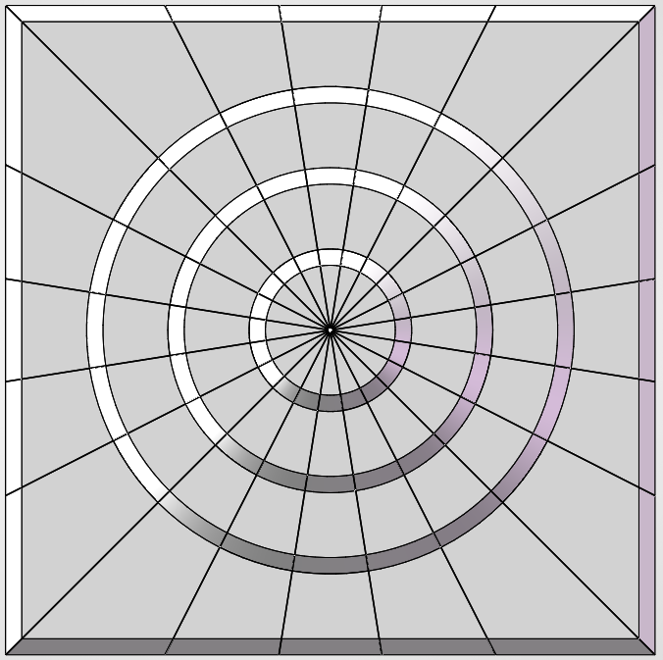
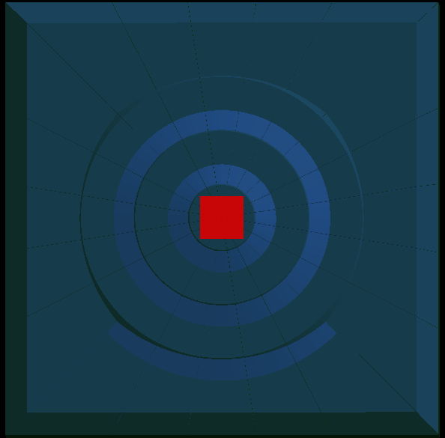
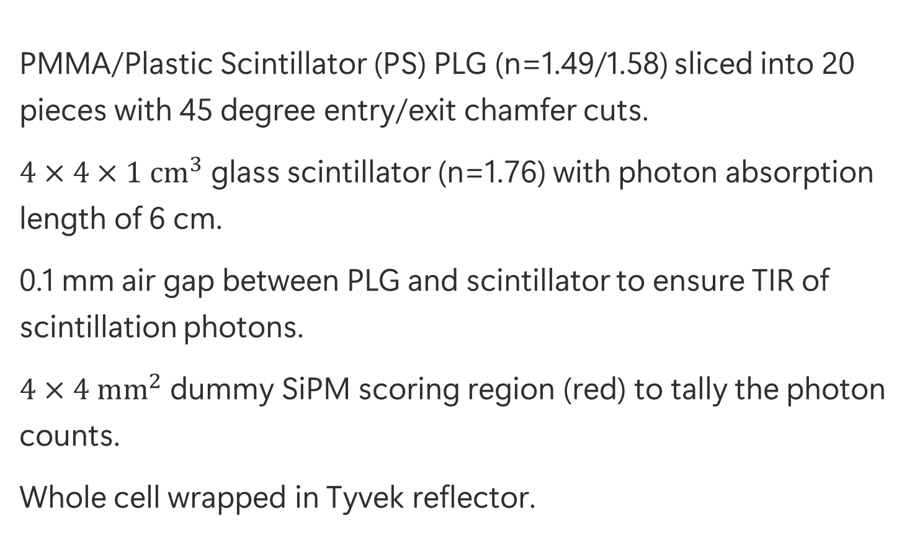
Geant4 Simulation Environment
PMMA/Plastic Scintillator (PS) PLG (n=1.49/1.58) sliced into 20 pieces with 45 degree entry/exit chamfer cuts.
$4×4×1 {cm}^{3}$ glass scintillator (n=1.76) with photon absorption length of 6 cm.
0.1 mm air gap between PLG and scintillator to ensure TIR of scintillation photons.
$4×4 {mm}^{2}$ dummy SiPM scoring region (red) to tally the photon counts.
Whole cell wrapped in Tyvek reflector.
Notes:
To verify the feasibility of PLG in improving the LCE and response uniformity of the calorimeter. I set up a Geant4 simulation environment with a simple design.
In this simulation, I put a PLG with triple relay on top of a glass scintillator and a SiPM on top of it, with the whole wrapped up in Tyvek. Then I shoot 4 GeV muons onto this setup and score the number of photons I’m getting here at the SiPM.

Slide 5
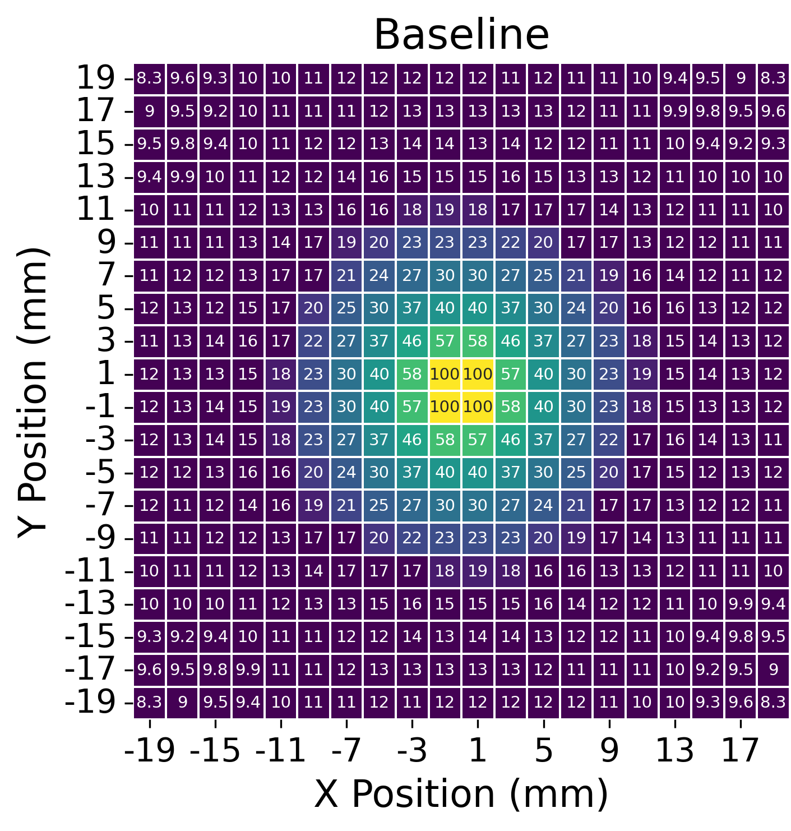
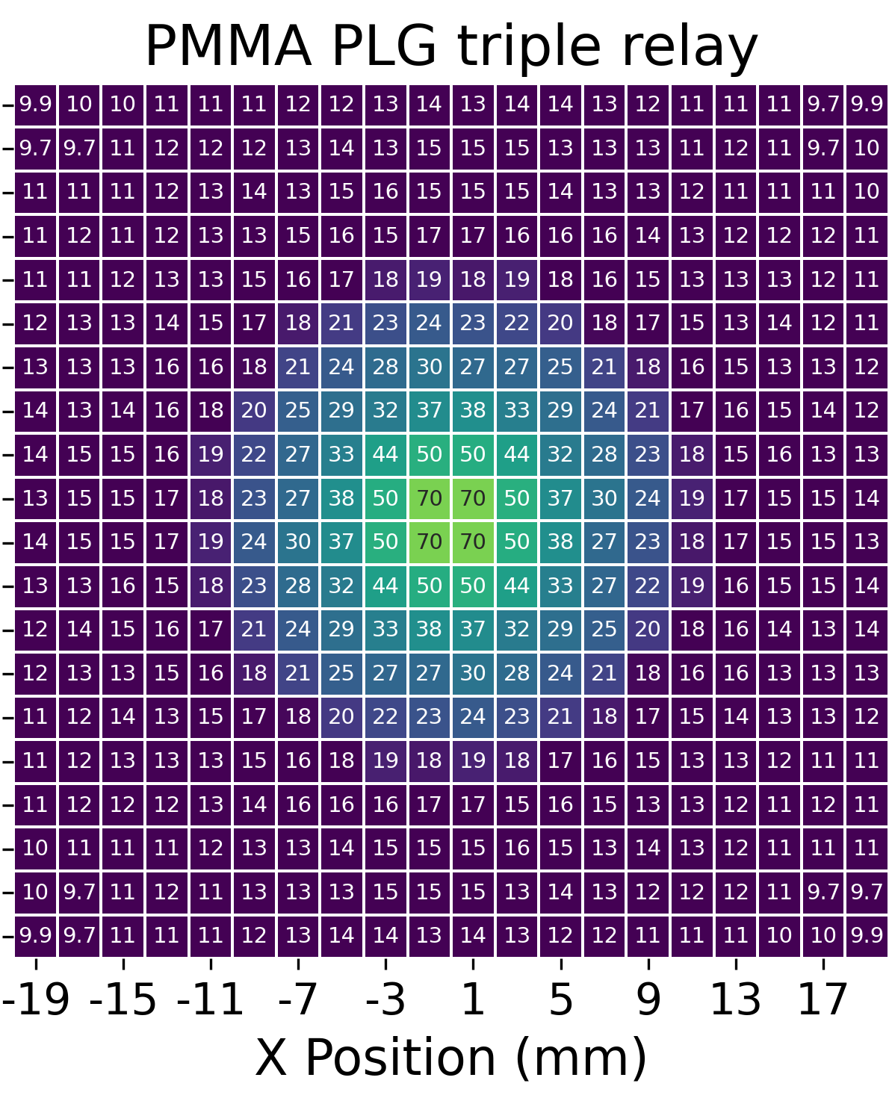
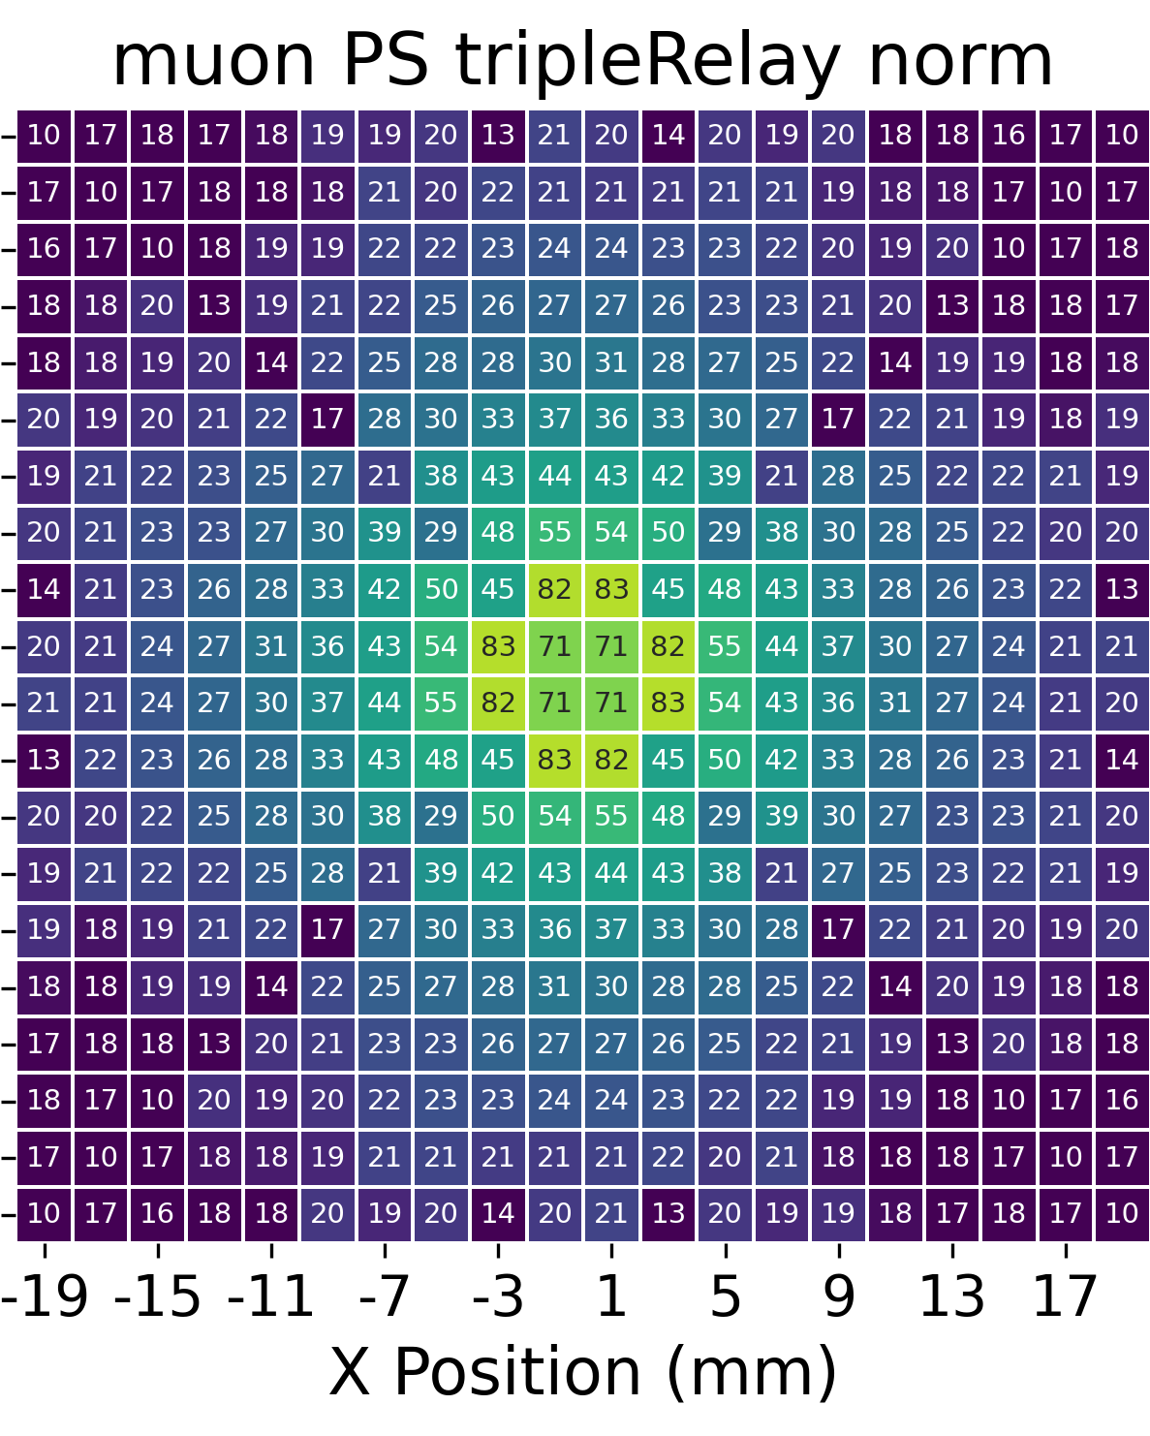
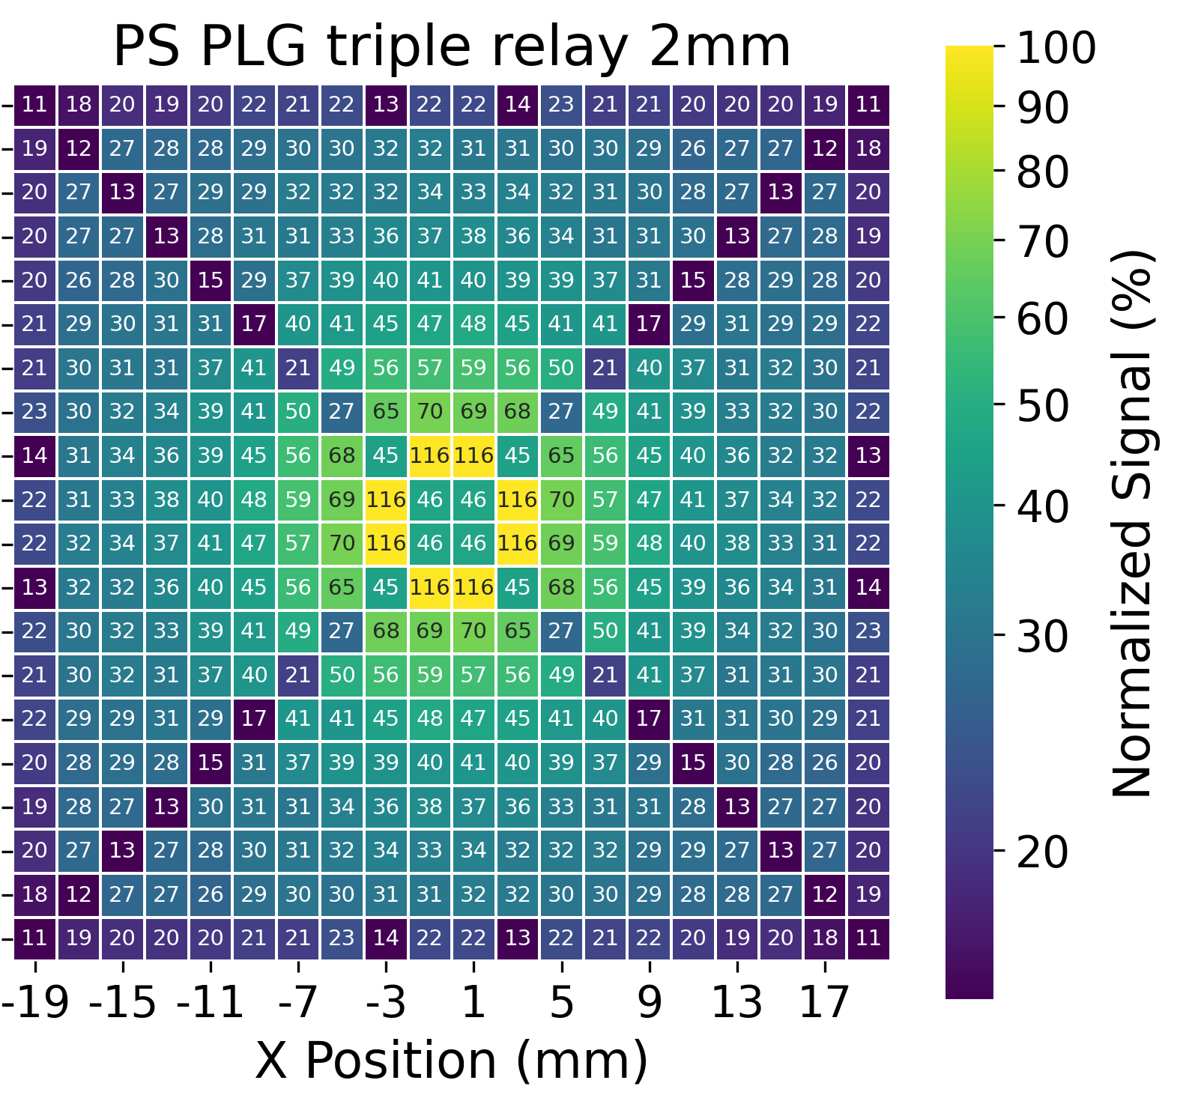
Simulation Results
Shooting 4 GeV muons vertically down at different locations of the cell to map out the LCE
Courtesy of Sen Qian, IHEP, for the PS idea
LCE: 100%
Non-uniformity: 0.725
101%
0.543
149%
0.504
197%
0. 499
Non-uniformity $≡\frac{Standard Deviation}{Mean}$ Lower is better
Notes:
Here is the compilation of the simulation results.
I mapped out the LCE in heat maps so we can see how the uniformity changes with different configuration.
Here on the most left, is the baseline result, which is simply putting the SiPM on the scintillator without the PLG. We treat the average of the LCE as 100% and define the non-uniformity to be the standard deviation of these numbers divided by the mean.
The use of a 1mm thick PMMA PLG can improve the uniformity clearly without sacrificing the LCE. To also level up the LCE, professor Qian from IHEP suggested we can use plastic scintillator instead of just PMMA. So after switching to plastic scintillator, we can see that both LCE and uniformity climb up a lot compared to baseline. If we increase the thickness of the plastic scintillator from 1 mm to 2 mm thick. The improvement is even larger.
Now you may noticed that even though these area light up, we have a dim cross going through the center of the square. This is due to an artifact in the simulation setup, where muons go through the air gaps in between the PLG pieces, corresponding to this illustration here.

Slide 6
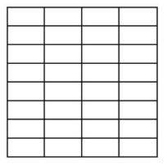
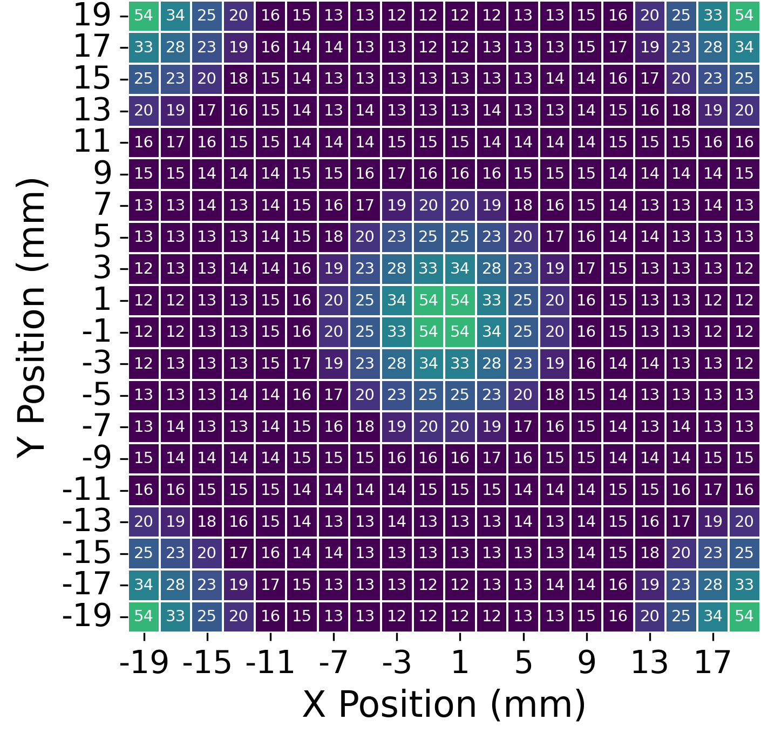
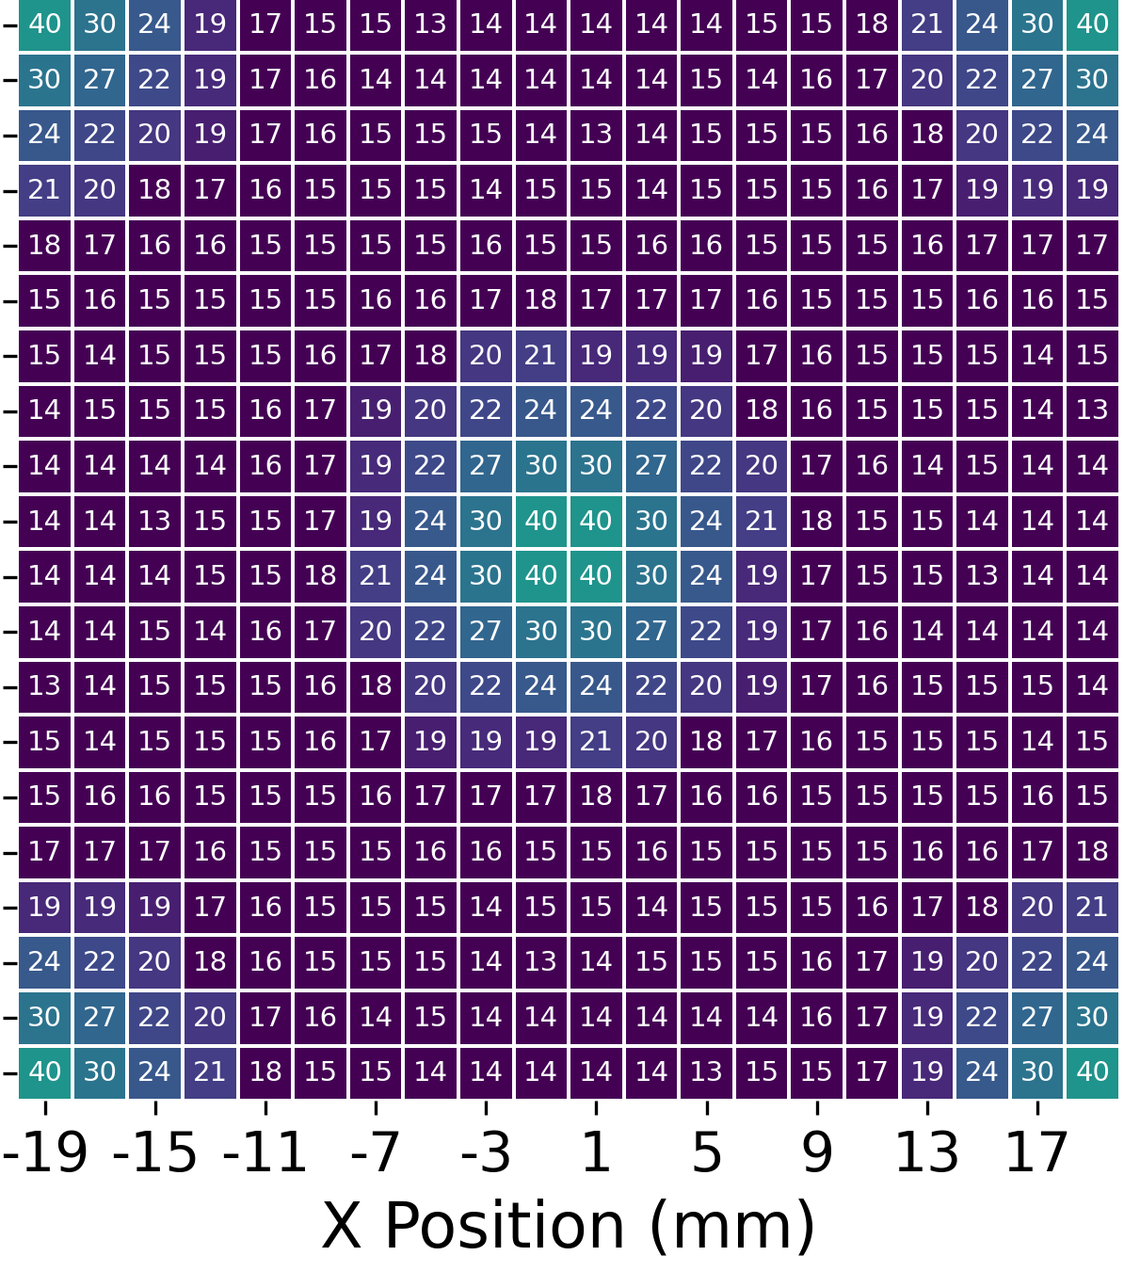
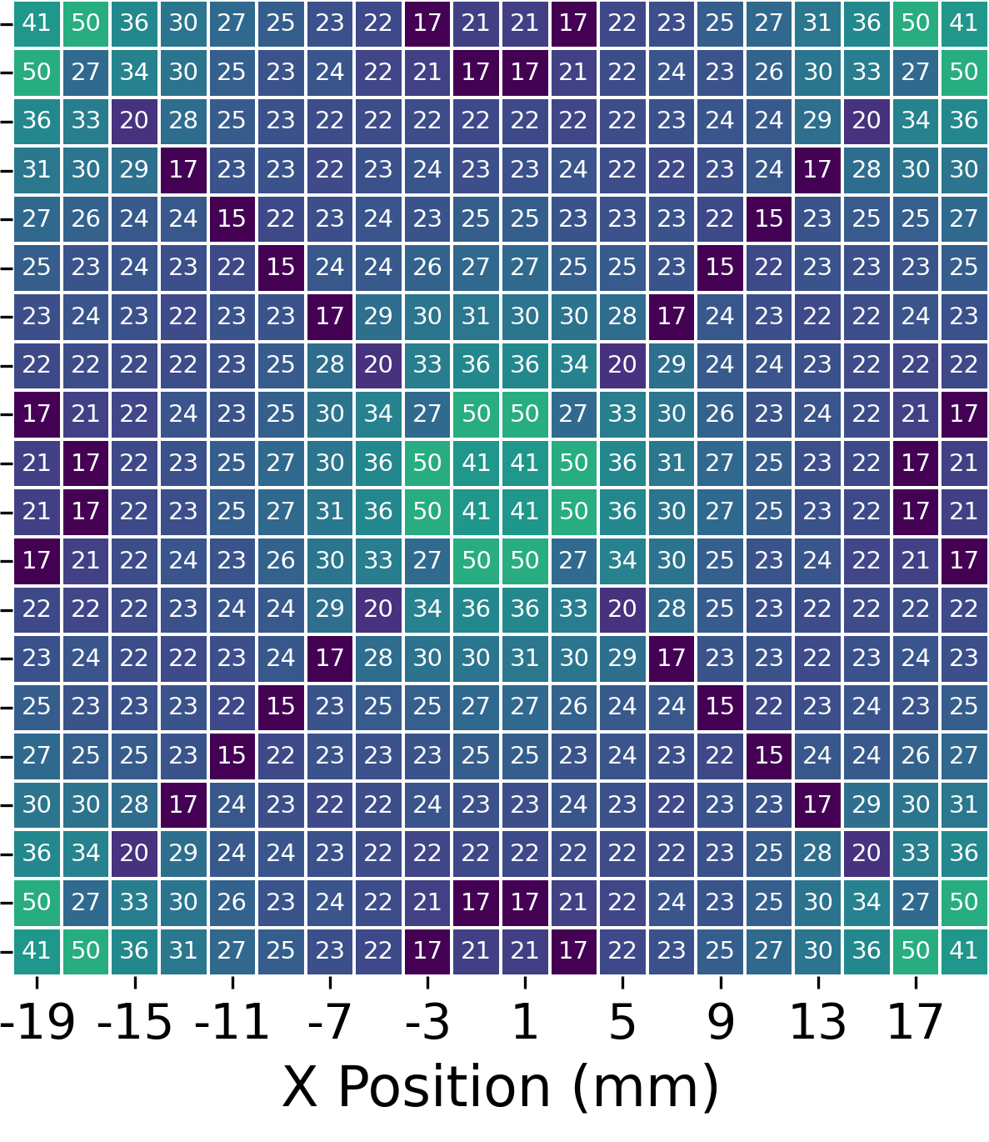
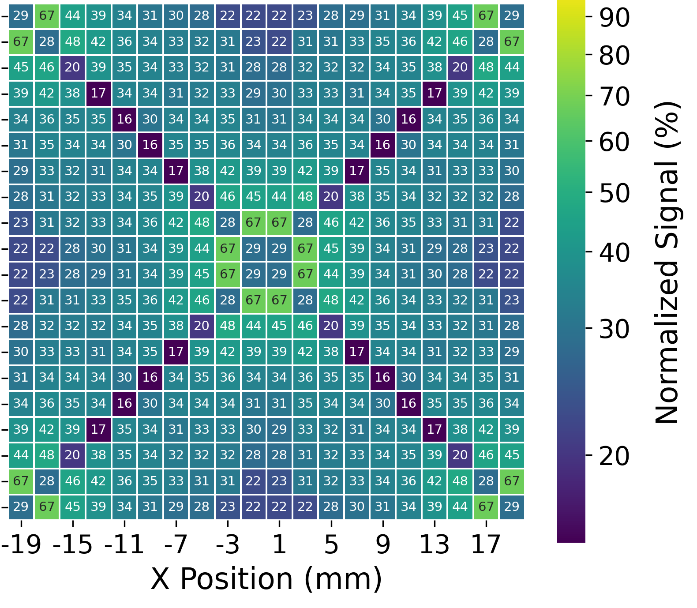
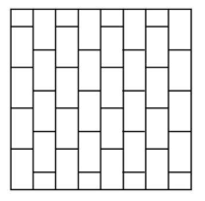
Cross Laying Pattern to Further Improve Uniformity
LCE: 100%
Non-uniformity: 0.725
101%
0.543
149%
0.504
197%
0. 499
0.415
0. 286
0.269
0.275
Notes:
Now from previous results, we see that the LCE is always higher at the center then quickly falls off towards the corners.
To improve the uniformity even further. We tried out a cross laying pattern of calorimeter cells instead of just overlay them on top of each other orderly so the response from particles can maybe be evened out.
Here on the left is a 3D and 2D illustration of the idea. And we can see that even without the PLG, simply by cross laying these cells, the response uniformity can be improved a lot. Where the best result comes from the 2 mm thick plastic scintillator.

Slide 7
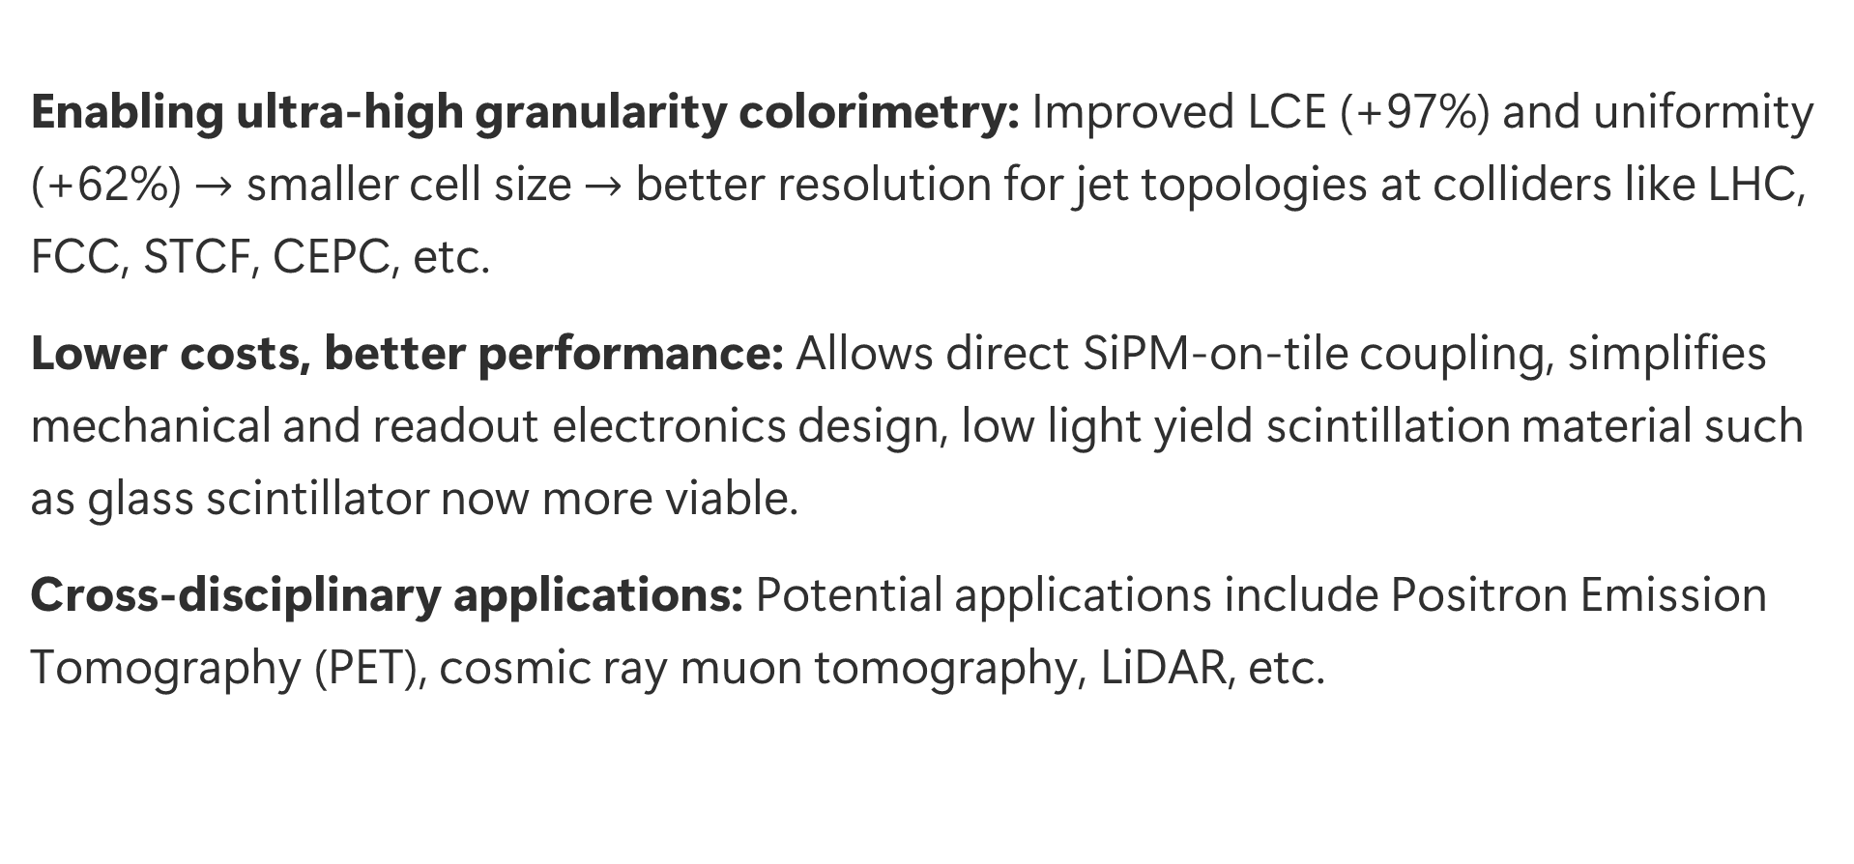
Impact & Expectations
Enabling ultra-high granularity colorimetry: Improved LCE (+97%) and uniformity (+62%) $→$ smaller cell size $→$ better resolution for jet topologies at colliders like LHC, FCC, STCF, CEPC, etc.
Lower costs, better performance: Allows direct SiPM-on-tile coupling, simplifies mechanical and readout electronics design, low light yield scintillation material such as glass scintillator now more viable.
Cross-disciplinary applications: Potential applications include Positron Emission Tomography (PET), cosmic ray muon tomography, LiDAR, etc.
Notes:
The results so far look promising. If we can improve the LCE and uniformity by this much, we can use smaller cell sizes and achieve better jet resolution at present and future colliders.
The compactness of the PLG also means we can use direct SiPM-on-tile coupling, which simplifies mechanical and readout electronics design, and also enabling the use of low light yield scintillation material such as glass scintillator.
Aside from the impact of this study on the physics side, it also has great potential in other fields, such as PET scan, muon tomography, LiDAR and so on.

Slide 8
Future Work
Simulation work on the implementation of side relay PLG.
Raise the fidelity of the simulation environment (PDE of SiPM, fine tuning optical surface treatment against experiment, etc.).
Systematic design optimization based on calorimeter cell specification.
Iterative prototype evaluation with cosmic ray muon, beam line.
Notes:
Future work of this project would first involve adding the side relay PLG and raising the fidelity of the simulation environment.
Results demonstrated so far are still preliminary. A more systematic design optimization of the PLG is underway, and would be highly dependent on the specification of the calorimeter cell.
We have acquired some prototype PLGs and are preparing experiments with them to evaluate their performance and compare the results against the simulation.

Slide 9
Notes:
Here’s the wrap of my presentation, thank you for your time. Feel free to ask any questions. And if you are interested in this idea, we welcome any collaboration and please contact us after the conference.

Slide 10
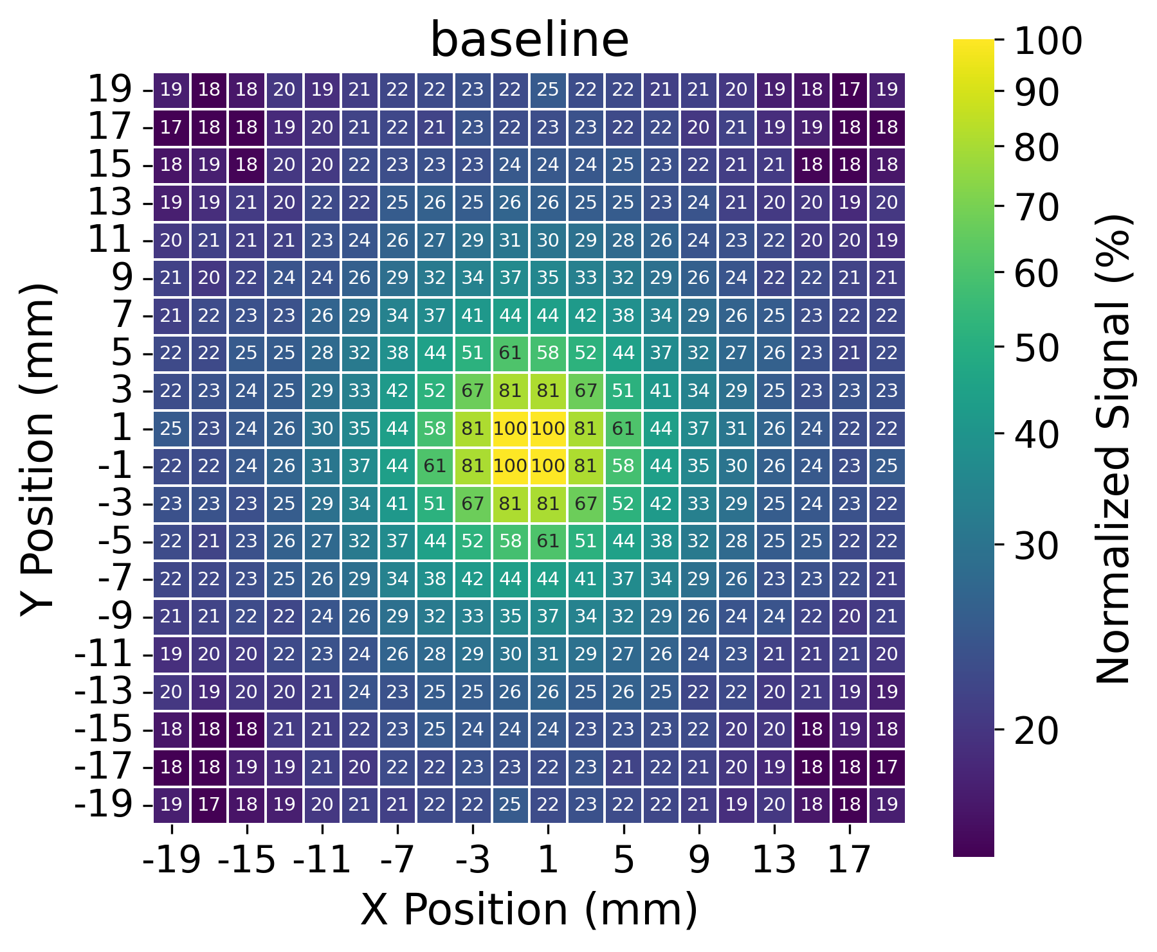
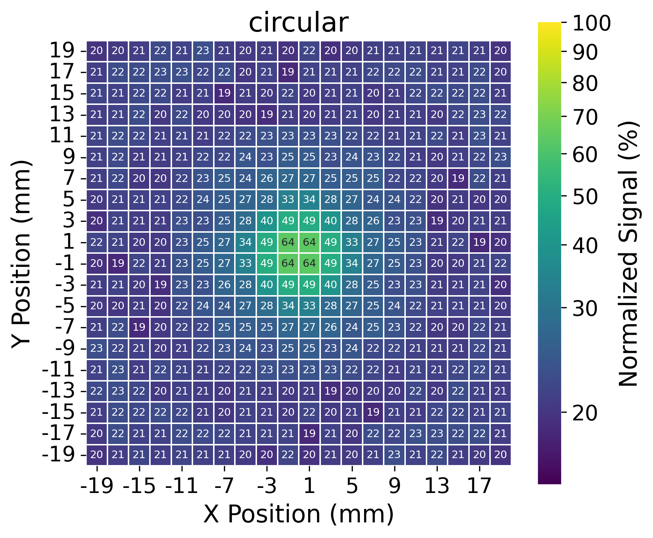
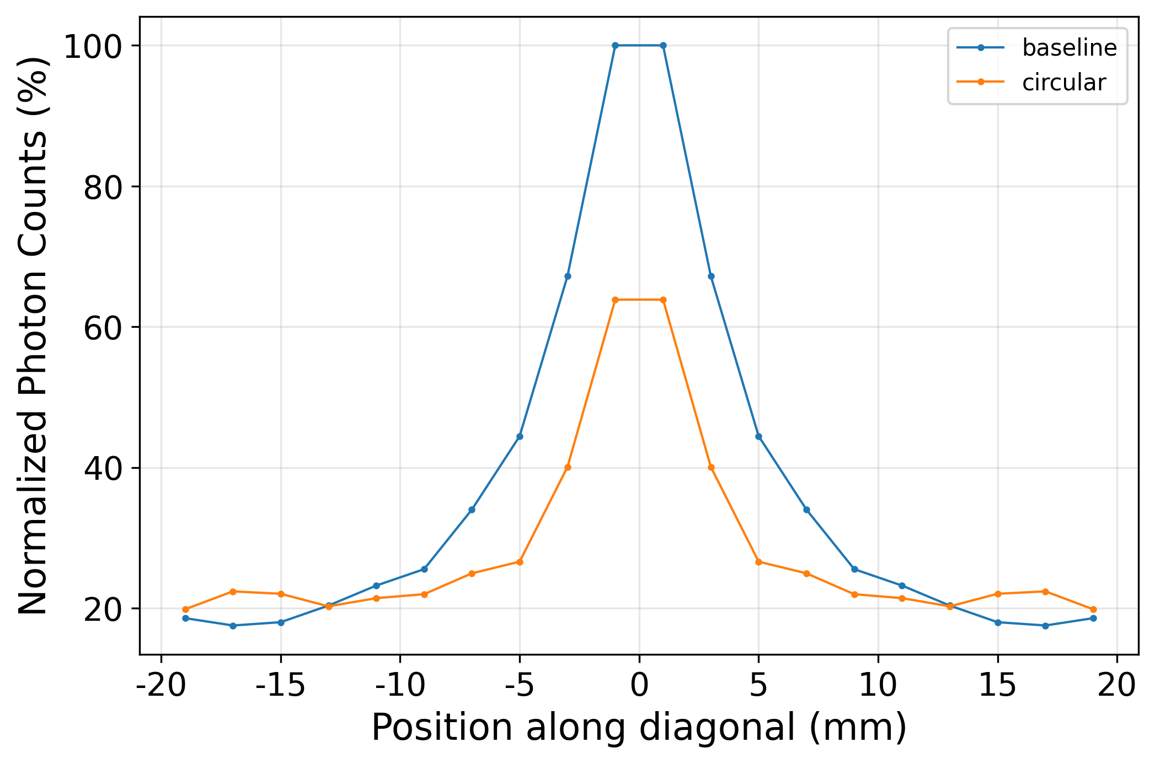
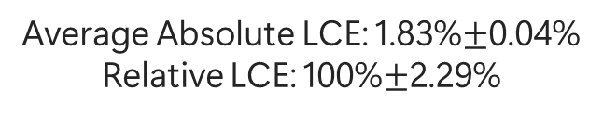
Simulation with Geant4
闪烁体
Average Absolute LCE: 1.83%$±$0.04%
Relative LCE: 100%$±$2.29%
Absolute LCE: 1.50%
Relative LCE: 81.9%
Conclusion: Improved uniformity at cost of average LCE, due to raised SiPM and photon loss at interfaces.
Notes:
To evaluate the performance of the PLG, I divided the whole glass scintillator into 400 cubes and released photons isotopically at the center of each cube and scores the number of photons at the SiPM region.
The results is then plotted in these heat maps. Where the XY axes representing the location, the color and number represent normalized photon counts.
Here the average absolute LCE represents the average percentage of photons we are expected to collect if a random particle pass through this cell. And the results from not using PLG is set as the baseline, which its relative LCE is 100%.
To see how PLG improves the response uniformity, we take a look at the photon counts along the diagonal of these plots. Here’s a plot of the photon counts along the diagonal of both setup. We can see that the baseline has a much higher non-uniformity than the one used the PLG. The PLG improved the LCE exactly at the location of entry chamfer, as expected. But this is at the cost of losing the average LCE, which mainly due to raised SiPM and photon loss at interfaces.

Slide 11
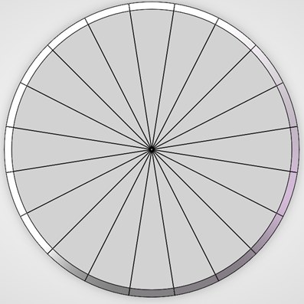
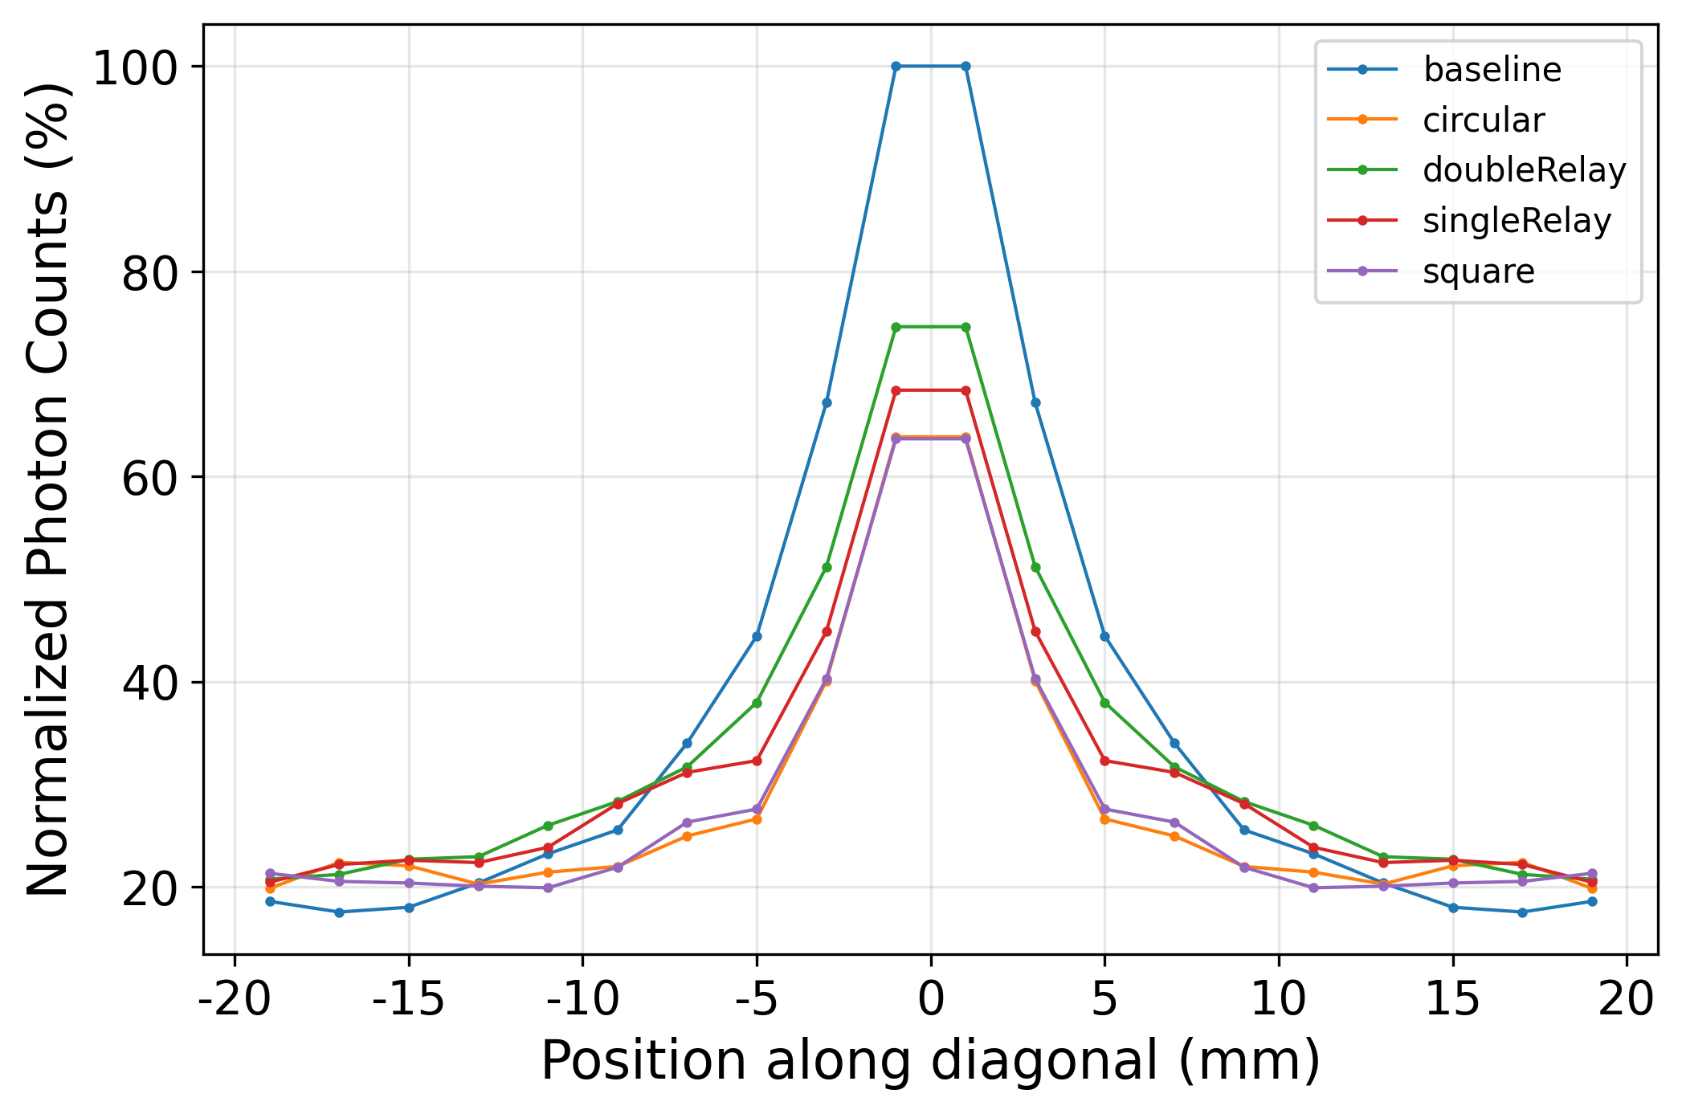
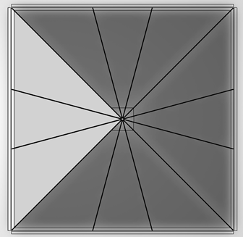
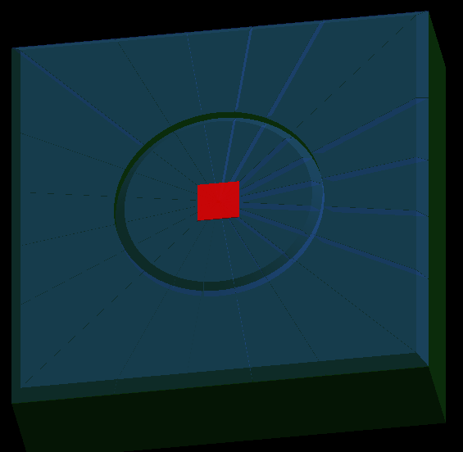
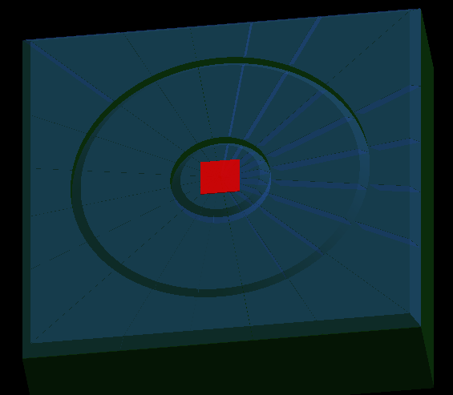
Double Relay PLG
Circular
Relative LCE: 81.9%
Square
LCE: 82.9%
Single relay
LCE: 94.3%
Double relay
LCE: 101%
Notes:
To see if we can boost the LCE while also improve the uniformity, we experiments with different geometry.
Here are the compilation of the results and we see that for double relay configuration, the LCE exceeds Non PLG version.

Slide 12
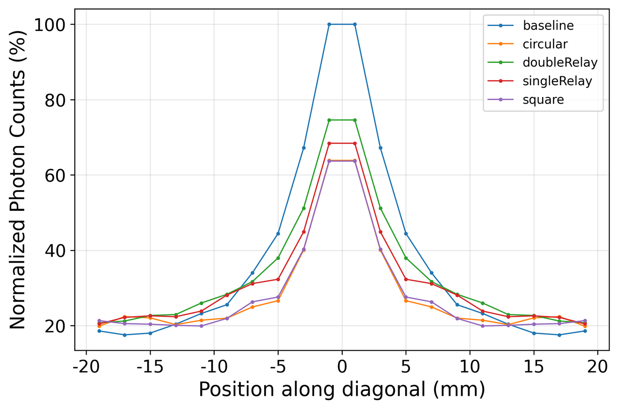
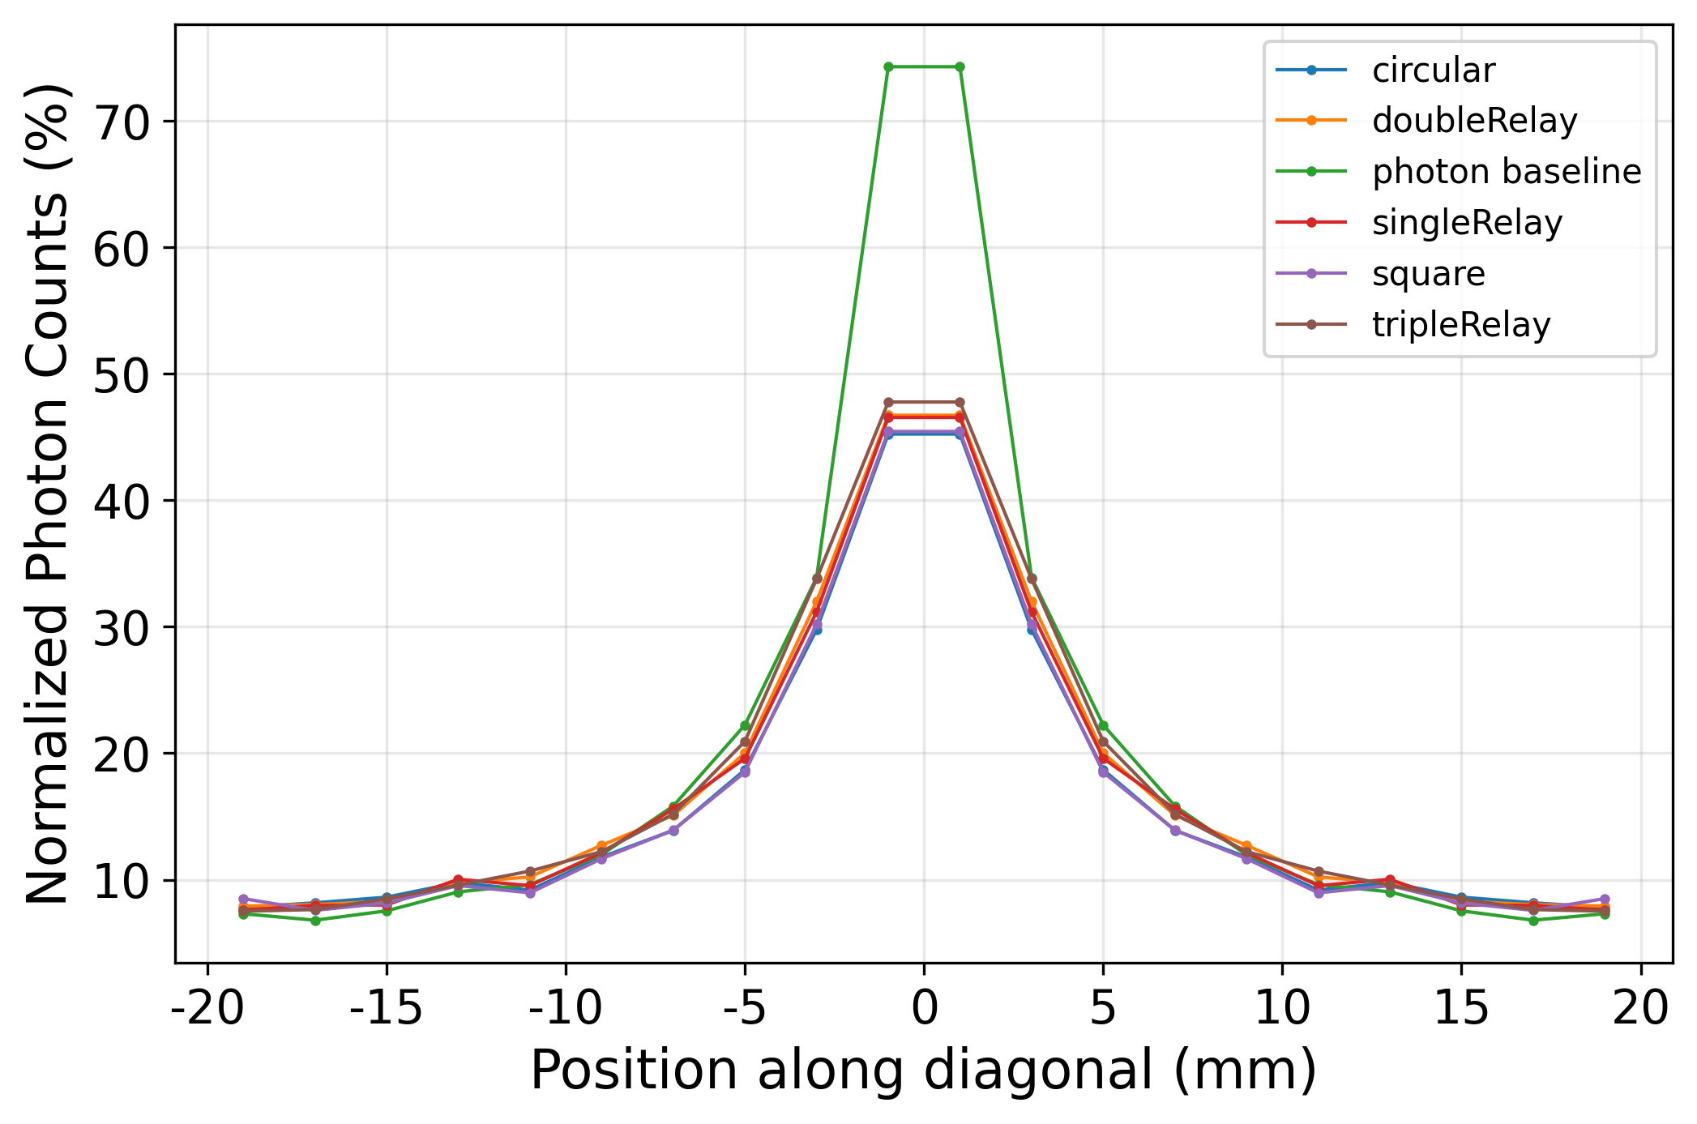
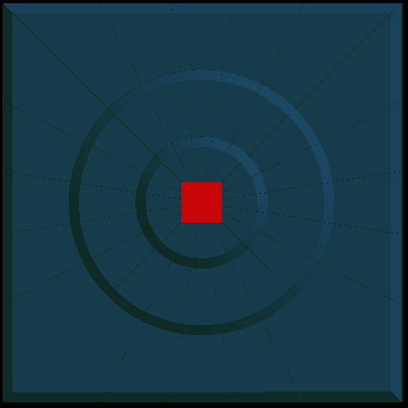
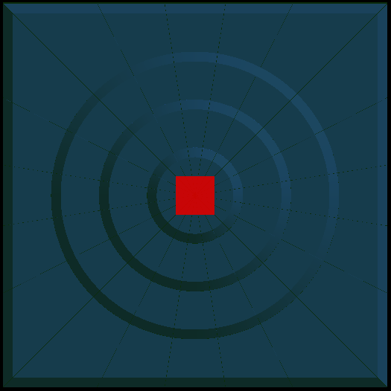
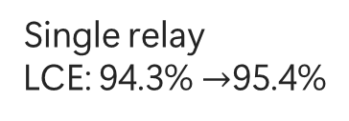
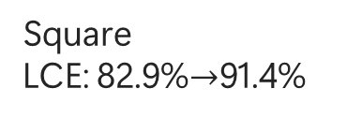
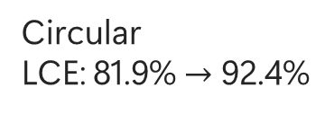
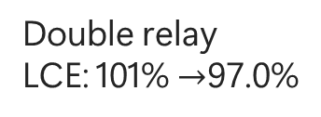
Results Comparison
Circular
LCE: 81.9% $→$ 92.4%
Square
LCE: 82.9%$→$91.4%
Single relay
LCE: 94.3% $→$95.4%
Double relay
LCE: 101% $→$97.0%
Old result (Al reflector+ no interface)
New result (Tyvek + interface)
Conclusion: The addition of the scintillator-air interface reduced the effect of PLG on uniformity profile shaping.
Triple relay
LCE: 97.7%
Uncertainty: 2.9%
Notes:
To see if we can boost the LCE while also improve the uniformity, we experiments with different geometry.
Here are the compilation of the results and we see that for double relay configuration, the LCE exceeds Non PLG version.

Slide 13
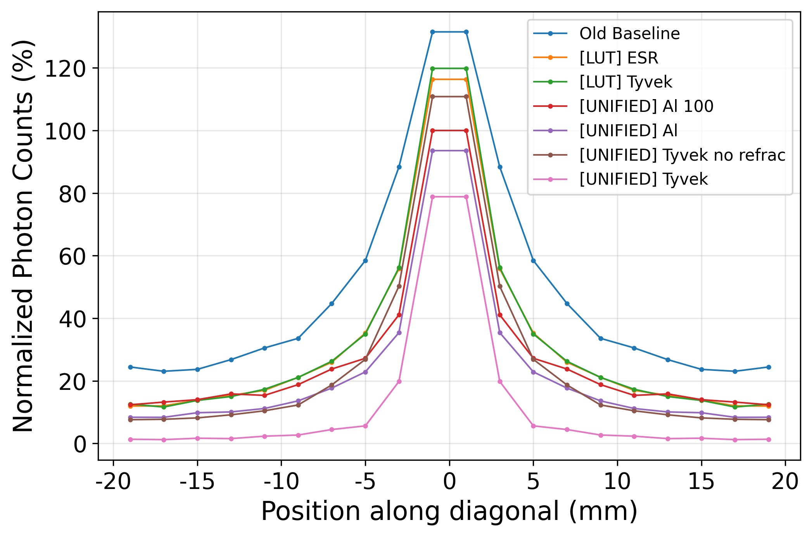
Baseline Comparison w/ Diff. Reflector
Old Baseline: UNIFIED model, 100% reflectivity Al, NO refraction, polished, NO Scintillator-air interface.
[LUT] ESR: Everything (refrac. idx., reflectivity, etc.) according to LBNL LUT.
[LUT] Tyvek: Everything according to LUT.
[UNIFIED] Al 100: 100% reflectivity, NO refraction, polished.
[UNIFIED] Al: 90% reflectivity, NO refraction.
[UNIFIED] Tyvek no refrac: 90% reflectivity, ground with front painted, NO refraction.
[UNIFIED] Tyvek: 90% reflectivity, ground, refraction.
 | Relative LCE | Uncertainty
Old Baseline | 185% | 2.3%
[LUT] ESR | 111% | 2.9%
[LUT] Tyvek | 110% | 2.9%
[UNIFIED] Al 100 | 100% | 3.1%
[UNIFIED] Al | 75% | 3.6%
[UNIFIED] Tyvek no refrac | 78% | 3.4%
[UNIFIED] Tyvek | 22% | 5.8%
Normalized to [UNIFIED] Al 100 max. count
Notes:
To see if we can boost the LCE while also improve the uniformity, we experiments with different geometry.
Here are the compilation of the results and we see that for double relay configuration, the LCE exceeds Non PLG version.

Slide 14
Conclusion
Old Baseline vs. [UNIFIED] Al 100: Difference in LCE and uniformity purely due to the introduction of Scintillator-Air interface.
[LUT] ESR vs. [LUT] Tyvek: No significant difference in performance.
[UNIFIED] Al vs. [UNIFIED] Tyvek no refrac: No significant difference in performance if Aluminum and Tyvek have similar reflectivity.
[UNIFIED] Tyvek: Tyvek has a refractive index of 1.5, a huge amount of photons would refract into Tyvek if we enable refraction. Refraction should not be enabled for a reflector.
Notes:
To see if we can boost the LCE while also improve the uniformity, we experiments with different geometry.
Here are the compilation of the results and we see that for double relay configuration, the LCE exceeds Non PLG version.

Slide 15
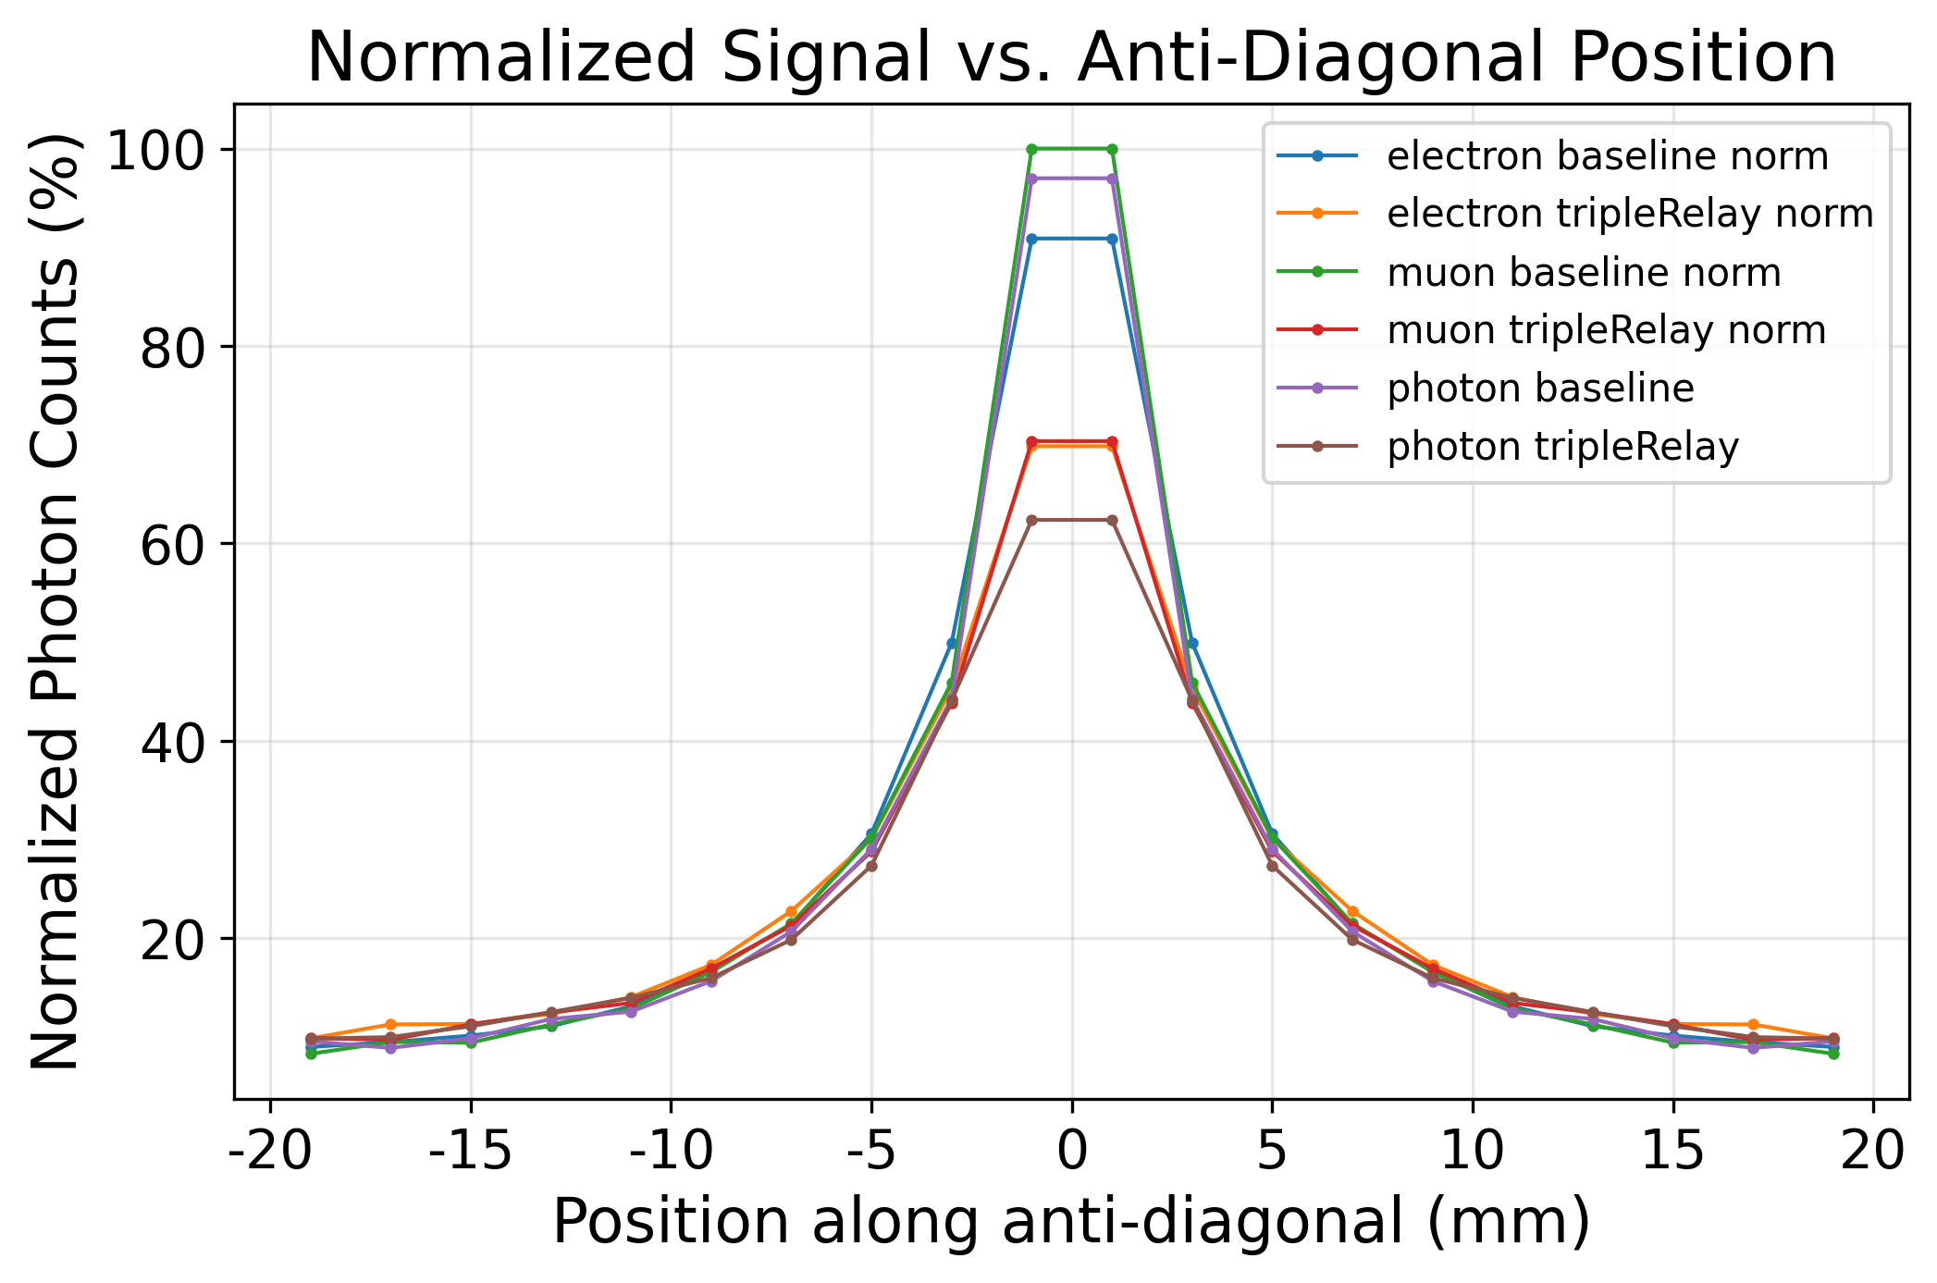
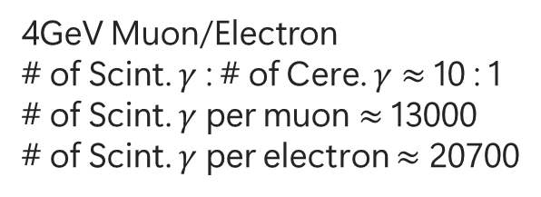
Muon/Photon/Electron Source Comparison
4GeV Muon/Electron
# of Scint. $γ$ : # of Cere. $γ$ $≈$ 10 : 1
# of Scint. $γ$ per muon $≈$ 13000
# of Scint. $γ$ per electron $≈$ 20700
 | Relative LCE | Uncertainty
muon baseline | 100.07% | 3.40%
electron baseline | 103.33% | 4.27%
photon baseline | 100% | 2.98%
electron tripleRelay | 105% | 4.23%
muon tripleRelay | 101.96% | 3.42%
photon tripleRelay | 97.67% | 3.06%
Conculsion:
Compared to photon point source, muon/electron induced photons have direction dependency, which makes the LCE higher at the vicinity of SiPM, becomes marginal at further locations.
No significant difference in result after normalization.
Notes:
To see if we can boost the LCE while also improve the uniformity, we experiments with different geometry.
Here are the compilation of the results and we see that for double relay configuration, the LCE exceeds Non PLG version.

Slide 16
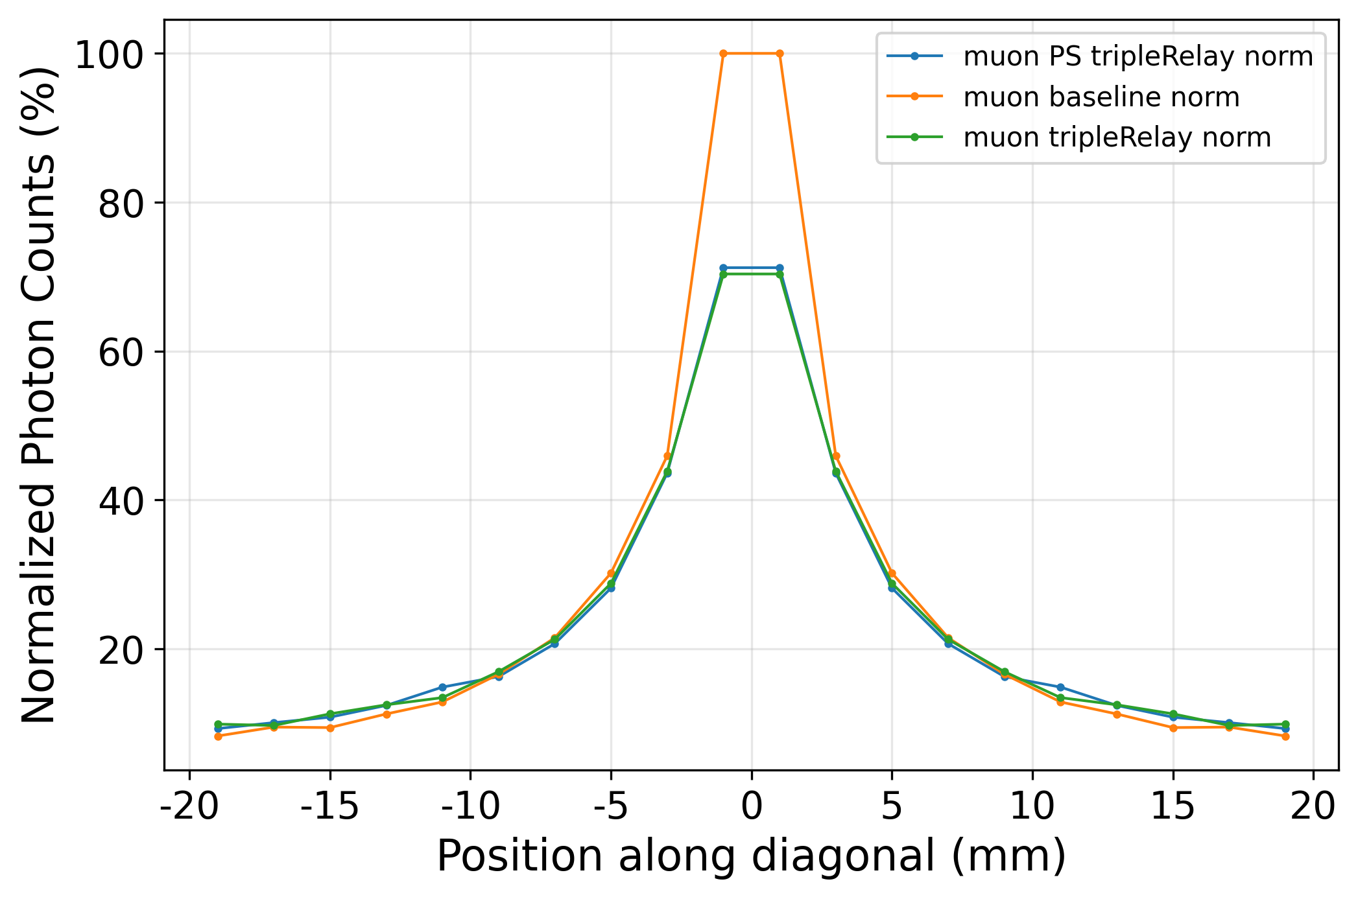

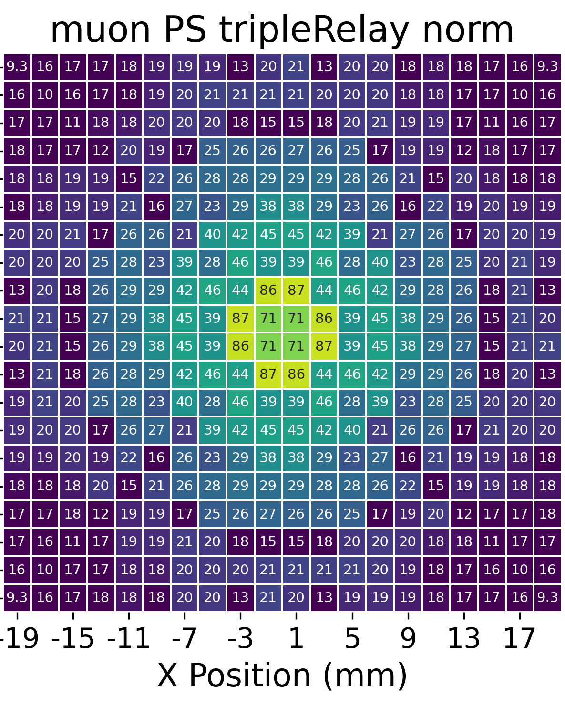
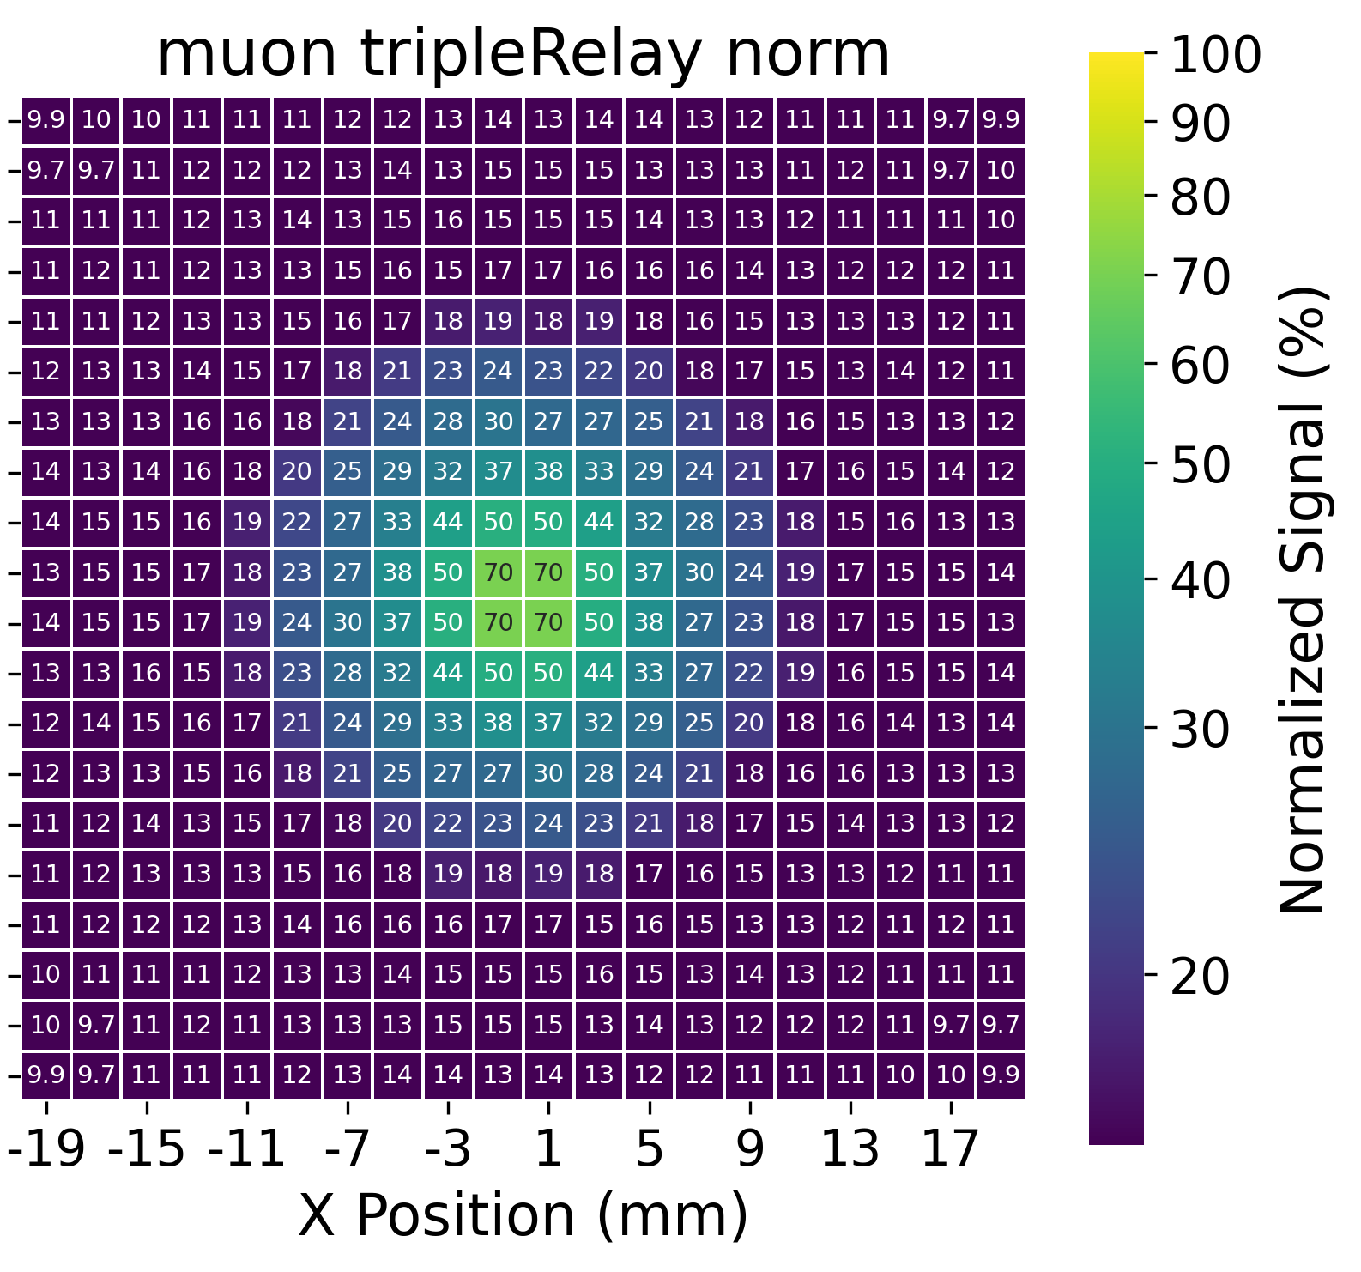

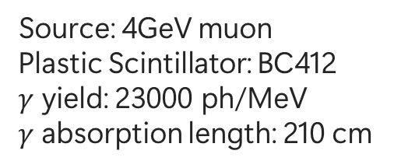
Plastic Scintillator vs. PMMA
Source: 4GeV muon
Plastic Scintillator: BC412
$γ$ yield: 23000 ph/MeV
$γ$ absorption length: 210 cm
Diagonal LCE cannot effectively show the uniformity change
Non-uniformity $≡\frac{Standard Deviation}{Mean}$
Lower = Better uniformity
LCE: 100%
LCE: 143%
LCE: 101%
 | Non-uniformity
Baseline | 0.7252
PS triple relay | 0.5295
PMMA triple relay | 0.5425
Red dashed line = Chamfer cut area = Less plastic scintillator material
Conclusion: LCE from air gaps among the relay rings show the contribution of plastic scintillator in producing addition photons.
Notes:
To see if we can boost the LCE while also improve the uniformity, we experiments with different geometry.
Here are the compilation of the results and we see that for double relay configuration, the LCE exceeds Non PLG version.

Slide 17
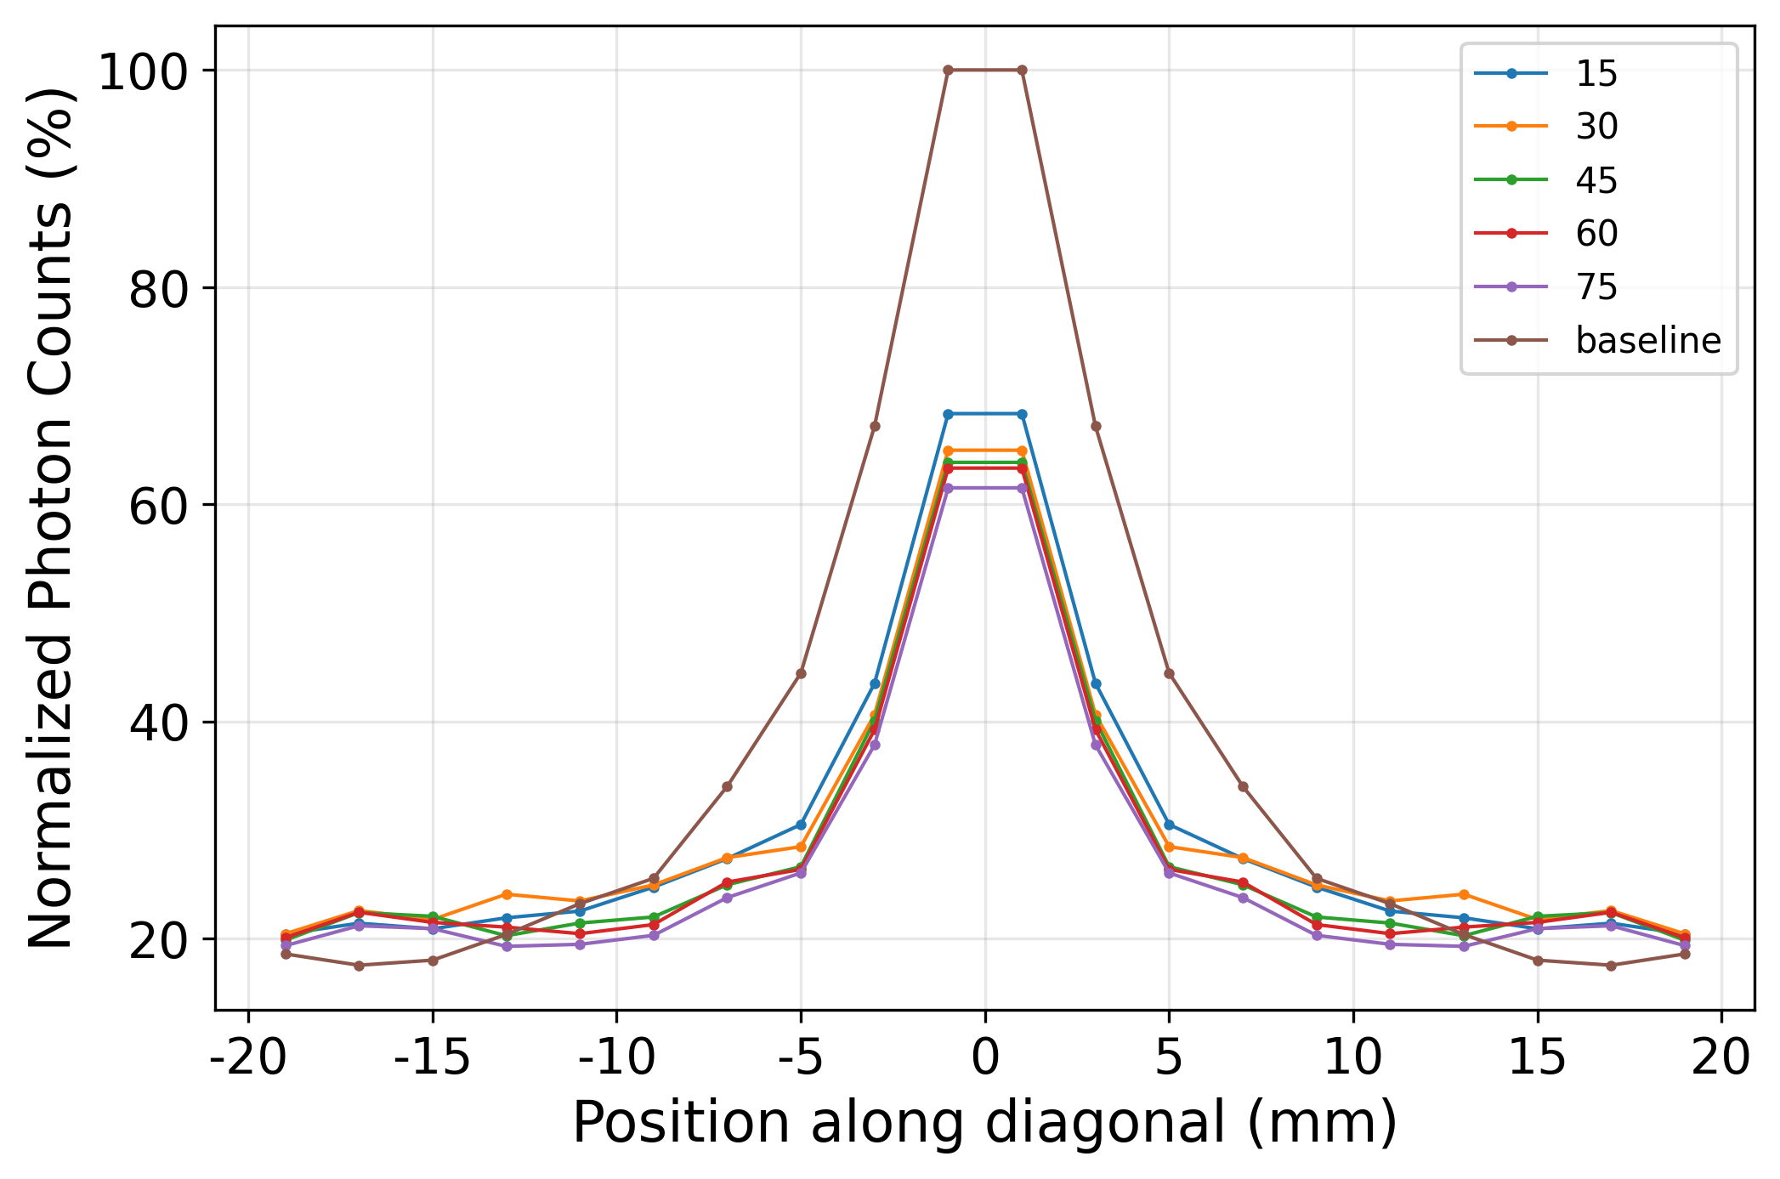
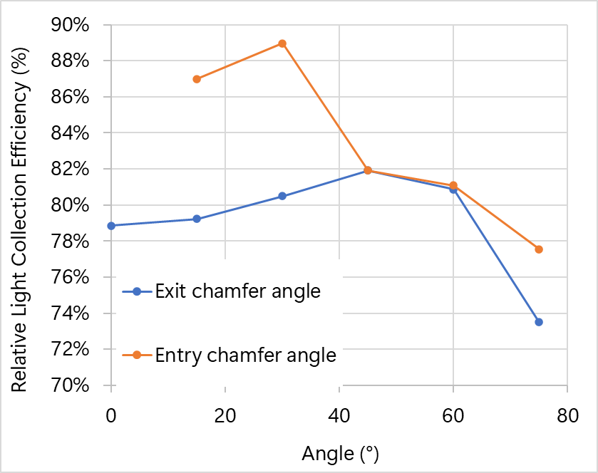
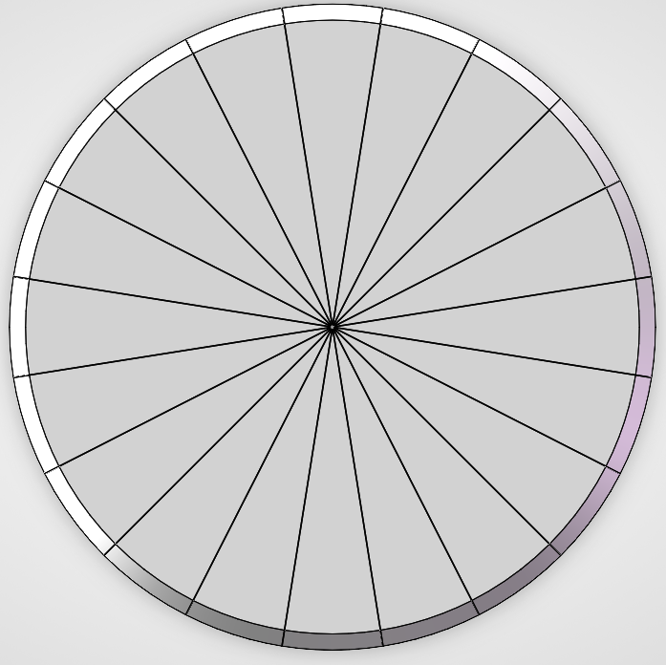
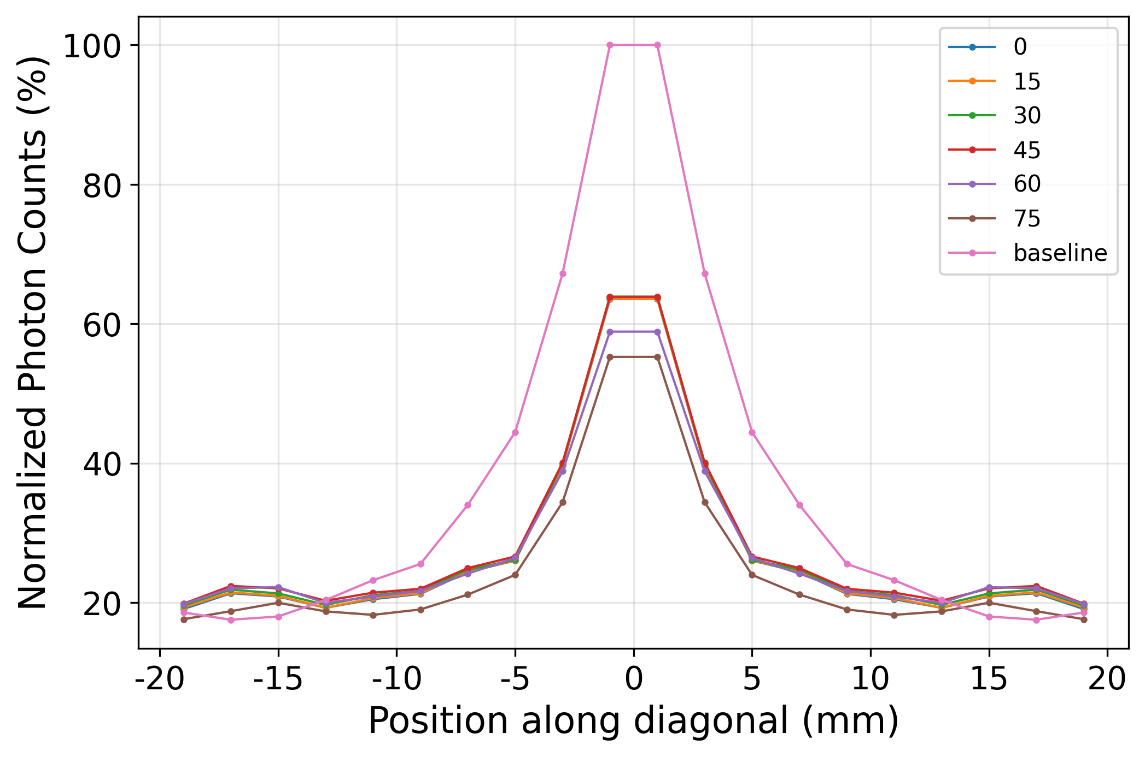
Chamfer Angle Study
Response uniformity with different entry chamfer angle
Entry
Exit
Response uniformity with different exit chamfer angle
Notes:
To further improve the performance of the PLG. We did some rudimentary study on the geometric parameters of the design.
Take the single circular disk as an example. The entry and exit chamfer angle has noticeable effects on the LCE and response uniformity, following different patterns.

Slide 18
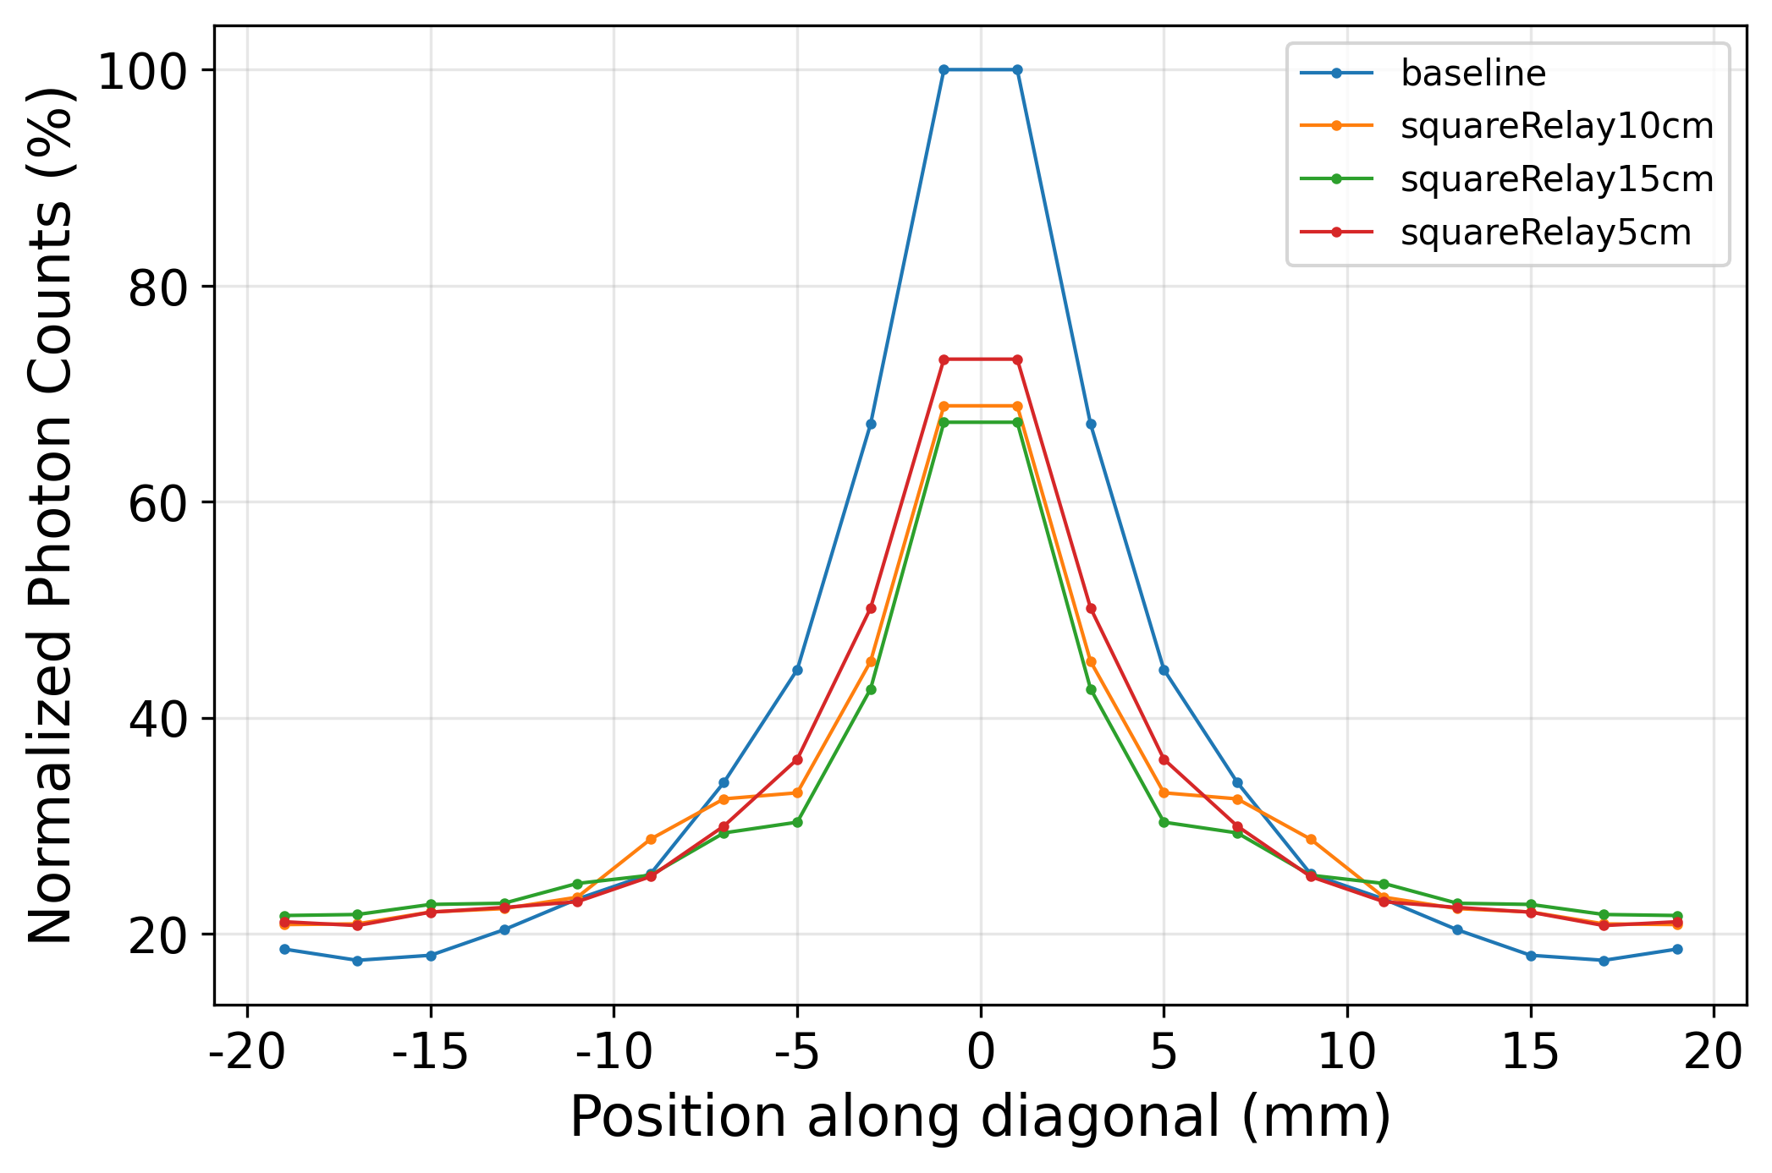
Relay Position Study
Relay position | Relative LCE
(mm) | (%)
5 | 94.7
10 | 95.6
15 | 93.4
Conclusion: The relay position has a more noticeable effect on the response uniformity profile than the average LCE.
Notes:
For configurations using relays. The position of the relay point also have an effect on the performance of PLG.
Here we take the single relay configuration as an example. Simply by moving the replay position, the response uniformity changes accordingly. However, we see that the average light collection efficiency do not change much.

Slide 19
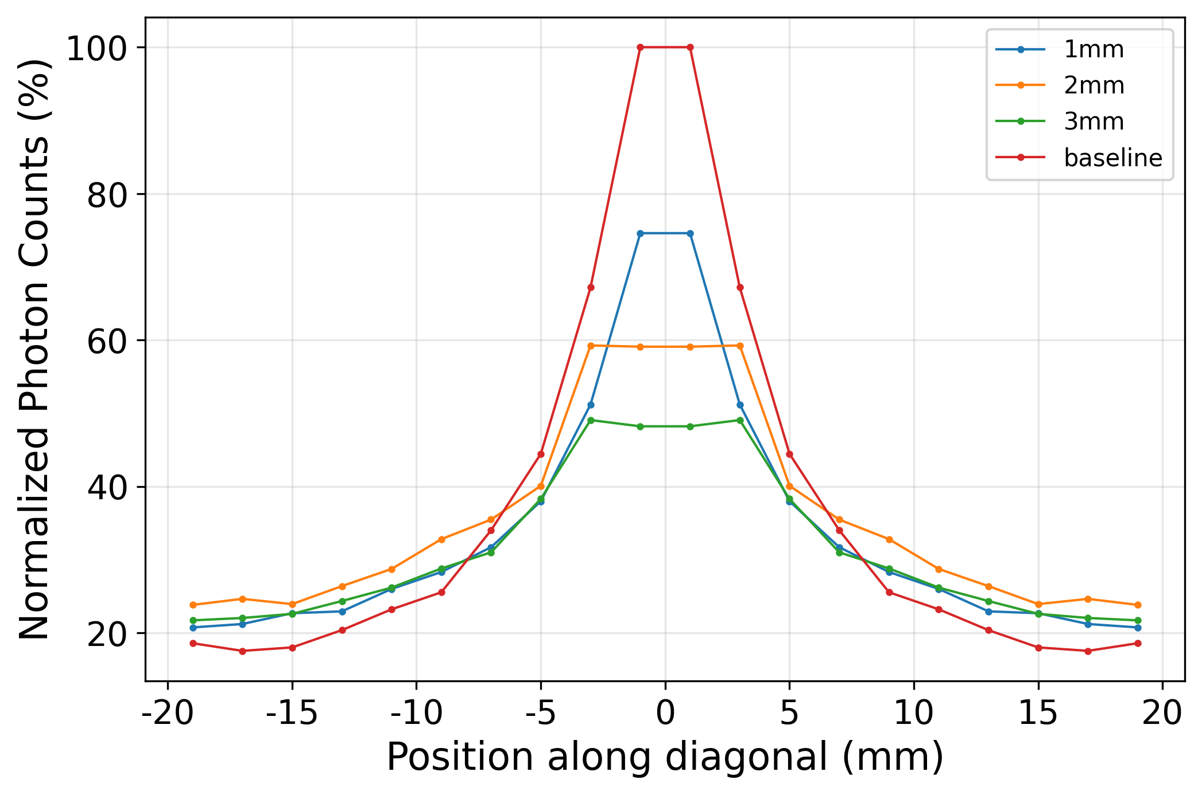

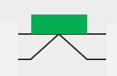
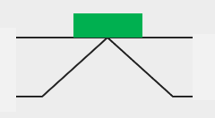
PLG Thickness Study
PLG thickness | Relative LCE
(mm) | (%)
1 | 100.5
2 | 110.5
3 | 99.6
Conclusion: The benefit of increasing the thickness (chamfer area) is not monotonic.
Trade-off decision between LCE and uniformity profile should based on application requirement.
Notes:
Aside from the chamfer angle and relay position. The thickness of the PLG also plays an important role in modifying the LCE and the uniformity.
We can see that as we increase the thickness, we are doing 2 things simultaneously: 1 is that we are increasing the chamfer surface area, so that more photons will be reflected in the PLG on both entry and exit chamfers. 2 is that we are moving the SiPM away from the scintillator, thus reducing the possibility of photons entering the SiPM directly.
So there’s a trade-off between the LCE and uniformity profile, and should be optimized based on specific application.

Slide 20
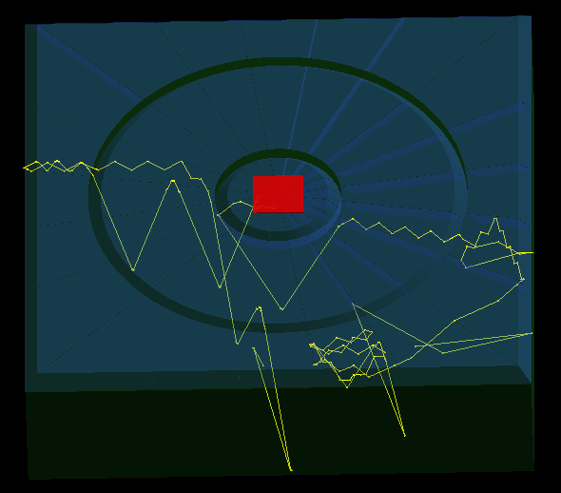
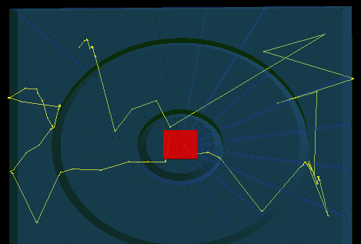
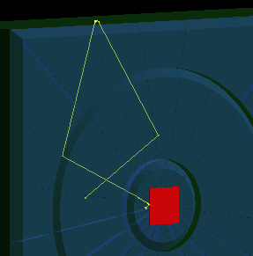
Photon Track Scenario
Photons entering the SiPM directly, w/o the need of PLG.
Reflection of photons at the entry chamfers, on different PLG ring.
TIR inside PLG.
Photon can “hop” through the gap between PLG rings due to TIR angle.

