Slide 1





Development of the Muon Trigger Detector for the muEDM Experiment at PSI
Xingyun Huang
2026/07/16

Slide 2
01.
Motivation
03.
Test Beam 2025
02.
Muon Trigger Detector
04.
Conclusion

Slide 3
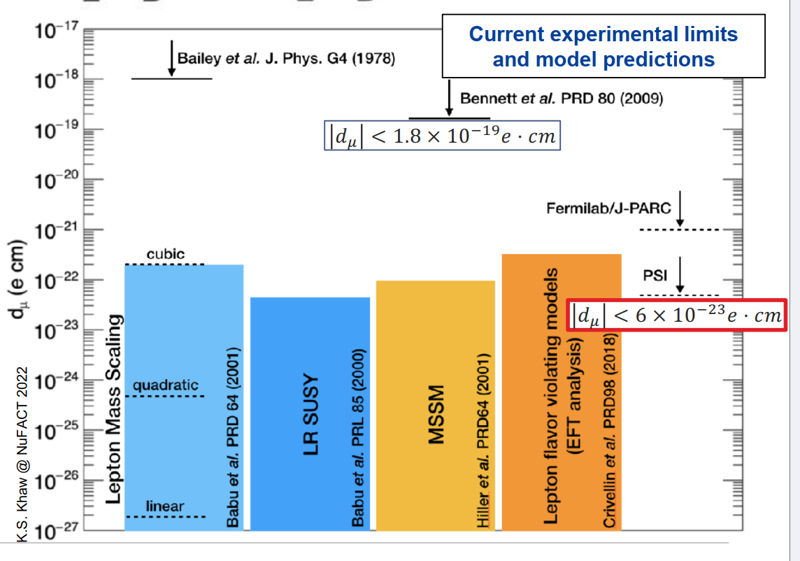
Motivation
Matter-antimatter asymmetry:
Sakharov Conditions: CP violation is necessary
In SM, CP violation mainly comes from phase of CKM matrix, far from enough to explain Matter-antimatter asymmetry
Search for EDM of muon:
CP violation also contribute to the EDMs of elementary particles
Several BSM theories give much higher EDM values compared to SM

Slide 4
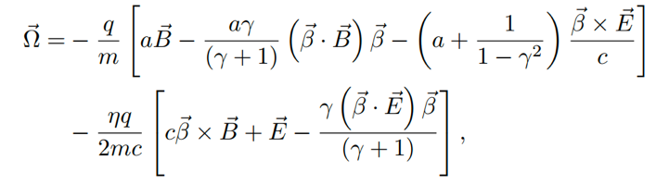
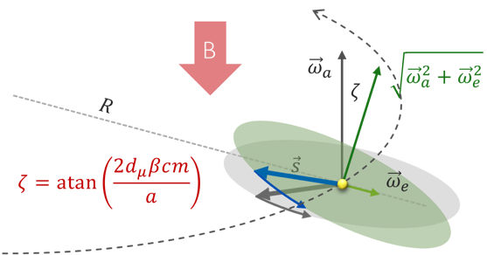
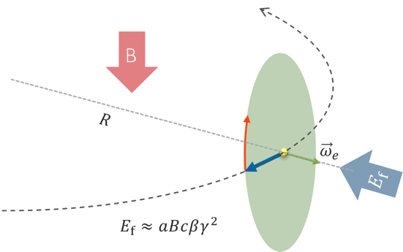
Frozen-spin technique
muEDM Experiment at PSI:
Phase 1: 28 MeV/c beam aim at a sensitivity of 10⁻²¹ e﻿⋅cm
Phase 2: 125 MeV/c beam aim at a sensitivity of 10⁻²³ e﻿⋅cm
Frozen-Spin technique:
～mrad
FNAL/J-PARC
g-2 experiment
muEDM experiment
with frozen-spin

Slide 5
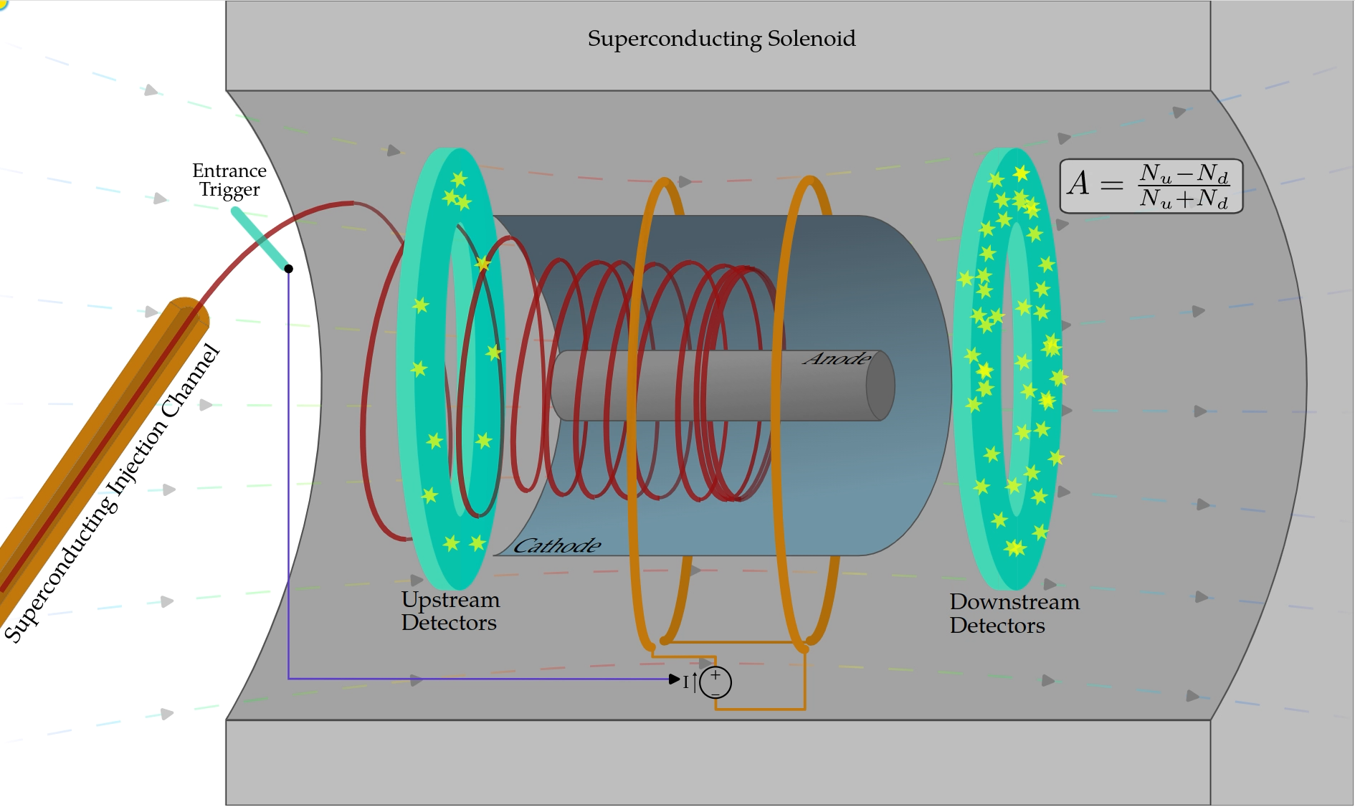
muEDM Experiment at PSI
Animation by C. Dustov

Slide 6
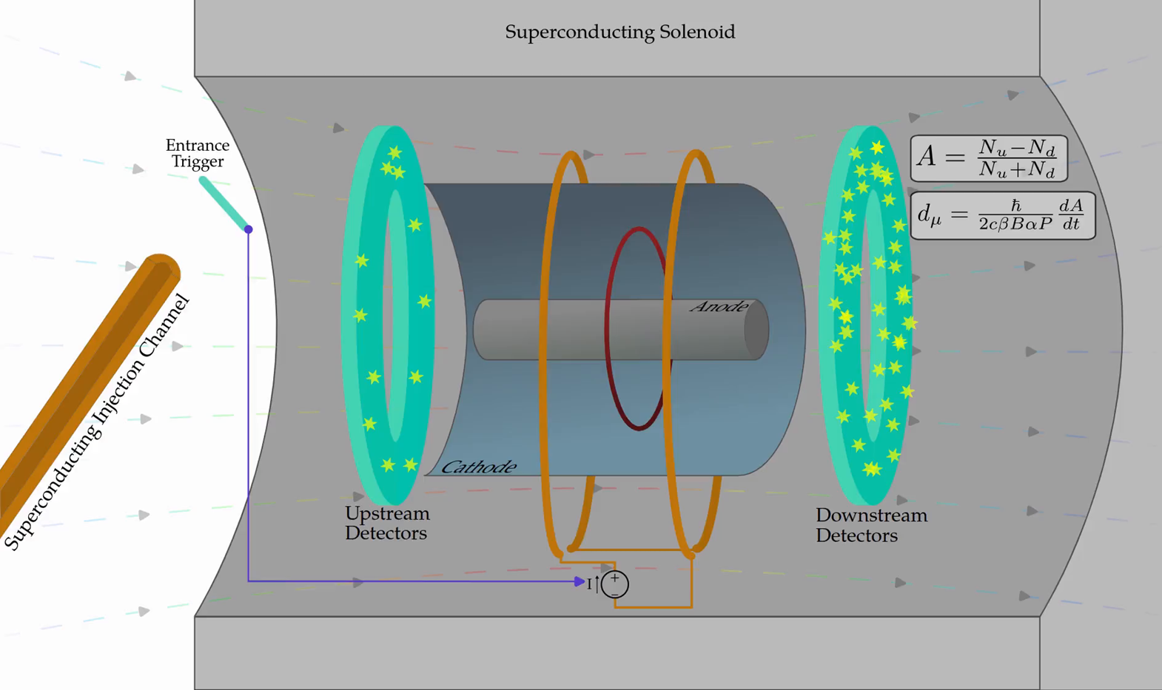
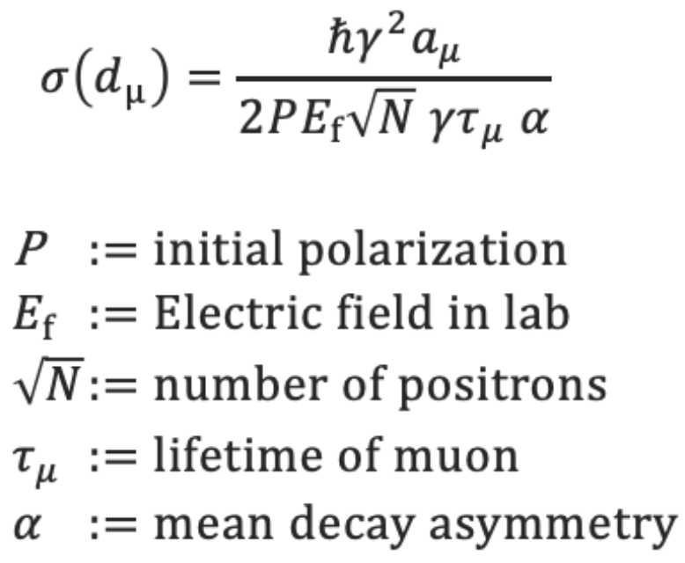
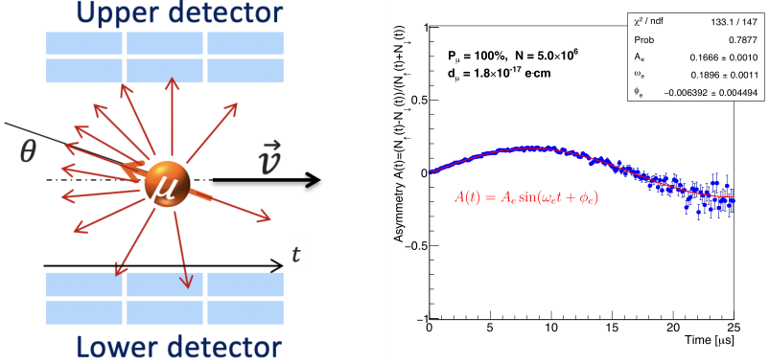

muEDM Experiment at PSI
Sensitivity from the asymmetry, “PENTA”:
$μ$EDM signal
Animation by C. Dustov

Slide 7
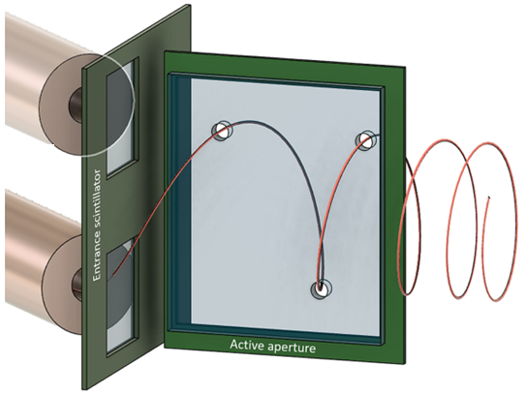
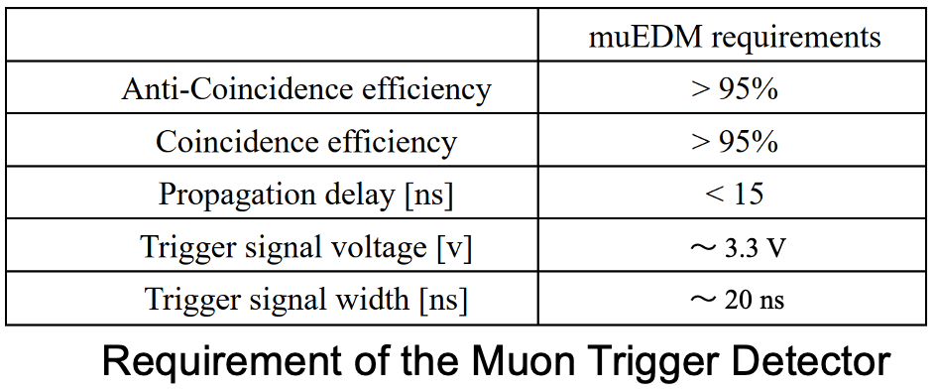
Muon Trigger Detector
Only roughly 500 out of 120 kHz could be stored.
MTD is responsible for detecting the injection of the muons and distinguishing wether it could be stored.
If the muon could be stored, a TTL signal is sent to the Kicker system.
Requirements of the MTD:
Fast enough to trigger the kicker.
High coincidence and anti-coincidence efficiencies.

Slide 8
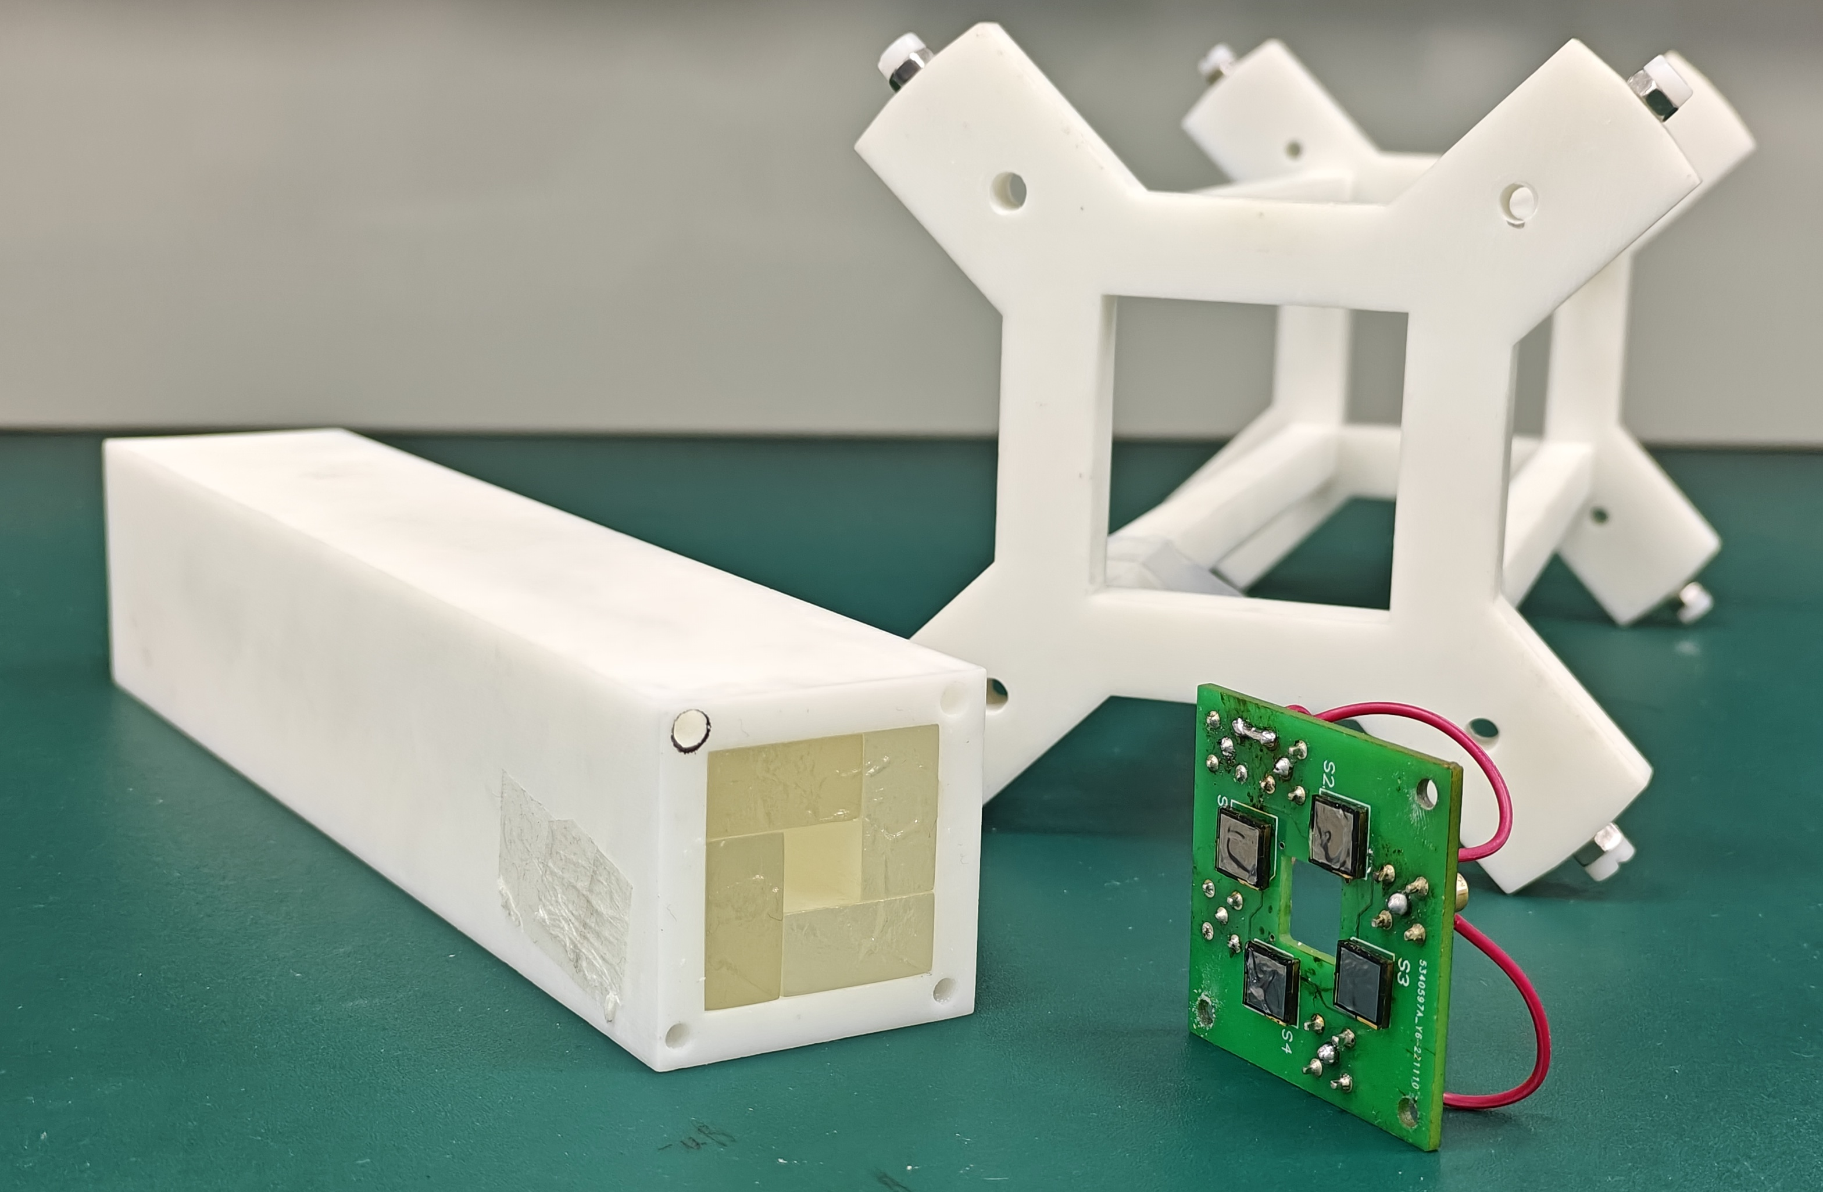
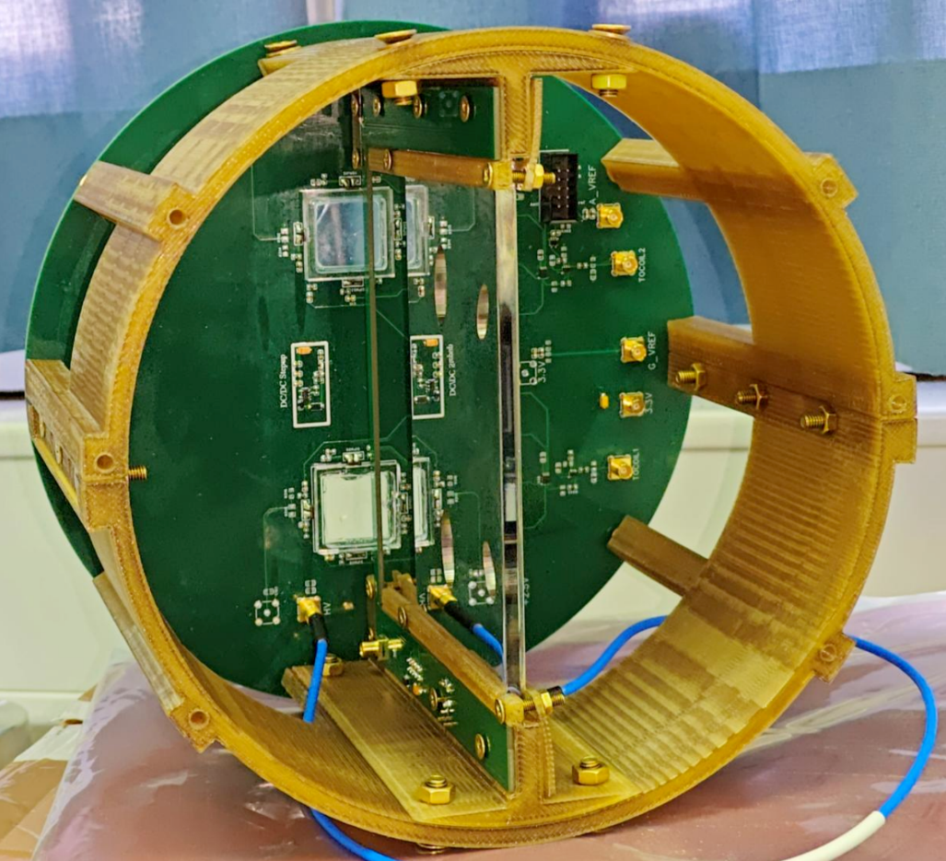
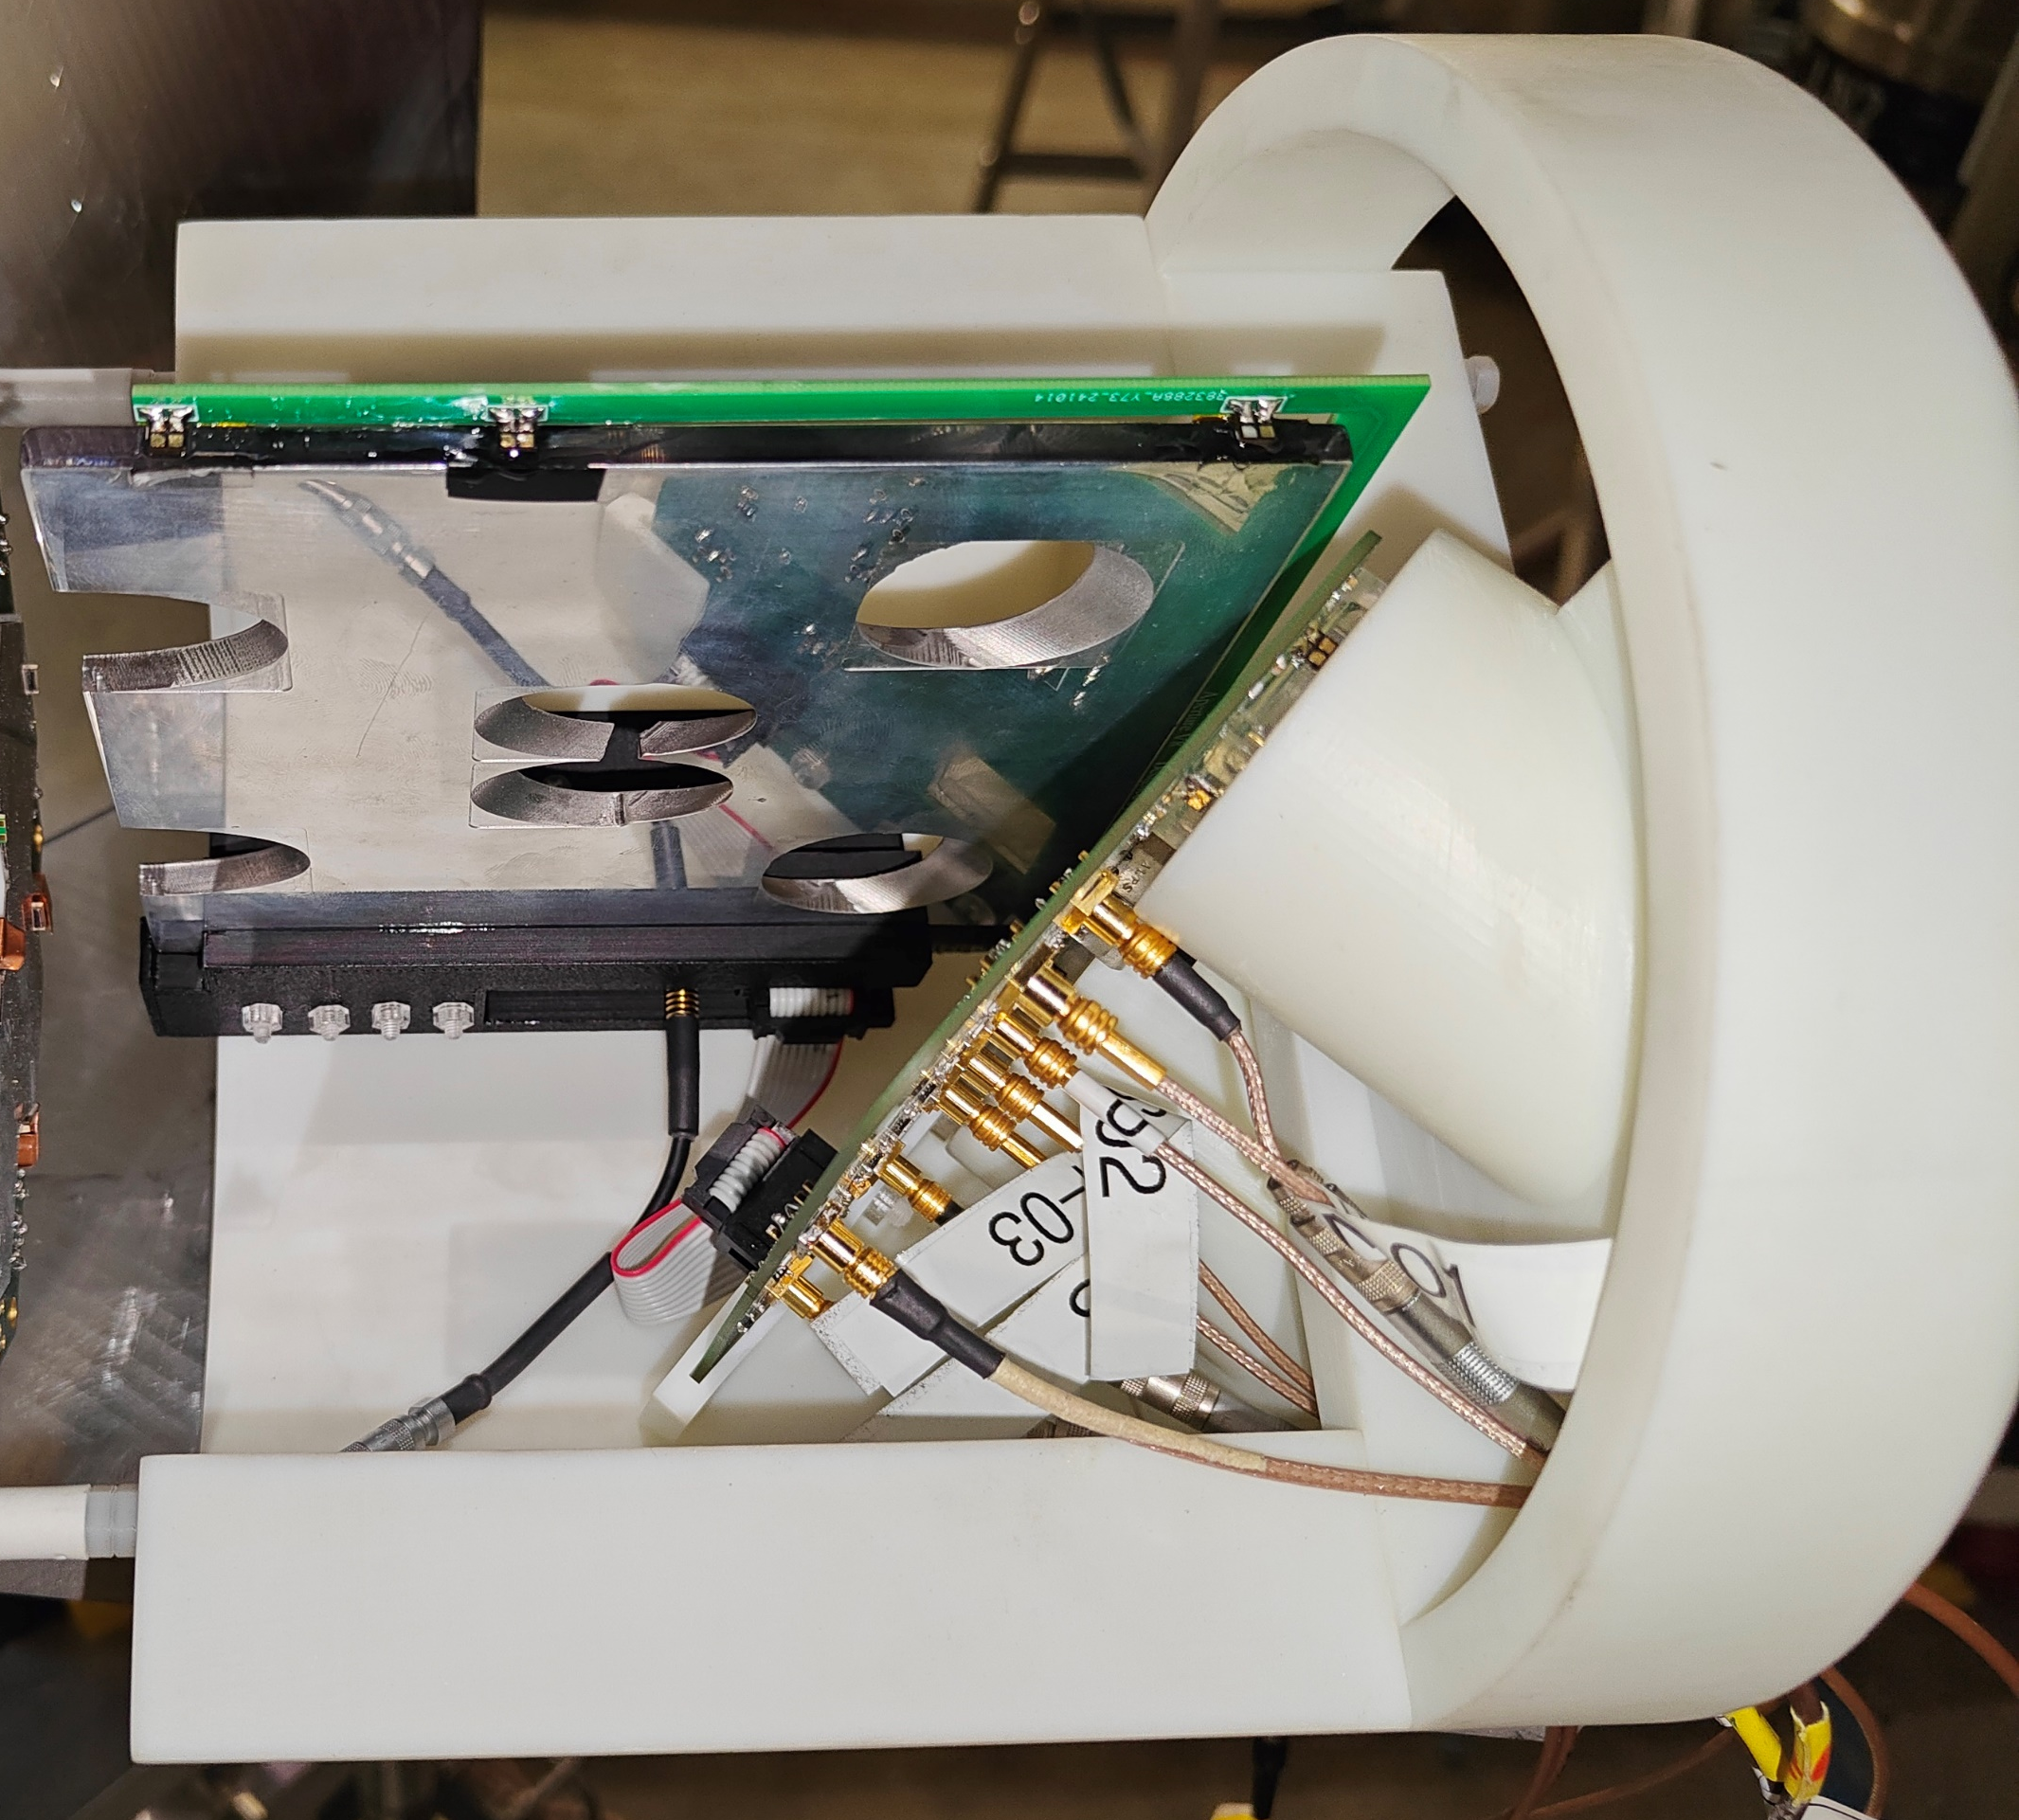
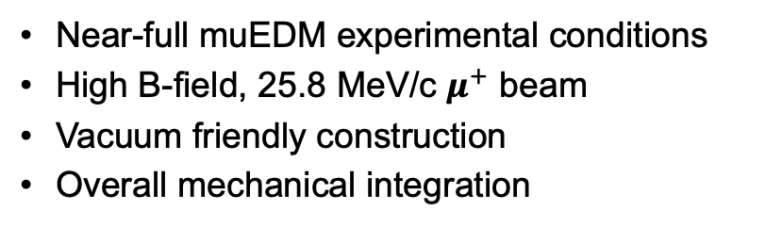
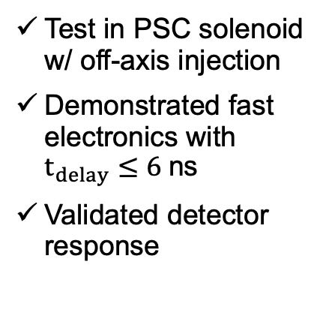
Development of the Muon Trigger Detector
Test beam 2022: proof-of-concept
Test beam 2025: prototype v2
Minimal setup, decided detector options
Demonstrated anti-coincidence trigger scheme
Test beam 2024: prototype v1
Test in PSC solenoid w/ off-axis injection
Demonstrated fast electronics with $t_{delay}≤6$ns
Validated detector response
Near-full muEDM experimental conditions
High B-field, 25.8 MeV/c $μ^{+}$ beam
Vacuum friendly construction
Overall mechanical integration

Slide 9
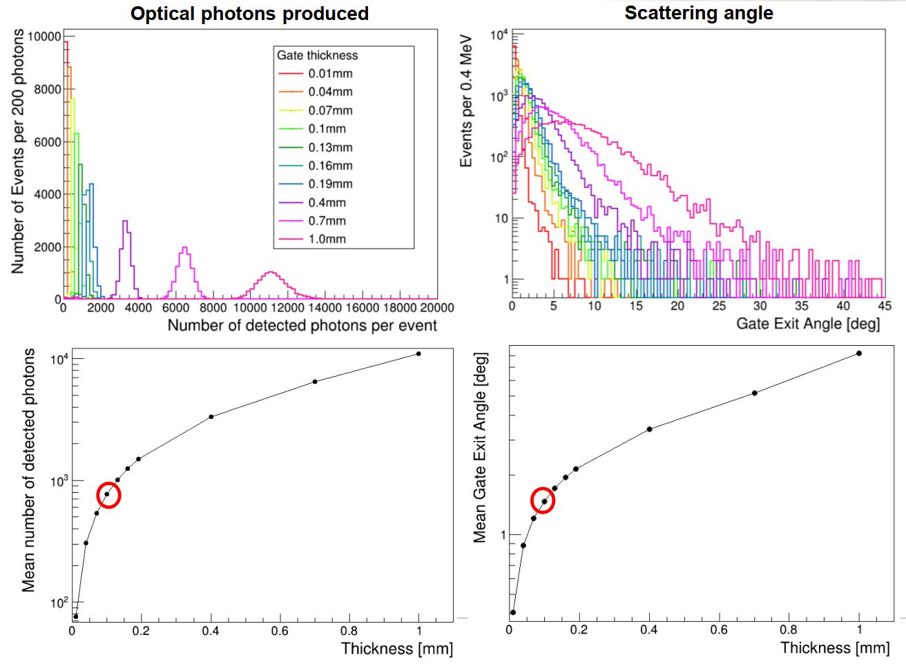
Gate scintillator
Decide the thickness of gate scintillators:
Too thin: no enough photon to trigger SiPMs
Too thick: strongly distrube the motion of muons
﻿Geometry constraining the scattering angle 𝜽 ≤ 𝟏. 𝟒 𝒅𝒆𝒈
0.1 mm thickness give optimal results
DOI: 10.1016/j.nuclphysbps.2024.05.014
DOI: 10.1007/s41605-025-00570-4

Slide 10

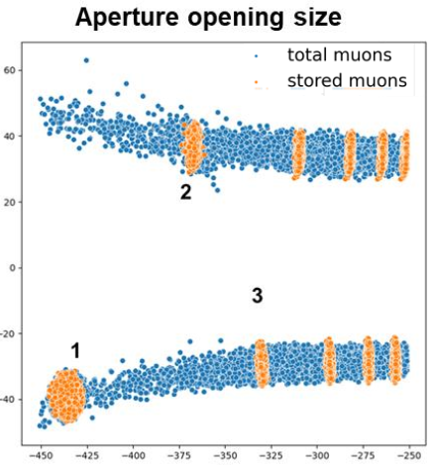
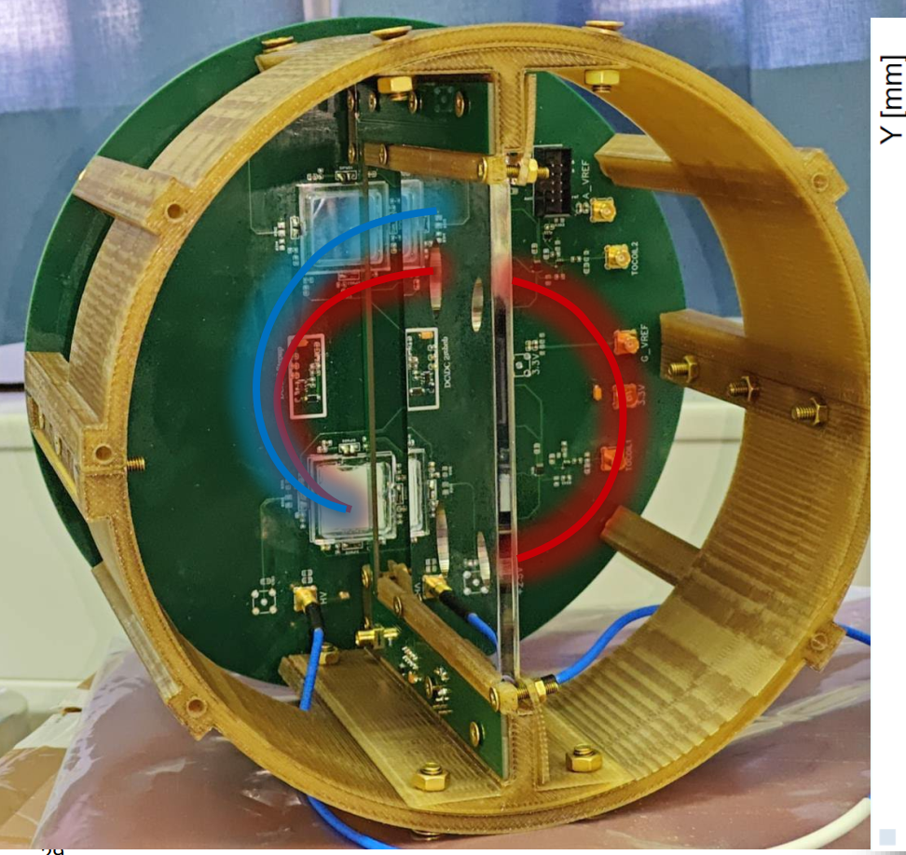
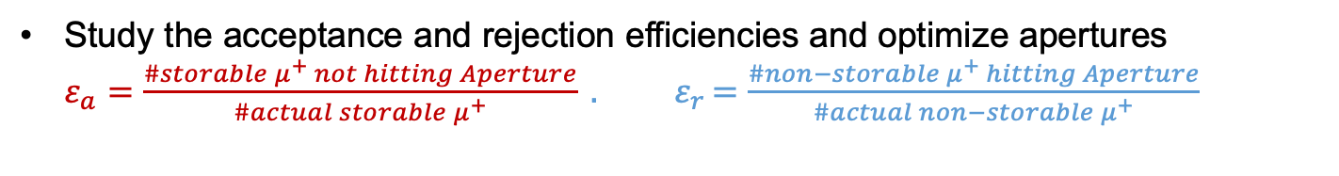
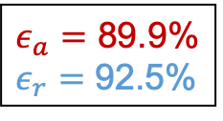

Aperture scintillator
$ε_{a}=$ 89.9%
$ε_{r}=$ 92.5%
$$ε_{sto}≈0.17\%$$
Phase spaces are obtained to guide the design of Aperture
Study the acceptance and rejection efficiencies and optimize apertures
$ε_{a}=\frac{\#storable μ^{+} not hitting Aperture}{\#actual storable μ^{+}} {. ε}_{r}=\frac{\#non−storable μ^{+} hitting Aperture}{\#actual non−storable μ^{+}}$

Slide 11
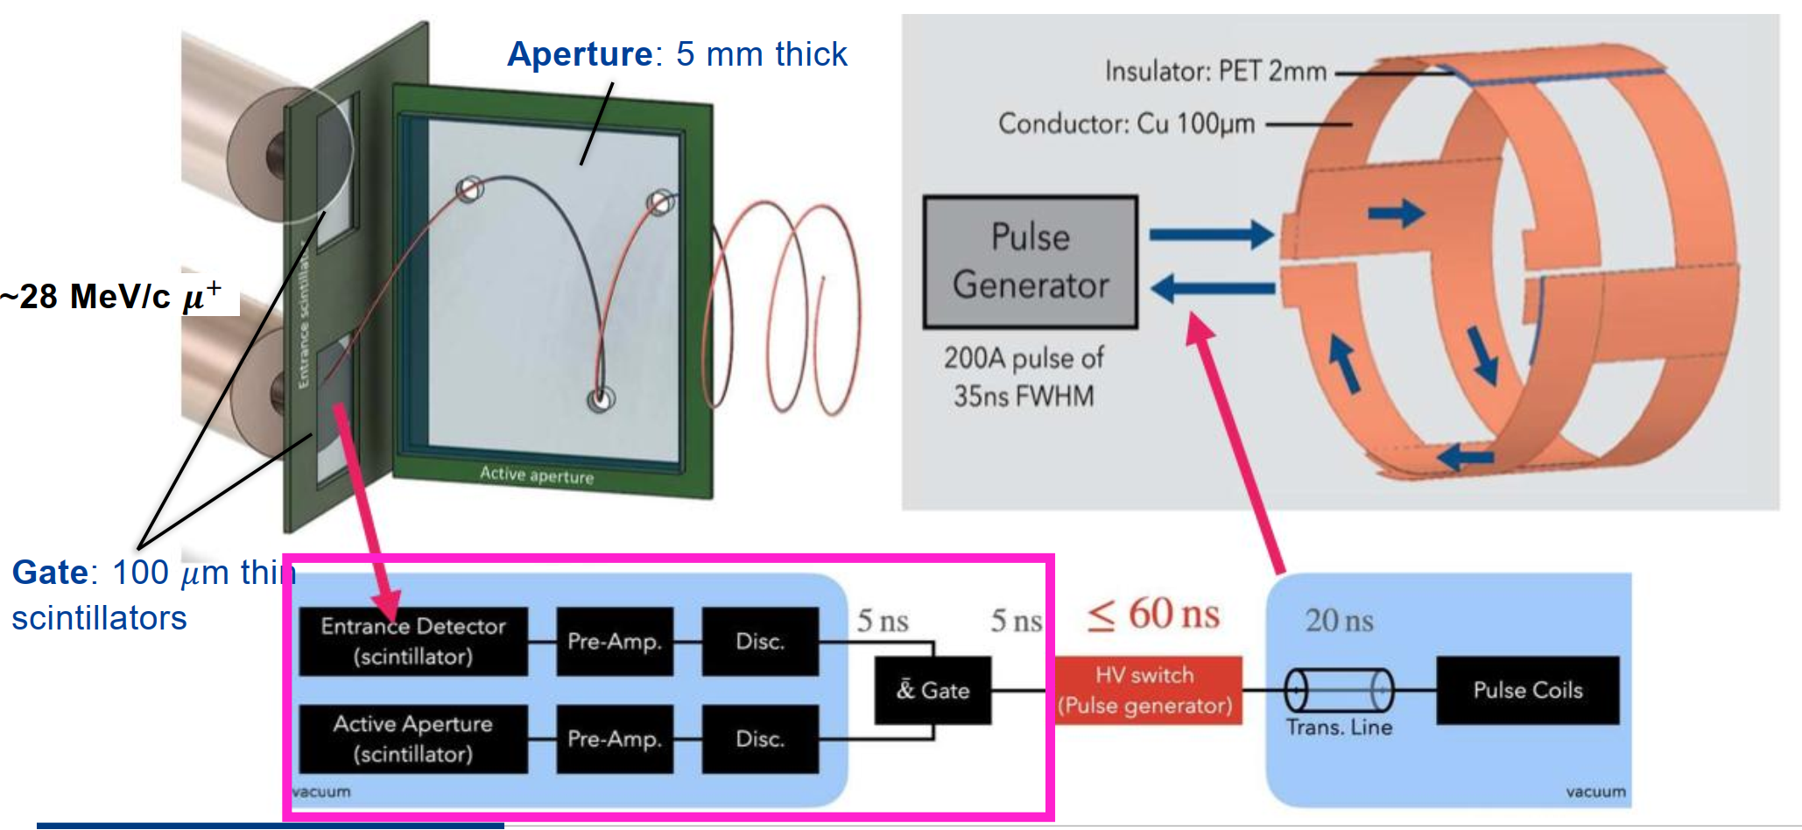
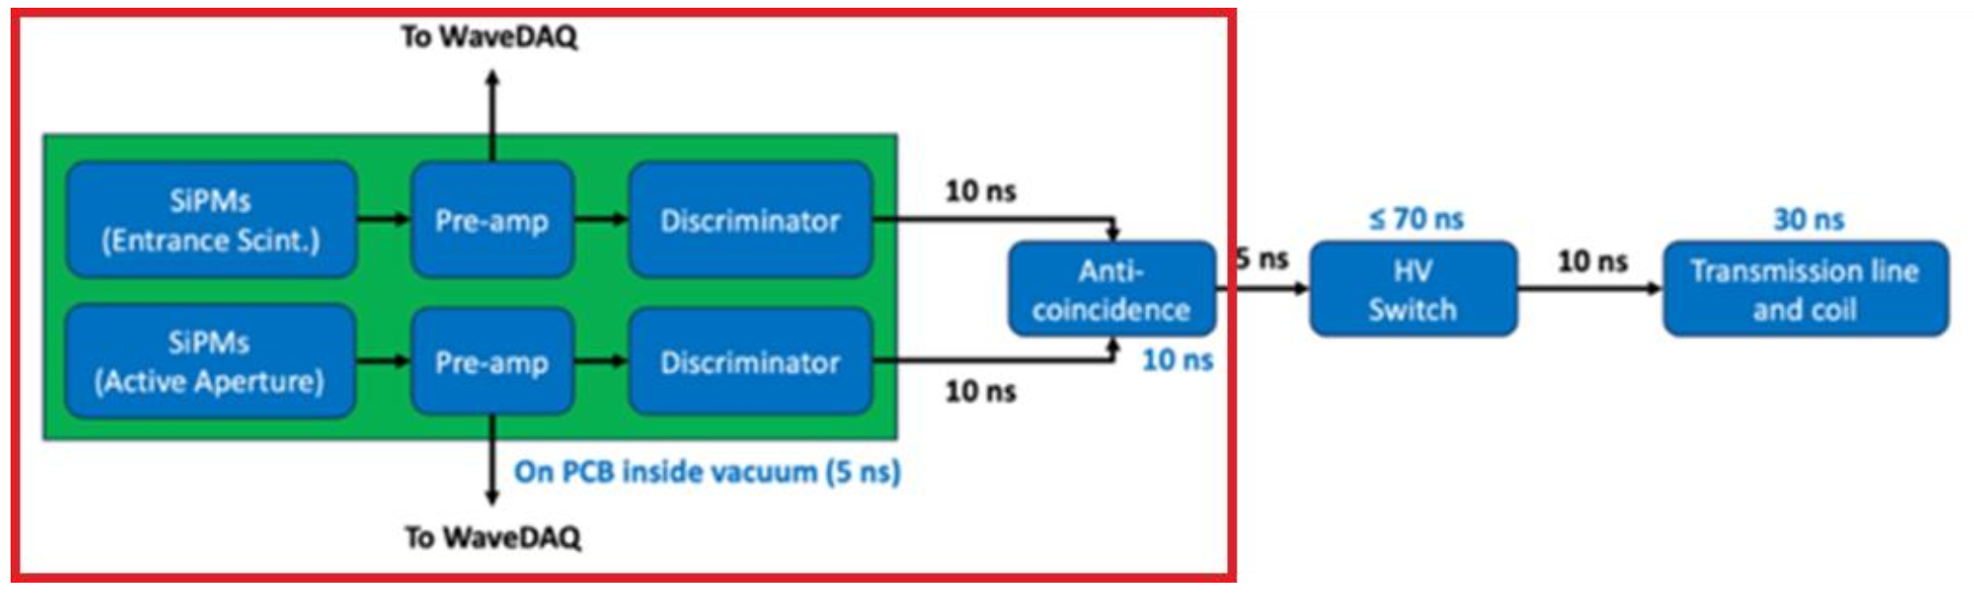
Electronics
Electronics sketch of the trigger detector during TB24

Slide 12
Fast electronics
SiPM
SiPM
SiPM
SiPM
SiPM
SiPM
SiPM
SiPM
SiPM
SiPM
Amplifier
Amplifier
Amplifier
Amplifier
Amplifier
Discriminator
Discriminator
Discriminator
Discriminator
Discriminator
Converter
Converter
Converter
Converter
To DAQ
Converter
AND
AND
NAND
Aperture Detector
VCC
To DAQ
AND
To Coil
Gate Detector
DOI: 10.1109/TNS.2025.3578674

Slide 13
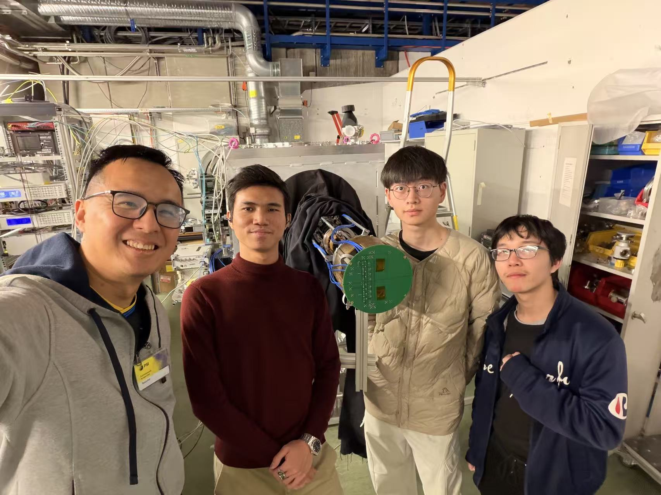
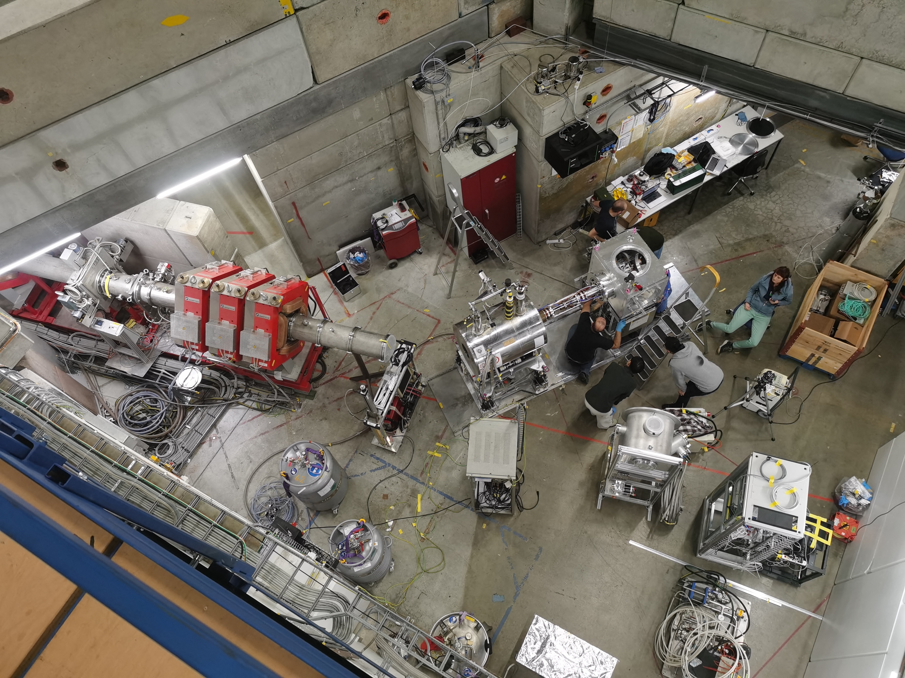
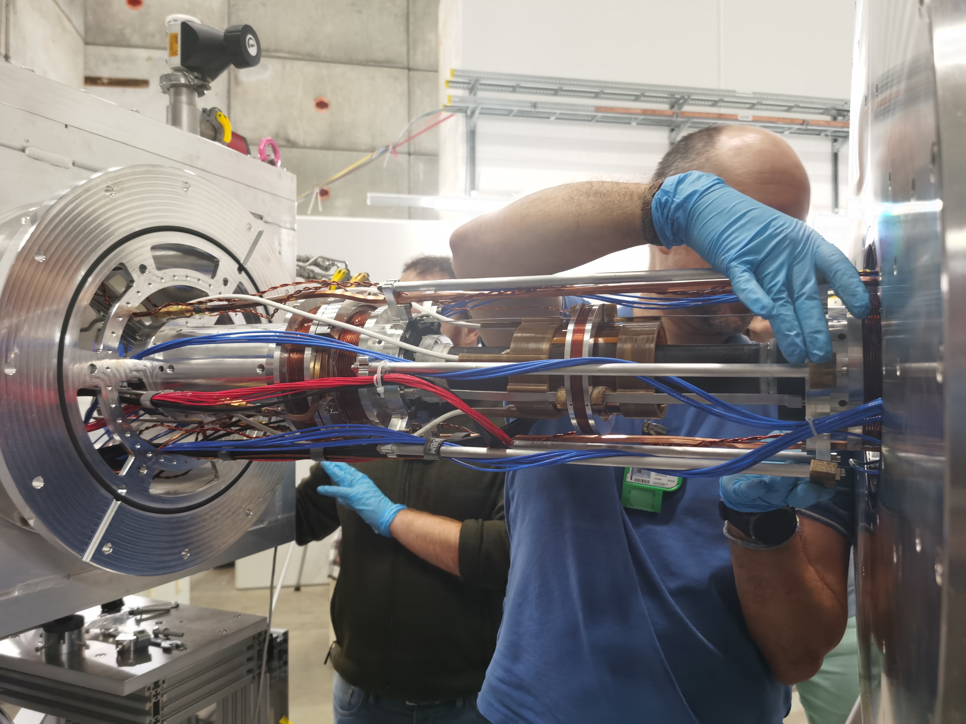
Test Beam

Slide 14
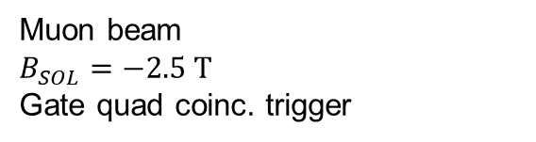

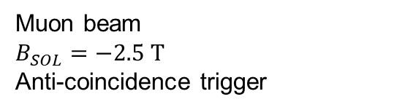
Propagation delay
Time of arrival (ToA) analysis to obtain propagation delay, $t_{pd}$
TB24: $t_{pd}≈5.92$ ns
Run 448
Muon beam
$B_{SOL}=−2.5 T$
Anti-coincidence trigger
Run 442
Muon beam
$B_{SOL}=−2.5 T$
Gate quad coinc. trigger

Slide 15
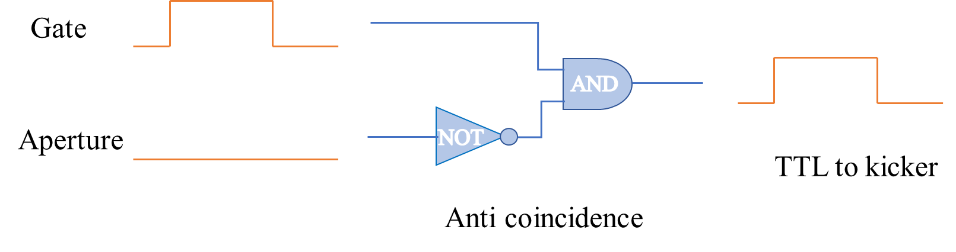
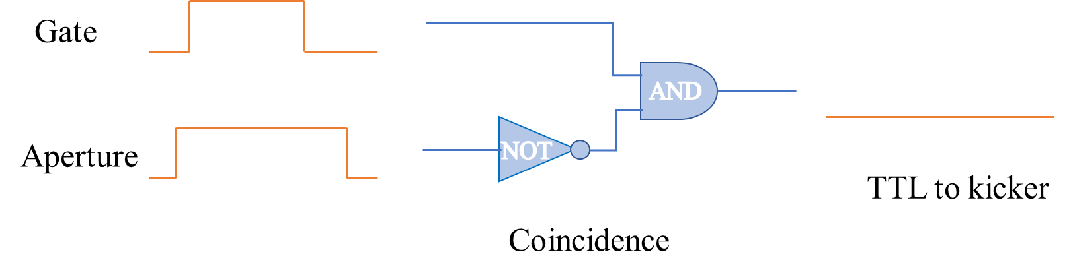
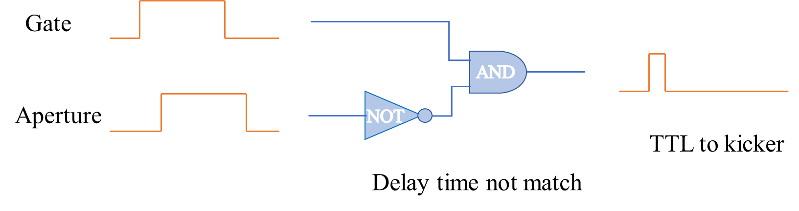
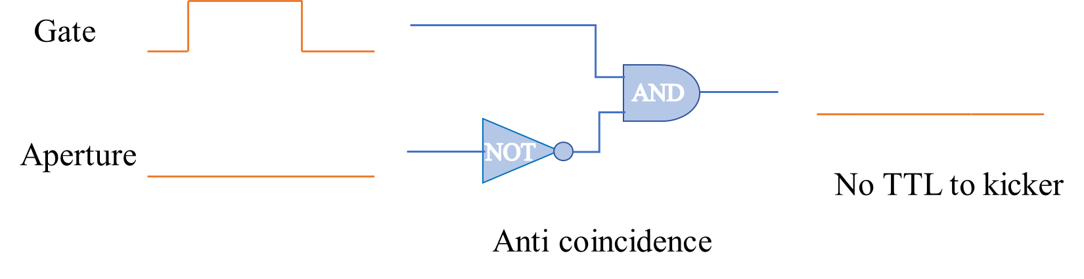
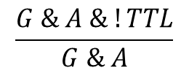
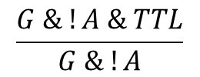
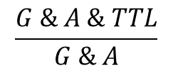
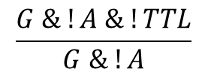
Event topology
No
Anti-coincidence efficiency:
$$\frac{G \& !A \& TTL}{G \& !A}$$
Coincidence efficiency:
$$\frac{G \& A \& !TTL}{G \& A}$$
Storable muons
Unstorable muons
False coincidence rate:
$$\frac{G \& A \& TTL}{G \& A}$$
$$\frac{G \& !A \& !TTL}{G \& !A}$$
False anti-coincidence rate:
Unstorable but triggered
Storable but not triggered

Slide 16
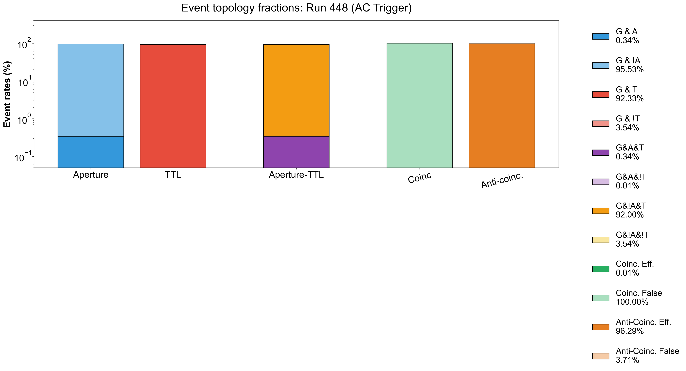
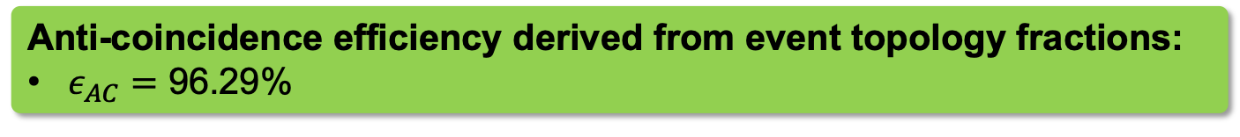
Event topology
DAQ Triggered by Anti-coincidence
Anti-coincidence efficiency derived from event topology fractions:
$ε_{AC}=$ 96.29%

Slide 17
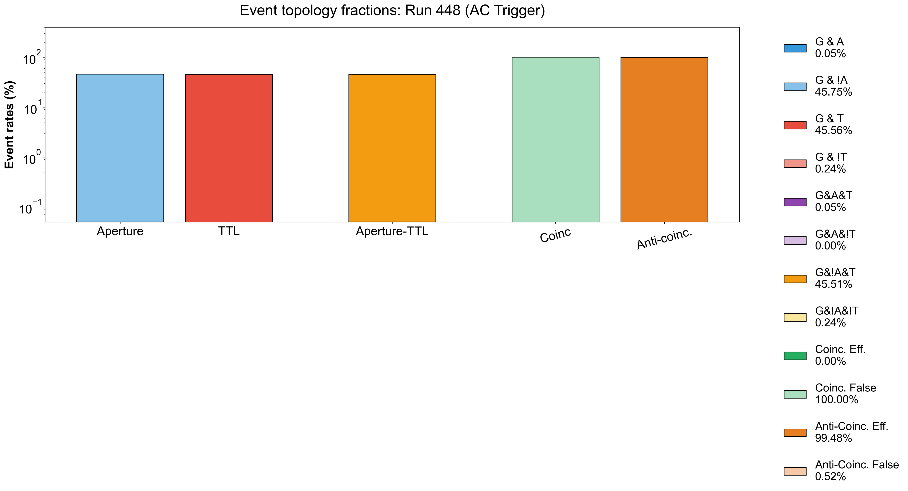
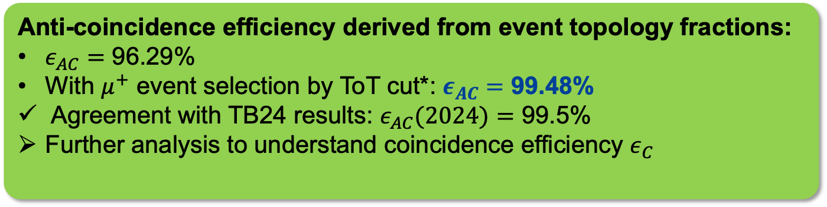
Event topology
DAQ Triggered by Anti-coincidence
With Muon Selection
Anti-coincidence efficiency derived from event topology fractions:
$ε_{AC}=$ 96.29%
With $μ^{+}$ event selection by ToT cut*: $ε_{AC}=$ 99.48%
Agreement with TB24 results: $ε_{AC}(2024)=$ 99.5%
Further analysis to understand coincidence efficiency $ε_{C}$

Slide 18
Conclusion
muEDM experiment aims at the sensitivity of 10⁻²³ e·cm with frozen-spin technique.
Muon Trigger Detector is responsible for distinguishing storable muons and trigger kicker coil.
  Fast enough to store muons. t_{pd} < 15 ns
  Very precise to increase trigger efficiencies.
Latest version was tested during Test Beam 2025 at PSI
  Propagation delay was measured to be 6.46 ns, smaller than the requirement
  Anti-coincidence was measured to be 99.48%, agree with result of TB24.
MTD upgrade
  Main functions outside of the vacuum chamber: stable environment and eazy to debug
  Hermetic veto detector and more SiPM channels
  Reliable anti-coincidence logic: Gate and Aperture arrival mismatch.

Slide 20
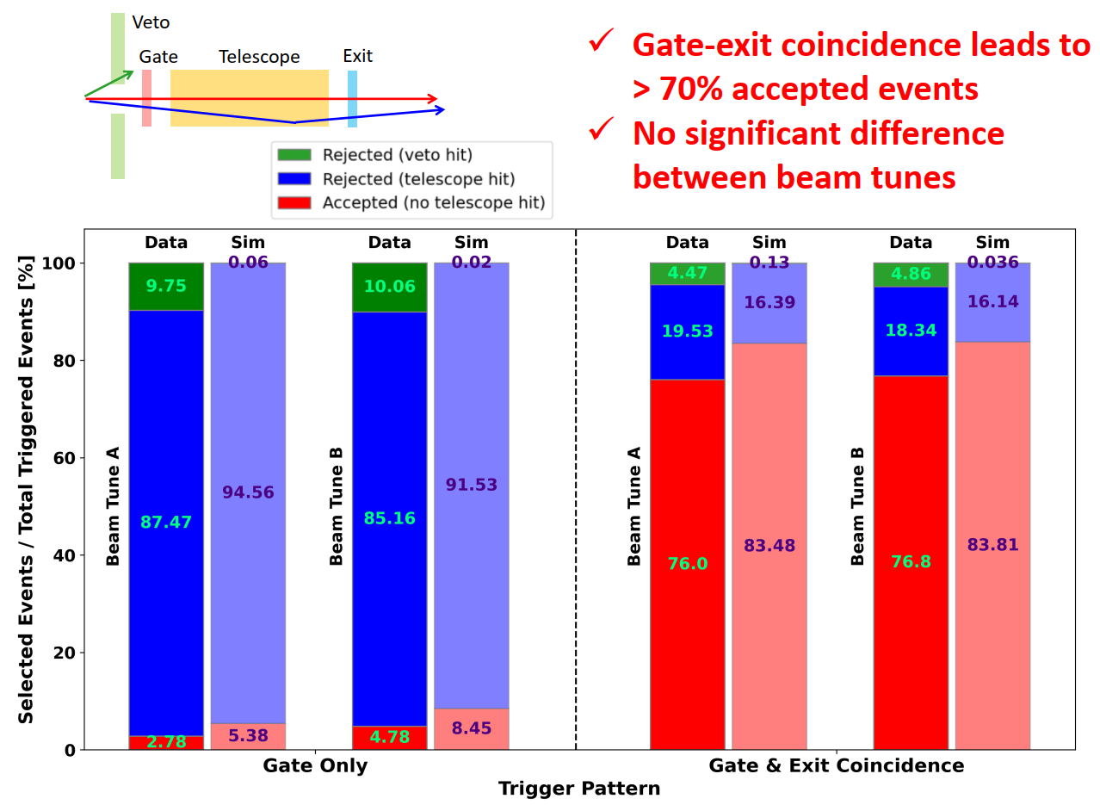
Test Beam 2022
﻿Gate-exit coincidence leads to > 70% accepted events
No significant difference between beam tunes
Published: https://doi.org/10.1007/s41605-025-00570-4

Slide 21
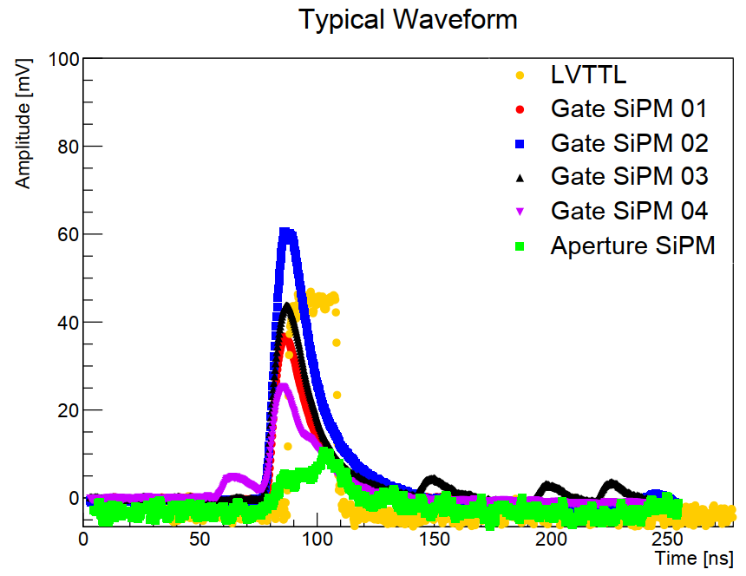
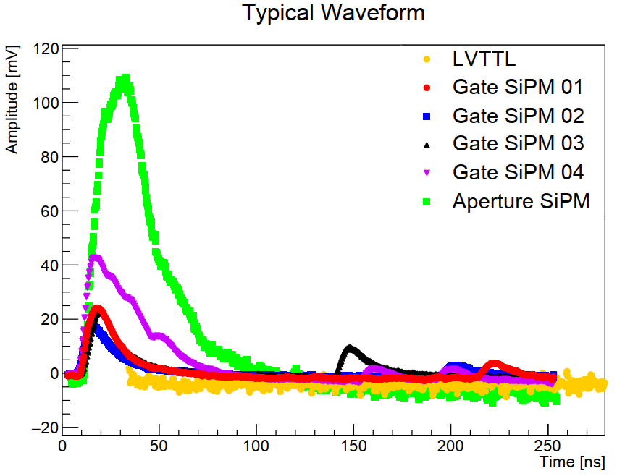
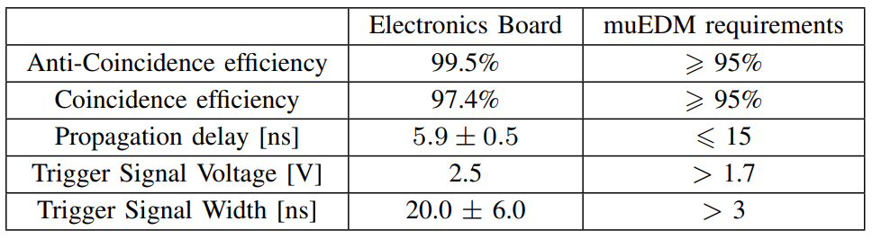
Test Beam 2024
Test beam 2024: prototype v1
Coincidence Logic
Anti-coincidence Logic
Key Parameters and Requirements

Slide 22
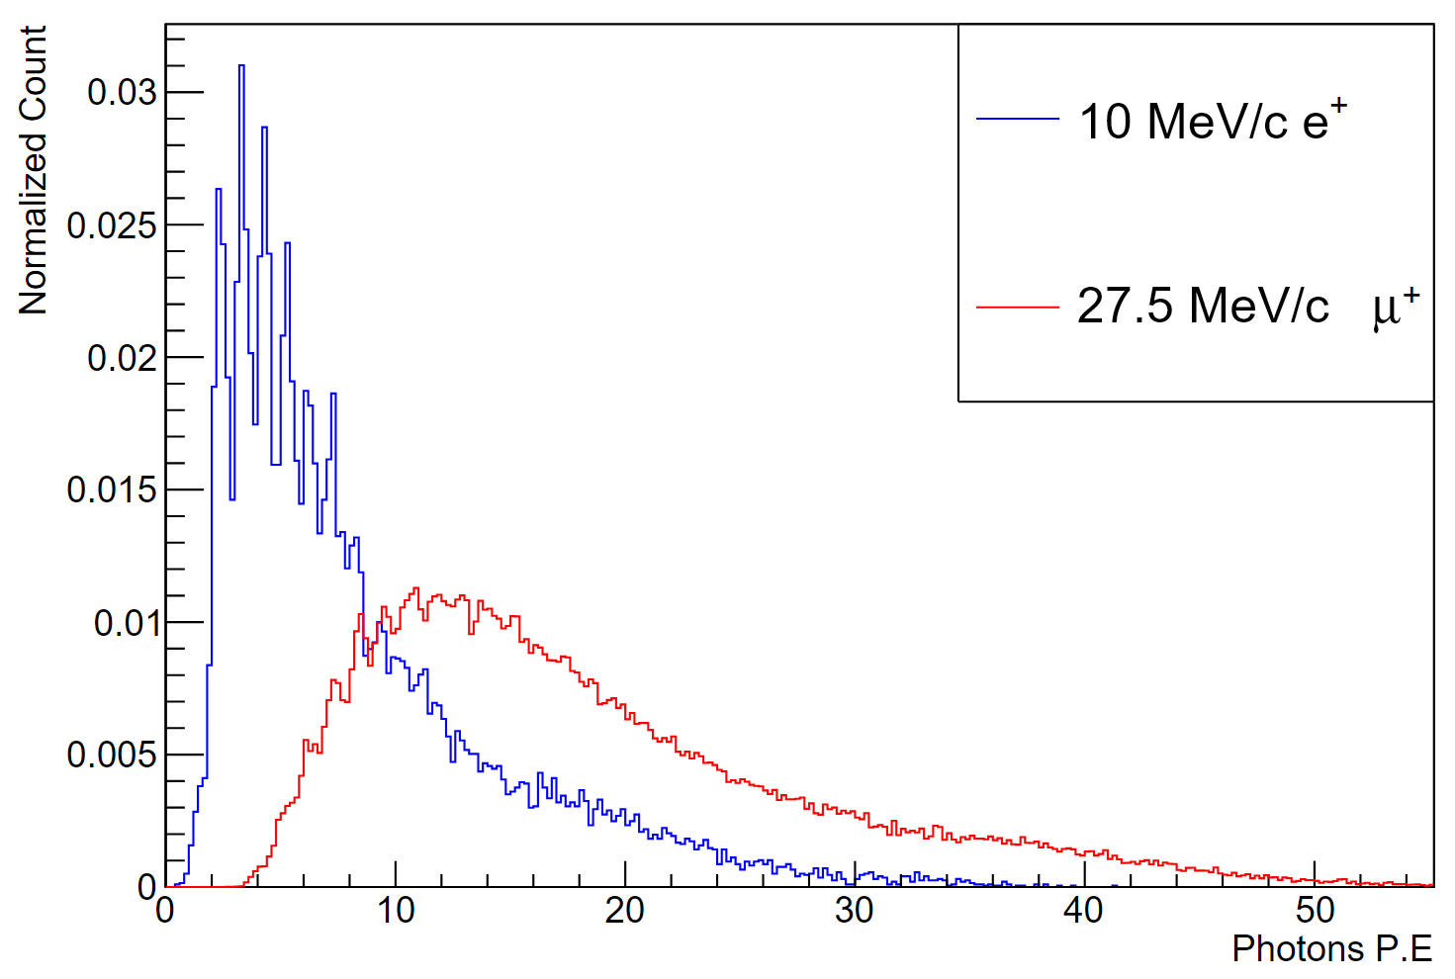
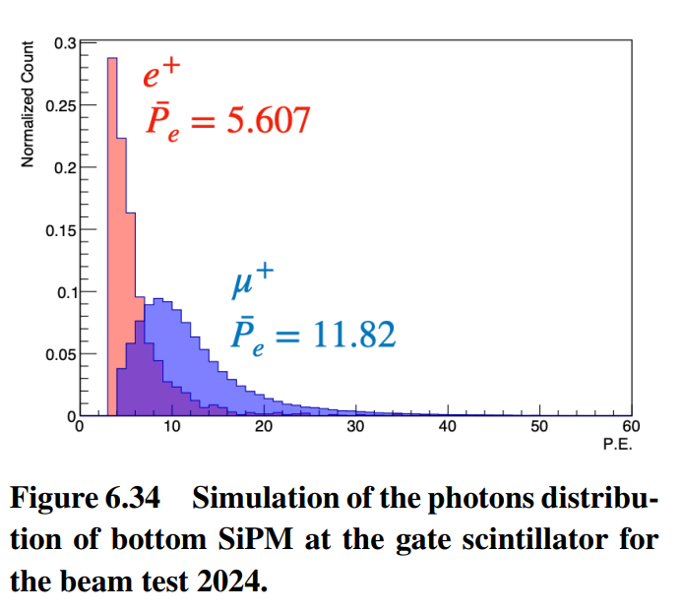


Gate distinguishing $μ^{+}$ vs $e^{+}$
Charge distribution of Gate detector in TB24, indicating a clear separation of $μ^{+}$ vs $e^{+}$
Gate trigger threshold set to select $μ^{+}$ will filter out $e^{+}$ events

Slide 23
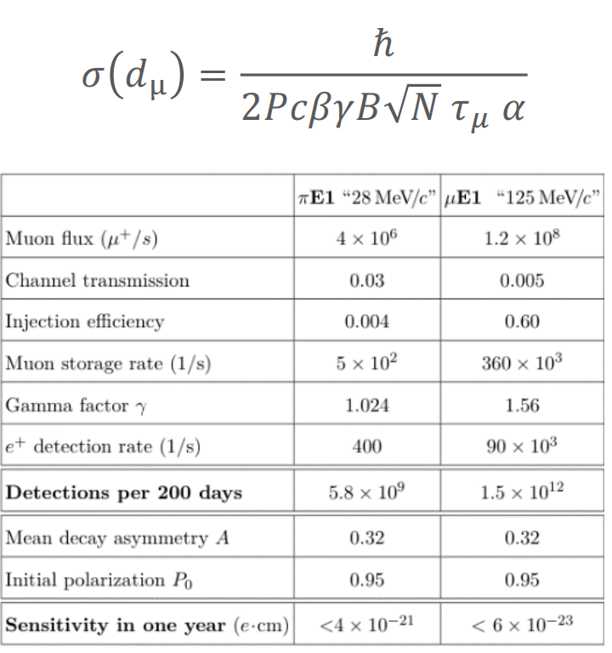
Sensitivity of muEDM experiment

Slide 24
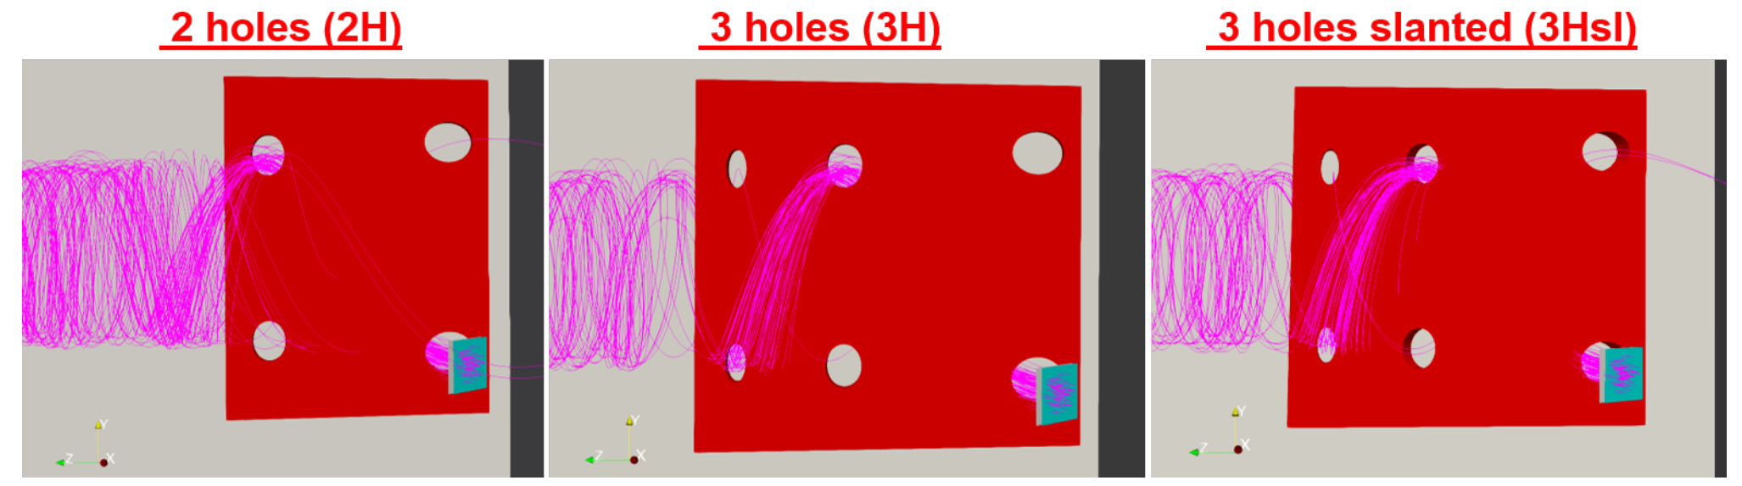
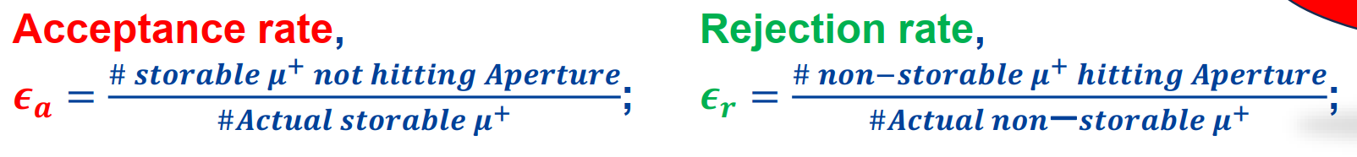
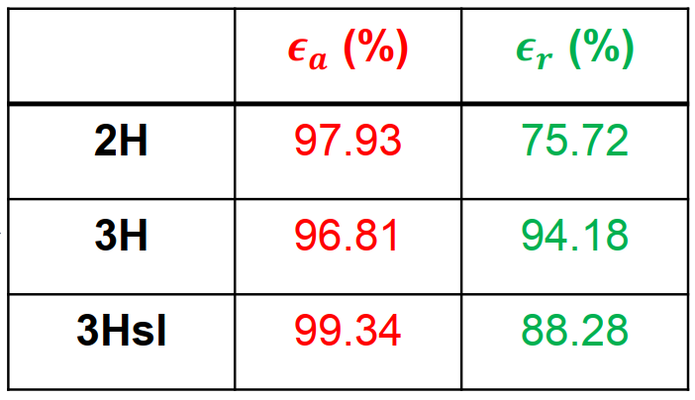
Aperture Simulation
musrSim simulation was conducted to study the acceptance and rejection efficiencies and optimize apertures
Different configurations are tested.

Slide 25




Hermetic Veto Detector
One single aperture scintillator is not sufficient to distinguish storable muons and measure the performance of the beam.
Hermetic veto detector is needed. Electronics need to be updated.
Dimensions (mm): 100*100*5
2 channel readout
Output to discriminator (anti-coinc. TTL production): 1 ch
Dimensions (mm): 60*5*110 per side
4 channel readout
Output to discriminator (anti-coinc. TTL production): 2 ch
Dimensions (mm): 5*130*80
4 channel readout
Output to discriminator (anti-coinc. TTL production): 2 ch

Slide 26
Upgrade MTD electronics
Gate Detector
Aperture Detector
SiPM
SiPM
SiPM
SiPM
SiPM
SiPM
SiPM
SiPM
Amplifier
Amplifier
Amplifier
Amplifier
Amplifier
Amplifier
Discriminator
Discriminator
Discriminator
Discriminator
Discriminator
Discriminator
Converter
Converter
Converter
Converter
Converter
Converter
AND
AND
NOR
4, 8, 12, 16, 20 ns
Delay are avaliable
AND
DS1100-20
Time Delay
AND
ToKicker

Slide 27



PCBs
Coincidence Board
Gate Board
Aperture Board

Slide 28



Propagation delay test
Propagation Delay between input and TTL signal of Coincidence Board was estimated.
SiPM.signals were replaced by function generator signals.
Cable length was controlled to be same.
t_{pd} of Amplifiers was estimated to be 3 ~ 5 ns, while Tianqi assume to be 0.
t_{pd} of Gate part was estimated to be 11.2 ns, t_{pd} of Aperture part was 10.6 ns.
Labels:
CH1(Yellow): Input Signal
CH2(Red): Amplified Sig
CH4(Green): TTL Signal
Amplifier
Aperture
Gate

Slide 29


Time match between Gate and Aperture
t_{pd} of Gate part was estimated to be 11.2 ns, t_{pd} of Aperture part was 10.6 ns.
If hit time of Gate and Aperture matches, the anti-coincidence logic will work properly.
CH1(Yellow): Gate signal CH2(Red): Aperture signal. CH4(Green): TTL signal
Only Gate signal
Both Gate and Aperture signals

Slide 30


Time match between Gate and Aperture
If AA is several nanoseconds later than Gate, then a narrow TTL will be generated.
Aperture input signal was delayed for 5 ns with an extra 1 m co-axial cable.
CH1(Yellow): Gate signal CH2(Red): Aperture signal. CH4(Green): TTL signal
Only Gate signal
Both Gate and Aperture signals

Slide 31



Time match between Gate and Aperture
Aperture input signal was delayed for 5 ns with an extra 1 m co-axial cable.
Gate was delayed for 4 ns with Time-Delay Module.
tpd of Gate reaches 16.55 ns, 30Hz/1kHz narrow TTL were output.
CH1(Yellow): Gate signal CH2(Red): Aperture signal. CH4(Green): TTL signal
Only Gate signal
Both Gate and Aperture signals

Slide 32



Time match between Gate and Aperture
Aperture input signal was delayed for 5 ns with an extra 1 m co-axial cable.
Gate was delayed for 8 ns with Time-Delay Module.
tpd of Gate reaches 21 ns, 30Hz/1kHz narrow TTL were output.
CH1(Yellow): Gate signal CH2(Red): Aperture signal. CH4(Green): TTL signal
Only Gate signal
Both Gate and Aperture signals

Slide 33



Time Walk Correction
Before time walk correction
After time walk correction
Timewalk correction process:
Divide ToT to several bins
For each ToT bin, calculate Avg(ToA)
Fit Avg(ToA) vs ToT curve: f(ToT)
For each hit, ToA_Corr = ToA_raw – f(ToT_raw)
Propagation delay is obtained by: t_{PD} = ToA_TTL – ToA_Gate

Slide 34
Propagation delay
Time of arrival (ToA) analysis to obtain propagation delay, $t_{pd}$
After time walk correction
TB24: $t_{pd}≈5.92$ ns
Run 448
Muon beam
$B_{SOL}=−2.5 T$
Anti-coincidence trigger
Run 442
Muon beam
$B_{SOL}=−2.5 T$
Gate quad coinc. trigger

Slide 35


Inlab Propagation Delay Test
Before Time Walk Correction
After Time Walk Correction

Slide 36
ToT cut selection

