Slide 1

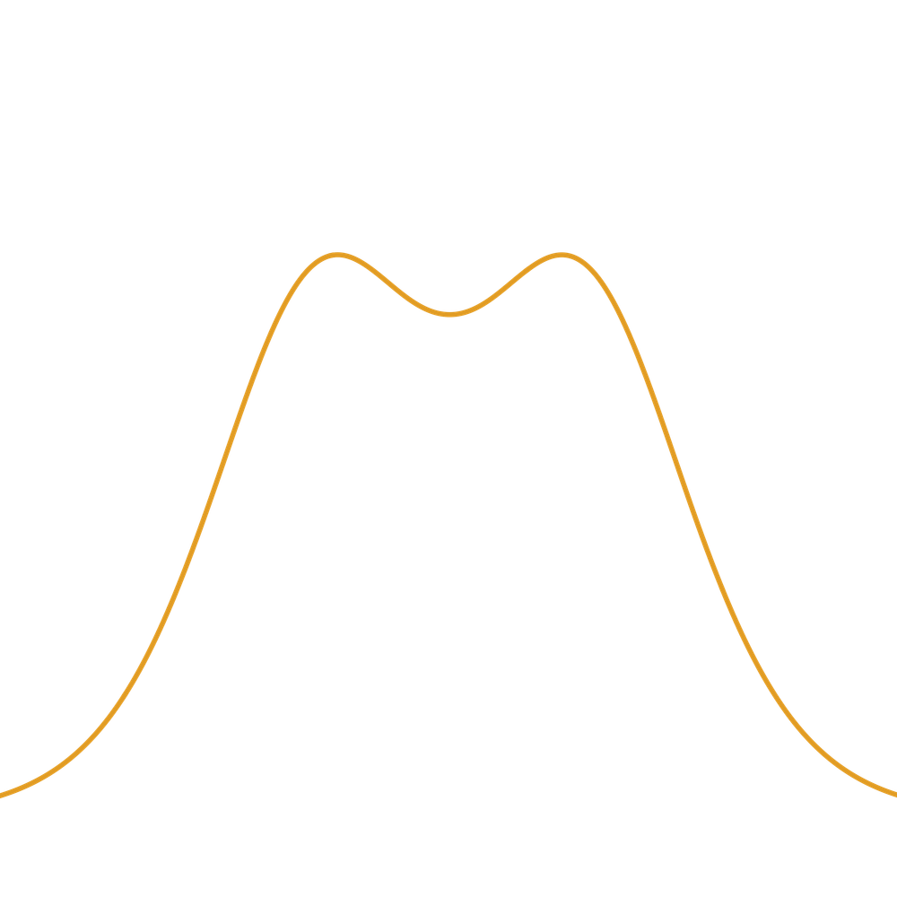
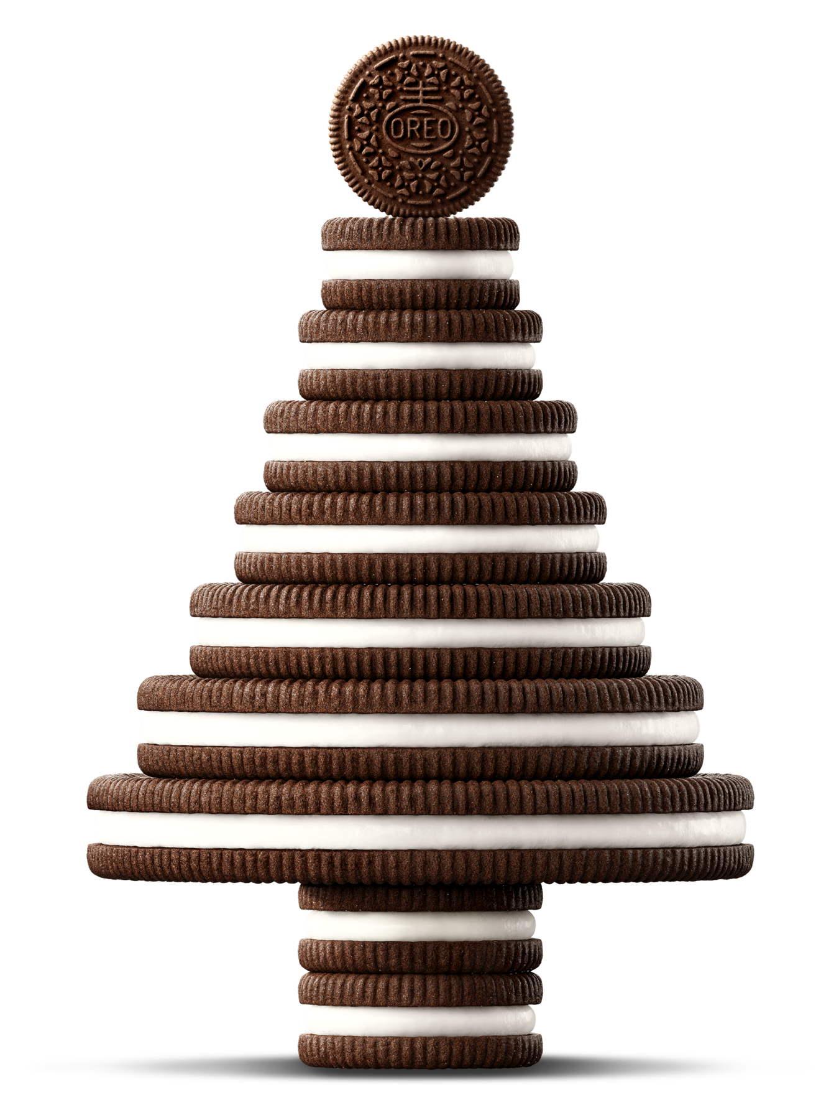

超越Z₂的畴壁
检验味物理的新方法
付博文
中国物理学会高能物理分会第十二届全国会员代表大会暨学术年会
2026年7月16日
BF, S. F. King, L. Marsili, S. Pascoli, J. Turner, Y-L. Zhou, 2409.16359
BF, S. F. King, L. Marsili, J. Turner, Y-L. Zhou, 2512.13784
1

Slide 2
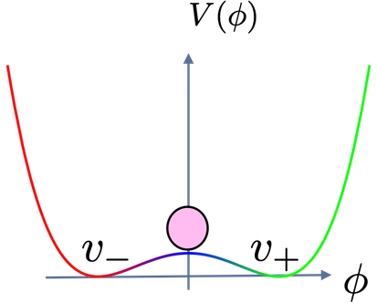
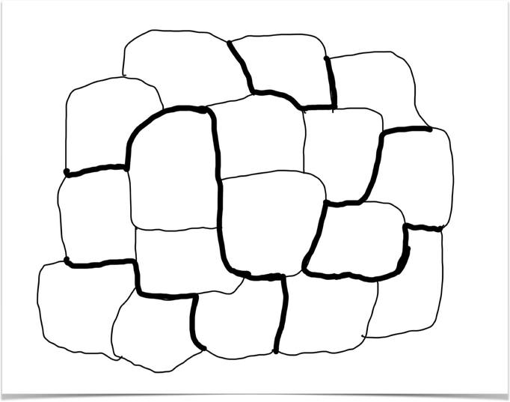
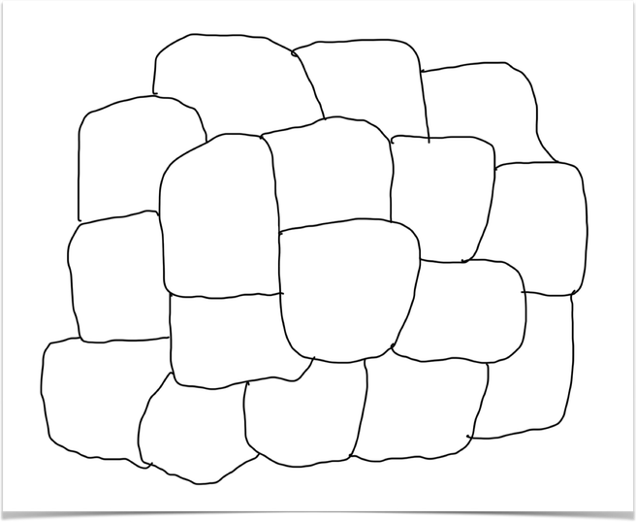
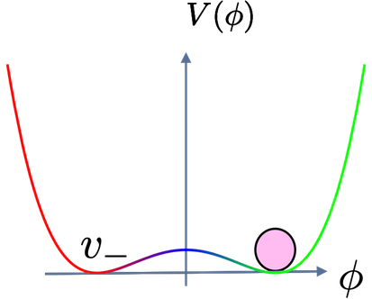
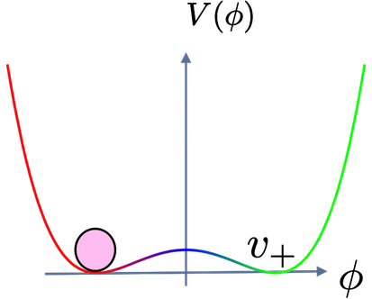
Domain walls
false vacuum remnants from early universe symmetry-breaking phase transitions
Simplest example: Z₂ domain walls
unbroken phase
+
－
+
+
+
+
broken phase
－
－
－
+
－
－
+
+
+
+
－
2

Slide 3
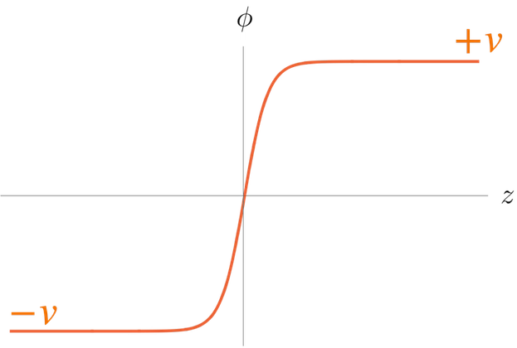
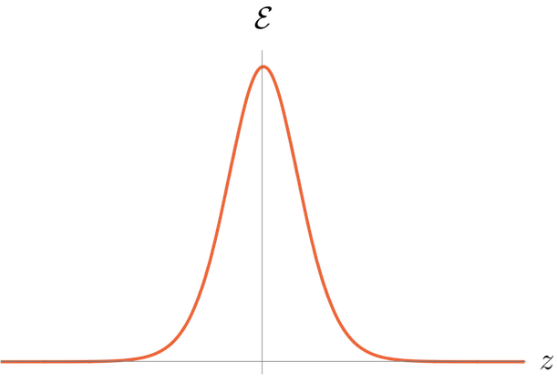
Domain walls
false vacuum remnants from early universe symmetry-breaking phase transitions
Simplest example: Z₂ domain walls
unbroken phase
broken phase
3

Slide 4
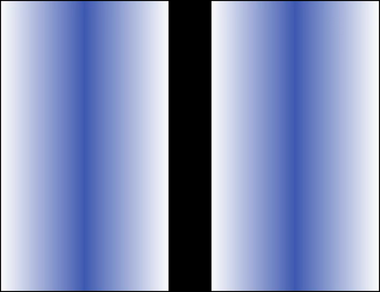
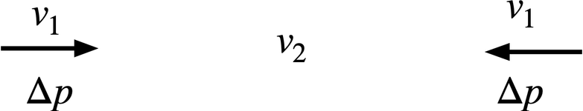
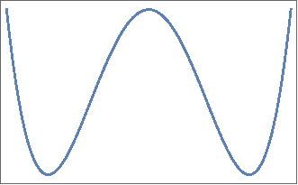
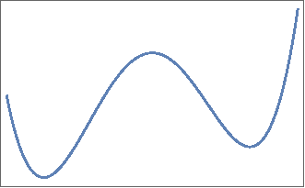
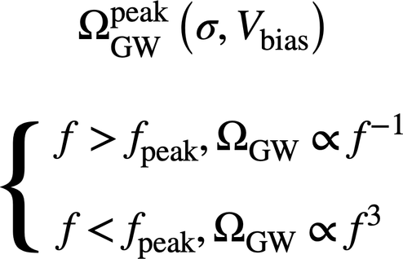
Domain walls
false vacuum remnants from early universe symmetry-breaking phase transitions
Simplest example: Z₂ domain walls
4
Saikawa [2017]

Slide 5
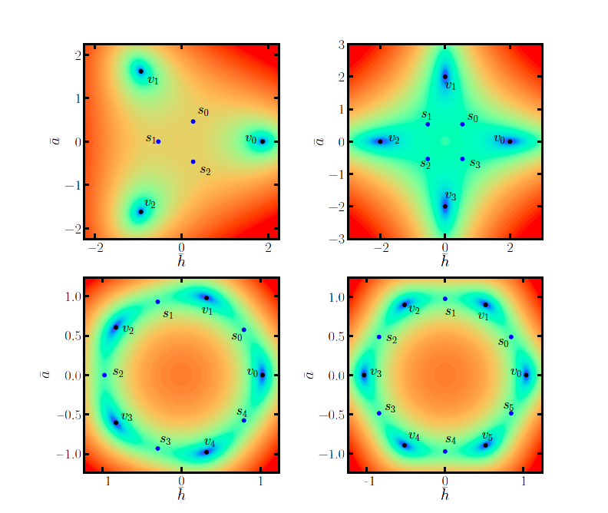
Simplest extension: Z_{N}
Symmetry beyond Z₂
Z₂ symmetry is the simplest discrete symmetry, but is it enough?
Wu, Xie, Zhou [2022]
4

Slide 6
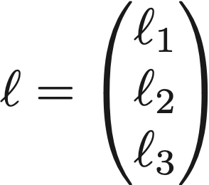
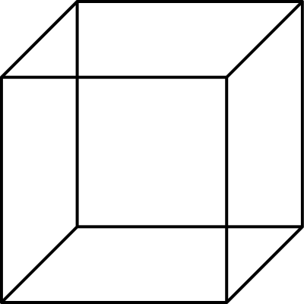
Lepton triplets
Embed leptons of different flavours into a triplet representation
Symmetry beyond Z₂
A4
rigid rotation group of a tetrahedron
Z₂ symmetry is the simplest discrete symmetry, but is it enough?
S4
rigid rotation group of a cube
5

Slide 7
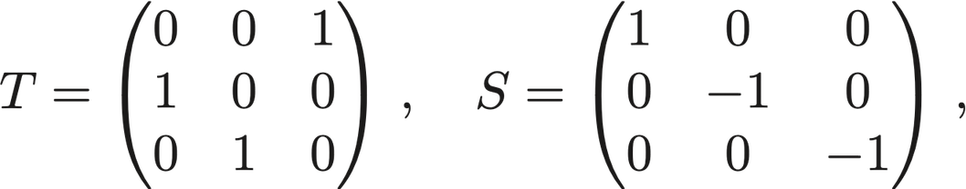
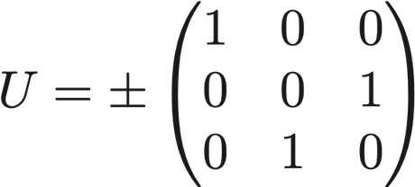
Lepton triplets
Embed leptons of different flavours into a triplet representation
Symmetry beyond Z₂
A4
rigid rotation group of a tetrahedron
Z₂ symmetry is the simplest discrete symmetry, but is it enough?
Non-Abelian
S4
rigid rotation group of a cube
6

Slide 8
Non-Abelian Domain walls
Cosmological consequence of non-Abelian discrete symmtry breaking
7

Slide 9

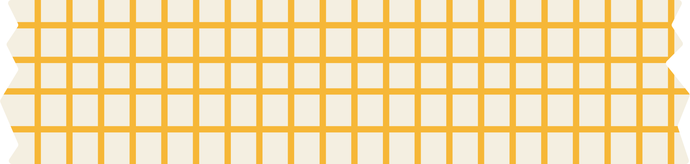
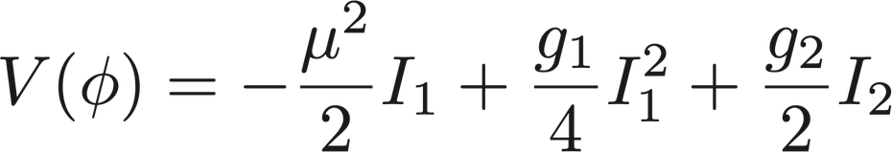
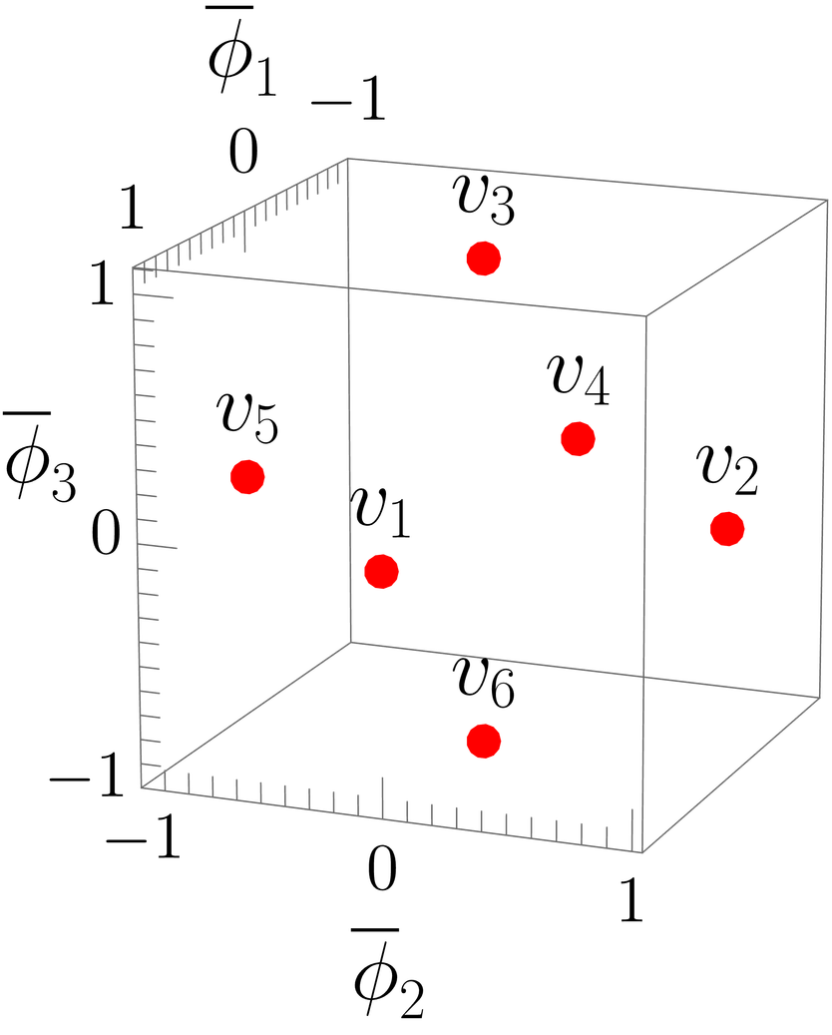
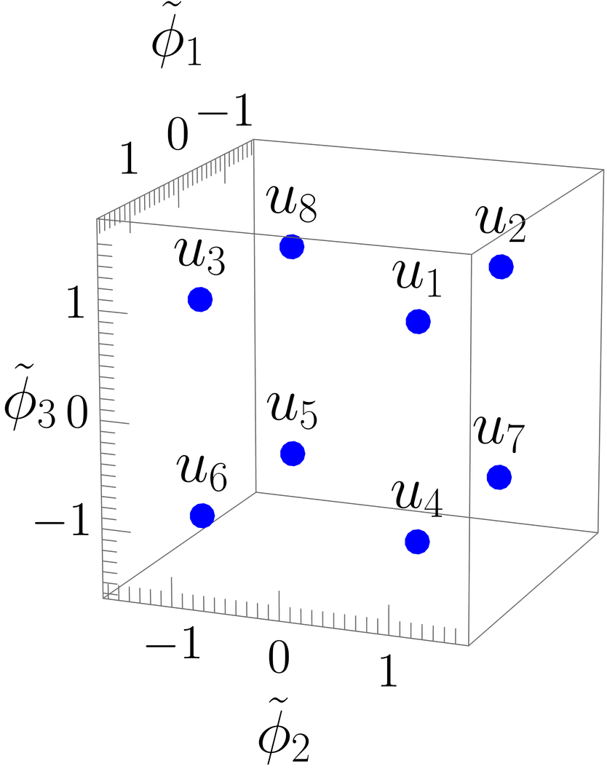
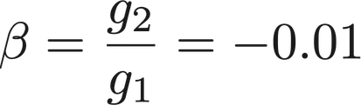

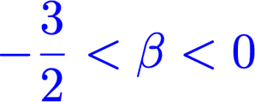

S4: Vaccum structure
8

Slide 10

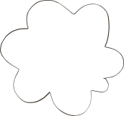

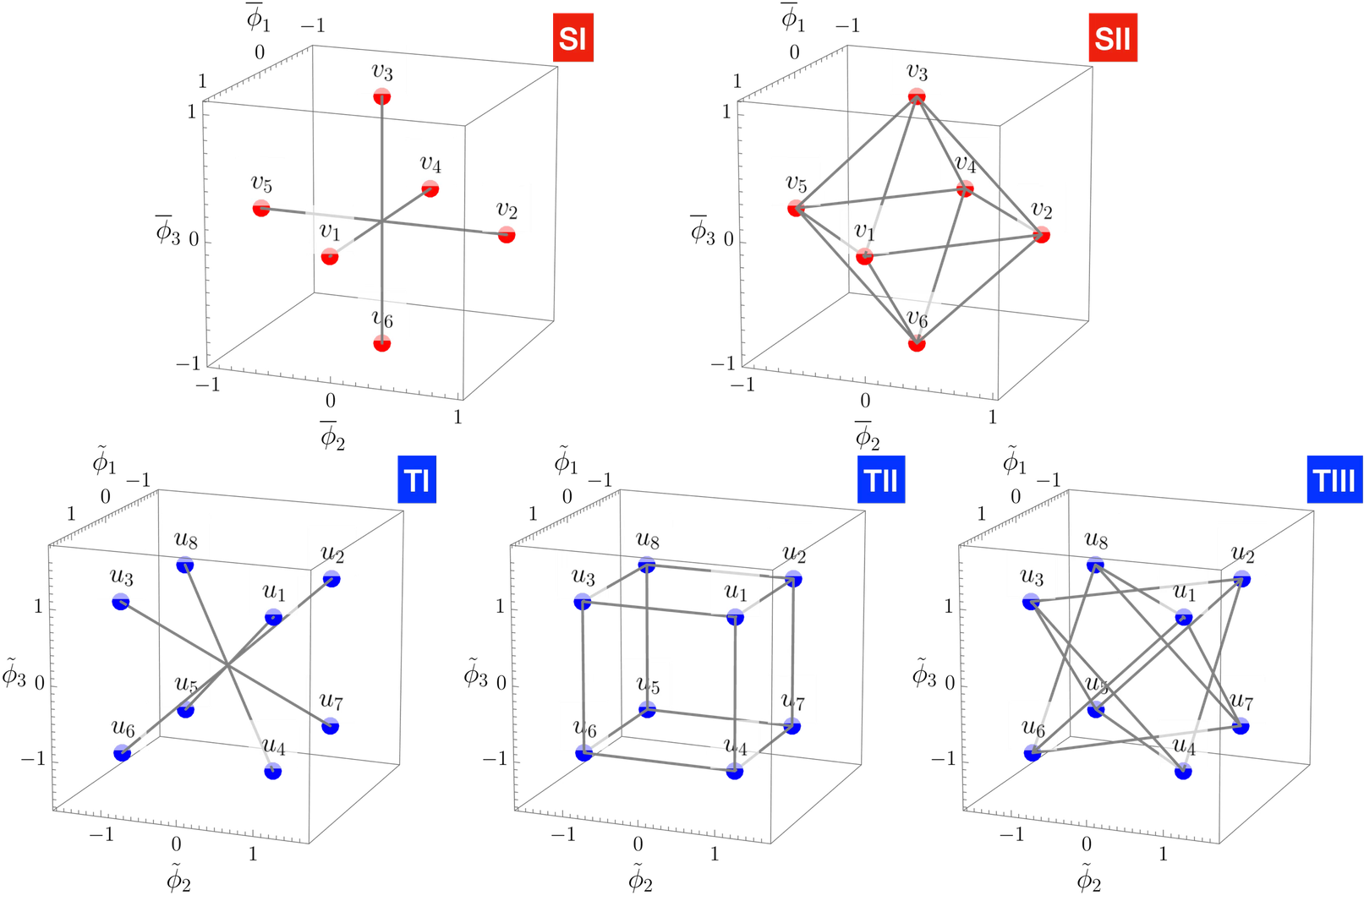

Domain wall topology
9

Slide 11
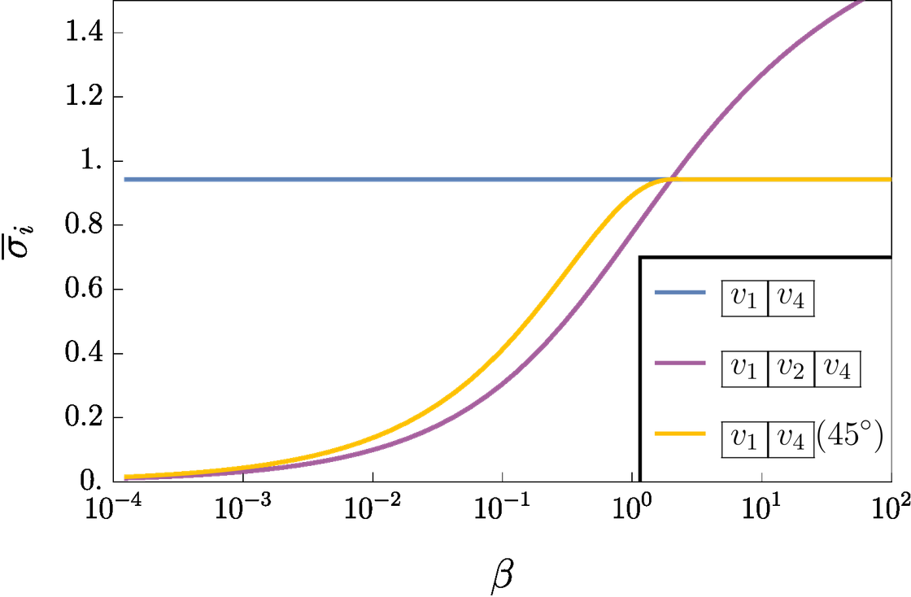
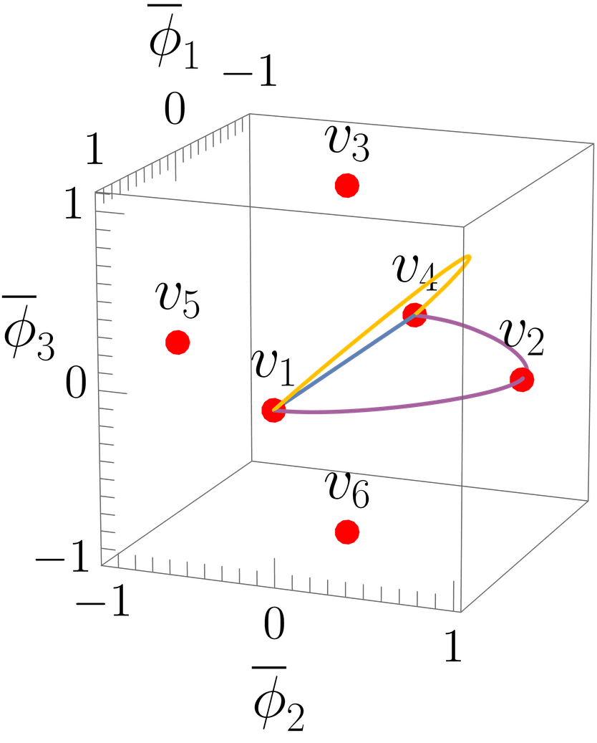
Different path, different tension
10

Slide 12
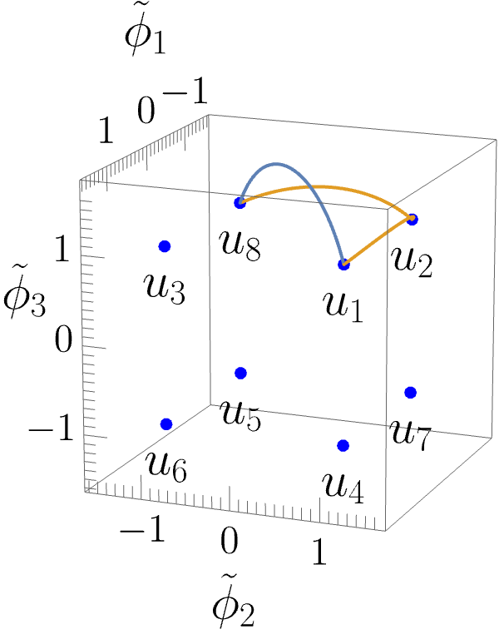
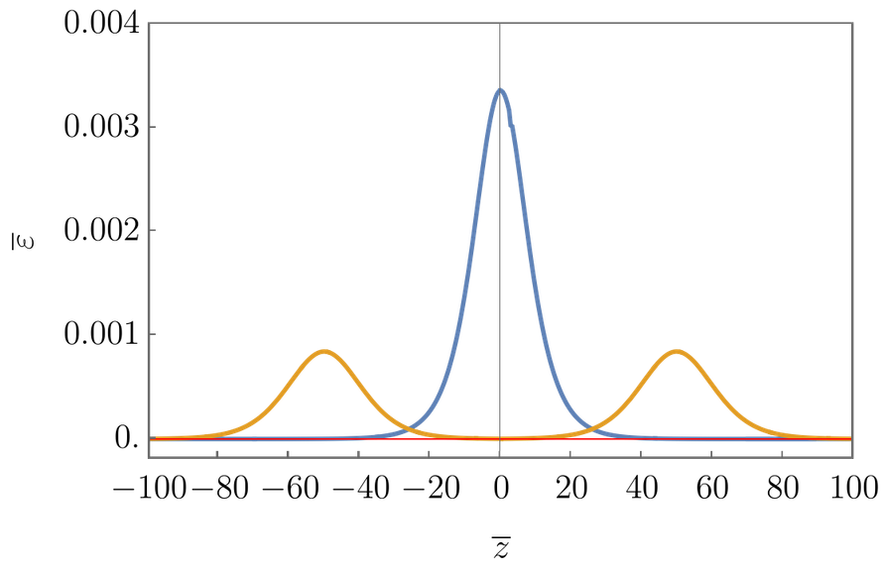
Multiple solutions
1 peak
2 peaks
11

Slide 13

From S4 to A4
12

Slide 14

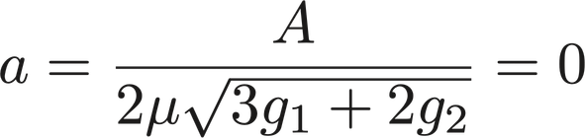
From S4 to A4
13

Slide 15
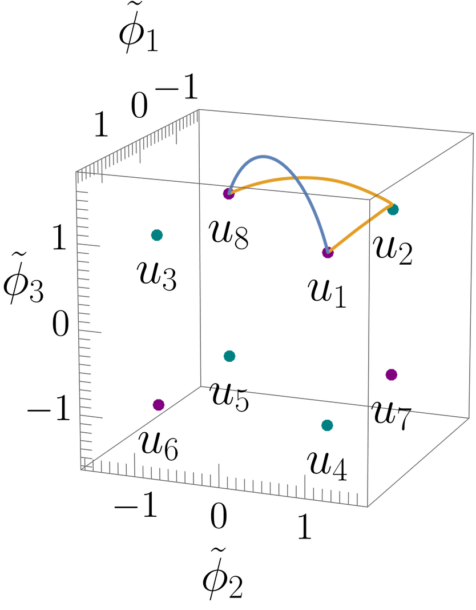
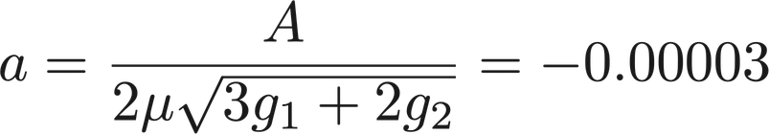
From S4 to A4
14

Slide 16
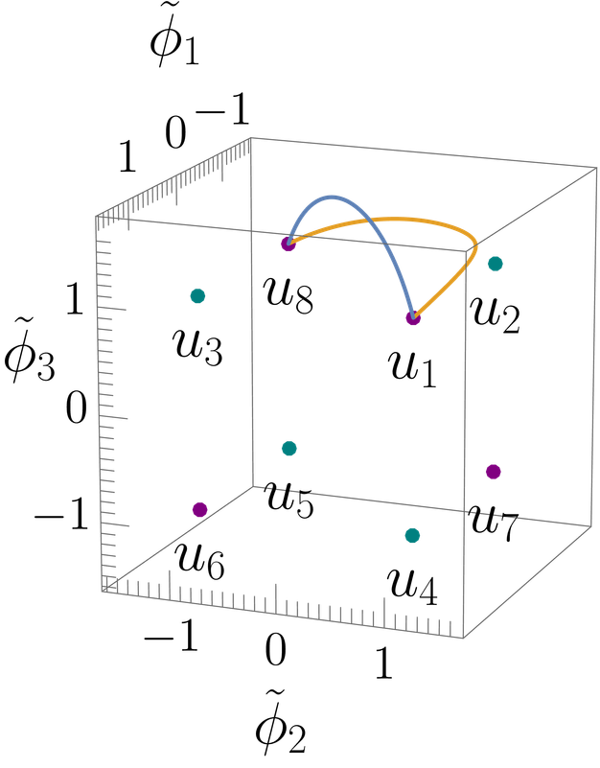
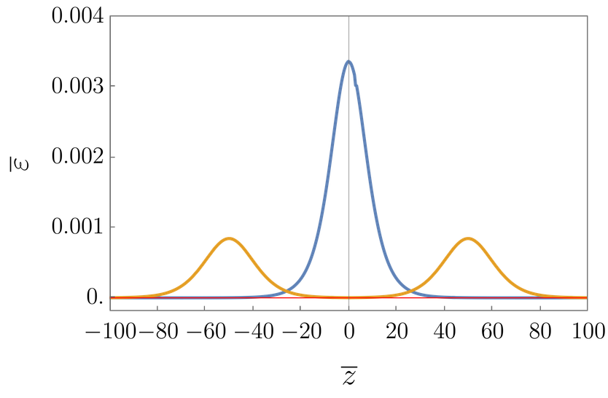
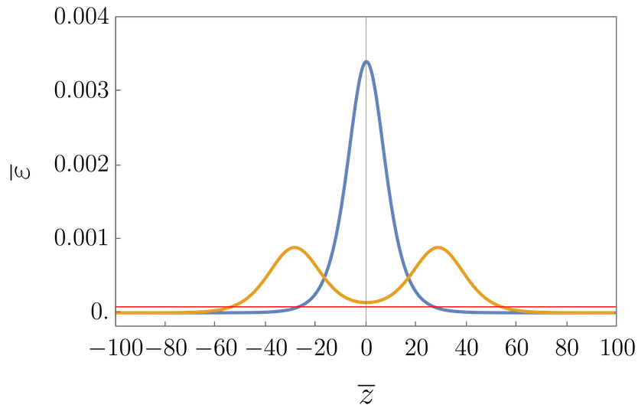
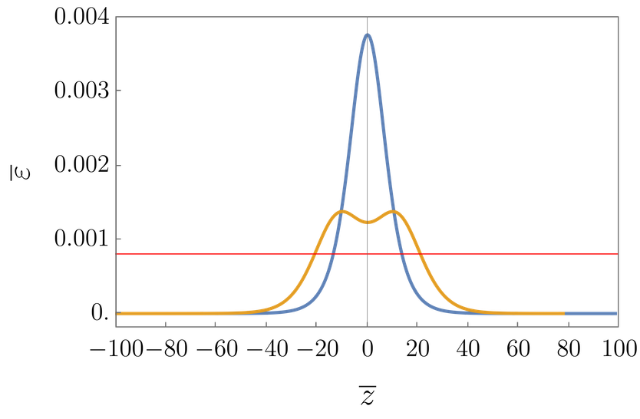
Path and Energy Density
As “a” become larger, the path in field space departs from u2 and the energy density in the “valley” grows.
15
a=0
a=-3x10-5
a=-3x10-4

Slide 17
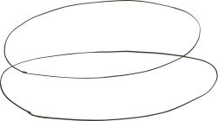
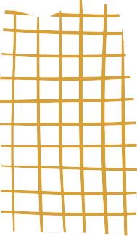
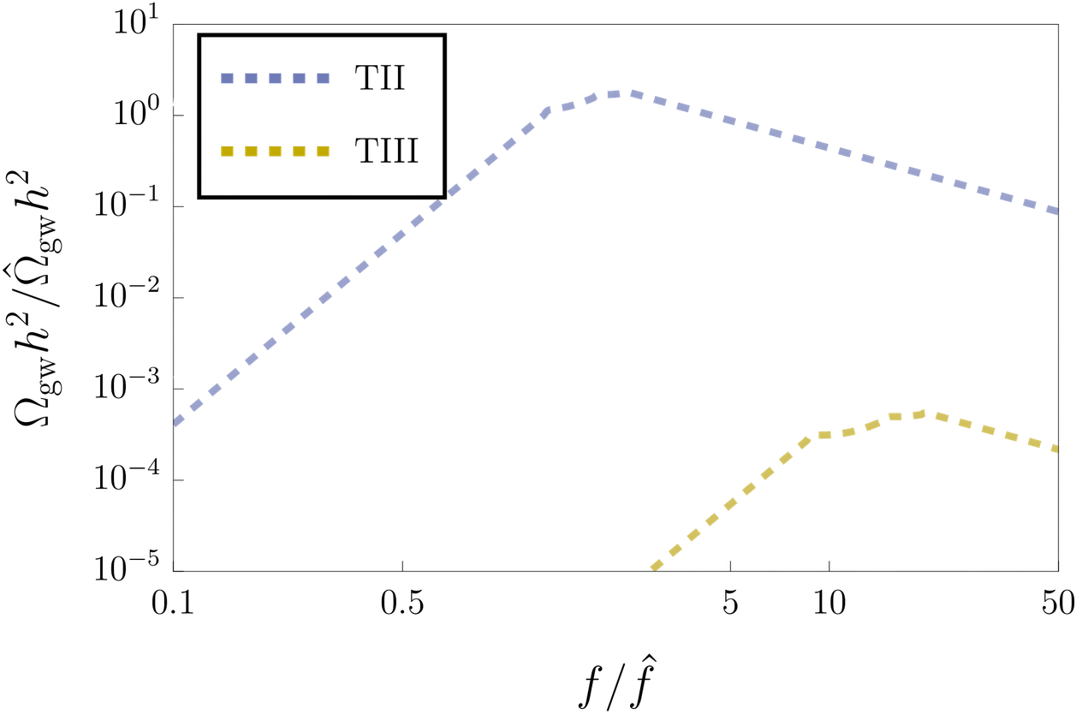

Gravitational wave
The cubic term in acts as an effective bias for the walls. As it is allowed by the symmetry, we expect it to be larger than the explicit symmetry breaking term.
16

Slide 18
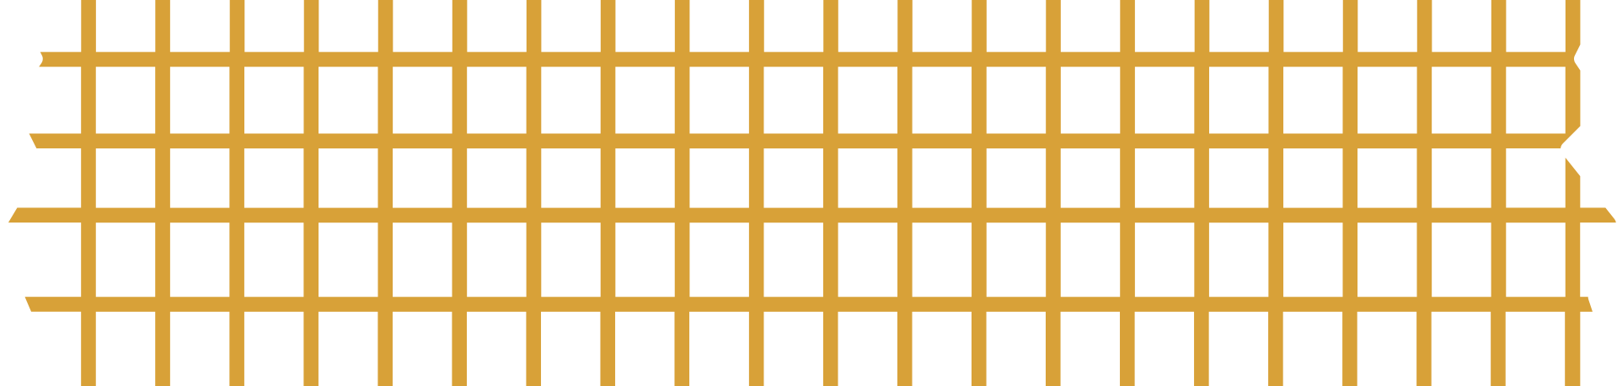



SUMMARY
MOTIVATED BY FLAVOUR PHYSICS
Flavour physics provide strong motivation to consider spontaneous breaking of non-Abelian symmetries and there consequence in the ealry universe. Domain wall provide us a good phenomena that can be use to test the flavour models.
ABUNDANT VARIETIES
In non-Abelian symmetric models, the domain wall can have non-trivial internal structures, like an “oreo”.
SPONTANEOUS CP VIOLATION
In complex models with non-Abelian symmetries, the CP symmetry can be spontaneously broken, and the walls between CP conjugate vacua further provide a difference in the CP phase.
22

Slide 19
Thanks
23

Slide 20
CP violating Domain walls
consequence of complex vacua

Slide 21
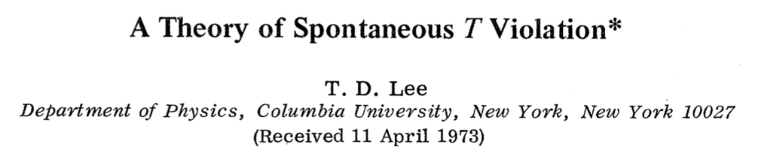
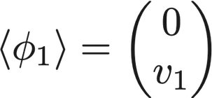
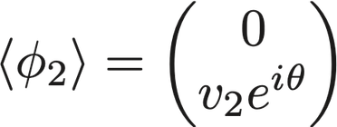
Spontaneous CP violation
Two Higgs Doublet Model
The concept of spontaneous CP violation (SCPV) was first proposed by the Chinese-American physicist T. D. Lee in 1973.
The two Higgs doublets get VEVs with a relevant phase.
18

Slide 22

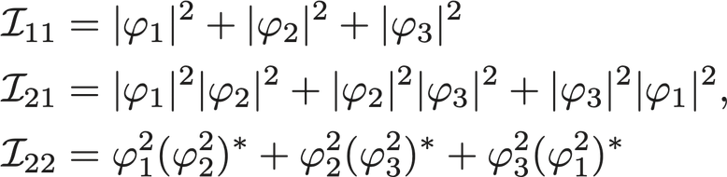
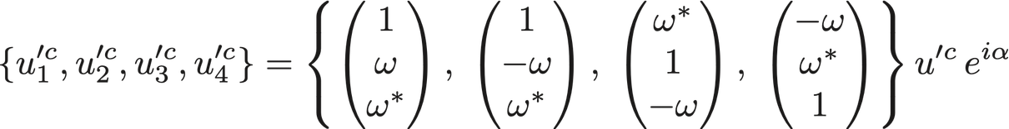
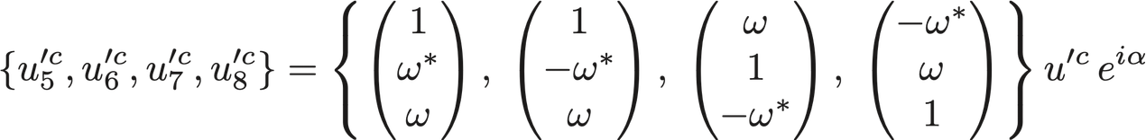


complex scalar model with
Spontaneous CP violation in A4 symmetric model
If the VEVs of different scalars in the scalar triplet show phase differences, the CP is spontaneously broken.
19

Slide 23
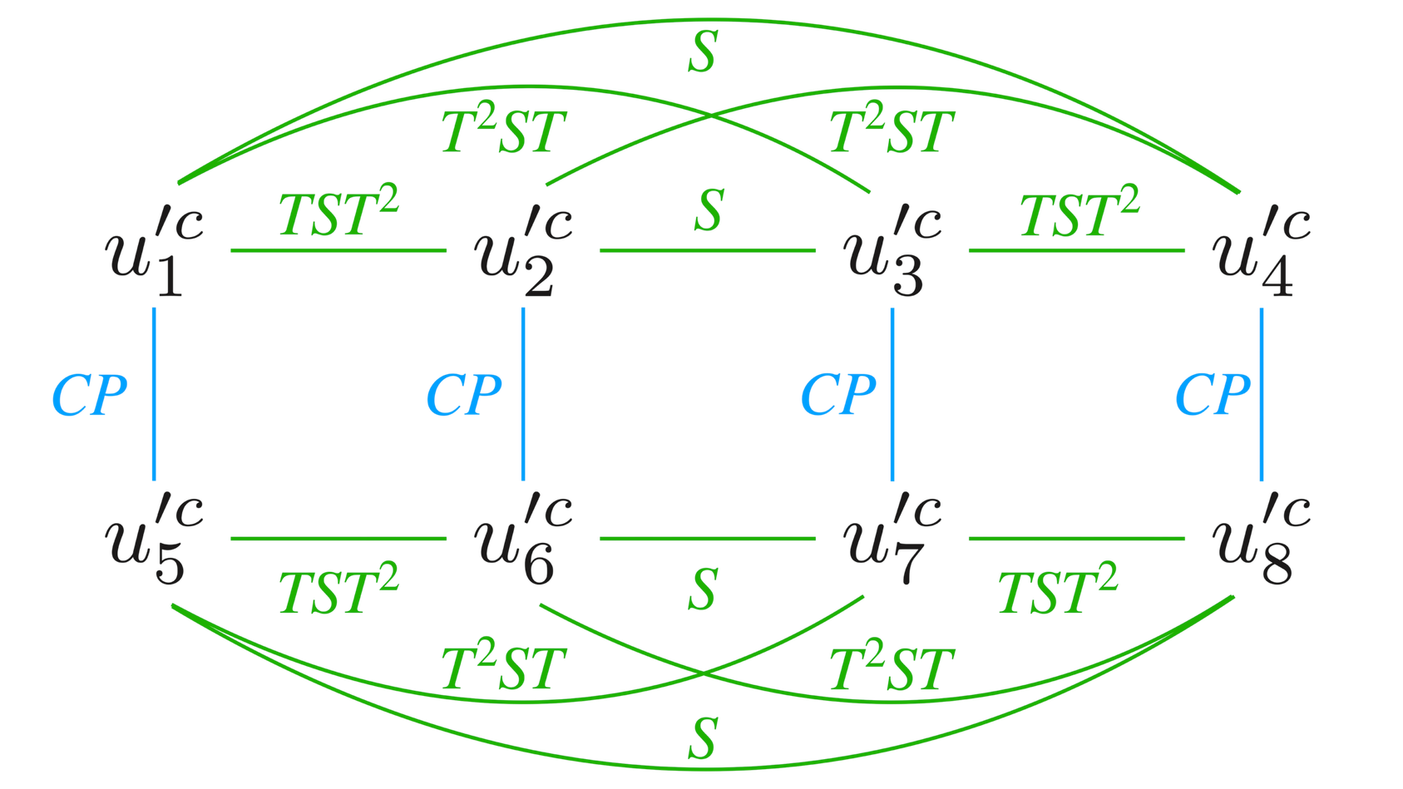
Relation between the vacua
The vacua can be related by A4 transformations.
20

Slide 24
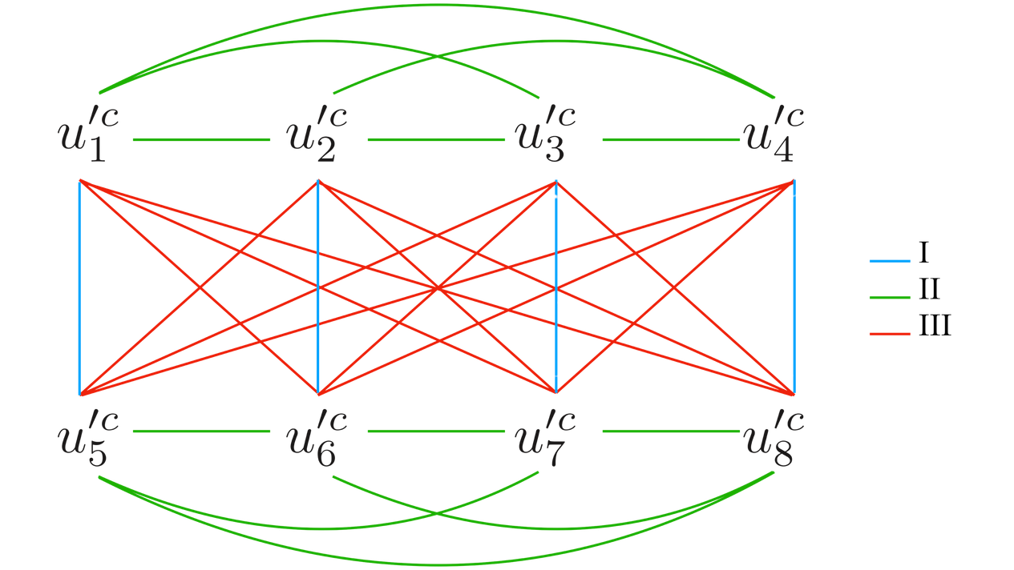
CP-violating domain walls
We refer the walls between two CP-conjugated vacua as the CP-violating domain walls as CP is violated differently on the two sides of the wall.
21

