Slide 1


Validation System for OSCAR
Guoping Liu, Teng Li
Shandong University
高能物理分会•粒子物理实验技术，广州，July 16, 2026

Slide 2
Outline
Background
Validation System
  Dashboard
  AI interpretation
Summary

Slide 3
Background

Slide 4
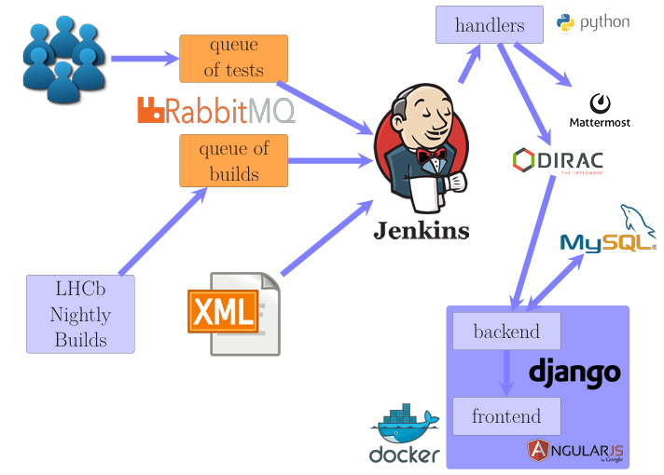
Software validation
Software validation catches issues at different levels:
Wrong physics — silent regressions in reconstruction, efficiencies, resolutions, backgrounds
Build & runtime failures — compile errors, crashes
Computing performance — CPU, memory, throughput
Code quality — regressions in modules and APIs
Critical for HEP software:
Developers — find problems early (on commit / in CI)
Releases — sign off new versions quickly, reliably, and correctly
LHCbPRworkflow,
EPJ Web of Conferences 214, 05014 (2019)
Evolving detector R&D (STCF): sub-detector and simulation changes may also shift validation plots — validation should track software and design iteration together.
Leveraging AI — research potential
Release validation produces hundreds to millions of performance plots. Fully manual review is slow and easy to miss subtle regressions. AI could help interpret plots in release context, prioritize suspicious cases in large batches, and link anomalies to software changes — toward richer diagnosis than comparison alone.

Slide 5
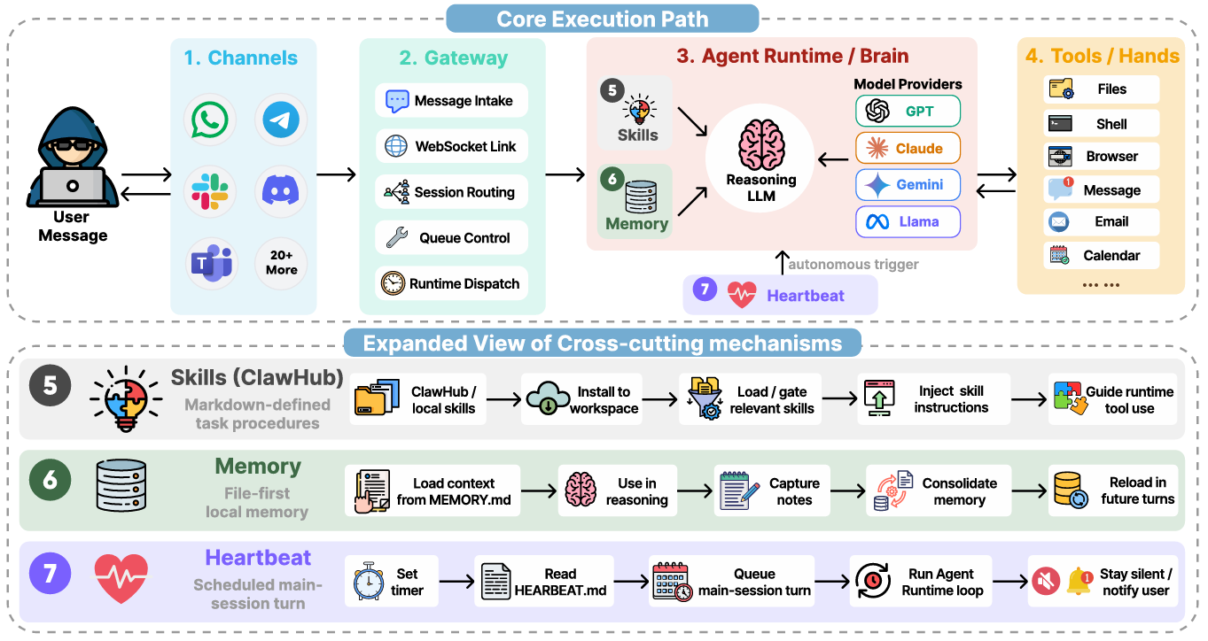
Agent - OpenClaw
AI Chat
LLM API
Prompt
Context
Coding Agent
Vibe coding
AI assistant
Harness
Loop
ChatGPT
Gemini
Claude
Qwen
……
Wang, Z. et al. (2026).
Copilot
Cursor
Claude code
Gemini cli
OpenClaw
Harmes
CodeX
WorkBuddy
Autonomous agents powered by large language models are moving from curated demos to persistent, open-world deployment.

Slide 6
Validation System

Slide 7
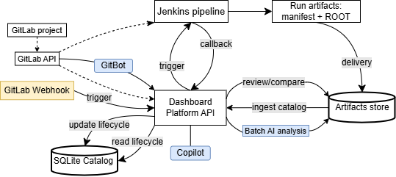
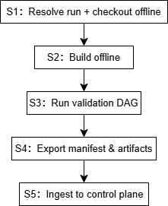
Validation System (Architecture)
Validation runs: Build OSCAR, run full-chain physics tasks, export performance plots.
Review platform: Browse results, compare Current vs Reference, track runs to sign-off.
Control plane: React + FastAPI + SQLite — trigger, lifecycle, Review/Compare.
Execution plane: Jenkins + Snakemake (S1–S5 pipeline) → manifest + ROOT artifacts.
Experiment-agnostic: can be easily ported to other experiments

Slide 8
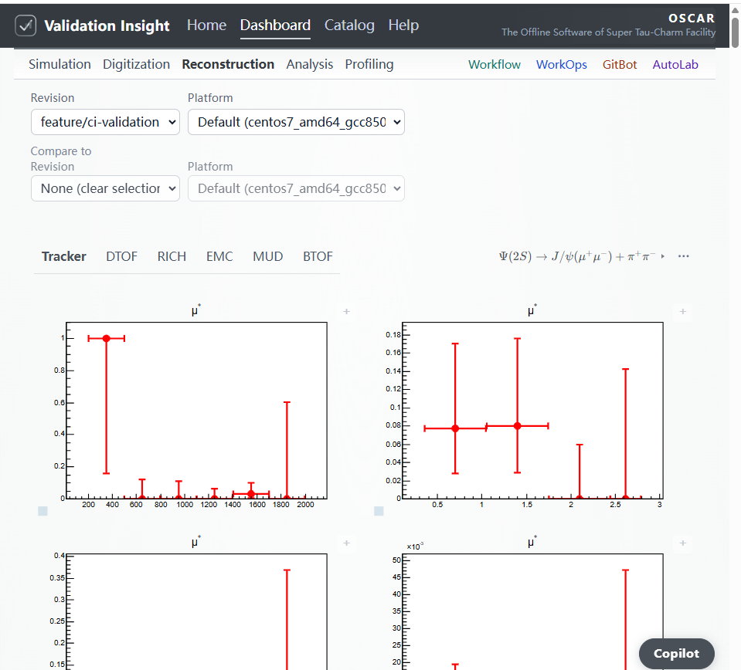
Dashboard - Review
Performance review and revision regression on ingested validation artifacts
Reconstruction and Profiling coverage for decay channels and particle gun
Detector / task navigation driven by the validation manifest (task_tree, root_file)
Overlay comparison between two software revisions

Slide 9
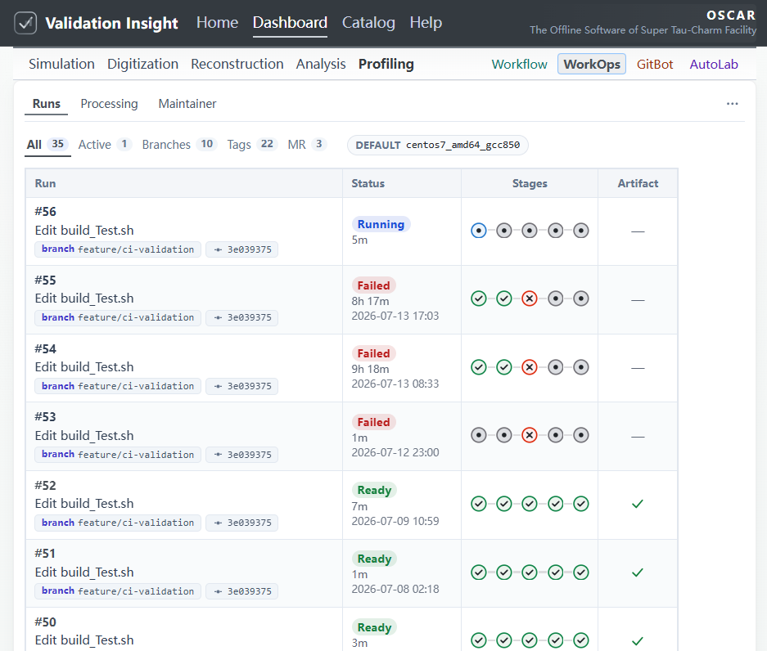
Dashboard - WorkOps
Runs: lifecycle tracking, delivery status, Sync & Ingest fallback
Processing: ROOT → JSON → AI Grade → AI Review batch pipeline
Compare pairs: AI Compare for Review-scoped A/B runs
Maintainer: manual Jenkins trigger (operator override)

Slide 10
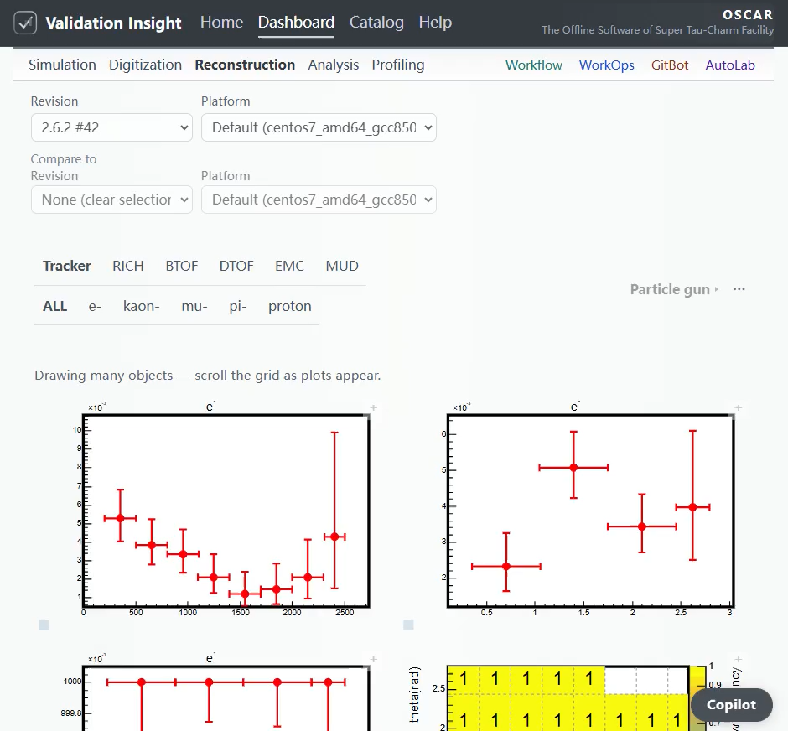
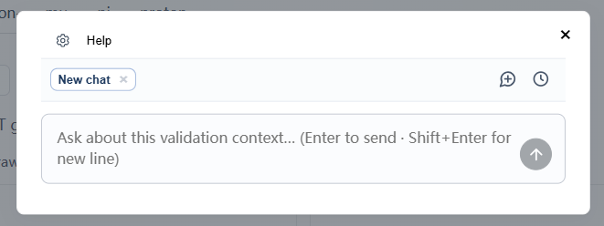
AI Interpretation
Developed Copilot:
In-dashboard assistant on Review & Compare
Context engineering — OpenAI-style text messages: user question + plot refs; histogram digests and validation context in XML system prompts.
Dockerized deployment with configurable Agent/LLM
Roadmap (vision): full-chain root-cause hints via plot lineage.

Slide 11
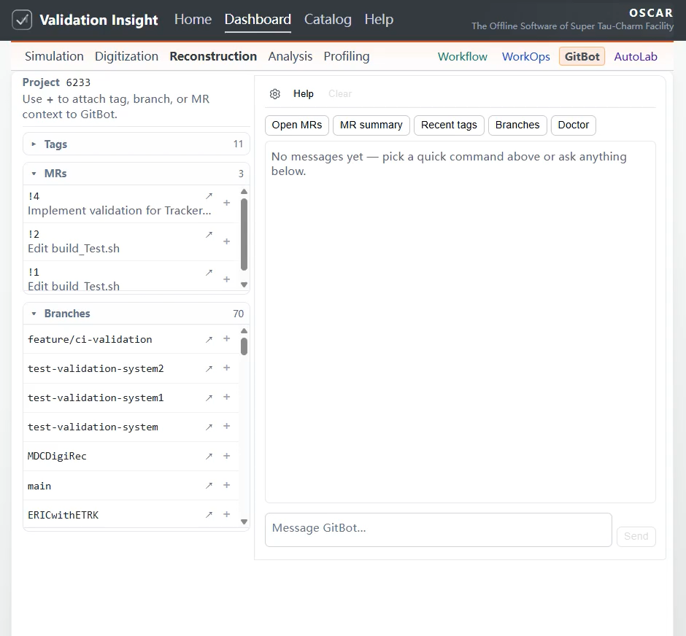
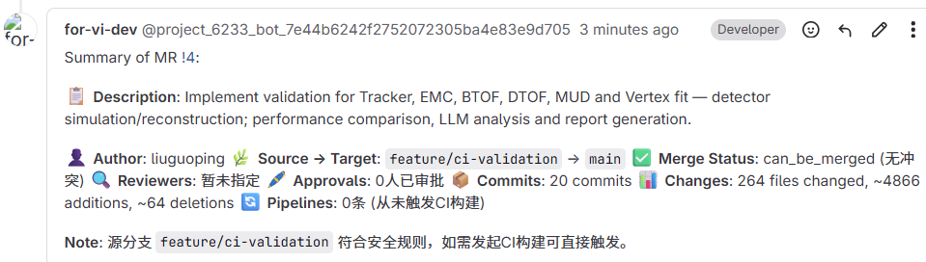
AI Interpretation
Developed GitBot:
GitLab integration — query merge requests, tags, branches, and pipelines via natural language and quick actions.
Repo context — bound to the active software repository (oscar1/offline).
MR comments — post validation summaries and review comments on merge requests (implemented).
Multi-surface — Dashboard GitBot and Mattermost share one agent.

Slide 12
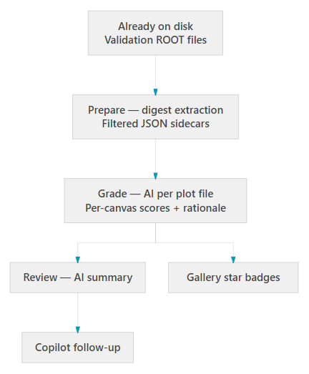
AI Interpretation
Batch analysis:
Whole-run screening — Automated screening across all performance plots in one workflow.
Structured evidence, lasting outputs
Per-plot scores and a run-wide report from filtered JSON — not screenshots.
Gallery overlays; optional follow-up in Copilot.

Slide 13
Summary

Slide 14
Summary & Outlook
Full-chain physics validation — Representative tasks and performance plots as primary evidence for offline software quality.
Performance regression — Systematic Current vs Reference comparison before sign-off.
AI assists reviewers — Batch screening of performance plots; interactive Q&A on selected plots; natural-language access to GitLab MR / repo context.
Near term (planned) — automated trigger and MR comments with validation results for human reviewers.
Longer term (planned) — Make the full validation workflow readable to AI, so anomalies can be traced to software changes—with coding agents assisting under human oversight.

Slide 15
backup

Slide 16
Motivation
Ensures Correctness of Physics Results：Validates software updates against "Golden Samples" using rigorous statistical tests (e.g., KS/Chi-squared) to guarantee that core physical conclusions remain unchanged.
Enhances Code Quality & Robustness：Deploys automated regression and unit tests to catch defects early in development, enforcing high coding standards and long-term maintainability.
Guarantees Performance & Stability：Monitors CPU/memory usage to detect performance regressions and memory leaks, ensuring efficient throughput for processing large-scale experimental data.
Leverages AI for Deep Insights；
Addresses the challenge of manually reviewing hundreds of performance plots, a task prone to human fatigue and oversight. AI excel at analyzing these vast visual datasets, identifying complex correlations and offering superior root-cause analysis capabilities.

Slide 17
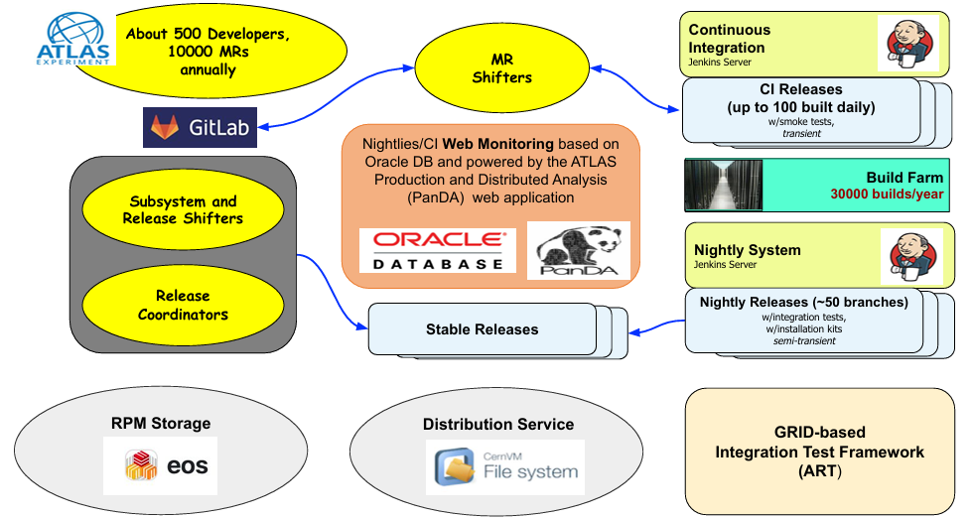
Software validation
Validation of Software Releases for CMS (CERN CDS)
CMS CompOpsRelVal (TWiki)
CMS PyReleaseValidation (TWiki)
ART — ATLAS Release Tester using the Grid (CHEP2020)
Operational Intelligence in ATLAS CI
ATLAS software & computing Run 3 (EPJ C, 2024)
ATLAS Software Build System Infrastructure
LHCbPRworkflow,
EPJ Web of Conferences 214, 05014 (2019)
Offline Software Development Workflow at a Glance,
Joint experiment meeting, February 6, 2025

Slide 18
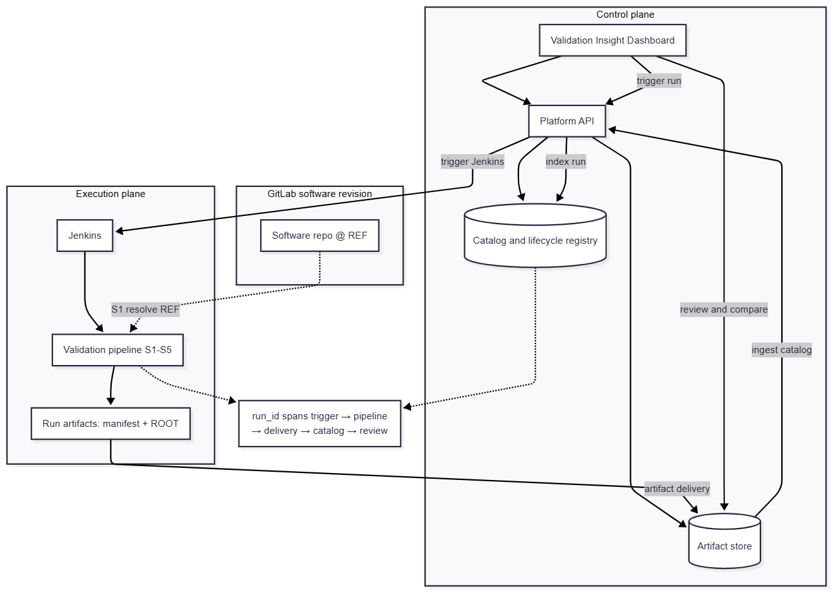
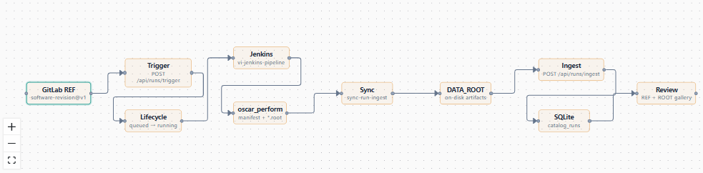
Validation workflow

Slide 19
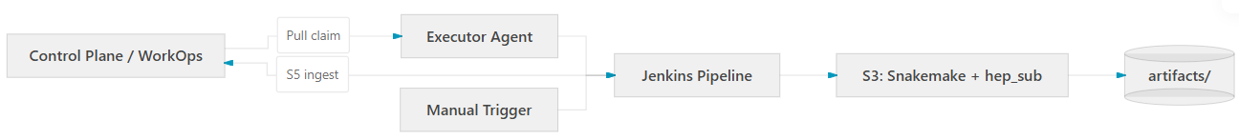
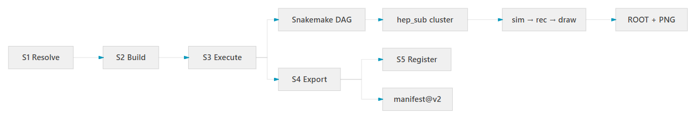
Execution Plane
Execution plane: Jenkins + Snakemake on HEP cluster infrastructure
System Flow
Pipeline (S1–S5)

Slide 20
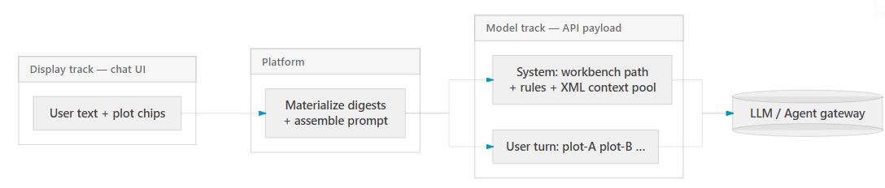
AI Interpretation– Copilot details
Interactive depth — The operator attaches one or a few plots from the gallery and asks follow-up questions; Copilot complements batch run-wide analysis.
Dual-track context — The chat UI keeps the user’s original wording; the outbound request uses short plot references in the user turn and moves full histogram data into the system prompt.
Structured digest, not vision — The platform materializes filtered ROOT JSON on the server; messages are text-only (no screenshots or multimodal API).
Grounded answers — Responses must cite attached plots and use only injected data — no invented metrics or sign-off conclusions.

Slide 21
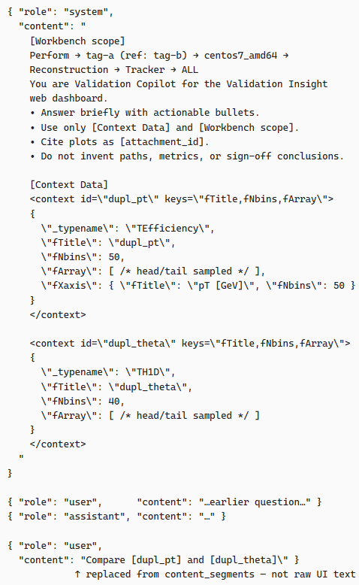
AI implementation – Copilot details
OpenAI-Compatible Message Format
  Standard { role, content } message array.
  Text only — no screenshots, no image_url, no vision API.
Dual-Track Representation (Display ≠ Model)
Layered System Prompt
  [Workbench scope] — breadcrumb workflow path (e.g. Perform → tag → platform → category).
  Instructions — role, tone, citation rules, anti-hallucination constraints.
  [Context Data] — XML-wrapped structured JSON pool.
XML Tags Delimit Data Boundaries
Server-Side Materialize (Not Client Upload)
Human vs. Model Perception

Slide 22
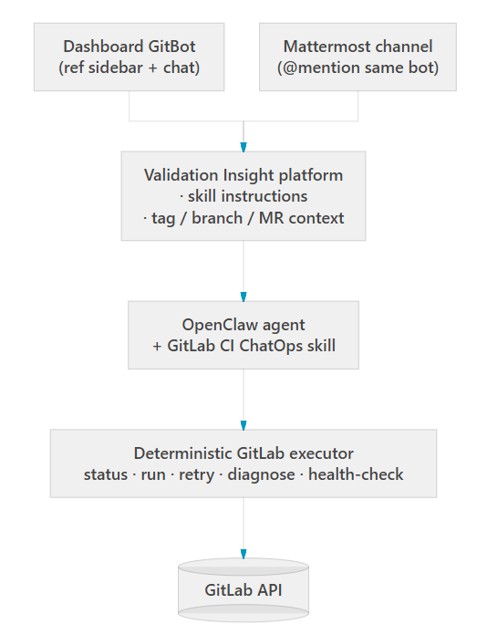
AI implementation – GitBot details
One agent, two entry points — Dashboard GitBot and Mattermost invoke the same OpenClaw agent and the GitLab CI ChatOps skill.
Skill-driven behavior — Agent rules, dashboard instructions, quick commands, and a deterministic command executor all live in one skill bundle (not ad-hoc prompts).
Auditable replies — Actions go through the packaged executor with branch policy guards; answers follow Execution Facts → Diagnosis & Next Step (no fabricated pipeline results).

Slide 23
AI implementation – Batch analysis
Batch, not chat — Operators select runs (or compare pairs) and run Prepare → Grade → Review; the system processes hundreds of plots without hand-picking each one.
Structured data, not screenshots — ROOT objects are filtered to compact JSON sidecars on disk; the LLM reads numeric histogram summaries, not gallery images.
Three-stage pipeline — Prepare materializes digests (no LLM) → Grade scores each canvas (LLM or heuristic fallback) → Review synthesizes a run-wide report (one LLM call).
Durable, reusable outputs — Grades and summaries are written beside the data, drive gallery star overlays and compare indicators, and can continue in Copilot for follow-up questions.

Slide 24
AI-readable workflow & root-cause tracing
Goal
Make the whole validation workflow immediately readable to AI — like a structured project — so a suspicious result can be traced: plot → artifacts → scripts/steps → software change.
Two sides of the same coin
• AI understands the workflow — stages, I/O, what a plot means
• Workflow is AI-legible — stable IDs, manifest, digests, lineage (not screenshots alone)
Then: root-cause from results
From Current vs Reference / bad grade, walk the chain with evidence — not guess from a canvas alone.
Today vs ahead
• Today: digests, batch triage, plot Q&A, some Git/CI context
• Ahead: full-chain lineage so “read the project” and “trace the fault” are routine
How we implement (division of labor)
Our job — workflow understanding
• Materialize facts the AI can read (plot_id, artifacts, step status, software ref)
• Package as Skills / system context: how to resolve a plot, which repo/path/tag to open
• Orchestrate the investigation (when to triage, when to hand off)
Not our job — rebuild code intelligence
• Do not build an in-house source navigator / semantic code search
• Hand off to a coding agent (e.g. OpenCode, Claude Code, Cursor) once paths + ref are known
• Coding agents are stronger at deep repo tracing; we ground them with workflow maps
Runtime sketch
Validation facts + Skills → orchestrator → coding agent (read/trace/patch proposal)
OpenClaw (or similar) can host Skills and call the coding agent as a tool — not replace it for code deep-dives
Gates — any code change stays human-approved; AI does not replace RelVal sign-off

