Slide 1
AURORA: A High Performance DAQ Framework for PandaX-xT
郭弈含，谌勋
上海交通大学
2026年7月16日

Slide 2
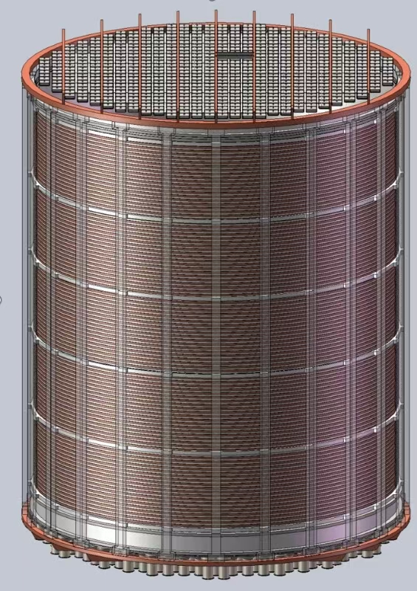
Motivation
PandaX-20T: ~3,000 readout channels (8,000 final)
  Rate: 300 MB/s (initial) → 800 MB/s (final)
  Peak during Expected data calibration: up to 1.6 GB/s sustained
Existing PandaX-4T DAQ:
  Maximum sustained throughput: 600 MB/s
Urgent need for a more robust, scalable solution.

Slide 3
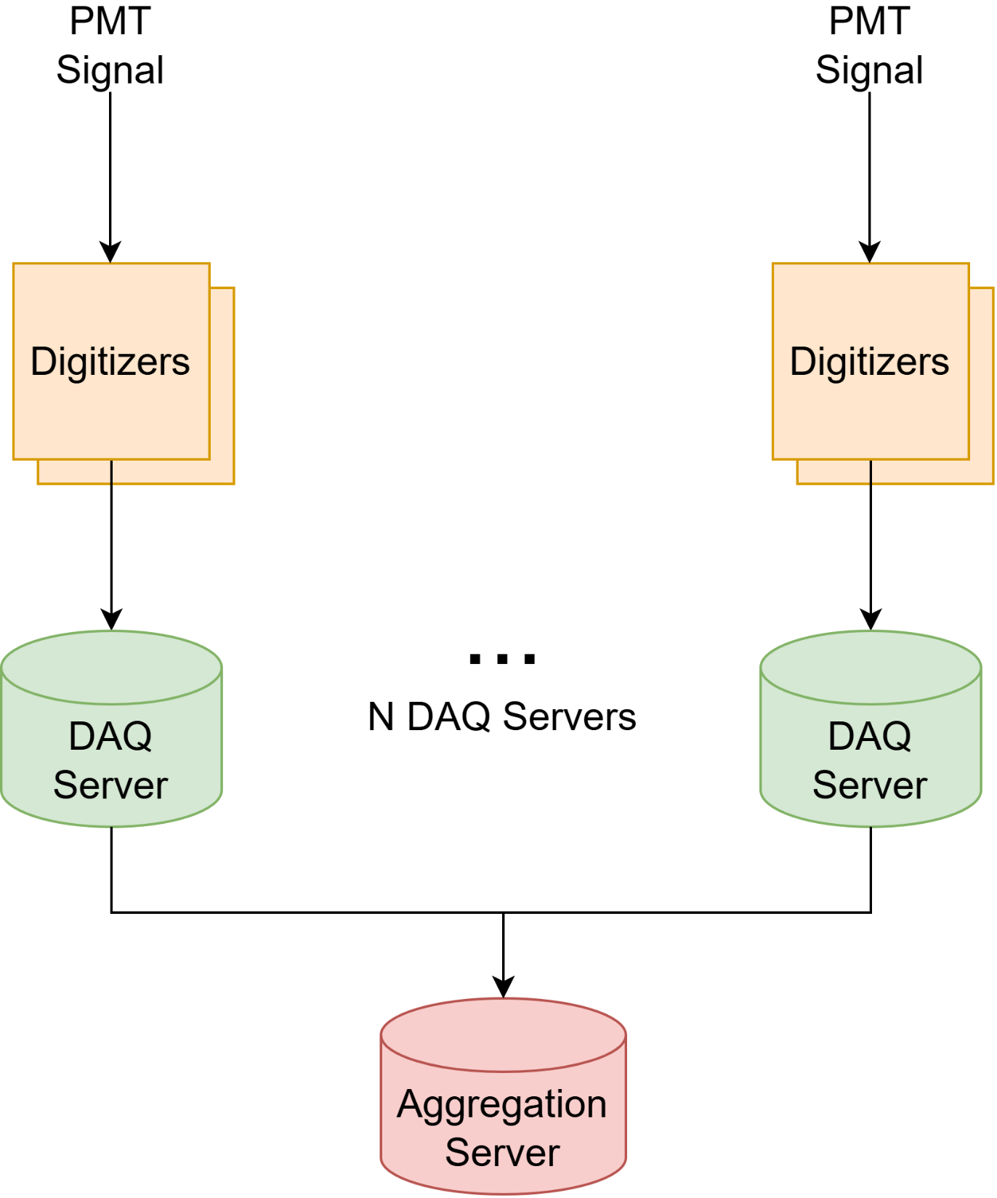
System Requirements
Performance & Scalability
  1.0 GB/s sustained throughput, 1.6 GB/s peak
  Distributed architecture supporting ≥8 servers
Data Integrity & Reliability
  Zero data loss from digitizer to disk
  ≥24 hours continuous stable operation
Multi-Stream Data Handling
  Independent streams for TPC and Outer Veto
The most import requirement is the PERFORMANCE!

Slide 4
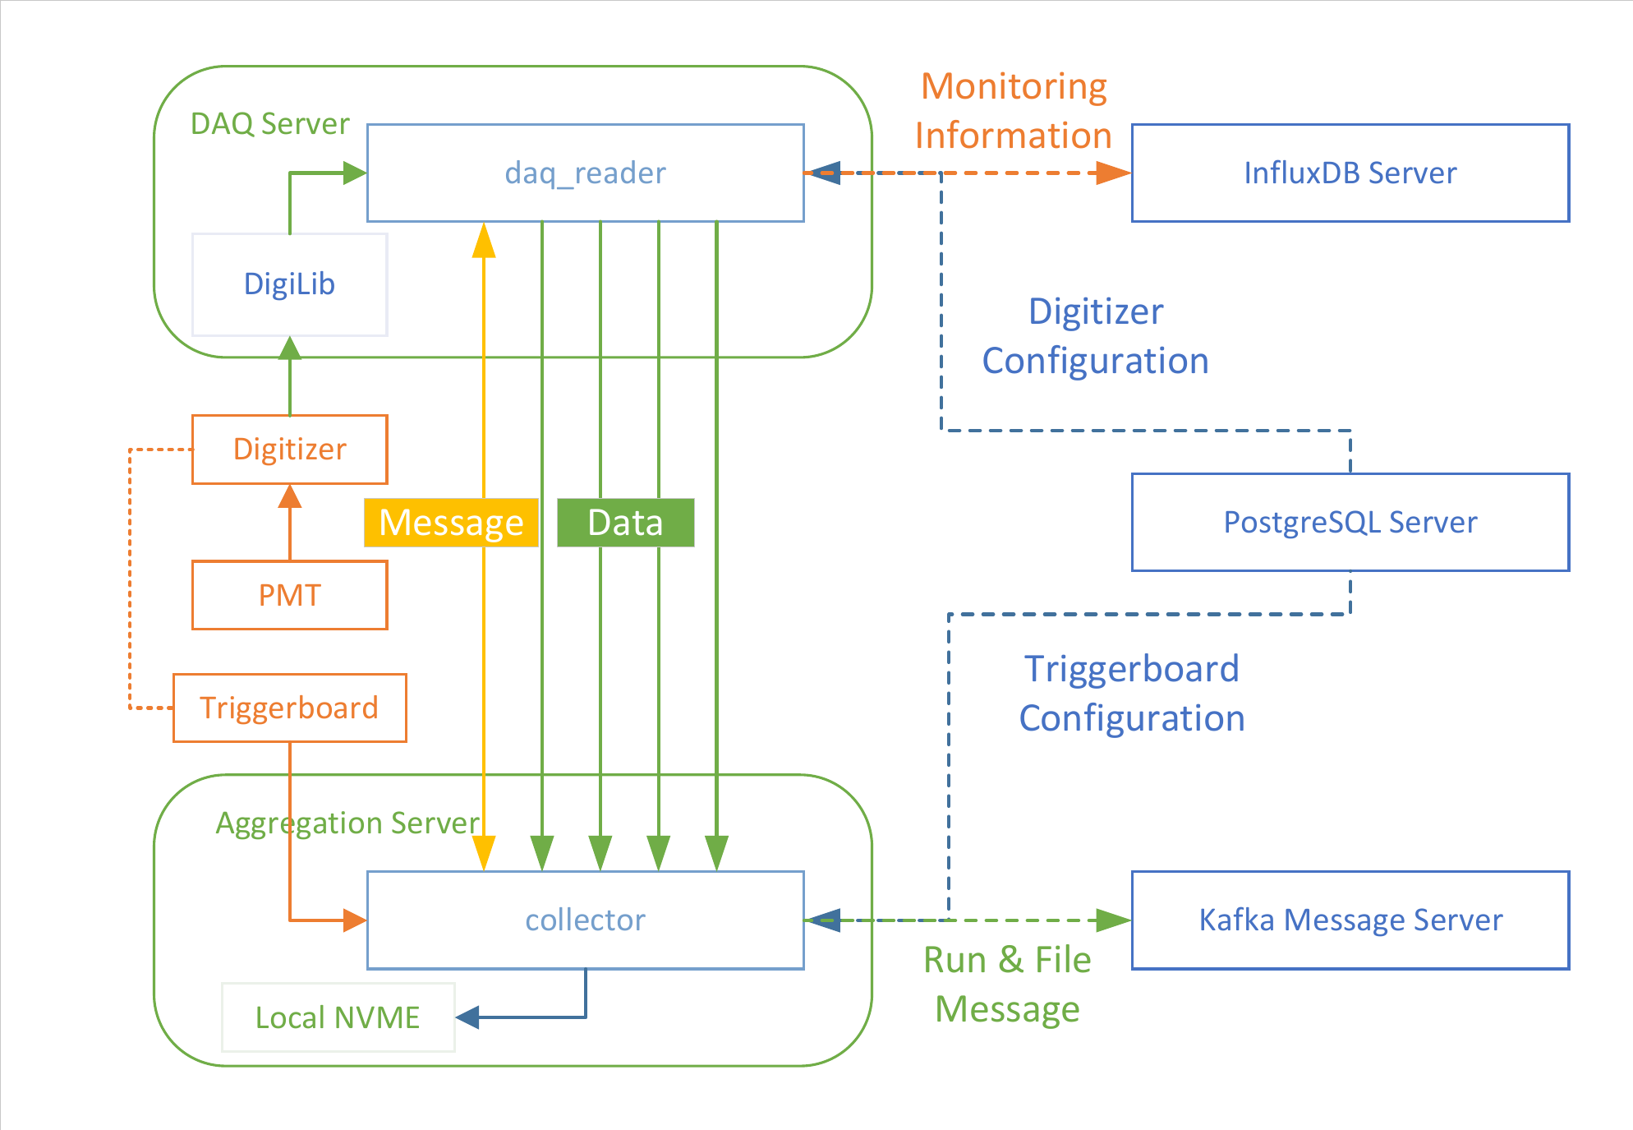
Architecture of AURORA
Distributed Architecture
N DAQ reader:
  Receive data from digitizers.
  Transmit data to Collector.
Collector:
  Unpack and sort data by timestamp, then write it to NVME Disk.

Slide 5
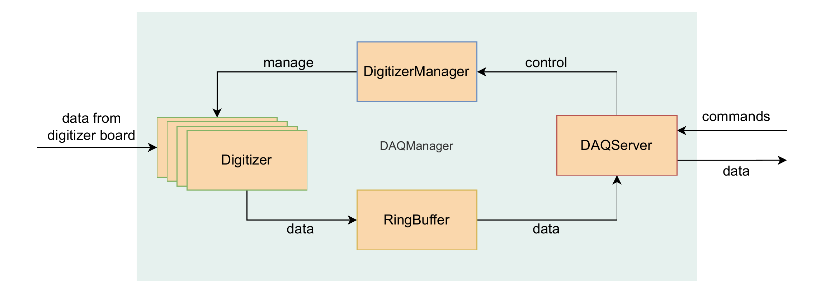
DAQ reader Architecture
Digitizer: Independent data acquisition thread.
Ring Buffer: Accepts input from N independent digitizer threads, while a dedicated thread outputs data.
DAQServer: Communicate with Collector with TCP.

Slide 6
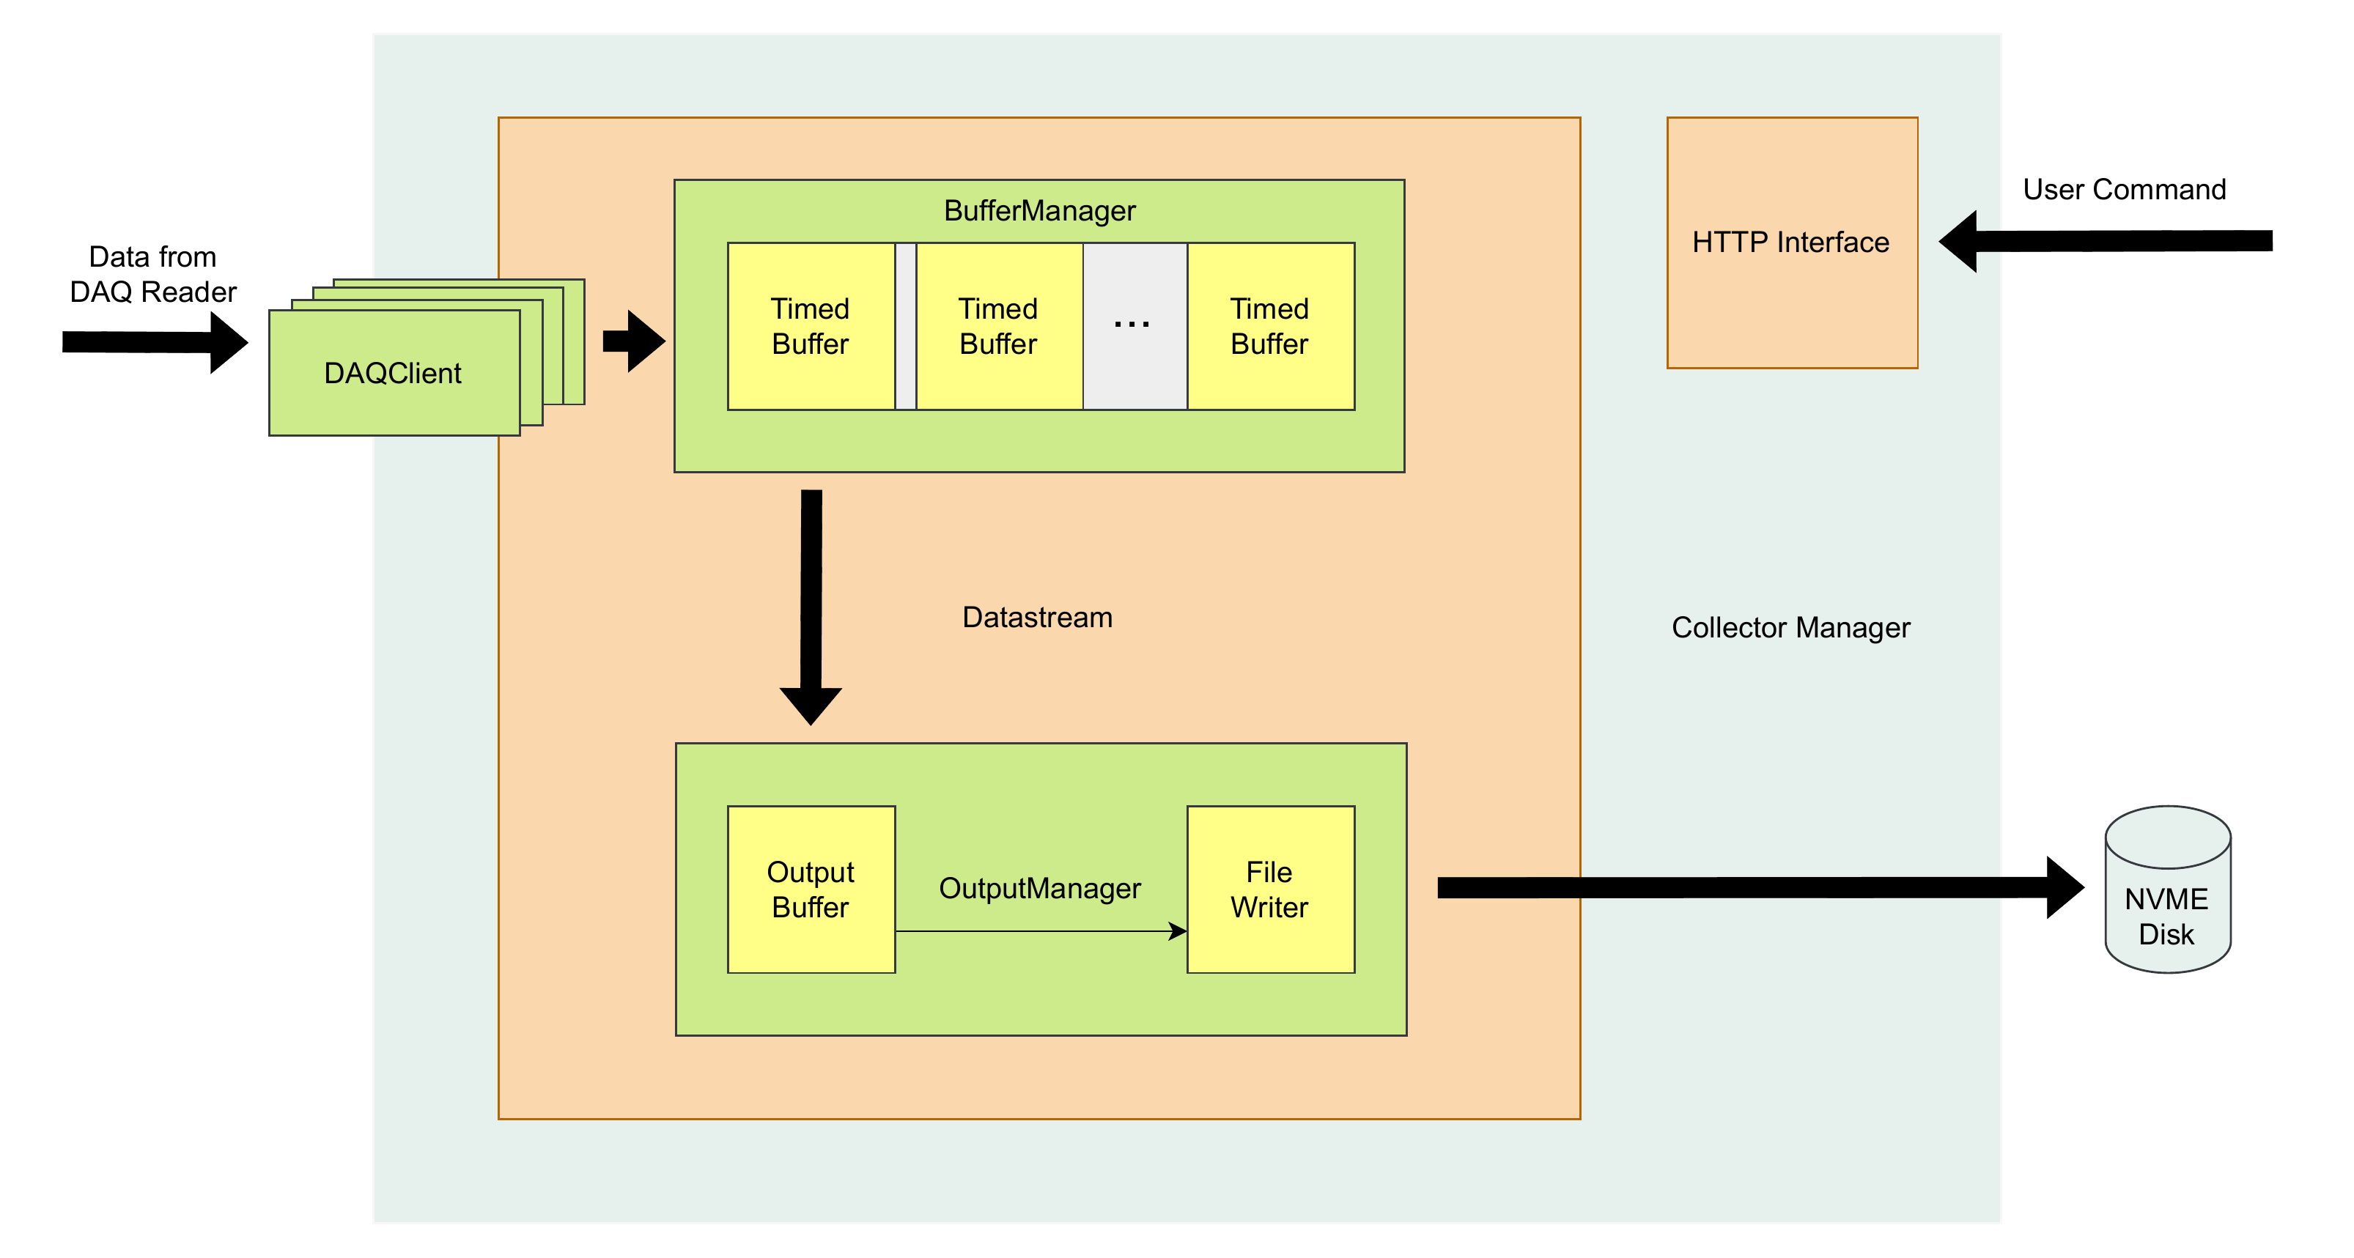
Collector Architecture

Slide 7
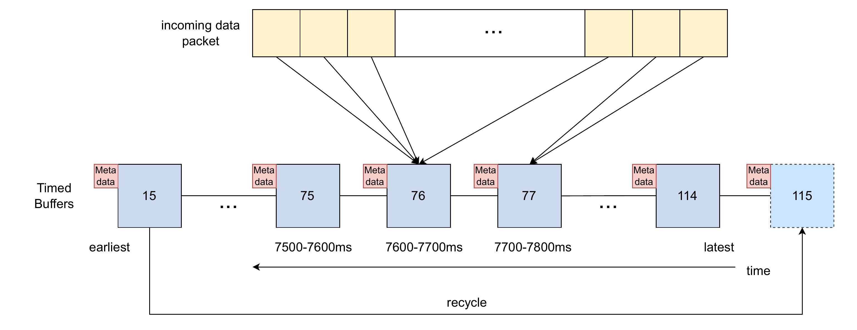
Process incoming data
Timed Buffers form a timestamped ring buffer.
Most incoming data packets fall into the middle Timed Buffers.
Every 100 ms, the earliest Timed Buffer is processed by the Output Manager and recycled.
Header + ADC data
Timestamp
Channel
Block size
Position in buffer

Slide 8
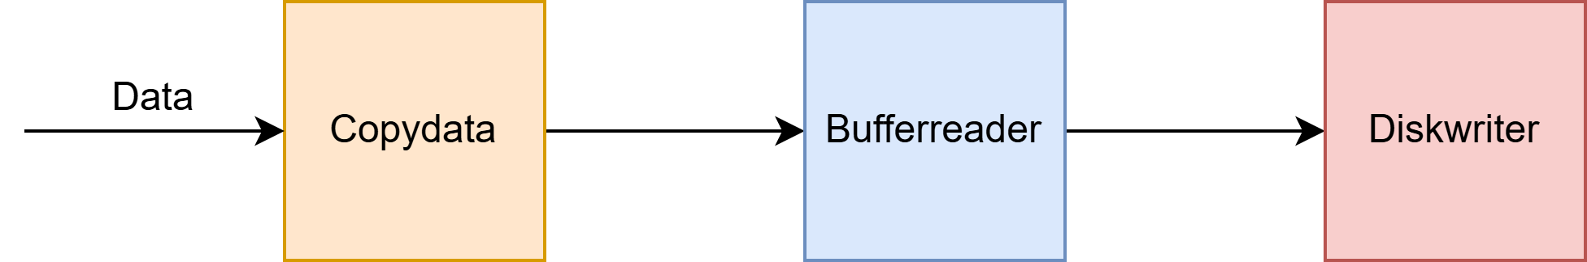
Performance: Throughput Benchmarks
Copy data to timed buffer: 15-26 GB/s
Copy data to output buffer: 3.13 - 3.64 GB/s
Write data to disk: 5.47 GB/s
All stages exceed the 1.6 GB/s design target.
Test platform: Dell R7625, AMD EPYC 9554, 192 GB RAM

Slide 9
Stability and Real-World Validation
Long-term test: 58+ hours continuous run with 1,400+ channels on TDLI test platform
  No errors, no data corruption, exceeds 24h requirement
PandaX-4T calibration validation:
  Sustained 800 MB/s average during AmC calibration
  Peak 900 MB/s during ²²⁰Rn injection campaigns
  Average >450 MB/s over multiple days
  No interruptions, proven reliable in real operation

Slide 10
Summary
AURORA is a high-performance distributed DAQ for PandaX-xT
Benchmark tests achieved a data throughput of over 3 GB/s, exceeding the 1.6 GB/s design target.
Demonstrated stable continuous operation for over 58 hours on TDLI test platform at a data throughput of several hundred MB/s.

Slide 11
Thank you

Slide 12
Backup

Slide 13
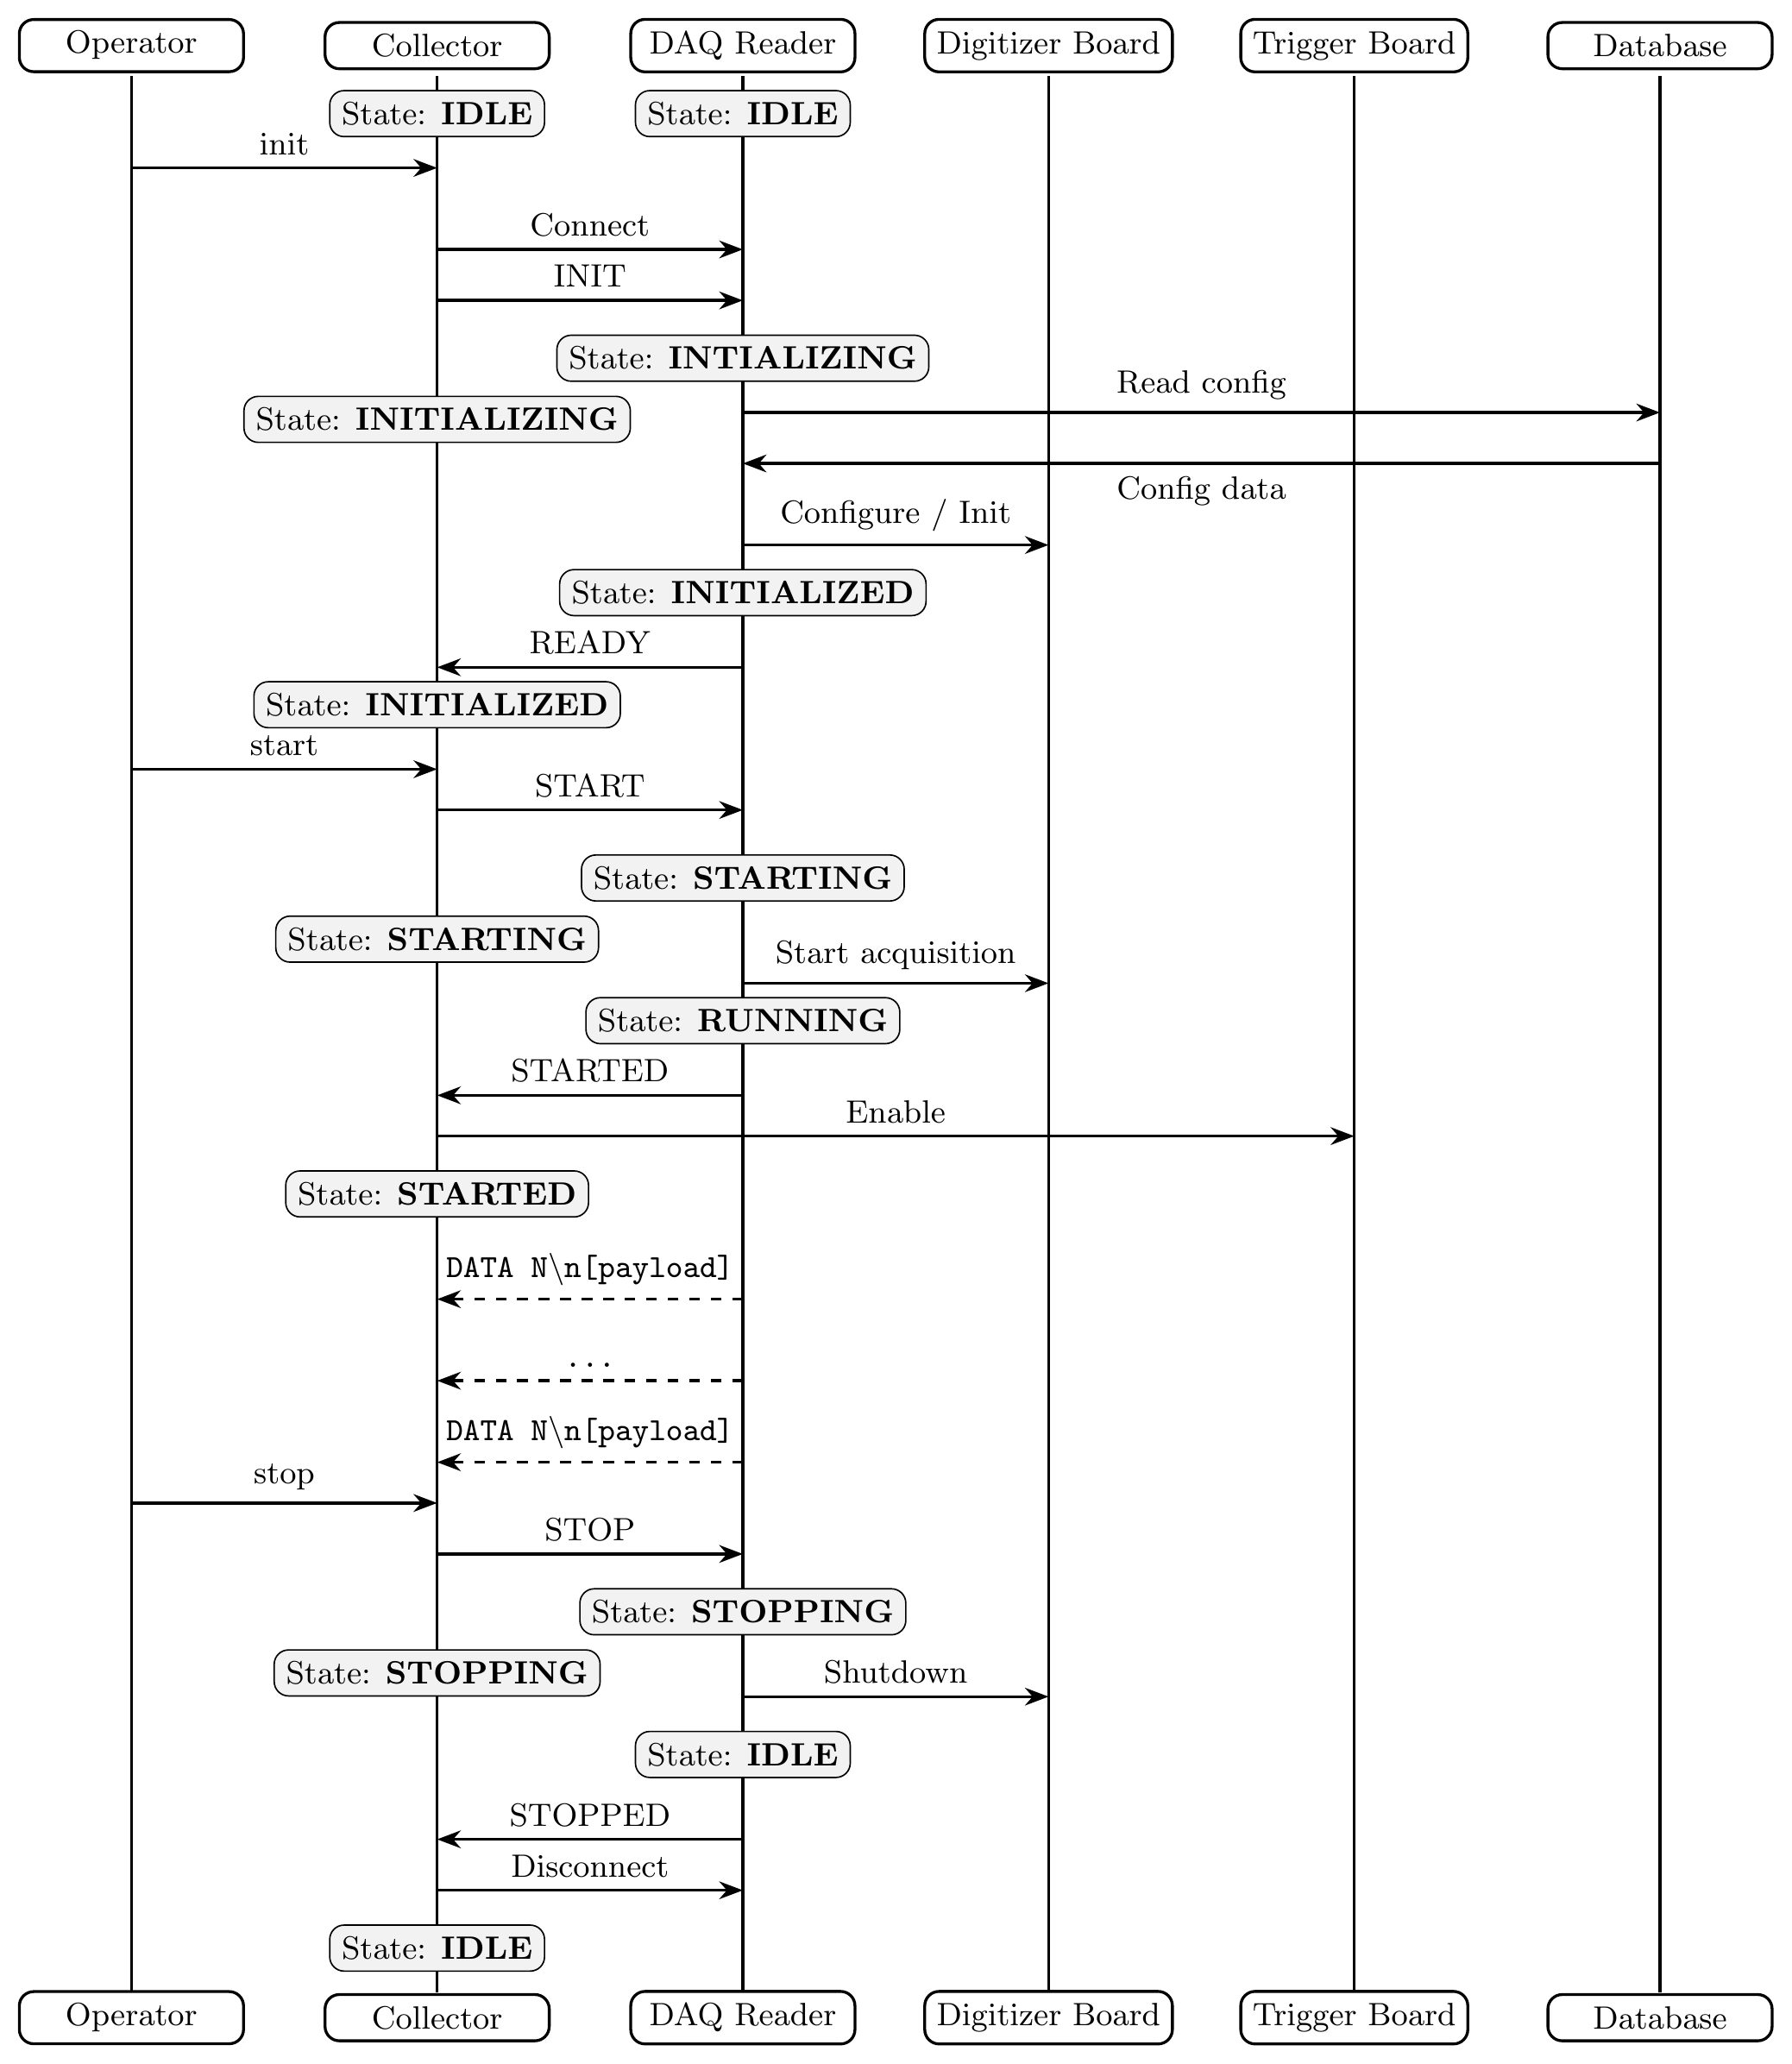
DAQ Acquisition Cycle Flow
Network Layer:
• Asynchronous I/O via Asio C++ library
• DAQ reader (TCP server) ↔ Collector (TCP client)
• Separate connections for control and data
• State-machine protocol for reliable coordination

Slide 14
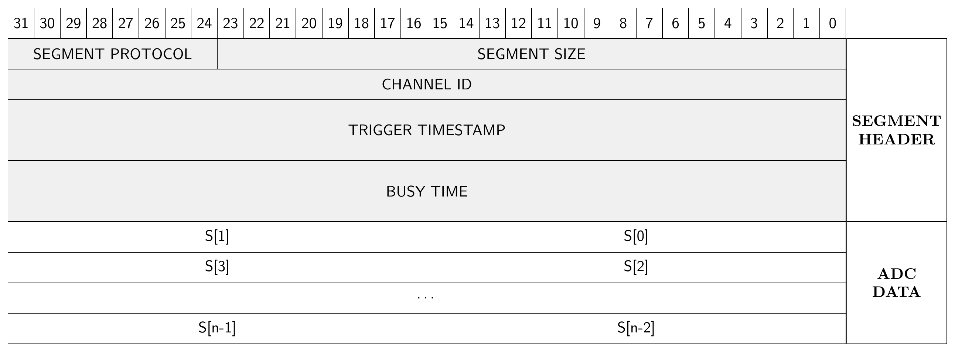
Data package and data block
Data transferred on network as packages.
  In format of DATA N\n[package], where N is the package size in byte.
A package contains many data blocks.
A data block contains the continuous recorded waveform of a single readout channel
  Header + ADC data

Slide 15
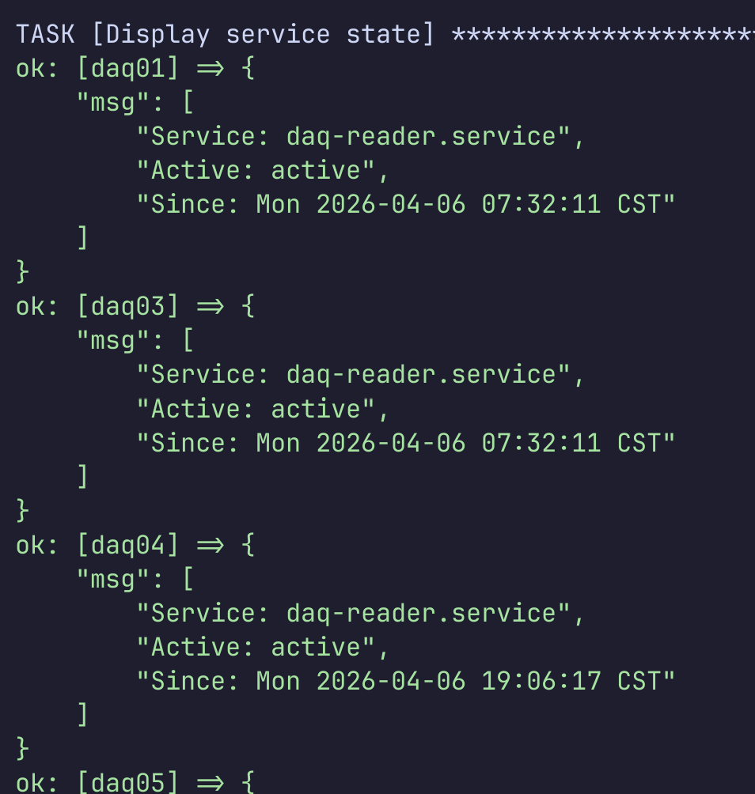
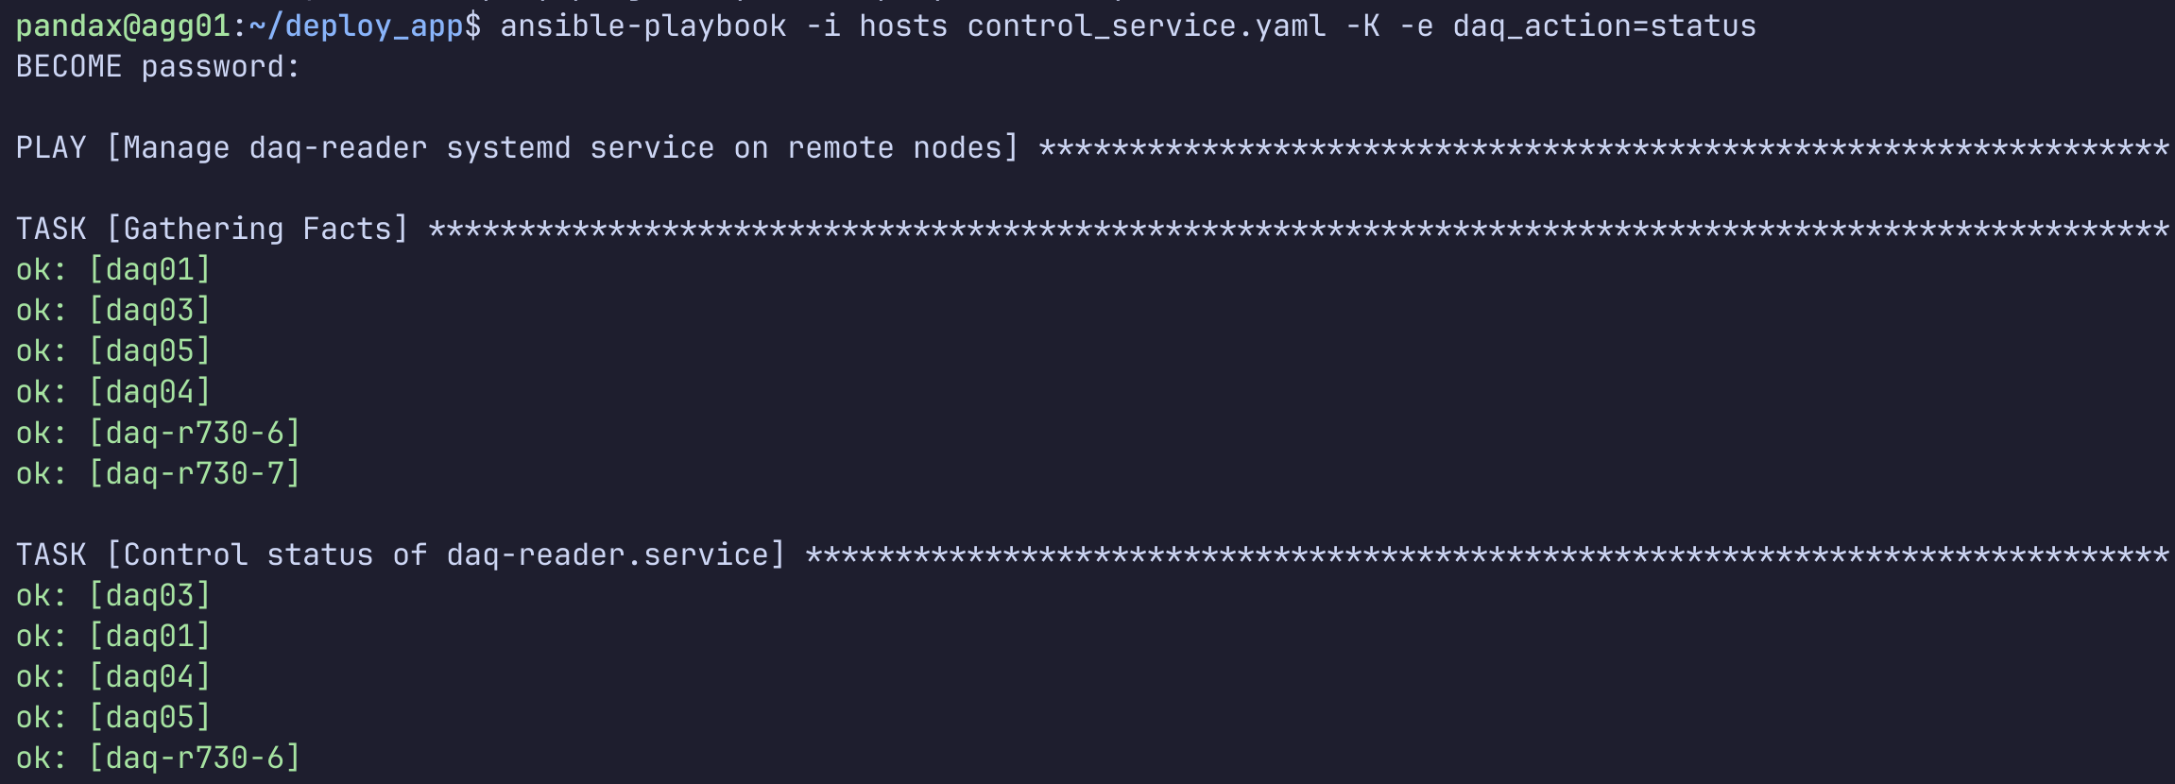
Deployment
Based on systemd and ansible-playbook

Slide 16
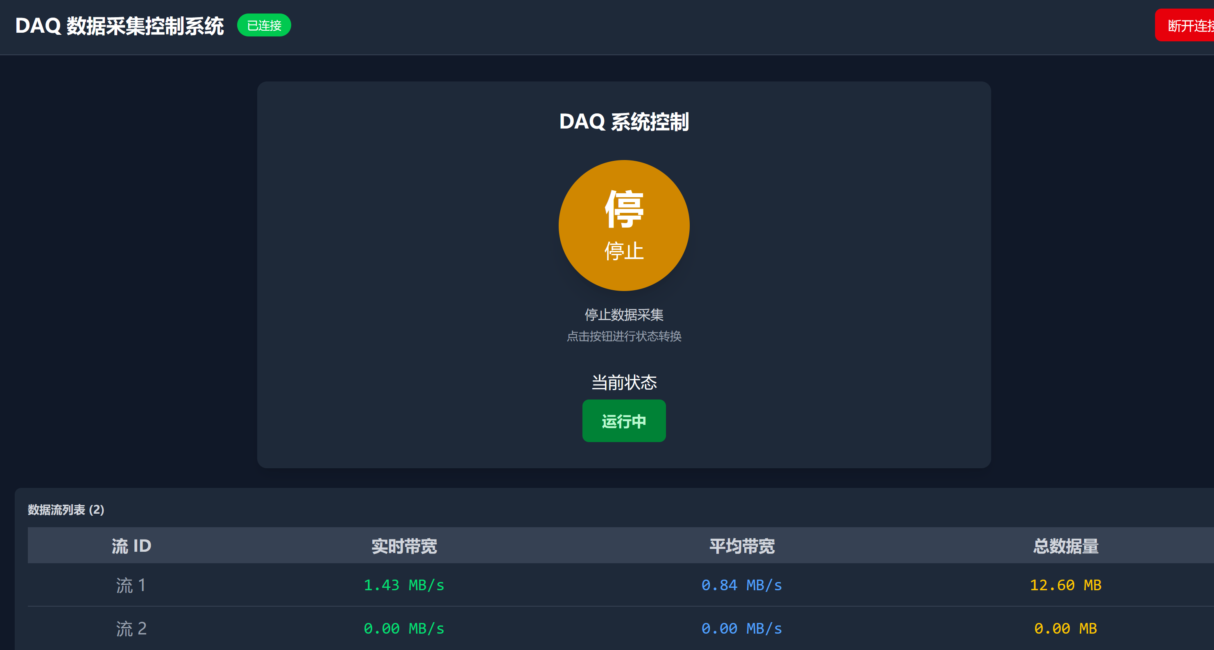
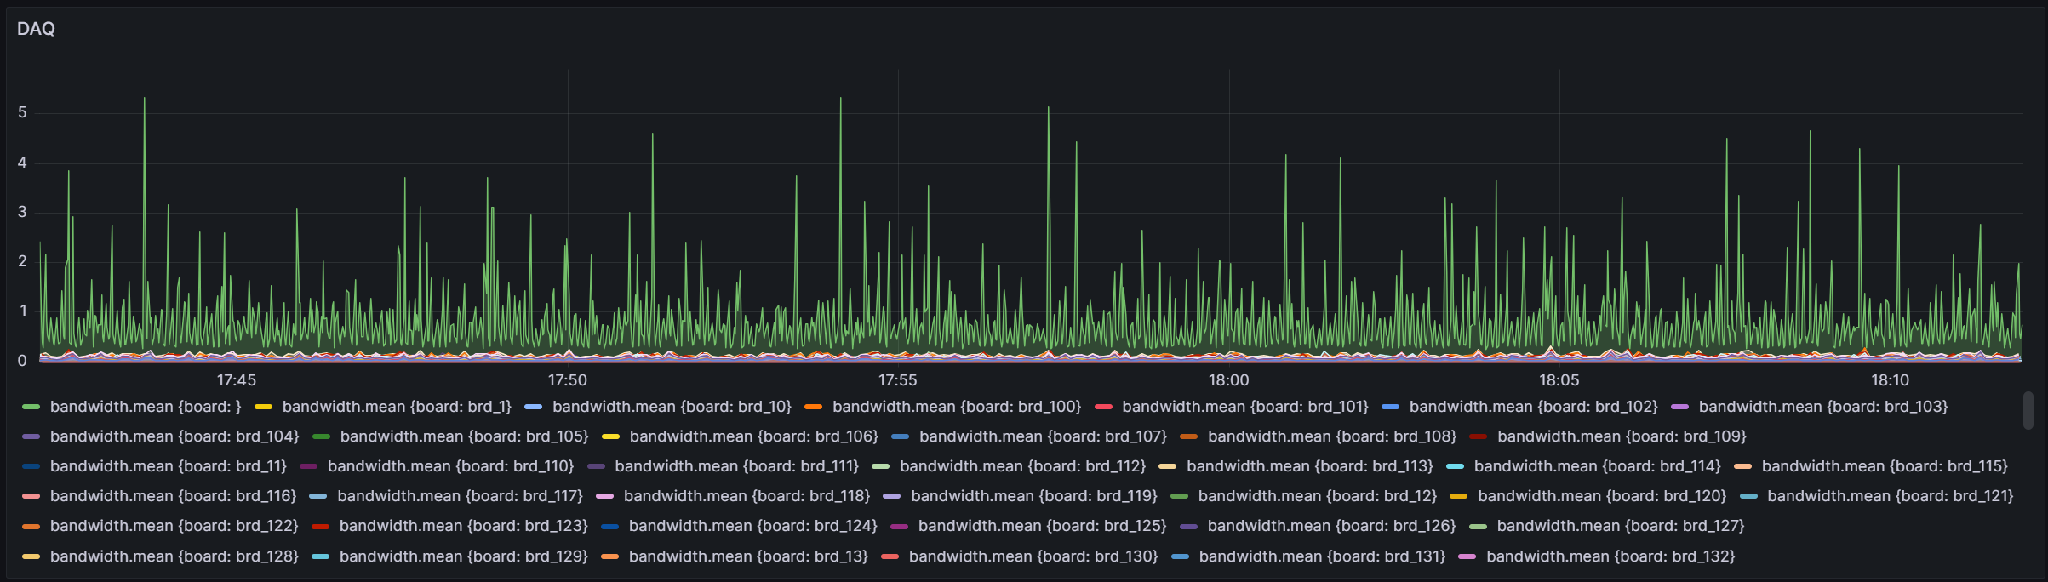
Monitoring
Based on influxDB and Grafana

Slide 17
Readiness for PandaX-20T
Each DAQ reader is connected with 7 * 4 * 8 = 224 channels
  7 NIC, 4 Port, 8 channel
Need 14 servers for 3000 channels
In case of excessive bandwidth:
  Add additional collectors and store data independently
Now we have 16 servers for DAQ reader, 4 servers for Collector

