Slide 1
Performance of JUNO-TAO Central Detector
IHEP TangHaozhong
on behalf of JUNO collaboration
20260717

Slide 2
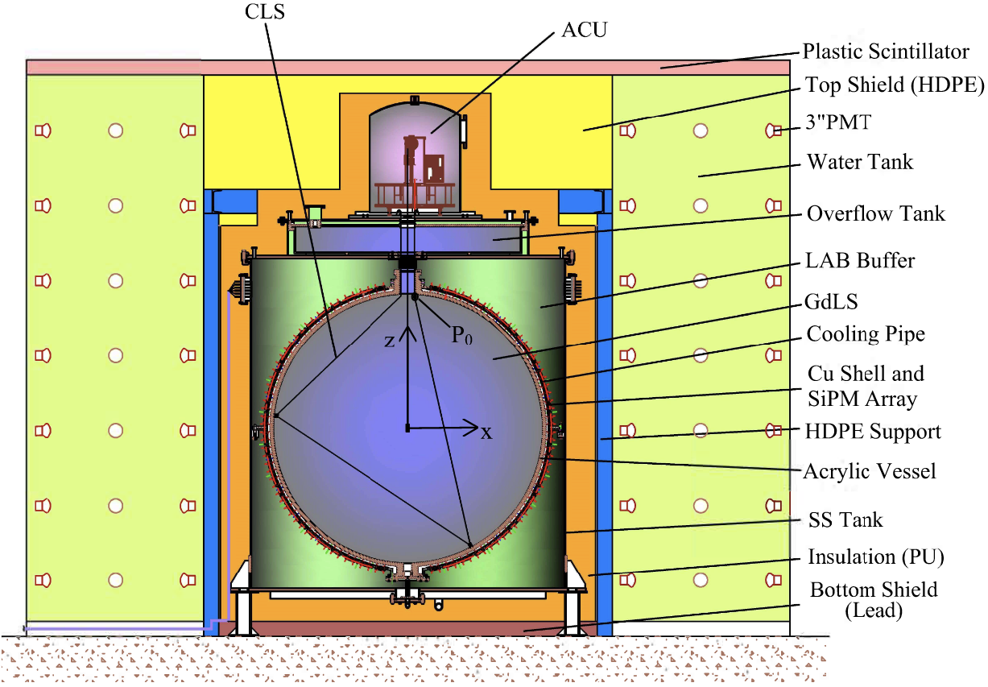
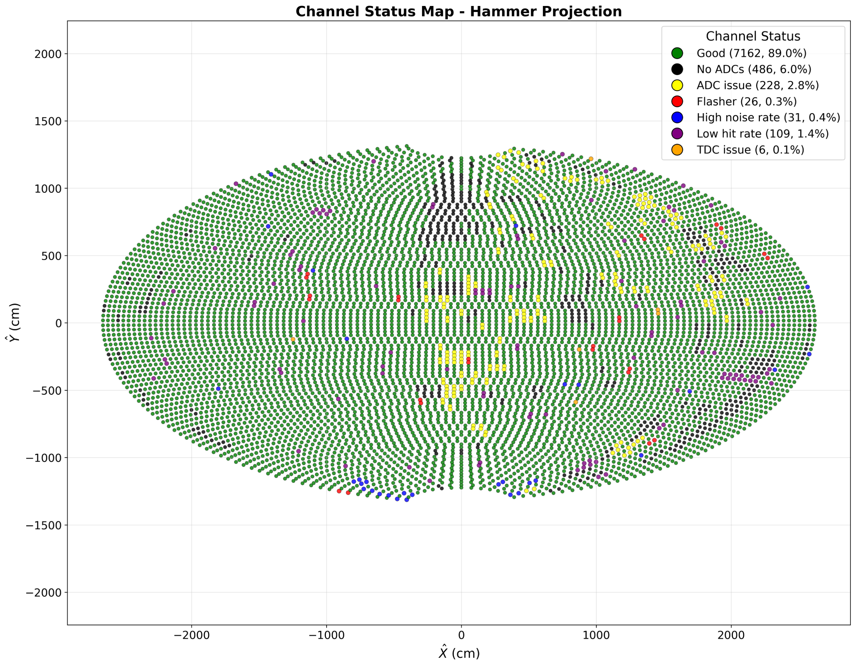
Taishan Antineutrino Observatory
Central Detector
  ~44m from Taishan reactor core
  Diameter: 1.8m
  Temperature: ~-50℃
  2.8ton GdLS
  Total channel number: 8048; ~90% is OK now
  ~10m² SiPM，~83.3% photosensitive coverage
  Light Yield: ~4500 photoelectrons/MeV
  2026.2: Data Taking!

Slide 3
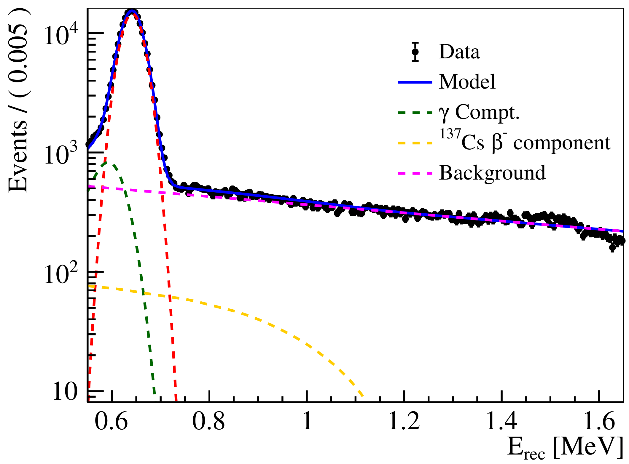
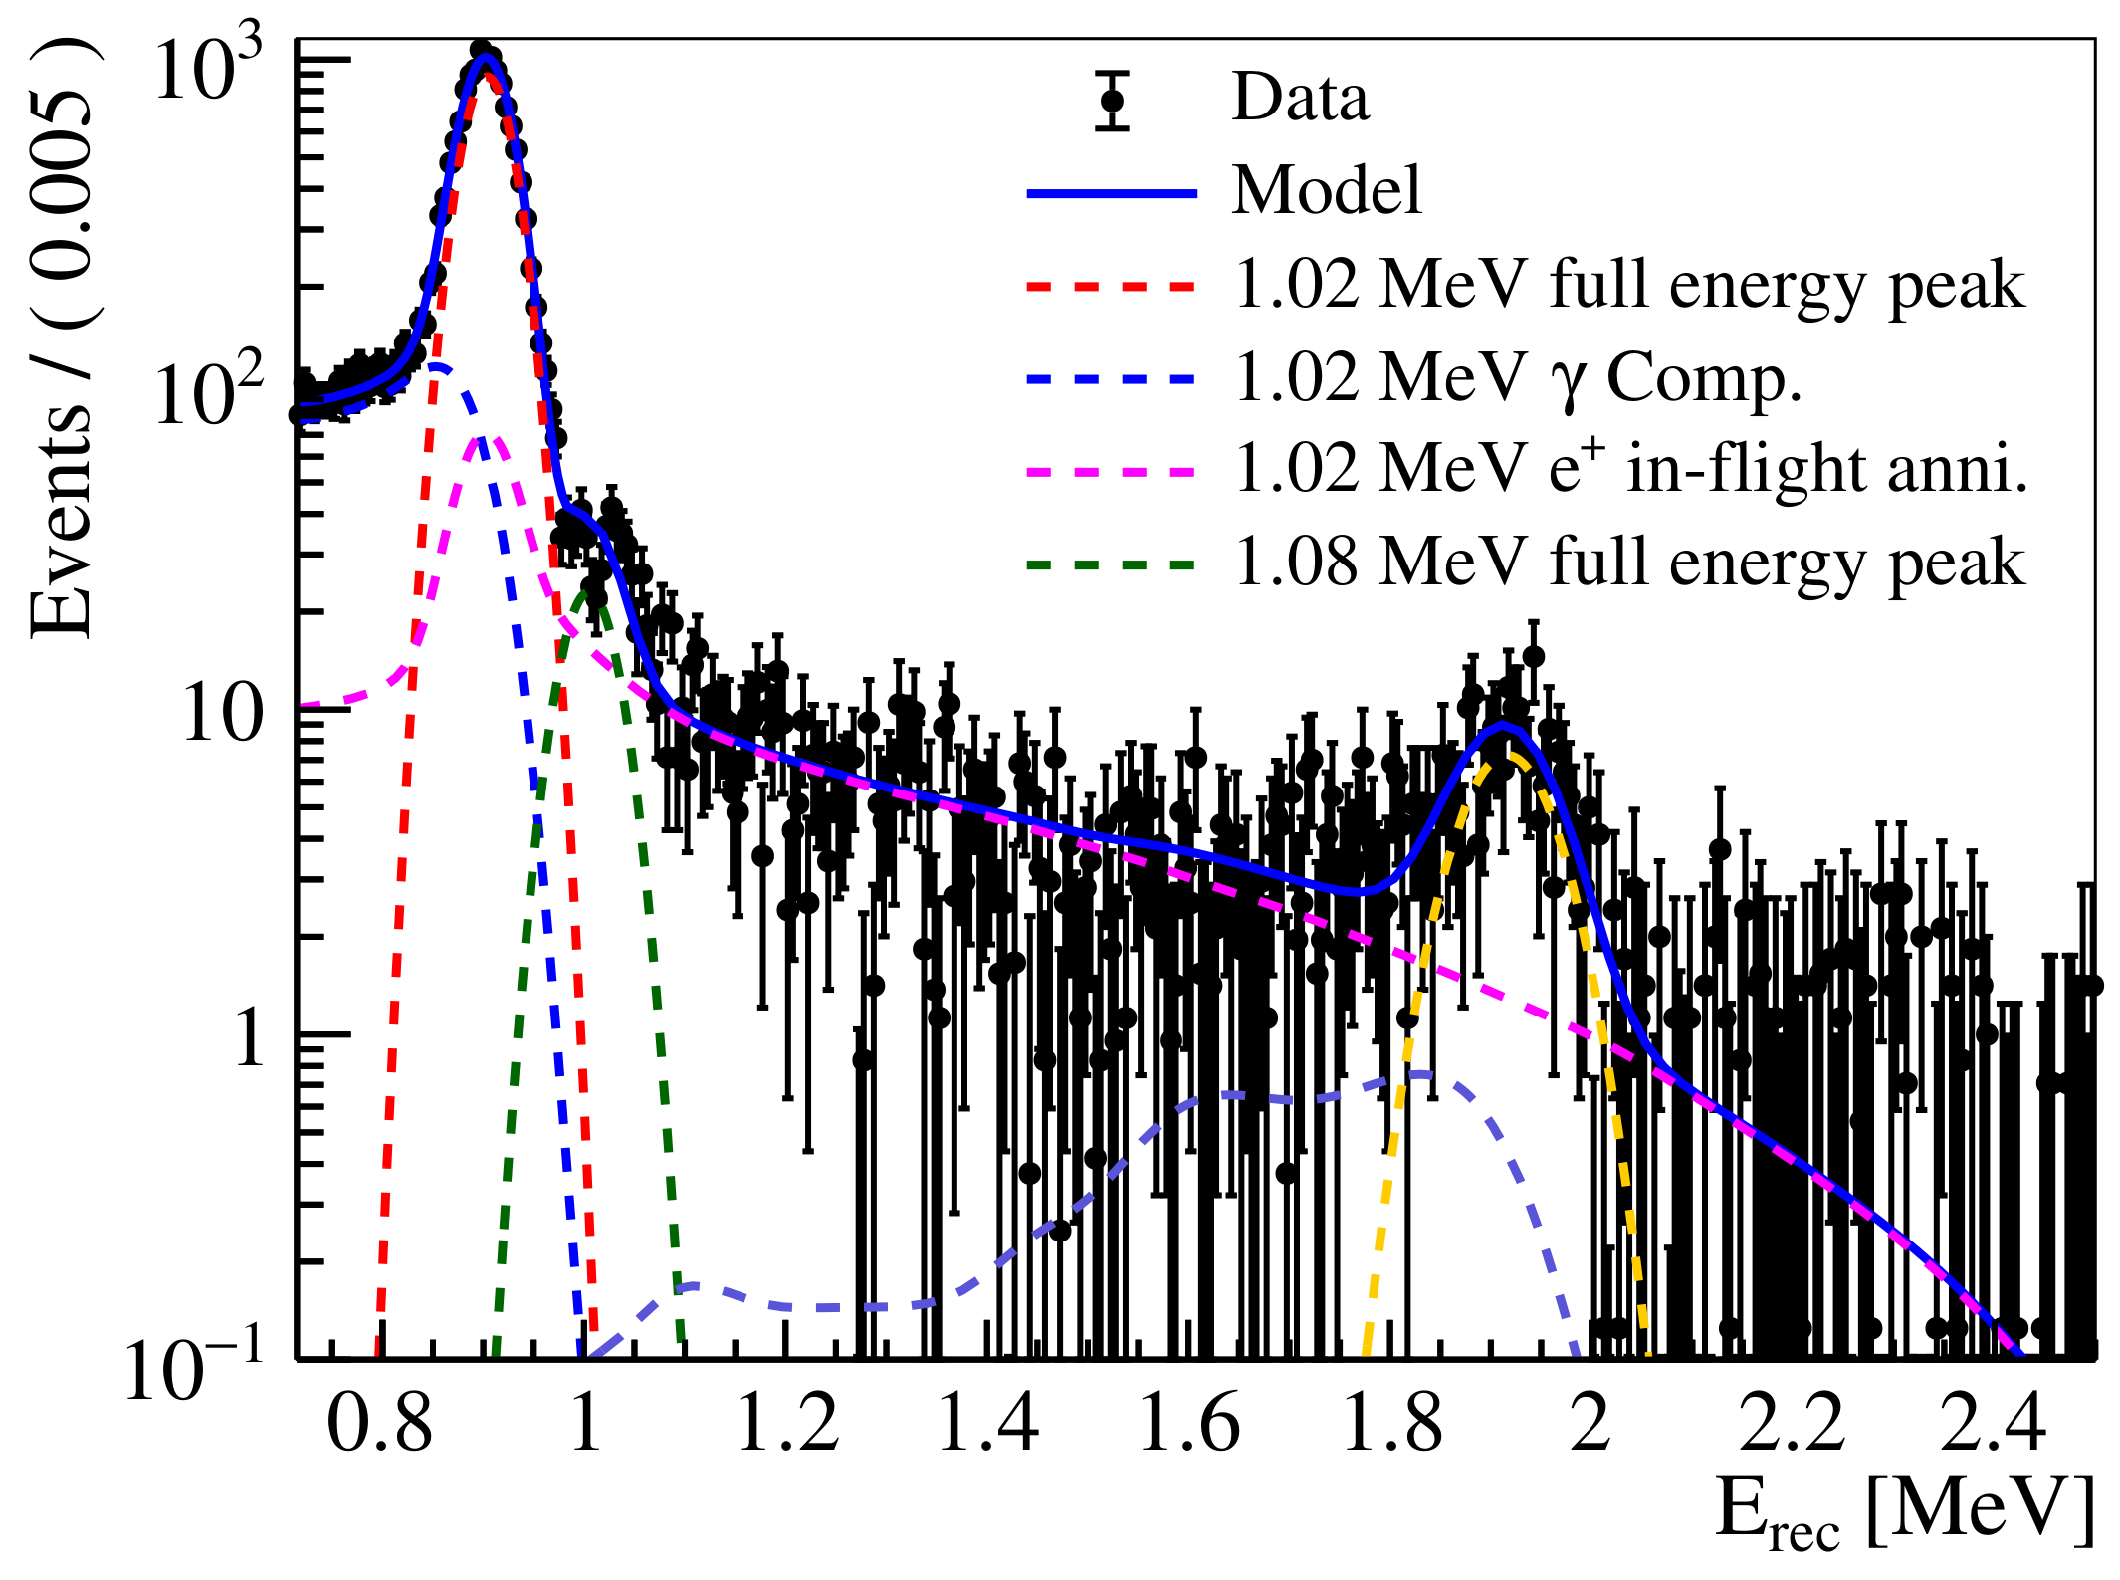
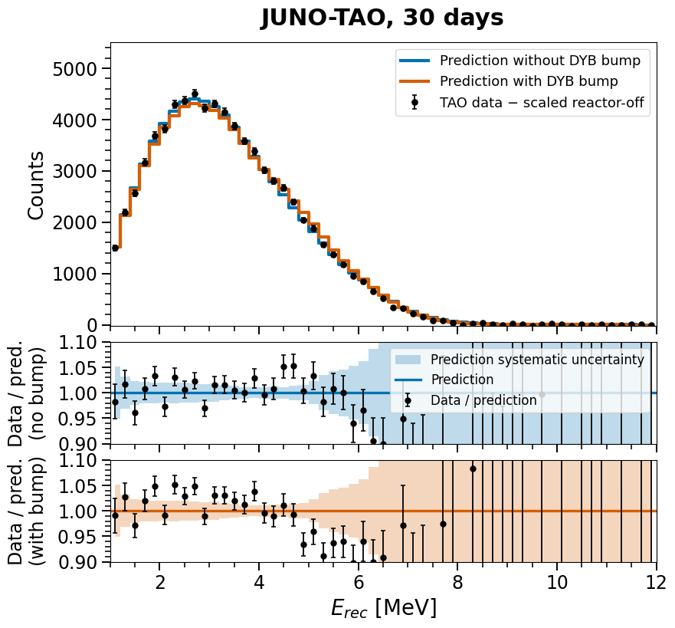
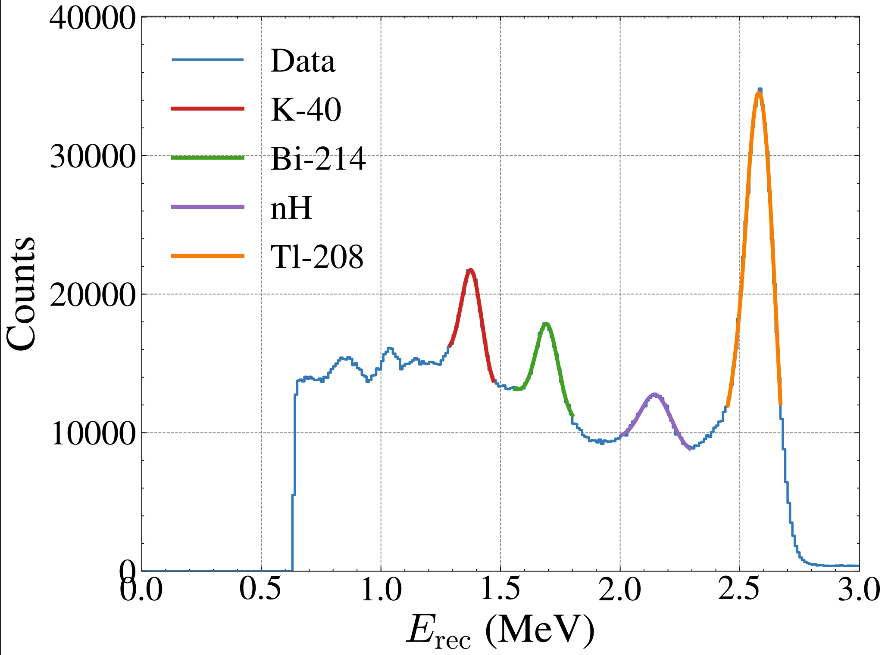
Spectrum
Cs137 Spectrum and fit
Ge68 spectrum and fit
IBD prompt spectrum
Singles Spectrum

Slide 4
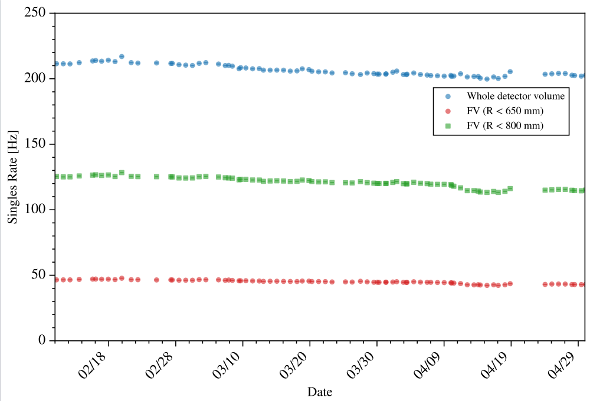
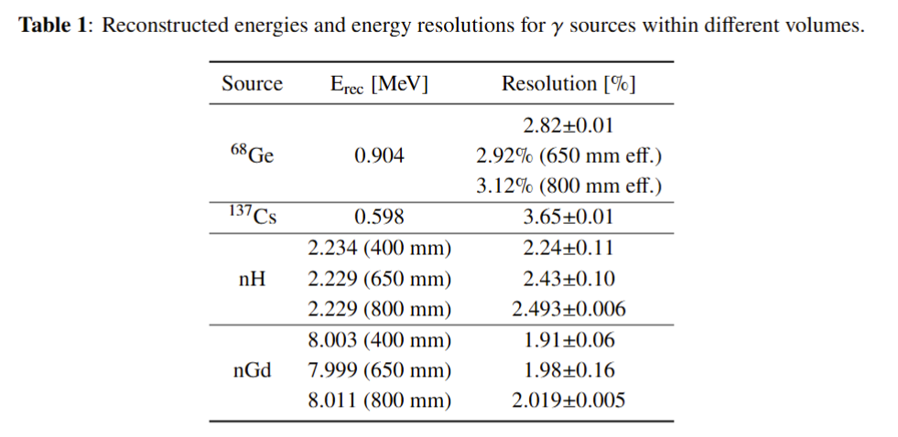
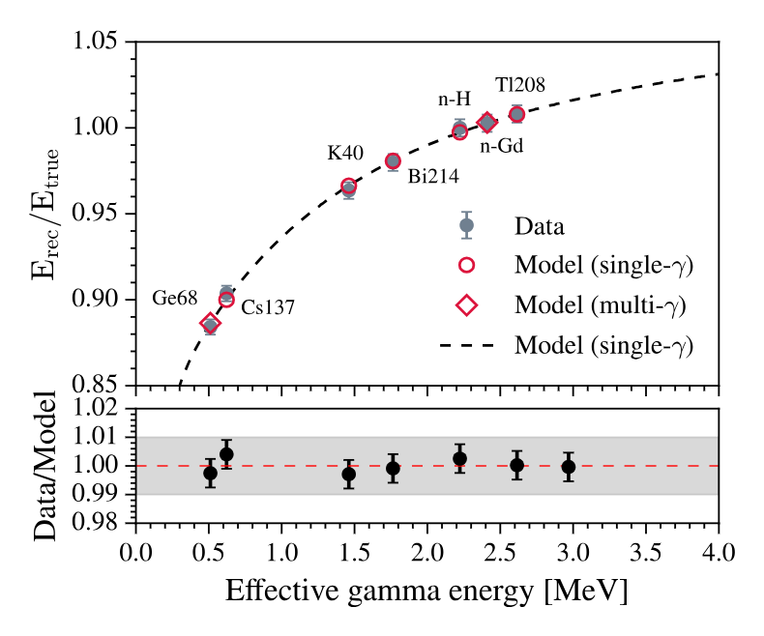
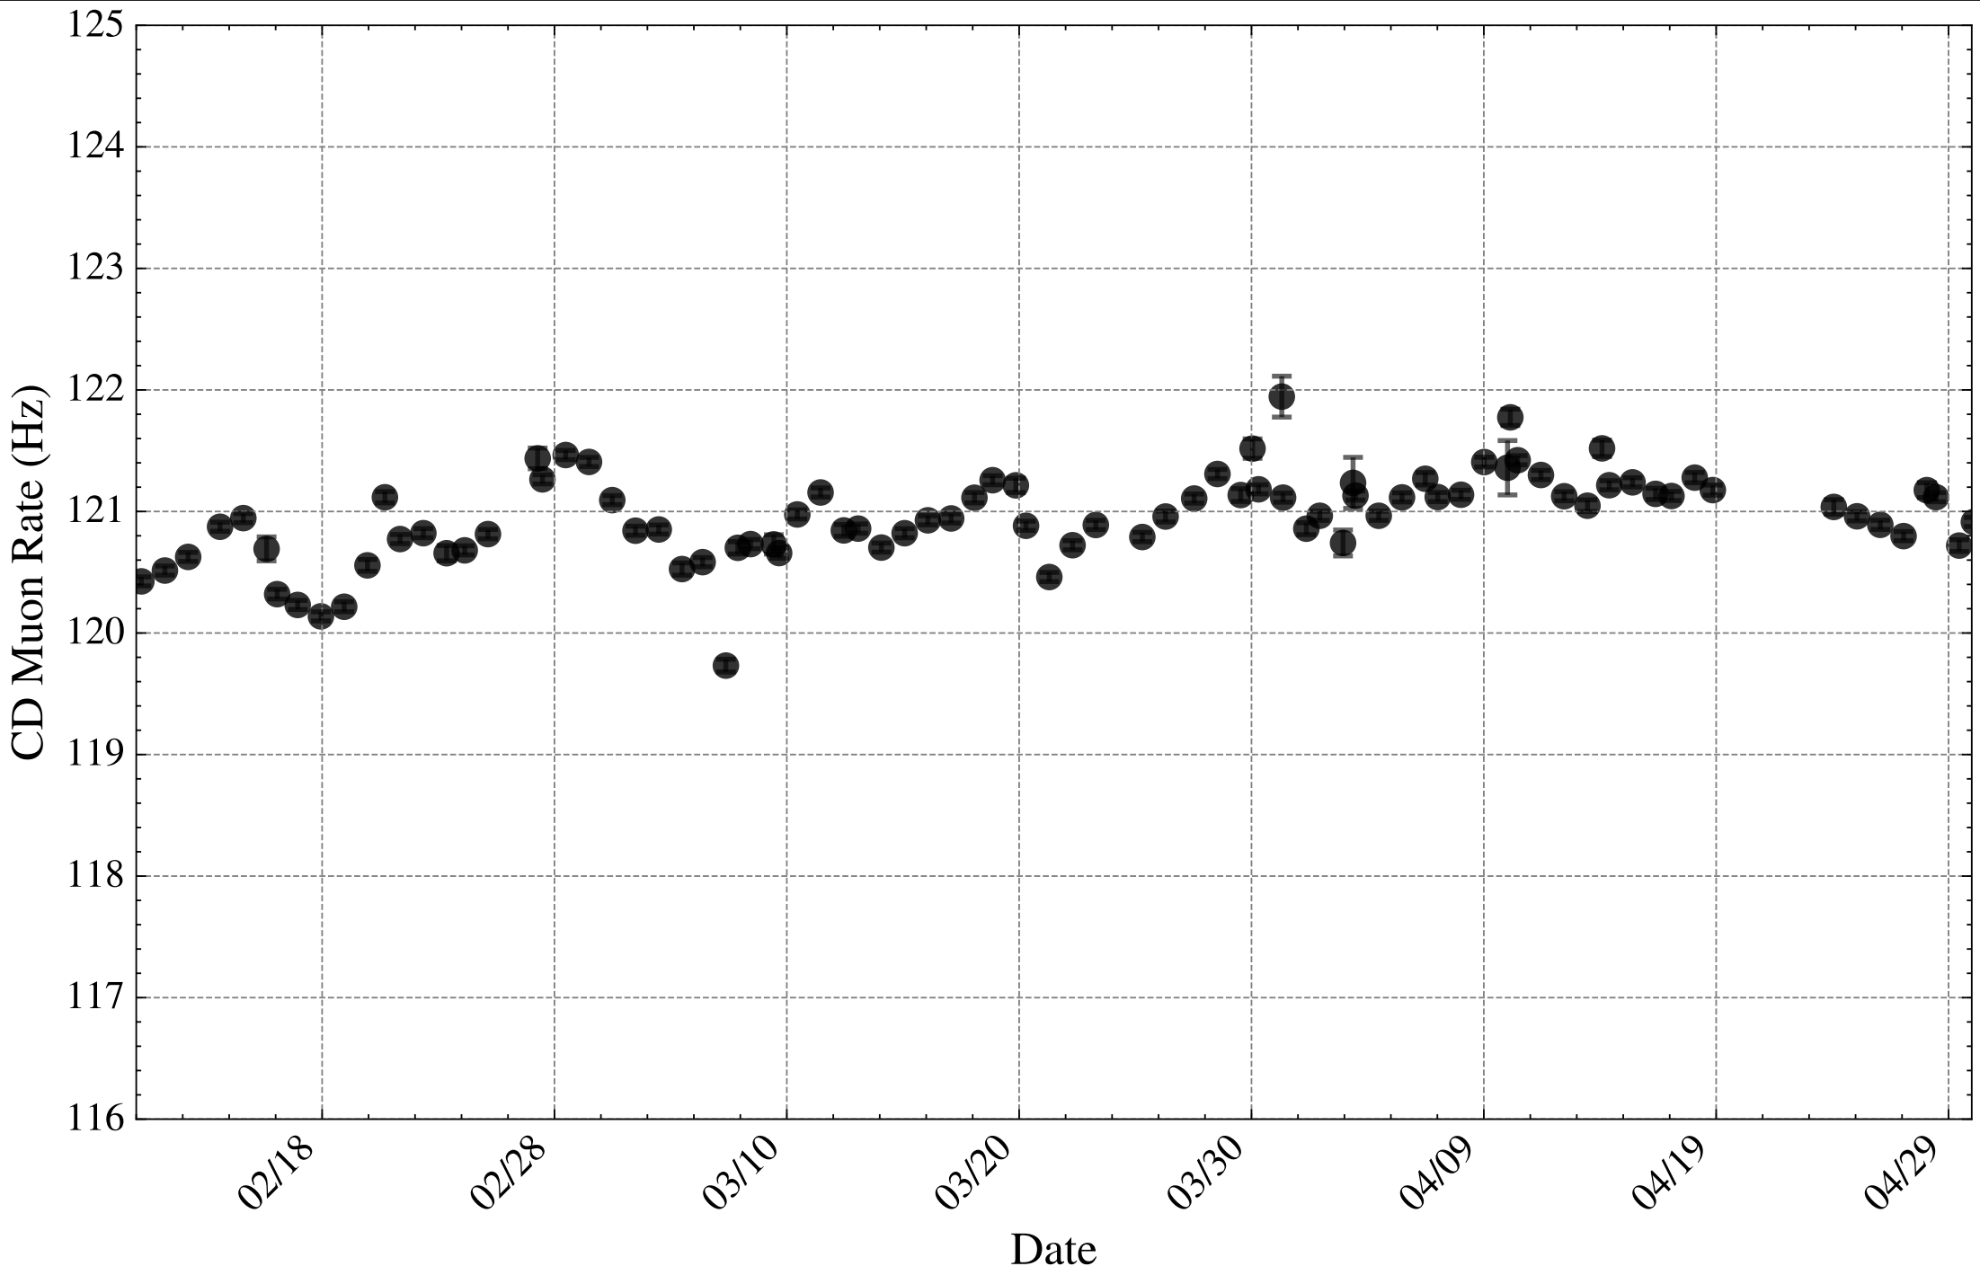
Detector Performance
Energy resolution (JUNO Ge at center:~3.5%) Singles rate
Energy nonlinearity CDmuon rate

