Slide 1

IBD selection study at TAO
Ziang Li
13950037268@163.com
School of Physics
Sun Yat-sen University
July 16, 2026

Slide 2

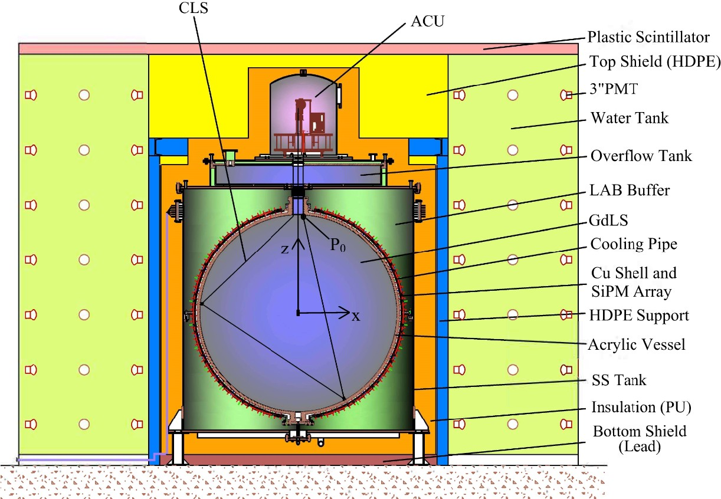
Introduction of TAO
TAO serves as a satellite detector of JUNO for high-resolution reactor antineutrino spectrum measurement.
World leading energy resolution 2.8% @Ge-68, further improvements expected.
Enable studies of fine spectral
structures and tests of reactor flux models.
TAO began physics data taking on Feb. 10, 2026; this work presents the IBD selection and prompt
energy spectrum measurement.
IBD selection study at TAO
2 4

Slide 3
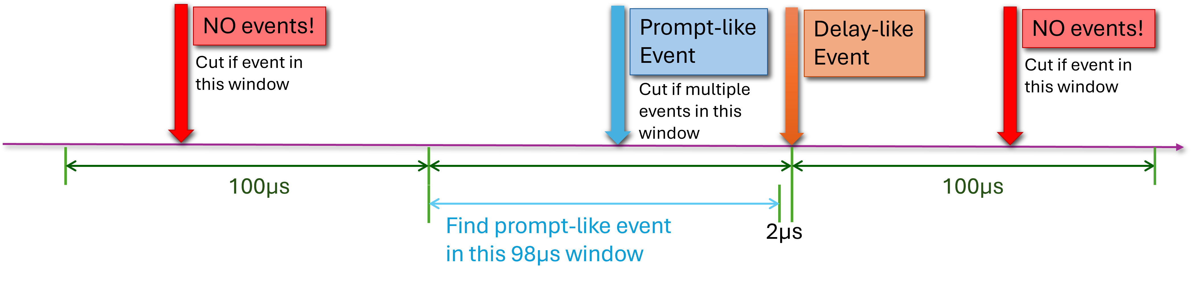
Selection Process
Muon Veto: The CD events in certain time window after muon events are vetoed, pick possible delay events for later selection.
Pairing: For each Delay-like candidates, search for the prompt events in [−100, −2] µs time window.
Multiplicity Cut: no other non-muon events should appear in [−200, 100] µs time window of delay events.
After pairing, cuts of delay energy, fiducial volume (for prompt event only), prompt-delay distance are applied.
IBD selection study at TAO

Slide 4
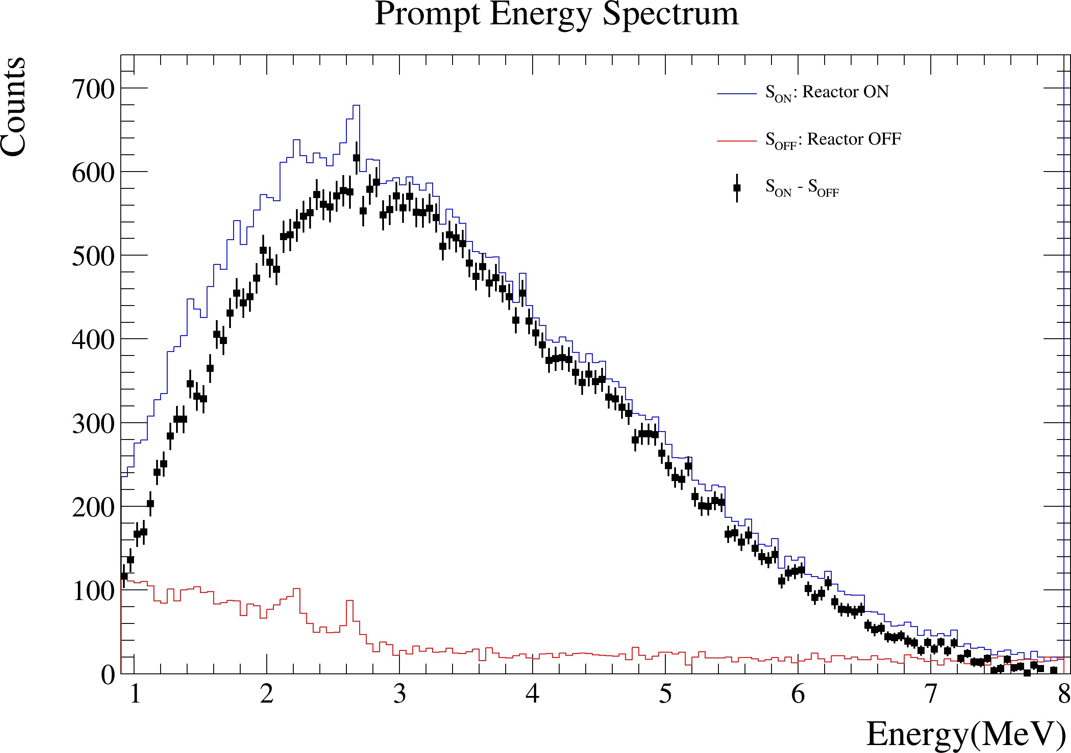
Selection Result
The prompt signal energy spectra from the reactor-on and reactor-off data after all the above cuts is shown below.
The subtraction of reactor-on over reactor-off is presented
to extract the IBD signal.
In the future, the spectrum will be used to generate unfolded neutrino energy
spectra, to compare with theoretical prediction.
IBD selection study at TAO

