Slide 1

Detector and Event Visualization based on PHOENIX in the JUNO experiment
Jiaqi Lyu (吕佳琪) Xuesen Wang (王学森)
Yumei Zhang (张玉美) Zhengyun You (尤郑昀)
Sun Yat-sen University
lvjq7@mail2.sysu.edu.cn
July 17, 2026

Slide 2
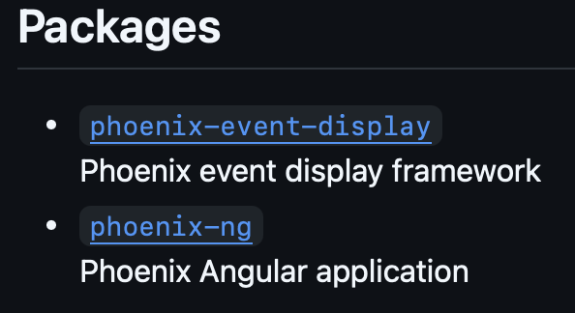
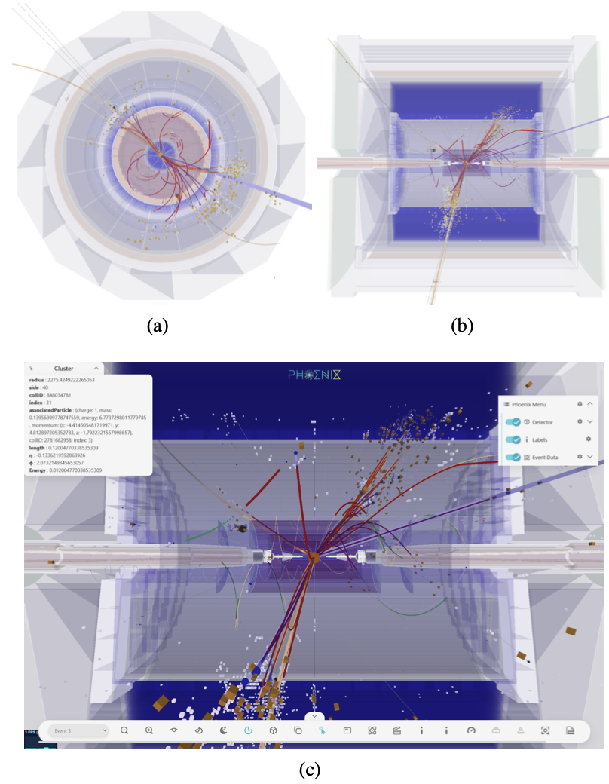
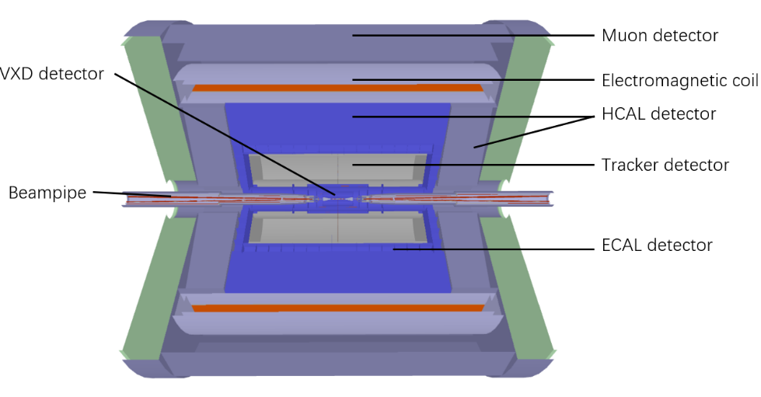
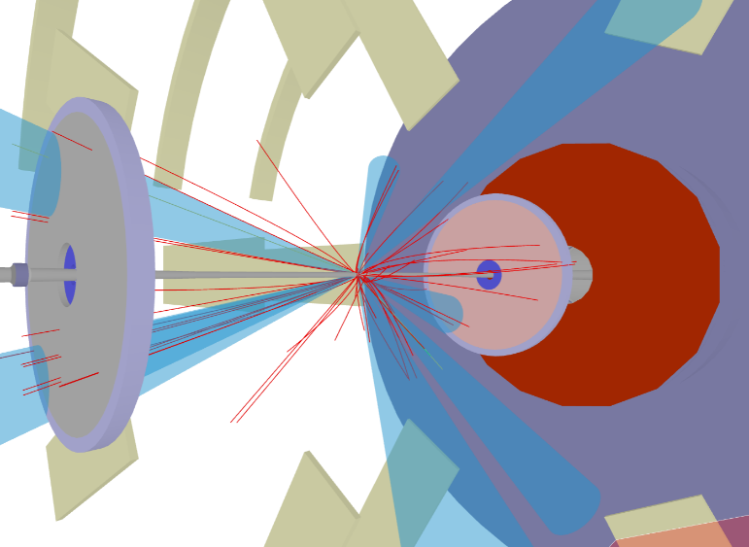
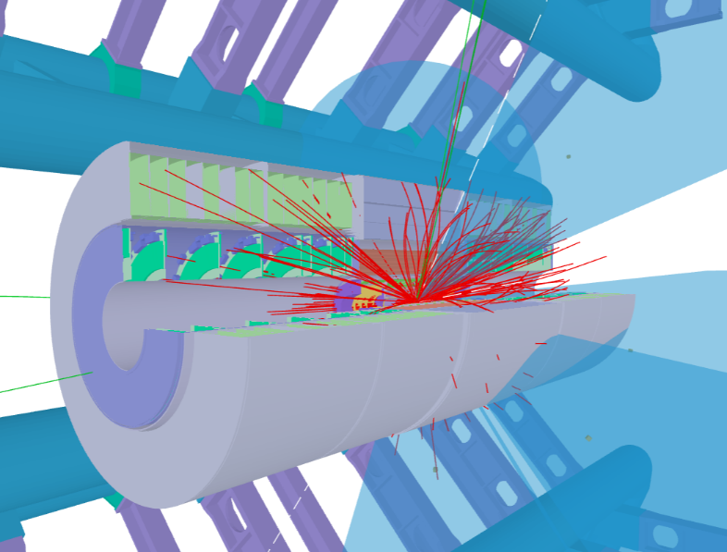
Phoenix for HEP Experiments
Phoenix is a TypeScript-based event display framework, using the popular three.js library for 3D.
It focuses on being experiment agnostic by design, with common tools (such as custom menus, controls, propagators) and the possibility to add experiment specific extensions.
TypeScript-based, which is an extended version of JavaScript.
Use the popular three.js library for 3D support, can easily run the application in a web browser or in a web server through Node.js.
Phoenix has been the official web event display of ATLAS. It can be used to visualize different versions of ATLAS geometry, and uploaded events.
Also used in web event display of LHCb experiment.
TypeScript + three.js
https://github.com/HSF/phoenix
CEPC detector in Phoenix
ATLAS detector and events in Phoenix.
CMS detector and events in Phoenix.
arXiv: 2509.17118

Slide 3
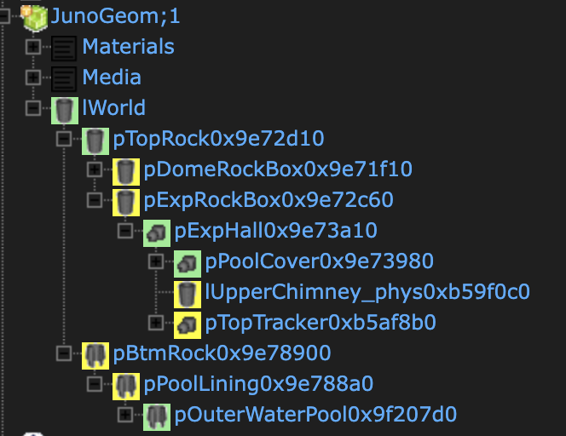
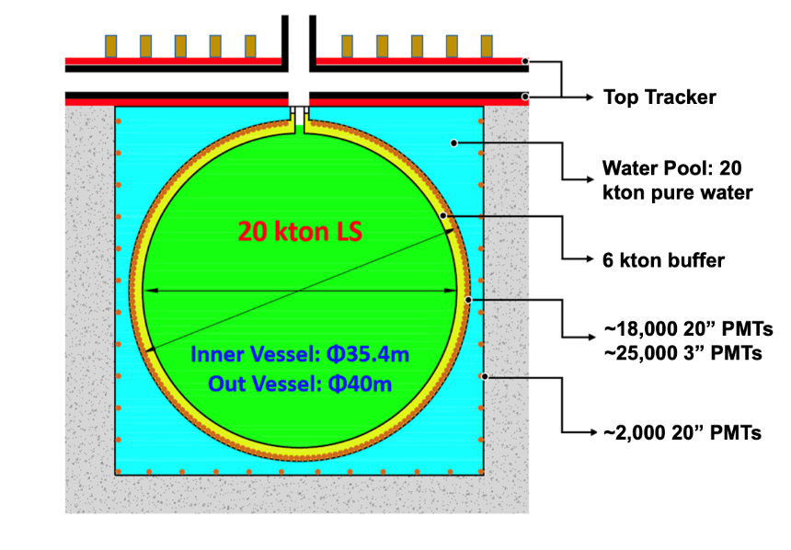
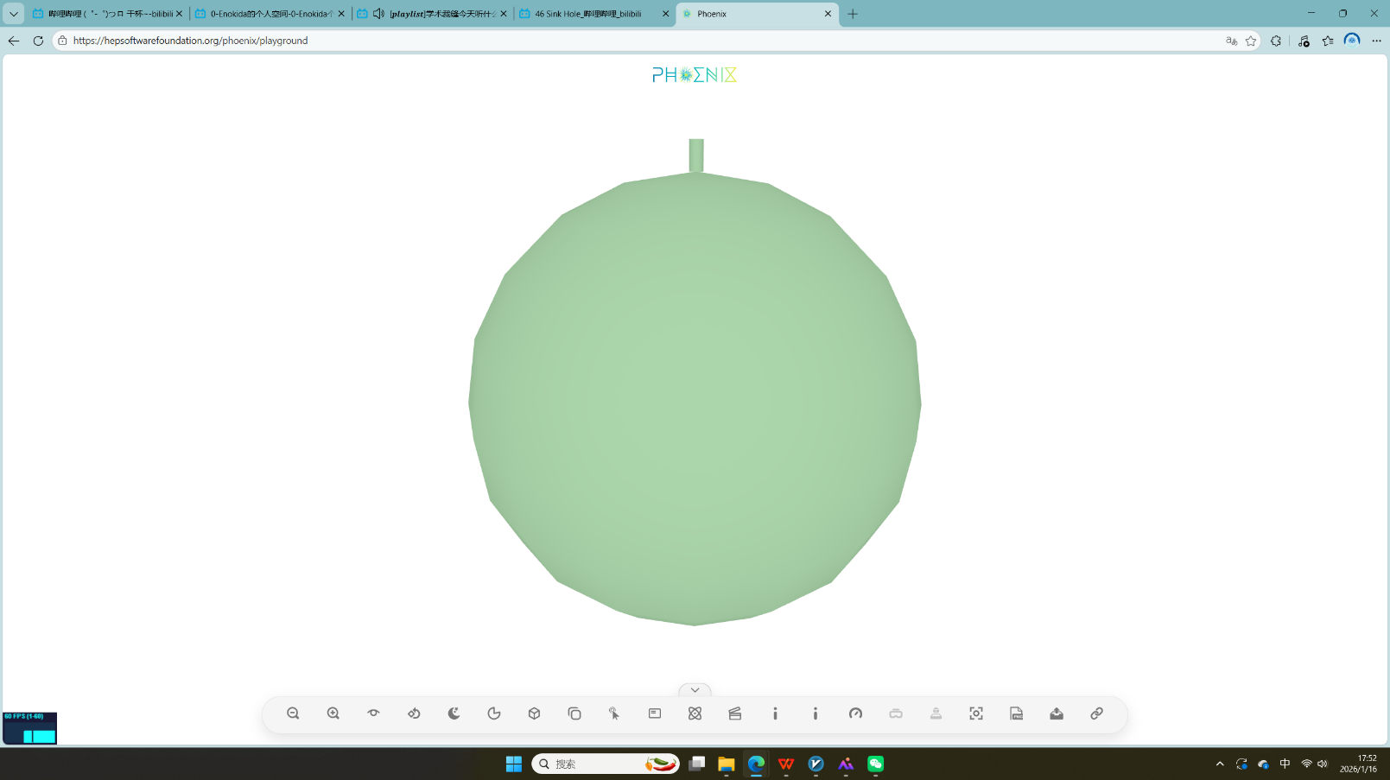
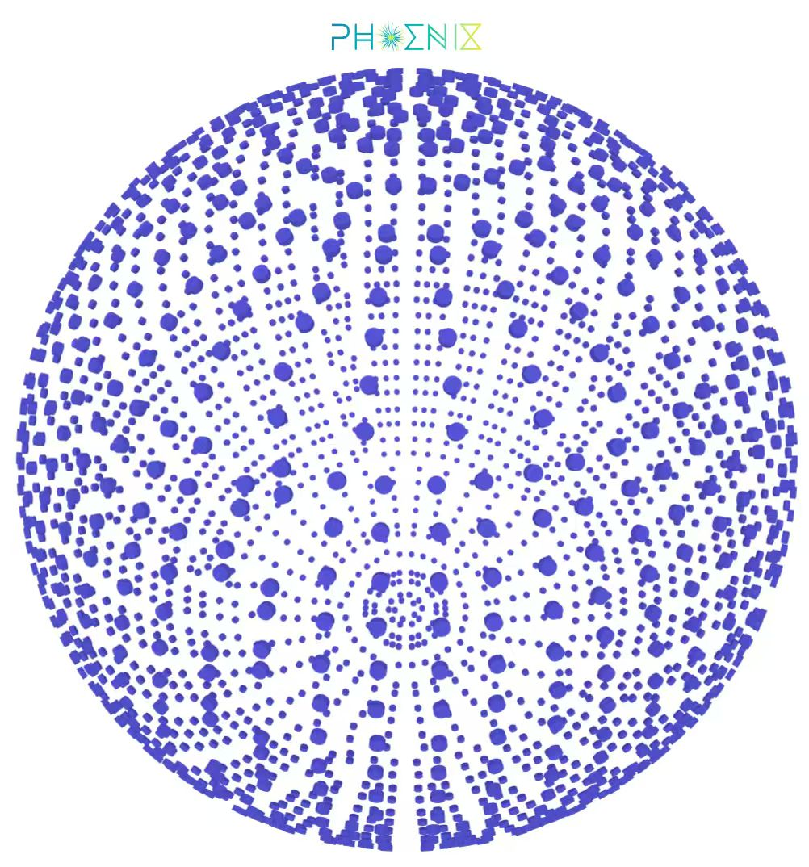
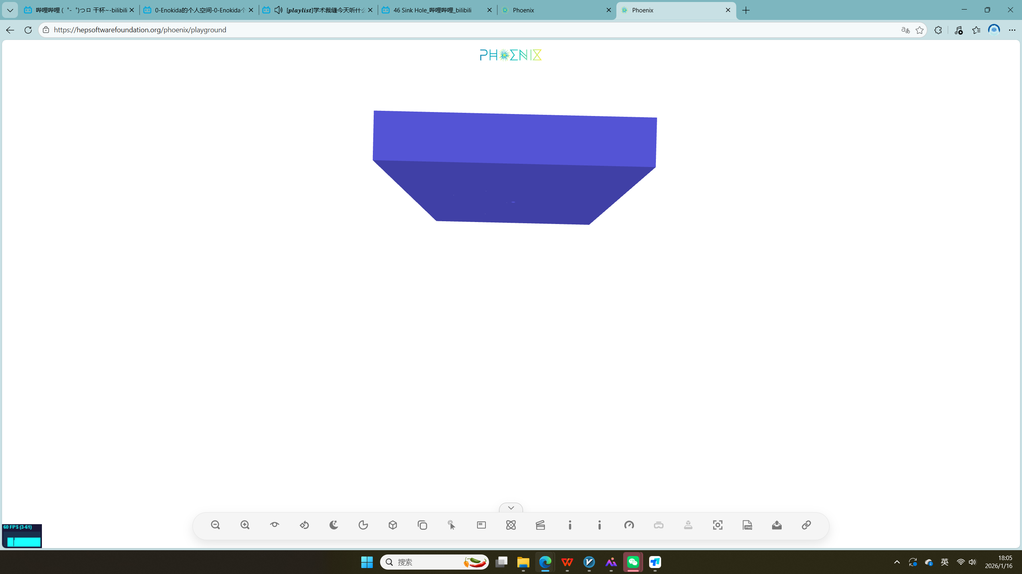
ROOT Geometry as Phoenix input
Detector Geometry
Phoenix
Central Detector
Geant4 Detector Construction
Detector
GDML file
ROOT
Geom file
Top Tracker
JUNO Geom Display
Event and data information of JUNO
Water pool
Others
JUNO Event Display
e.g. Use ROOT file to get geometry information of top tracker
Central Detector
CD PMTs
Top Tracker

Slide 4
Event Data
The Event Data Model (EDM) of JUNO is a data structure defined in its data processing framework (SNiPER).
PHOENIX is a visualization and analysis platform that supports JSON format input.
Event Header
Event Metadata
Calibrated Waveform
Geometric information
JSON format expected
EDM
RecEvent
Observational data
Visualization parameters
SimEvent

