Slide 1



Studies of leptogenesis in neutrino flavor symmetry models
Yan Shao（邵妍）
Liaoning Normal University
2026.7.17
Based on: Yan Shao, Zhen-hua Zhao*, arXiv:2604.20581
Yan Shao, Zhen-hua Zhao*, arXiv:2606.15825

Slide 2






Studies of leptogenesis in neutrino flavor symmetry models
baryon asymmetry of Universe
$n_{B}>n_{\overline{B}}$
neutrino masses
$m_{ν}≠0$
Type-I seesaw model
Leptogenesis
Flavor symmetry
introduces right-handed neutrinos (RHN) $N_{I}$
explains lepton mixing patterns
responsible for neutrino masses and leptogenesis
lepton asymmetry
non-Abelian discrete (A₄, S₄, …)
most relevant for lepton mixing (TM1 / TBM, …)
sphaleron
baryon asymmetry
constrains Yukawa and Majorana structures
These features motivate the study of leptogenesis in flavor-symmetric seesaw frameworks.
2

Slide 3
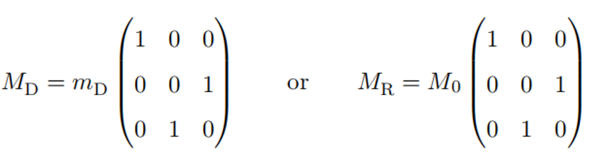

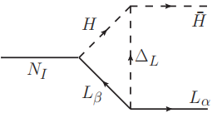

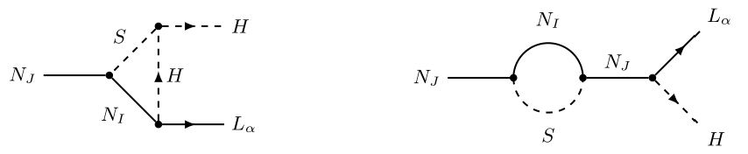







Studies of leptogenesis in neutrino flavor symmetry models
Rescuing flavor-symmetry-forbidden leptogenesis within the left-right symmetric framework
Flavon assisted low scale leptogenesis
Conventional leptogenesis fails in the flavor-symmetric limit
Type-I seesaw is insufficient for low-scale leptogenesis
resonant leptogenesis
low scale leptogenesis
ARS leptogenesis
$$ε^{0}∝{\left({{M’}_{D}^{†}M’}_{D}\right)}_{IJ}=0$$
$$ε^{0}∝ΔM=0$$
Both scenarios require a highly degenerate RHN mass spectrum
The left-right symmetric model
The flavon fields are introduced in flavor-symmetry neutrino mass models
the Higgs triplet $Δ_{L}$ generates additional contributions to $ε$
generates RHN masses
the flavon field S
couples to the RHNs
$$ε^{0}=0$$
$$ε=ε^{0}+ε^{Δ}$$
in the flavor-symmetric limit
New decay channels and loop-induced CP phases enhance leptogenesis efficiency.
but $ε^{Δ}≠0$
rescuing leptogenesis via scalar triplet contributions
without requiring a highly degenerate RHN spectrum
2

Slide 4
THANKS FOR YOUR LISTENING!
Yan Shao （邵妍）
2026.7.17

