Slide 1



HIGH ENERGY PHYSICS 2026
Unique Properties of Daily Proton and Helium Fluxes
Aleksandr Stuzhin, Shandong Institute of Advanced Technology,
on behalf of the AMS Collaboration
中国物理学会高能物理分会第十二届全国会员代表大会
暨学术年会
Jul 13-19, 2026 · Guangzhou Baiyun International Convention Center
Guangzhou · 2026

Slide 2
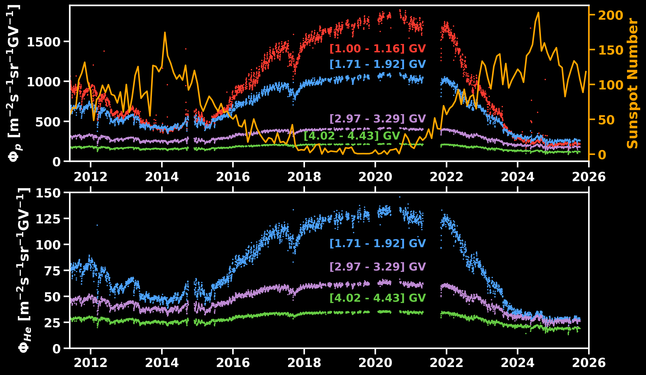
Daily Flux Evolution over 14.5 Years
1
The daily proton and helium fluxes show different temporal variations
Long-term variations with 11-year solar cycle
(sunspot number)
Non-recurrent short-term
(arrows)
Recurrent structures
Unique Properties of Daily Proton and Helium Fluxes
中国物理学会高能物理分会第十二届全国会员代表大会暨学术年会 · July 13-19 2026

Slide 3
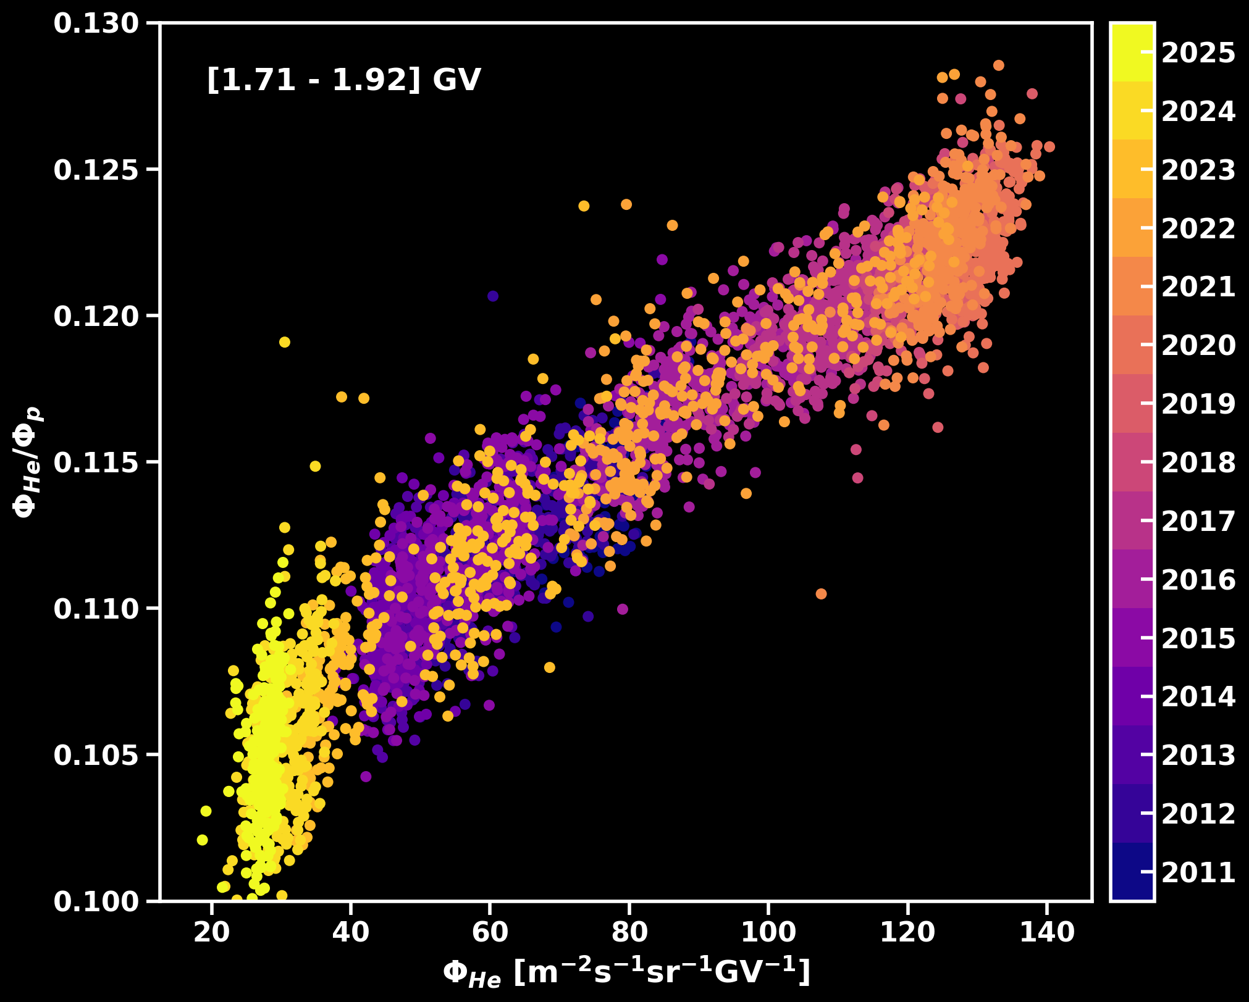
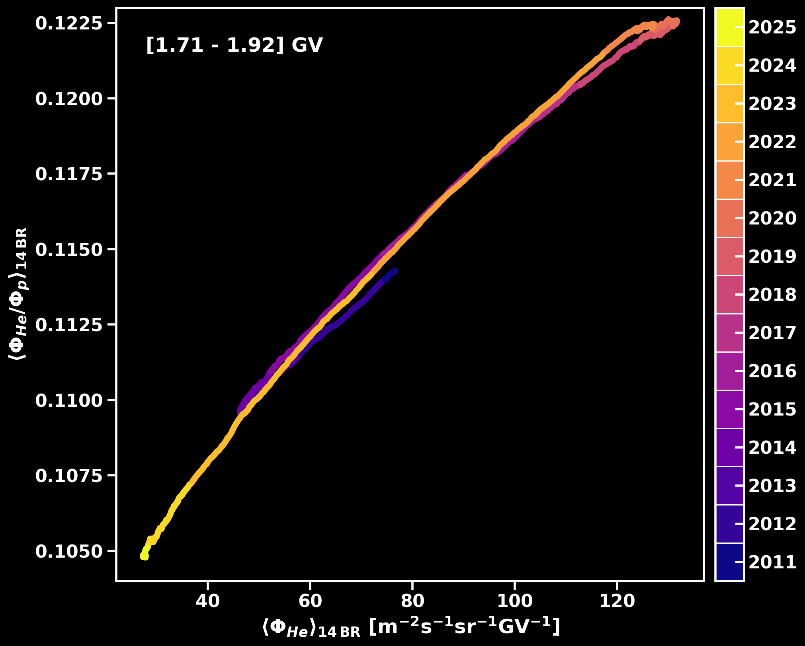


Hysteresis of Helium/Proton Ratio
2
For rigidity bins below 2.4 GV a hysteresis between the helium to proton flux ratio and the helium flux is observed.
It indicates a different solar modulation of the two species
Dec 2019
Solar maximum
Solar minimum
$$\sim 10 \%$$
Jan 2014
$$\sim 15 \%$$
Oct 2024
Unique Properties of Daily Proton and Helium Fluxes
中国物理学会高能物理分会第十二届全国会员代表大会暨学术年会 · July 13-19 2026

Slide 4
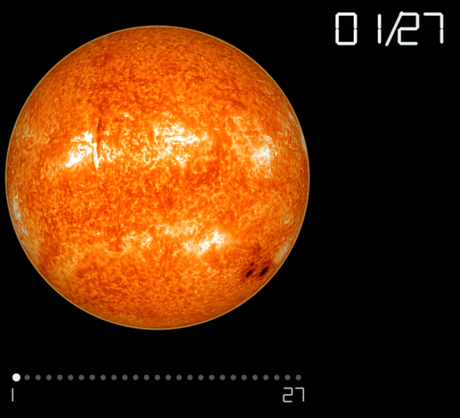
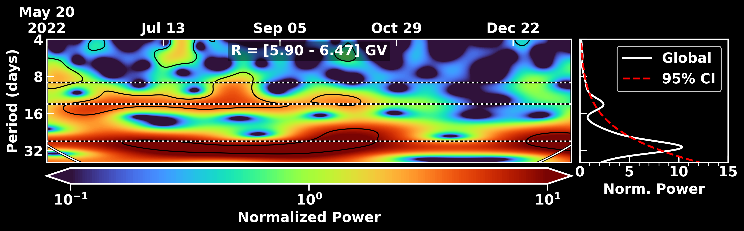
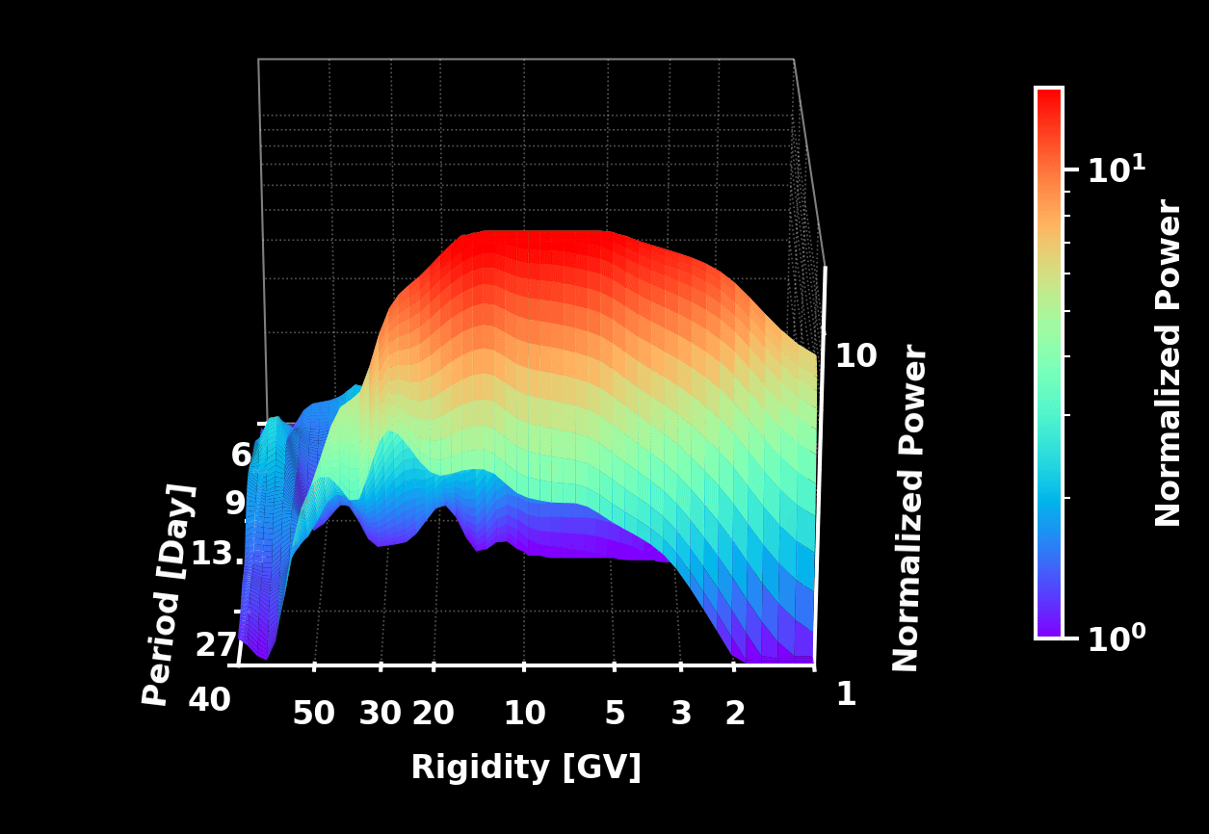
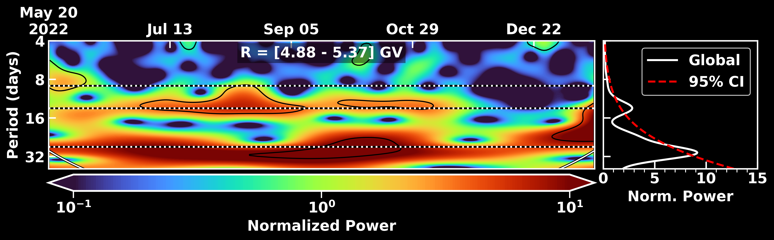

Periodicity Analysis
3
Wavelet analysis localizes flux variations in both time and frequency
Sun rotation period $\sim 27$ days
Proton
9
13.5
27
Proton, 2nd half of 2022
Helium
9
13.5
27
Unique Properties of Daily Proton and Helium Fluxes
中国物理学会高能物理分会第十二届全国会员代表大会暨学术年会 · July 13-19 2026

Slide 5
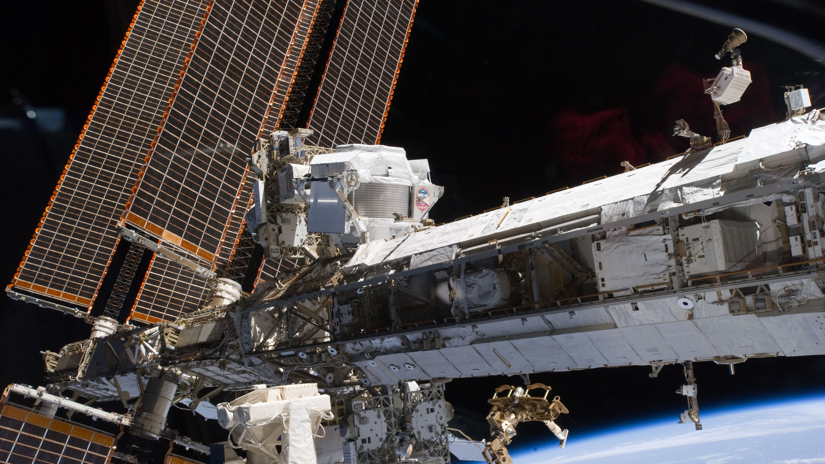
Thank you!
谢谢！

