Slide 1


Light Dark Matter Search with
7.8 Tonne-Year of Ionization-Only Data in XENONnT
TANG Jie, CUHK-Shenzhen
jietang@link.cuhk.edu.cn
CPS-HEP 2026, Guangzhou
July 17, 2026

Slide 2
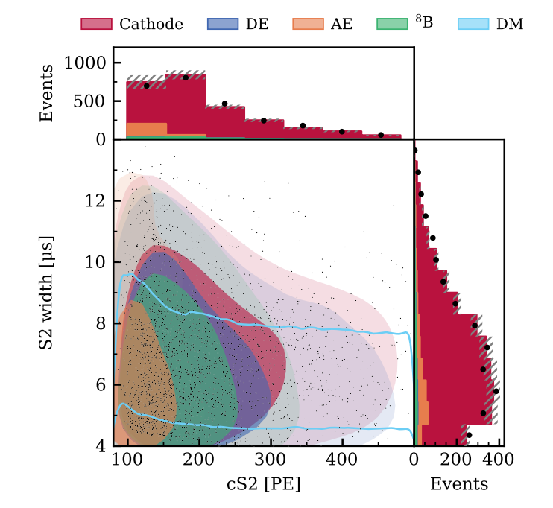
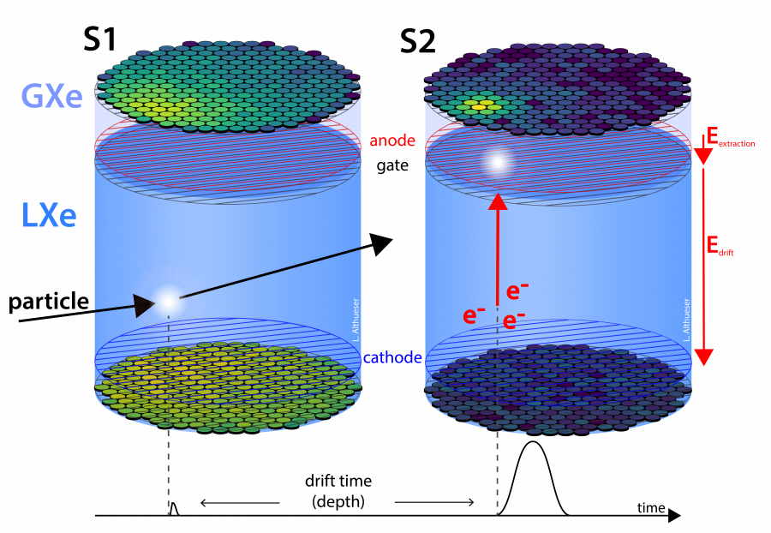
Overview & Background Model
Total Mass: 8.5t
Threshold: S1+S2 → S2-only
NR: ~3keV → 0.5keV
ER: ~0.5keV → 0.04keV
Detector background:
Top electrodes/Gas background
Suppressed by S2 width/AFT cuts (negligible)
Delayed electrons (DE) pile-up
Accidental electrons (AE) pile-up
Suppressed by DE BDT & S2 pattern cut
Cathode background
Suppressed by Cathode BDT cut
Wall background
Suppressed by fiducial volume
(negligible)
Expected & Observed background events
CPS-HEP 2026, Guangzhou, July 17th 2026
TANG Jie, CUHK-Shenzhen
LDM search with XENONnT S2-only Data

Slide 3
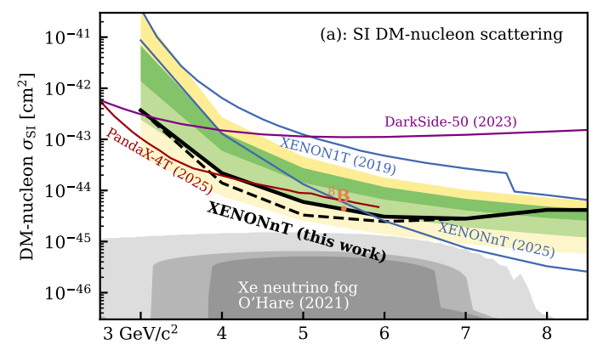
LDM Search Result
Exposure: 7.8ty
DM mass
90% confidence level upper limits on the DM-nucleon scattering
CPS-HEP 2026, Guangzhou, July 17th 2026
TANG Jie, CUHK-Shenzhen
LDM search with XENONnT S2-only Data

Slide 4
Thank you!
CPS-HEP 2026, Guangzhou, July 17th 2026
TANG Jie, CUHK-Shenzhen
LDM search with XENONnT S2-only Data

