Slide 1
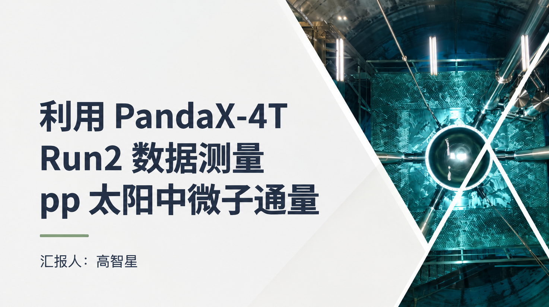

Progress in Solar pp Neutrino Research at PandaX-4T
Zhixing Gao (高智星)
On behalf of the PandaX Collaboration
gao_zx@sjtu.edu.cn

Slide 2
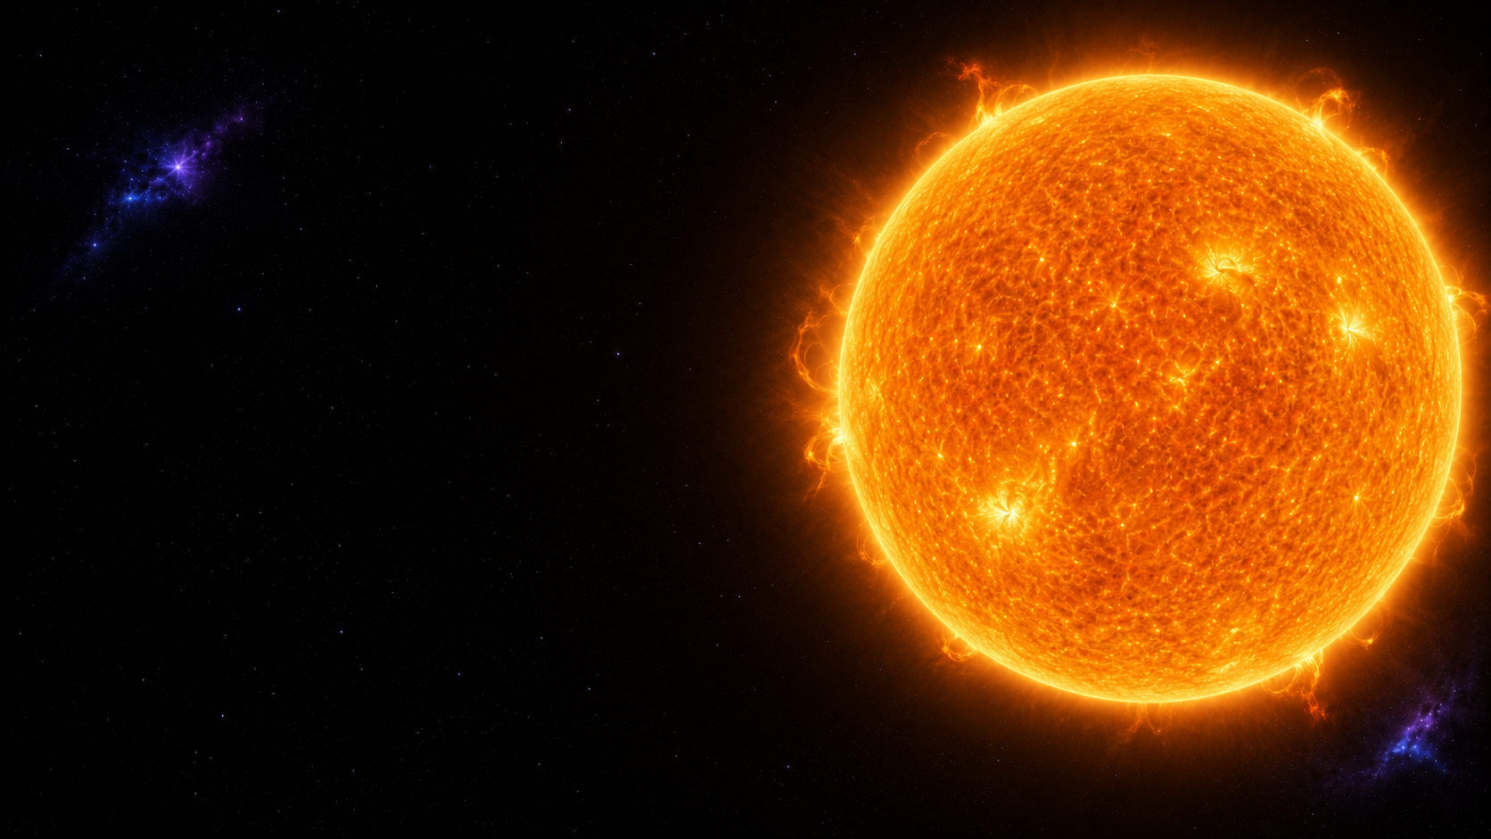
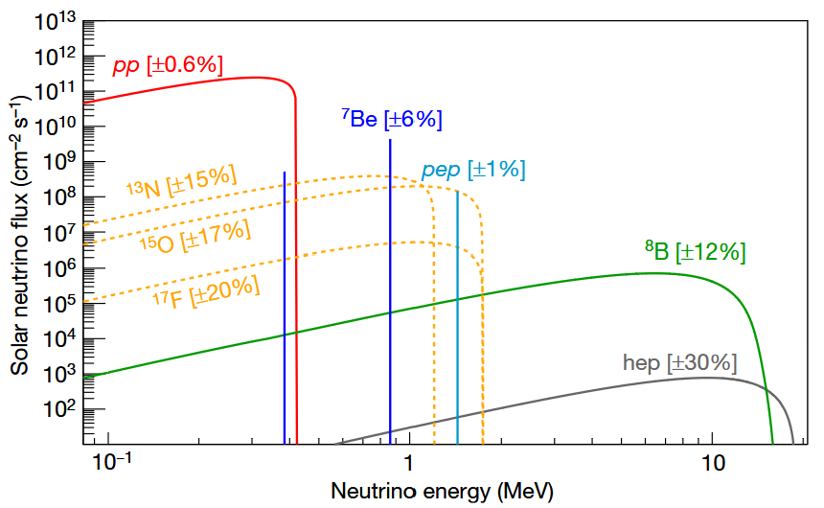
Nature 562, 505–510 (2018)
Solar pp neutrinos are produced in the first reaction of the proton–proton chain in the Sun. They have the highest flux and provide a key window for testing solar models.

Slide 3
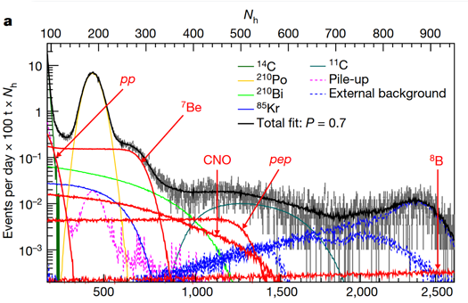
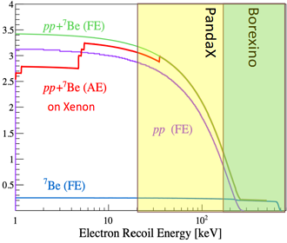
Advantages of PandaX-4T for Neutrino Detection
Borexino spectrum > 165 keV
PandaX-4T spectrum include < 165 keV
Ultra-low background
Borexino spectrum
Low-threshold ER window
Nature 562, 505–510 (2018)
Full-spectrum reconstruction
PandaX-4T extends ER spectrum to lower energies beyond Borexino’s range.

Slide 4
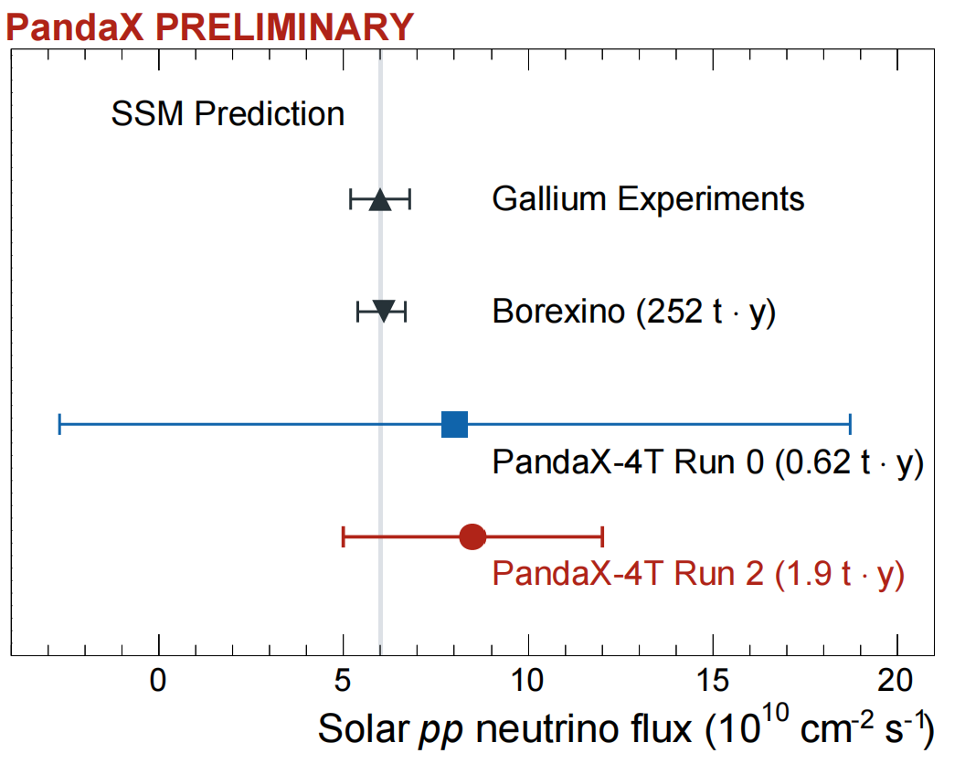



PandaX-4T Run2 Measurement of the Solar pp Neutrino Flux
Higher Exposure
Run2 reached ~1.9 t·yr, increasing statistics.
Detector Upgrades
New TPC reflectors,
higher-transparency electrodes,
online distillation,
and neutron veto.
Improved Readout
Measured pp flux is consistent with the Standard Solar Model; significance reaches 2.2σ over the background-only hypothesis.
PMT-base linearity improved,
custom 14-bit 500 MS/s digitizers.
First positive indication of solar pp ν–e scattering in the ER energy < 165 keV region.
Notes:
在 Run2 中，曝光量提升到了约 1.9 吨年，同时在数据处理、背景建模和分析方法上都有进一步改进。最终测得的 pp 中微子通量与标准太阳模型预期一致，相对于本底达到 2.2σ 的统计显著性，首次在 165 keV 以下的电子反冲能区获得了太阳 pp 中微子—电子散射的正向迹象。

Slide 5


