Slide 1
IBD selection and related study on JUNO’s 207 days data
Chengfeng YangBi Wu, PengFei Yang
SUN YAT-SEN UNIVERSITY
2026/07/17

Slide 2
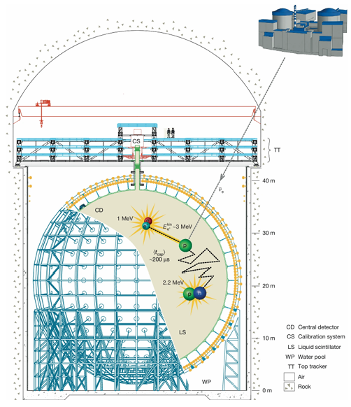
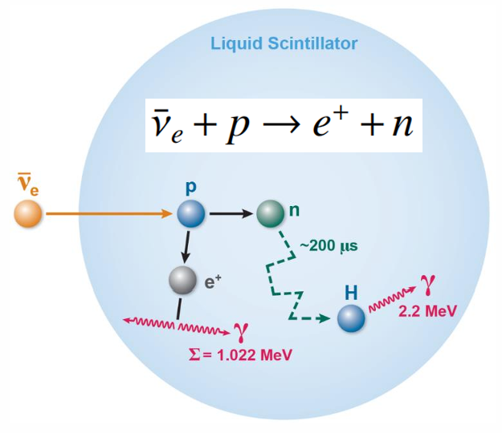
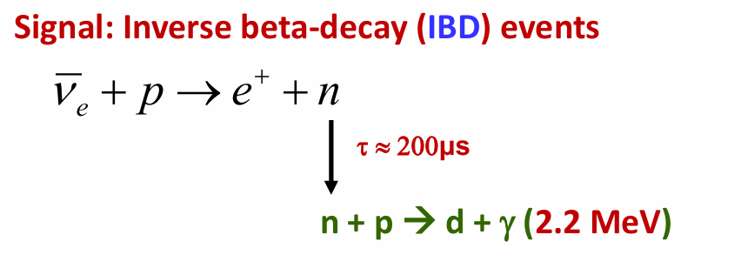
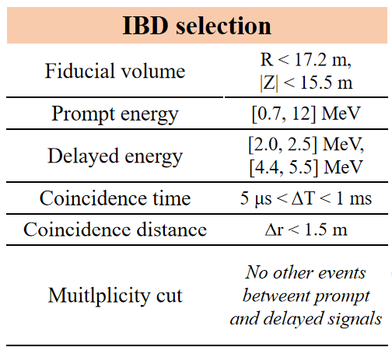
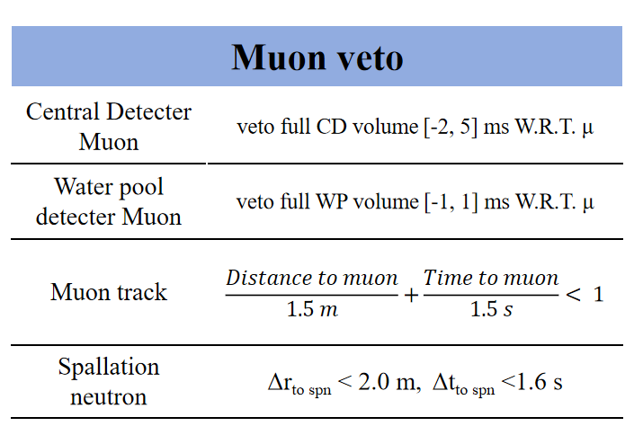

Introduction and selection startegy
JUNO main physics goals
1. Determine of the neutrino mass ordering
2. Precision measurement of neutrino oscillation parameters $θ_{12}, ∆m_{21}^{2}$ and $∆m_{31}^{2}$^{[1]}
Signals: inverse beta decay of electron antineutrinos from reactors：~50 cpd

Slide 3
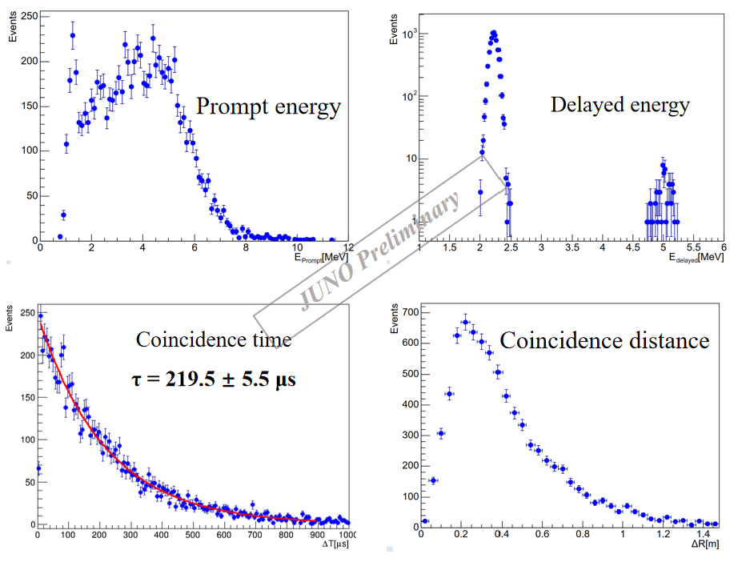
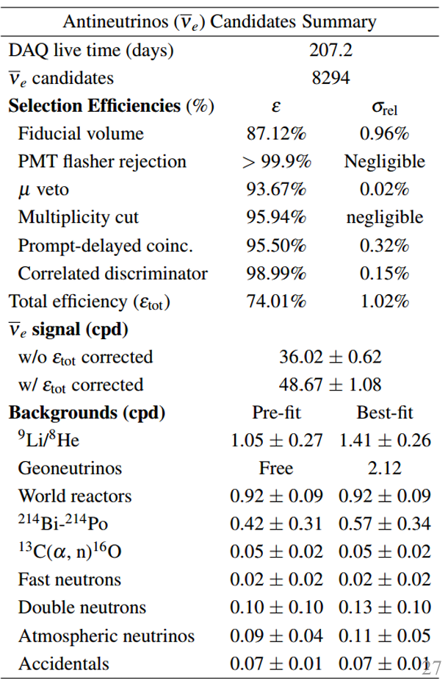
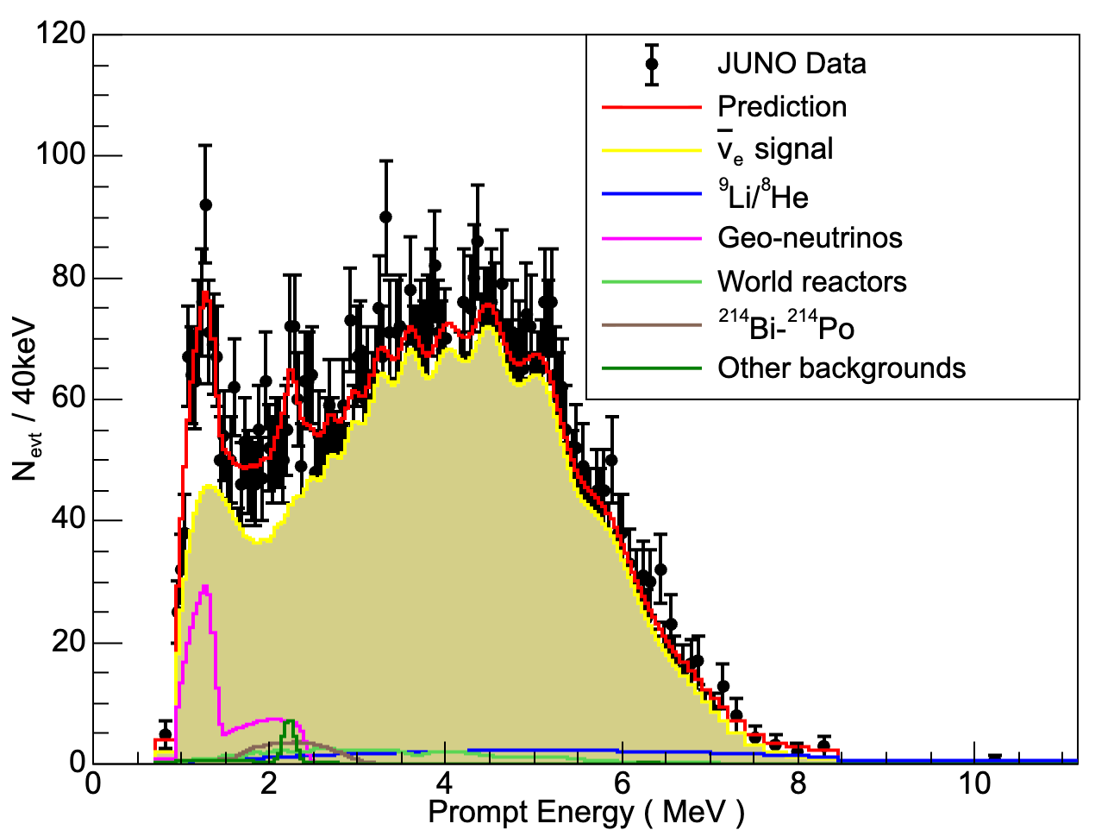
IBD selection result
Top: The histogram of IBD candidates
Left: Measured Reactor Neutrino Spectrum

