Slide 1
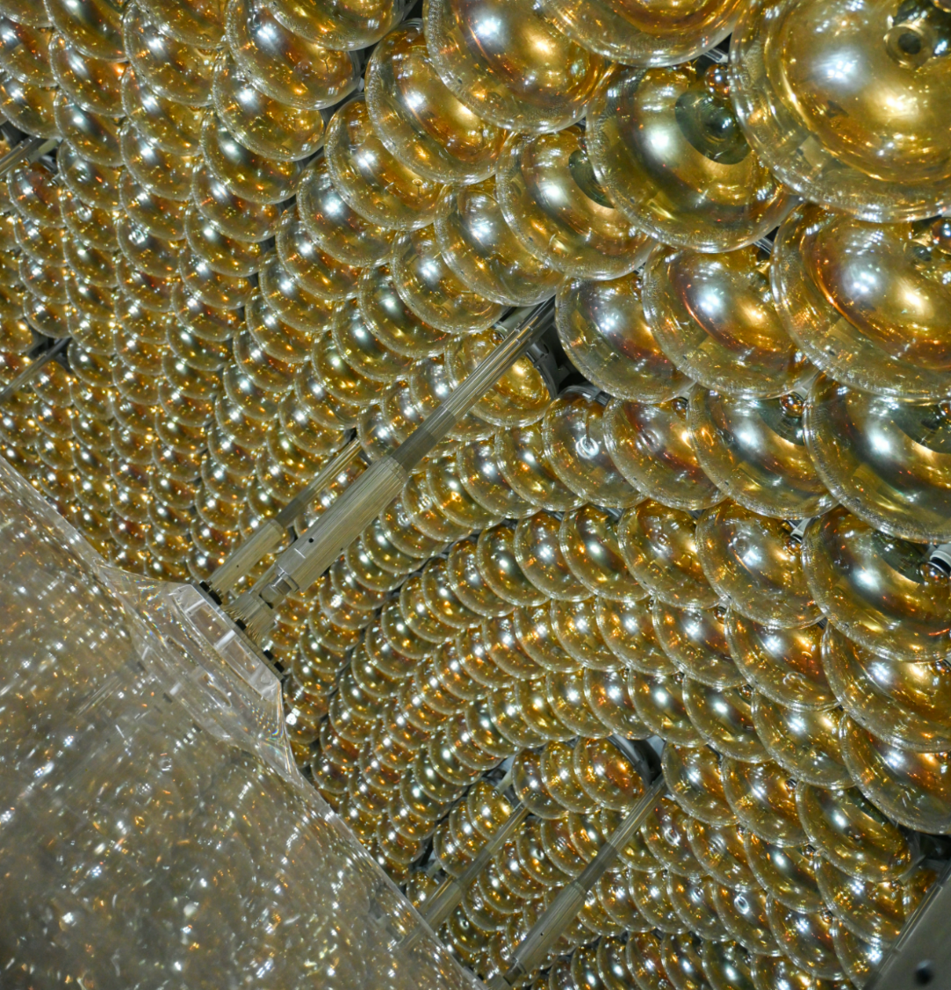

Measurement of reactor neutrino oscillation with the first JUNO data
Zhiyuan Chenª, Iwan Morton-Blake^{b}, Mingxia Sunª, Mingyuan Wangª, Han Zhangª
On behalf of the JUNO collaboration
ª Institute of High Energy Physics, Chinese Academy of Sciences
^{b} Tsung-Dao Lee Institute / Shanghai Jiao Tong University
14th Chenguang Cup,
12th CHEP Annual Meeting
15th July 2026

Slide 2
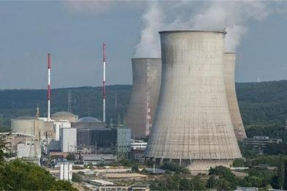
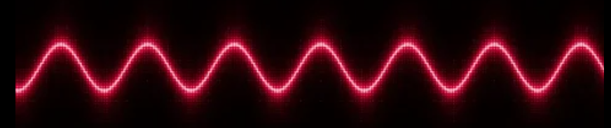








Antineutrino Detection
$${\overline{ν}}_{e}+p→e^{+}+n$$
Inverse Beta Decay (IBD)
Distinct coincident event pair correlated in time and space
Powerful background reduction
Energy of ${\overline{ν}}_{e}$ measured from $e^{+}$
$$E_{{\overline{ν}}_{e}}≈E_{e^{+}}+0.78 MeV$$
$$γ$$
$${\overline{ν}}_{e}$$
$$e^{+}$$
$$γ$$
p
$$n$$
n-capture (e.g. on H)
~100 μs later
C. L. Cowan, F. Reines et al., Detection of the free neutrino: A confirmation, Science 124 (1956) 103
$$γ$$
Charged particle energy deposition
=

Slide 3
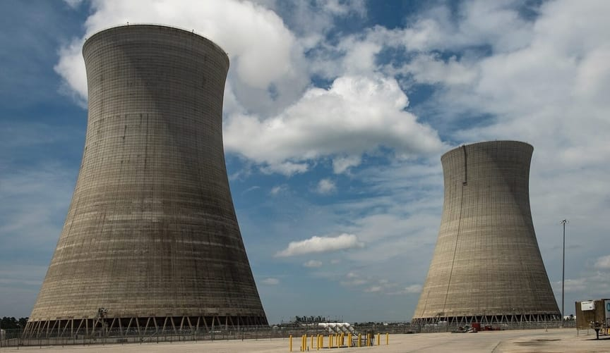
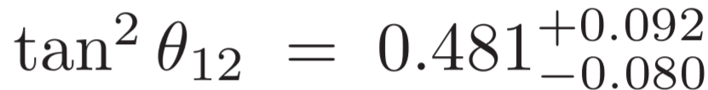

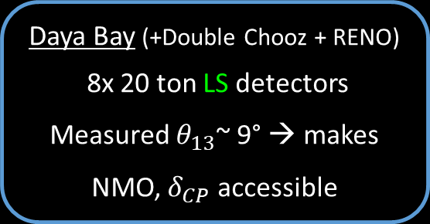
Previous Reactor Oscillation Measurements
~180 km
~10 years data-taking:
$$=$$
KamLAND
1000 tons of liquid scintillator (LS)
First clear demonstration of L/E dependence in neutrino oscillations (2003)
Daya Bay
Avg.* Oscillation Survival Probability
Daya Bay (+Double Chooz + RENO)
8x 20 ton LS detectors
Measured $θ_{13}$~ 9° → makes NMO, $δ_{CP}$ accessible
1.5 km
Distance to reactor [km]
Far Hall
*(${\overline{ν}}_{e}$survival averaged over reactor energy spectrum)
0.5 km
Near Halls

Slide 4
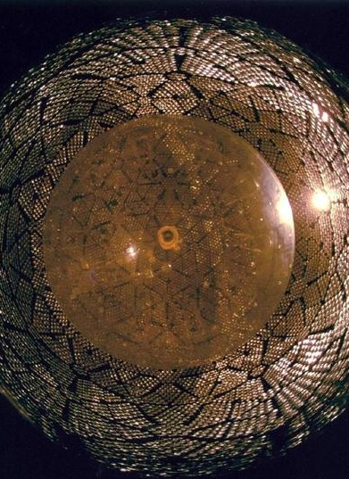
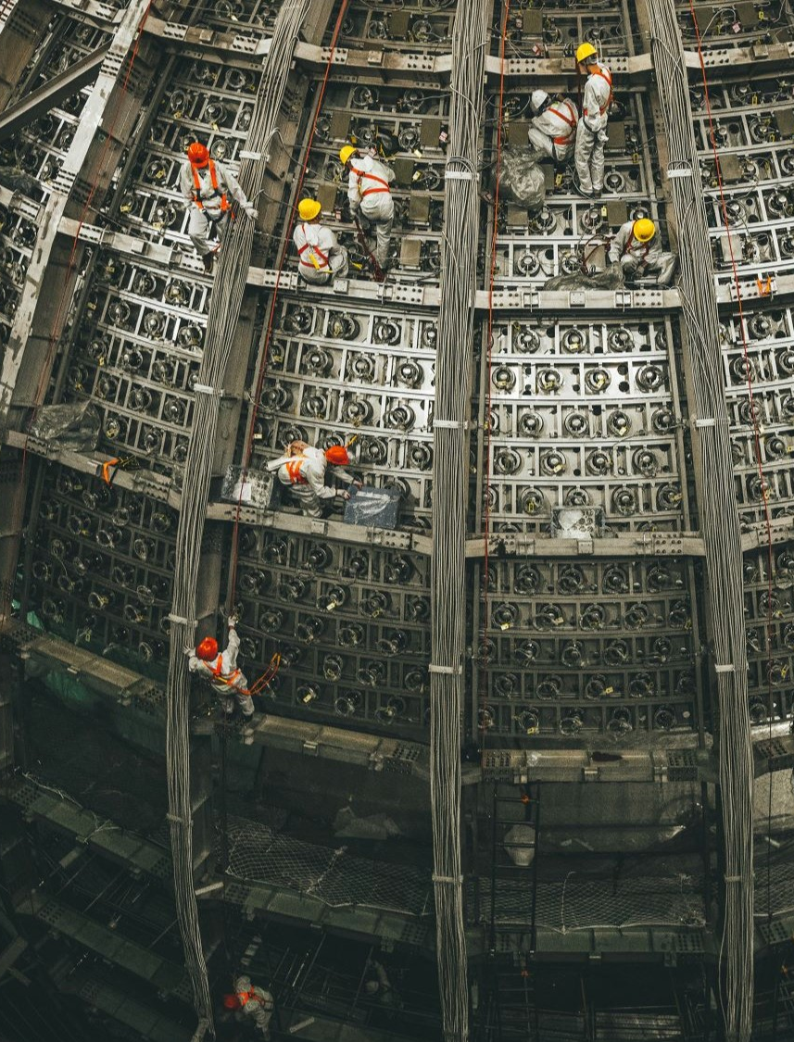
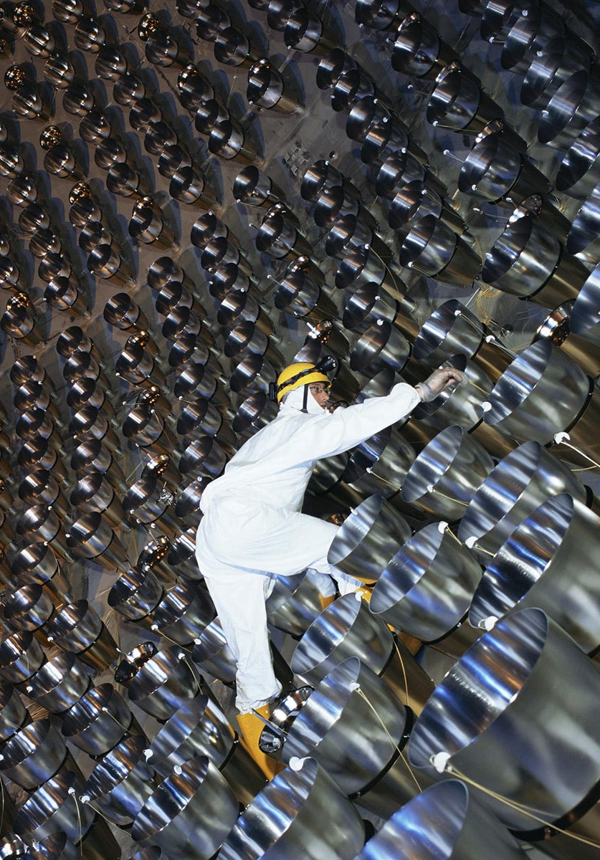
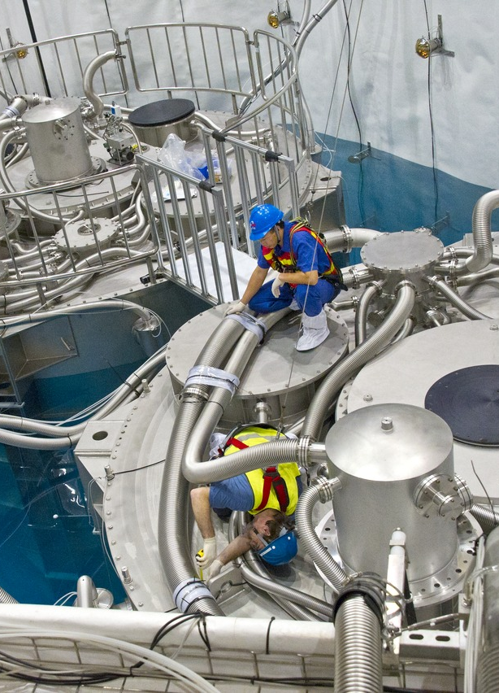
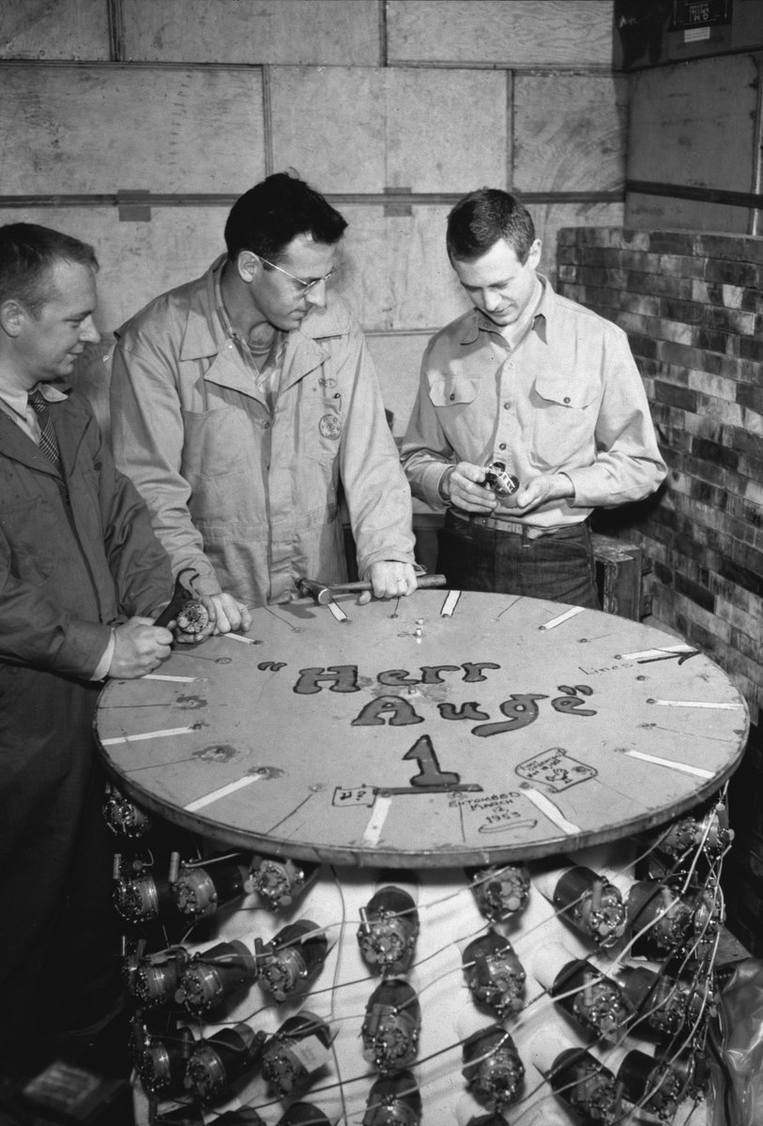
JUNO
20,000 t
Stepping into the next generation
300 t
1,000 t
8 x 20 tons
300 L

Slide 5
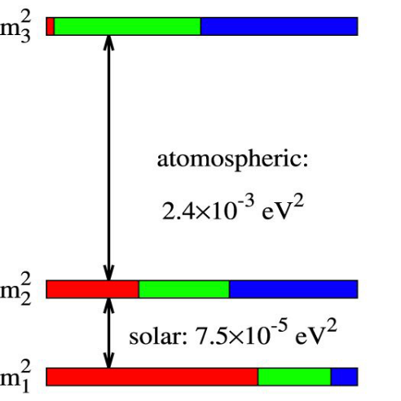
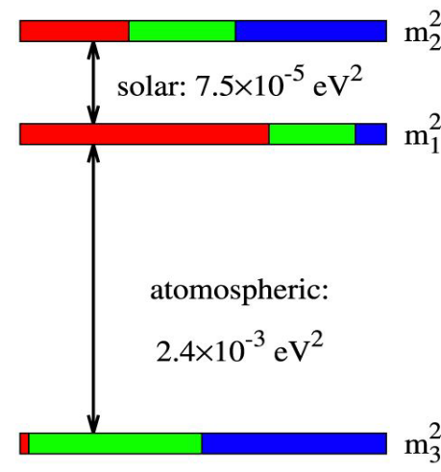




JUNO’s Primary Physics Goals
Determine Neutrino Mass Ordering (NMO)
Precisely determine oscillation parameters $Δm_{31}^{2},Δm_{21}^{2}$and $sin2θ_{12}$
atmospheric:
atmospheric:
Normal Ordering
$$m_{1}<m_{2}<m_{3}$$
Inverted Ordering
$$m_{3}<m_{1}<m_{2}$$

Slide 6
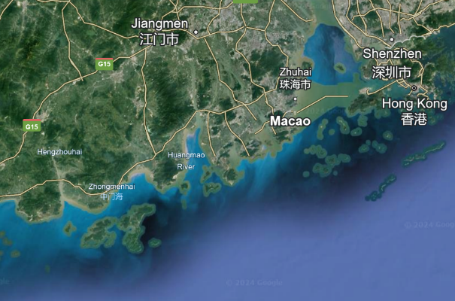
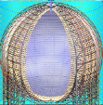



JUNO : Reactor Neutrinos
JUNO
KamLAND
TAO
JUNO TAO
Daya Bay
53km
Avg.* Oscillation Survival Probability
JUNO
53km
Need < 0.5km baseline difference!
Optimal distance for ${\overline{ν}}_{e}$ disappearence
Screenshot Google Earth
Distance to reactor [km]
*(${\overline{ν}}_{e}$survival averaged over reactor energy spectrum)
Maximal sensitivity found at a baseline of ~53km
Need 20,000 ton detector for enough statistics!
“Unambiguous determination of the neutrino mass hierarchy using reactor neutrinos,” PRD 88, 013008 (2013).

Slide 7
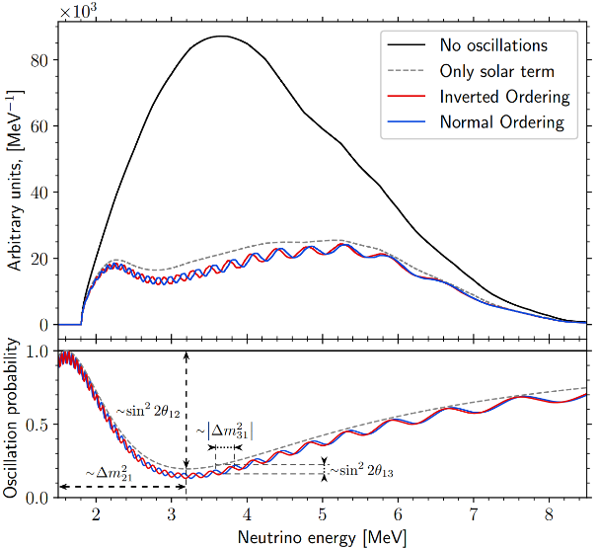



JUNO : Reactor Neutrinos
Reactor ${\overline{ν}}_{e}$ Energy Spectrum
KamLAND
TAO
Daya Bay
Avg.* Oscillation Survival Probability
JUNO
Optimal distance for ${\overline{ν}}_{e}$ disappearence
Distance to reactor [km]
*(${\overline{ν}}_{e}$survival averaged over reactor energy spectrum)
$$P_{{\overline{ν}}_{e}→{\overline{ν}}_{e}}=1−\sin^{2}{2θ_{13}}(\cos^{2}{θ_{12}\sin^{2}{Δ_{31}+\sin^{2}{θ_{12}\sin^{2}{Δ_{32})}}}}−\cos^{4}{θ_{13}\sin^{2}{2θ_{12}\sin^{2}{Δ_{21}}}}$$
No $δ_{CP}, θ_{23}$ dependency
$$Δ_{ij}=\frac{Δm_{ij}^{2}L}{4E}$$

Slide 8
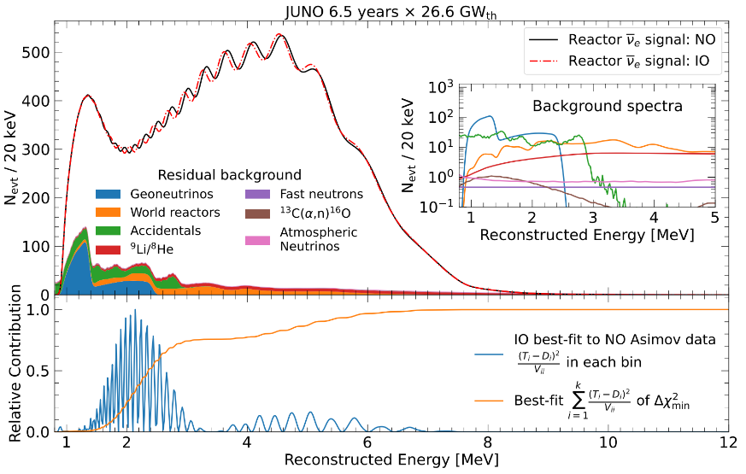
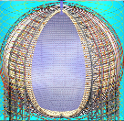
JUNO : Reactor Neutrinos
“Potential to Identify the Neutrino Mass Ordering with Reactor Antineutrinos in JUNO,” Chinese Phys. C 49, (2025)
“Sub-percent precision measurement of neutrino oscillation parameters with JUNO,” Chin. Phys. C 46 (2022)
Reactor ${\overline{ν}}_{e}$ Energy Spectrum
Expected Reconstructed Energy Spectrum
Detector Response
Excellent Energy Resolution
Needed to resolve fine oscillation structure

Slide 9
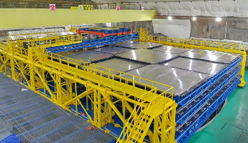
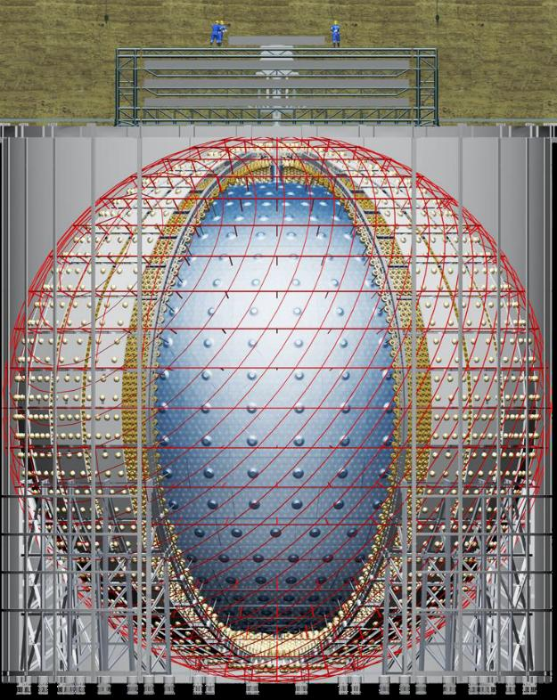
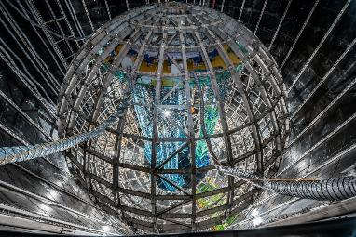
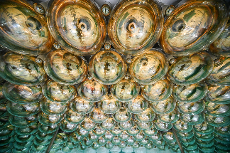
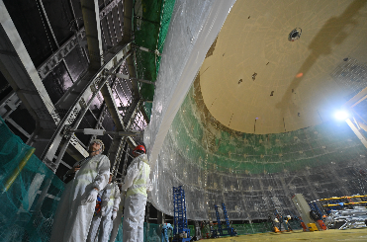
The JUNO Detector
μ
~650m
overburden
Top Tracker
3 plastic scintillator layers
Outer Cherenkov Detector
35 kilotons ultrapure water
>2500 20” PMTs
PMTs
17,596 20” + 25,600 3”
17.7m
Acrylic Vessel
17.7 m in radius
20 kilotons of liquid scintillator
LAB + 2.5 g/L PPO + 3 mg/L bis-MSB

Slide 10
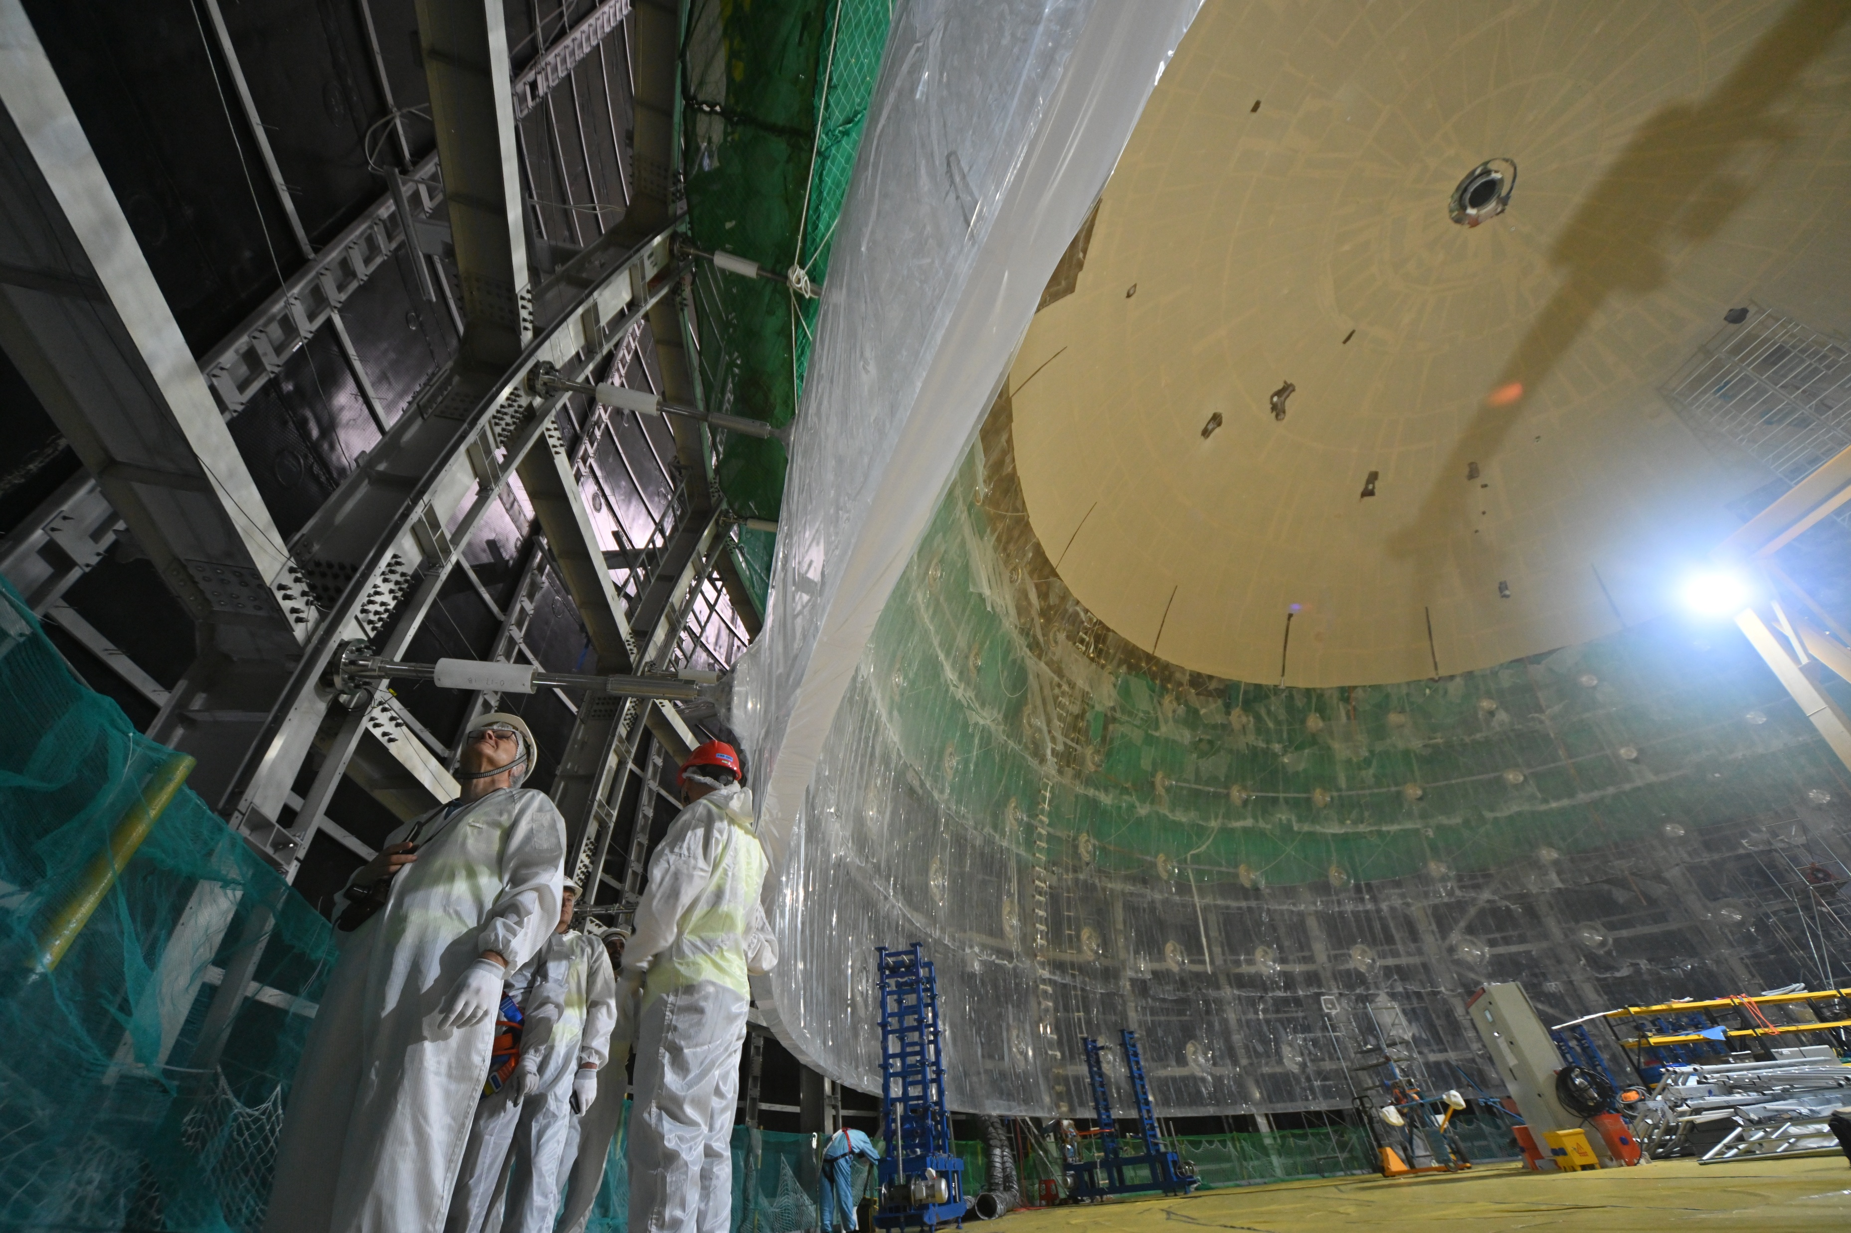
JUNO Start

Slide 11
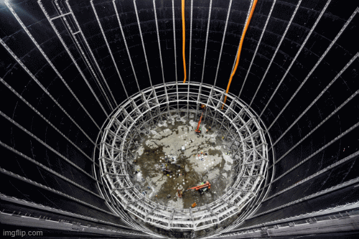
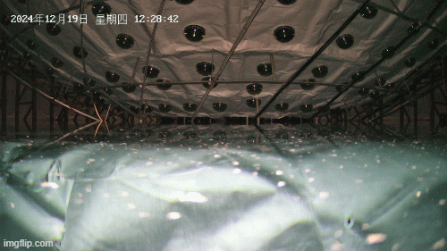
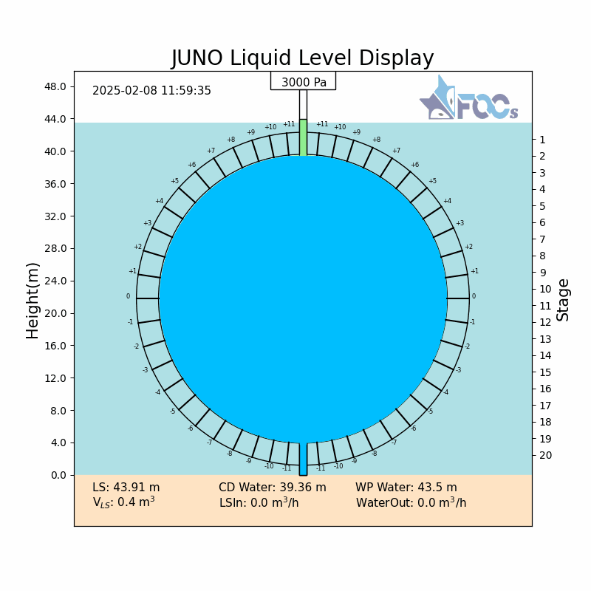
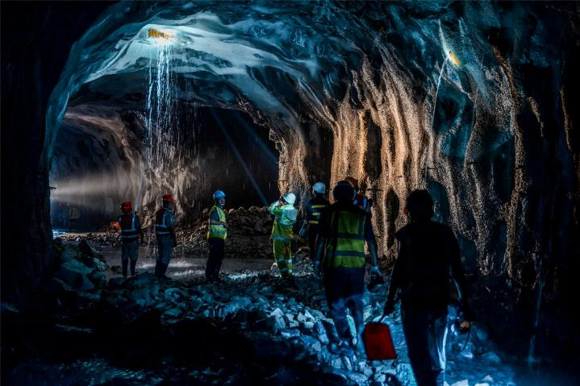
Project starts
Detector installation
Water filling starts
LS/Water exchange
2013
2015
2022
2024
Dec 18 2024
Feb 1 2025
Feb 8 2025
Aug 26 2025
Civil construction starts
Installation complete
Water filling complete
Physics data begins

Slide 12
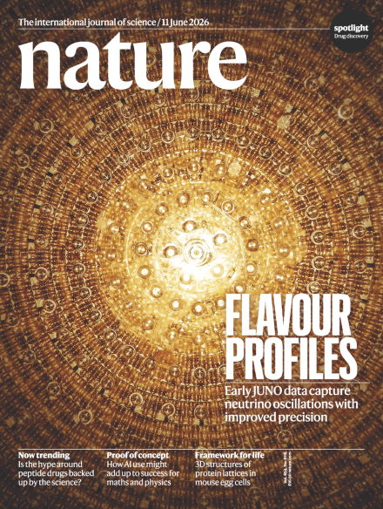
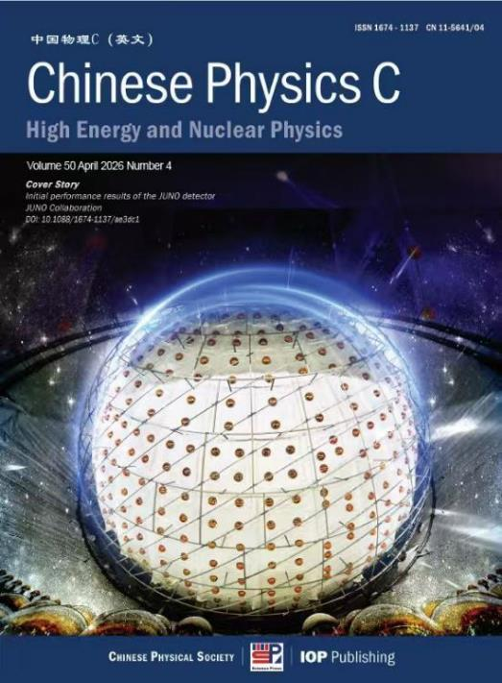
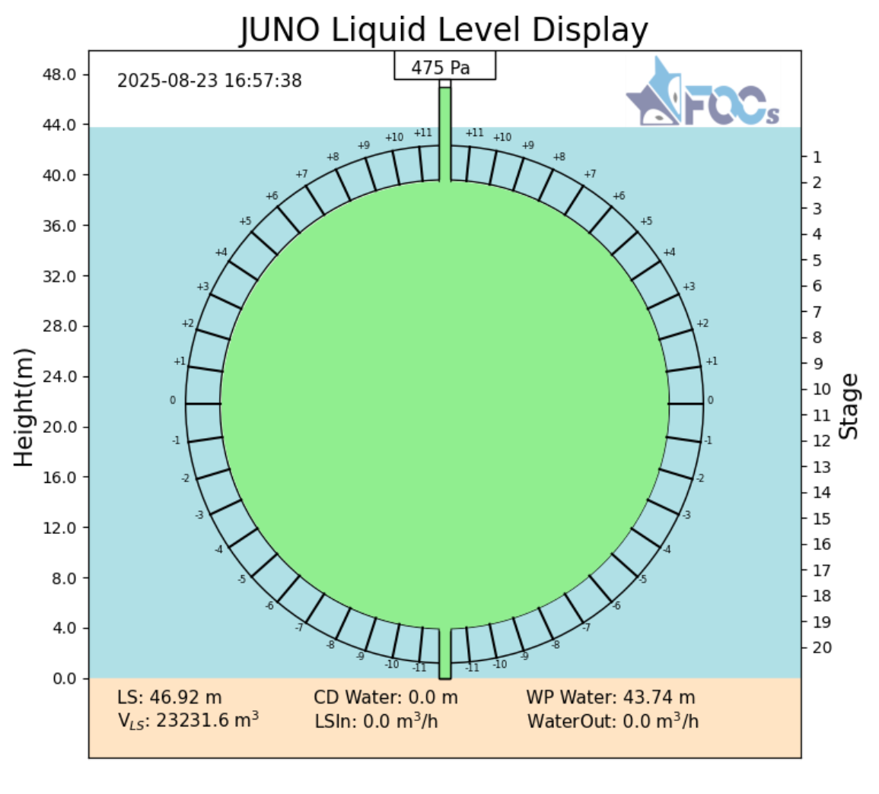
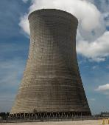
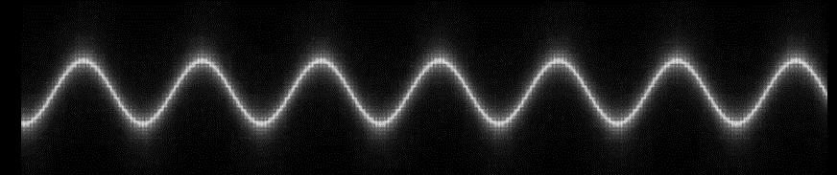


Rapid Results
Aug 26 2025
JUNO was fully filled with LS
Physics begins
November 19 2025
First 59 day result announced
Recently published to Nature
$${\overline{ν}}_{e}$$
$$e^{+}$$

Slide 13

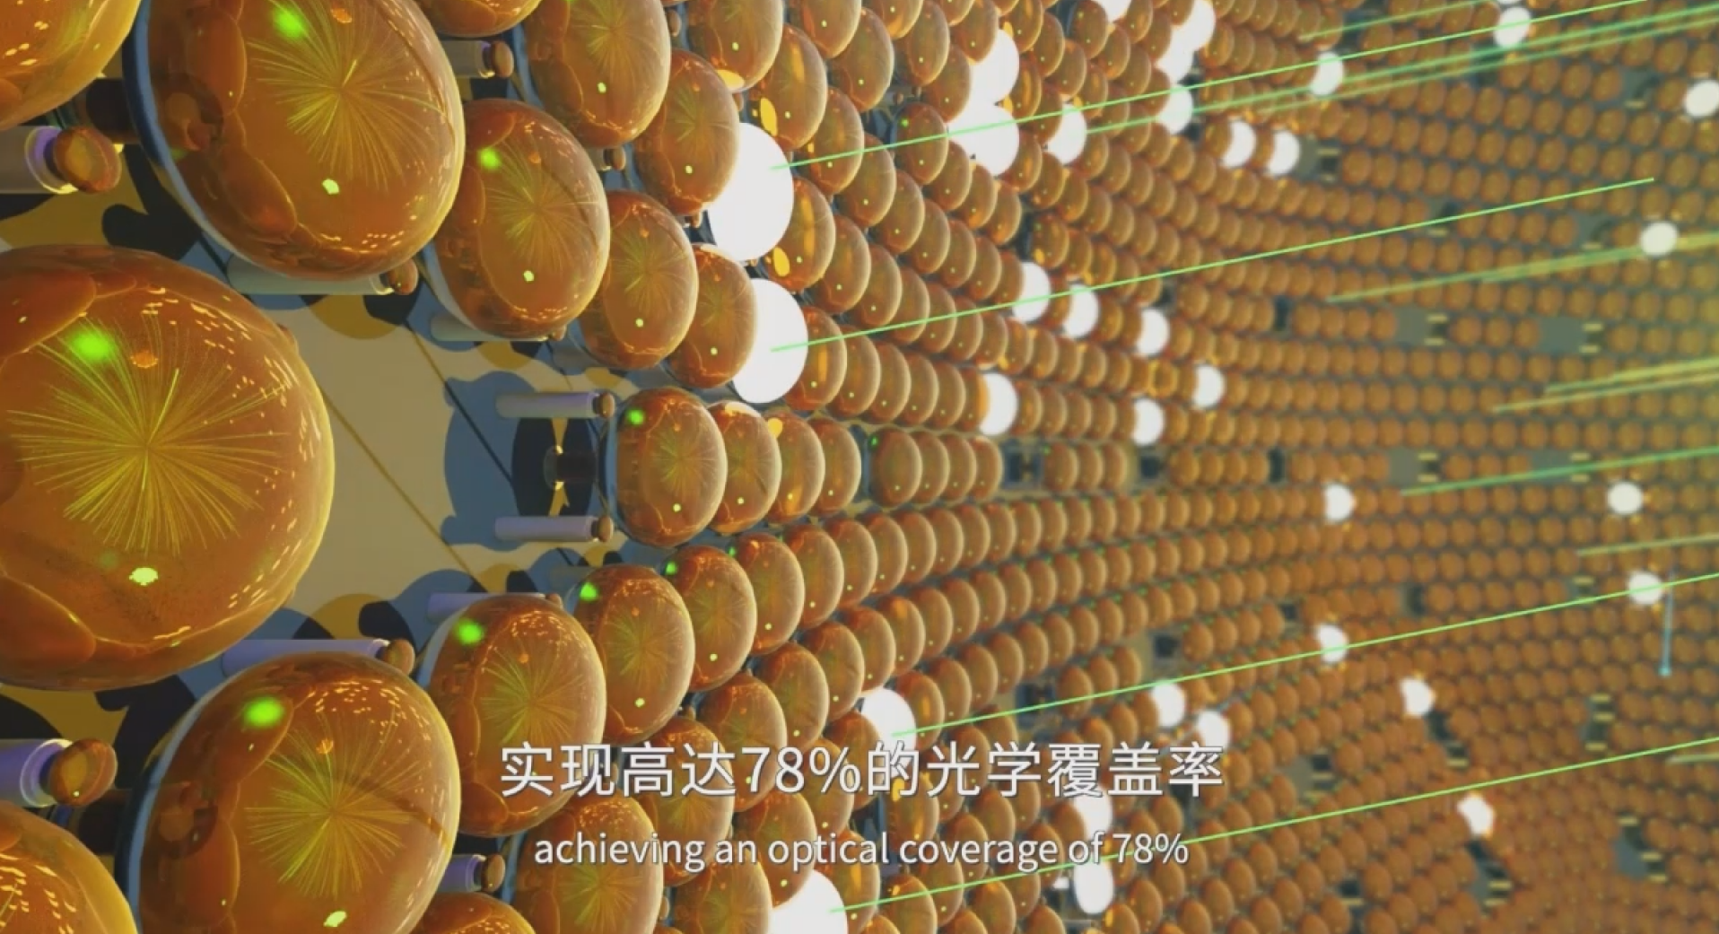
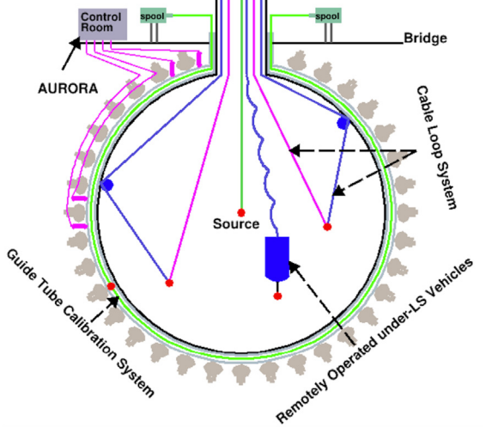
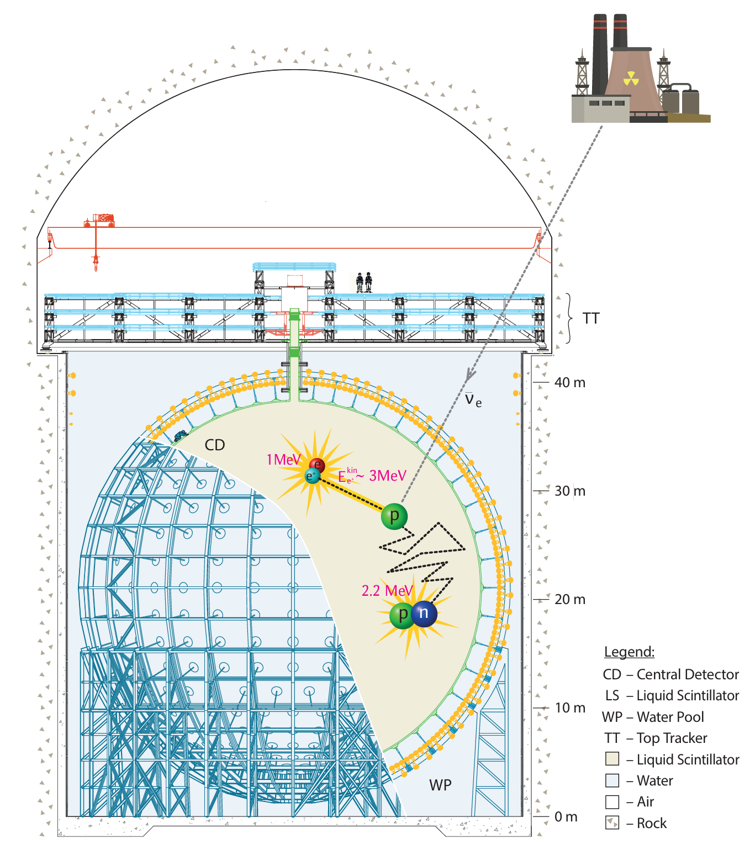
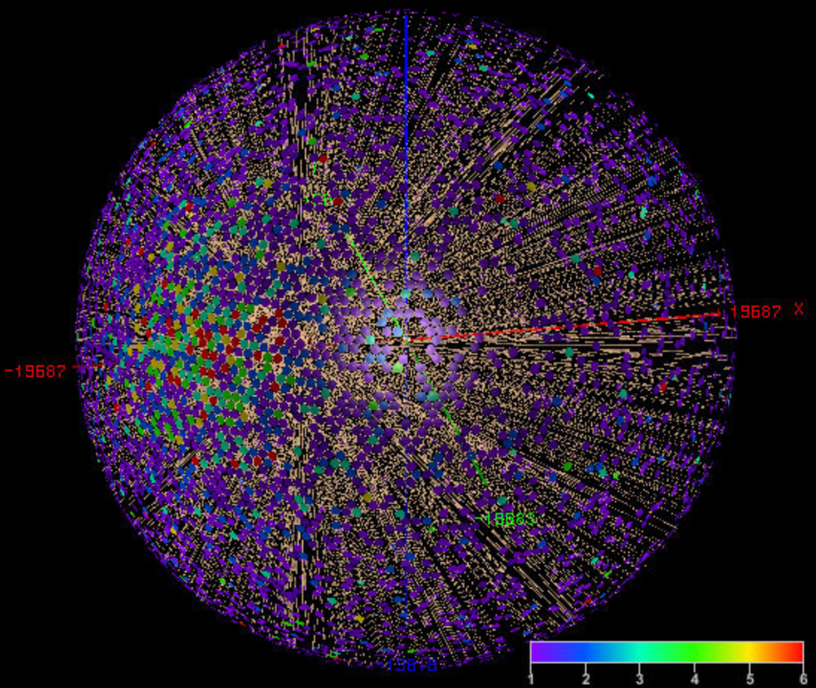
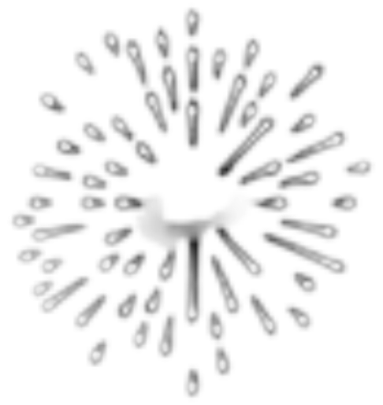
First Oscillation Analysis
(to summarise things simply):
Calibration
+
Reconstruction
Signal
+
Backgrounds
Input data
Spectral Fit

Slide 14
First Oscillation Analysis
(to summarise things simply):
Calibration
+
Reconstruction
Signal
+
Backgrounds
Input data
Spectral Fit
Focusing here on the contributions of five nominated analyzers
Many other contributions/methods not shown here, essential for this result
Updated oscillation and detector performance results recently shared at Neutrino 2026

Slide 15
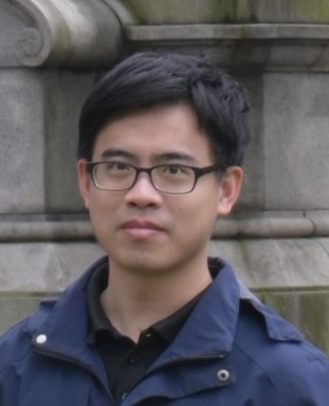
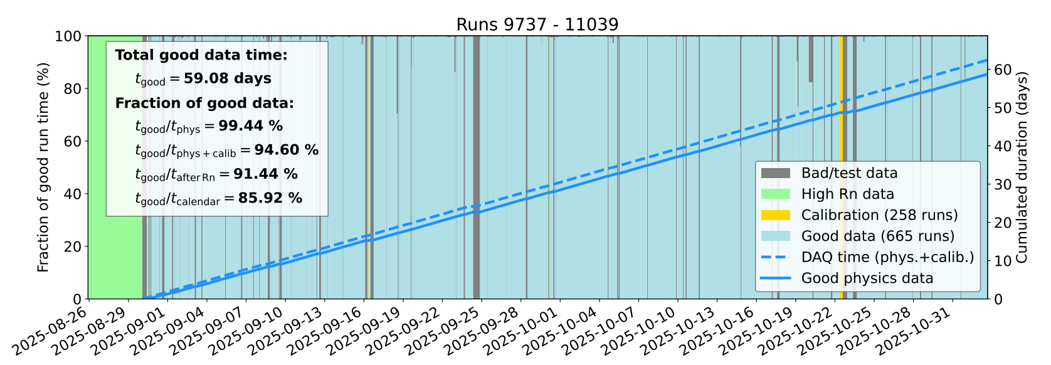
Efficient data-taking
Designed efficient offline data monitoring systems to ensure high quality data.
Established criteria for good electronic channels and data.
Zhiyuan Chen
(IHEP)
Detector live for 97.8% of the time from 30th August to 2nd November 2025
59.1 days high quality physics data for the first result

Slide 16

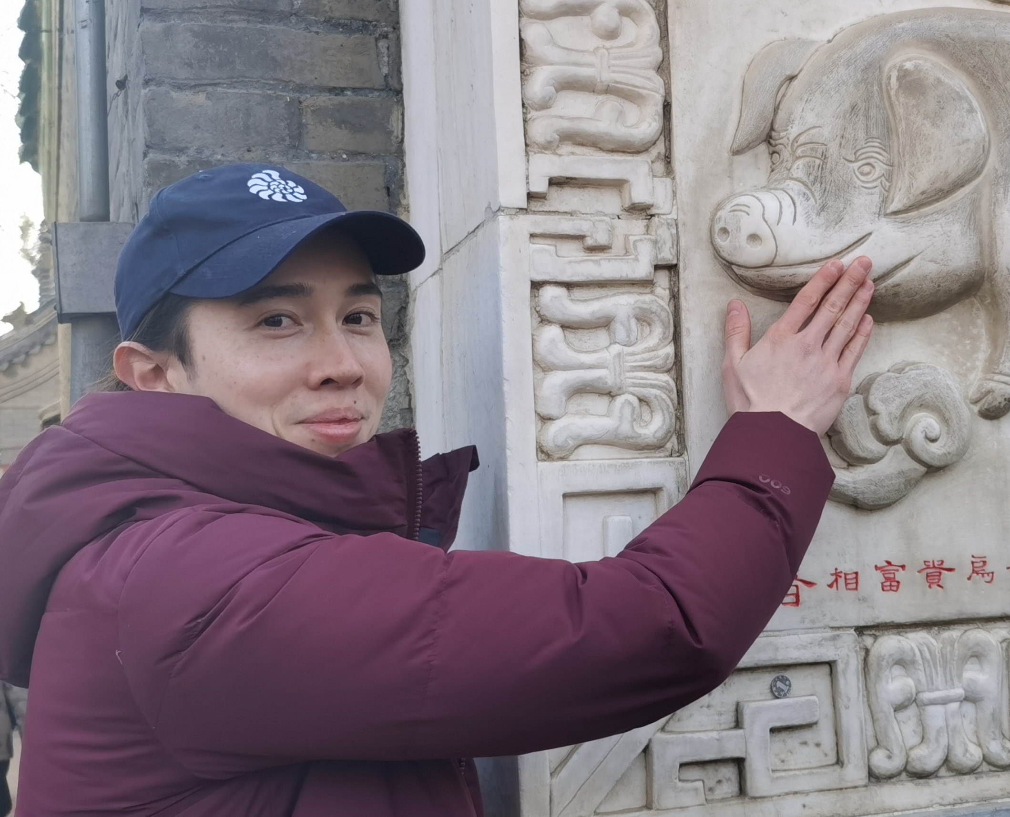
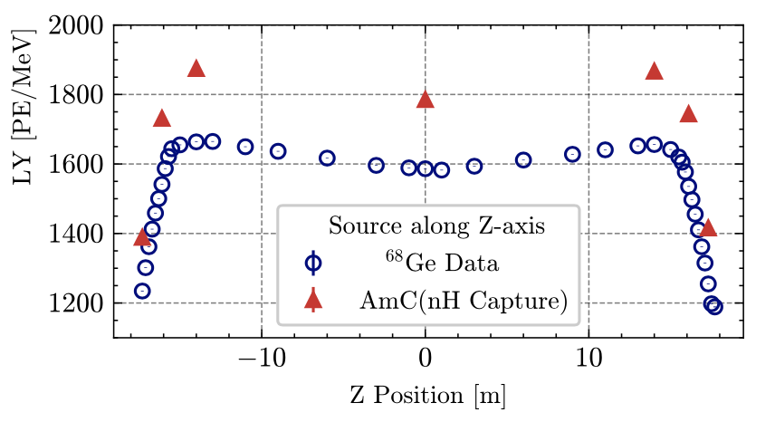

Light Collection and Reconstruction
Mingxia Sun
(IHEP)
Iwan Morton-Blake
(TDLI/SJTU)
Contributed vertex reconstruction methods, calibration methods with BiPo214
Lead detailed studies quantifying the detector response
Energy and Vertex Reconstruction:
Likelihood-based algorithms use PMT hit times and charges, time of flight
With calibration sources and naturally-present radioactivity (e.g. ²¹⁴Po $α$s):
  Calc. the expected charge seen (and not seen) by each PMT, versus position in the detector
Deploying calibration sources along the z-axis
Measured light yield along the z-axis
Light yield found to be better than expectation
~1600 PE/MeV for ⁶⁸Ge and ~1780 PE/MeV for neutrons

Slide 17
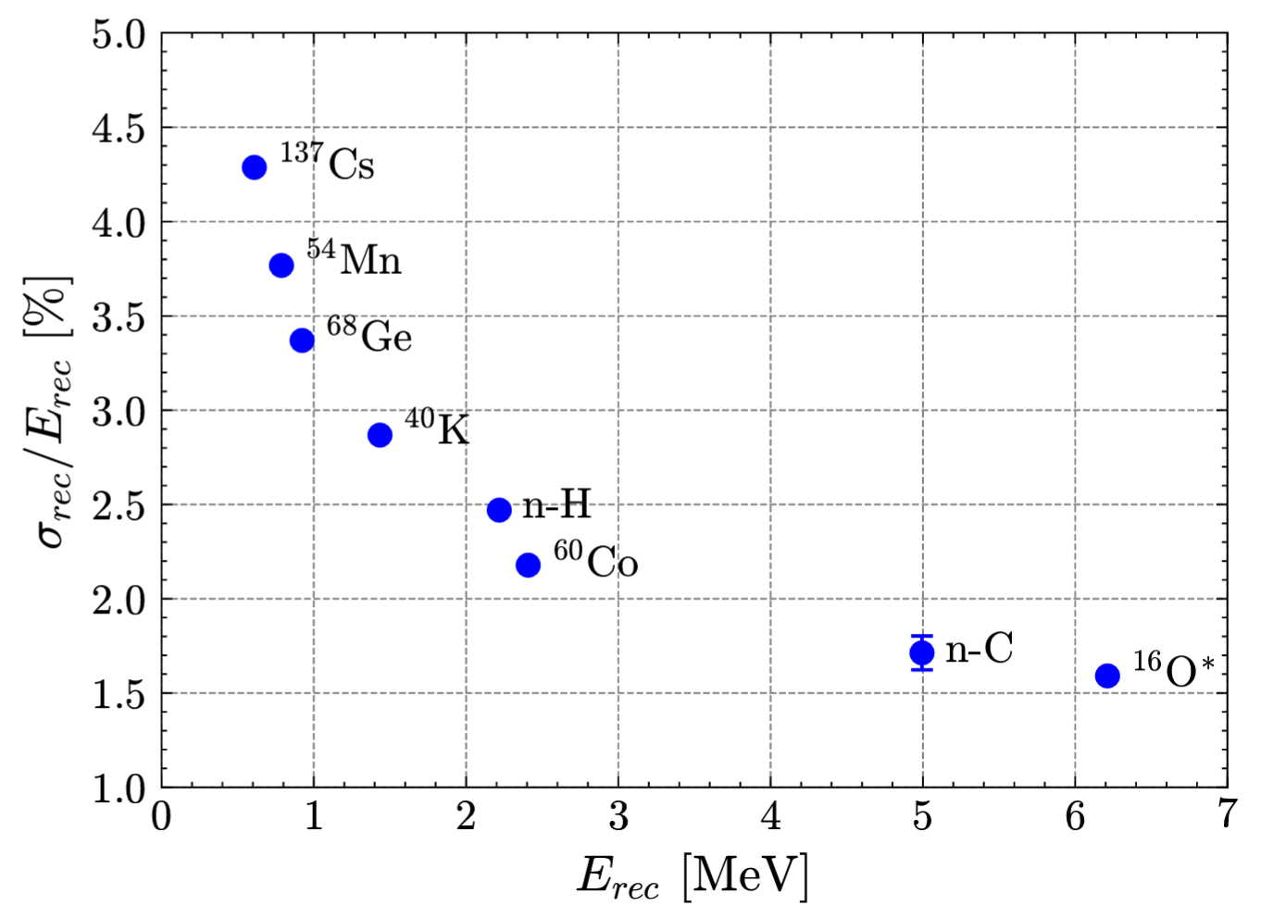
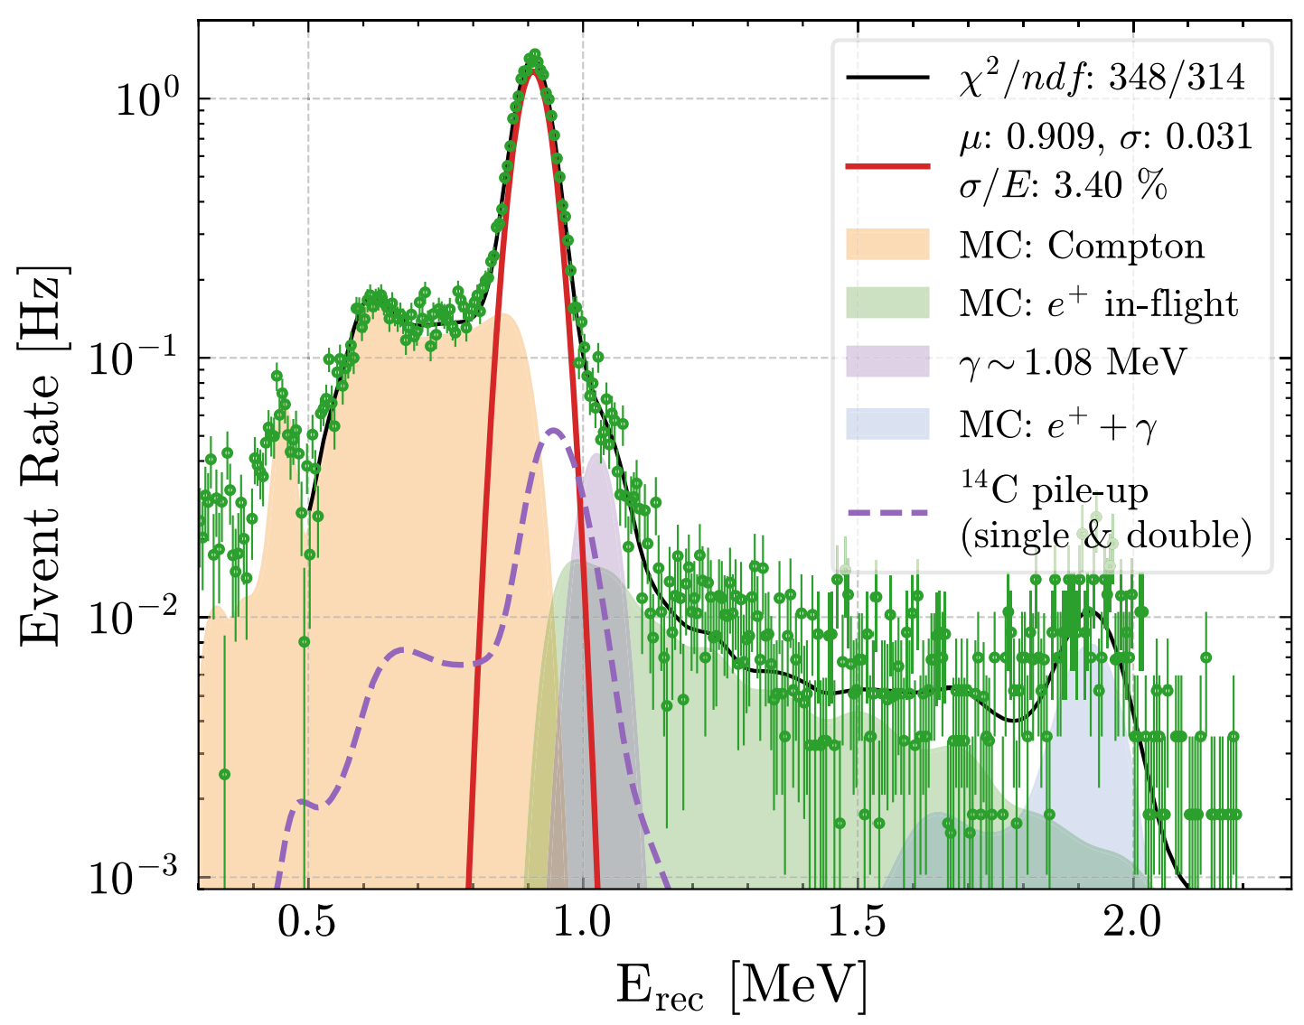
Energy Resolution
Established detector modelling and performance, achieving a precise scale uncertainty
Mingxia Sun
(IHEP)
Energy resolution is approaching design level
→ Expecting improvements with more comprehensive calibration

Slide 18
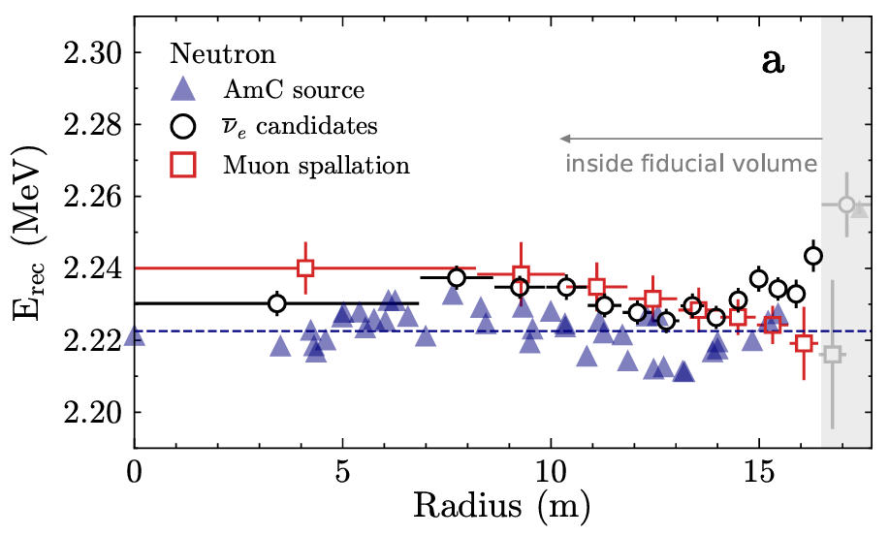
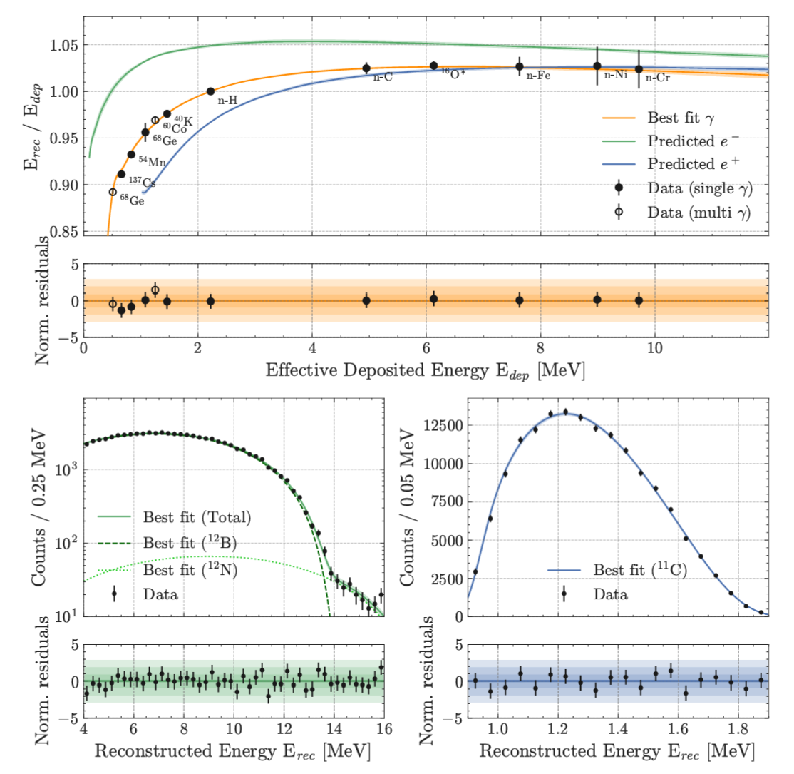

Energy Non-linearity
Established detector modelling and performance, achieving a precise scale uncertainty
Mingxia Sun
(IHEP)
E_{rec} against radius
E_{rec} modelling ($γ,e^{−},e^{+}$)
Energy non-linearity characterised within 1%
Energy scale certainty essential for precision. Non-uniformity within ±0.5% for r < 16.5m

Slide 19
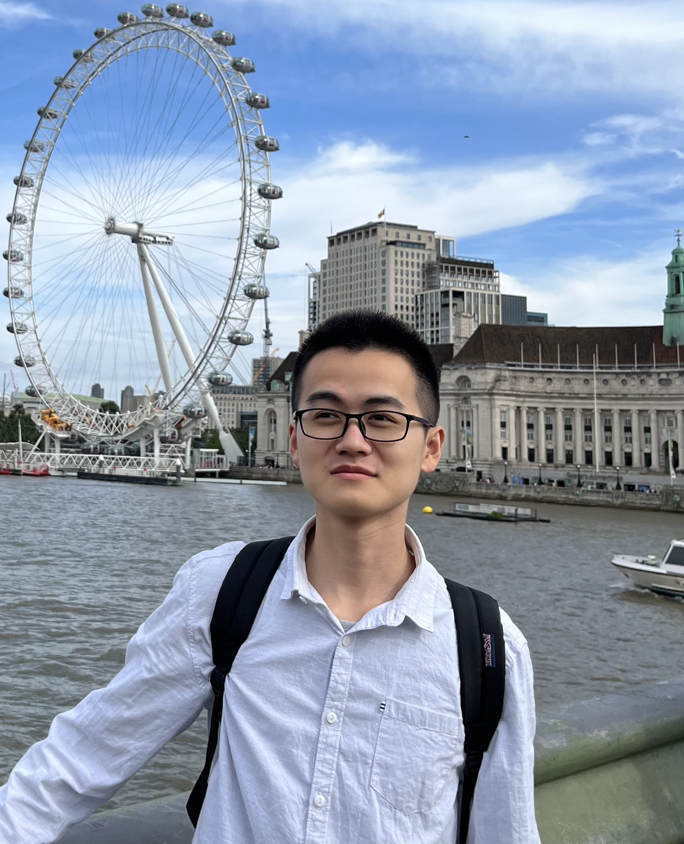
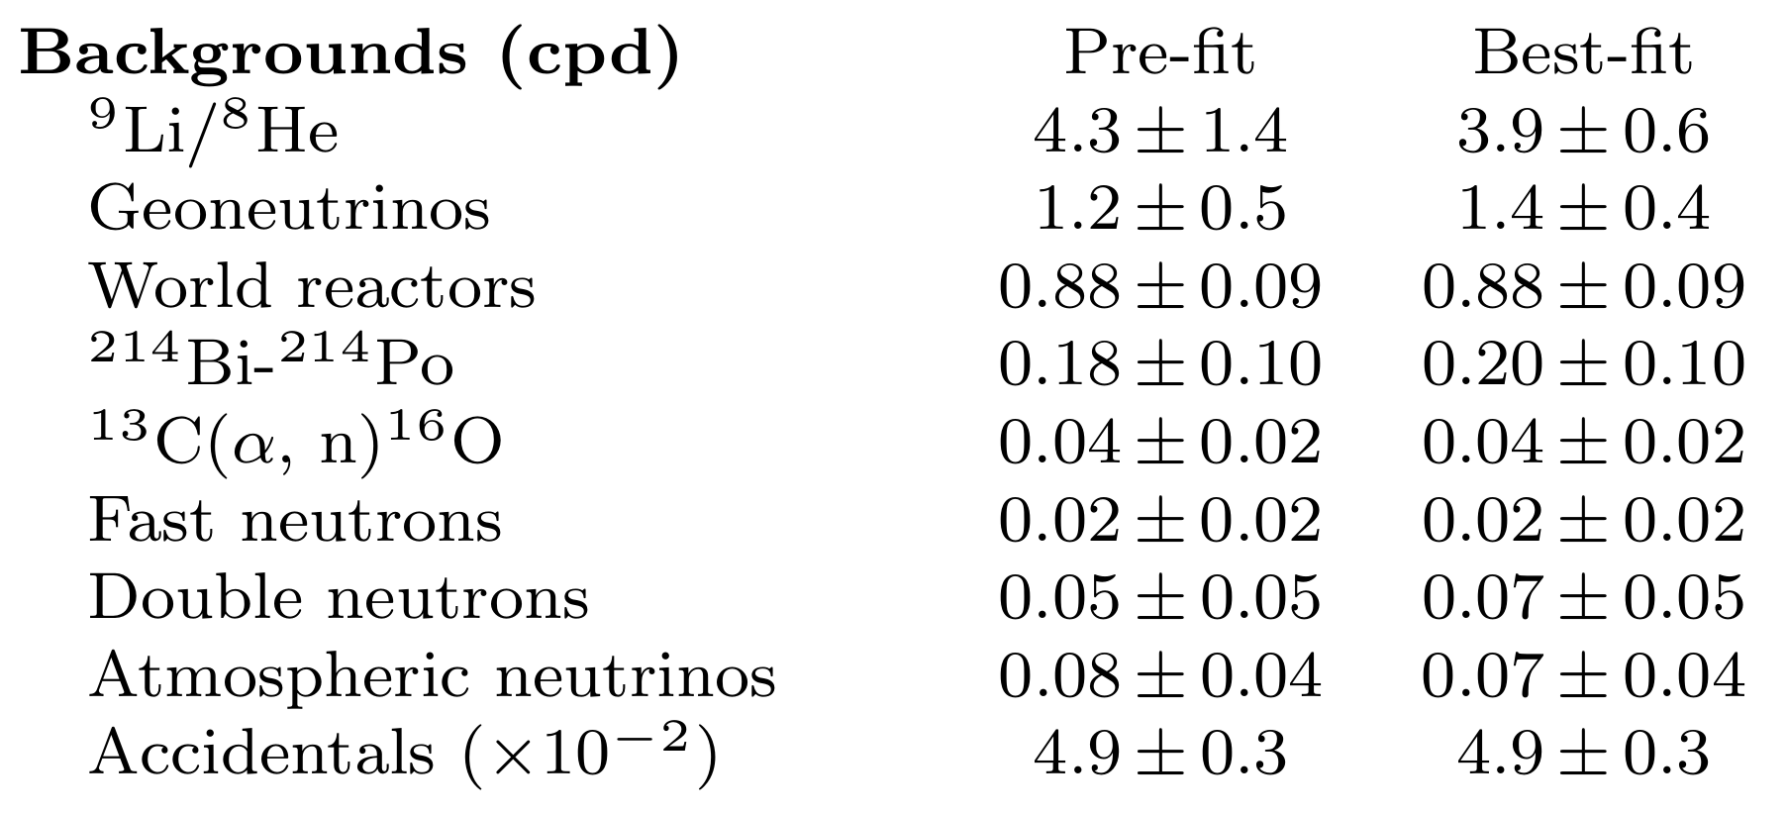
Signal extraction
Mingyuan Wang
(IHEP)
Iwan Morton-Blake
(TDLI/SJTU)
Fiducial volume: Remove events near the edge (higher backgrounds, worse energy resolution)
irreducible!
(cartoons not to scale)

Slide 20

Signal extraction
Mingyuan Wang
(IHEP)
Iwan Morton-Blake
(TDLI/SJTU)
Development of signal selection analysis cuts, prediction of background rates and spectra from in-situ sideband measurements
$$μ$$
n
Reconstruct muons and their spallation products:
Removing spallation neutrons and long-lived ⁹Li/⁸He → e⁻ + n
Cut out spheres/cylinders of data in the detector
n
n
irreducible!
n
n
(cartoons not to scale)

Slide 21

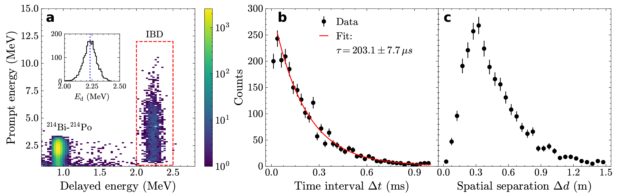

Signal extraction
Mingyuan Wang (IHEP)
Iwan Morton-Blake (TDLI)
Zhiyuan Chen (IHEP)
Calculation of analysis selection efficiencies and uncertainties, implementing a variety of methods
e⁺ - Neutron
Time difference
e⁺ vs neutron Energy
e⁺ - Neutron distance
Energy, distance and time coincidence cuts to isolate IBD signal
~70% signal efficiency
1.6% uncertainty

Slide 22


Oscillated energy spectral fit
Han Zhang
(IHEP)
Statistical analysis and neutrino oscillation parameter fitting, combined JUNO and Daya Bay spectral analysis
Nuclear power plant data
Accurate reactor core baseline measurements
Time-varying reactor operational data incorporated
Constrained reactor spectrum using published Daya Bay near hall data

Slide 23


Oscillation parameters
Han Zhang
(IHEP)
Statistical analysis and neutrino oscillation parameter fitting, combined JUNO and Daya Bay spectral analysis

Slide 24



Fast precision
JUNO reaches world’s best precision in $\sin^{2}{θ_{12}}$ and $Δm_{21}^{2}$ in 59.1 days
Factor of ~1.6 improvement in precision over the existing global knowledge

Slide 25
Fast precision
+ many
JUNO reaches world’s best precision in $\sin^{2}{θ_{12}}$ and $Δm_{21}^{2}$ in 59.1 days
Factor of ~1.6 improvement in precision over the existing global knowledge

Slide 26



Conclusions
Over ~12 years, with >700 scientists and >1000 contractors, JUNO’s first result established the detector as the largest and most precise detector of its kind.
World-leading measurements of $\sin^{2}{θ_{12}}$ and $Δm_{21}^{2}$ were made in ~60 days of data. The first results were a clear, early demonstration that the detector is performing to expectation.
As mentioned before:
Focusing here on the contributions of five nominated analyzers
Many other contributions/methods not shown here, essential for this result
Updated oscillation and detector performance results recently shared at Neutrino 2026
Looking forward to more updates!

