Slide 1


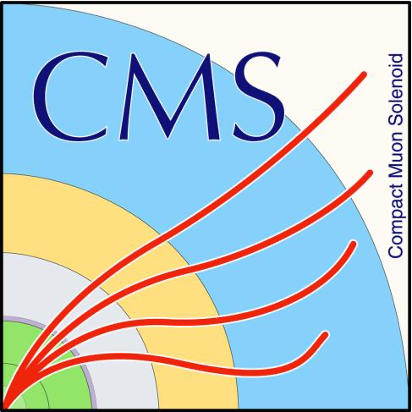
CMS实验上全粲四夸克态家族自旋宇称的测量
Nature 648 (2025) 58: Determination of the spin and parity of all-charm tetraquarks
王晰宁
清华大学/南京师范大学
晨光杯
2026年7月15日

Slide 2
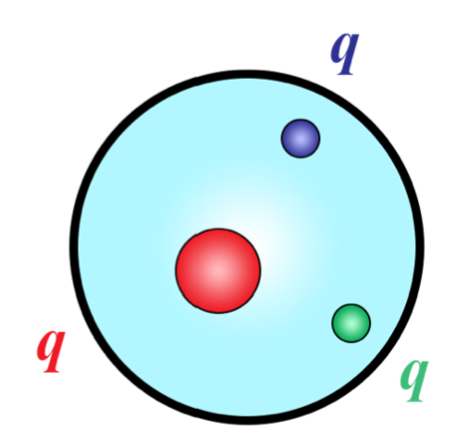
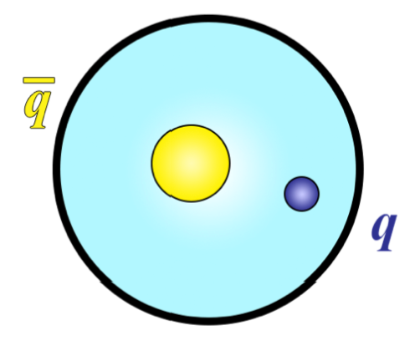
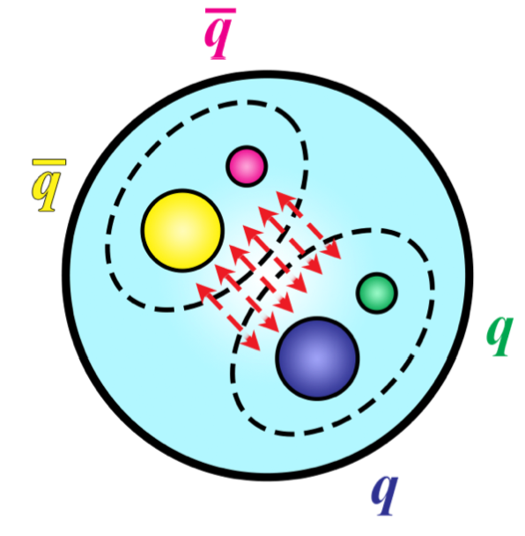
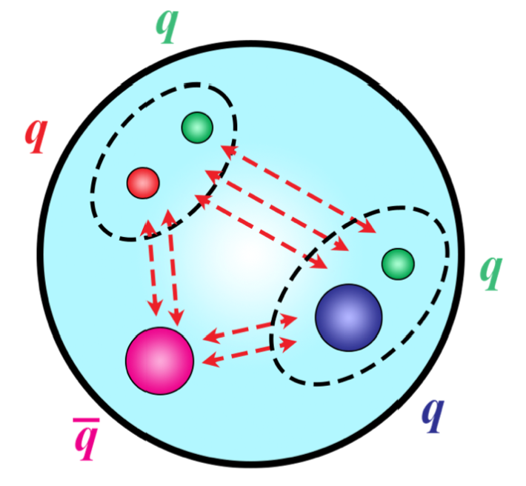
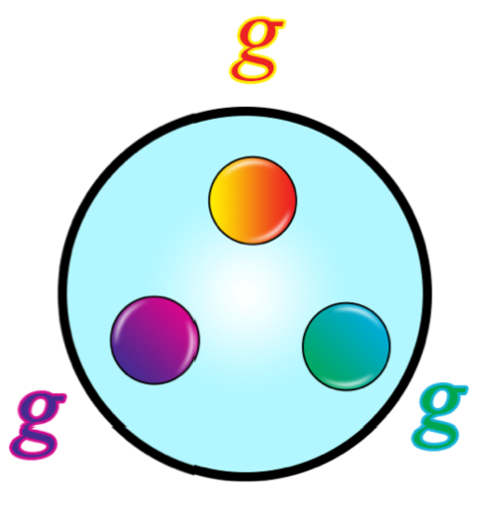
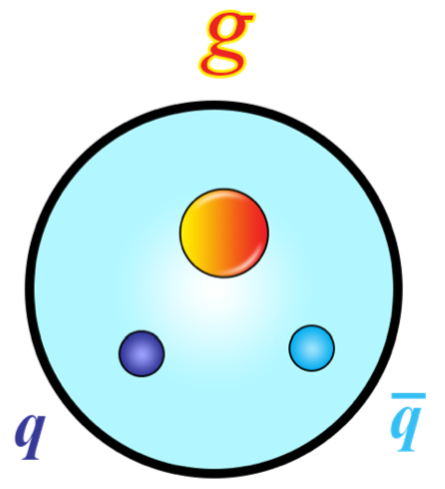
奇特强子态
~60 奇特强子态，24@LHC
现存困境
  多数奇特强子态含轻夸克自由度
  内部结构尚无定论
研究方案
  聚焦全重奇特强子——更简单体系
  能否确立内部结构图像？
arXiv:2204.02649v2
2

Slide 3
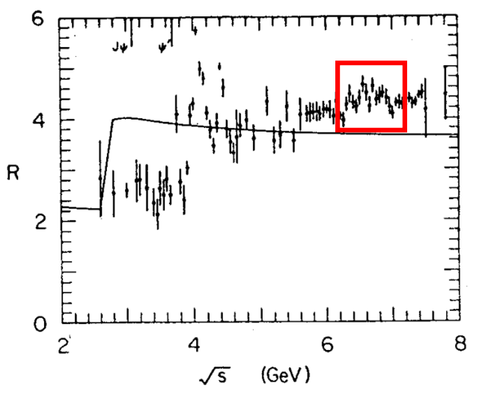
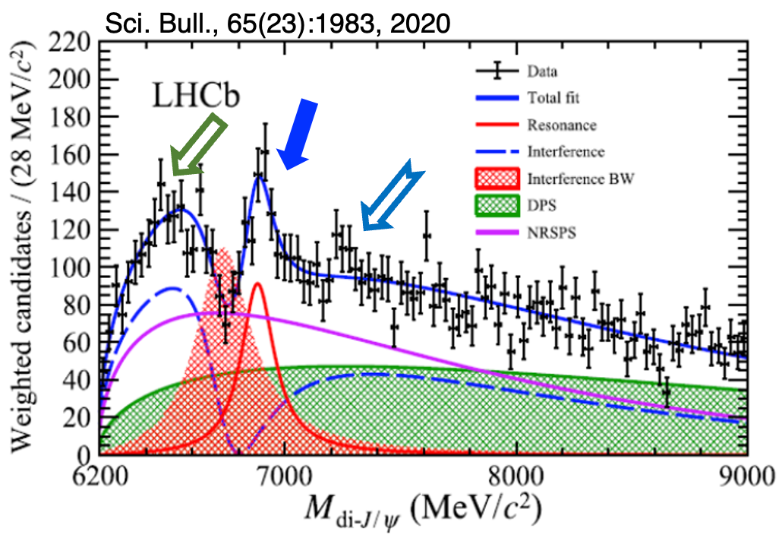
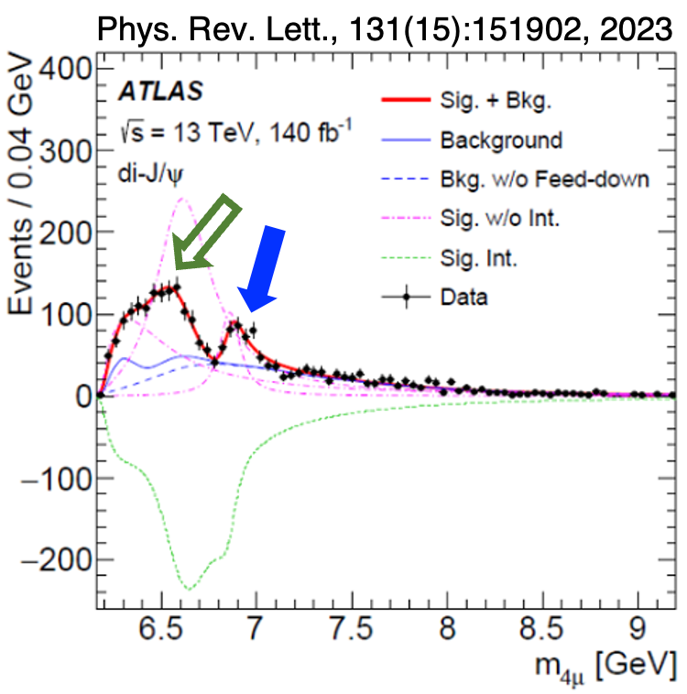
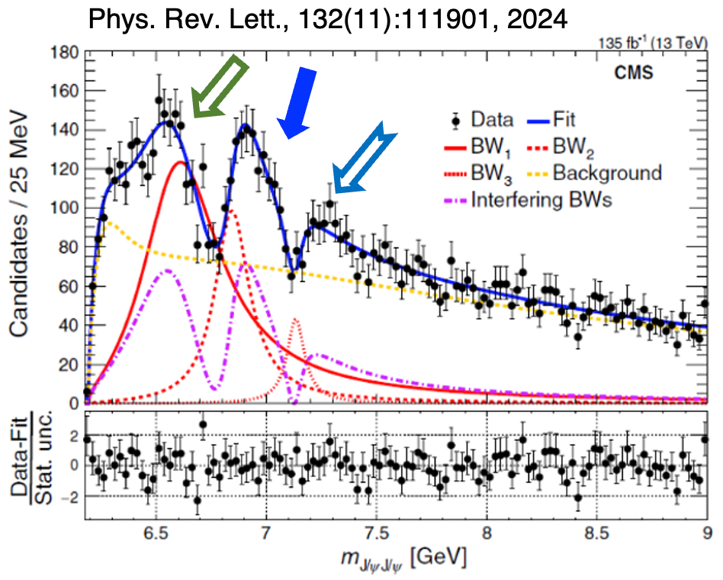
全粲四夸克态的研究
全重体系
4c态的首次提出 6.2 GeV (1975):
Y. Iwasaki, Prog. of Theo. Phys. Vol. 54, No. 2
4c态的首次计算 (1981):
K.-T. Chao, Z. Phys. C 7 (1981) 317
LHC Run2各实验 J/ψJ/ψ 衰变道全粲四夸克态：
LHCb
ATLAS
CMS
3

Slide 4
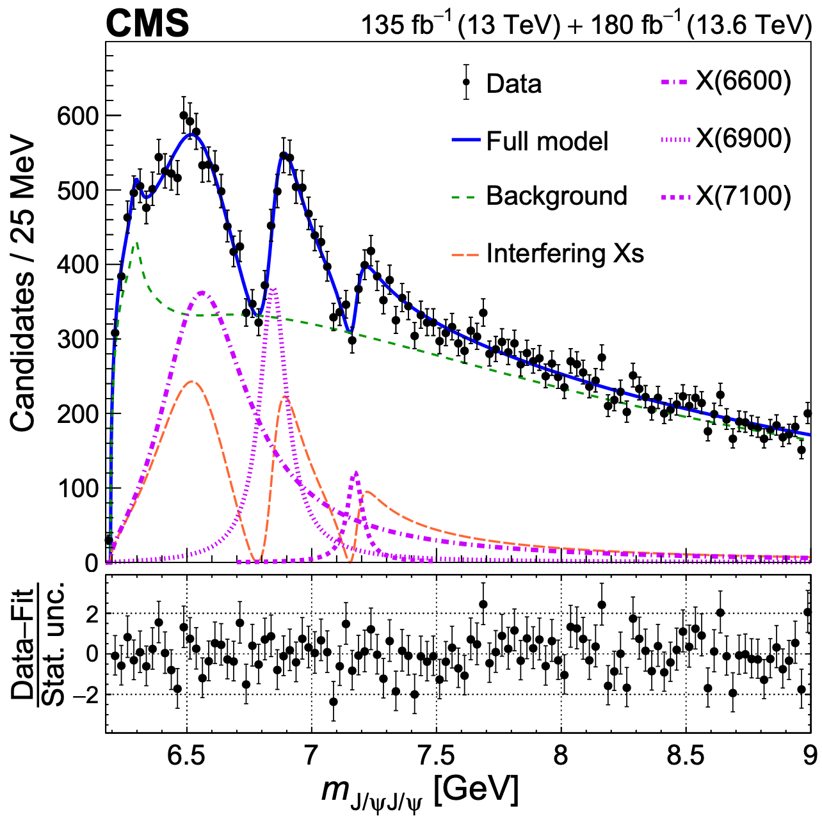
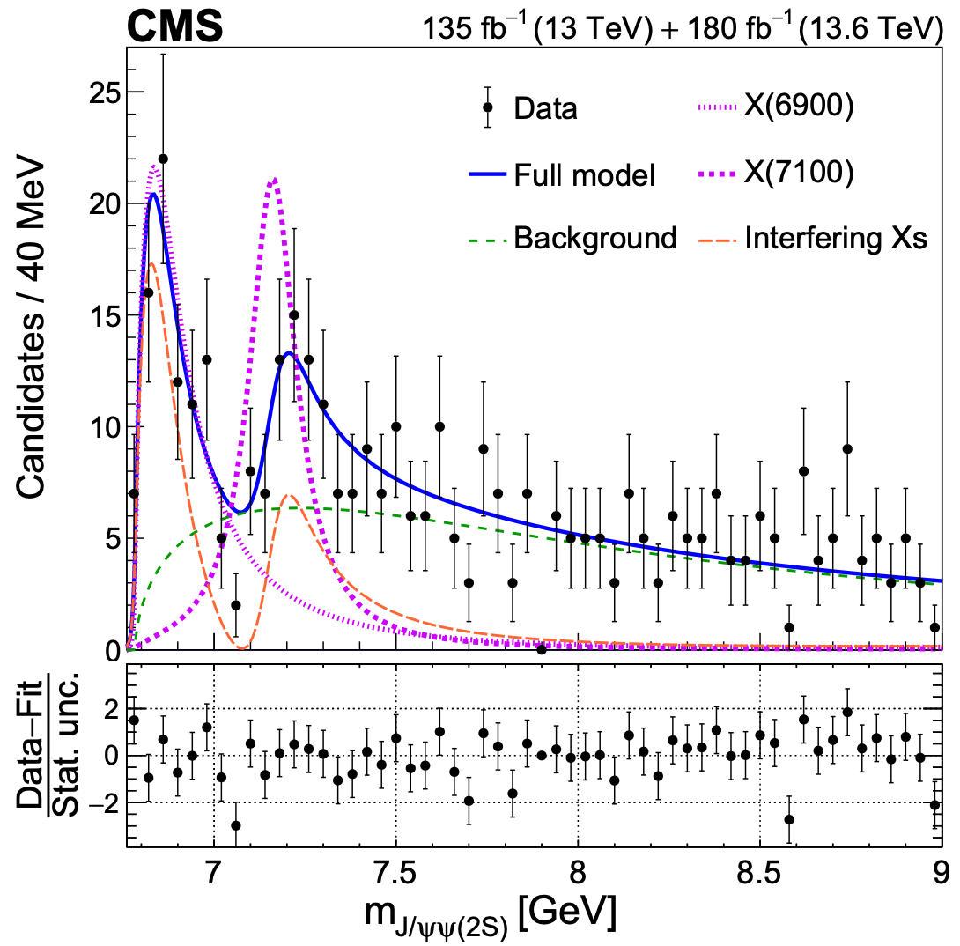
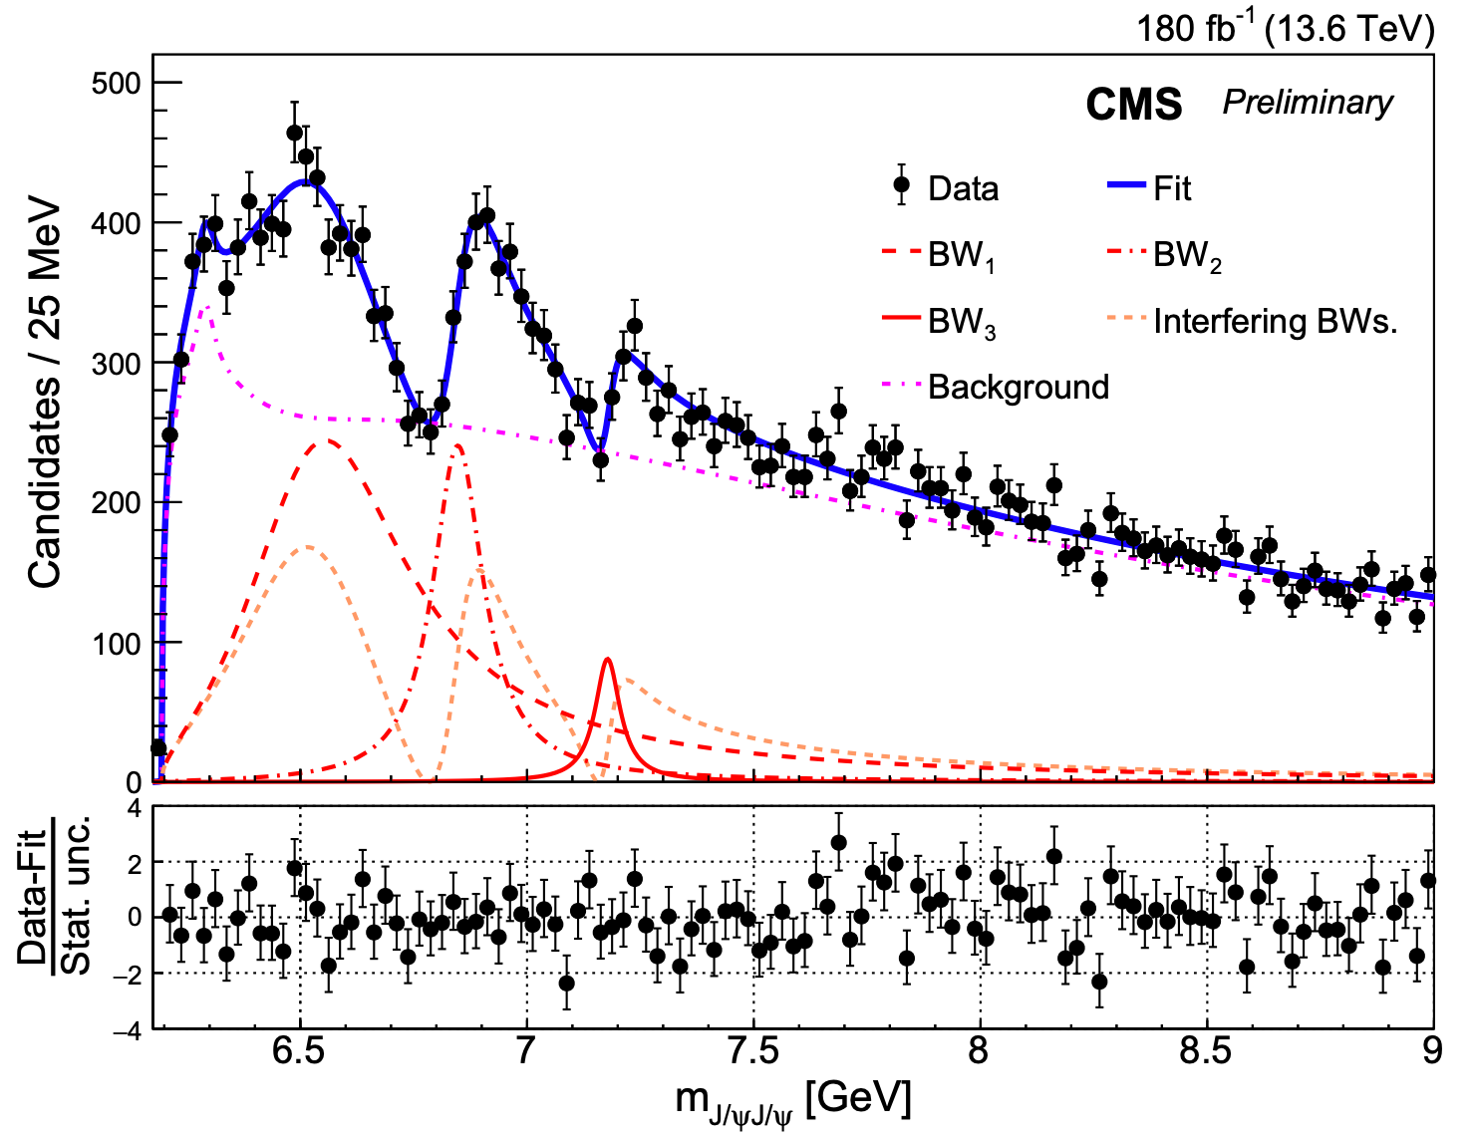

CMS上发现及确认四粲夸克态X(6600)、X(7100)
CMS Run3数据独立确认
CMS Run2+Run3精度提高2-3倍
CMS $J/ψψ\left(2S\right)$衰变道
X(6600) 12.7σ
X(6600) 15.2σ
X(6900) 8.1σ
X(6900) 12.9σ
X(6900) 16.7σ
X(7100) 4.3σ
X(7100) 6.3σ
X(7100) 7.7σ
arXiv:2602.02252, submitted to Science Advances
首次发现全粲四夸克态X(6600)和X(7100)
高精度确认X(6900)的存在
新衰变道首次观测X(6900)及X(7100)存在证据
为全粲多夸克态谱系研究建立了系列关键实验基础
4

Slide 5
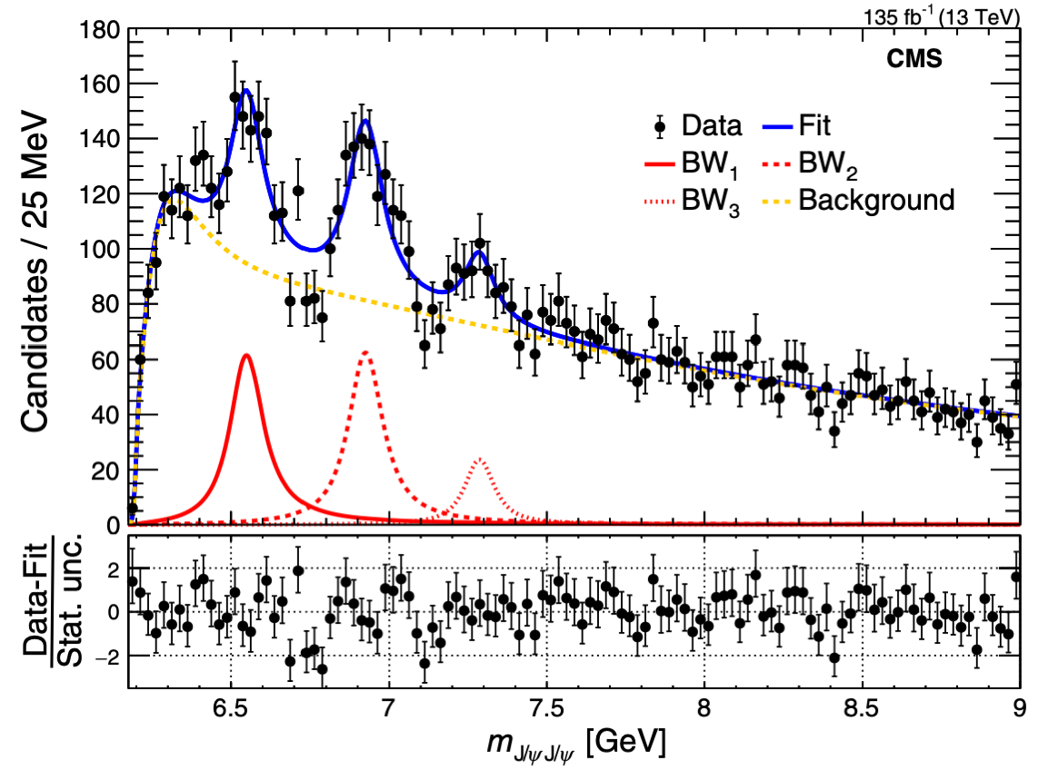
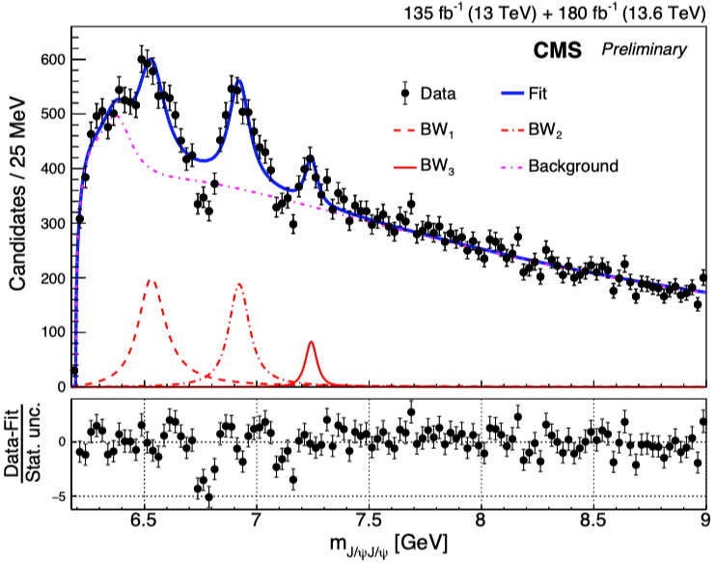
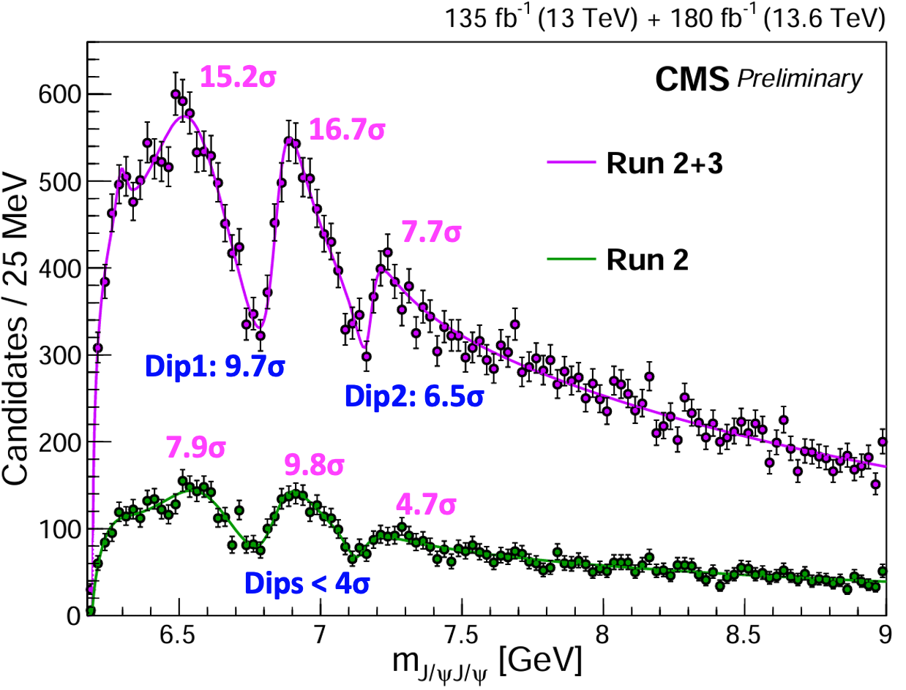
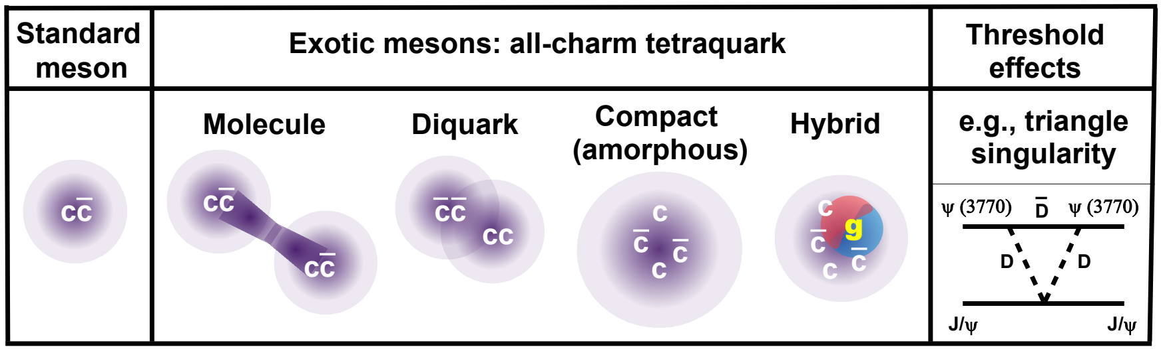
三重态干涉效应首次提出与验证
CMS Run 2数据非干涉拟合
CMS Run2+Run3数据非干涉拟合
CMS 干涉拟合
X(6600)
X(6600)
X(6900)
Run2+Run3
X(6900)
X(7100)
Run2
X(7100)
Run2+Run3
Run2
Phys. Rev. Lett. 132 (2024) 111901
arXiv:2602.02252, submitted to Science Advances
首次提出并研究全粲四夸克三重态之间的干涉效应
以超过5σ的统计显著度证实该现象
支持具有相同量子数的四粲夸克态家族
5

Slide 6
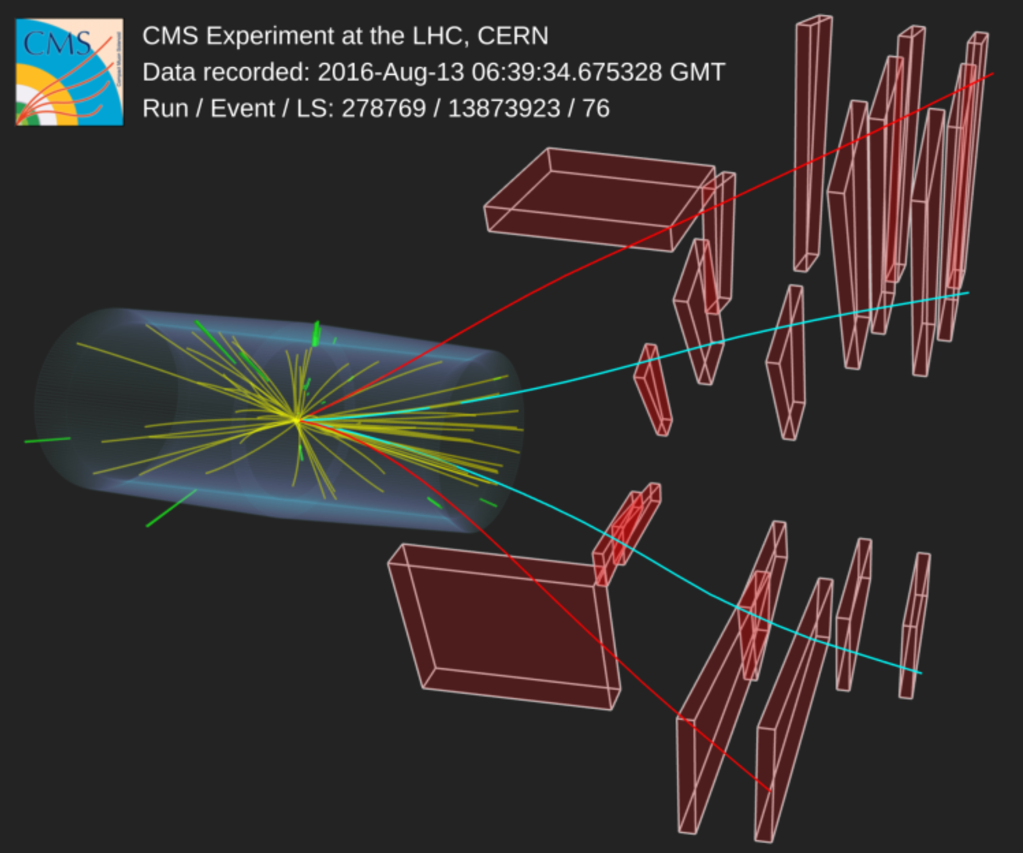
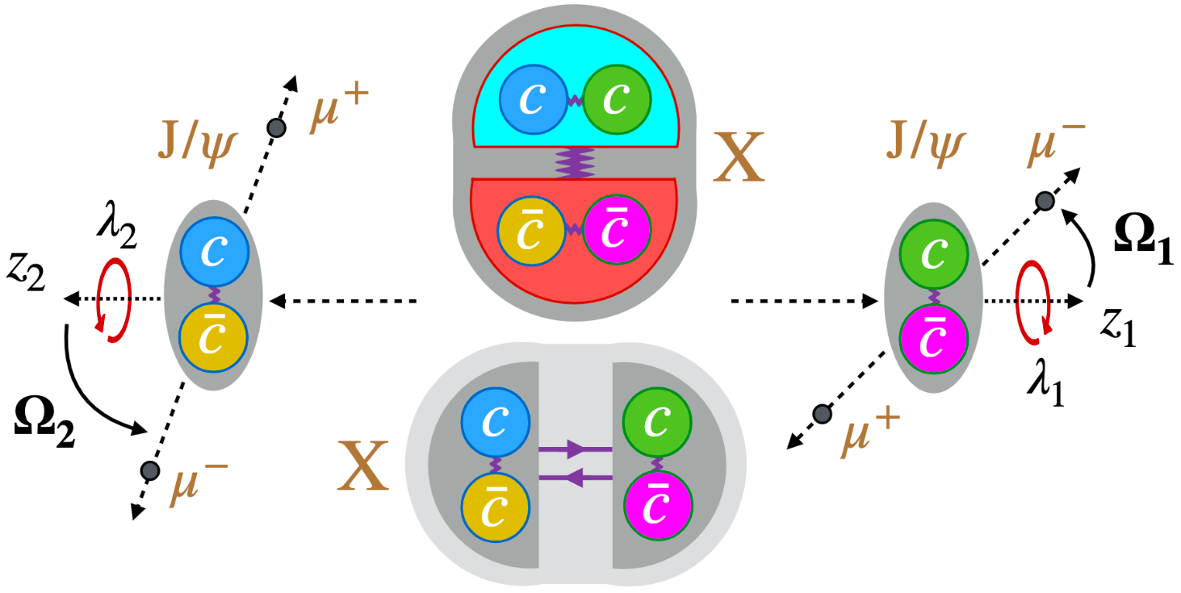

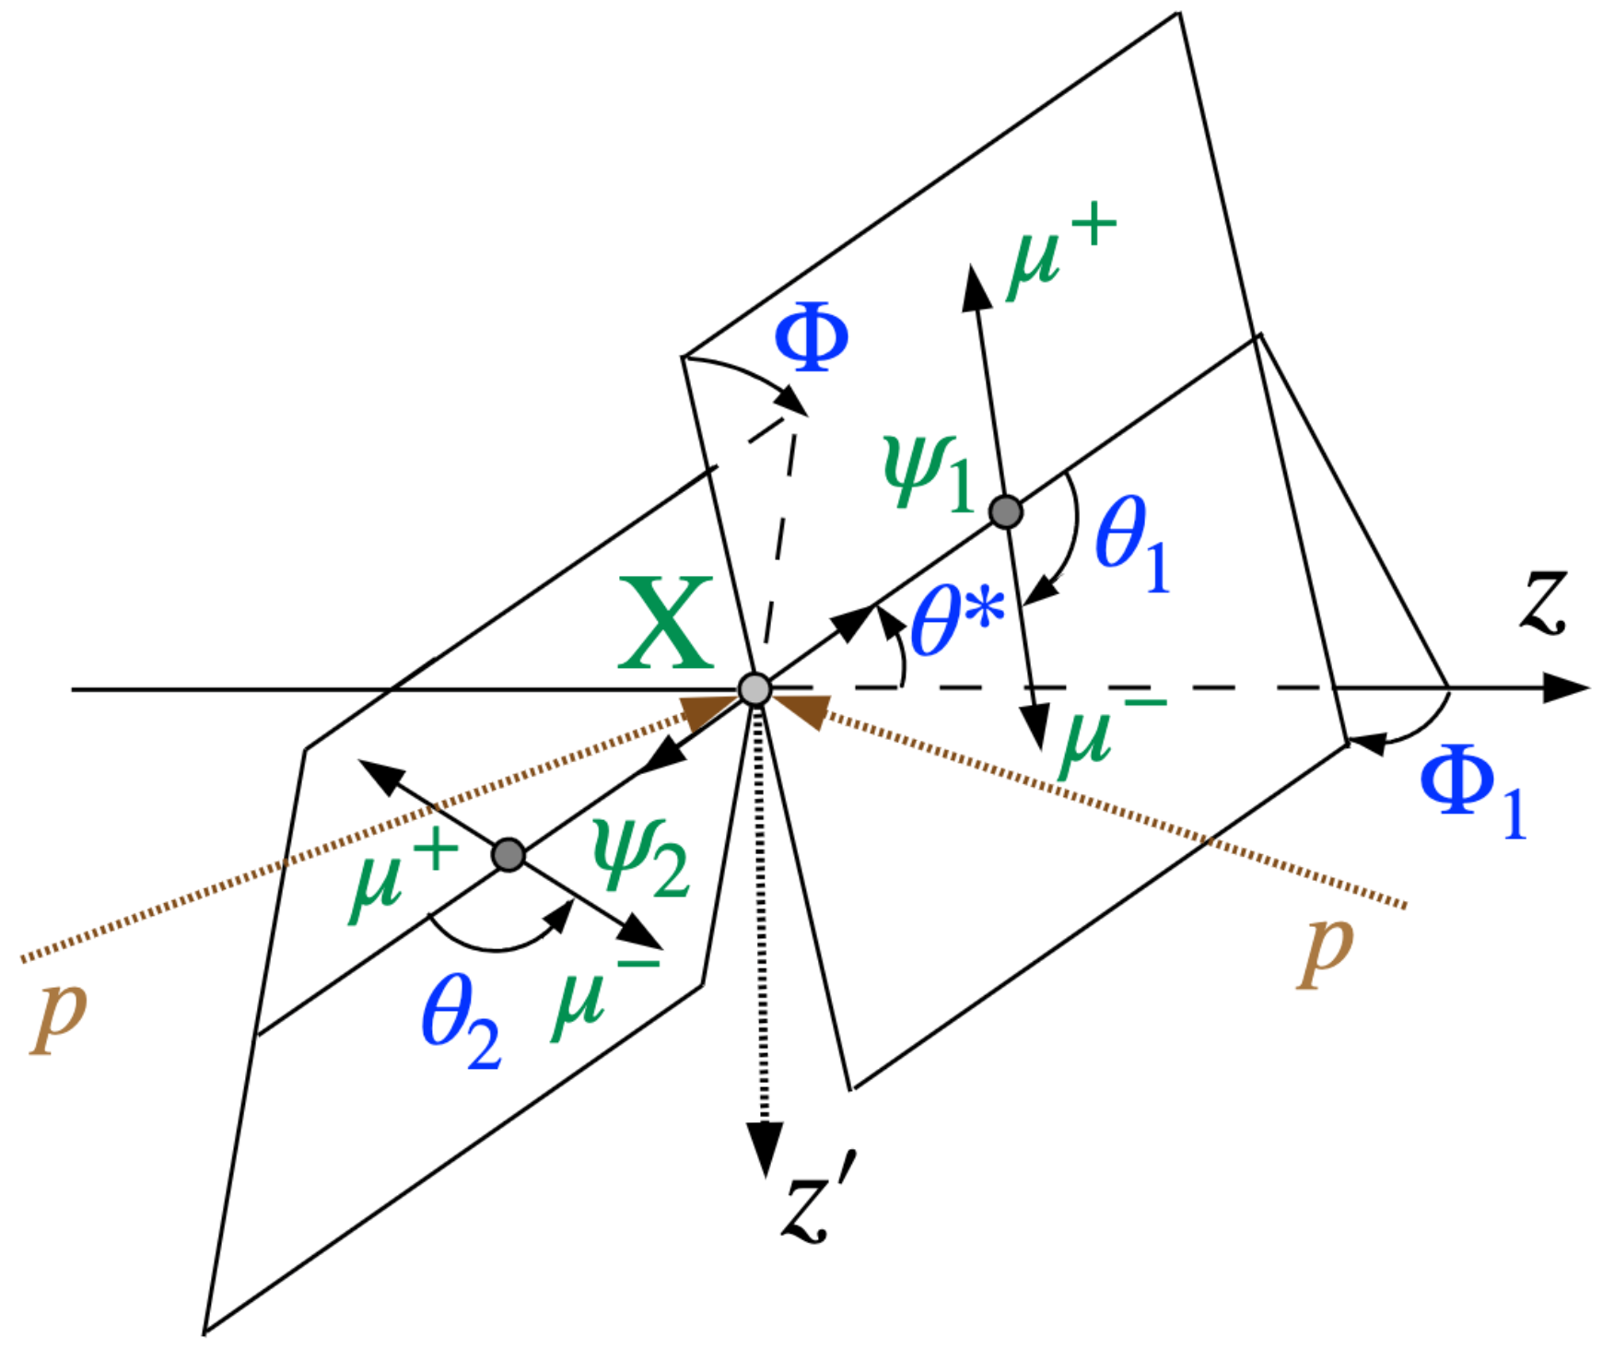



自旋宇称测量
6

Slide 7
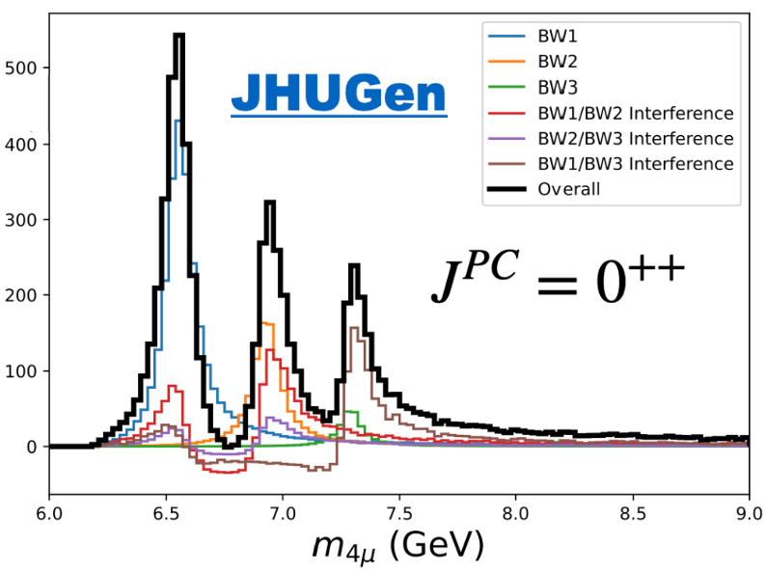
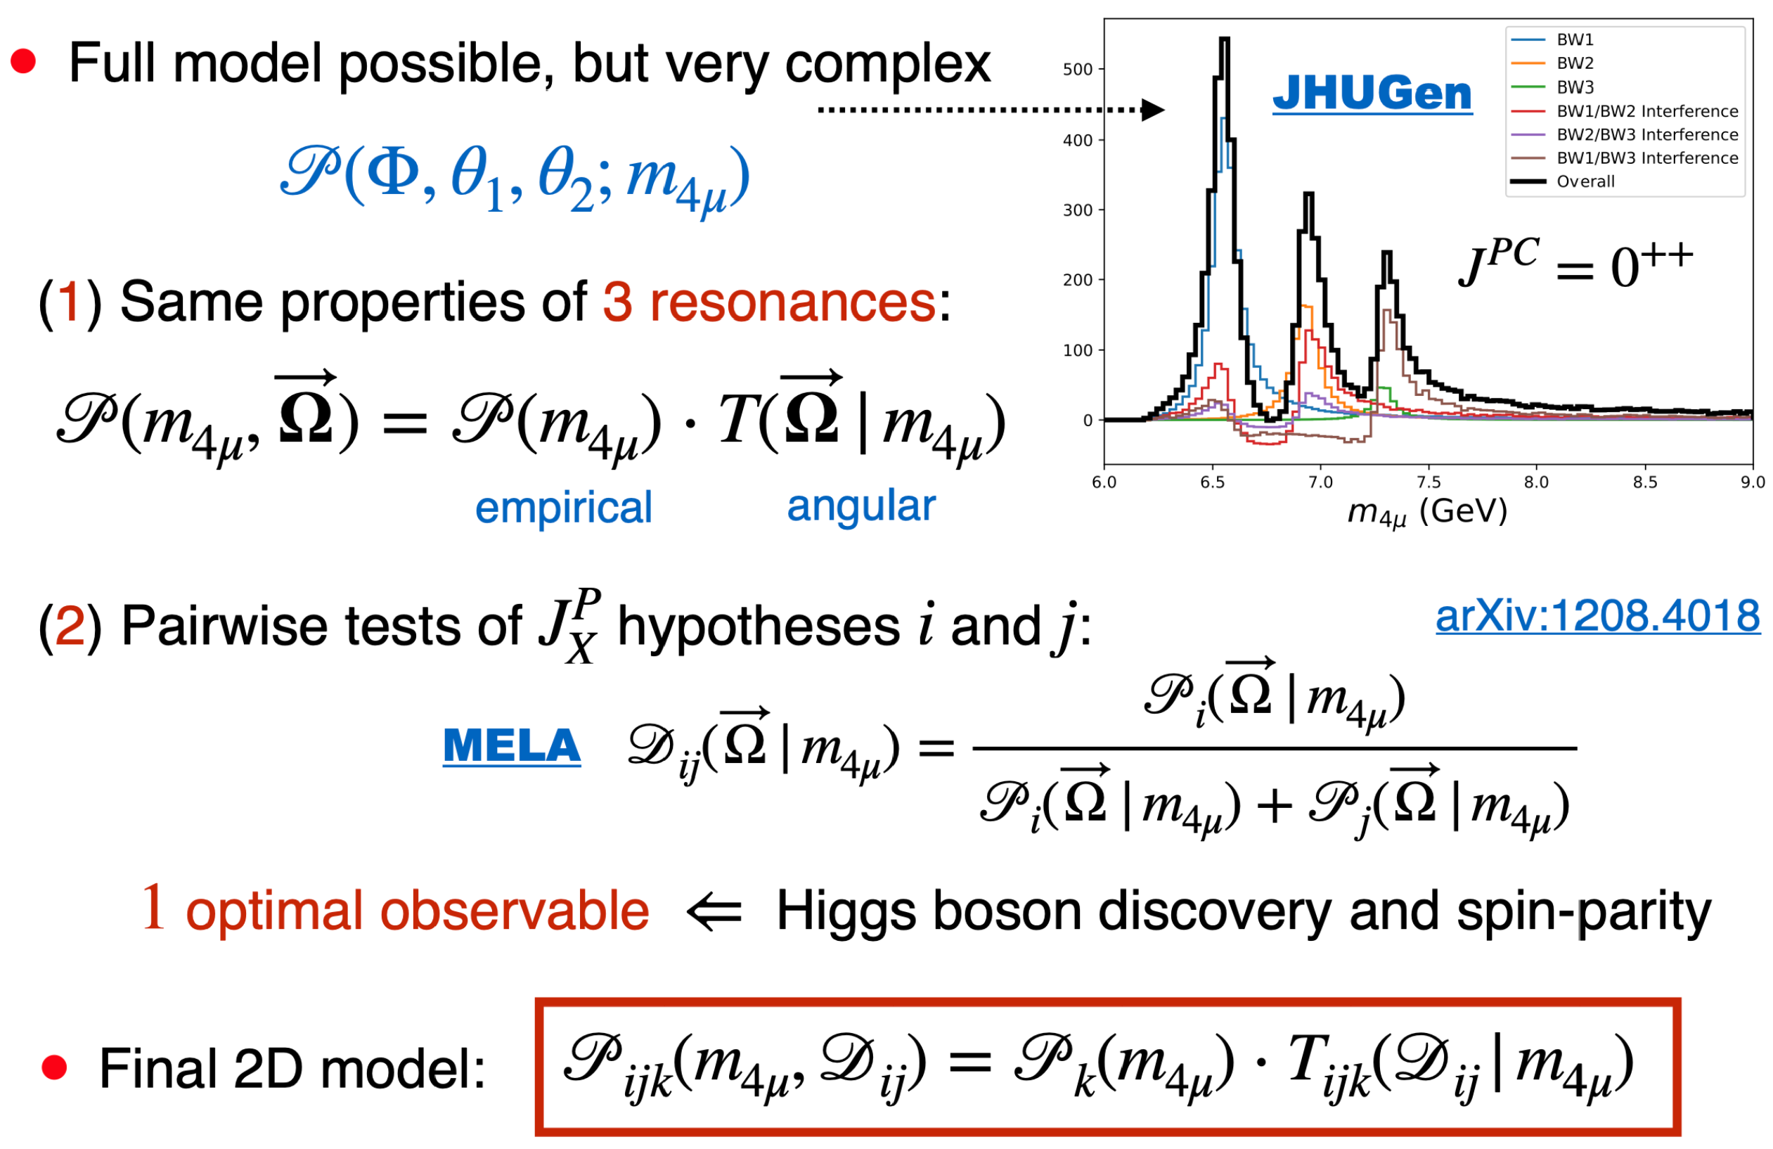
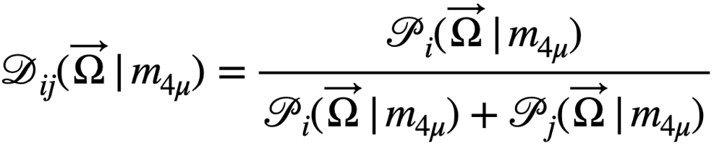
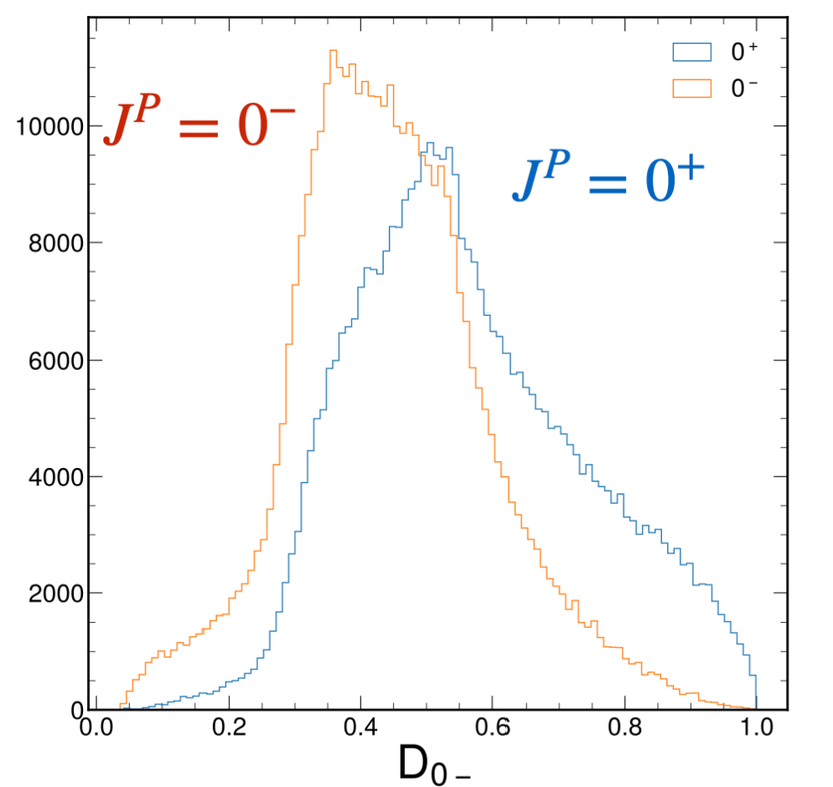
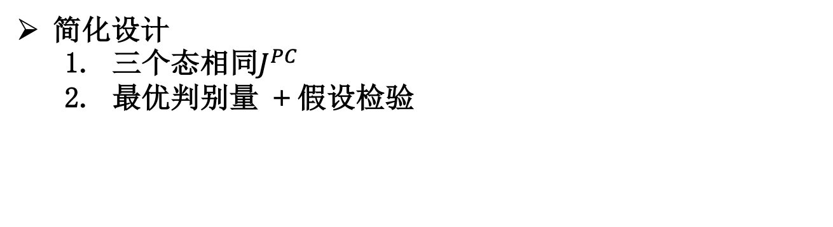
角分析
全振幅分析
BW1
BW2
Interf BW1 & BW2
Interf BW1 & BW3
简化设计
  三个态相同$J^{PC}$
  最优判别量 + 假设检验
Interf BW2 & BW3
BW3
Private work (CMS simulation)
二维拟合
Empirical
Angular
7

Slide 8
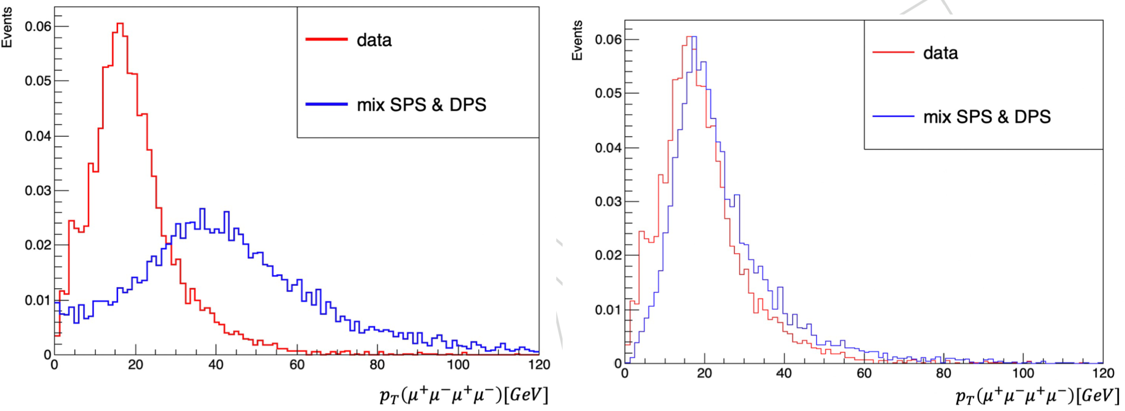
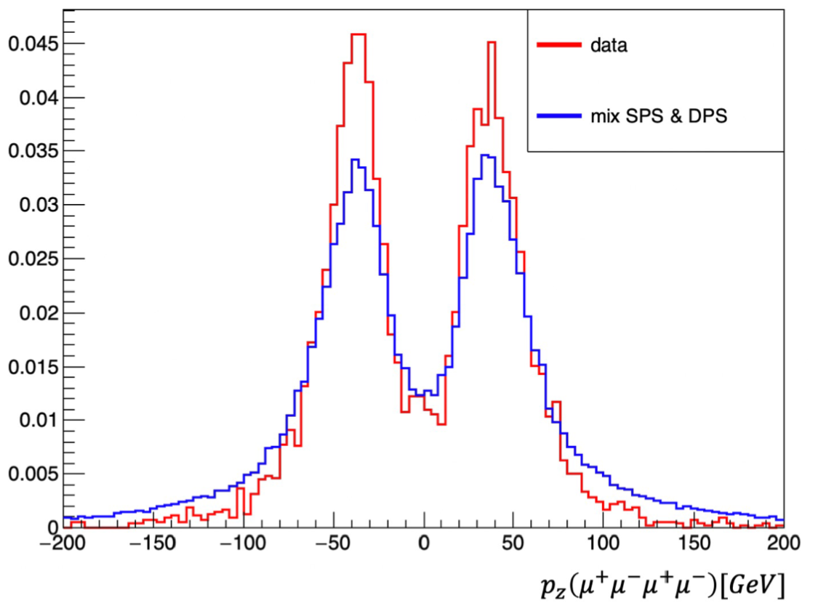
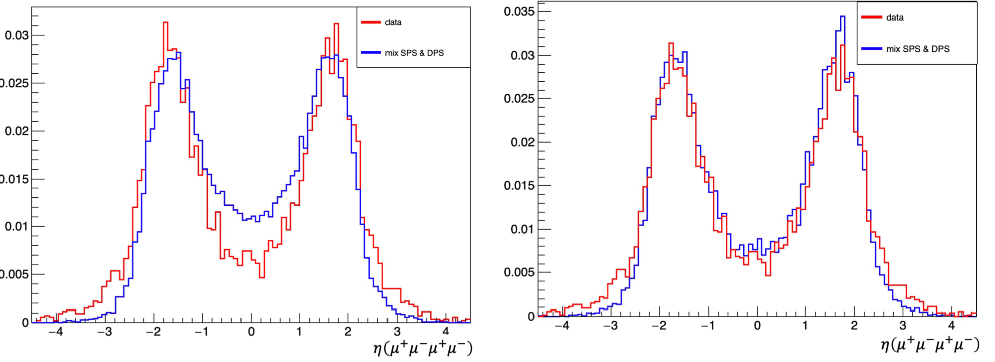

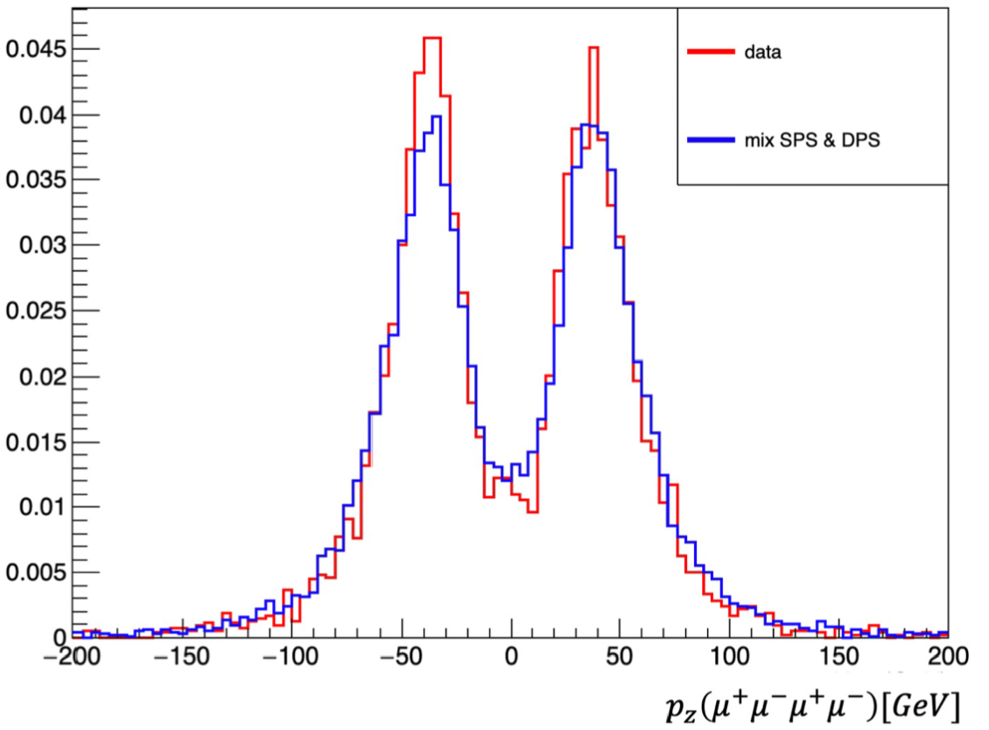



核心挑战：MC与data不一致
影响最优判别量的可靠性，制约分析进展
产生子调参，数据驱动方法修正残余差异
Data
MC
$p_{T}(X$)
$$p_{z}(X)$$
$$η(X)$$
8

Slide 9
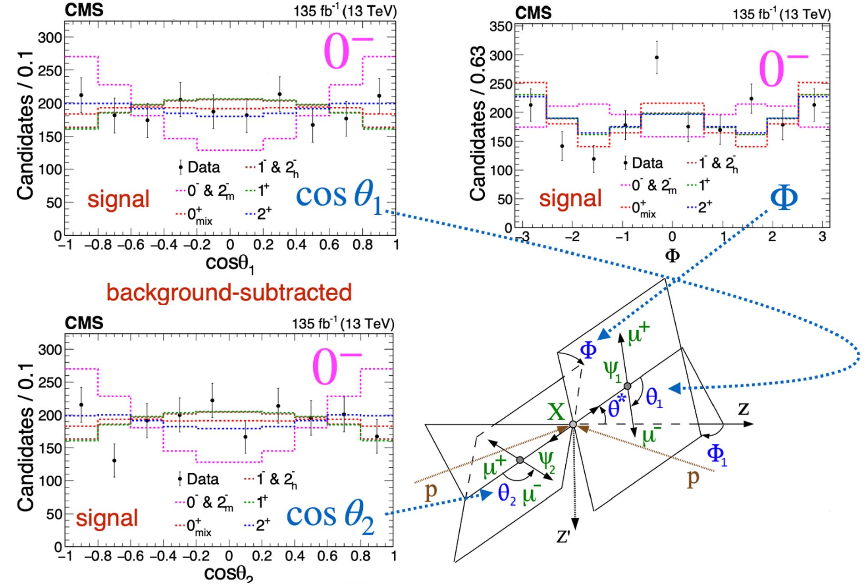

衰变角分布
Nature 648 (2025) 58
一维投影 $→$ 有限分辨能力
9

Slide 10
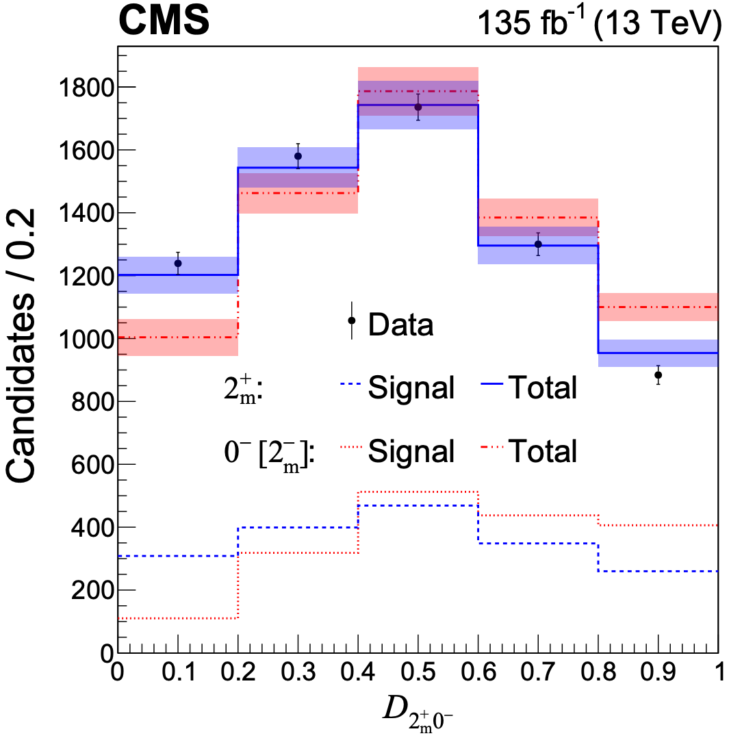
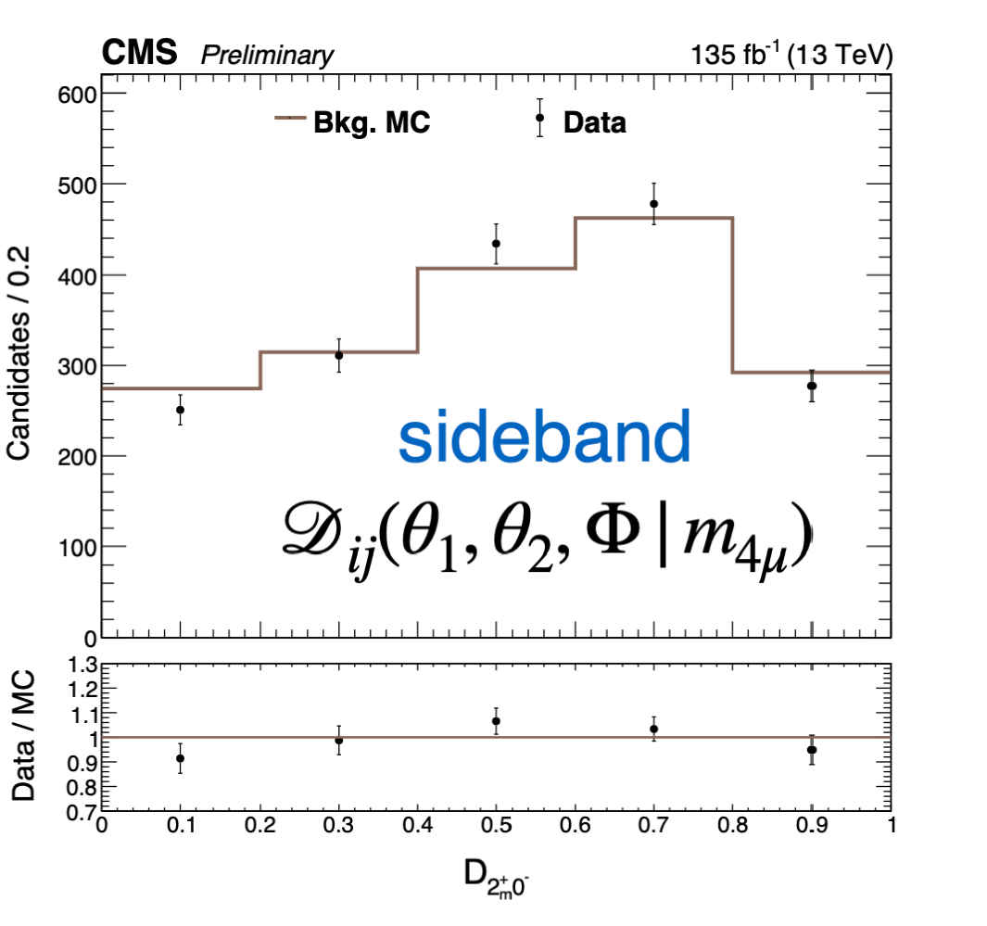





最优判别量
二维参数化：
最优判别量：
MC
Data
$$J^{P}=0^{−}$$
Data
边带区间
$$J^{P}=2^{+}$$
Nature 648 (2025) 58
二维分布$P(m, D)$的一维投影 $→$ 有限分辨能力
边带区间检验本底模型可靠性
10

Slide 11
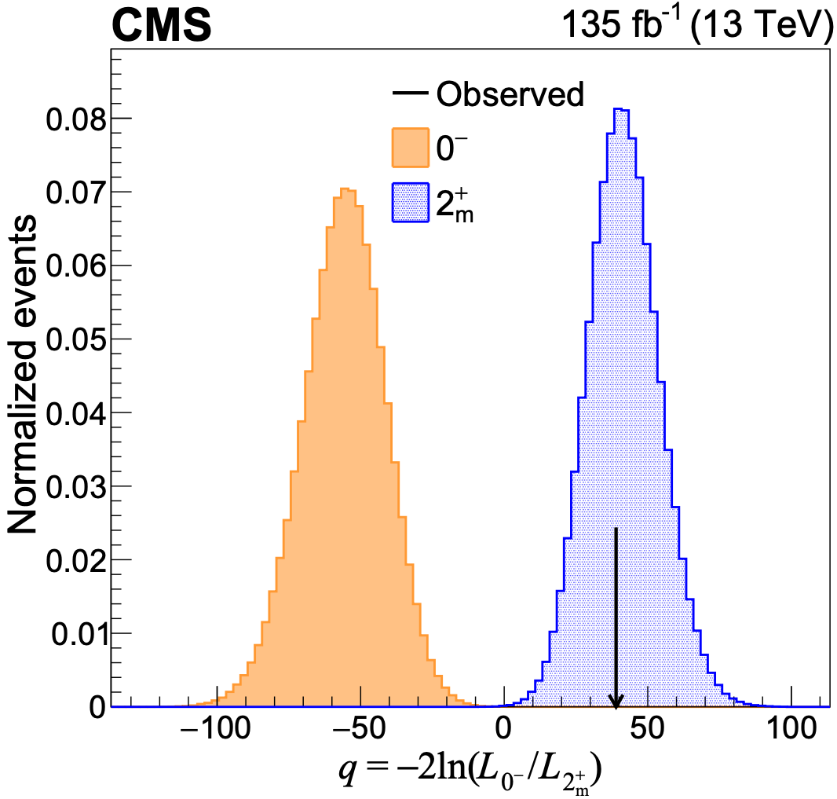
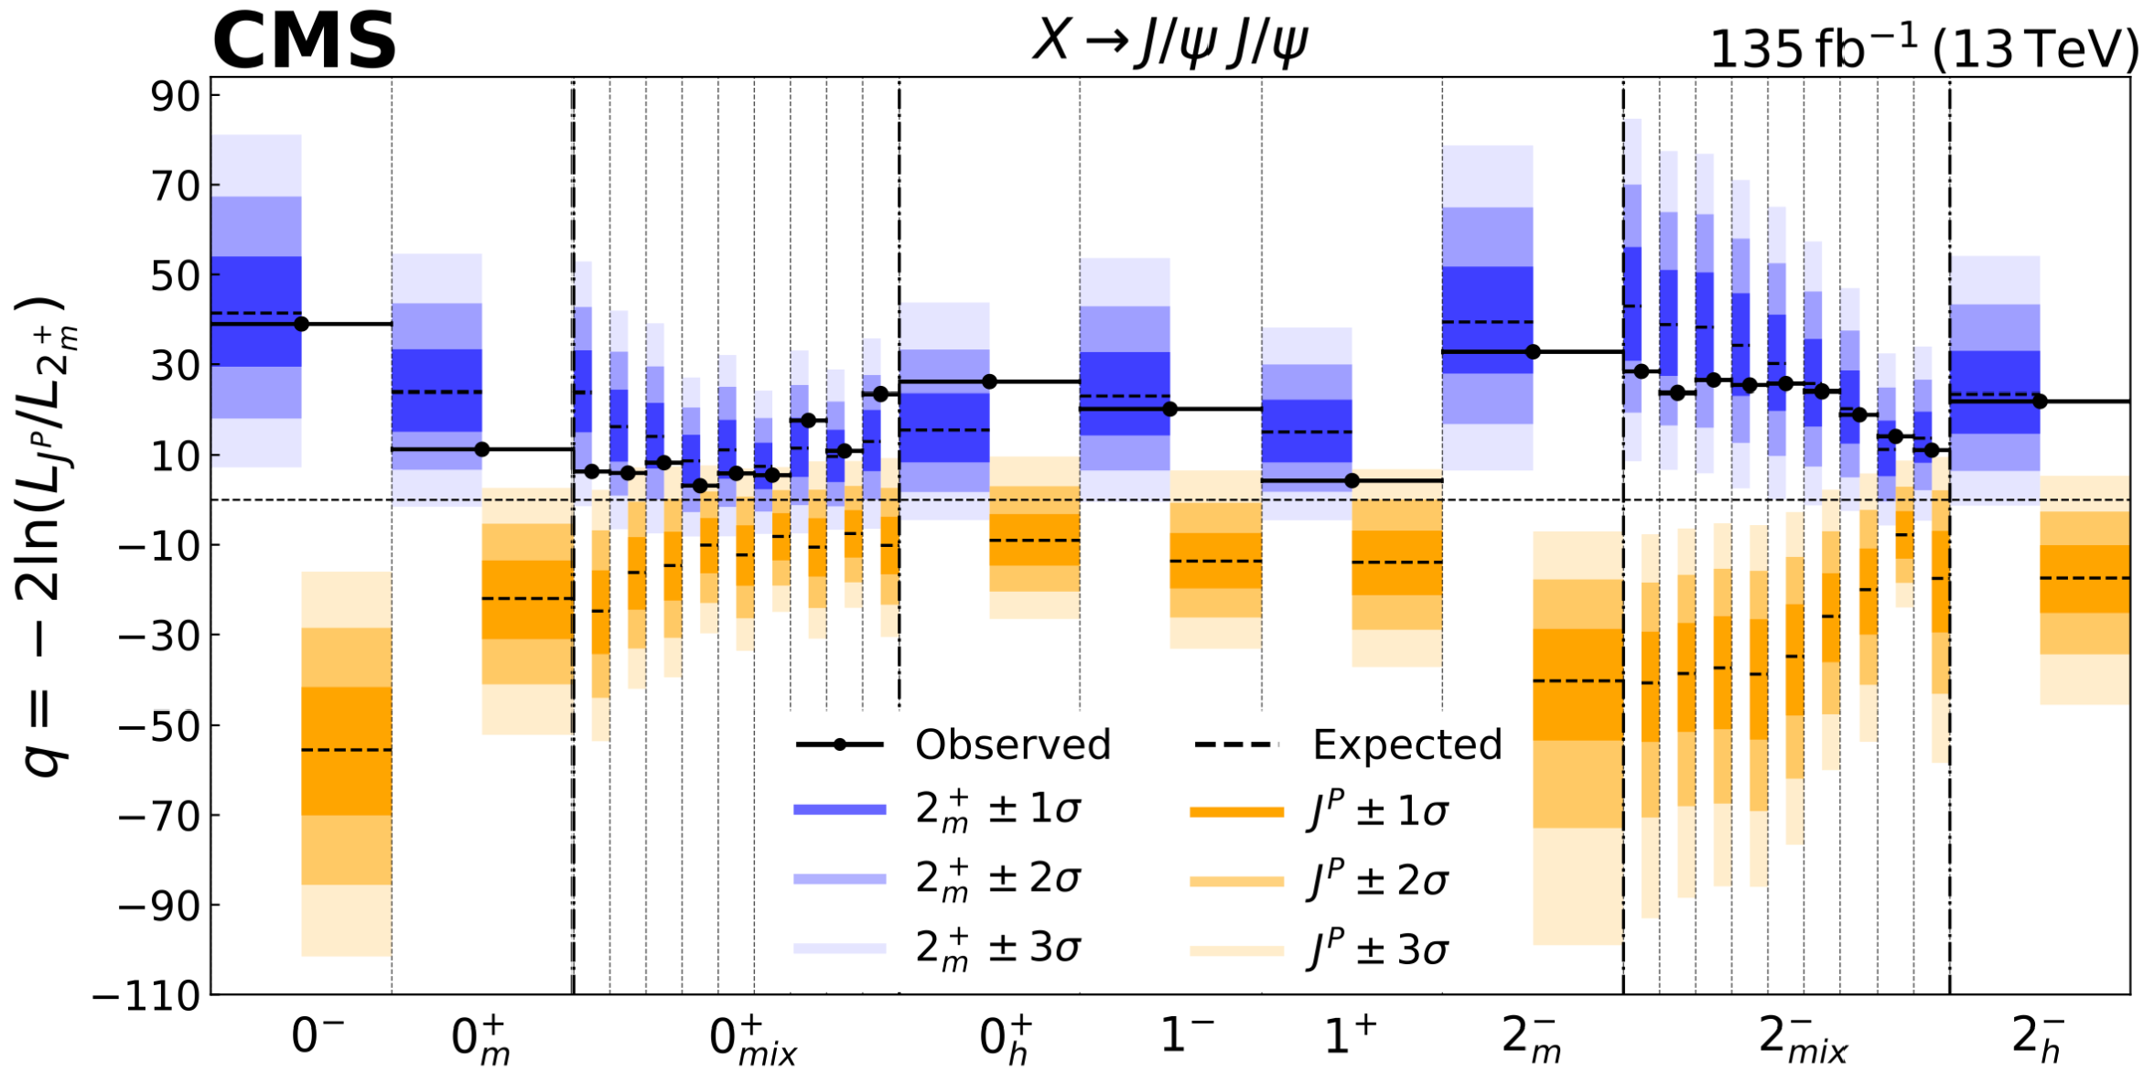


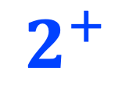
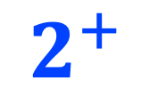

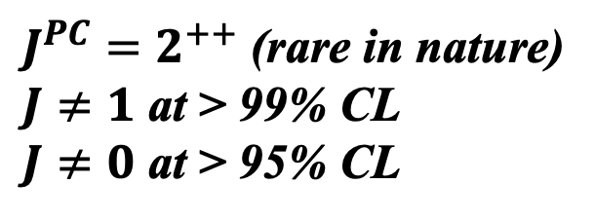
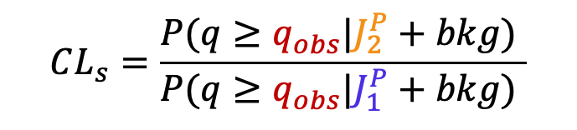
统计分析
假设检验
$$2^{+}$$
$$0^{−}$$
$$2^{+}$$
Toy generated based on hypo.
Data
Data
$$J^{P}$$
Nature 648 (2025) 58
检验统计量：$q=−2ln⁡(ℒ_{J_{2}^{P}}/ℒ_{J_{1}^{P}})$
$J^{PC}=2^{++}$ (rare in nature)
$J≠1$ at > 99% CL
$J≠0$ at > 95% CL
$$CL_{s}=\frac{P(q≥q_{obs}|J_{2}^{P}+bkg) }{P(q≥q_{obs}|J_{1}^{P}+bkg) }$$
11

Slide 12
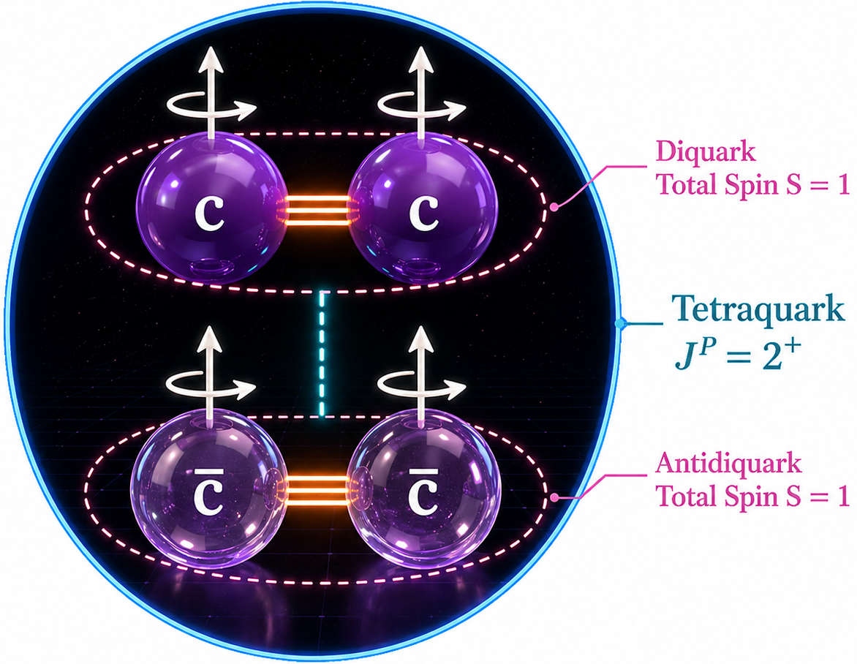
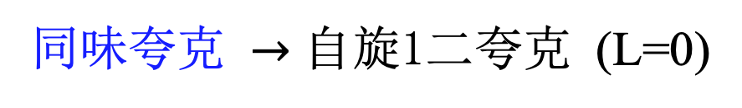
讨论—初步物理图像
Nature News and View (2025) Elena Santopinto:
“ This could be the beginning of a golden age of exotic-state research…. Although it does not rule out either theory, the 2⁺⁺ result favours the compact tetraquark rather than the loosely bound pair of mesons. … Studying exotic hadrons might improve scientists’ knowledge of the strong force. This knowledge, in turn, could help to explain how hadrons formed a few microseconds after the Big Bang; aid the development of accurate models of neutron stars; and help scientists to search for physics not described in the standard model. ”
同味夸克 $→$ 自旋1二夸克 (L=0)
12

Slide 13
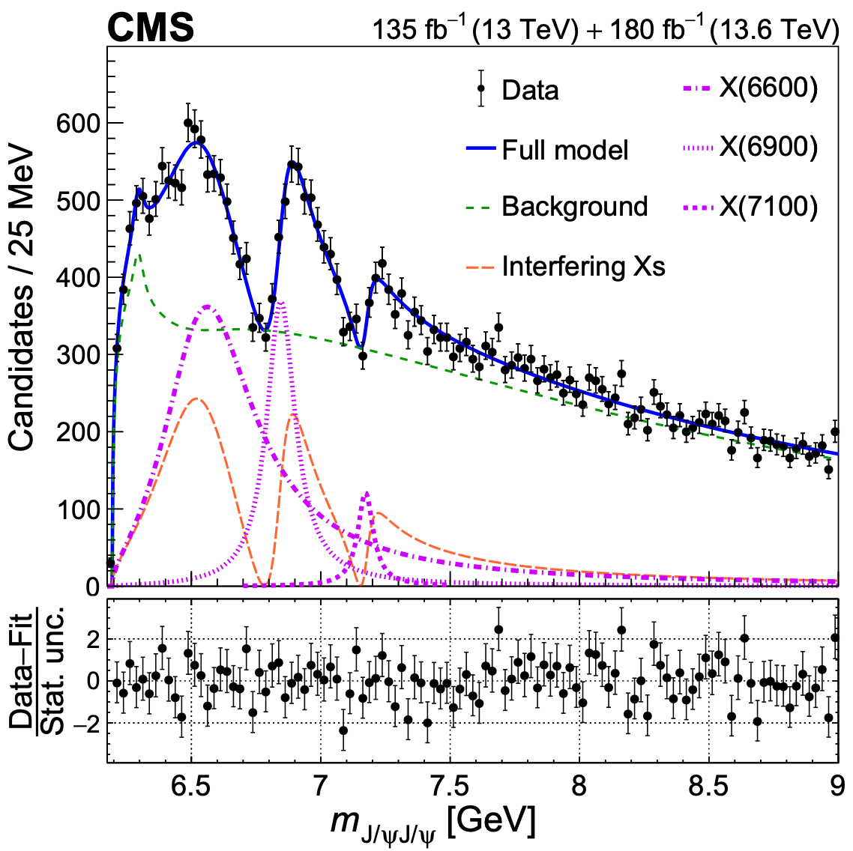
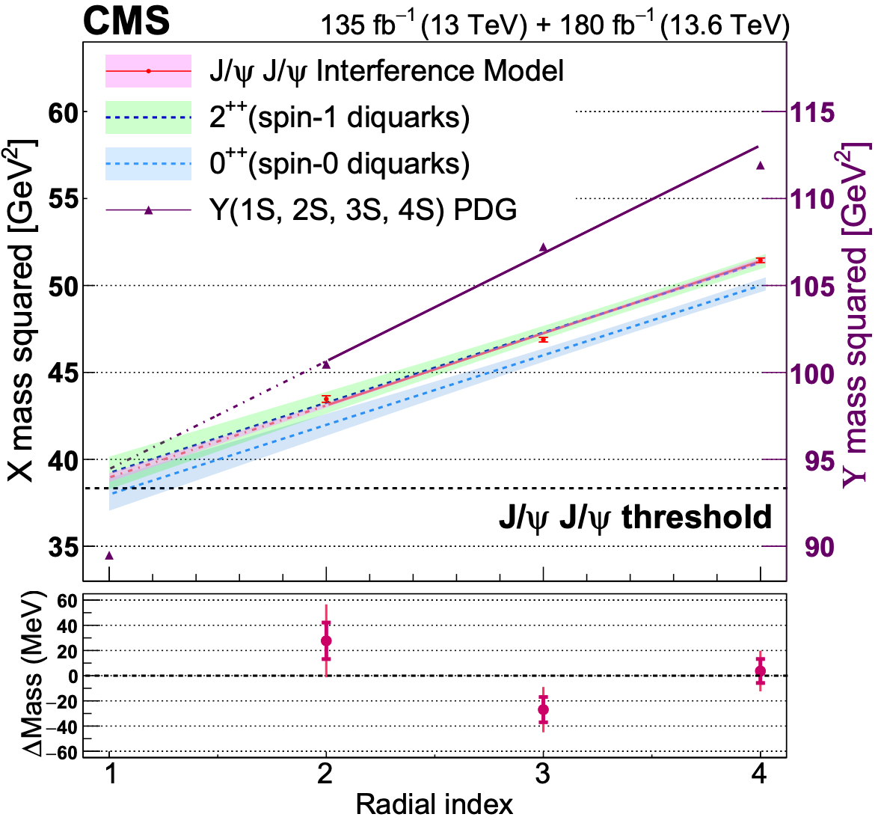
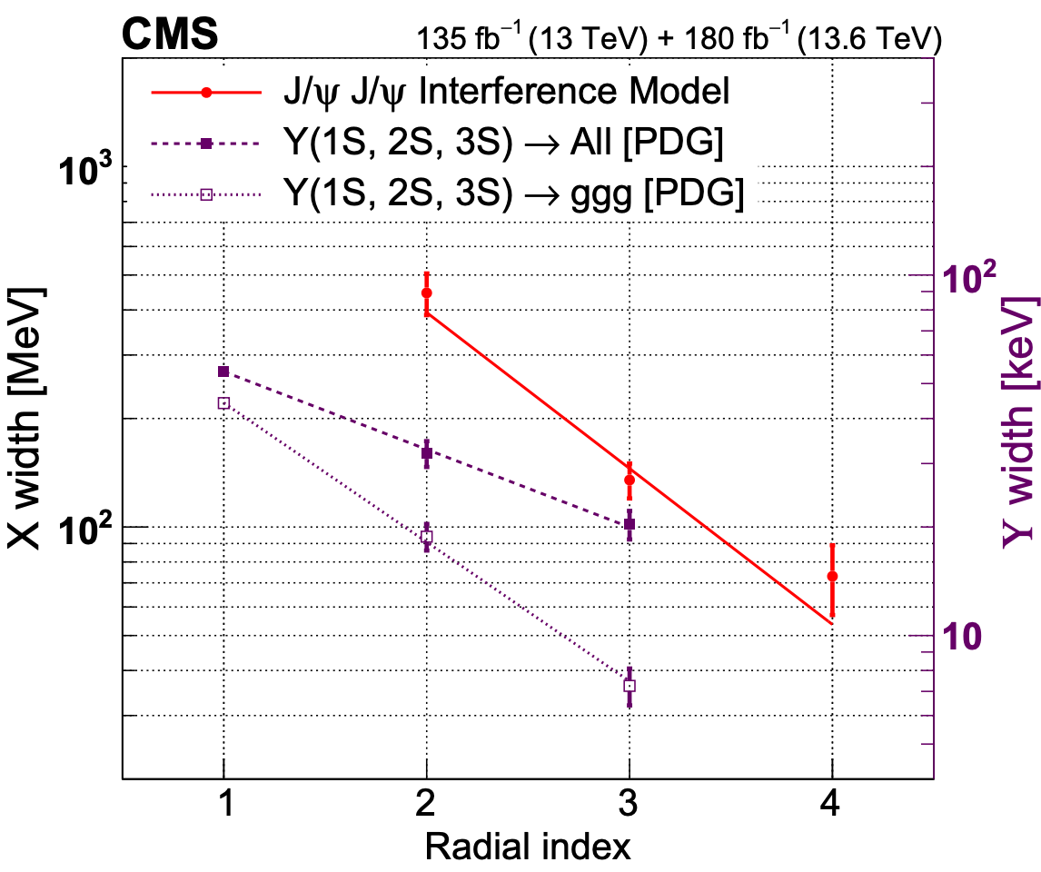



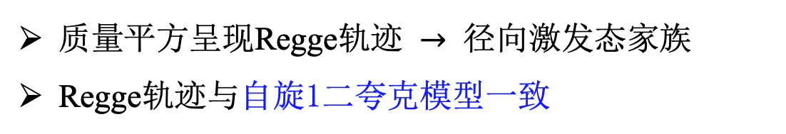
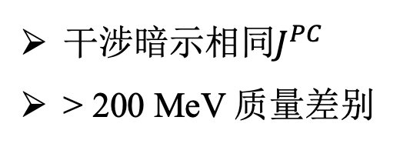
讨论—初步物理图像
X(6600)
X(6600)
X(6900)
X(7100)
$$Υ\left(1S\right)$$
X(7100)
X(6900)
X(6900)
X(6600)
$$Υ\left(2S\right)$$
X(7100)
$$Υ\left(3S\right)$$
arXiv:2602.02252, submitted to Science Advances
干涉暗示相同$J^{PC}$
> 200 MeV 质量差别
质量平方呈现Regge轨迹 $→$ 径向激发态家族
Regge轨迹与自旋1二夸克模型一致
13

Slide 14
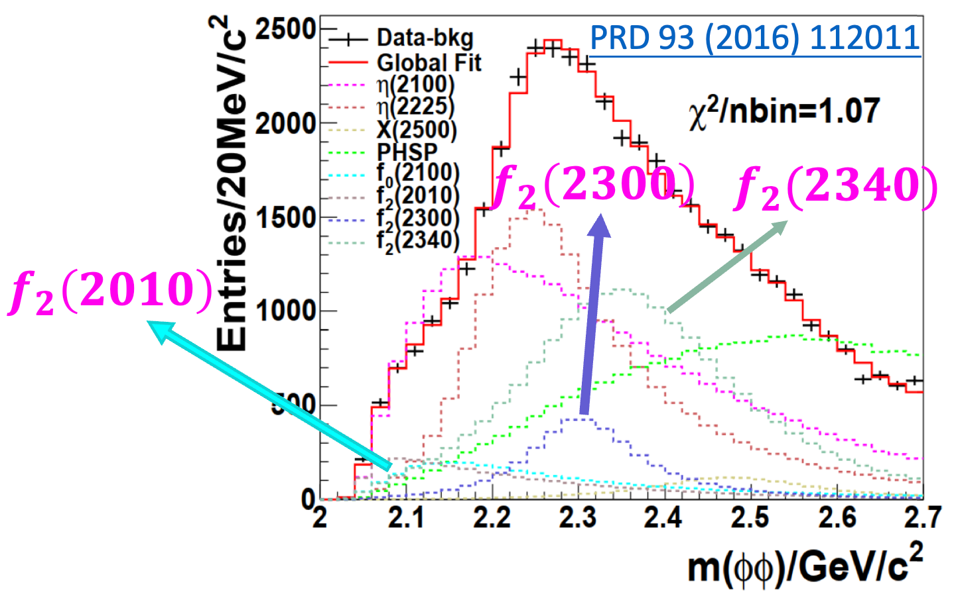
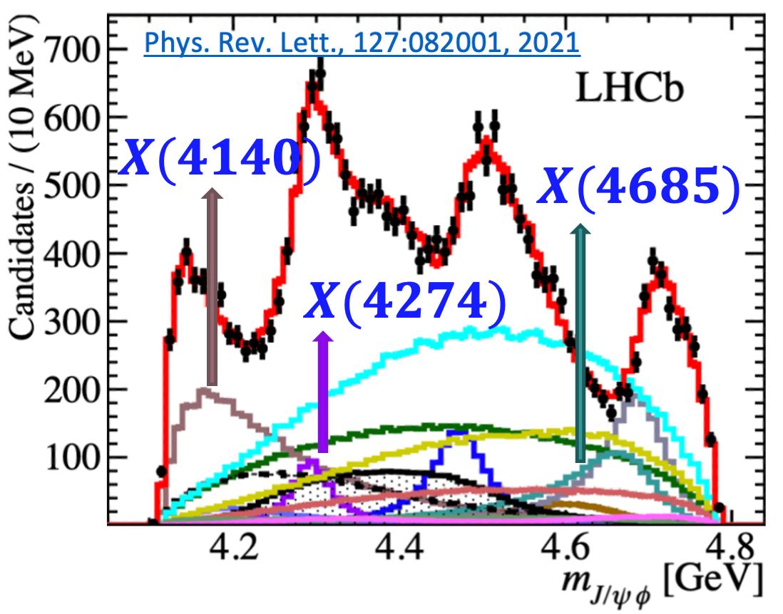
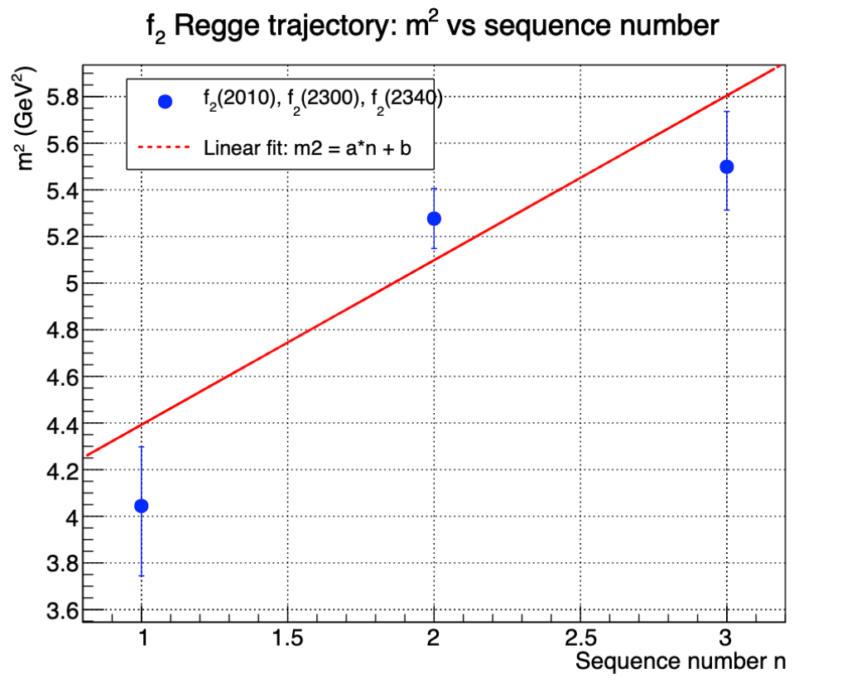
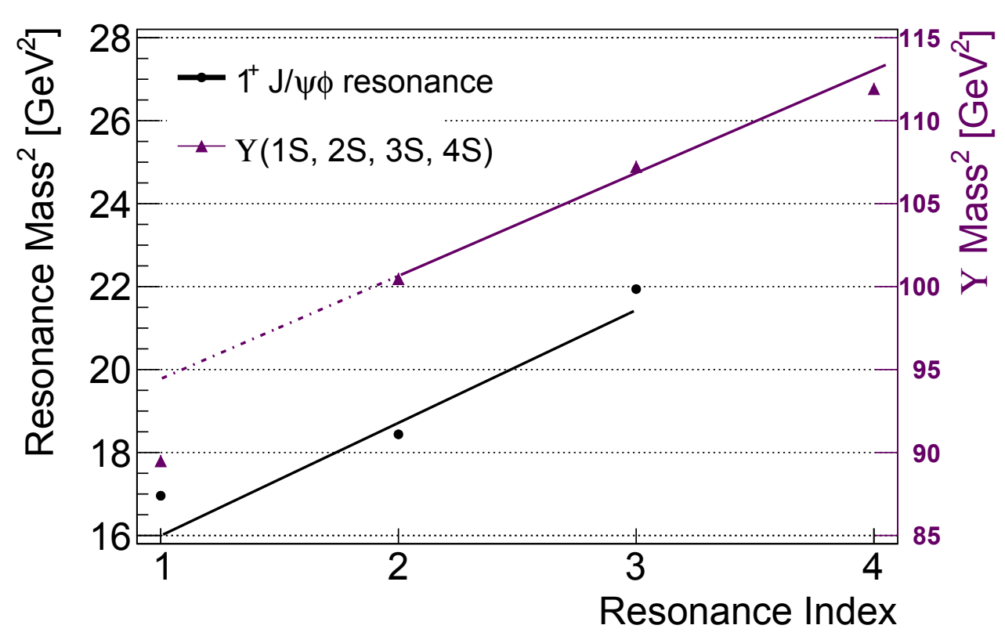






讨论—初步物理图像
arXiv:2602.02252
X(6600)
X(6900)
X(7100)
$J/ψJ/ψ$系统 $(J^{P}=2^{+})$
$φφ$系统 $(J^{P}=2^{+})$
$J/ψφ$系统 $(J^{P}=1^{+})$
$$f_{2}(2340)$$
X(7100)
X(6900)
$$f_{2}(2300)$$
X(4685)
X(6600)
X(4274)
$$f_{2}(2010)$$
X(4140)
Chin. Phys. Lett. 42 (2025) 120202
14

Slide 15








国内外媒体报道
15
https://cms.cern/news/cms-observes-potential-family-tetra-quark-states-composed-only-charm-quarks
https://www.natureasia.com/en/info/press-releases/detail/9171
https://www.nature.com/articles/d41586-025-03591-7
https://phys.org/news/2024-04-cms-collaboration-heavy-quark.html
https://news.njnu.edu.cn/info/1044/113117.htm
https://www.hepac.org.cn/hotattention_detail?type=1&id=151
http://digitalpaper.stdaily.com/http_www.kjrb.com/kjrb/html/2022-07/11/content_538336.htm?div=-1
https://epaper.gmw.cn/gmrb/html/2022-07/12/nw.D110000gmrb_20220712_1-08.htm
https://news.sciencenet.cn/sbhtmlnews/2022/7/370291.shtm
https://baijiahao.baidu.com/s?id=1738144380542647820
https://m.thepaper.cn/newsDetail_forward_18951763
https://mp.weixin.qq.com/s/ZowIHuzzcR8UIyE1wL0LdQ

Slide 16
国内外专家评价
在这个系统中，由于没有轻夸克组分，不太会形成‘常见’的通过交换轻介子而形成的分子态结构，从而给我们一个更为简单的物理图像帮助理解。
院士
赵光达
Studying exotic hadrons might improve scientists’ knowledge of the strong force. This knowledge, in turn, could help to explain how hadrons formed a few microseconds after the Big Bang; aid the development of accurate models of neutron stars; and help scientists to search for physics not described in the standard model.
Elena Santopinto
This observation opens up an important new field of doubly-heavy tetraquarks…
2007年樱井奖得主、斯坦福大学教授
Stanley Brodsky
The systems with four heavy quarks provide a laboratory to study their underlying dynamics, conceivably in the framework of non-relativistic QCD.
美国物理学会会士
韩涛
目前观测到的奇特强子态质量都靠近具有吸引力的一对强子的阈值，这表明这些奇特强子态都可能由强子分子态图像来描述。
院士
邹冰松
In particular, CMS groups from China made significant contributions to the CMS detector and took a leading role in this analysis, and I am looking forward to many important contributions from them.
该研究CMS内部评审主席
CMS合作组副发言人
Wolfgang Adam
In particular, the CMS groups from China have made a big difference by taking leading roles in these analyses.
其中一项分析的评审委员会主席
CMS合作组前发言人
Joel Butler
……30年以来，这是第一次由一个中国CMS团队主导发现新粒子。
中国科学院院士、
中国LHC项目的前负责人
陈和生
16

Slide 17



CMS B 物理组召集人对个人贡献的证明
关键个人贡献
前序新粒子发现及此分析主要完成人
  Phys. Rev. Lett. 132 (2024) 111901
  Nature 648 (2025) 58
率先开展自旋宇称测量可行性研究
构建全套分析体系，完成物理结果量化分析
负责合作组评审、关键节点汇报及文章撰写
... made significant contributions as a key contributor …
17

Slide 18


总结
新里程碑: 建立$J^{PC}=2^{++}$全粲四夸克态家族
  全重体系: 连接非微扰与微扰QCD之间的桥梁
  三重态家族：对区分理论模型提供更高鉴别度
  $J^{PC}$测量: 探测内部结构
    LHC首次瞬发奇特强子的$J^{PC}$测量
    在已确立(>5σ)的奇特强子中首个自旋2态
  理解奇特强子的新平台，勾勒出初步物理图像
18

Slide 19







讨论—Regge 轨迹
L=0
L=0
L=0
L=1
Many models predict individual tetraquark states, while few predict a family pattern
Available family-level predictions are compared
L=1
L=1
L=2
19

Slide 20



$J/ψ$ polarizations
20

Slide 21


Angular analysis
Valid
for any J
21

Slide 22

Lorentz-Invariant Amplitude
22

Slide 23

Lorentz-Invariant Amplitude
23

Slide 24







Statistical Analysis
Hypothesis test with toy MC for $J_{1}^{P}=$ $2_{m}^{+}$ vs $J_{2}^{P}=0^{−}$
Test statistic $q=−2ln⁡(ℒ_{J_{2}^{P}}/ℒ_{J_{1}^{P}})$
Consistency of data with $J_{1}^{P}/J_{2}^{P}$ using p-value:
  $$p=P(q≤q_{obs}|J_{1}^{P}+bkg)$$
  $$p=P(q≥q_{obs}|J_{2}^{P}+bkg)$$
Significance:
  Converted from p-value
  via Gaussian one-sided tail integral
Confidence level
$$0^{−}$$
$$2_{m}^{+}$$
observed $q_{obs}$
Nature 648 (2025) 58
$$CL_{s}=\frac{P(q≥q_{obs}|J_{2}^{P}+bkg) }{P(q≥q_{obs}|J_{1}^{P}+bkg) }$$
24

Slide 25









𝑱/𝝍𝑱/𝝍 --Data samples & Event selections at CMS
135 fb⁻¹ CMS data taken in 2016, 2017 and 2018 LHC runs
Blinded signal region: [6.2,7.8] GeV
based on preliminary investigation on data collected in 2011-2012
$$μ_{1}^{+}$$
  $p_{T}\left(μ\right)>2 GeV$ (2016) & $p_{T}\left(μ\right)>3.5 GeV$ (2017, 2018)
  $$\left|η\left(μ\right)\right|<2.4$$
  $2.95 GeV≤M\left(μ^{+}μ^{−}\right)≤3.25 GeV$, then constrain to J/𝝍 mass
  $$p_{T}\left(J/ψ\right)>3.5 GeV$$
  $$Soft Muon ID \left(very loose\right)$$
  $$Vertex Probability\left(μ^{+}μ^{−}μ^{+}μ^{−}\right)> 0.5\%$$
$$J/{ψ_{1}}$$
$$μ_{2}^{−}$$
$$X$$
$$μ_{3}^{+}$$
$$J/{ψ_{2}}$$
$$μ_{4}^{−}$$
Main selections:
    Fire corresponding trigger in each year & offline selection
    Multiple candidates’ treatment:
    Select best combination of same 4$μ$ (~0.2%) with
  $χ_{m}^{2}={\left(\frac{m_{1}\left(μ^{+}μ^{−}\right)−M_{J/ψ}}{σ_{m1}}\right)}^{2}+{\left(\frac{m_{2}\left(μ^{+}μ^{−}\right)−M_{J/ψ}}{σ_{m2}}\right)}^{2}$
    Keep all candidates arising from > 4$μ$(~0.2%)
Signal and background MC samples produced by Pythia8, JHUGen, HELAC-Onia…
25

Slide 26
Hard scattering process
Hadronization
FSR
Incoming proton
Incoming proton
ISR
26

Slide 27


Underlying event at the LHC
Underlying event: any hadronic activity not associated with hard scattering process
Contributions not always calculable in perturbative QCD, phenomenological models in MC, which must be tuned to data
Typically modelled with: MPI, ISR, FSR, beam remnants
27

