Slide 1
高能物理战略研讨会
基于HIAF高能核物理实验规划
-- From H-NS to EicC
July 14, 2026
许 怒
中国科学院近代物理研究所
华中师范大学
Nu Xu
May 16, 2022

Slide 2
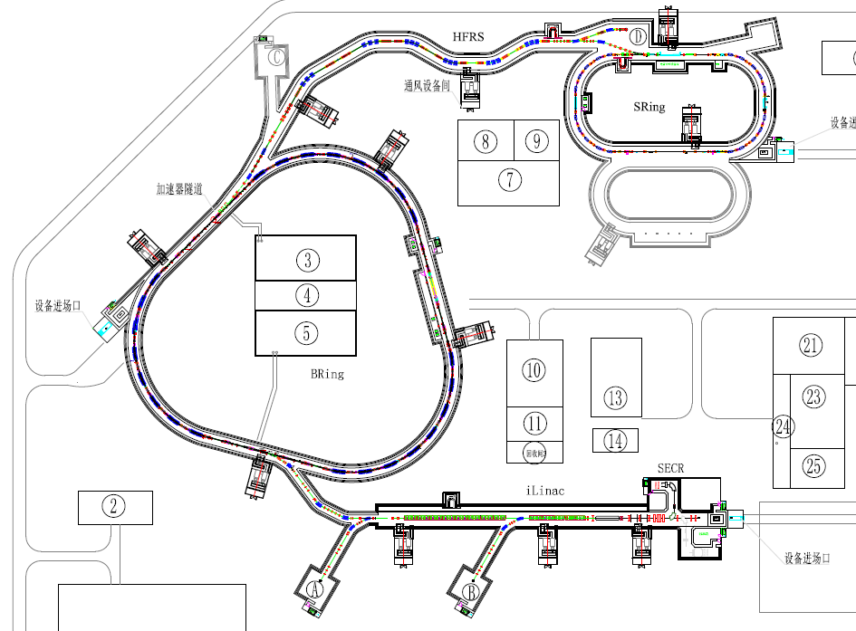

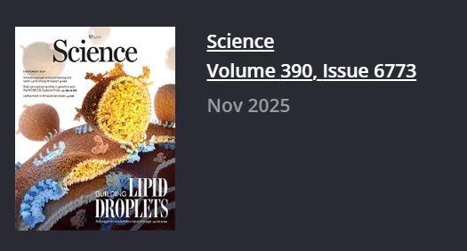

High Intensity heavy-ion Accelerator Facility
(HIAF, Huizhou, China)
② H.E. Terminal
④ E.T. Terminal
⑥ Mass Terminal
HIAF Physics：
Atomic physics;
Nuclear physics;
Applied research in biology and material science etc.
QCD
HFRS
③ RIB
Atomic Physics
HIAF Commission started in 2025
BRing
iLinac
SECR
HIAF
① L.E. Terminal

Slide 3
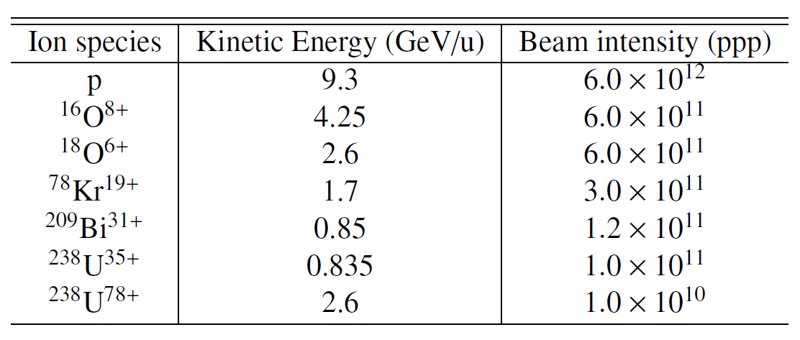
HIAF Beam Parameters

Slide 4
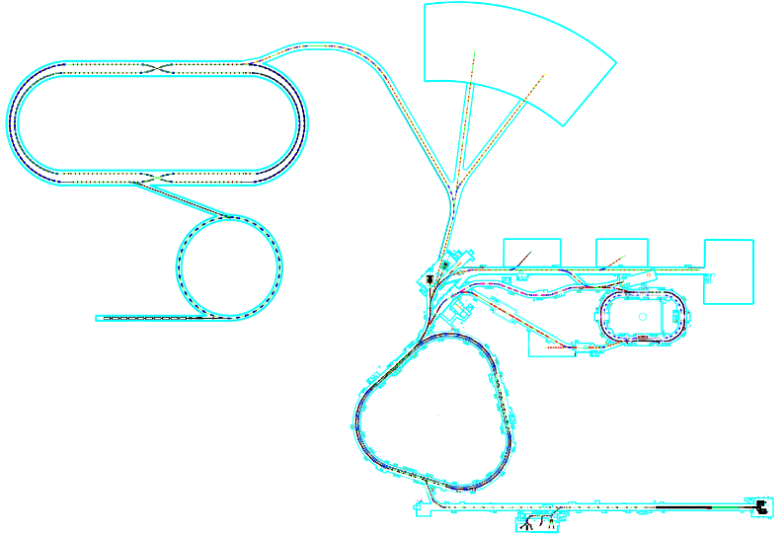
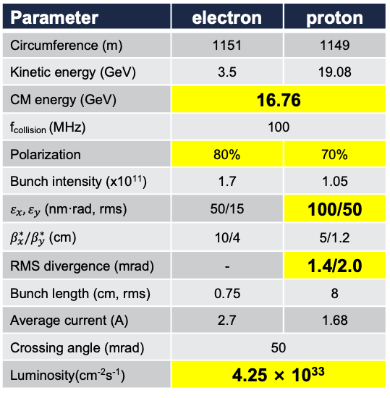
HIAF and Its Upgrade Plan
EicC
EicC 加速器设计参数
Muon physics and applications
Parameter | electron | proton
Circumference (m) | 1151 | 1149
Kinetic energy (GeV) | 3.5 | 19.08
CM energy (GeV) | 16.76
f_{collision} (MHz) | 100
Polarization | 80% | 70%
Bunch intensity (x10¹¹) | 1.7 | 1.05
$ε_{x},ε_{y}$ (nm·rad, rms) | 50/15 | 100/50
$β_{x}^{∗}/β_{y}^{∗}$ (cm) | 10/4 | 5/1.2
RMS divergence (mrad) | - | 1.4/2.0
Bunch length (cm, rms) | 0.75 | 8
Average current (A) | 2.7 | 1.68
Crossing angle (mrad) | 50
Luminosity(cm⁻²s⁻¹) | 4.25 × 10³³
Collider ring ~1149 m
Muon physics and applications
Electron ring ~287.80 m
2.8 - 5 GeV
H-NS
eLinac
HIAF
BRing_N
BRing_S
p beam up to 25 GeV
Phase0: Nuclear physics
Phase1: HIAF-U for applied
sciences
Phase2: EicC

Slide 5
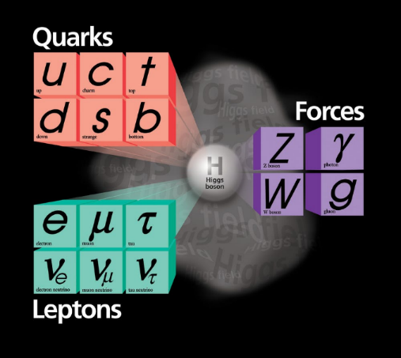
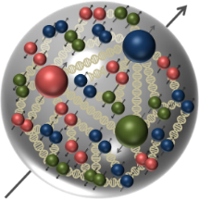



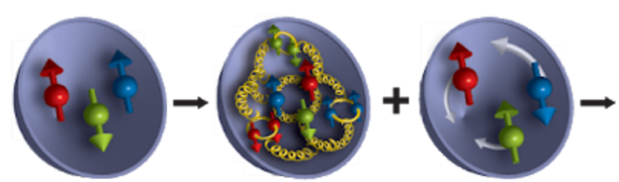
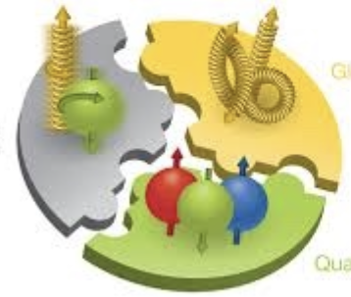

Understand Visible Matter: 核子内部结构
5
质子自旋结构？
可见物质
质子质量起源？
自旋
质量
Higgs mechanism
Gell-Mann
夸克模型
Dynamics of gluons
~99%
质子质量
夸克质量~1%
质子质量

Slide 6

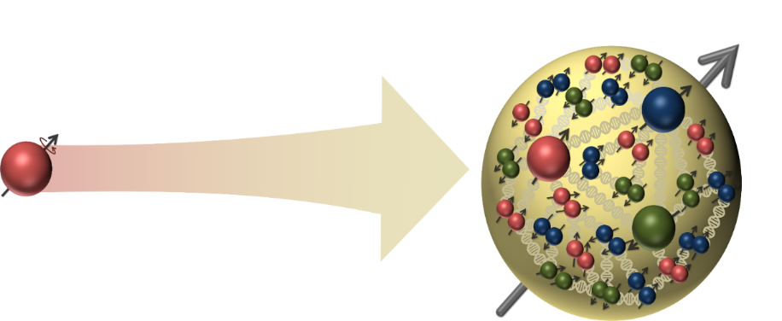
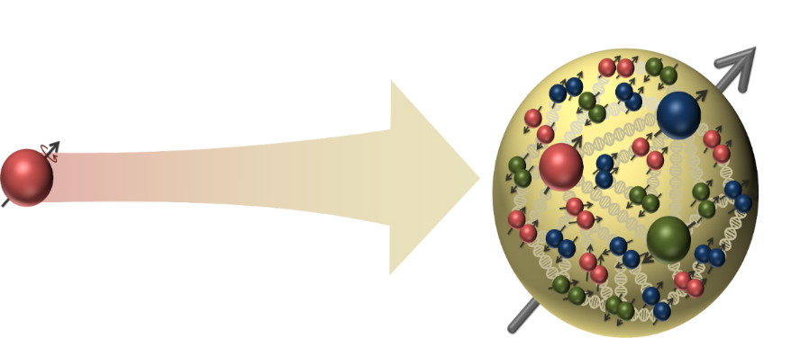

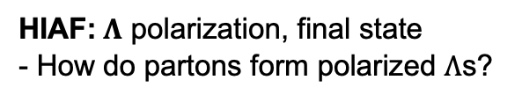
Hadron Structure with “Spin”
EIC: Initial state is polarized
- How do partons form polarized nucleons?
HIAF: $Λ$ polarization, final state
- How do partons form polarized $Λ$s?
Final state
Initial state created by accelerator
$Λ$ serves as its own spin analyzer through the decay $Λ^{0}→p+π^{−}$
Origin of nucleon spin may well related to the origin of the $Λ$ polarization

Slide 7
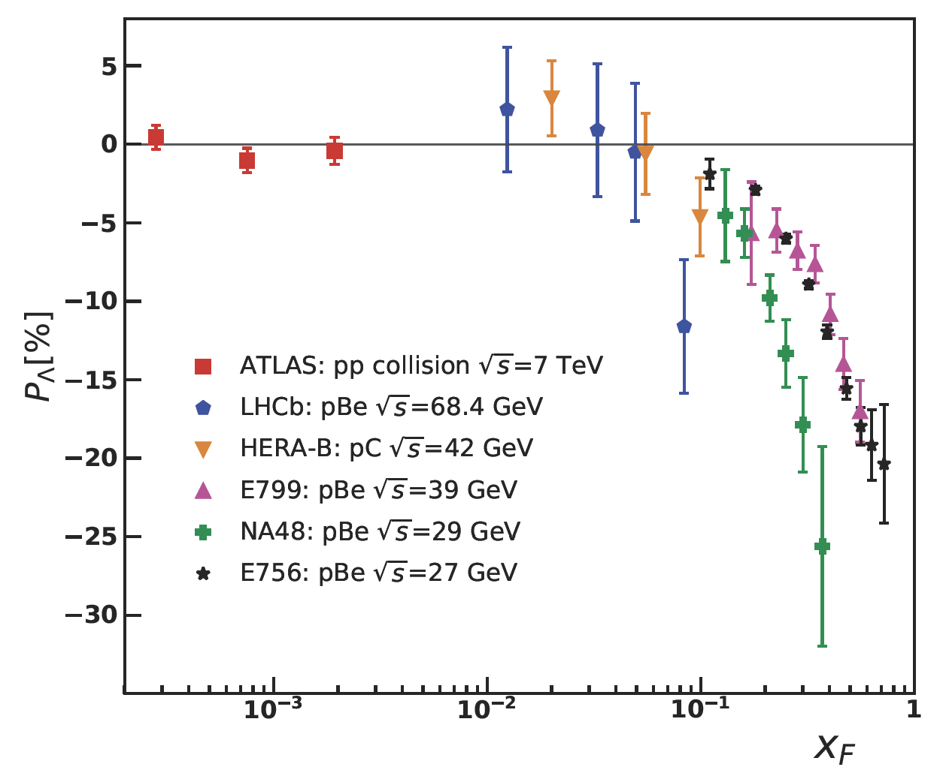
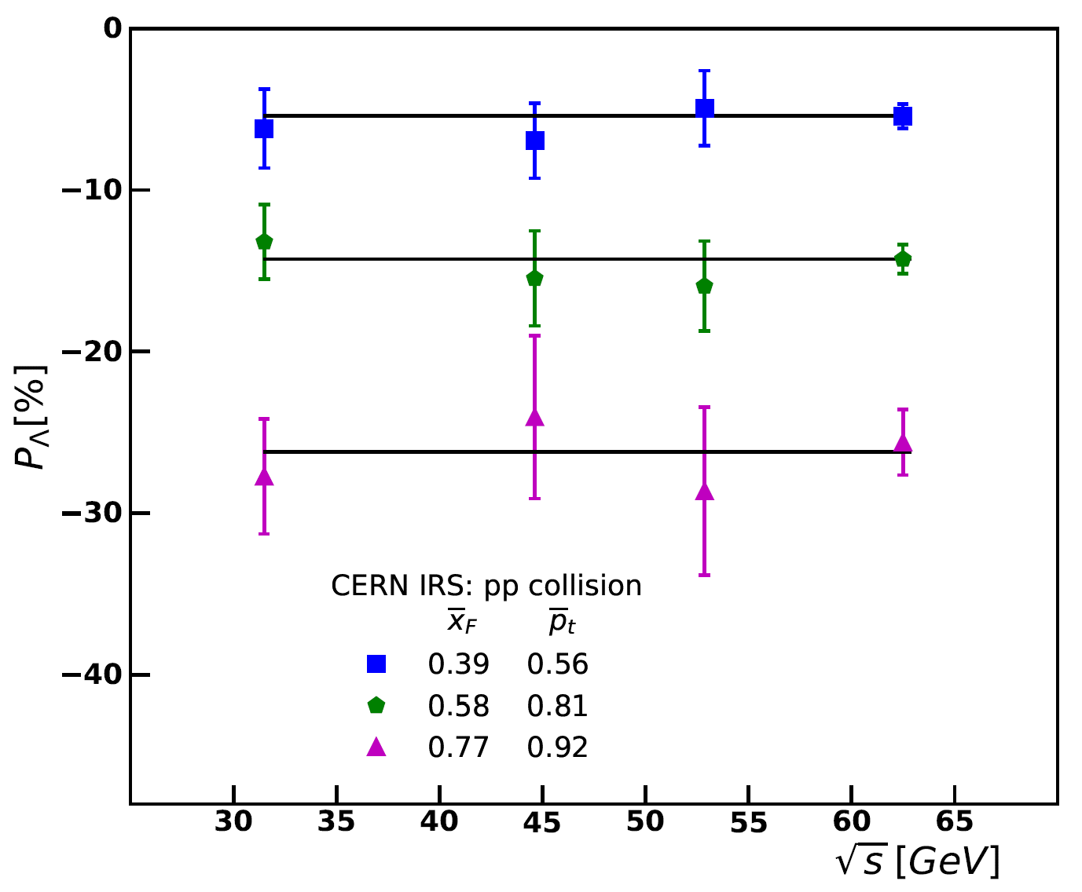
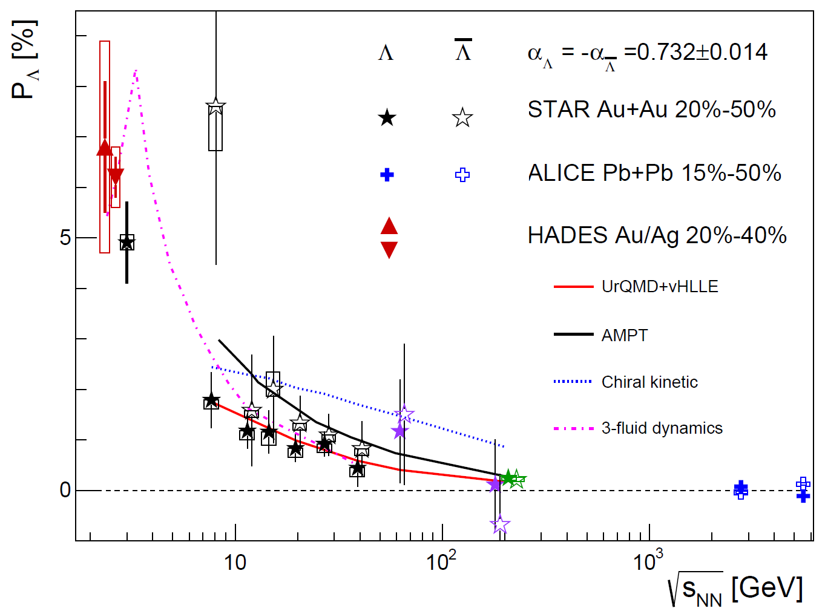


早期$Λ$极化实验研究
$Λ$production plane (p+A)
Event plane (A+A)
极化信号显著
是HIAF覆盖的区域
能量依赖展现出 “scaling” 现象 (?)
重离子反应中的整体极化效应
HIAF覆盖能区信号显著

Slide 8
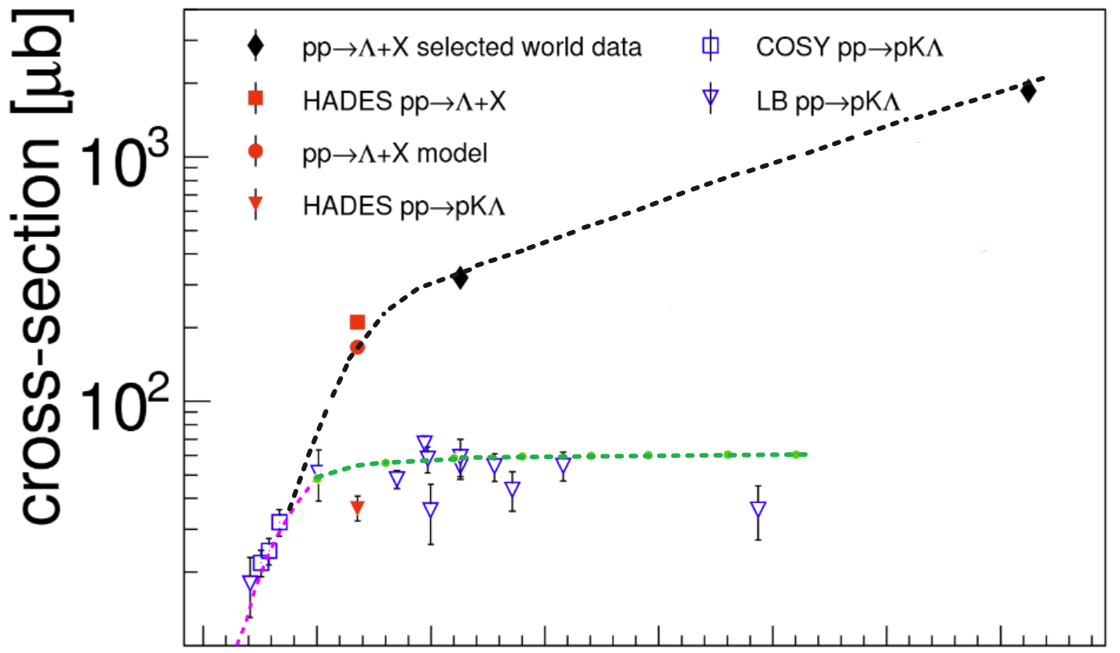
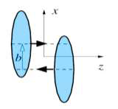
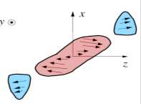

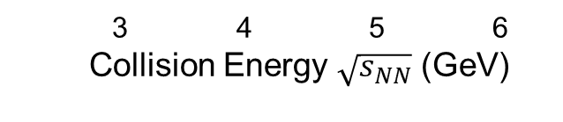



$Λ$ Production and Polarization
p + p (A) $→Λ+X$
Polarization puzzle:
ZT Liang, and C. Boros, PRL79, 3608 (1997); PRD61, 117503 (2000). H Dong and ZT Liang, PRD70, 014019 (2004); PRD72, 033006 (2005).
(2) p + p $→Λ+K+p$
Exclusive Process:
R Machleidt, K Holinde and C Elster, Phys. Rept.149, 1 (1987). BC Liu, BS Zou, PRL96, 042002 (2006).
HIAF
HIAF-U
3 4 5 6
Collision Energy $\sqrt{s_{NN}}$ (GeV)
(3) A + A$→Λ+X$
Vorticity created in
non-central heavy-ion
collisions
Global Polarizations:
ZT Liang, XN Wang, PRL94,102301 (2005); PLB629, 20 (2005). JH Gao, et al., PRC77, 044902 (2008).

Slide 9
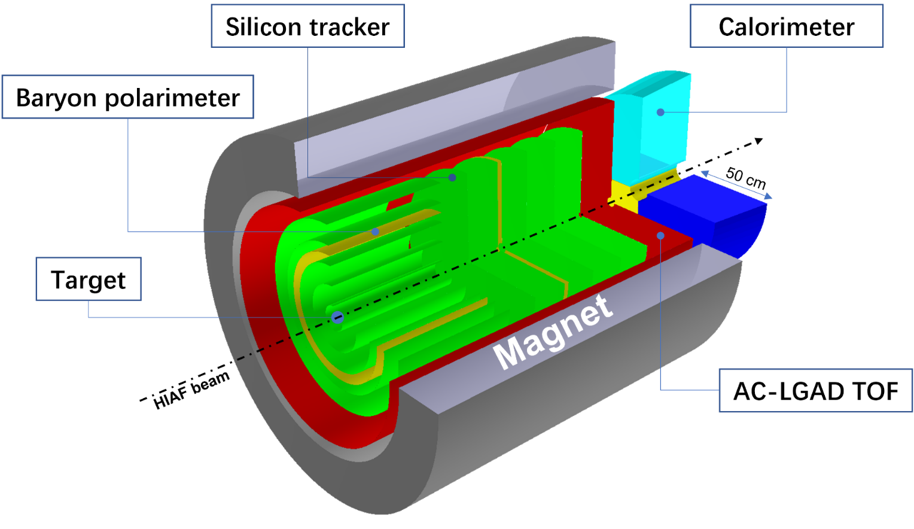
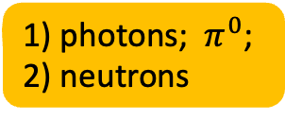
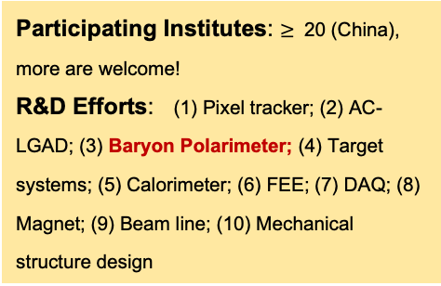
超子-核子谱仪 (H-NS) 概念设计
photons; $π^{0}$;
neutrons
Participating Institutes: $≥$ 20 (China), more are welcome!
R&D Efforts: (1) Pixel tracker; (2) AC-LGAD; (3) Baryon Polarimeter; (4) Target systems; (5) Calorimeter; (6) FEE; (7) DAQ; (8) Magnet; (9) Beam line; (10) Mechanical structure design
H-NS
H-NS
H-NS

Slide 10
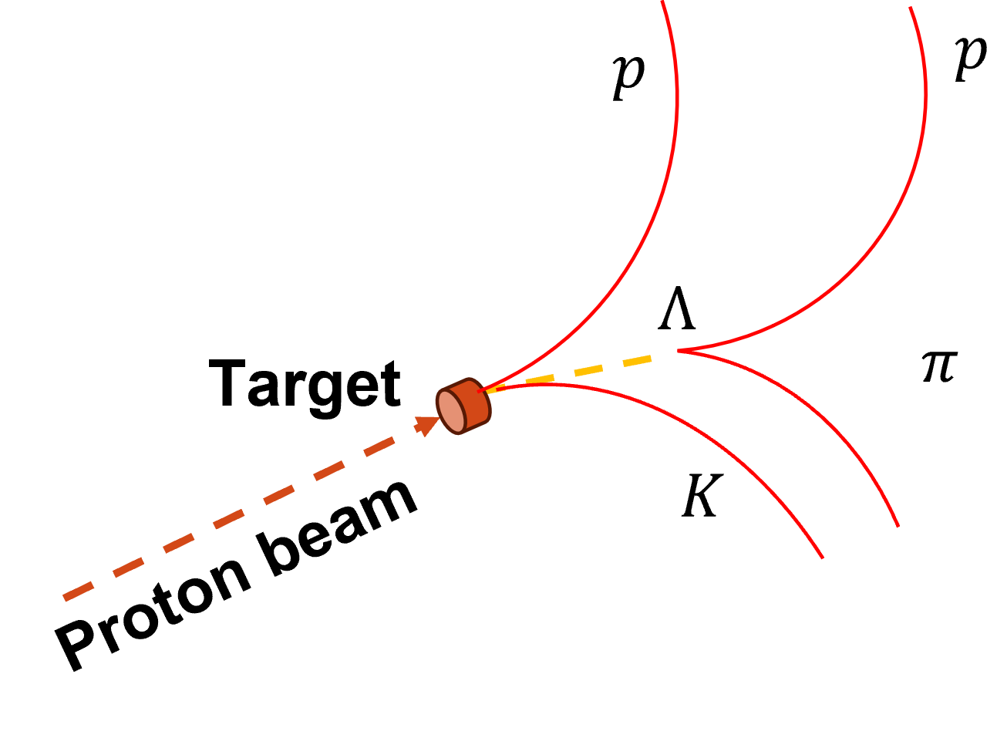
Is Proton Polarized ?
pp → p K Λ
Polarized?
Polarized?
pp → p/Λ + X
H-NS上专门设计了探测器直接测量质子极化

Slide 11
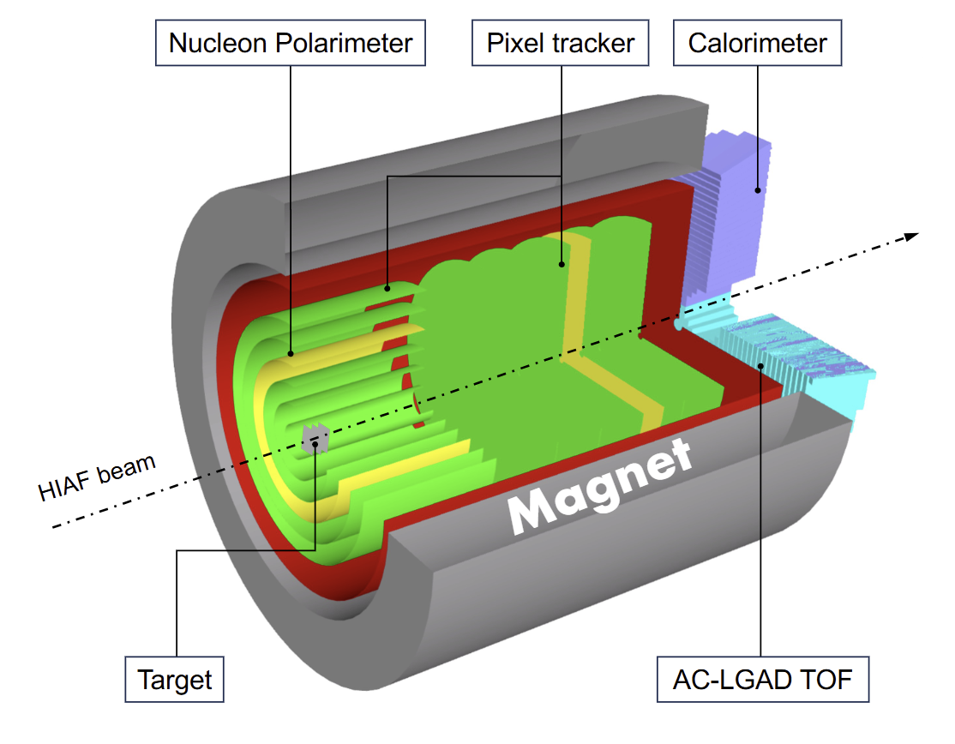
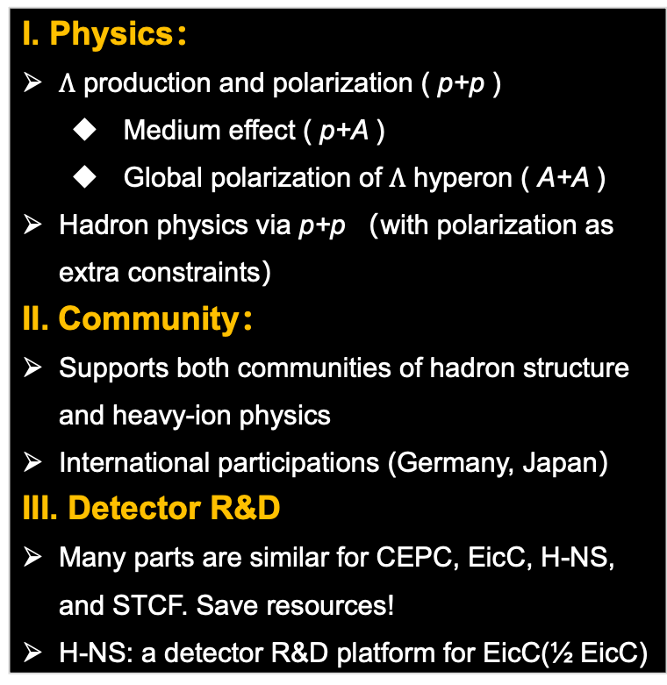
Hyperon-Nucleon Spectrometer
I. Physics：
$Λ$ production and polarization ( p+p )
  Medium effect ( p+A )
  Global polarization of $Λ$ hyperon ( A+A )
  Hadron physics via p+p （with polarization as extra constraints）
II. Community：
Supports both communities of hadron structure and heavy-ion physics
International participations (Germany, Japan）
III. Detector R&D
Many parts are similar for CEPC, EicC, H-NS, and STCF. Save resources!
H-NS: a detector R&D platform for EicC(½ EicC)
Participating Institute（目前21家单位）：北京航空航天大学、北京师范大学、复旦大学、高能物理研究所、国科大、河南师范大学、湖州师范学院、华东师范大学、华南师范大学、华中师范大学、近代物理研究所、理论物理所、南开大学、清华大学、山东大学、香港中文大学（深圳）、中国原子能研究院、郑州大学、中科大、中山大学…
Subsystems：Silicon tracker, T0+AC-LGAD, Target, Nucleon polarimeter, Calorimeter, Electronics, DAQ, Magnet, Beamline, Detector control system, Mechanics + Engineering …
H-NS 白皮书：2606.06553

Slide 12
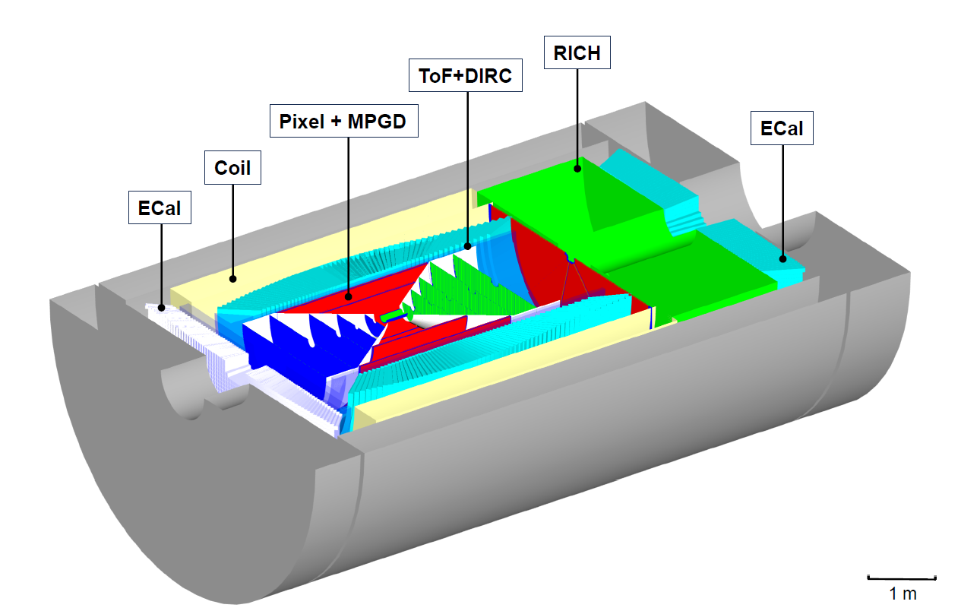
H-NS探测器 = ½ EicC探测器
H-NS
EicC

Slide 13
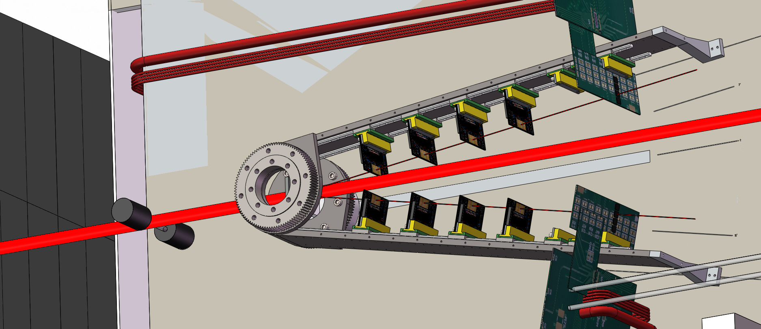
H-NS ➔ EicC
18 | 19 | 20 | 21 | 22 | 23 | 24 | 25 | 26 | 27 | 28 | 29 | 30 | 31 | 32 | 33 | 34 | 35 | 36 | 37 | 38 | 39 | 40
十三五 |  |  | 十四五 |  |  |  |  | 十五五 |  |  |  |  | 十六五 |  |  |  |  | 十七五
HIAF
HIAF-U
Accelerator
EicC
CEE@CSR
H-NS DEMO
H-NS construction
H-NS run
Detector
EicC
完成谱仪小样机
推动基于HIAF大科学装置上强相互作用物理可持续性、世界一流研究

Slide 14
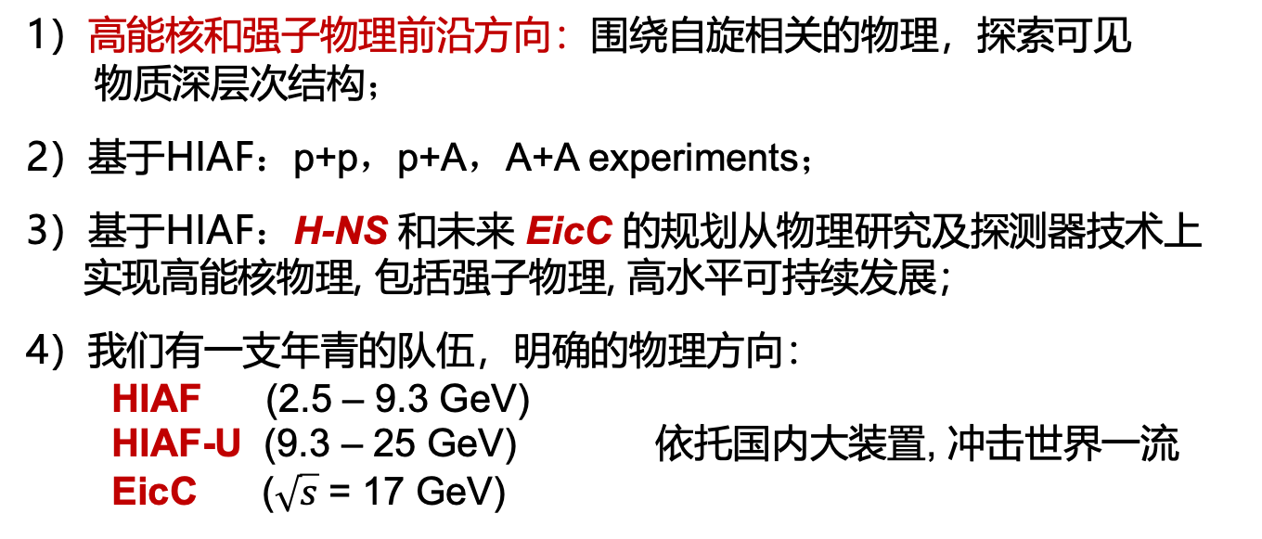
小结
超子-核子谱仪 (H-NS) ➔ 中国电子-离子对撞机 (EicC)
1）高能核和强子物理前沿方向：围绕自旋相关的物理，探索可见
物质深层次结构；
2）基于HIAF：p+p，p+A，A+A experiments；
3）基于HIAF：H-NS 和未来 EicC 的规划从物理研究及探测器技术上
实现高能核物理, 包括强子物理, 高水平可持续发展；
4）我们有一支年青的队伍，明确的物理方向：
HIAF (2.5 – 9.3 GeV)
HIAF-U (9.3 – 25 GeV) 依托国内大装置, 冲击世界一流
EicC ($\sqrt{s}$ = 17 GeV)

Slide 15
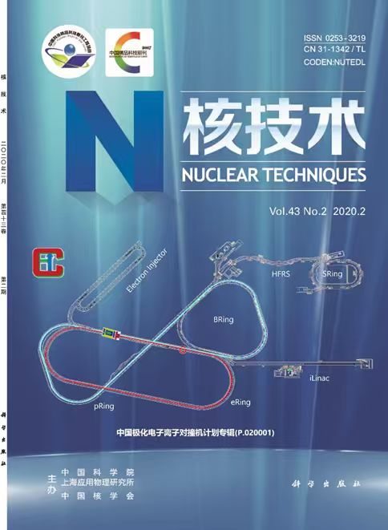
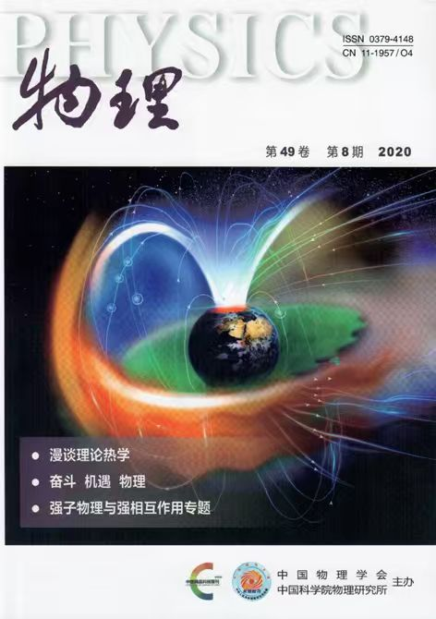
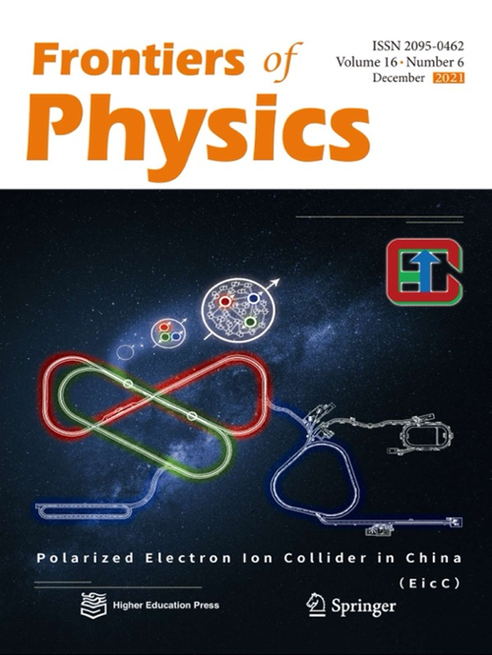
Publications
EicC | H-NS
EicC白皮书：Frontiers of Physics, Volume16, Issue 6 (2021) | H-NS 白皮书：2606.06553
科普专题：《物理》第49卷，第8期 （2020） | H-NS重子极化仪：Phys. Rev. D 112, L031502, 2512.02804, 2601.21325
中文白皮书：《核技术》第43卷，第2期 （2020）
中文综述：《中国科学》第50卷，第11期 （2020）
EicC概念设计报告：Frontiers of Physics（Volume-I: 加速器 Volume-II: 物理和探测器）, 待发表
英文综述：Progress in Particle and Nuclear Physics，待发表

Slide 16
Publications （H-NS 白皮书）
Xiaozhi Bai, Xu Cao, Zhe Cao, Jinhui Chen, Kai Chen, Qibo Chen, Shi Chen, Xin Chen, Yuquan Chen, Zhenyu Chen, Jianping Dai, Heng-Tong Ding, Dongshuo Du, Shuxian Du, Limin Duan, Zhe Duan, Anhui Feng, Jie Feng, Yicheng Feng, Jinlin Fu, Xiaofeng Fu, Chaosong Gao, Liang Ge, Wenwen Ge, Lisheng Geng, Boxing Gou, An Gu, Yinghui Guan, Yutian Guan, Aiqiang Guo, Fengkun Guo, Lu Guo, Hao Han, Weijia Han, Yunxiang Hao, Wanbing He, Xionghong He, Zhixuan He, Defu Hou, Tingting Hou, Jinniu Hu, Shouyang Hu, Zhen Hu, Fei Huang, Kaixuan Huang, Linqin Huang, Mei Huang, Xuguang Huang, Yuanjing Ji, Xincai Kang, Jie Kong, Cheng Li, Demin Li, Haibo Li, Jibo Li, Lixuan Li, Min Li, Peilian Li, Peiyu Li, Ronghua Li, Suxian Li, Weilong Li, Wuyuan Li, Xin Li, Xiaomei Li, Xiaqing Li, Yang Li, Yangu Li, Yutie Liang, Zheng Liang, Zuotang Liang, Chuangxin Lin, Dexu Lin, Shoulong Lin, Ting Lin, Bo Liu, Bo-Chao Liu, Feng Liu, Hang Liu, Hongna Liu, Hui Liu, Kai Liu, Liuming Liu, Qian Liu, Tianbo Liu, Tong Liu, Xiang Liu, Yanwen Liu, Pengzhong Lu, Weijian Lu, Xiaofeng Luo, Xiao-Rui Lyu, Bo-Qiang Ma, Jianping Ma, Kuo Ma, Weihu Ma, Yugang Ma, Lijun Mao, Ruishi Mao, Yu Meng
, Norihito Muramatsu, Maowu Nie, Xiaoyang Niu, Hua Pei, Ronggang Ping, Shi Pu, Tianlei Pu, Cheng Qian, Wenbin Qian, Yi Qian, Guangyou Qin, Jiajun Qin, Cong-Feng Qiao, Zan Ren, Dingyu Shao, Qianshun She, Diyu Shen, Guodong Shen, Wenhan Shen, Xiaomin Shen, Lina Sheng, Shusu Shi, Jinxing Song, Qintao Song, Yuan Song, Zihe Su, Baohua Sun, Hao Sun, Kai-Jia Sun, Liangting Sun, Peng Sun, Pengfei Sun, Xiangming Sun, Xu Sun, Yelei Sun, Zhipeng Sun, Zhiyu Sun, Shuwen Tang, Zebo Tang, Jing Tian, Ye Tian, Yu Tian, Yapeng Wan, Boqun Wang, Changxin Wang, En Wang, Enke Wang, Haozhen Wang, Hulin Wang, Jiansong Wang, Ling Wang, Qun Wang, Tianao Wang, Xiangang Wang, Xiang-Peng Wang, Xiaoyu Wang, Xinyu Wang, Xiongfei Wang, Xiuhua Wang, Yaping Wang, Shuyi Wei, Xianglun Wei, Xiangjie Wen, Fengjun Wu, Jia-jun Wu, Xin Wu, Bowen Xiao, Le Xiao, Zhigang Xiao, Guannan Xie, Yaping Xie, Hongxi Xing, Weizhi Xiong, Ji Xu, Lailin Xu, Nu Xu, Qinghua Xu, Xiaowei Xu, Junwei Yan, Wenbiao Yan, Wencheng Yan, Xiaoyu Yan, Bo Yang, Chi Yang, Haibo Yang, Herun Yang, Jiancheng Yang, Qian Yang, Shuai Yang, Tongjun Yang, Yadong Yang, Yuansheng Yang, Yuna Yang, Zaochen Ye, Zhihong Ye, Li Yi, Hang Yin, Junhao Yin, Yi Yin, Kejie You, Zhengyun You, Chunxu Yu, Yuhong Yu, Zhaoyang Yuan, Wangmei Zha, Honglin Zhang, Jianyu Zhang, Jin Zhang, Jinlong Zhang, Jinqun Zhang, Shisheng Zhang, Weibin Zhang, Xiang Zhang, Xueheng Zhang, Yapeng Zhang, Yateng Zhang, Yifei Zhang, Yumei Zhang, Yuqiao Zhang, Zhe Zhang, He Zhao, Hongyun Zhao, Lei Zhao, Yuxiang Zhao, Zhengguo Zhao, Yajun Zheng, Yangheng Zheng, Zhiyang Zheng, Daicui Zhou, Jian Zhou, Jiangpeng Zhou, Jing Zhou, Kai Zhou, Xianrong Zhou, Xiaorong Zhou, Yiyu Zhou, Sitao Zhu, Xiao Zhuang, Xinyu Zong, Bingsong Zou
(collapse list)

Slide 17
谢谢支持！

Slide 18
