Slide 1
Group Meeting
邹世明
2026/01/16

Slide 2
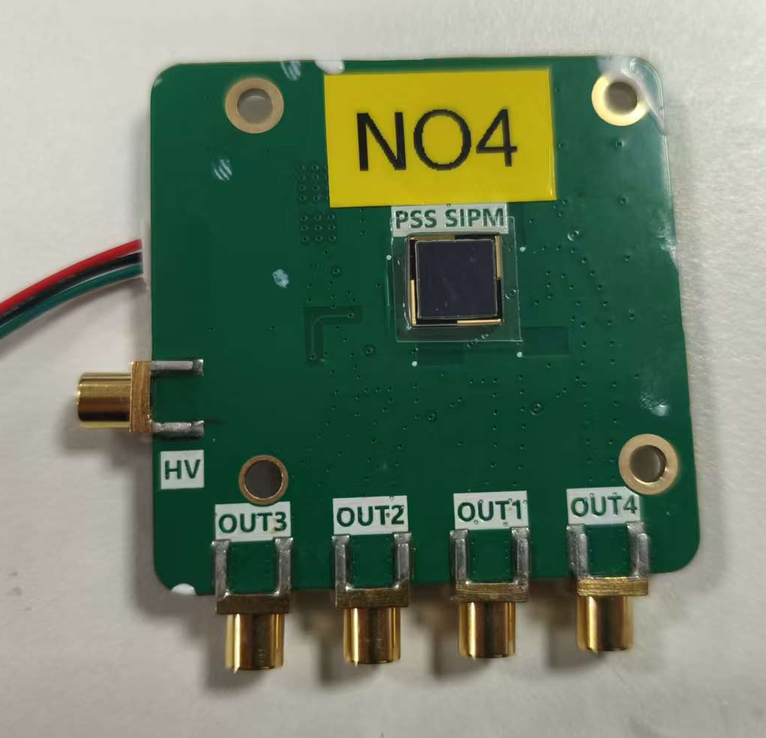
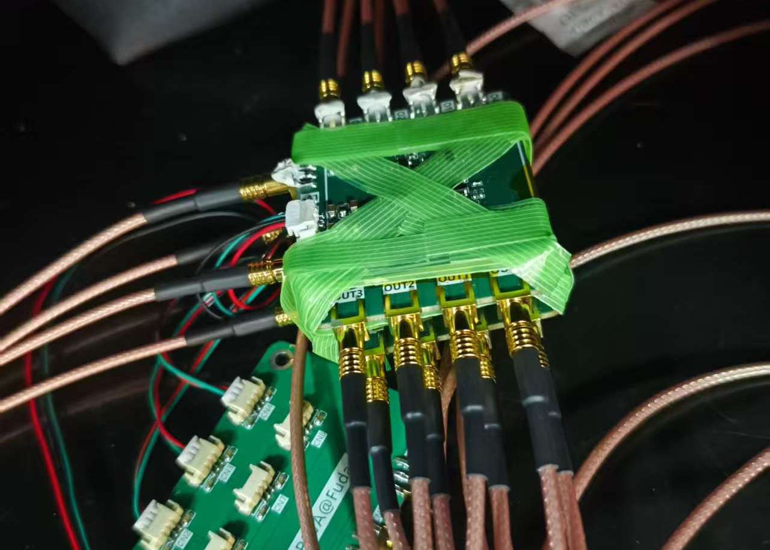
Cosmic ray test of 4 PSS6060
触发逻辑：四块PCB有大于等于一块输出大信号即记录

Slide 3
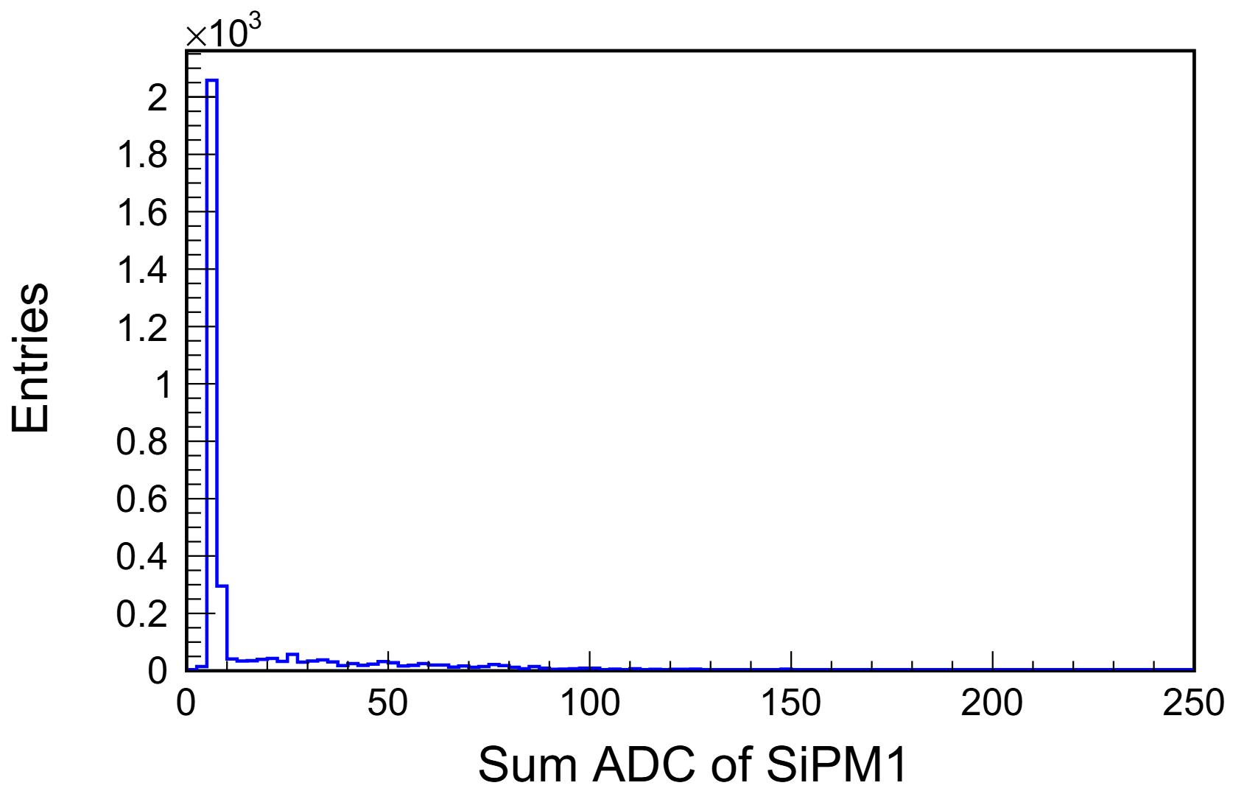
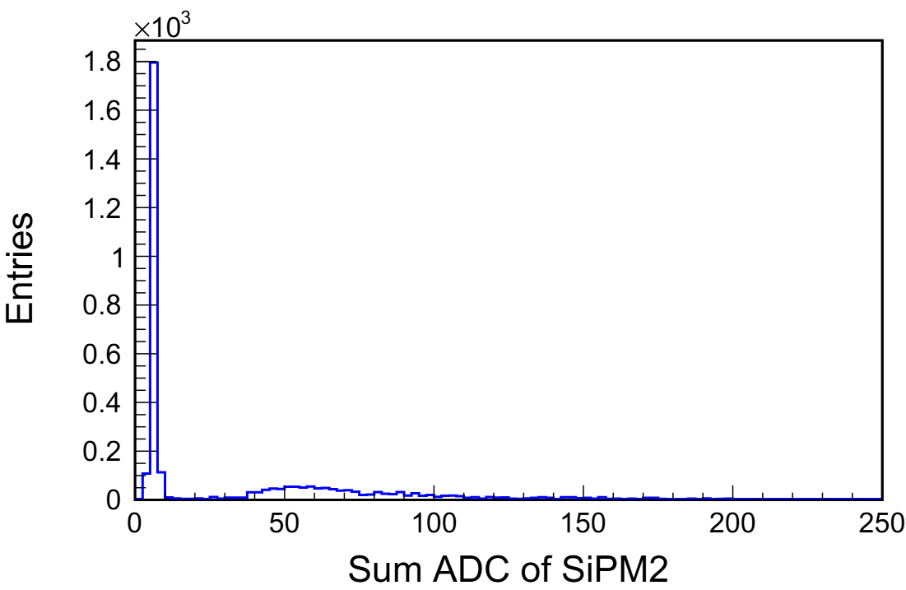
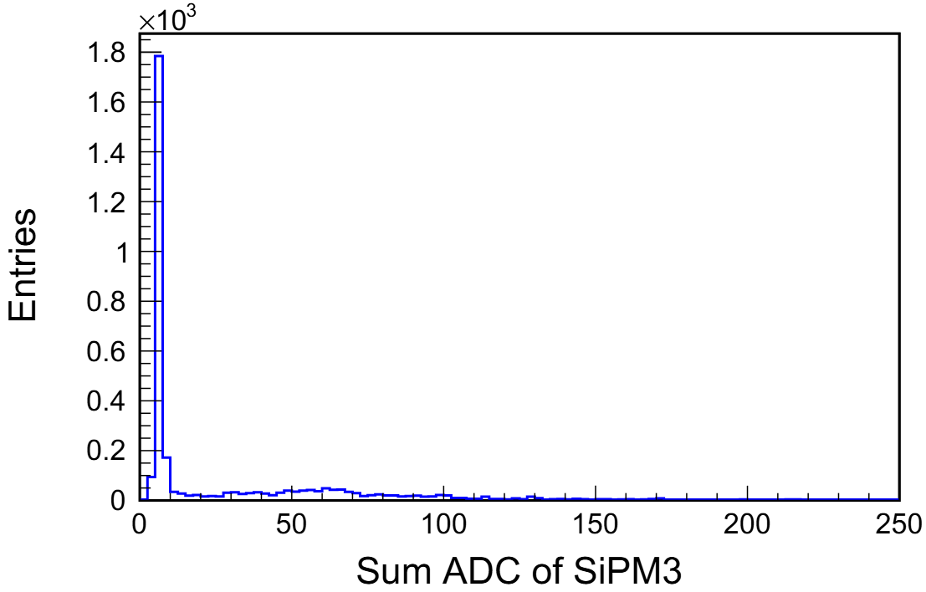

ADC distirbution
单个SiPM四路读出ADC之和

Slide 4
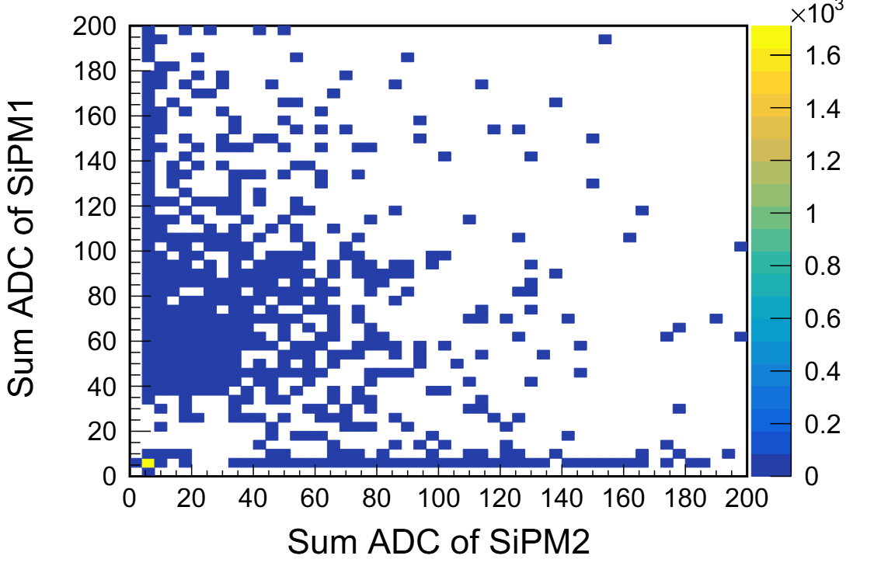
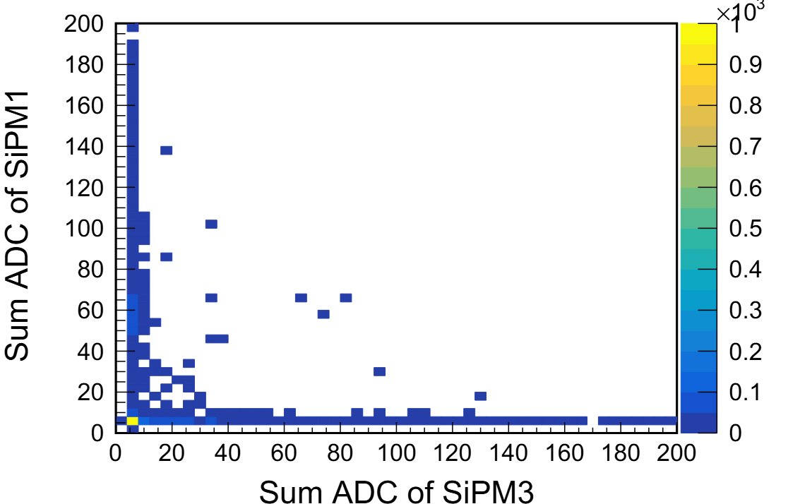
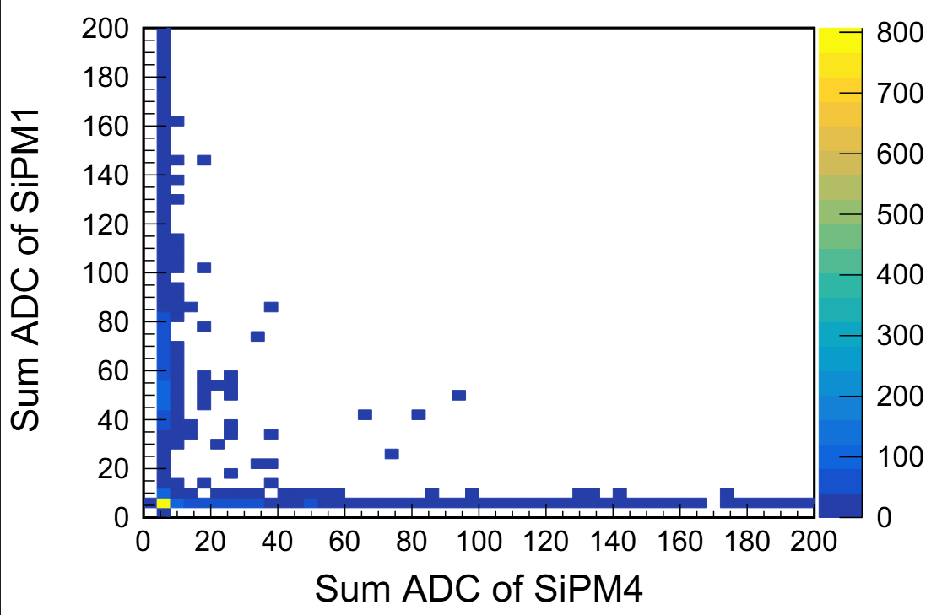
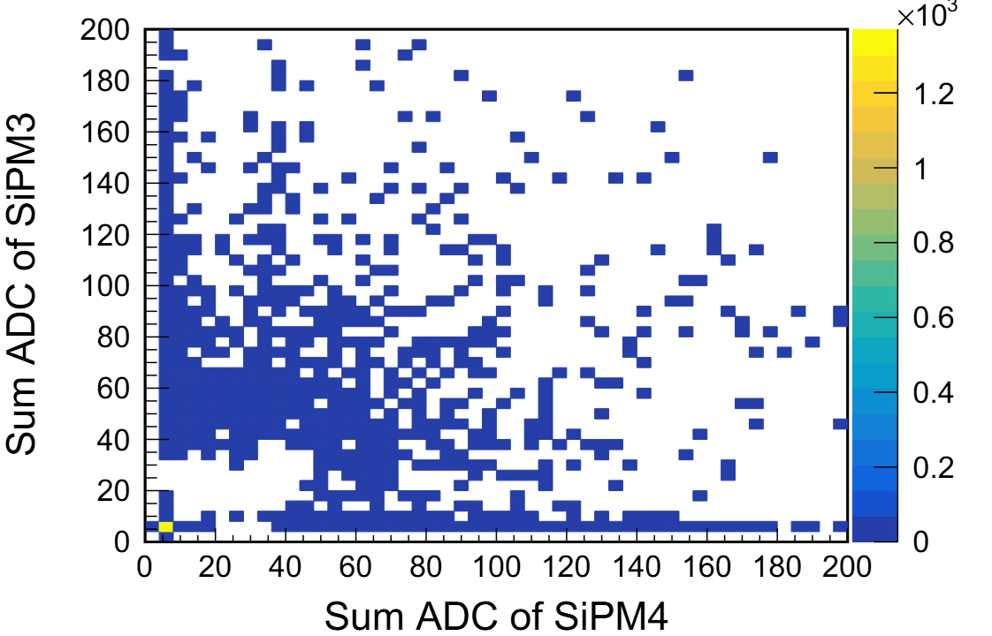
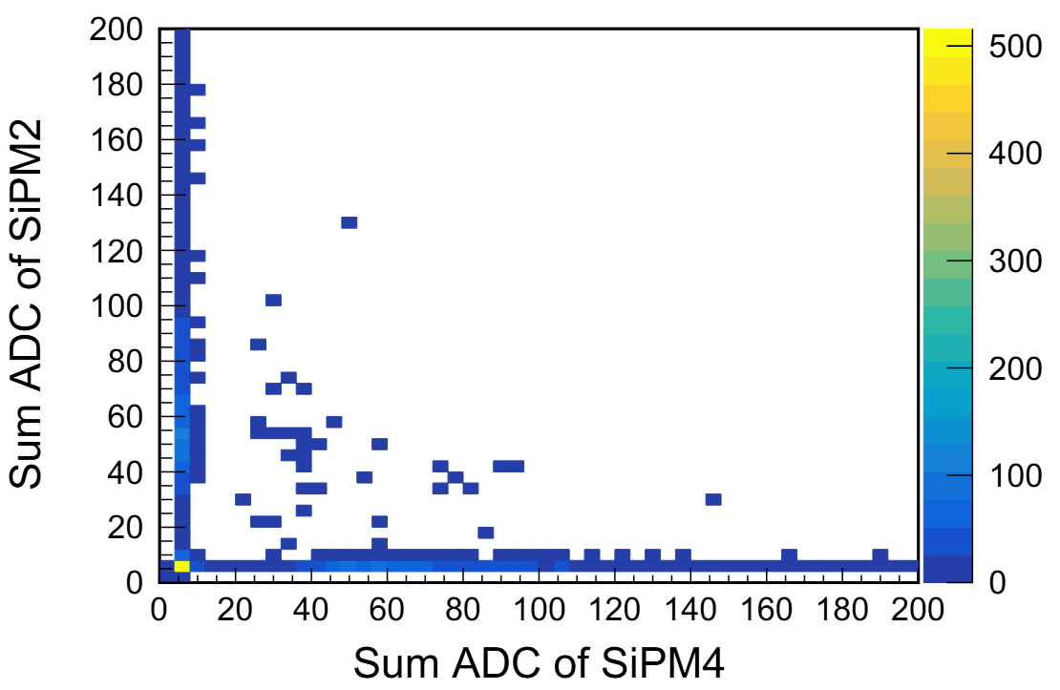
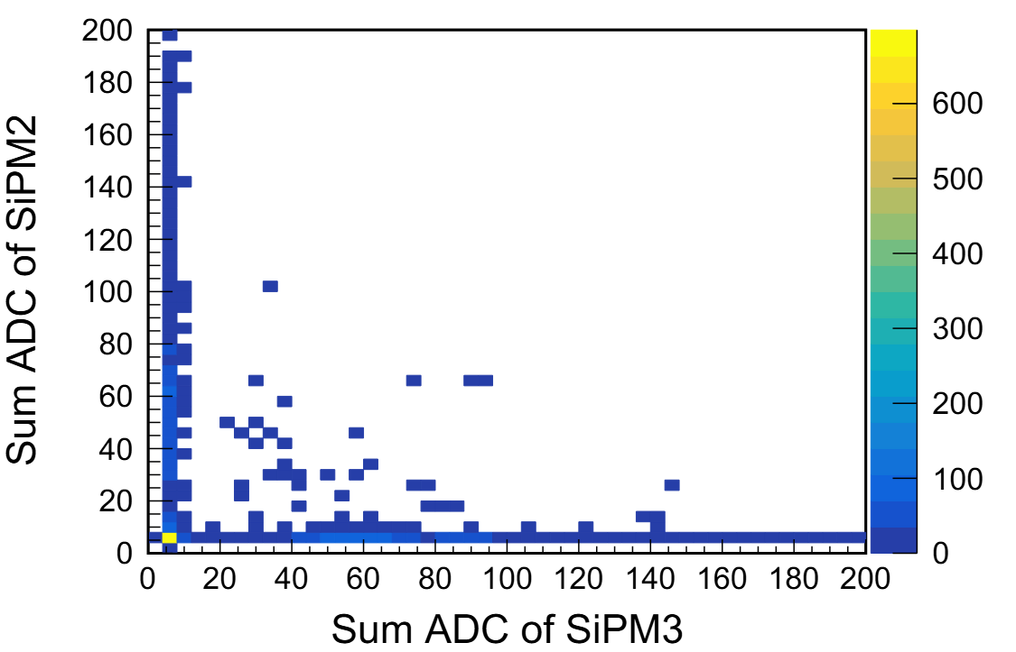
ADC distribution
SiPM1与SiPM2紧贴，SiPM3与SiPM4紧贴

Slide 5
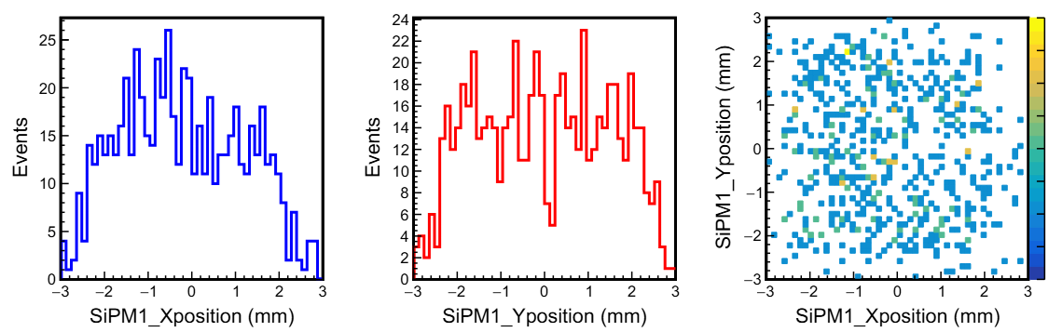
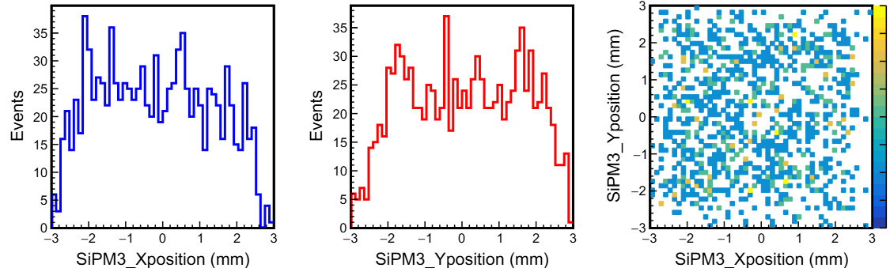
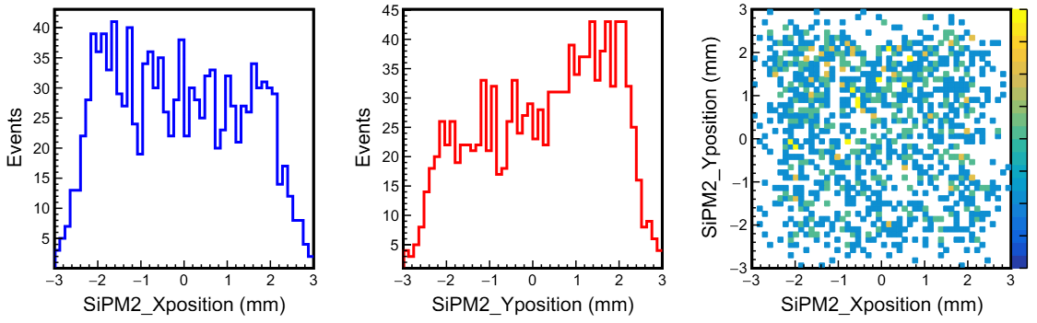
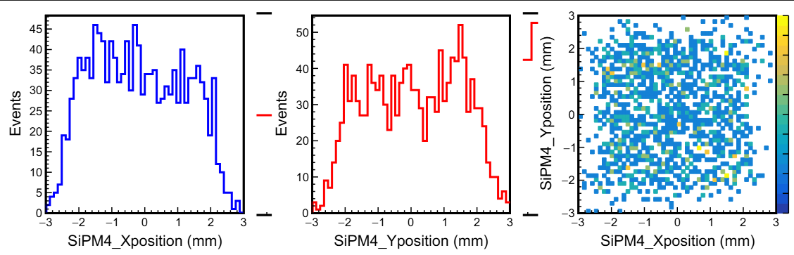
Hit position

Slide 6
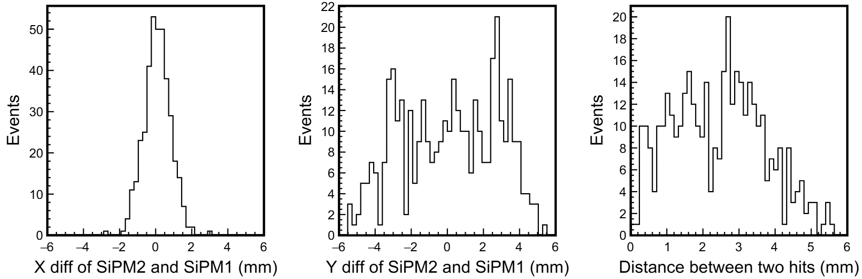
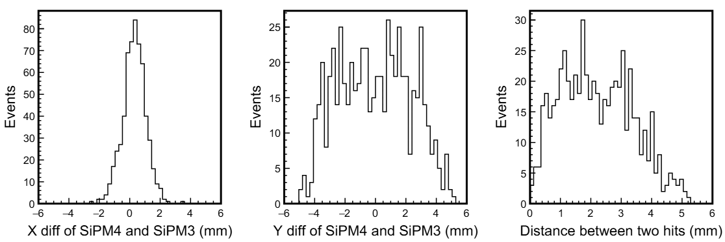

Hit position
$$Distance=\sqrt{{\left(x_{1}−x_{2}\right)}^{2}+{\left(y_{1}−y_{2}\right)}^{2}}$$

Slide 7
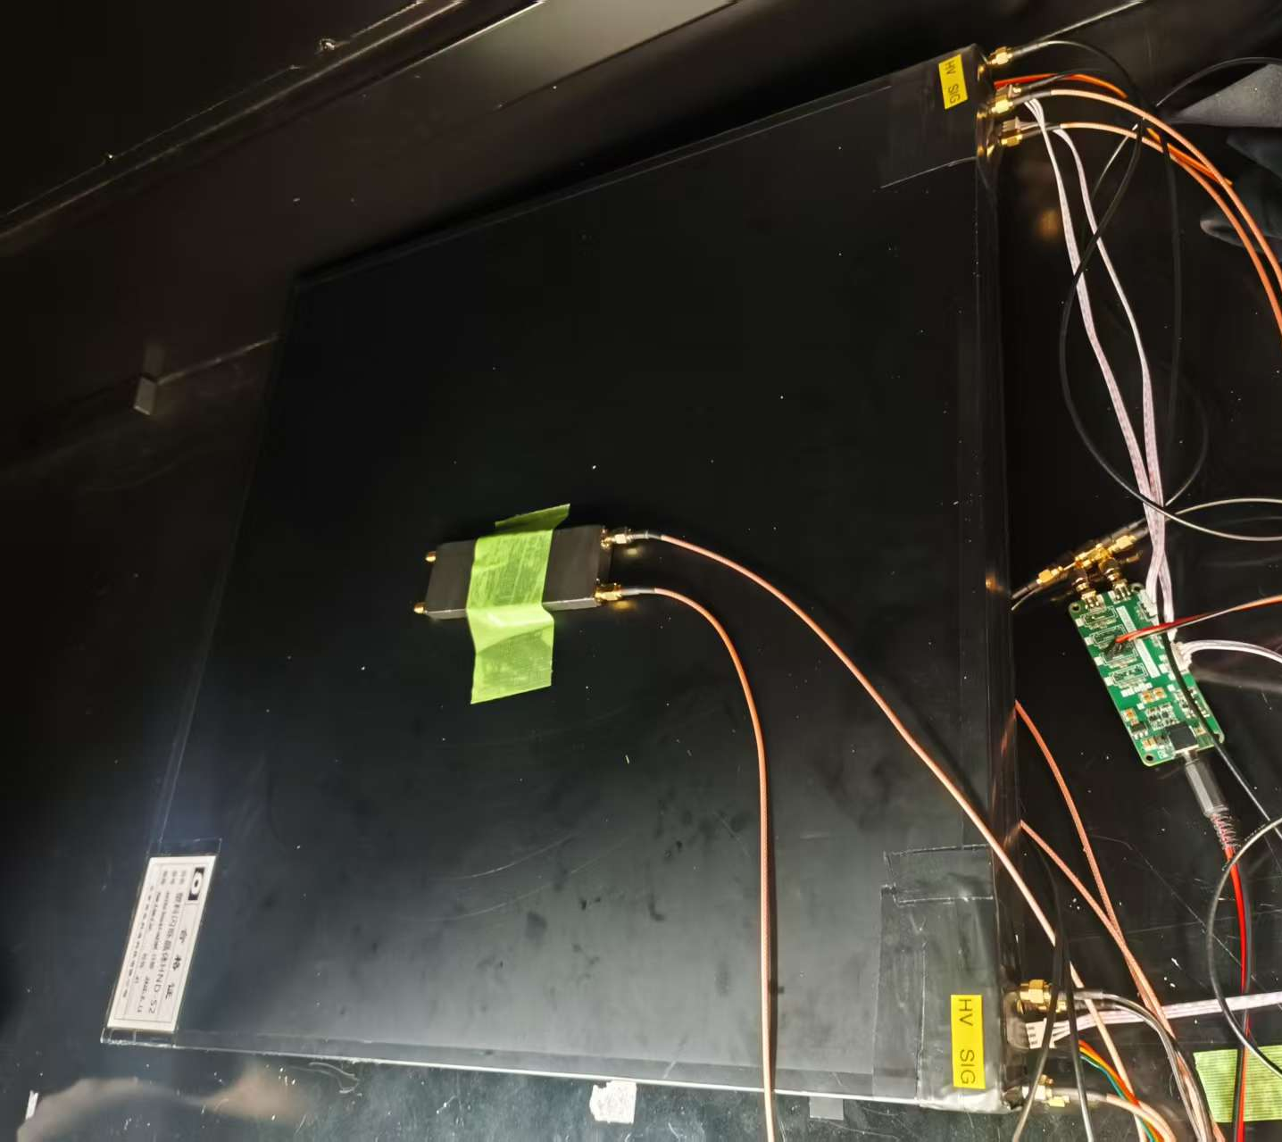
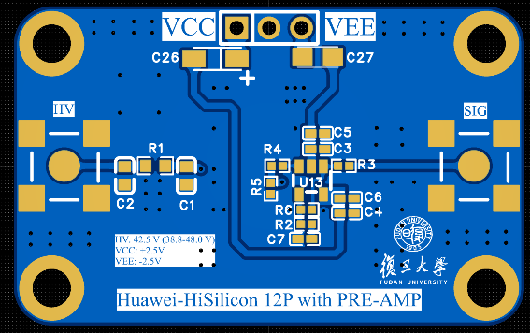
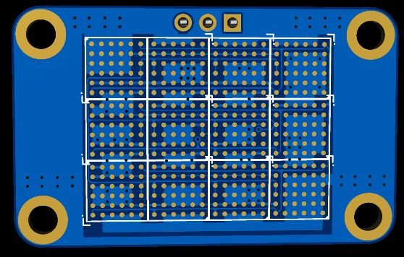
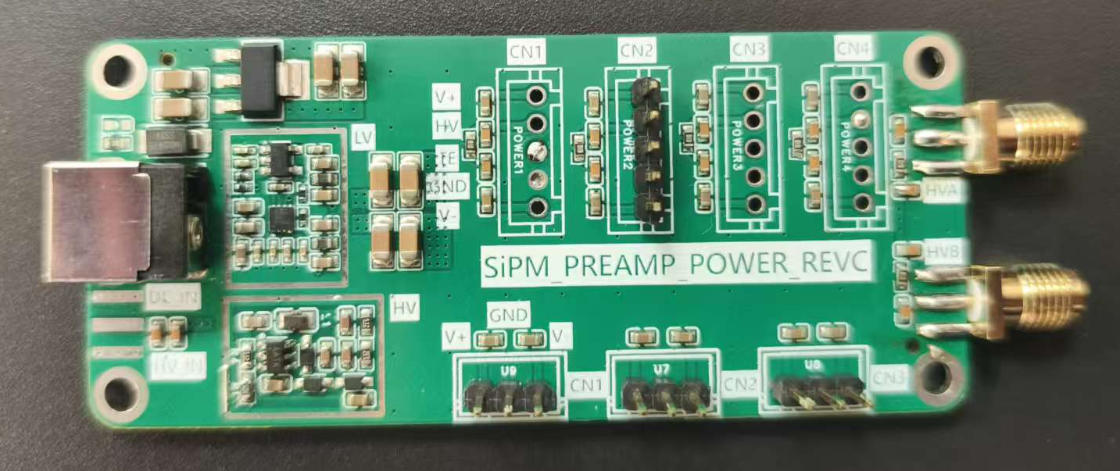
Large scintillators for trigger
The readout board with 12 Huawei-HiSilicon SiPMs in parallel configuration.
Two 50 cm*50 cm scintillators
Power supply board.

Slide 8
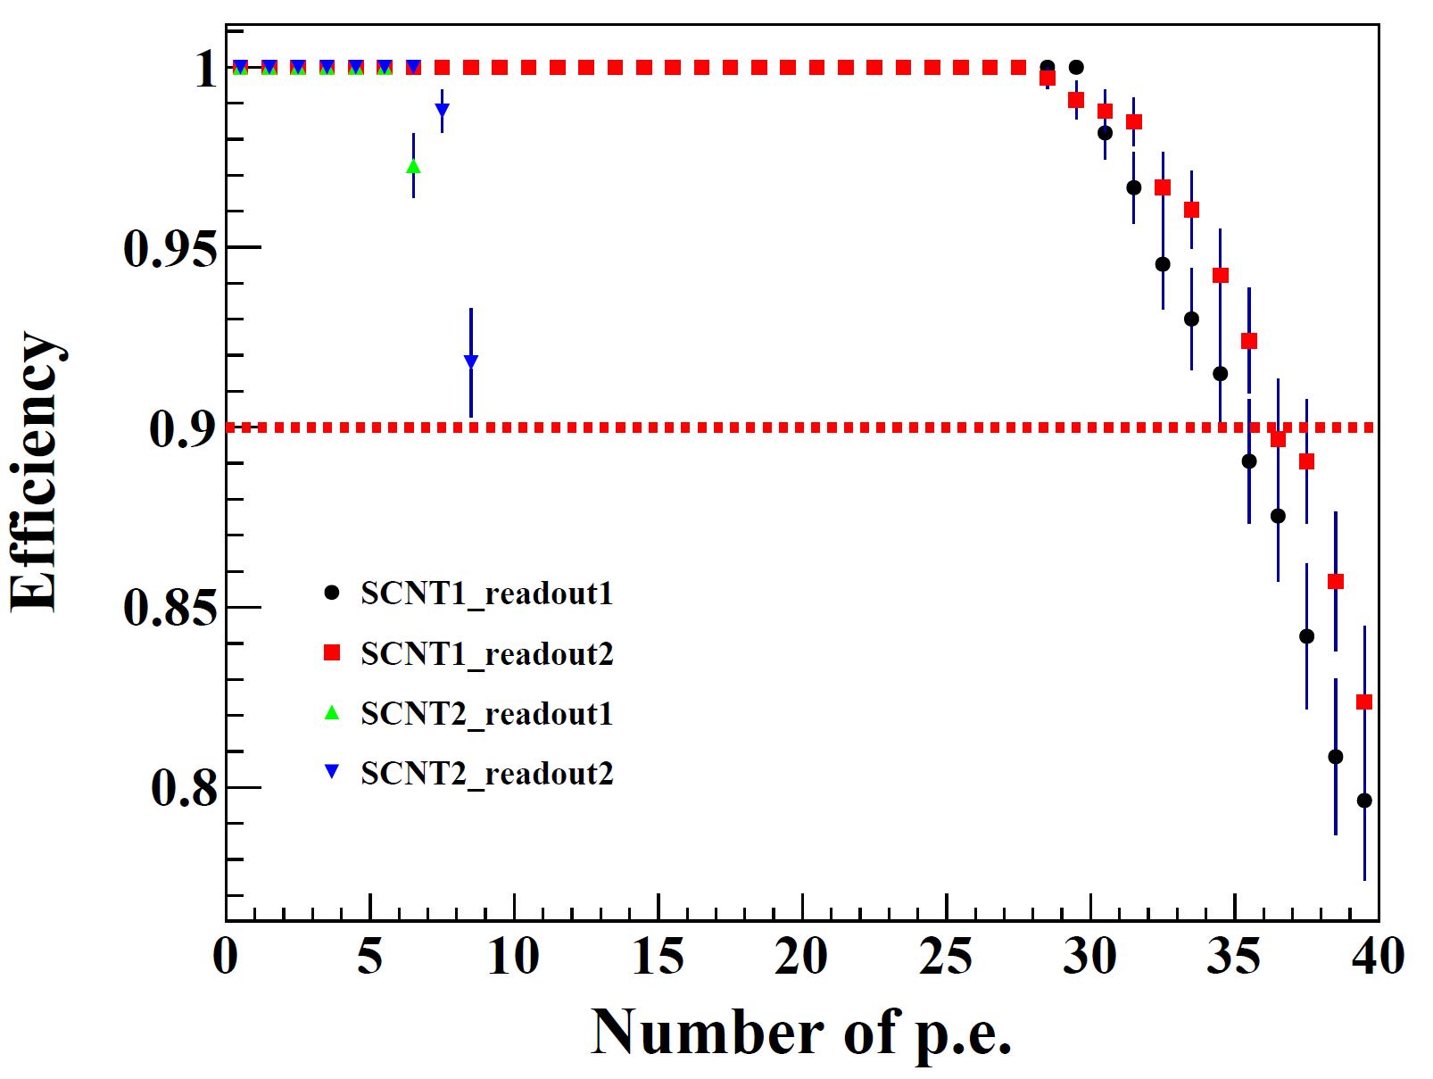
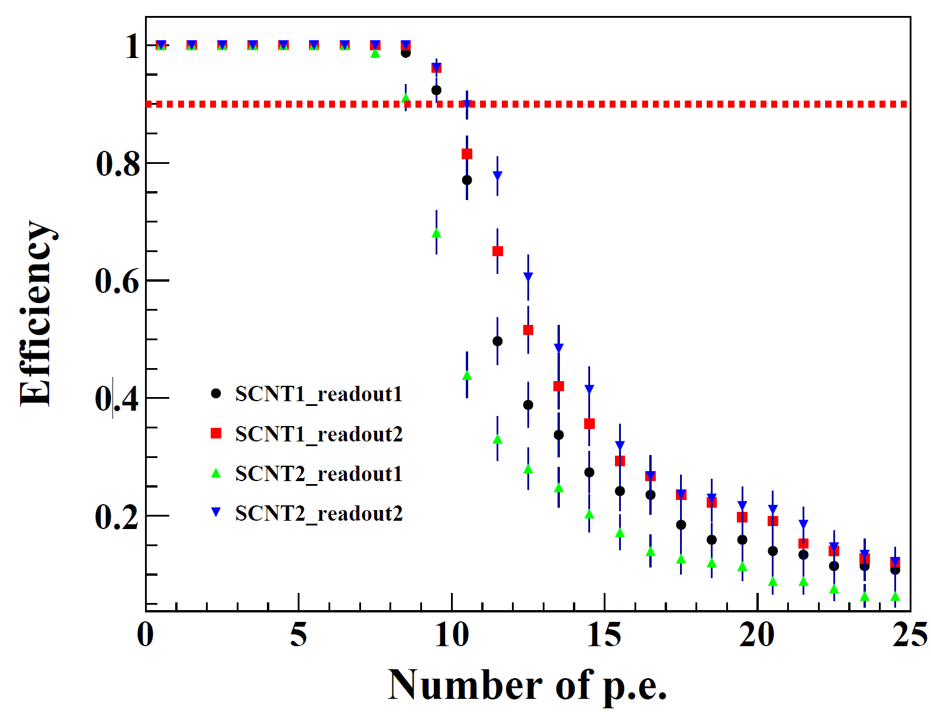
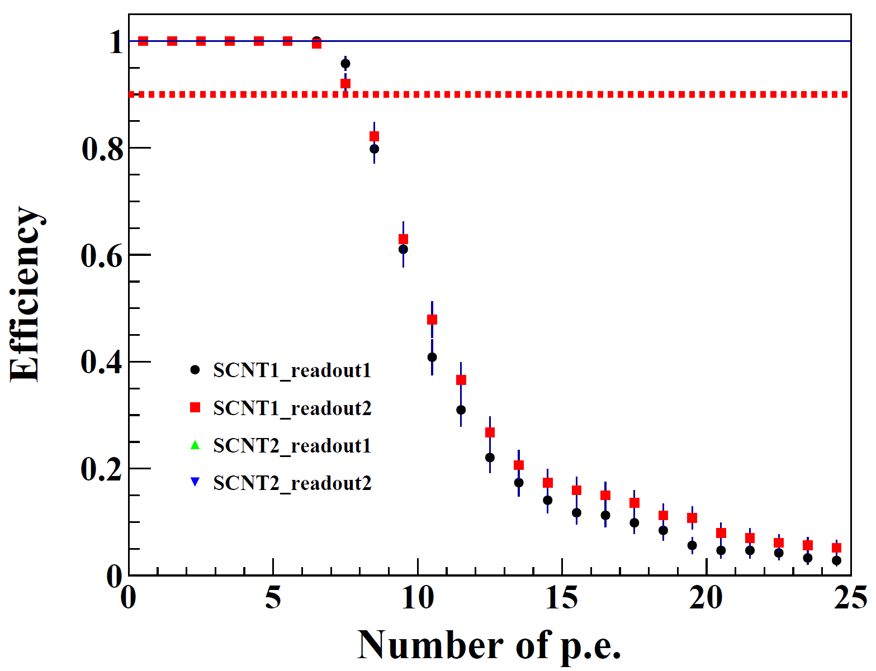
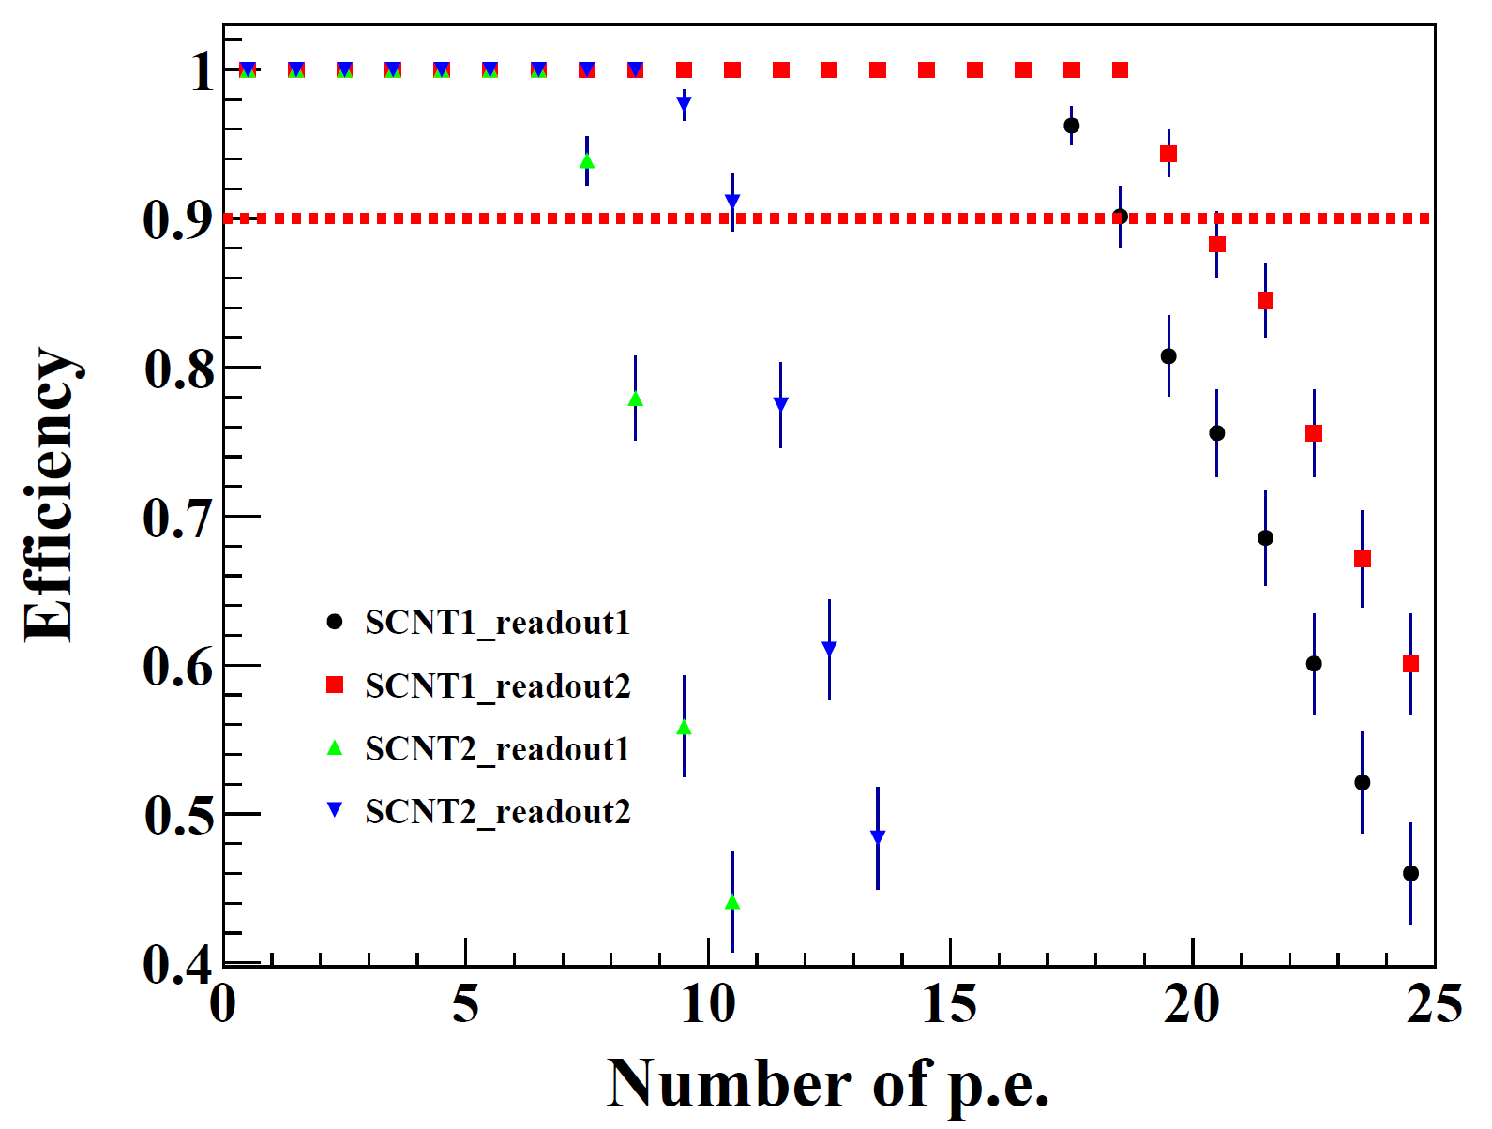
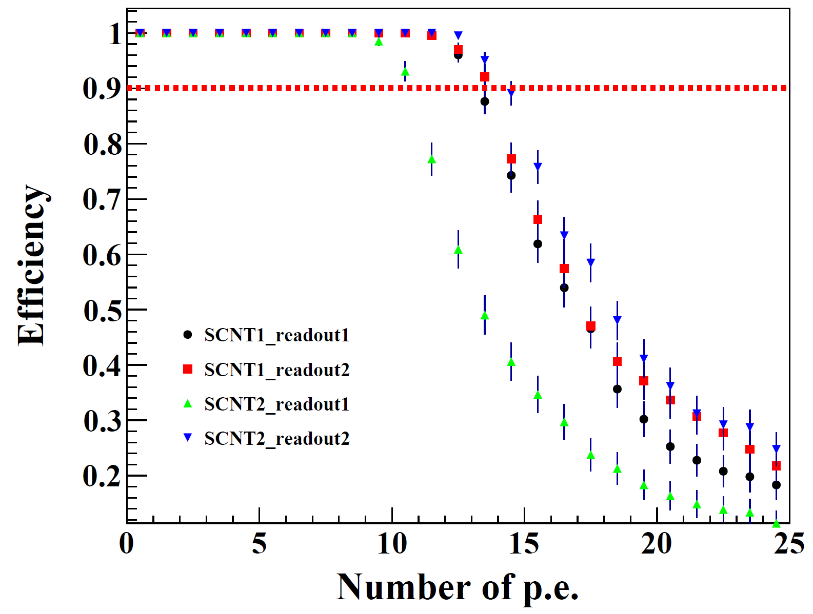
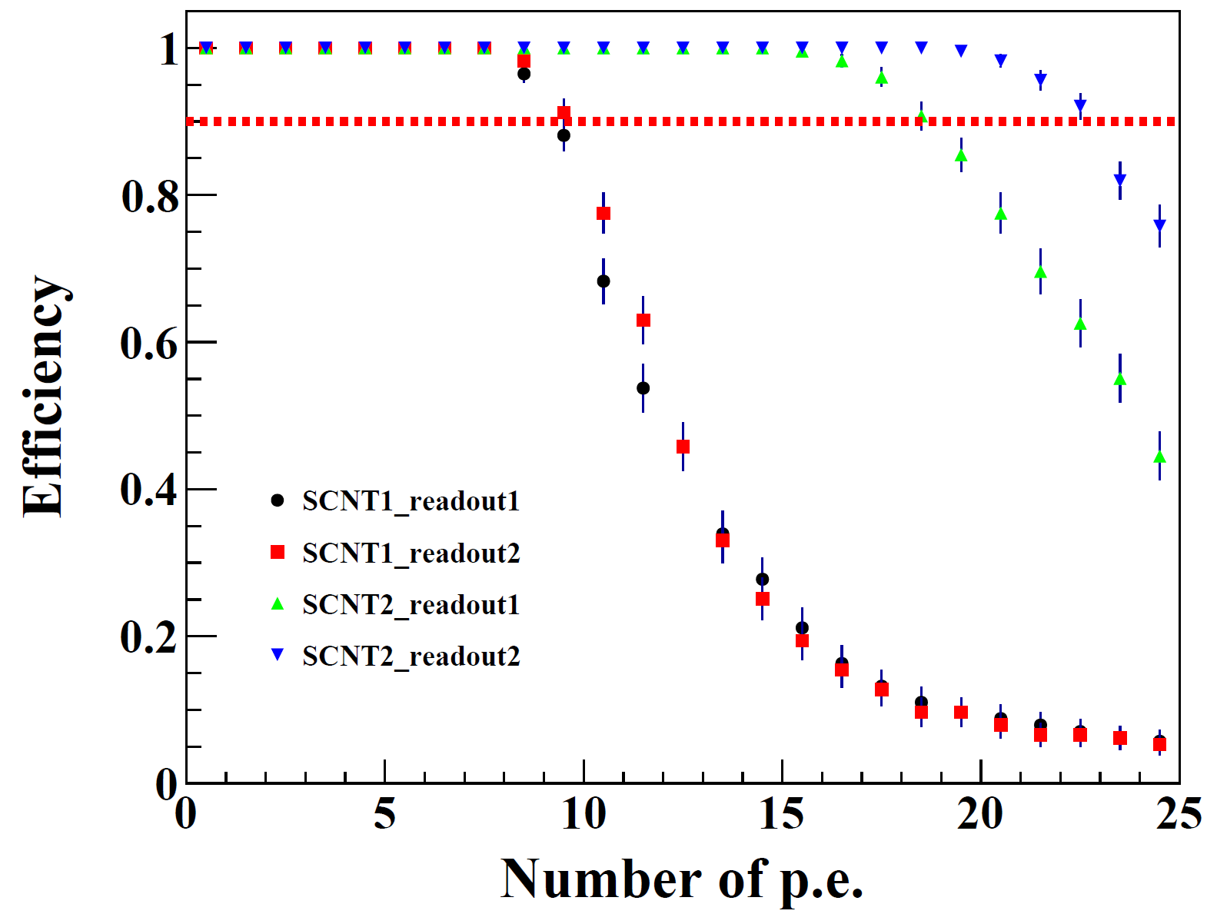
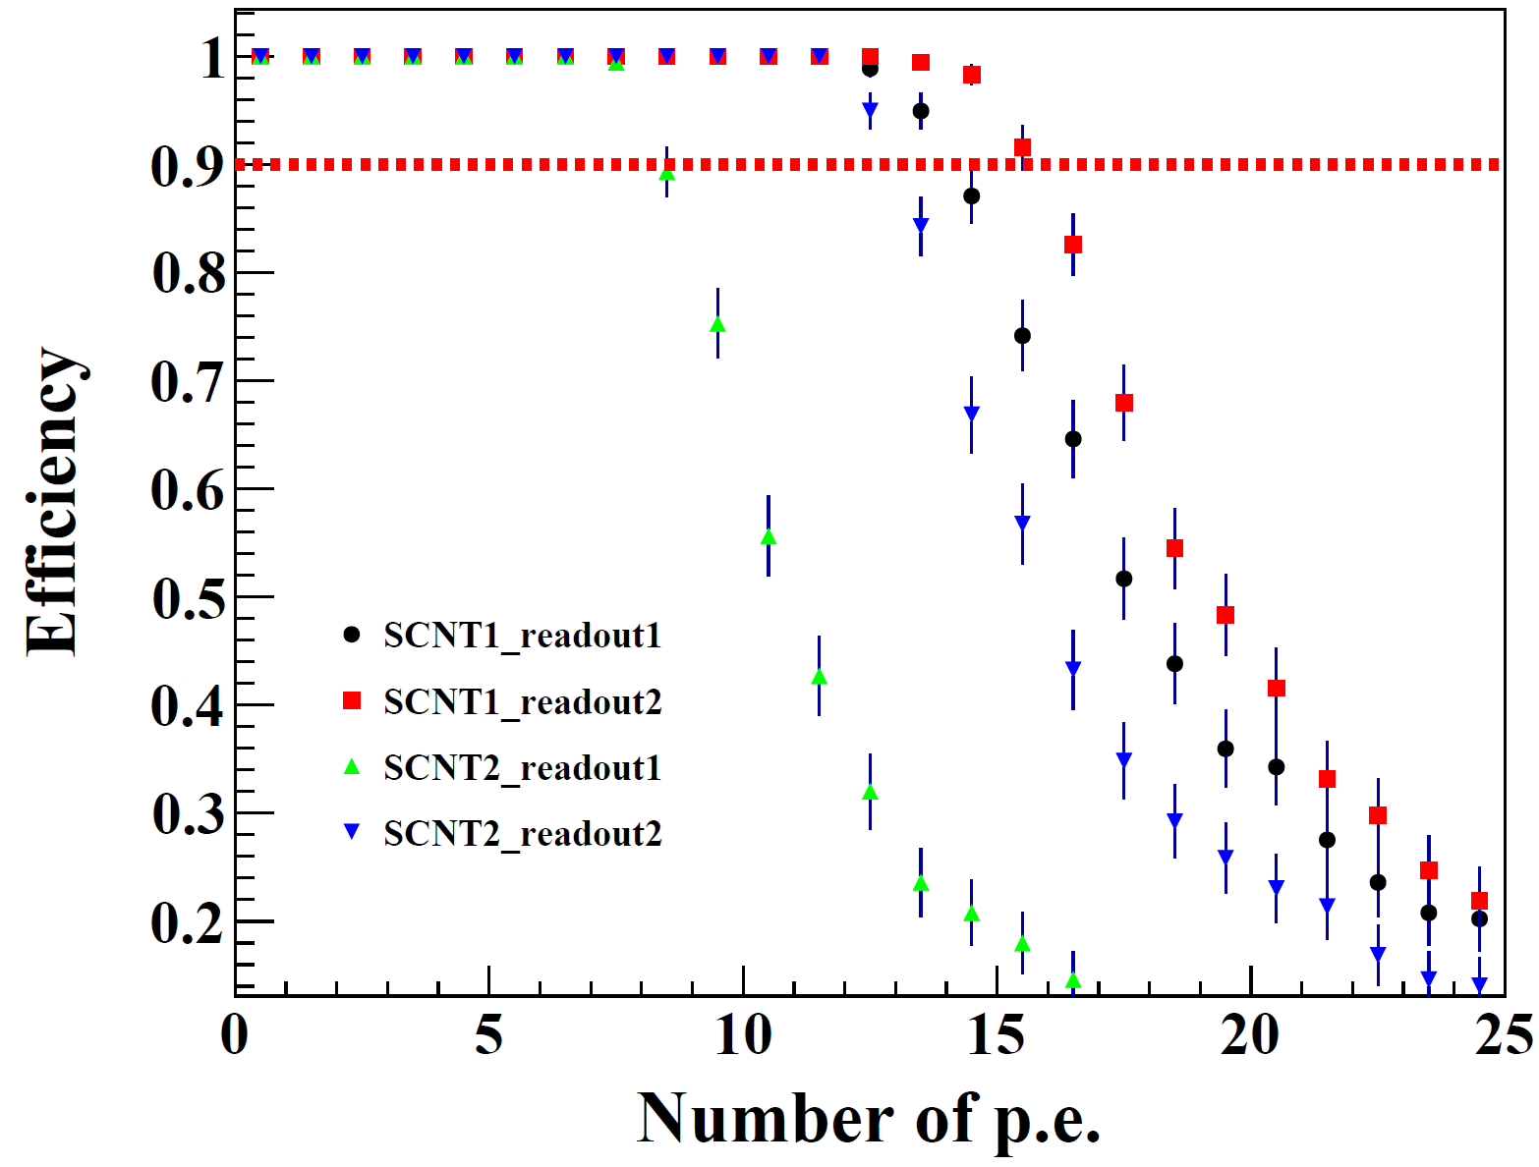
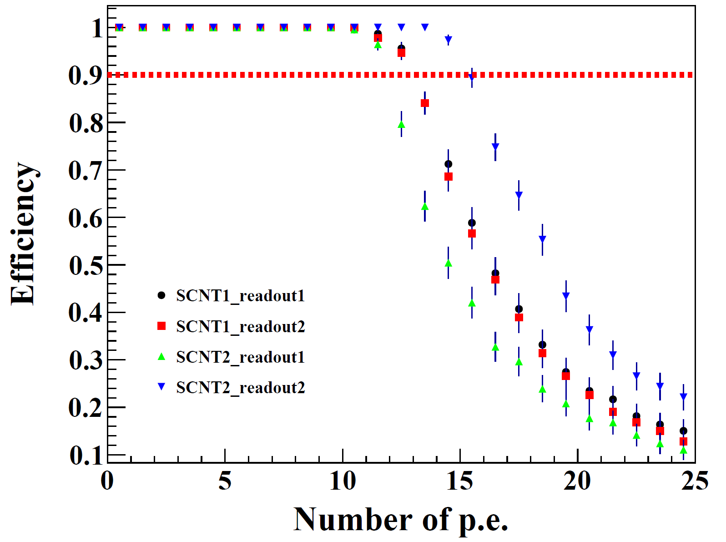
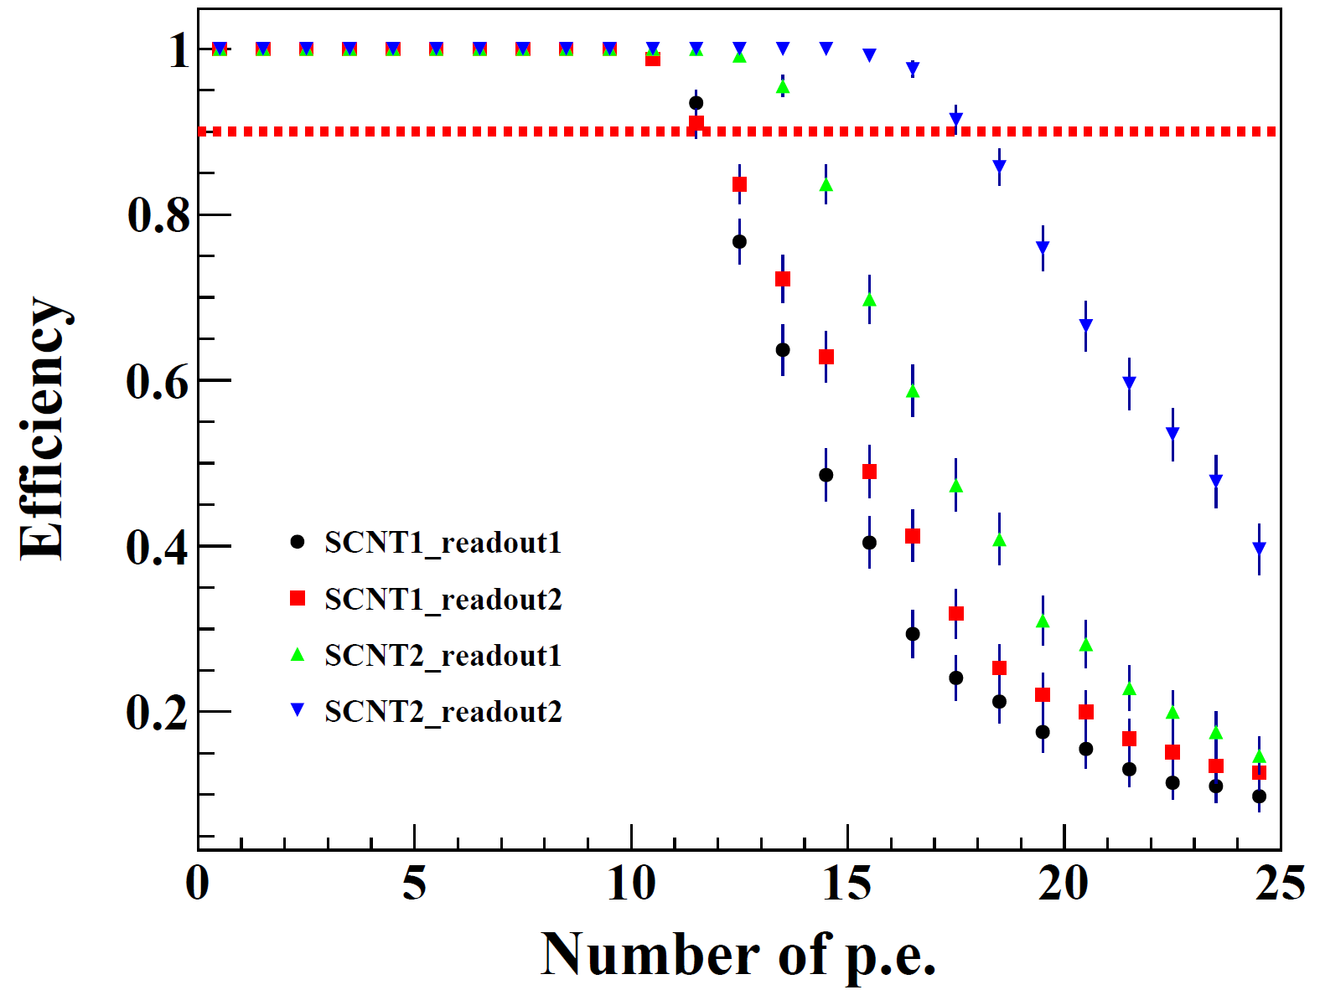
Efficiencies of the large scintillators
SiPM1
SiPM2
PNT4
PNT7
PNT1
PNT4
PNT7
PNT1
PNT2
PNT5
PNT8
PNT5
PNT8
PNT3
PNT6
PNT9
PNT2
The efficiency decreases significantly when the cosmic-ray hit point and the SiPM are at a large relative angle.
At the far ends, the efficiency can keep 90% at the threshold of about 10 p.e.
PNT3
PNT6
PNT9

