Slide 1

Decoherence as renormalization group flow:
Quantum information loss in high energy collisions
邵鼎煜
复旦大学
2026年新物理前沿与交叉科学研讨会 南京 2026年5月15日-19日

Slide 2
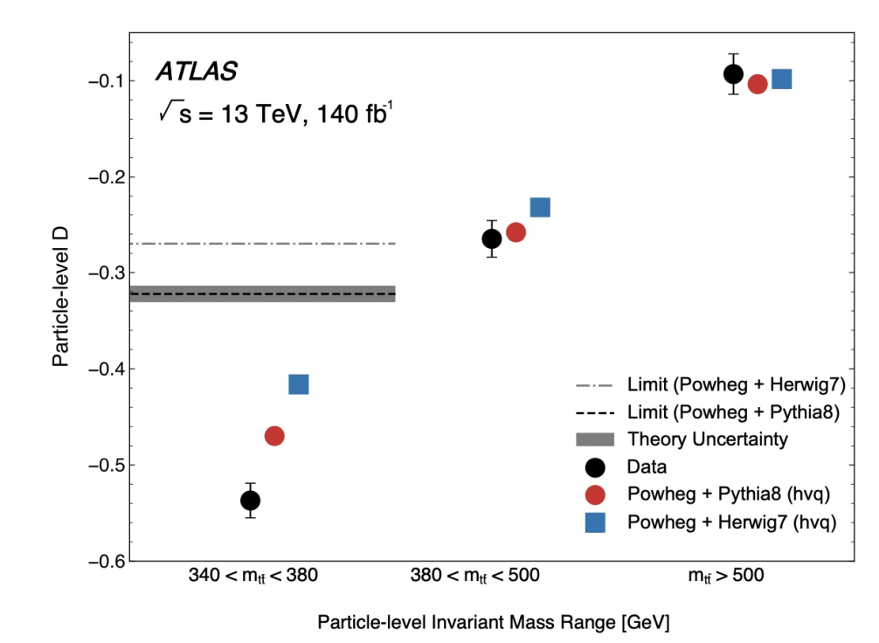
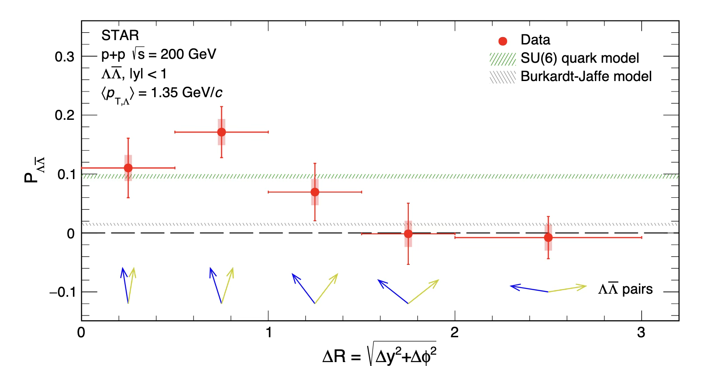
Decoherence in high energy collisions
The study of quantum information in high-energy collider physics is rapidly transitioning from a theoretical curiosity to an experimental reality
High energy collisions are complicated.
Measurement often can’t capture everything.
  For example, additional radiation can be missed due to acceptance and thresholds.
Decoherence due to incomplete information needs to be taken into account for an accurate interpretation of the results.
Nature 2024
Nature 2026

Slide 3
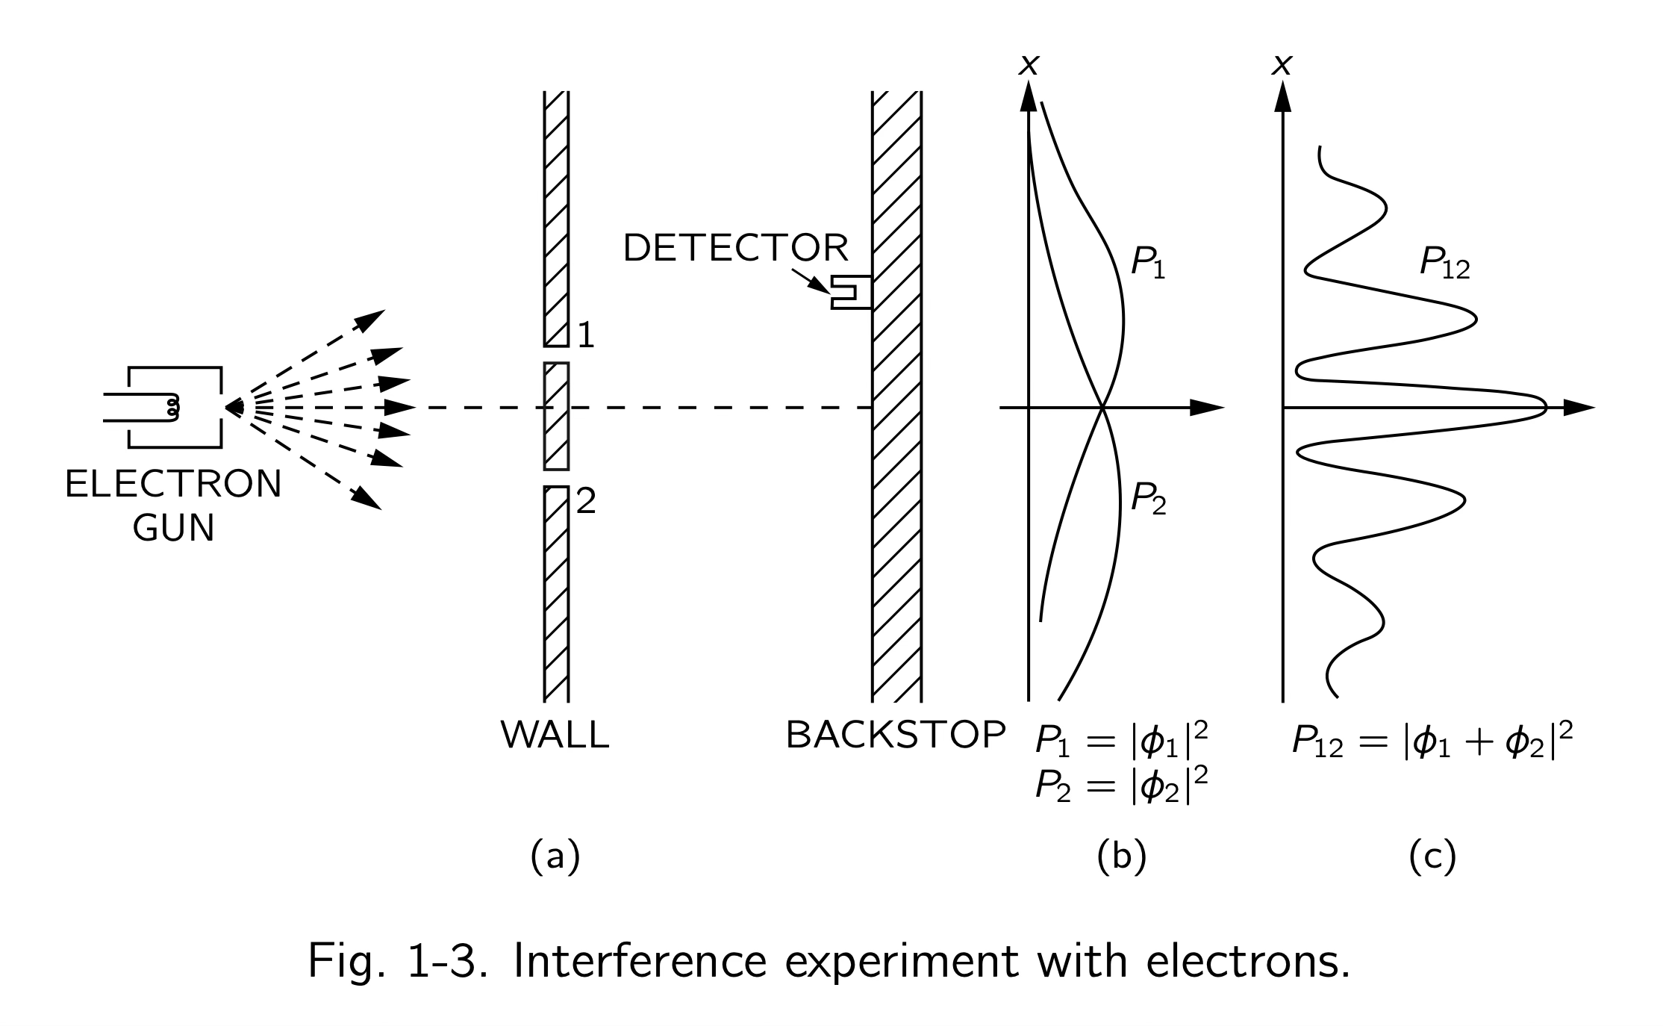
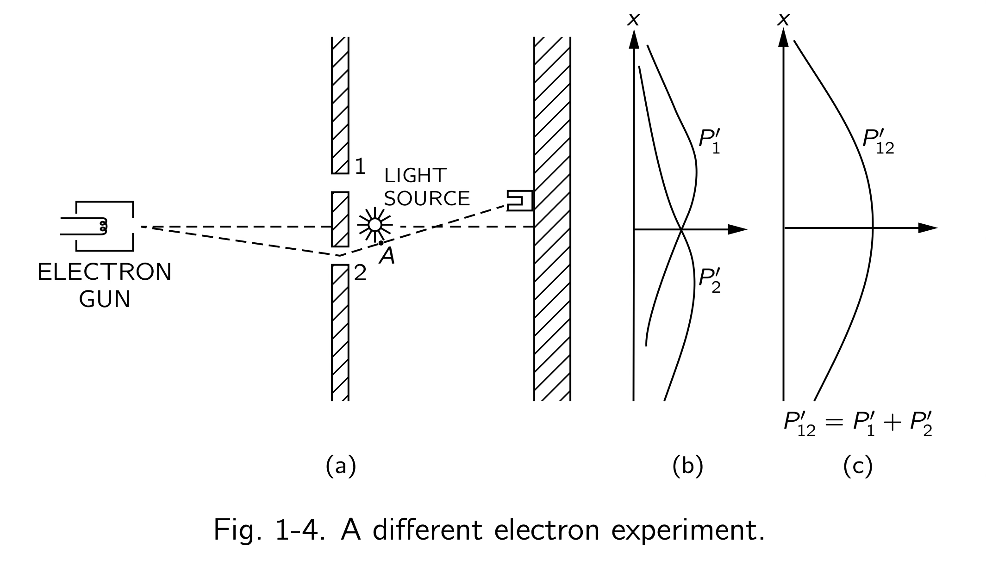
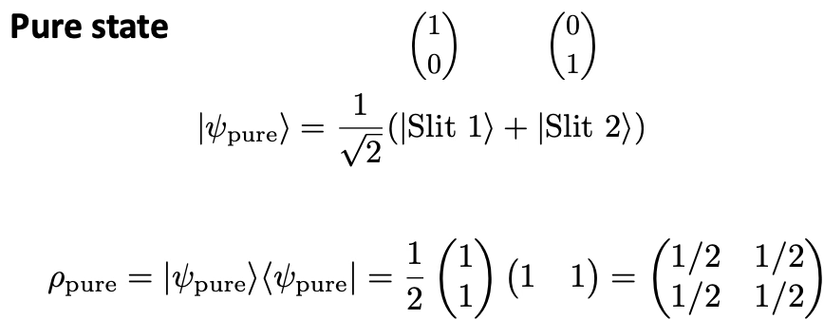
Decoherence in the double-slit experiment
Mixed state
Pure dephasing quantum channel
Λ is the decoherence rate. It describes how fast the quantum coherence (the off-diagonal terms) disappears; decoherence time t ≈ 1/Λ
《The Feynman Lectures on Physics》

Slide 4

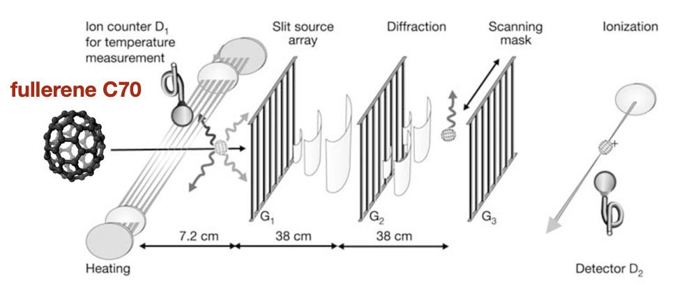
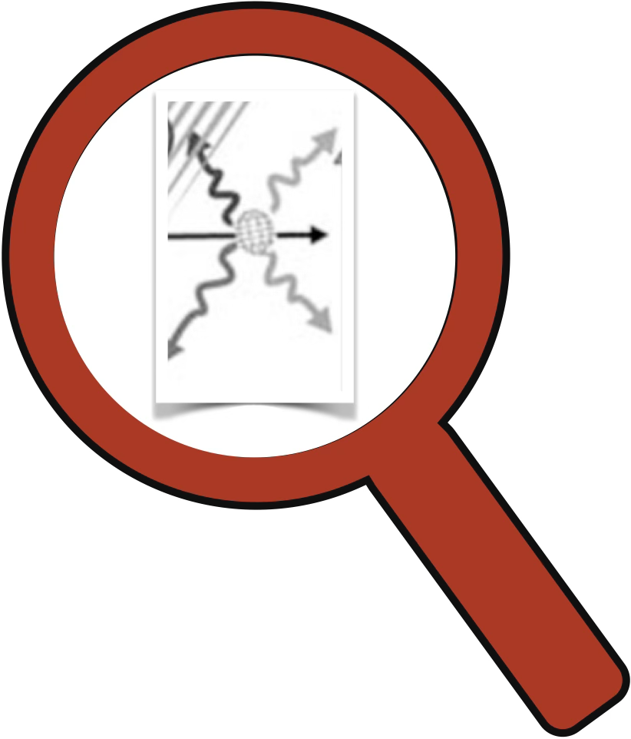
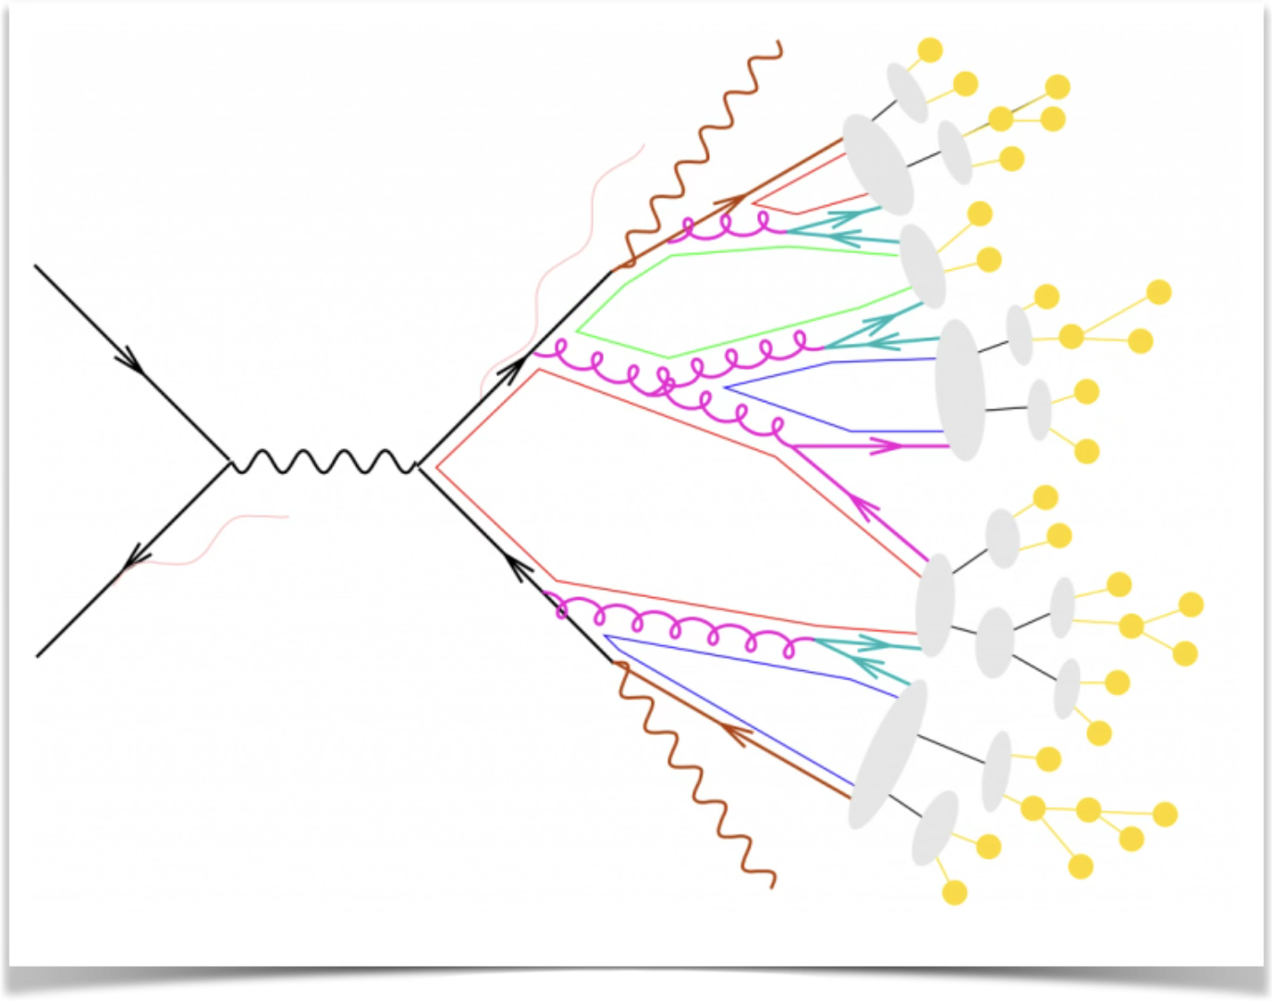
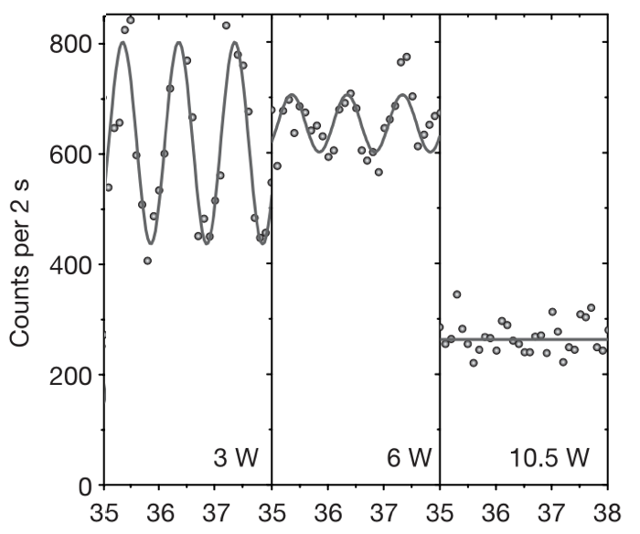
Decoherence by thermal emission of photons
Hackermuller, Hornberger, Brezger, Zeilinger, Arndt Nature ‘04
A Talbot-Lau interferometer
Before entering the interferometer, C70 molecules pass through a laser beam to increase their internal temperature
The internal temperature is varied from below 1,000 K (cold) up to 3,000 K (hot)
Cold Molecules:
  Molecules emit negligible radiation.
  Result: Strong quantum interference is observed with a fringe visibility.
Hot Molecules:
  Molecules emit thermal photons that carry path information
  Result: The interference fringe visibility drops to 0%.
The decoherence mechanism is the thermal emission of photons by the molecule itself

Slide 5
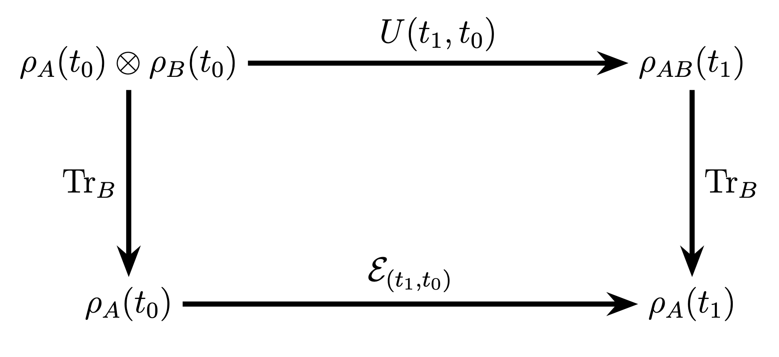
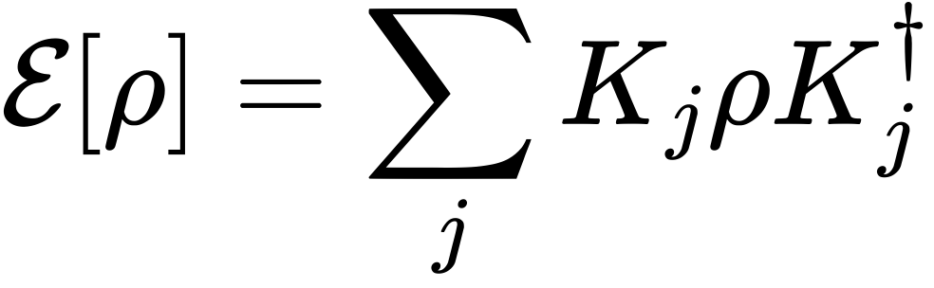
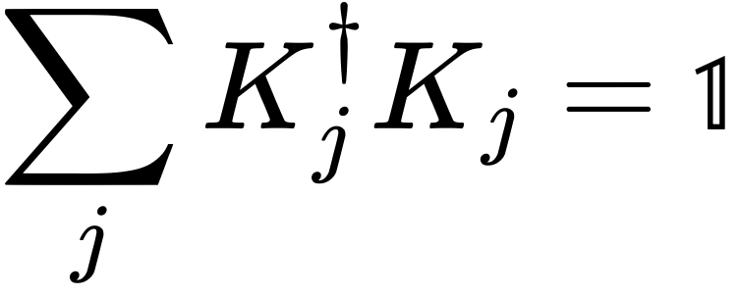
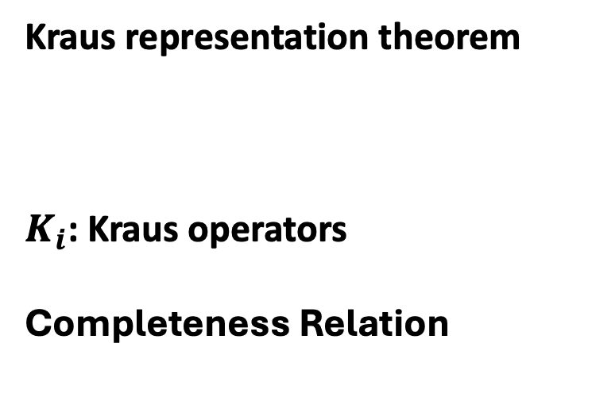
Decoherence and quantum channel
Consider a bipartite system (assume no entanglement initially)
Kraus representation theorem
$K_{i}$: Kraus operators
Completeness Relation
qquantum map or quantum channel

Slide 6
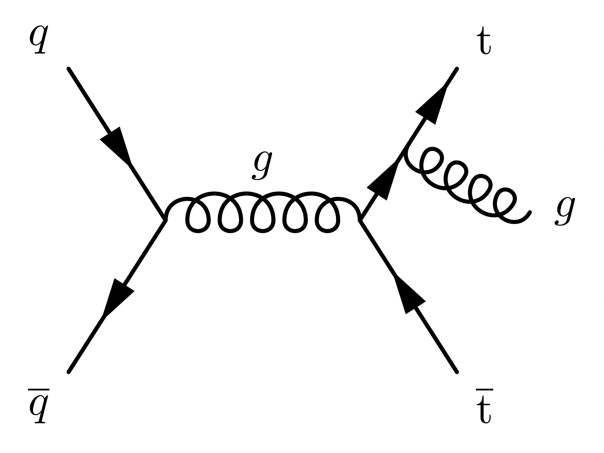


Decoherence in high energy collisions
Radiation, leaking information from the “system” to “environment”
enviroment
system
leakage of information

Slide 7
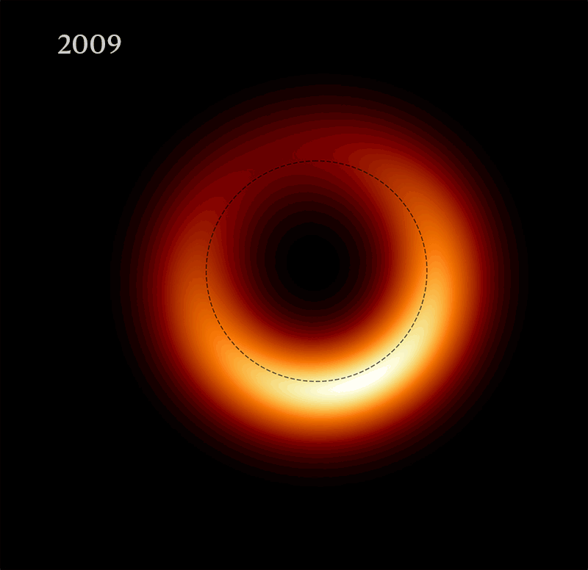
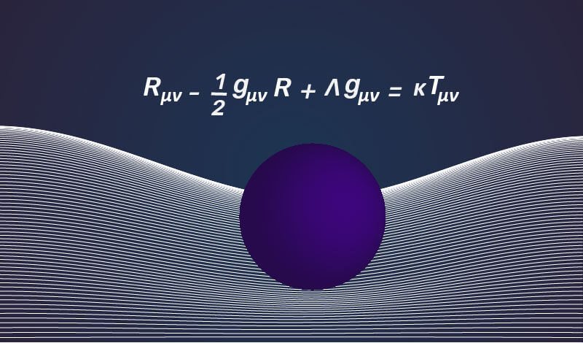
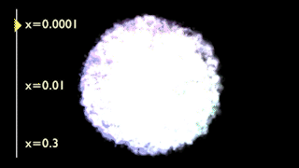
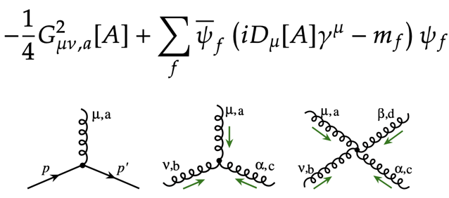
Nucleon tomograph
Black hole imaging will deepen our understanding of gravity
Nucleon imaging will deepen our understanding of the strong interaction

Slide 8
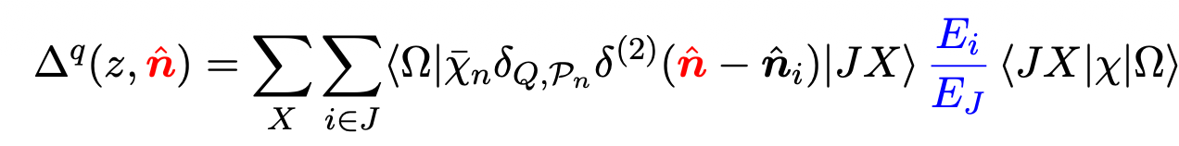
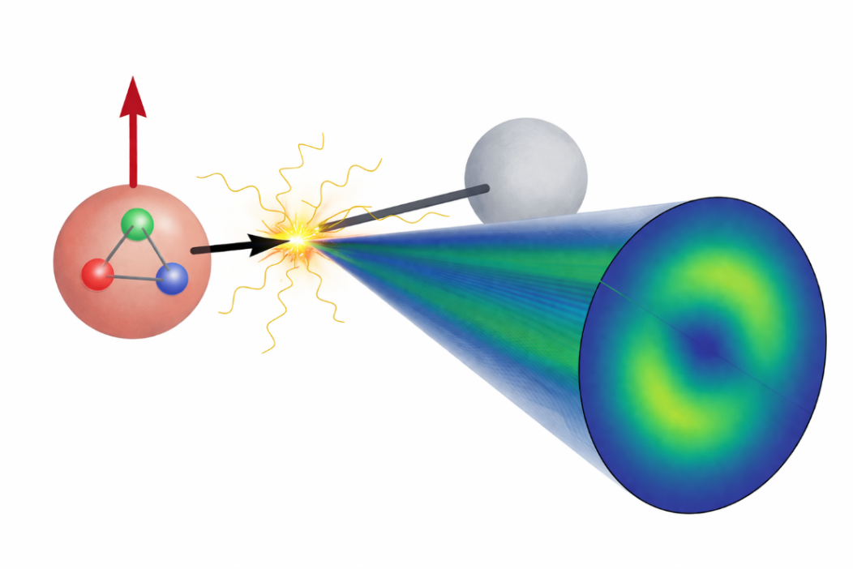
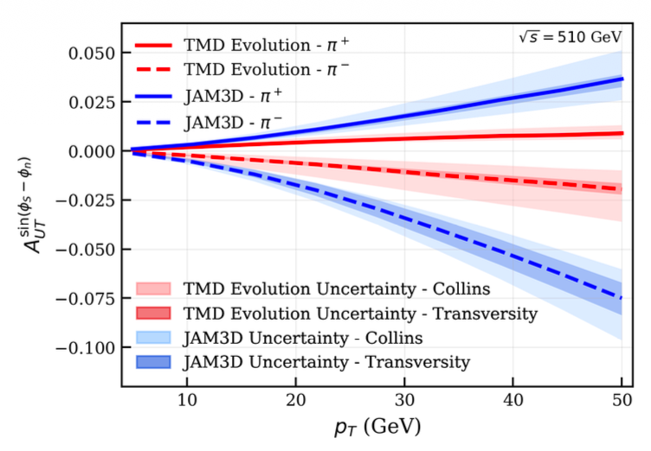
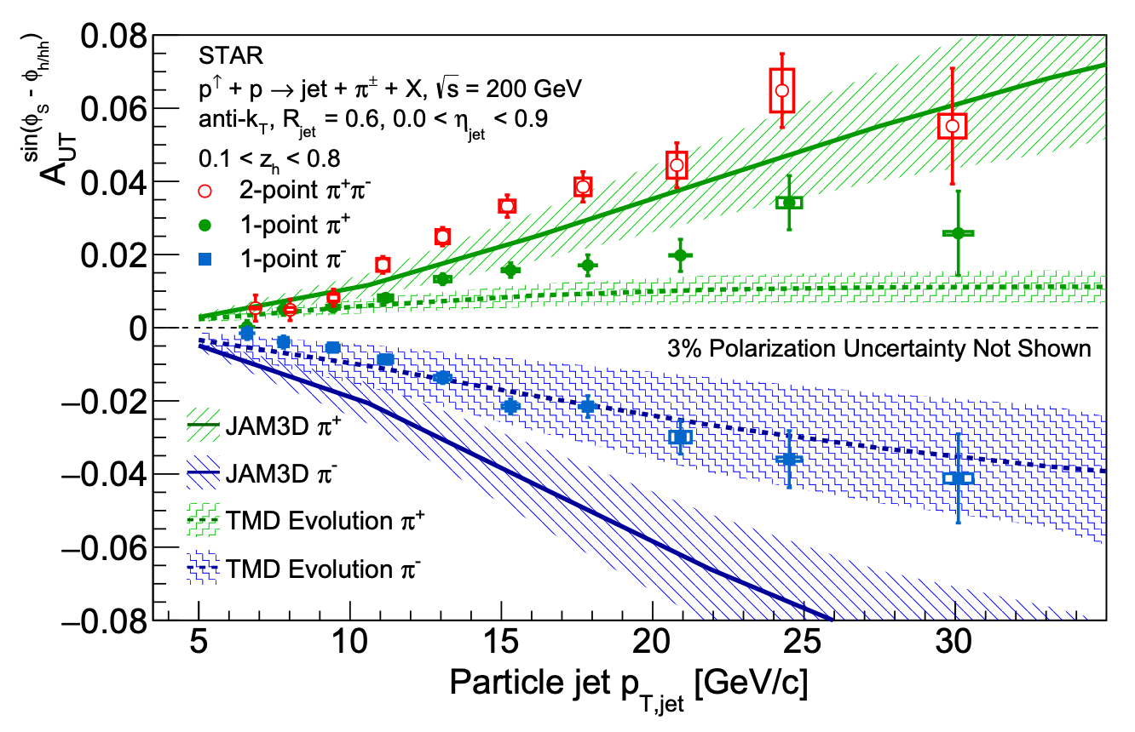

Accessing Nucleon Transversity via One-Point Energy Correlators
Gao(高梅森), Kang, Li(李婉辰), DYS PRL 136 (2026) 151902
Transversity distribution $h_{1}^{q}$ is a fundamental, yet less known, parton distribution.
Its chiral-odd nature prevents access via inclusive DIS
Nucleon tensor charge $δq$ is essential for BSM search, Lattice QCD benchmarks
We introduce the one-point energy correlator (OPEC) to probe the nucleon transversity
RHIC-STAR 2604.15543

Slide 9
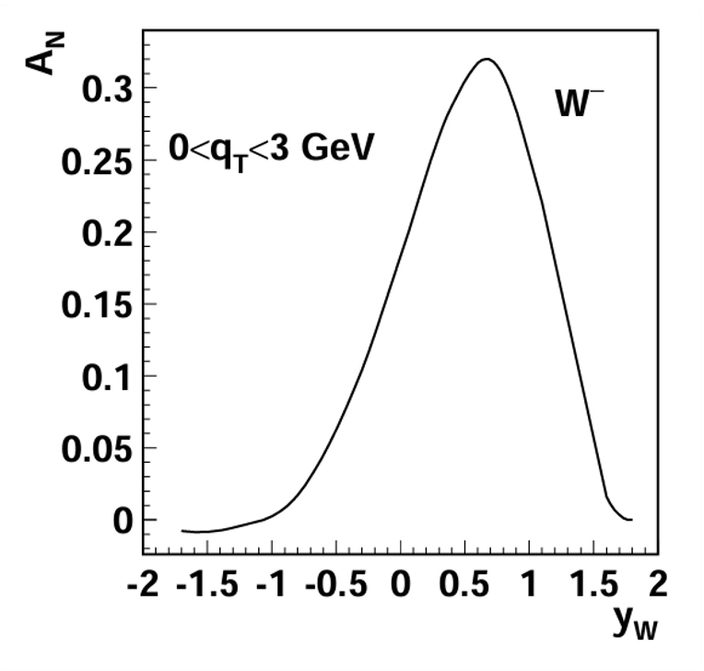
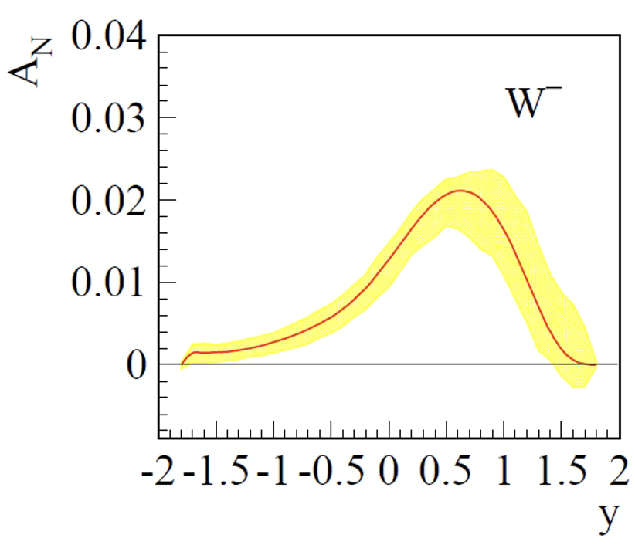
Spin asymmetry and QCD evolution
Without evolution
With evolution
Quantum information interpretation
Soft and collinear radiation destroy superposition
Soft radiation decohere the directions of the momenta and the gauge representations of the particles
Collinear radiation decohere the energies and the spin
Kang & Qiu ‘09
Echevarria, Idilbi, Kang, Vitev ’14
Carney, Chaurette, Neuenfeld, Semenof ’17
Neill, Waalewijn ’19
S.J. Lin, M.J. Liu, DYS, S.Y. Wei ‘25
J.Y. Gu, S.J. Lin, DYS, S.X. Yang, L.T Wang ’25
… …
Evolution reduces the asymmetry

Slide 10
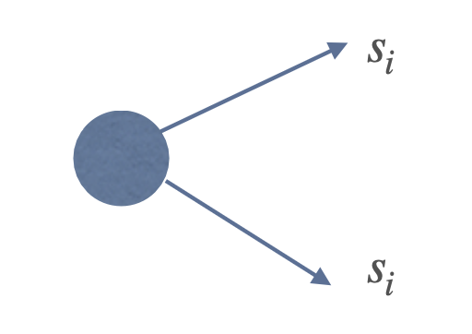
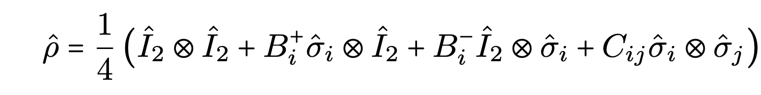

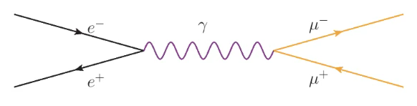
Spin correlation at leading order (no radiation)
Production a pair of particle
Leading-order QED
Maximum entanglement cosθ = 0
spin correlation

Slide 11
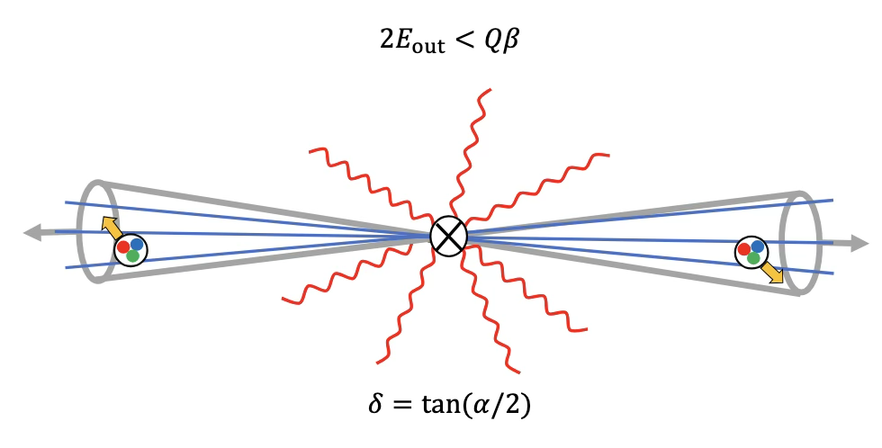
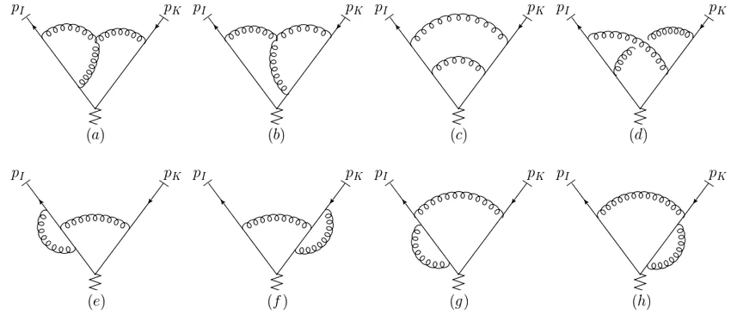
Effective field theory for decoherence
S.J. Lin(林士佳), M.J. Liu(刘铭钧), DYS, S.Y. Wei 25 JHEP; J.Y. Gu, S.J. Lin(林士佳), DYS, S.X. Yang(杨斯翔), L.T Wang 25
Radiation should be considered unresolvable if either soft of collinear
We introduce the energy and angular resolution parameters
  similar to Sterman-Weinberg jet definition (Sterman, Weinberg ’77)
We apply soft-collinear effective theory (SCET) + jet effective theory (Becher, Neubert, Rothen, DYS ’16 PRL)
The initial spin state generated by the short-distance hard scattering
Two fermion events

Slide 12
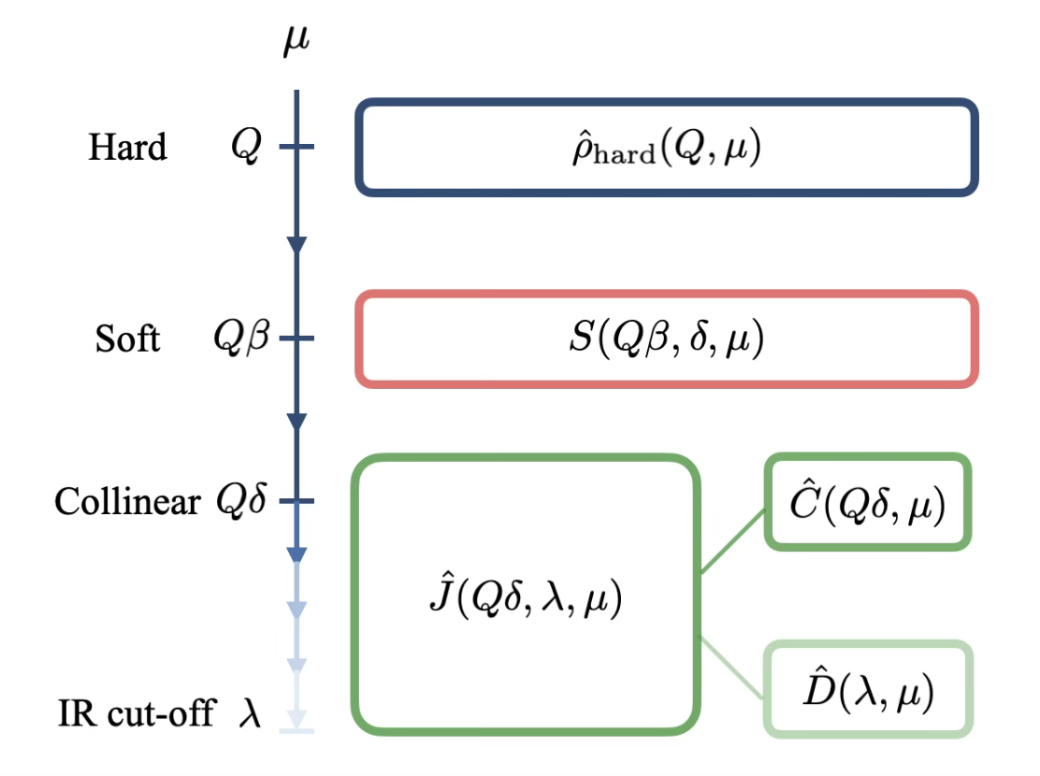
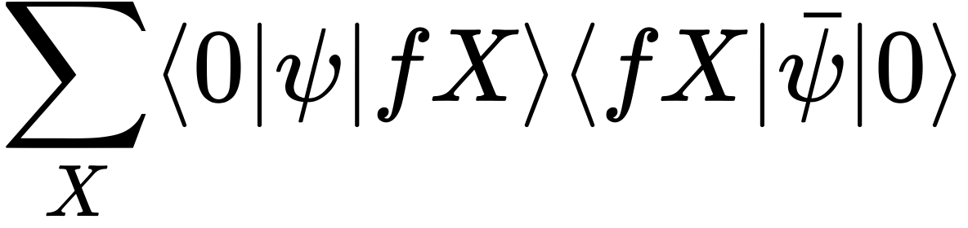
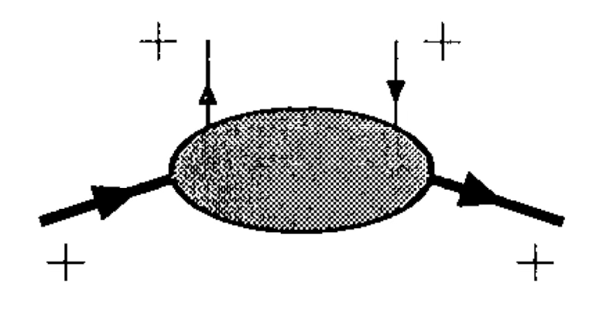
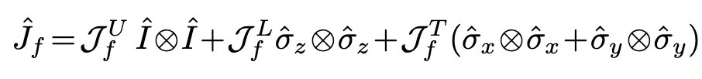
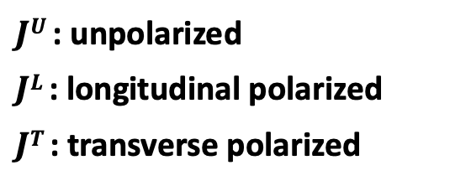
Factorization of the density operator
This definition allows us to apply the factorization theorems
Soft function accounts for large-angle soft radiation.
  At the leading power, soft emissions are spin-independent and thus do not induce decoherence
The fragmenting jet operators project the hard scattering state onto the Hilbert space of the observed particles.
  This effectively traces over unobserved collinear radiation, and induces decoherence
  Spin decomposition Chen, Goldstein, Jaffe & Ji ‘94
$JU$ : unpolarized
$JL$ : longitudinal polarized
$JT$: transverse polarized

Slide 13

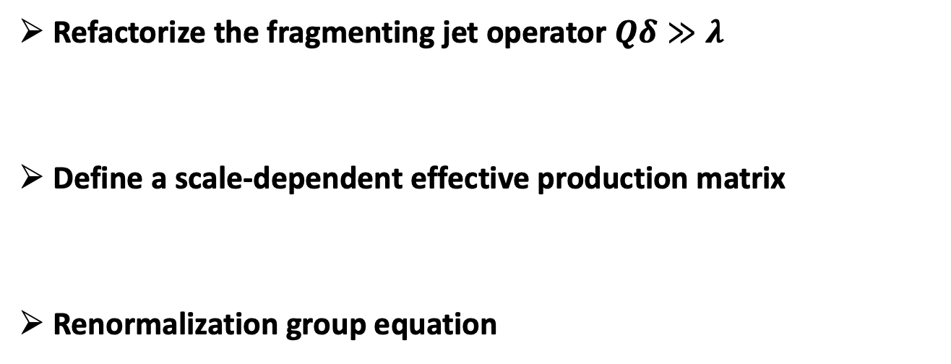
Factorization of the density operator
Refactorize the fragmenting jet operator $Qδ≫λ$
Define a scale-dependent effective production matrix
Renormalization group equation
Fragmentation opertator
decoherence = RG flow
anomalous dimensions determine the rate of information loss
1st moment of splitting function

Slide 14

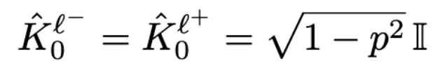
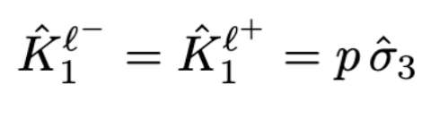
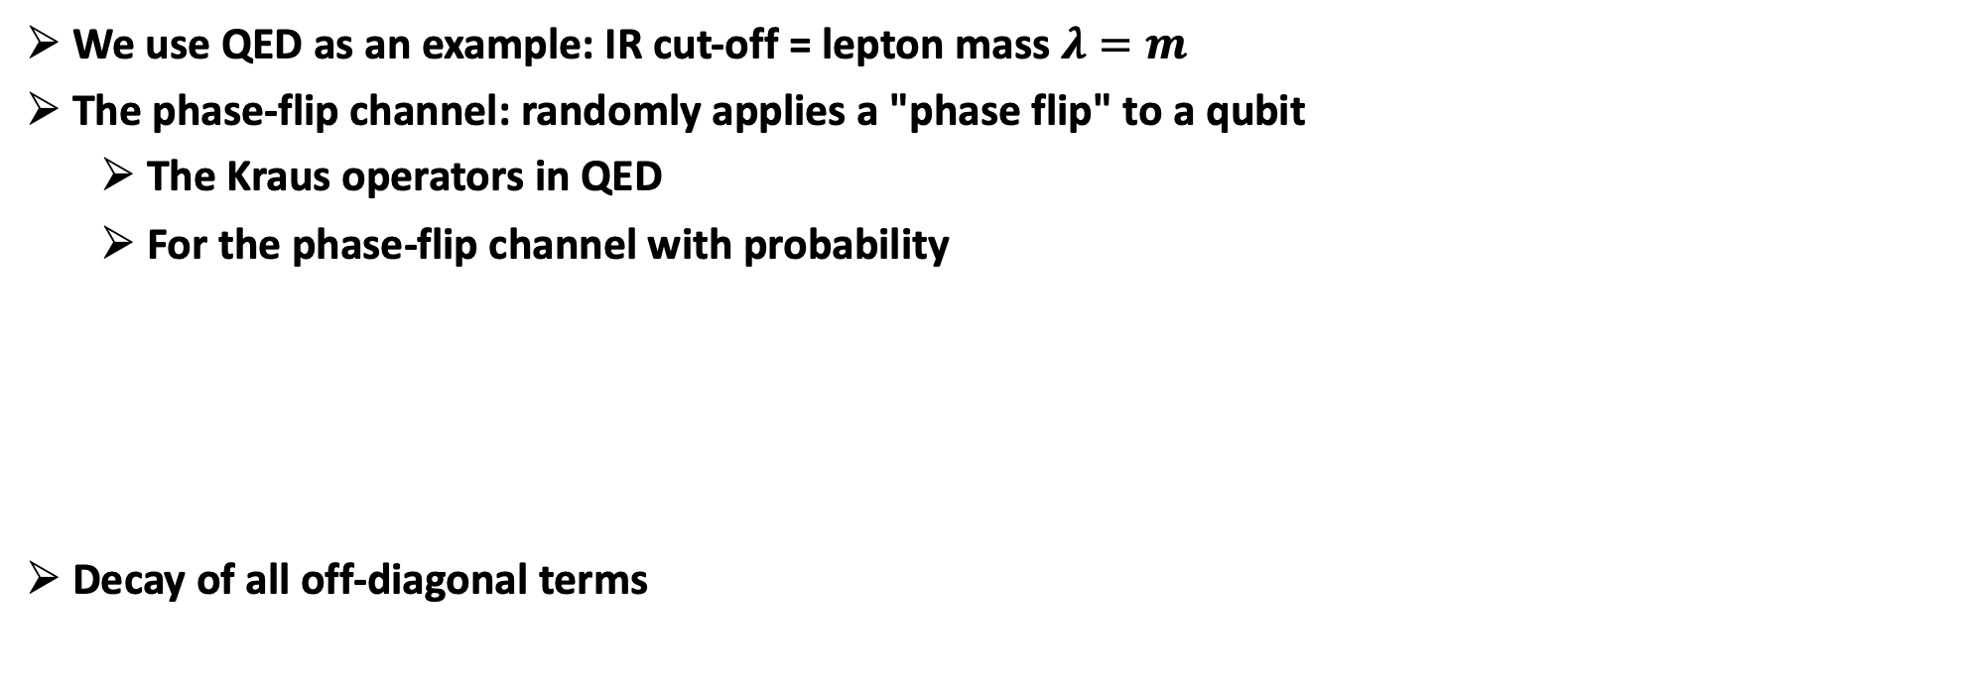


Kraus operators in QED
J.Y. Gu, S.J. Lin(林士佳), DYS, S.X. Yang(杨斯翔), L.T Wang 25
We use QED as an example: IR cut-off = lepton mass $λ=m$
The phase-flip channel: randomly applies a "phase flip" to a qubit
  The Kraus operators in QED
  For the phase-flip channel with probability
Decay of all off-diagonal terms
with probability $1 − p2$
with probability $p2$

Slide 15


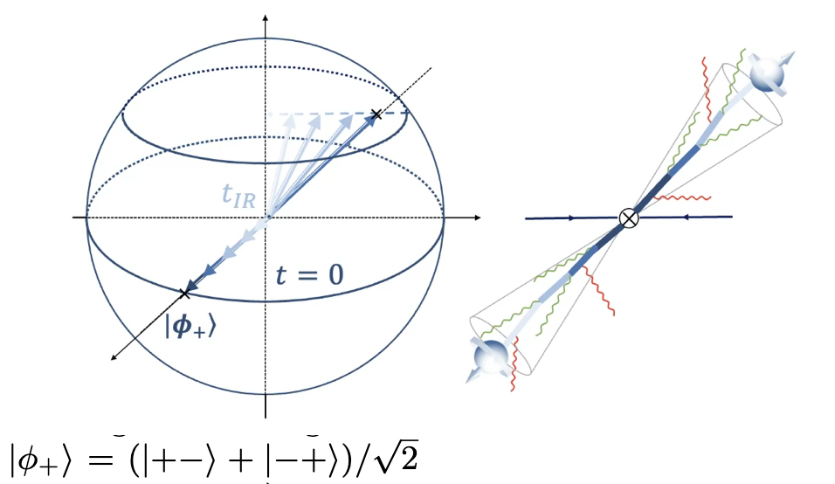
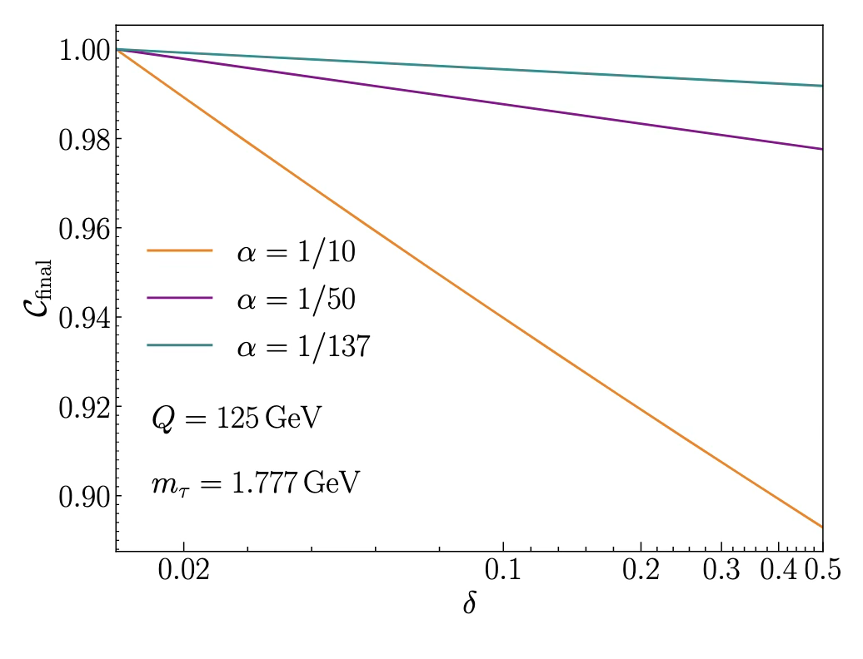
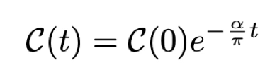
Master equation
J.Y. Gu, S.J. Lin(林士佳), DYS, S.X. Yang(杨斯翔), L.T Wang 25
Gorini-Kossakowski-Sudarshan-Lindblad master equation and jump operators
Lindblad jump operators
Quantum trajectory interpretation: each “jump” corresponds to an unresolved collinear photon emission from either of the fermion legs, which induces a stochastic phase-flip
Concurrence

Slide 16
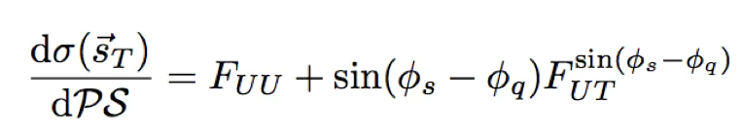
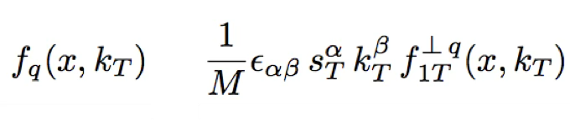
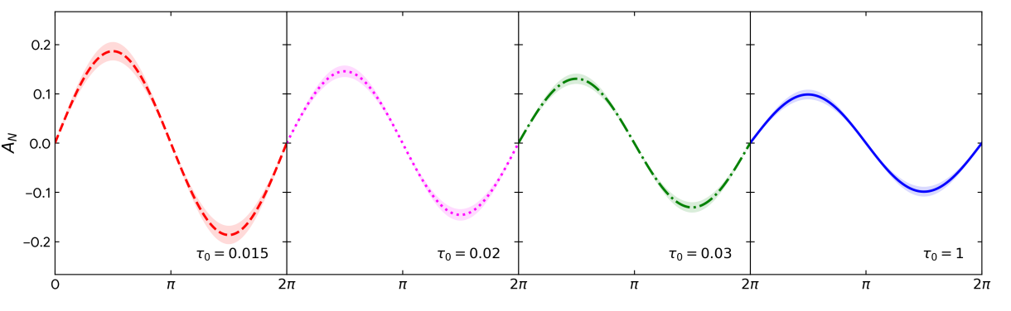
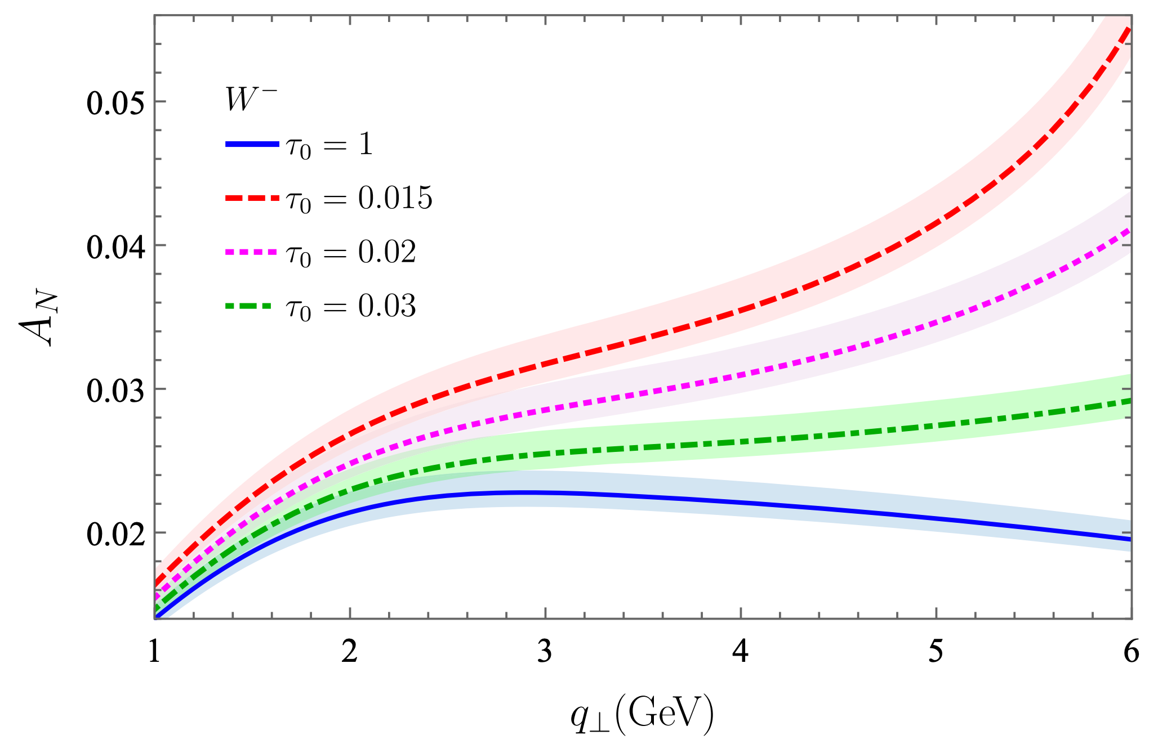
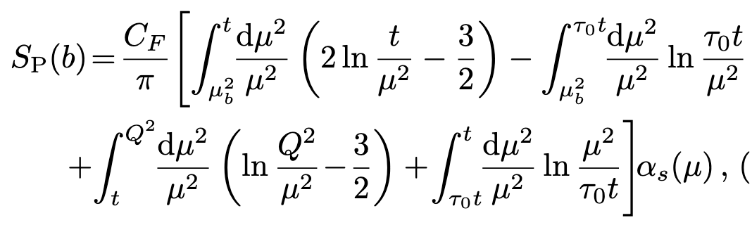


Nature 04
Nucleon tomography with zero-jettiness
Fang(方申), Lin(林硕), DYS, Zhou PRL136 (2026)021901
TMDs encode the quantum correlations between hadron polarization and the motion and polarization of quarks and gluons
However, at high energies, initial state radiation acts as environmental noise, causing decoherence that obscures these signals.
We introduce 0-jettiness $τ=2\sum_{i}{min\left\{p_{a}⋅l_{i} ,p_{b}⋅l_{i}\right\}/Q^{2}}$ into a tunable resolution scale for quantum coherence
We demonstrate a substantial enhancement of the asymmetry signal (e.g., by 83% for Z SSA at qT=5 GeV)
Modified Sukakov factor

Slide 17
Summary and outlooks
Decoherence is calculable and measurable: RG evolution drives the loss of information
  We unified SCET/RGE (HEP) + Open quantum systems (QIS)
  RG flow = Quantum channel
Quantum information
entanglement
decoherence
Spin physics
Jet physics

Slide 18
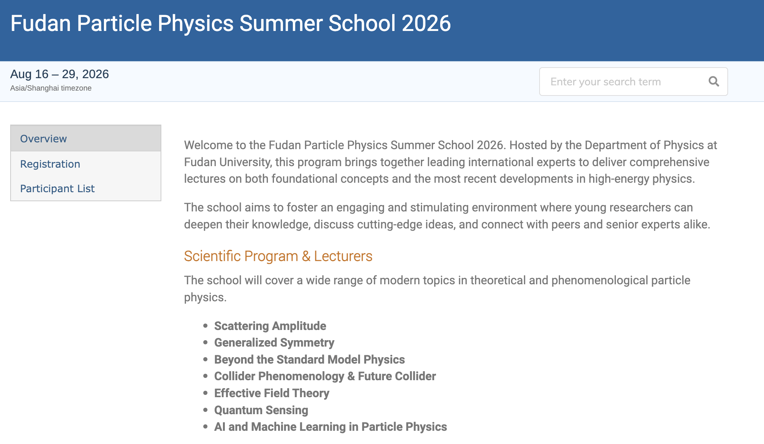

https://indico.ihep.ac.cn/event/29307/

Slide 19
Thank you

