Slide 1
Domain Wall in a Continuous gauged U(1) model
Yi-Lei Tang （汤亦蕾）

Slide 2
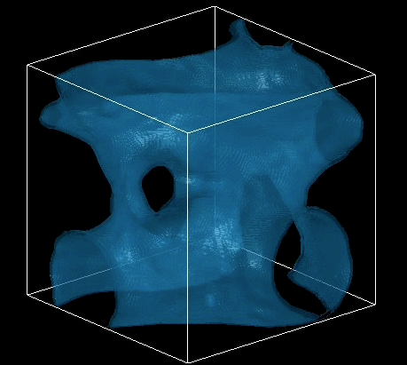
Domain Wall Problem
Domain wall is usually called a problem in a discrete symmetry spontaneously breaking theory.
No such things observed.
Overclose the universe.

Slide 3
Possible Solution to the Problem
Discrete symmetry embedded in a continuous group.
Continuous group can be gauged.
Step-by-step breaking.

Slide 4



???GUT???
Continuous Symmetry
$$v_{1}>>v_{2}$$
$$v_{1}$$
Discrete Subgroup
$$v_{2}$$
Trivial Group

Slide 5
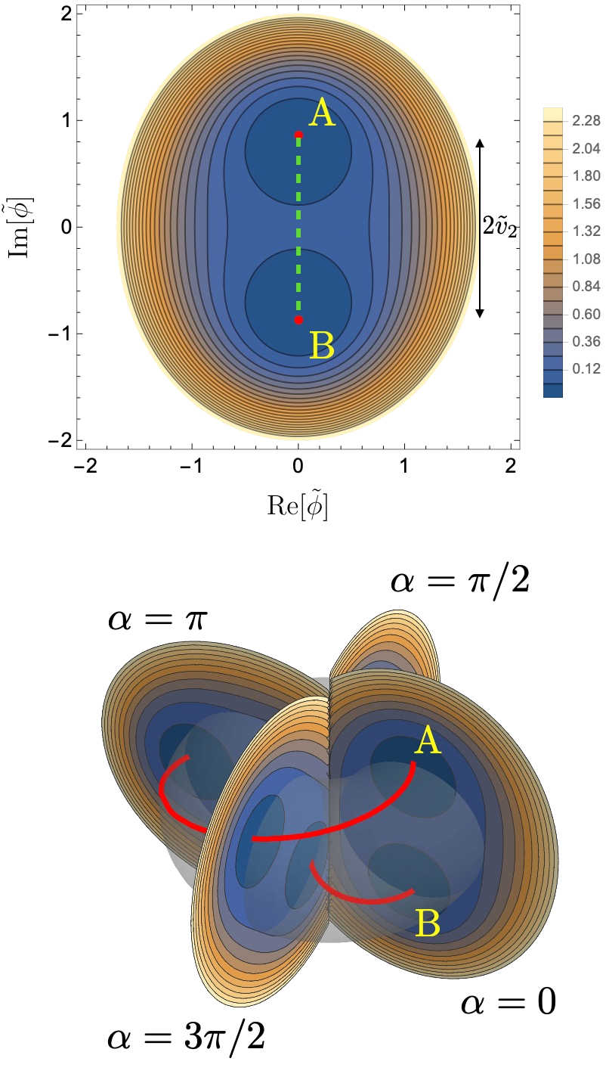
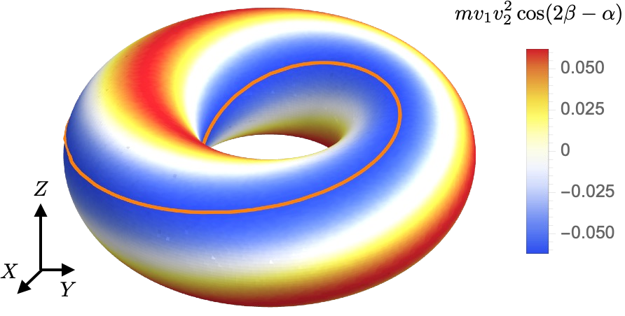
Step-by-step Breaking
Minoru Eto, et.al, arXiv:2309.04248v2.
Longer, but continuous path
connecting two “discrete”
vacuums
exist!

Slide 6
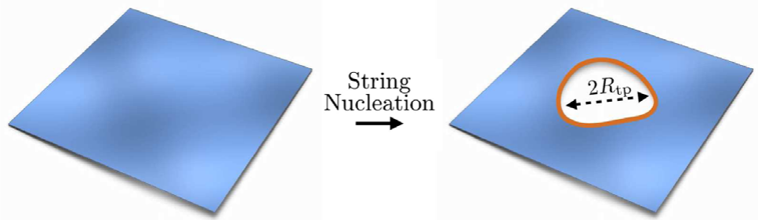
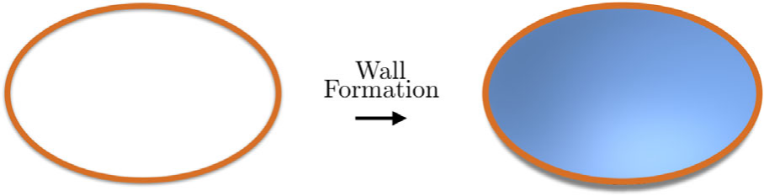
Step-by-step Breaking
In this case, the domain wall exists, but becomes unstable.
Finally, such domain wall disappears. (David I. Dunsky, et.al, PRD 106, 075030)

Slide 7
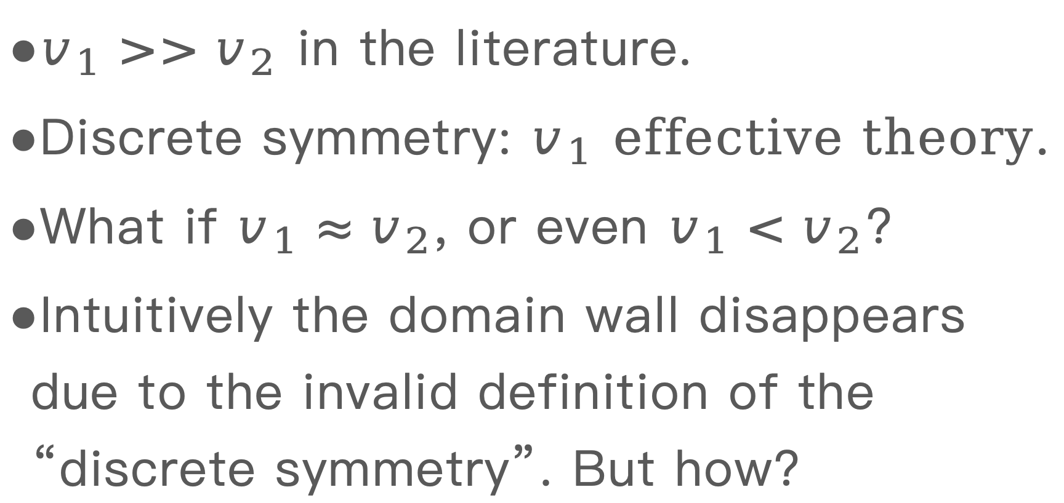
Step-by-step Breaking
$v_{1}>>v_{2}$ in the literature.
Discrete symmetry: $v_{1}$ effective theory.
What if $v_{1}≈v_{2}$, or even $v_{1}<v_{2}$?
Intuitively the domain wall disappears due to the invalid definition of the “discrete symmetry”. But how?

Slide 8
3:1 Toy Model
arXiv:2605/6.XXXXX? in progress

Slide 9
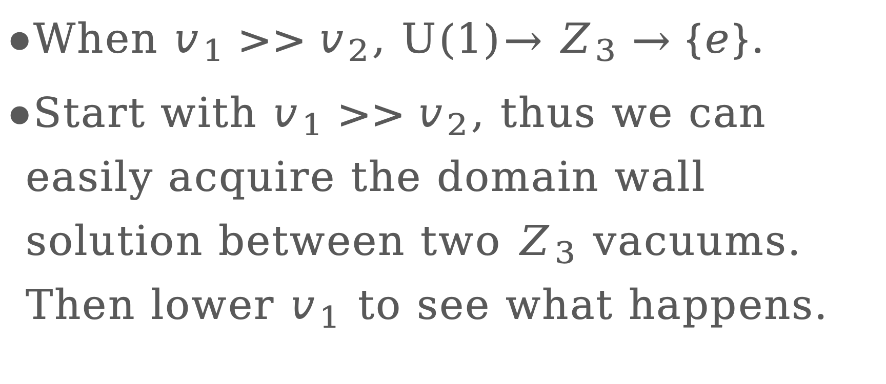
3:1 Toy Model
When $v_{1}>>v_{2}$, U(1)$→Z_{3}→\{e\}$.
Start with $v_{1}>>v_{2}$, thus we can easily acquire the domain wall solution between two $Z_{3}$ vacuums. Then lower $v_{1}$ to see what happens.

Slide 10
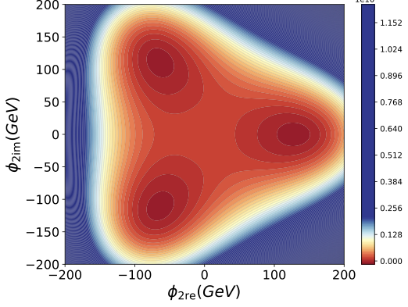
3:1 Toy Model
Shooting Method Failed!

Slide 11
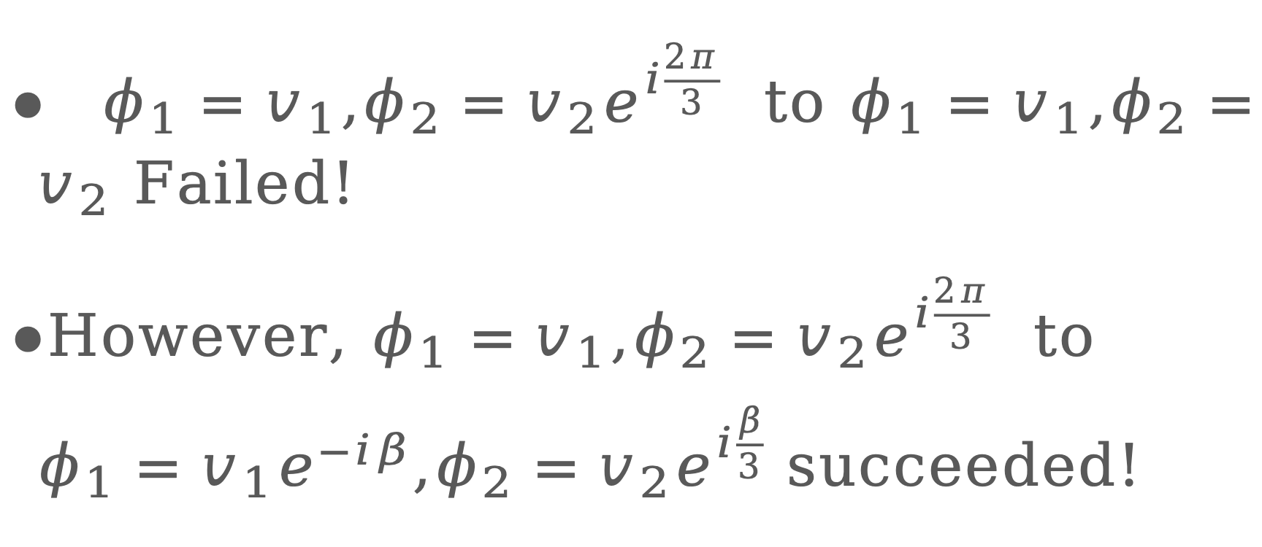
3:1 Toy Model
$φ_{1}=v_{1}$,$φ_{2}=v_{2}e^{i\frac{2π}{3}}$ to $$φ_{1}=v_{1}$$,$φ_{2}=v_{2}$ Failed!
However, $φ_{1}=v_{1}$,$φ_{2}=v_{2}e^{i\frac{2π}{3}}$ to $φ_{1}=v_{1}e^{−iβ}$,$φ_{2}=v_{2}e^{i\frac{β}{3}}$ succeeded!

Slide 12
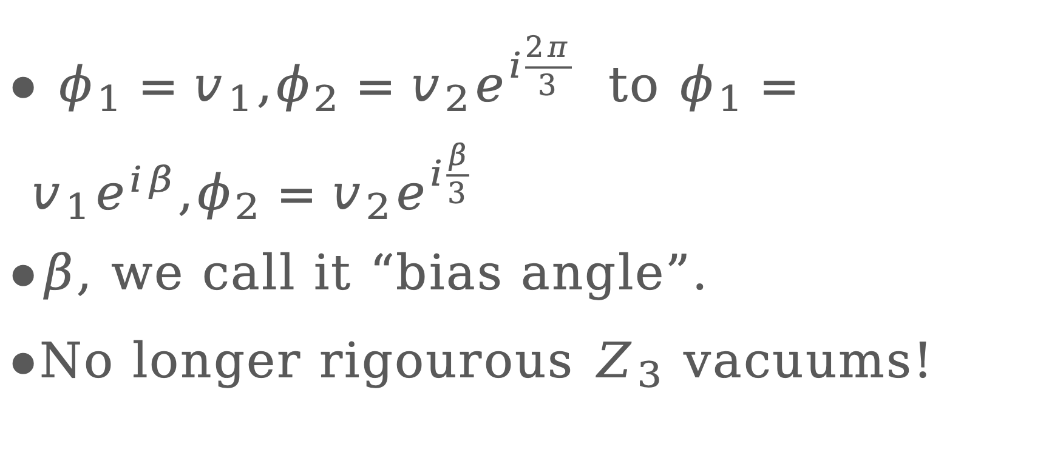
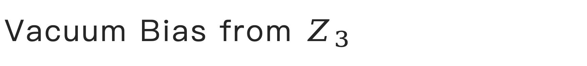
Vacuum Bias from $Z_{3}$
$φ_{1}=v_{1}$,$φ_{2}=v_{2}e^{i\frac{2π}{3}}$ to $φ_{1}=v_{1}e^{iβ}$,$φ_{2}=v_{2}e^{i\frac{β}{3}}$
$β$, we call it “bias angle”.
No longer rigourous $Z_{3}$ vacuums!

Slide 13
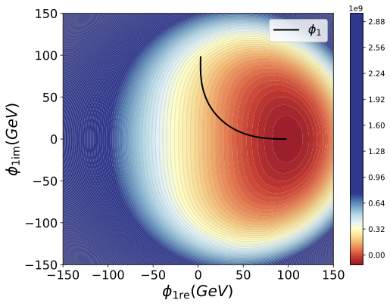
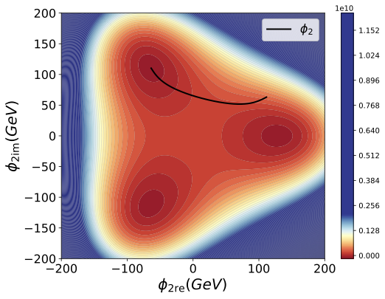

Bias from $Z_{3}$
.

Slide 14
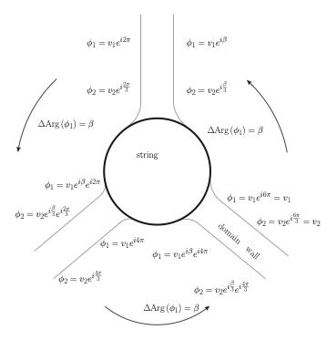
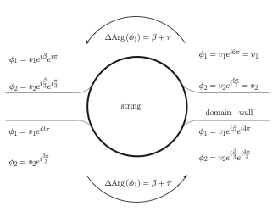
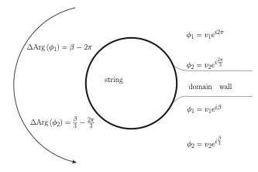
Hybrid String-Wall Structures
“Winding numbers” of the string in the complex structures are no longer integers.

Slide 15
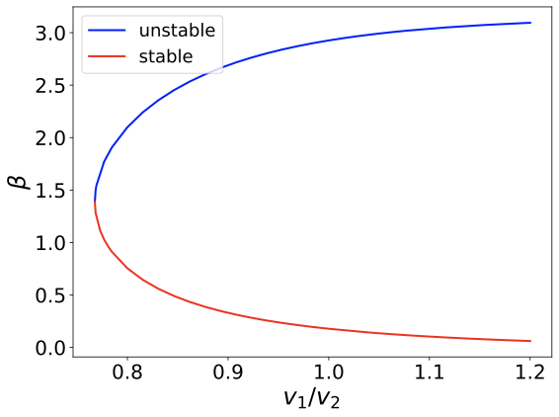
Stability of the Domain Wall Solutions
Sometimes two solutions arise。
Path Deformation
Algorithm can help
us discuss the
stability of the
solutions.

Slide 16
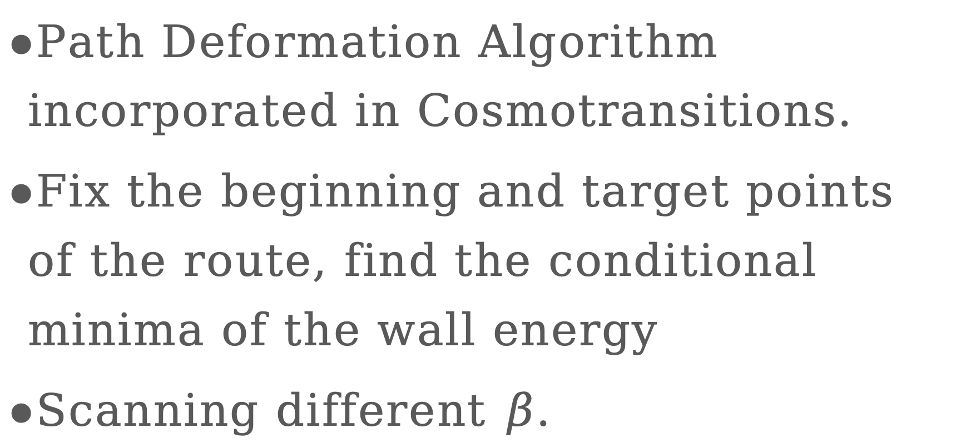
Stability of the Domain Wall Solutions
Path Deformation Algorithm incorporated in Cosmotransitions.
Fix the beginning and target points of the route, find the conditional minima of the wall energy
Scanning different $β$.

Slide 17
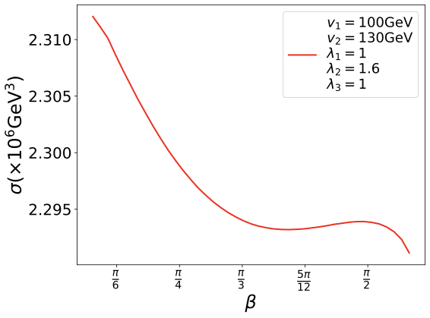
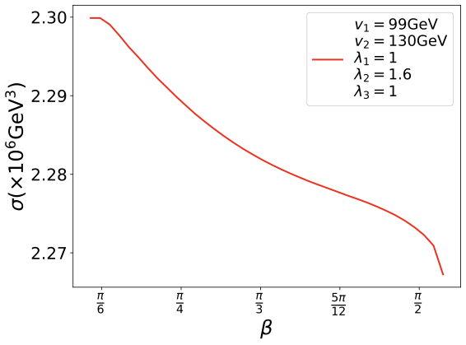

Stability of the Domain Wall Solutions
Fix the $β$ results in the conditional minima of the action.

Slide 18
Preliminary Gravitational Wave
One-step phase transition. Domain wall network with “two-conjunctions” or “three conjunctions”, finally eaten by the hole bounded by string.

Slide 19
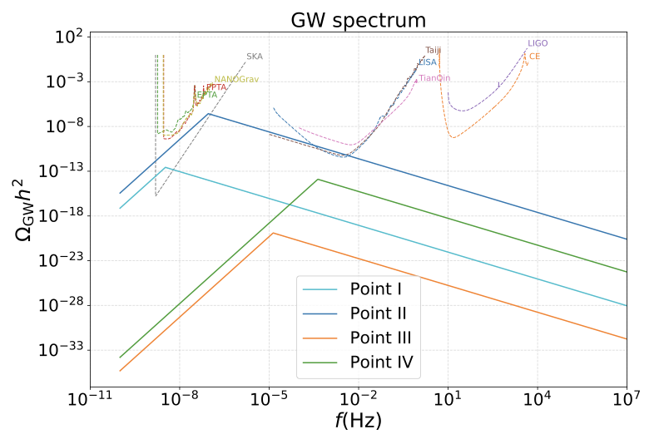
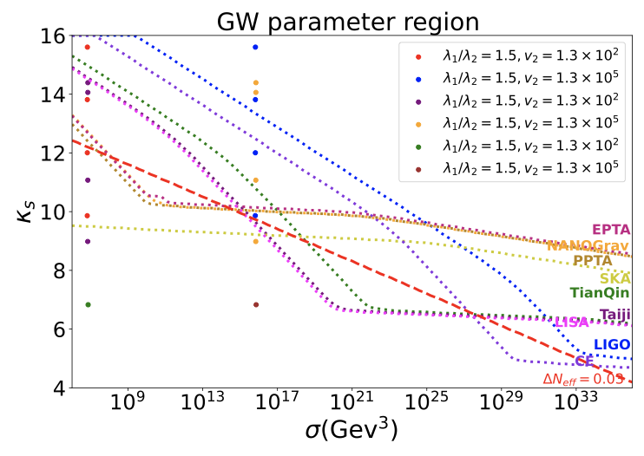
Preliminary Gravitational Wave

Slide 20
Summary
Nonzero bias angle.
“phase transition” of the domain wall disappearance.
Hybrid string profile calculation should be revised due to the bias angle.

Slide 21
Further Prospect
Any possibility to revise the calculation of the GW?

