Slide 1


Simulating sound waves from first-order phase transitions in an expanding universe
田驰 (Chi Tian)
安徽大学
2026 Workshop on New Physics and Interdisciplinary Sciences (NPhiS 2026)
2026.5, Nanjing
Collaborator: Xiao Wang, Csaba Balazs
Based on work in preparation

Slide 2
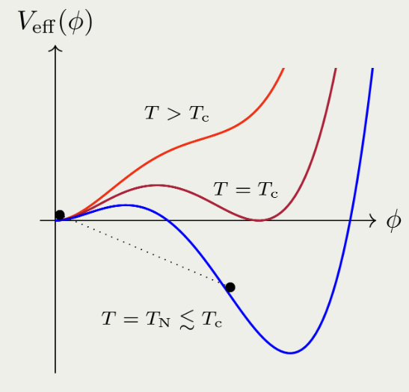
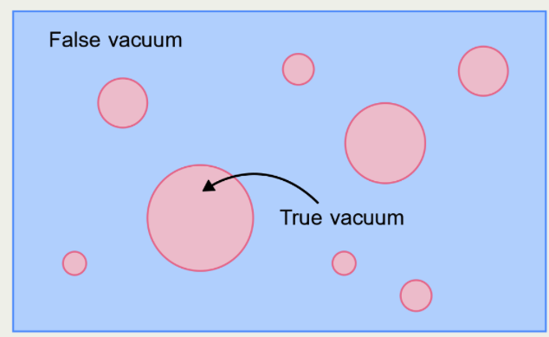
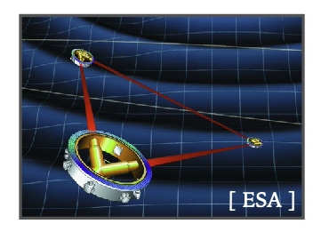
Credit: 1205.2451
Credit: 1205.2451
Cosmological FOPTs as SGWB sources
Bubble nucleation
Dynamics of
bubbles

Slide 3

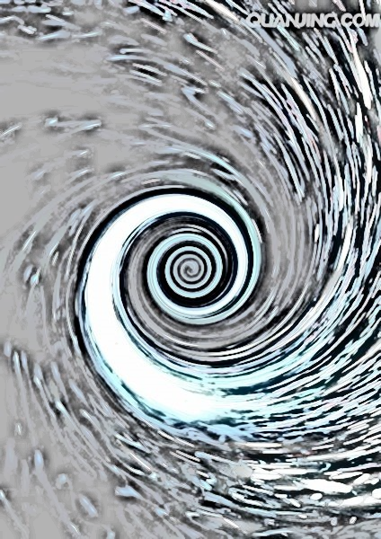
Credit: 1205.2451
Various GW generation mechanisms
GWs sources of FOPT:
Bubble collisions
Sound wave
Turbulence
JCAP 0809, 022 (2008); PRL112, 041301 (2014); PRD92, no. 12,123009 (2015); PRD96, no. 10,103520 (2017); Phys. Rev. D 66, 024030 (2002), Phys. Rev. D 76 (2007) 083002, JCAP 0912, 024 (2009)
The amplitude and shape of GW spectrum are strongly related to PT dynamics.
Formation and expansion of bubbles
Decreasing temperature
Bubble collision
Overlapping of sound shell
Shells of rarefaction
Shells of compression
Overlapping of sound shell
Bubble collision
Detonation mode
Deflagration mode
Turbulence
Wang, et. al. PRD 2022

Slide 4
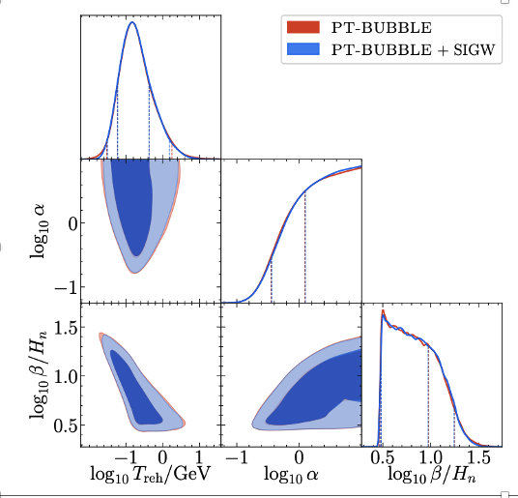
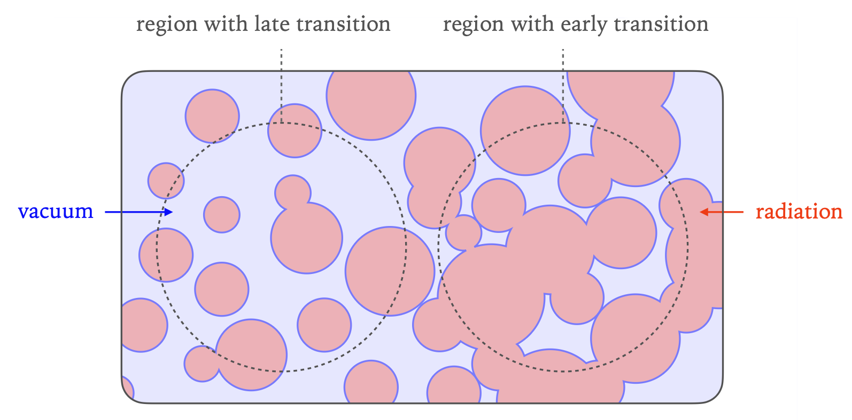
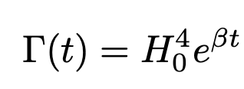

Credit: 1205.2451
Credit: 1205.2451
Cosmological FOPTs as SGWB origins
, when $β$ is small
PTA prefers slow transitions!

Slide 5
Credit: 1205.2451
Credit: 1205.2451
Cosmological FOPTs as SGWB origins
, when $β$ is small
Interested in curvature perturbations from slow FOPT?
Pay attention to Ran Ding’s talk on Mon. afternoon

Slide 6
Credit: 1205.2451
Credit: 1205.2451
Something is different when considering CE
Reducing mean separation of bubbles;
Growing strength of the FOPTs;
Different sound wave dynamics!

Slide 7
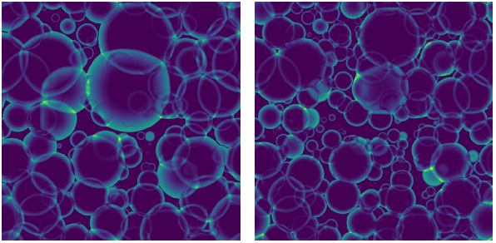
Credit: 1205.2451
Credit: 1205.2451
Something is different when considering CE
Reducing mean separation of bubbles;
Growing strength of the FOPTs;
Different sound wave dynamics!
Simulating Poissonian process
Increasing physical volume
Reducing mean-bubble separation
Guo, et. al. JCAP 2021

Slide 8
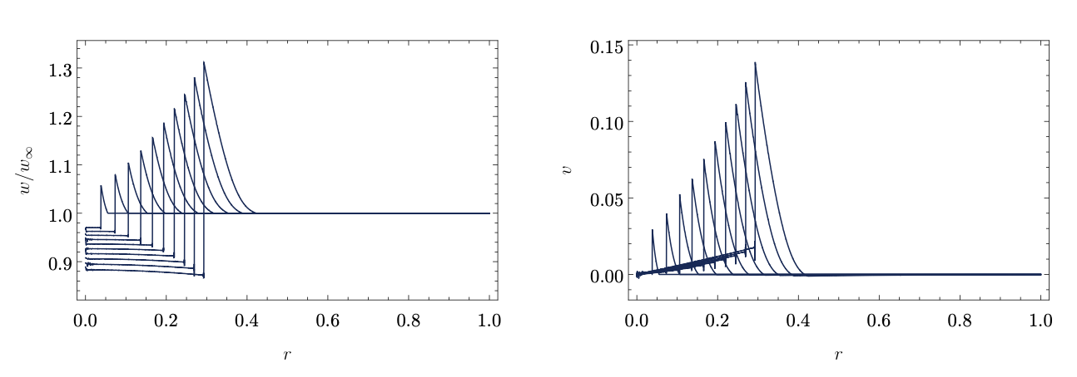


Credit: 1205.2451
Credit: 1205.2451
Something is different when considering CE
Reducing mean separation of bubbles;
Growing strength of the FOPTs;
Different sound wave dynamics!
Initial strength:
$$α_{0}=ε/ρ_{rad}(t=0)$$
Time dependent strength:
$$α\left(t\right)∝{ a}^{4}(t)$$
Jinno, et. al. JCAP 2022

Slide 9

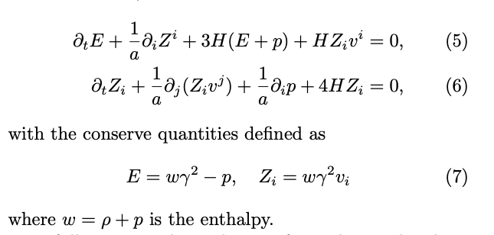
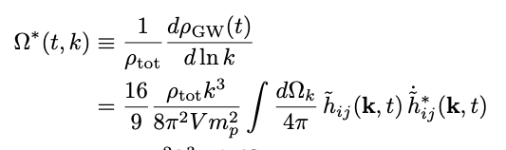
Credit: 1205.2451
Credit: 1205.2451
Something is different when considering CE
Reducing mean separation of bubbles;
Growing strength of the FOPTs;
Different sound wave dynamics!
Evolving EOM for GWs
Use Higgsless conserved hydro-dynamical equation

Slide 10
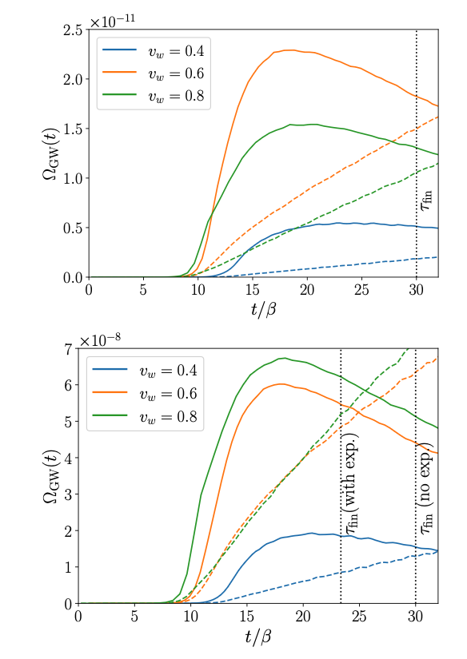


Credit: 1205.2451
Credit: 1205.2451
Something is different when considering CE
Weak $α_{0}=0.005$
Reducing mean separation of bubbles;
Growing strength of the FOPTs;
Different sound wave dynamics!
Intermediate $α_{0}=0.05$
Use conserved hydro-dynamical equations:

Slide 11
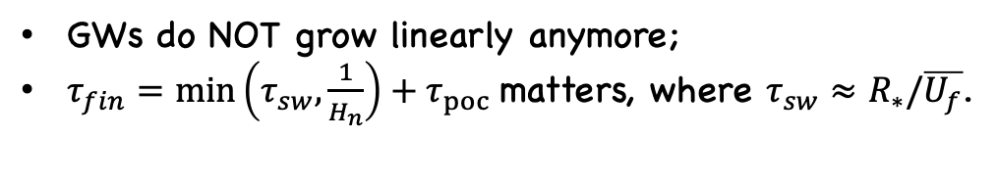

Credit: 1205.2451
Credit: 1205.2451
Something is different when considering CE
Weak $α_{0}=0.005$
Reducing mean separation of bubbles;
Growing strength of the FOPTs;
Different sound wave dynamics!
Intermediate $α_{0}=0.05$
GWs do NOT grow linearly anymore;
$τ_{fin}=\min\left(τ_{sw},\frac{1}{H_{n}}\right)+τ_{poc}$matters, where $τ_{sw}≈R_{∗}/\overline{U_{f}}$.
Preliminary

Slide 12
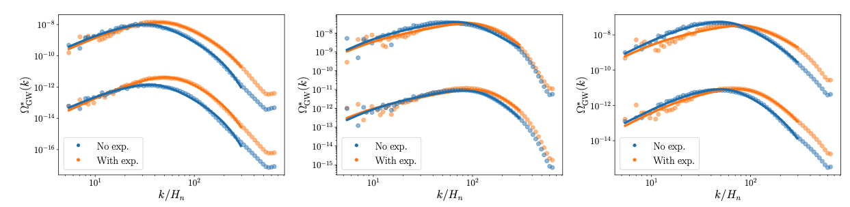
Credit: 1205.2451
Credit: 1205.2451
Something is different when considering CE
Reducing mean separation of bubbles;
Growing strength of the FOPTs;
Different sound wave dynamics!
Preliminary

Slide 13
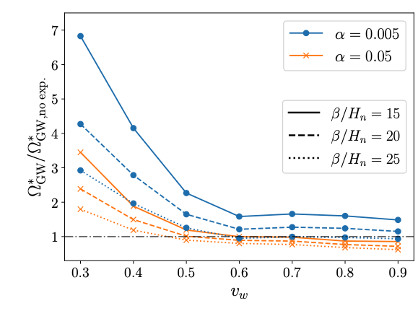
Credit: 1205.2451
Credit: 1205.2451
Something is different when considering CE
Reducing mean separation of bubbles;
Growing strength of the FOPTs;
Different sound wave dynamics!
Preliminary

Slide 14
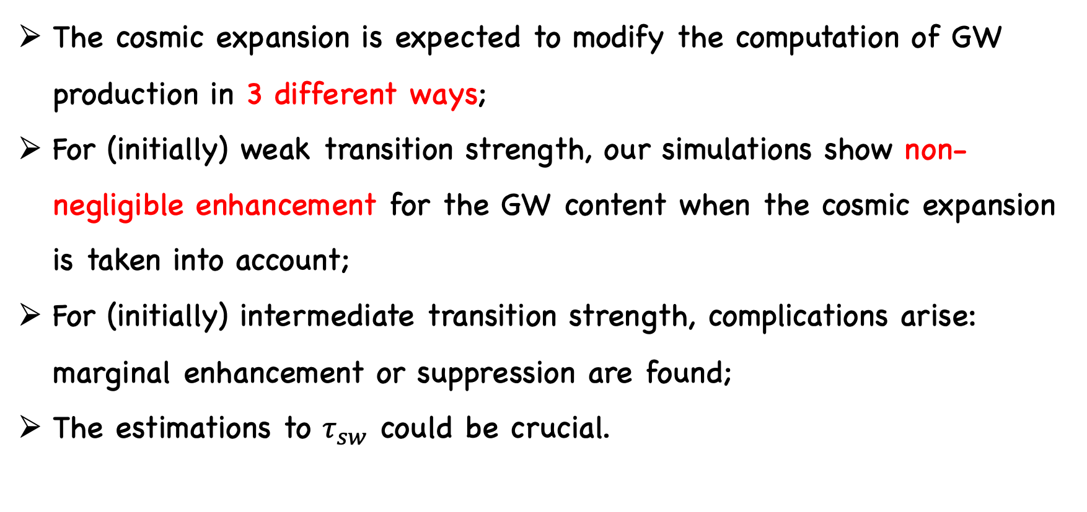
Summary
The cosmic expansion is expected to modify the computation of GW production in 3 different ways;
For (initially) weak transition strength, our simulations show non-negligible enhancement for the GW content when the cosmic expansion is taken into account;
For (initially) intermediate transition strength, complications arise: marginal enhancement or suppression are found;
The estimations to $τ_{sw}$ could be crucial.

Slide 15
Thank You

